Slide 1

Class22
CSC 495/583 Topics of Software Security
Heap Exploitation (3): Unlink, House of Force
Dr. Si Chen (schen@wcupa.edu)

Slide 2
Pseudo Memory Map
0x00000000 – Start of memory
0x00000000 – Start of memory
Runtime Memory
Libraries (libc)
ELF Executable
.text segment
.data segment
Heap
Stack
Runtime Memory
Libraries (libc)
ELF Executable
.text segment
.data segment
Heap
Stack
0x08048000 – Start of .text Segment
0x08048000 – Start of .text Segment
0xb7ff0000 – Top of heap
0xbfff0000 – Top of stack
0xFFFFFFFF – End of memory
MBE - 04/07/2015
2

Slide 3
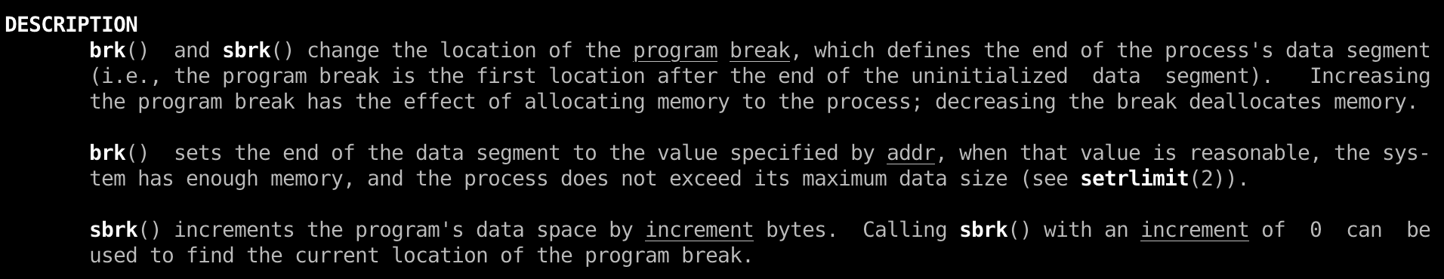
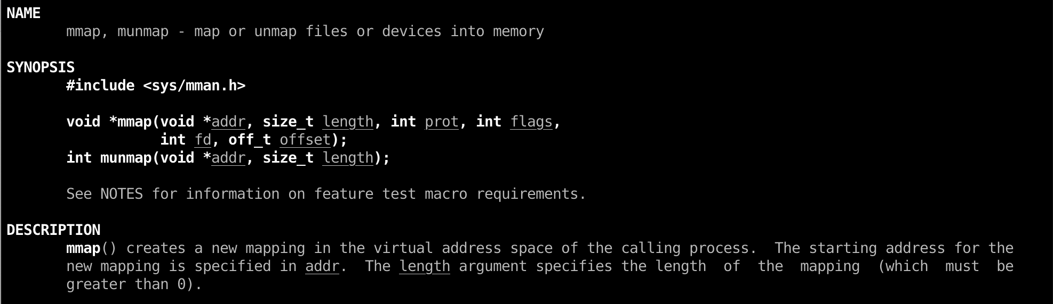
Heap in Linux (GNU C Library – glibc)
ptmalloc2
System call:
brk()
mmap()

Slide 4
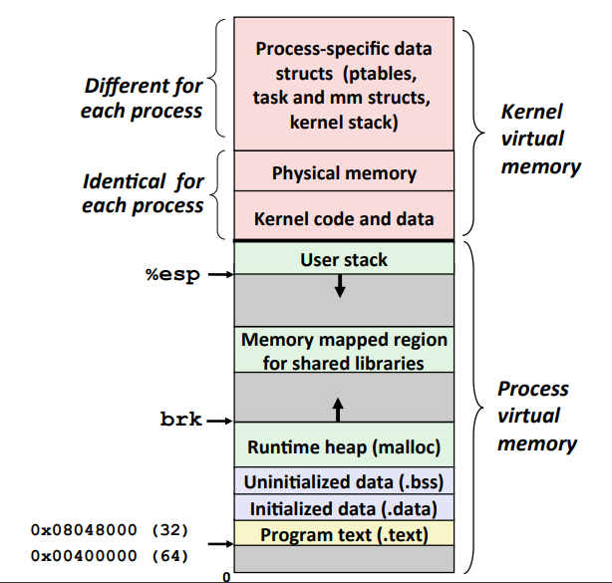
The Heap

Slide 5
Design your own Heap management system
Linked List

Slide 6
Design your own Heap management system
H: header --> 11
B: Body --> 10
F: Free → 00
bitmap
Bitmap representation:
(HIGH) 11 00 00 10 10 10 11 00 00 00 00 00 00 00 10 11 (LOW)
128 byte per chunk
1MB / 128 = 8k

Slide 7
glibc source code
https://code.woboq.org/userspace/glibc/malloc/malloc.c.html

Slide 8
Arena
Arena: the top level memory management entity.
There are two types of arenas.
  Main arena covers the traditional heap area: the space between start_brk and brk for a process from kernel point of view, only one main arena exists for a process.
  Non-main arena manages the memory fetched from kernel via mmap() system call, there could be 0 to 2*(number of cpu cores) such arenas based on process threads usage.

Slide 9
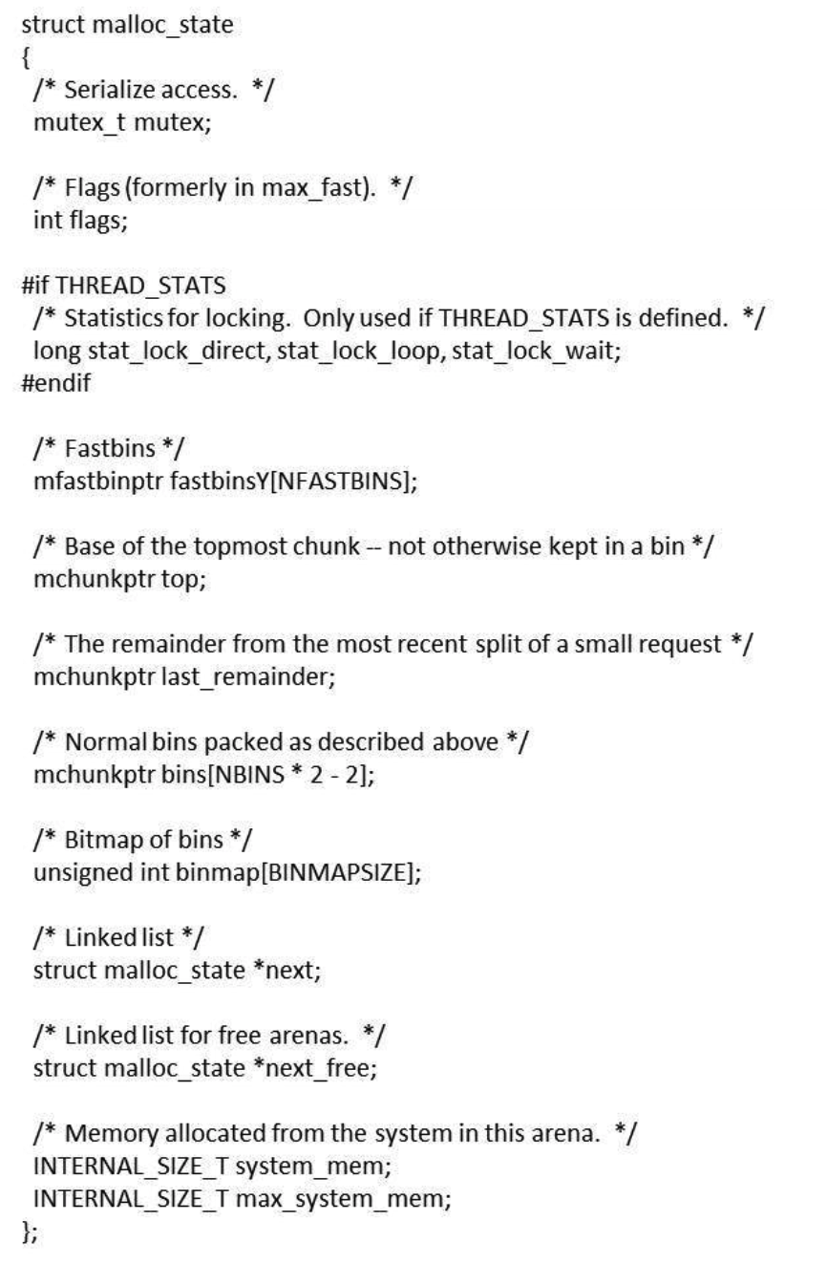
Arena

Slide 10
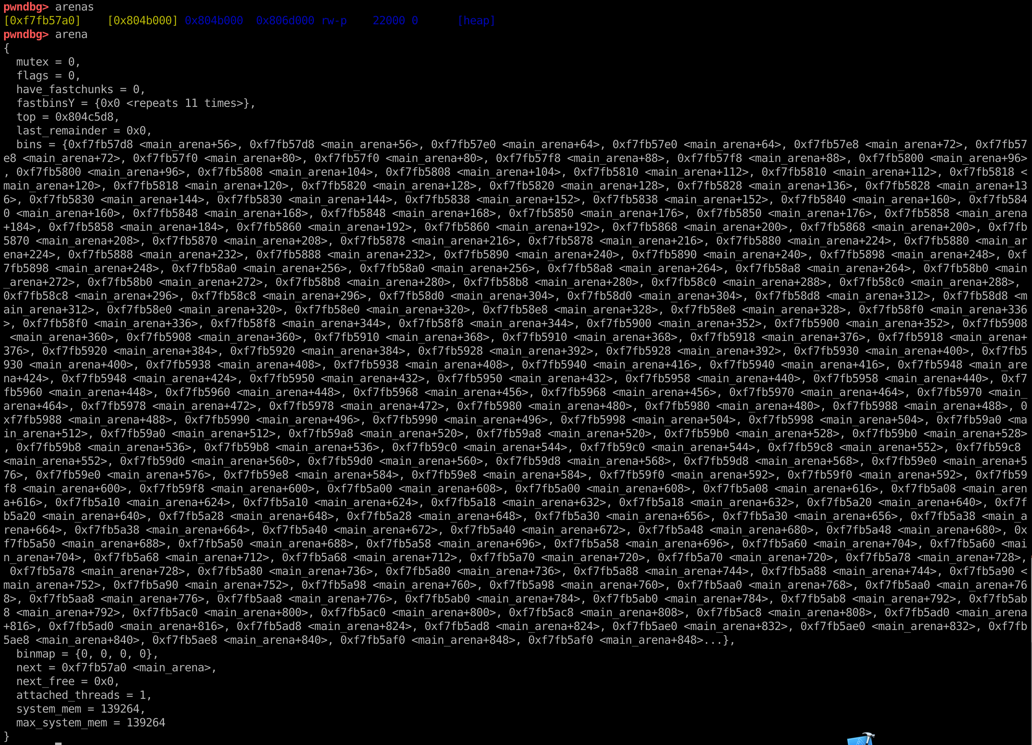
Arena

Slide 11
glibc source code
https://code.woboq.org/userspace/glibc/malloc/malloc.c.html

Slide 12
Bins and Chunks
A bin is a list (doubly or singly linked list) of free (non-allocated) chunks. Bins are differentiated based on the size of chunks they contain:
  Fast bin
  Unsorted bin
  Small bin
  Large bin

Slide 13
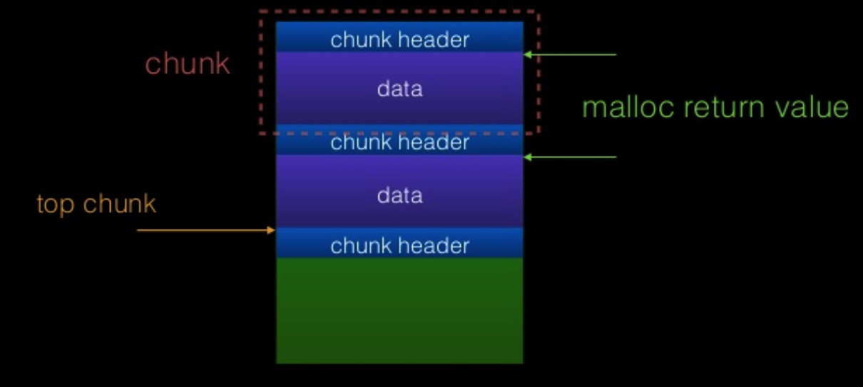
Mechanism of glibc malloc
Allocated chunk
Free chunk
Top chunk

Slide 14
Top Chunk
Top Chunk: Chunk which is at the top border of an arena is called top chunk. It doesn't belong to any bin. Top chunk is used to service user request when there is NO free blocks, in any of the bins. If top chunk size is greater than user requested size top chunk is split into two:
  User chunk (of user requested size)
  Remainder chunk (of remaining size)
The remainder chunk becomes the new top. If top chunk size is lesser than user requested size, top chunk is extended using sbrk (main arena) or mmap (thread arena) syscall.

Slide 15
The Malloc Maleficarum (2004)
The Malloc Maleficarum
  In late 2001, "Vudo Malloc Tricks" and "Once Upon A free()" defined the exploitation of overflowed dynamic memory chunks on Linux.
  In late 2004, a series of patches to GNU libc malloc implemented over a dozen mandatory integrity assertions, effectively rendering the existing techniques obsolete.
  It is for this reason, a small suggestion of impossibility, that they present the Malloc Maleficarum:
    The House of Prime
    The House of Mind
    The House of Force
    The House of Lore
    The House of Spirit
    The House of Chaos

Slide 16
House of Force
House of Force: In this technique, attacker abuses top chunk size and tricks ‘glibc malloc’ to service a very large memory request (greater than heap system memory size) using top chunk. Now when a new malloc request is made, GOT entry of free would be overwritten with shellcode address. Hence from now on whenever free is called, shellcode gets executed!!

Slide 17
The Malloc Maleficarum (2004)
The Malloc Maleficarum
  In late 2001, "Vudo Malloc Tricks" and "Once Upon A free()" defined the exploitation of overflowed dynamic memory chunks on Linux.
  In late 2004, a series of patches to GNU libc malloc implemented over a dozen mandatory integrity assertions, effectively rendering the existing techniques obsolete.
  It is for this reason, a small suggestion of impossibility, that they present the Malloc Maleficarum:
    The House of Prime
    The House of Mind
    The House of Force
    The House of Lore
    The House of Spirit
    The House of Chaos
https://dl.packetstormsecurity.net/papers/attack/MallocMaleficarum.txt

Slide 18
House of Force

Slide 19
House of Force
This attack assumes an overflow into the top chunk's header. The size is modified to a very large value (-1 in this example).
This ensures that all initial requests will be services using the top chunk, instead of relying on mmap.
On a 64 bit system, -1 evaluates to 0xFFFFFFFFFFFFFFFF.
A chunk with this size can cover the entire memory space of the program.

Slide 20
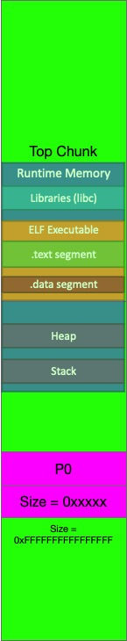
House of Force
Let us assume that the attacker wishes 'malloc' to return address P. Now, any malloc call with the size of: &top_chunk - P will be serviced using the top chunk. Note that P can be after or before the top_chunk.

Slide 21
House of Force
E.g. top_chunk=0x601200
malloc(0xffe00020)
0xffe00030 < top_chunk_size
0xffe00030+0x601200=0x100401230
top_chunk=0x401230

Slide 22
House of Force
Prerequisites: Three malloc calls are required to successfully apply house of force as listed below:
  Malloc 1: Attacker should be able to control the size of top chunk. Hence heap overflow should be possible on this allocated chunk which is physically located previous to top chunk.
  Malloc 2: Attacker should be able to control the size of this malloc request.
  Malloc 3: User input should be copied to this allocated chunk.

Slide 23
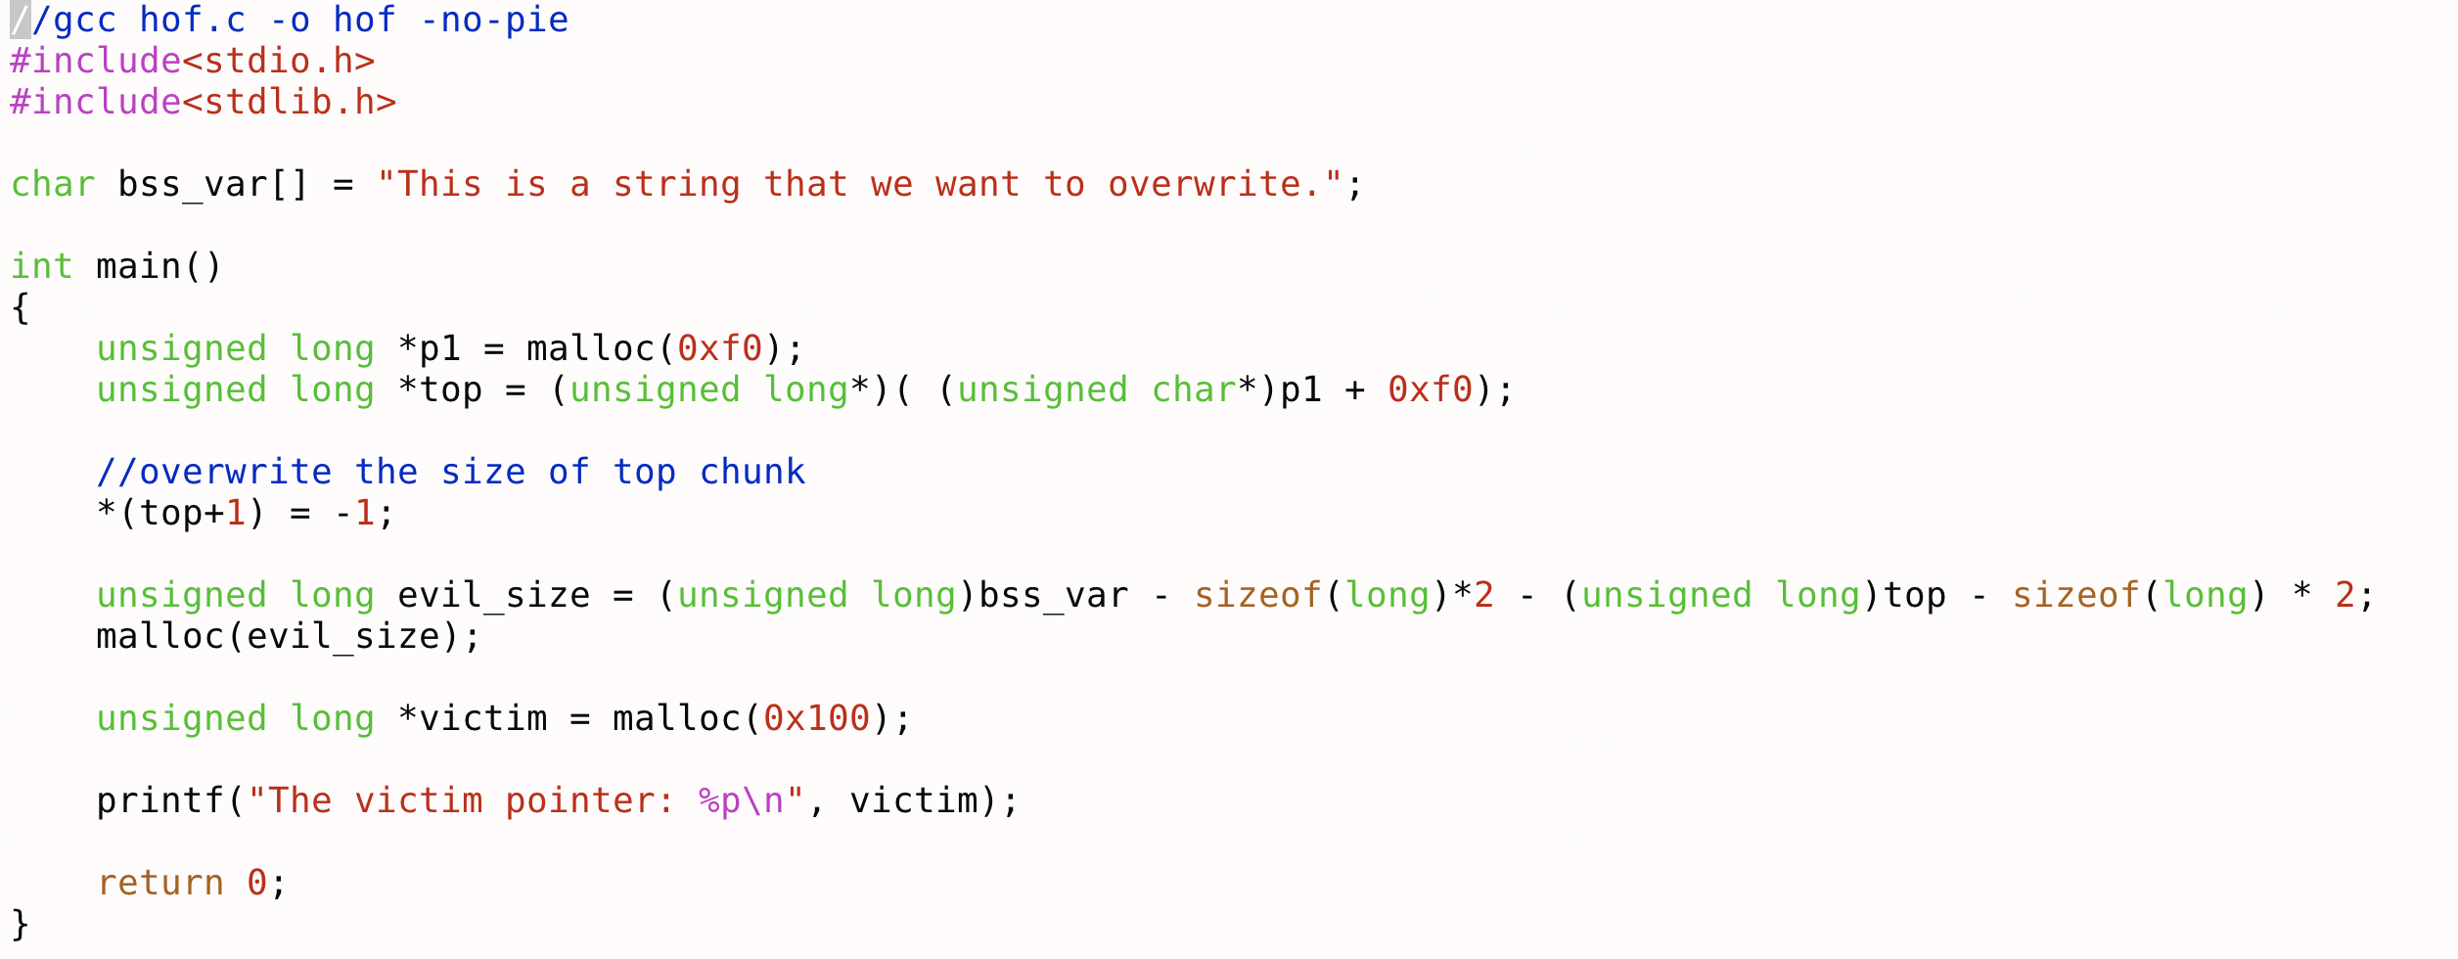
House of Force - example

Slide 24
Exercise: BambooBox
Source Code:
https://github.com/ctf-wiki/ctf-challenges/blob/master/pwn/heap/house-of-force/hitcontraning_lab11/bamboobox.c
Solution:
https://github.com/ctf-wiki/ctf-challenges/blob/master/pwn/heap/house-of-force/hitcontraning_lab11/exp.py

Slide 25
Q & A

