Slide 1

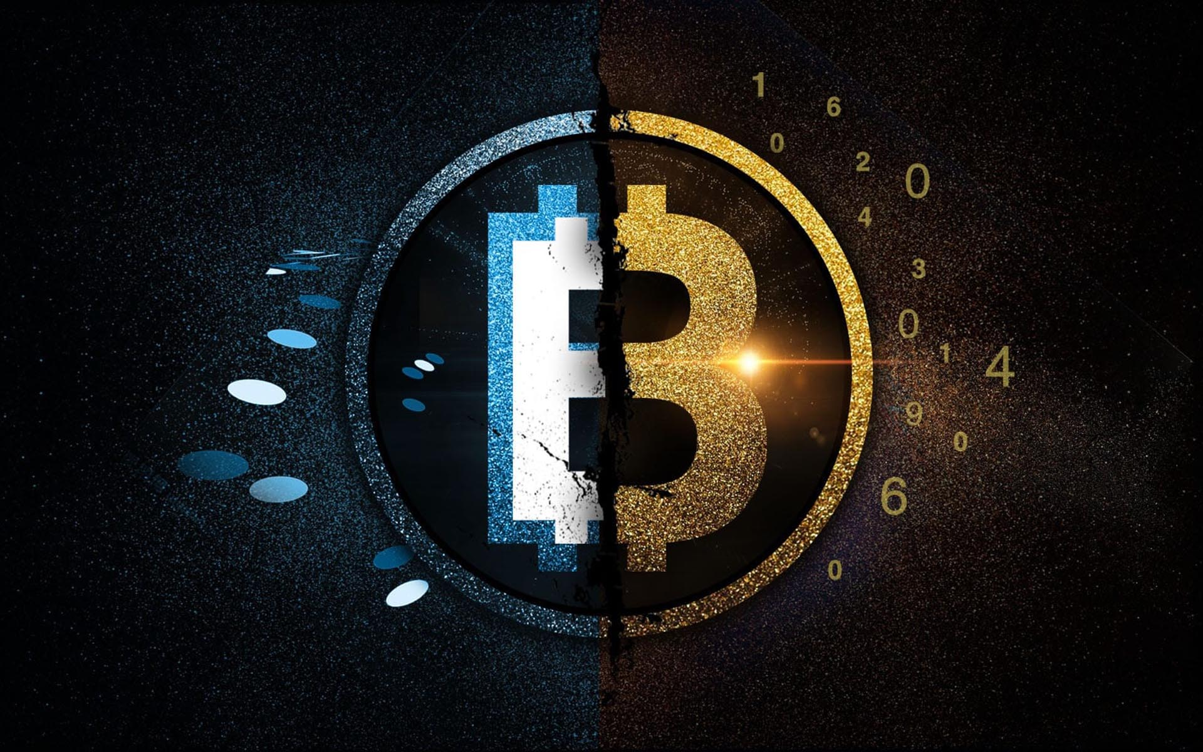
Class9
CSC 495/583 Advanced Topics in Computer Security
Scam / Cybercriminals: Blockchain Security
Si Chen (schen@wcupa.edu)

Slide 2
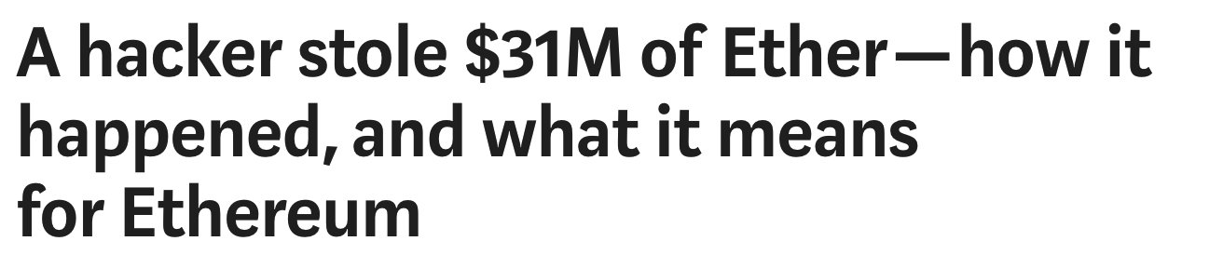
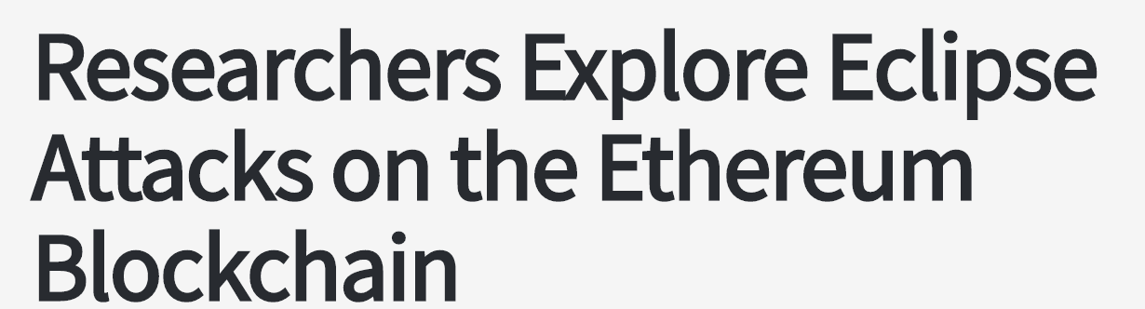
Cybercriminals

Slide 3
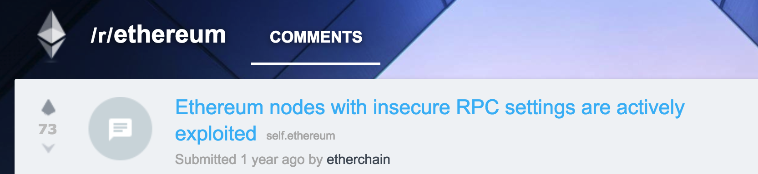
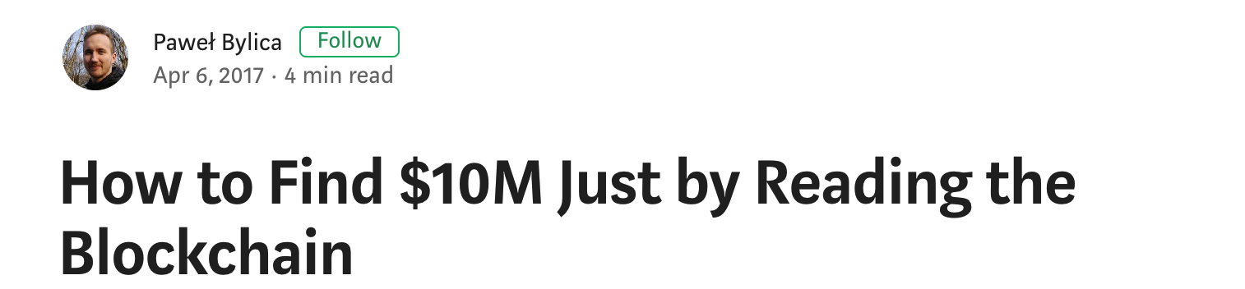
Cybercriminals

Slide 4
Outline
Blockchain Security
  Introduction
  Blockchain Security
  Smart Contract Security (Ethereum)
    The DAO Attack
    The ERC20 Short Address Attack
    Ethereum Smuggling Vulnerability

Slide 5
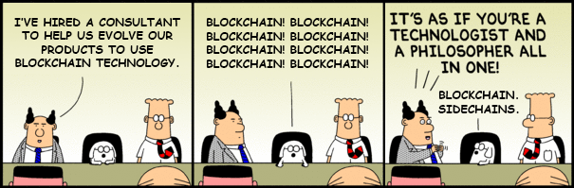
WHAT IS THE BLOCKCHAIN?
A blockchain is a tamper-proof, shared digital ledger that records transactions(history) that take place between the peers in a peer- to-peer network.
All the confirmed and validated transaction blocks are linked and chained from the beginning of the chain to the most current block, hence the name blockchain.
BLOCK CHAIN

Slide 6
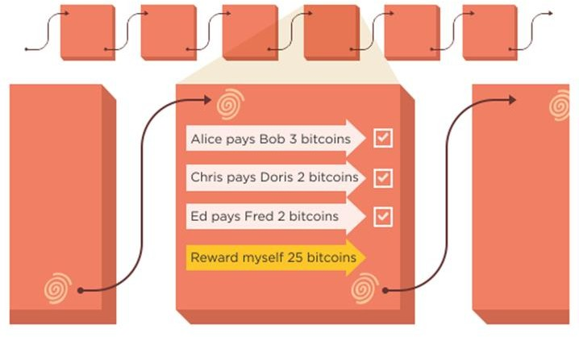
SHA256(SHA256(80 byte header of block k)). data's integrity.
WHAT IS THE BLOCKCHAIN?

Slide 7
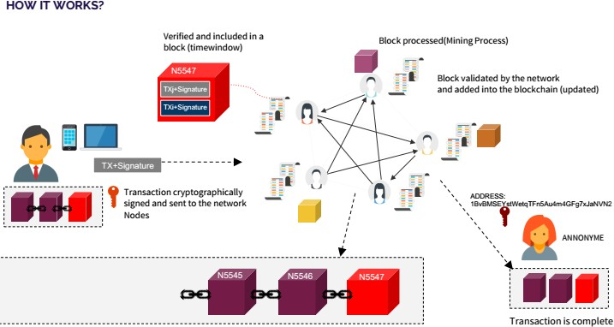
NO SPOF
WHAT IS THE BLOCKCHAIN?

Slide 8



STACK VUE (Blockchain System):
In the Context of protocol stack, cryptocurrency is a blockchain service
HOW IT WORKS?
GMAIL |  | THE DIGITAL CURRENCY
SMTP – SIMPLE MAIL TRANSFER PROTOCOL |  | CONSENSUS PROTOCOL TRANSACTION PROTOCOL
TCP/IP – TRANSMISSION CONTROL PROTOCOL/INTERNET PROTOCOL |  | THE LEDGER : SHARED DATA LAYER
Security
layer
Application
Layer
Application Protocol Layer
General
Protocol Layer
5

Slide 9
FEATURES
WHAT IS THE BLOCKCHAIN?
TRANSPARENCE &
ANONYMITY
DATA is available to the
participants.
Users are anonymous
IMMUTABILITY
DECENTRALIZED
CONSENSUS
Ensure Consensus within a
decentralized Network.
Data is stored for ever in the
blockchain and can’t be
altered
*The genesis blockchain

Slide 10
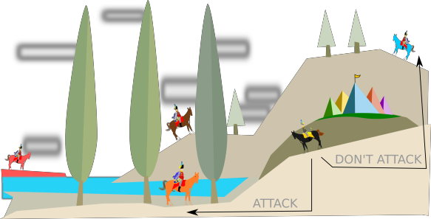
Blockchain is BFT (Byzantine fault tolerance)
POW : Byzantine general problem resolution.

Slide 11
Blockchain is Secure by design Cryptography + Computational shield
SHA256(Pow, address), RIPEMD-160(address), ECDSA Variant of DSA that ECC(1992 by Vanstone)secp256k1, from SECG (the "Standards for Efficient Cryptography Group", founded by Certicom)

Slide 12
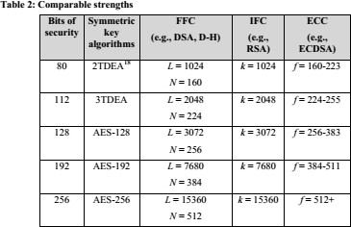
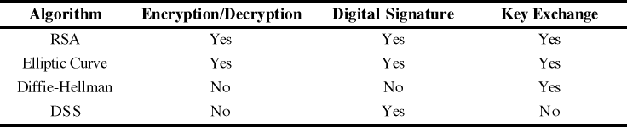
Security Level
Benefits Of ECC :
Smaller key size provides
Storage efficiencies
Bandwidth savings
Computational efficiencies
Relatively newer field
“256-bit ECC public key should provide comparable security to a 3072-bit RSA public key”

Slide 13
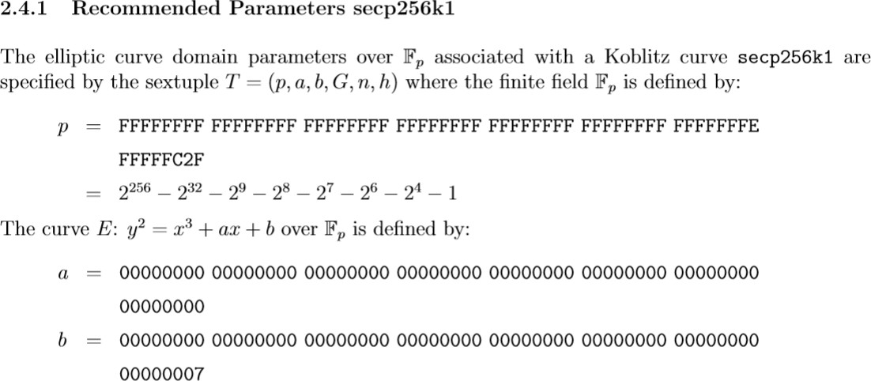
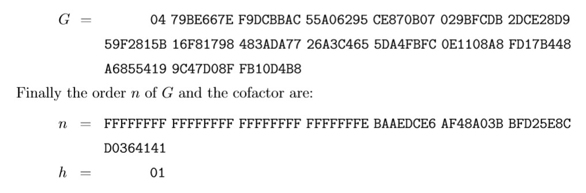

Slide 14
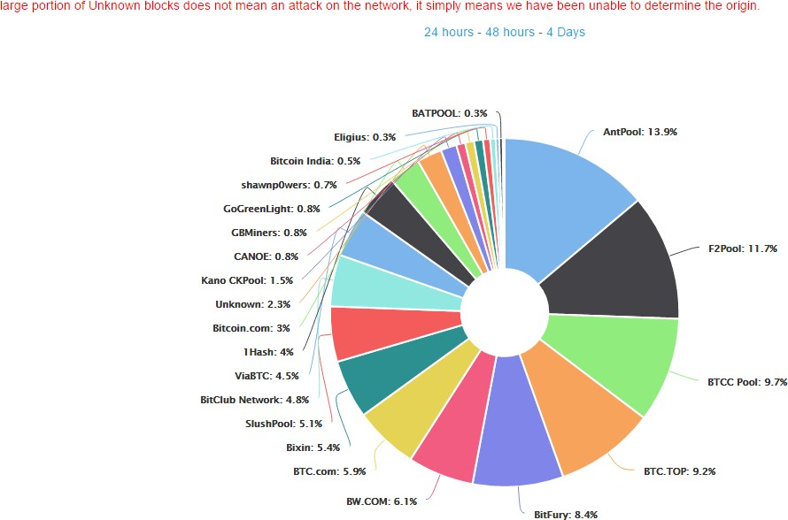
Computational shield
51% Attack
for an attacker to be able to successfully interfere with the Bitcoin network and block and reverse transactions
The probability of a transaction being reversed decreases exponentially with the number of confirmations it has received.

Slide 15
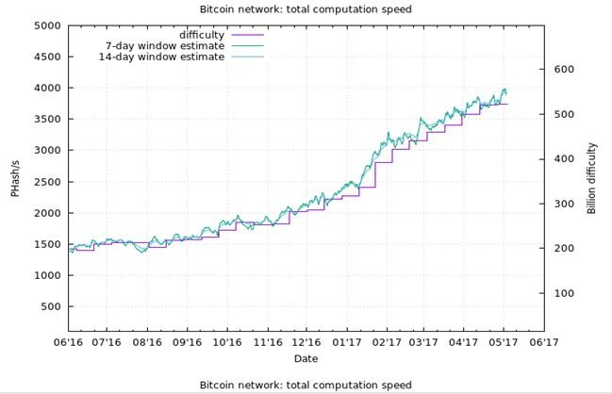
Computational shield
3 ExaHash/S !!!
Bitcoin uses SHA- 256 encryption for both its Proof- of-Work (PoW) system and transaction verification

Slide 16
Computational shield
The computing power of the Bitcoin network is 7468 times higher than the one of the cumulative 500 world supercomputers.
X7500

Slide 17

Computational shield
An Antminer S9 runs at 0.1 Joule per GH (109 hashe 1026 hashes 0.1 J / 109 hashes = 1015 joules 1015 joules = 2,777,777,778 kw hours $0.10 kw/hour = $277,777,778 worth of electricity to rewrite the entire blockchain
$3,028 worth of electricity per block
s)

Slide 18
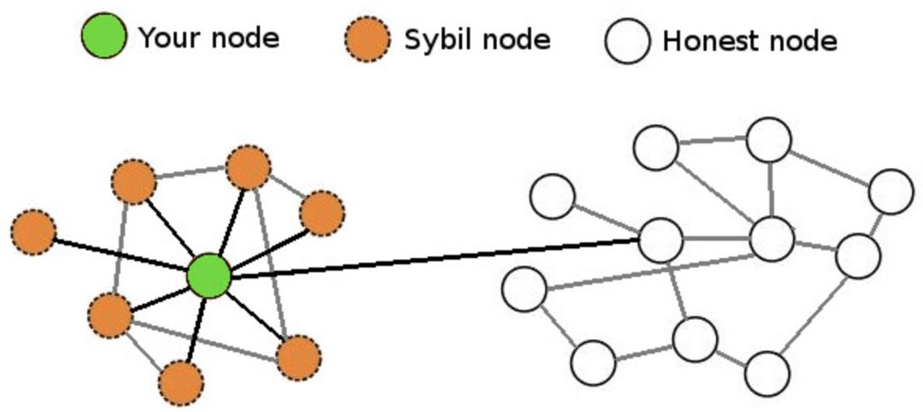
Computational shield
it’s not possible for someone to launch an attack against a
node by creating many dishonest peers
Sybil Attack (resistance)
Because the bitcoin protocol considers the true chain to be the one with the most cumulative proof of work (not the longest chain as is often incorrectly stated,)

Slide 19
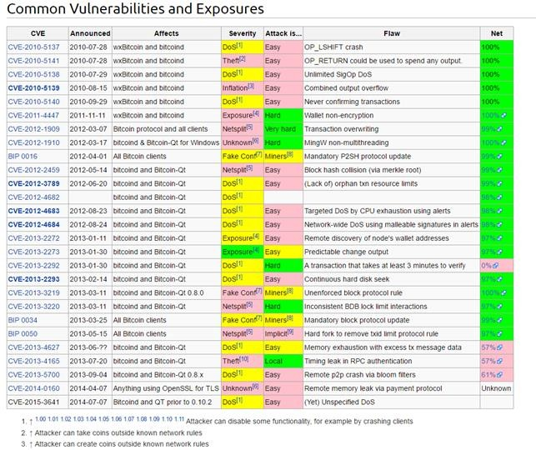
Bitcoin Code Bugs
most real Blockchain vulnerabilities do not stem from a weakness in the underlying hardness assumption, but rather from implementation issues

Slide 20
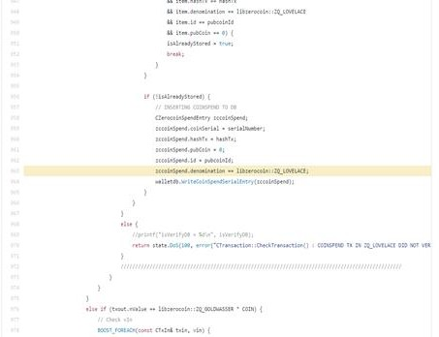
Human Factor
Computational shield
Zerocoin bug in the code allowed the attacker to reuse his existing valid proofs to generate additional Zerocoin spend transactions (370,000 Zcoins => 410 BTC).

Slide 21
Smart Contract Security
ETHEREUM BLOCKCHAIN

Slide 22
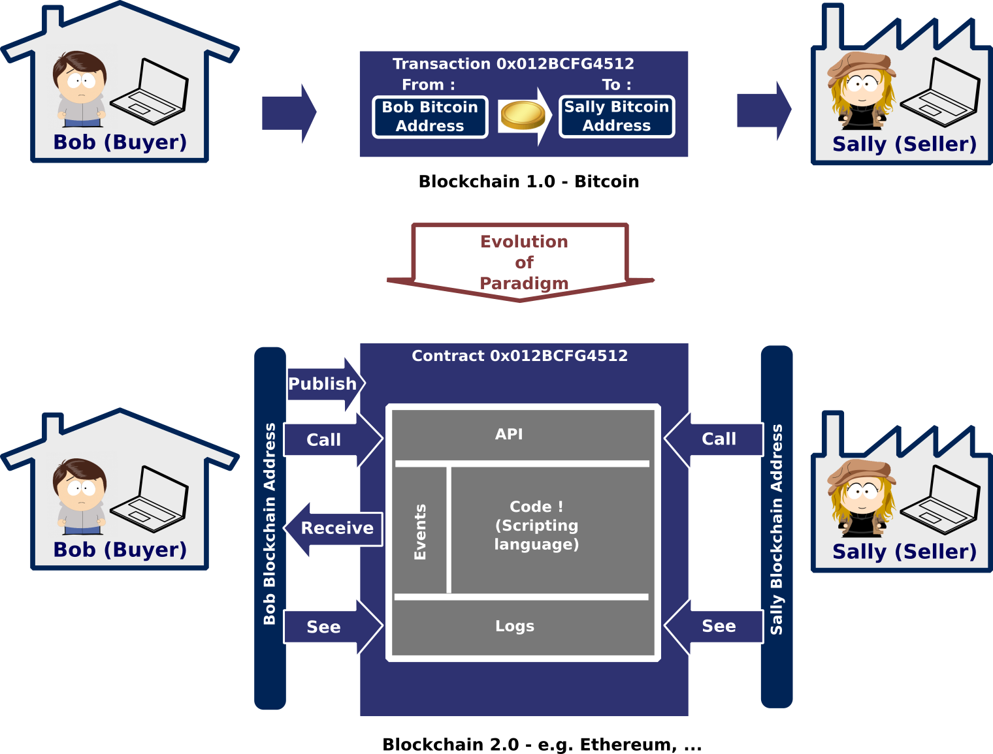

Slide 23
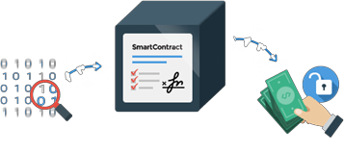
“A smart contract is a program
that runs on the blockchain
and has its correct execution enforced by the consensus protocol”
SMART CONTRACT
They enable trustless financial services like loans, micropayments, and more.
Get rid of intermediaries and third parties

Slide 24
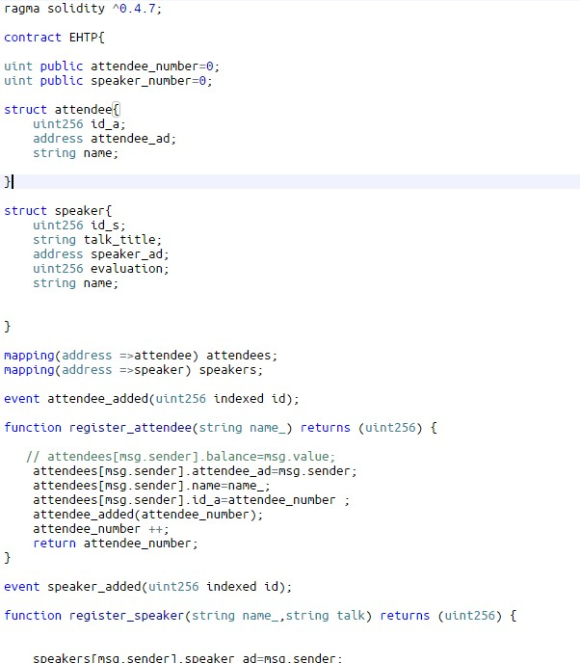
SMART CONTRACT

Slide 25
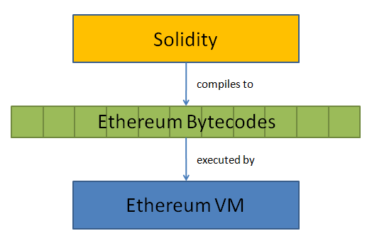
    The ERC20 Short Address Attack

Slide 26
DAO
The DAO has lost 3.6m ether
1ether =17(60M) $
today =531.95(1874M)
The DAO was the largest crowdfunding in history, having raised over $150m from more than 11,000 enthusiastic members.

Slide 27
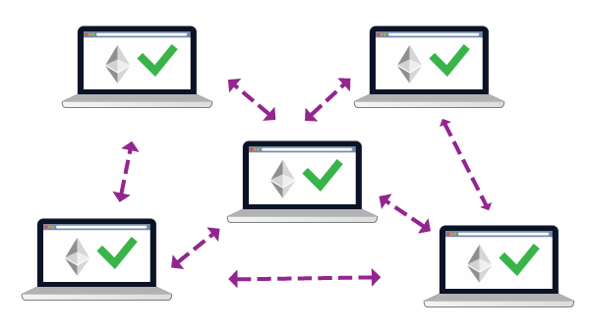
DAO Hack
Code Issue Leads to $60M Theft

Slide 28
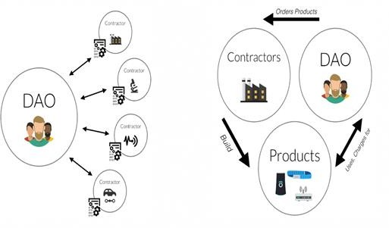
DAO
Decentralized Autonomous Organization (DAO)
Organization without CA => No CEO => Smart contract Decentralized fund manager

Slide 29
The Heist
function splitDAO(...
...
withdrawRewardFor(msg.sender); // be nice, and get
totalSupply -= balances[msg.sender]; balances[msg.sender] = 0;
paidOut[msg.sender] = 0;
return true;
}
his rewards
the attacker managed to drain more than 3.6 million Ether into a “child DAO” that has the same structure as The DAO

Slide 30
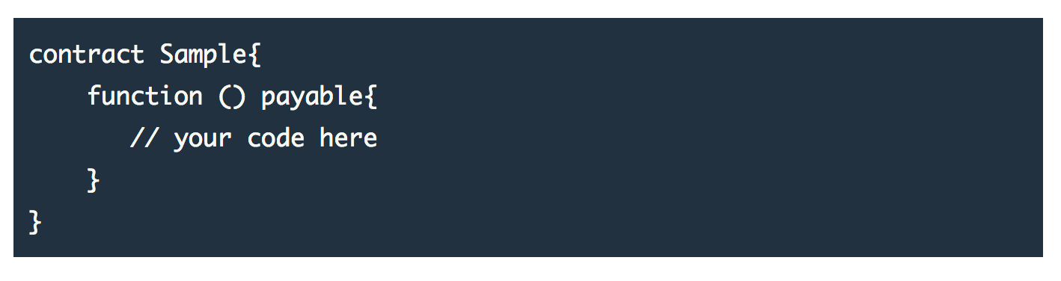
    Fallback Function

Slide 31
The attack (quite simple)
On 17th of June an attacker tried to rob ~3.5M ETH using the reentry exploit

Slide 32
reentry exploit
func tion getBalanc e(address user)
c onstant returns(uint) {
return userBalanc es[user];
func tion () {
}
func tion addToBalanc e() {
// To be c alled by a vulnerable
c ontrac t with a withdraw func tion.
// This will double withdraw.
userBalanc es[msg.sender] +=
msg.amount;
vulnerableContrac t v;
uint times;
if (times == 0 && attac kModeIsOn) {
times = 1;
}
func tion withdrawBalanc e() {
amountToWithdraw =
v.withdrawBalance ();
userBalanc es[msg.sende r];
if
} else { times = 0; }
(!(msg.sender.c all.value(a mountToWith
}
draw)())) { throw; }
userBalanc es[msg.sender] = 0;
}
vulnerableContract.withdraw run 1
attacker default function run 1
vulnerableContract.withdraw run 2
attacker default function run 2

Slide 33
Correction
func tion withdrawBalanc e() { amountToWithdraw =
userBalanc es[msg.sende r]; userBalanc es[msg.sender] = 0; if (amountToWithdraw > 0) {
if
(!(msg.sender.send(a mountToWithdraw
))) { throw; }
}
}

Slide 34
    The ERC20 Short Address Attack
What is an ERC20 Token
  ERC stands for Ethereum Request for Comments. This is an official protocol for proposing improvements to the Ethereum network. '20’ is the unique proposal ID number.
  ERC20 defines a set of rules which need to be met in order for a token to be accepted and called as 'ERC20 Token'. The standard rules apply to all ERC20 Tokens since these rules are required to interact with each other on the Ethereum network.
In essence, ERC20 tokens are smart contracts that run on the Ethereum blockchain.

Slide 35
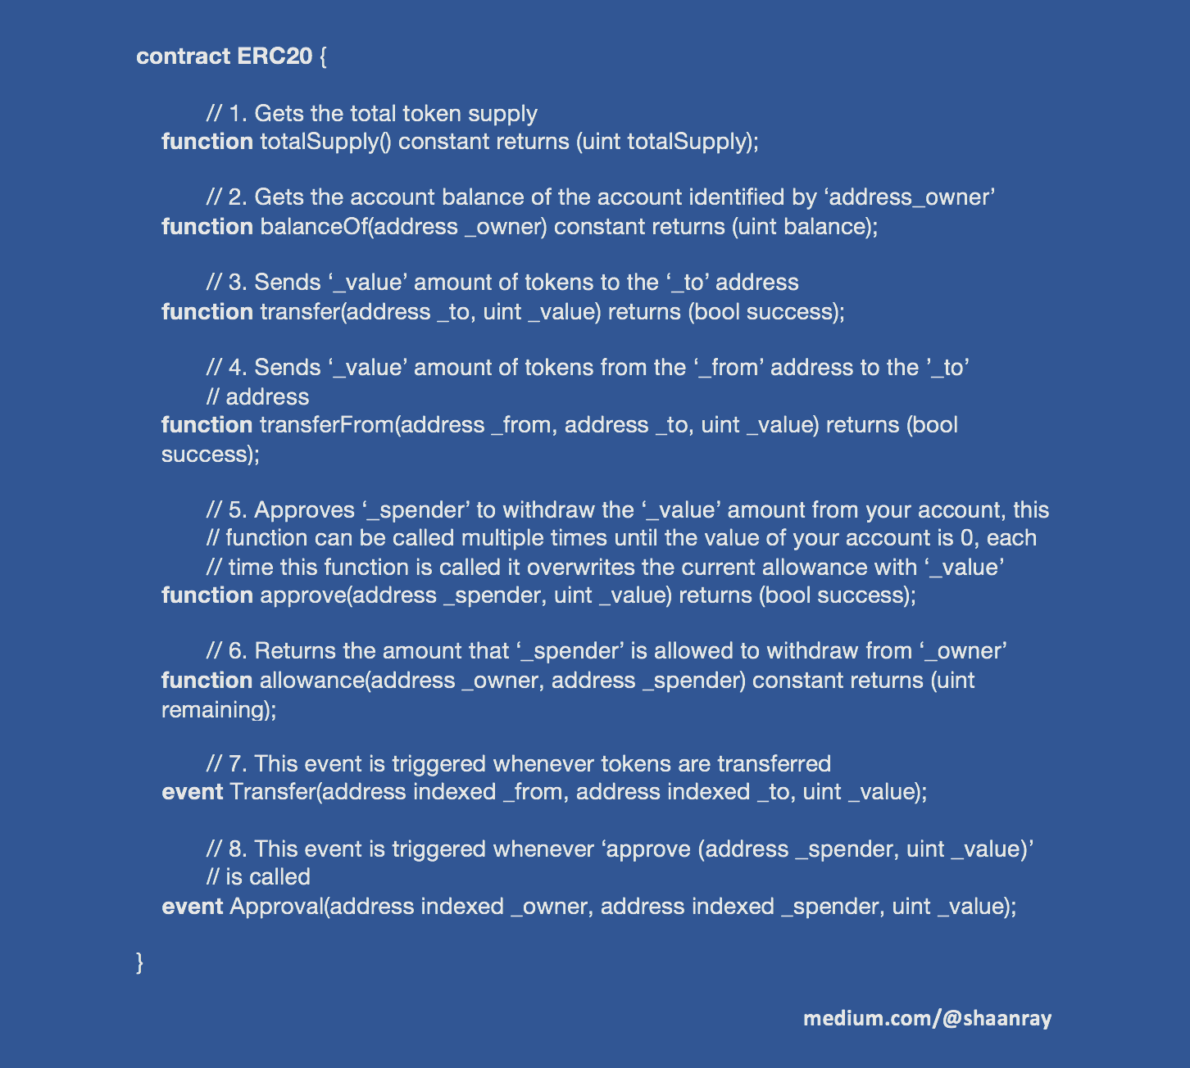
    The ERC20 Short Address Attack
function transfer(address to, uint tokens) public returns (bool success);

Slide 36
When we call transfer function to send N ERC-20 coin to an address, the transaction input data can be divide into three parts：
4 Byte, Hash value of the function: a9059cbb
32 Byte, Ethereum Address, The Ethereum Address is now 20 Byte (padding 0 at the front)
000000000000000000000000abcabcabcabcabcabcabcabcabcabcabcabcabca
32Byte, Number of coin need to be transferred, like 1*10^18 GNT
0000000000000000000000000000000000000000000000000de0b6b3a7640000
Combine them together, we got：
a9059cbb000000000000000000000000abcabcabcabcabcabcabcabcabcabcabcabcabca0000000000000000000000000000000000000000000000000de0b6b3a7640000

Slide 37
The ERC20 Short Address Attack
0x1234567890123456789012345678901234567800

Slide 38
The ERC20 Short Address Attack
Hash
Address
Value
0x90b98a11 00000000000000000000000062bec9abe373123b9b635b75608f94eb8644163e 0000000000000000000000000000000000000000000000000000000000000002
0x90b98a11 00000000000000000000000062bec9abe373123b9b635b75608f94eb8644163e 0000000000000000000000000000000000000000000000000000000000000002
0x90b98a11 00000000000000000000000062bec9abe373123b9b635b75608f94eb86441600 0000000000000000000000000000000000000000000000000000000000000200

Slide 39
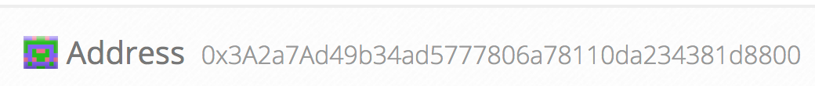

Slide 40
Ethereum Smuggling Vulnerability

Slide 41
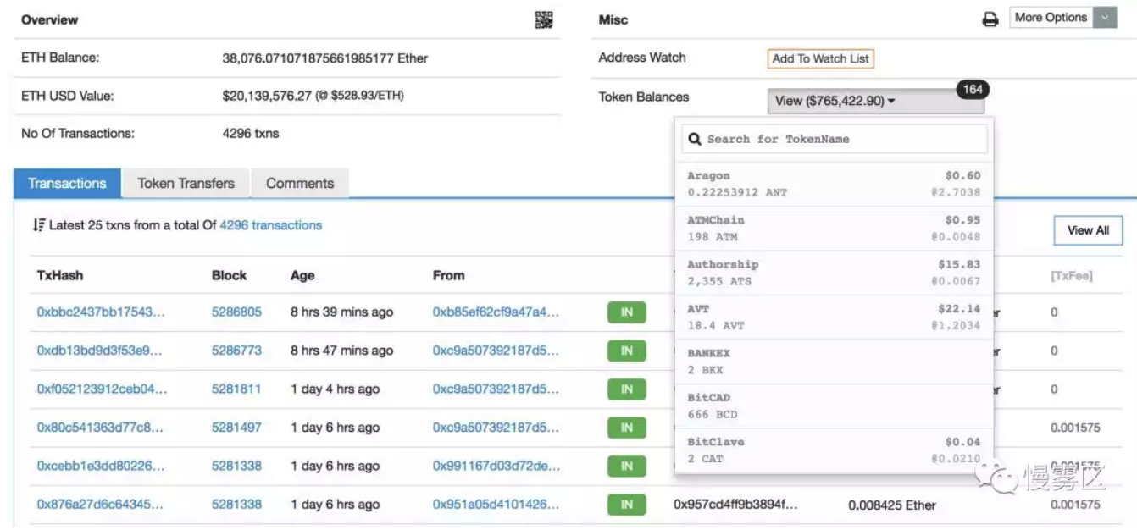
20M $$$

Slide 42
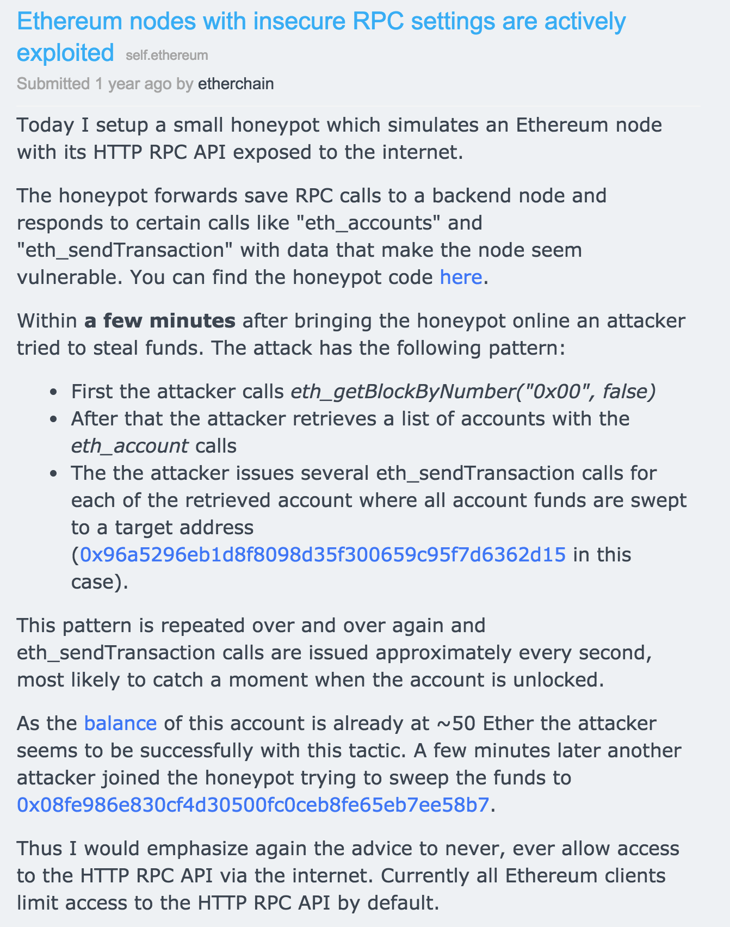

Slide 43
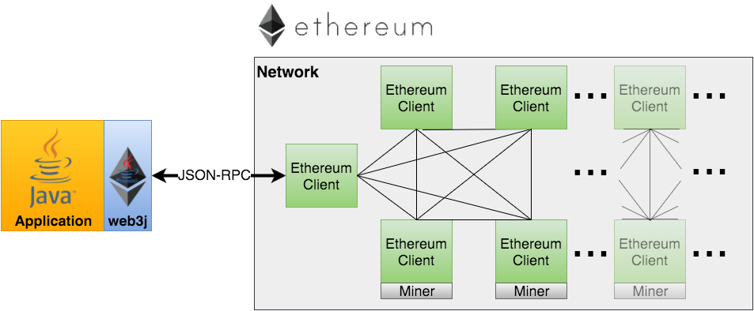
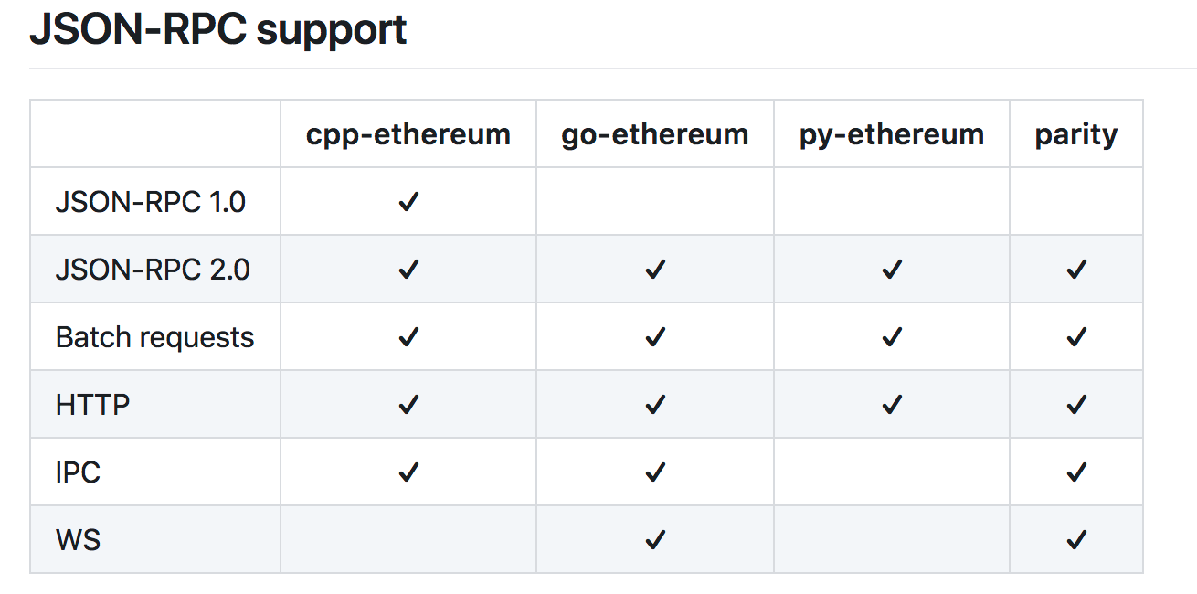
Remote Procedure Call (RPC) API

Slide 44
Node’s RPC port is open to public
Node’s RPC port allows API call
The height of the block is updated

Slide 45
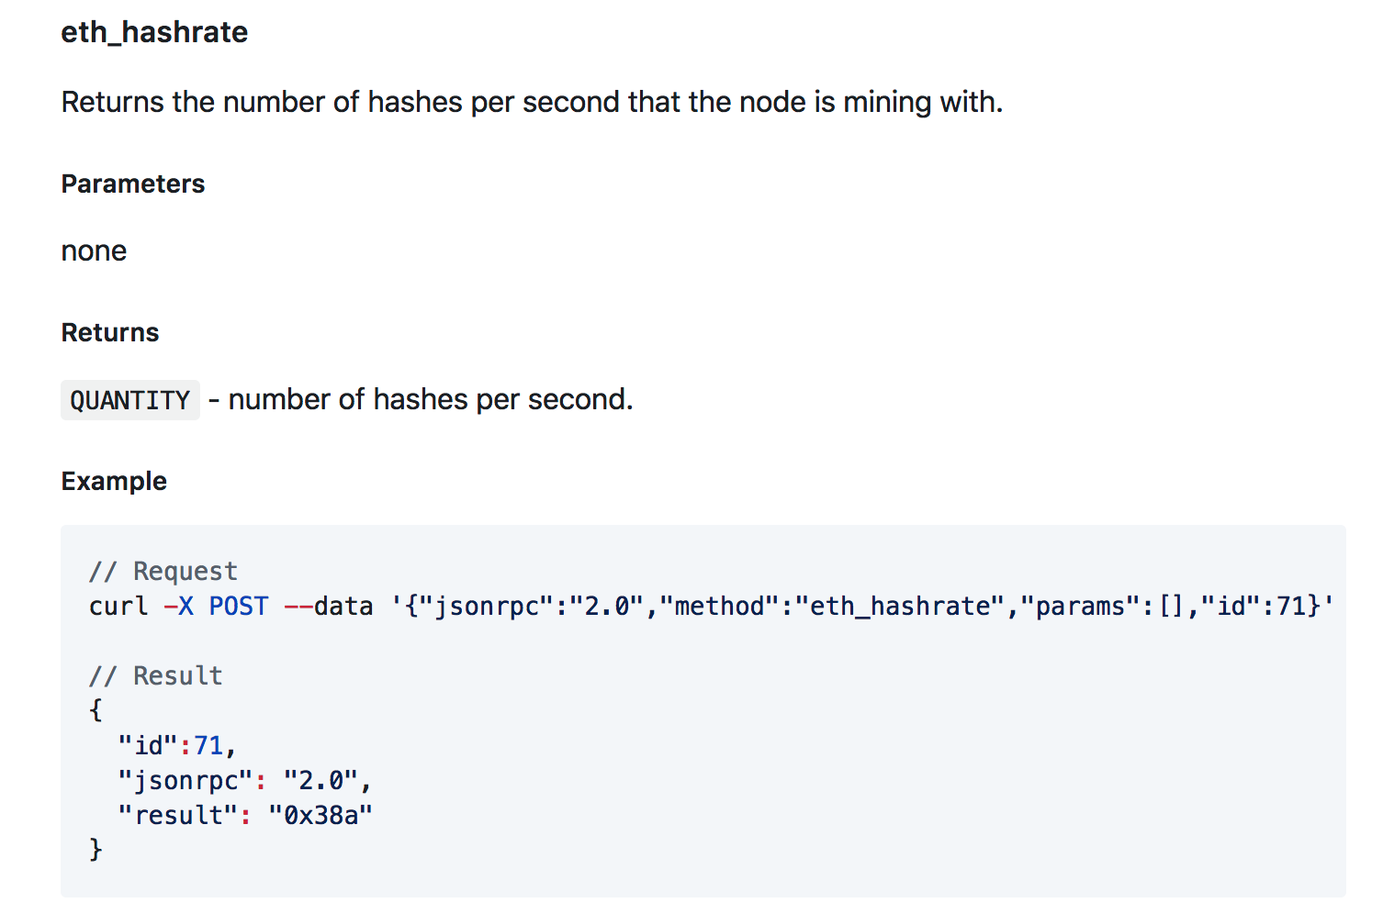
API Example

Slide 46
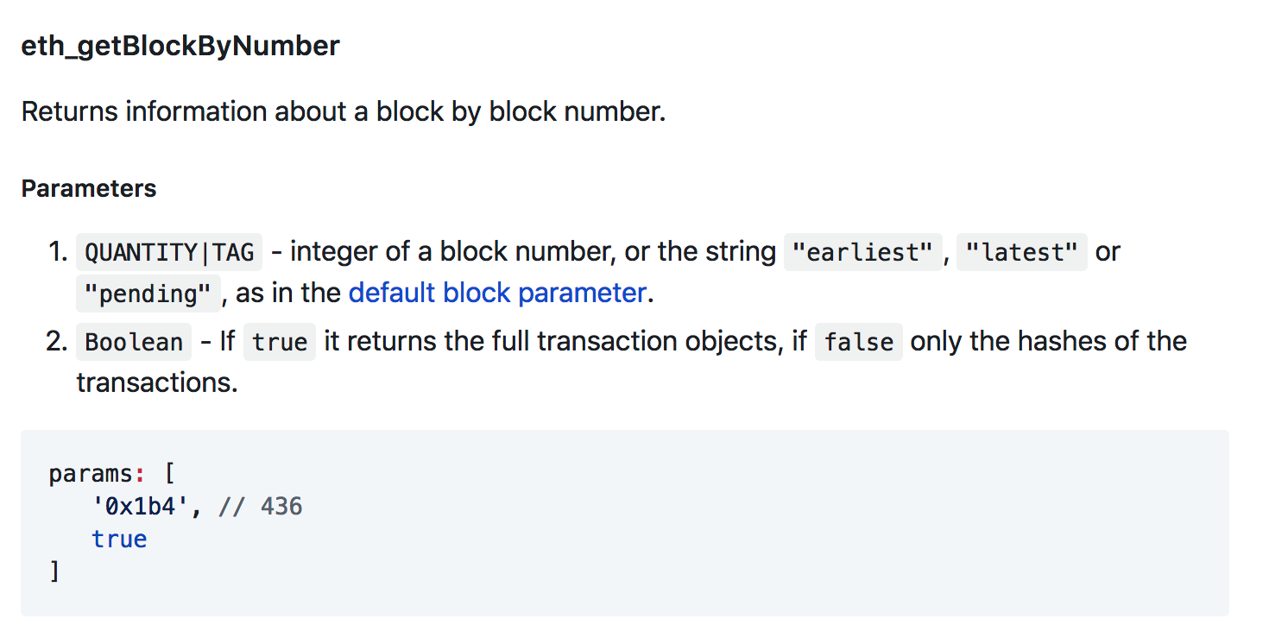
Scan
// Request curl -X POST --data '{"jsonrpc":"2.0","method":"eth_getBlockByNumber","params":["0xe670ec64341771606e55d6b4ca35a1a6b75ee3d5145a99d05921026d1527331", true],"id":1}' //
// Result
{ "id":1, "jsonrpc":"2.0", "result": { "number": "0x1b4", // 436 "hash": "0xe670ec64341771606e55d6b4ca35a1a6b75ee3d5145a99d05921026d1527331", "parentHash": "0x9646252be9520f6e71339a8df9c55e4d7619deeb018d2a3f2d21fc165dde5eb5", "nonce": "0xe04d296d2460cfb8472af2c5fd05b5a214109c25688d3704aed5484f9a7792f2", "sha3Uncles": "0x1dcc4de8dec75d7aab85b567b6ccd41ad312451b948a7413f0a142fd40d49347", "logsBloom": "0xe670ec64341771606e55d6b4ca35a1a6b75ee3d5145a99d05921026d1527331", "transactionsRoot": "0x56e81f171bcc55a6ff8345e692c0f86e5b48e01b996cadc001622fb5e363b421", "stateRoot": "0xd5855eb08b3387c0af375e9cdb6acfc05eb8f519e419b874b6ff2ffda7ed1dff", "miner": "0x4e65fda2159562a496f9f3522f89122a3088497a", "difficulty": "0x027f07", // 163591 "totalDifficulty": "0x027f07", // 163591 "extraData": "0x0000000000000000000000000000000000000000000000000000000000000000", "size": "0x027f07", // 163591 "gasLimit": "0x9f759", // 653145 "gasUsed": "0x9f759", // 653145 "timestamp": "0x54e34e8e" // 1424182926 "transactions": [{...},{ ... }] "uncles": ["0x1606e5...", "0xd5145a9..."] } }

Slide 47
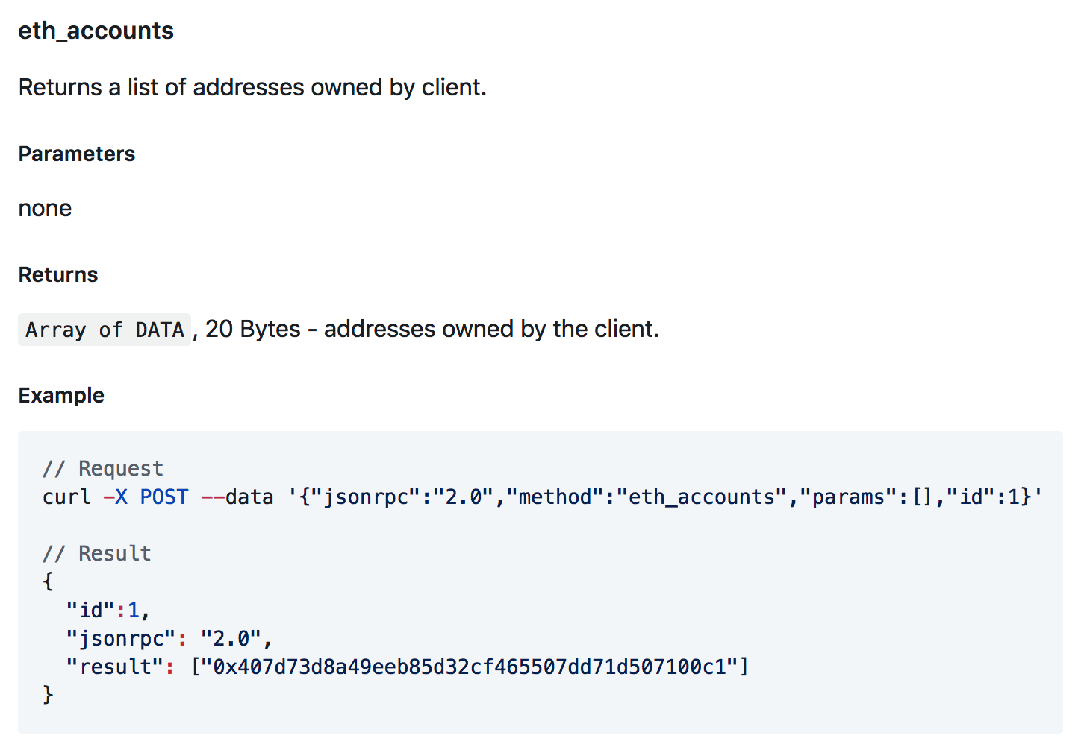
Get info

Slide 48
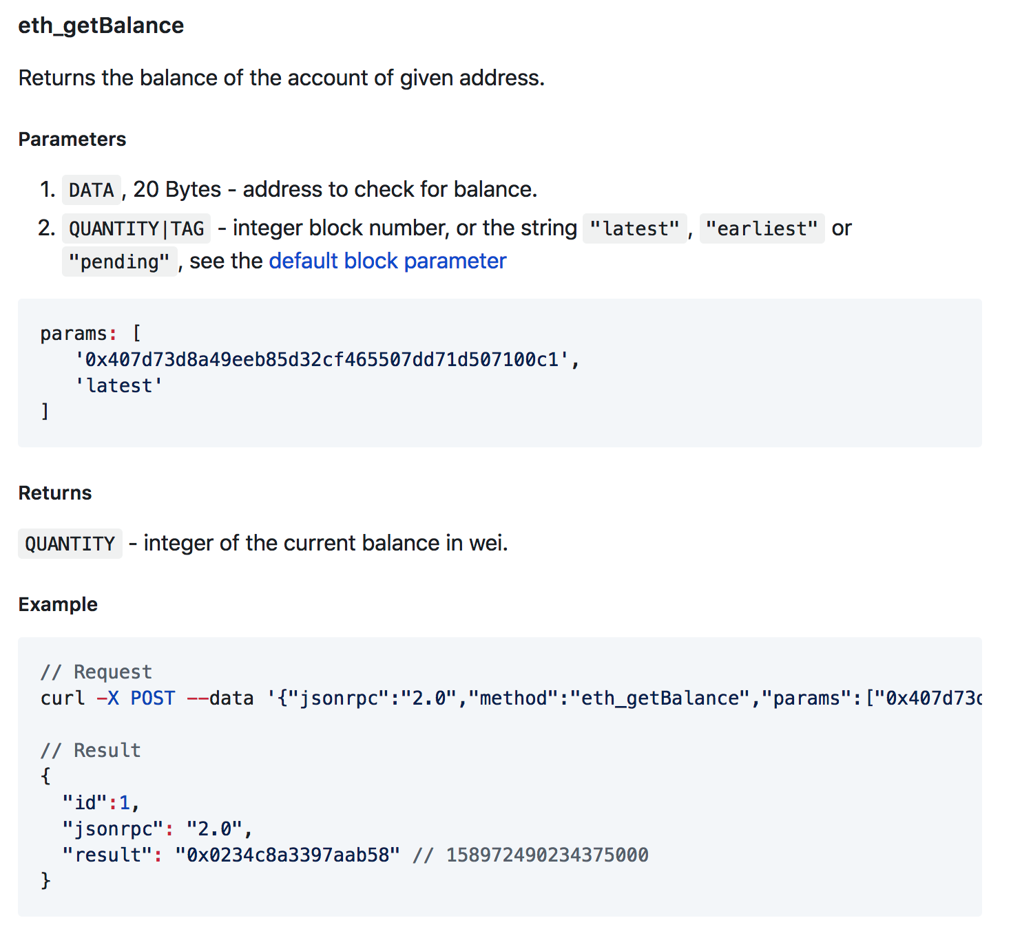
Get info

Slide 49
Security measures

Slide 50
Cap contracts
It’s early days - we lack experience:
Solidity version 0.4.11
Mist version 0.8.9
Geth version 1.6.1
Frontier has been launched ~ 2 year ago
Number of operating Dapps still very low
Vitalik suggested 10M$ as cap in foundation blog

Slide 51
Formal proof verification
Mathematically proof that a contract has a certain feature or invariant
http://dr-y.no-ip.net/
formal verification is the act of proving or disproving the correctness of intended algorithms underlying a system with respect to a certain formal specification or property, using formal methods of mathematics.

Slide 52
Time Delays
DAO:
7 Days for splitDAO proposals
14 Days for regular proposals
27 days creation period
…
Gives time for a central authority (if implemented in the contract) to act

Slide 53
Minimal complexity
Statistics: ~15-50 bugs per 1000 lines of code
Not everything needs decentralization and needs to be in the smart contract
Only include in a smart contract the very core of a Dapp
Reuse trusted proven code
Standard Token Contract
Foundation multisig
(Hopefully one day a DAO standard framework)

Slide 54
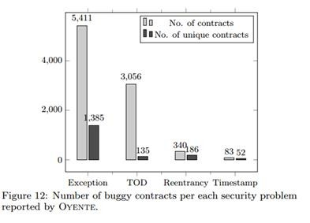
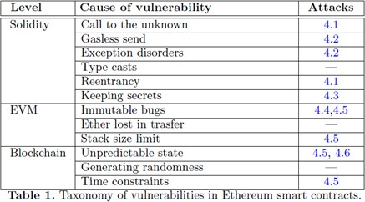
Code security flaws
Statistics: ~15-50 bugs per 1000 lines of code
Not everything needs decentralization and needs to be in the smart contract
Only include in a smart contract the very core of a Dapp
Source: https://eprint.iacr.org/2016/633.pdf

Slide 55
Better tools
Formal proof verification (work in progress)
Compiler warnings (work in progress)
Improved IDEs (work in progress)
Trusted Libraries (work in progress)
Best practices literature (work in progress)
Decentralized master keys / Decentralized escape hatches / trusted community multisig to be used in smart contracts as centralized authorities

Slide 56
Best practices

Slide 57
Establish security patterns
1024 call stack depth -> always check return values of each call
Block gas limit -> No arbitrary length loops
Reentry exploit -> update state before executing CALLs
Ether sent to contract without contract invocation -> be careful with Invariants
Specify right amount of gas (SEND vs CALL)
Block timestamp can be manipulated -> block.number are safer
Tx.orgin vs msg.sender (pishing attacks)
…
Literature: https://github.com/ConsenSys/smart-contract-best-practices
http://solidity.readthedocs.io/en/latest/security-considerations.html

Slide 58
Conclusion
It’s early days, like the internet in 90s
Bitcoin’s Security Model Revisited
https://arxiv.org/pdf/1605.09193.pdf

Slide 59

Q & A

