Slide 1
Class8
CSC 495/583 Advanced Topics in Computer Security
Privacy and Security in Mobile
Si Chen (schen@wcupa.edu)

Slide 2


Slide 3

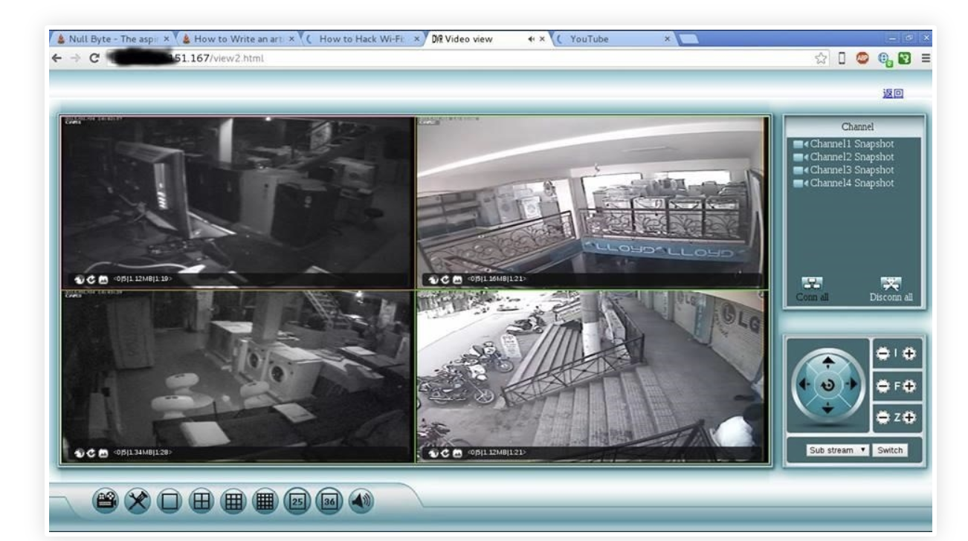


Internet of Things (IoT) & Mobile Application Security

Slide 4

Internet of Things (IoT) & Mobile Application Security

Slide 6
Software Security and Privacy
Measurement of software security is an ongoing research field.
Privacy is also becoming an imperative target as social networking and ubiquitous computing evolve and users exchange high volumes of personal information.
However, security and privacy alone don't guarantee proper data protection; software must also be dependable.

Slide 7

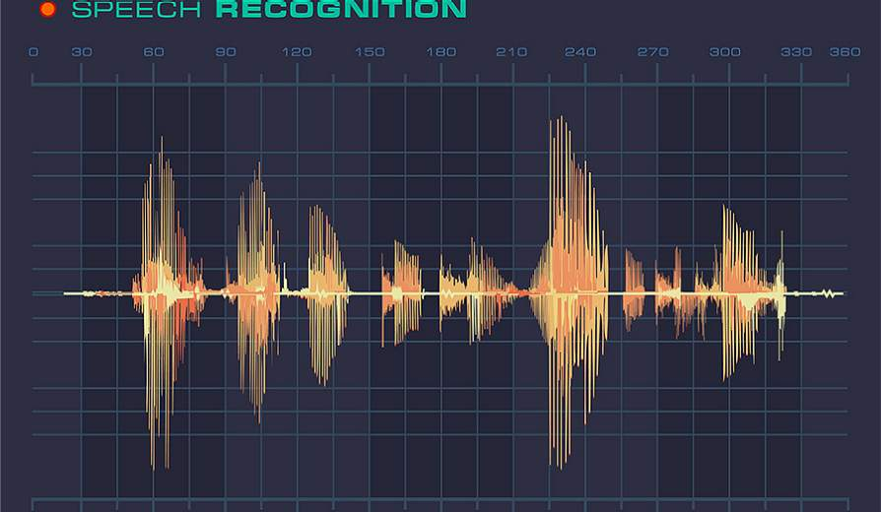
You Can Hear But You Cannot Steal
Defending against Voice Impersonation Attacks
on Smartphones
Si Chen, Kui Ren, Sixu Piao, Cong Wang, Qian Wang,
Jian Weng, Lu Su, Aziz Mohaisen
Department of Computer Science and Engineering, University at Buffalo
Department of Computer Science, West Chester University
Department of Computer Science, City University of Hong Kong
Department of Computer Science, Wuhan University
Department of Computer Science, Jinan University

Slide 8
Outline
Introduction
Problem Formulation
The Proposed Solution
Evaluation
Conclusion

Slide 9
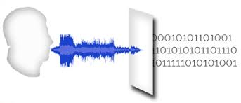
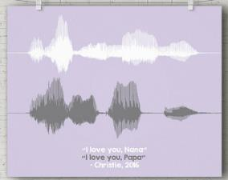
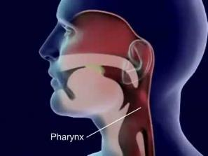
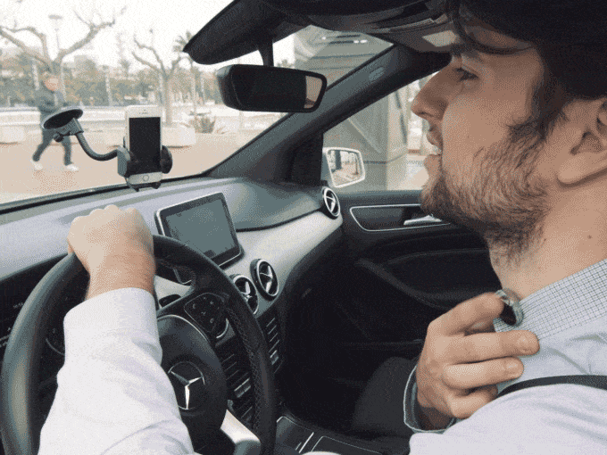
Voice Authentication
Voice, has a significant advantage over the conventional keyboard-based input methods
No memorization
Easy to Use
Low Cost
Notes:
Voice, as a convenient and efficient way of information delivery, has a significant advantage over the conventional
keyboard-based input methods, especially on small mobile devices
such as smartphones and smartwatches.
No memorization: use the special features inside the voice to authenticate (your voice is unique). The Pharynx is the main resonating chamber for the voice + physical shape of the vocal tract + motion of the mouth and pronunciations → biometrics authentication → No need to remember the password
Low cost: Use microphone to capture voice → cheap, widely adopted
Easy to Use:

Slide 10
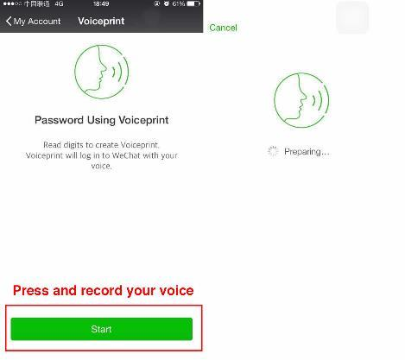




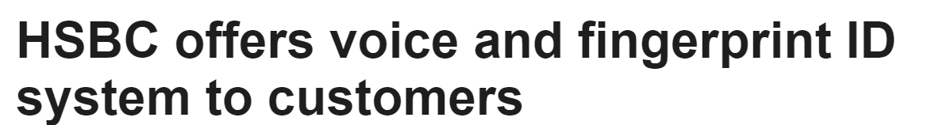



Voice Authentication on Smartphones
Voice-enable Logins
E-Commerce
Mobile Banking
Notes:
Voice-enable Logins: Google has integrated it into Android operating systems to allow users to unlock mobile devices, and Tencent has updated its WeChat mobile app to support voice logins.
SayPay Technologies provides cutting-edge biometric and voice-enabled solutions. Our solutions enable users to securely access enterprise environments, approve high-value wires and brokerage orders, sign in and make bill payments without PINs and passwords, and transaction financial functions with just the sound of their voices.
HSBC is launching voice recognition and touch security services in the UK in a big leap towards the introduction of biometric banking.

Slide 11
Outline
Introduction
Problem Formulation
The Proposed Solution
Evaluation
Conclusion

Slide 12
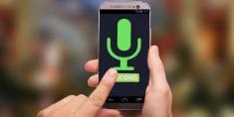

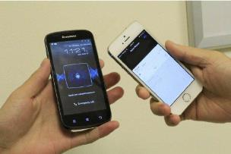
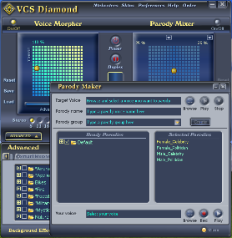

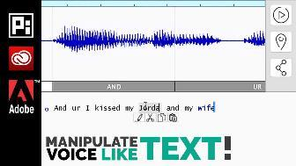
Problem Formulation
The human voice could often be exposed to the public, an attacker can:
  Collect sound samples of targeted victims
  Change voice biometrics by using different methods
  Launch voice impersonation attacks to spoof those voice-based applications
Voice Replay Attack
Voice Morphing Attack
Voice Synthesize Attack
Notes:
Voice Morphing Attack. In this type of attack, the attacker is able to imitate the target’s voice by applying voice morphing (conversion) techniques.
Voice Synthesize (Example: Adobe VOCO)
Attack: This type of attacker is able to synthesize target voice by using the state-of-the-art speech synthesizers techniques.
We assume the attacker is ableto use text-to-speech (TTS) technique to generate the natural-sounding synthetic speech of the targeted user from any inputtexts.
The attacker tries to spoof the speaker verification system by directly broadcasting the synthetic voice using a loudspeaker.

Slide 13
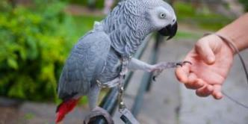
Problem Formulation
Adversary Model
Voice impersonation attacks
  Machine-based Voice Impersonation Attack
    Voice Replay Attack
    Voice Morphing Attack
    Voice Synthesize Attack
  Human-based Voice Impersonation Attack
    Human Mimicking

Slide 14
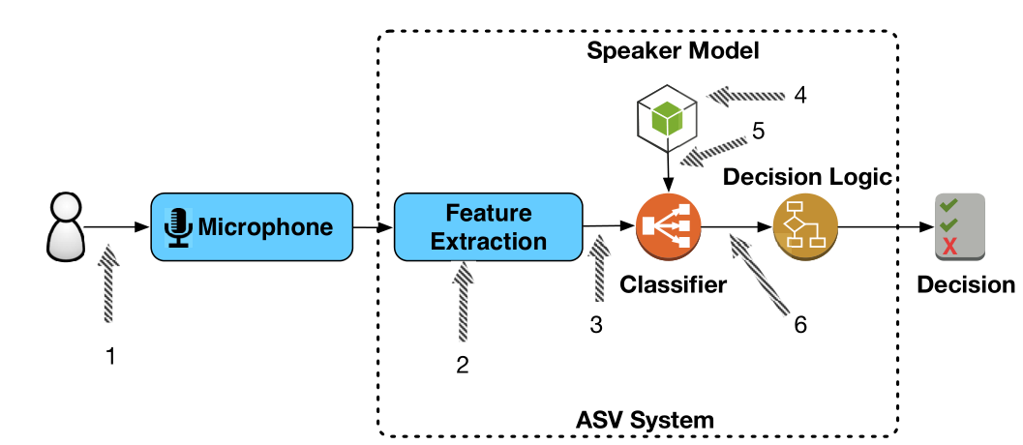
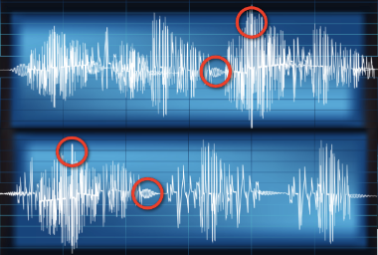
Existing Solutions: Automatic speaker verification (ASV) system
A generic automatic speaker verification (ASV) system with seven possible attack points
ASV system:
  Effective in detecting human voice imitation (human mimicking)
  Ineffective in detecting machine-based voice impersonation attacks
Notes:
Hence, more robust designs resilient to both human-based and machine-based voice impersonation attacks are in great demand yet to be fully explored.
The traditional methods of defending against the voice impersonation attacks require an automatic speaker verification (ASV) system, which employs unique spectral and prosodic features of a user’s voice for user authentication.
However, current ASV systems are far from perfect. While they are effective in detecting human-based voice impersonation attacks (human voice imitation) they are widely known for their inability to detect voice replay attacks.

Slide 15
Problem Formulation
Can we build software-based defense system tailored for mobile platforms against voice impersonation attacks?
… and meet these design goals
  High accuracy
  Easy to integrate with off-the-shelf mobile phones
  Low latency
  Low computational cost

Slide 16
Problem Formulation
Can we build software-based defense system tailored for mobile platforms against voice impersonation attacks?
… and meet these design goals
  High accuracy
  Easy to integrate with off-the-shelf mobile phones
  Low latency

Slide 17
Outline
Introduction
Problem Formulation
Proposed Solution
Evaluation
Conclusion

Slide 18
Proposed Solution
Voice Replay Attack
Voice Morphing Attack
Voice Synthesize Attack
Notes:
our key insight is to detect the magnetic field produced by the conventional loudspeakers. By using the magnetometer (compass) in modern smartphones, we can distinguish between a human speaker and a computer loudspeaker, since the human vocal tract would not produce any magnetic field.

Slide 19
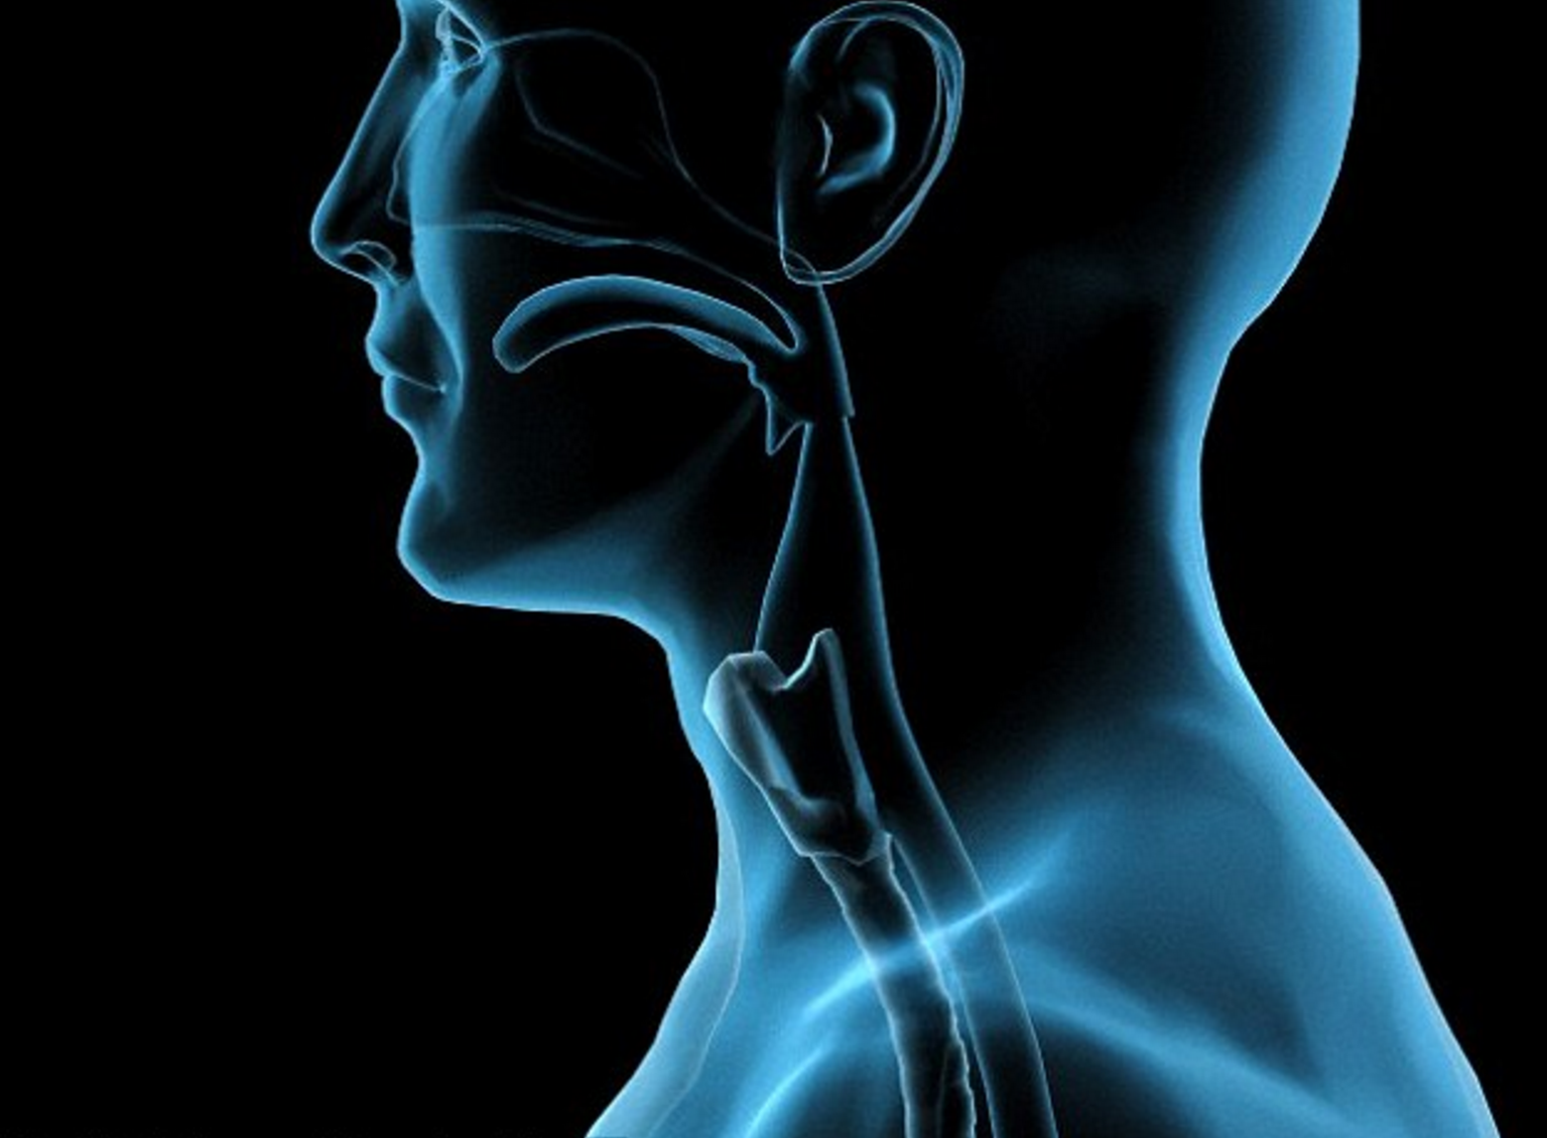
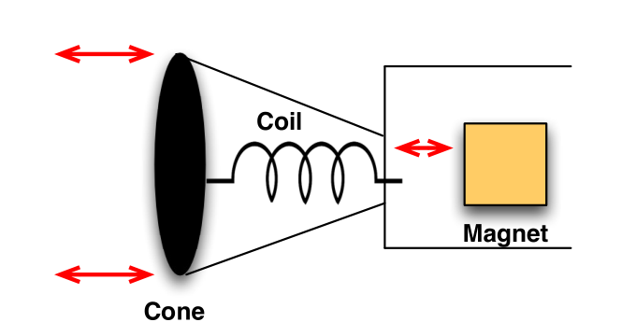
Proposed Solution
The human vocal tract
The architecture of conventional loudspeaker
Key insight:
The human vocal tract → No magnetic field
The conventional loudspeakers → Has magnetic field
Use the magnetometer (compass) in smartphone to detect!
Notes:
our key insight is to detect the magnetic field produced by the conventional loudspeakers. By using the magnetometer (compass) in modern smartphones, we can distinguish between a human speaker and a computer loudspeaker, since the human vocal tract would not produce any magnetic field.

Slide 20
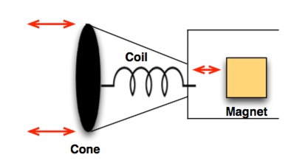
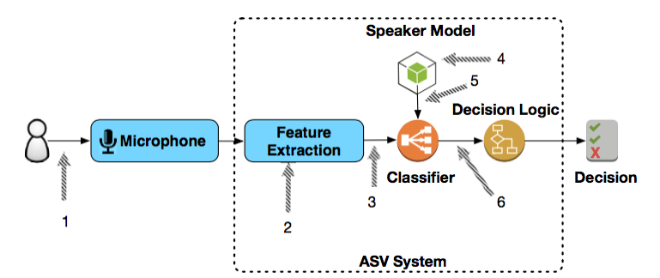
Proposed Solution
  Machine-based Voice Impersonation Attack
magnetometer (compass) equipped on modern smartphones
  Human-based Voice Impersonation Attack
Spear speaker verification system

Slide 21
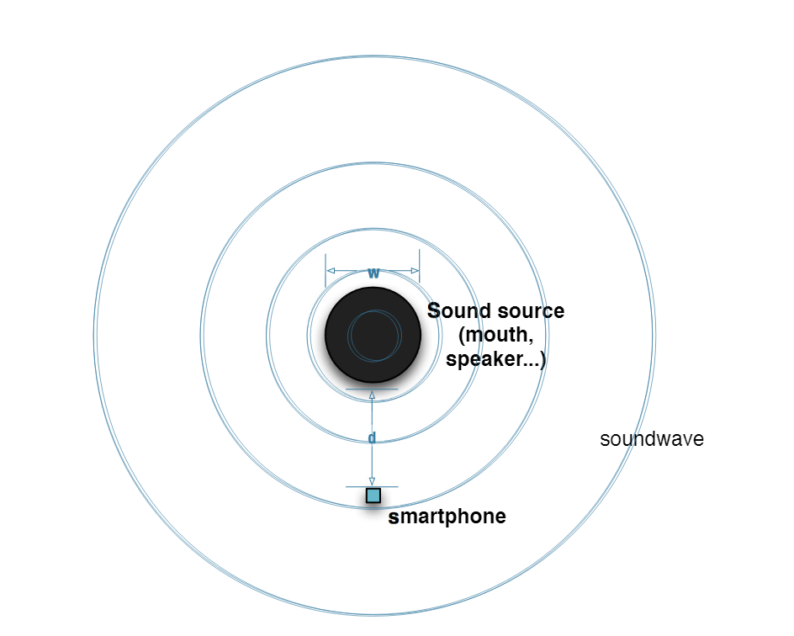
Proposed Solution
To successfully leverage our key insight, we require users to place the smartphone as close as possible to the sound source.
Notes:
This is because the magnetic field produced by the loudspeaker can only be detected within a short range.
However, the distance between the smartphone and the sound source is hard to measure.
Therefore, we design non-intrusive use cases to confine the moving pattern of the smartphone and assist in measuring the distance.
As shown in this Figure, our scheme requires the user first to open our mobile application and hold the smartphone near his head vertically or horizontally (a similar interaction model has been adopted by [11]);
The user starts speaking the voice command while moving the smartphone towards his or her mouth at the same time.
Finally, the user waits for our application to verify his identity. During this process, our application first collects the acoustic data and the reading of the inertial sensors, and then feeds them into the verification pipeline.

Slide 22
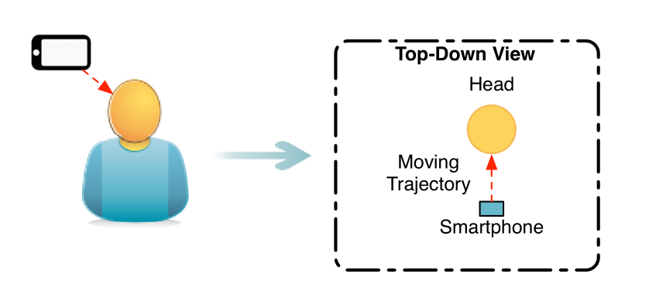
Proposed Solution
Move towards the mouth
Notes:
This is because the magnetic field produced by the loudspeaker can only be detected within a short range.
However, the distance between the smartphone and the sound source is hard to measure.
Therefore, we design non-intrusive use cases to confine the moving pattern of the smartphone and assist in measuring the distance.
As shown in this Figure, our scheme requires the user first to open our mobile application and hold the smartphone near his head vertically or horizontally (a similar interaction model has been adopted by [11]);
The user starts speaking the voice command while moving the smartphone towards his or her mouth at the same time.
Finally, the user waits for our application to verify his identity. During this process, our application first collects the acoustic data and the reading of the inertial sensors, and then feeds them into the verification pipeline.

Slide 23
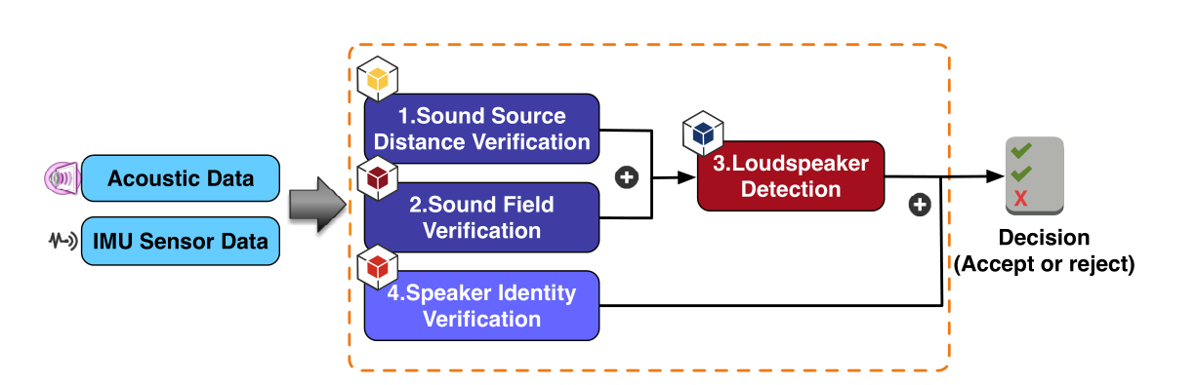
Proposed Solution
The architecture of our defense system
Sound Source Distance Verification
  Reconstruct the moving trajectory of the smartphone
  Calculate the distance between sound source and smartphone
Sound Field Verification
  Justify whether the received sound is broadcast from a human mouth
Loudspeaker Detection
  Detect the magnetic field emitted from the loudspeaker.
Speaker Identity Verification
  Defend against human-based voice impersonation attacks
Notes:
This is because the magnetic field produced by the loudspeaker
can only be detected within a short range. However, the
distance between the smartphone and the sound source is
hard to measure. Therefore, we design non-intrusive use cases
to confine the moving pattern of the smartphone and assist
in measuring the distance. As shown in Fig. 3, our scheme
requires the user first to open our mobile application and
hold the smartphone near his head vertically or horizontally
(a similar interaction model has been adopted by [11]); the
user starts speaking the voice command while moving the
smartphone towards his or her mouth at the same time. Finally,
the user waits for our application to verify his identity. During
this process, our application first collects the acoustic data and
the reading of the inertial sensors, and then feeds them into
the verification pipeline.

Slide 24
Proposed Solution
The architecture of our defense system
Our defense system consists of four verification components for defending against voice impersonation attacks:
  Component 1, 2, 3: Detect Machine-based voice impersonation attacks
  Component 4: Detect human-based voice impersonation attacks

Slide 25
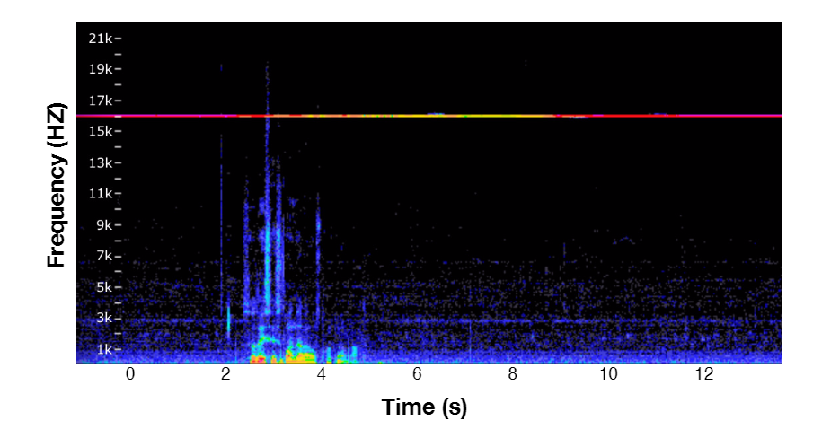
The Proposed Solution
Sound Source Distance Verification
  Reconstruct the moving trajectory of the smartphone
  Calculate the distance between sound source and smartphone
Motion Trajectory Reconstruction
  Acoustic sound
  IMU Sensor

Slide 26
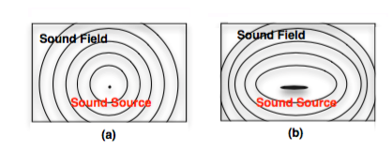
The Proposed Solution
Sound Field Verification
  Justify whether the received sound is broadcast from a human mouth
The sound field created by
(a) a point sound source and (b) created by a strip-type sound source.

Slide 27
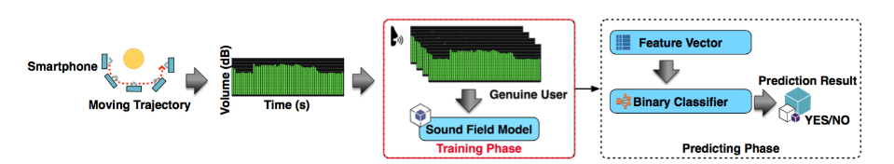
The Proposed Solution
Sound Field Verification
The sound source validation process, containing two phases:
i) training phase and ii) predicting phase.

Slide 28
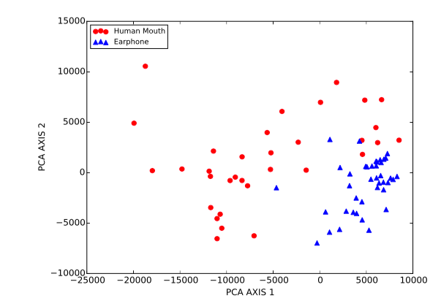
The Proposed Solution
Sound Field Verification
The feature point of the human mouth sound field (red circle)
and the earphone sound field (blue triangle) after principal component analysis (PCA)

Slide 29
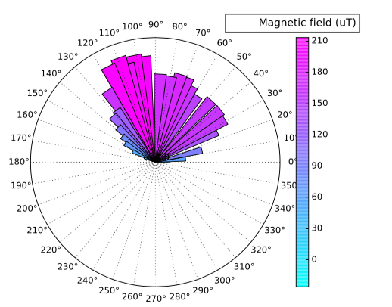
The Proposed Solution
Loudspeaker Detection
  Detect the magnetic field emitted from the loudspeaker.
Polar graph of the magnetic field reading for a conventional loudspeaker.

Slide 30
Outline
Introduction
Problem Formulation
The Proposed Solution
Evaluation
Conclusion

Slide 31
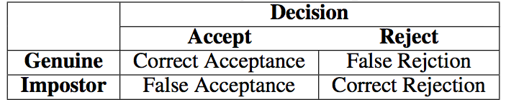
Evaluation
Methodology
We design and build a small testbed environment
  a real loudspeaker
  a smartphone hardware.
Our evaluation focuses on the machine-based voice impersonation anti-spoofing sub-system
We choose the standard automatic speaker verification metrics
  False Acceptance Rate (FAR)
  False Rejection Rate (FRR)
  Equal Error Rate (EER)
    the rate at which the acceptance and rejection errors are identical
Performance Metrics

Slide 32
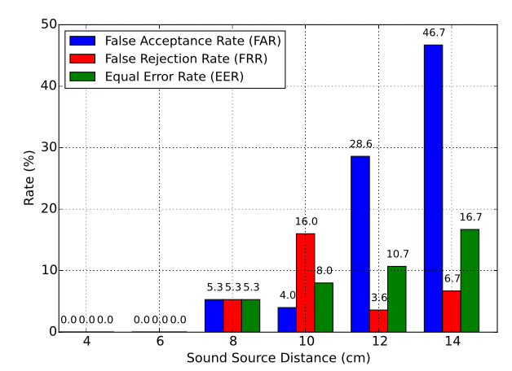
Evaluation
Impact of sound source distance of our defense scheme.
The FAR, FRR and EER values of our system are all equal to zero when the distance is less than or equal to 6 cm.

Slide 33
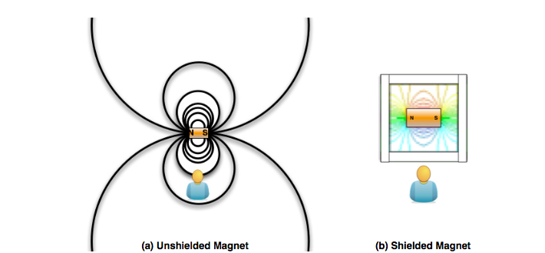
Evaluation
The magnetic field distribution of: (a) unshielded magnet and (b) shielded magnet.
Mu-metal
Mu-metal is a nickel-iron alloy
Perfect to shield the magnetic field.

Slide 34
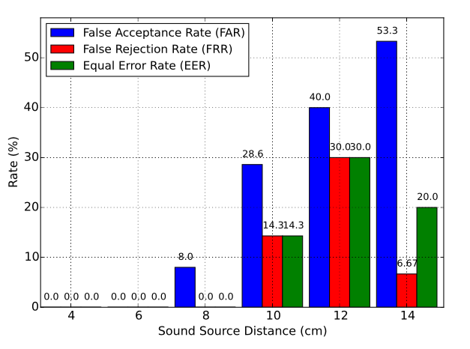
Evaluation
Impact of sound source distance for Magnetic field shielding of our defense scheme.

Slide 35
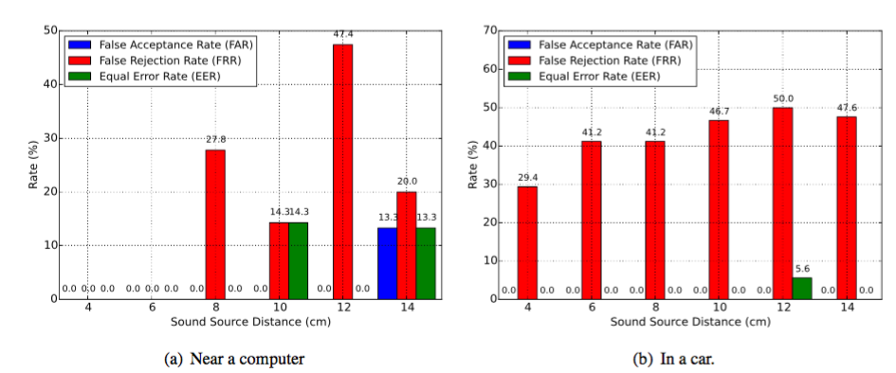
Evaluation
The FAR, FRR and EER values of our system with environmental magnetic interference: (a) Near a computer (iMac 27’ Late 2009) and (b) In a car’s front seat (Hyundai Sonata 2012).

Slide 36
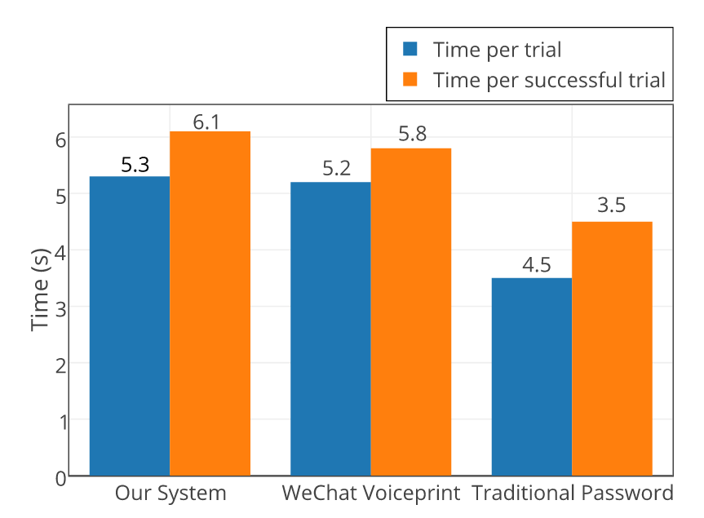
Evaluation
Authentication time comparison

Slide 37
Outline
Introduction
Problem Formulation
The Proposed Solution
Evaluation
Conclusion

Slide 38
Conclusion
Software-based solution tailored for mobile platform for defending against voice impersonation attacks
Defeat the vast majority of voice impersonation attacks and significantly raise the level of security for existing voice-based mobile applications
Our system achieves design goals
  High accuracy (~100% accuracy when <= 6 cm)
  Easy to integrate with off-the-shelf mobile phones (software-based approach)
  Low latency (~ 6.1s for authentication)

Slide 39


PlaceRaider
Virtual Theft in Physical Spaces with Smartphones
Robert Templeman
Naval Surface Warfare Center, Crane Division Indiana University Bloomington
Zahid Rahman, David Crandall, Apu Kapadia
Indiana University Bloomington

Slide 40
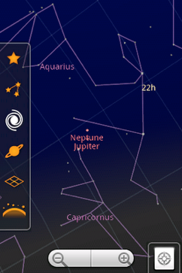






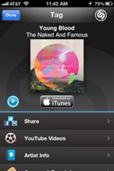

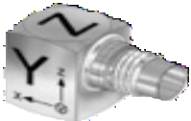
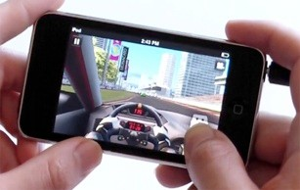
Today’s smartphones are highly capable sensing platforms
http://www.google.com/mobile/skymap/
www.shazam.com
www.kronospark.com
2

Slide 41
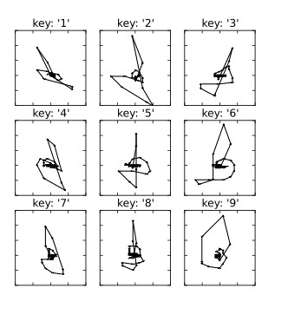
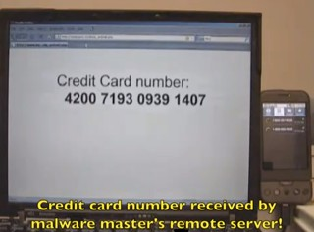
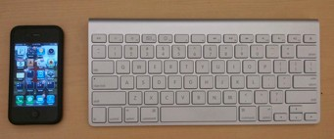
These sensors allow for a new generation of sensory malware
Hearing credit card numbers
Feeling keystrokes with accelerometer
Feeling Soft- keyboard taps
(sp)iPhone Marquardt et al.
CCS ’11
Soundcomber Schlegel et al.
NDSS ’11
TouchLogger Cai and Chen HotSec ’11
3

Slide 42
We explore sensory malware with the sense of sight
(beyond taking compromising photos)

Slide 43
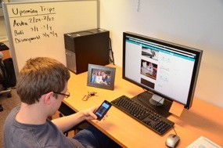













Virtual Theft
Performing remote reconnaissance and targeted theft
using the victim’s camera
Attacker loses control of the camera Faced with a data deluge
Cannot make sense of the environment
Can the attacker reconstruct a 3D model of the victim’s space for structured navigation?

Slide 44
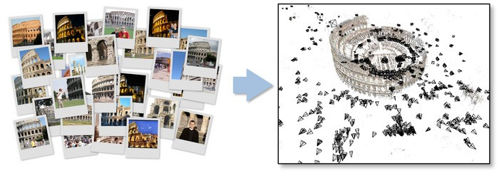
Building 3D models from images
http://phototour.cs.washington.edu/bundler/
Photo Tourism, Snavely et al. 2006 Building Rome in a Day, Agarwal et al. 2009
Building Rome on a Cloudless Day, Frahm et al. 2010 Accurate, Dense, and Robust Multiview Stereopsis, Furukawa et al. 2010
SfM with MRFs, Crandall et al. 2012

Slide 45



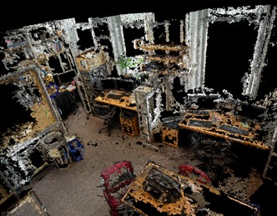









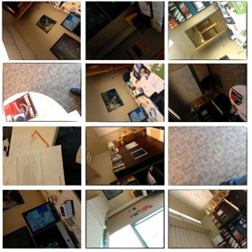


Can we generate good 3D models from surreptitiously taken photos?
Deliberate Photos
7
Opportunistic
?
Photos

Slide 46
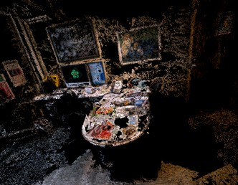
Can we generate good 3D models from surreptitiously taken photos?
Deliberate Photos
8
Opportunistic
Photos

Slide 47

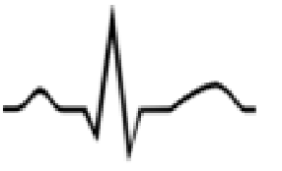
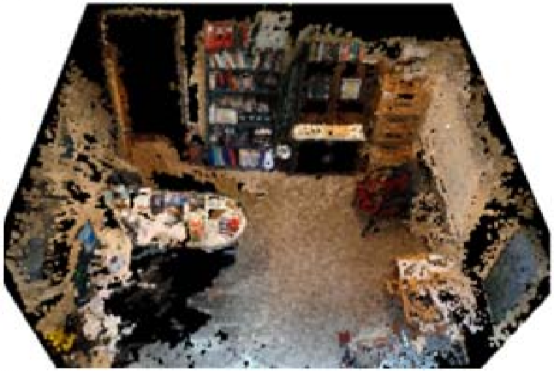



PlaceRaider Architecture
Collecting data
PlaceRaider mobile app PlaceRaider command and control
collect images
anisotropic threshold reduction
3D
model generation
PlaceRaider viewer
collect sensor data
sensor-based reduction
system overview
t a_{x} a_{y} a_{z} 0_{x} 0_{y} 0_{z}
+
+

Slide 48
PlaceRaider Architecture
Reducing data
PlaceRaider mobile app PlaceRaider command and control
collect images
anisotropic threshold reduction
3D
model generation
PlaceRaider viewer
collect sensor data
sensor-based reduction
system overview
t a_{x} a_{y} a_{z} 0_{x} 0_{y} 0_{z}
+
+

Slide 49
PlaceRaider Architecture
Building a 3D model
PlaceRaider mobile app PlaceRaider command and control
collect images
anisotropic threshold reduction
3D
model generation
PlaceRaider viewer
collect sensor data
sensor-based reduction
system overview
t a_{x} a_{y} a_{z} 0_{x} 0_{y} 0_{z}
+
+

Slide 50
PlaceRaider Architecture
Navigating the model
PlaceRaider mobile app PlaceRaider command and control
collect images
anisotropic threshold reduction
3D
model generation
PlaceRaider viewer
collect sensor data
sensor-based reduction
system overview
t a_{x} a_{y} a_{z} 0_{x} 0_{y} 0_{z}
+
+

Slide 51


Collecting Images
PlaceRaider mobile app
collect images
PlaceRaider command and control
anisotropic threshold reduction
3D
model generation
PlaceRaider viewer
collect sensor data
sensor-based reduction
system overview
t a_{x} a_{y} a_{z} 0_{x} 0_{y} 0_{z}
+
+

Slide 52

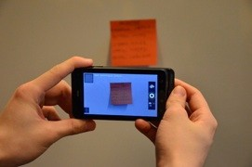
Disabling image previews and shutter sounds
Click
Image preview

Slide 53
Disabling image previews and shutter sounds
preXview
camera.setPreviewDisplay(null)
Click
Image

Slide 54
Disabling image previews and shutter sounds
C_{X}lick
preXview
camera.setPreviewDisplay(null)
Image
AudioManager.setRingerMode(AudioManager.RINGER_MODE_SILENT) camera.takePicture(null,null,jpegCallback); AudioManager.setRingerMode(AudioManager.RINGER_MODE_NORMAL)

Slide 55
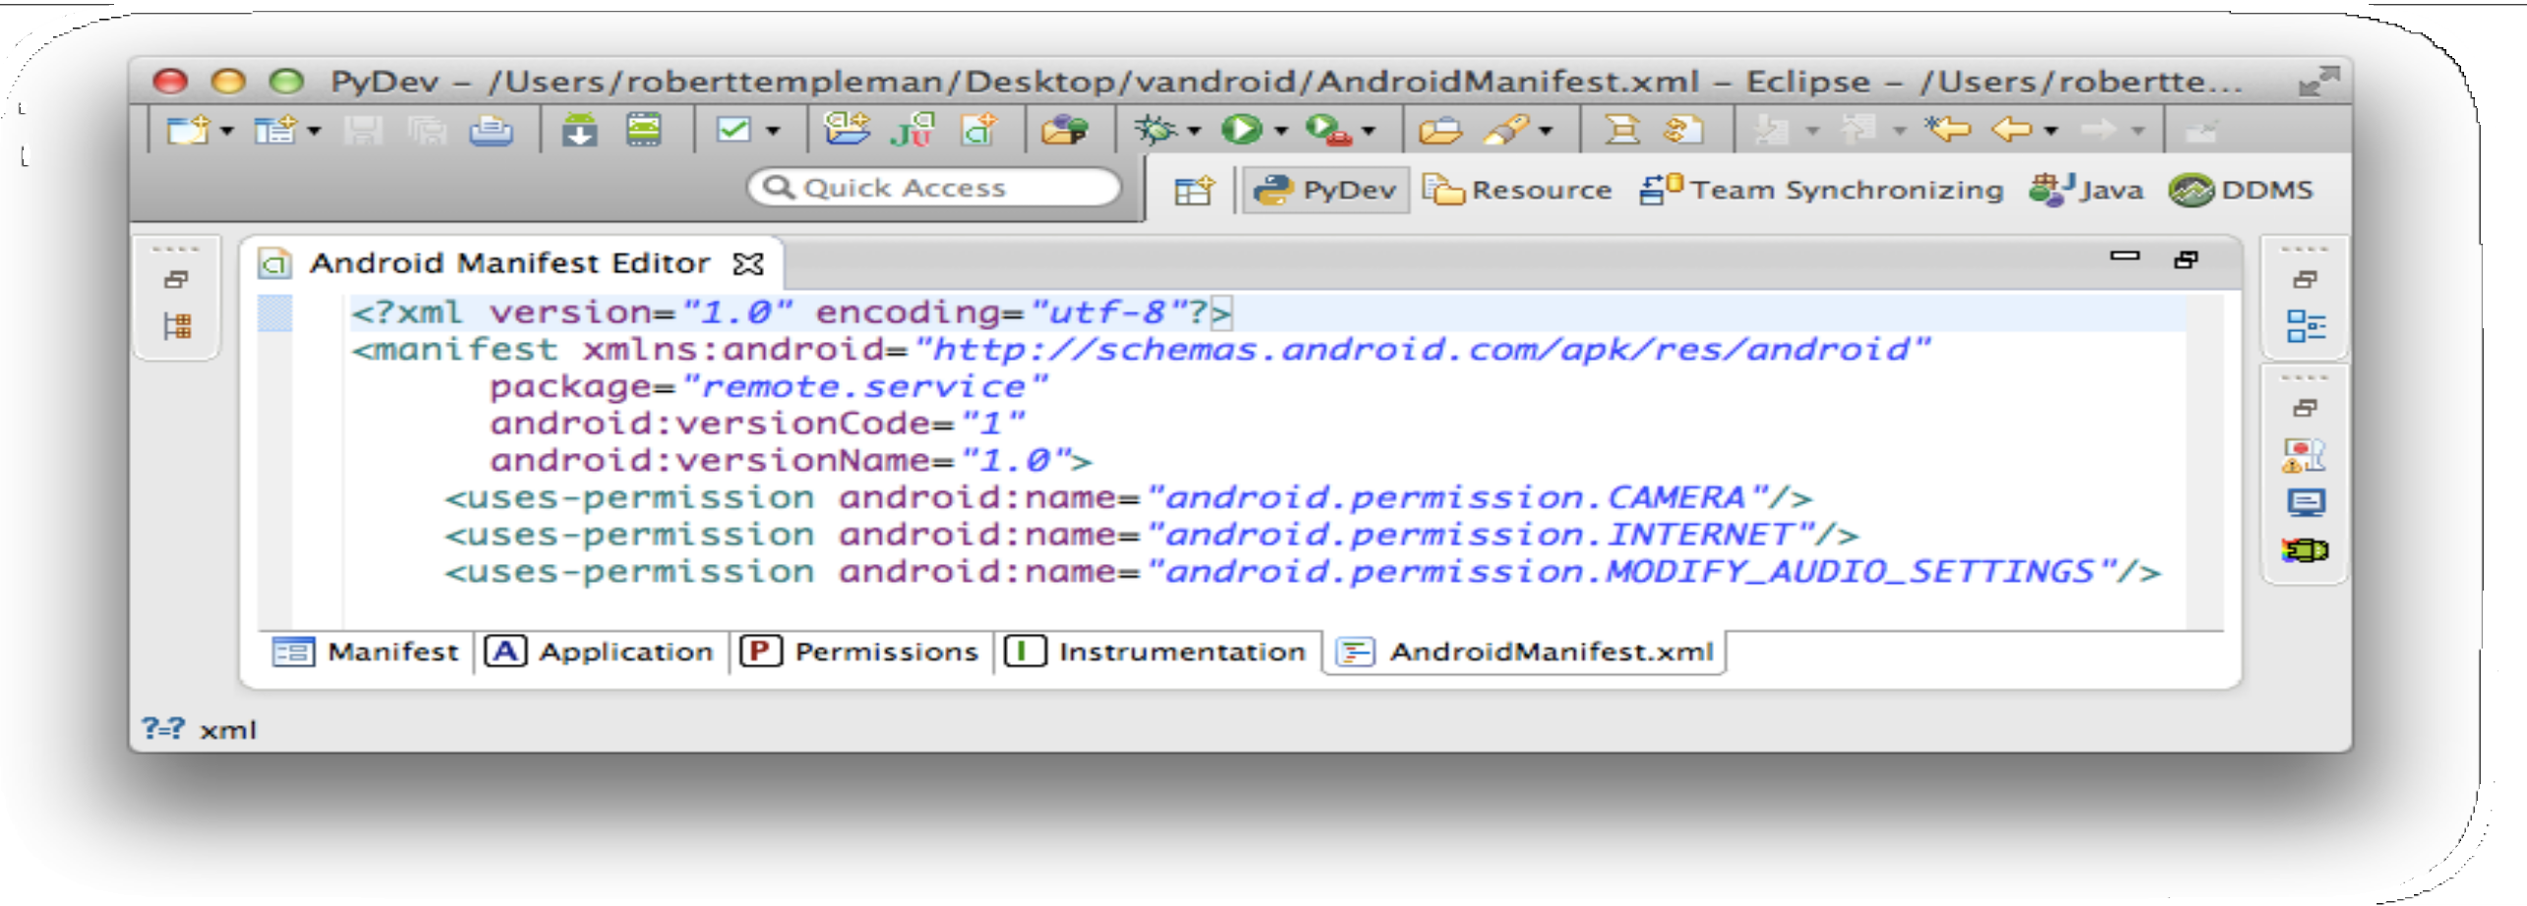
PlaceRaider Trojan requires innocuous permissions

Slide 56




PlaceRaider Trojan requires innocuous permissions
Retro Camera
LINE
Tango

Slide 57


Removing low-quality images
PlaceRaider mobile app
collect images
PlaceRaider command and control
anisotropic threshold reduction
3D
model generation
PlaceRaider viewer
collect sensor data
sensor-based reduction
system overview
t a_{x} a_{y} a_{z} 0_{x} 0_{y} 0_{z}
+
+

Slide 58





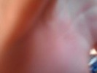

Removing low-quality images
Anisotropic analysis
(Gabarda and Cristobal 2007)
Variance in directional pixel entropy as a measure of image quality
or
‘edginess’

Slide 59
Removing low-quality images
Anisotropic analysis
(Gabarda and Cristobal 2007)
Variance in directional pixel entropy as a measure of image quality
or
‘edginess’
X X X X X

Slide 60


Guided removal of redundant images
PlaceRaider mobile app
collect images
PlaceRaider command and control
anisotropic threshold reduction
3D
model generation
PlaceRaider viewer
collect sensor data
sensor-based reduction
system overview
t a_{x} a_{y} a_{z} 0_{x} 0_{y} 0_{z}
+
+

Slide 61








Guided removal of redundant images
Movement-based reduction
Θt = (θxt, θyt, θzt)
∆Θt = ||Θt+1 − Θt||
Identify sequences of images within some rotation threshold
developer.android.com

Slide 62
Guided removal of redundant images
Movement-based reduction
X X X X
Keep the image in each series with the highest anisotropic index

Slide 63


Building a 3D model
PlaceRaider mobile app
collect images
PlaceRaider command and control
anisotropic threshold reduction
3D
model generation
PlaceRaider viewer
collect sensor data
sensor-based reduction
system overview
t a_{x} a_{y} a_{z} 0_{x} 0_{y} 0_{z}
+
+

Slide 64

















Building a 3D model
Bundler
sparse 3D reconstruction of camera and scene geometry
http://phototour.cs.washington.edu/bundler/
PMVS2
dense multi-view stereopsis
http://www.di.ens.fr/pmvs/
Bundler
PMVS2
Sparse model Dense model
PLY - polygon file format
PMVS - patch-based multi-view stereo

Slide 65


Navigating the Data
PlaceRaider mobile app
collect images
PlaceRaider command and control
anisotropic threshold reduction
3D
model generation
PlaceRaider viewer
collect sensor data
sensor-based reduction
system overview
t a_{x} a_{y} a_{z} 0_{x} 0_{y} 0_{z}
+
+

Slide 66


Navigating the Data
Meshlab - Point cloud (.PLY) viewer
custom plugin to select vertices and list contributing images
JExifViewer - image viewer integrated with plugin
explore and manipulate presented image sets

Slide 67
Evaluation

Slide 68

Study 1: Can we build 3D models from opportunistically collected photos?
20 participants
Android HTC Amaze phone Surreptitious collection in lab
Tasks
tests took ~20-45 minutes
μimages=864/test

Slide 69




Examined 3D reconstructions for each participant’s dataset
Model quality varied (partly a function of # of images)
Average reduction of 73.2% in # of images per test

Slide 70
http://www.youtube.com/watch?v=ltA791RGvrM

Slide 71


Study 2: Do these 3D models aid virtual theft?
3D group
Raw group
vs.
N = 10 N = 8
Coarse features - walls, doors, pieces of furniture, etc.
Fine features - checks, barcodes, monitors, whiteboard, etc.

Slide 72
PlaceRaider is useful for reconnaissance and exploration
Coarse features - 3D group performed better
Raw images: 5.8% of raw features correctly identified (σ = 45.8%) 3D model + viewer: 86% (σ = 10.2%)
(Welch’s t-test, p < 0.002)
Fine features - no statistical significance between groups
People can visually process images at high rates, (20 images/second)
http://chronicle.com/article/From-Bench-to-Bunker-/132743/
But 3D models may perform better in larger reconstructions

Slide 73


Defending against sensory malware like PlaceRaider - it’s complicated
www.mysecuritysign.com
OS-based defenses
Require a substantial preview surface object
Hardwire a shutter sound or add another hardware indicator
User driven access control
(Roesner et al., Oakland ’12)

Slide 74





In conclusion...
Visual malware enables sophisticated reconnaissance and ‘virtual theft’
This threat is only amplified with augmented reality and first-person video applications
Memoto
Need generalizable defenses to counter sensory malware
Google

Slide 75


Slide 76


Slide 77


Slide 78


Slide 79


Slide 80


Slide 81


Slide 82


Slide 83


Slide 84


Slide 85


Slide 86


Slide 87

Route distinguishability is a classification problem: we collected power profiles associated with known routes and want to classify new samples based on this training set.
We treat each power profile as a time series which needs to be compared to other time series. A score is assigned after each comparison, and based on these scores we select the most likely matching route.

Slide 88


Slide 89

We consider the following task: the attacker knows that a mobile user is traveling along a particular route and our objective is to track the mobile device as it is moving along the route.
We do not assume a particular starting point along the route, meaning, in probabilistic terms, that our prior on the initial location is uniform.
The attacker has reference power profiles collected in advance for the target route, and constantly receives new power measurements from an application installed on the target phone.
Its goal is to locate the device along the route, and continue tracking it in real-time as it travels along the route.

Slide 90


Slide 91


Slide 92

Here we specifically aim to identify the final location of the phone after it traversed an unknown route.
We assume that the area in which the mobile device owner moves is known, however the number of all possible routes in that area may be too large to practically pre-record each one.

Slide 93


Slide 94


Slide 95


Slide 96


Slide 97


Slide 98


Slide 99


Slide 100


Slide 101


Slide 102


Slide 103


Slide 104


Slide 105


Slide 106


Slide 107


Slide 108


Slide 109


Slide 110


Slide 111


Slide 112


Slide 113

Q & A

