Slide 1
Class7
CSC 495/583 Advanced Topics in Computer Security
Risk Assessment for Large Scale Attacks
Si Chen (schen@wcupa.edu)

Slide 2
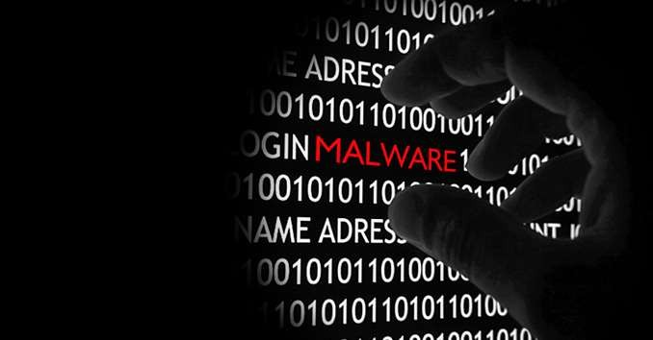
Why and what is malware analysis ?
◆ To gain an understanding of how a specific piece of malware functions so that
defenses can be built to protect an organization’s network.
◆ We can write,
◆ Host-based signatures(HIPS), or indicators, are used to detect malicious code on victim computers.
◆ Network signatures(NIPS) are used to detect malicious code by monitoring network
traffic.
◆ Malware Analysis types –
◆ Static/Code Analysis
◆ Dynamic/Behavioral Analysis

Slide 3
Brief intro on static analysis….
◆ Taking a closer look at the suspicious file by examining its static properties.
◆ Static properties include the strings embedded into the file, header details, hashes, embedded resources, packer signatures, metadata such as the creation date, etc.
◆ This process also helps determine whether the analyst should take closer look at the specimen using more comprehensive techniques and where to focus the subsequent steps.

Slide 4
What is dynamic analysis ?
◆ When performing behavioral analysis, look for changes to the system as well as any unusual behavior on an infected system.
◆ Changes on the system that should raise a red flag include files that have been added and/or modified, new services that have been installed, new processes that are running, any registry modifications noting which modifications took place, and finally, if any systems settings have been modified.
◆ Beside the behavior of the system itself, network traffic will also be examined.

Slide 5
Why dynamic analysis ?
◆ Both types accomplish the same goal of explaining how malware works, the tools, time and skills required to perform the analysis are very different.
◆ Behavioral analysis is how the malware behaves when executed, who it talks to, what gets installed, and how it runs.
◆ Both static and dynamic analysis should be performed to gain a complete understanding on how a particular malware functions.
◆ Knowing how malware functions allows for better defenses to protect the organization from this piece of malware

Slide 6
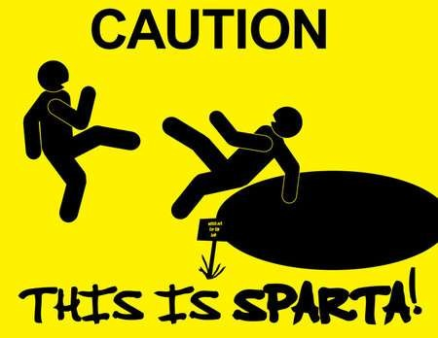
Caution while doing!!!
◆ you must set up a safe environment.
◆ For the best protection of production networks, the malware lab should never be connected to any network.
◆ Dynamic analysis techniques are extremely powerful & dynamic analysis can put your network and system at risk.

Slide 7

How we do it ?.....
◆ Sandboxes
◆ Process monitors
◆ Registry snapshots
◆ Network service faking tools
◆ Domain faking tools
◆ Packet sniffers

Slide 8
Tools & use case

Slide 9
Sandboxes
◆ A sandbox is a security mechanism for running untrusted programs in a safe environment without fear of harming “real” systems.
◆ Ex: Norman SandBox, GFI Sandbox, Anubis, Joe Sandbox, ThreatExpert, BitBlaze, and Comodo Instant Malware Analysis
◆ Malware sandboxes do have a few major drawbacks.
◆ Ex: the sandbox simply runs the executable, without command-line options.
◆ The sandbox also may not record all events, because neither you nor the sandbox may wait long enough.
◆ Malware may detect the virtual machine, and it might stop running or behave differently.

Slide 10
How Malware Detects Virtualized Environment
Registry Check: Whenever we spawn a new VM using VMware product, In the guest OS there are many entries related to VMware. Malware queries entries like these to confirm the presence of VMware environment. Some examples like below:
  HKEY_LOCAL_MACHINE\SYSTEM\ControlSet001\Control\Class\{4D36E968-E325-11CE-BFC1-08002BE10318}\0000\DriverDesc
    VMware SCSI Controller
  HKEY_LOCAL_MACHINE\SYSTEM\ControlSet001\Control\Class\{4D36E968-E325-11CE-BFC1-08002BE10318}\0000\ProviderName
    VMware, Inc.

Slide 11
How Malware Detects Virtualized Environment
Memory Check: Location of various memory structures especially IDT varies in VM as compared to a physical machine.
  Malware checks the usage of various memory structures like Store Interrupt Descriptor Table (SIDT), Store Local Descriptor Table (SLDT), Store Global Descriptor Table (SGDT).
Communication Channel Check: Malware often checks any communication with the host.
  For this Malware executes the IN instruction. The VM raises a connection with the host and if the magic number ‘VMxh’ is returned to the register EBX, malware is certain that it is currently running under a VM.
Notes:
Store Interrupt Descriptor Table (SIDT): In a VM this is typically located at 0xffXXXXXX whereas, in a physical machine, this is located somewhat lower than that typically around 0x80ffffff.
Other structures which are often checked by malware are:
Store Local Descriptor Table (SLDT)
Store Global Descriptor Table (SGDT)
Store Task Register (STR)
Input from Port
IN instruction is a privileged instruction and can only be run from Ring 0. However if it runs from Ring 3, then it will raise an exception. However when this instruction is triggered from malware within VM, no such exception if raised. Instead,

Slide 12
How Malware Detects Virtualized Environment
Processes and Files Check: On all the spawned VM there are various VMware processes which keep running in the background like VMwareService.exe, VMwareTray.exe, etc. Also, sometimes VMware also install some tools in the spawned VM. Malware keeps an eye on all such as processes and files to detect VM environment.
MAC check: Malware also checks for underlying machine MAC address. MAC address starting with 00-05-69, 00-0c-29, 00-1c-14 or 00-50-56 belongs to VMware. The malware also for BIOS serial number. Usually spawned VM’s have ‘VMware’ string appended to their BIOS serial number.
Other Hardware Check: There are various hardware parameters which are specific to VMware as compared to the physical system. Malware queries various attributes like SerialNo, SocketDesignation, Caption to check the values of Motherboard, Processor, SCSI controller respectively.
Notes:
Store Interrupt Descriptor Table (SIDT): In a VM this is typically located at 0xffXXXXXX whereas, in a physical machine, this is located somewhat lower than that typically around 0x80ffffff.
Other structures which are often checked by malware are:
Store Local Descriptor Table (SLDT)
Store Global Descriptor Table (SGDT)
Store Task Register (STR)

Slide 13
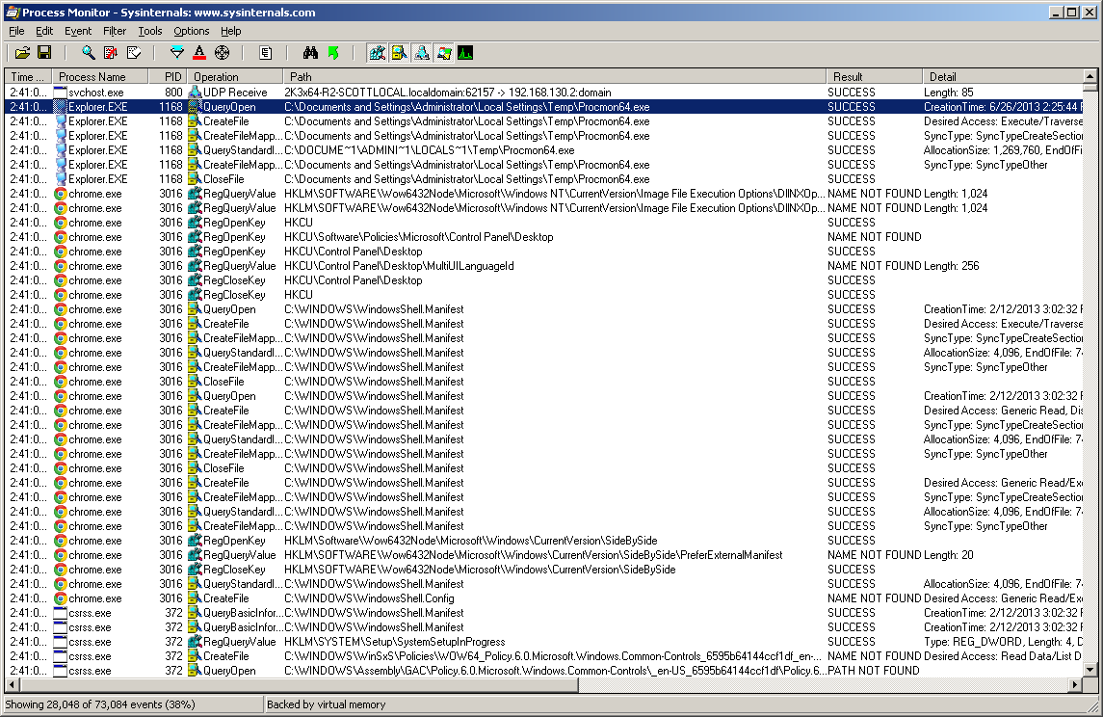
Monitoring with Process Monitor
◆ Process Monitor, or procmon, is an advanced monitoring tool for Windows that provides a way to monitor certain registry, file system, network, process, and thread activity.
◆ Procmon monitors all system calls it can gather as soon as it is run. sometimes more than 50,000 events a minute. It can crash a virtual machine using all available memory.

Slide 14
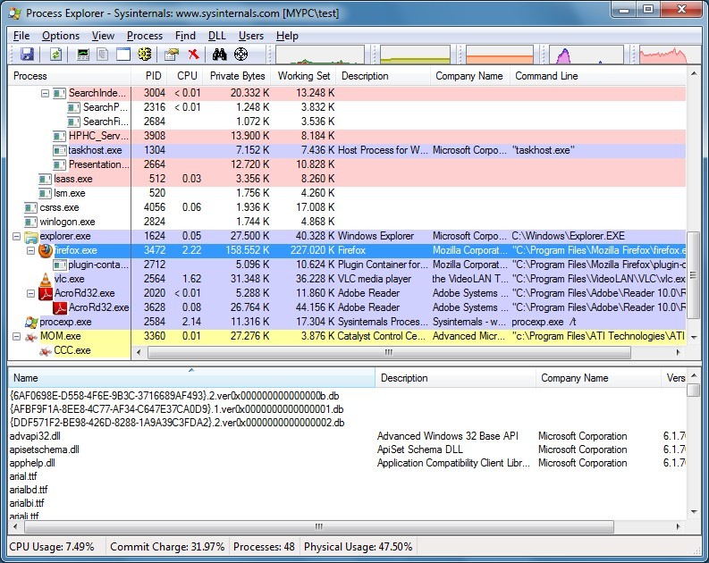
Processes with Process Explorer
◆ The Process Explorer, free from Microsoft, is an extremely powerful task manager that should be running when you are performing dynamic analysis.
◆ You can use Process Explorer to list active processes, DLLs loaded by a process, various process properties, and overall system information.

Slide 15
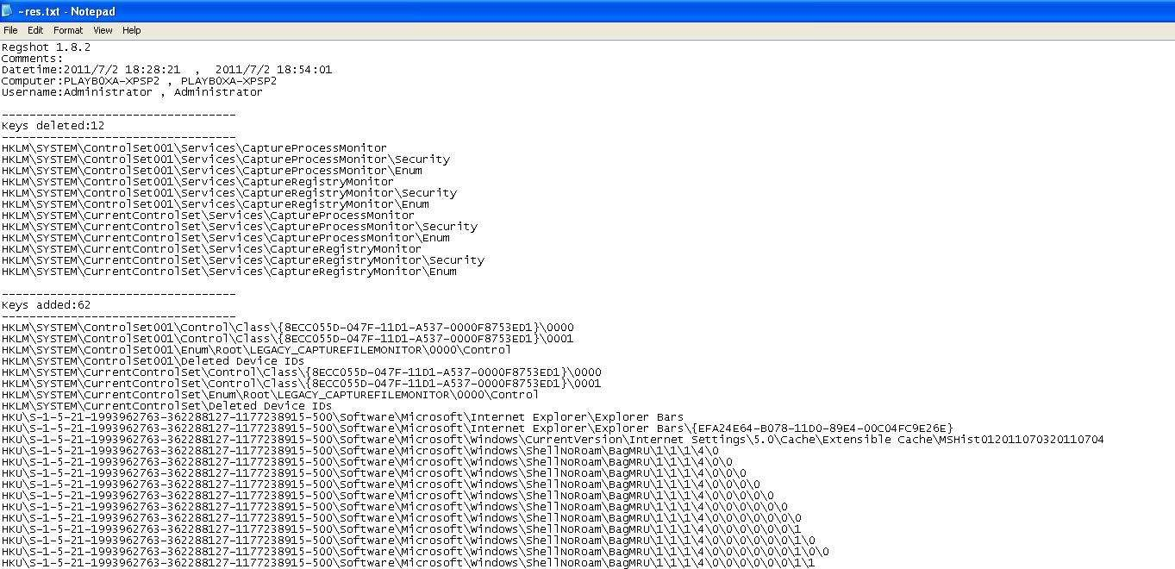
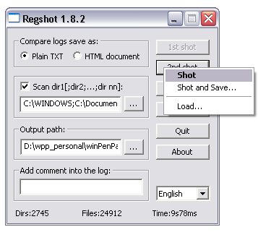
Registry Snapshots with Regshot
◆ Regshot is an open source registry comparison tool that allows you to take and compare two registry snapshots.

Slide 16
Faking a Network Using ApateDNS
◆ Malware often beacons out and eventually communicates with a commandand-control server.
◆ You can create a fake network and quickly obtain network indicators, without actually connecting to the Internet.
◆ ApateDNS spoofs DNS responses to a user-specified IP address by listening on UDP port 53 on the local machine.
◆ It responds to DNS requests with the DNS response set to an IP address you specify.

Slide 17
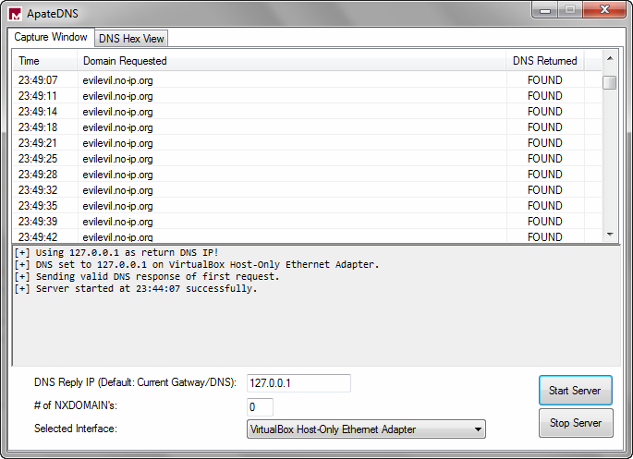
Faking a Network Using ApateDNS

Slide 18
Using INetSim
◆ INetSim is a free, Linux-based software suite for simulating common Internet services.
◆ INetSim is the best free tool for providing fake services, allowing you to analyze the network behavior of unknown malware samples by emulating services such as HTTP, HTTPS, FTP, IRC, DNS, SMTP, and others.
◆ INetSim does its best to look like a real server, and it has many easily configurable features to ensure success.
◆ Ex: by default, it returns the banner of Microsoft IIS web server if is it scanned and INetSim can serve almost any file requested.

Slide 19
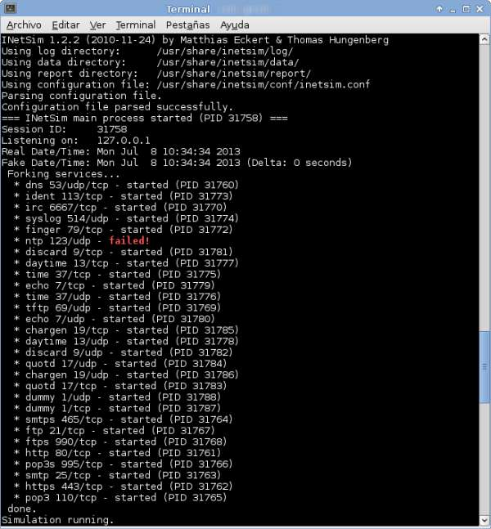
Using INetSim

Slide 20
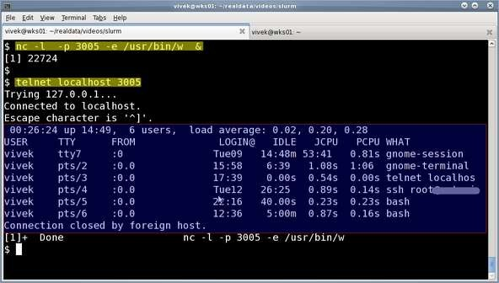
Monitoring with Netcat
◆ Netcat, the “TCP/IP Swiss Army knife,” can be used over both inbound and outbound connections for port scanning, tunneling, proxying, port forwarding, and much more.

Slide 21
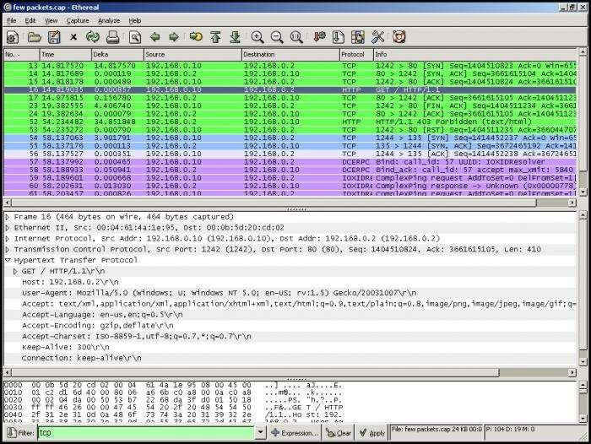
Packet Sniffing with Wireshark
◆ Wireshark is an open source sniffer, a packet capture tool that intercepts and logs network traffic.
◆ Wireshark provides visualization, packet-stream analysis, and in-depth analysis of individual packets.

Slide 22

Packet Sniffing
What kinds of data can we get?
Asked another way, what kind of information would be most useful to a malicious user?
Answer: Anything in plain text
  Passwords are the most popular

Slide 23
Packet Sniffing
How can we protect ourselves?
SSH, not Telnet
  Many people at CMU still use Telnet and send their password in the clear (use PuTTY instead!)
  Now that I have told you this, please do not exploit this information
  Packet sniffing is, by the way, prohibited by Computing Services
HTTP over SSL
  Especially when making purchases with credit cards!
SFTP, not FTP
  Unless you really don’t care about the password or data
  Can also use KerbFTP (download from MyAndrew)
IPSec
  Provides network-layer confidentiality

Slide 24
Network Countermeasures

Slide 25
Common Network Countermeasures
Filtering with firewalls and routers
  By IP address, TCP and UDP ports
DNS Servers
  Resolve malicious domain names to an internal host (a sinkhole )
Proxy servers
  Can detect or prevent access to specific domains

Slide 26
Content-Based Countermeasures
These devices can look at layer 7 data (deep packet inspection)
  IDS (Intrusion Detection System)
    IPS (Intrusion Prevention System)
    Email proxy
    Web proxy

Slide 27
Observing the Malware in Its Natural Habitat
Before static or dynamic analysis
Mine logs, alerts, and packet captures generated by malware in its original location

Slide 28
Advantages of Real Networks
Live-captured data is the most accurate
  Some malware detects lab environments
Real traffic contains information about both ends, infected host and C&C server
Passively monitoring traffic cannot be detected by the attacker
  OPSEC (Operational Security)

Slide 29
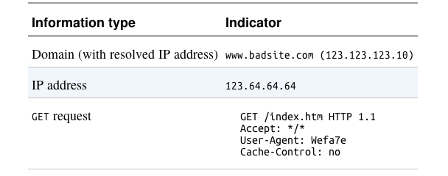
Indications of Malicious Activity

Slide 30
OPSEC
Preventing adversaries from obtaining sensitive information
Running malware at home may alert attackers
  Who expected it to be run in a company

Slide 31
Ways an Attacker Can Identify Investigative Activity
Send spear-phishing email with a link to a specific individual
  Watch for access attempts outside the expected geographic area
Design an exploit that logs infections
  In a blog comment, Twitter, Pastebin, etc.
Embed an unused domain in malware
  Watch for attempts to resolve the domain

Slide 32
Safely Investigate an Attacker Online

Slide 33
Indirection Tactics
Proxy server, Tor, Web-based anonymizer
  Not subtle—it's obvious that you are hiding
Use a dedicated VM for research
  Hide its location with a cellular or VPN connection
Use an ephemeral cloud machine
  Such as an Amazon E2C virtual machine

Slide 34
Search Engines
Usually safe
If the domain was previously unknown to the search engine, it may be crawled
Clicking results still activates secondary links on the site
  Even opening cached resources

Slide 35
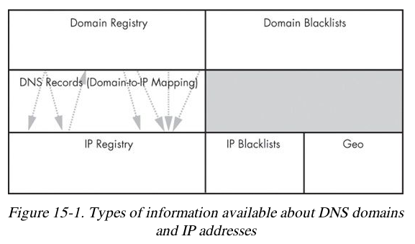
Getting IP Address and Domain Information

Slide 36
Command-Line v.Web-Based Lookups
whois and dig can be used, but they will expose your IP address
Websites that do the query for you provide anonymity
  May give more information

Slide 37
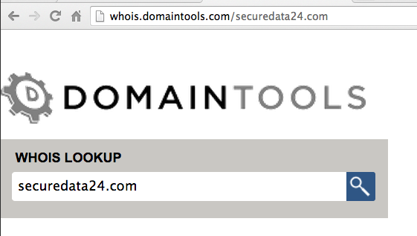
DomainTools
Historical DNS records
Reverse IP lookups
Reverse whois (lookup based on contact information metadata)

Slide 38
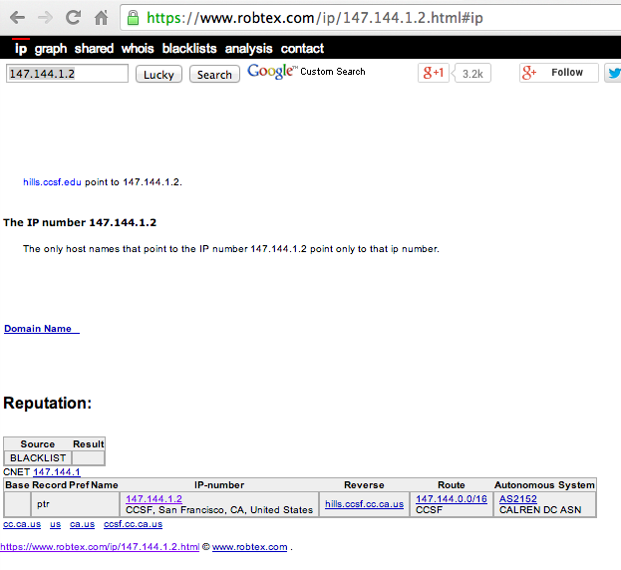
RobTex
Finds multiple domain names that point to a single IP address
Checks blacklists

Slide 39
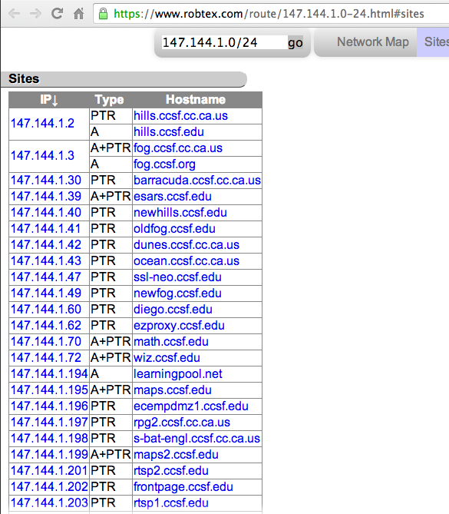

Slide 40
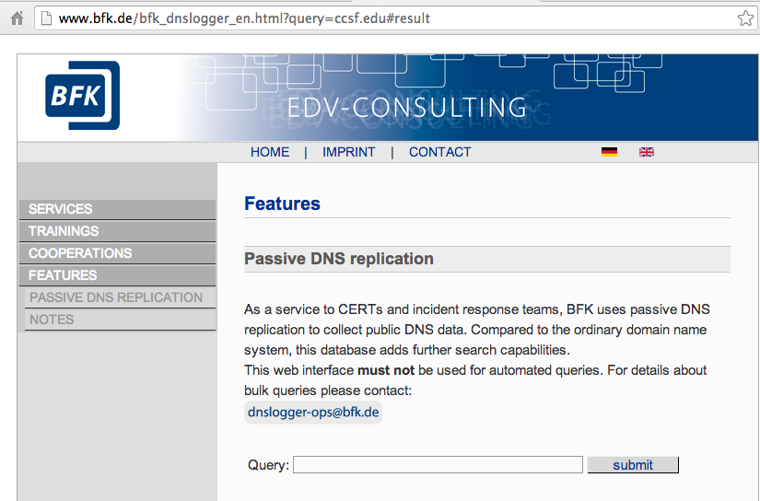
BFK DNS Logger
Gathers data with passive DNS monitoring
Stealthy

Slide 41
Content-Based Network Countermeasures

Slide 42
Intrusion Detection with Snort
Rule-based detection, can use:
  TCP or IP headers
  Size of payload
  Connection state (such as ESTABLISHED)
  Layer 7 payload data

Slide 43
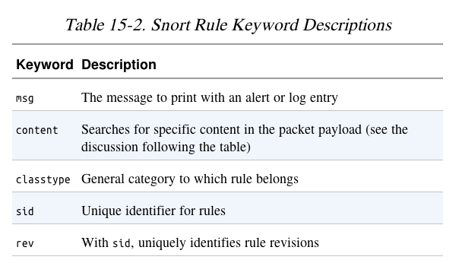
Snort Rule to Block HTTP Traffic by User-Agent

Slide 44
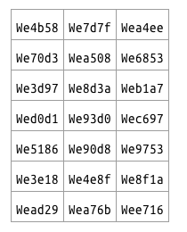
Taking a Deeper Look
Running the malware several times shows these User-Agent strings
Rules can be fine-tuned to capture the malware without false positives

Slide 45
Combining Dynamic and Static Analysis Techniques

Slide 46
Two Objectives of Deeper Analysis
Full coverage of functionality
  Provide new inputs to drive the malware down unused paths
  Using iNetSim or custom scripts
Understanding functionality, including inputs and outputs
  Static analysis finds where and how content is generated
  Dynamic analysis confirms the expected behavior

Slide 47
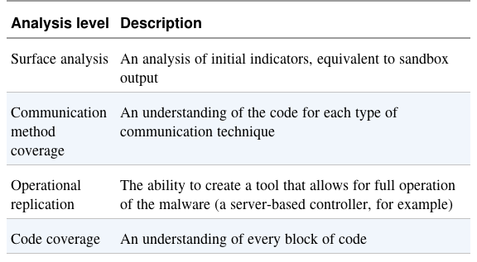
Danger of Overanalysis

Slide 48
Hiding in Plain Sight
Attackers mimic existing protocols
  Often HTTP, HTTPS, and DNS
  HTTP for beaconing (request for instructions)
  HTTPS hides the nature and intent of communications
  Information can be transmitted in DNS requests
    For example, in long domain names

Slide 49
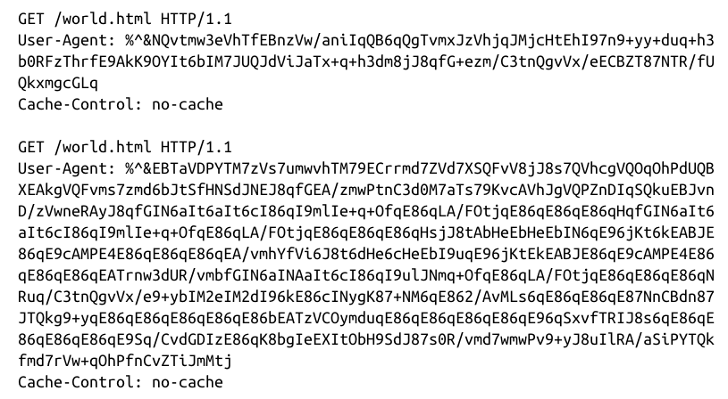
GETs
Used to send a command prompt followed by a directory listing

Slide 50
User Agents
Early malware used strange User-Agent strings
This made it easy to block
Valid user agent:

Slide 51

3 Possible User Agents
Malware alternates between these to defeat detection

Slide 52
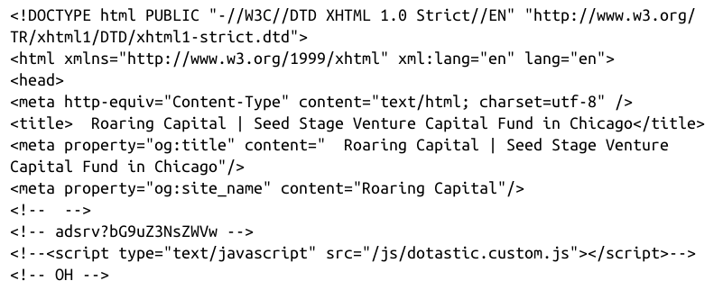
Attackers Use Existing Infrastructure
Botnet commands concealed in source code of a Web page

Slide 53
Leveraging Client-initiated Beaconing
Hosts behind NATs or proxy servers have a concealed IP address
Makes it difficult for attackers to know which bot is phoning home
Beacon identifies host with an unique identifier
  Such as an encoded string with basic information about the host

Slide 54
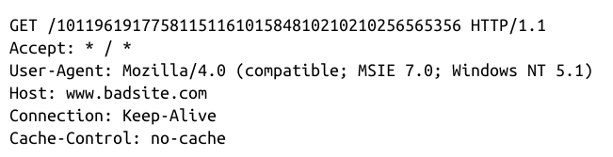
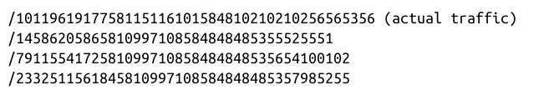
Understanding Surrounding Code
Malware beacon
URIs

Slide 55
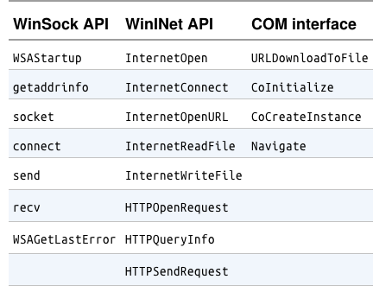
Windows Networking APIs

Slide 56
Example Malware
Uses InternetOpen and HTTPOpenRequest
URI is generated from calls to
  GetTickCount, Random, gethostbyname

Slide 57
Sources of Network Content
Random data
Data from networking libraries
  Such as the GET created from a call to HTTPSendRequest
Hard-coded data
Data about the host and its configuration
  Hostname, current time, CPU speed
Data received from other sources
  Remote server, file system, keystrokes

Slide 58
Hard-Coded vs. Ephemeral Data
Malware using lower-level networking APIs such as Winsock
  Requires more manually-generated content to mimic common traffic
  More hard-coded data
  Likely the author makes a mistake that leaves a signature in the network traffic
  May misspell a word like Mozilla

Slide 59
How URI is Generated

Slide 60
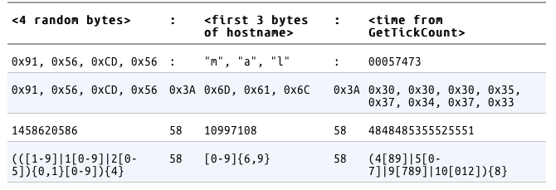
Identifying and Leveraging the Encoding Steps

Slide 61
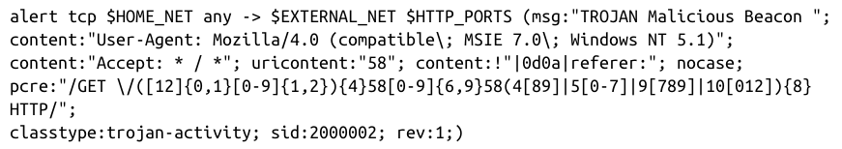
Creating a Signature
Avoid excessive complexity
  Slows down the IDS
Include enough detail to eliminate false positives

Slide 62

Analyzing the Parsing Routines
Malware strings and the Web page comments both include the string adsrv?

Slide 63
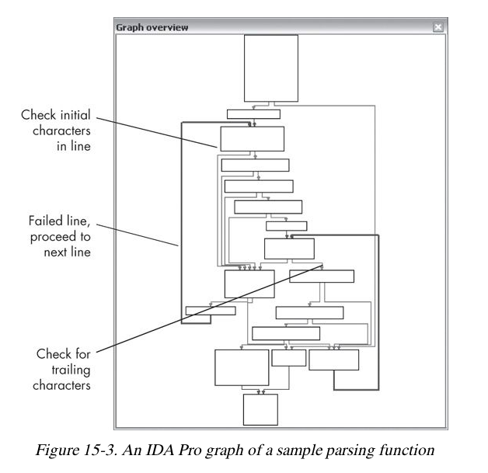
Parser looks for 3 elements

Slide 64
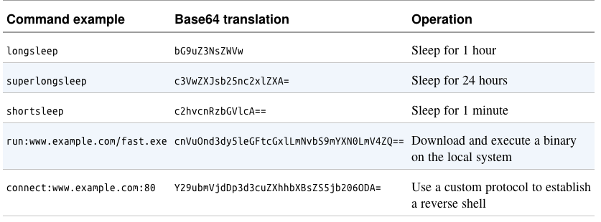
Sample Malware Commands

Slide 65
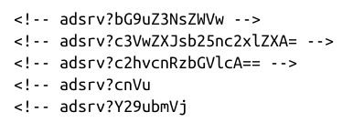
Possible Signatures
The five possible commands
These will work, but any change in the malware will evade them

Slide 66
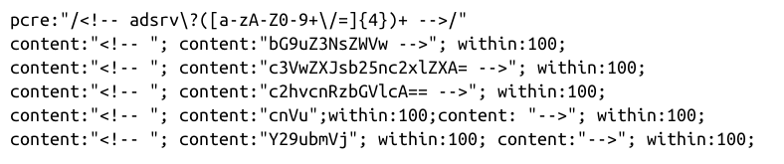
Targeting Multiple Elements
These are more general
The first one accepts any Base64 in a comment with the adsrv prefix

Slide 67

Making General Signatures

Slide 68
Understanding the Attacker's Perspective

Slide 69
Rules of Thumb
Focus on elements of the protocol that are part of both end points
  Look for elements that use code on both the client and server
  It will be hard for the attacker to change them both

Slide 70
Rules of Thumb
Focus on elements of the protocol known to be part of a key
  Such as a User-Agent that identifies bot traffic
  Again, it would require updating both ends to change
Identify elements of the protocol that are not immediately apparent in traffic
  This will be less likely to be used by other, sloppy, defenders who leak info to the attacker

Slide 71
DNS Security

Slide 72
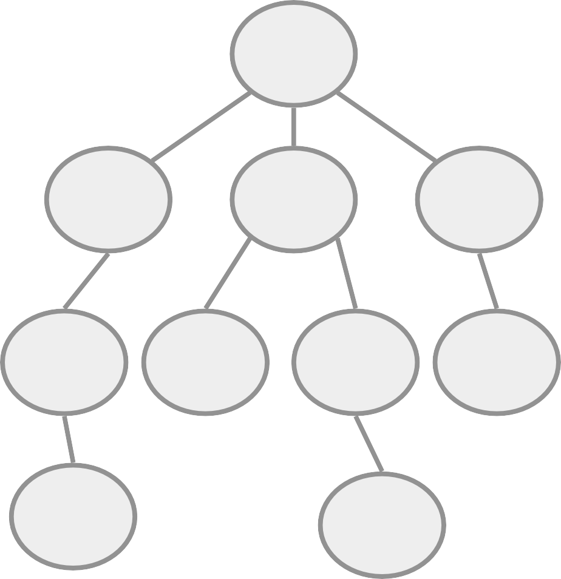
The Domain Name System
Virtually every application uses
Root
the Domain Name System (DNS).
DNS database maps:
edu
mil
ru
– Name to IP address
www.darpa.mil = 128.9.176.20
– And many other mappings
(mail servers, IPv6, reverse…)
isi
darpa
af
mil
Data organized as tree structure.
nge
andrews
– Each zone is authoritative
for its local data.

Slide 73
DNS Query and Response
www.darpa.mil A?
Root DNS Server
www.darpa.mil A 128.9.128.127
End-user
Caching DNS Server
mil DNS Server
Actually www.darpa.mil = 192.5.18.195. But how would you determine this?
darpa.mil DNS Server

Slide 74
DNS Vulnerabilities
Original DNS design focused on data availability
  DNS zone data is replicated at multiple servers.
  A DNS zone works as long as one server is available.
    DDoS attacks against the root must take out 13 root servers.
But the DNS design included no authentication.
  Any DNS response is generally believed.
  No attempt to distinguish valid data from invalid.
    Just one false root server could disrupt the entire DNS.

Slide 75

A Simple DNS Attack
Easy to observe UDP DNS query sent to well known server on well known port.
www.darpa.mil A?
Root DNS Server
www.darpa.mil
A 192.5.18.19
Joe’s Laptop
Caching DNS Server
www.darpa.mil A 128.9.128.127
mil DNS Server
Dan’s Laptop
First response wins. Second response is silently dropped on the floor.
darpa.mil DNS Server

Slide 76

A More Complex Attack
Secure64 Caching Server
Response
www.attacker.com
attacker.com attacker.com ns.attacker.com www.google.com
A 128.9.128.127
NS ns.attacker.com NS www.google.com A 128.9.128.2
A 128.9.128.127
ns.attacker.com
Query
www.attacker.com
www.google.com
= 128.9.128.127
Query www.google.com
Secure64 Laptop
Remote attacker

Slide 77




Routing Based DNS Attacks
BGP Also Provides No Authentication
  Faults and attacks can mis-direct traffic.
  One (of many) examples observed from BGP logs.
  Server could have replied with false DNS data.
originates route to 192.26.92/24
ISPs announced new path for 20 minutes to 3 hours
Internet
c.gtld-servers.net
BGP
monitor
192.26.92.30

Slide 78
The Problem in a Nutshell
Resolver can not distinguish between
valid and invalid data in a response.
Idea is to add source authentication
  Verify the data received in a response is equal to the data entered by the zone administrator.
  Must work across caches and views.
  Must maintain a working DNS for old clients.

Slide 79

Q & A

