Slide 1
Class6
CSC 495/583 Advanced Topics in Computer Security
Large Scale Attacks
Si Chen (schen@wcupa.edu)

Slide 2
Outline
Distributed Denial of Service (DDOS)
Worm
Mirai Analysis

Slide 3
Denial of Service Attack: an attack on a computer or network that prevents legitimate use of its resources.
DoS Attacks Affect:
  Software Systems
  Network Routers/Equipment/Servers
  Servers and End-User PCs

Slide 7
Preventing Denial of Service
DoS is caused by asymmetric state allocation
  If responder opens new state for each connection attempt, attacker can initiate thousands of connections from bogus or forged IP addresses
Cookies ensure that the responder is stateless until initiator produced at least two messages
  Responder’s state (IP addresses and ports of the connection) is stored in a cookie and sent to initiator
  After initiator responds, cookie is regenerated and compared with the cookie returned by the initiator

Slide 8
SYN Cookies
C
S
SYN_{C}
Listening…
Compatible with standard TCP;
simply a “weird” sequence number scheme
SYN_{S}, ACK_{C}
sequence # = cookie
Does not store state
F(source addr, source port,
dest addr, dest port,
coarse time, server secret)
Cookie must be unforgeable
and tamper-proof
Client should not be able
to invert a cookie
F=Rijndael or crypto hash
ACK_{S}(cookie)
Recompute cookie,
compare with with the one
received, only establish
connection if they match
More info: http://cr.yp.to/syncookies.html

Slide 9
Slowloris DOS
Developed by Robert "RSnake" Hansen, Slowloris is DDoS attack software that enables a single computer to take down a web server.
Slowloris works by opening multiple connections to the targeted web server and keeping them open as long as possible.
Periodically, the Slowloris sends subsequent HTTP headers for each request, but never actually completes the request.
Ultimately, the targeted server’s maximum concurrent connection pool is filled, and additional (legitimate) connection attempts are denied.
https://github.com/llaera/slowloris.pl/blob/master/slowloris.pl

Slide 10
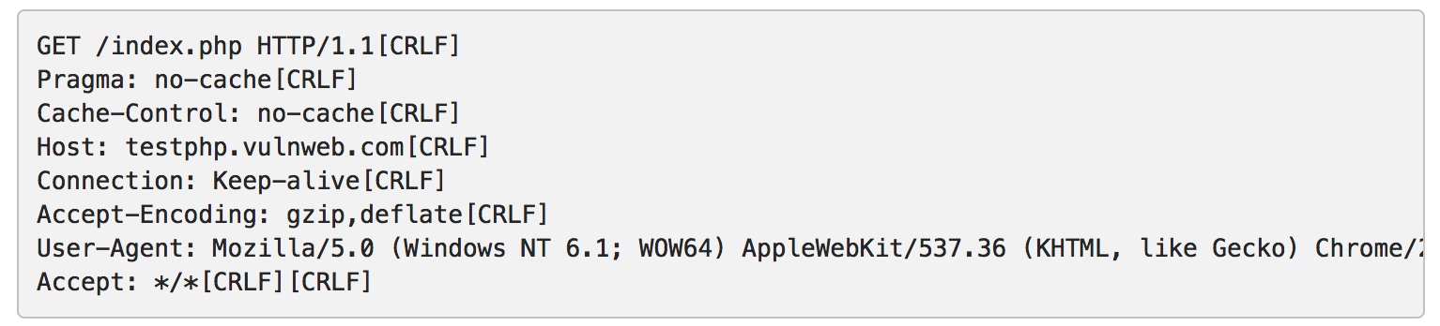
Slowloris DOS (2009)
Carriage Return Line Feed (CRLF), is a non-printable character that is used to denote the end of a line.
Similar to text editors, an HTTP request would contain a [CRLF] at the end of a line to start a fresh line and two [CRLF] characters to denote a blank line.
The HTTP protocol defines a blank line as the completion of a header.
A Slow HTTP DoS takes advantage of this by NOT sending a finishing blank line to complete the HTTP header.

Slide 11
HTTP POST DOS (2010)
An attacker establishes a number of connections with the web servers. Each one of these connections contains a Content-Length header with a large number (e.g. Content-Length: 10000000). Therefore, the web server will expect 10000000 bytes from each one of these connections.
The trick is not to send all this data at once but to send it character by character over a long period of time (e.g. 1 character each 10-100 seconds).
The web server will keep these connections open for a very long time, until it receives all the data.
In this time, other clients will have a hard time connecting to the server, or even worse will not be able to connect at all because all the available connections are taken/busy.

Slide 12
Regular expression Denial of Service – ReDoS (2003)
The Regular Expression naïve algorithm builds a Nondeterministic Finite Automaton (NFA), which is a finite state machine where for each pair of state and input symbol there may be several possible next states.
For example, the Regex ^(a+)+$ is represented by the following NFA:
For the input aaaaX there are 16 possible paths in the above graph.
But for aaaaaaaaaaaaaaaaX there are 65536 possible paths, and the number is double for each additional a. This is an extreme case where the naïve algorithm is problematic, because it must pass on many many paths, and then fail.
Notes:
Then the engine starts to make transition until the end of the input. Since there may be several possible next states, a deterministic algorithm is used. This algorithm tries one by one all the possible paths (if needed) until a match is found (or all the paths are tried and fail).

Slide 13
Regular expression Denial of Service – ReDoS (2003)

Slide 14
Attack | Affected Area | Example | Description
Network Level Device | Routers, IP Switches, Firewalls | Ascend Kill II, “Christmas Tree Packets” | Attack attempts to exhaust hardware resources using multiple duplicate packets or a software bug.
OS Level | Equipment Vendor OS, End-User Equipment. | Ping of Death, ICMP Echo Attacks, Teardrop | Attack takes advantage of the way operating systems implement protocols.
Application Level Attacks | Finger Bomb | Finger Bomb, Windows NT RealServer G2 6.0 | Attack a service or machine by using an application attack to exhaust resources.
Data Flood (Amplification, Oscillation, Simple Flooding) | Host computer or network | Smurf Attack (amplifier attack) UDP Echo (oscillation attack) | Attack in which massive quantities of data are sent to a target with the intention of using up bandwidth/processing resources.
Protocol Feature Attacks | Servers, Client PC, DNS Servers | SYN (connection depletion) | Attack in which “bugs” in protocol are utilized to take down network resources. Methods of attack include: IP address spoofing, and corrupting DNS server cache.

Slide 15
Attack | Countermeasure Options | Example | Description
Network Level Device | Software patches, packet filtering | Ingress and Egress Filtering | Software upgrades can fix known bugs and packet filtering can prevent attacking traffic from entering a network.
OS Level | SYN Cookies, drop backlog connections, shorten timeout time | SYN Cookies | Shortening the backlog time and dropping backlog connections will free up resources. SYN cookies proactively prevent attacks.
Application Level Attacks | Intrusion Detection System | GuardDog, other vendors. | Software used to detect illicit activity.
Data Flood (Amplification, Oscillation, Simple Flooding) | Replication and Load Balancing | Akami/Digital Island provide content distribution. | Extend the volume of content under attack makes it more complicated and harder for attackers to identify services to attack and accomplish complete attacks.
Protocol Feature Attacks | Extend protocols to support security. | ITEF standard for itrace, DNSSEC | Trace source/destination packets by a means other than the IP address (blocks against IP address spoofing). DNSSEC would provide authorization and authentication on DNS information.

Slide 16
DoS attacks are unable to attack large bandwidth websites – one upstream client cannot generate enough bandwidth to cripple major megabit websites.
New distributed server architecture makes it harder for one DoS to take down an entire site.
New software protections neutralize existing DoS attacks quickly
Service Providers know how to prevent these attacks from effecting their networks.
“Old” Internet Technology – something new needs to take it’s place (Hackers want the challenge of a new technology).

Slide 17
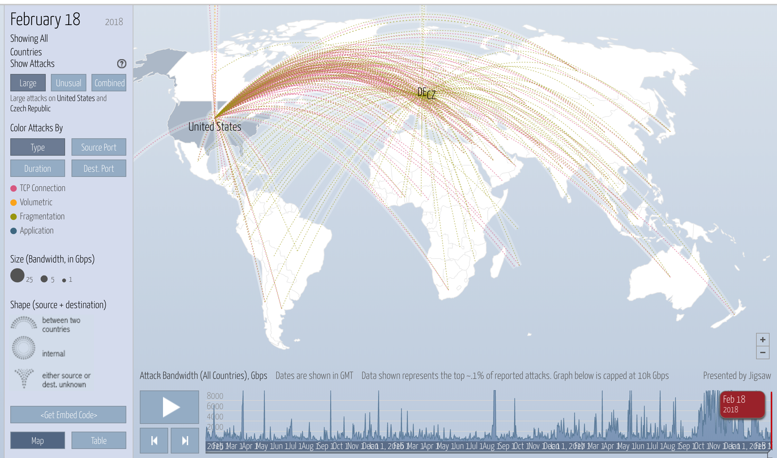
https://www.digitalattackmap.com/

Slide 18
Worms
The Morris Worm

Slide 19
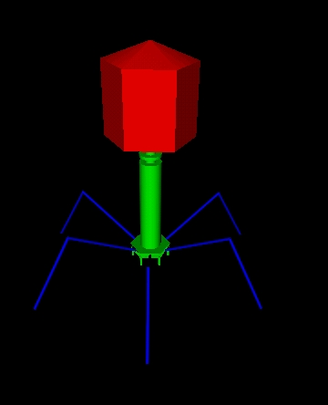
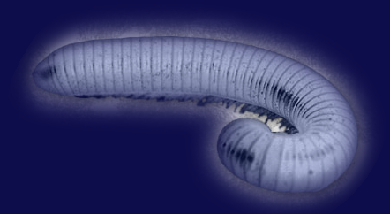
Worm vs a virus
1. Self propagates across the network
2. Exploits security or policy flaws in widely used services
3. Less mature defense today

Slide 20
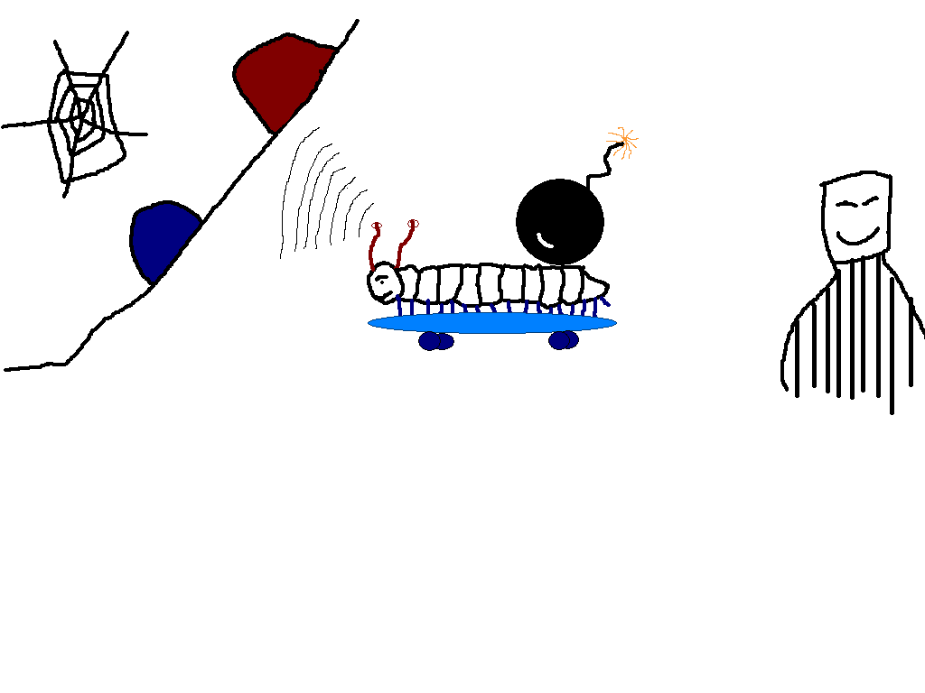

Slide 21
+
Activation
Target Discovery
Attacker
Payload
Carrier
OVERVIEW

Slide 22
Target Discovery

Slide 23
Target Discovery
Scanning
sequential, random
Target Lists
pre-generated, external (game servers), internal
Passive

Slide 24
Carrier

Slide 25
Carrier
Self-Carried
active transmission
Second Channel
e.g. RPC, TFTP ( blaster worm )
Embedded
e.g. web requests

Slide 26
Activation

Slide 27
Activation
Human Activation
Social Enginnering e.g. MyDoom → SCO Killer !
Human activity-based activation
e.g. logging in, rebooting
Scheduled process activation
e.g. updates, backup etc.
Self Activation e.g. Code Red

Slide 28
Mirai and IoT Botnet Analysis
Terabit scale attacks end of 2016
~600mbps against Brian Krebs
~1 terabit against OVH
~1.2 terabit against DYn
Infects cameras
Most cameras
Also printers, routers
Hundreds of thousands of devices

Slide 29
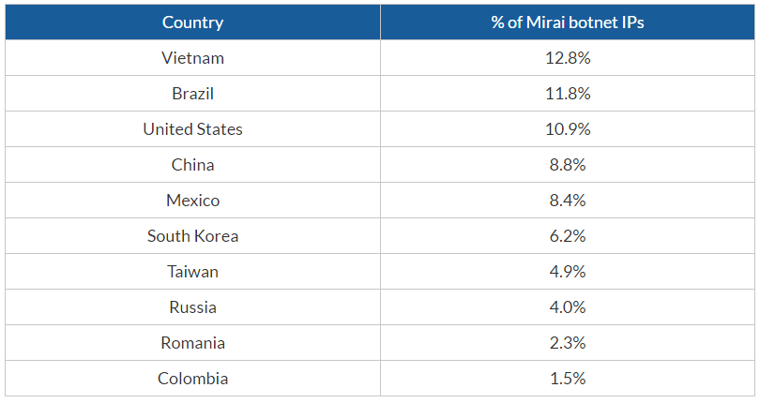
Where the botnet resides
https://www.incapsula.com/blog/malware-analysis-mirai-ddos-botnet.html

Slide 30
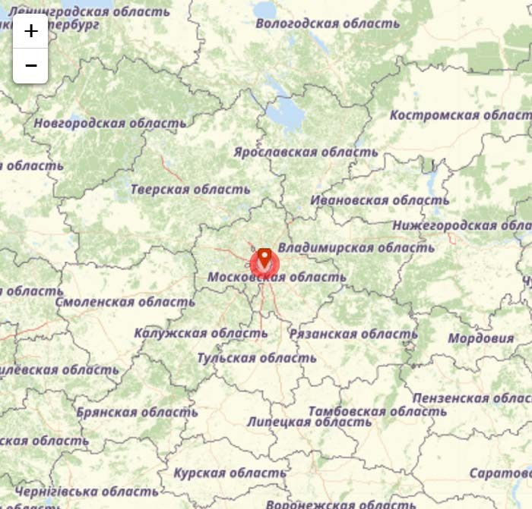
CnC servers
192.227.222.73
192.227.222.74
192.227.222.75
192.227.222.76
188.166.65.12
188.166.189.189
185.25.51.115
185.144.29.7
118.89.41.125
93.158.216.170
54.187.144.227
52.163.49.59
46.166.185.34
46.183.223.229
45.119.127.190
35.162.249.35
5.249.154.190
Notes:
The CnC server is written in Go, which provides easy multi-threading, C-like syntax, and built-in memory management. Considering that the botnet author stated that Mirai regularly collected 300,000 peers, these features of Go are understandably welcome. The Bot code itself is simple ANSI C, and cross-compiles across 18 different architectures without problem, including MIPS, ARM, and x86.

Slide 31
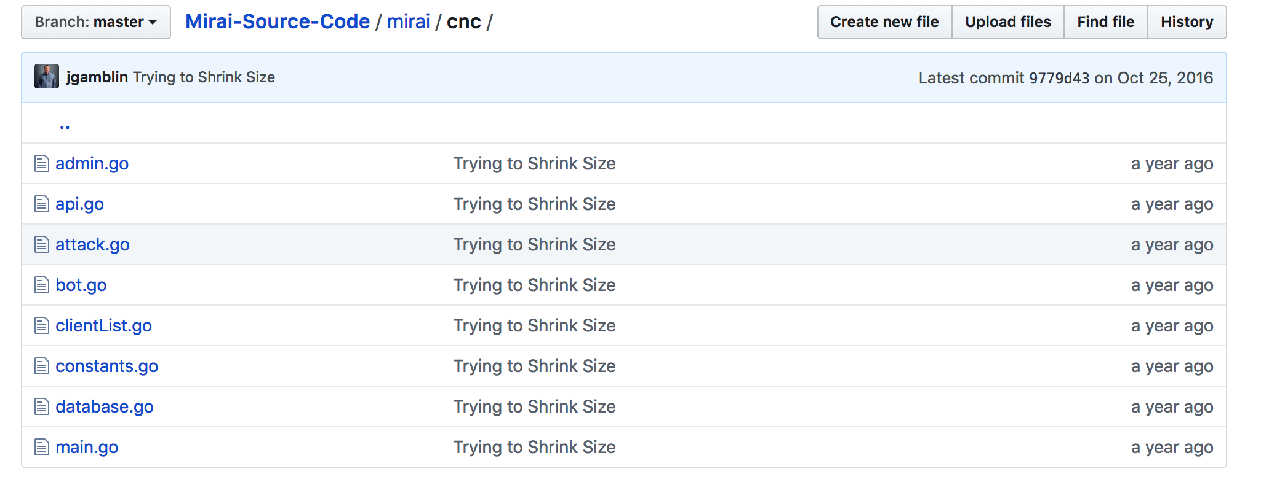
CNC Source Code

Slide 32
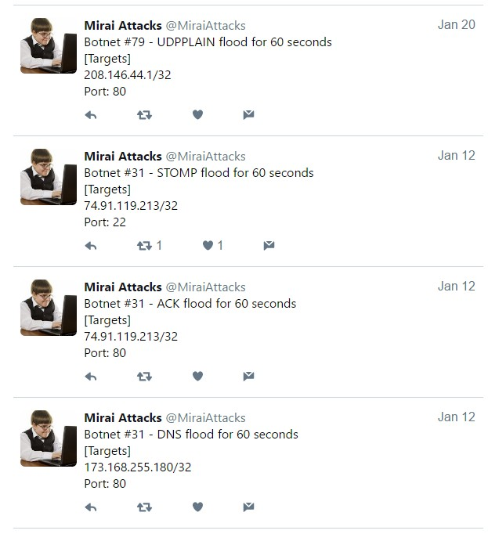
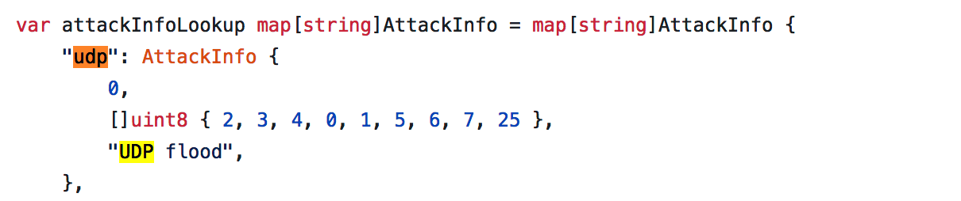
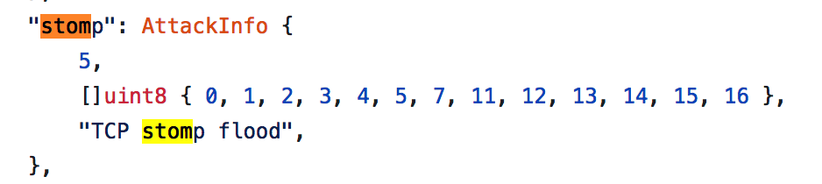
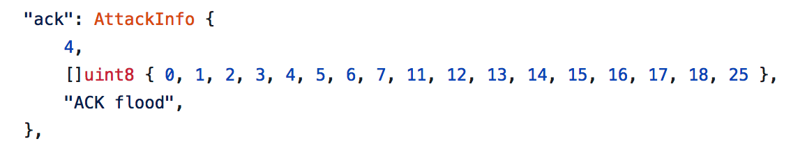
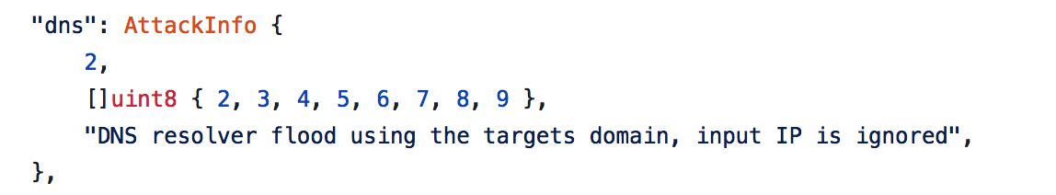

Slide 33
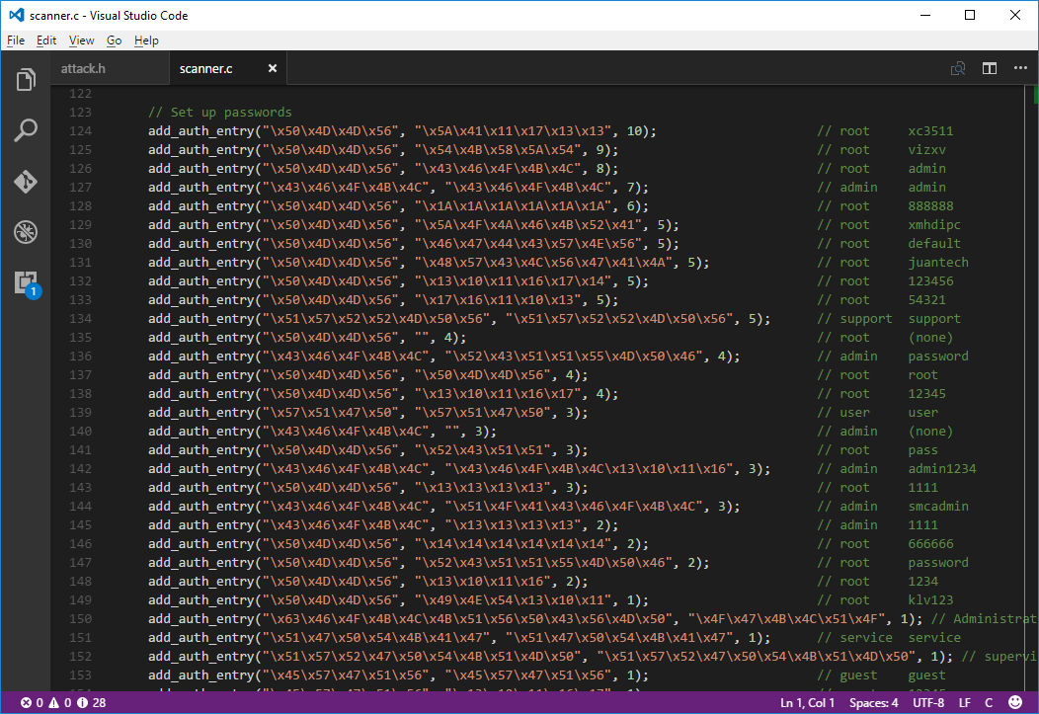

Slide 34
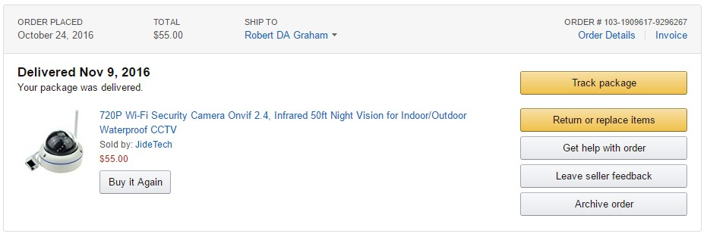
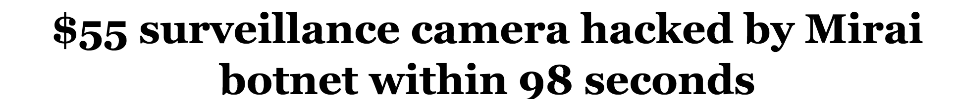
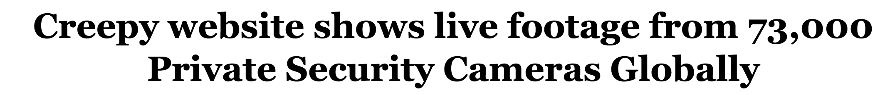
Ordering camera

Slide 35
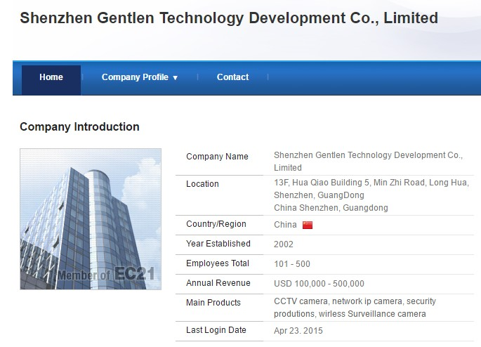

Slide 36
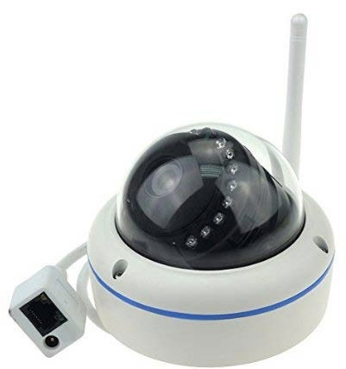
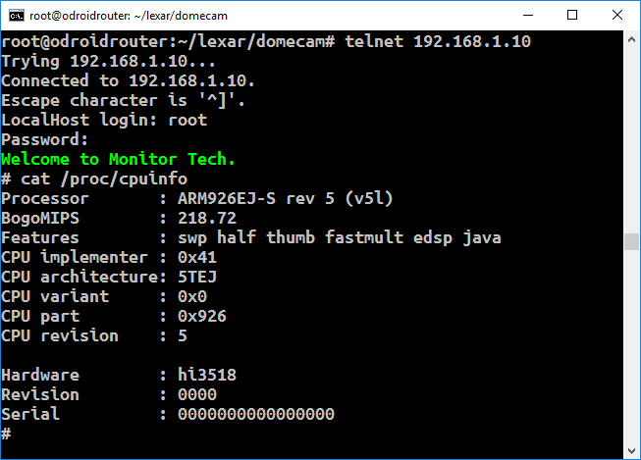
What do the cameras look like?
HiSilicon HI3518 CPU

Slide 37
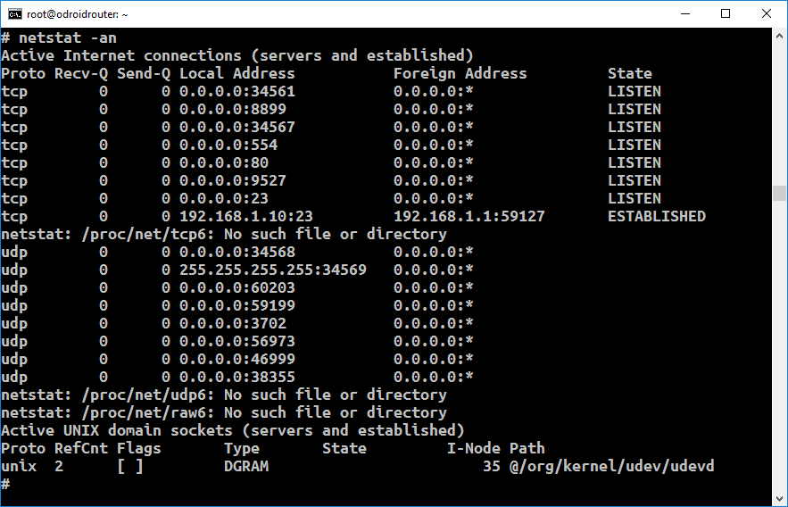
Which ports are listening

Slide 38
What does the camera look like?
23: Telnet
80: HTTP
554: RTSP
9527: some weird shell with no auth 8899: some other web interface

Slide 39
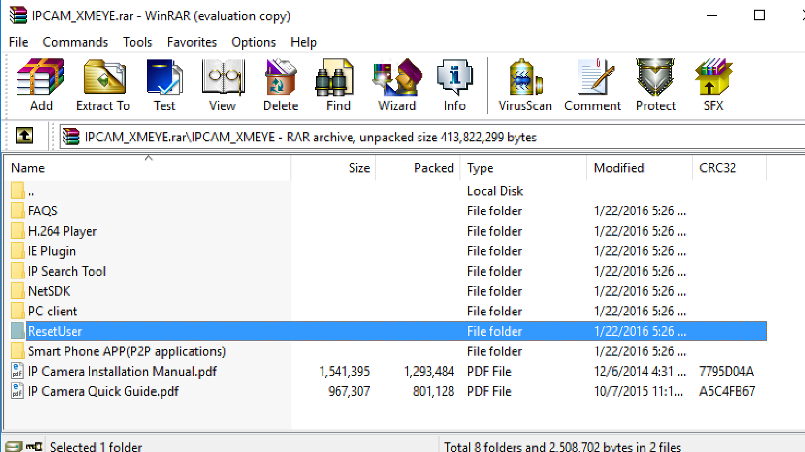

Slide 40
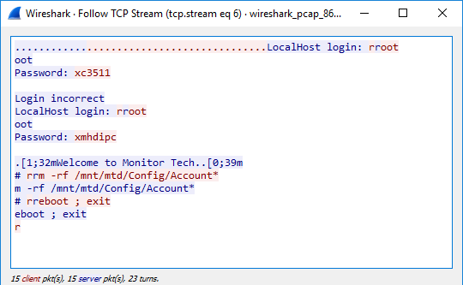

Slide 41
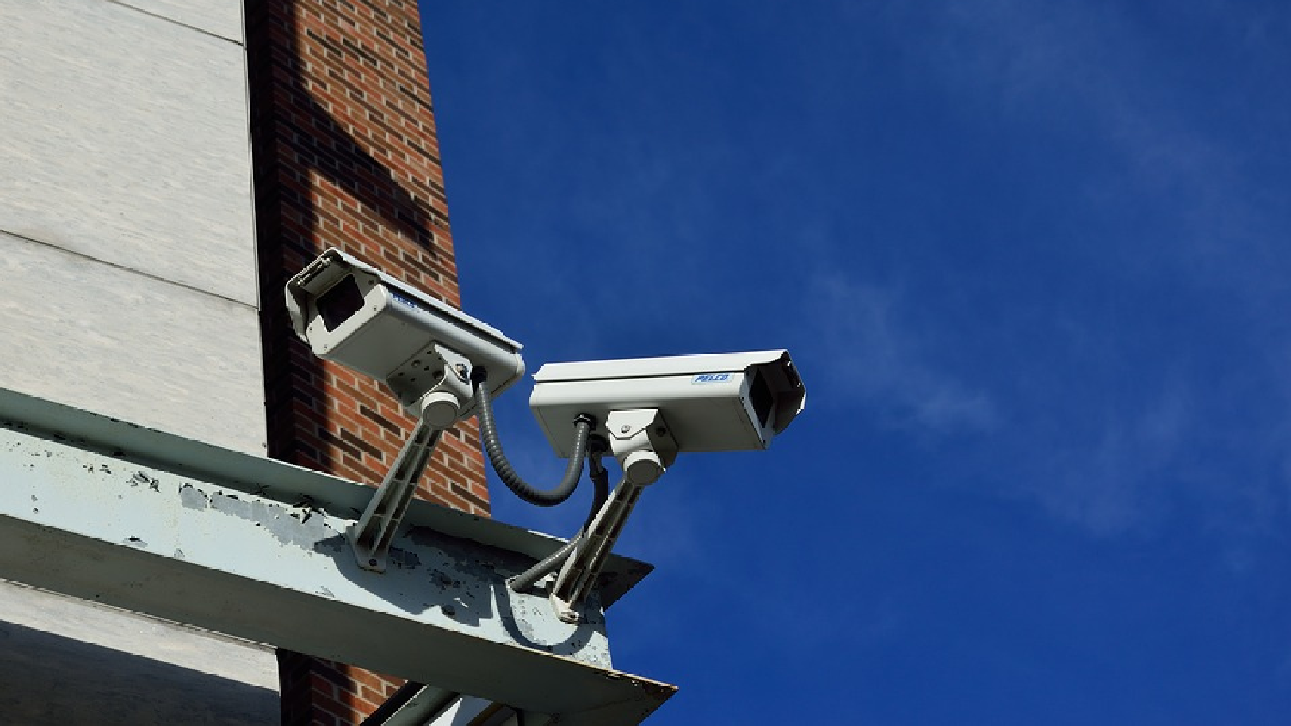

Slide 42
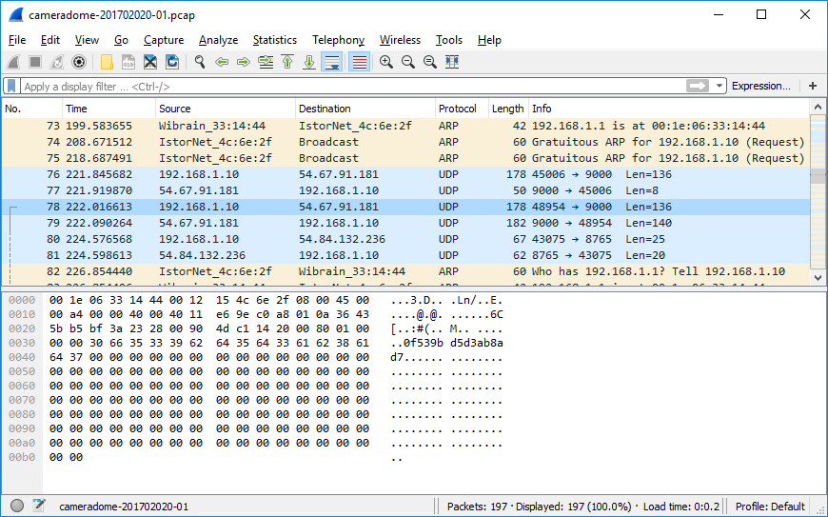
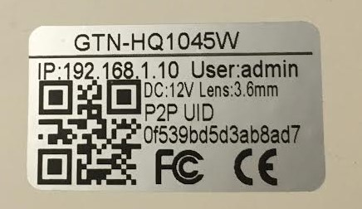

Slide 43
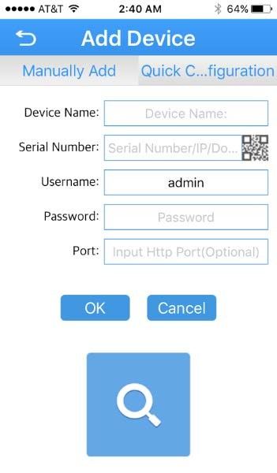
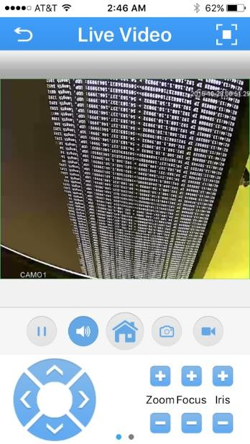

Slide 44

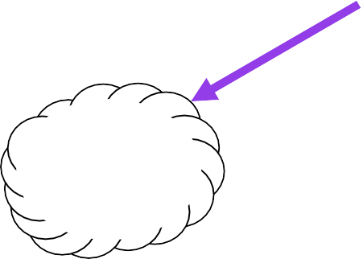





Camera/Phone firewalled
12:3
8
AWS
54.163.237.146
ec2-54-163-237-146.compute-1.amazonaws.com

Slide 45
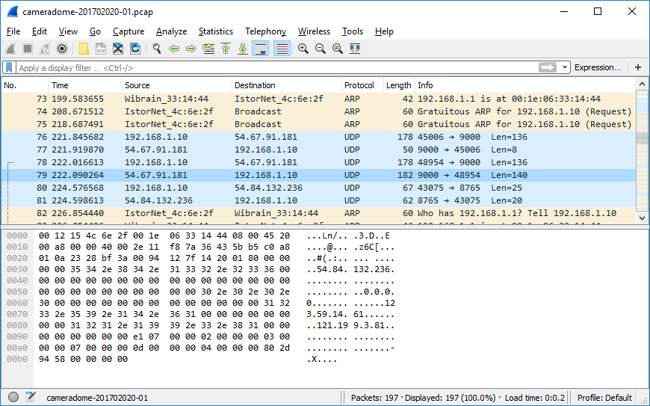

Slide 46
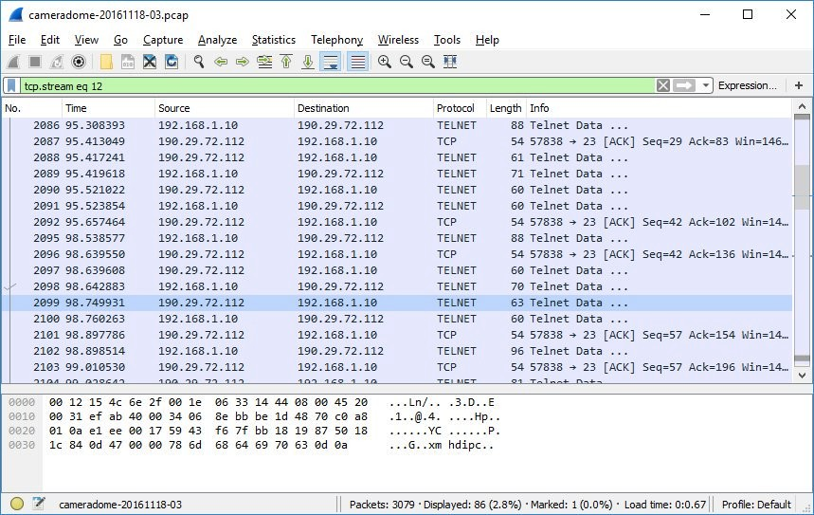
98 seconds to infection!

Slide 47
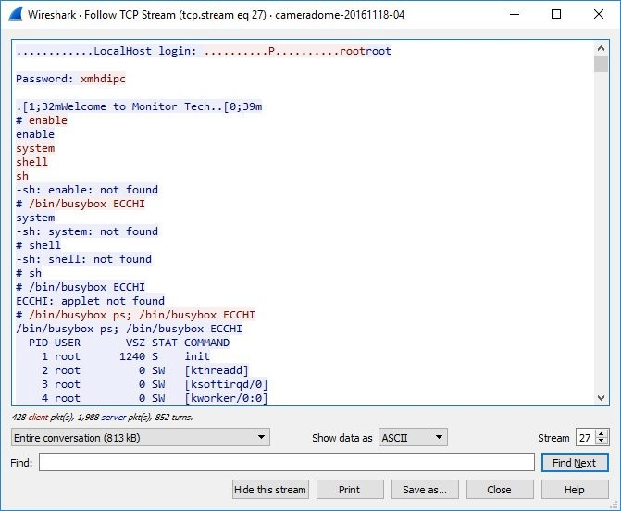
Infection process

Slide 48
The ECHI trick
Generates error message
It’s how the bot recognizes that the output is done
Different devices have different command-prompts, so it’s harder parsing output for a command prompt

Slide 49
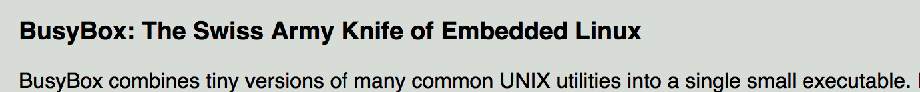
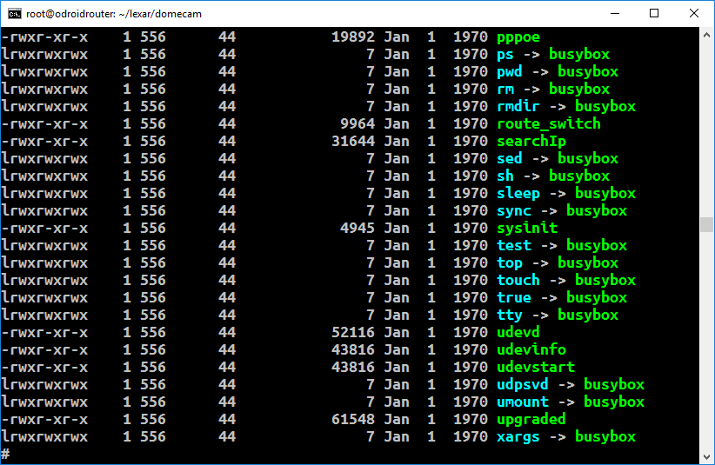
What is BusyBox?
Most common shell on IoT devices

Slide 50
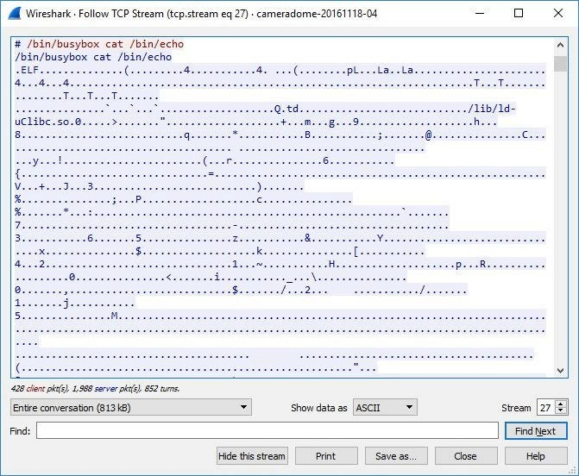
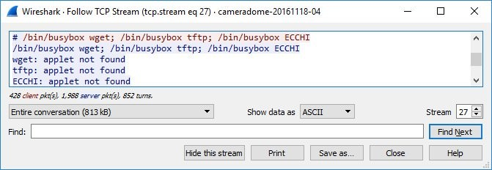
Find out CPU: x86, ARM, MIPS, PowerPC

Slide 51
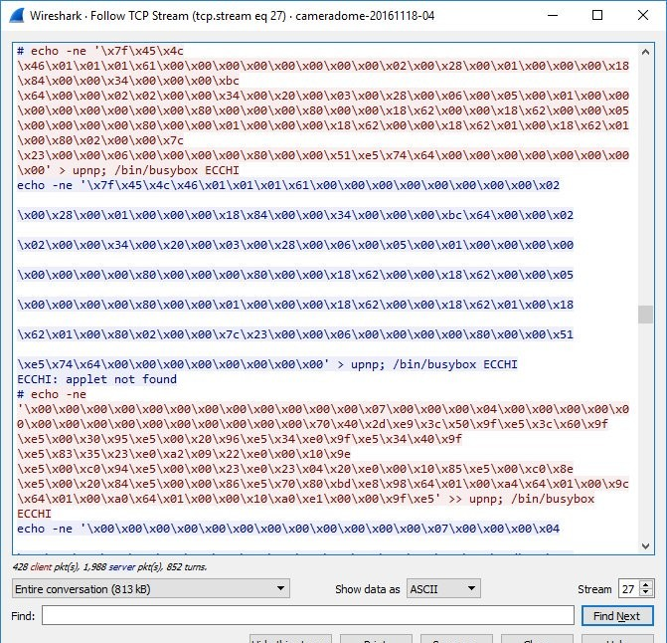
Download bot

Slide 52
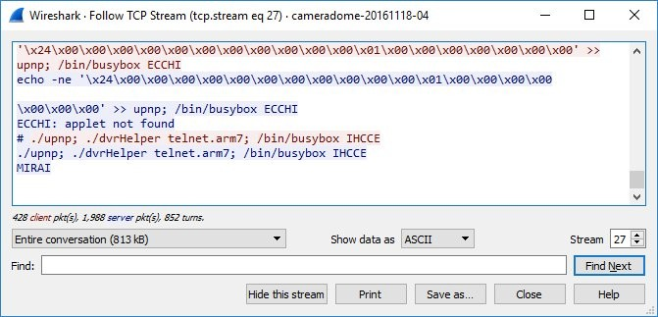
Now run the bot

Slide 53
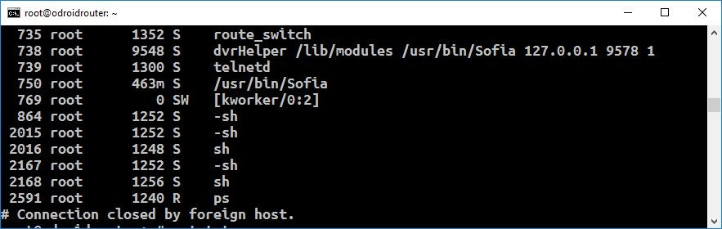
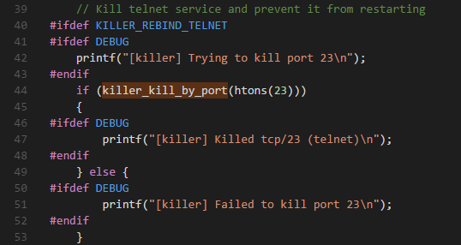
Kills Telnet
/bin/busybox telnetd –p 2323

Slide 54
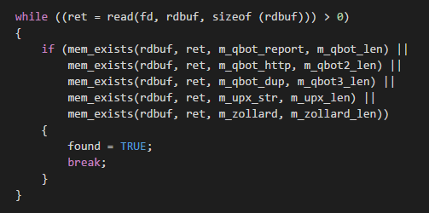
Kills rival bots

Slide 55
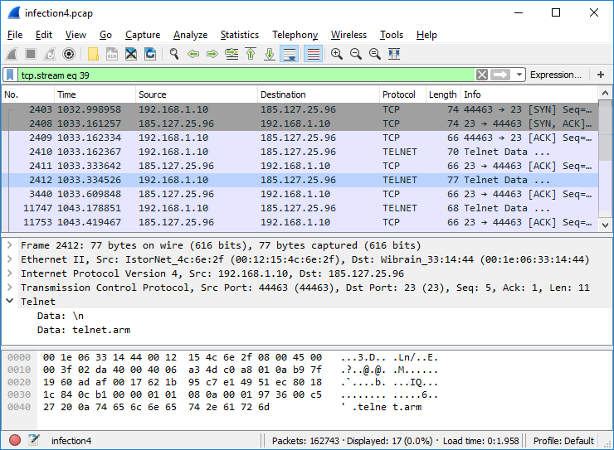
Connect to command/control

Slide 56
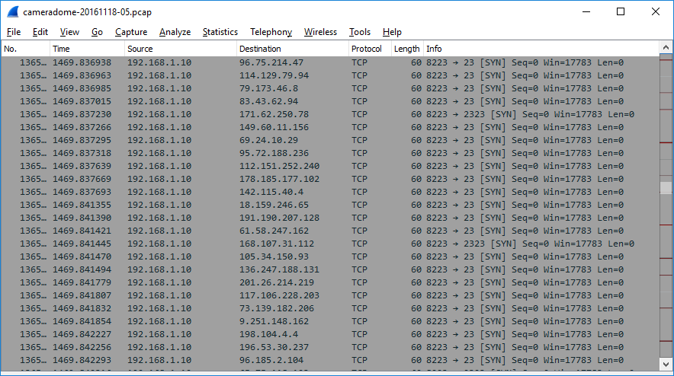

Slide 57
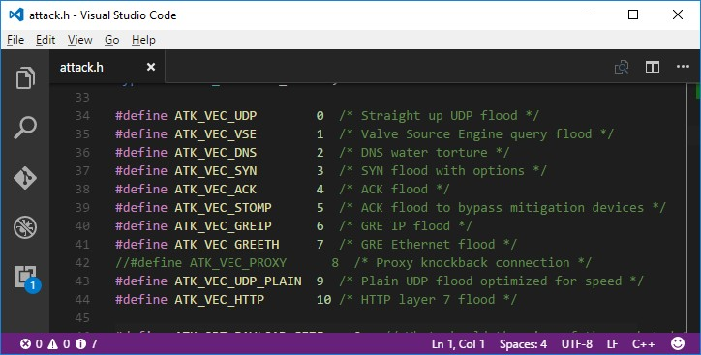
List of possible attacks

Slide 58
Attack on Google Project Shield
https://arstechnica.com/security/2017/02/how-google-fought-back-against-a-crippling-iot-powered-botnet-and-won/

Slide 59
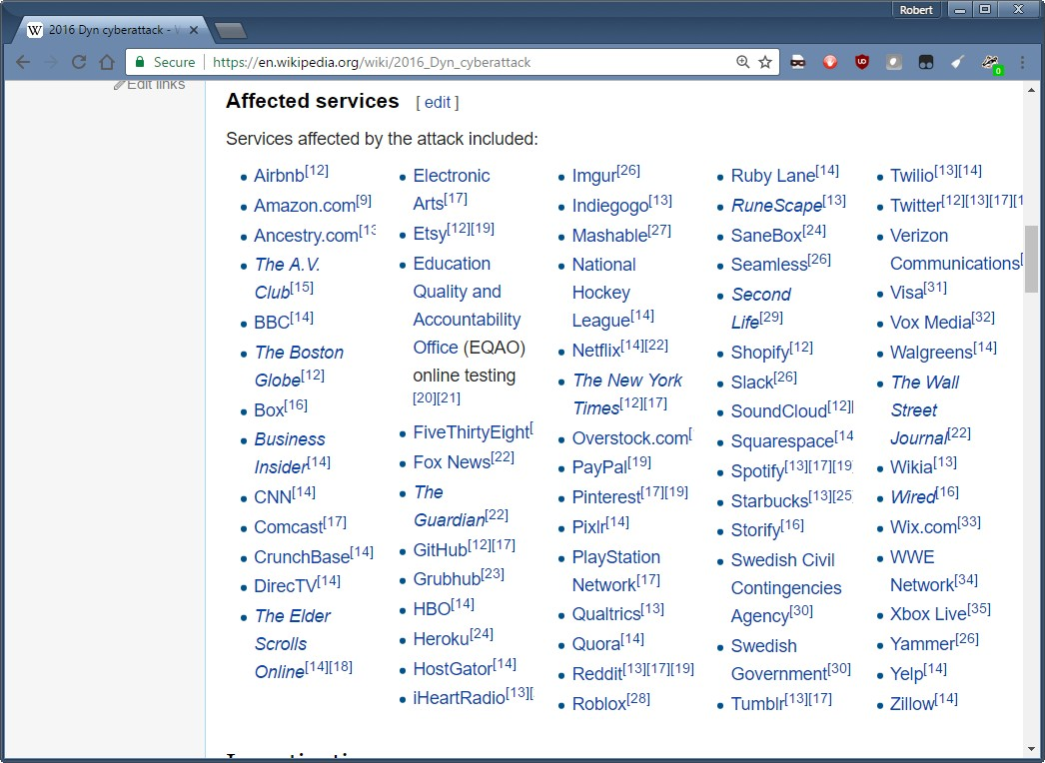

Slide 60
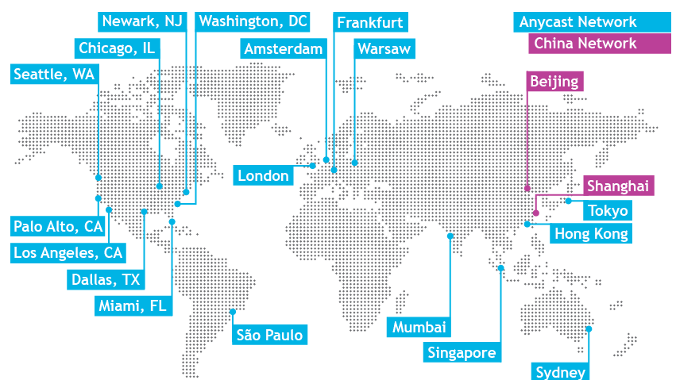
http://dyn.com/dns/network-map/

Slide 61
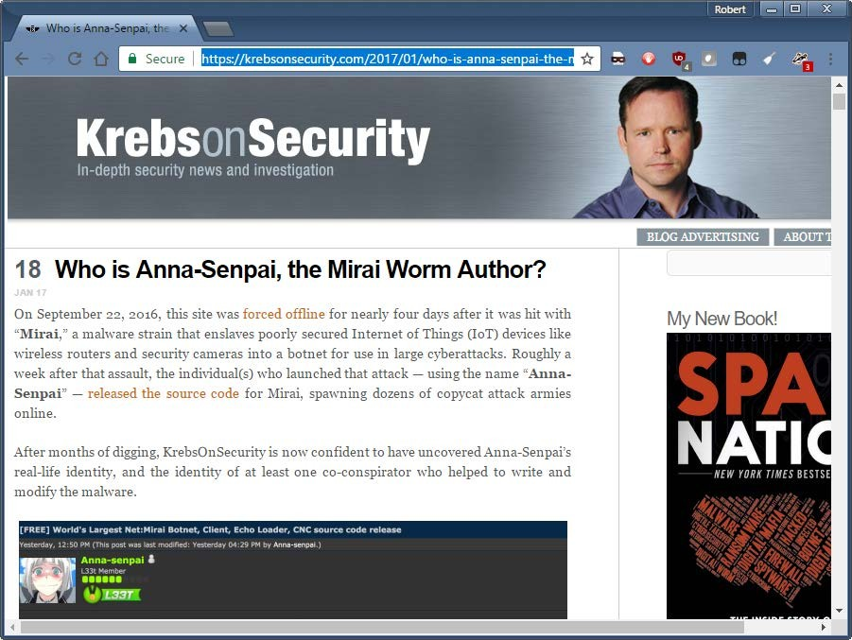
https://krebsonsecurity.com/2017/01/who-is-anna-senpai-the-mirai-worm-author/

Slide 62
Complicated
Paras Jha, 20 year old student
Minecraft server maintainer, then anti-DDoS company
Way to drive customers from other anti-DDoS companies
Complicated interactions with the underground

Slide 63
Source code
Amateurish, like that of 20 year old students
Doesn’t mean “stupid”, just not features of professional coders.
Multiple coders https://github.com/jgamblin/Mirai-Source-Code

Slide 64
Apply: How to protect yourself?
If you don’t have cameras
  Vuln scanning for it on your network is probably pointless
DNS strategy
DDoS strategy
UPnP strategy

Slide 65
DNS server strategy
Use redundant servers
One should be a server than can handle DDoS
Set longer TTLs

Slide 66
Apply: Policy question
For government policy makers crafting laws/regulations
What can government do to ward off IoT botnets.
Only 10.9% are in the United States
Unbranded grey market, where they ignore regulation anyway
IoT is behind firewall, cameras are exposed.
This was not an IoT botnet
Cameras need remote reset (aka. Backdoor)
Dyn fixed itself, without government help

Slide 67

Q & A

