Slide 1
Class5
CSC 495/583 Advanced Topics in Computer Security
Core Defense Mechanisms for Web
Si Chen (schen@wcupa.edu)

Slide 2
Core Defense Mechanisms
The fundamental security problem with web applications — that all user input is untrusted
Handling User Access
Handling User Input
Handling Attackers
Managing the Application

Slide 3
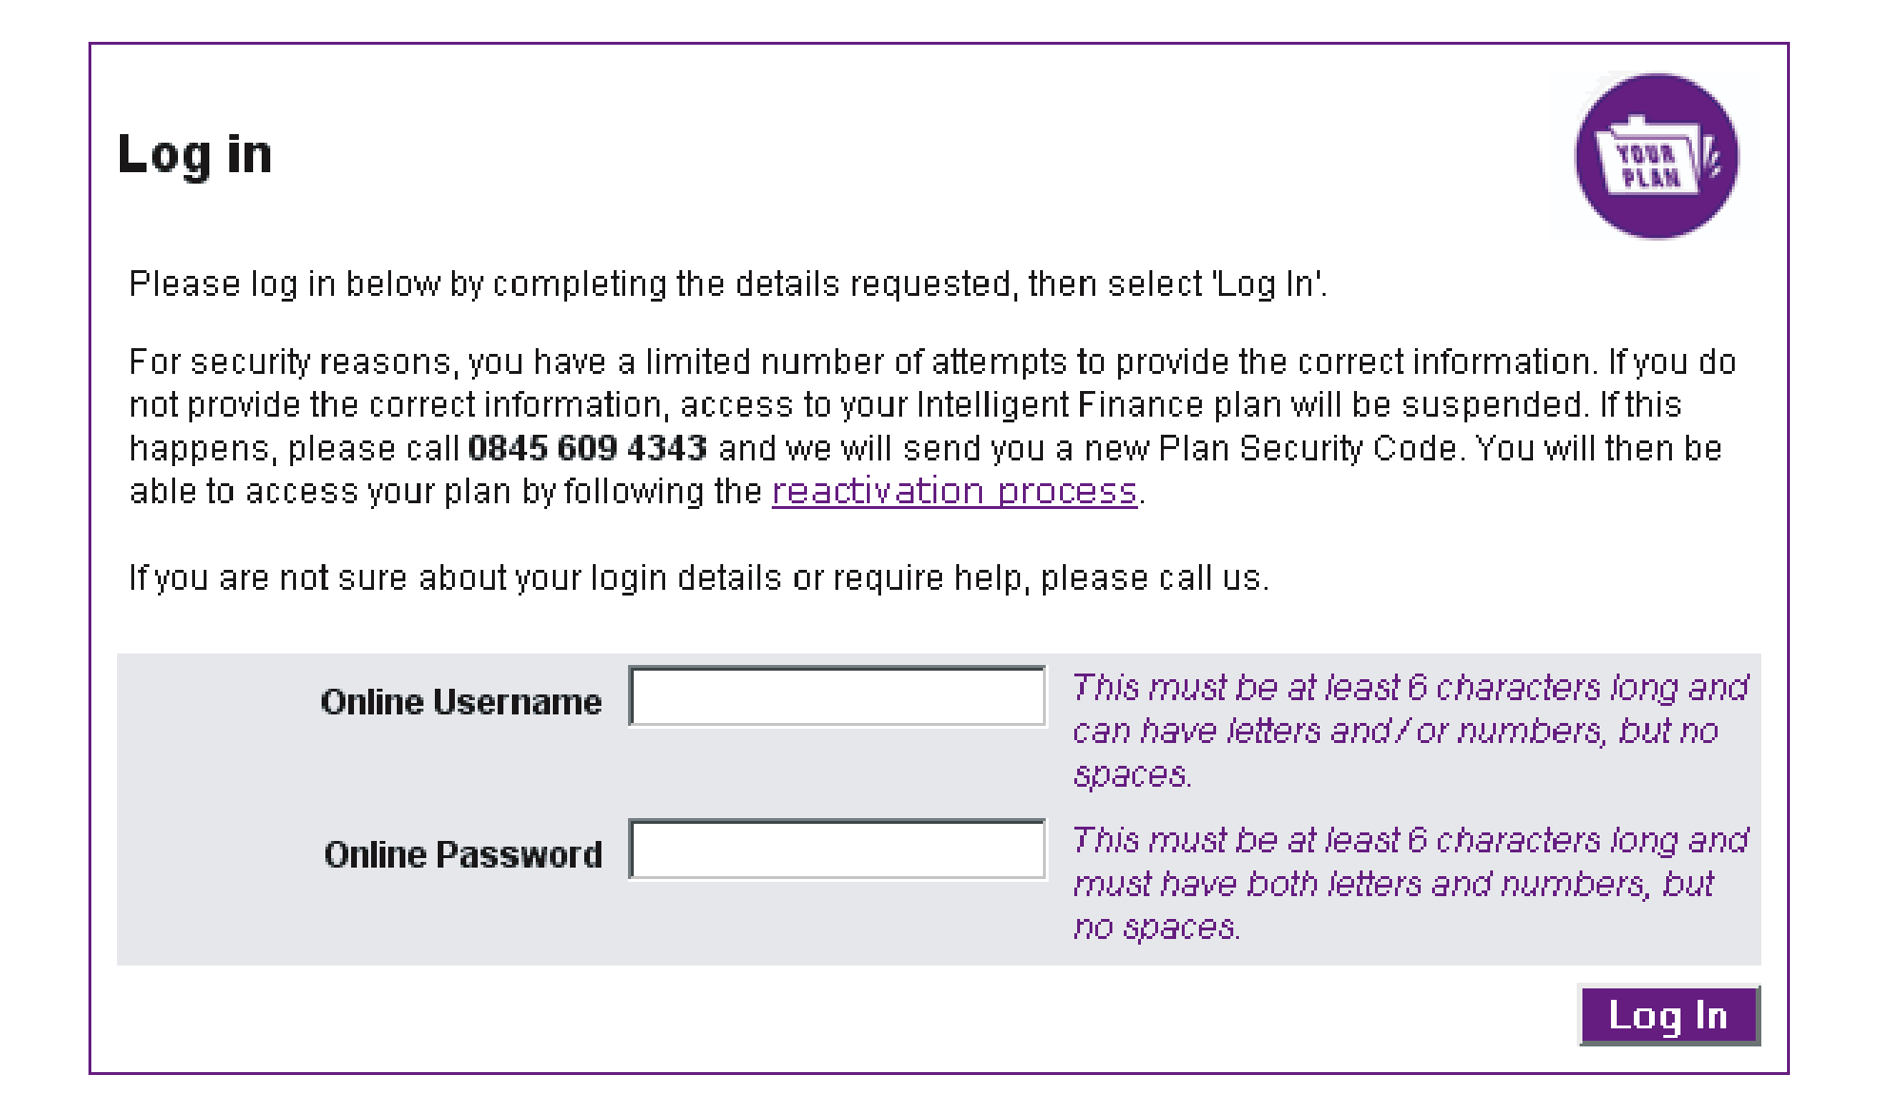
Handling User Access
Authentication
  Authenticating a user involves establishing that the user is in fact who he claims to be.
A typical login function

Slide 4
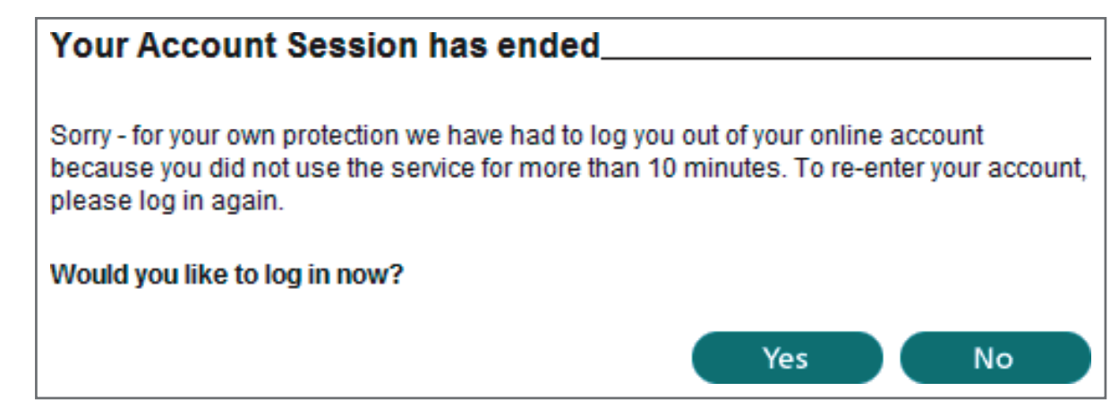
Handling User Access
Session Management
  To enforce effective access control, the application needs a way to identify and process the series of requests that originate from each unique user.
An application enforcing session timeout

Slide 5
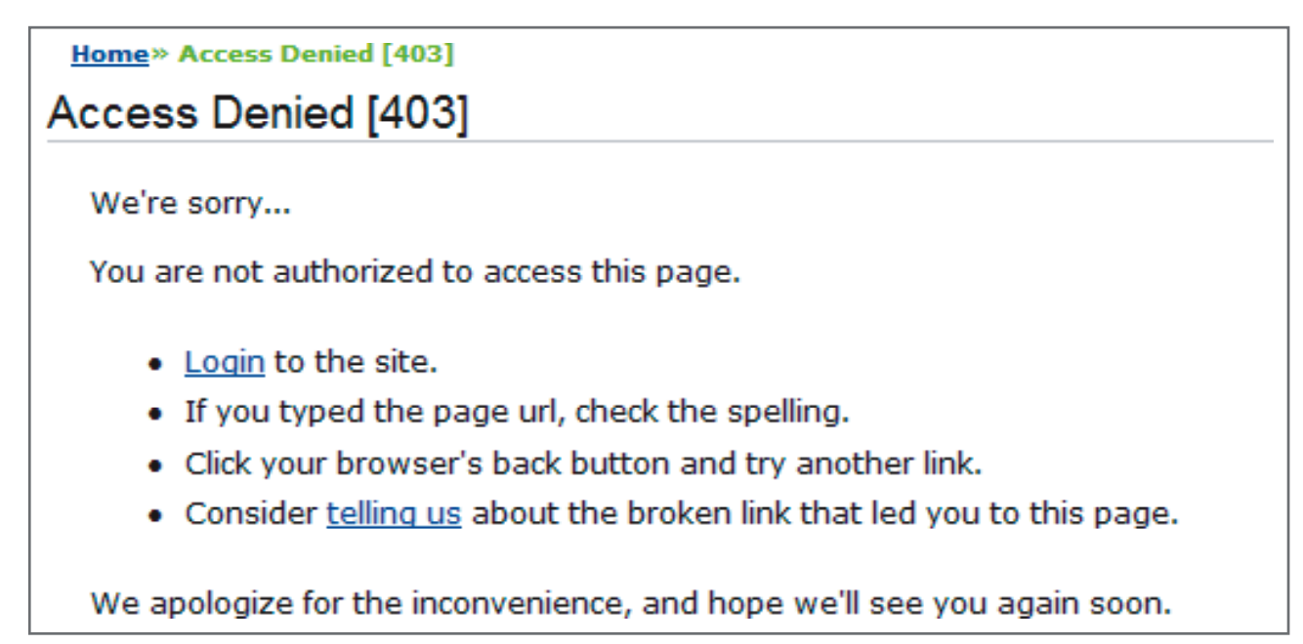
Handling User Access
Access Control
  Make and enforce correct decisions about whether each individual request should be permitted or denied.
An application enforcing access control

Slide 6
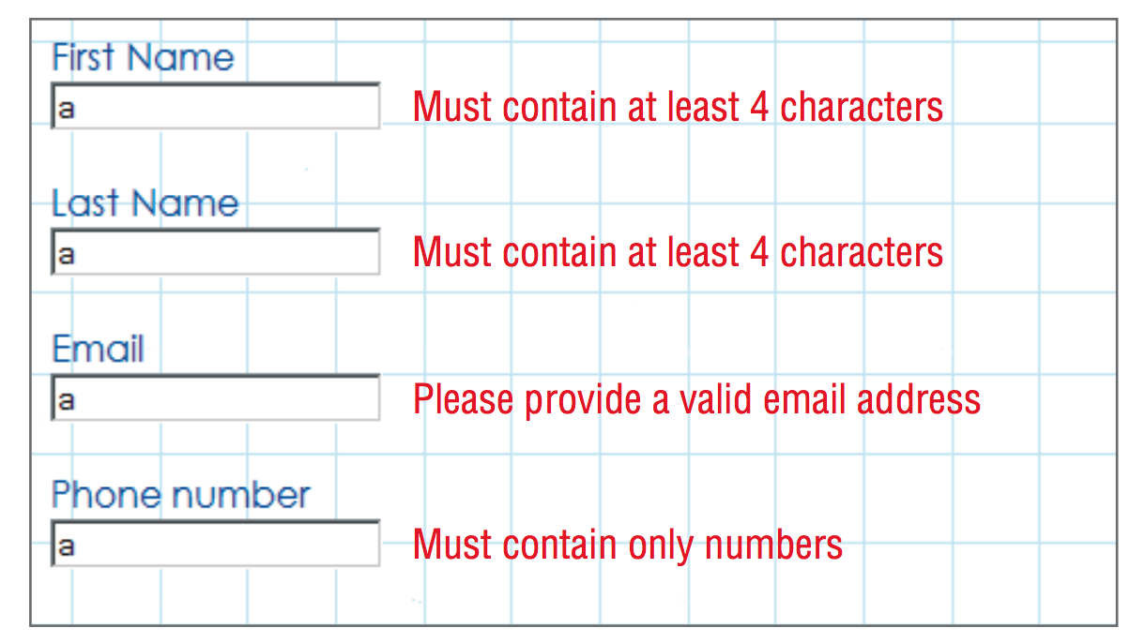
Handling User Input
Varieties of Input
  A typical web application processes user-supplied data in many different forms. Some kinds of input validation may not be feasible or desirable for all these forms of input.
An application performing input validation

Slide 7
Handling User Input
Approaches to Input Handling
  “Reject Known Bad”
    This approach typically employs a blacklist containing a set of literal strings or patterns that are known to be used in attacks.
    The least effective approach to validating user input:
      Same input may be encoded or represented in various ways.
      Techniques for exploitation are constantly evolving.
SELECT
SeLeCt
or 1=1--
or 2=2--
alert(‘xss’)
prompt(‘xss’)

Slide 8
Handling User Input
In other cases, filters designed to block specific keywords can be bypassed by using nonstandard characters between expressions to disrupt the tokenizing performed by the application.

Slide 9
Handling User Input
Approaches to Input Handling
  “Accept Known Good”
    This approach employs a whitelist containing a set of literal strings or patterns, or a set of criteria, that is known to match only benign input.
    The most effective approach to validating user input (if feasible).
    However, in numerous situations an application must accept data for processing that does not meet any reasonable criteria for what is known to be “good.”
      some people’s names containan apostrophe or hyphen.

Slide 10
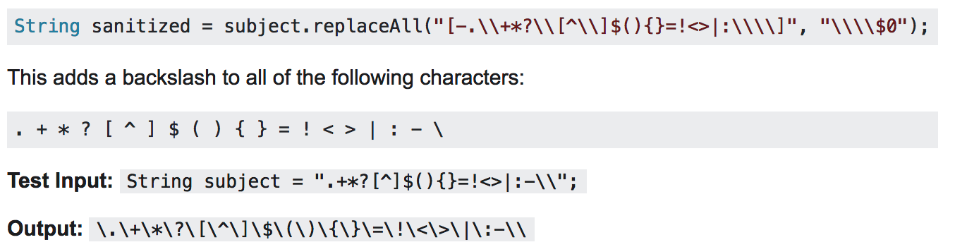
Handling User Input
Approaches to Input Handling
  Sanitization
    Potentially malicious characters may be removed from the data, leaving only what is known to be safe, or they may be suitably encoded or “escaped” before further processing is performed.
    Data sanitization are often highly effective, and in many situations they can be relied on as a general solution to the problem of malicious

Slide 11
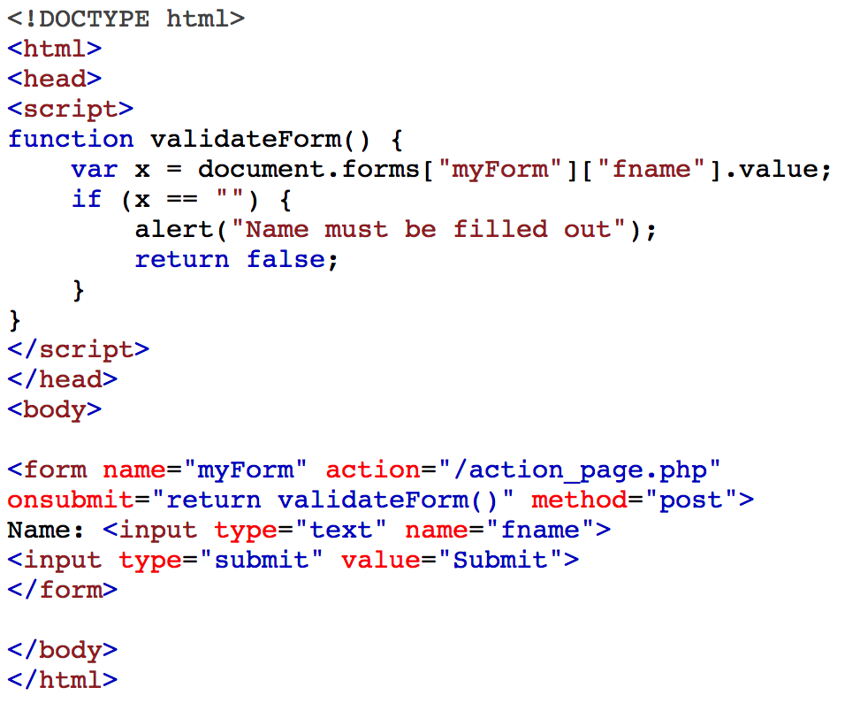
Handling User Input
Approaches to Input Handling
  Boundary Validation
Is this safe?

Slide 12
Handling User Input
Approaches to Input Handling
  Boundary Validation
An Input validation
Is this safe?

Slide 13
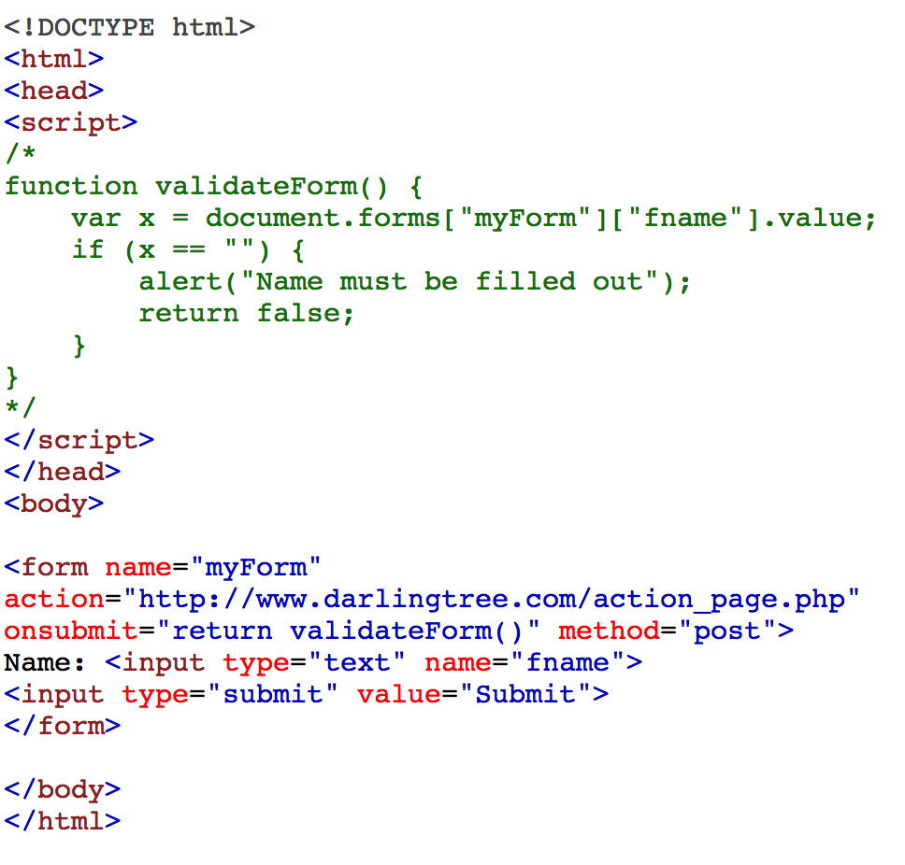
Handling User Input
Although input validation checks implemented on the client side may improve performance and the user’s experience, they DO NOT provide any assurance about the data that actually reaches the server.

Slide 14
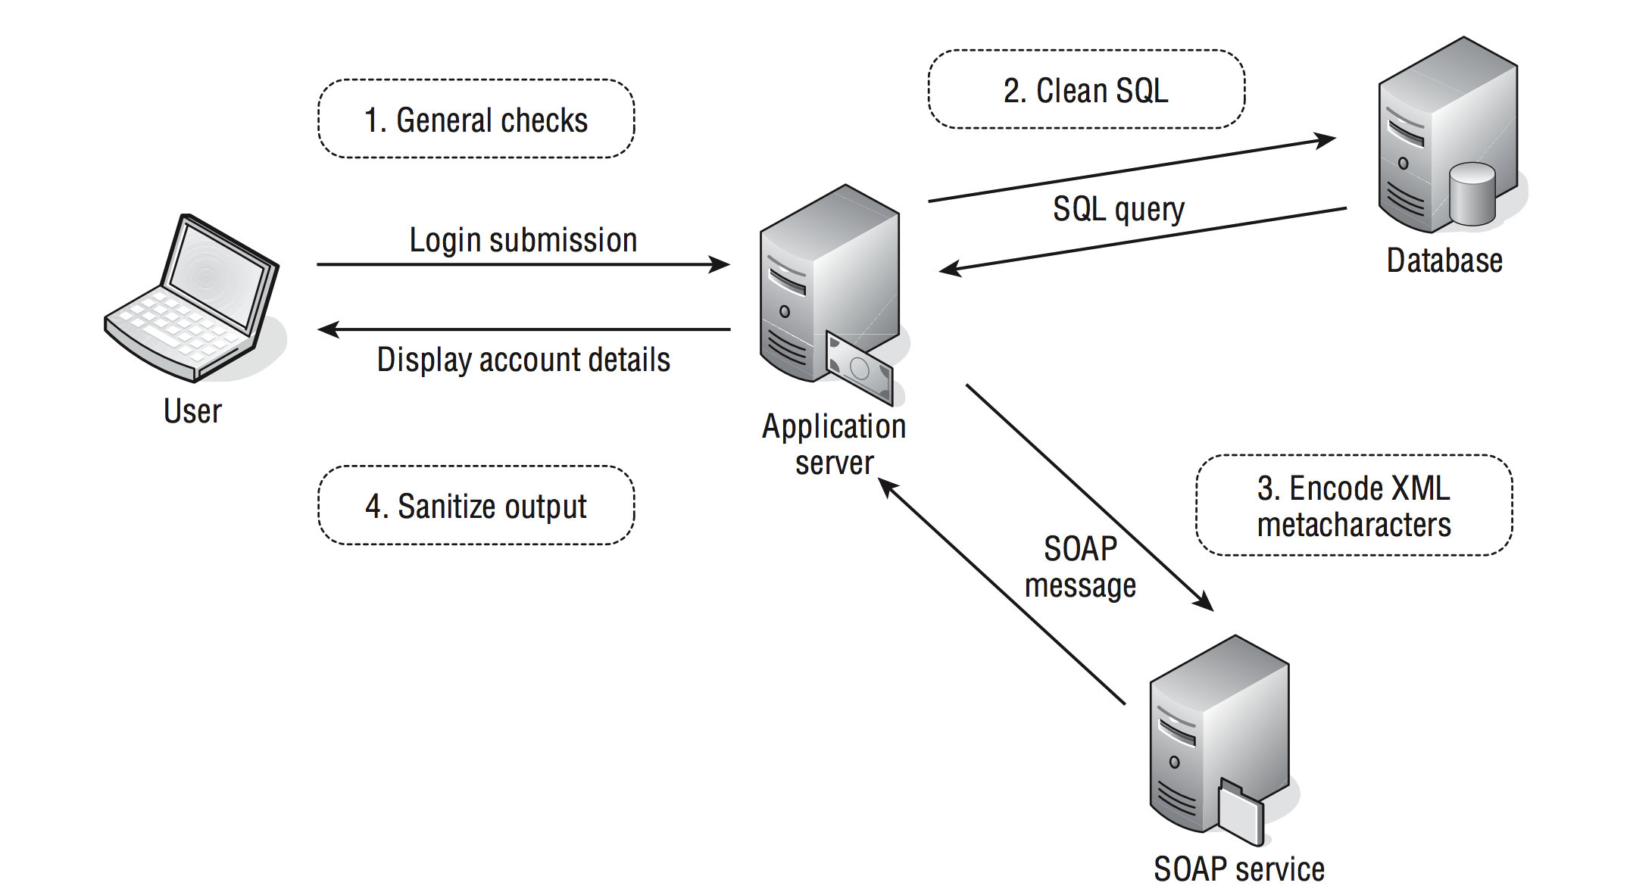
Handling User Input
A more effective model uses the concept of boundary validation:
  Each individual component or functional unit of the server-side application treats its inputs as coming from a potentially malicious source
  Data validation is performed at each of these trust boundaries, in addition to the external frontier between the client and server..
An application function using boundary validation at multiple stages of processing

Slide 15


Handling User Input
Approaches to Input Handling
  Multistep Validation and Canonicalization
    A common problem encountered by input-handling mechanisms arises when user-supplied input is manipulated across several steps as part of the validation logic.
      An application may attempt to strip the expression:
If the filter is not being applied recursively

Slide 16
Handling User Input
An input validation mechanism designed to block cross-site scripting attacks performs the following sequence of steps on an item of input:
1. Strip any expressions that appear.
2. Truncate the input to 50 characters.
3. Remove any quotation marks within the input.
4. URL-decode the input.
5. If any items were deleted, return to step 1.
Can you bypass this validation mechanism to smuggle the following data past it?
”><script>alert(“foo”)</script>

Slide 17
Handling User Input
1. Strip any expressions that appear.
2. Truncate the input to 50 characters.
3. Remove any quotation marks within the input.
4. URL-decode the input.
5. If any items were deleted, return to step 1.
%22>%3cscript>alert(%22foo%22)</script>

Slide 18
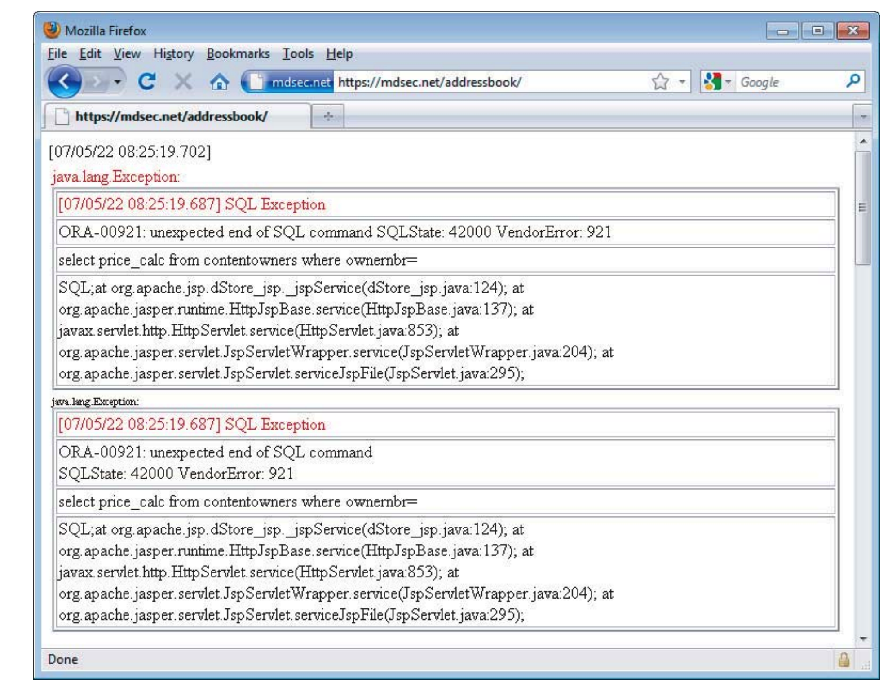
Handling Attackers
Handling Errors
  A key defense mechanism is for the application to handle unexpected errors gracefully, and either recover from them or present a suitable error message to the user.
    In a production context, the application should never return any system-generated messages or other debug information in its responses.

Slide 19
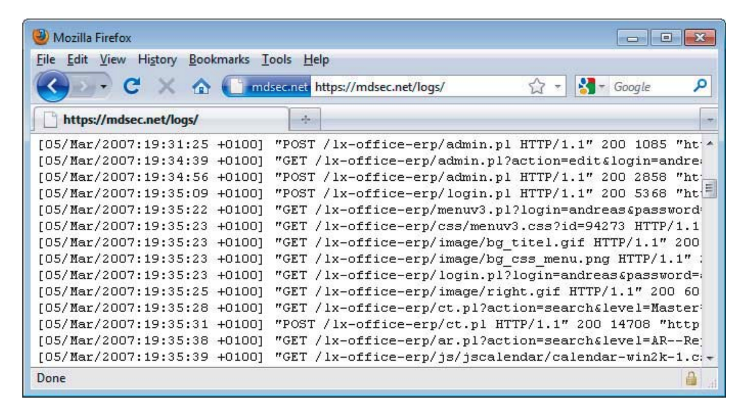
Handling Attackers
Maintaining Audit Logs
  Audit logs are valuable primarily when investigating intrusion attempts against an application:
    All events relating to the authentication functionality, such as successful and failed login, and change of password
    Key transactions, such as credit card payments and funds transfers
    Access attempts that are blocked by the access control mechanisms
    Any requests containing known attack strings that indicate overtly malicious intentions
  Poorly protected audit logs can provide a gold mine of information to an attacker.

Slide 20
Handling Attackers
Alerting Administrators
  Alerting mechanisms must balance the conflicting objectives of reporting each genuine attack reliably and of not generating so many alerts that these come to be ignored:
    Usage anomalies, such as large numbers of requests being received from a single IP address or user, indicating a scripted attack
    Business anomalies, such as an unusual number of funds transfers being made to or from a single bank account
    Requests containing known attack strings
    Requests where data that is hidden from ordinary users has been modified

Slide 21
Handling Attackers
Reacting to Attacks
  Applications take automatic reactive measures to frustrate the activities of an attacker who is working in this way
    respond increasingly slowly to the attacker’s requests or terminate the attacker’s session
    requiring him to log in or perform other steps before continuing the attack

Slide 22
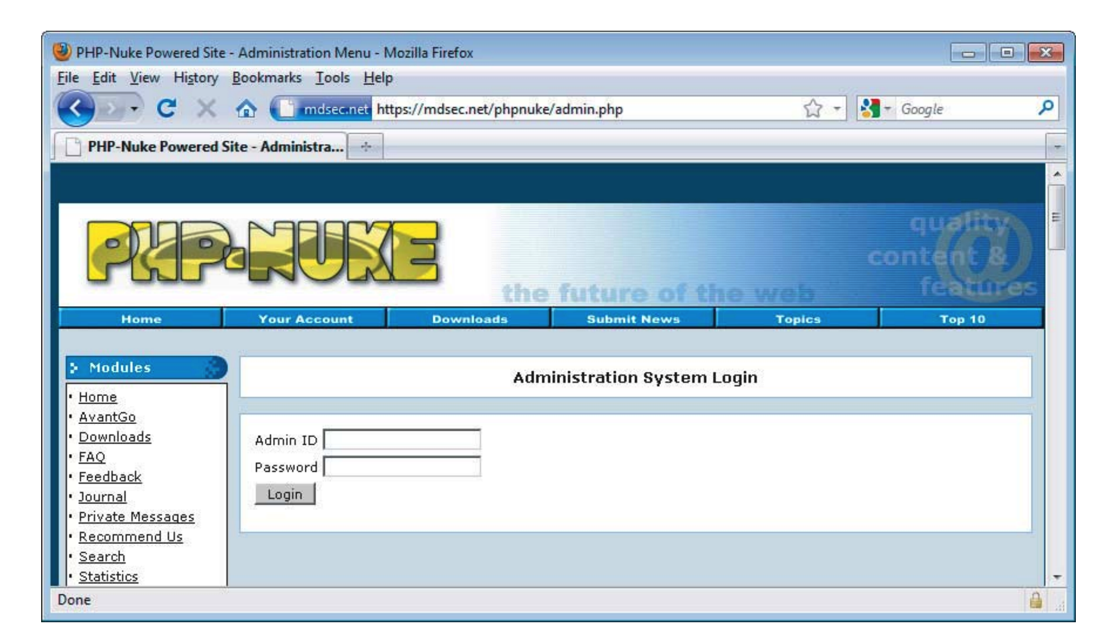
Managing the Application
Any useful application needs to be managed and administered.

Slide 23
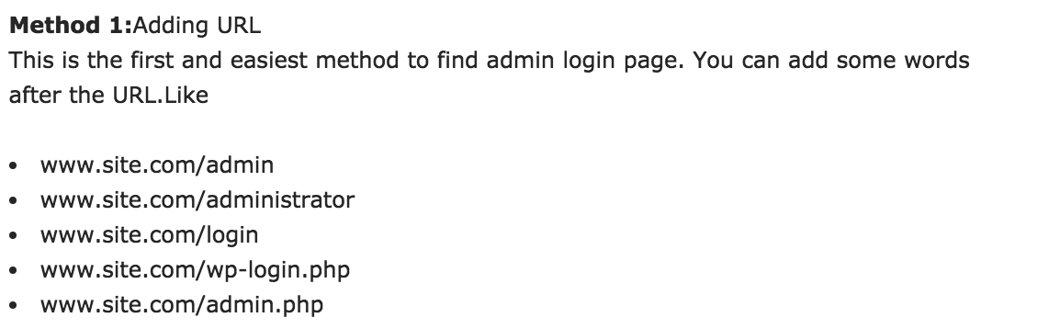
Managing the Application
Method 2:Using Various Script
Method 3:Crawling
Method 4:Google Dorks

Slide 24
Conclusion
The mechanisms for handling user access and user input are the most important and should receive most of your attention when you are targeting an application.
Defects in these mechanisms often lead to complete compromise of the application, enabling you to access data belonging to other users, perform unauthorized actions, and inject arbitrary code and commands.

Slide 25
Browser Extensions

Slide 26
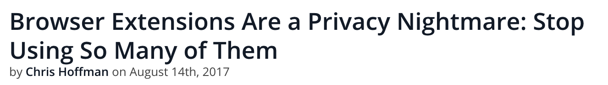

Slide 27
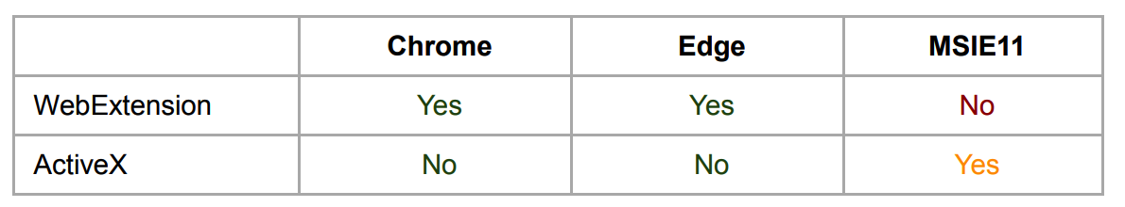
Web Extension Architecture Overview
A Web Extension has a very similar structure to the one found for HTML websites handling folders and their respective data.
The extension file itself is nothing but a compressed folder structure containing HTML files, JavaScript, HTML, CSS, images, audio, and so on

Slide 28
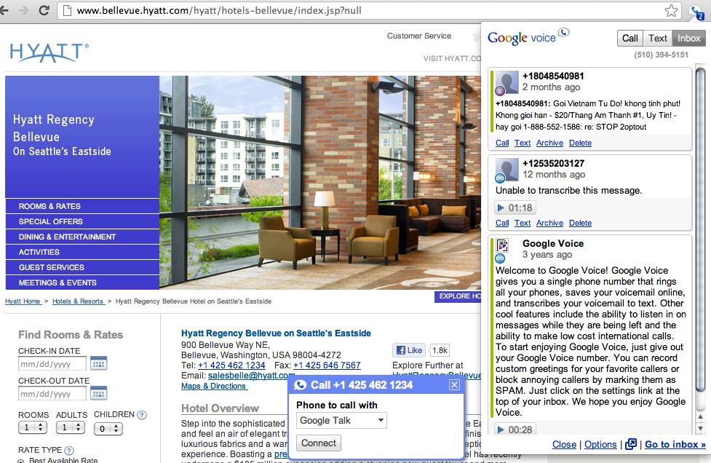
CHROME EXTENSIONS

Slide 29
CHROME EXTENSIONS

Slide 30




servers
servers
client-side website
extension
client-side
browser API
history bookmarks
website
WEB ATTACKER

Slide 31
servers
servers
client-side website
extension
client-side
browser API
history bookmarks
website
WEB ATTACKER

Slide 32
servers
servers
client-side website
extension
client-side website
browser API
history bookmarks
NETWORK ATTACKER

Slide 33
servers
servers
client-side website
extension
client-side website
browser API
history bookmarks
NETWORK ATTACKER

Slide 34
CHROME’S
SECURITY MECHANISMS

Slide 35


servers
servers
client-side website
content script
core extension
extension
browser API
history bookmarks
PRIVILEGE SEPARATION

Slide 36
servers
servers
client-side website
content script
core extension
content script
extension
client-side website
browser API
history bookmarks
ISOLATED WORLDS

Slide 37


server
servers
server
client-side website
content script
core extension
extension
client-side website
browser API
history bookmarks
PERMISSIONS

Slide 38
FINDING BUGS
SAMPLE
50 most popular + 50 random extensions
METHODS
Black-box testing + source code analysis
VERIFICATION
Built exploits to confirm the vulnerabilities

Slide 39
Popular | Random | Total
22 | 18 | 40
VULNERABLE EXTENSIONS

Slide 40
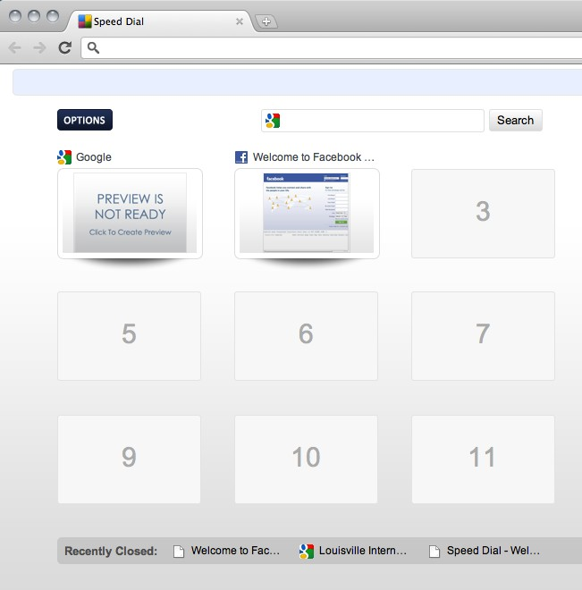
EXAMPLE: SPEED DIAL
Notes:
Example. The Speeddial extension replicates Chrome’s built-in list of recently closed pages. Speeddial keeps track of the tabs opened using the tabs manager and does not sanitize the titles of these pages before adding them to the HTML of one of its core extension pages. If a title were to contain an inline script, it would execute with the core extension’s permissions.

Slide 41
ISOLATED WORLDS

Slide 42
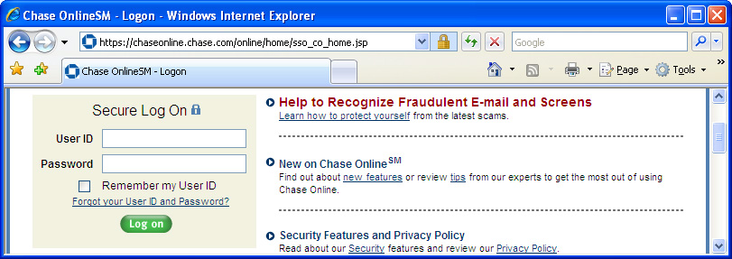
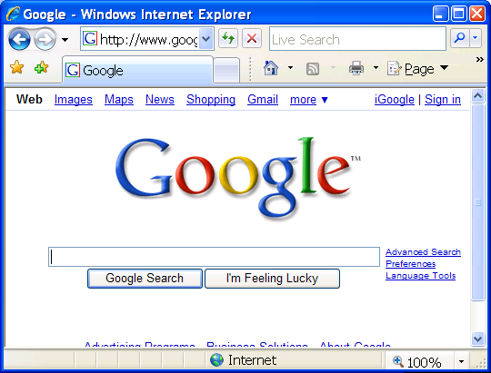

Need for isolation
If Googkle can script other windows, then can steal passwords, post fraudulent bank or retail transactions, etc., etc.

Slide 43
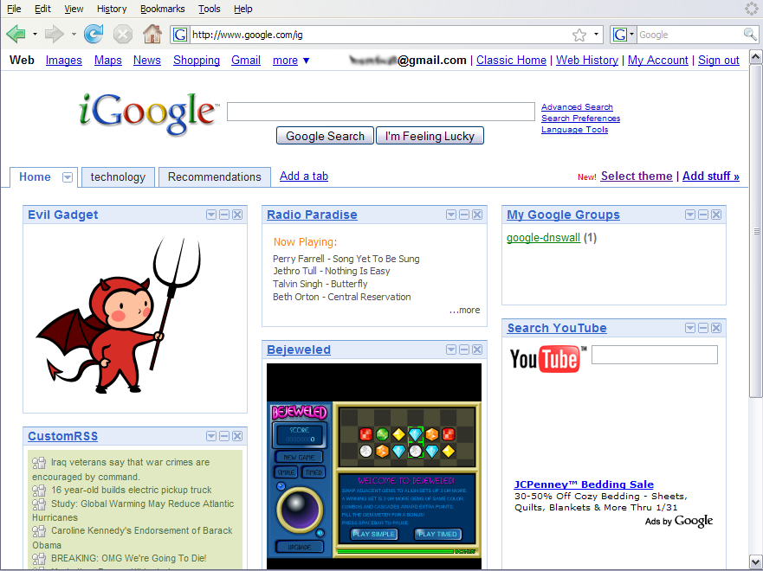
Need for isolation - mashups

Slide 44
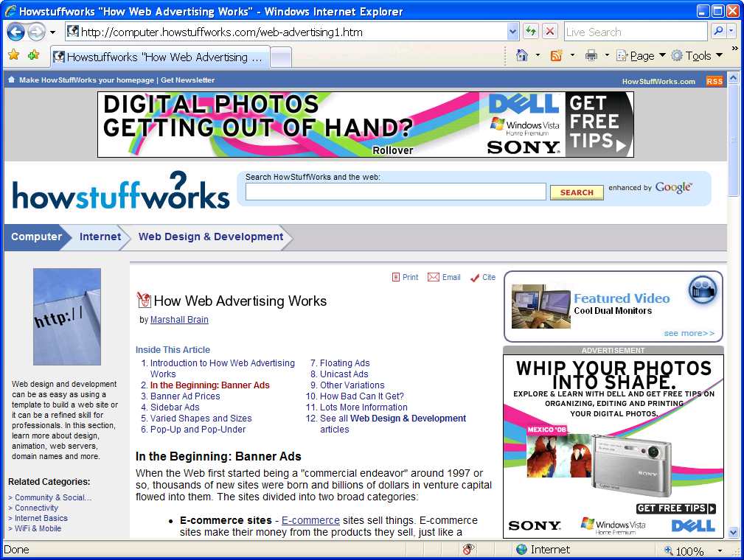
Need for isolation - advertisements

Slide 45
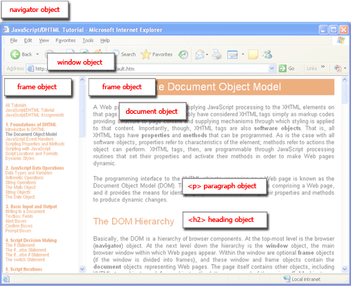
Browser and document tree structure
W3C standard differs from models supported in existing browsers

Slide 46
Vulnerability count:
3 content script vulns

Slide 47
DATA AS HTML
MISTAKE
Insert data as HTML, where it can execute
MITIGATION
Will execute in website’s isolated world
VULNERABILITIES
6 extensions have data-as-HTML bugs that
don’t cause content script vulnerabilities

Slide 48
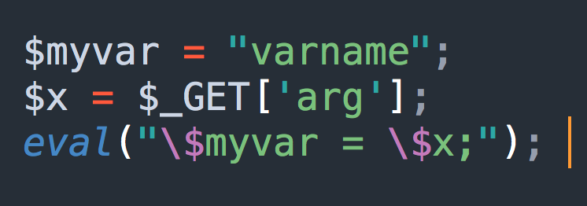
EVAL
MISTAKE
Use eval to execute untrusted data
MITIGATION
Isolated worlds does not mitigate this bug
VULNERABILITIES
2 vulnerabilities due to this mistake

Slide 49
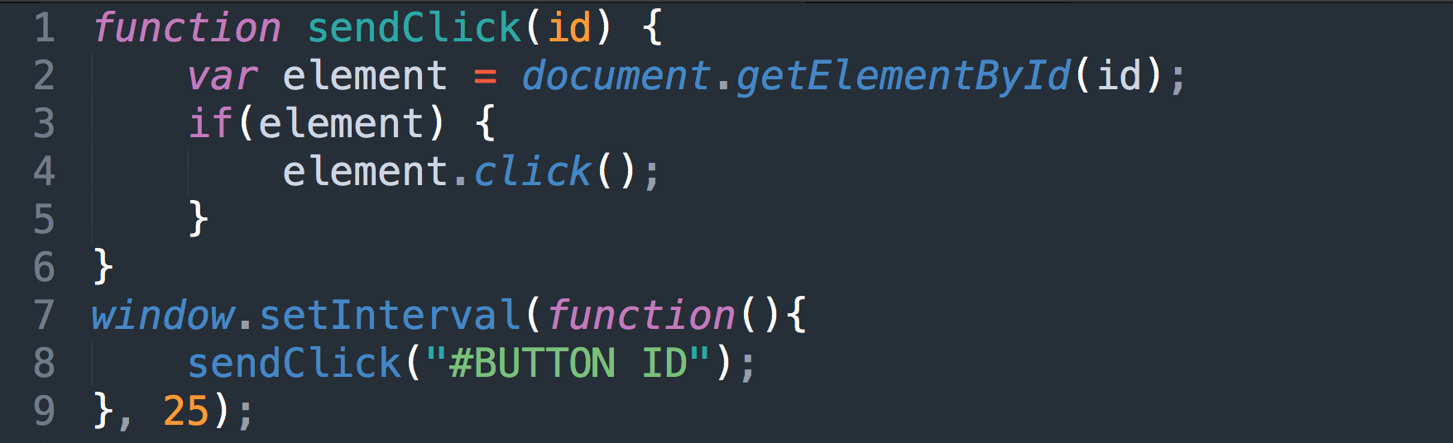
CLICK INJECTION
MISTAKE
Trusting event handlers on a website
MITIGATION
Isolated worlds does not mitigate this bug
VULNERABILITIES
1 vulnerability due to this mistake

Slide 50
Isolated worlds is highly effective because it mitigates common bugs

Slide 51
PRIVILEGE SEPARATION

Slide 52
Privilege separation: protect core extensions

Slide 53
client-side website
content script
core extension
extension
browser API
history bookmarks
PRIVILEGE SEPARATION

Slide 54
Vulnerability count:
50 core extension vulns

Slide 55
servers
client-side website
content script
core
extension
extension
browser API
history bookmarks
METADATA ATTACK

Slide 56
EXAMPLE: SPEED DIAL
Notes:
Example. The Speeddial extension replicates Chrome’s built-in list of recently closed pages. Speeddial keeps track of the tabs opened using the tabs manager and does not sanitize the titles of these pages before adding them to the HTML of one of its core extension pages. If a title were to contain an inline script, it would execute with the core extension’s permissions.

Slide 57
servers
client-side website
content script
core extension
extension
browser API
history bookmarks
HTTP SCRIPTS/XHRS

Slide 58
PERMISSIONS

Slide 59
Javascript Security Model
“Sandbox” design
  No direct file access, restricted network access
Same-origin policy
  Frame can only read properties of documents and windows from same place: server, protocol, port
However, this does not apply to
  Script loaded in enclosing frame from arbitrary site
  This script runs as if it were loaded from the site that provided the page!
<script type="text/javascript">
src="http://www.example.com/scripts/somescript.js">
</script>
Reference: http://www.devarticles.com/c/a/JavaScript/JavaScript-Security/

Slide 60
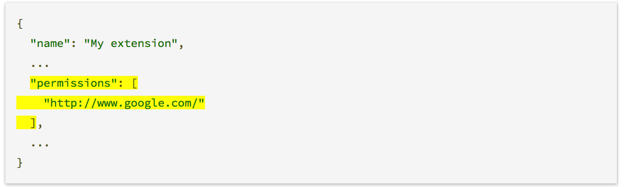
Cross-Origin XMLHttpRequest
Regular web pages can use the XMLHttpRequest object to send and receive data from remote servers, but they're limited by the same origin policy.
Extensions aren't so limited. An extension can talk to remote servers outside of its origin, as long as it first requests cross-origin permissions.

Slide 61
Permissions:
limit the scope of core vulnerabilities

Slide 62








None 15%
Low
High 44%
11%
Medium 30%
27 buggy extensions
PERMISSION RATE

Slide 63
Reduces potential for severe attacks by half

Slide 64









None 15%
None 1%
Low 12%
Low
High 44%
11%
Medium 30%
High 49%
Medium 37%
with bugs
others
RATE COMPARISON

Slide 65
No correlation between bugs and permissions

Slide 66
Yes, permissions limit the scope of vulnerabilities

Slide 67

Q & A

