Slide 1
Class4
CSC 495/583 Advanced Topics in Computer Security
Web Security and privacy (2)
Si Chen (schen@wcupa.edu)

Slide 2
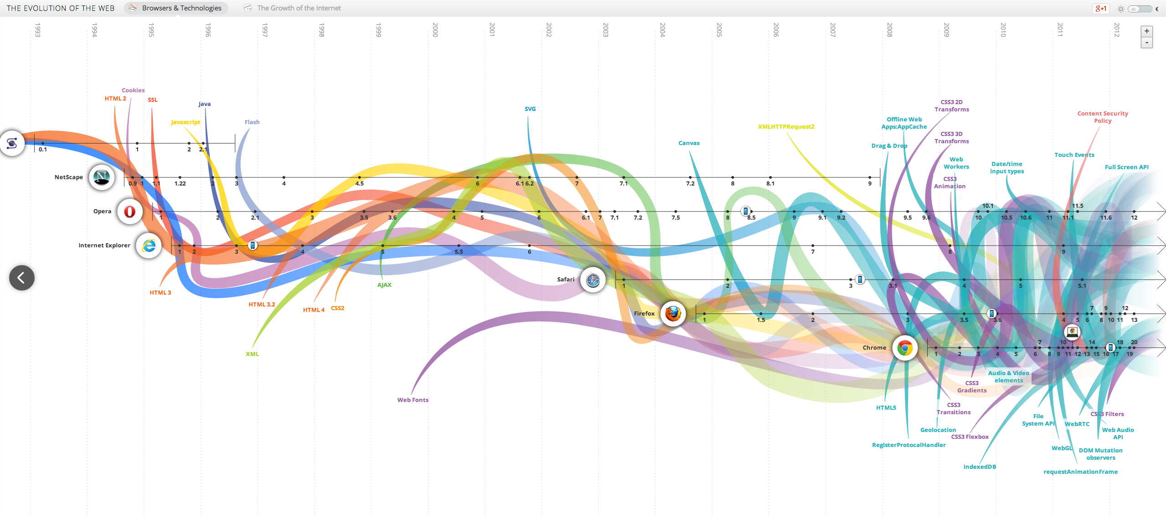
The Reality
Web application security is massively complex.
Constant evolving field
  WebGL, HTML5, CSS3, AJAX…
.
http://www.evolutionoftheweb.com/

Slide 3

Fertile Ground
Web application security is massively complex in reality:
  Security researchers specialize in specific portions of the stack
  Protocols and specs exist but aren’t implemented uniformly
  The platforms are changing
    Smartphone, tablets, embedded systems, etc…

Slide 4
Definition of a Security Vulnerability
A security vulnerability is a weakness in a product that could allow an attacker to compromise the integrity, availability, or confidentiality of that product.

Slide 5
Web Browser Security
Network
Browser
request
Web site
reply
OS
Hardware
Browser sends requests
  May reveal private information (in forms, cookies)
Browser receives information, code
  May corrupt state by running unsafe code
Interaction susceptible to network attacks
  Consider network security later in the course

Slide 6
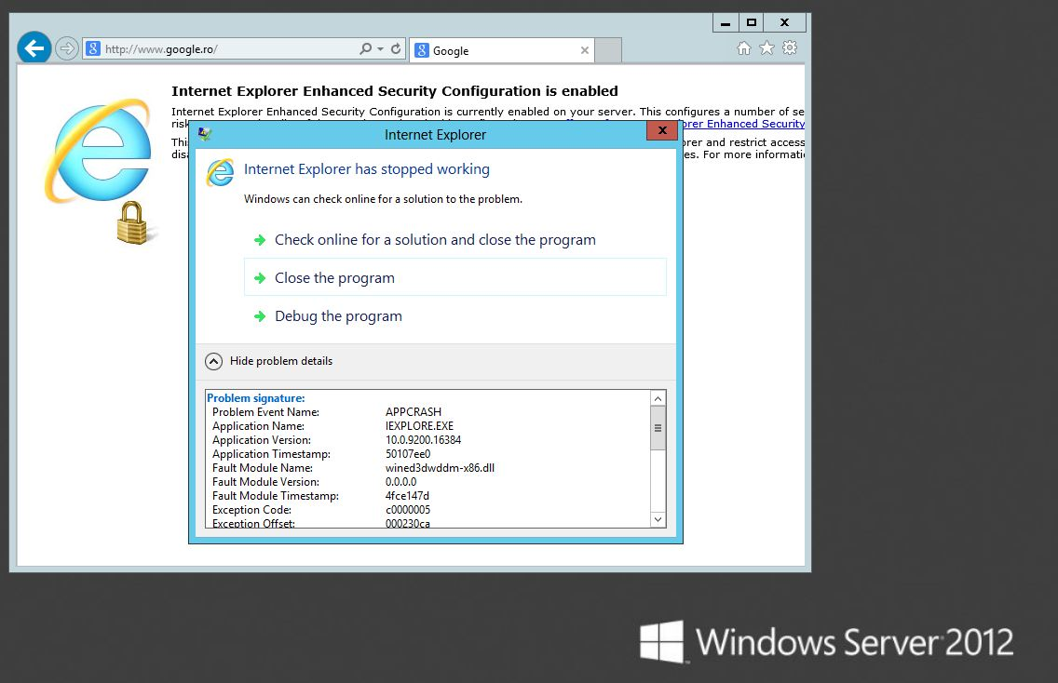

Slide 7
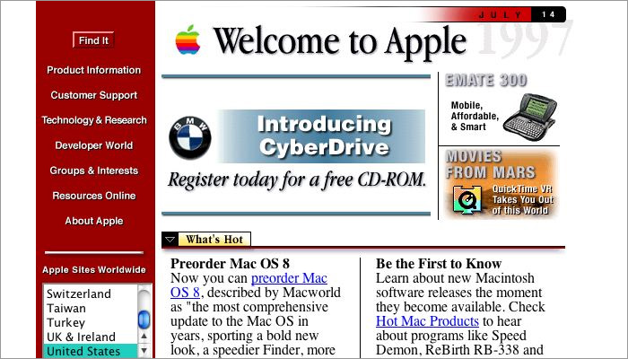
The Evolution of Web Applications
In the early days of the Internet, the World Wide Web (WWW) consisted only of websites.
  essentially information repositories containing static documents.

Slide 8
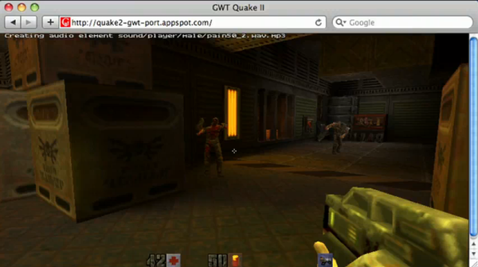
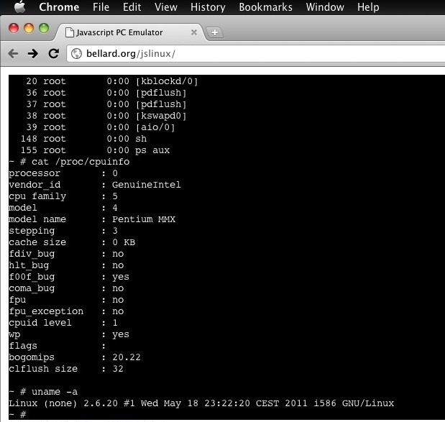

Slide 9
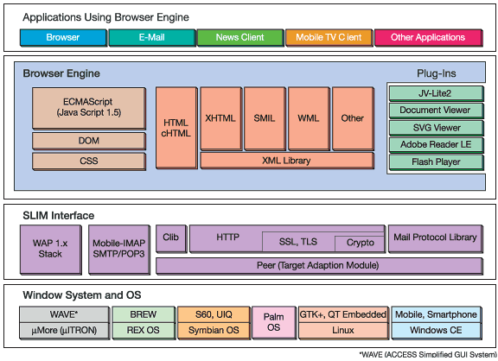
Sample architecture

Slide 10
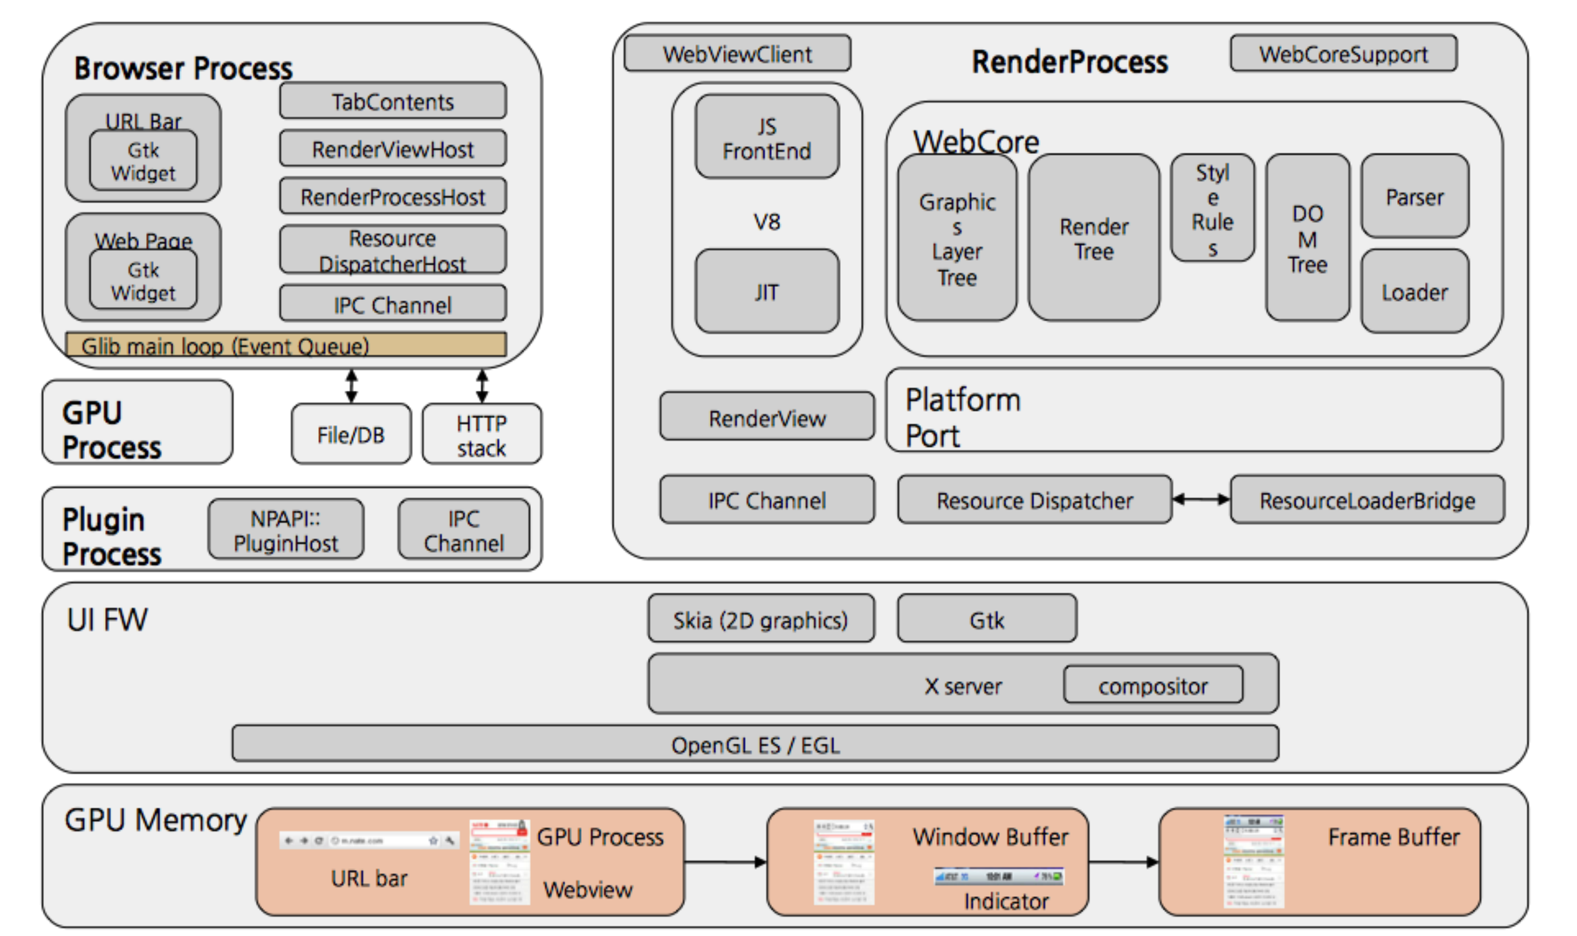
Chrome Architecture

Slide 11
HTML5 Game

Slide 12
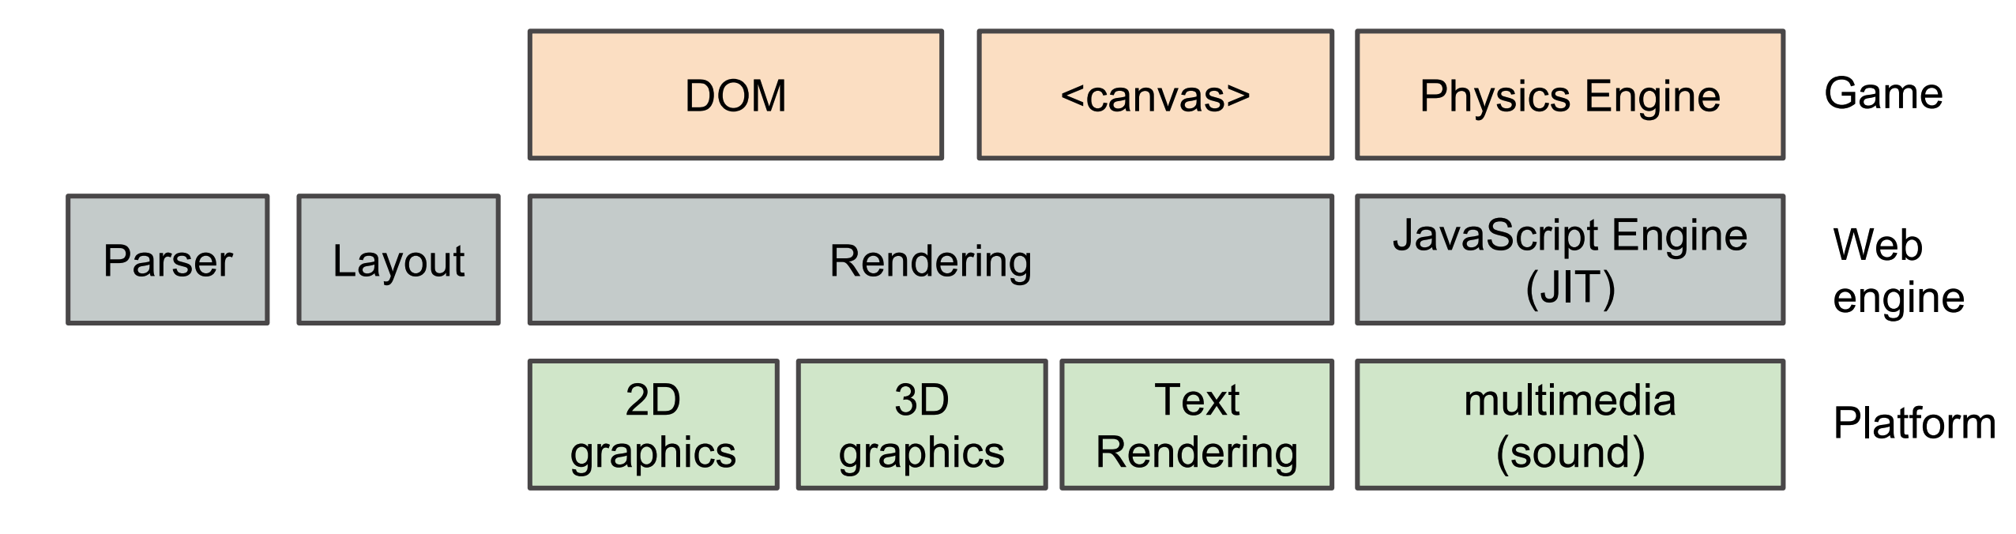
HTML5 Game RunTime: WebKit
Layout/Rendering
  2D, 3D graphics by GPU, text rendering
Sound
  WebAudio
Physics
  JavaScript engine, JIT, multi-core by WebWorker

Slide 13
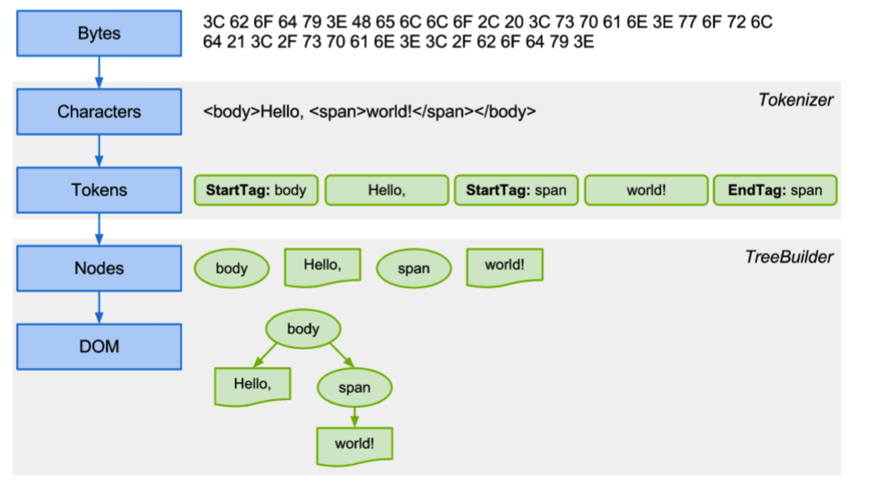
Parsing before Rendering

Slide 14
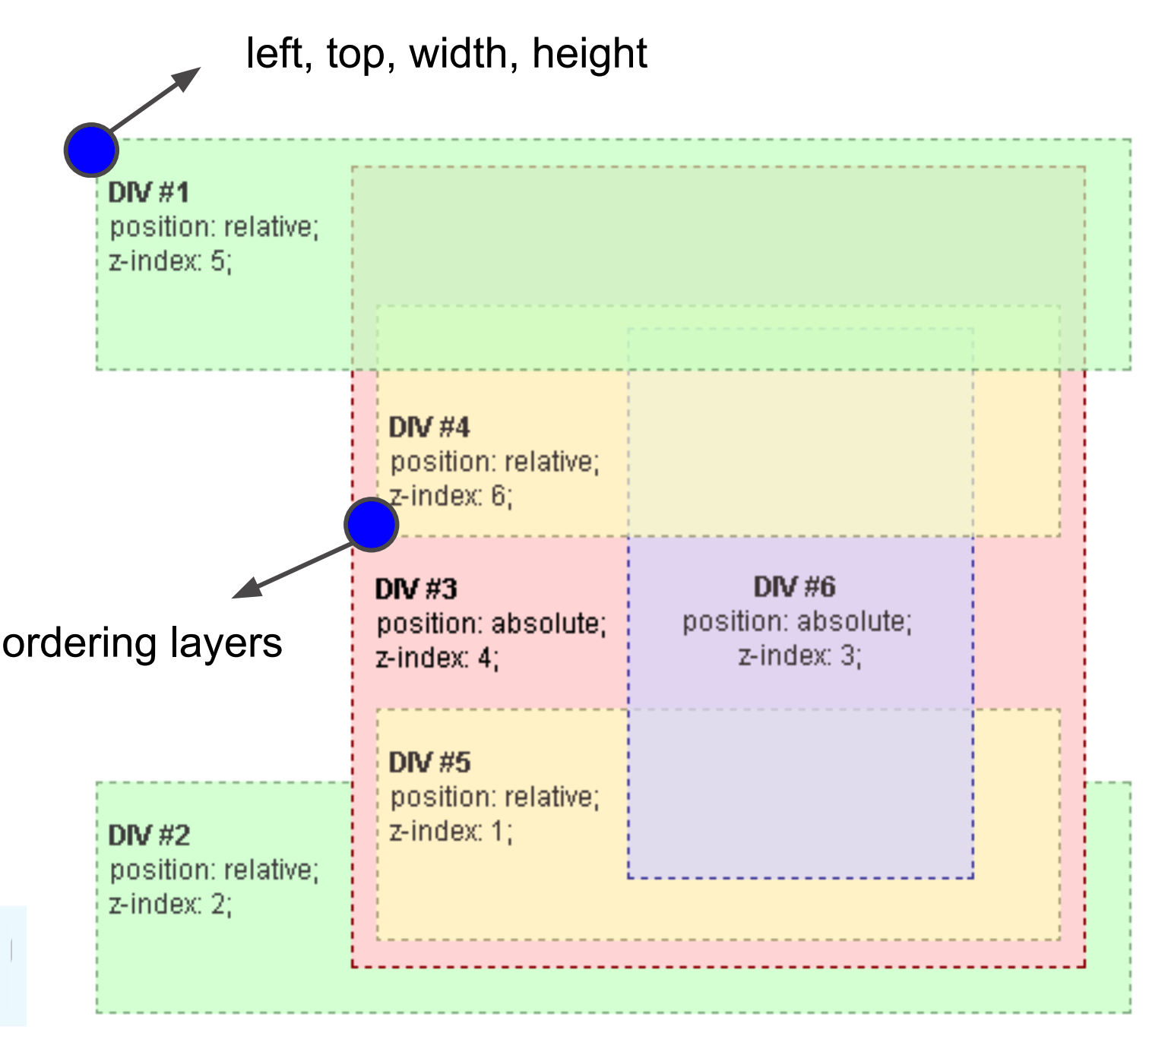
WebKit Internal: Layout
Calculate left top, width, height of all DOM nodes contained in a HTML document
Group a set of DOM nodes then, stack the resultant groups accordingly

Slide 15
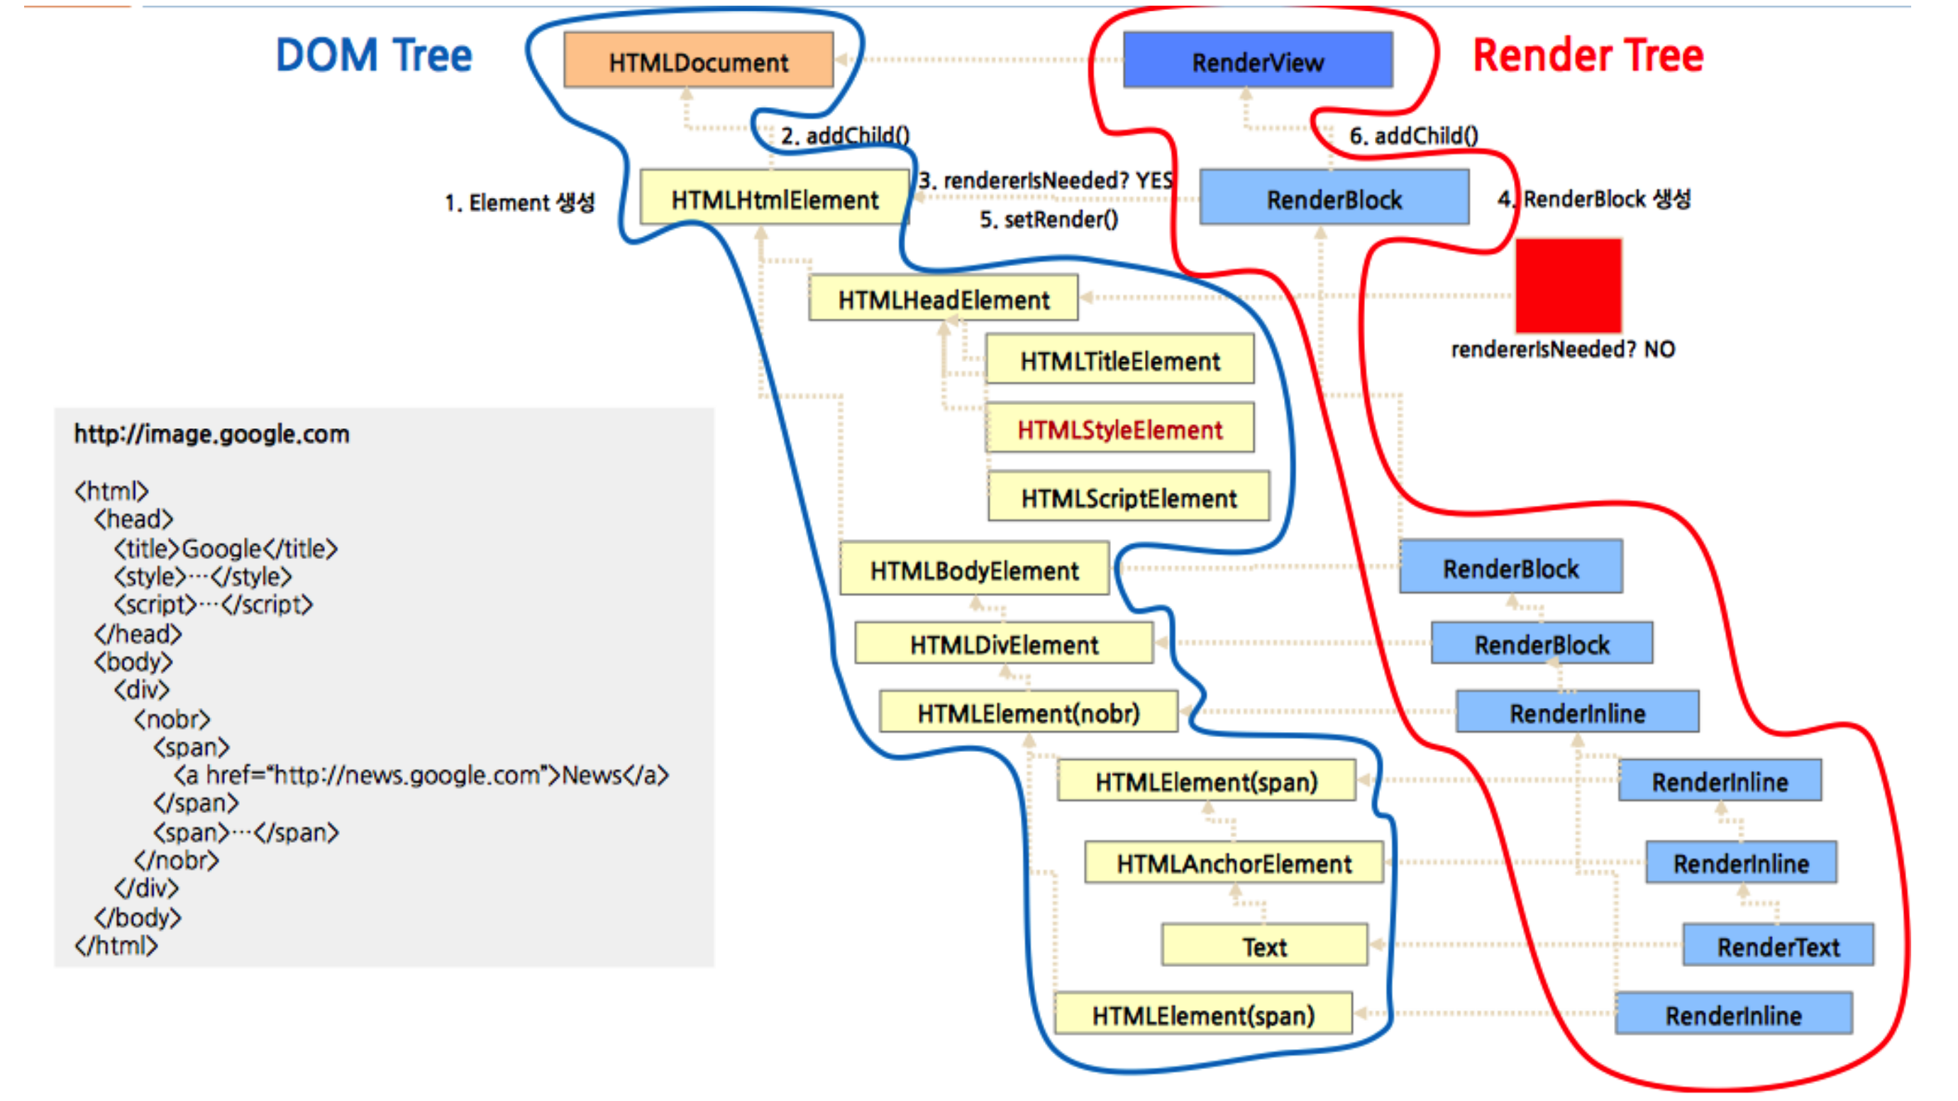
Internal Data Structure for Rendering

Slide 16
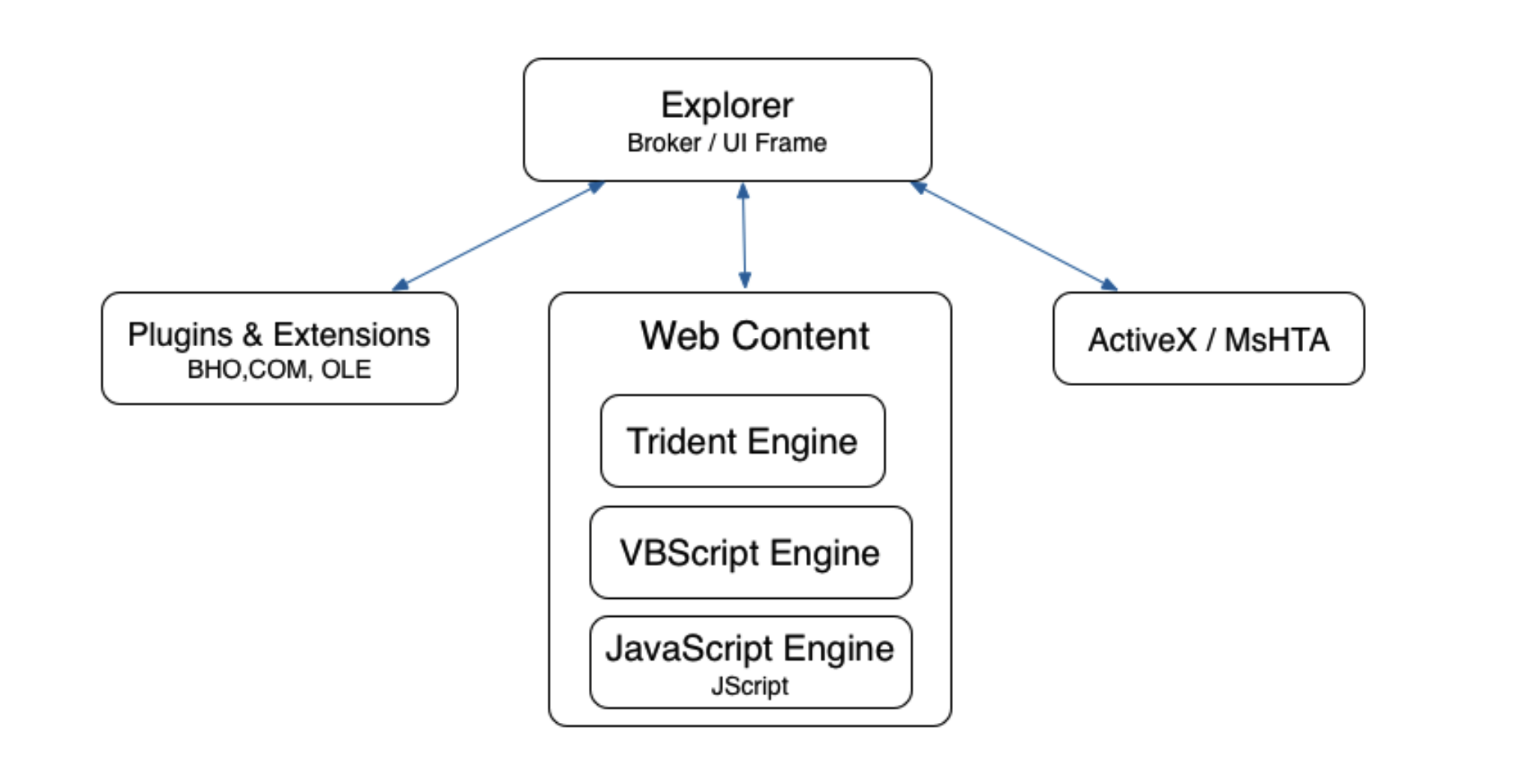
Internet Explorer Logical Components

Slide 17
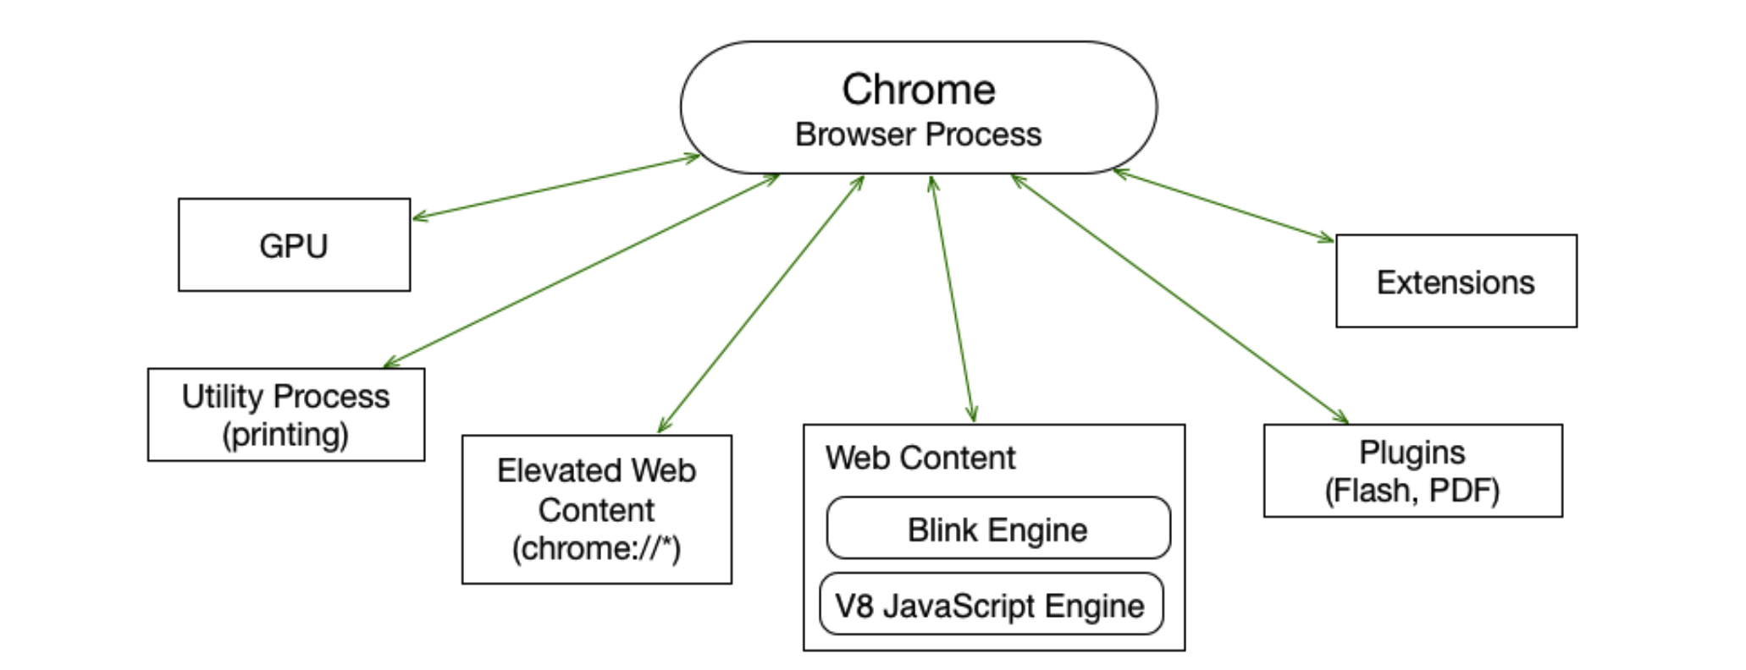
Chrome Logical Components

Slide 18
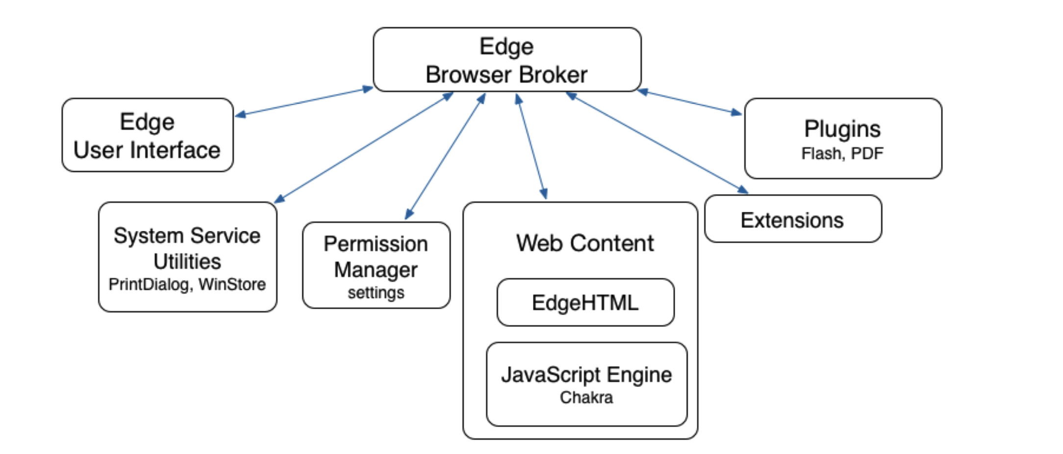
Edge Logical Components

Slide 19
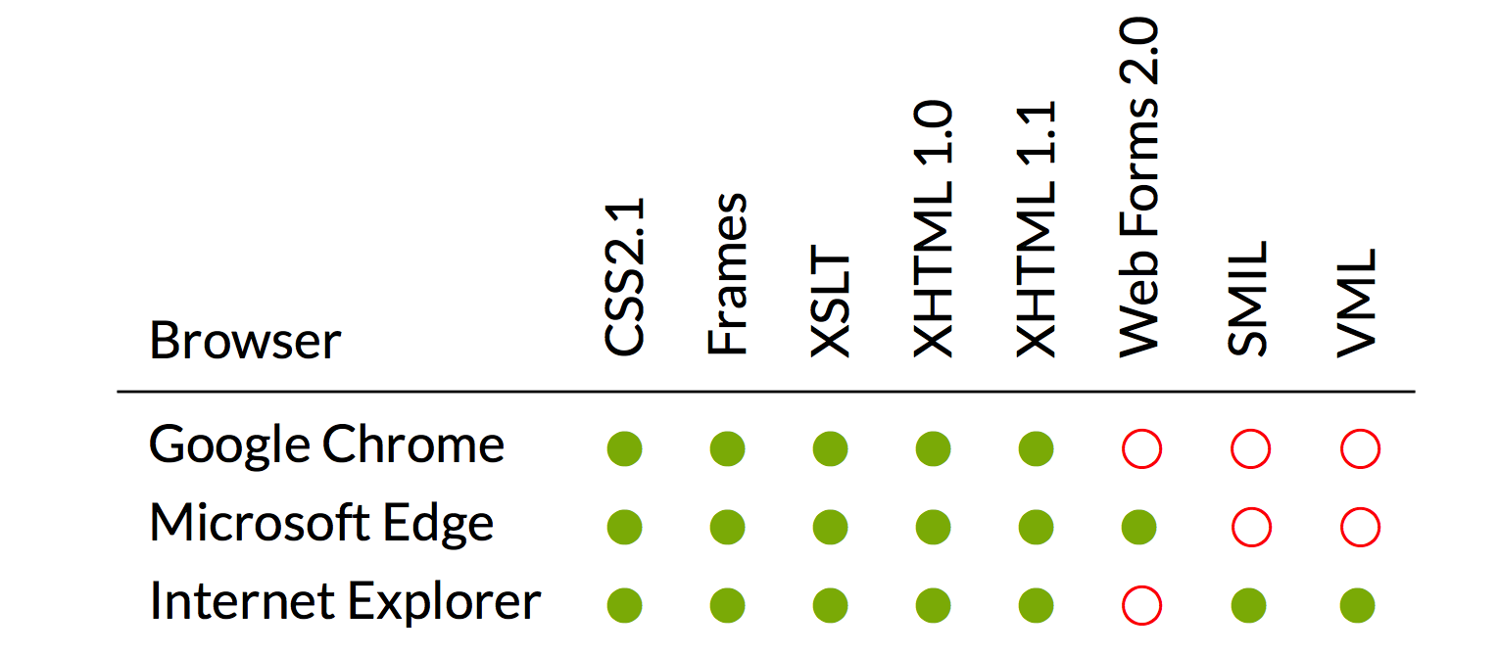
Web Technologies supported by Browsers

Slide 20
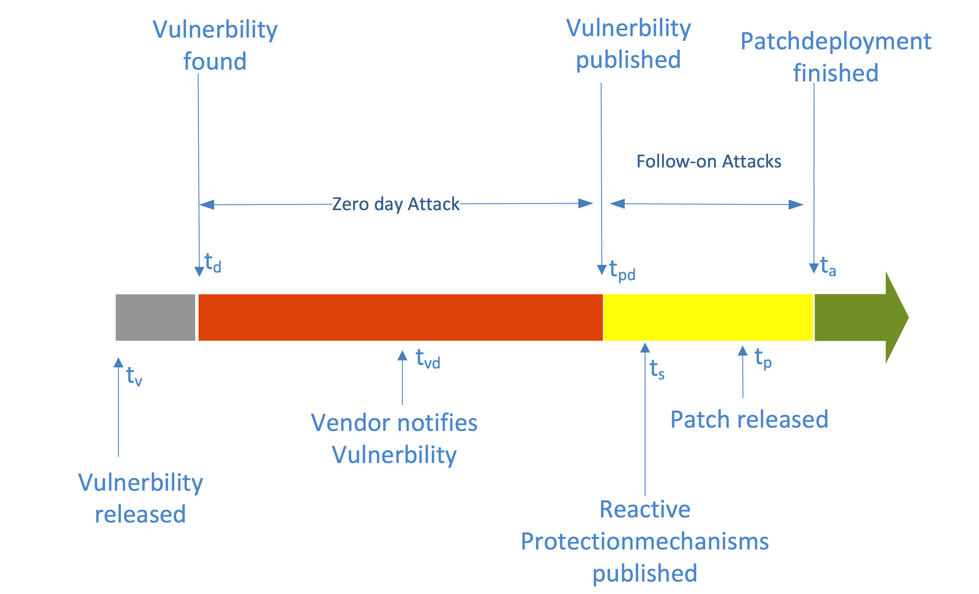
Life cycle of an Exploit

Slide 21
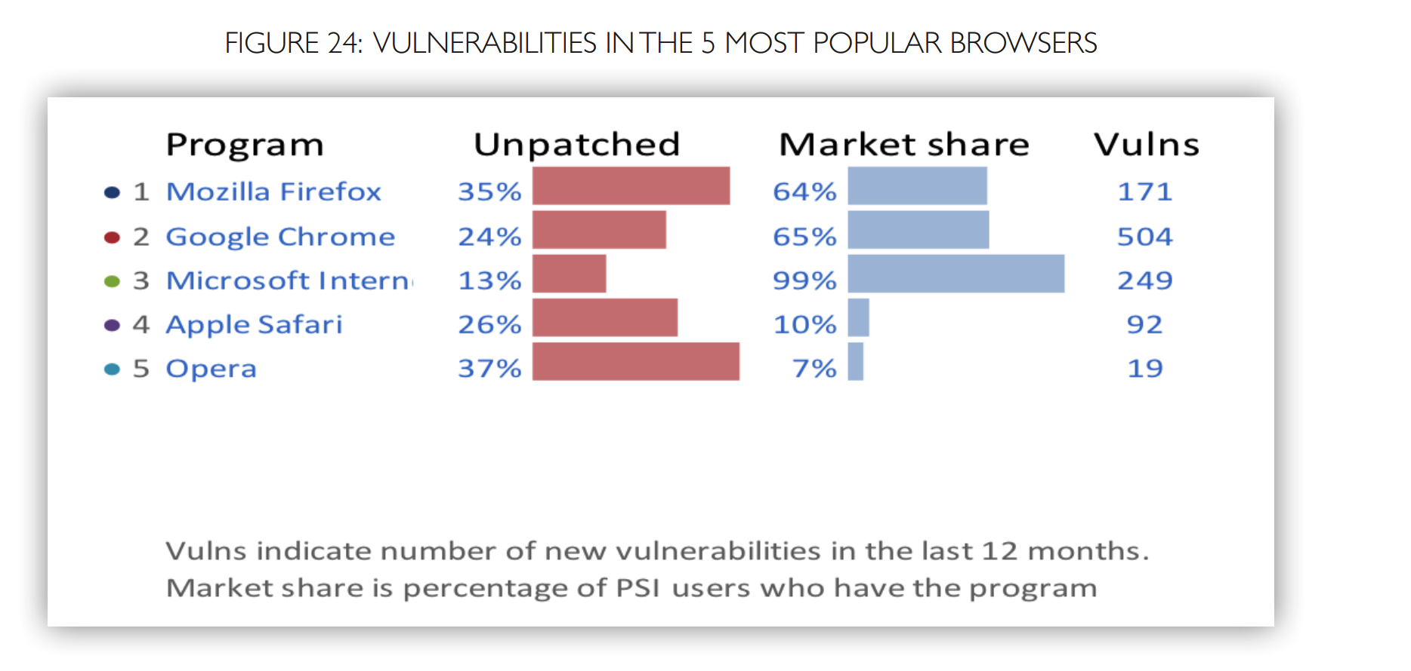
Secunia Report (2015)

Slide 22
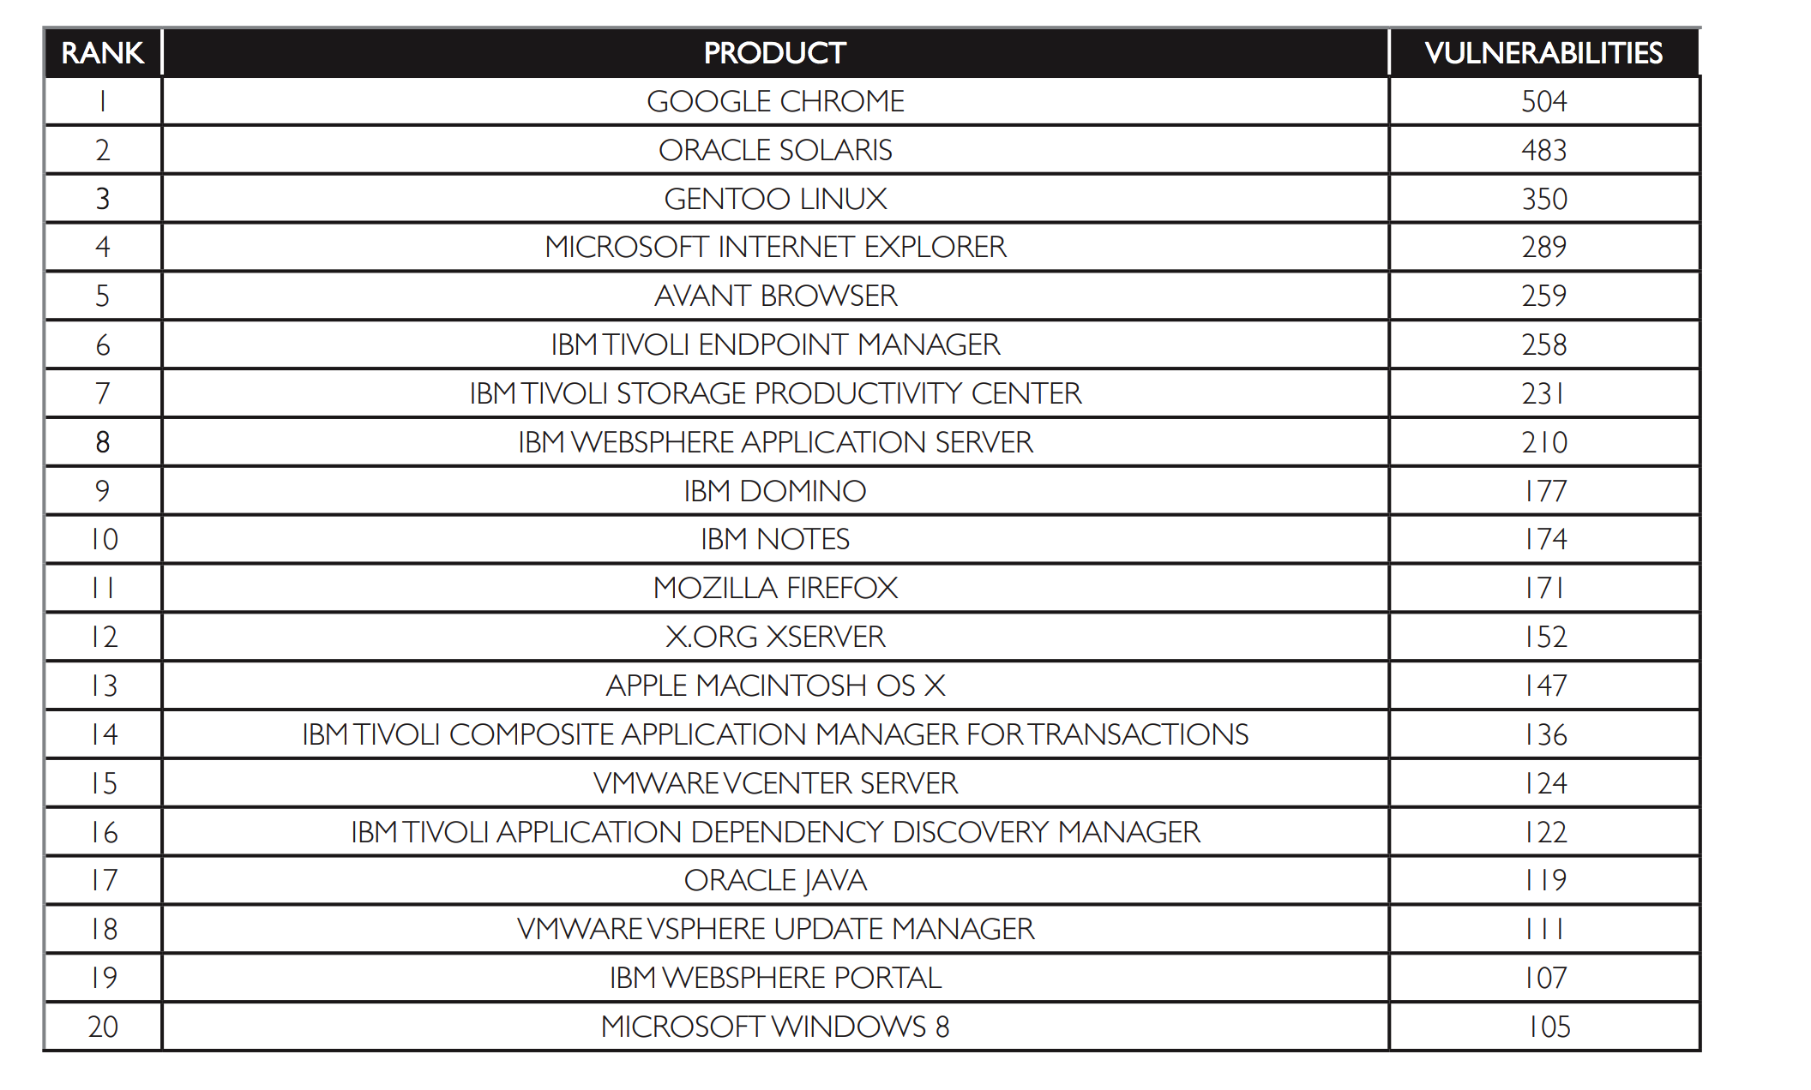
The 20 core products with the most vulnerabilities in 2014

Slide 23
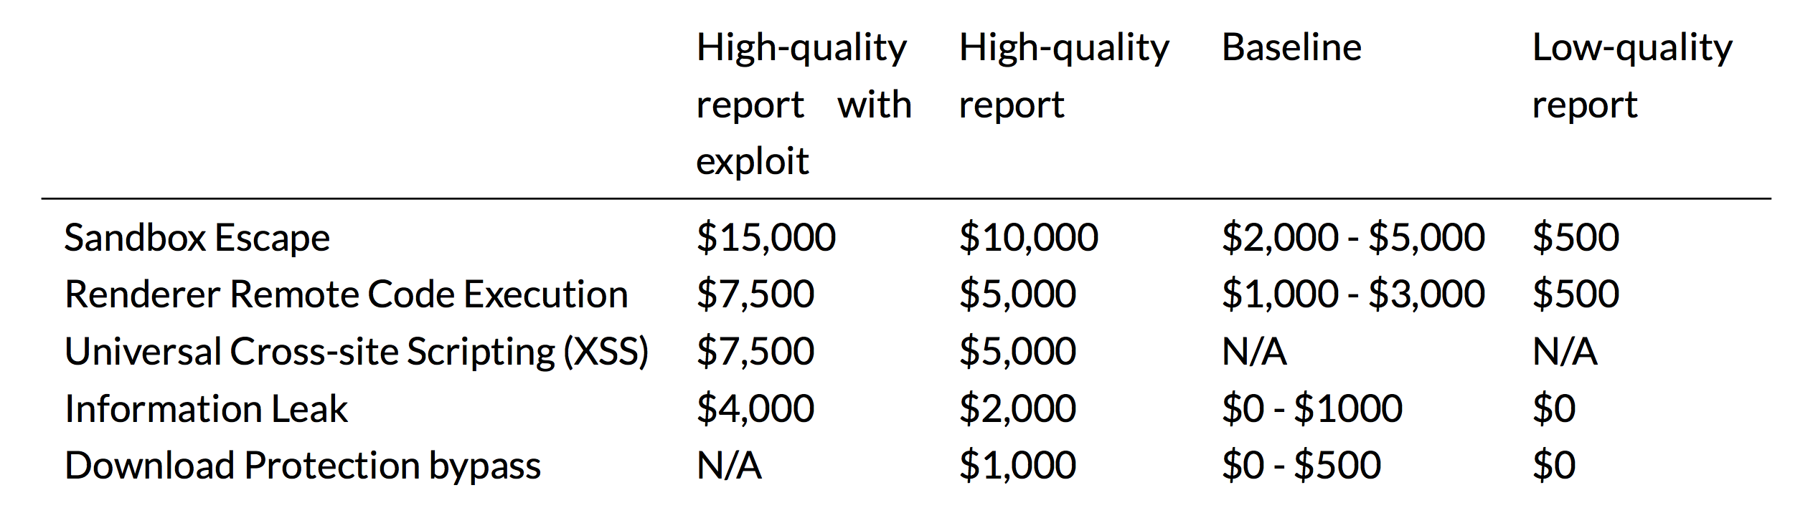
Google Chrome Bug Bounty Rewards

Slide 24
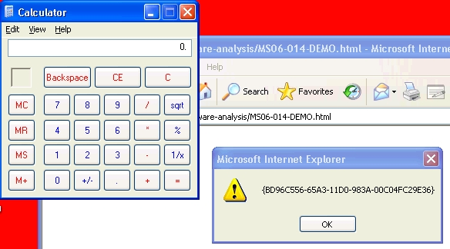
MS06-014
MS06-014
Microsoft Internet Explorer COM CreateObject Code Execution
This module exploits a generic code execution vulnerability in Internet Explorer by abusing vulnerable ActiveX objects.

Slide 26
UI Spoof

Slide 27
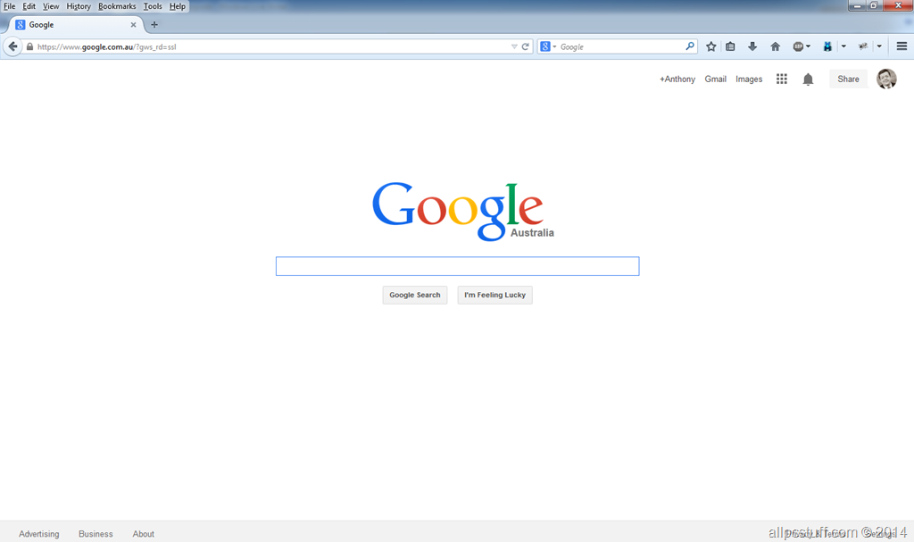
Browser UI

Slide 28
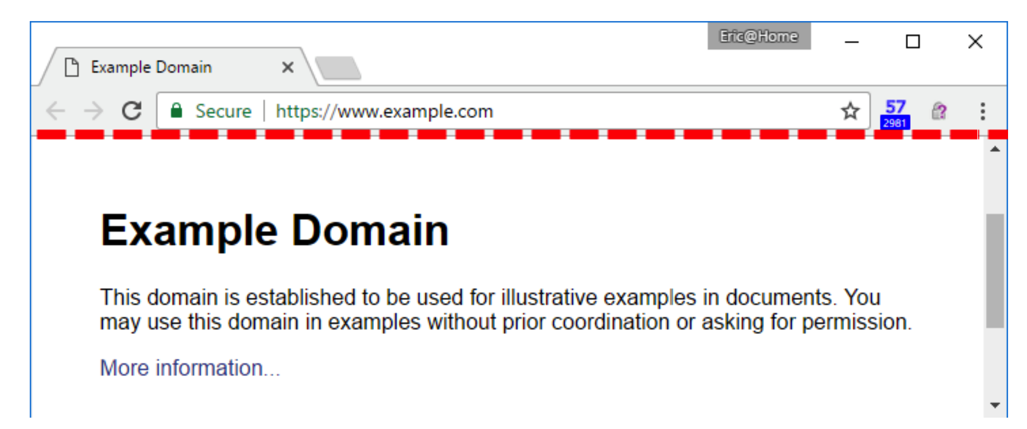
THE LINE OF DEATH (LoD)
In web browsers, the browser itself usually fully controls the top of the window, while pixels under the top are under control of the site.
If a user trusts pixels above the line of death, the thinking goes, they’ll be safe, but if they can be convinced to trust the pixels below the line, they’re goanna die.

Slide 29
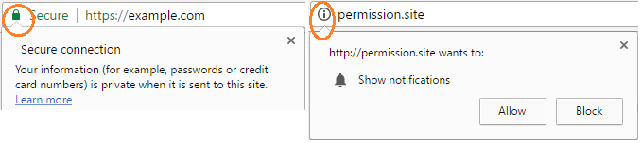
THE LINE OF DEATH (LoD)
For instance, because the area above the LoD is so small, sometimes more space is needed to display trusted UI. Chrome attempts to resolve this by showing a little chevron that crosses the LoD:

Slide 30
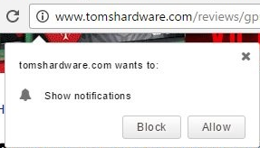
THE LINE OF DEATH (LoD)
The chevron is subtle, and most users will fall for a faked chevron, like some sites have started to use:

Slide 31
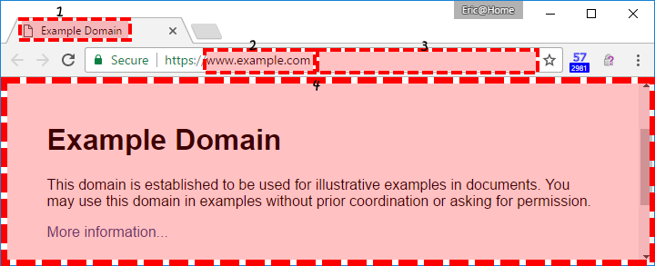
Zone of Death
The bigger problem is that some attacker data is allowed above the LoD; while trusting the content below the LoD will kill your security, there are also areas of death above the line.
A more accurate Zones of Death map might look like this:

Slide 32
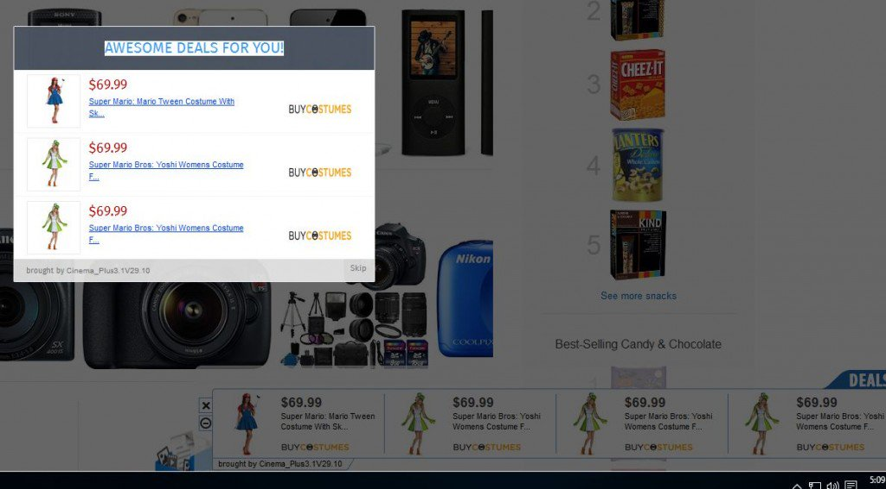
IE6 – No frame browser window

Slide 33
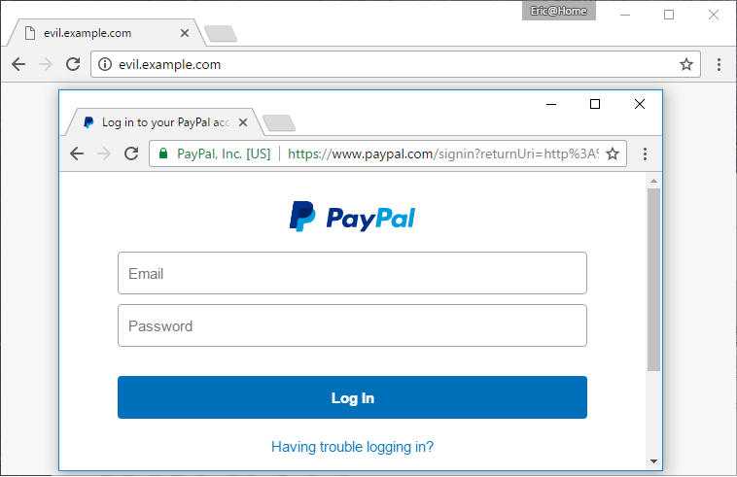
Picture-in-picture attacks

Slide 34
URL Format

Slide 35
Internationalized Resource Identifier (IRI)
The Internationalized Resource Identifier (IRI) was defined by the Internet Engineering Task Force (IETF) in 2005 as a new internet standard to extend upon the existing Uniform Resource Identifier (URI) scheme.^{[1]} The new standard was published in RFC 3987.
While URIs are limited to a subset of the ASCII character set, IRIs may contain characters from the Universal Character Set (Unicode/ISO 10646), including Chinese or Japanese kanji, Korean, Cyrillic characters, and so forth.

Slide 36
Internationalized domain name (IDN)
An internationalized domain name (IDN) is an Internet domain name that contains at least one label that is displayed in software applications, in whole or in part, in a language-specific script or alphabet, such as Arabic, Chinese, Cyrillic, Tamil, Hebrew or the Latin alphabet-based characters with diacritics or ligatures, such as French.
These writing systems are encoded by computers in multi-byte Unicode. Internationalized domain names are stored in the Domain Name System as ASCII strings using Punycode transcription.

Slide 38
Unicode/Punycode

Slide 39
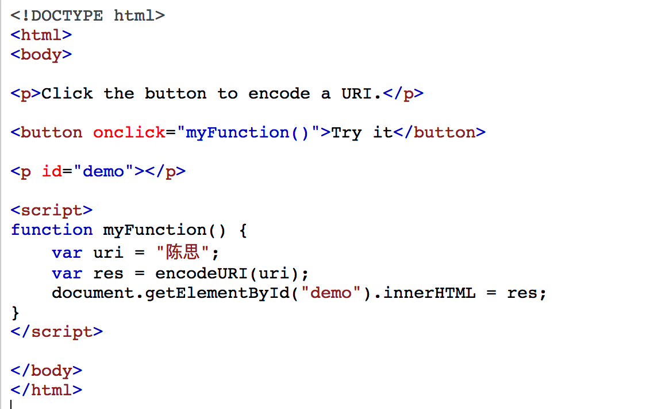
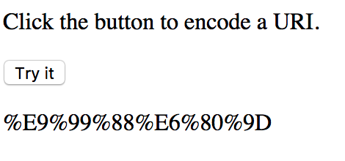
Encode my Name

Slide 40
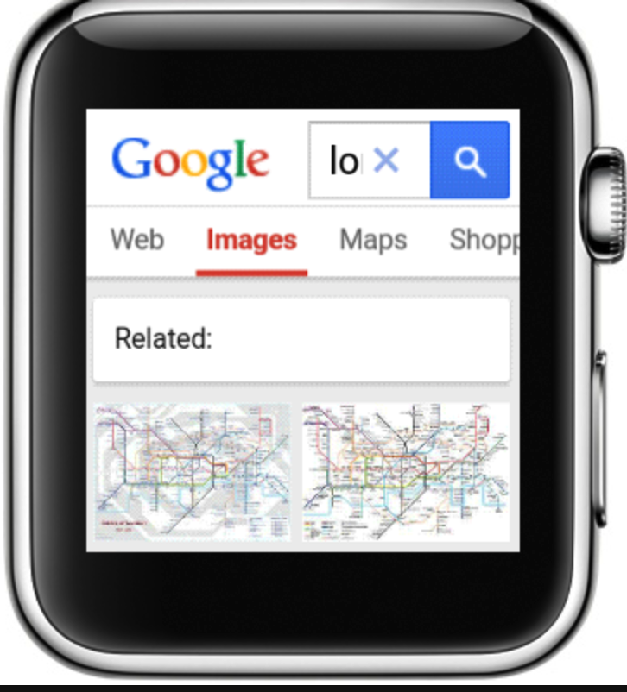
IDN Homograph Attack
∖ (U+2216) and ＼(U+FF3C)

Slide 41
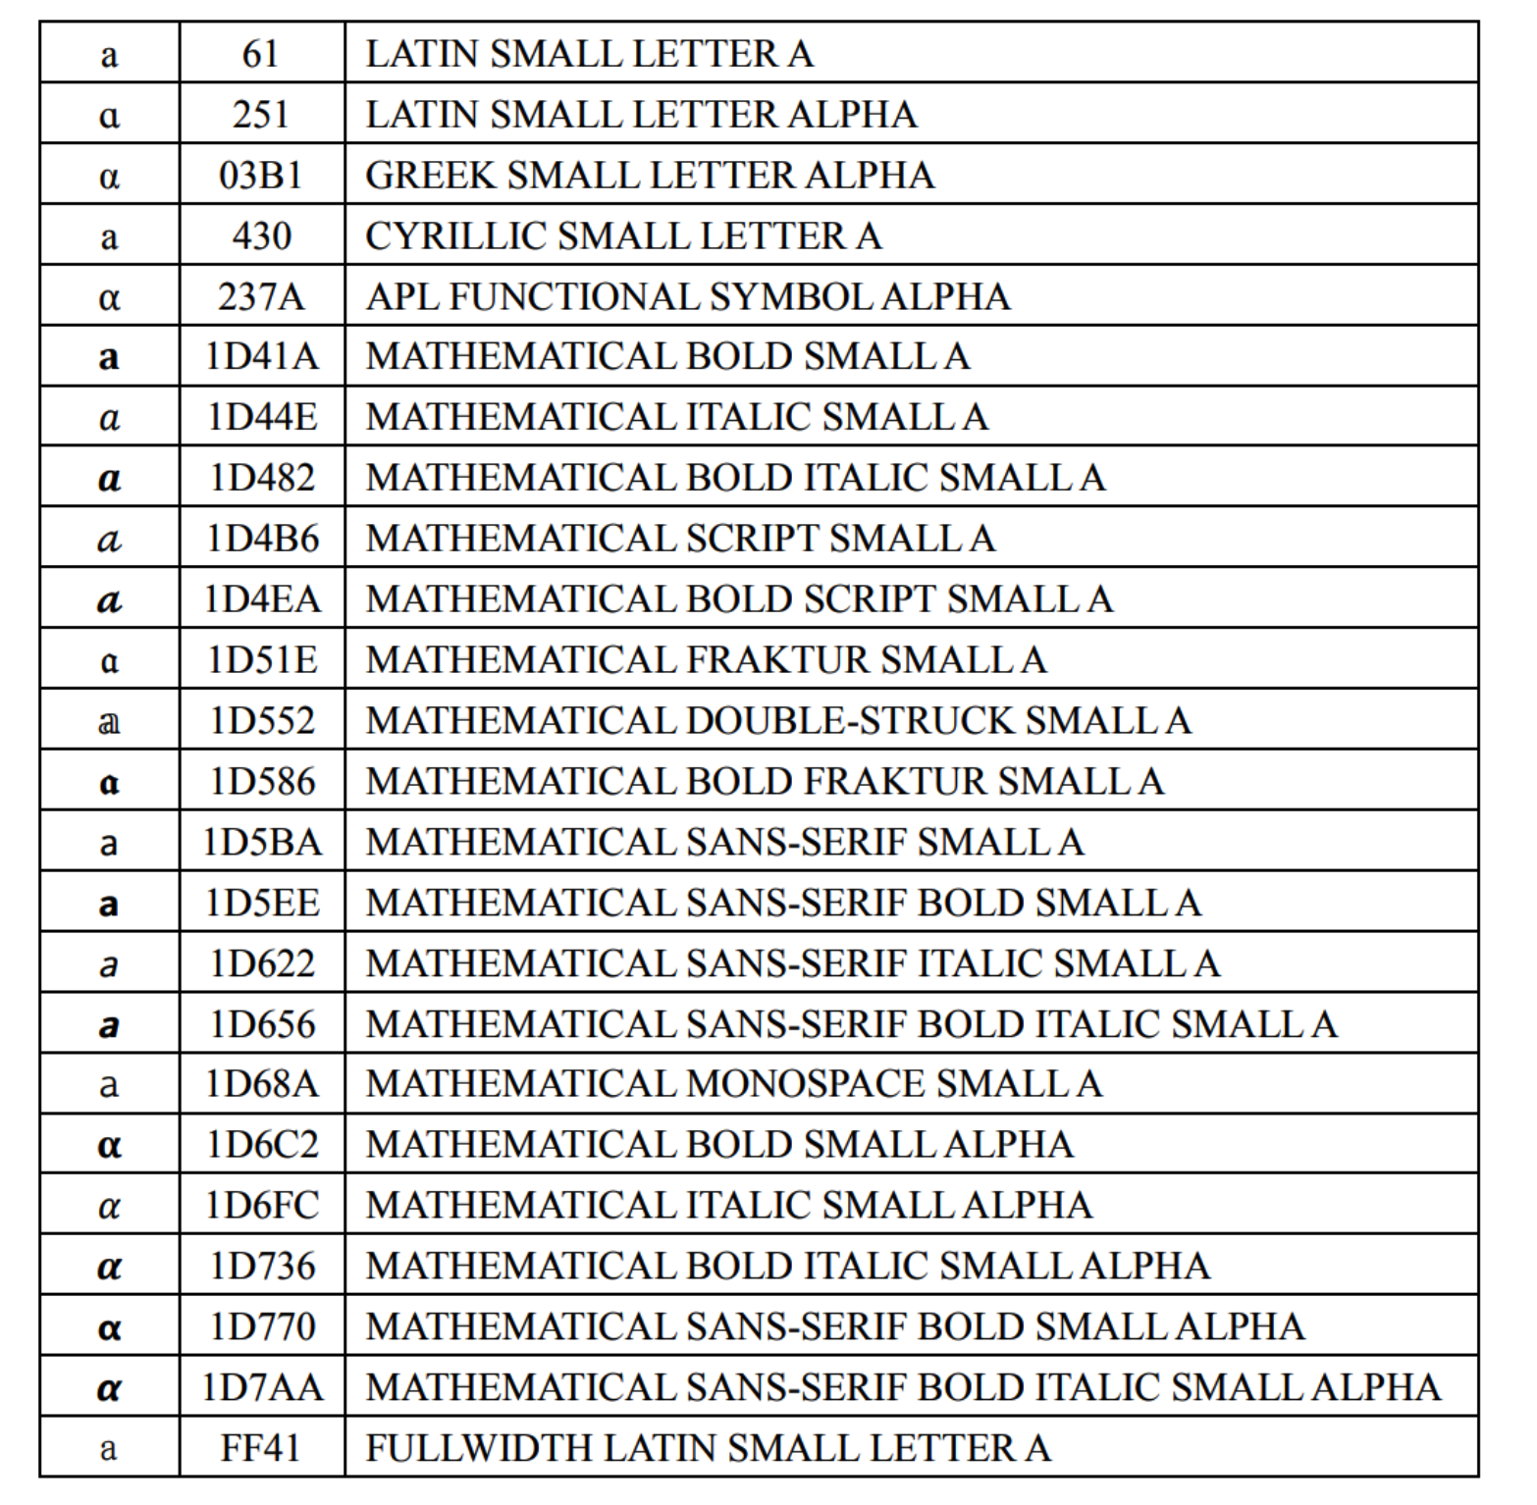
Crafty URL Phishing Method
a(U+0061)

Slide 42
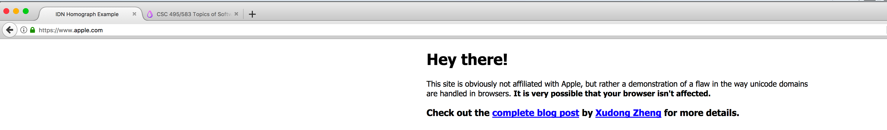
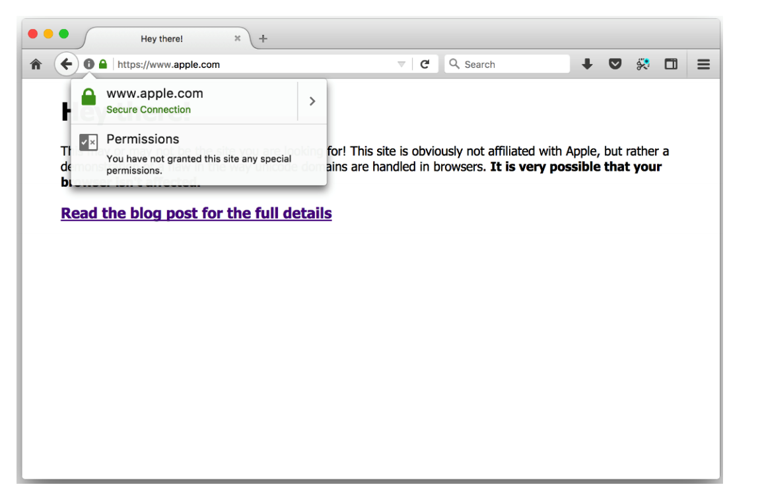
Apple.com (not really)
(CVE-2017-5060）
Cyrillic script

Slide 43
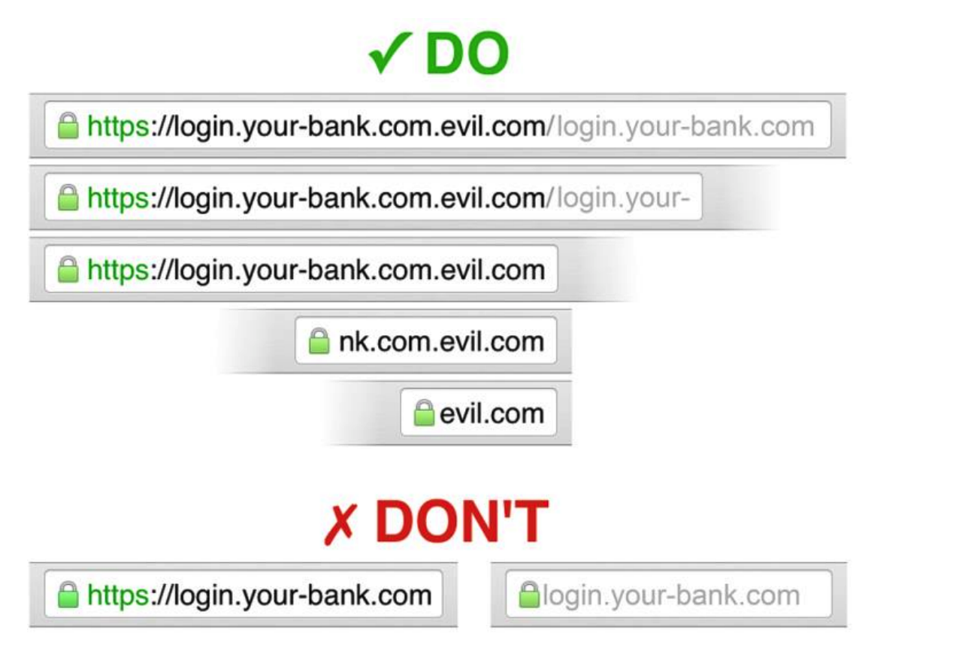
Crafty URL Phishing Method
Malicious URL:
    https://login.your-bank.com.evil.com/login.your-bank.com

Slide 44
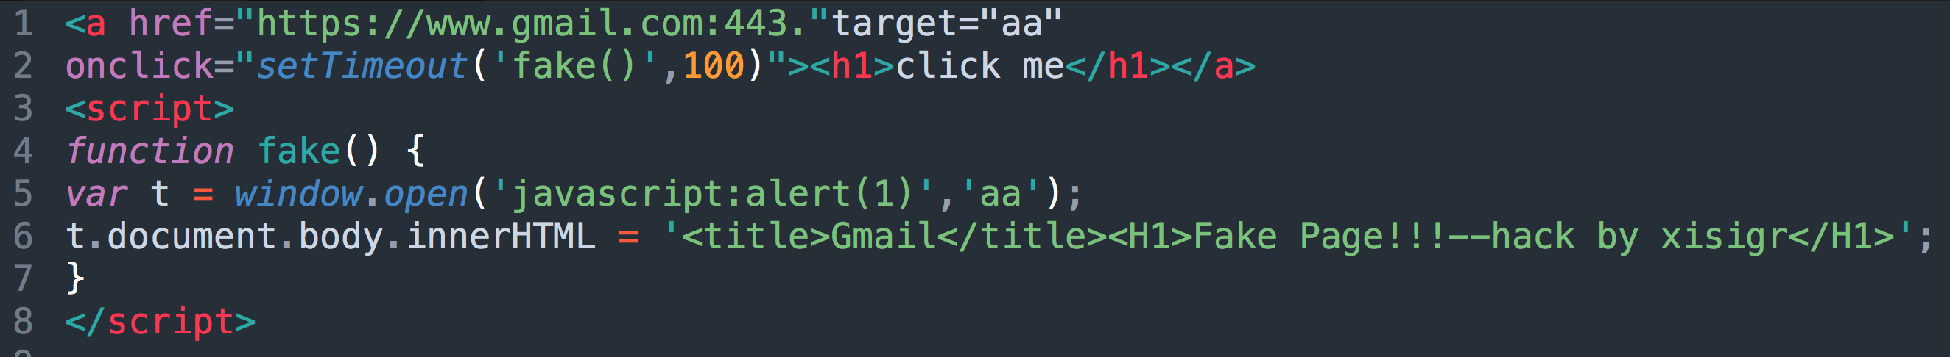
CVE-2015-3755

Slide 45
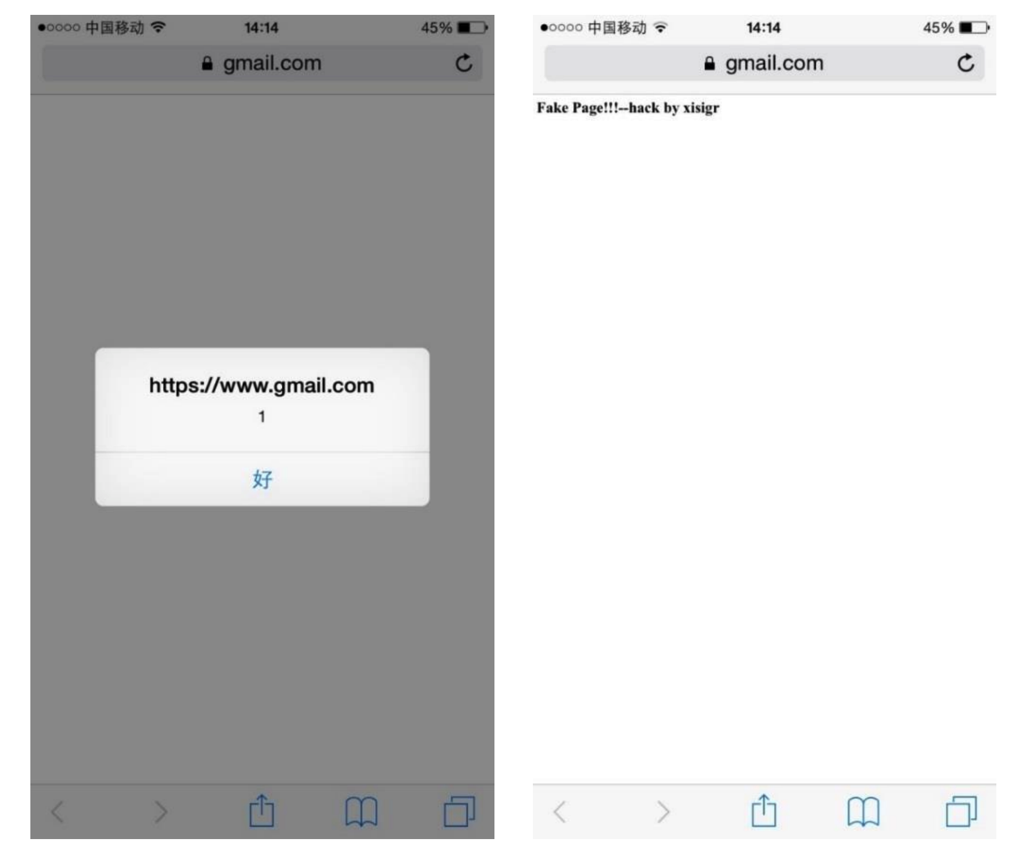

Slide 46
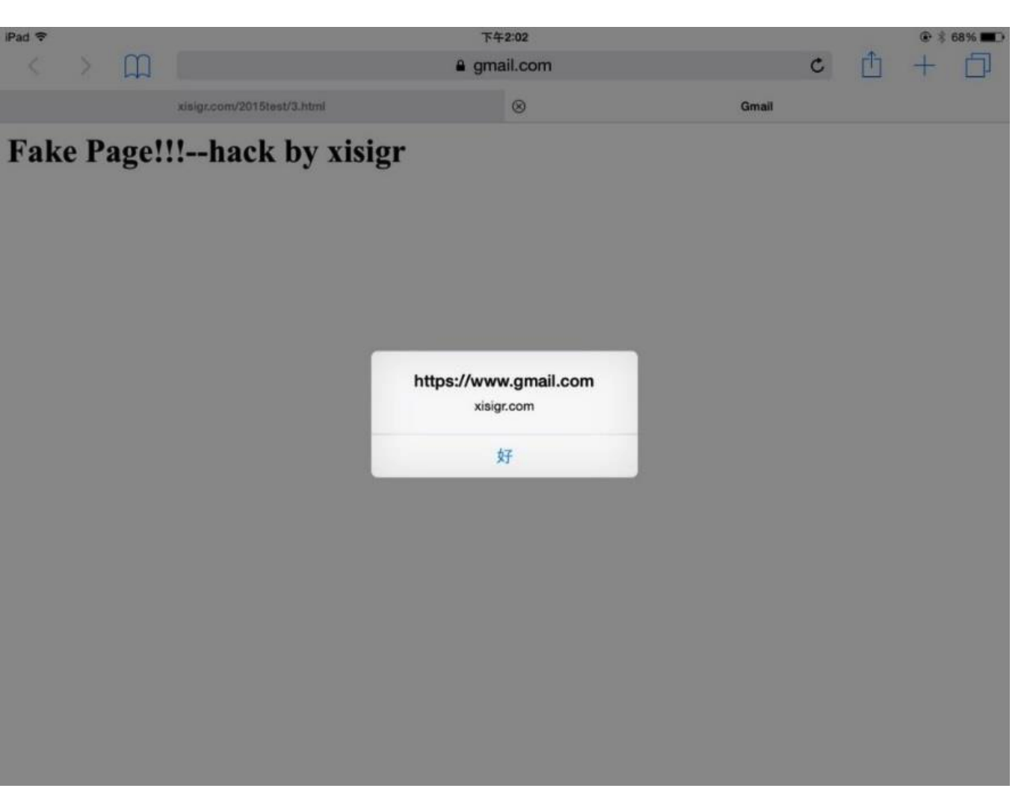
CVE-2015-3755
https://www.gmail.com:443.

Slide 47
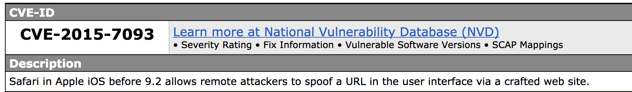
CVE-2015-7093

Slide 48
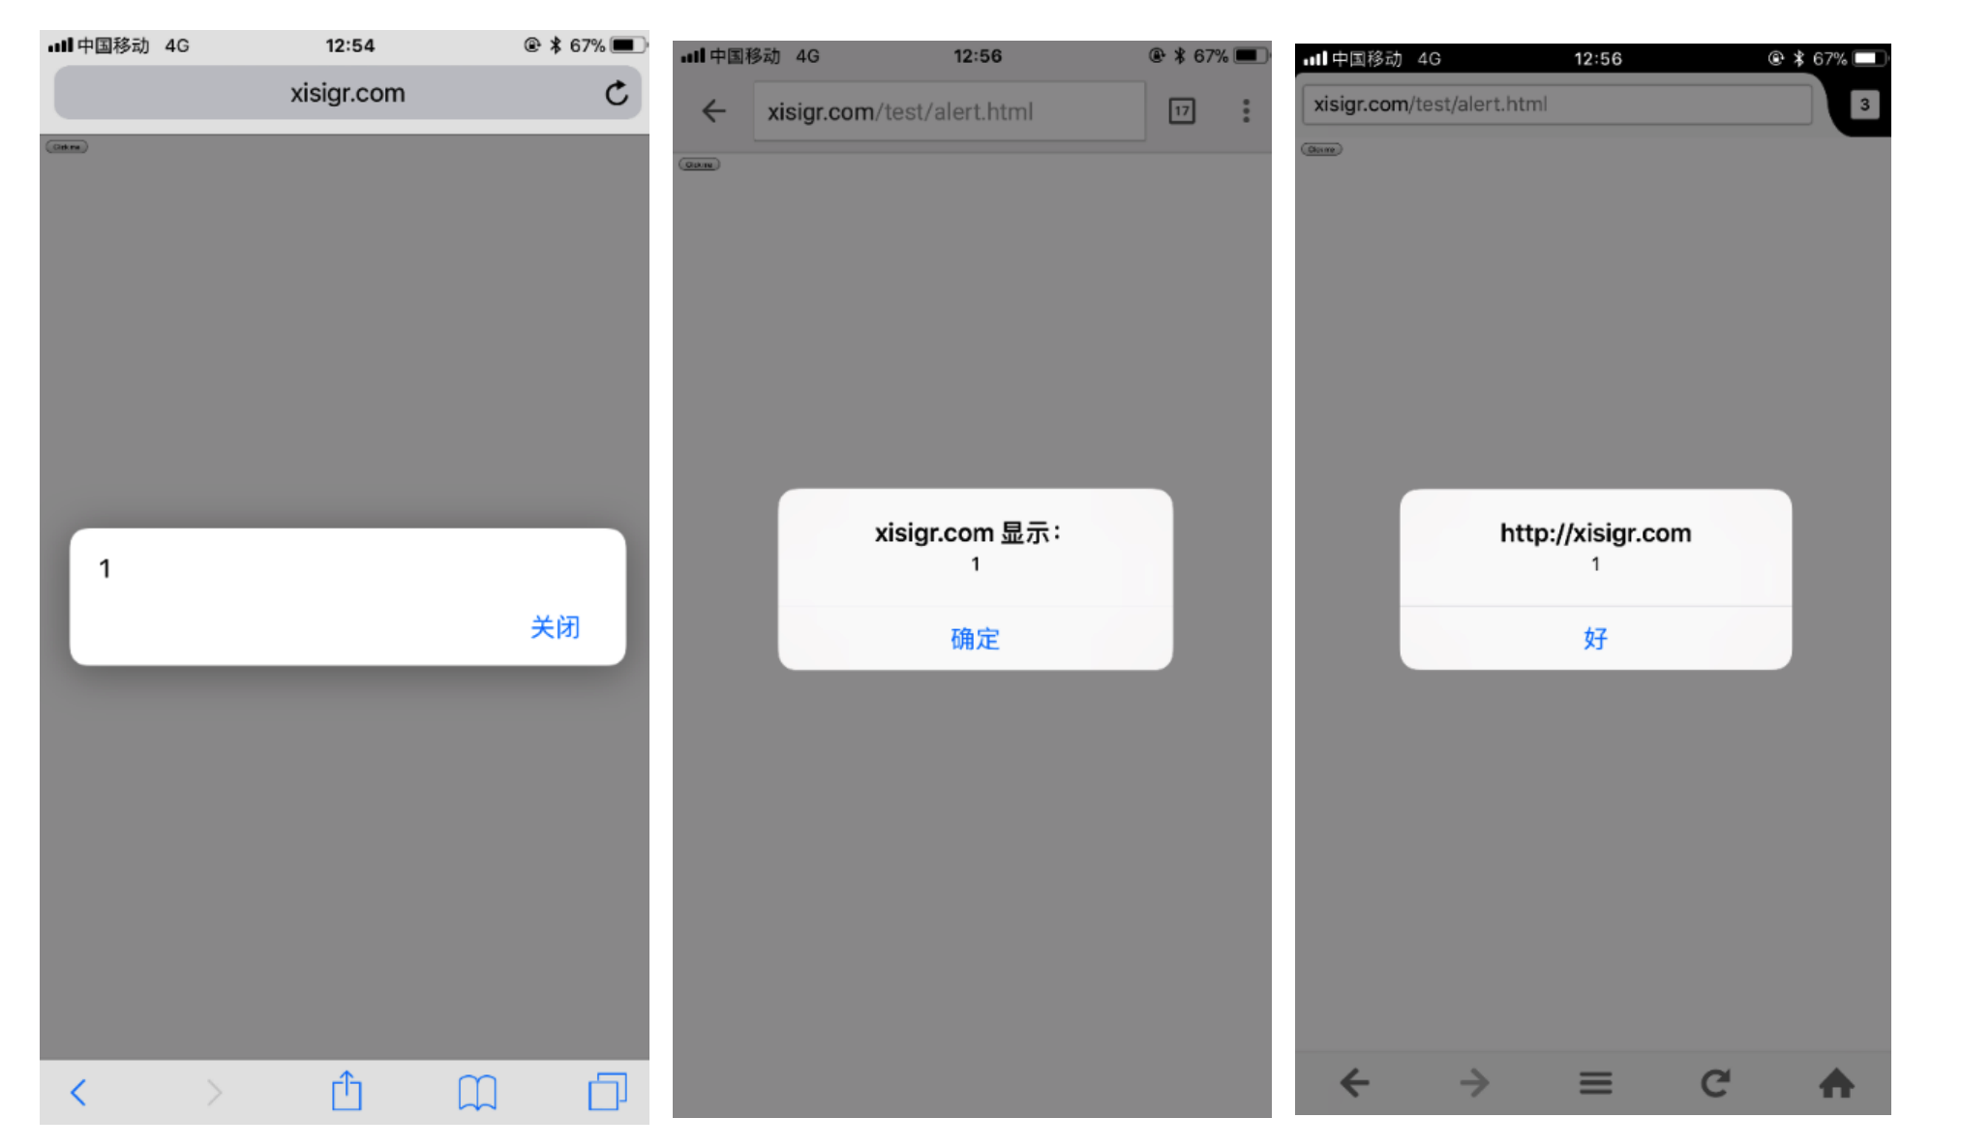
CVE-2015-7093

Slide 49
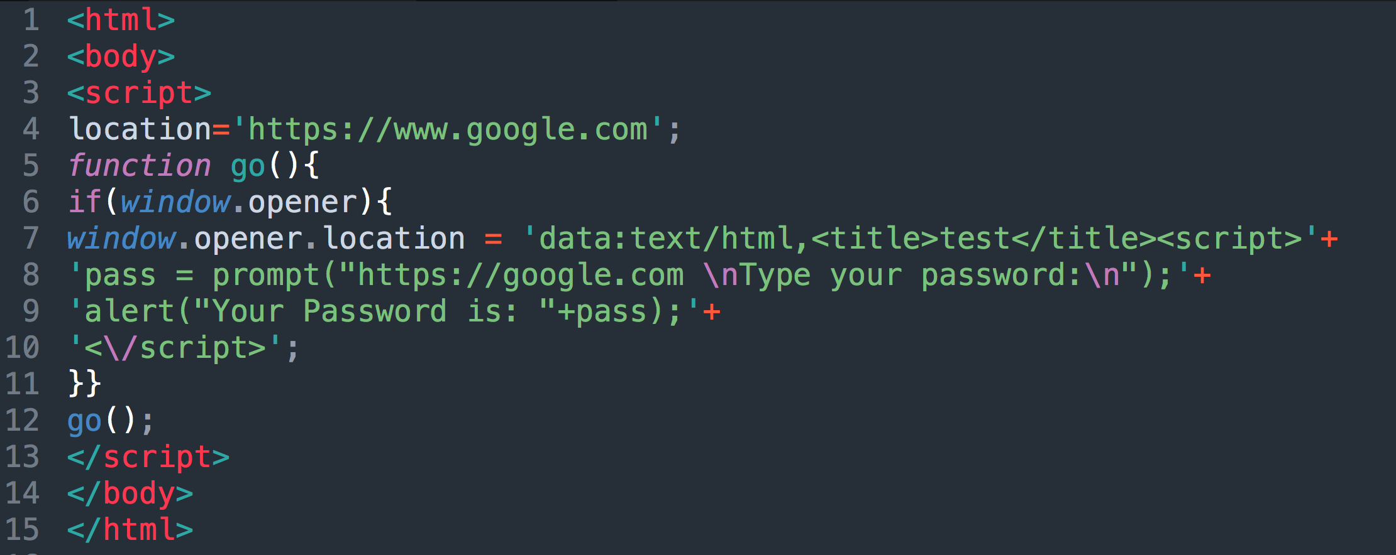
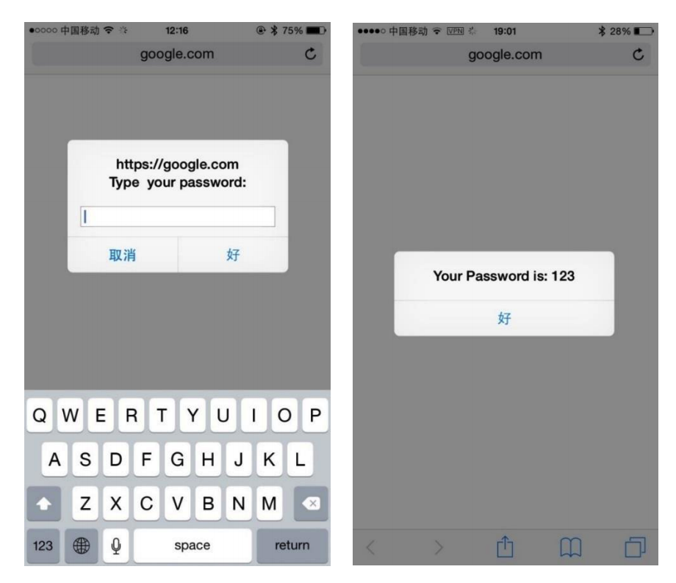
CVE-2015-7093

Slide 50
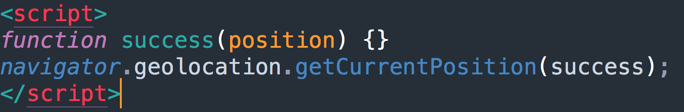
CVE-2016-1779

Slide 51
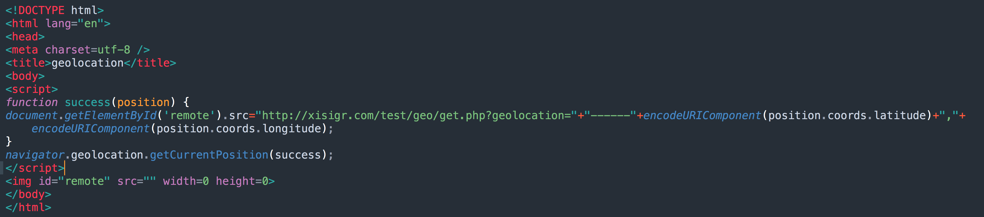
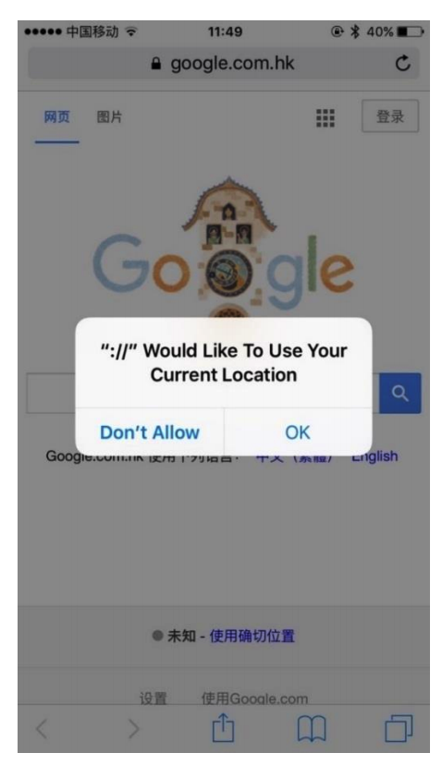

Slide 52
CVE-2016-5189 & CVE-2016-7623
Blob-URLs Spoofing

Slide 53
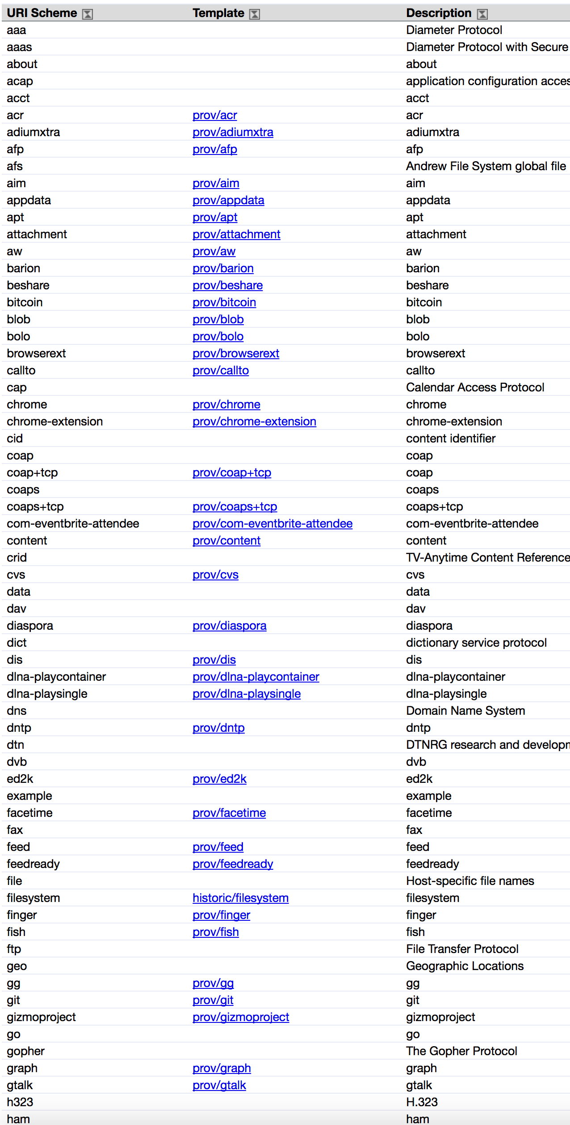
CVE-2016-5189 & CVE-2016-7623
Blob URL
blob -- binary large object

Slide 54
CVE-2016-5189 & CVE-2016-7623
Blob URL
blob -- binary large object

Slide 55
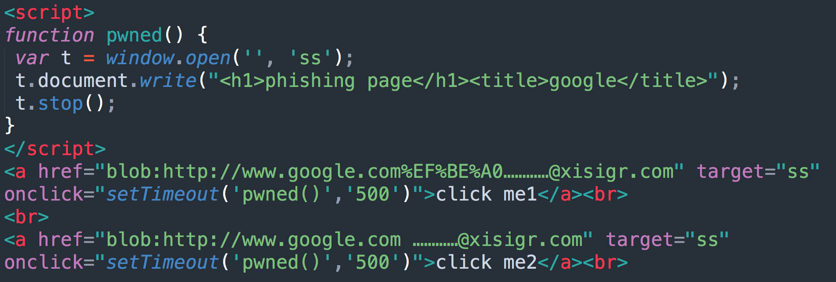
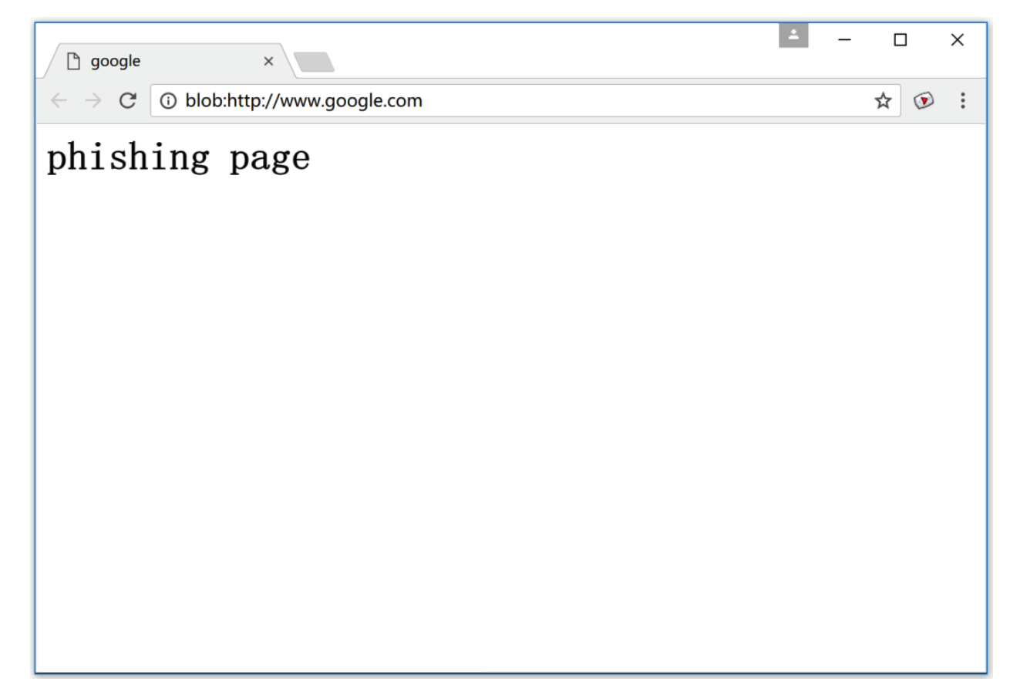
CVE-2016-5189 & CVE-2016-7623

Slide 56
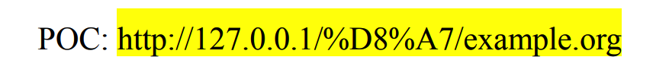
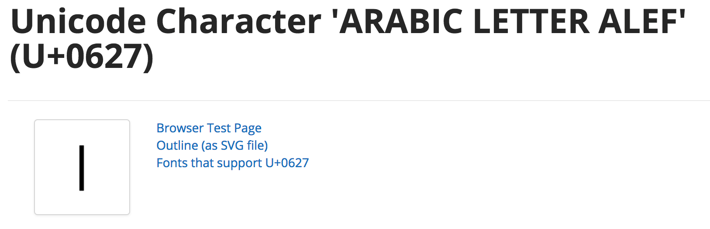
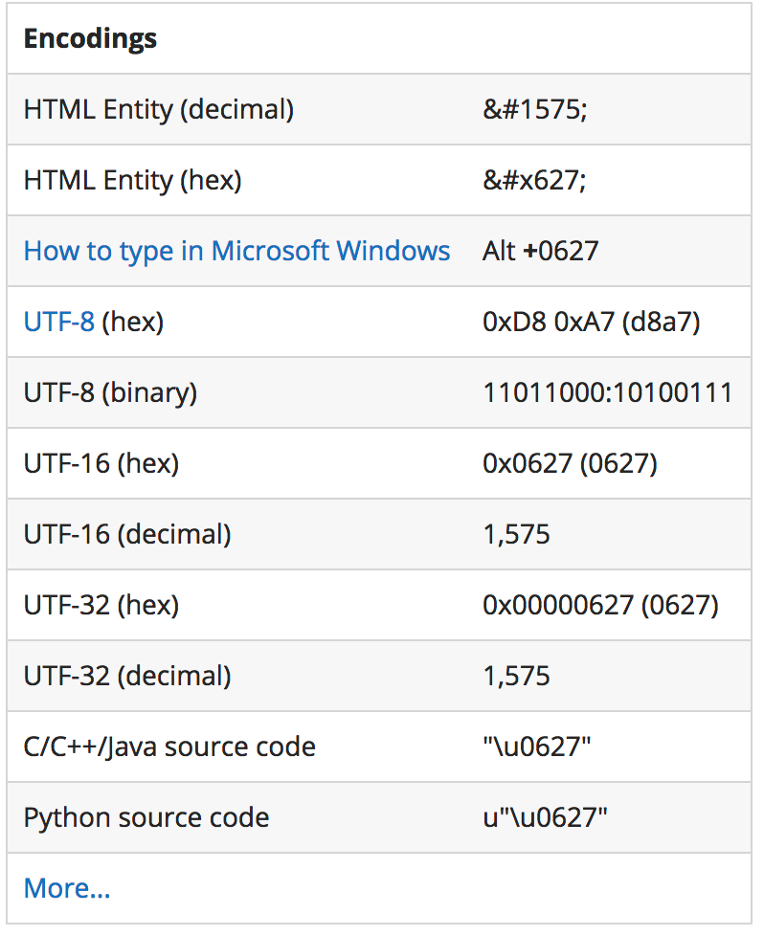
CVE-2017-5072
RTL character in URL flips domain and path (Android 4.2 and earlier)

Slide 58

Status Bar Spoofing

Slide 59


Slide 60
Browser Extensions

Slide 61


Slide 62

Web Extension Architecture Overview
A Web Extension has a very similar structure to the one found for HTML websites handling folders and their respective data.
The extension file itself is nothing but a compressed folder structure containing HTML files, JavaScript, HTML, CSS, images, audio, and so on

Slide 63

CHROME EXTENSIONS

Slide 64
CHROME EXTENSIONS

Slide 65




servers
servers
client-side website
extension
client-side
browser API
history bookmarks
website
WEB ATTACKER

Slide 66
servers
servers
client-side website
extension
client-side
browser API
history bookmarks
website
WEB ATTACKER

Slide 67
servers
servers
client-side website
extension
client-side website
browser API
history bookmarks
NETWORK ATTACKER

Slide 68
servers
servers
client-side website
extension
client-side website
browser API
history bookmarks
NETWORK ATTACKER

Slide 69
CHROME’S
SECURITY MECHANISMS

Slide 70


servers
servers
client-side website
content script
core extension
extension
browser API
history bookmarks
PRIVILEGE SEPARATION

Slide 71
servers
servers
client-side website
content script
core extension
content script
extension
client-side website
browser API
history bookmarks
ISOLATED WORLDS

Slide 72


server
servers
server
client-side website
content script
core extension
extension
client-side website
browser API
history bookmarks
PERMISSIONS

Slide 73
FINDING BUGS
SAMPLE
50 most popular + 50 random extensions
METHODS
Black-box testing + source code analysis
VERIFICATION
Built exploits to confirm the vulnerabilities

Slide 74
Popular | Random | Total
22 | 18 | 40
VULNERABLE EXTENSIONS

Slide 75

EXAMPLE: SPEED DIAL
Notes:
Example. The Speeddial extension replicates Chrome’s built-in list of recently closed pages. Speeddial keeps track of the tabs opened using the tabs manager and does not sanitize the titles of these pages before adding them to the HTML of one of its core extension pages. If a title were to contain an inline script, it would execute with the core extension’s permissions.

Slide 76
ISOLATED WORLDS

Slide 77



Need for isolation
If Googkle can script other windows, then can steal passwords, post fraudulent bank or retail transactions, etc., etc.

Slide 78

Need for isolation - mashups

Slide 79

Need for isolation - advertisements

Slide 80

Browser and document tree structure
W3C standard differs from models supported in existing browsers

Slide 81
Vulnerability count:
3 content script vulns

Slide 82
DATA AS HTML
MISTAKE
Insert data as HTML, where it can execute
MITIGATION
Will execute in website’s isolated world
VULNERABILITIES
6 extensions have data-as-HTML bugs that
don’t cause content script vulnerabilities

Slide 83

EVAL
MISTAKE
Use eval to execute untrusted data
MITIGATION
Isolated worlds does not mitigate this bug
VULNERABILITIES
2 vulnerabilities due to this mistake

Slide 84

CLICK INJECTION
MISTAKE
Trusting event handlers on a website
MITIGATION
Isolated worlds does not mitigate this bug
VULNERABILITIES
1 vulnerability due to this mistake

Slide 85
Isolated worlds is highly effective because it mitigates common bugs

Slide 86
PRIVILEGE SEPARATION

Slide 87
Privilege separation: protect core extensions

Slide 88
client-side website
content script
core extension
extension
browser API
history bookmarks
PRIVILEGE SEPARATION

Slide 89
Vulnerability count:
50 core extension vulns

Slide 90
servers
client-side website
content script
core
extension
extension
browser API
history bookmarks
METADATA ATTACK

Slide 91
EXAMPLE: SPEED DIAL
Notes:
Example. The Speeddial extension replicates Chrome’s built-in list of recently closed pages. Speeddial keeps track of the tabs opened using the tabs manager and does not sanitize the titles of these pages before adding them to the HTML of one of its core extension pages. If a title were to contain an inline script, it would execute with the core extension’s permissions.

Slide 92
servers
client-side website
content script
core extension
extension
browser API
history bookmarks
HTTP SCRIPTS/XHRS

Slide 93
PERMISSIONS

Slide 94
Javascript Security Model
“Sandbox” design
  No direct file access, restricted network access
Same-origin policy
  Frame can only read properties of documents and windows from same place: server, protocol, port
However, this does not apply to
  Script loaded in enclosing frame from arbitrary site
  This script runs as if it were loaded from the site that provided the page!
<script type="text/javascript">
src="http://www.example.com/scripts/somescript.js">
</script>
Reference: http://www.devarticles.com/c/a/JavaScript/JavaScript-Security/

Slide 95

Cross-Origin XMLHttpRequest
Regular web pages can use the XMLHttpRequest object to send and receive data from remote servers, but they're limited by the same origin policy.
Extensions aren't so limited. An extension can talk to remote servers outside of its origin, as long as it first requests cross-origin permissions.

Slide 96
Permissions:
limit the scope of core vulnerabilities

Slide 97








None 15%
Low
High 44%
11%
Medium 30%
27 buggy extensions
PERMISSION RATE

Slide 98
Reduces potential for severe attacks by half

Slide 99









None 15%
None 1%
Low 12%
Low
High 44%
11%
Medium 30%
High 49%
Medium 37%
with bugs
others
RATE COMPARISON

Slide 100
No correlation between bugs and permissions

Slide 101
Yes, permissions limit the scope of vulnerabilities

Slide 102

Q & A

