Slide 1
Class2-3
CSC 495/583 Advanced Topics in Computer Security
Web Security and privacy
Si Chen (schen@wcupa.edu)

Slide 2
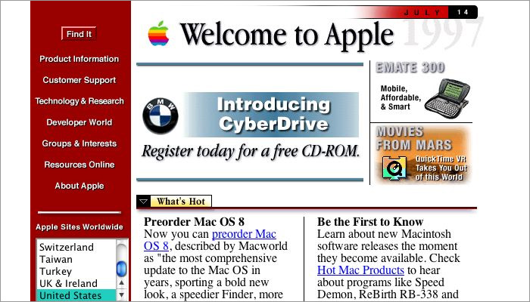
The Evolution of Web Applications
In the early days of the Internet, the World Wide Web (WWW) consisted only of websites.
  essentially information repositories containing static documents.

Slide 3
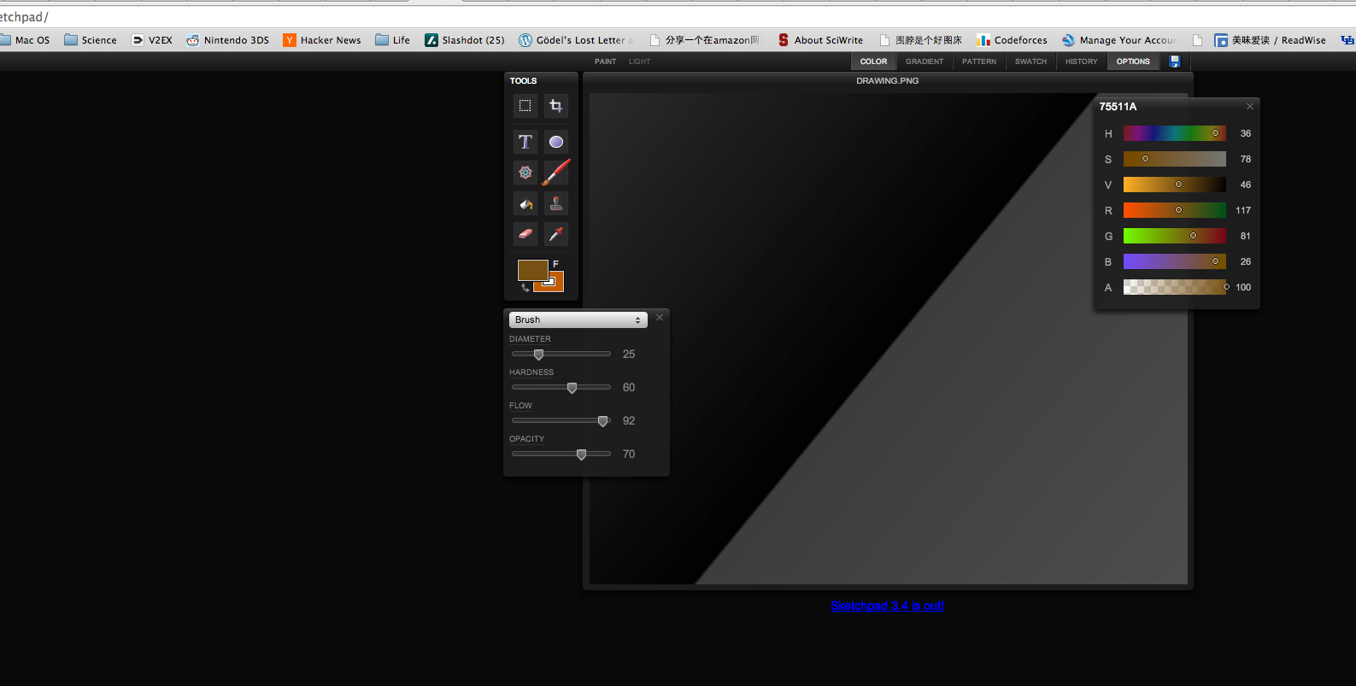
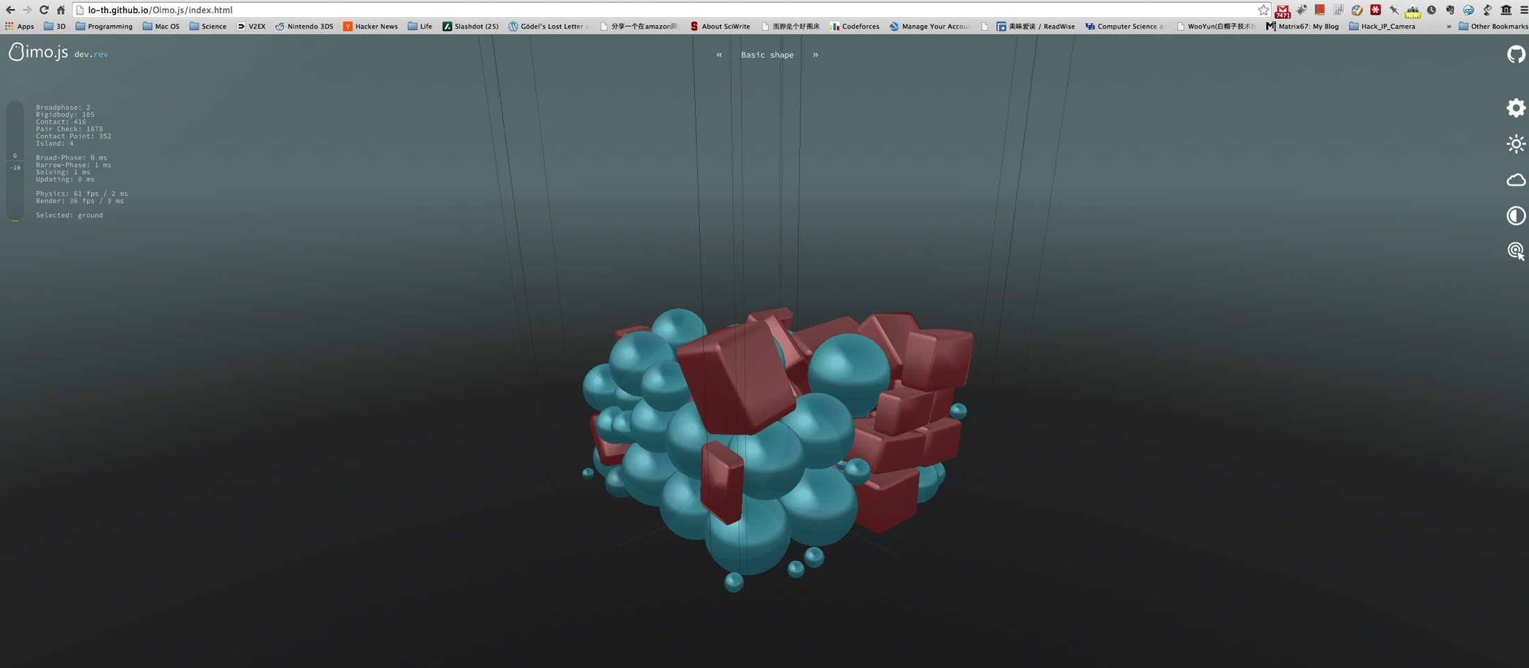
The Evolution of Web Applications
Today, the majority of sites on the web are in fact applications.
  Highly functional
  Rely on two-way flow of information between the server and browser.

Slide 4
THE WEB IS SIMPLE
Hyper Text Transfer Protocol (HTTP)
Designed to allow remote document retrieval
Simple client server model:
Client
Server

Slide 5
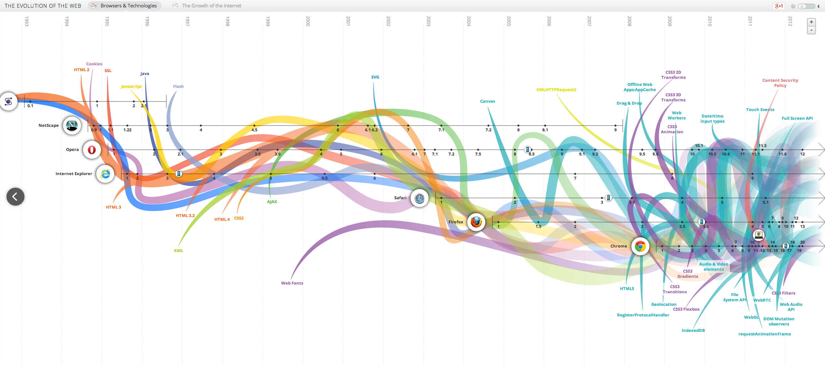
The Reality
Web application security is massively complex.
Constant evolving field
  WebGL, HTML5, CSS3, AJAX…
.
http://www.evolutionoftheweb.com/

Slide 6
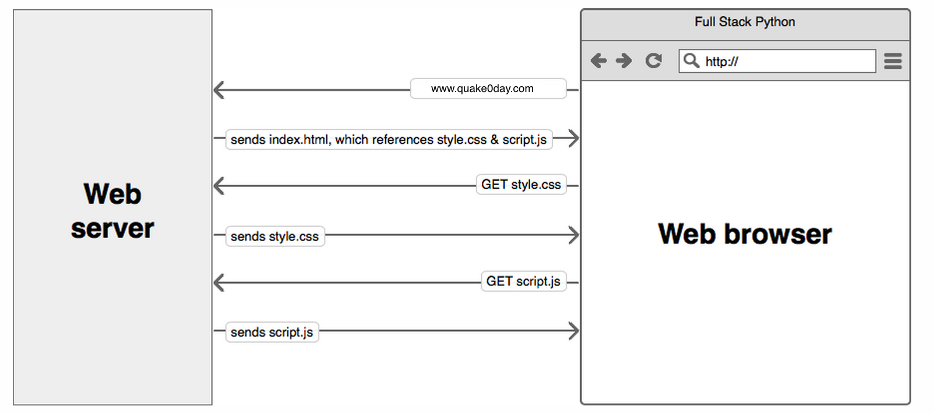
Typical Web Application Stack
Browser (client)
HTTP over TCP/IP
Server
  Operating system
  Web Server
  Scripting Language
  Database or persistence layer

Slide 7
Just the client
Many different clients, all implementing differently (Chrome, Firefox, Microsoft Edge, Safari, Opera, etc…)
The breakdown of the client-server divide
  The functional boundaries between client and server responsibilities were quickly eroded
JavaScript
JavaScript allows for client side programming (responsive user interface (UI))
Plug-in’s allow for store data locally (jStorage)
AJAX allows display multiple HTML sources in one page
Notes:
Benefits: low CPU and memory requirements in the server side, responsive user interfaces,
The web began as a classical example of proper client-server architecture

Slide 8

Fertile Ground
Web application security is massively complex in reality:
  Security researchers specialize in specific portions of the stack
  Protocols and specs exist but aren’t implemented uniformly
  The platforms are changing
    Smartphone, tablets, embedded systems, etc…

Slide 9
What’s Worse
In the browser world, the separation between high-level data objects (documents), user-level code (applications) is virtually nonexistent.
Firewalls become irrelevant as everything flows over port 80 (http), 443 (https)
Web is becoming the default content and application deliver mechanism

Slide 10
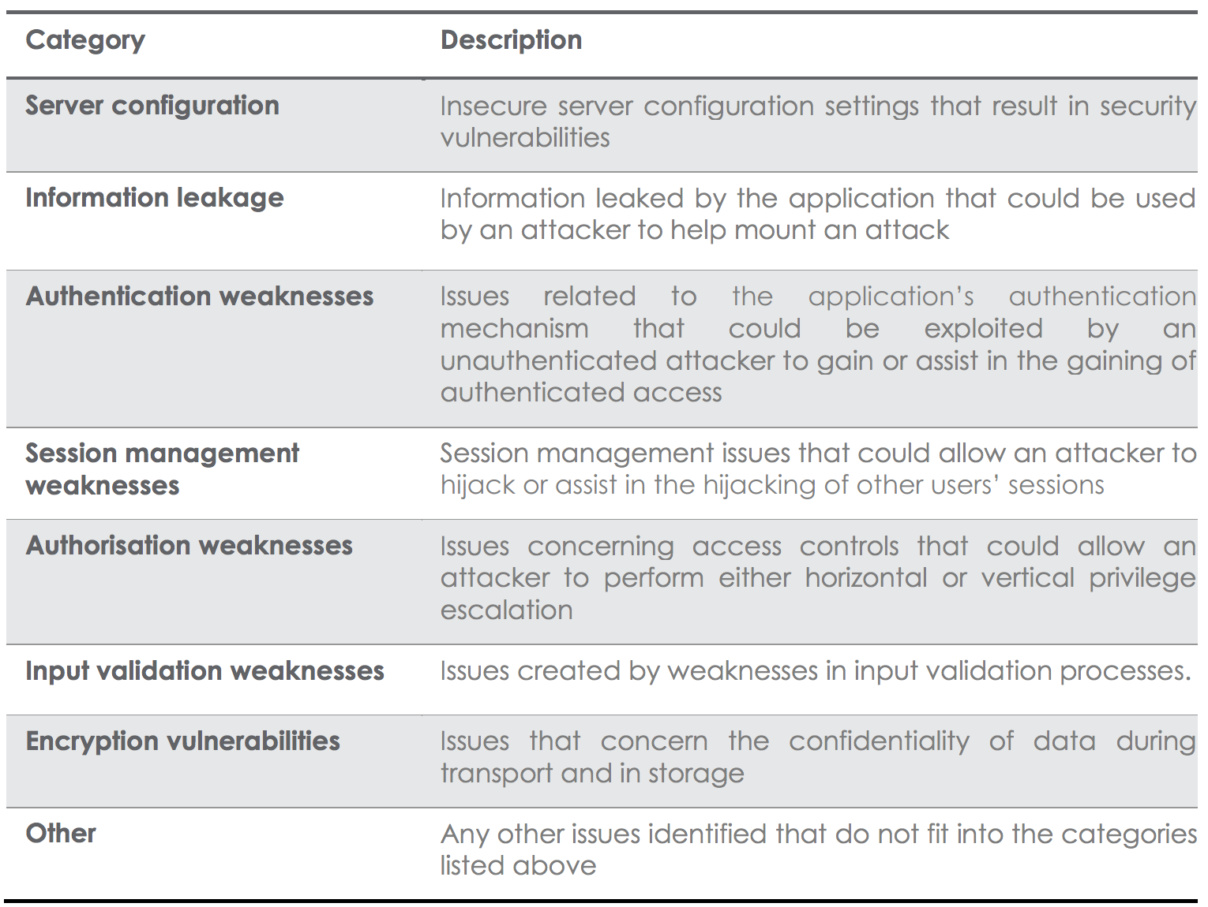
Categories of Vulnerability
http://www.contextis.com/files/Web_Application_Vulnerability_Statistics_-_June_2013.pdf
Notes:
Unpatched security flaws in the server software Server software flaws or misconfigurations that permit directory listing and directory traversal attacks Unnecessary default, backup, or sample files, including scripts, applications, configuration files, and web pages Improper file and directory permissions Unnecessary services enabled, including content management and remote administration Default accounts with their default passwords Administrative or debugging functions that are enabled or accessible Overly informative error messages (more details in the error handling section) Misconfigured SSL certificates and encryption settings Use of self-signed certificates to achieve authentication and man-in-the-middle protection Use of default certificates Improper authentication with external systems

Slide 11
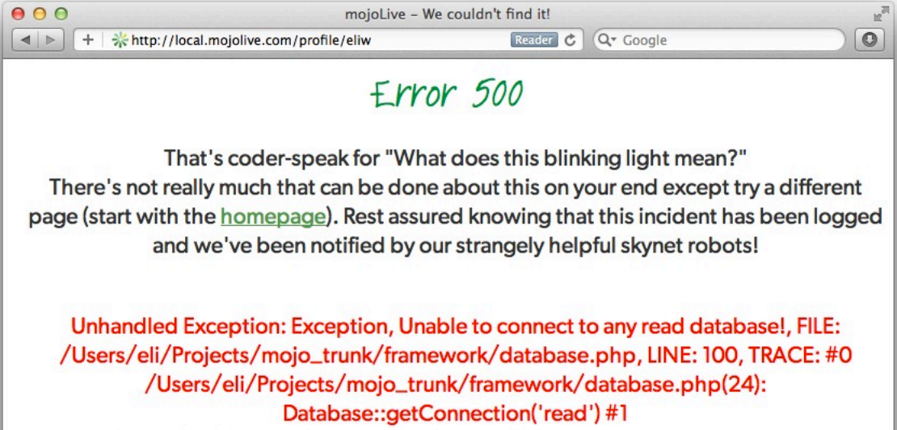
Information Leakage
Visible Error Handling
http://Local.mojolive.com/profile/eliw

Slide 12
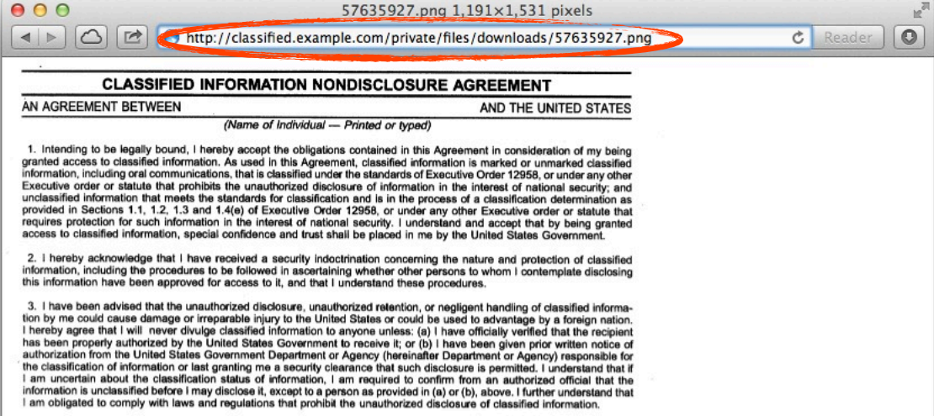
Authentication Weakness
Direct URL access to a protected file
Eli White, Web Security and You,page6

Slide 13
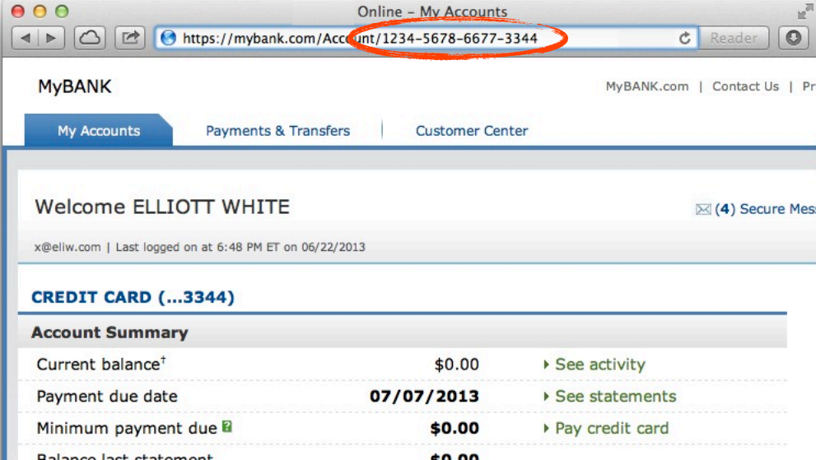
Authentication Weakness
Ability to URL-hack to access unauthorized data.
Eli White, Web Security and You,page7

Slide 14
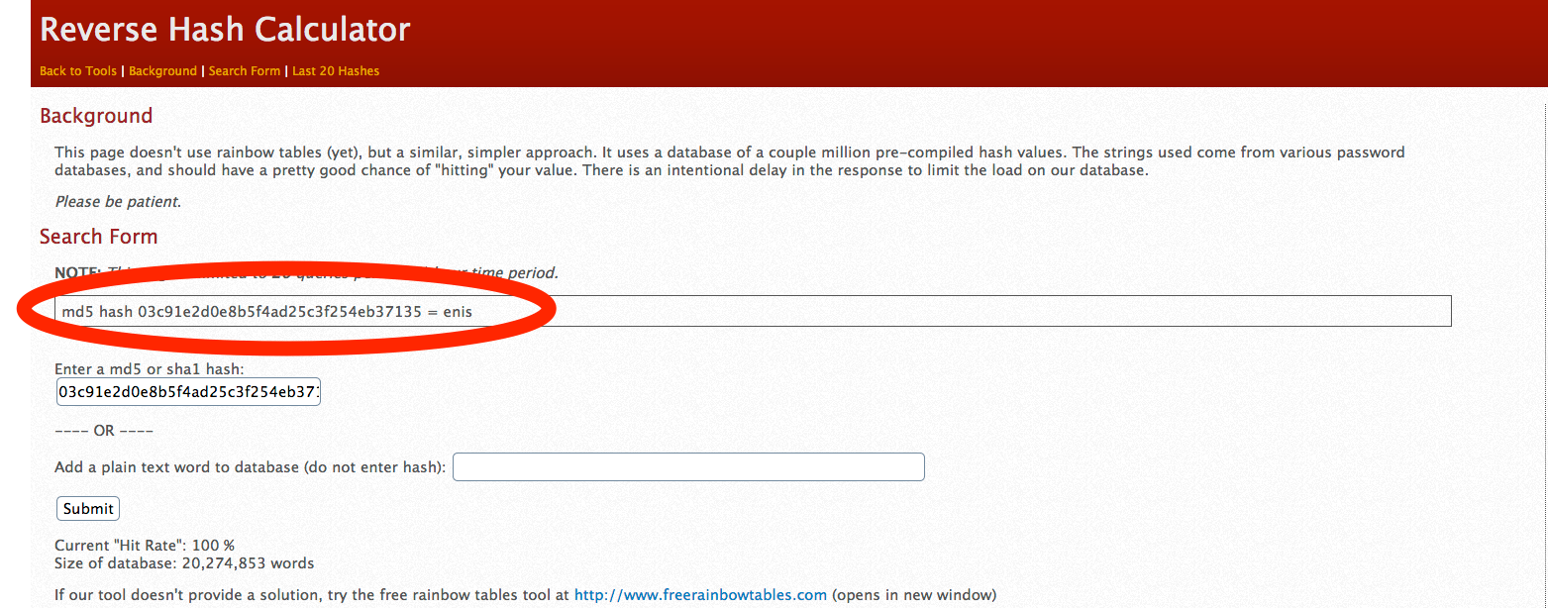
Encryption Vulnerabilities
Low Security Hashes
Don’t just use MD5 (use SHA256, Blowfish,etc…) Even SHA-1 is better
Always salt your hashes

Slide 15
Various Attack Vectors
Now moving on to true ‘attacks’….

Slide 16
Attacking Data Stores: SQL Injection
SQL stands for Structured Query Language.
SQL is used to communicate with a database.
SQL Injection
Web Application Server
SQL Database

Slide 17
Attacking Data Stores: SQL Injection
It is common to build an SQL Database query based in part on a user submission.
  User submits a login request, we need to check the database for a matching account.
Malicious user know we will be building an SQL query.
  They can attempt to confuse the Database server by putting in special characters
SQL Injection
Web Application Server
SQL Database

Slide 18
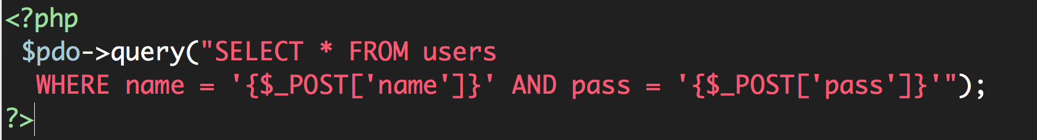
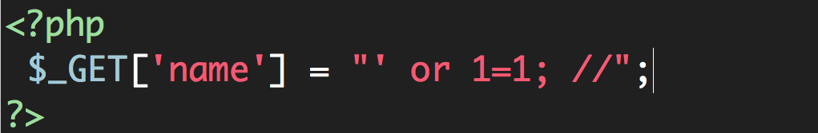
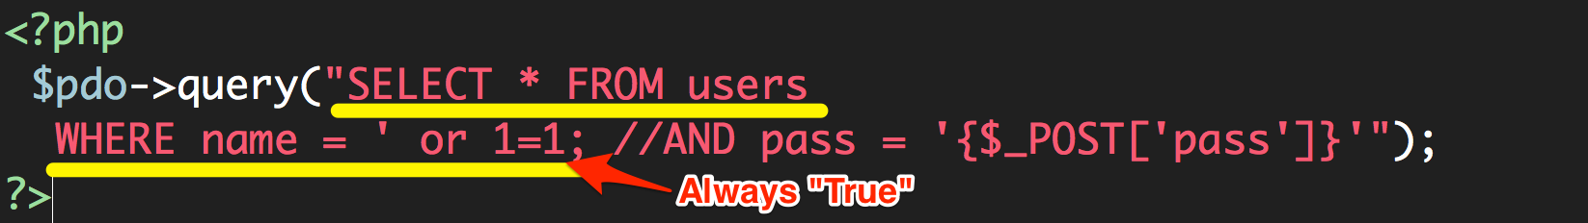
Attacking Data Stores: SQL Injection
A user having the ability to send data that is directly interpreted by your SQL engine.
The Security Hole:
The Attack:

Slide 19
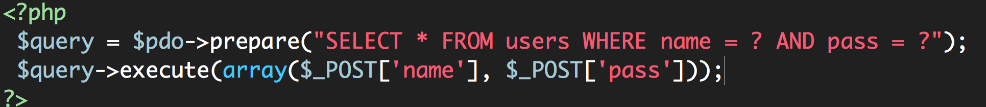
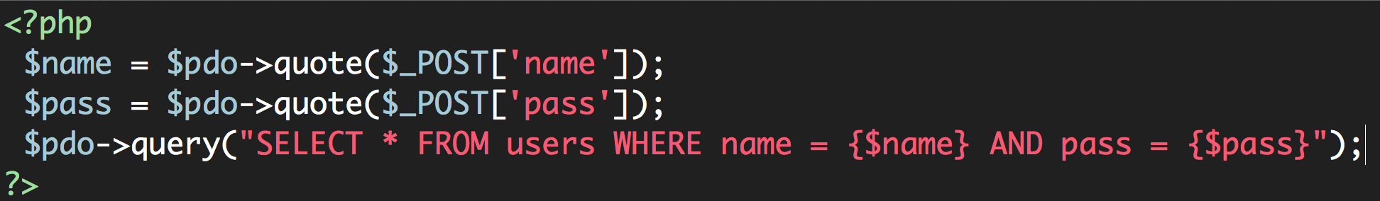
Attacking Data Stores: SQL Injection
Sanitize every value received from the user.
  Make sure there is no funny business going on
  Makes any string safe to put in a query
The Solution:
OR:

Slide 20
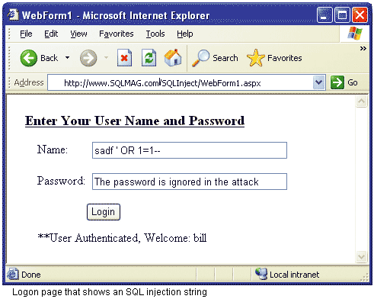
Attacking Data Stores: SQL Injection
http://sqlmag.com/content/content/43012/figure_01.gif

Slide 21
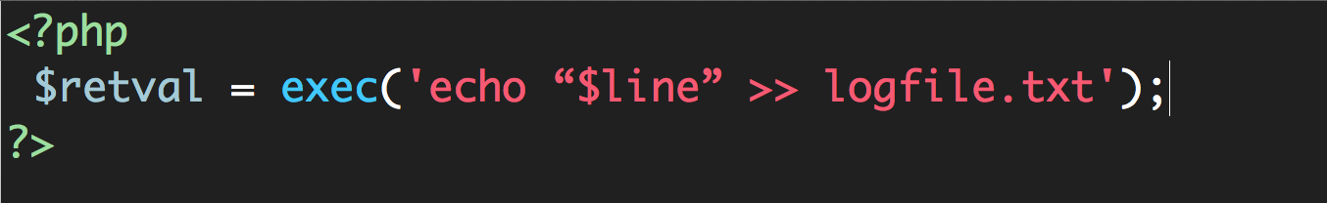
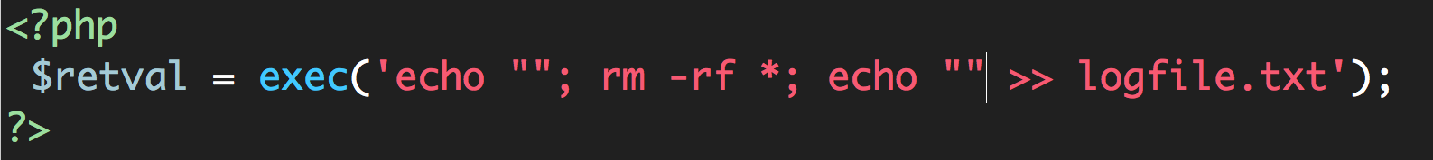
Other Injections
Command Injection: The user being able to inject code into a command line
Unchecked File Uploads: The user being allowed to uploadan executable file.
Code Injection: User being able to directly inject code.
becomes
https://security.web.cern.ch/security/recommendations/images/command_injection.png

Slide 22
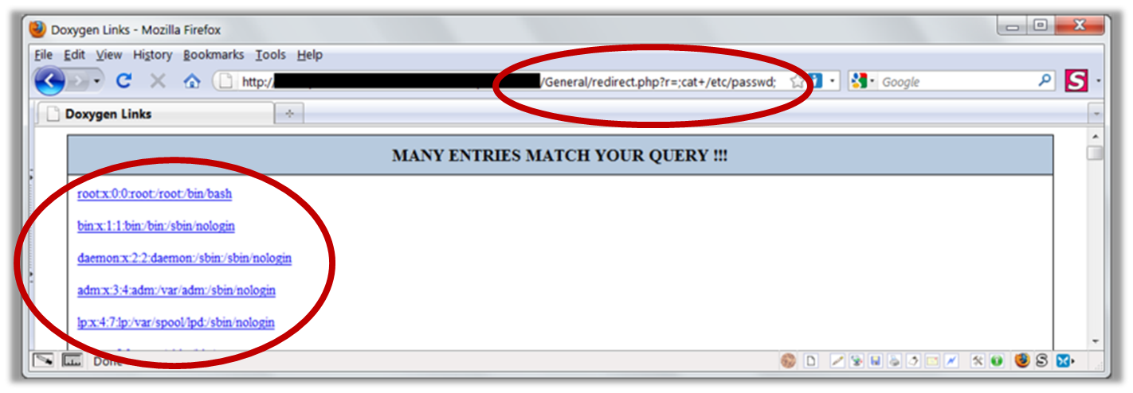
Other Injection
Command Injection: The user being able to inject code into a command line
Unchecked File Uploads: The user being allowed to uploadan executable file.
Code Injection: User being able to directly inject code.
https://security.web.cern.ch/security/recommendations/images/command_injection.png

Slide 23
Real World Attacks
https://www.youtube.com/watch?v=Qb8-0zGiE7A

Slide 24
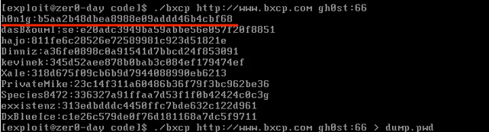
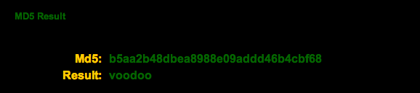
Real World Attacks

Slide 25
Attacking Session Management: Session Hijacking
The HTTP protocol is essentially stateless. It is based on a simple request-response model.
Majority of web applications allow you to register and log in. To implement this functionality, web apps need to use the concept of a session.
The vulnerabilities that exists in session management mechanisms largely fall into two categories:
  Weakness in the generation of session tokens
  Weakness in the handling of session tokens throughout their life cycle

Slide 26
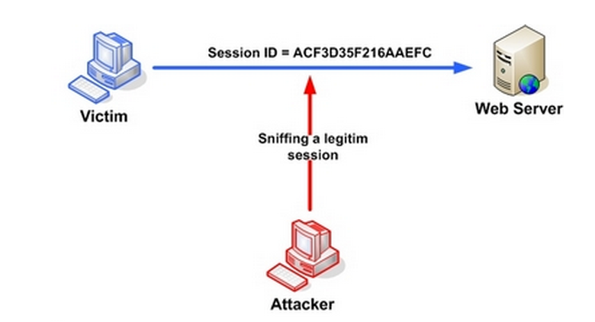
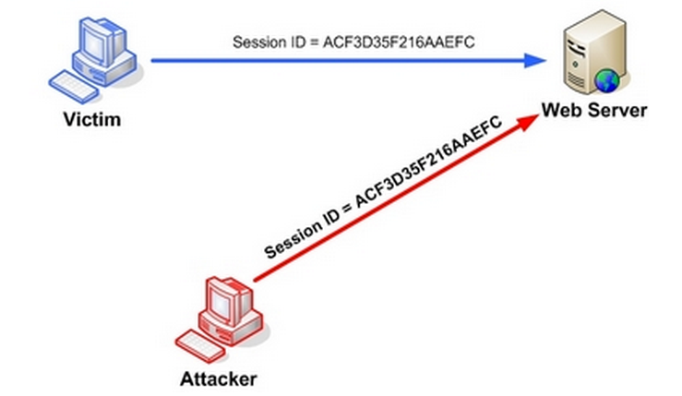
Attacking Session Management: Session Hijacking
One user ‘becoming’ another by taking over their session via impersonation.
  Avoid “session Fixation”, don’t use URL cookies for your sessions
  Always regenerates Session IDs on a change of access level
  Save an anti-hijack token to another cookie & session. Require it to be present & match. Salt on unique data (such as User Agent)
https://www.owasp.org/index.php/Session_hijacking_attack

Slide 27
Attacking Session Management: Session Hijacking
A user being able to provide a known session ID to another user.
The Attack:
The Solution:
Don’t use cookies for your sessions.
Protect from more complicated fixation attacks, by regenerating sessions on change of access level.
Use anti-hijack measures to ensure user is legit

Slide 28
Attacking Users: Cross-Site Scripting (XSS)
The attacks we have considered so far involve directly targeting the sever-side application.
Many of these attacks do impinge upon other users, such as SQL injection. But the attacker’s essential methodology was to interact with the server in unexpected ways to perform unauthorized actions and access unauthorized data.
Cross-site scripting, however, are in a different category.
The attacker’s primary target: the application’s other users.
Basic idea: A user sending data that is executed as script

Slide 29
Attacking Users: Cross-Site Scripting (XSS)
XSS vulnerabilities come in various forms and may be divided into three varieties: reflected, stored, and DOM-based.
They have important differences in how they can be identified and exploited.
In all cases: Everything from a user is suspect (forms, user-agent, headers, etc) when fixing, escape to the situation (HTML, JS, XML, etc) FIEO (Filter Input, Escape Output)
We will examine each variety of XSS in turn.

Slide 30



Attacking Users: Cross-Site Scripting (XSS)
XSS- Reflected XSS:
Directly echoing back content from the user.
1. User logs in
3.User requests attacker’s URL
4. Server response with
attacker’s JavaScript
7. Attacker hijacks
user’s session
2. Attacker feeds crafted URL to user
6. User’s browser sends session token to attacker

Slide 31
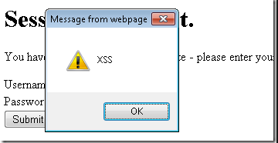
Attacking Users: Cross-Site Scripting (XSS)
XSS- Reflected XSS:
Directly echoing back content from the user.
The Security Hole:
The Attack:
This type of simple XSS bug accounts for approximately 75% of the XSS vulnerabilities that exists in real-world web apps.
It is called reflected XSS because exploiting the vulnerability involves crafting a request containing embedded JavaScript that is reflected to any user who makes the requests

Slide 32
XSS- Reflected XSS:
Directly echoing back content from the user.
http://twitter.com/index.php?%75%73%65%72%3D%3C%73%63%72%69%70%74%3E%61%6C%65%72%74%28%31%32%33%29%3C%2F%73%63%72%69%70%74%3E
Twitter?
http://twitter.com/index.php?user=<script>alert(123)</script>

Slide 33
Attacking Users: Cross-Site Scripting (XSS)
XSS- Stored XSS:
You store the data, then later display it.
2. User logs in
Attacker submits question
containing malicious JavaScript
3.User views attacker’s question
4. Server response with
attacker’s JavaScript
6. Attacker hijacks
user’s session
5. User’s browser sends session token to attacker

Slide 34
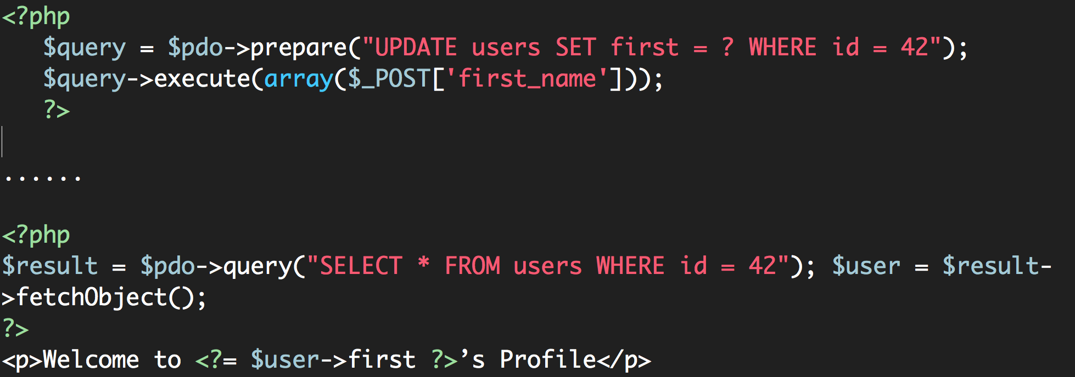
Attacking Users: Cross-Site Scripting (XSS)
XSS- Stored XSS:
You store the data, then later display it.
The Security Hole:
The Attack:

Slide 35
Attacking Users: Cross-Site Scripting (XSS)
XSS- DOM XSS:
What happens in JavaScript, stays in JavaScript.
1. User logs in
7. Attacker hijacks
user’s session
3.User requests attacker’s URL
4. Server response with
Page containing hard-coded JavaScript
2. Attacker feeds crafted URL to user
6. User’s browser sends session token to attacker

Slide 36
Attacking Users: Cross-Site Scripting (XSS)
XSS- DOM XSS:
What happens in JavaScript, stays in JavaScript.
A user requests a crafted URL supplied by the attacker and containing embedded JavaScript
The server’s response does not contain the attacker’s script in any form
When the user’s browser process this response, the script is executed nonetheless.

Slide 37
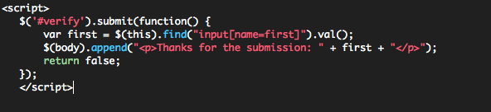
XSS- DOM XSS:
What happens in JavaScript, stays in JavaScript.
The Security Hole:
The Attack:

Slide 38
XSS is Everywhere
XSS is by far the most prevalent web app vulnerability
XSS is often misunderstood because the proof of concept (pop-up) doesn’t demonstrate true attacker capability
XSS can lead to reputational damage, denial of service, and chained exploit.
XSS can be used against site administrators

Slide 39
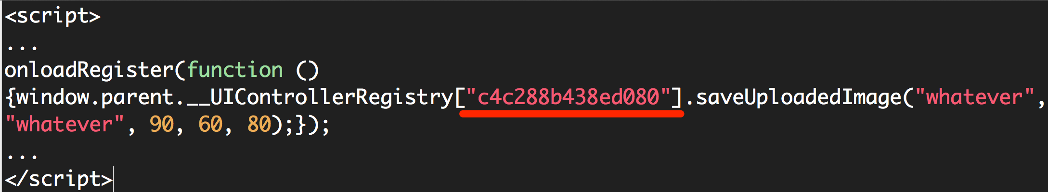
Attacking Users: Cross-Site Scripting (XSS)
Real-world Scenario of XSS Attack
Facebook makes use of PHP scripts. The following script became vulnerable to cross-site scripting some time in July 2010:
www.facebook.com/ads/create/photos/creative_uploader.php
This script takes various parameters, one of which (controller_id) was writing user input directly inside a script tag. Take the following URL as example:
www.facebook.com/ads/create/photos/creative_uploader.php?controller_id=c4c288b438ed080&path=whatever&src=whatever&vol=90&w=60&h=80&post_upload=1
https://www.acunetix.com/websitesecurity/xss-facebook/

Slide 40
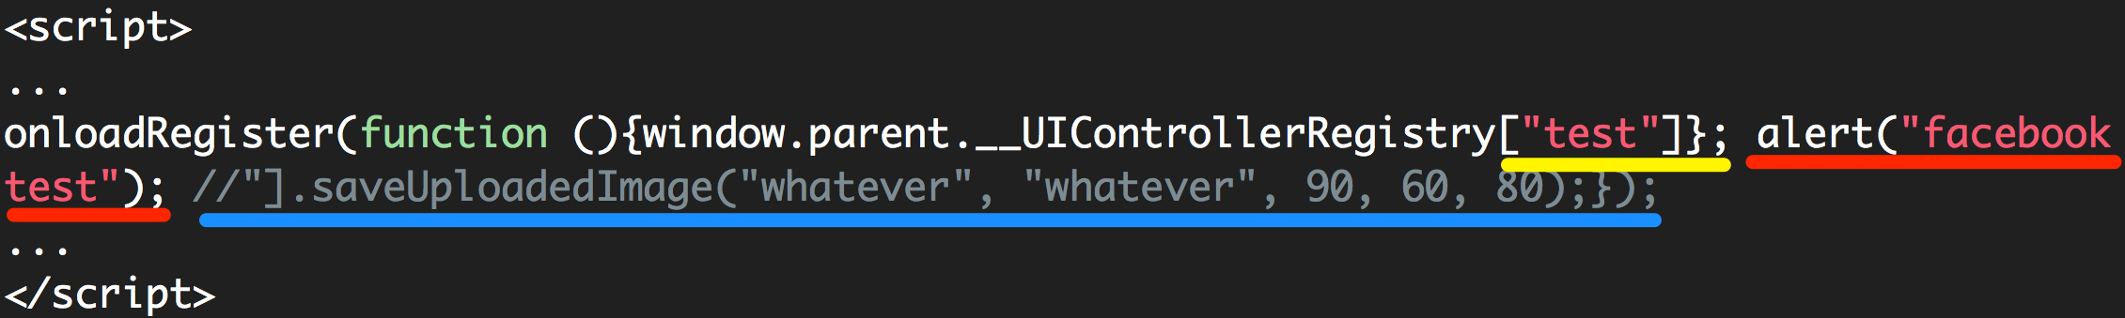
Attacking Users: Cross-Site Scripting (XSS)
Real-world Scenario of XSS Attack
By inserting a double quote, an attacker is able to escape the Array’s key string and insert JavaScript directly within a page on facebook.com.

Slide 41
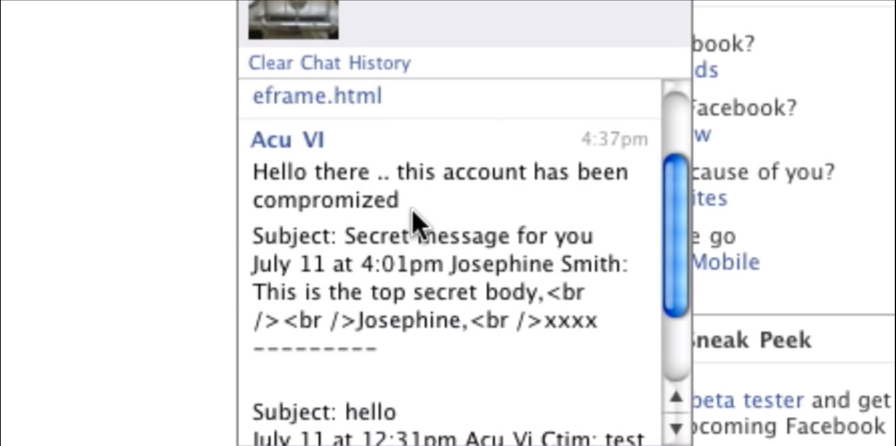
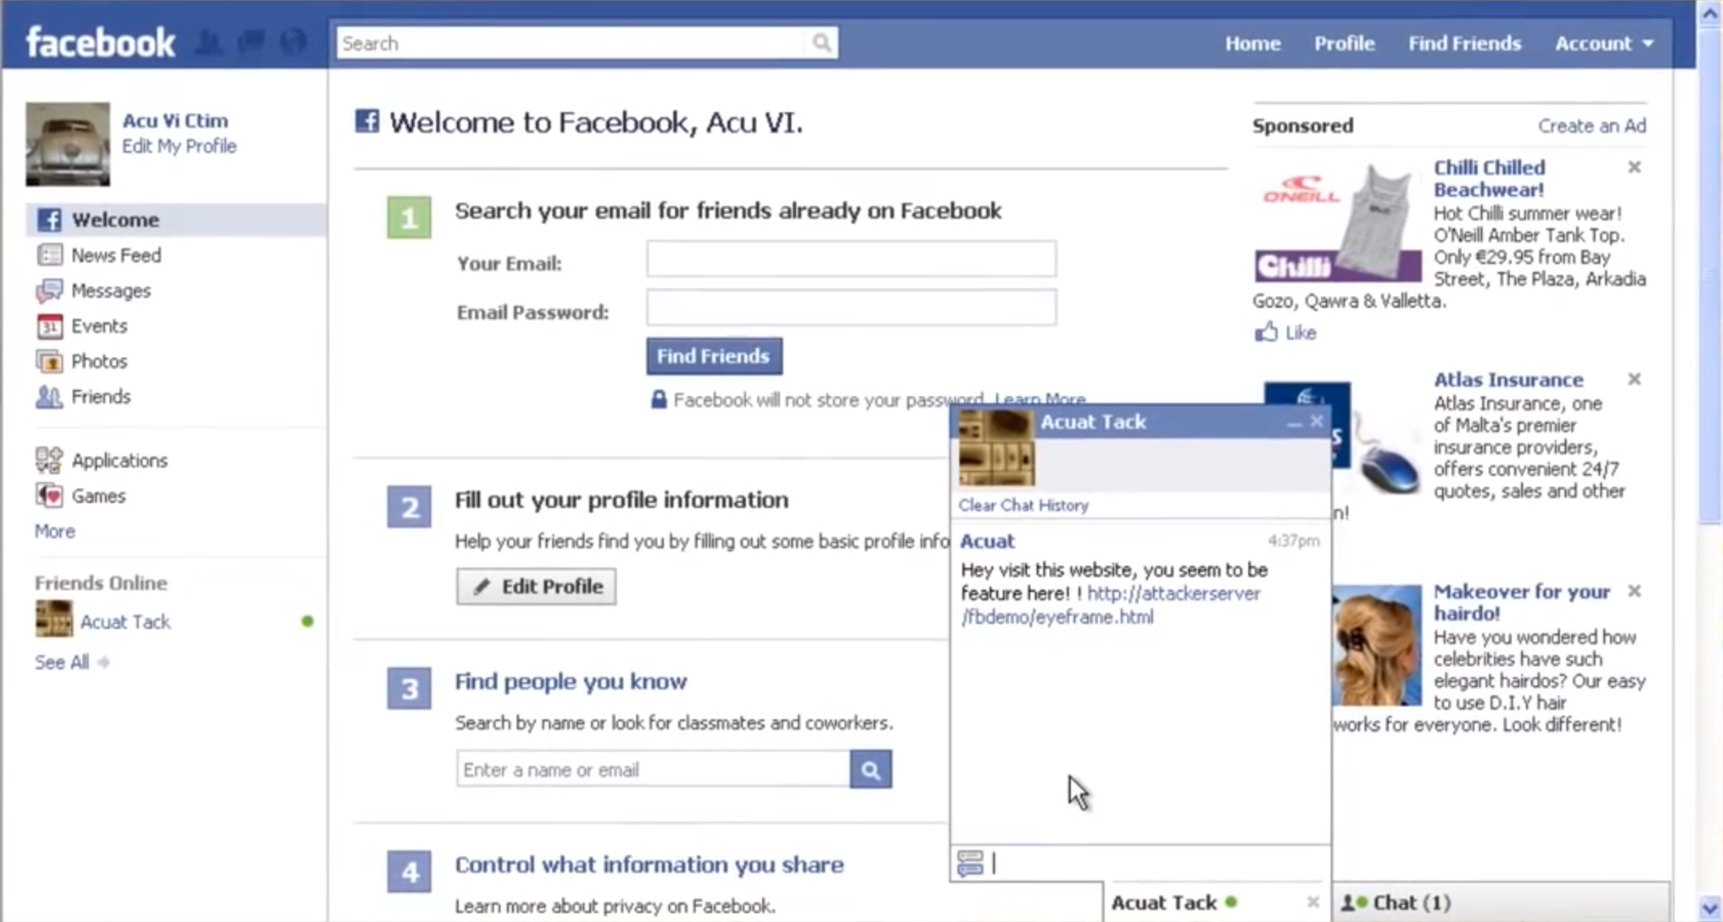
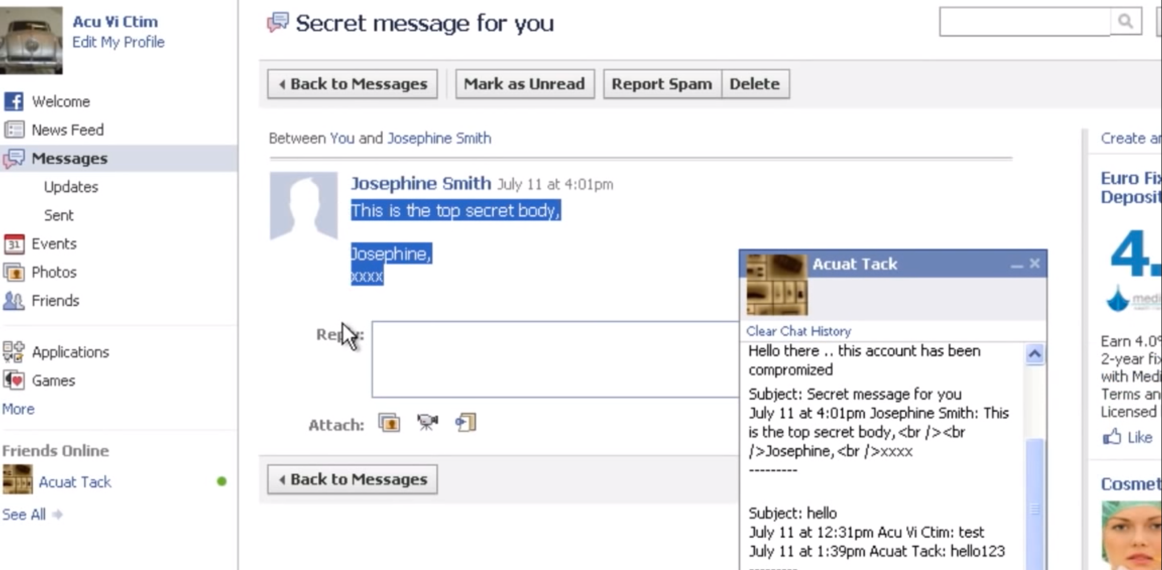
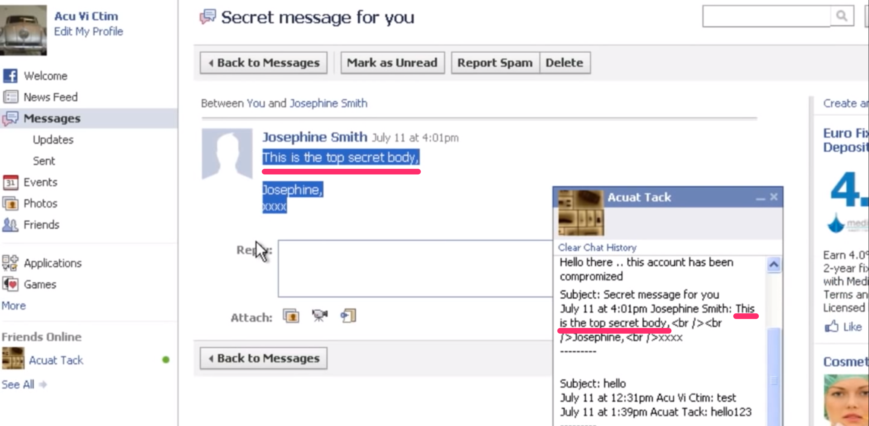
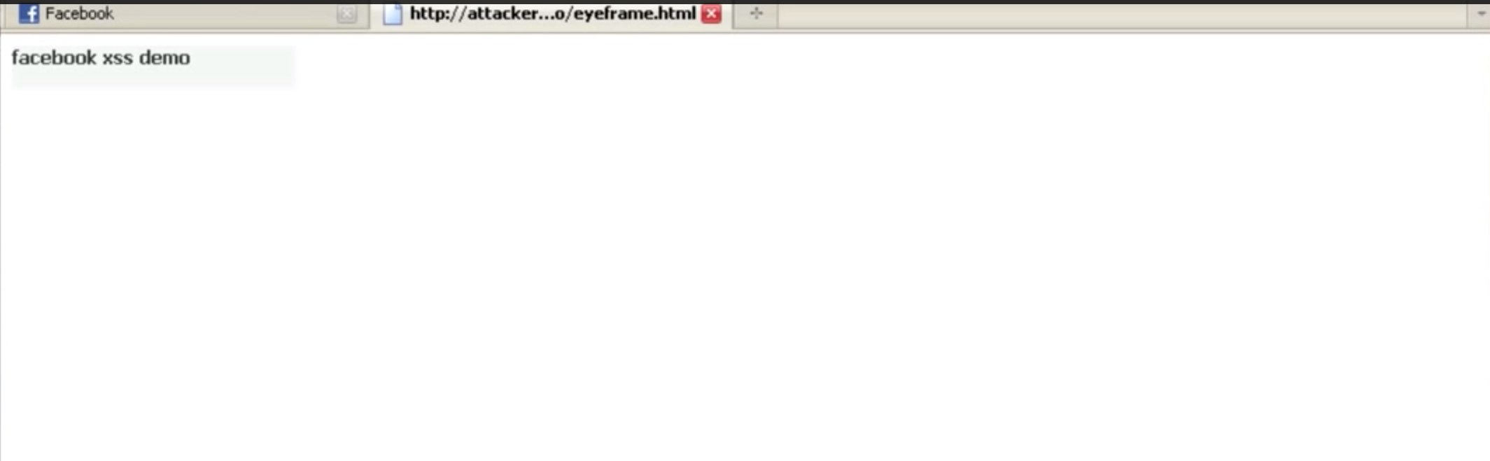
Attacking Users: Cross-Site Scripting (XSS)
Real-world Scenario of XSS Attack
https://www.acunetix.com/websitesecurity/xss-facebook/

Slide 42
Why XSS detection is hard
Extremely difficult to automate tests for XSS
Often times XSS defense can be bypassed in clever ways
Developers should strive to use 3rd party libraries that are collaboratively maintained

Slide 43
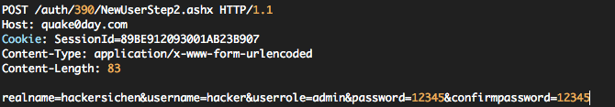
Attacking Users: CSRF (Cross Site Request Forgery)
In cross-site request forgery (CSRF) attacks, the attacker creates an innocuous-looking website that causes the user’s browser to submit a request directly to the vulnerable application to perform some unintended action that is beneficial to the attacker.
Normally, “the same-origin” policy does not prohibit one website from issuing requests to a different domain.
The request performs a privileged action. In the example shown, the request creates a new user with administrative privileges
The application relies solely on HTTP cookies for tracking sessions. No session-related tokens are transmitted else where within the request
The attacker can determine all the parameters required to perform the action. Aside from the session token in the cookie, no unpredictable values need to be included in the request.

Slide 44
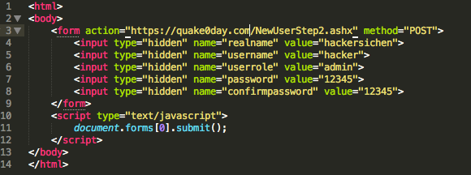
Attacking Users: CSRF (Cross Site Request Forgery)
An attacker can construct a webpage that makes a cross-domain request to the vulnerable application containing everything needed to perform the privileged action.
Here is an example of such an attack.
This form will be automatically submitted. When the user’s browser submits the form, it automatically adds the user’s cookies for the target domain. If an admin user who is logged in the vulnerable app visits this web page, the requests is processed within the administrator’s session.

Slide 45
Attacking Users: CSRF (Cross Site Request Forgery)
Cross site request forgery is a trust exploit
The server trusts (wrongly) the browser request of users b/c authentication cookies are supplied
Attacker forces the users browser to take action on their behalf
Clever way to take over web applications

Slide 46
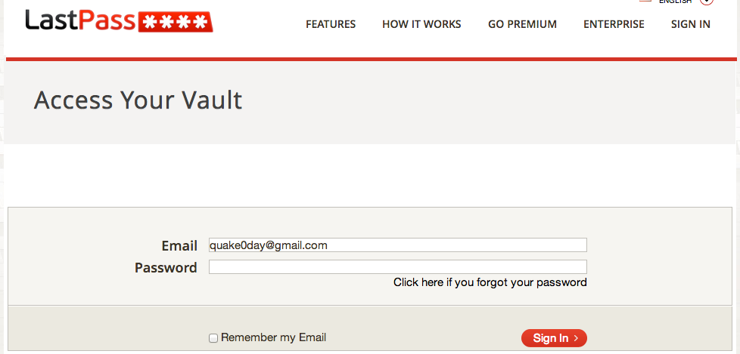
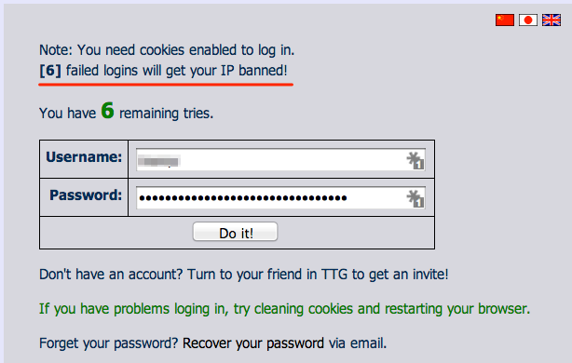
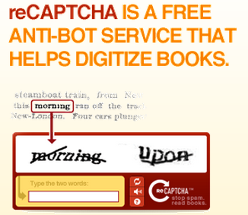
Brute Force Attacks (Password)
CAPTCHA
IP rate limiting

Slide 47
Server Level Security
A classic LAMP stack
  Linux
  Apache
  MySQL
  PHP
Security exists at every level of the stack
Keep all your software up to date.

Slide 48

Heartbleed
CVE-2014-0160

Slide 49
Heartbleed
Description
The (1) TLS and (2) DTLS implementations in OpenSSL 1.0.1 before 1.0.1g do not properly handle Heartbeat Extension packets, which allows remote attackers to obtain sensitive information from process memory via crafted packets that trigger a buffer over-read, as demonstrated by reading private keys, related to d1_both.c and t1_lib.c, aka the Heartbleed bug.

Slide 50
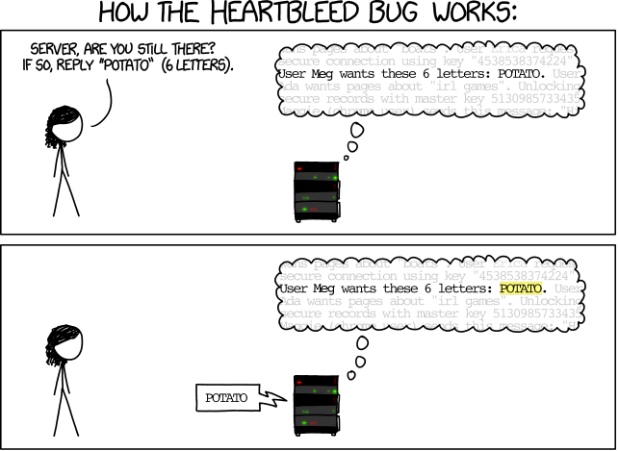
How The Heartbleed bug works
http://imgs.xkcd.com/comics/heartbleed_explanation.png

Slide 51
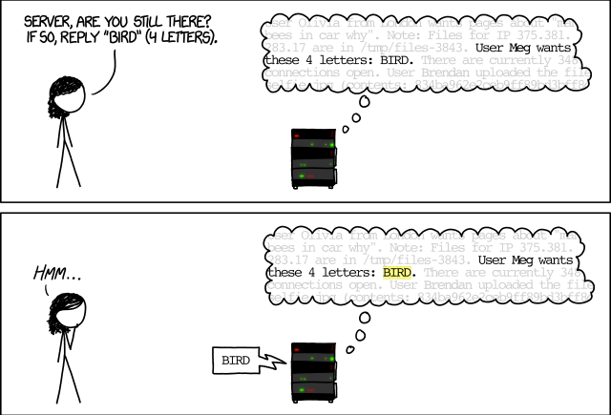
How The Heartbleed bug works
http://imgs.xkcd.com/comics/heartbleed_explanation.png

Slide 52
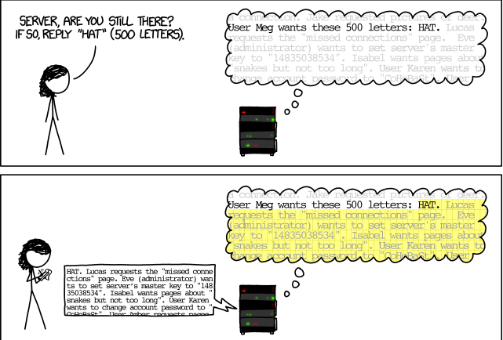
How The Heartbleed bug works
http://imgs.xkcd.com/comics/heartbleed_explanation.png

Slide 53

Heartbleed and OpenSSL
OpenSSL is an open-source cryptography library, widely used to implement the Internet’s Transport Layer Security (TLS) protocol.
https://scienceofbusiness.files.wordpress.com/2014/04/heartbleed-openssl-bug.jpg

Slide 54
No boundary check.
The attacker controls both of these length fields!

Slide 55
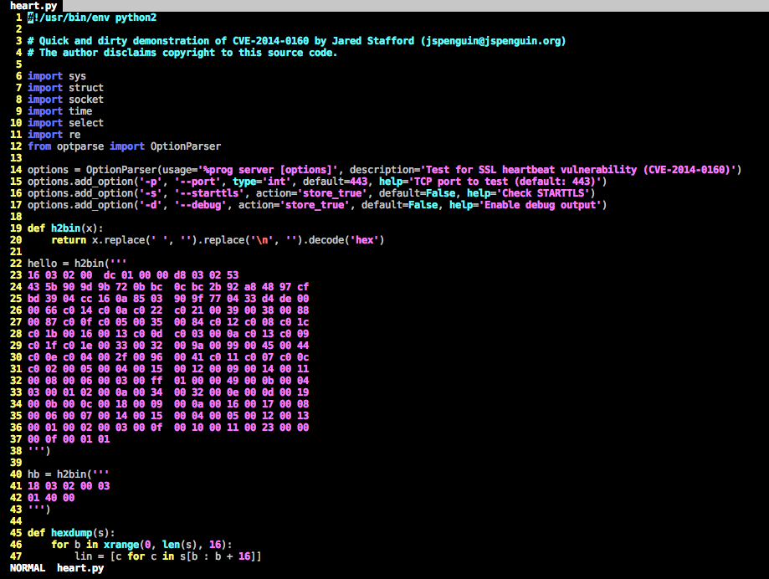

Slide 56
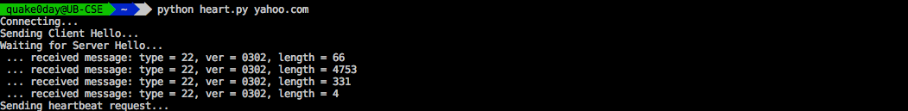
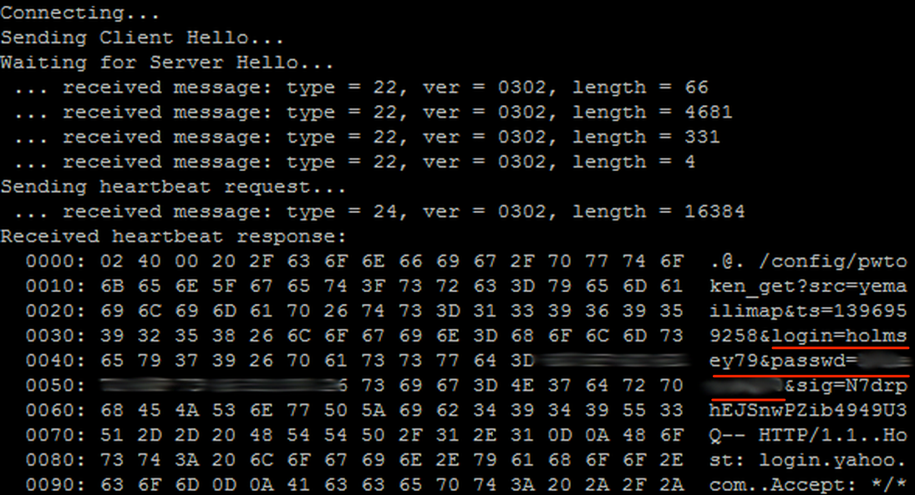
Heartbleed Attack

Slide 57
Vulnerability Tracking
OSVDB
  Open Source Vulnerability Database
CVE
  Common Vulnerability Enumerator
  Assigned by Mitre (http://cve.mitre.org)
NVD
  National Vulnerability Database
  Supported by NIST, DHS and US-CERT

Slide 58
Exploitation
BeEF - http://beefproject.com/
Metasploit – http://www.metasploit.com
Exploit DB - http://www.exploit-db.com/
Packet Storm - http://packetstormsecurity.org/files/tags/exploit/
SLQMap - http://sqlmap.org/
W3AF - http://w3af.sourceforge.net/

Slide 59
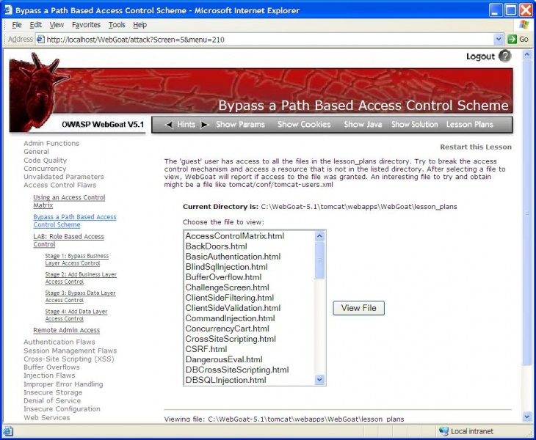
OWASP WebGoat Project
Open Web Application Security Project
https://www.owasp.org/index.php/File:WebGoat-Bypass-Access-Control-Lesson.JPG

Slide 60
Information Leakage
Leaking sensitive information about the server, configuration, application or database
Error messages are a common exposure
Login failure messages can help brute force attacks
Configuration files or backups of files could be exposed via web browser
Plain text exposure of source code

Slide 61
The Core Security Problem
The core security problem:
Users Can Submit Arbitrary Input
Users can interfere with any piece of data transmitted between the client and the server, including request parameters, cookies, and HTTP headers. Any security controls implemented on the client side, such as input validation checks, can be easily circumvented.
Users can send requests in any sequence and can submit parameters at a different stage than the application expects. Any assumption developers make about how users will interact with the application may be violated.
Users are not restricted to using only a web browser to access the application. Numerous widely available tools operate alongside a browser to help attack web applications.

Slide 62

Q & A

