Slide 1
Class1
CSC 495/583 Advanced Topics in Computer Security
Attack/Defense, Risk Analysis and more
Introduction
Si Chen (schen@wcupa.edu)

Slide 2
What is computer security?
•
Most developers and operators are concerned with
correctness: achieving desired behavior
A working banking web site, word processor, blog, …
•
•
Security is concerned with preventing undesired behavior
Considers an enemy/opponent/hacker/adversary who is actively and maliciously trying to circumvent any protective measures you put in place
•

Slide 3
Security Expectations
Confidentiality: requires that information be kept private
Integrity: the trustworthiness and correctness of data.
Availability: the capability to use information and resources.

Slide 4
Kinds of undesired behavior
•
Stealing information:confidentiality
•
Corporate secrets (product plans, source code, …) Personal information (credit card numbers, SSNs, …)
•
•
Modifying information or functionality:integrity
•
Installing unwanted software (spyware, botnet client, …) Destroying records (accounts, logs, plans, …)
•
•
Denying access:availability
•
Unable to purchase products
Unable to access banking information
•

Slide 5

General perspectives and attack research

Slide 6
General perspectives and attack research
This course will over some of the state-of-the-art research results and on-going research activities in some topics
Software security
Web security
Security and privacy issues in cloud computing
Mobile devices and networks
IoT devices and systems
In particular, we will discuss new threats emerged from these new platforms and applications such as AR and VR, the rich cloud and mobile platforms, and IoT and Block chain systems, study various analysis techniques and tools for vulnerability discovery and threat analysis, and explore approaches for building in better security in these platforms and applications.

Slide 7
Risk analysis and economics of security
If you are a CISO (chief information security officer) at Google, given 10 million dollars budget, what would you do for its security? If you are a CISO at a small to medium sized company, given less than $500K budget, what would you do for its security?
Risk analysis is used to ensure that security is cost effective, relevant, timely and responsive to threats.

Slide 8
Our approach
Breakdown each topic into two parts:
  Part I: Foundations and Perspectives
    Lecture
    Reading paper and answer some questions (Reading Homework)
  Part II: Research Area Case Studies
    Group Presentation
    Discussion

Slide 9
Top computer security conference

Slide 10
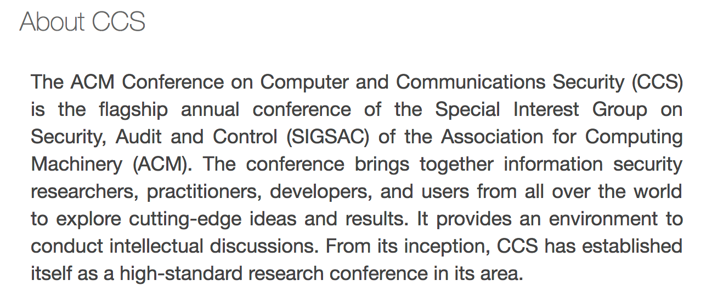
Top computer security conference
ACM Conference on Computer and Communications Security (CCS)

Slide 11
Top computer security conference
IEEE Symposium on Security and Privacy (S&P)
Since 1980, the IEEE Symposium on Security and Privacy (S&P)has been the premier forum for the presentation of developments in computer security and electronic privacy, and for bringing together researchers and practitioners in the field.

Slide 12
Top computer security conference
ISOC Network and Distributed System Security Symposium (NDSS)
The Network and Distributed System Security Symposium (NDSS) fosters information exchange among researchers and practitioners of network and distributed system security. The target audience includes those interested in practical aspects of network and distributed system security, with a focus on actual system design and implementation. A major goal is to encourage and enable the Internet community to apply, deploy, and advance the state of available security technologies.

Slide 13
Top computer security conference
Usenix Security Symposium (USENIX)
The USENIX Security Symposium brings together researchers, practitioners, system administrators, system programmers, and others interested in the latest advances in the security and privacy of computer systems and networks.

Slide 14
Top Cryptology conference
1. International Cryptology Conference (Crypto)
2. European Cryptology Conference (EuroCrypt)

Slide 15
Top Security Conference for Hacking
  Black hat USA
  DEFCON

Slide 16
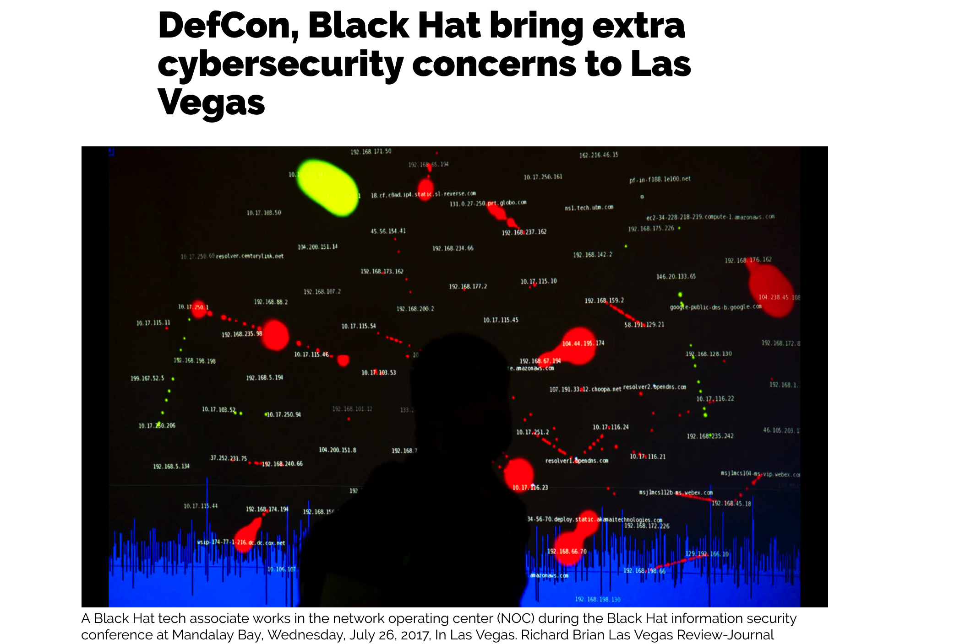

Slide 17
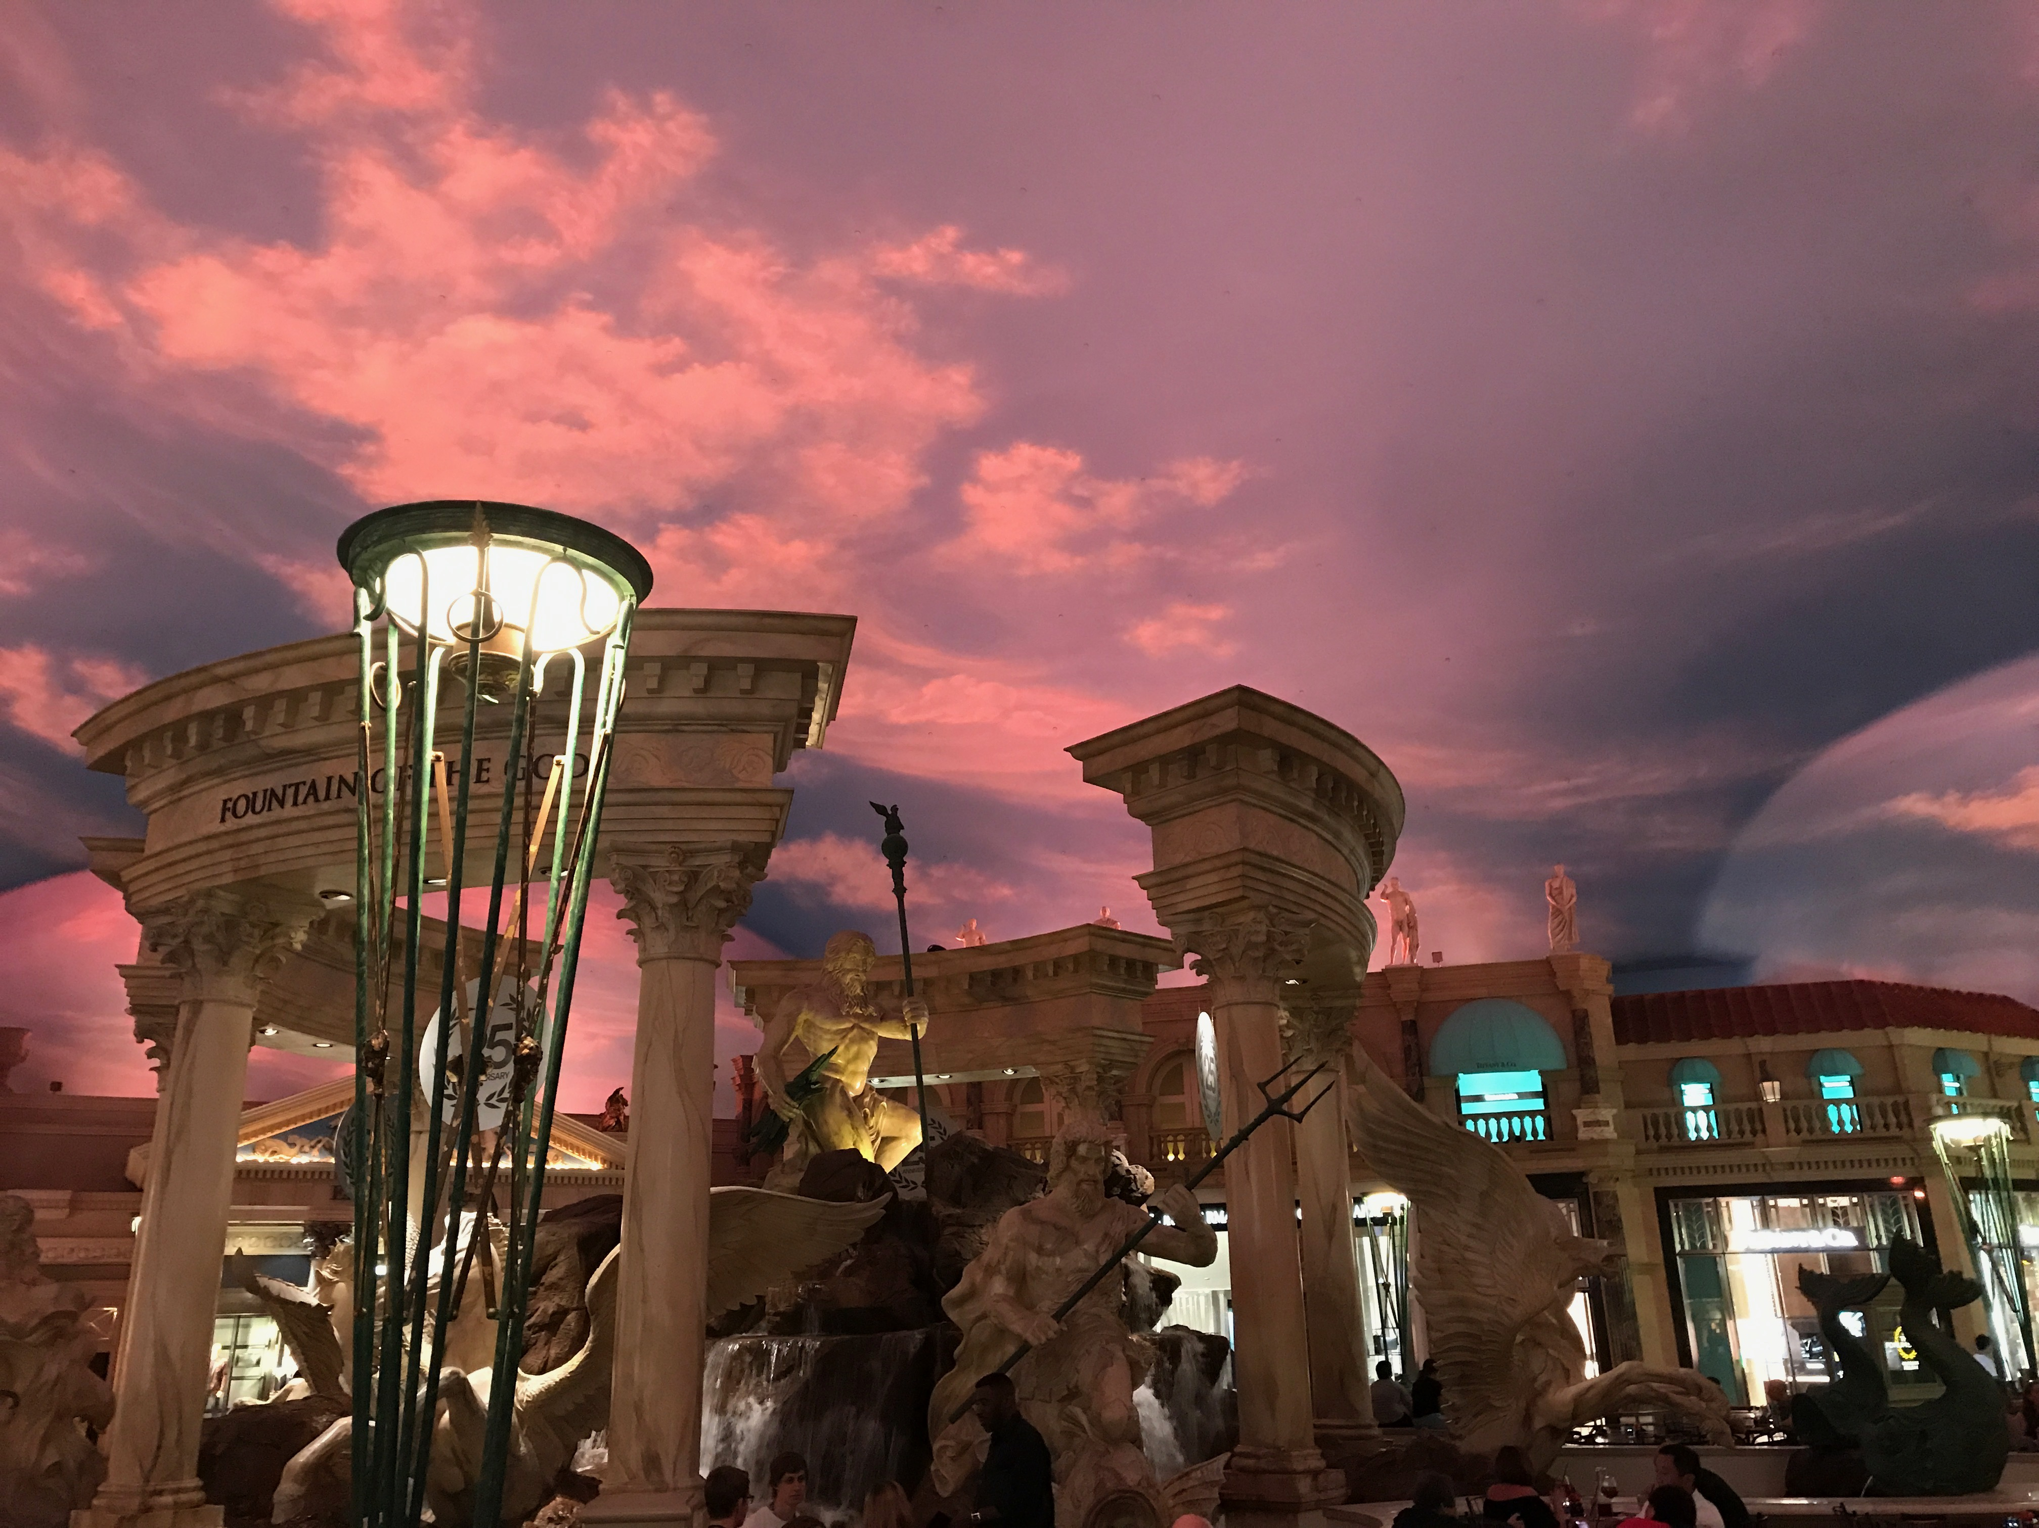
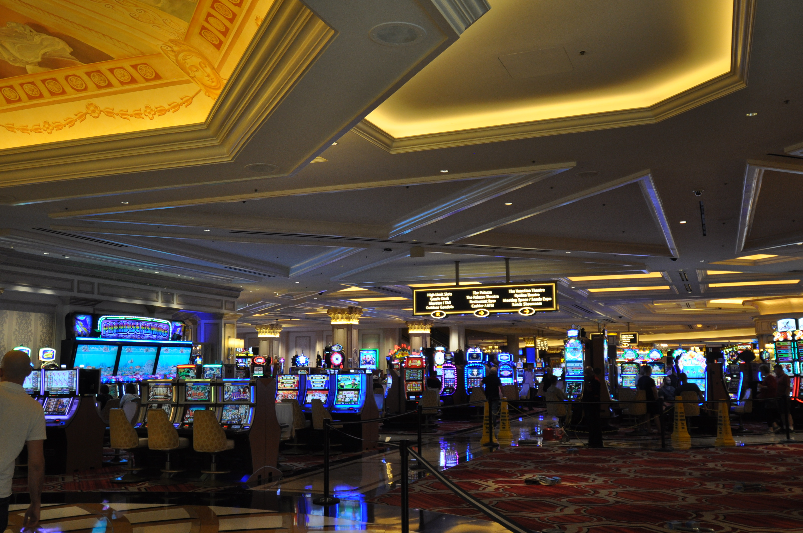
\

Slide 18

Q & A

