Slide 1
Class24
CSC 495/583 Topics of Software Security
Kernel Exploitation
Dr. Si Chen (schen@wcupa.edu)

Slide 2
Use After Free
Use After Free
A class of vulnerability where data on the heap is freed, but a leftover reference or ‘dangling pointer’ is used by the code as if the data were still valid
Most popular in Web Browsers, complex programs
Also known as UAF

Slide 3
Use After Free
http://security.cs.rpi.edu/courses/binexp-spring2015/lectures/17/10_lecture.pdf

Slide 4
Use After Free
http://security.cs.rpi.edu/courses/binexp-spring2015/lectures/17/10_lecture.pdf

Slide 5
Use After Free
http://security.cs.rpi.edu/courses/binexp-spring2015/lectures/17/10_lecture.pdf

Slide 6
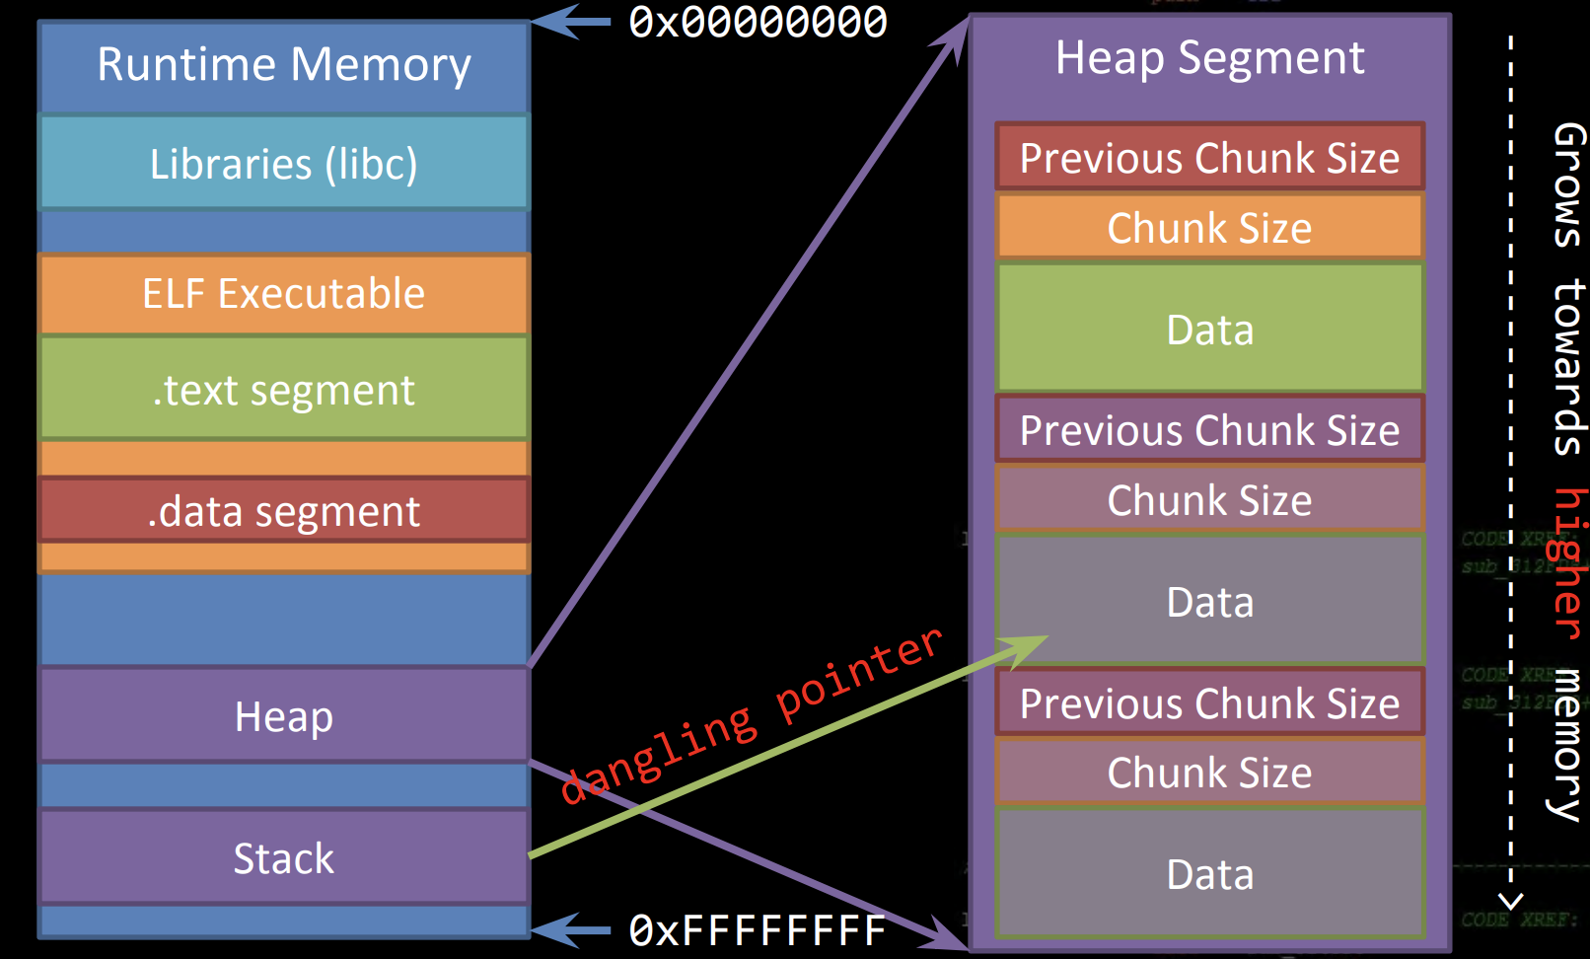
Use After Free
http://security.cs.rpi.edu/courses/binexp-spring2015/lectures/17/10_lecture.pdf

Slide 7
Use After Free
Dangling Pointer
A left over pointer in your code that references free’d data and is prone to be re-used
As the memory it’s pointing at was freed, there’s no guarantees on what data is there now
Also known as stale pointer, wild pointer
http://security.cs.rpi.edu/courses/binexp-spring2015/lectures/17/10_lecture.pdf

Slide 8
Use After Free
http://security.cs.rpi.edu/courses/binexp-spring2015/lectures/17/10_lecture.pdf

Slide 9
Use After Free
http://security.cs.rpi.edu/courses/binexp-spring2015/lectures/17/10_lecture.pdf

Slide 10
Use After Free
http://security.cs.rpi.edu/courses/binexp-spring2015/lectures/17/10_lecture.pdf

Slide 11
Use After Free
You actually don’t need any form of memory corruption to leverage a use after free
It’s simply an implementation issue
pointer mismanagement
http://security.cs.rpi.edu/courses/binexp-spring2015/lectures/17/10_lecture.pdf

Slide 12
Use After Free: PoC Example

Slide 13
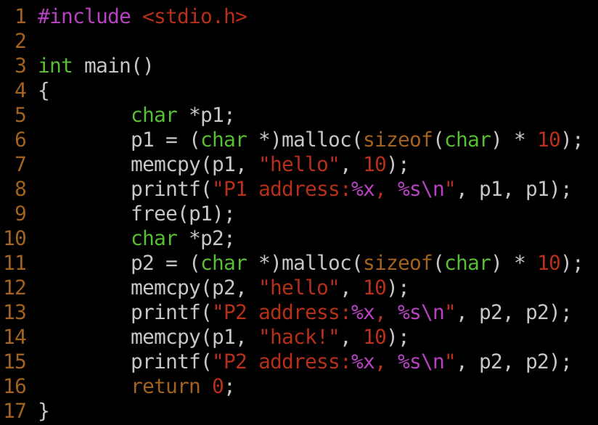
Use After Free: PoC Example

Slide 14
Introduction

Slide 15
Introduction
The kernel is also a program that:
Manages the data I/O requirements issued by the software
Escaping these requirements into instructions
Handing them over to the CPU

Slide 16
Kernel Exploitation Strategy

Slide 17
Kernel Exploitation Strategy
The most common place to find vulnerabilities is inside of Loadable Kernel Modules (LKMs).
LKMs are like executables that run in Kernel Space. A few common uses are listed below:
> Device Drivers
> Filesystem Drivers
> Networking Drivers
> Executable Interpreters
> Kernel Extensions
> ( rootkits :P )

Slide 18
Kernel Exploitation Strategy
LKMs are just binary blobs like your familiar ELF’s, EXE’s and MACH-O’s. (On Linux, they even use the ELF format)
You can drop them into GDB and reverse-engineer them like you’re used to already.

Slide 19
Kernel Exploitation Strategy
There’s a few useful commands that deal with LKMs on Linux.
insmod | ---> | Insert a module into the running kernel
rmmod | ---> | Remove a module from the running kernel
lsmod | ---> | List currently loaded modules
A general familiarity with these is helpful

Slide 20
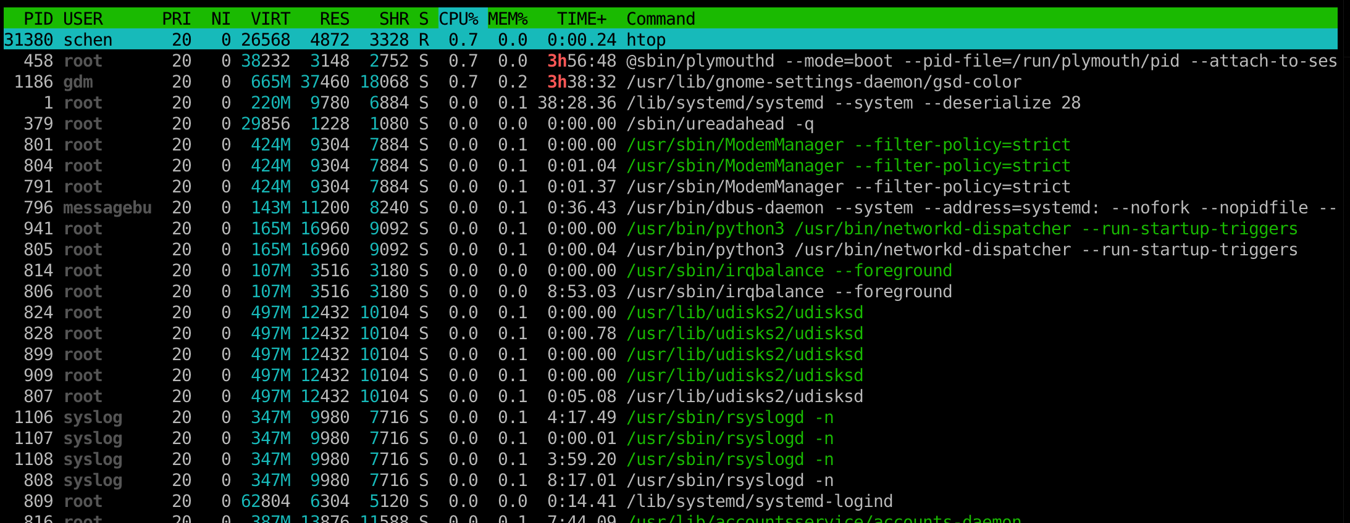
Traditional UNIX credentials.
Real User ID
Real Group ID

Slide 21
Elevate Privileges
Remember: The Kernel manages running processes
Therefore: The Kernel keeps track of permissions
https://code.woboq.org/linux/linux/include/linux/cred.h.html#cred

Slide 22
Elevate Privileges
Conveniently, the Linux Kernel has two wrapper functions for updating process credentials and generating process credentials!

Slide 23
Elevate Privileges
Now we can map out what we need to do
commit_creds(prepare_kernel_cred(0));
We can find their addresses in /proc/kallsyms

Slide 24
Returning to UserSpace
Why bother returning to Userspace?
Most useful things we want to do are much easier from userland.
In KernelSpace, there’s no easy way to:
> Modify the filesystem
> Create a new process
> Create network connections

Slide 25
Returning to UserSpace
How does the kernel do it?
This will usually get you out of “Kernel Mode” safely.

Slide 26
Returning to UserSpace
For exploitation, the easiest strategy is highjacking execution, and letting the kernel return by itself.
> Function Pointer Overwrites
> Syscall Table Highjacking
> Use-After-Free
You need to be very careful about destroying Kernel state. A segfault probably means a reboot!

Slide 27
Example: Babydriver
https://github.com/ctf-wiki/ctf-challenges/tree/master/pwn/kernel

Slide 28
Example: Babydriver
boot.sh
rootfs.cpio

Slide 29
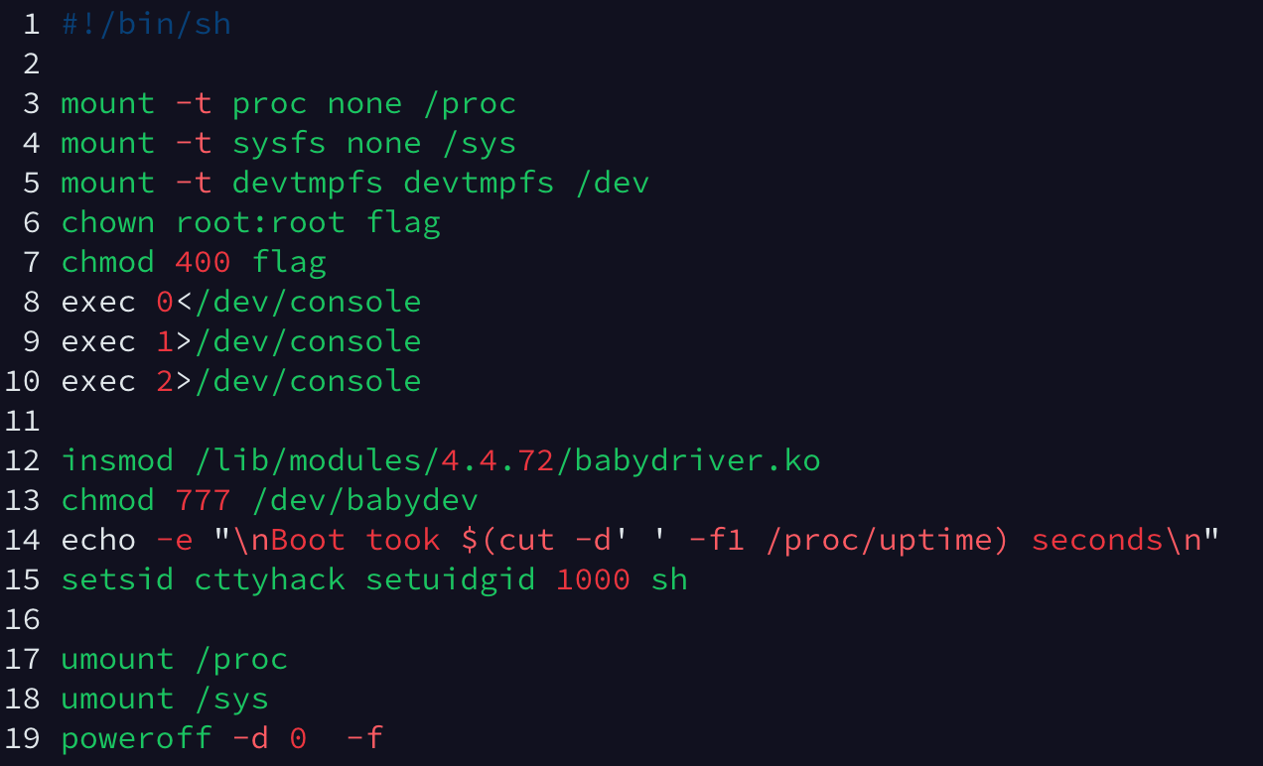
Example: Babydriver
rootfs.cpio
init
insmod | ---> | Insert a module into the running kernel

Slide 30
Example: Babydriver
Analysis babydriver.ko
Ghidra is a free and open source reverse engineering tool developed by the National Security Agency. The binaries were released at RSA Conference in March 2019; the sources were published one month later on GitHub. Ghidra is seen by many security researchers as a competitor to IDA Pro and JEB Decompiler.

Slide 31
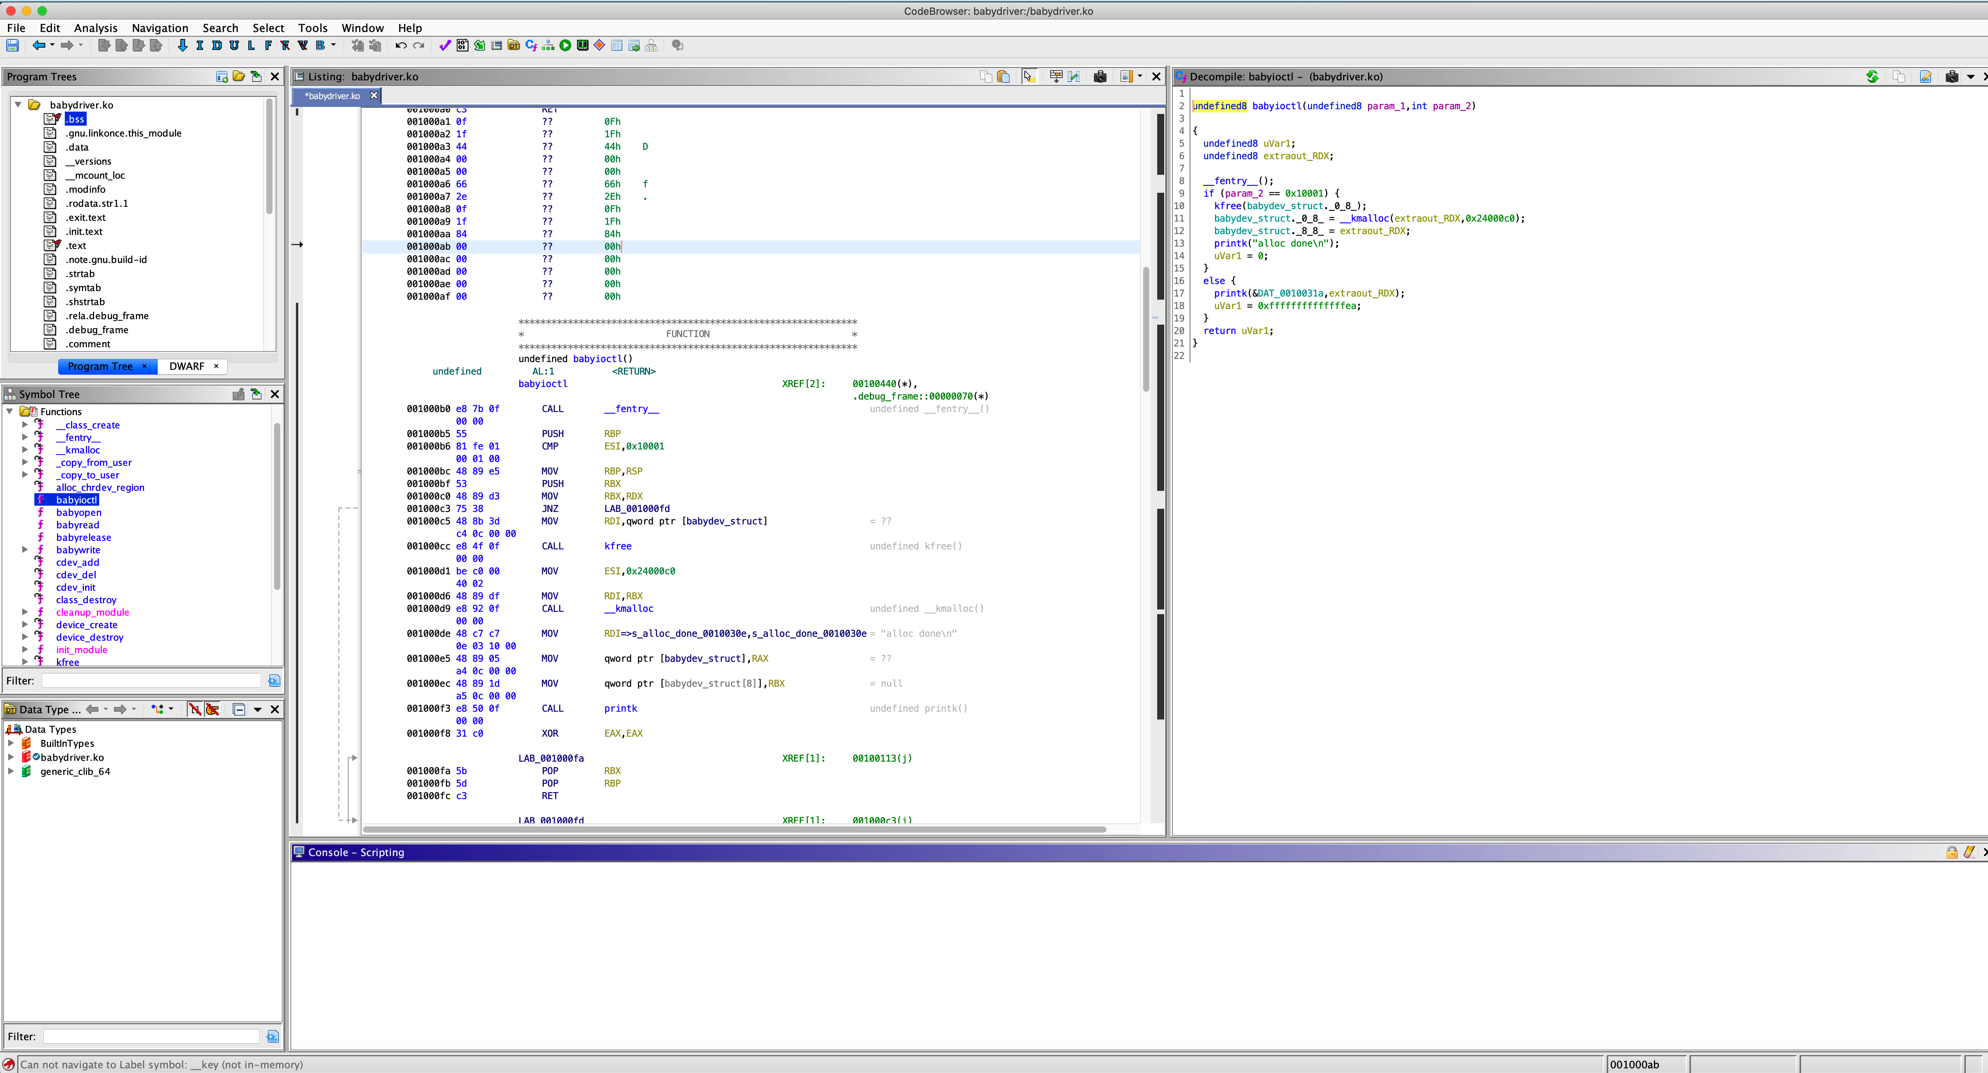
Example: Babydriver
babyioctl()
babyopen()
babyread()
babyrelease()
babywrite()

Slide 32
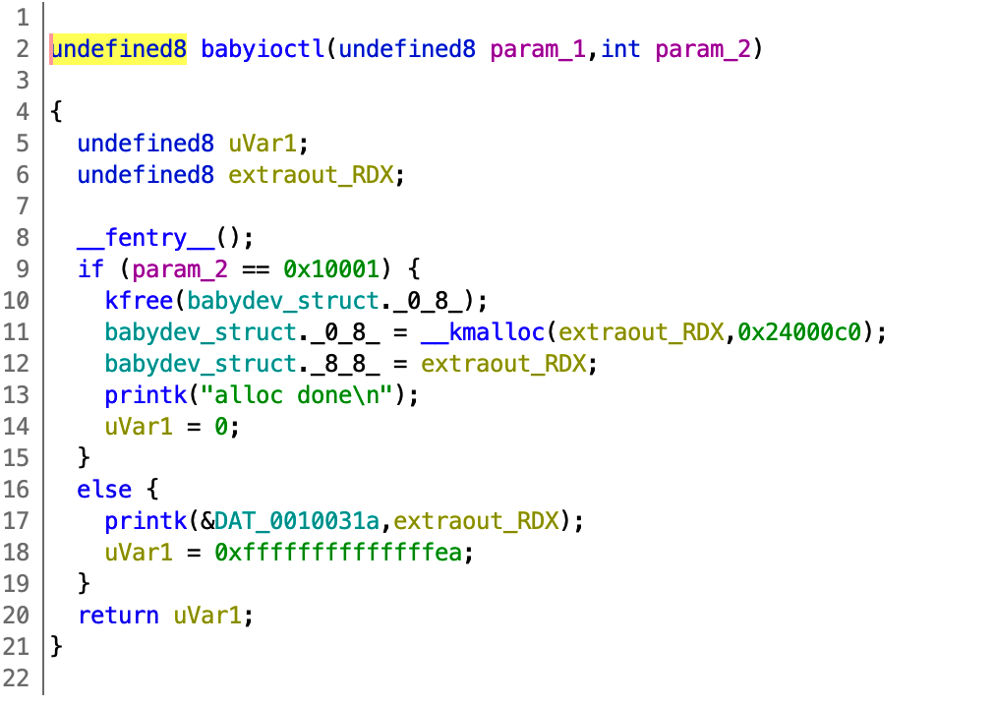
Example: Babydriver
babyioctl()
babyopen()
babyread()
babyrelease()
babywrite()

Slide 33
Example: Babydriver
babyioctl()
babyopen()
babyread()
babyrelease()
babywrite()
size: 0x40

Slide 34
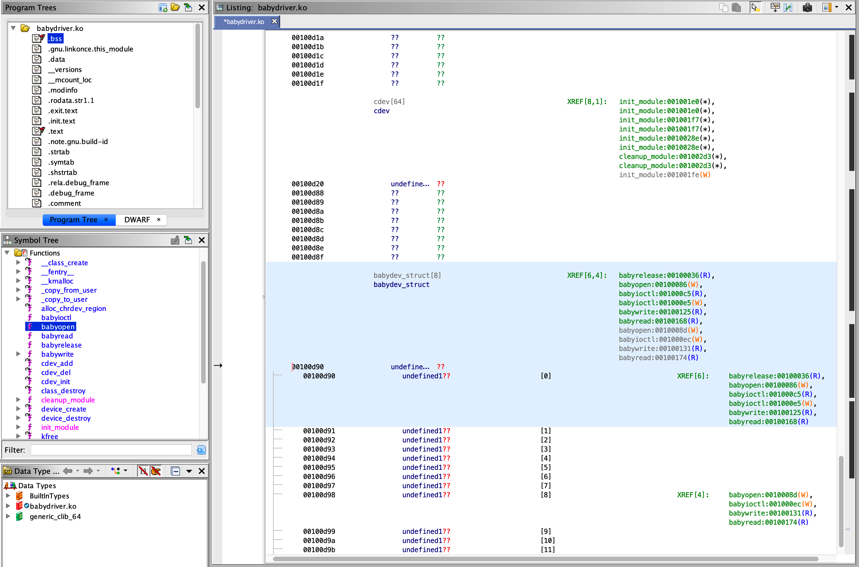
Example: Babydriver
babydev_struct is a global variable!

Slide 35
Example: Babydriver
babyioctl()
babyopen()
babyread()
babyrelease()
babywrite()
size: 0x40
babyopen: Apply for a space of 0x40 bytes, the address is stored in the global variable babydev_struct.device_buf

Slide 36
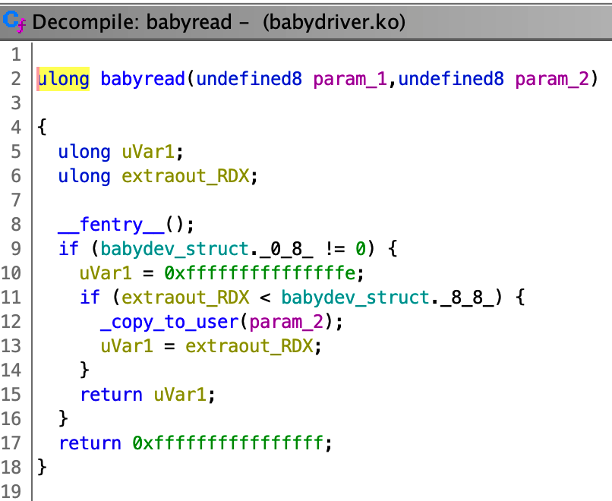
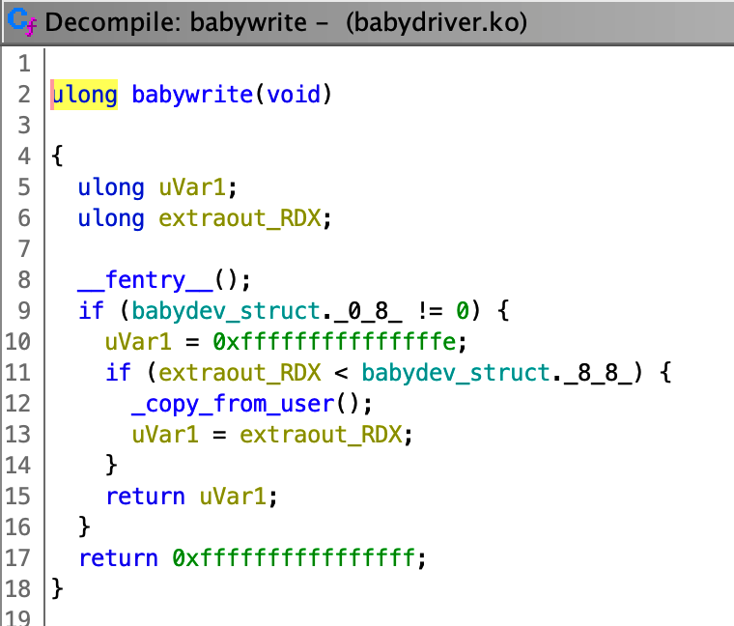
Example: Babydriver
babyioctl()
babyopen()
babyread()
babyrelease()
babywrite()
First check if the length, then copy the data in babydev_struct.device_buf to the buffer, the buffer and the length are the parameters passed by the user.
Similar to babyread, the difference is from the buffer copy to the global variable

Slide 37
Example: Babydriver
There is a UAF vulnerability caused by pseudo-conditional competition.
This means that if we open both devices at the same time, the second time will overwrite the first allocated space, because babydev_struct is global.
Similarly, if the first one is released, then the second one is actually released, which results in a UAF.
How do we use UAF? As mentioned before, the cred structure can be modified to grant root to root.

Slide 38
Example: Babydriver
There is a UAF vulnerability caused by pseudo-conditional competition.
This means that if we open both devices at the same time, the second time will overwrite the first allocated space, because babydev_struct is global.
Similarly, if the first one is released, then the second one is actually released, which results in a UAF.
How do we use UAF? As mentioned before, the cred structure can be modified to grant root to root.

Slide 39
Example: Babydriver
Plan:
Turn on the device twice and change its size to the size of the cred structure via ioctl
Release one, fork a new process, then At the space of the cred of this new process will overlap with the previously released space
The same time, we can write to this space through another file descriptor, just need to change uid, gid to 0, that is, you can achieve the right to root

Slide 41
Kernel Space Protections
By now, you’re familiar with the alphabet soup of exploit mitigations
DEP ASLR
Canaries
etc...
Green: Present in Kernel Space Yellow: Present, with caveats
There’s a whole new alphabet soup for Kernel Mitigations!

Slide 42
Kernel Space Protections
Some new words in our soup (There’s plenty more...)
MMAP_MIN_ADDR KALLSYMS RANDSTACK STACKLEAK SMEP / SMAP
Most of these will be off for the labs!

Slide 43
MMAP_MIN_ADDR
This makes exploiting NULL pointer dereferences harder.
Low Memory
Malicious Program
0xffffffff

Slide 44
MMAP_MIN_ADDR
This makes exploiting NULL pointer dereferences harder.
Program does mmap(0,....)
0x000000
Low Memory
Malicious Program
0xffffffff

Slide 45
MMAP_MIN_ADDR
This makes exploiting NULL pointer dereferences harder.
Program does mmap(0,....) Program writes malicious Code
0x000000
Low Memory
Malicious Program
0xffffffff

Slide 46
MMAP_MIN_ADDR
This makes exploiting NULL pointer dereferences harder.
0x000000
Program does mmap(0,....)
Kernel Memory
Program writes malicious Code
Low Memory
Program triggers Kernel Bug
Malicious Program
0xffffffff

Slide 47
MMAP_MIN_ADDR
This makes exploiting NULL pointer dereferences harder.
0x000000
Program does mmap(0,....)
Kernel Memory
Program writes malicious Code
Low
Memory
Program triggers Kernel Bug
Malicious Program
Kernel starts executing malicious Code
0xffffffff

Slide 48
MMAP_MIN_ADDR
This makes exploiting NULL pointer dereferences harder.
0x000000
mmap_min_addr disallows programs from allocating low memory.
Kernel Memory
Low
Memory
Makes it much more difficult to exploit a simple NULL pointer dereference in the kernel.
Malicious Program
0xffffffff

Slide 49
KALLSYMS
/proc/kallsyms gives the address of all symbols in the kernel.
We need this information to write reliable exploits without an info-leak!

Slide 50
KALLSYMS
kallsyms used to be world-readable.
Now, it returns 0’s for unprivileged users
Can still be a useful source of information on older systems

Slide 51
SMEP / SMAP
SMEP: Supervisor Mode Execution Protection
Introduced in Intel IvyBridge
SMAP: Supervisor Mode Access Protection Introduced in Intel Haswell

Slide 52
SMEP / SMAP
Common Exploitation Technique: Supply your own “get
root” code.
0x000000
void get_r00t() {
commit_creds(prepare_kernel_cred(0));
}
int main(int argc, char * argv) {
… trigger_fp_overwrite(&get_r00t);
…
//trigger fp use trigger_vuln_fp();
// Kernel Executes get_r00t
...
// Now we have root system(“/bin/sh”);
}
Kernel Memory
Low Memory
Malicious Program
0xffffffff

Slide 53
SMEP / SMAP
SMEP prevents this type of attack by triggering a page fault if the processor tries to execute memory that has the “user” bit set while in “ring 0”.
SMAP works similarly, but for data access in general
This doesn’t prevent vulnerabilities, but it adds considerable work to developing a working exploit
We need to use ROP, or somehow get executable code into kernel memory.

Slide 54
Conclusion

Slide 55
Q & A

