Slide 1

Class23
CSC 495/583 Topics of Software Security
Heap Exploitation (5): Use After Free (UAF), Double Free
Kernel Exploitation
Dr. Si Chen (schen@wcupa.edu)

Slide 2
Review

Slide 3
House of Force

Slide 4
House of Force
This attack assumes an overflow into the top chunk's header. The size is modified to a very large value (-1 in this example).
This ensures that all initial requests will be services using the top chunk, instead of relying on mmap.
On a 64 bit system, -1 evaluates to 0xFFFFFFFFFFFFFFFF.
A chunk with this size can cover the entire memory space of the program.

Slide 5

House of Force
E.g. top_chunk=0x601200
malloc(0xffe00020)
0xffe00030 < top_chunk_size
0xffe00030+0x601200=0x100401230
top_chunk=0x401230

Slide 6
House of Force
Prerequisites: Three malloc calls are required to successfully apply house of force as listed below:
  Malloc 1: Attacker should be able to control the size of top chunk. Hence heap overflow should be possible on this allocated chunk which is physically located previous to top chunk.
  Malloc 2: Attacker should be able to control the size of this malloc request.
  Malloc 3: User input should be copied to this allocated chunk.

Slide 7
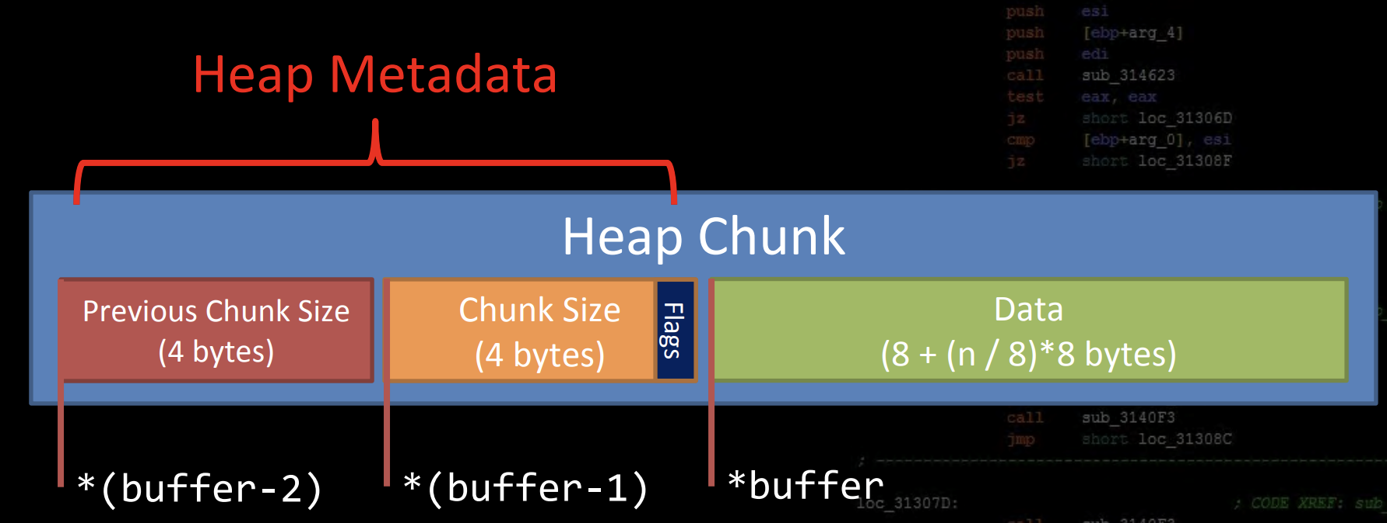
Metadata Corruption -- Unlink, House of Force
Metadata corruption based exploits involve corrupting heap metadata in such a way that you can use the allocator’s internal functions to cause a controlled write of some sort
Generally involves faking chunks, and abusing its different coalescing or unlinking processes

Slide 8
Use After Free
Use After Free
  A class of vulnerability where data on the heap is freed, but a leftover reference or ‘dangling pointer’ is used by the code as if the data were still valid
  Most popular in Web Browsers, complex programs
  Also known as UAF

Slide 9
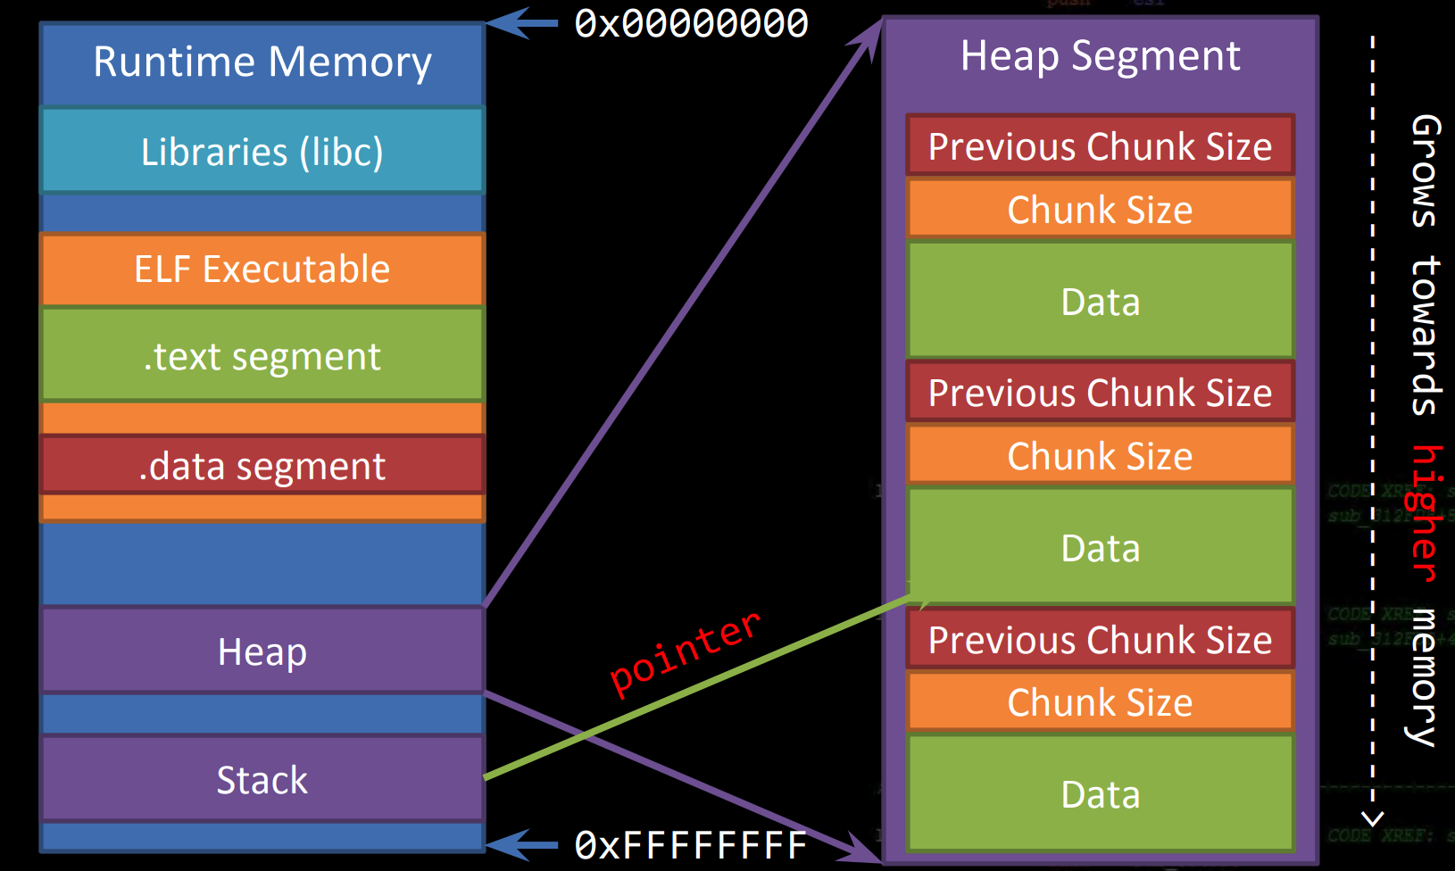
Use After Free
http://security.cs.rpi.edu/courses/binexp-spring2015/lectures/17/10_lecture.pdf

Slide 10
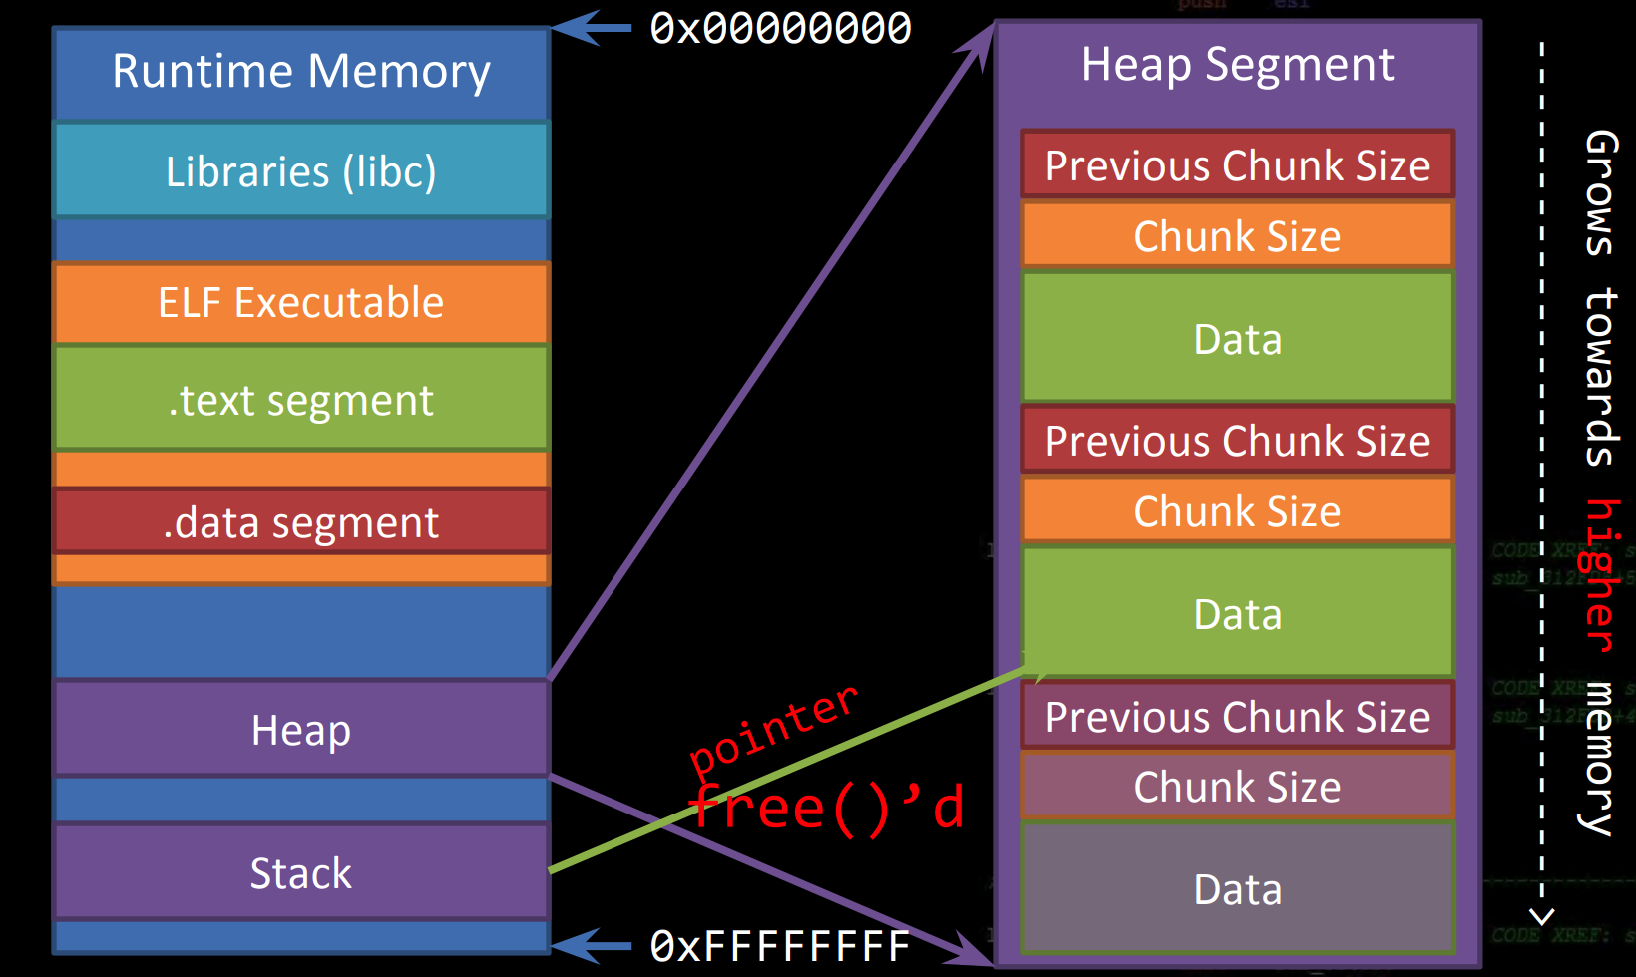
Use After Free
http://security.cs.rpi.edu/courses/binexp-spring2015/lectures/17/10_lecture.pdf

Slide 11
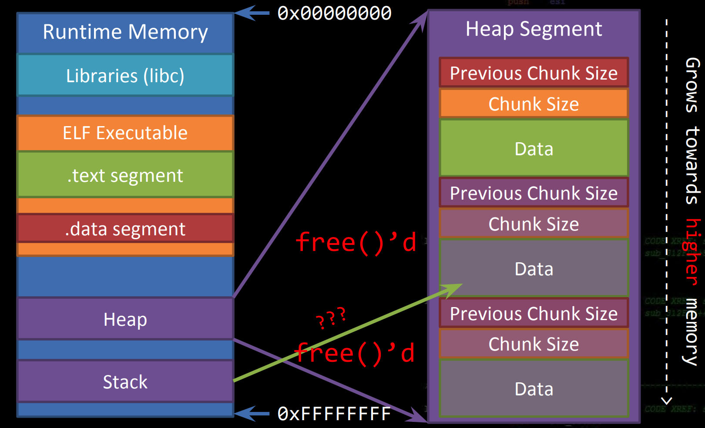
Use After Free
http://security.cs.rpi.edu/courses/binexp-spring2015/lectures/17/10_lecture.pdf

Slide 12
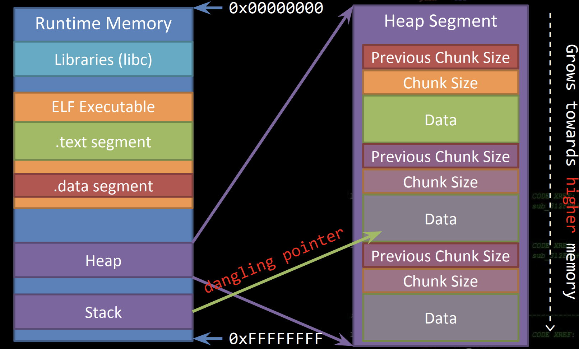
Use After Free
http://security.cs.rpi.edu/courses/binexp-spring2015/lectures/17/10_lecture.pdf

Slide 13
Use After Free
Dangling Pointer
  A left over pointer in your code that references free’d data and is prone to be re-used
  As the memory it’s pointing at was freed, there’s no guarantees on what data is there now
  Also known as stale pointer, wild pointer
http://security.cs.rpi.edu/courses/binexp-spring2015/lectures/17/10_lecture.pdf

Slide 14
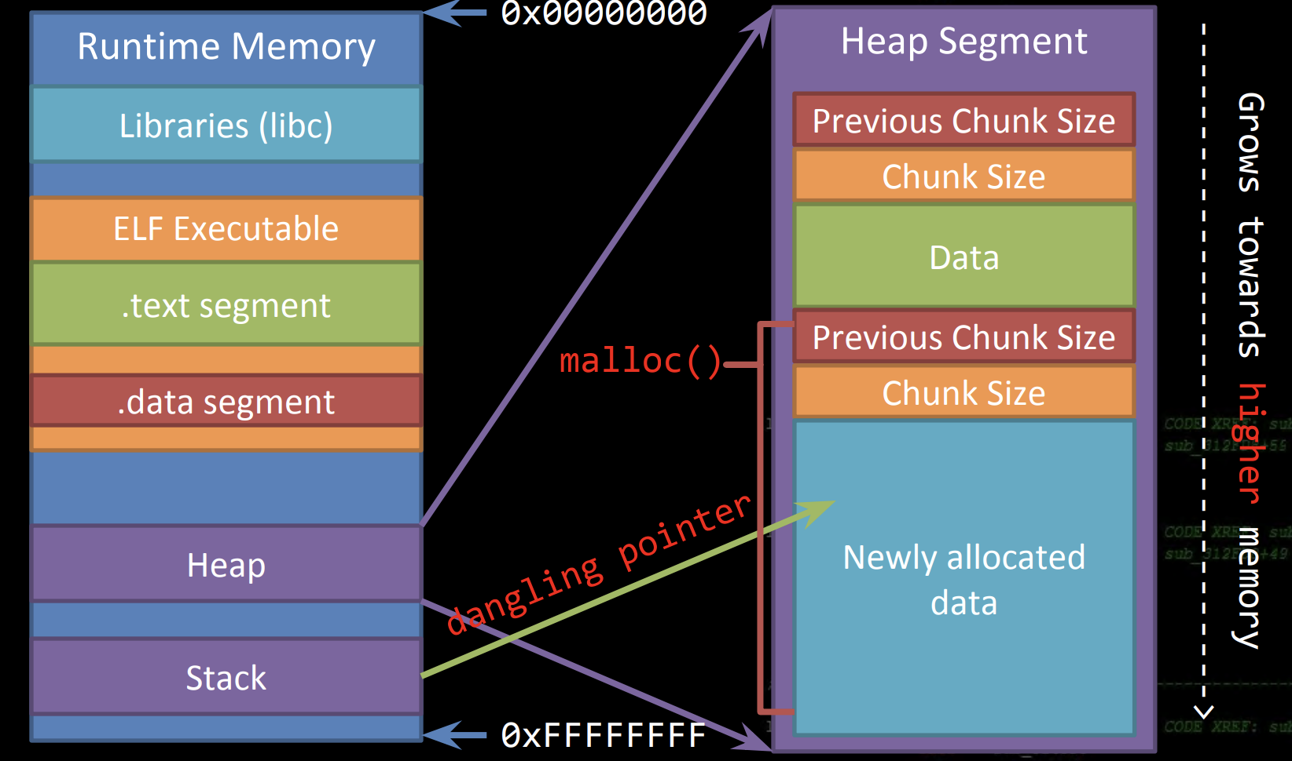
Use After Free
http://security.cs.rpi.edu/courses/binexp-spring2015/lectures/17/10_lecture.pdf

Slide 15
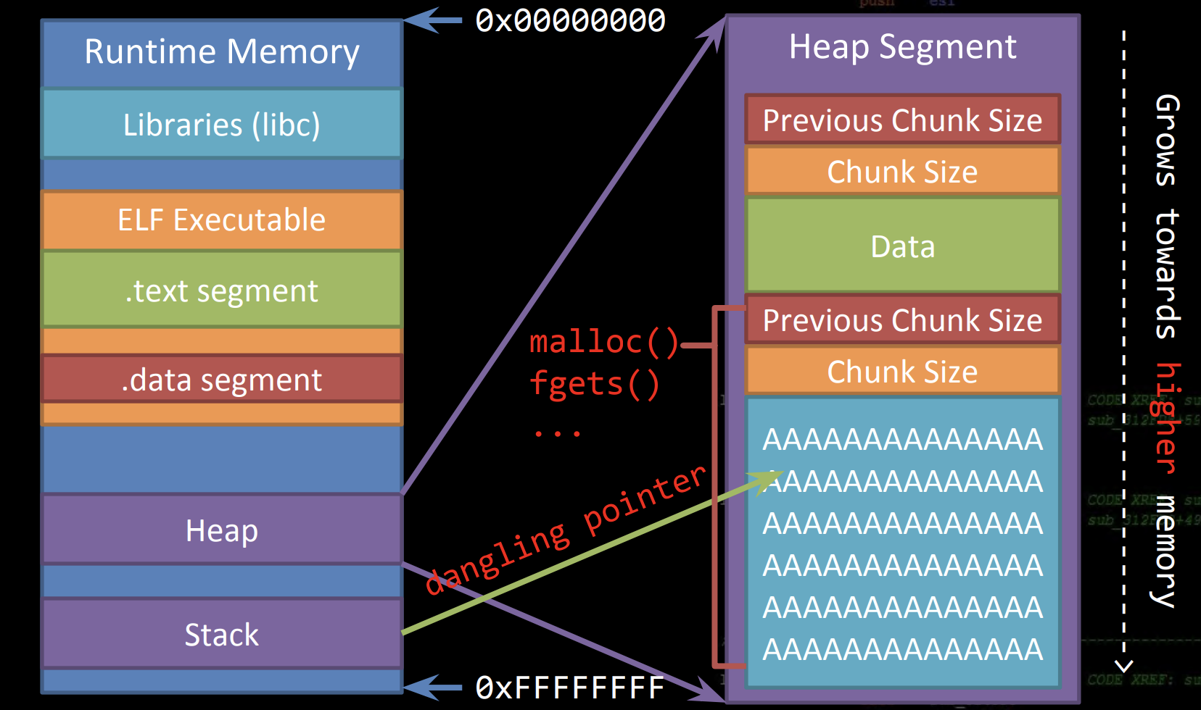
Use After Free
http://security.cs.rpi.edu/courses/binexp-spring2015/lectures/17/10_lecture.pdf

Slide 16
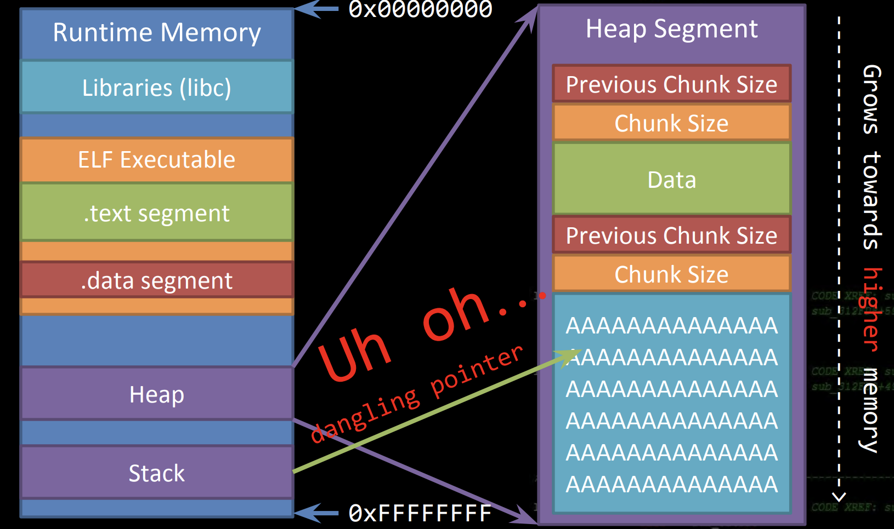
Use After Free
http://security.cs.rpi.edu/courses/binexp-spring2015/lectures/17/10_lecture.pdf

Slide 17
Use After Free
You actually don’t need any form of memory corruption to leverage a use after free
It’s simply an implementation issue
  pointer mismanagement
http://security.cs.rpi.edu/courses/binexp-spring2015/lectures/17/10_lecture.pdf

Slide 18
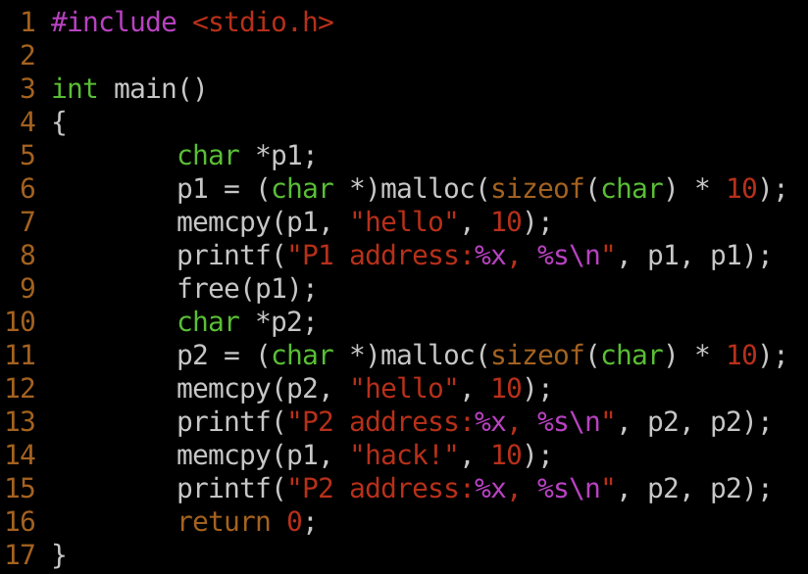
Use After Free: PoC Example

Slide 19
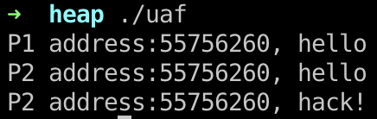
Use After Free: PoC Example

Slide 20
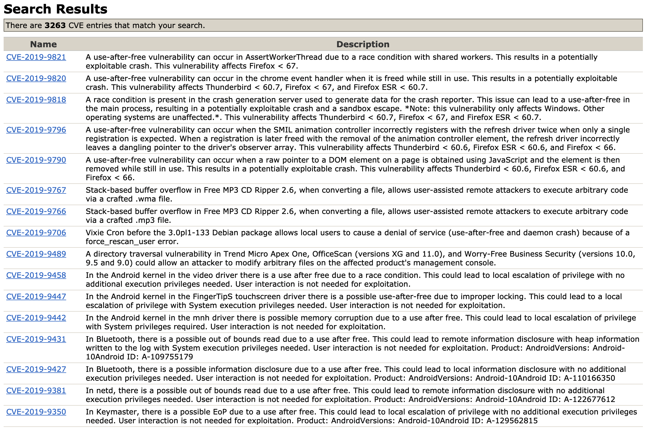
Use After Free
The ‘hot’ vulnerability nowadays, almost every modern browser exploit leverages a UAF

Slide 21
Use After Free
From the defensive perspective, trying to detect use after free vulnerabilities in complex applications is very difficult, even in industry
Why?
  UAF’s only exist in certain states of execution, so statically scanning source for them won’t go far
  They’re usually only found through crashes, but symbolic execution and constraint solvers are helping find these bugs faster

Slide 22












Introduction

Slide 23
Introduction

Slide 24





Introduction

Slide 25
Introduction
The kernel is also a program that:
Manages the data I/O requirements issued by the software
Escaping these requirements into instructions
Handing them over to the CPU

Slide 26
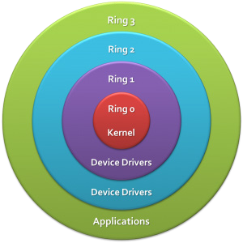
Ring Model
Hardware Enforced Model
0: Privileged, Kernelspace
3: Restricted, Userspace

Slide 27
Ring Model
Hardware Enforced Model
0: Privileged, Kernelspace
3: Restricted, Userspace
Ring 1 and Ring 2 are not utilized by most popular/modern Operating Systems (Linux / Windows / OSX)

Slide 28

Ring Model

Slide 29

Ring Model

Slide 30




“Matrix”

Slide 31








Kernel Pwning

Slide 32
Jailbreak Game Console

Slide 33

Kernel Basics

Slide 34








Kernel Basics

Slide 35














Kernel Exploitation Strategy

Slide 36
Kernel Exploitation Strategy
You already know how to find these!
Kernel vulnerabilities are almost exactly the same as userland vulnerabilities.
Stack Overflows
Heap Overflows
By now, finding these should be a familiar process

Slide 37
Kernel Exploitation Strategy
Monolithic Kernel
  Monolithic kernel is a single large processes running entirely in a single address space. It is a single static binary file. All kernel services exist and execute in kernel address space. The kernel can invoke functions directly.
LKMs

Slide 38
Kernel Exploitation Strategy
The most common place to find vulnerabilities is inside of Loadable Kernel Modules (LKMs).
LKMs are like executables that run in Kernel Space. A few common uses are listed below:
> Device Drivers
> Filesystem Drivers
> Networking Drivers
> Executable Interpreters
> Kernel Extensions
> ( rootkits :P )

Slide 39
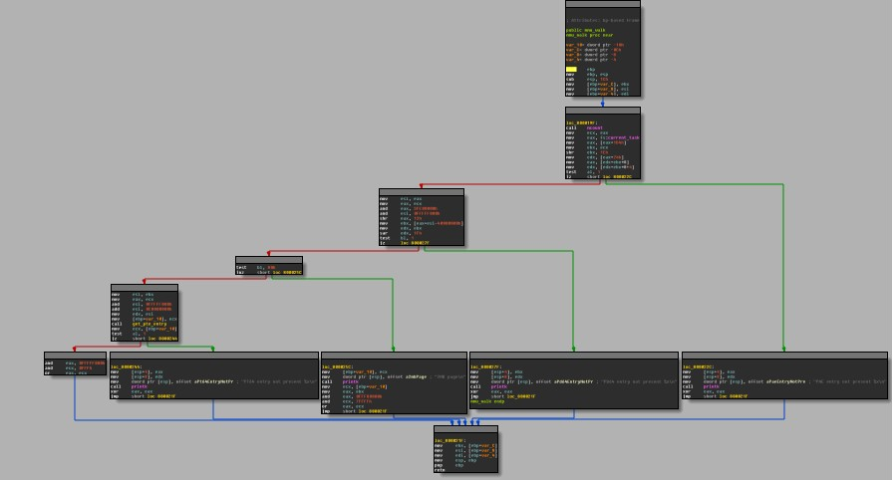
Kernel Exploitation Strategy
LKMs are just binary blobs like your familiar ELF’s, EXE’s and MACH-O’s. (On Linux, they even use the ELF format)
You can drop them into GDB and reverse-engineer them like you’re used to already.

Slide 40
Kernel Exploitation Strategy
There’s a few useful commands that deal with LKMs on Linux.
insmod | ---> | Insert a module into the running kernel
rmmod | ---> | Remove a module from the running kernel
lsmod | ---> | List currently loaded modules
A general familiarity with these is helpful

Slide 41


Kernel Exploitation Strategy

Slide 42








Kernel Functions
fr
(slab/slub allocator)
free()
kfree()

Slide 43




Kernel Debugging

Slide 44




Kernel Debugging

Slide 45



Kernel Debugging

Slide 46
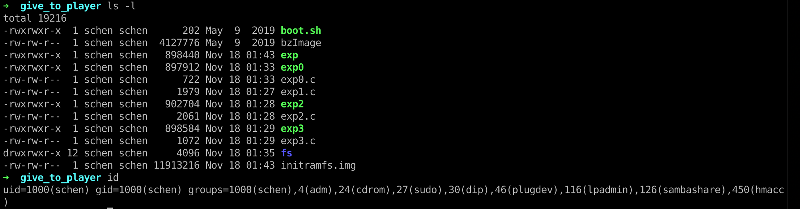
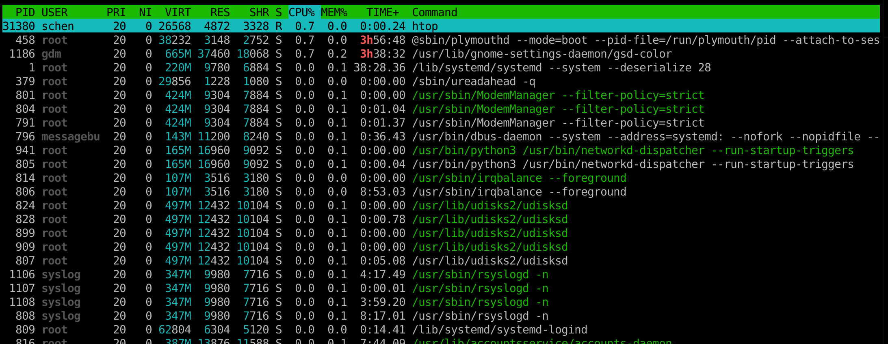
Traditional UNIX credentials.
Real User ID
Real Group ID

Slide 47
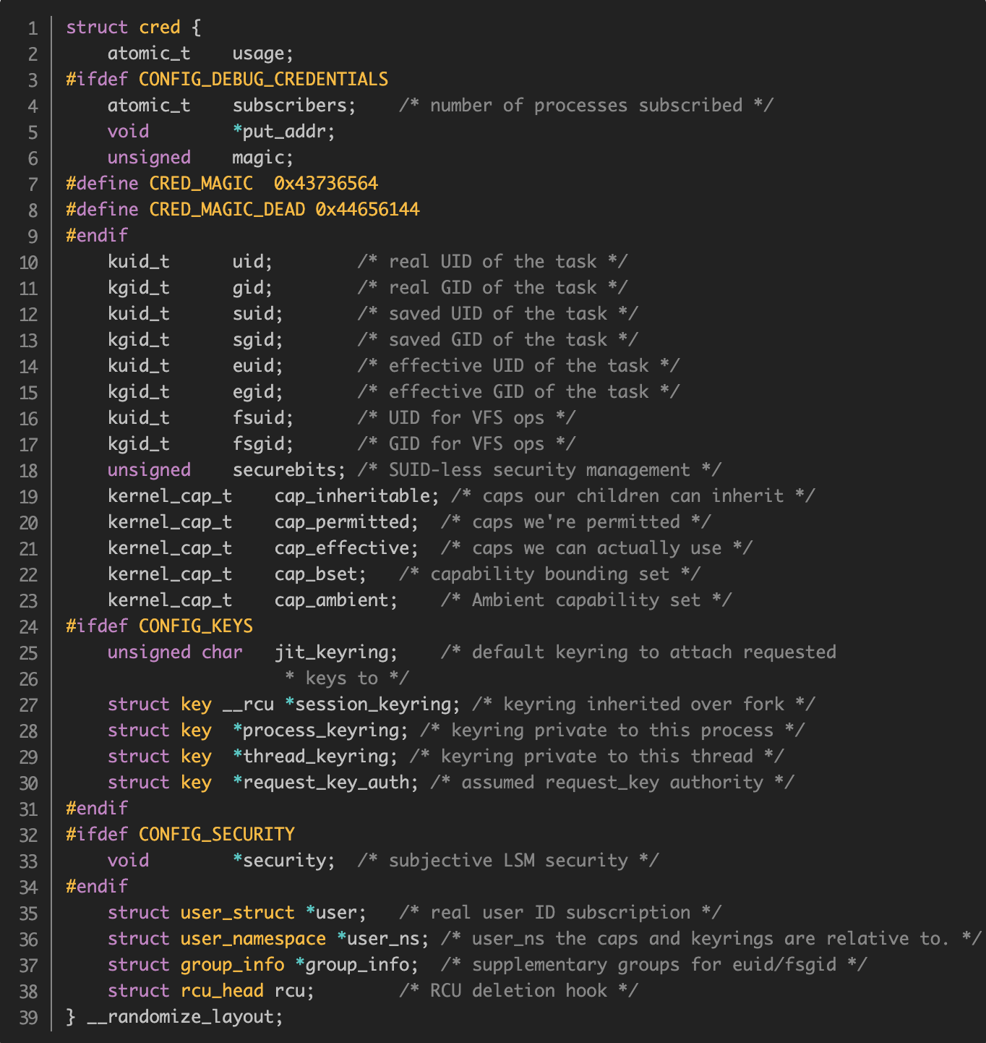
Elevate Privileges
Remember: The Kernel manages running processes
Therefore: The Kernel keeps track of permissions
https://code.woboq.org/linux/linux/include/linux/cred.h.html#cred

Slide 48





Elevate Privileges
Conveniently, the Linux Kernel has two wrapper functions for updating process credentials and generating process credentials!

Slide 49
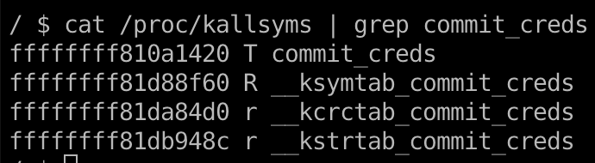
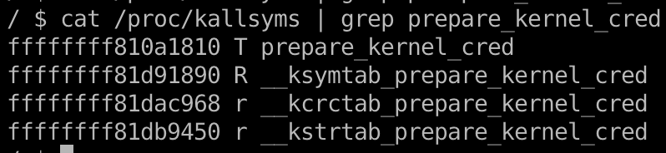
Elevate Privileges
Now we can map out what we need to do
commit_creds(prepare_kernel_cred(0));
We can find their addresses in /proc/kallsyms

Slide 50
Returning to UserSpace
Why bother returning to Userspace?
Most useful things we want to do are much easier from userland.
In KernelSpace, there’s no easy way to:
> Modify the filesystem
> Create a new process
> Create network connections

Slide 51









Returning to UserSpace
How does the kernel do it?
This will usually get you out of “Kernel Mode” safely.

Slide 52
Returning to UserSpace
For exploitation, the easiest strategy is highjacking execution, and letting the kernel return by itself.
> Function Pointer Overwrites
> Syscall Table Highjacking
> Use-After-Free
You need to be very careful about destroying Kernel state. A segfault probably means a reboot!

Slide 53
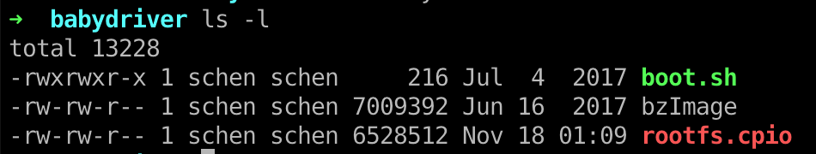
Example: Babydriver
https://github.com/ctf-wiki/ctf-challenges/tree/master/pwn/kernel

Slide 55
Kernel Space Protections
By now, you’re familiar with the alphabet soup of exploit mitigations
DEP ASLR
Canaries
etc...
Green: Present in Kernel Space Yellow: Present, with caveats
There’s a whole new alphabet soup for Kernel Mitigations!

Slide 56
Kernel Space Protections
Some new words in our soup (There’s plenty more...)
MMAP_MIN_ADDR KALLSYMS RANDSTACK STACKLEAK SMEP / SMAP
Most of these will be off for the labs!

Slide 57
MMAP_MIN_ADDR
This makes exploiting NULL pointer dereferences harder.
Low Memory
Malicious Program
0xffffffff

Slide 58
MMAP_MIN_ADDR
This makes exploiting NULL pointer dereferences harder.
Program does mmap(0,....)
0x000000
Low Memory
Malicious Program
0xffffffff

Slide 59
MMAP_MIN_ADDR
This makes exploiting NULL pointer dereferences harder.
Program does mmap(0,....) Program writes malicious Code
0x000000
Low Memory
Malicious Program
0xffffffff

Slide 60
MMAP_MIN_ADDR
This makes exploiting NULL pointer dereferences harder.
0x000000
Program does mmap(0,....)
Kernel Memory
Program writes malicious Code
Low Memory
Program triggers Kernel Bug
Malicious Program
0xffffffff

Slide 61
MMAP_MIN_ADDR
This makes exploiting NULL pointer dereferences harder.
0x000000
Program does mmap(0,....)
Kernel Memory
Program writes malicious Code
Low
Memory
Program triggers Kernel Bug
Malicious Program
Kernel starts executing malicious Code
0xffffffff

Slide 62
MMAP_MIN_ADDR
This makes exploiting NULL pointer dereferences harder.
0x000000
mmap_min_addr disallows programs from allocating low memory.
Kernel Memory
Low
Memory
Makes it much more difficult to exploit a simple NULL pointer dereference in the kernel.
Malicious Program
0xffffffff

Slide 63
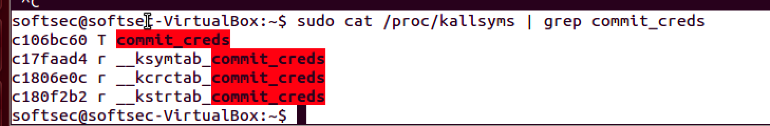
KALLSYMS
/proc/kallsyms gives the address of all symbols in the kernel.
We need this information to write reliable exploits without an info-leak!

Slide 64
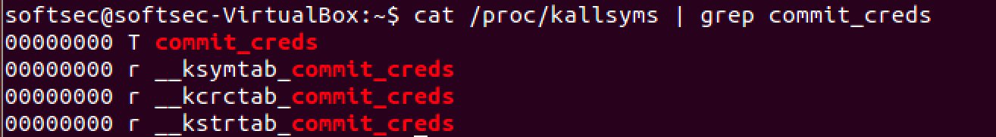
KALLSYMS
kallsyms used to be world-readable.
Now, it returns 0’s for unprivileged users
Can still be a useful source of information on older systems

Slide 65
SMEP / SMAP
SMEP: Supervisor Mode Execution Protection
Introduced in Intel IvyBridge
SMAP: Supervisor Mode Access Protection Introduced in Intel Haswell

Slide 66
SMEP / SMAP
Common Exploitation Technique: Supply your own “get
root” code.
0x000000
void get_r00t() {
commit_creds(prepare_kernel_cred(0));
}
int main(int argc, char * argv) {
… trigger_fp_overwrite(&get_r00t);
…
//trigger fp use trigger_vuln_fp();
// Kernel Executes get_r00t
...
// Now we have root system(“/bin/sh”);
}
Kernel Memory
Low Memory
Malicious Program
0xffffffff

Slide 67
SMEP / SMAP
SMEP prevents this type of attack by triggering a page fault if the processor tries to execute memory that has the “user” bit set while in “ring 0”.
SMAP works similarly, but for data access in general
This doesn’t prevent vulnerabilities, but it adds considerable work to developing a working exploit
We need to use ROP, or somehow get executable code into kernel memory.

Slide 68



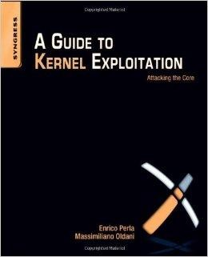
Conclusion

Slide 69
Q & A

