Slide 1

Class20
CSC 495/583 Topics of Software Security
Heap Exploitation (2): Unlink Attack
Dr. Si Chen (schen@wcupa.edu)

Slide 2
Pseudo Memory Map
0x00000000 – Start of memory
0x00000000 – Start of memory
Runtime Memory
Libraries (libc)
ELF Executable
.text segment
.data segment
Heap
Stack
Runtime Memory
Libraries (libc)
ELF Executable
.text segment
.data segment
Heap
Stack
0x08048000 – Start of .text Segment
0x08048000 – Start of .text Segment
0xb7ff0000 – Top of heap
0xbfff0000 – Top of stack
0xFFFFFFFF – End of memory
MBE - 04/07/2015
2

Slide 3
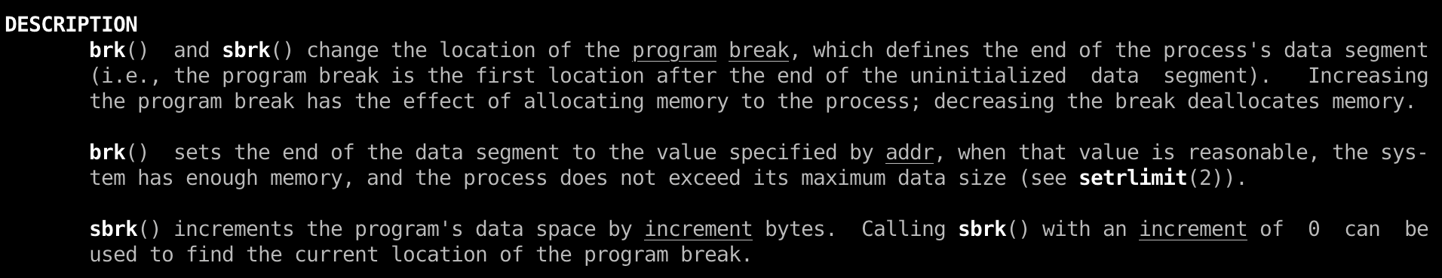
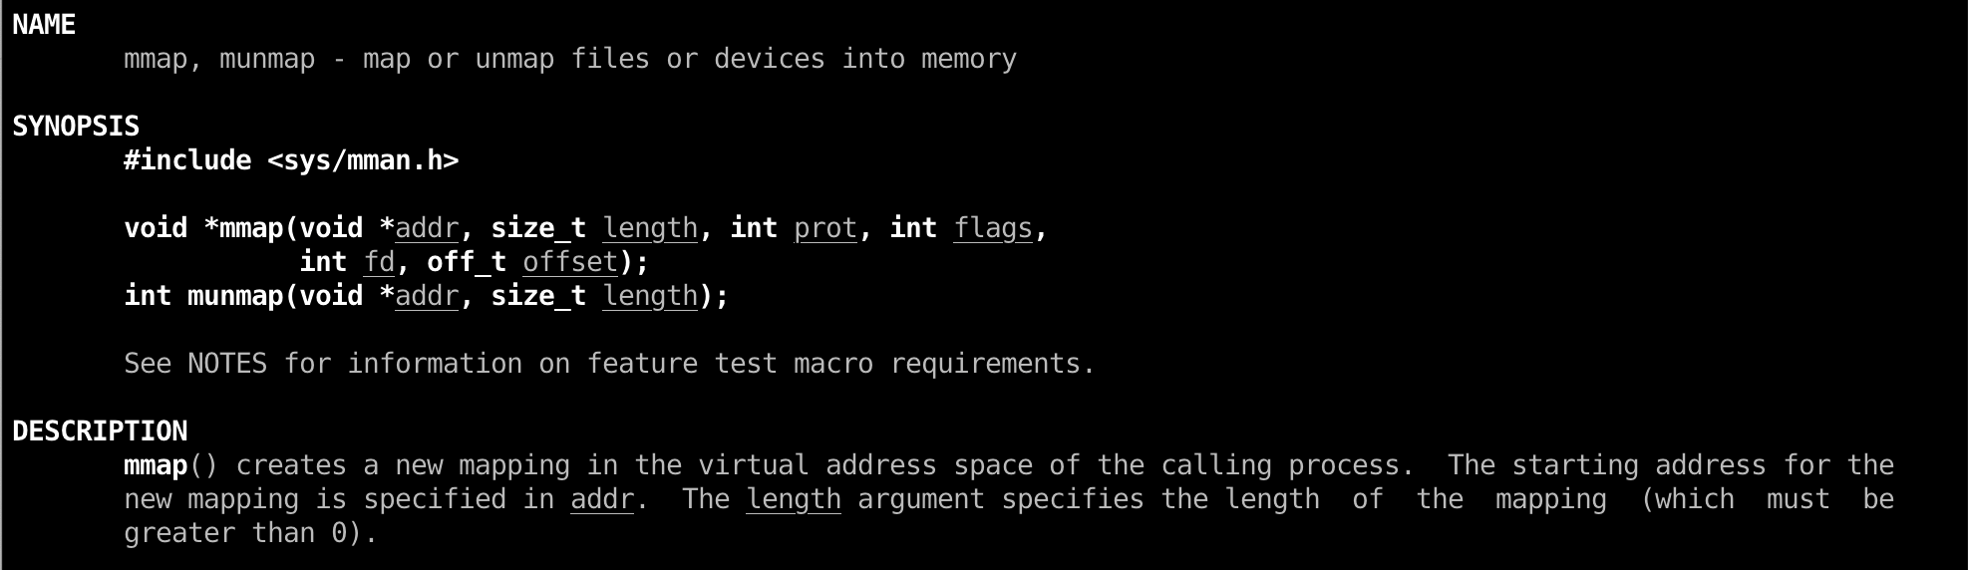
Heap in Linux (GNU C Library – glibc)
ptmalloc2
System call:
brk()
mmap()

Slide 4
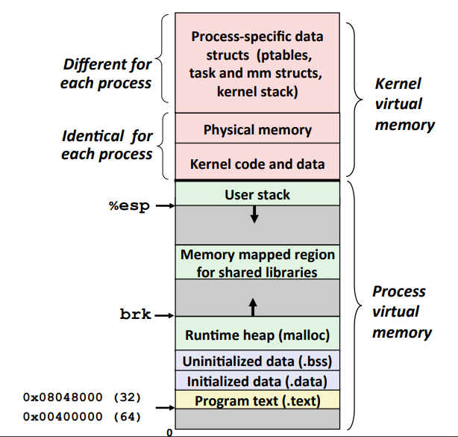
The Heap

Slide 5
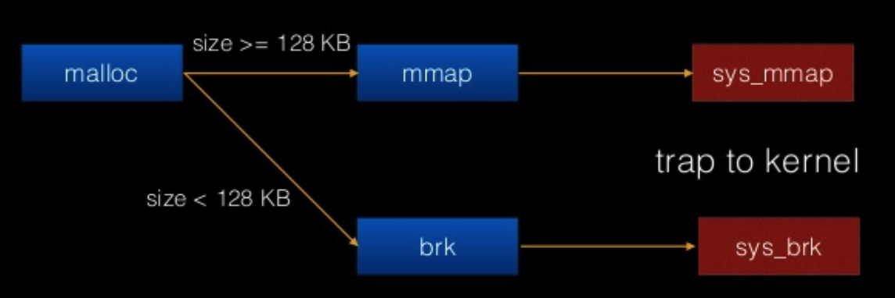
The workflow of malloc()

Slide 6
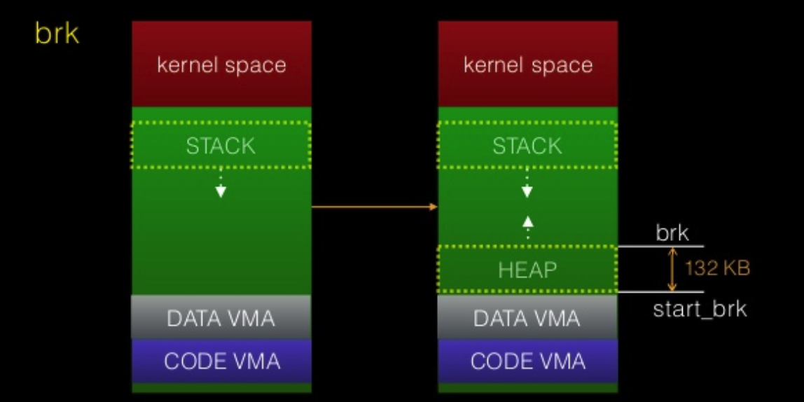
The workflow of malloc()
If malloc size < 128KB then Kernel will return a 132KB heap segment (rw)
which called main arena

Slide 7
Doug Lea‘s malloc Heap Chunks
Heap chunks exist in two states
  in use (malloc’d)
  free’d

Slide 8
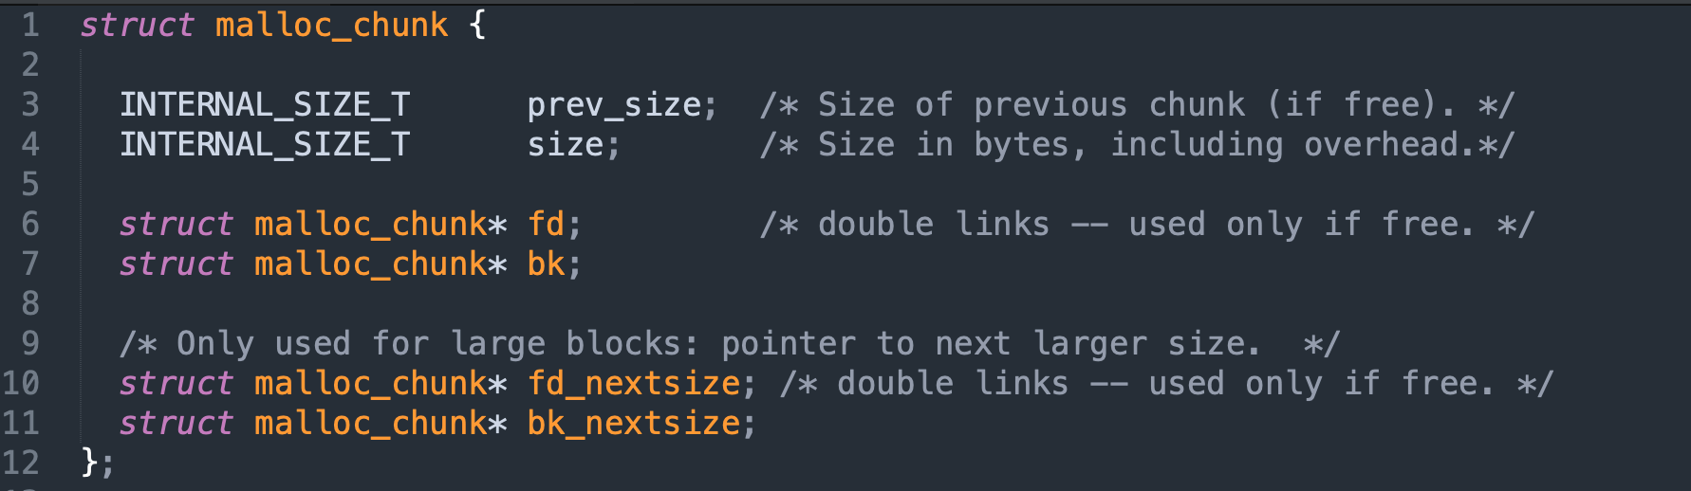
malloc chunk

Slide 9
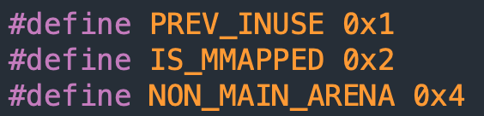
Heap Chunks
unsigned int * buffer = NULL; buffer = malloc(0x100);
//Out comes a heap chunk
Heap Chunk
Previous Chunk Size (4 bytes)
Chunk Size (4 bytes)
Flags
Data
(8 + (n / 8)*8 bytes)
*(buffer-2)
*(buffer-1)
*buffer

Slide 10
Heap Chunks – Freed
unsigned int * buffer = NULL; buffer = malloc(0x100);
free(buffer);
Forward Pointer
  A pointer to the next freed chunk
Backwards Pointer
  A pointer to the previous freed chunk
Heap Chunk (freed)
Previous Chunk Size (4 bytes)
Chunk Size (4 bytes)
Flags
FD
(4 bytes)
BK
(4 bytes)
*(buffer-2)
*(buffer-1)
*buffer
*(buffer+1)

Slide 11
Heap Allocations
0x00000000
Runtime Memory
Libraries (libc)
ELF Executable
.text segment
.data segment
Heap
Stack
Heap Segment
Grows towards higher memory
--------------------------------->
Previous Chunk Size
Chunk Size
Data
0xFFFFFFFF

Slide 12
Heap Allocations
0x00000000
Runtime Memory
Libraries (libc)
ELF Executable
.text segment
.data segment
Heap
Stack
Heap Segment
Grows towards higher memory
--------------------------------->
Previous Chunk Size
Chunk Size
Data
Previous Chunk Size
Chunk Size
Data
0xFFFFFFFF

Slide 13
Heap Allocations
0x00000000
Runtime Memory
Libraries (libc)
ELF Executable
.text segment
.data segment
Heap
Stack
Heap Segment
Grows towards higher memory
--------------------------------->
Previous Chunk Size
Chunk Size
Data
Previous Chunk Size
Chunk Size
Data
Previous Chunk Size
Chunk Size
Data
0xFFFFFFFF

Slide 14
Heap Overflows
0x00000000
Runtime Memory
Libraries (libc)
ELF Executable
.text segment
.data segment
Heap
Stack
Heap Segment
Grows towards higher memory
--------------------------------->
Previous Chunk Size
Chunk Size
Data
Previous Chunk Size
Chunk Size
Data
Previous Chunk Size
Chunk Size
Data
0xFFFFFFFF

Slide 15
Heap Overflows
Buffer overflows are basically the same on the heap as they are on the stack
0x00000000
Runtime Memory
Libraries (libc)
ELF Executable
.text segment
.data segment
Heap
Stack
Heap Segment
Grows towards higher memory
--------------------------------->
Previous Chunk Size
Chunk Size
AAAAAAAAAAAAAA AAAAAAAAAAAAAA AAAAAAAAAAAAAA AAAAAAAAAAAAAA AAAAAAAAAAAAAA … heap overflow
Previous Chunk Size
Chunk Size
Data
Previous Chunk Size
Chunk Size
Data
0xFFFFFFFF

Slide 16
Unlink Attack

Slide 17
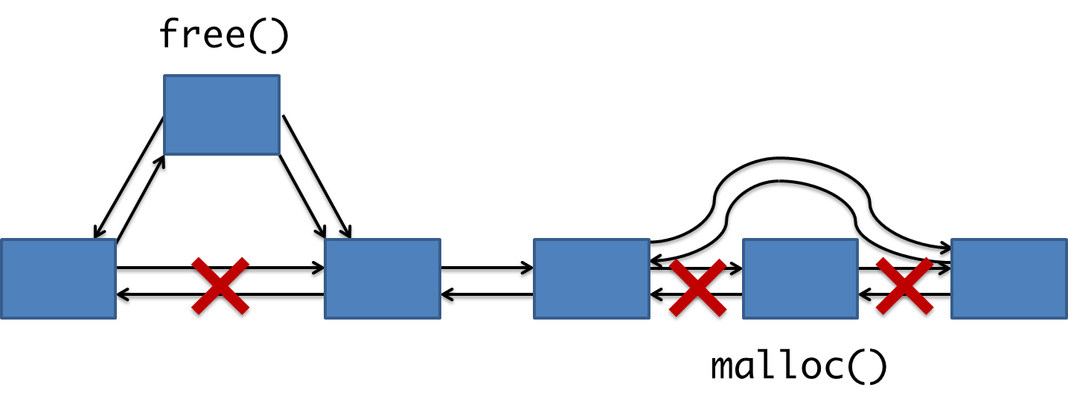
Unlink Attack: malloc & free

Slide 18
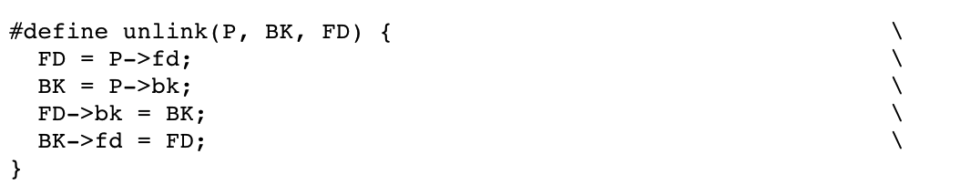
Unlink
remove a chunk from linked list

Slide 19
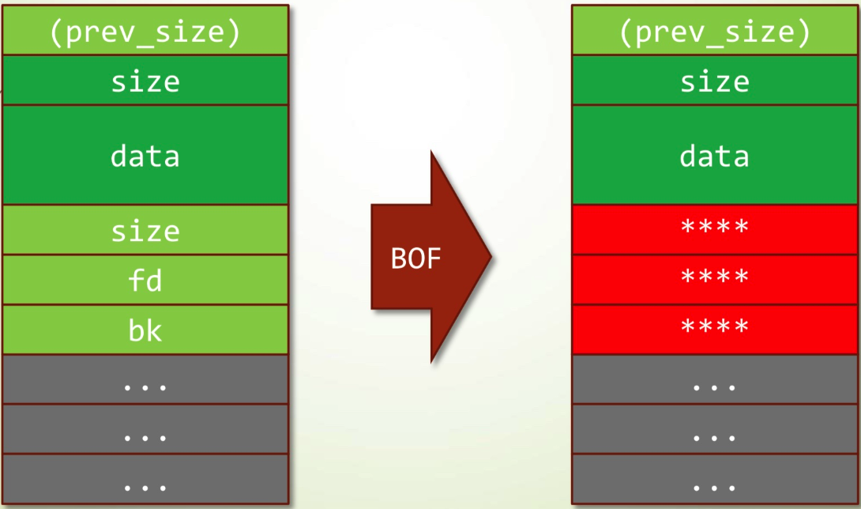
Unlink

Slide 20
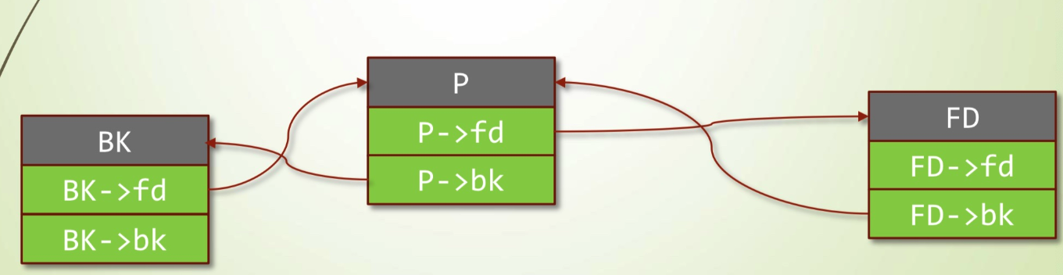
Freed Heap Chunks – Doubly linkedlist
free(buffer);
Forward Pointer
  A pointer to the next freed chunk
Backwards Pointer
  A pointer to the previous freed chunk
Heap Chunk (freed)
Previous Chunk Size (4 bytes)
Chunk Size (4 bytes)
Flags
FD
(4 bytes)
BK
(4 bytes)
*(buffer-2)
*(buffer-1)
*buffer
*(buffer+1)

Slide 21
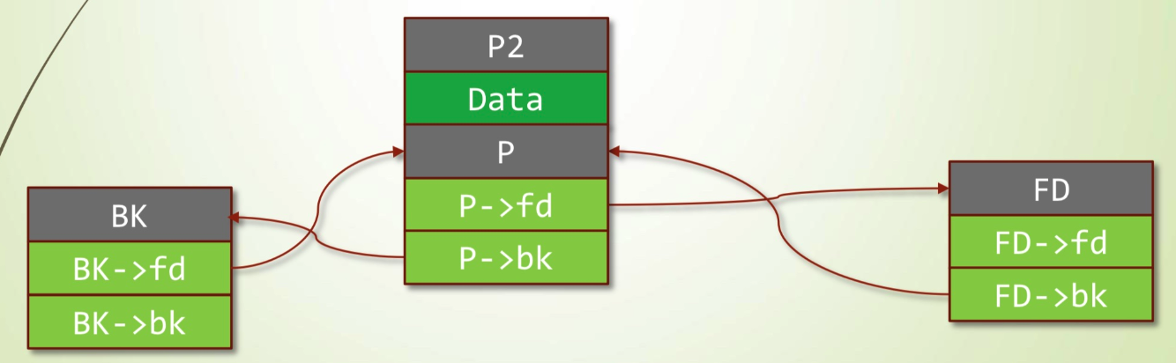
Normal Free()
P2 is in in-use state, we can get P’s (freed) address by using:
P2’s address + P2’s size

Slide 22
Normal Free()
If we execute free(P2). It will generate two contiguous free space
OS will automatically combined two continues free chunks and generate one big free chunk
  --> P will be temporarily deleted from the doubly linked-list

Slide 23
Normal Free()
If we execute free(P2). It will generate two contiguous free space
OS will automatically combined two continues free chunks and generate one big free chunk
  --> P will be temporarily deleted from the doubly linked-list

Slide 24
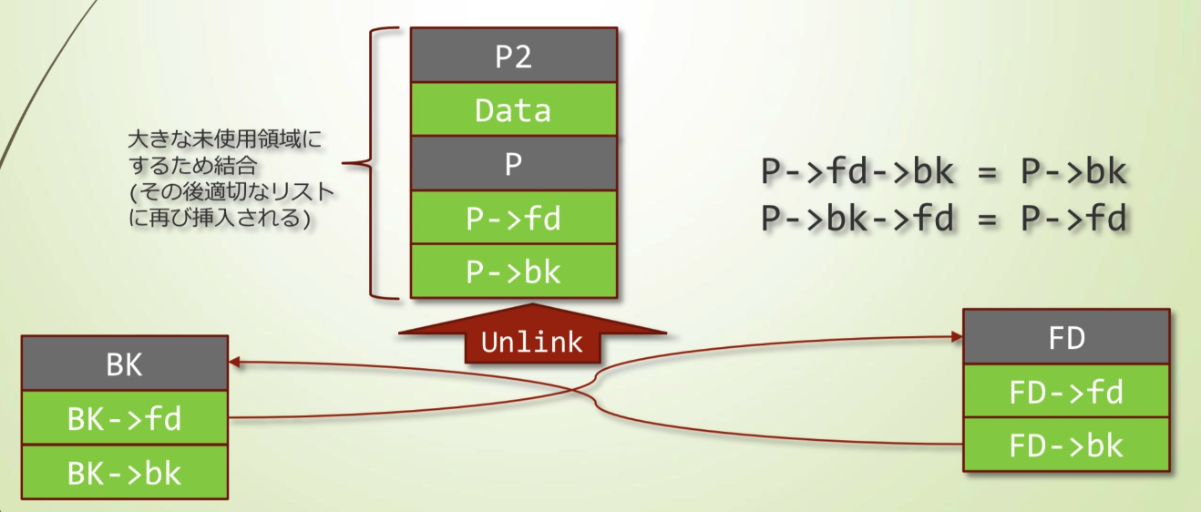
Normal Free()
If we execute free(P2). It will generate two contiguous free space
OS will automatically combined two continues free chunks and generate one big free chunk
  --> P will be temporarily deleted from the doubly linked-list
  This is done inside free()
  When you free(P2). P will also get unlinked!!
OS will automatically combined two continues free chunks and generate one big free chunk

Slide 25
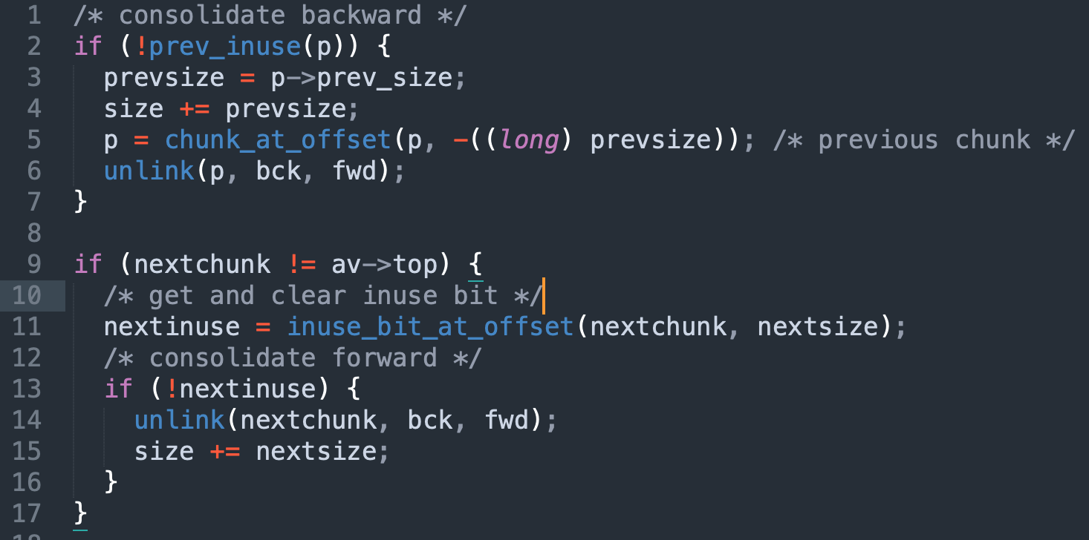
Consolidate Free Chunk

Slide 26
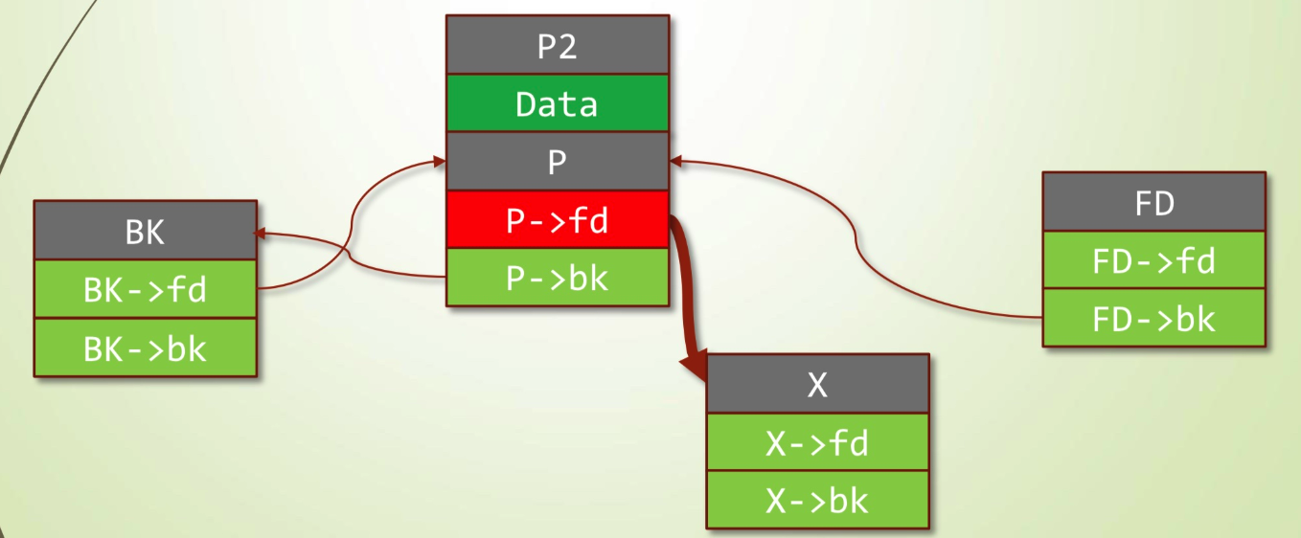
Unlink Attack
Exploit P2, overwrite fd
  Let it pointing to X

Slide 27
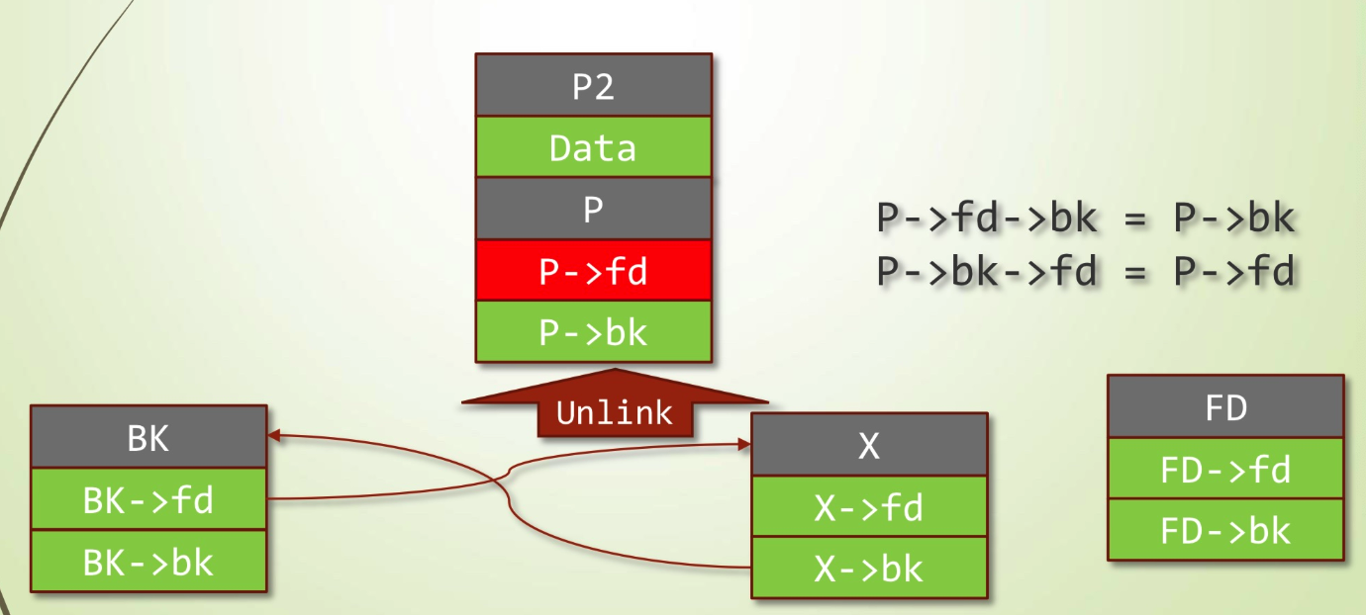
Unlink Attack
When you free(P2). P will also be unlinked.

Slide 28
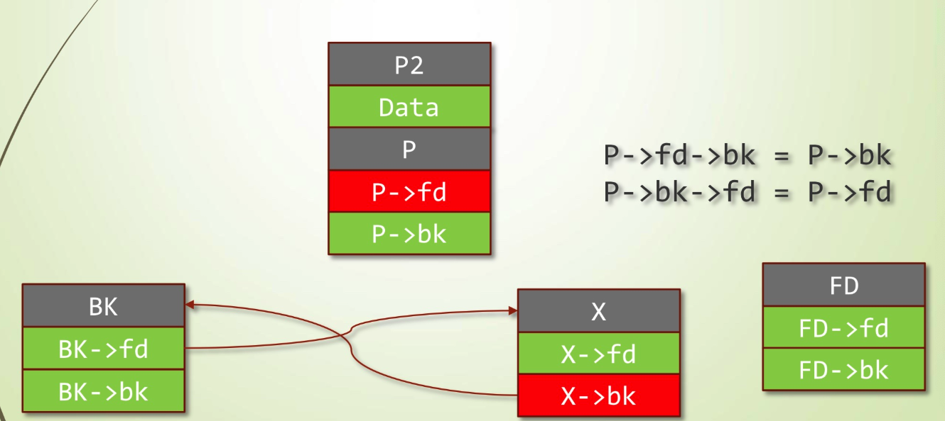
Unlink Attack
Then, BK and X will be connected.

Slide 29
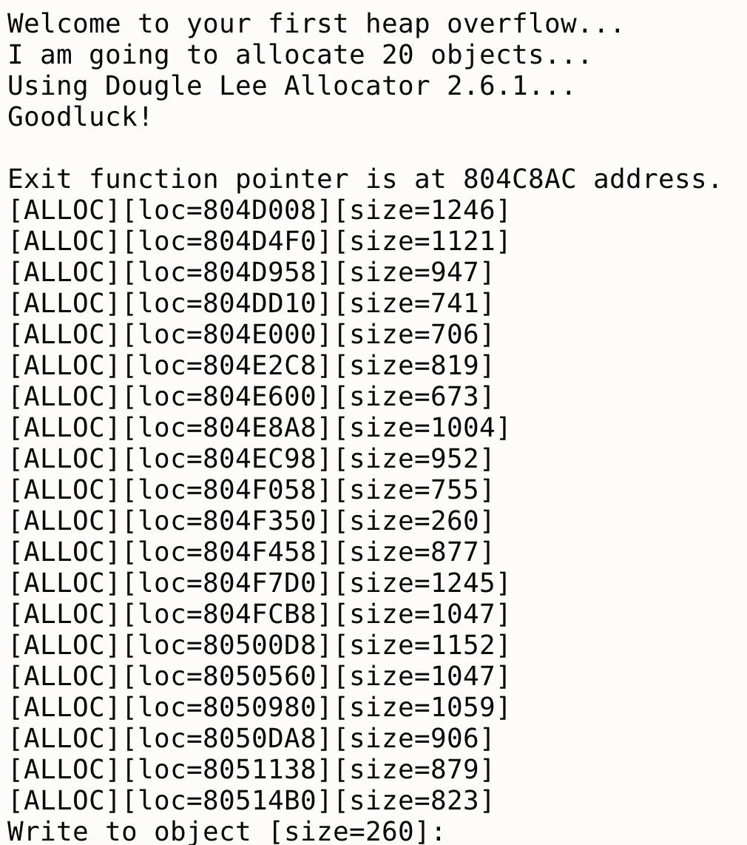
Unlink Attack Example: DEFCON 2014 CTF-Baby's First-heap

Slide 30
DEFCON 2014 CTF-Baby's First-heap

Slide 31
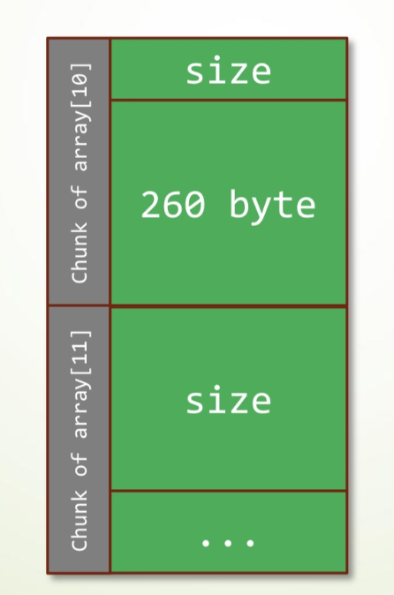
DEFCON 2014 CTF-Baby's First-heap

Slide 32
DEFCON 2014 CTF-Baby's First-heap
Array[10]
Array[11]
memcpy() lead to heap overflow
Array[11] is in in-use state:
Let’s overflow Array[10]
And set Array[11] to freed state

Slide 33
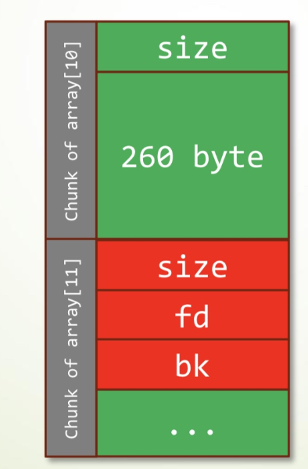
DEFCON 2014 CTF-Baby's First-heap
Array[10]
Array[11]
memcpy() lead to heap overflow
Array[11] is in in-use state:
Let’s overflow Array[10]
And set Array[11] to freed state

Slide 34
DEFCON 2014 CTF-Baby's First-heap
Array[10]
Array[11]
memcpy() lead to heap overflow
Array[11] is in in-use state:
Let’s overflow Array[10]
And set Array[11] to freed state

Slide 35
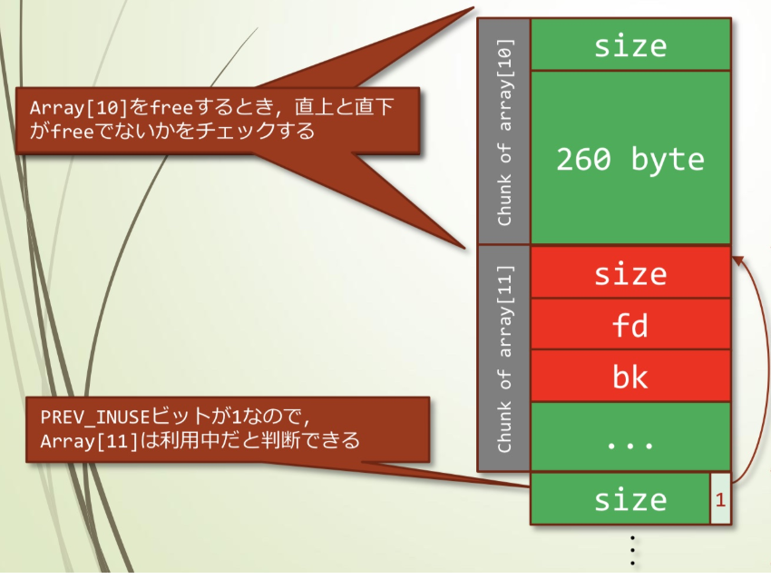
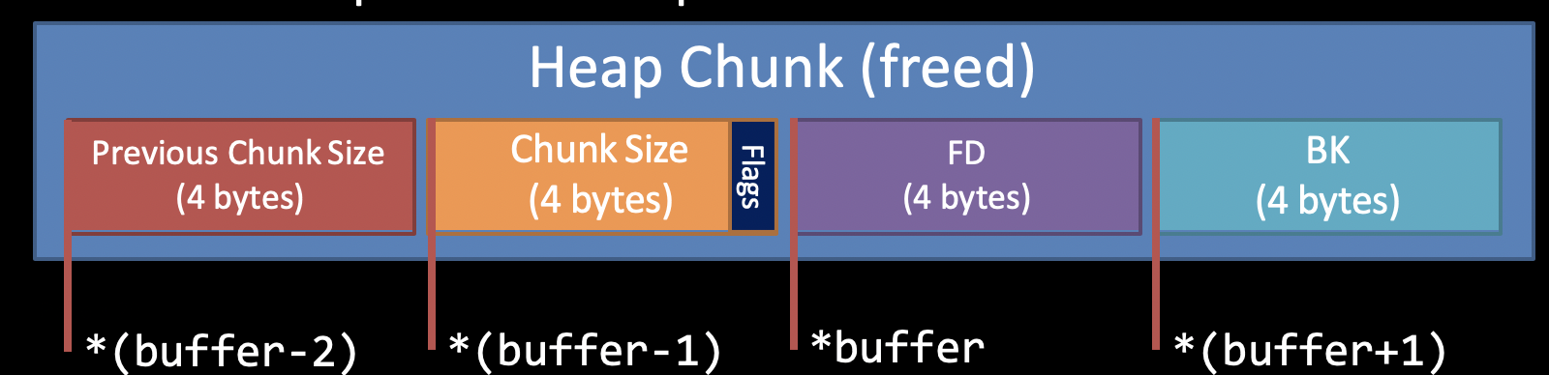
DEFCON 2014 CTF-Baby's First-heap
Check PREV_INUSE
from the previous chunk
Check PREV_INUSE
bit of the next chunk → → Array[12]
1: In-use
0: Freed

Slide 36
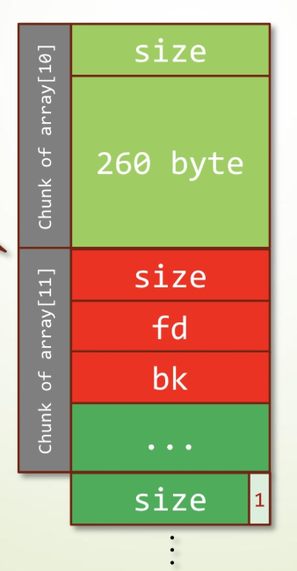
DEFCON 2014 CTF-Baby's First-heap
How to find the address of Chunk Size for
both Array[11] and Array[12]?
Addr_Array[10] + chunk_size[10] == addr_Array[11]
Addr_Array[11] + chunk_size[11] == addr_Array[12]
1: In-use
0: Freed

Slide 37
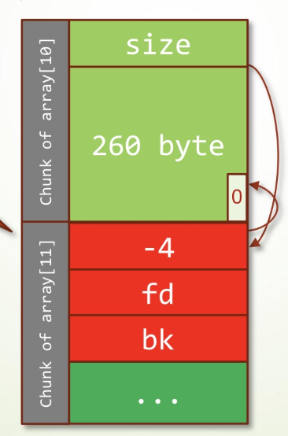
DEFCON 2014 CTF-Baby's First-heap
If we change Array[11]’s size to -4
Aka. 0xfffffffc
Then, Array[10] thought array[11] is in freed state
Then in order to find Array[12], computer use:
Addr_Array[11] + chunk_size[11] == addr_Array[12]
Where chunk_size[11] is negative 4.
So the addr_array[12] is pointing to the end of Array[10]
And it’s PREV_INUSE is 0. So system think Array[11] is in freed state
1: In-use
0: Freed

Slide 38
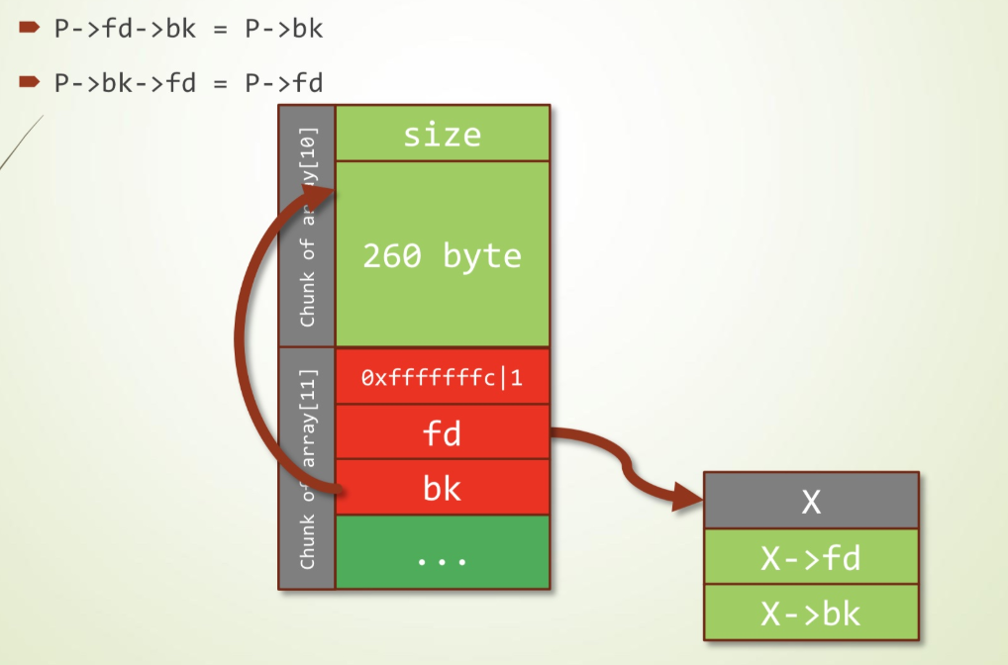
DEFCON 2014 CTF-Baby's First-heap
P : Array[11]
Launch unlink attack!

Slide 39
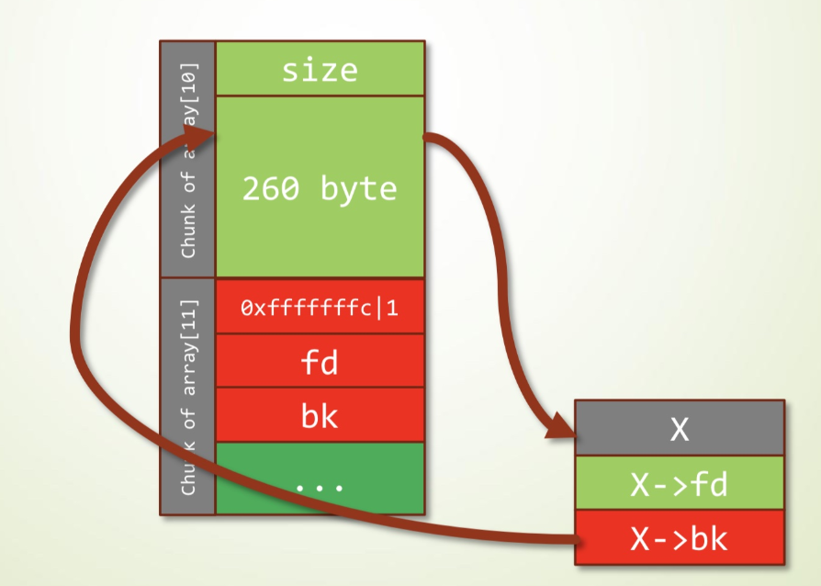
DEFCON 2014 CTF-Baby's First-heap
P : Array[11]
Launch unlink attack!

Slide 40
DEFCON 2014 CTF-Baby's First-heap
P : Array[11]
Let x->bk become printf@GOT

Slide 41
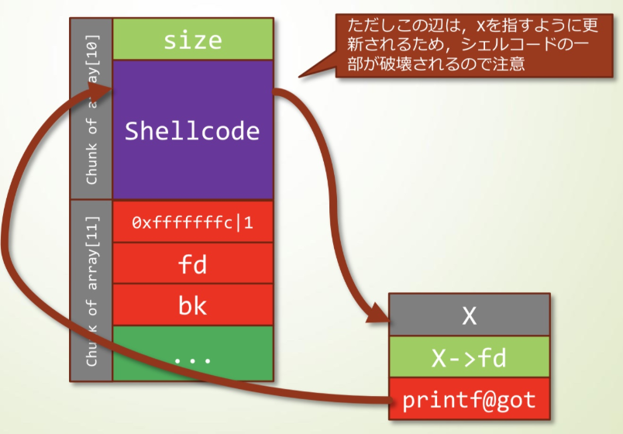
DEFCON 2014 CTF-Baby's First-heap
P : Array[11]
Let x->bk become printf@GOT and
change it’s value to shellcode’s address
→ call printf() == call shellcode
Write shellcode into array[10]

Slide 42
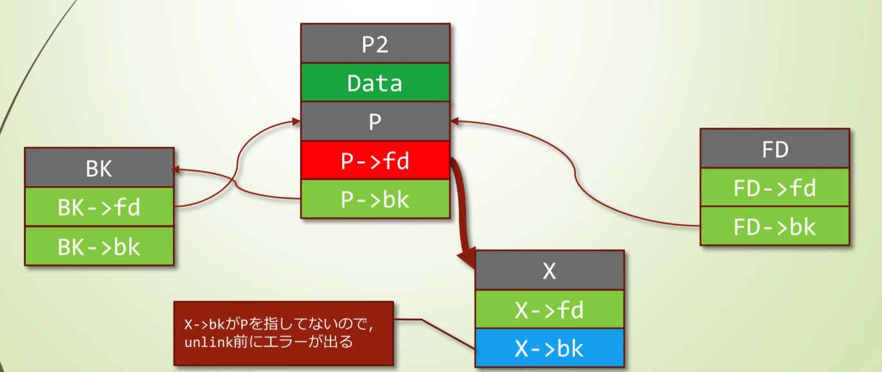
Unlink Attack – After 2004
After 2004, libc updates it’s free() function. Added the following judgement:
P->fd->bk == P
P->bk->fd == P
P->fd->bk = x->bk != P

Slide 43
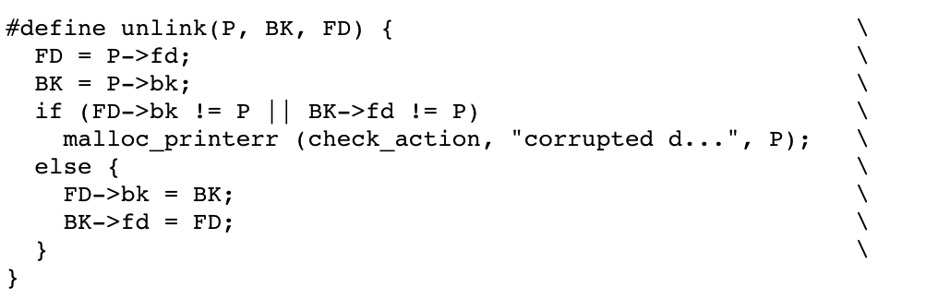
Unlink Attack – After 2004

Slide 44
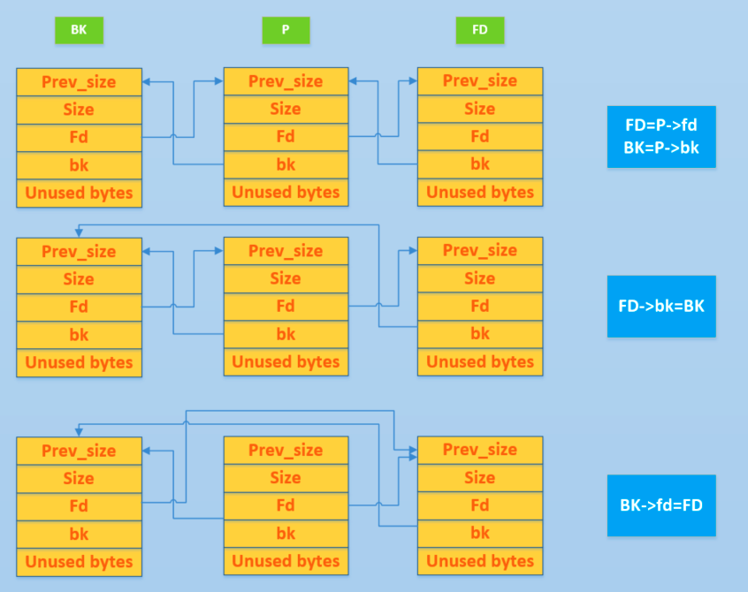
Unlink

Slide 45
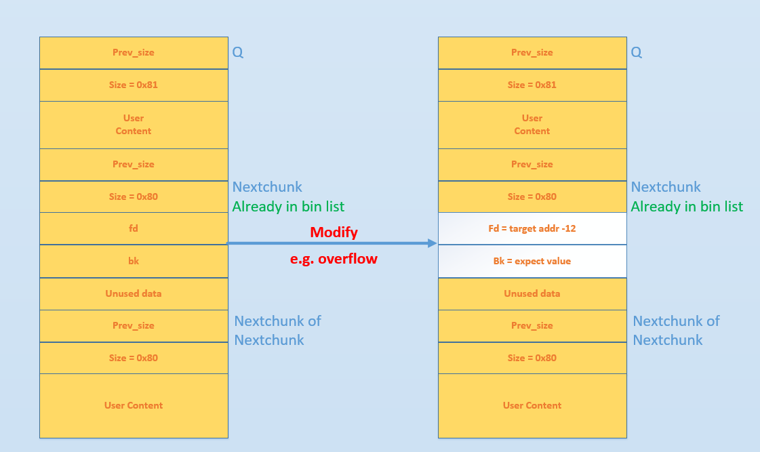
(Old) Unlink Attack
In Use: Q
Freed: Nextchunk
free(Q);

Slide 46
(Old) Unlink Attack
FD = P-> fd = target addr – 12 FD->bk = BK which is *(target addr – 12 + 12) = BK = expect value
BK = P->bk = expect value BK-> fd = FD which is *(expect value + 8) = FD = target addr - 12

Slide 47
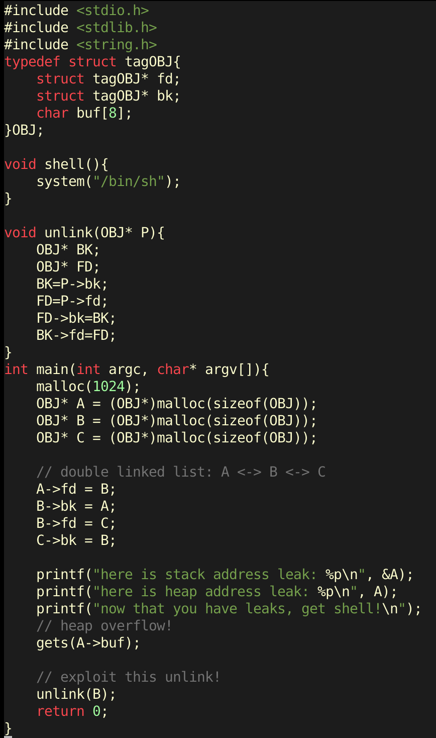
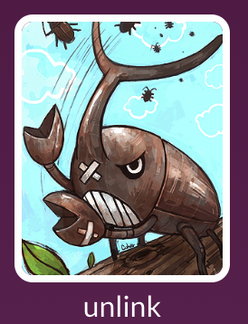
Unlink Exercise

Slide 48
Initial Idea
Fd → Unlink() Return Address
Bk → shell() address

Slide 49
Initial Idea
FD = P-> fd = target addr – 12 FD->bk = BK which is *(target addr – 12 + 12) = BK = expect value
BK = P->bk = expect value BK-> fd = FD which is *(expect value + 8) = FD = target addr - 12
Fd → Unlink() Return Address
Bk → shell() address
Shell() has been changed!

Slide 50

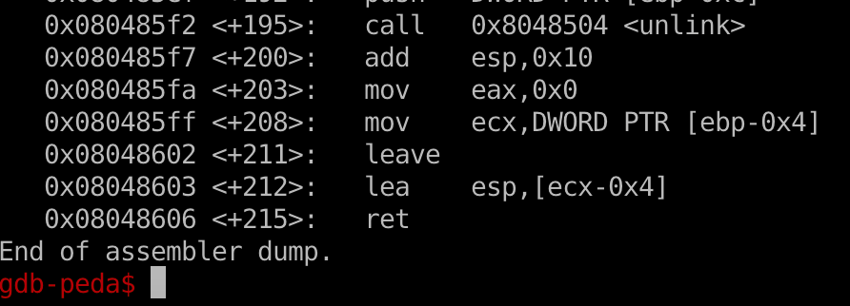
Solution
ret --> set EIP value as ESP
lea esp, [ecx-0x4] → put [ecx-0x4] to esp
mov ecx, DWORD PTR [ebp-0x4] → put [ebp-0x4] to ecx

Slide 51
Solution
ret --> set EIP value as ESP
lea esp, [ecx-0x4] → put [ecx-0x4] to esp
mov ecx, DWORD PTR [ebp-0x4] → put [ebp-0x4] to ecx
set [ecx-0x4] == shell() addr
→ set ecx == shell() addr + 4
--> set [ebp-0x4] == shell() addr + 4

Slide 52
Solution
Shellcode structure:
  shell() address + dummy characters + Fd + Bk
malloc(sizeof(OBJ)) → 8 * (int (4 + 4 + 8 + 4) / 8 +1) = 24
24 byte = 4 byte (Previous Chunk Size) + 4 byte (chunk Size) + 16 byte Data

Slide 53
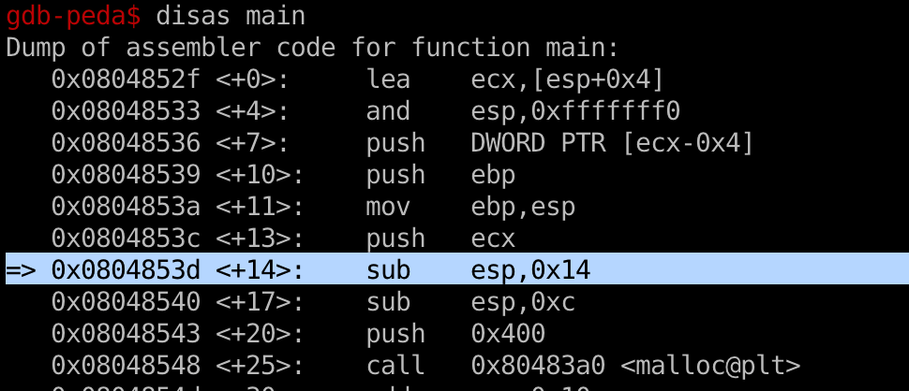
Solution
sub esp, 0x14 → ebp = esp + 14
→ ebp – 4 = esp + 10

Slide 54
Solution
Shell() addr + 4 == heap_leak + 8 + 4
            = heap_leak + 0xc

Slide 55
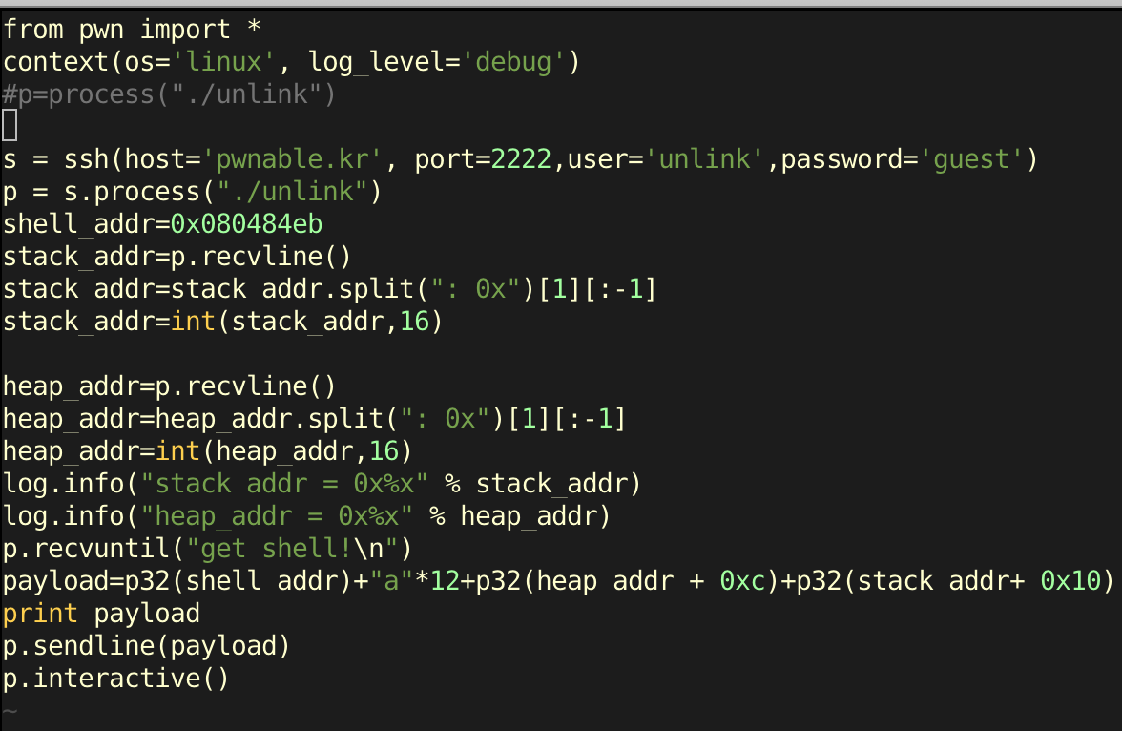

Slide 56
glibc source code
https://code.woboq.org/userspace/glibc/malloc/malloc.c.html

Slide 57
Bins and Chunks
A bin is a list (doubly or singly linked list) of free (non-allocated) chunks. Bins are differentiated based on the size of chunks they contain:
  Fast bin
  Unsorted bin
  Small bin
  Large bin

Slide 58
Q & A

