Slide 1

Class19
CSC 495/583 Topics of Software Security
Heap Exploitation (1)
Dr. Si Chen (schen@wcupa.edu)

Slide 2
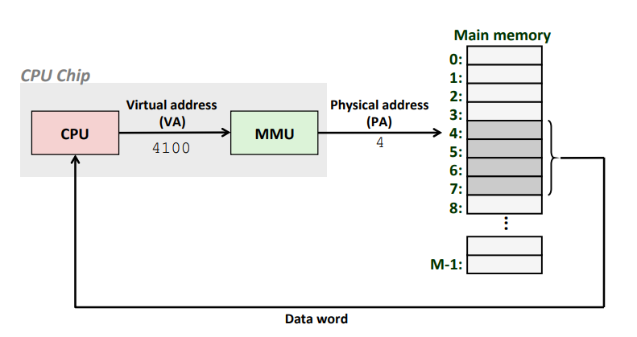
Virtual Memory
Memory Management Unit(MMU)

Slide 3
The Heap
Runtime Memory
Libraries (libc)
ELF Executable
.text segment
.data segment
Heap
Stack
0x00000000
It’s just another segment in runtime memory
0xFFFFFFFF

Slide 4
Basics of Dynamic Memory
int main()
{
char * buffer = NULL;
/* allocate a 0x100 byte buffer */ buffer = malloc(0x100);
/* read input and print it */ fgets(stdin, buffer, 0x100); printf(“Hello %s!\n”, buffer);
/* destroy our dynamically allocated buffer */ free(buffer);
return 0;
}

Slide 5
Heap vs Stack
Heap
Dynamic memory allocations at runtime
Objects, big buffers, structs, persistence, larger things
Slower, Manual
  Done by the programmer
  malloc/calloc/recalloc/free
  new/delete
Stack
Fixed memory allocations known at compile time
Local variables, return addresses, function args
Fast, Automatic
  Done by the compiler
  Abstracts away any concept of allocating/de-allocating

Slide 6
Doug Lea‘s malloc Heap Chunks
Heap chunks exist in two states
  in use (malloc’d)
  free’d

Slide 7
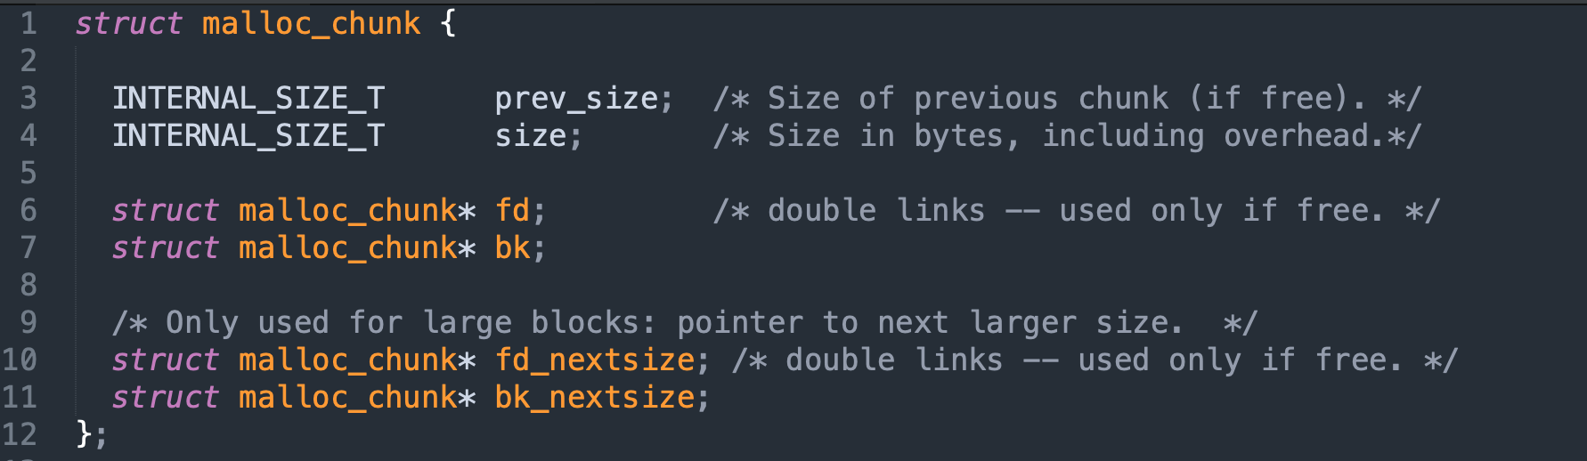
malloc chunk

Slide 8
Heap Chunks – Freed
unsigned int * buffer = NULL; buffer = malloc(0x100);
free(buffer);
Forward Pointer
  A pointer to the next freed chunk
Backwards Pointer
  A pointer to the previous freed chunk
Heap Chunk (freed)
Previous Chunk Size (4 bytes)
Chunk Size (4 bytes)
Flags
FD
(4 bytes)
BK
(4 bytes)
*(buffer-2)
*(buffer-1)
*buffer
*(buffer+1)

Slide 9
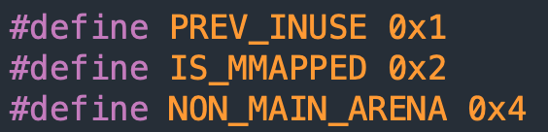
Heap Chunks
unsigned int * buffer = NULL; buffer = malloc(0x100);
//Out comes a heap chunk
Heap Chunk
Previous Chunk Size (4 bytes)
Chunk Size (4 bytes)
Flags
Data
(8 + (n / 8)*8 bytes)
*(buffer-2)
*(buffer-1)
*buffer

Slide 10
Pseudo Memory Map
0x00000000 – Start of memory
0x00000000 – Start of memory
Runtime Memory
Libraries (libc)
ELF Executable
.text segment
.data segment
Heap
Stack
Runtime Memory
Libraries (libc)
ELF Executable
.text segment
.data segment
Heap
Stack
0x08048000 – Start of .text Segment
0x08048000 – Start of .text Segment
0xb7ff0000 – Top of heap
0xbfff0000 – Top of stack
0xFFFFFFFF – End of memory
MBE - 04/07/2015
10

Slide 11
Heap Allocations
0x00000000
Runtime Memory
Libraries (libc)
ELF Executable
.text segment
.data segment
Heap
Stack
Heap Segment
Grows towards higher memory
--------------------------------->
Previous Chunk Size
Chunk Size
Data
0xFFFFFFFF

Slide 12
Heap Allocations
0x00000000
Runtime Memory
Libraries (libc)
ELF Executable
.text segment
.data segment
Heap
Stack
Heap Segment
Grows towards higher memory
--------------------------------->
Previous Chunk Size
Chunk Size
Data
Previous Chunk Size
Chunk Size
Data
0xFFFFFFFF

Slide 13
Heap Allocations
0x00000000
Runtime Memory
Libraries (libc)
ELF Executable
.text segment
.data segment
Heap
Stack
Heap Segment
Grows towards higher memory
--------------------------------->
Previous Chunk Size
Chunk Size
Data
Previous Chunk Size
Chunk Size
Data
Previous Chunk Size
Chunk Size
Data
0xFFFFFFFF

Slide 14
Heap Overflows
0x00000000
Runtime Memory
Libraries (libc)
ELF Executable
.text segment
.data segment
Heap
Stack
Heap Segment
Grows towards higher memory
--------------------------------->
Previous Chunk Size
Chunk Size
Data
Previous Chunk Size
Chunk Size
Data
Previous Chunk Size
Chunk Size
Data
0xFFFFFFFF

Slide 15
Heap Overflows
Buffer overflows are basically the same on the heap as they are on the stack
0x00000000
Runtime Memory
Libraries (libc)
ELF Executable
.text segment
.data segment
Heap
Stack
Heap Segment
Grows towards higher memory
--------------------------------->
Previous Chunk Size
Chunk Size
AAAAAAAAAAAAAA AAAAAAAAAAAAAA AAAAAAAAAAAAAA AAAAAAAAAAAAAA AAAAAAAAAAAAAA … heap overflow
Previous Chunk Size
Chunk Size
Data
Previous Chunk Size
Chunk Size
Data
0xFFFFFFFF

Slide 16
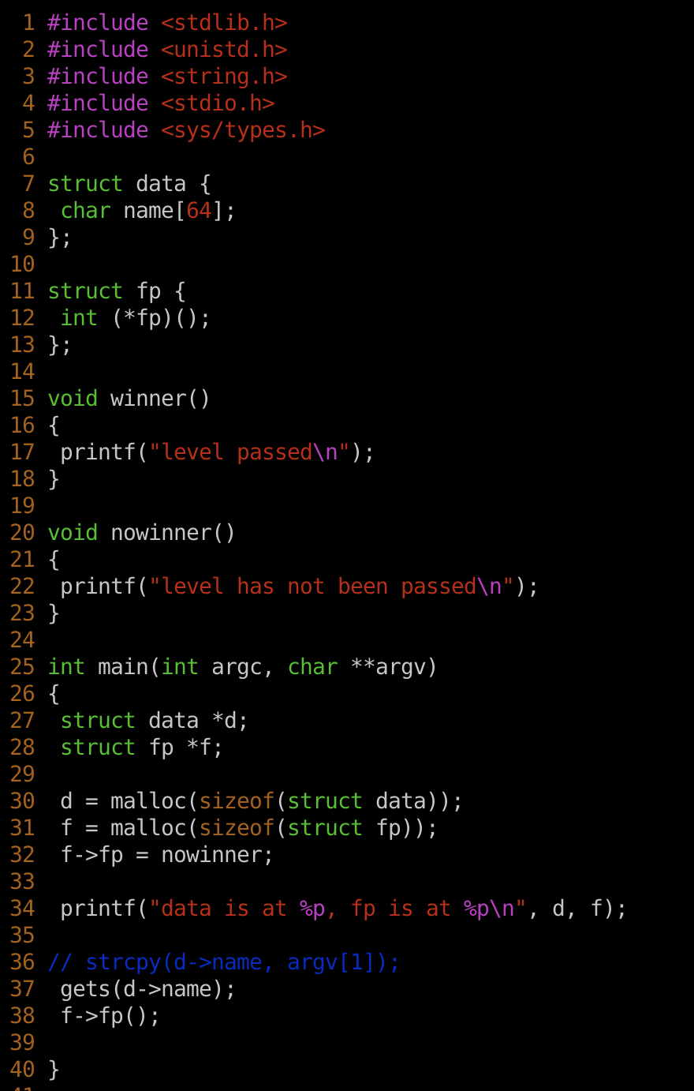
heap0.c

Slide 17
First object on heap; name[64]
Second object on heap; fp → contains a pointer
Winner() – We want to execute this function

Slide 18
Second object on heap; fp → contains a pointer
Winner() – We want to execute this function
malloc() allocates storage on the heap
fp points to nowinner()
gets() take user input and copied into 64-byte array on the heap,
without checking its length... oops

Slide 19
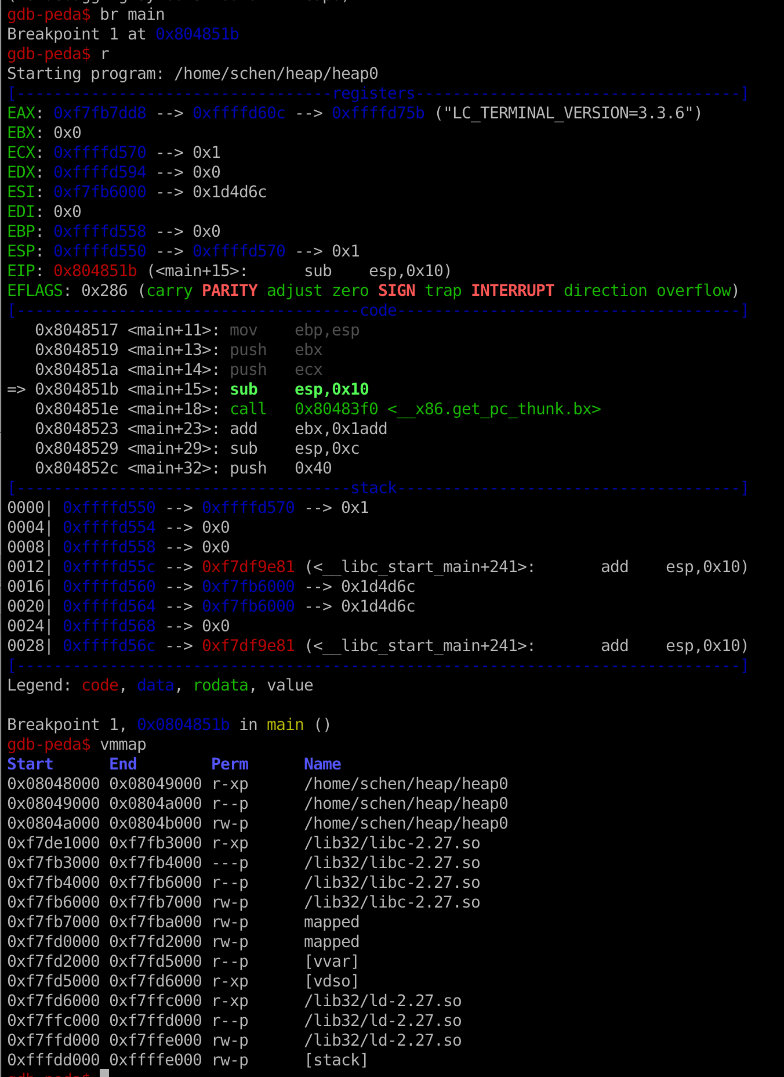
Check Heap Address
Before the malloc() function call.
No heap

Slide 20
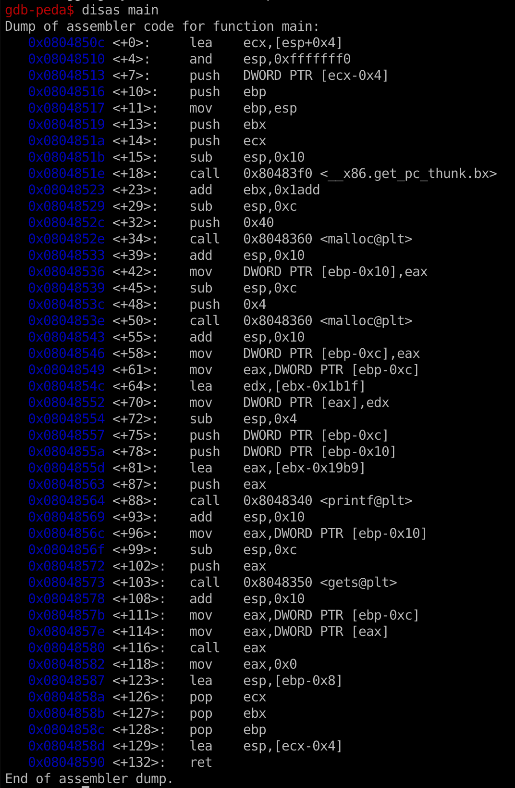
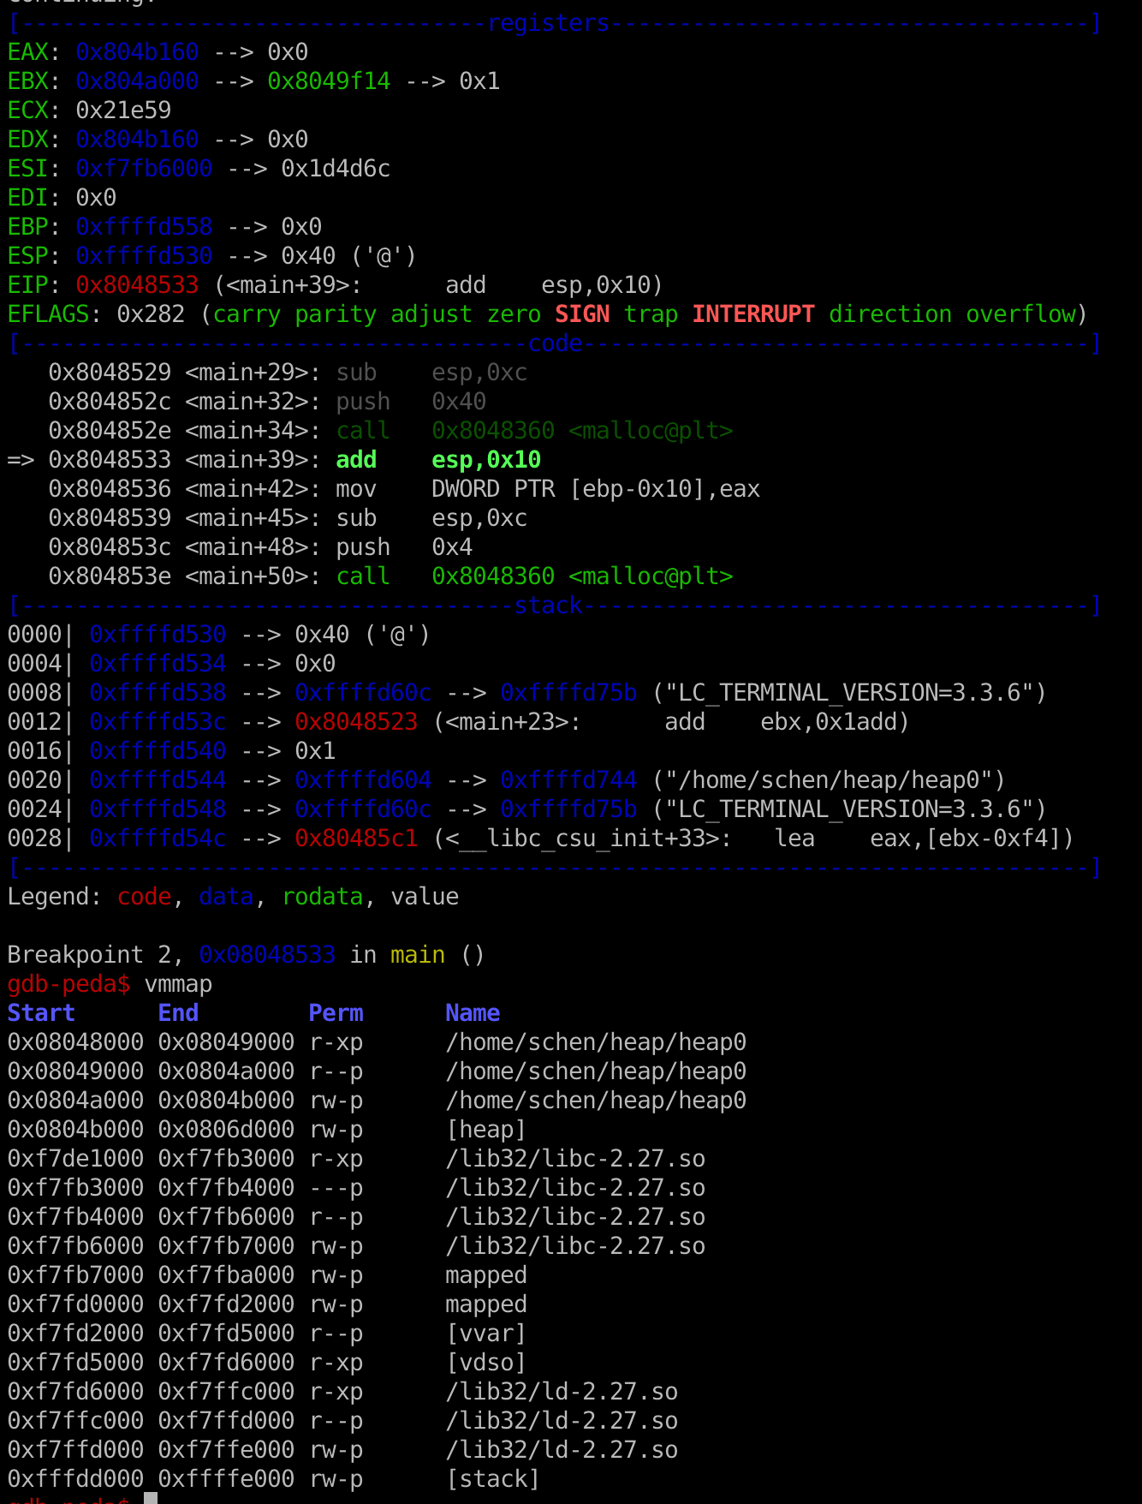
Check Heap Address
After the first malloc() function call.
Heap: 0x804b000 – 0x806d000

Slide 21

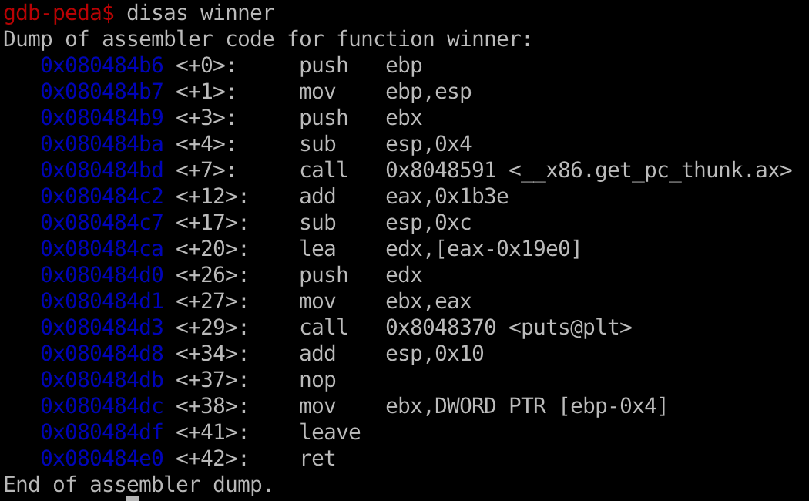
Collect info
find the offset
Why 80 bytes??
find the winner() address

Slide 22
Why 80 Bytes?
Heap Chunk
Previous Chunk Size (4 bytes)
Chunk Size (4 bytes)
Flags
Data
(8 + (n / 8)*8 bytes)
*(buffer-2)
*(buffer-1)
*buffer
Previous Chunk Size
Chunk Size
Data
Previous Chunk Size
Chunk Size
Data
Previous Chunk Size
Chunk Size
Data
72
+ 4
+ 4 = 80
malloc(64) → n = 64
Data = 8 + (64 / 8) * 8 = 72 bytes

Slide 23
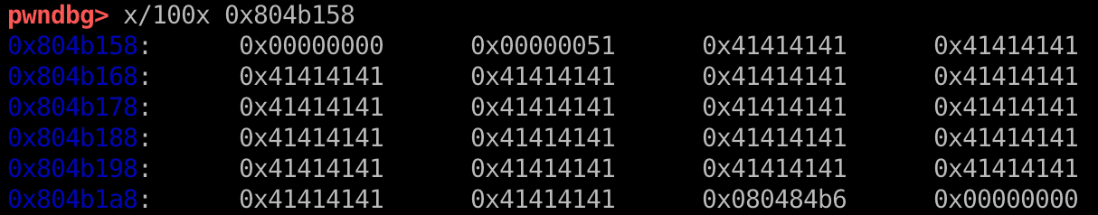
Why 80 Bytes?
Heap Chunk
Previous Chunk Size (4 bytes)
Chunk Size (4 bytes)
Flags
Data
(8 + (n / 8)*8 bytes)
*(buffer-2)
*(buffer-1)
*buffer
Previous Chunk Size
Chunk Size
Data
Previous Chunk Size
Chunk Size
Data
Previous Chunk Size
Chunk Size
Data
72
+ 4
+ 4 = 80
malloc(64) → n = 64
Data = 8 + (64 / 8) * 8 = 72 bytes
Heap Chunk1
Heap Chunk2

Slide 24
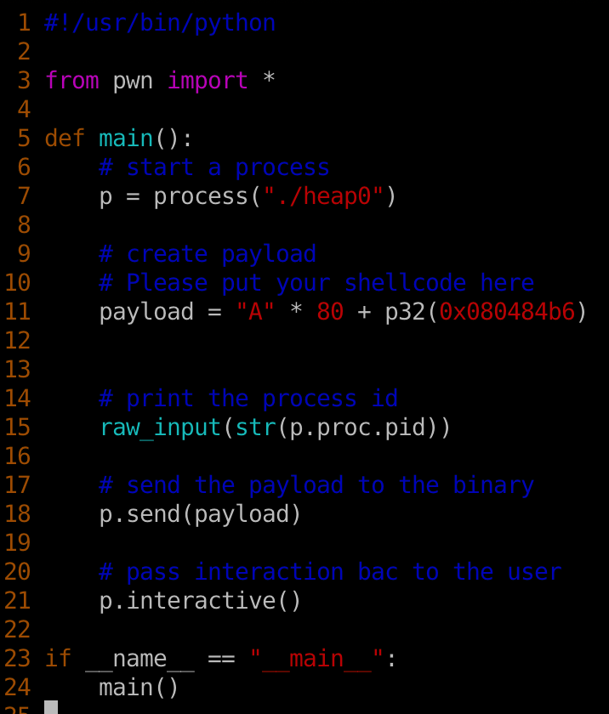
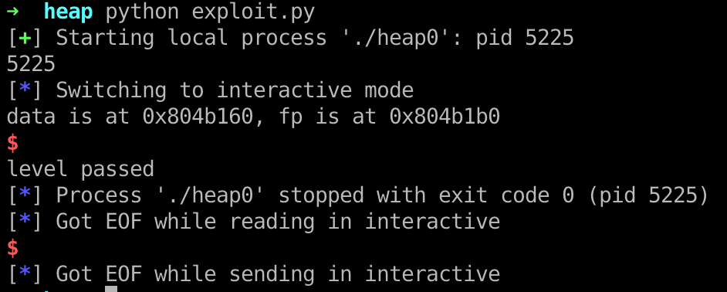
Shellcode and Attack

Slide 25
Heap Overflows
In the real world, lots of cool and complex things like objects/structs end up on the heap
  Anything that handles the data you just corrupted is now viable attack surface in the application
It’s common to put function pointers in structs which generally are malloc’d on the heap
  Overwrite a function pointer on the heap, and force a codepath to call that object’s function!

Slide 26
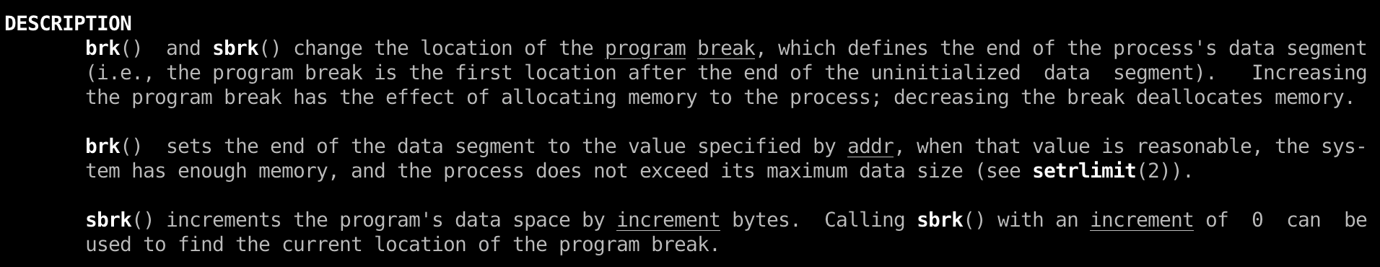
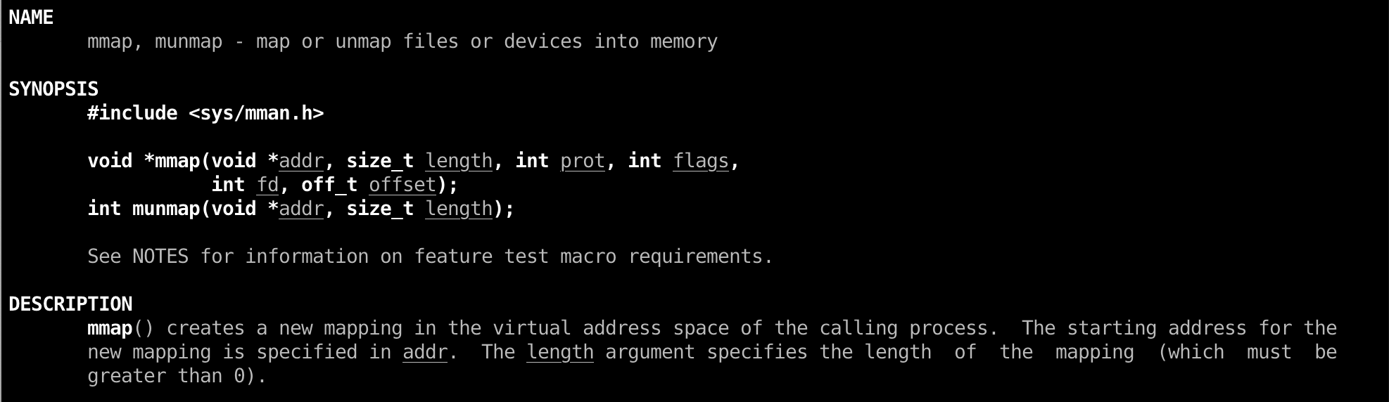
Heap in Linux (GNU C Library – glibc)
ptmalloc2
System call:
brk()
mmap()

Slide 27
Heap Chunks
unsigned int * buffer = NULL; buffer = malloc(0x100);
//Out comes a heap chunk
Heap Chunk
Previous Chunk Size (4 bytes)
Chunk Size (4 bytes)
Flags
Data
(8 + (n / 8)*8 bytes)
*(buffer-2)
*(buffer-1)
*buffer

Slide 28
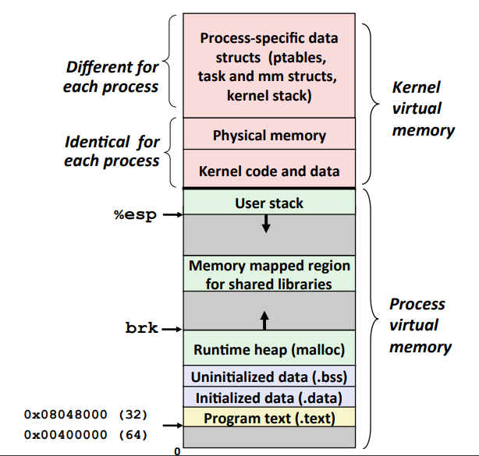
The Heap

Slide 29
Design your own Heap management system
Linked List

Slide 30
Design your own Heap management system
H: header --> 11
B: Body --> 10
F: Free → 00
bitmap
Bitmap representation:
(HIGH) 11 00 00 10 10 10 11 00 00 00 00 00 00 00 10 11 (LOW)
128 byte per chunk
1MB / 128 = 8k

Slide 31
glibc source code
https://code.woboq.org/userspace/glibc/malloc/malloc.c.html

Slide 32
Arena
Arena: the top level memory management entity.
There are two types of arenas.
  Main arena covers the traditional heap area: the space between start_brk and brk for a process from kernel point of view, only one main arena exists for a process.
  Non-main arena manages the memory fetched from kernel via mmap() system call, there could be 0 to 2*(number of cpu cores) such arenas based on process threads usage.

Slide 33
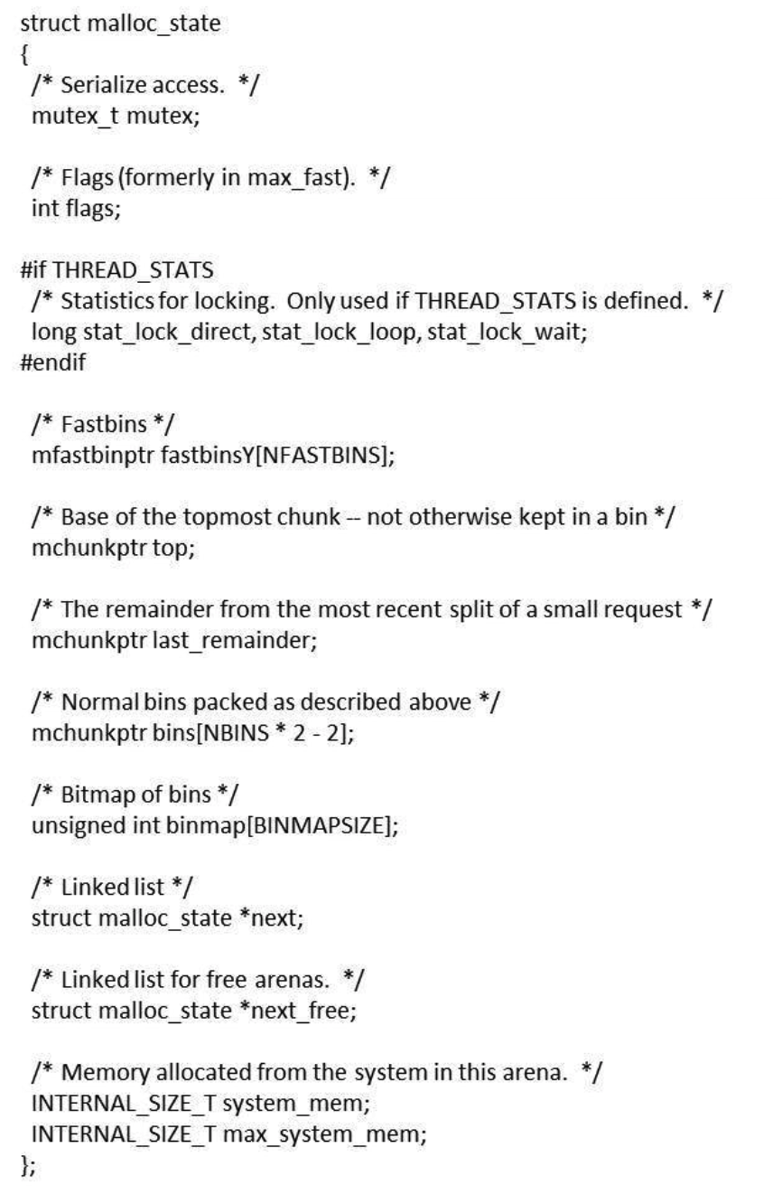
Arena

Slide 34
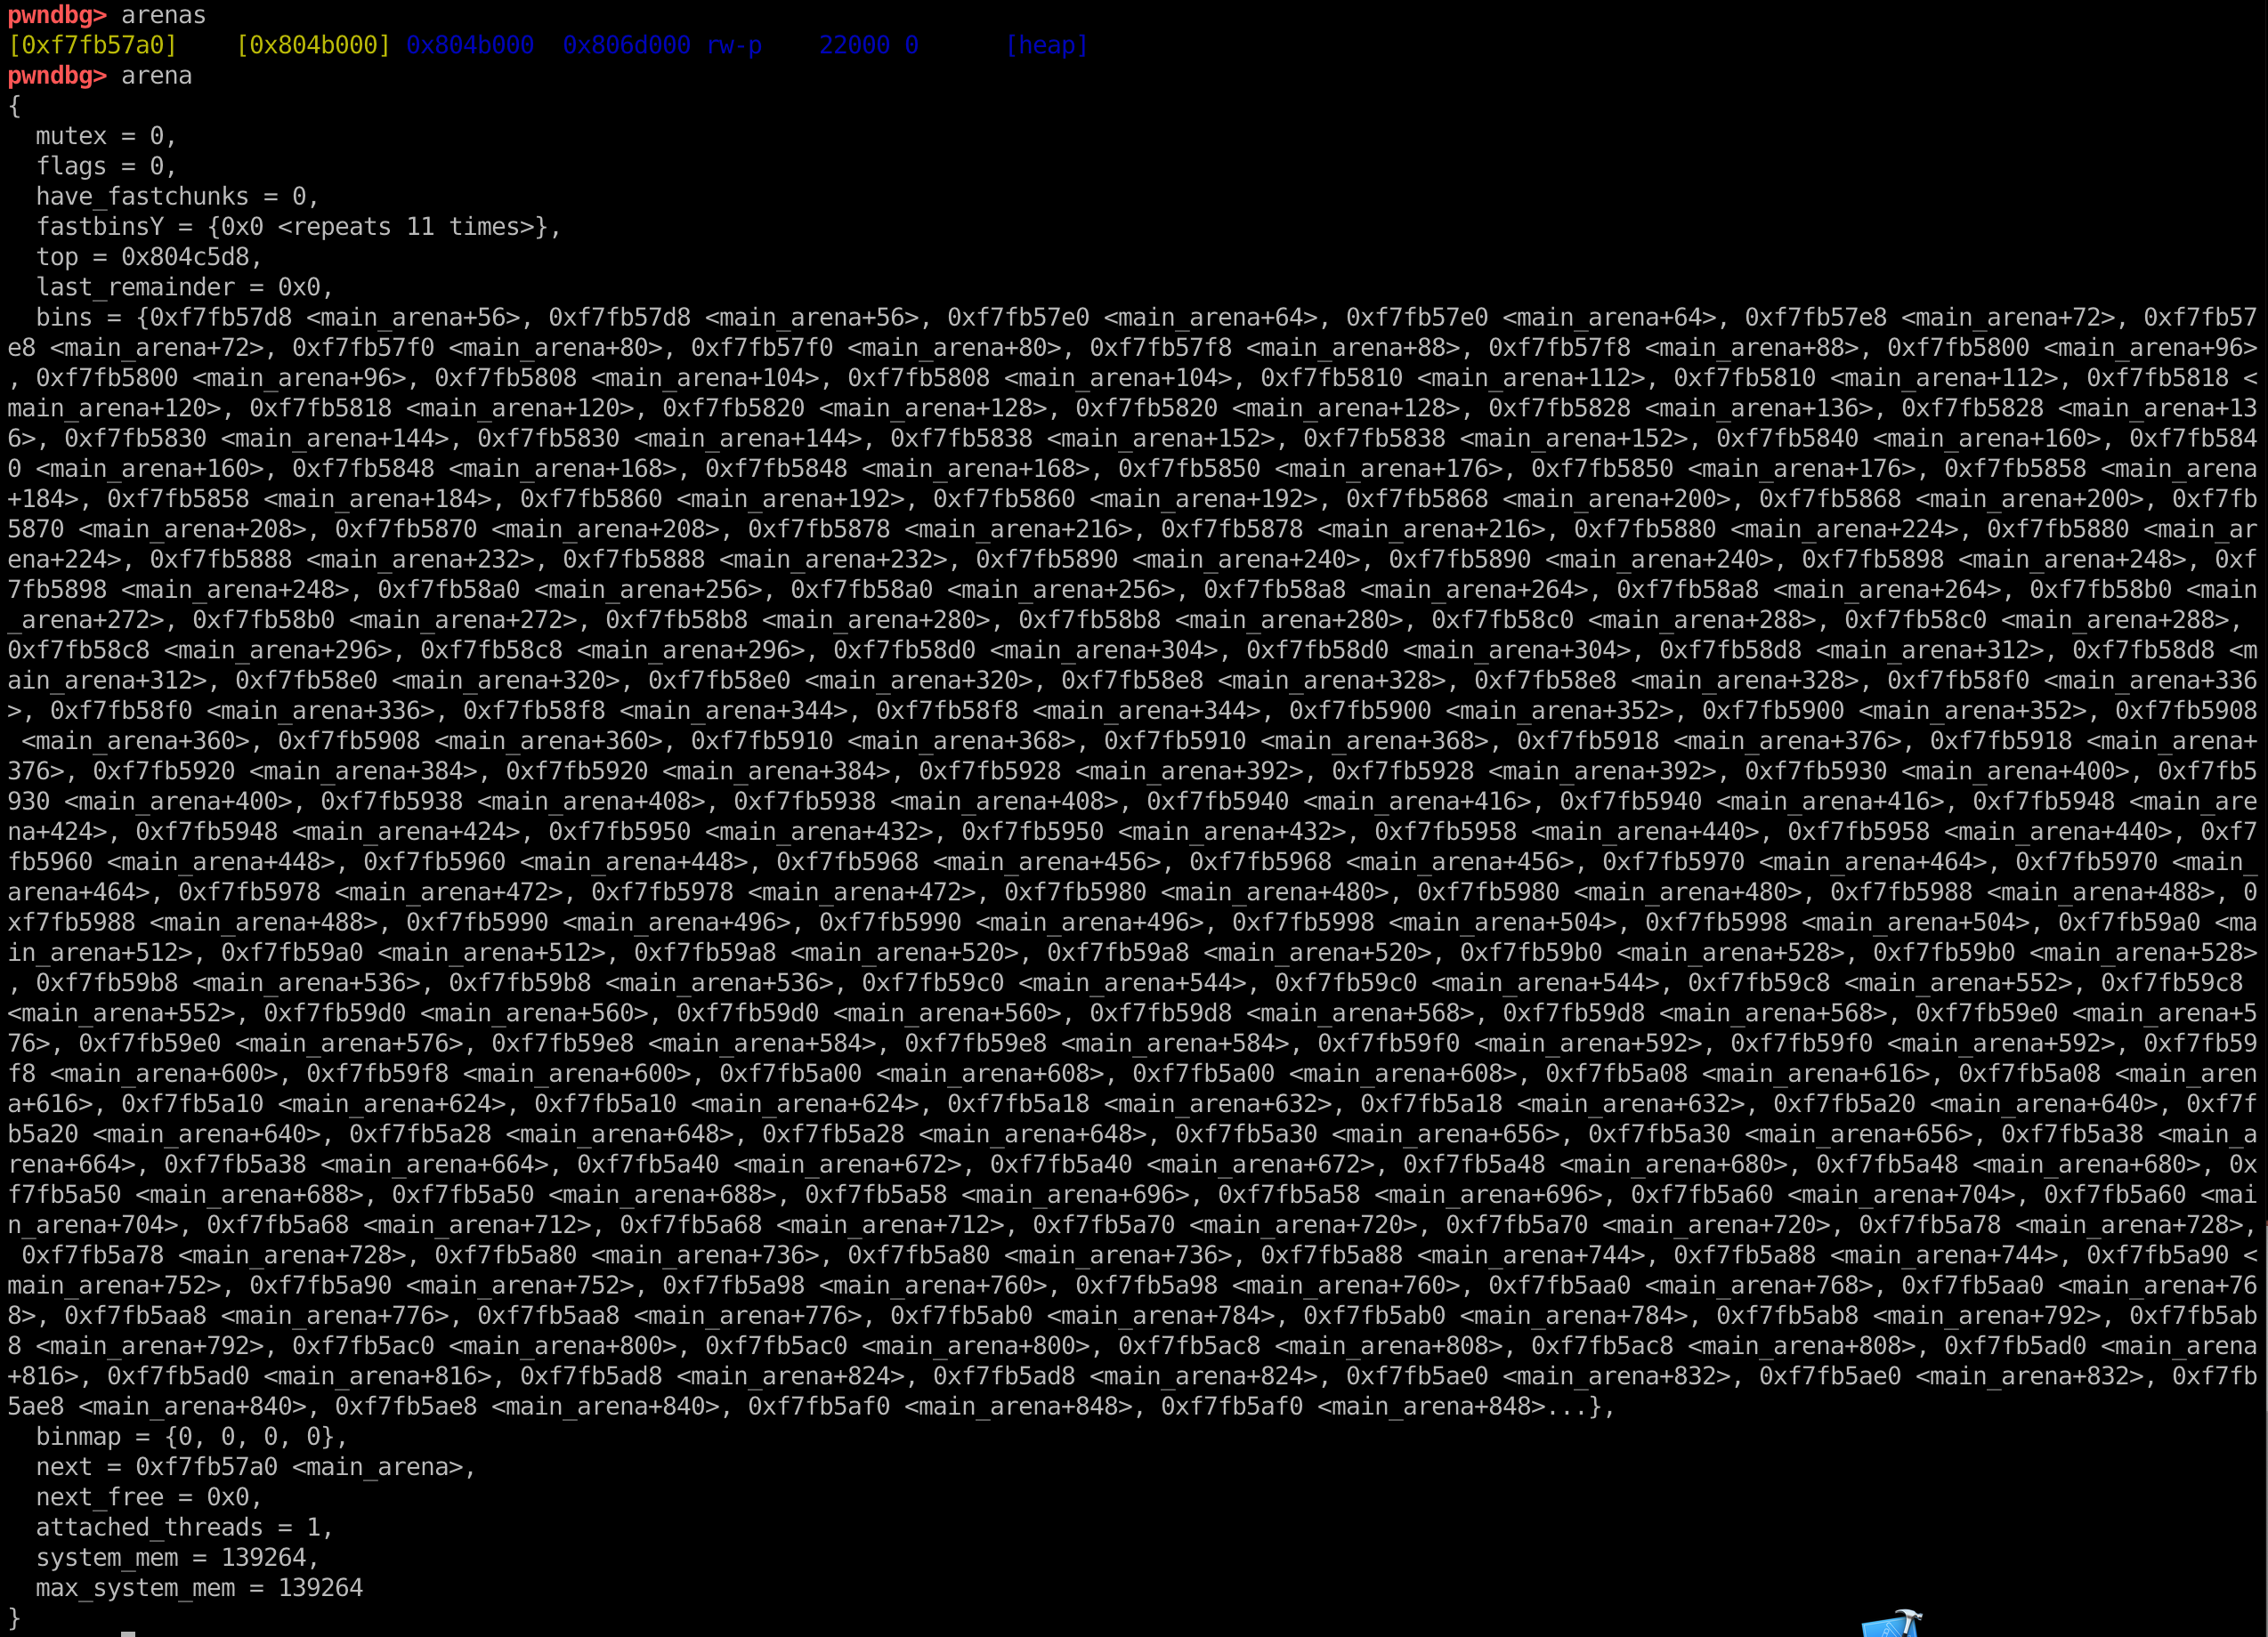
Arena

Slide 35
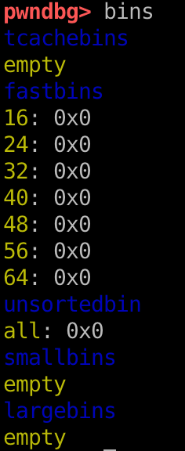
Bins and Chunks
A bin is a list (doubly or singly linked list) of free (non-allocated) chunks. Bins are differentiated based on the size of chunks they contain:
  Fast bin
  Unsorted bin
  Small bin
  Large bin
  tcache bin

Slide 36

Educational Heap Exploitation
https://github.com/shellphish/how2heap

Slide 37
To be continued …

Slide 38
First-fit behavior
This technique describes the 'first-fit' behavior of glibc's allocator.
Whenever any chunk (not a fast chunk) is freed, it ends up in the unsorted bin.
Insertion happens at the HEAD of the list.
On requesting new chunks (again, non fast chunks), initially unsorted bins will be looked up as small bins will be empty.
This lookup is from the TAIL end of the list. If a single chunk is present in the unsorted bin, an exact check is not made and if the chunk's size >= the one requested, it is split into two and returned. This ensures first in first out behavior.

Slide 39
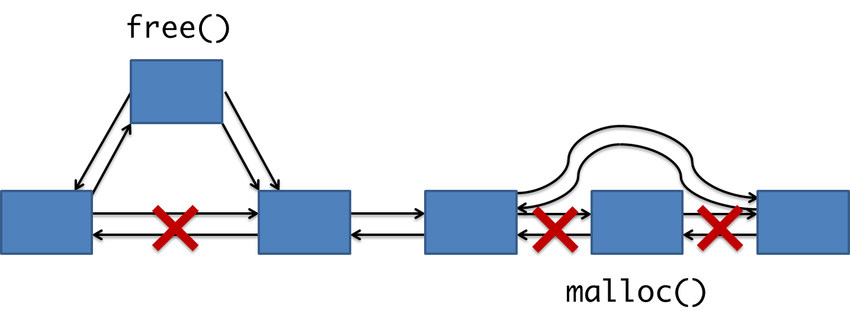
malloc & free

Slide 40
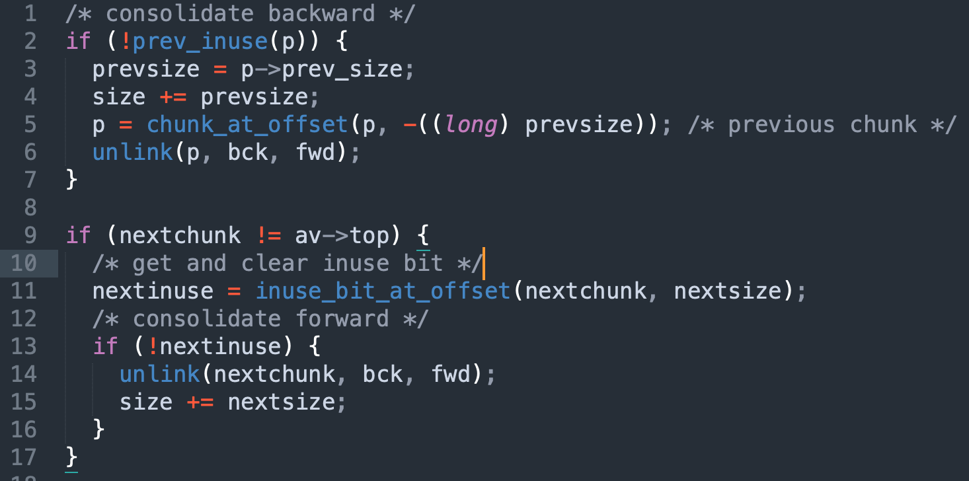
Consolidate Free Chunk

Slide 41
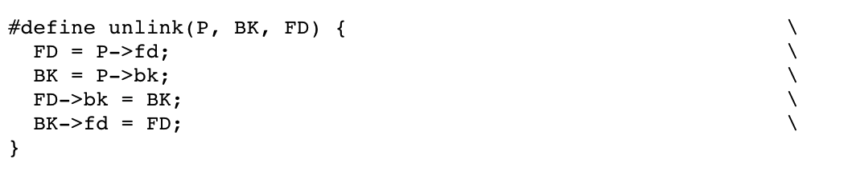
Unlink
remove a chunk from linked list

Slide 42
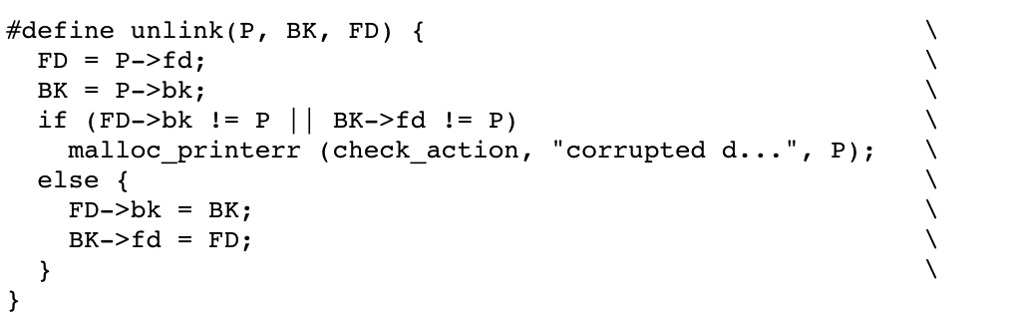
The truth

Slide 43
Q & A

