Slide 1

Class17
CSC 495/583 Topics of Software Security
StackGuard & Format String Bug
Dr. Si Chen (schen@wcupa.edu)

Slide 2
Binary Protection Mechanism
NX/DEP (turn off execution)
ASLR (Randomize the address)
turn off stack guard

Slide 3
StackGuard
Sometimes called Stack Canaries, or Cookies
Insert Canary (random integer) before the function being called.
Check this value to see if it been tweaked PRIOR to Function RETURN
Cowan, Crispan, et al. "Stackguard: automatic adaptive detection and prevention of buffer-overflow attacks." USENIX Security Symposium. Vol. 98. 1998.
https://www.usenix.org/legacy/publications/library/proceedings/sec98/full_papers/cowan/cowan.pdf

Slide 4
“Canaries”
Canaries were iconically used in coal mines to detect the presence of carbon monoxide.
The bird's rapid breathing rate, small size, and high metabolism, compared to the miners, led birds in dangerous mines to succumb before the miners, thereby giving them time to take action.

Slide 5
StackGuard -- History
In 1998, the first canary was introduced and was hardcoded
0xDEADBEEF

Slide 6
StackGuard
Terminator canary
  CR, LF, 00, -1
Single random canary
  Using /dev/random
Single XOR random canary
  Xor-ed return address

Slide 7
Drawbacks
Adds overhead (huge cache footprint)
Only defends against stack overflows
NULL canaries can potentially be abused
Random canaries can potentially be learned

Slide 8
Bypass StackGuard
How to bypass StackGuard?

Slide 9
StackGuard: Brute force stack reading
Overwrite canary byte by byte and try every possible value
  If no crash → success
  Crash → wrong guess
Requires same canary for each thread, so can’t call execve()
0xCAFEBABE
Canary (0xCAFEBABE):
-Buffer- | BE | BA | FE | CA
Brute force attack for finding the first byte -- “BE”:
AAAA… | 01 | BA | FE | CA
Crash!
AAAA… | 02 | BA | FE | CA
Crash!
…
AAAA… | BD | BA | FE | CA
Crash!
AAAA… | BE | BA | FE | CA
No crash!

Slide 10
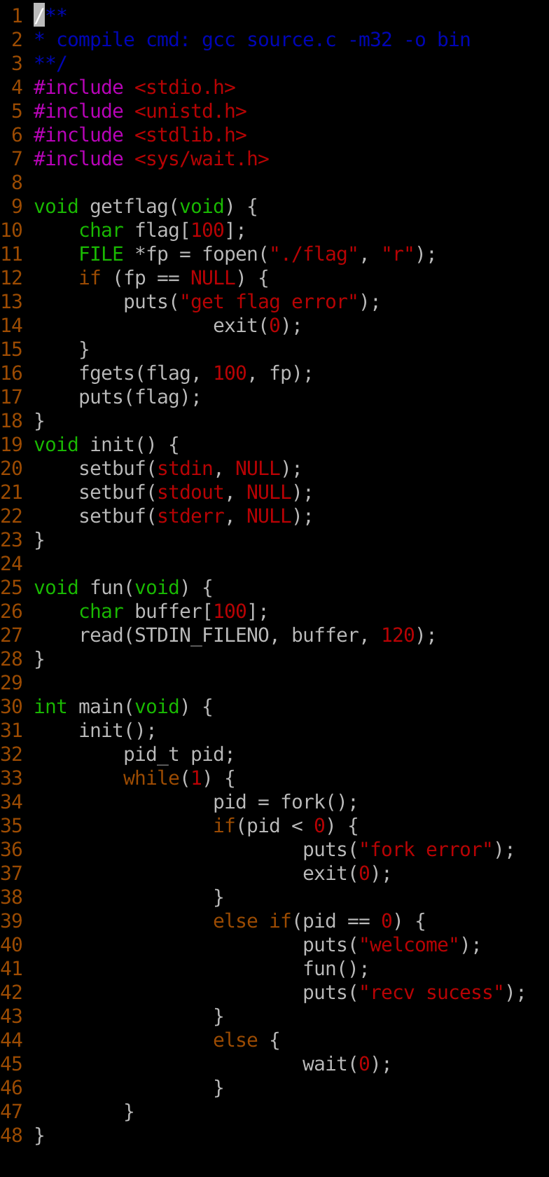
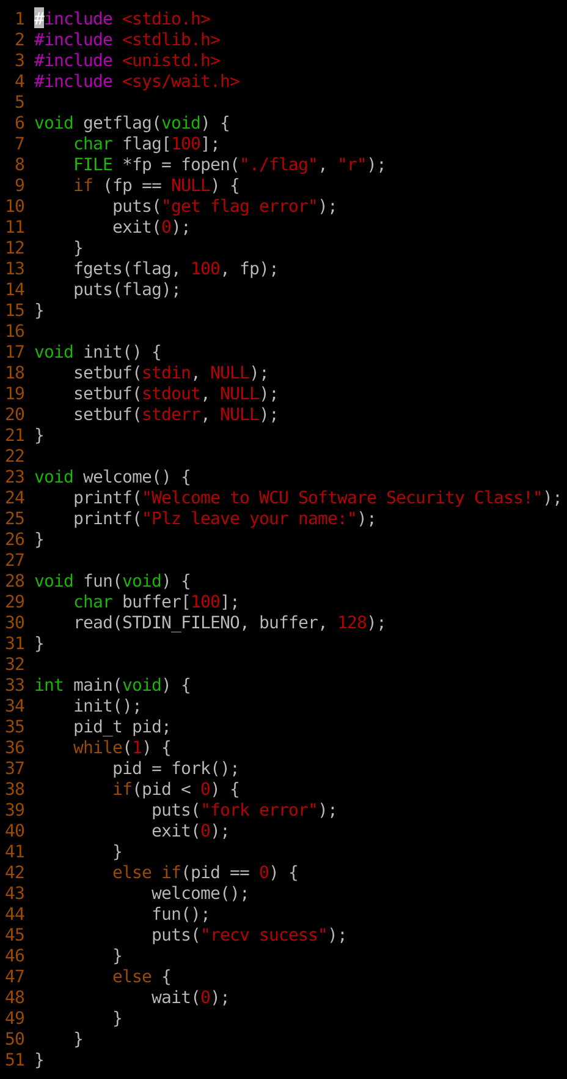
Brute Force Attack -- Examples
easy_canary_32.c
easy_canary_64.c

Slide 11
Brute Force Attack -- Examples
easy_canary_32.c
easy_canary_64.c
First, download both files into a folder. And compile it by typing:
Then, create a file with name flag and type some text
Execute the Python script: easy_canary_32.py or easy_canary_64.py

Slide 12
Format String Bug

Slide 13
Format String Bug
What is a Format String?
A Format String is an ASCII string that contains text and format parameters
printf("%s %d\n", str, a);
fprintf(stderr, "%s %d\n", str, a); sprintf(buffer, "%s %d\n", str, a);
E.g.
My name is Chen

Slide 14
Format String Bug

Slide 15
Format String Bug
The wrong way…

Slide 17
Example: fmt_wrong.c

Slide 18
Example: fmt_wrong.c
%08x. %08x. %08x. %08x. %08x. %08x. %08x. %08x. %08x. %08x. %08x. %08x. %08x. %08x. %08x. %08x. %08x. %08x. %08x. %08x. %08x. %08x. %08x. %08x.%08x. %08x. %08x. %08x. %08x. %08x. %08x. %08x. %08x. %08x. %08x. %08x.
the argument is passed directly to the “printf” function.
the function didn’t find a corresponding variable or value on stack so it will start popping values off the stack

Slide 19
Example: fmt_wrong.c

Slide 20
Example: fmt_wrong.c
Notice that the value “41414141” was popped off the stack which means the prepended string is written on stack

Slide 21
Advanced Usage: Format String Direct Access
this let’s try to directly access the 12th parameter on stack using the dollar sign qualifier. “%12$x” is used which will read the 12th parameter on stack

Slide 22
Advanced Usage: Format String Direct Access

Slide 23
What is this BUG used for?
Read data in any memory address:
  %s to read data in an arbitrary memory address
Write data in any memory address:
  printf not only allows you to read but also write
  %n

Slide 24
fmt_write.c
In C printf(), %n is a special format specifier which instead of printing something causes printf() to load the variable pointed by the corresponding argument with a value equal to the number of characters that have been printed by printf() before the occurrence of %n.

Slide 25
Write data in any memory address:
%n → DWORD
%hn → WORD
%hhn → BYTE

Slide 26
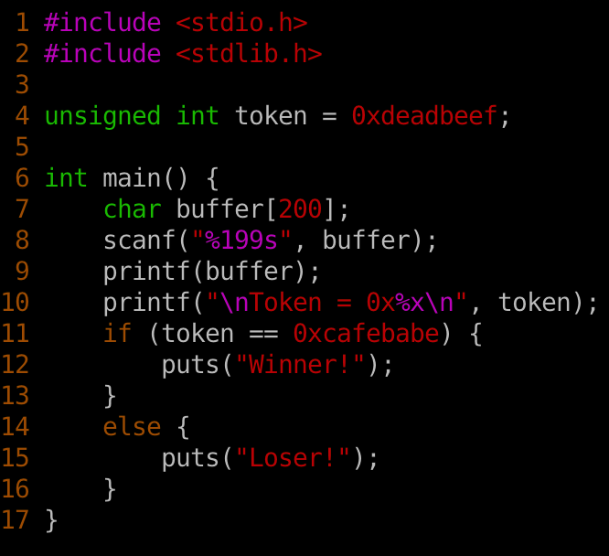

Format String Bug Example:
Goal: Modify token from 0xdeadbeef to 0xcafebabe

Slide 27
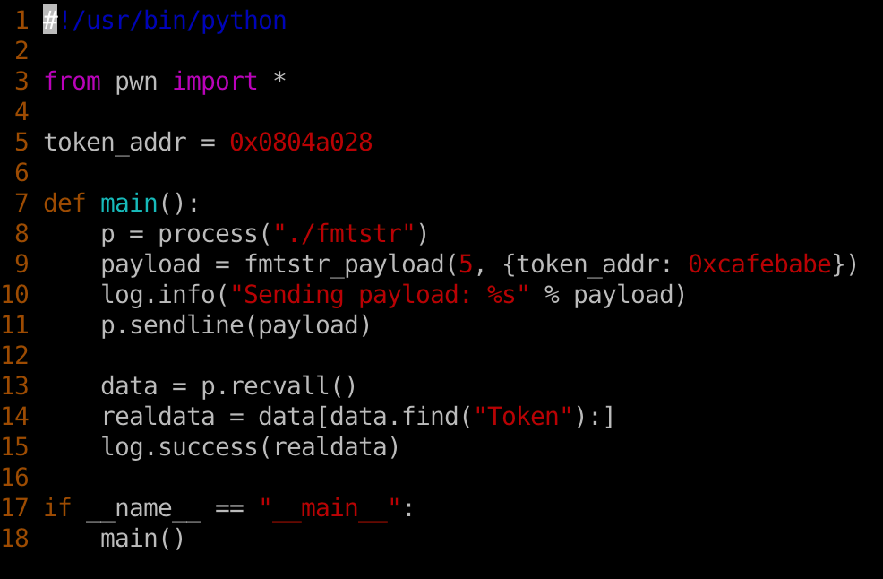
Format String Bug Example:
use nm to find token’s address
Goal: Modify token from 0xdeadbeef to 0xcafebabe

Slide 28
What is this BUG used for?
Disclose sensitive information:
  Variable(s)
  EBP value
  The correct location for putting Shellcode

Slide 29
What is this BUG used for?
Disclose StackGuard Canary:
  By pass stack checking

Slide 30
What is this BUG used for?
Disclose Library Address
  When enable ASLR, the library address will change each time
    It’s impossible to call these functions in your shellcode (e.g. system())
  Use this bug to disclose one function’s address in a given library.
    you can use it to deduce other function’s address

Slide 31
What is this BUG used for?
Disclose Library Address
  When enable ASLR, the library address will change each time
    It’s impossible to call these functions in your shellcode (e.g. system())
  Use this bug to disclose one function’s address in a given library.
    you can use it to deduce other function’s address

Slide 32
Q & A

