Slide 1
Class15
CSC 495/583 Topics of Software Security Bypassing ASLR/NX with GOT Overwrite
Dr. Si Chen (schen@wcupa.edu)

Slide 2
Review

Slide 3
Bypassing ASLR/NX with Ret2PLT

Slide 4
How to bypass ASLR/NX?
When ASLR has been enabled, we no longer can be sure where the libc will be mapped at.
However, that begs the question: how does the binary know where the address of anything is now that they are randomized?
The answer lies in something called the Global Offset Table (GOT) and the Procedure Linkage Table (PLT).

Slide 5
ASM CALL
Call’s in ASM are ALWAYS to absolute address
How does it work with dynamic addresses for shared libraries?
Solution:
A “helper” at static location
In Linux: the Global Offset Table (GOT) and the Procedure Linkage Table (PLT).(they work together in tandem)

Slide 6
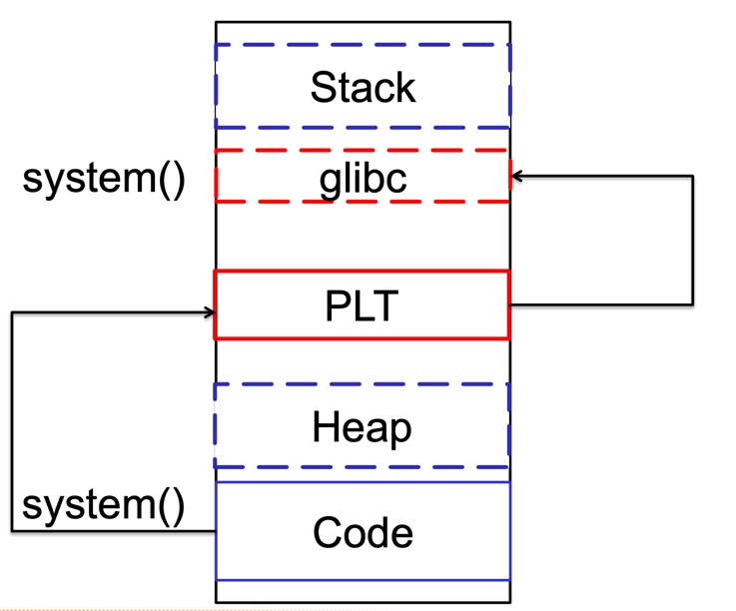
Procedure Linkage Table (PLT)
How does it work?
“call system” is actually call system@plt
The PLT resolves system@libc at runtime
The PLT stores system@libc in system@got

Slide 7
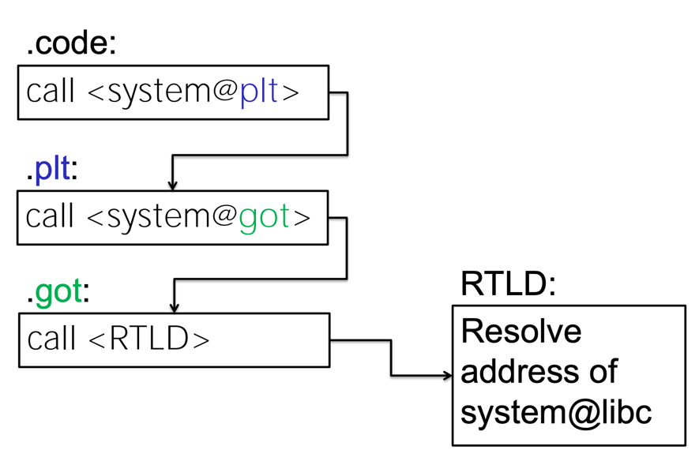
Call System() Function in libc with PLT, GOT

Slide 8
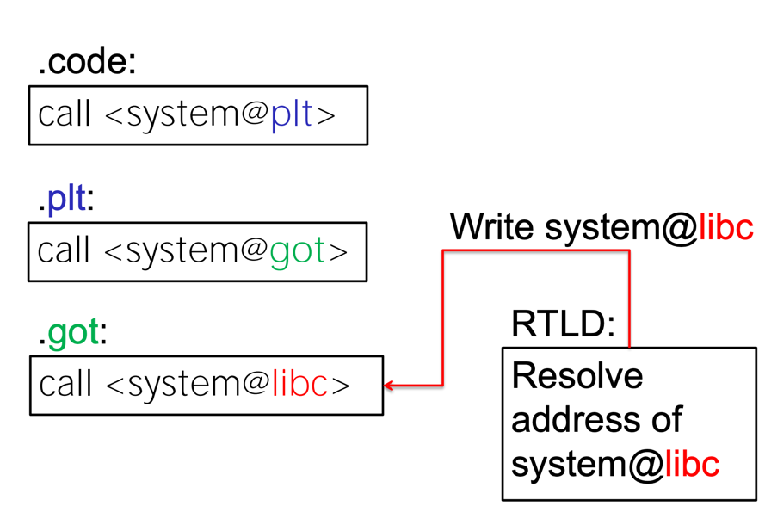
Call System() Function in libc with PLT, GOT

Slide 9
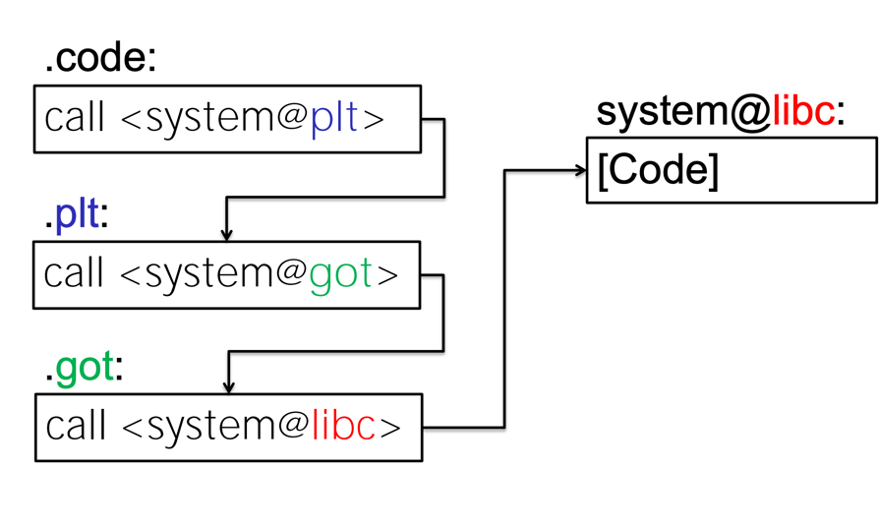
Call System() Function in libc with PLT, GOT

Slide 10
Lazy Binding
1st time call System()
After the 1st System() call
system@libc

Slide 11
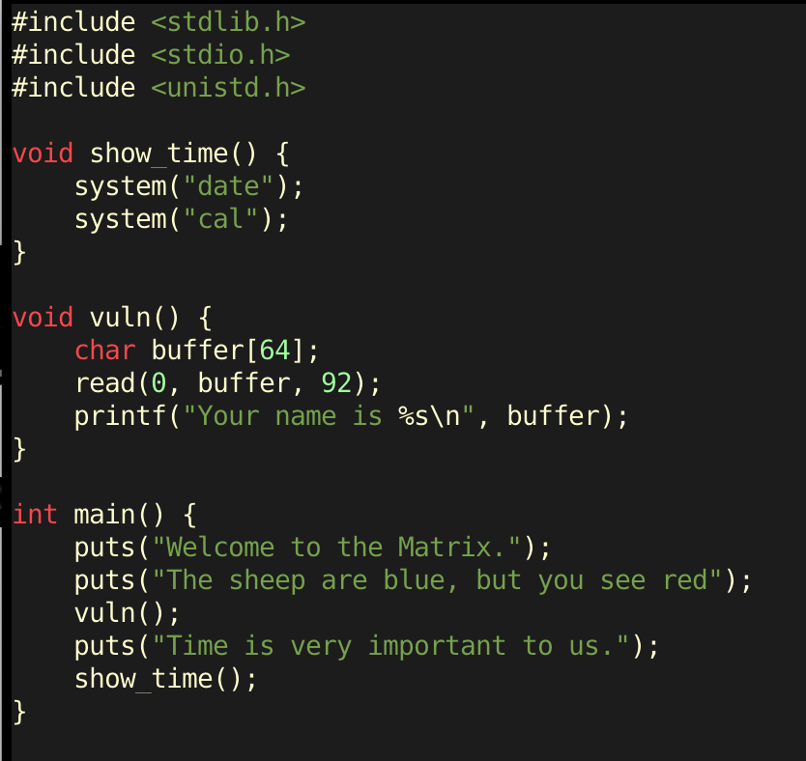
Bypass ASLR/NX with Ret2plt Attack
Enable ASLR (Address space layout randomization)
ret2plt.c

Slide 12
Bypass ASLR/NX with Ret2plt Attack
ret2plt.c
PIE | Position independent executable

Slide 13
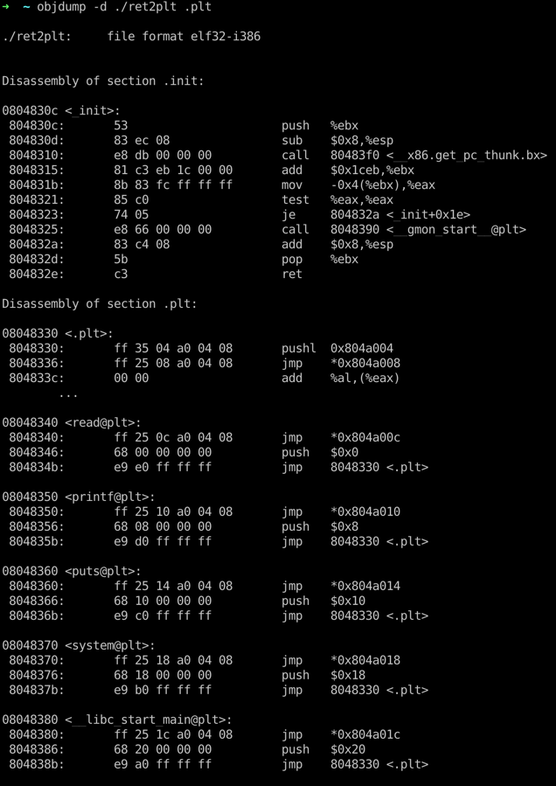
Check PLT stub Address
0x08048370
For system@plt

Slide 14
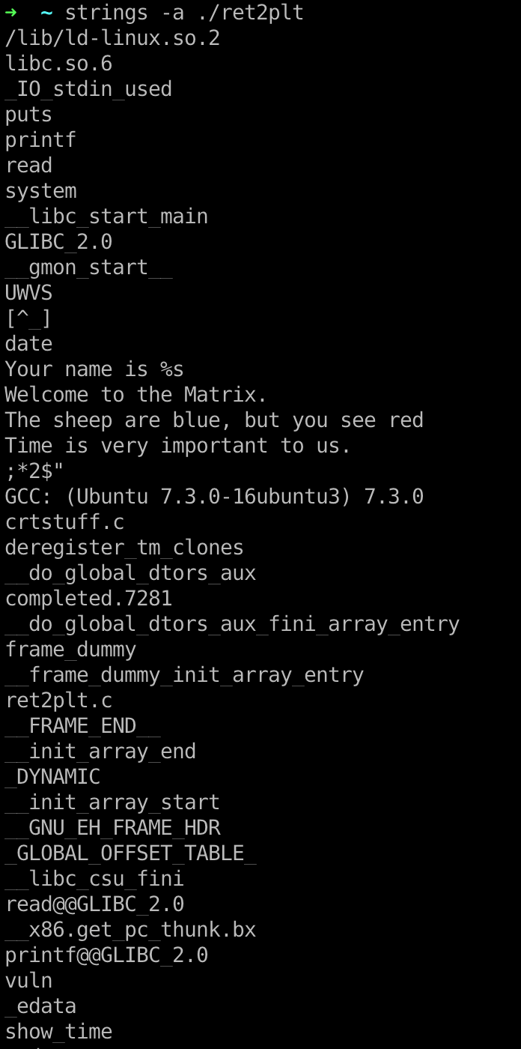
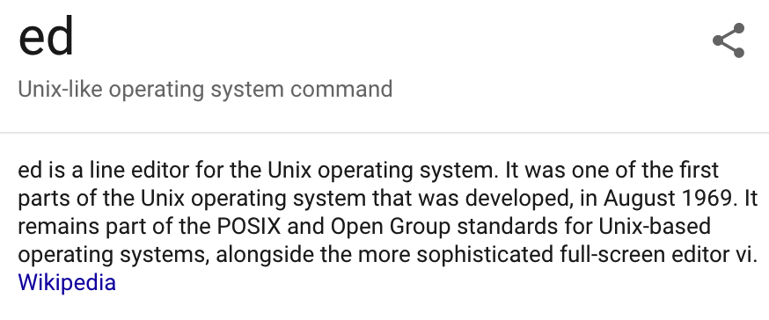
Find Useable String as Parameter for System() function
The sheep are blue, but you see red

Slide 15
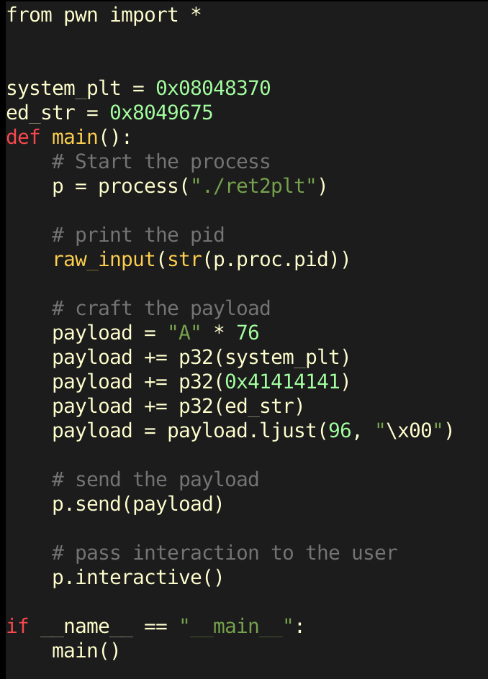
Pwn Script

Slide 16
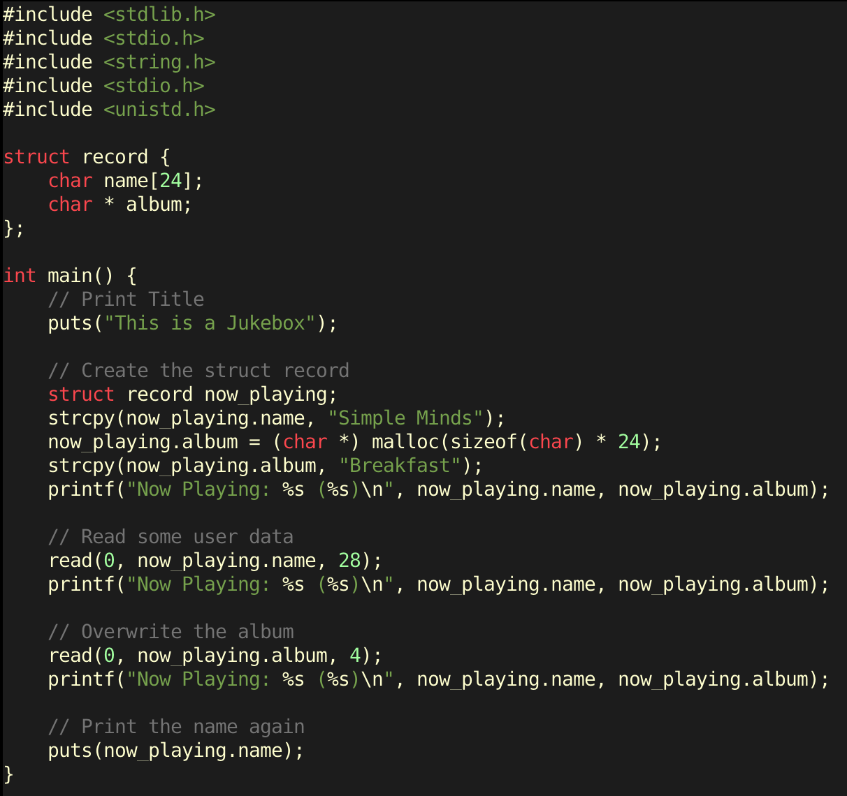
bypassGOT.c

Slide 17
bypassGOT.c
The program is vulnerable in two ways:
It provides an information leak opportunity when the now_playing.album pointer is overwritten and the album name is printed.
It provides a write what where primitive when the now_playing.album pointer is overwritten and input is provided to the second prompt.

Slide 18
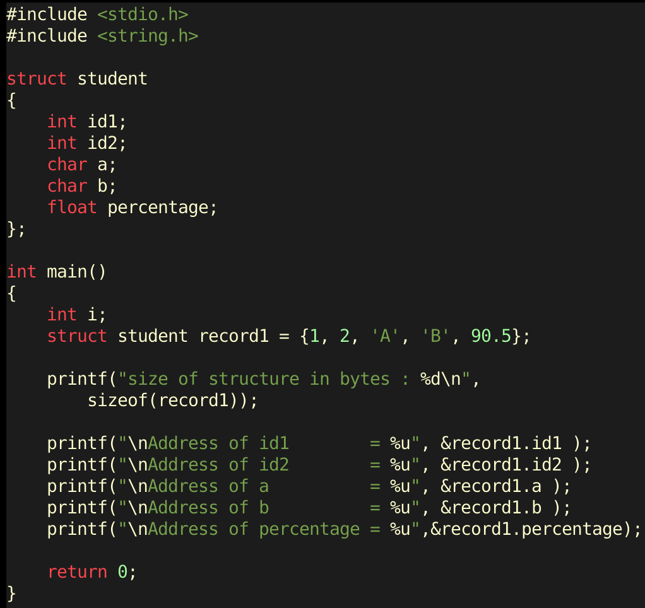
Struct.c

Slide 19
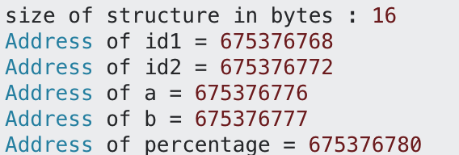
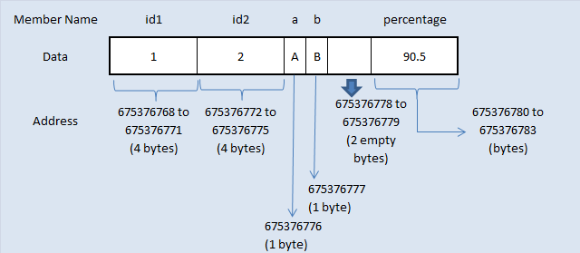
Struct.c

Slide 20
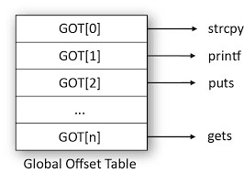
bypassGOT.c
If we take a look at the source code again, the following function is called last:
puts(now_playing.name);
If we leak the address of puts in libc, we can calculate the address of the libc base and subsequently, the address of the system function. Also, once we have that, we can write the address of the system function into the puts@got entry so that when this final line executes, it will actually execute:
system(now_playing.name);
Which means that system will be called with a parameter that we control!
Notes:
At the moment, we do not have a target to leak and to overwrite. We must be careful to pick a suitable one because the information leak and arbitrary write has to be performed on the same address. Additionally, the write has to result in EIP control at some point of the program's execution since we do not have that yet.

Slide 21
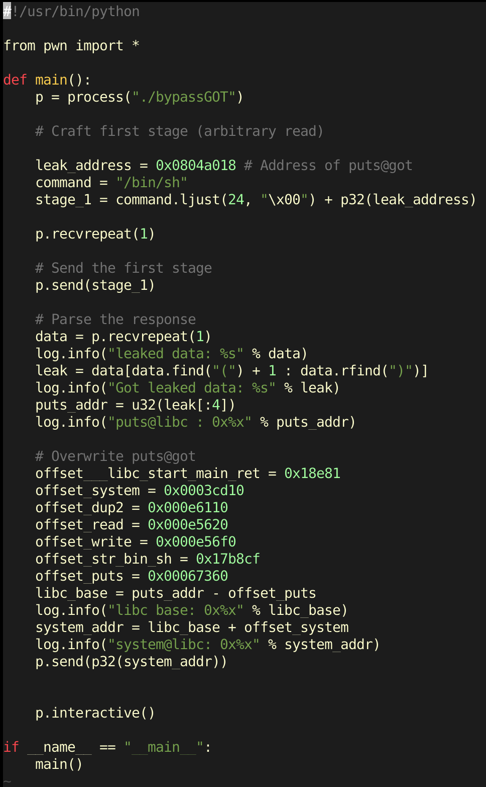
Pwn Script

Slide 22
Event1.c
Kaizen-86 Artificial Intelligence

Slide 23
Q & A

