Slide 1

Class14
CSC 495/583 Topics of Software Security
PLT, GOT & Return-to-plt Attack
Dr. Si Chen (schen@wcupa.edu)

Slide 2
Review

Slide 3
Glossary of Terms
Binary: A binary is the output file from compiling a C or C++ file. Anything in the binary has a constant address.
Stack: The stack is part of the memory for a binary. Local variables and pointers are often stored here. The stack can be randomized.
NX (Non-Executable): Security measure in modern OSes to separate processor instructions (code) and data (everything that's not code.) This prevents memory from being both executable and writable.
ROP (Return Oriented Programming): Reusing tiny bits of code throughout the binary to construct commands we want to execute.
libc: A binary is dynamically linked and has a libc file. This means that the whole set of standard library functions are located somewhere in the memory used by the program.
ASLR (Address Space Layout Randomization): Security measure in modern OSes to randomize stack and libc addresses on each program execution.
Canary: A canary is some (usually random) value that is used to verify that nothing has been overrwritten. Programs may place canaries in memory, and check that they still have the exact same value after running potentially dangerous code, verifying the integrity of that memory.

Slide 4
Return-oriented programming
(ROP)

Slide 5
ROP: The Main Idea

Slide 6
ret2libc Attack

Slide 7
Introduction
“Getting around non-executable stack (and fix)”, Solar Designer (BUGTRAQ, August 1997)
https://seclists.org/bugtraq/1997/Aug/63
The ret2libc and return oriented programming (ROP) technique relies on overwriting the stack to create a new stack frame that calls the system function.

Slide 8
ret2libc Attack
We were able to pick from a wealth of ROP gadgets to construct the ROP chain in the previous section because the binary was huge.
Now, what happens if the binary we have to attack is not large enough to provide us the gadgets we need?
One possible solution, since ASLR is disabled, would be to search for our gadgets in the shared libraries loaded by the program such as libc.
However, if we had these addresses into libc, we could simplify our exploit to reuse useful functions. One such useful function could be the system() function.

Slide 9
libc
C standard library
Provides functionality for string handling, mathematical computations, input/output processing, memory management, and several other operating system services
  <stdio.h>
  <stdlib.h>
  <string.h>
However, if we had these addresses into libc, we could simplify our exploit to reuse useful functions. One such useful function could be the system() function.
→ find System() function’s address

Slide 10
Ret2lib Shellcode Structure
Function Address
Return Address (Old EIP)
Arguments
Dummy Characters
Address for System() in libc
Address for Exit() function in libc (if you want to exit the program gracefully)
Address for Command String (“e.g. /bin/sh”)

Slide 11
Shutdown ASLR
Shutdown ASLR (Address space layout randomization)

Slide 12
Address Space Layout Randomization (ASLR)
Address Space Layout Randomization (ASLR) is a technology used to help prevent shellcode from being successful.
It does this by randomly offsetting the location of modules and certain in-memory structures.

Slide 13
PLT, GOT & Return-to-plt Attack

Slide 14
Bypassing ASLR/NX with Ret2PLT

Slide 15
How to bypass ASLR/NX?
When ASLR has been enabled, we no longer can be sure where the libc will be mapped at.
However, that begs the question: how does the binary know where the address of anything is now that they are randomized?
The answer lies in something called the Global Offset Table (GOT) and the Procedure Linkage Table (PLT).

Slide 16
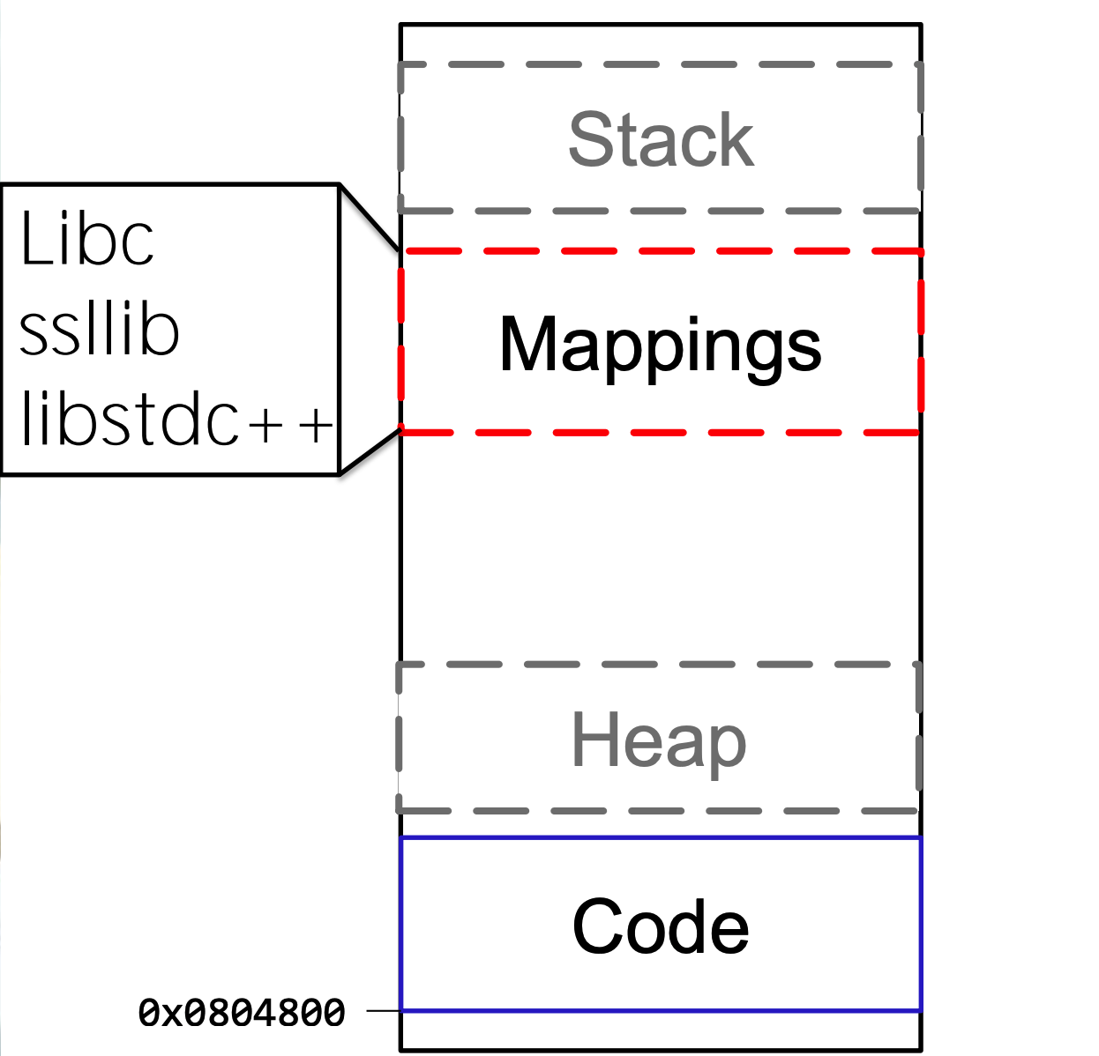
Call Function(s) in libc

Slide 17
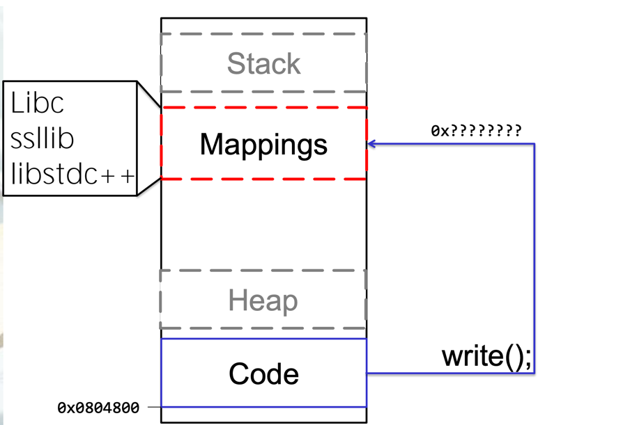
Call Function(s) in libc

Slide 18
ASM CALL
Call’s in ASM are ALWAYS to absolute address
How does it work with dynamic addresses for shared libraries?
Solution:
A “helper” at static location
In Linux: the Global Offset Table (GOT) and the Procedure Linkage Table (PLT).(they work together in tandem)

Slide 19
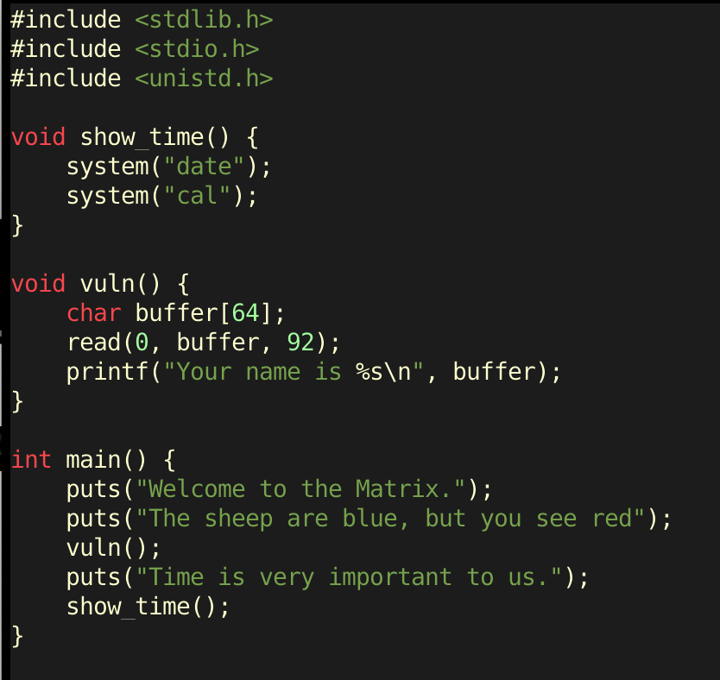
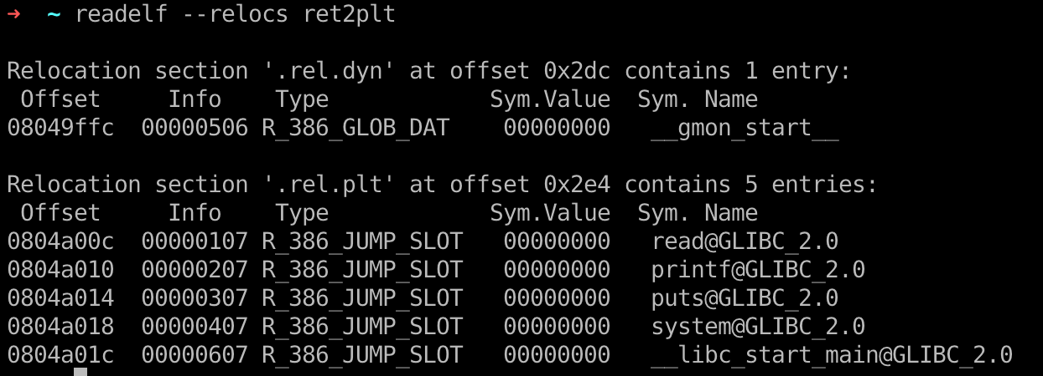
Global Offset Table
To handle functions from dynamically loaded objects, the compiler assigns a space to store a list of pointers in the binary.
Each slot of the pointers to be filled in is called a 'relocation' entry.
This region of memory is marked readable to allow for the values for the entries to change during runtime.
We can take a look at the '.got' segment of the binary with readelf.
ret2plt.c
gcc ret2plt.c -m32 -o ret2plt -no-pie -fno-stack-protector

Slide 20

Global Offset Table
Let's take the read entry in the GOT as an example. If we hop onto gdb, and open the binary in the debugger without running it, we can examine what is in the GOT initially.
0x08048346: An address within the Procedure Linkage Table (PLT)

Slide 21

Global Offset Table
If we run it and break just before the program ends, we can see that the value in the GOT is completely different and now points somewhere in libc.

Slide 22
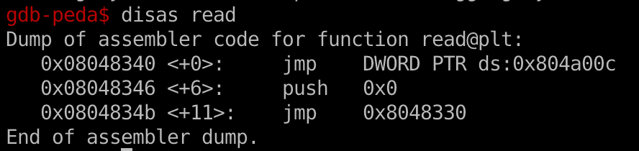
Procedure Linkage Table (PLT)
When you use a libc function in your code, the compiler does not directly call that function but calls a PLT stub instead.
Let's take a look at the disassembly of the read function in PLT.
Here's what's going on here when the function is run for the first time:
The read@plt function is called.
Execution reaches jmp DWORD PTR ds:0x804a00c and the memory address 0x804a00c is dereferenced and is jumped to. If that value looks familiar, it is. It was the address of the GOT entry of read.
Since the GOT contained the value 0x08048346 initially, execution jumps to the next instruction of the read@plt function because that's where it points to.
The dynamic loader is called which overwrites the GOT with the resolved address.
Execution continues at the resolved address.

Slide 23
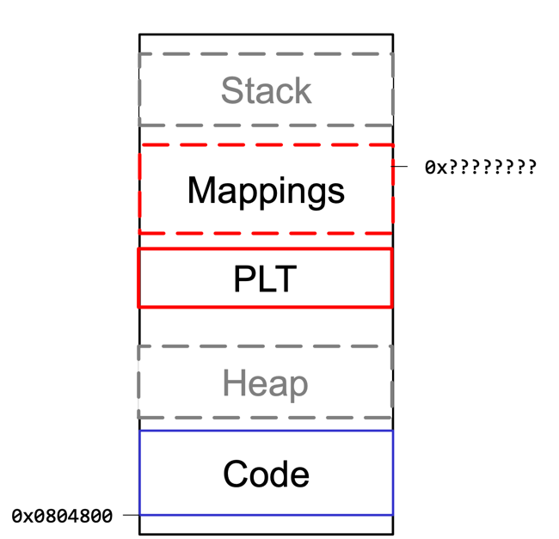
Procedure Linkage Table (PLT)

Slide 24
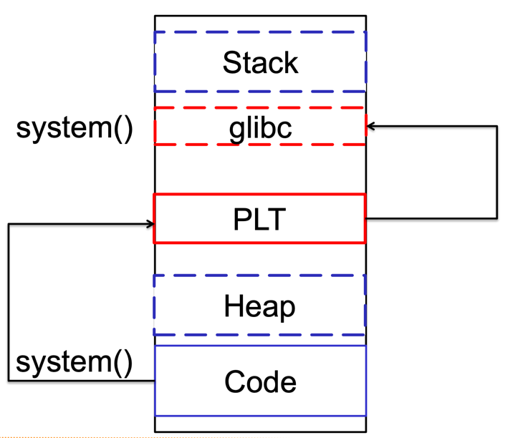
Procedure Linkage Table (PLT)
How does it work?
“call system” is actually call system@plt
The PLT resolves system@libc at runtime
The PLT stores system@libc in system@got

Slide 25
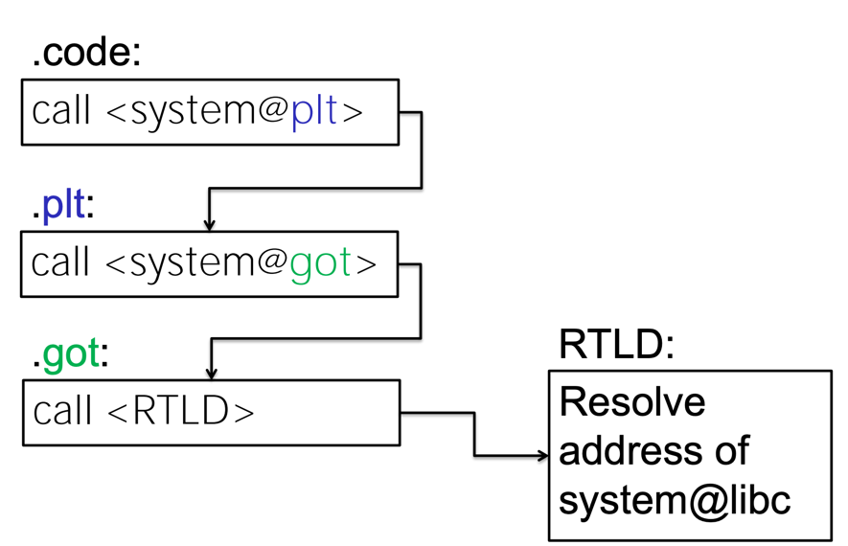
Call System() Function in libc with PLT, GOT

Slide 26
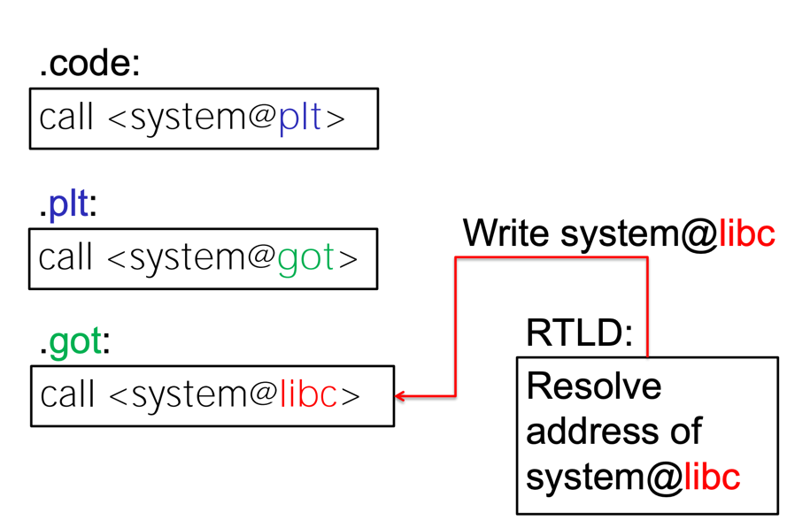
Call System() Function in libc with PLT, GOT

Slide 27
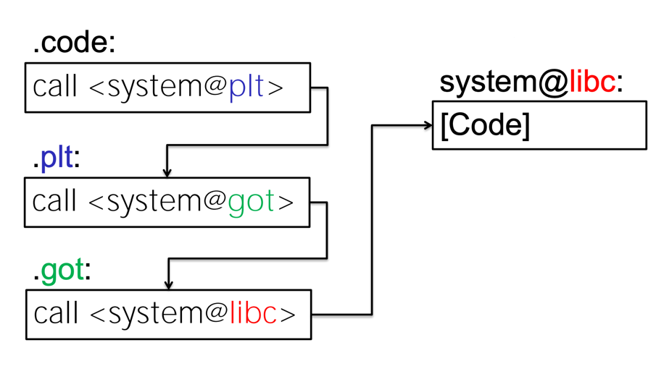
Call System() Function in libc with PLT, GOT

Slide 28

Lazy Binding
1st time call System()
After the 1st System() call
system@libc

Slide 29
Bypass ASLR/NX with Ret2plt Attack
Enable ASLR (Address space layout randomization)
ret2plt.c

Slide 30
Bypass ASLR/NX with Ret2plt Attack
ret2plt.c
PIE | Position independent executable

Slide 31
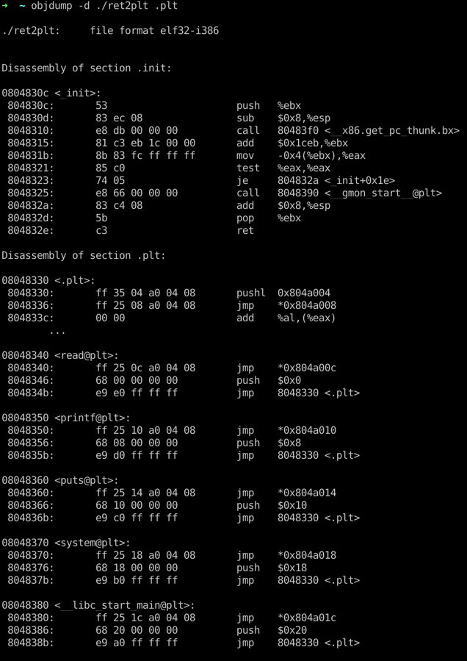
Check PLT stub Address
0x08048370
For system@plt

Slide 32
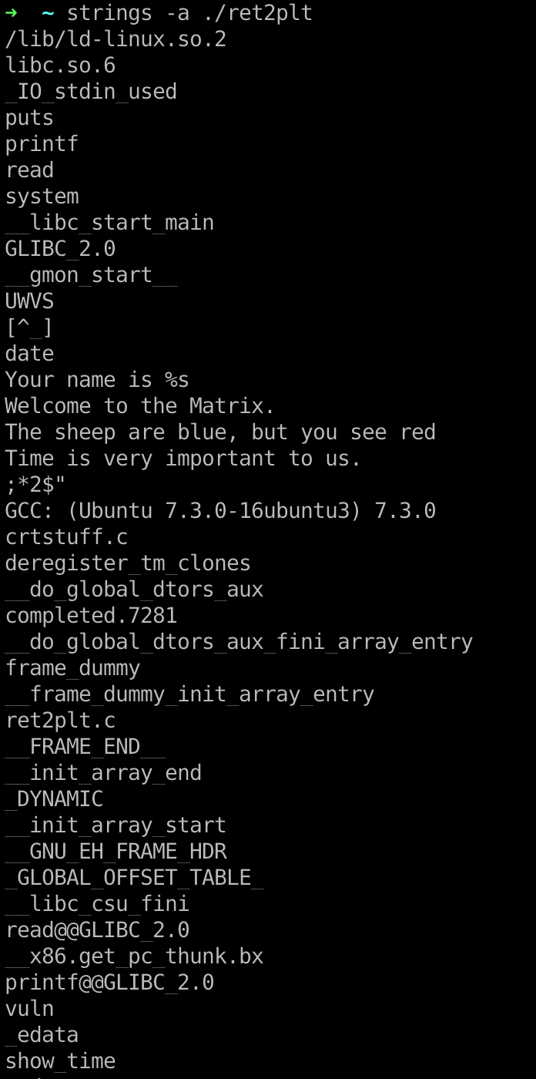
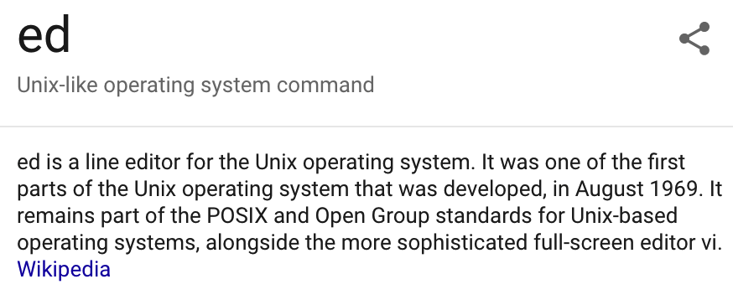
Find Useable String as Parameter for System() function
The sheep are blue, but you see red

Slide 33
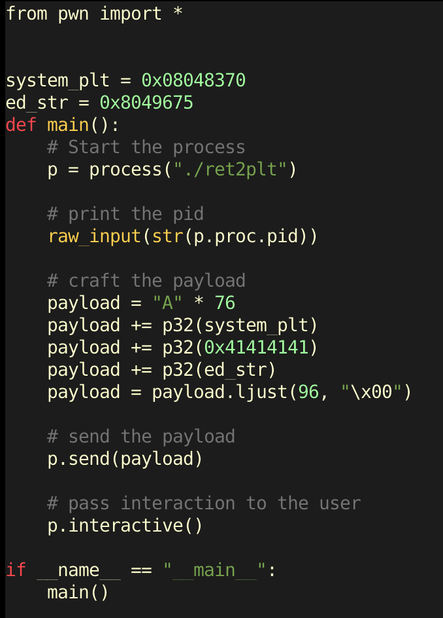
Pwn Script

Slide 34
Q & A

