Slide 1
Class13
CSC 495/583 Topics of Software Security Intro to Web Security (2)
Dr. Si Chen (schen@wcupa.edu)

Slide 2
Review

Slide 3
THE WEB IS SIMPLE
Hyper Text Transfer Protocol (HTTP)
Designed to allow remote document retrieval
Simple client server model:
Client
Server

Slide 4
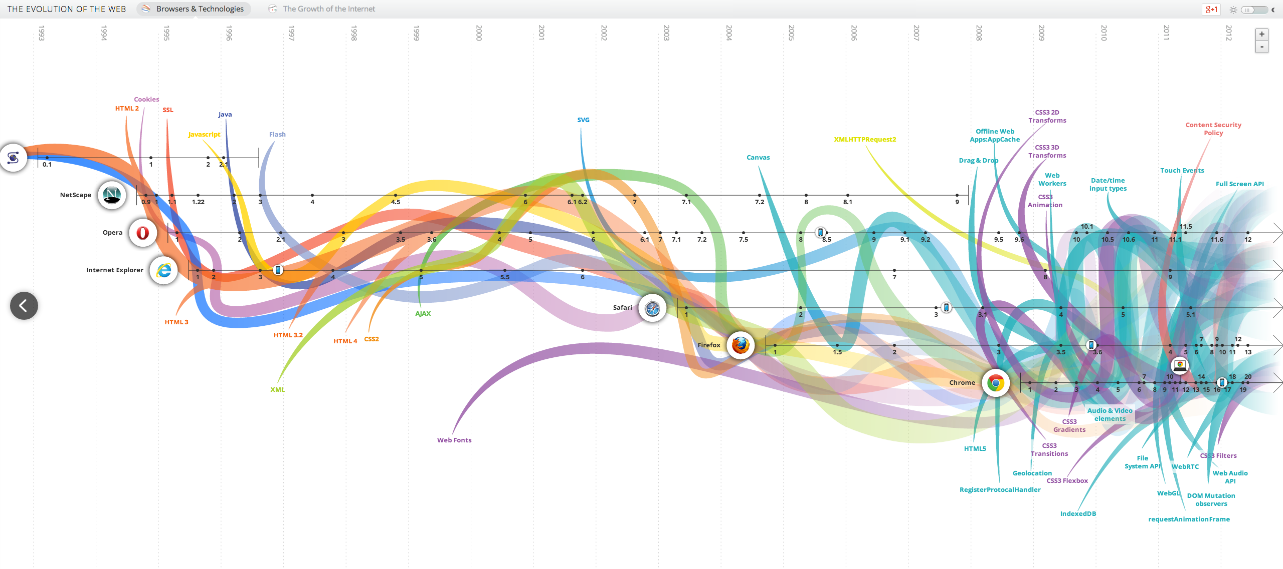
The Reality
Web application security is massively complex.
Constant evolving field
WebGL, HTML5, CSS3, AJAX…
.
http://www.evolutionoftheweb.com/

Slide 5
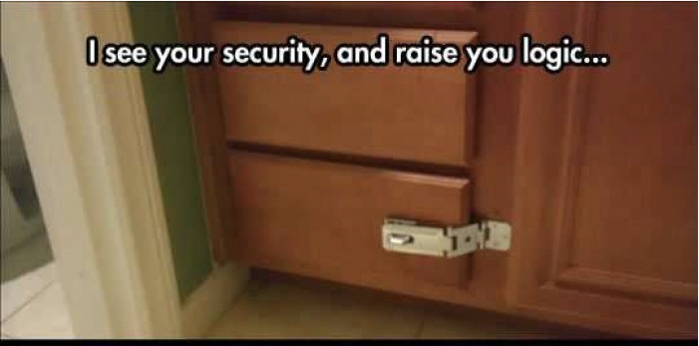
Web Security v.s. Penetration Testing

Slide 6
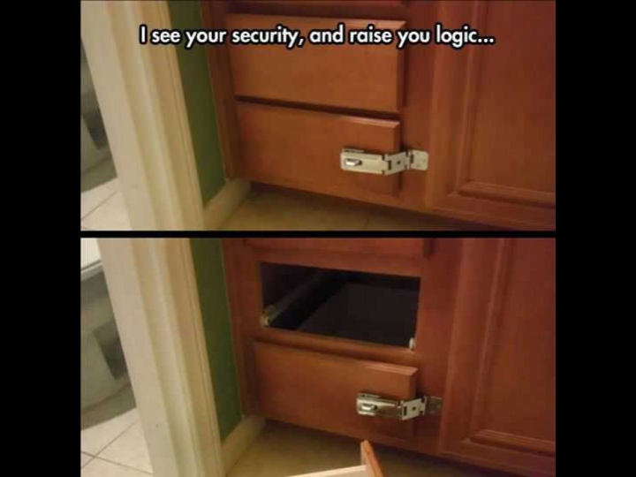
Web Security v.s. Penetration Testing

Slide 8
News.php
ID | TITLE | CONTENT | DATE
1 | Facing poverty, academics sleeping in cars | …. | 09/28/2017
2 | China orders N.K. firms to close down within 120 days | …. | 09/28/2017
3 | Bitcoin blow as fund drops U.S. exchange application | …. | 09/28/2017

Slide 9
News.php?id=1
ID | TITLE | CONTENT | DATE
1 | Facing poverty, academics sleeping in cars | …. | 09/28/2017
2 | China orders N.K. firms to close down within 120 days | …. | 09/28/2017
3 | Bitcoin blow as fund drops U.S. exchange application | …. | 09/28/2017

Slide 10
News.php?id=2
ID | TITLE | CONTENT | DATE
1 | Facing poverty, academics sleeping in cars | …. | 09/28/2017
2 | China orders N.K. firms to close down within 120 days | …. | 09/28/2017
3 | Bitcoin blow as fund drops U.S. exchange application | …. | 09/28/2017

Slide 11
News.php?id=1…Evil
ID | TITLE | CONTENT | DATE
1 | Facing poverty, academics sleeping in cars | …. | 09/28/2017
2 | China orders N.K. firms to close down within 120 days | …. | 09/28/2017
3 | Bitcoin blow as fund drops U.S. exchange application | …. | 09/28/2017

Slide 12
News.php?id=1 ; delete from news
ID | TITLE | CONTENT | DATE
1 | Facing poverty, academics sleeping in cars | …. | 09/28/2017
2 | China orders N.K. firms to close down within 120 days | …. | 09/28/2017
3 | Bitcoin blow as fund drops U.S. exchange application | …. | 09/28/2017

Slide 13
News.php?id=1 ; delete from news
ID | TITLE | CONTENT | DATE
1 | Facing poverty, academics sleeping in cars | …. | 09/28/2017
2 | China orders N.K. firms to close down within 120 days | …. | 09/28/2017
3 | Bitcoin blow as fund drops U.S. exchange application | …. | 09/28/2017

Slide 14
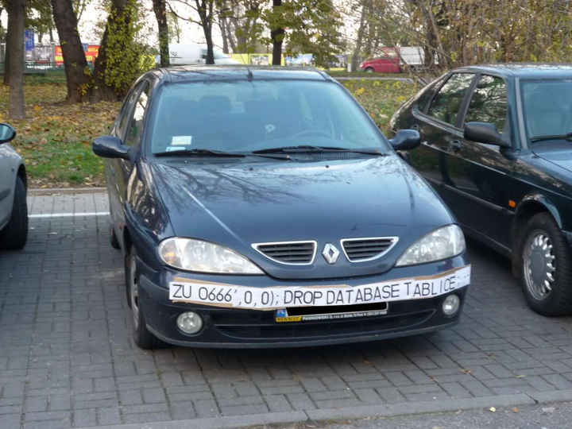

Slide 15
Upload Hacking: Apache + PHP

Slide 16
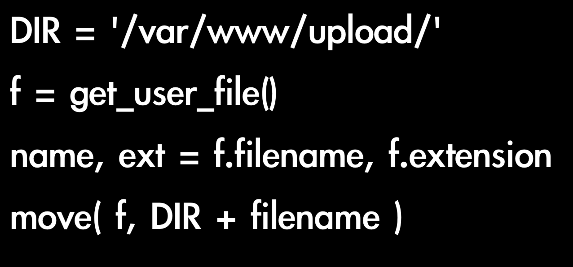
Upload Hacking: Apache + PHP
hack.php

Slide 19
One sentence webshell

Slide 20
Upload Hacking: Apache + PHP (Patch1)

Slide 21
Upload Hacking: Apache + PHP (Patch1)
Hack.php3, hack.php4, hack.phtml

Slide 22
Upload Hacking: Apache + PHP (Patch2)

Slide 23
Upload Hacking: Apache + PHP (Patch2)
Hack.php[SPACE]

Slide 24
Upload Hacking: Apache + PHP (Patch3)

Slide 25
Upload Hacking: Apache + PHP (Patch3)
Hack.php.xxx
.htaccess

Slide 27
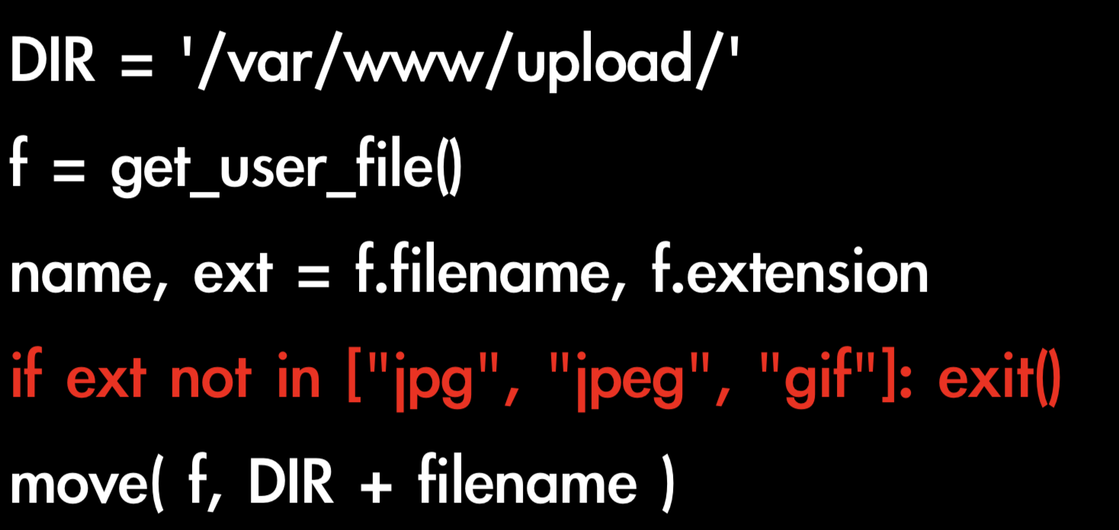
Nginx + PHP

Slide 28
05_avatar_big.jpg
PHP webshell with a JPEG header to bypass weak image verification checks.

Slide 29
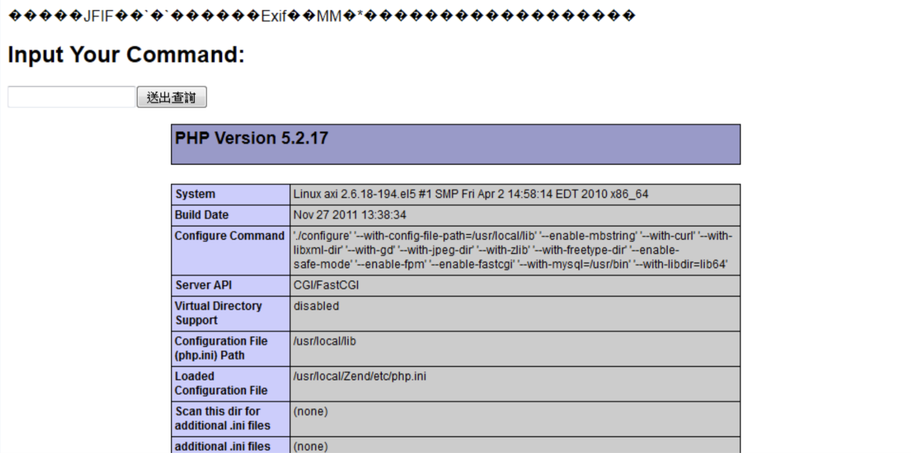
05_avatar_big.jpg/.php

Slide 30
Upload and More
Check file extension
Check file extension in JavaScript
Check Mine Type
Check File Header
Check File format
Check URL Pattern

Slide 31
Attacking Users: Cross-Site Scripting (XSS)
The attacks we have considered so far involve directly targeting the sever-side application.
Many of these attacks do impinge upon other users, such as SQL injection. But the attacker’s essential methodology was to interact with the server in unexpected ways to perform unauthorized actions and access unauthorized data.
Cross-site scripting, however, are in a different category.
The attacker’s primary target: the application’s other users.
Basic idea: A user sending data that is executed as script

Slide 32
Attacking Users: Cross-Site Scripting (XSS)
XSS vulnerabilities come in various forms and may be divided into three varieties: reflected, stored, and DOM-based.
They have important differences in how they can be identified and exploited.
In all cases: Everything from a user is suspect (forms, user-agent, headers, etc) when fixing, escape to the situation (HTML, JS, XML, etc) FIEO (Filter Input, Escape Output)
We will examine each variety of XSS in turn.

Slide 33
Attacking Users: Cross-Site Scripting (XSS)
XSS- Reflected XSS:
Directly echoing back content from the user.
1. User logs in
3.User requests attacker’s URL
4. Server response with
attacker’s JavaScript
7. Attacker hijacks
user’s session
2. Attacker feeds crafted URL to user
6. User’s browser sends session token to attacker

Slide 34
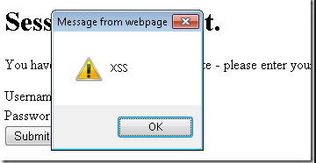
Attacking Users: Cross-Site Scripting (XSS)
XSS- Reflected XSS:
Directly echoing back content from the user.
The Security Hole:
The Attack:
This type of simple XSS bug accounts for approximately 75% of the XSS vulnerabilities that exists in real-world web apps.
It is called reflected XSS because exploiting the vulnerability involves crafting a request containing embedded JavaScript that is reflected to any user who makes the requests

Slide 35
XSS- Reflected XSS:
Directly echoing back content from the user.
http://twitter.com/index.php?%75%73%65%72%3D%3C%73%63%72%69%70%74%3E%61%6C%65%72%74%28%31%32%33%29%3C%2F%73%63%72%69%70%74%3E
Twitter?
http://twitter.com/index.php?user=<script>alert(123)</script>

Slide 36
Attacking Users: Cross-Site Scripting (XSS)
XSS- Stored XSS:
You store the data, then later display it.
2. User logs in
Attacker submits question
containing malicious JavaScript
3.User views attacker’s question
4. Server response with
attacker’s JavaScript
6. Attacker hijacks
user’s session
5. User’s browser sends session token to attacker

Slide 37
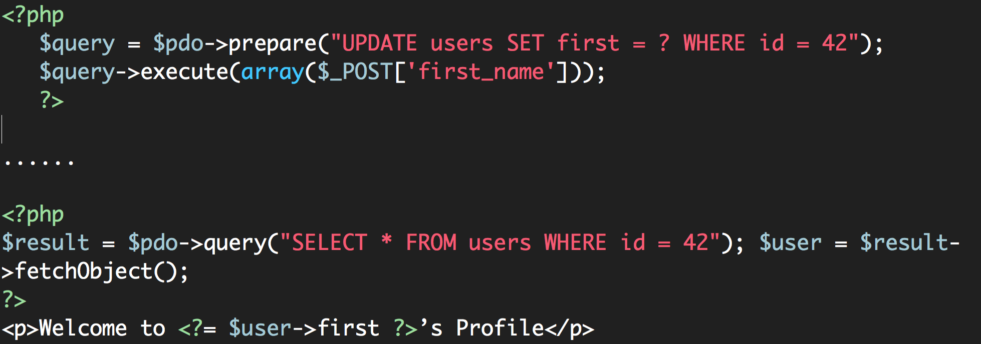
Attacking Users: Cross-Site Scripting (XSS)
XSS- Stored XSS:
You store the data, then later display it.
The Security Hole:
The Attack:

Slide 38
Attacking Users: Cross-Site Scripting (XSS)
XSS- DOM XSS:
What happens in JavaScript, stays in JavaScript.
1. User logs in
7. Attacker hijacks
user’s session
3.User requests attacker’s URL
4. Server response with
Page containing hard-coded JavaScript
2. Attacker feeds crafted URL to user
6. User’s browser sends session token to attacker

Slide 39
Attacking Users: Cross-Site Scripting (XSS)
XSS- DOM XSS:
What happens in JavaScript, stays in JavaScript.
A user requests a crafted URL supplied by the attacker and containing embedded JavaScript
The server’s response does not contain the attacker’s script in any form
When the user’s browser process this response, the script is executed nonetheless.

Slide 40
XSS- DOM XSS:
What happens in JavaScript, stays in JavaScript.
The Security Hole:
The Attack:

Slide 41
XSS is Everywhere
XSS is by far the most prevalent web app vulnerability
XSS is often misunderstood because the proof of concept (pop-up) doesn’t demonstrate true attacker capability
XSS can lead to reputational damage, denial of service, and chained exploit.
XSS can be used against site administrators

Slide 42
Attacking Users: Cross-Site Scripting (XSS)
Real-world Scenario of XSS Attack
Facebook makes use of PHP scripts. The following script became vulnerable to cross-site scripting some time in July 2010:
www.facebook.com/ads/create/photos/creative_uploader.php
This script takes various parameters, one of which (controller_id) was writing user input directly inside a script tag. Take the following URL as example:
www.facebook.com/ads/create/photos/creative_uploader.php?controller_id=c4c288b438ed080&path=whatever&src=whatever&vol=90&w=60&h=80&post_upload=1
https://www.acunetix.com/websitesecurity/xss-facebook/

Slide 43
Attacking Users: Cross-Site Scripting (XSS)
Real-world Scenario of XSS Attack
By inserting a double quote, an attacker is able to escape the Array’s key string and insert JavaScript directly within a page on facebook.com.

Slide 44
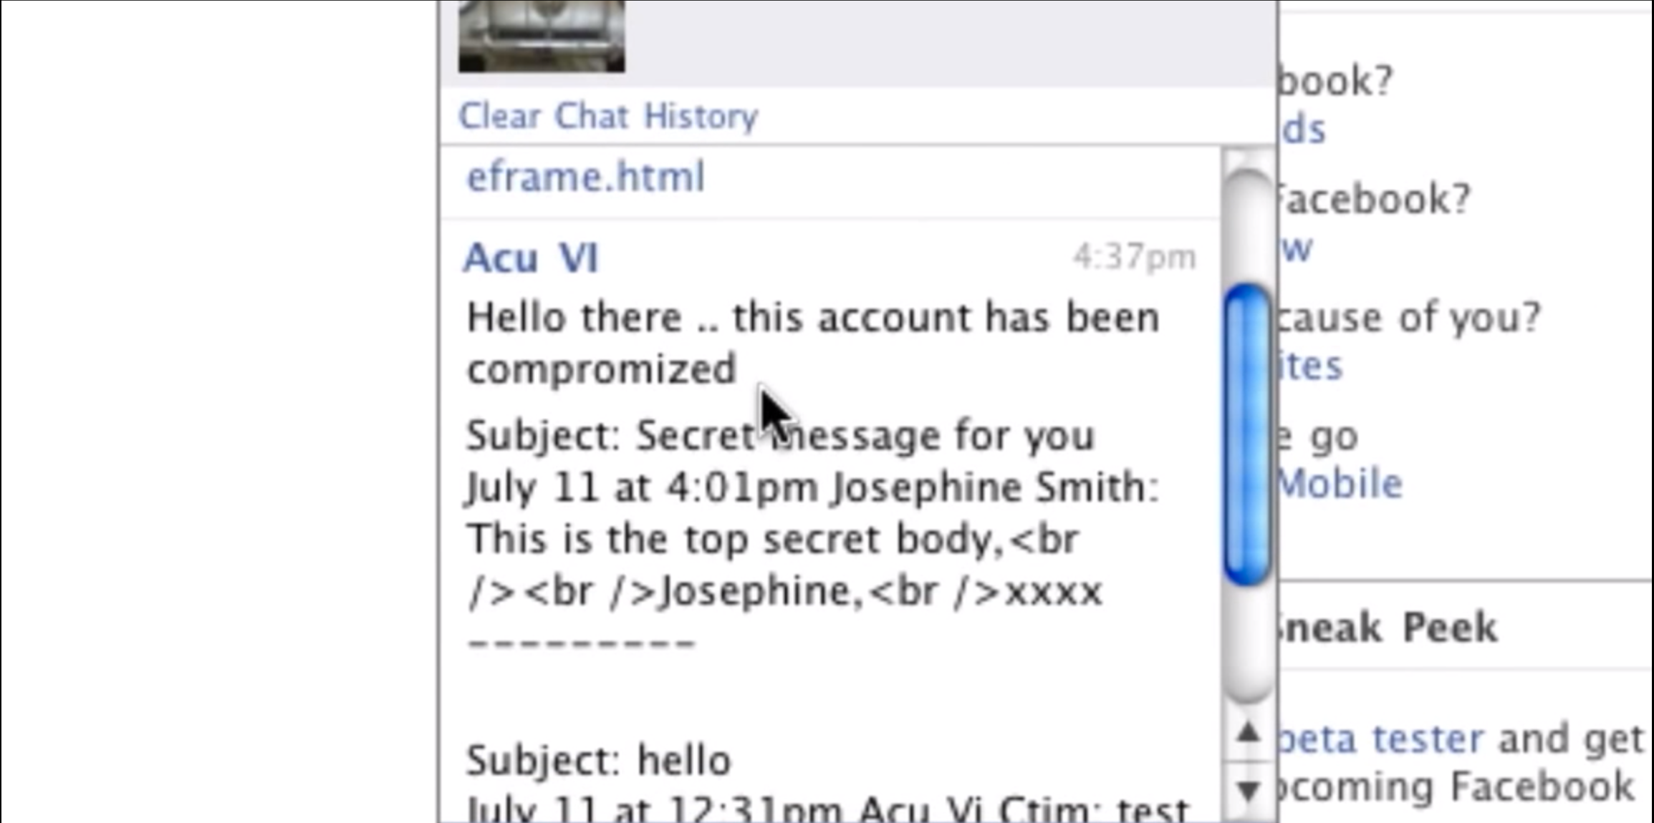
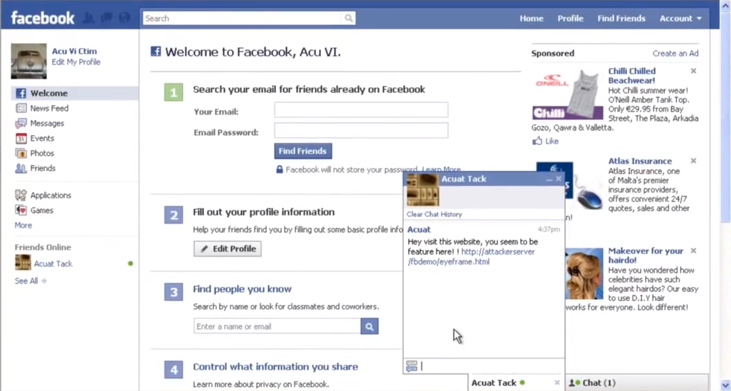
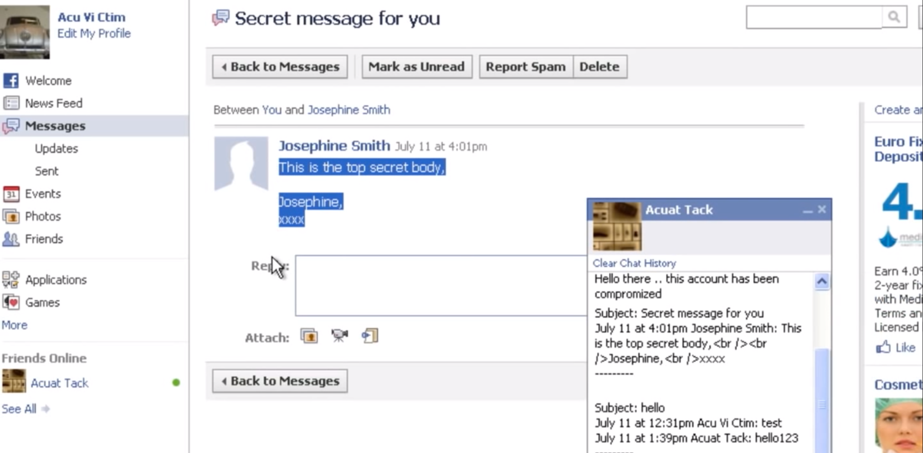
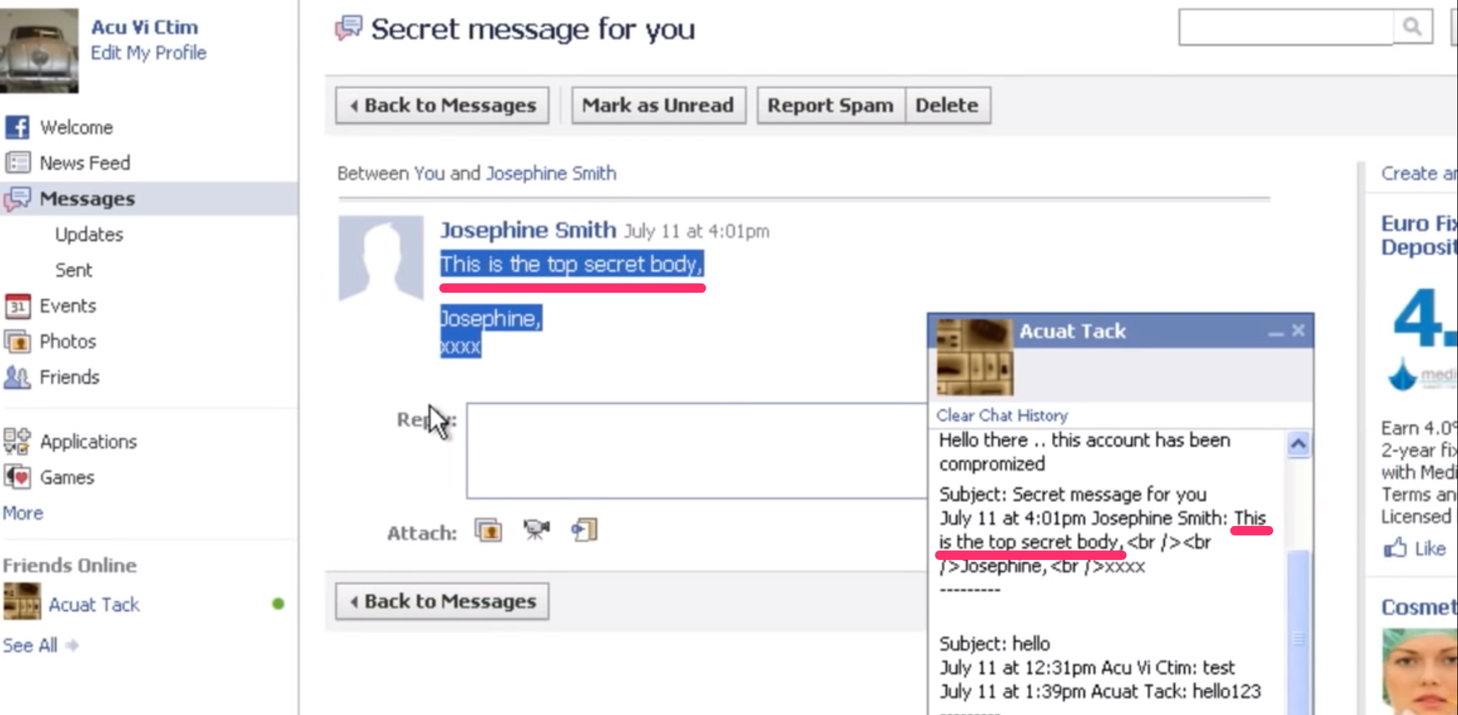
Attacking Users: Cross-Site Scripting (XSS)
Real-world Scenario of XSS Attack
https://www.acunetix.com/websitesecurity/xss-facebook/

Slide 45
Why XSS detection is hard
Extremely difficult to automate tests for XSS
Often times XSS defense can be bypassed in clever ways
Developers should strive to use 3rd party libraries that are collaboratively maintained

Slide 46
Attacking Users: CSRF (Cross Site Request Forgery)
In cross-site request forgery (CSRF) attacks, the attacker creates an innocuous-looking website that causes the user’s browser to submit a request directly to the vulnerable application to perform some unintended action that is beneficial to the attacker.
Normally, “the same-origin” policy does not prohibit one website from issuing requests to a different domain.
The request performs a privileged action. In the example shown, the request creates a new user with administrative privileges
The application relies solely on HTTP cookies for tracking sessions. No session-related tokens are transmitted else where within the request
The attacker can determine all the parameters required to perform the action. Aside from the session token in the cookie, no unpredictable values need to be included in the request.

Slide 47
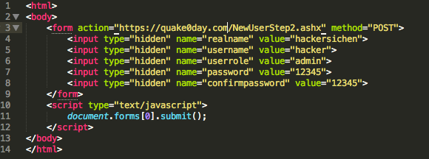
Attacking Users: CSRF (Cross Site Request Forgery)
An attacker can construct a webpage that makes a cross-domain request to the vulnerable application containing everything needed to perform the privileged action.
Here is an example of such an attack.
This form will be automatically submitted. When the user’s browser submits the form, it automatically adds the user’s cookies for the target domain. If an admin user who is logged in the vulnerable app visits this web page, the requests is processed within the administrator’s session.

Slide 48
Attacking Users: CSRF (Cross Site Request Forgery)
Cross site request forgery is a trust exploit
The server trusts (wrongly) the browser request of users b/c authentication cookies are supplied
Attacker forces the users browser to take action on their behalf
Clever way to take over web applications

Slide 49
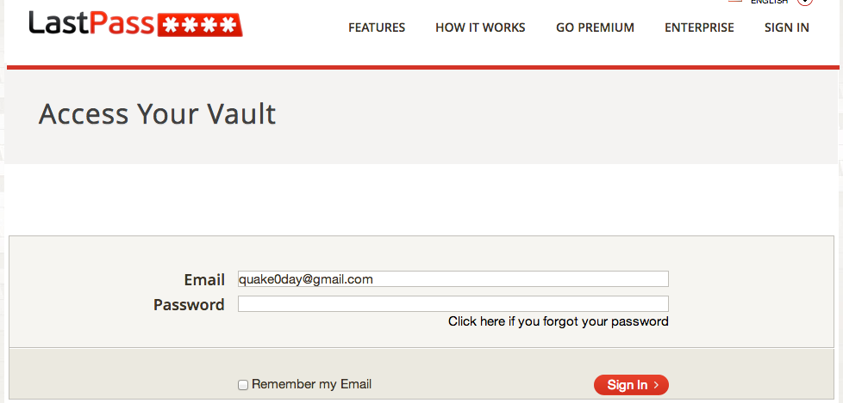
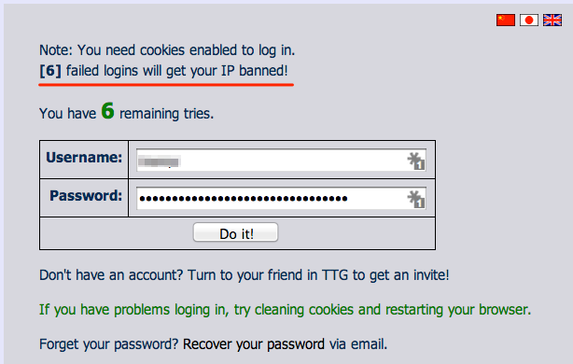
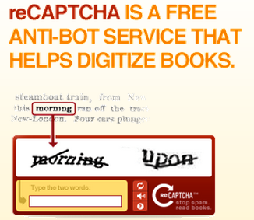
Brute Force Attacks (Password)
CAPTCHA
IP rate limiting

Slide 50
Q & A

