Slide 1
Class9
CSC 495/583 Topics of Software Security Return-oriented programming
(ROP)
Dr. Si Chen (schen@wcupa.edu)

Slide 2
Review

Slide 3
Compile the code
gcc -m32 –fno-stack-protector –zexecstack –o ./overflow2 ./overflow2.c

Slide 4
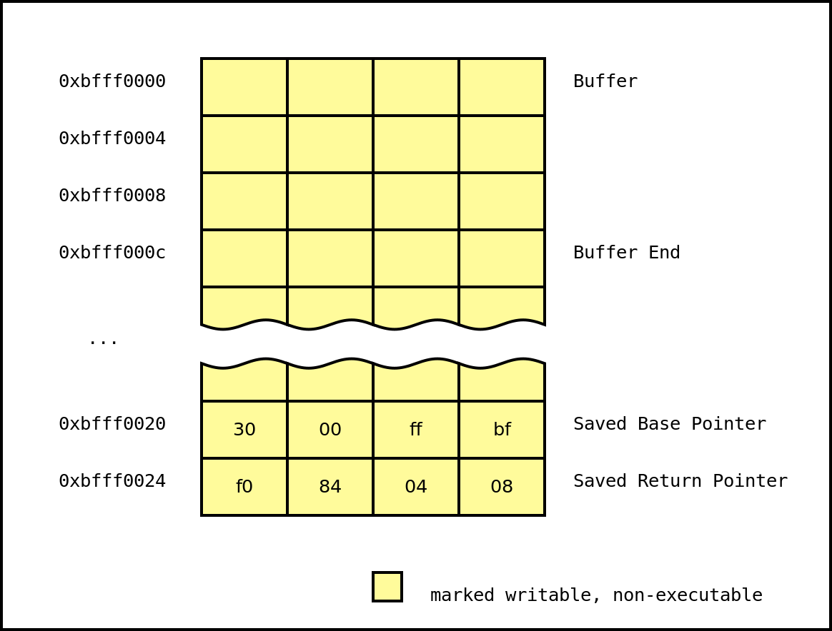
No eXecute (NX)
-zexecstack
Also known as Data Execution Prevention (DEP), this protection marks writable regions of memory as non-executable.
This prevents the processor from executing in these marked regions of memory.

Slide 5
No eXecute (NX)
After the function returns, the program will set the instruction pointer to 0xbfff0000 and attempt to execute the instructions at that address. However, since the region of memory mapped at that address has no execution permissions, the program will crash.

Slide 6
No eXecute (NX)
Thus, the attacker's exploit is thwarted.

Slide 7
Data Execution Prevention (DEP): No eXecute bit (NX)
NX bit is a CPU feature
–
On Intel CPU, it works only on x86_64 or with Physical Address Extension (PAE) enable
Enabled, it raises an exception if the CPU tries to
execute something that doesn't have the NX bit set
The NX bit is located and setup in the Page Table Entry

Slide 8
Page Table
Each process in a multi-tasking OS runs in its own memory sandbox.
This sandbox is the virtual address space, which in 32-bit mode is always a 4GB block of memory addresses.
These virtual addresses are mapped to physical memory by page tables, which are maintained by the operating system kernel and consulted by the processor.
Each process has its own set of page tables.

Slide 9
Page Table
To each virtual page there corresponds one page table entry (PTE) in the page tables, which in regular x86 paging is a simple 4-byte record shown below:

Slide 10
Data Execution Prevention (DEP): No eXecute bit (NX)
●
The last bit is the NX bit (exb)
–
0 = disabled
1 = enabled
–

Slide 11
Return-oriented programming
(ROP)

Slide 12
ROP Introduction
●
When Good Instructions Go Bad: Generalizing Return-Oriented Programming to RISC
[1] -Buchanan, E.; Roemer, R.; Shacham, H.; Savage, S. (October 2008)
●
Return-Oriented Programming: Exploits Without Code Injection
[2] - Shacham, Hovav; Buchanan, Erik; Roemer, Ryan; Savage, Stefan. Retrieved 2009-08-12.

Slide 14
Ordinary programming: the machine level
insn | insn | insn | insn
instruction pointer
Instruction pointer (EIP) determines which instruction to fetch & execute
Once processor has executed the instruction, it automatically increments EIP to next instruction
Control flow by changing value of EIP

Slide 15
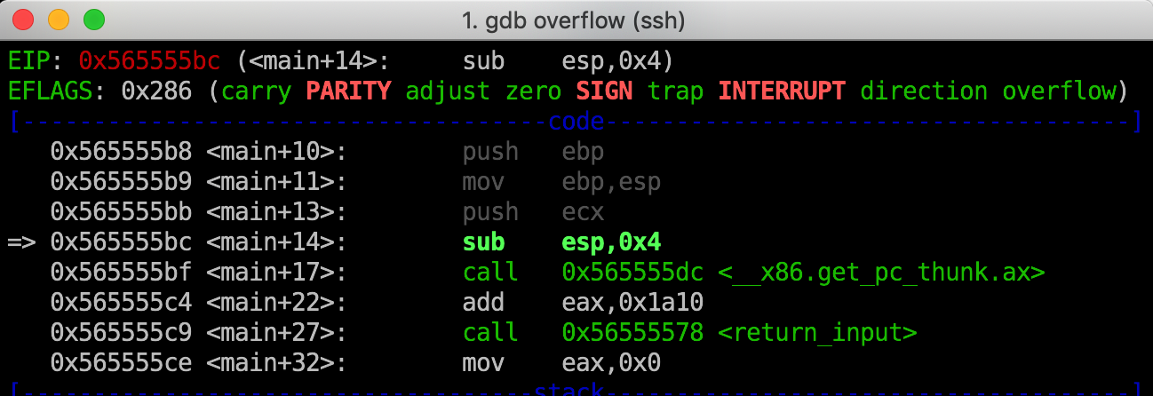
EIP
Instruction pointer (EIP) determines which instruction to fetch & execute
Once processor has executed the instruction, it automatically increments EIP to next instruction
Control flow by changing value of EIP

Slide 16
Return-oriented programming: the machine level
insns … ret
insns … ret
C library
insns … ret
insns … ret
insns … ret
stack pointer
Stack pointer (ESP) determines which instruction sequence to fetch & execute
Processor doesn’t automatically increment ESP; — but the “ret” at end of each instruction sequence does

Slide 17
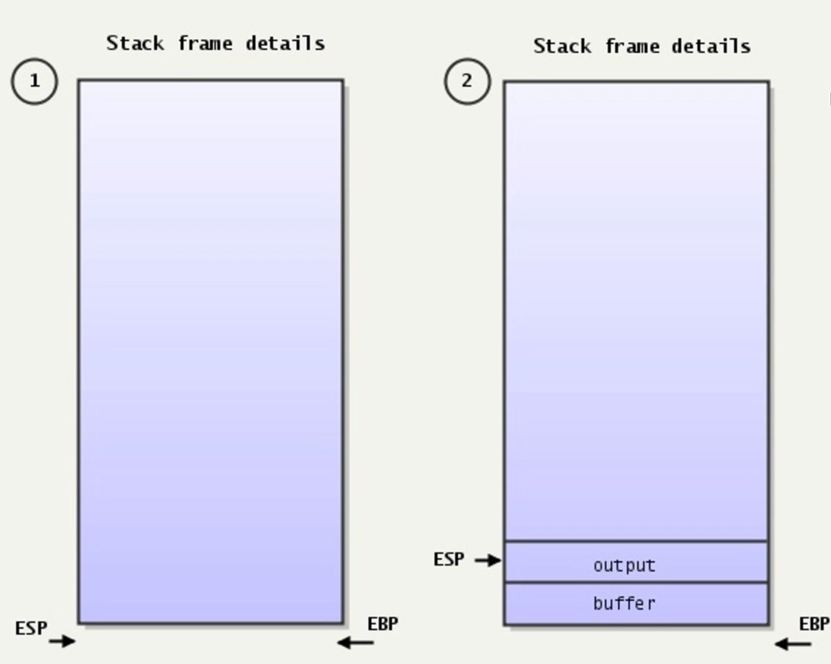
ESP – Always pointing to the top of the stack
Stack pointer (ESP) determines which instruction sequence to fetch & execute
Processor doesn’t automatically increment ESP; — but the “ret” at end of each instruction sequence does

Slide 18
ROP: The Main Idea

Slide 19
ROP Gadget
“The Gadget”: July 1945

Slide 20
Attack Process on x86
Gadget1 is executed and returns
Gadget2 is executed and returns
Gadget3 is executed and returns
●
So, the real execution is:

Slide 21
How can we ﬁnd gadgets?
Several ways to find gadgets
Old school method : objdump and grep
Some gadgets will be not found: objdump aligns instructions
Make your own tool which scans an executable segment
Use an existing tool

Slide 22
Finding instruction sequences
Any instruction sequence ending in “ret” is useful — could be part of a gadget
Algorithmic problem: recover all sequences of valid instructions from libc that end in a “ret” insn
Idea: at each ret (c3 byte) look back:
are preceding i bytes a valid length-i insn?
recurse from found instructions
Collect instruction sequences in a trie

Slide 23
ROPgadget

Slide 24
Execution Path
main()
→ vulnerable_function (hacked)
→ add_bin()
add_bash()
exec_string()
Spawn shell

Slide 25
x
Execution Path
add_bin()
magic == 0xdeadbeef
add_bash()
magic1 == 0xcafebabe
magic2 == 0x0badf00d
exec_string()
Spawn shell

Slide 26
Basic Structure of
Return Chaining

Slide 27
Return Chaining
Function Address
Return Address (Old EIP)
Arguments

Slide 28
Return Chaining
Execution Path
Without parameters, the ROP chain
looks much simpler
main()
→ vulnerable_function (hacked)
→ add_bash()
add_bin()
exec_string()
Spawn shell
Add_bin()
Add_bash()
Exec_string()
Similarly to lab1, we use gdb to adjust the length of the dummy characters to trigger buffer overflow
Dummy Character “A”s
Address for Add_bin()
Address for Add_bash()
Address for exec_string()

Slide 29
Return Chaining
Execution Path
add_bin()
magic == 0xdeadbeef
add_bash()
magic1 == 0xcafebabe
magic2 == 0x0badf00d
exec_string()
Spawn shell
For add_bin(), we need to pass 0xdeadbeef,
So the ROP chain looks like:
Add_bin()
Add_bash()
Exec_string()
magic == 0xdeadbeef
Function Address
Return Address (Old EIP)
Arguments
Dummy Character “A”s
Address for Add_bin()
Address for Add_bash()
0xdeadbeef
Address for exec_string()
Broken link

Slide 30
Return Chaining
Execution Path
The previous ROP chain does not work, because argument
0xdeadbeef is still on the stack, we need to find a way to ”clean” it
add_bin()
magic == 0xdeadbeef
add_bash()
magic1 == 0xcafebabe
magic2 == 0x0badf00d
exec_string()
Spawn shell
Add_bin()
Add_bash()
Exec_string()
magic == 0xdeadbeef
Solution: use a pop, ret gadget to push the argument 0xdeadbeef into a register to remove it from the stack
Dummy Character “A”s
Address for Add_bin()
Address for pop_ret
0xdeadbeef
Address for Add_bash()

Slide 31
Return Chaining
Execution Path
For add_bash(), we need to pass 0xcafebabe and 0x0badf00d,
So we need to pop twice to remove both of them from the stack
add_bin()
magic == 0xdeadbeef
add_bash()
magic1 == 0xcafebabe
magic2 == 0x0badf00d
exec_string()
Spawn shell
Add_bin()
Add_bash()
Exec_string()
magic1 == 0xcafebabe
magic2 == 0x0badf00d
Dummy Character “A”s
Address for Add_bin()
Address for pop_ret
0xdeadbeef
Address for Add_bash()
Address for pop_pop_ret
0xcafebabe
0x0badf00d

Slide 32
Return Chaining
Execution Path
Finally, call exec_string()
add_bin()
magic == 0xdeadbeef
add_bash()
magic1 == 0xcafebabe
magic2 == 0x0badf00d
exec_string()
Spawn shell
Add_bin()
Add_bash()
Exec_string()
Dummy Character “A”s
Address for Add_bin()
Address for pop_ret
0xdeadbeef
Address for Add_bash()
Address for pop_pop_ret
0xcafebabe
0x0badf00d
Address for exec_string()

Slide 33
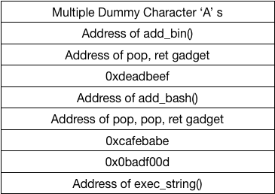

Slide 34
Q & A

