Slide 1
Class5
CSC 495/583 Topics of Software Security
Calling Convention, System Call & Introduction to PEDA and Pwntools Dr. Si Chen (schen@wcupa.edu)

Slide 2
Review

Slide 3
Stack
Pass arguments
Save the return address
Save local variable

Slide 4
https://www.slideshare.net/saumilshah/how-functions-work-7776073

Slide 5
https://www.slideshare.net/saumilshah/how-functions-work-7776073

Slide 6
https://www.slideshare.net/saumilshah/how-functions-work-7776073

Slide 7
https://www.slideshare.net/saumilshah/how-functions-work-7776073

Slide 8
https://www.slideshare.net/saumilshah/how-functions-work-7776073

Slide 9
CALL & RET
Two instructions control the use of assembly-language procedures:
CALL pushes the return address onto the stack and transfers control to a procedure.
RET pops the return address off the stack and returns control to that location.

Slide 11
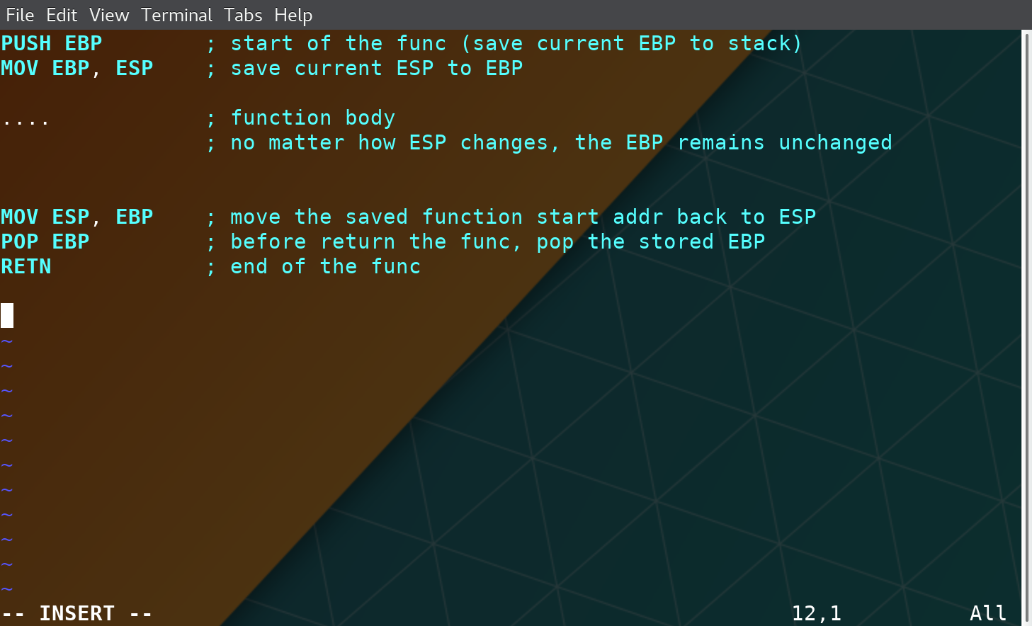
Stack Frame

Slide 12
Calling Convention

Slide 13
Two Questions
Q: When a function finished, how to handle the parameter left in the stack.
Q: When a function finished, how change the ESP value?
A: We don’t care…
A: ESP should be restored to the previous value

Slide 14
Standard C Calling Conventions
Calling conventions are a standardized method for functions to be implemented and called by the machine.
A calling convention specifies the method that a compiler sets up to access a subroutine.
There are three major calling conventions that are used with the C language on 32-bit x86 processors:
CDECL
STDCALL,
FASTCALL.

Slide 15
CDECL
The C language, by default, uses the CDECL calling convention
In the CDECL calling convention the following holds:
Arguments are passed on the stack in Right-to-Left order, and return values are passed in eax.
The calling function cleans the stack. This allows CDECL functions to have variable-length argument lists.

Slide 16
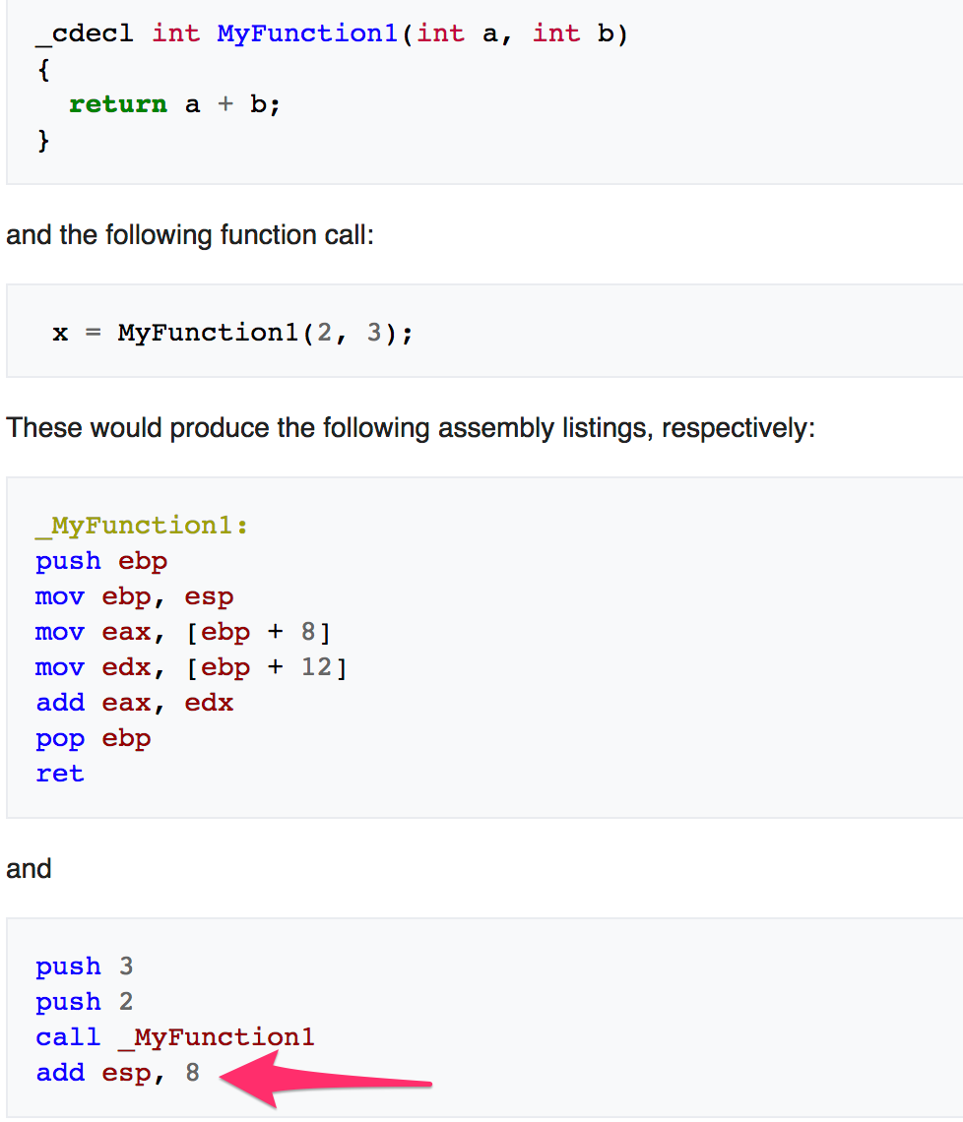
CDECL
The C language, by default, uses the CDECL calling convention
In the CDECL calling convention the following holds:
Arguments are passed on the stack in Right-to-Left order, and return values are passed in eax.
The calling function cleans the stack. This allows CDECL functions to have variable-length argument lists.

Slide 17
STDCALL
STDCALL, also known as "WINAPI" (and a few other names, depending on where you are reading it) is used almost exclusively by Microsoft as the standard calling convention for the Win32 API.
STDCALL passes arguments right-to-left, and returns the value in eax.
The called function cleans the stack, unlike CDECL. This means that STDCALL doesn't allow variable-length argument lists.

Slide 18
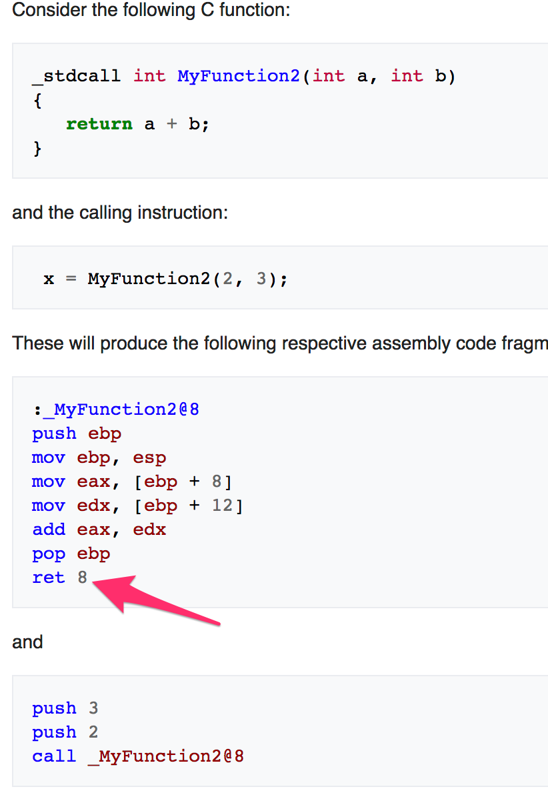
STDCALL
STDCALL, also known as "WINAPI" (and a few other names, depending on where you are reading it) is used almost exclusively by Microsoft as the standard calling convention for the Win32 API.
STDCALL passes arguments right-to-left, and returns the value in eax.
The called function cleans the stack, unlike CDECL. This means that STDCALL doesn't allow variable-length argument lists.
RET 8 ➔ RET + POP 8 Byte

Slide 19
Difference between CDECL and STDCALL
The main difference between the two lies in who is responsible for cleaning the stack for local variables.
For cdecl, this is the caller while for stdcall this is the callee (the function being called)
MyFunction2() aka the callee
main() → aka the caller

Slide 20
FASTCALL
The FASTCALL calling convention is not completely standard across all compilers, so it should be used with caution.
The calling function most frequently is responsible for cleaning the stack, if needed.
Use ECX, EDX to pass the first two arguments

Slide 21
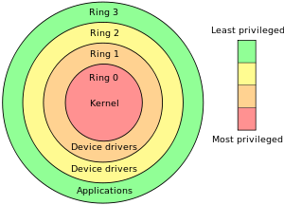
System Call

Slide 22
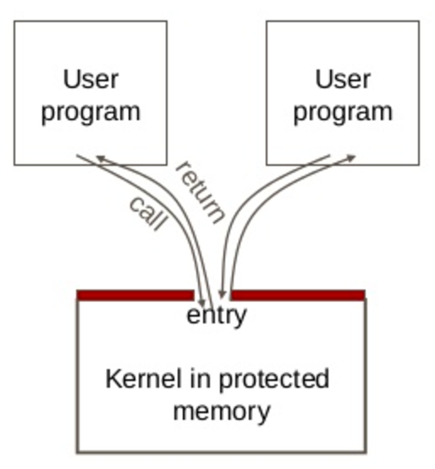
System Call
User code can be arbitrary
User code cannot modify kernel memory
The call mechanism switches code to kernel mode

Slide 23
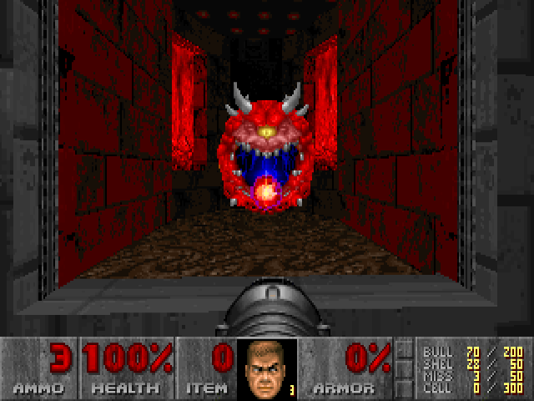
What is System Call?
System resources (file, network, IO, device) may be accessed by multiple applications at the same time, can cause confliction.
Modern OS protect these resources.
E.g. How to let a program to wait for a while?
100Mhz CPU -> 1s
1000Mhz CPU -> 0.1s
Use OS provide Timer

Slide 24
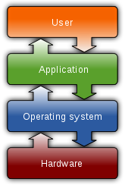
What System Call?
Let an application to access system resources.
OS provide an interface (System call) for the application
It usually use the technique called “interrupt vector”
Linux use 0x80
Windows use 0x2E
In system programming, an interrupt is a signal to the processor emitted by hardware or software indicating an event that needs immediate attention. An interrupt alerts the processor to a high-priority condition requiring the interruption of the current code the processor is executing. The processor responds by suspending its current activities, saving its state, and executing a function called an interrupt handler (or an interrupt service routine, ISR) to deal with the event. This interruption is temporary, and, after the interrupt handler finishes, the processor resumes normal activities.^{[1]} There are two types of interrupts: hardware interrupts and software interrupts. – From Wikipedia

Slide 25
CPU Interrupt
User Mode Execution
Interruption occurred
Next instruction
User Mode
Kernel Mode
Interrupt Vector Table
Interrupt Handler

Slide 26
Windows System Call and API
The Win32 API is a layer that runs in user mode (ring 3). Windows used to also support an OS/2 and POSIX API layer but they fell into disuse and were removed. The window manager is pure user mode code, no kernel calls are involved. Only API calls that use kernel resources (CreateThread, VirtualAlloc, etc) will call into the "real" operating system (ntdll.dll) and trap into ring 0 with a software interrupt (int 0x2e).

Slide 27
fwrite() path in both Linux and Windows
Application
fwrite()
./program
fwrite()
program.exe
C
Run Time
Library
write()
libc.a
libc.so
write()
Libcmt.lib
msvcr90.dll
libc.a
libc.so
interrupt 0x80
API (Windows)
NtWriteFile()
Kernel32.dll
NTDLL.dll
Interrupt 0x2e
Kernel
sys_write()
Kernel
./vlinuxz
IoWriteFile()
Kernel
NtosKrnl.exe

Slide 28
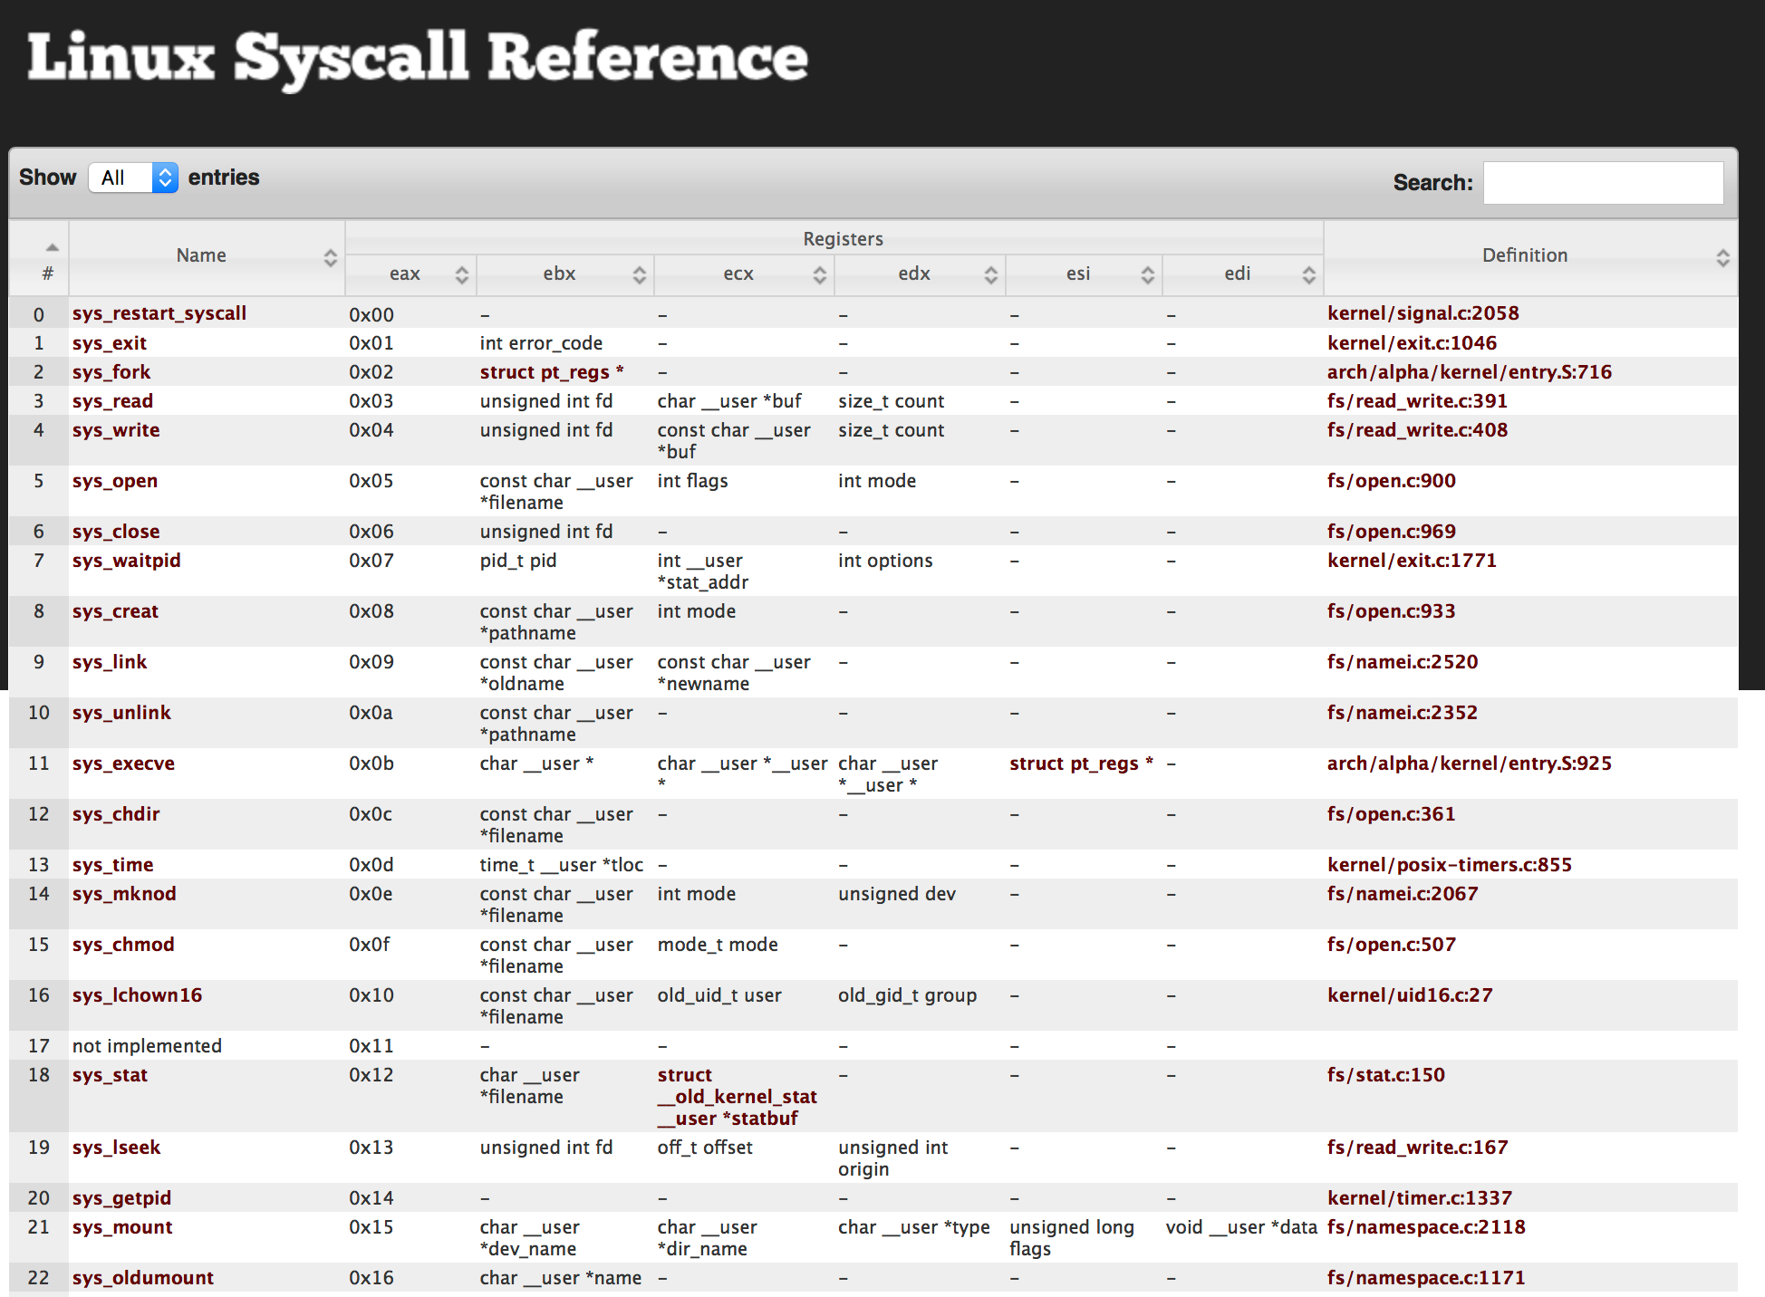
Linux System Call
http://syscalls.kernelgrok.com

Slide 30
Example: Hello World
Quick review:
DB - Define Byte. 8 bits
DW - Define Word. Generally 2 bytes on a typical x86 32-bit system
DD - Define double word. Generally 4 bytes on a typical x86 32-bit system
From x86 assembly tutorial,
helloworld.asm

Slide 31
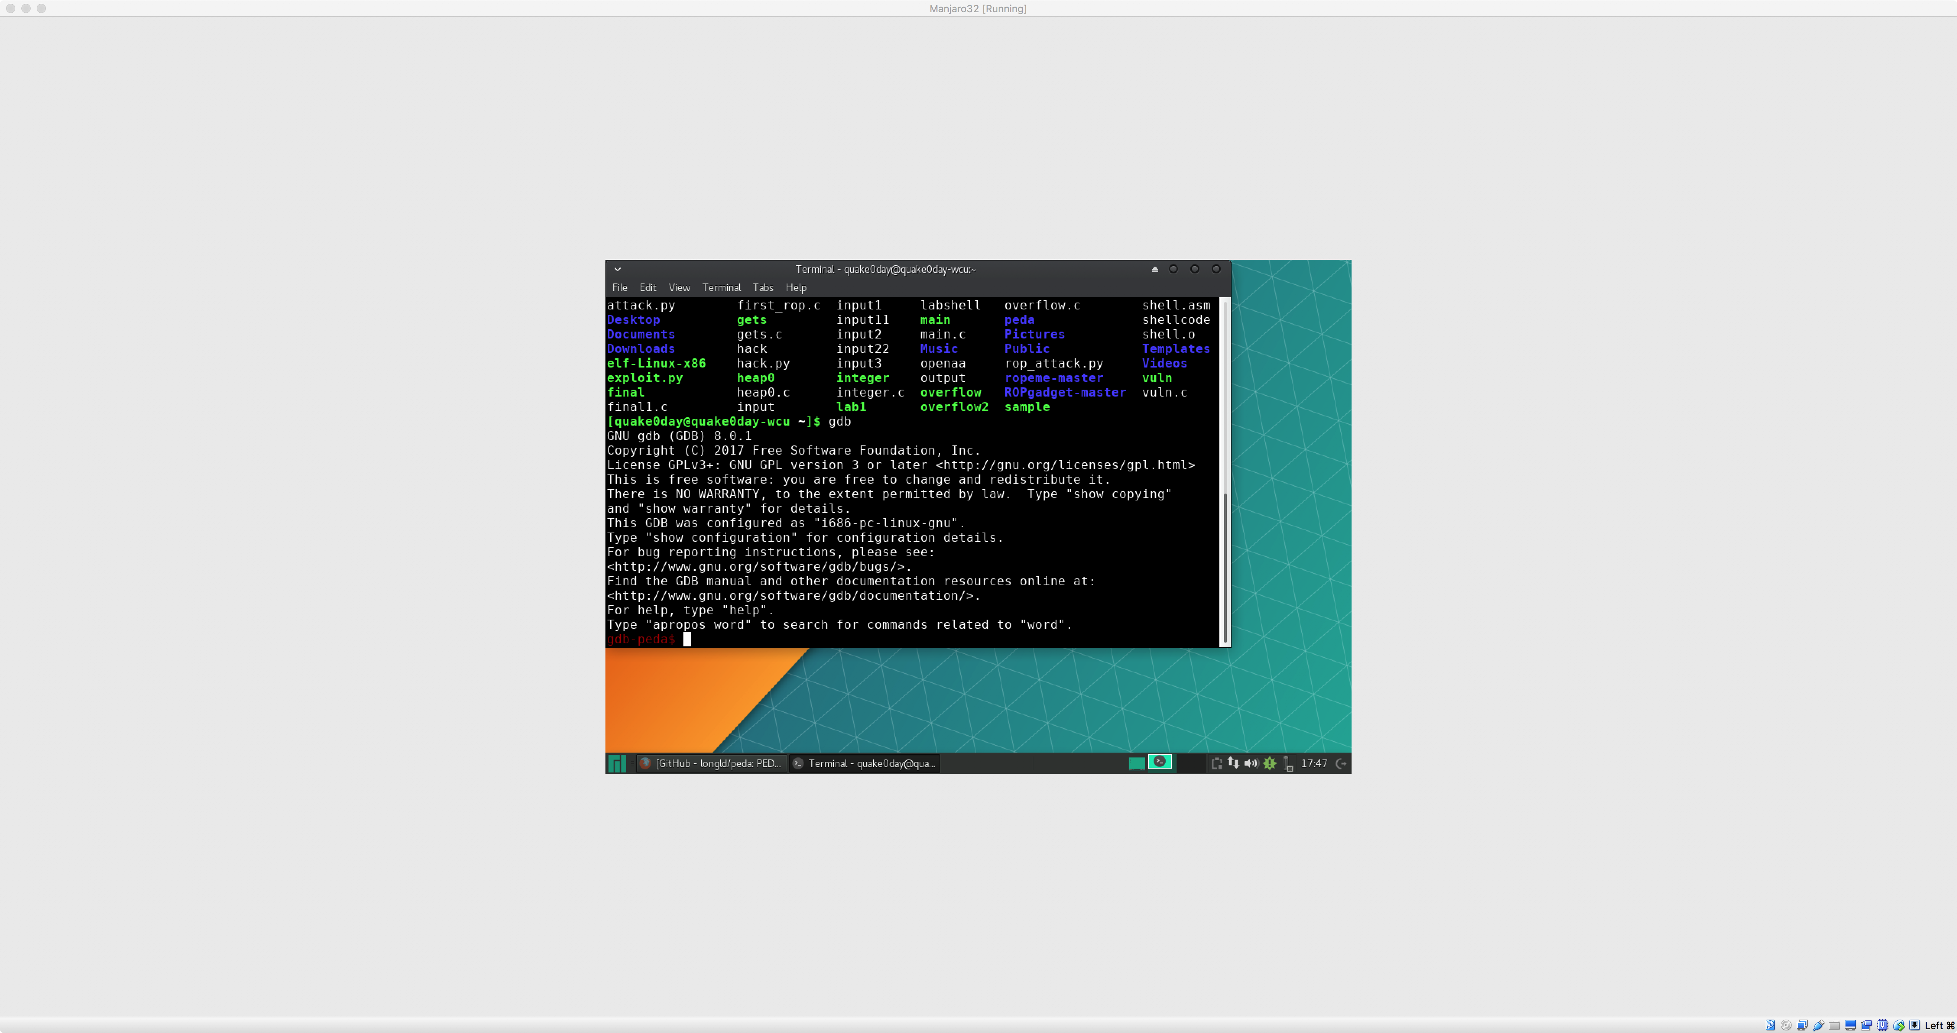
GDB with PEDA
GDB with PEDA and Pwntools are two tools that we will be using extensively throughout the course. This section is designed to run through their basic use and to work out any possible kinks that might arise.
GDB with PEDA

Slide 32
GNU Debugger - Basics
gdb
disassemble main (disas main)
break main (b main)
run
stepi (s), step into
nexti (n), step over

Slide 33
GNU Debugger – Examine Memory
Examine memory: x/NFU address
N = number
F = format
U = unit
• Examples
x/10xb 0xdeadbeef, examine 10 bytes in 0xdeadbeef
x/xw 0xdeadbeef, examine 1 word in 0xdeadbeef
x/s 0xdeadbeef, examine null terminated string

Slide 34
BASH refresher

Slide 35
gdb io

Slide 36
Pwntools
Pwntools is best supported on 64-bit Ubuntu LTE releases (12.04, 14.04, and 16.04). Most functionality should work on any Posix-like distribution (Debian, Arch, FreeBSD, OSX, etc.). Python 2.7 is required.

Slide 37
Q & A

