Slide 1
Class3
CSC 495/583 Topics of Software Security Stack Frame & Calling Convention
Dr. Si Chen (schen@wcupa.edu)

Slide 2
Review

Slide 3
Stack Frame
A stack frame is a frame of data that gets pushed onto the stack.
In the case of a call stack, a stack frame would represent a function call and its argument data.

Slide 4
Stack
Pass arguments
Save the return address
Save local variable

Slide 5
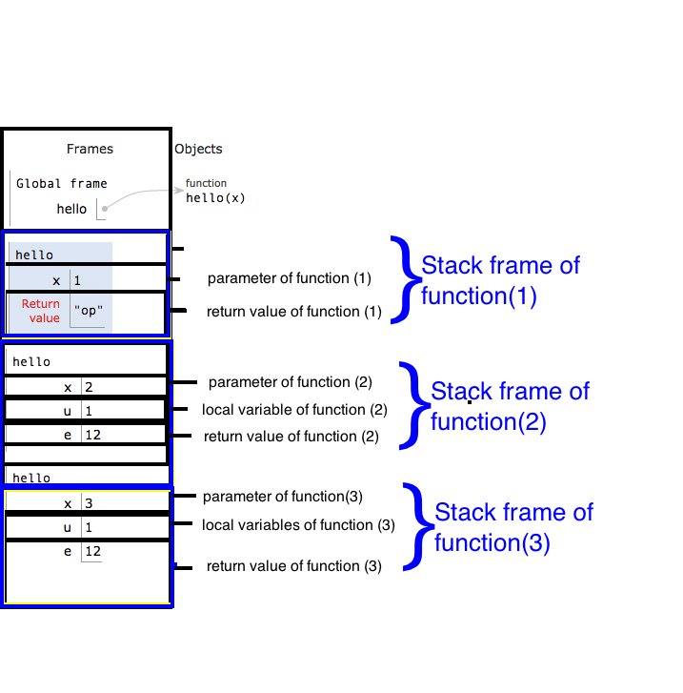
Stack Frame

Slide 6
Local Variable
Limited Register(s) → Store Local Variable in stack
Use esp and ebp to define a stack frame for current function
Use relative position of esp or ebp for retrieving and storing data
e.g. mov eax, [esp+124]
Very easy to do recursive call

Slide 7
https://www.slideshare.net/saumilshah/how-functions-work-7776073

Slide 8
https://www.slideshare.net/saumilshah/how-functions-work-7776073

Slide 9
https://www.slideshare.net/saumilshah/how-functions-work-7776073

Slide 10
https://www.slideshare.net/saumilshah/how-functions-work-7776073

Slide 11
https://www.slideshare.net/saumilshah/how-functions-work-7776073

Slide 12
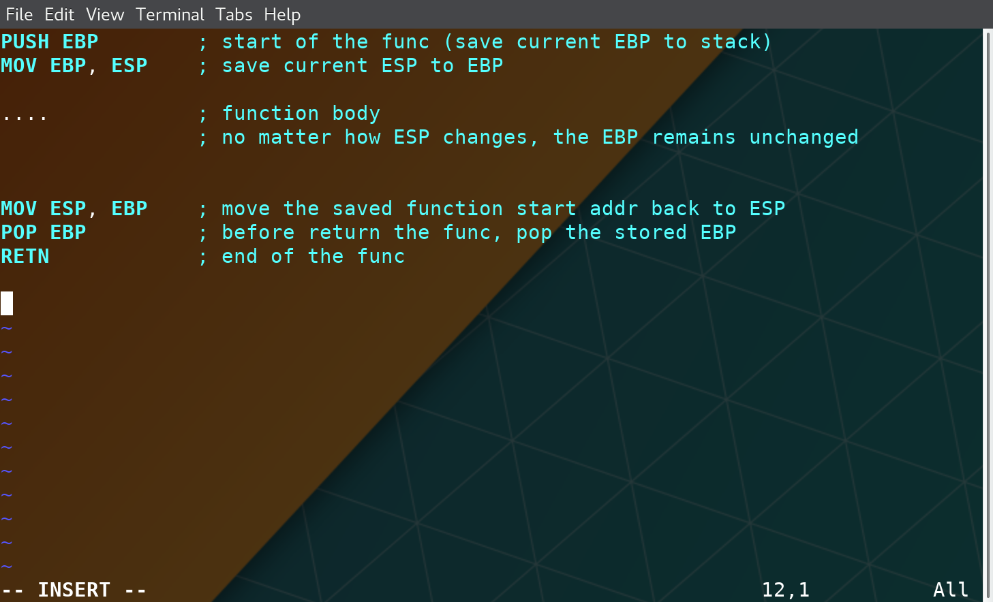
Stack Frame

Slide 13
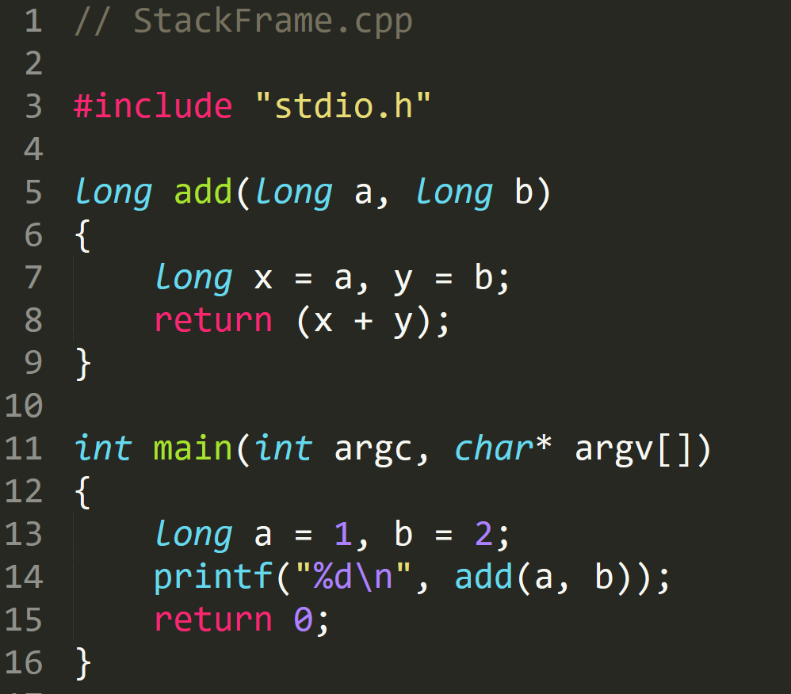
StackFrame.exe

Slide 14
StackFrame.exe

Slide 15
StackFrame.exe

Slide 16
StackFrame.exe
Notes:
EBP 12FFC0
ESP 12FF7C

Slide 17
StackFrame.exe
Notes:
EBP
ESP 12FF78

Slide 18
StackFrame.exe

Slide 19
StackFrame.exe
Create space for ‘a’ and ‘b’ → long → 4 byte
Notes:
EBP
ESP 12FF78

Slide 20
StackFrame.exe
Create space for ‘a’ and ‘b’ → long → 4 byte
Notes:
EBP
ESP 12FF78

Slide 21
StackFrame.exe
Assembly | C | Type Conversion
DWORD PTR SS:[EBP-4] | *(DWORD*)(EBP-4) | DWORD (4 byte)
WORD PTR SS:[EBP-4] | *(WORD*)(EBP-4) | WORD (2 byte)
BYTE PTR SS:[EBP-4] | *(BYTE*)(EBP-4) | 1 byte
4 Byte memory space at address [EBP-4]

Slide 22
StackFrame.exe

Slide 23
StackFrame.exe

Slide 24
StackFrame.exe

Slide 25
StackFrame.exe

Slide 26
StackFrame.exe

Slide 27
StackFrame.exe
Clean Stack

Slide 28
StackFrame.exe
Clean Stack

Slide 29
StackFrame.exe

Slide 30
StackFrame.exe
Set EAX –> 0
Faster than
MOV EAX,0

Slide 31
Calling Convention

Slide 32
Two Questions
Q: When a function finished, how to handle the parameter left in the stack.
Q: When a function finished, how change the ESP value?
A: We don’t care…
A: ESP should be restored to the previous value

Slide 33
Standard C Calling Conventions
Calling conventions are a standardized method for functions to be implemented and called by the machine.
A calling convention specifies the method that a compiler sets up to access a subroutine.
There are three major calling conventions that are used with the C language on 32-bit x86 processors:
CDECL
STDCALL,
FASTCALL.

Slide 34
CDECL
The C language, by default, uses the CDECL calling convention
In the CDECL calling convention the following holds:
Arguments are passed on the stack in Right-to-Left order, and return values are passed in eax.
The calling function cleans the stack. This allows CDECL functions to have variable-length argument lists.

Slide 35
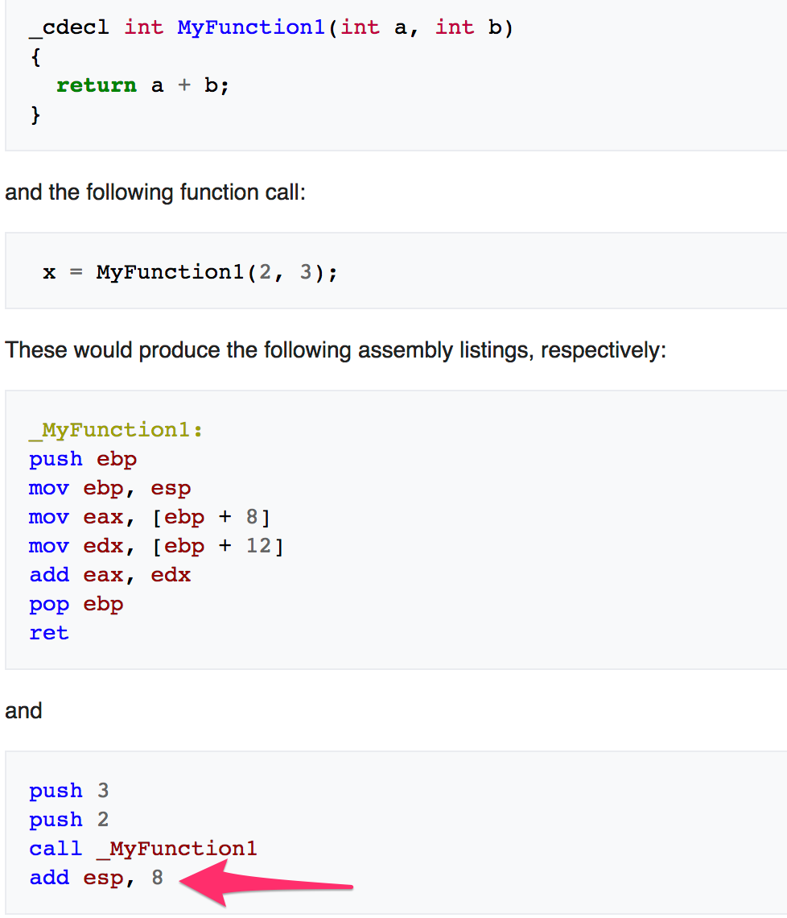
STDCALL
The C language, by default, uses the CDECL calling convention
In the CDECL calling convention the following holds:
Arguments are passed on the stack in Right-to-Left order, and return values are passed in eax.
The calling function cleans the stack. This allows CDECL functions to have variable-length argument lists.

Slide 36
STDCALL
STDCALL, also known as "WINAPI" (and a few other names, depending on where you are reading it) is used almost exclusively by Microsoft as the standard calling convention for the Win32 API.
STDCALL passes arguments right-to-left, and returns the value in eax.
The called function cleans the stack, unlike CDECL. This means that STDCALL doesn't allow variable-length argument lists.

Slide 37
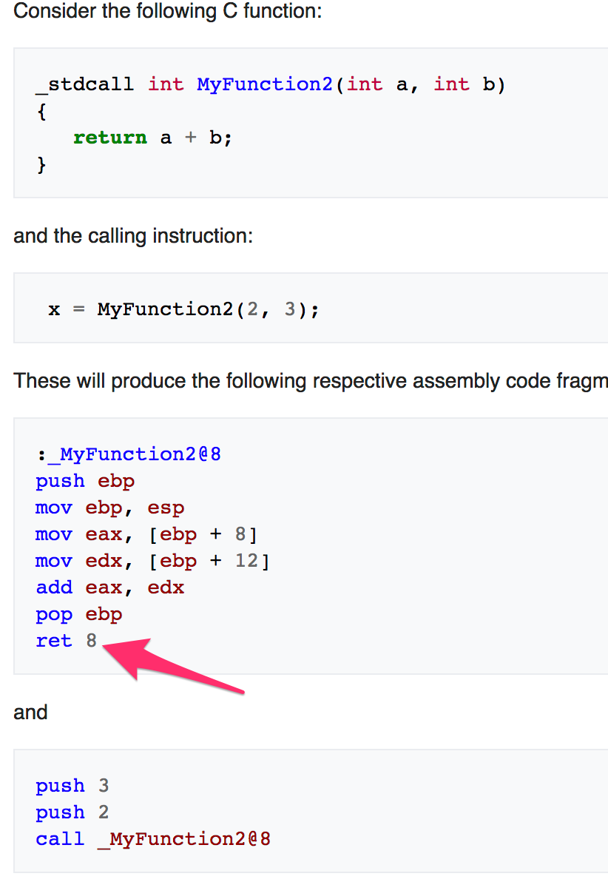
STDCALL
STDCALL, also known as "WINAPI" (and a few other names, depending on where you are reading it) is used almost exclusively by Microsoft as the standard calling convention for the Win32 API.
STDCALL passes arguments right-to-left, and returns the value in eax.
The called function cleans the stack, unlike CDECL. This means that STDCALL doesn't allow variable-length argument lists.
RET 8 ➔ RET + POP 8 Byte

Slide 38
FASTCALL
The FASTCALL calling convention is not completely standard across all compilers, so it should be used with caution.
The calling function most frequently is responsible for cleaning the stack, if needed.

Slide 39
Q & A

