Slide 1
Class3
CSC 495/583 Topics of Software Security X86 Assembly & Stack & Stack Frame
Dr. Si Chen (schen@wcupa.edu)

Slide 2
Review

Slide 3
General-purpose Registers
The eight 32-bit general-purpose data registers are used to hold operands for logical and arithmetic operations, operands for address calculations and memory pointers
4 Bytes
Notes:
The following figure shows the lower 16 bits of the general-purpose registers can be used with the names AX, BX, CX, DX, BP, SP, SI, and DI (the names for the corresponding 32-bit ones have a prefix "E" for "extended"). Each of the lower two bytes of the EAX, EBX, ECX, and EDX registers can be referenced by the names AH, BH, CH, and DH (high bytes) and AL, BL, CL, and DL (low bytes).

Slide 4
## Register
+ `esp` `ebp` `esi` `edi` - DWORD (32-bit)
+ `sp` `bp` `si` `di` - WORD (16-bit) - rarely used
+ \[esp, ebp\] - mark the range of stack frame
+ esi, edi - used as buffer pointer, some instruction will directly handle esi, edi
## Other Register
+ `eip` - Program counter, pointing to the current line
+ `eflags` - cannot change the value directly, store the instruction result
+ `cs` `ss` `ds` `es` `fs` `gs` - segment register

Slide 5
X86 ASM

Slide 6
MOV
Move reg/mem value to reg/mem
mov A, B is "Move B to A" (A=B)
Same data size
mov eax, 0x1337
mov bx, ax
mov [esp+4], bl

Slide 7
More About Memory Access
mov ebx, [esp + eax * 4] Intel
mov (%esp, %eax, 4), %ebx AT&T
mov BYTE [eax], 0x0f You must indicate the data size: BYTE/WORD/DWORD

Slide 8
ADD / SUB
ADD / SUB
Normallly "reg += reg" or "reg += imm"
Data size should be equal
add eax, ebx
sub eax, 123
sub eax, BL ; Illegal

Slide 9
Jump
Unconditional jump: jmp
Conditional jump: je/jne and ja/jae/jb/jbe/jg/jge/jl/jle ...
Sometime with ”cmp A, B” -- compare these two values and set eflags
Conditional jump is decided by some of the eflags bits.

Slide 10
Jump
ja/jae/jb/jbe are unsigned comparison
jg/jge/jl/jle are signed comparison

Slide 11
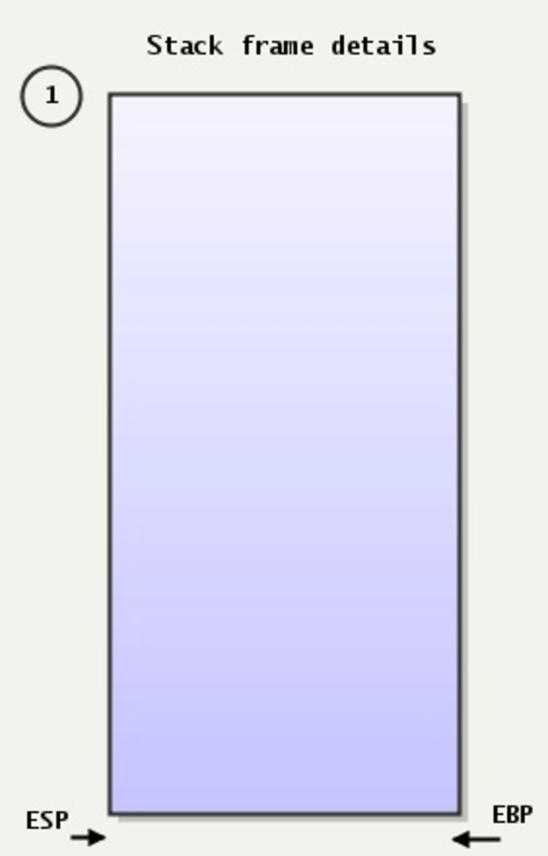
The Stack
Stack:
A special region of your computer's memory that stores temporary variables created by each functions
The stack is a "LIFO" (last in, first out) data structure
Once a stack variable is freed, that region of memory becomes available for other stack variables.
Top
12E00
Properties:
the stack grows and shrinks as functions push and pop local variables
there is no need to manage the memory yourself, variables are allocated and freed automatically
the stack has size limits
stack variables only exist while the function that created them, is running
PUSH
POP
EBP—Pointer to data on the stack ESP—Stack pointer
13000
Bottom

Slide 12
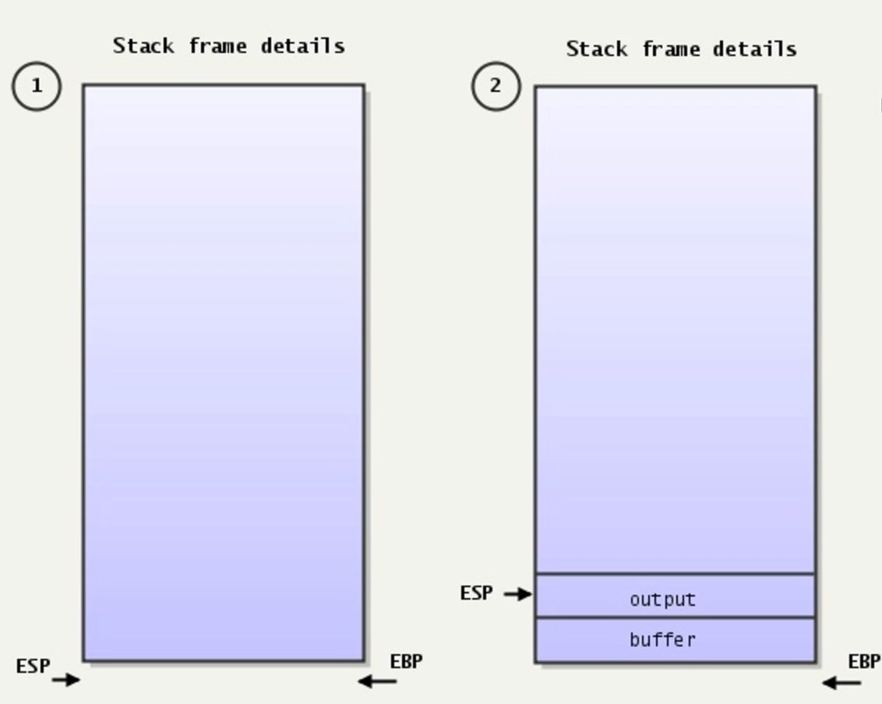
The Stack
Stack:
A special region of your computer's memory that stores temporary variables created by each functions
The stack is a "LIFO" (last in, first out) data structure
Once a stack variable is freed, that region of memory becomes available for other stack variables.

Slide 13
Stack Frame

Slide 14
Stack Frame
A stack frame is a frame of data that gets pushed onto the stack.
In the case of a call stack, a stack frame would represent a function call and its argument data.

Slide 15
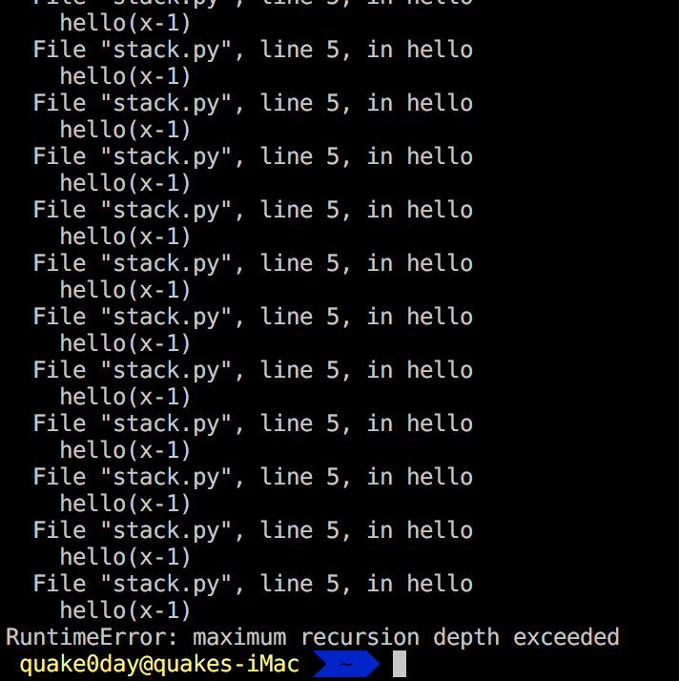
Stack Frame

Slide 16
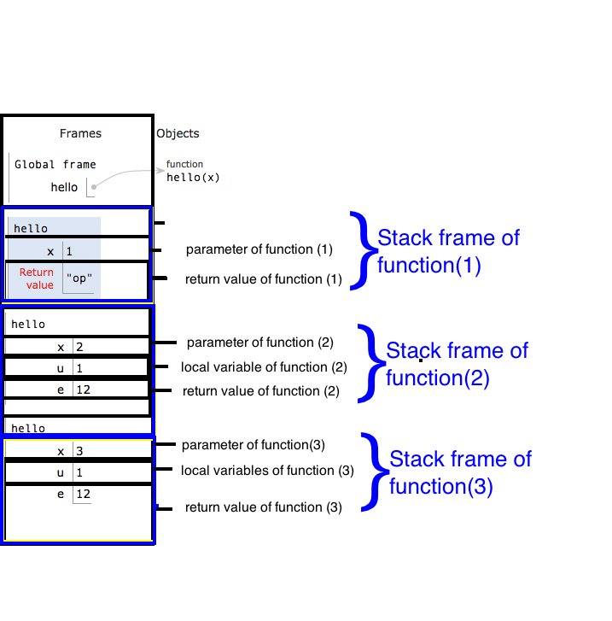
Stack Frame

Slide 17
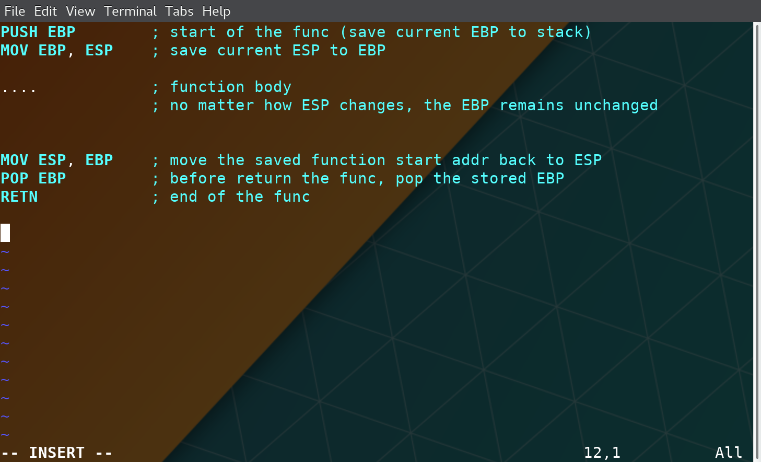
Stack Frame

Slide 18
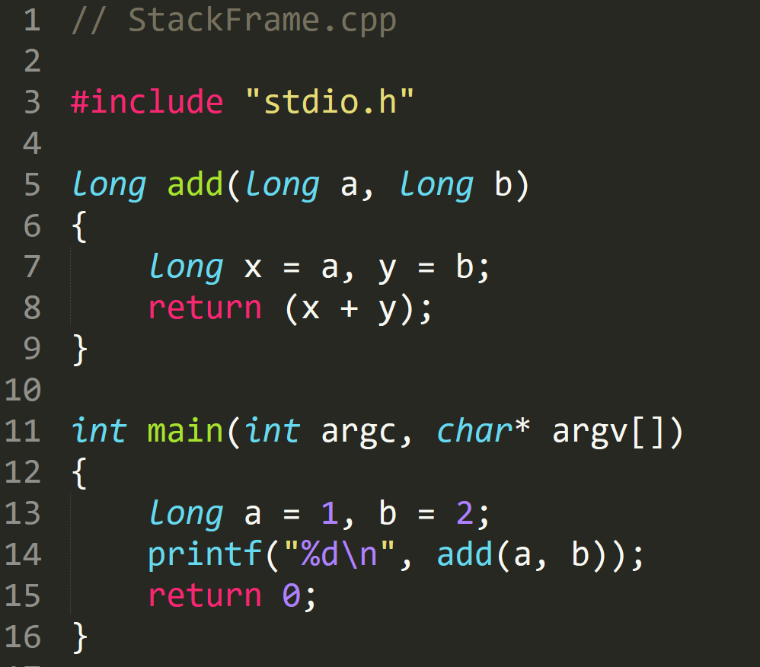
StackFrame.exe

Slide 19
StackFrame.exe

Slide 20
StackFrame.exe

Slide 21
StackFrame.exe
Notes:
EBP 12FFC0
ESP 12FF7C

Slide 22
StackFrame.exe
Notes:
EBP
ESP 12FF78

Slide 23
StackFrame.exe

Slide 24
StackFrame.exe
Create space for ‘a’ and ‘b’ → long → 4 byte
Notes:
EBP
ESP 12FF78

Slide 25
StackFrame.exe
Create space for ‘a’ and ‘b’ → long → 4 byte
Notes:
EBP
ESP 12FF78

Slide 26
StackFrame.exe
Assembly | C | Type Conversion
DWORD PTR SS:[EBP-4] | *(DWORD*)(EBP-4) | DWORD (4 byte)
WORD PTR SS:[EBP-4] | *(WORD*)(EBP-4) | WORD (2 byte)
BYTE PTR SS:[EBP-4] | *(BYTE*)(EBP-4) | 1 byte
4 Byte memory space at address [EBP-4]

Slide 27
StackFrame.exe

Slide 28
StackFrame.exe

Slide 29
StackFrame.exe

Slide 30
StackFrame.exe

Slide 31
StackFrame.exe

Slide 32
StackFrame.exe
Clean Stack

Slide 33
StackFrame.exe
Clean Stack

Slide 34
StackFrame.exe

Slide 35
StackFrame.exe
Set EAX –> 0
Faster than
MOV EAX,0

Slide 36
Calling Convention

Slide 37
Two Questions
Q: When a function finished, how to handle the parameter left in the stack.
Q: When a function finished, how change the ESP value?
A: We don’t care…
A: ESP should be restored to the previous value

Slide 38
Standard C Calling Conventions
Calling conventions are a standardized method for functions to be implemented and called by the machine.
A calling convention specifies the method that a compiler sets up to access a subroutine.
There are three major calling conventions that are used with the C language on 32-bit x86 processors:
CDECL
STDCALL,
FASTCALL.

Slide 39
CDECL
The C language, by default, uses the CDECL calling convention
In the CDECL calling convention the following holds:
Arguments are passed on the stack in Right-to-Left order, and return values are passed in eax.
The calling function cleans the stack. This allows CDECL functions to have variable-length argument lists.

Slide 40
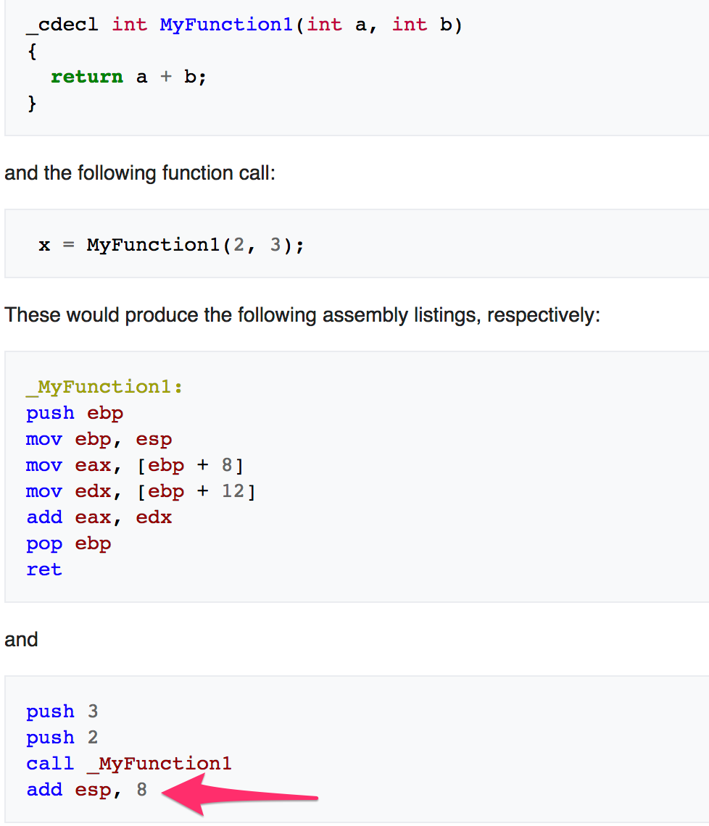
STDCALL
The C language, by default, uses the CDECL calling convention
In the CDECL calling convention the following holds:
Arguments are passed on the stack in Right-to-Left order, and return values are passed in eax.
The calling function cleans the stack. This allows CDECL functions to have variable-length argument lists.

Slide 41
STDCALL
STDCALL, also known as "WINAPI" (and a few other names, depending on where you are reading it) is used almost exclusively by Microsoft as the standard calling convention for the Win32 API.
STDCALL passes arguments right-to-left, and returns the value in eax.
The called function cleans the stack, unlike CDECL. This means that STDCALL doesn't allow variable-length argument lists.

Slide 42
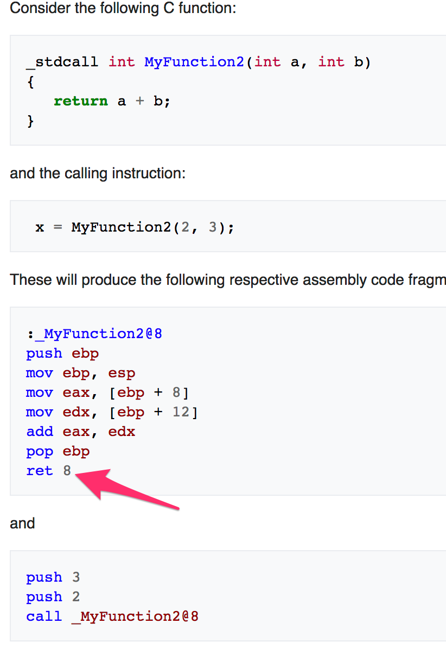
STDCALL
STDCALL, also known as "WINAPI" (and a few other names, depending on where you are reading it) is used almost exclusively by Microsoft as the standard calling convention for the Win32 API.
STDCALL passes arguments right-to-left, and returns the value in eax.
The called function cleans the stack, unlike CDECL. This means that STDCALL doesn't allow variable-length argument lists.
RET 8 ➔ RET + POP 8 Byte

Slide 43
FASTCALL
The FASTCALL calling convention is not completely standard across all compilers, so it should be used with caution.
The calling function most frequently is responsible for cleaning the stack, if needed.

Slide 44
Q & A

