Slide 1
Class2
CSC 495/583 Topics of Software Security IA-32 Register & Byte Ordering
& x86 ASM
Dr. Si Chen (schen@wcupa.edu)

Slide 2
IA-32 Register

Slide 3
Intel IA-32 Processor
Intel uses IA-32 to refer to Pentium processor family, in order to distinguish them from their 64-bit architectures.

Slide 4
Modes
The IA-32 processor has three operating modes:
Real-address mode. This mode lets the processor to address "real" memory address.
It can address up to 1Mbytes of memory (20-bit of address).
It can also be called "unprotected" mode since operating system (such as DOS) code runs in the same mode as the user applications.
Protected mode. This is the preferred mode for a modern operating system.
It can address up to 4GBbytes of memory (32-bit of address).
System management mode. This mode is designed for fast state snapshot and resumption. It is useful for power management

Slide 5
OS Boot Process

Slide 6
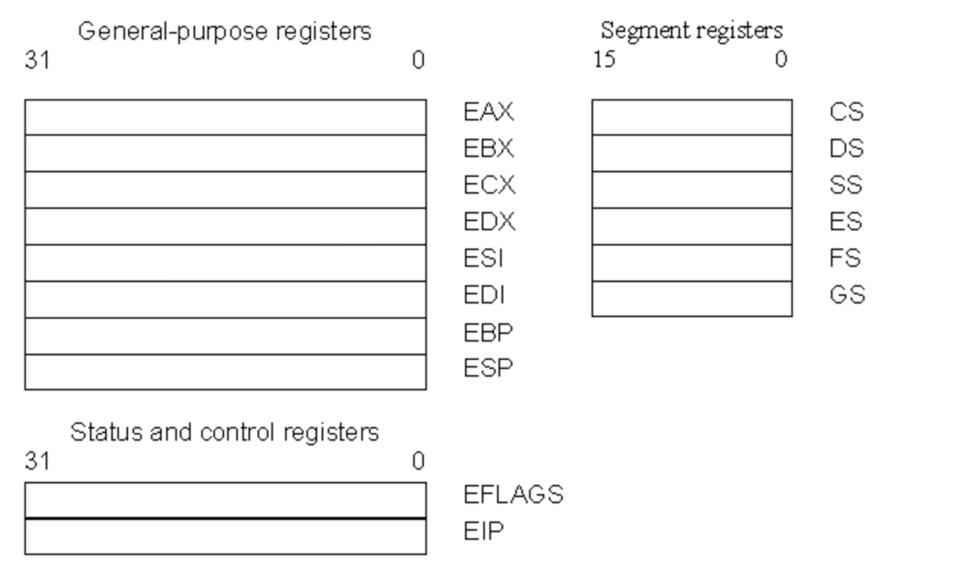
Register Set
There are three types of registers:
general-purpose data registers,
segment registers,
status and control registers.

Slide 7
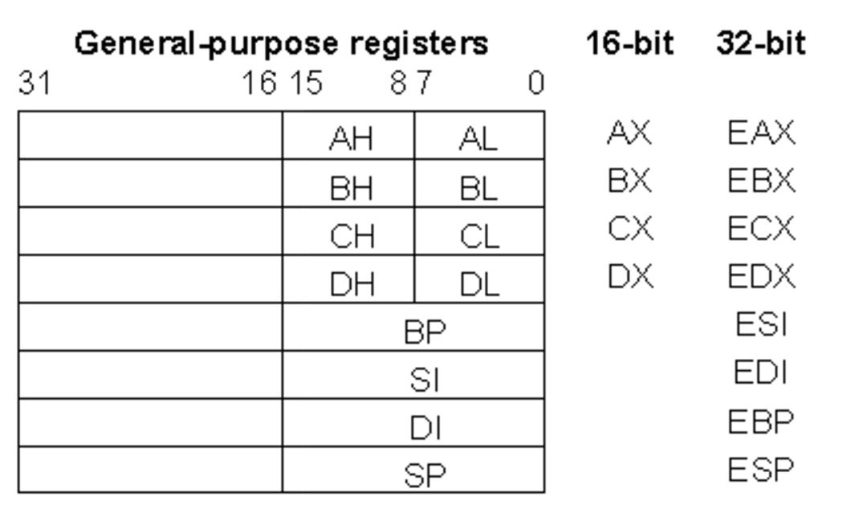
General-purpose Registers
The eight 32-bit general-purpose data registers are used to hold operands for logical and arithmetic operations, operands for address calculations and memory pointers
4 Bytes
Notes:
The following figure shows the lower 16 bits of the general-purpose registers can be used with the names AX, BX, CX, DX, BP, SP, SI, and DI (the names for the corresponding 32-bit ones have a prefix "E" for "extended"). Each of the lower two bytes of the EAX, EBX, ECX, and EDX registers can be referenced by the names AH, BH, CH, and DH (high bytes) and AL, BL, CL, and DL (low bytes).

Slide 8
Other uses…
EAX—Accumulator for operands and results data.
EBX—Pointer to data in the DS segment.
ECX—Counter for string and loop operations.
EDX—I/O pointer.
We use these four registers when we perform arithmetic operations (ADD, SUB, XOR, OR) -- store constant or variable’s value.
Some assembly operations (MUL, DIV, LODS) directly operate these register and altered the value when finished.
ECX is used for loop count → decrease 1 after each loop
EAX is used for storing the return value of a function (Win32 API)

Slide 9
Other uses…
ESI—Pointer to data in the segment pointed to by the DS register; source pointer for string operations.
EDI—Pointer to data (or destination) in the segment pointed to by the ES register; destination pointer for string operations.
EBP—Pointer to data on the stack.
ESP—Stack pointer.
PUSH, POP, CALL, RET

Slide 10
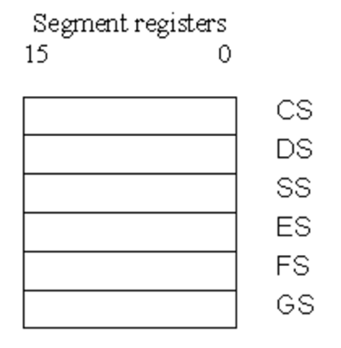
Segment Registers
What is “Segment”??
Physical Address = Segment * 16 + Offset

Slide 11
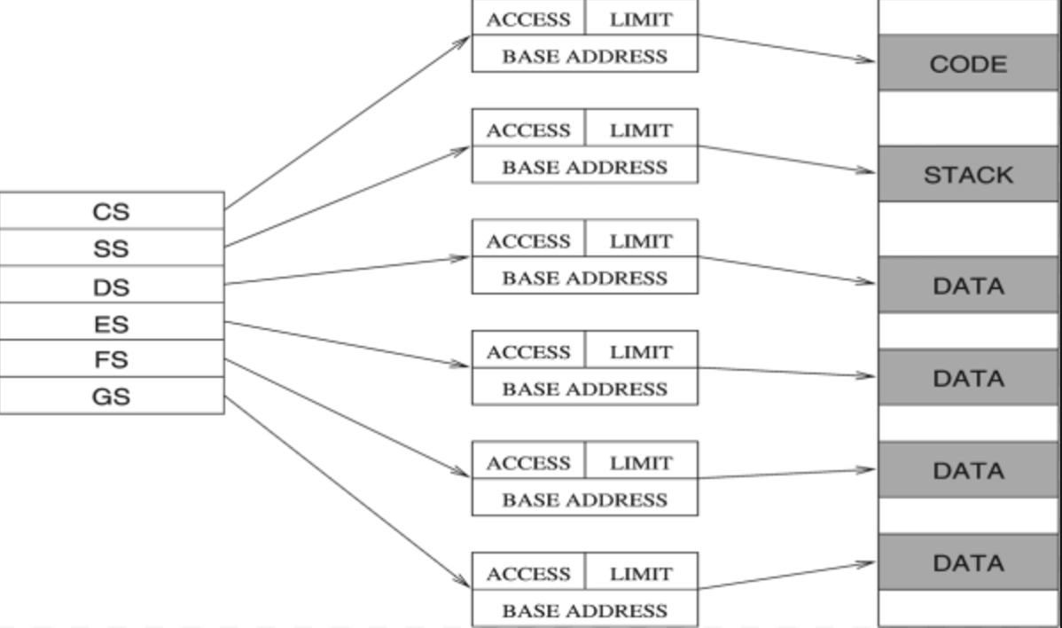
Segment Registers
There are six segment registers that hold 16-bit segment selectors. A segment selector is a special pointer that identifies a segment in memory.
CS: code segment register
SS: stack segment register
DS, ES, FS, GS: data segment registers

Slide 12
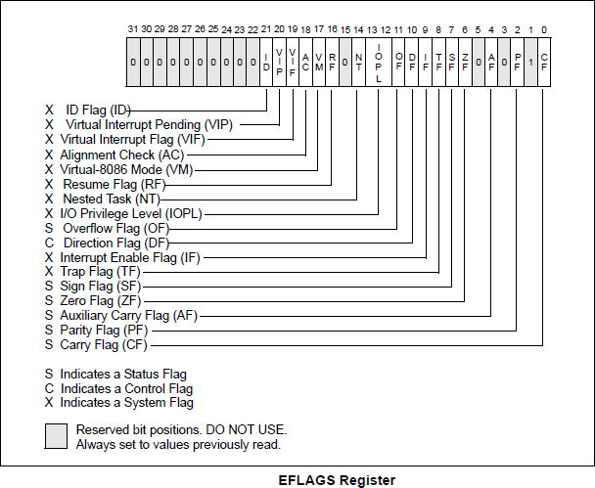
Status and Control Registers
The 32-bit EFLAGS register contains a group of status flags, a control flag, and a group of system flags.
JCC

Slide 13
Status and Control Registers
Change to ‘1’ if:
Signed integer overflow
Change in MSB (Most Significant Bit)
Change to ‘1’ if:
Calculation result is 0
Change to ‘1’ if:
unsigned integer overflow

Slide 14
Status and Control Registers
EIP Register (Instruction Pointer)
The EIP register (or instruction pointer) can also be called "program counter."
It contains the offset in the current code segment for the next instruction to be executed.
It is advanced from one instruction boundary to the next in straight-line code or it is moved ahead or backwards by a number of instructions when executing JMP, Jcc, CALL, RET, and IRET instructions.

Slide 15
Byte Order

Slide 16
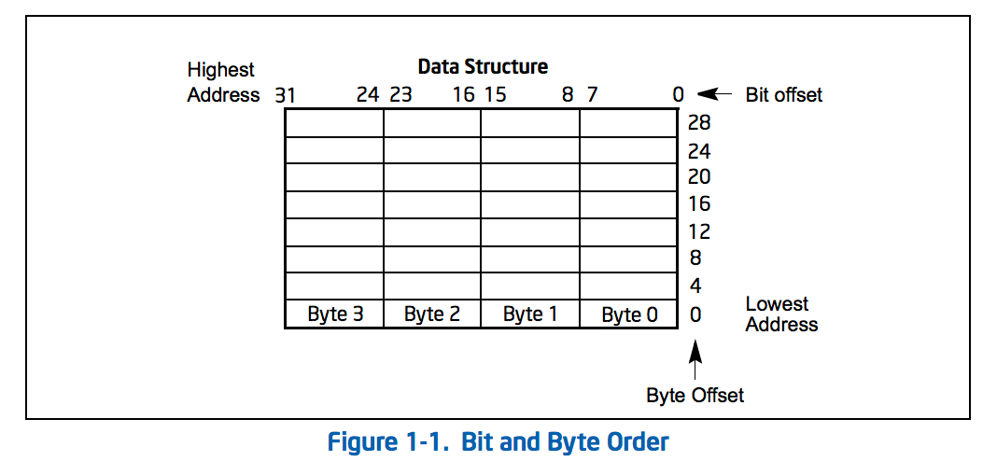
Little endian
IA-32 processors use "little endian" as their byte order. This means that the bytes of a word are numbered starting from the least significant byte and that the least significant bit starts of a word starts in the least significant byte.

Slide 17
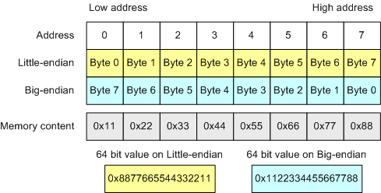
Byte Order

Slide 18
LittleEndian.exe

Slide 19
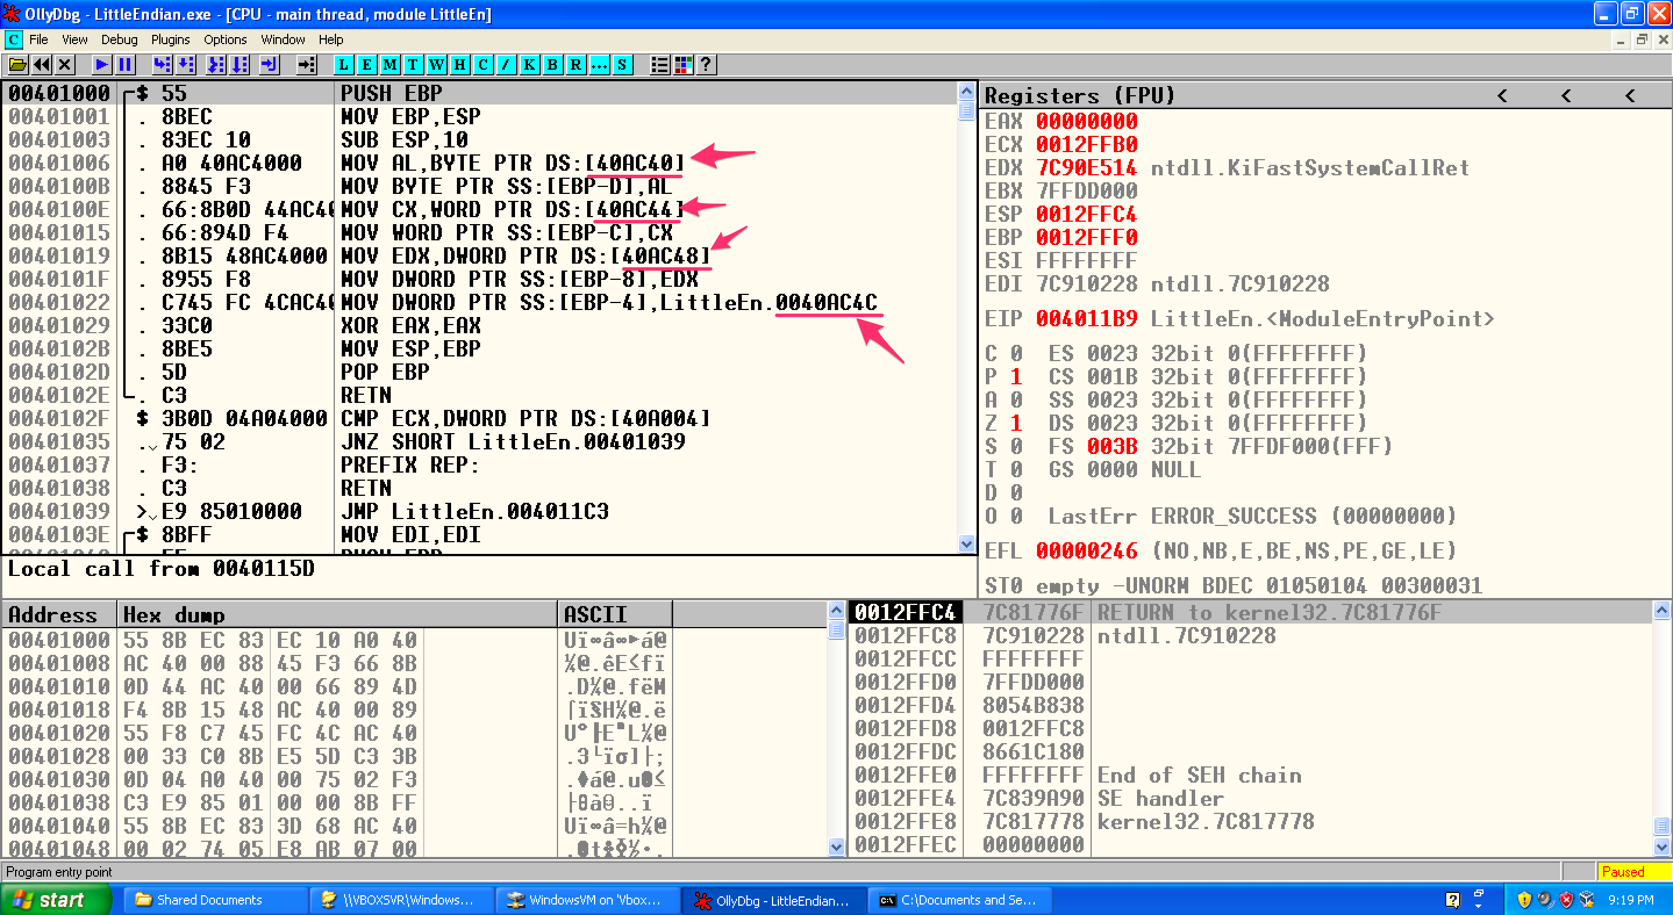
LittleEndian.exe

Slide 20
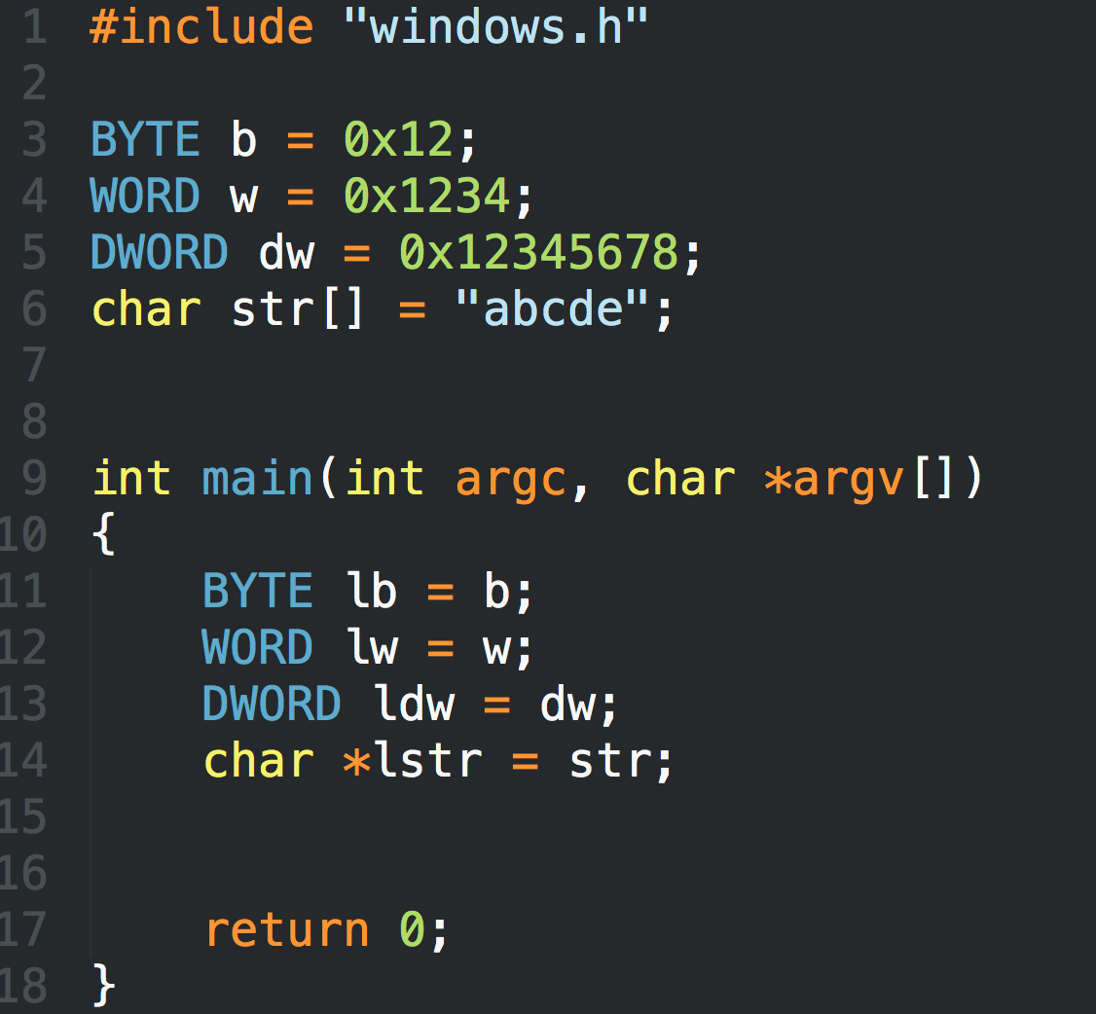
LittleEndian.exe

Slide 21
X86 ASM

Slide 22
MOV
Move reg/mem value to reg/mem
mov A, B is "Move B to A" (A=B)
Same data size
mov eax, 0x1337
mov bx, ax
mov [esp+4], bl

Slide 23
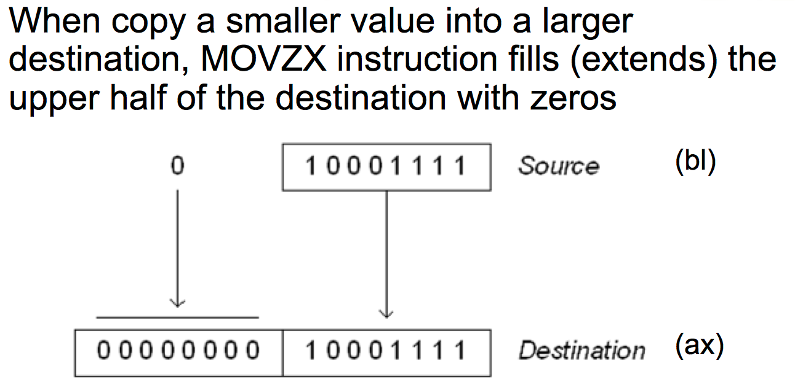
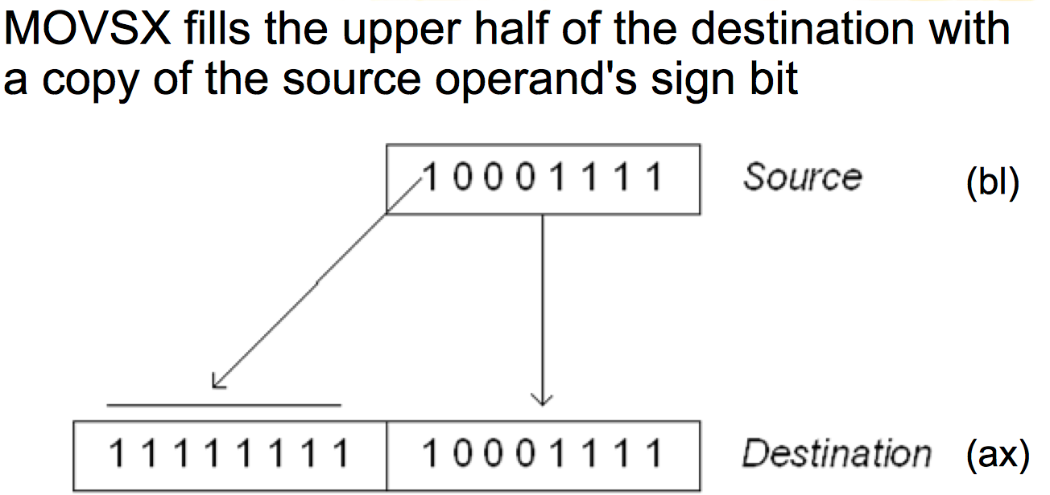
MOVZX / MOVSX
From small register to large register
Zero-extend (MOVZX) / sign-extend (MOVSX)
Example: movzx ebx, al

Slide 24
More About Memory Access
mov ebx, [esp + eax * 4] Intel
mov (%esp, %eax, 4), %ebx AT&T
mov BYTE [eax], 0x0f You must indicate the data size: BYTE/WORD/DWORD

Slide 25
ADD / SUB
ADD / SUB
Normallly "reg += reg" or "reg += imm"
Data size should be equal
add eax, ebx
sub eax, 123
sub eax, BL ; Illegal

Slide 26
INC / DEC
inc, dec — Increment, Decrement
The inc instruction increments the contents of its operand by one. The dec instruction decrements the contents of its operand by one.
Syntax inc <reg> inc <mem> dec <reg> dec <mem>
Examples dec eax — subtract one from the contents of EAX. inc DWORD PTR [var] — add one to the 32-bit integer stored at location var

Slide 27
SHL / SHR / SAR
Shift logical left / right
Shift arithmetic right
Common usage: SHL eax, 2 (when calculate memory address)

Slide 28
Jump
Unconditional jump: jmp
Conditional jump: je/jne and ja/jae/jb/jbe/jg/jge/jl/jle ...
Sometime with ”cmp A, B” -- compare these two values and set eflags
Conditional jump is decided by some of the eflags bits.

Slide 29
Jump
ja/jae/jb/jbe are unsigned comparison
jg/jge/jl/jle are signed comparison

Slide 30
CMP
cmp — Compare
Compare the values of the two specified operands, setting the condition codes in the machine status word appropriately. This instruction is equivalent to the sub instruction, except the result of the subtraction is discarded instead of replacing the first operand. Syntax cmp <reg>,<reg> cmp <reg>,<mem> cmp <mem>,<reg> cmp <reg>,<con>
Example cmp DWORD PTR [var], 10 jeq loop
If the 4 bytes stored at location var are equal to the 4-byte integer constant 10, jump to the location labeled loop.

Slide 31
Q & A

