Slide 1

Class10
CSC 497/583 Advanced Topics in Computer Security
Modern Malware Analysis
API Hook, Stealth process (Rootkit)
Si Chen (schen@wcupa.edu)

Slide 2
Review – Hook
A hook is a point in the system message-handling mechanism where an application can install a subroutine to monitor the message traffic in the system and process certain types of messages before they reach the target window procedure.

Slide 3
River System ???

Slide 4
Review – Message Hook

Slide 5
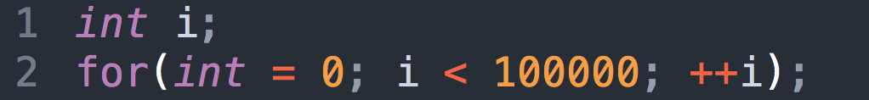
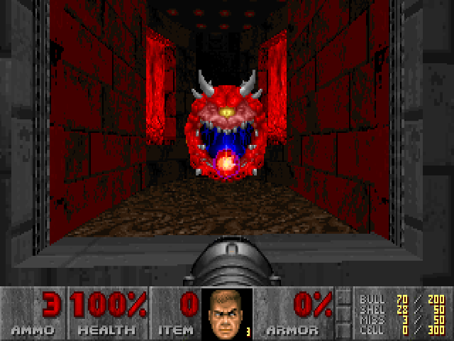
Introduction to WinAPI
System resources (file, network, IO, device) may be accessed by multiple applications at the same time, can cause confliction.
Modern OS protect these resources.
E.g. How to let a program to wait for a while?
100Mhz CPU -> 1s
1000Mhz CPU -> 0.1s
Use WinAPI → Timer

Slide 6
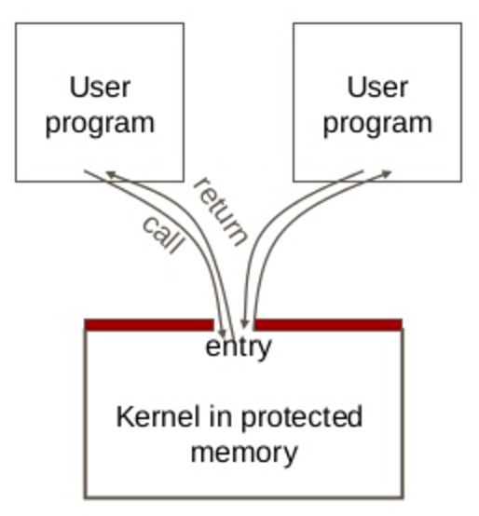
System Call & WinAPI
User code can be arbitrary
User code cannot modify kernel memory
The call mechanism switches code to kernel mode
System Call →
WinAPI (Windows)

Slide 7
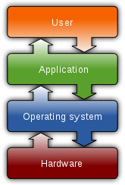
What is System Call?
Let an application to access system resources.
OS provide an interface (System call) for the application
It usually use the technique called “interrupt vector”
  Linux use 0x80 → Int 0x80
  Windows use 0x2E
In system programming, an interrupt is a signal to the processor emitted by hardware or software indicating an event that needs immediate attention.

Slide 8
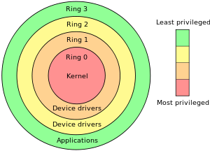
The “Ring”
System Call →
WinAPI (Windows)

Slide 9
CPU Interrupt
User Mode Execution
Interruption occurred
Next instruction
User Mode
Kernel Mode
Interrupt Vector Table
Interrupt Handler

Slide 10
Windows System Call and API
The Win32 API is a layer that runs in user mode (ring 3).
Only API calls that use kernel resources (CreateThread, VirtualAlloc, etc) will call into the "real" operating system (ntdll.dll) and trap into ring 0 with a software interrupt (int 0x2e).

Slide 11
User Mode and Kernel

Slide 12
Write a file in Notepad
Application
fwrite()
notepad.exe
Run Time
Library
write()
Libcmt.lib
msvcr90.dll
API (Windows)
NtWriteFile()
Kernel32.dll
NTDLL.dll
Interrupt 0x2e
Kernel
IoWriteFile()
Kernel
NtosKrnl.exe

Slide 13
API Hook
Application
fwrite()
notepad.exe
Run Time
Library
write()
Libcmt.lib
msvcr90.dll
API (Windows)
NtWriteFile()
Kernel32.dll
NTDLL.dll
Interrupt 0x2e
Kernel
IoWriteFile()
Kernel
NtosKrnl.exe

Slide 14
API Call (Normally)

Slide 15
API Hook
Detour Function

Slide 16
API Hook Tech Map
Method | Target | Location | Tech |  | API
Dynamic | Process/Memory 00000000 - 7FFFFFFF | IAT Code EAT | Interactive Debug |  | DebugActiveProcess GetThreadContext SetThreadContext
 |  |  | Standalone Injection | Independent Code | CreateRemoteThread
 |  |  |  | Dll File | Resistry (AppInit_DLLs) BHO (IE only)
 |  |  |  |  | SetWindowsHookEx CreateRemoteThread

Slide 17
API Hook Tech Map
Method | Target | Location | Tech |  | API
Dynamic | Process/Memory 00000000 - 7FFFFFFF | IAT Code EAT | Interactive Debug |  | DebugActiveProcess GetThreadContext SetThreadContext
 |  |  | Standalone Injection | Independent Code | CreateRemoteThread
 |  |  |  | Dll File | Resistry (AppInit_DLLs) BHO (IE only)
 |  |  |  |  | SetWindowsHookEx CreateRemoteThread

Slide 18
API Hook Tech Map
Method | Target | Location | Tech |  | API
Dynamic | Process/Memory 00000000 - 7FFFFFFF | IAT Code EAT | Interactive Debug |  | DebugActiveProcess GetThreadContext SetThreadContext
 |  |  | Standalone Injection | Independent Code | CreateRemoteThread
 |  |  |  | Dll File | Resistry (AppInit_DLLs) BHO (IE only)
 |  |  |  |  | SetWindowsHookEx CreateRemoteThread
IAT Hook Example

Slide 19
Stealth process (Rootkit)

Slide 20
Processes in Windows

Slide 21
Stealth Process
Northrop Grumman B-2 Spirit

Slide 22
Stealth Process
Stealth Process

Slide 23
API Hook Tech Map
Method | Target | Location | Tech |  | API
Dynamic | Process/Memory 00000000 - 7FFFFFFF | IAT Code EAT | Interactive Debug |  | DebugActiveProcess GetThreadContext SetThreadContext
 |  |  | Standalone Injection | Independent Code | CreateRemoteThread
 |  |  |  | Dll File | Resistry (AppInit_DLLs) BHO (IE only)
 |  |  |  |  | SetWindowsHookEx CreateRemoteThread

Slide 24
Processes in Windows
Detect Processes in User Mode (WinAPI):
  CreateToolhelp32Snapshot()
  EnumProcess()
HANDLE CreateToolhelp32Snapshot(
DWORD dwFlags,
DWORD th32ProcessID
);
Takes a snapshot of the specified processes, as well as the heaps, modules, and threads used by these processes.
BOOL EnumProcesses(
DWORD *lpidProcess,
DWORD cb,
LPDWORD lpcbNeeded
);
Retrieves the process identifier for each process object in the system.

Slide 25
Processes API
  CreateToolhelp32Snapshot()
  EnumProcess()
  ntdll.ZwQuerySystemInformation()
  ntdll.ZwQuerySystemInformation()
NTSTATUS WINAPI ZwQuerySystemInformation(
_In_ SYSTEM_INFORMATION_CLASS SystemInformationClass,
_Inout_ PVOID SystemInformation,
_In_ ULONG SystemInformationLength,
_Out_opt_ PULONG ReturnLength
);
Retrieves the specified system information.

Slide 26
Create Stealth Process
  CreateToolhelp32Snapshot()
  EnumProcess()
  ntdll.ZwQuerySystemInformation()
  ntdll.ZwQuerySystemInformation()
Process1
Process2
Process3
Process4
Process1
Process3
Process4

Slide 27
Processes in Windows
taskmgr.exe
ProcExp.exe
  ntdll.ZwQuerySystemInformation()
  ntdll.ZwQuerySystemInformation()
Notes:
Isseus:
How many process to hook?
New Process? Should we hook?

Slide 28
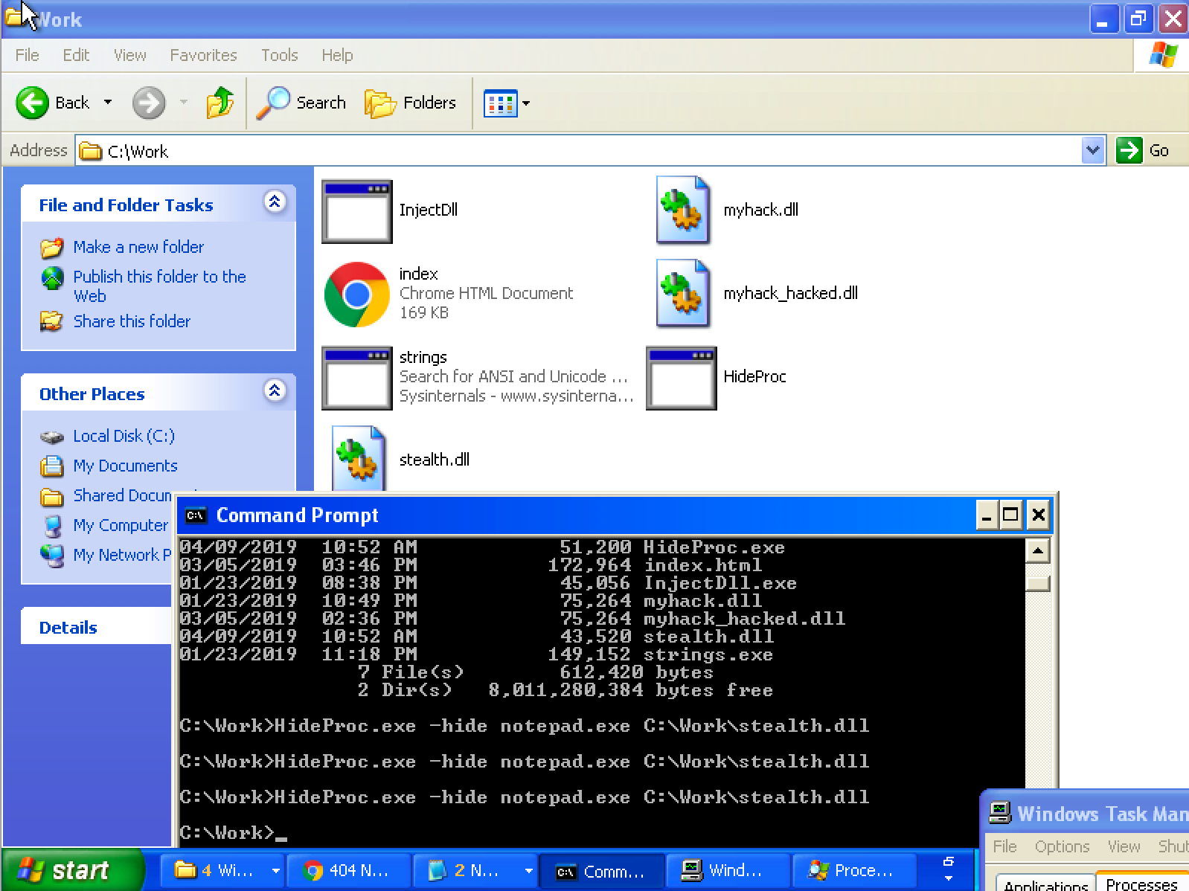
Example 1: Stealth Process
Download and try StealthProcess1.zip
HideProc.exe –hide notepad.exe C:\Work\stealth.dll

Slide 29
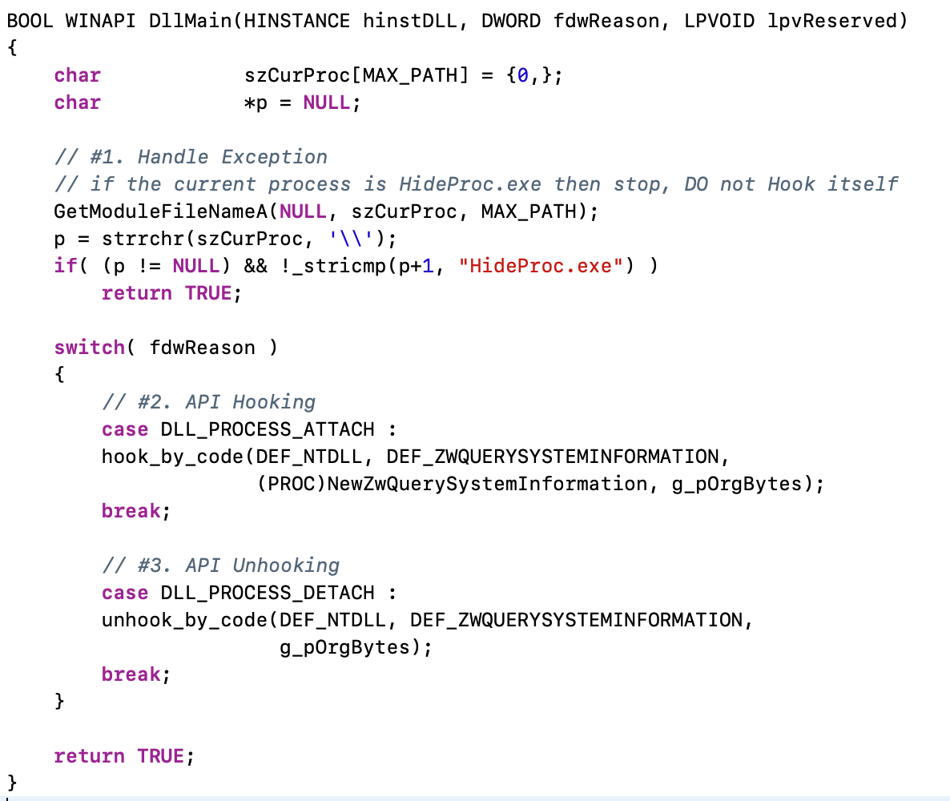
stealth.cpp → DllMain()

Slide 30
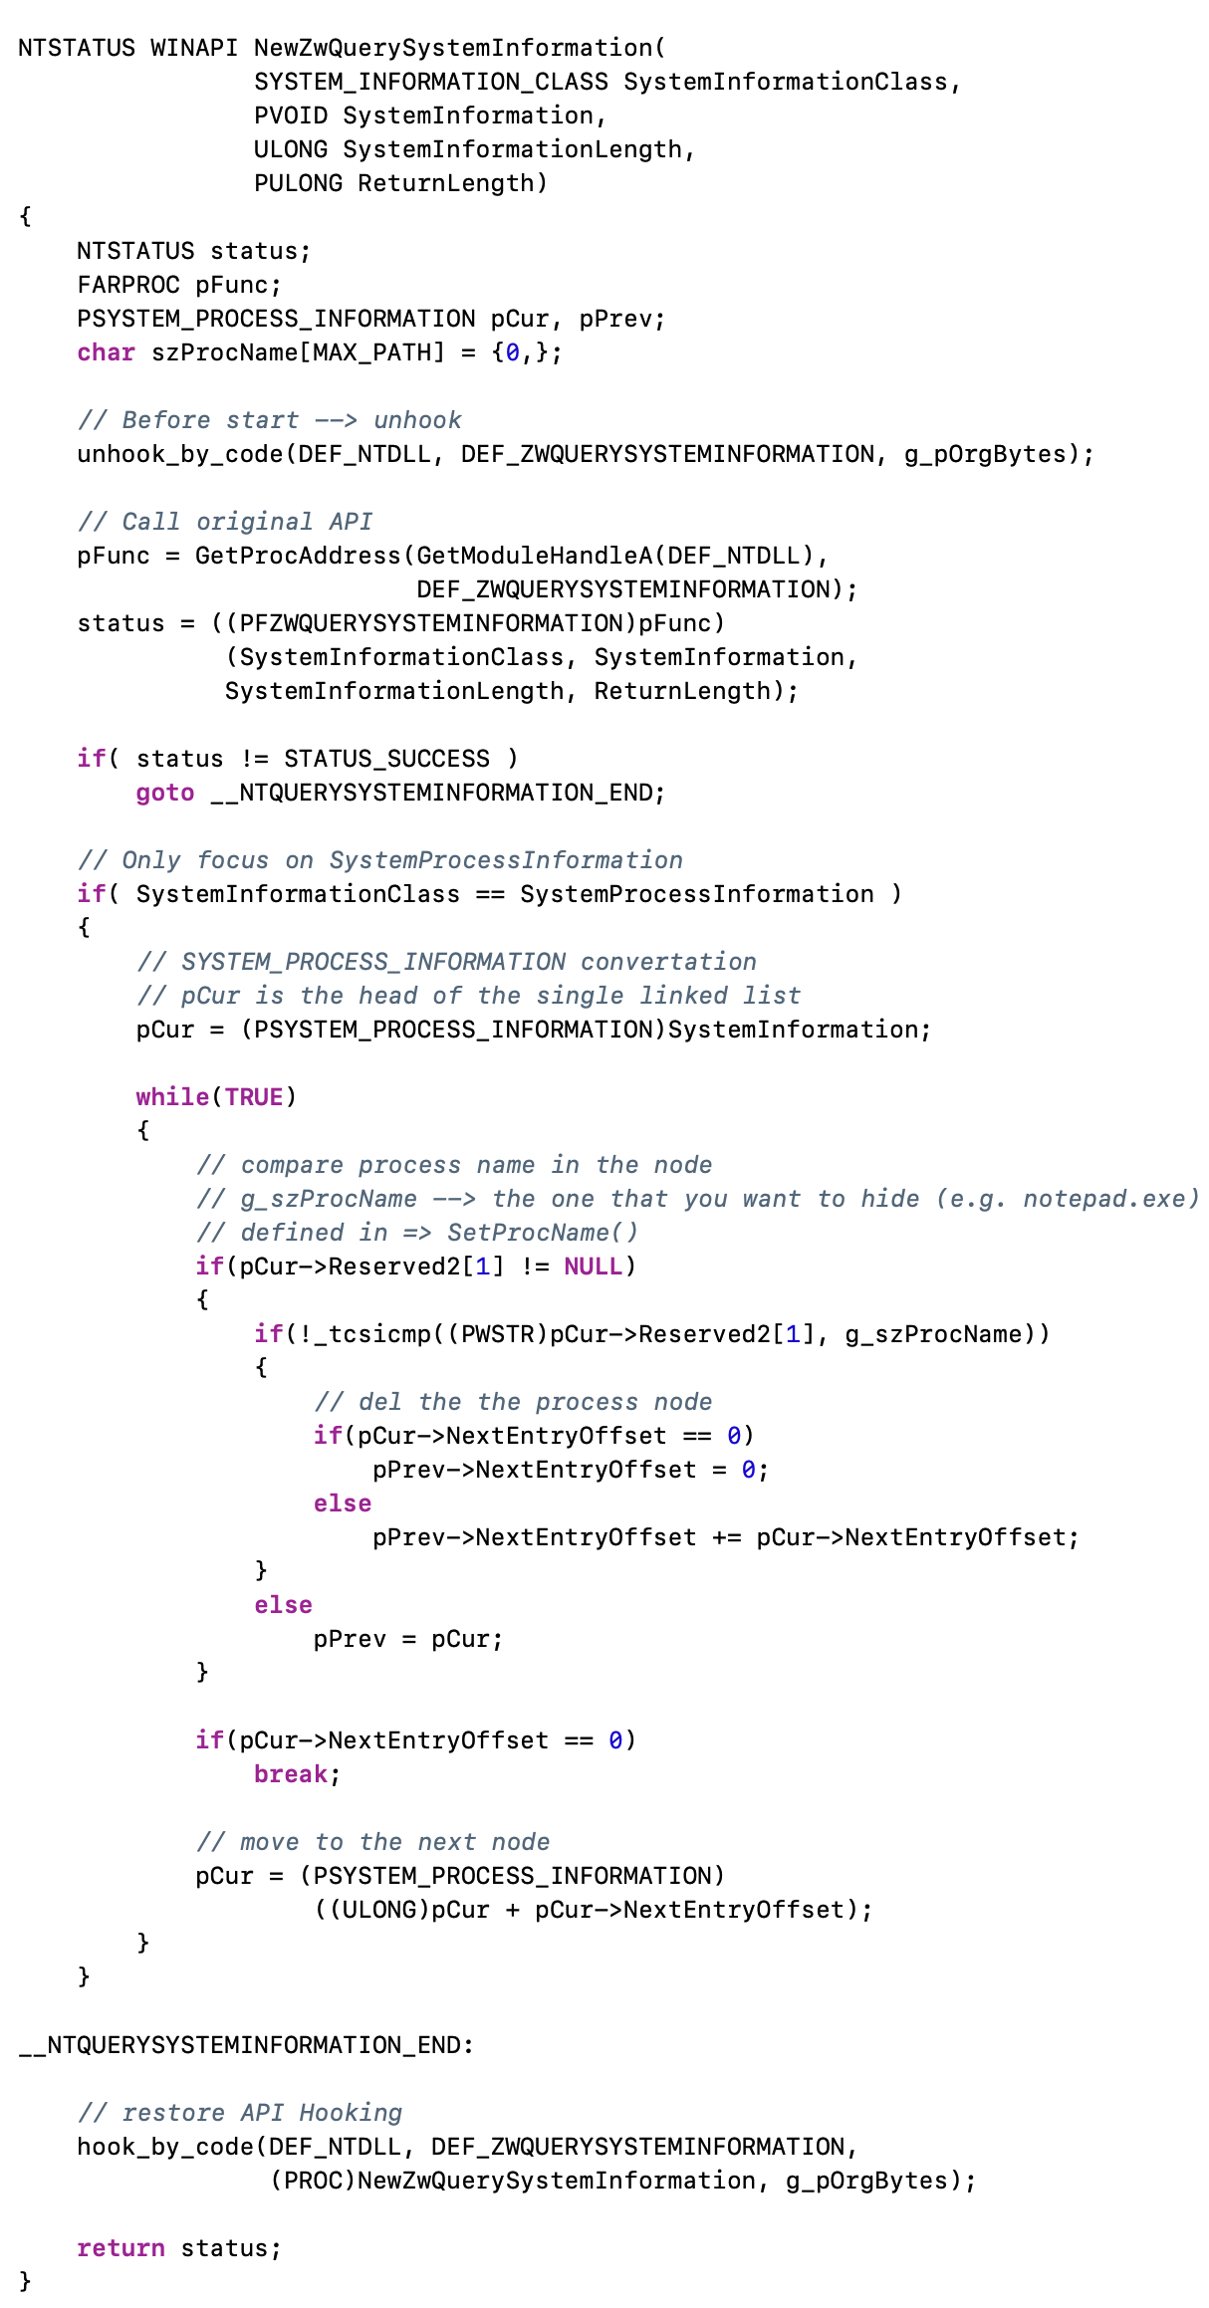
stealth.cpp → DllMain()

Slide 31
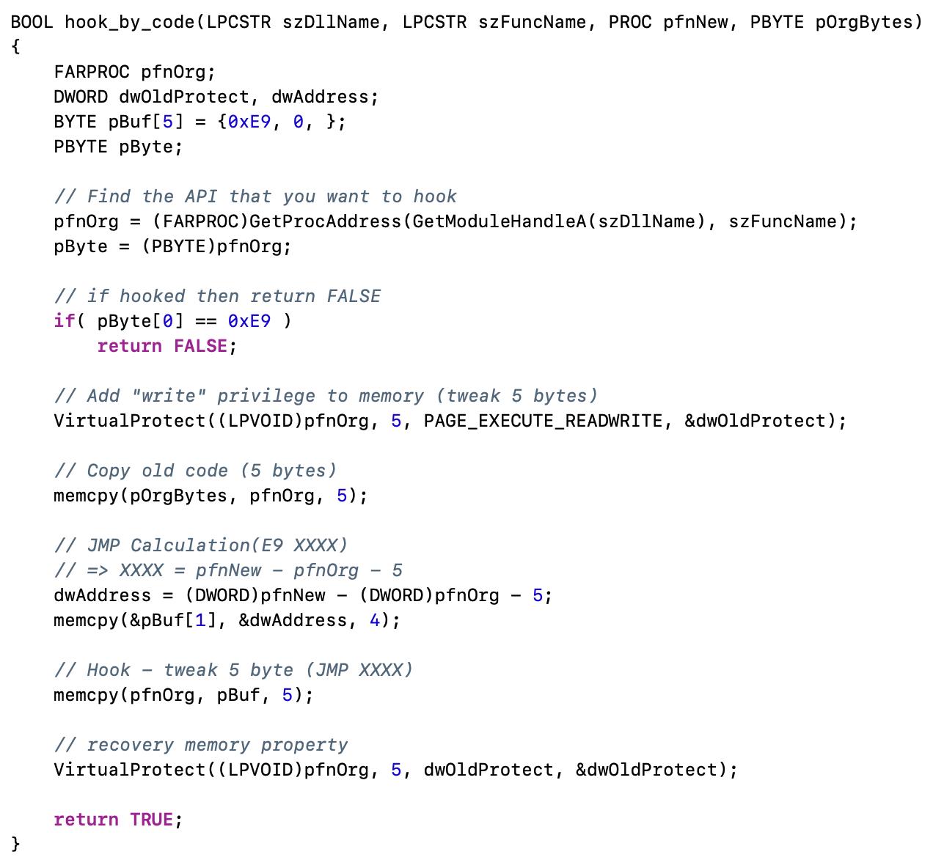
stealth.cpp → DllMain()

Slide 33
Create Stealth Process
  ntdll.ZwQuerySystemInformation()
  ntdll.ZwQuerySystemInformation()
Issues: How many process(es) should we hook?

Slide 34
Create Stealth Process
  ntdll.ZwQuerySystemInformation()
Issues: Newly created process(es)

Slide 35
Create Stealth Process
Solution: Hook all of them! → Global Hook

Slide 36
Example 2: Global Hook
Download and try StealthProcess2.zip
copy stealth2.dll to %SystemRoot%\system32 folder
HideProc2.exe –hide stealth2.dll

Slide 37
Kernel Mode Rootkit

Slide 39
Review: Stealth Process
Stealth Process

Slide 40
Processes API
  CreateToolhelp32Snapshot()
  EnumProcess()
  ntdll.ZwQuerySystemInformation()
  ntdll.ZwQuerySystemInformation()
NTSTATUS WINAPI ZwQuerySystemInformation(
_In_ SYSTEM_INFORMATION_CLASS SystemInformationClass,
_Inout_ PVOID SystemInformation,
_In_ ULONG SystemInformationLength,
_Out_opt_ PULONG ReturnLength
);
Retrieves the specified system information.

Slide 41
Create Stealth Process
  CreateToolhelp32Snapshot()
  EnumProcess()
  ntdll.ZwQuerySystemInformation()
  ntdll.ZwQuerySystemInformation()
Process1
Process2
Process3
Process4
Process1
Process3
Process4

Slide 42
The “Ring”
System Call →
WinAPI (Windows)

Slide 43
CPU Interrupt
User Mode Execution
Interruption occurred
Next instruction
User Mode
Kernel Mode
Interrupt Vector Table
Interrupt Handler

Slide 44
Windows System Call and API
The Win32 API is a layer that runs in user mode (ring 3).
Only API calls that use kernel resources (CreateThread, VirtualAlloc, etc) will call into the "real" operating system (ntdll.dll) and trap into ring 0 with a software interrupt (int 0x2e).

Slide 45
Write a file in Notepad
Application
fwrite()
notepad.exe
Run Time
Library
write()
Libcmt.lib
msvcr90.dll
API (Windows)
NtWriteFile()
Kernel32.dll
NTDLL.dll
Interrupt 0x2e
Kernel
IoWriteFile()
Kernel
NtosKrnl.exe

Slide 46
Rootkit (Kernel Mode)
Application
fwrite()
notepad.exe
Run Time
Library
write()
Libcmt.lib
msvcr90.dll
API (Windows)
NtWriteFile()
Kernel32.dll
NTDLL.dll
Interrupt 0x2e
Kernel
IoWriteFile()
Kernel
NtosKrnl.exe

Slide 47
Rootkit (Kernel Mode)
Kernel Mode Rootkits are installed as either drivers (SYS) or Kernel Modules (DLL)
Most rootkits target 32-bit Windows OS’s
64-bit Windows architectures require drivers to be signed by Microsoft before they can be installed
To subvert this, attackers will:
  Install a valid, signed driver with a known exploit
  Use stolen signing certificates
  Exploit the kernel itself

Slide 48
Rootkit (Kernel Mode)

Slide 50
1. Userland Hooking

Slide 51
Hooking
The most classic of all kernel rootkit techniques
Simple to implement, simple to detect
Still widely used
  Often in conjunction with other techniques

Slide 52
2. IDT Hooking

Slide 53
Interrupt Descriptor Table Hooking (IDT Hooking)
Base address of the IDT is stored in the IDTR
In order to hook a specific Interrupt, a rootkit just changes the pointer in the IDT to their own malicious function
SIDT and LIDT instructions
  Used to read/write to/from the IDTR register
  Each processor has it’s own IDTR and IDT
    This means that a rootkit will have to hook each IDT

Slide 54
IDT Hooking Problems
This technique is old
  As of 2009, INT 0x2E was made obsolete
SYSENTER is now used to perform syscalls
  Interrupt hooking is easy to detect
No way to filter results of an interrupt
  The rootkit’s hook function is just pass-through code that is executed before the interrupt handler

Slide 55
3. MSR Hooking

Slide 56
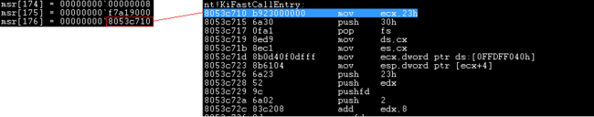
Machine Specific Register Hooking (MSR Hooking)
This is how we hook SYSENTER
  SYSENTER switches to kernel-mode using three MSR’s
    IA32_SYSENTER_CS → 0x174, 16-bit selector of ring 0 code segment
    IA32_SYSENTER_EIP → 0x176, 32-bit offset into ring 0 code segment
    IA32_SYSENTER_ESP → 0x175, 32-bit stack pointer for ring 0 stack
Just like the IDTR, there are instructions for accessing the MSR’s
  RDMSR and WRMSR - read/write MSR
  MSR’s are processor specific just like IDT’s
174h is the CS Register.
175h is the ESP Register.
176h is the EIP Register.

Slide 57
MSR Hooking Problems
More modern than IDT hooking
Still easy to detect, and only provides passthrough functions

Slide 58
4. SSDT Hooking

Slide 59
System Descriptor Table Hooking (SDT, SSDT)
SSDT resides in read-only memory
  Rootkits have to disable and then re-enable the Write Protection (WP) bit in the CR0 register
    Rootkit authors could also map a Memory Descriptor List (MDL) over the SSDT
Disable Write Protection (WP)
Enable Write Protection (WP)

Slide 60
Registers available in the x86-64 instruction set

Slide 61
System Descriptor Table Hooking (SDT, SSDT)
With WP off, the attacker swaps a new address into the target address
  Declare the original syscall prototype (e.g., ZwSetValueKey())
  Declare a corresponding function ptr (e.g., ZwSetValueKeyPtr)
  Define a function ptr (e.g., oldZwSetValueKey)
  Implement a hook routine (e.g., newZwSetValueKey())
  InterlockedExchange() to swap in a ptr to new function
    The new function can execute the old syscall, and filter the results
      Hook ZwQueryDirectoryFile() to hide directories
      Hook ZwQuerySystemInformation() to hide processes

Slide 62
System Descriptor Table Hooking (SDT, SSDT)
KeServiceDescriptorTable
KiServiceTable
Base
Count
Limit
Number
[0] | Function 0
[ i ] | Function i
Before Hook:
Kernel
Code
KeServiceDescriptorTable
KiServiceTable
Base
Count
Limit
Number
[0] Function 0
After Hook:
Kernel
[ i ] Function i
Hook
Code

Slide 63
SSDT Hooking Problems
Relatively straightforward to implement
Provides the ability to filter system calls!
On it’s own, still trivial to detect

Slide 64
6. Filter Driver
5. Code Patching

Slide 65
Windows Driver 101
This make drivers pretty complex and cumbersome to implement.
Notes:
Is this same driver going to do all the business of detecting the device attached to it, handle all its main functions, even auxiliary function like let's say encrypting and decrypting the flow of data to and from the device.

Slide 66
Windows Driver 101
Notes:
Thus, not all the drivers communicate directly with device. For a given I/O request, there are several drivers, layered as stack, that participate in the request.

Slide 67
Windows Driver 101
Driver Stack
Notes:
Bus Driver
A Bus driver drives an individual I/O bus device and provides per-slot functionality that is device independent.
Microsoft provides bus drivers for mist buses, such as PCI, SCSI, USB, etc. Other bus drivers can be provided by IHVs and OEMs. Bus drivers are required drivers => there is one bus driver for each type of bus on a machine.
The primary responsibility of a bus driver are to:
Enumerate the device on its bus.
Respond to Plug and Play and Power management IRPs.
Multiplex access to the bus.
Generically administer the devices on the bus.

Slide 68
Device Object and Driver Stack

Slide 69
Filter Driver Rootkit

Slide 70
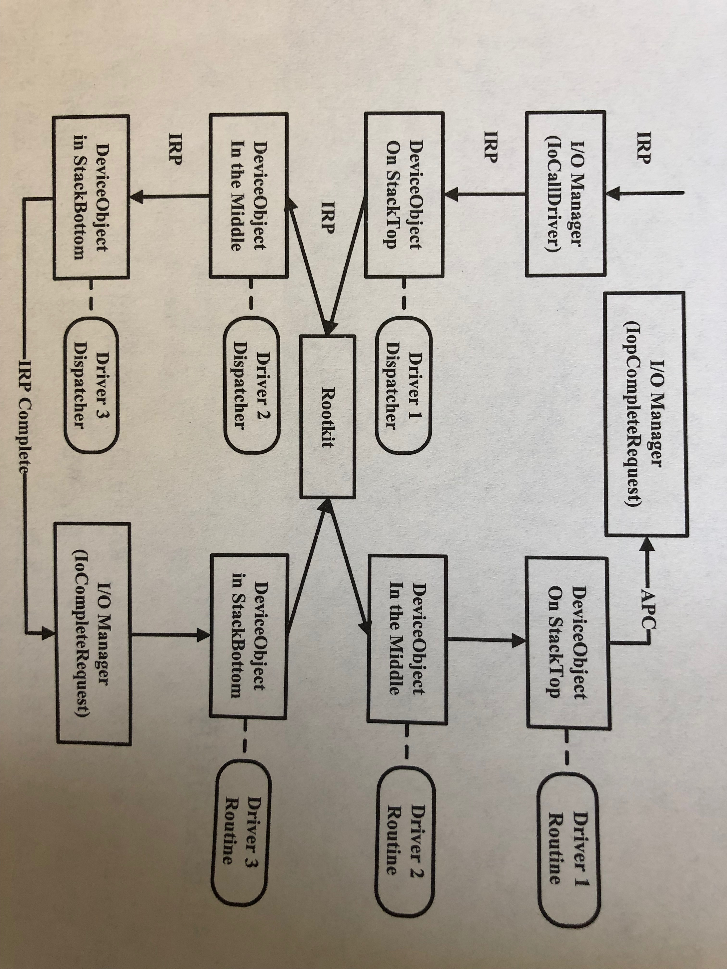
Filter Driver Rootkit

Slide 71
STUXnet

Slide 72
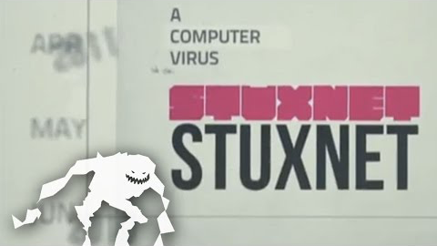
STUXnet

Slide 73
STUXnet

Slide 74
Analysis STUXnet Memory Dump Image
Malware
https://github.com/volatilityfoundation/volatility

Slide 75
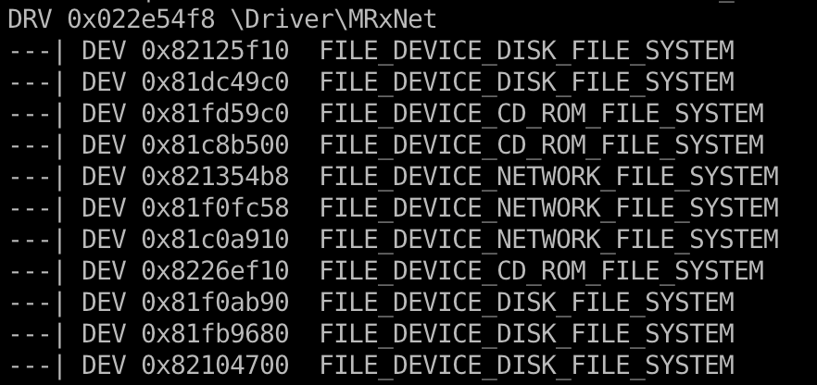
Analysis STUXnet Memory Dump Image

Slide 76
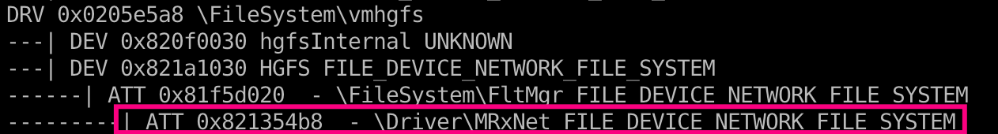
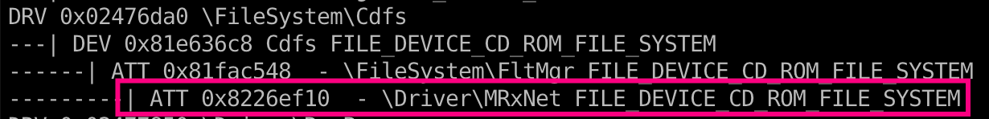
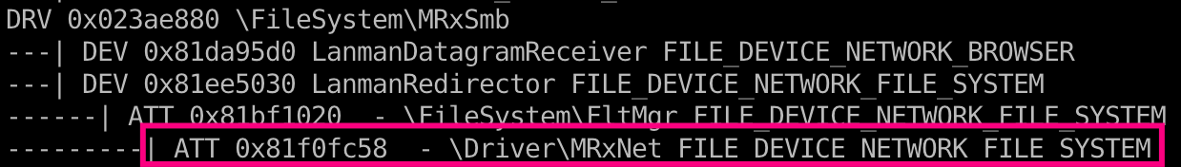
Analysis STUXnet Memory Dump Image
Now Stuxnet can filter or hide specifically named files and directories on those file systems!

Slide 77
Kernel Callback
A callback function is one which is passed as an argument to another function and is invoked after the completion of the parent function.
  In other words callback is a piece of executable code that is passed as an argument to other code, which is expected to call back (execute) the argument at some convenient time.
Kernel Callback
  Supported on 64 bit systems
  Safe for multicore machines
  Lists of events:
    Process creation
    Thread creation
    System shutdown
    File system registration
    PnP(Plug and Play)
    etc…

Slide 78
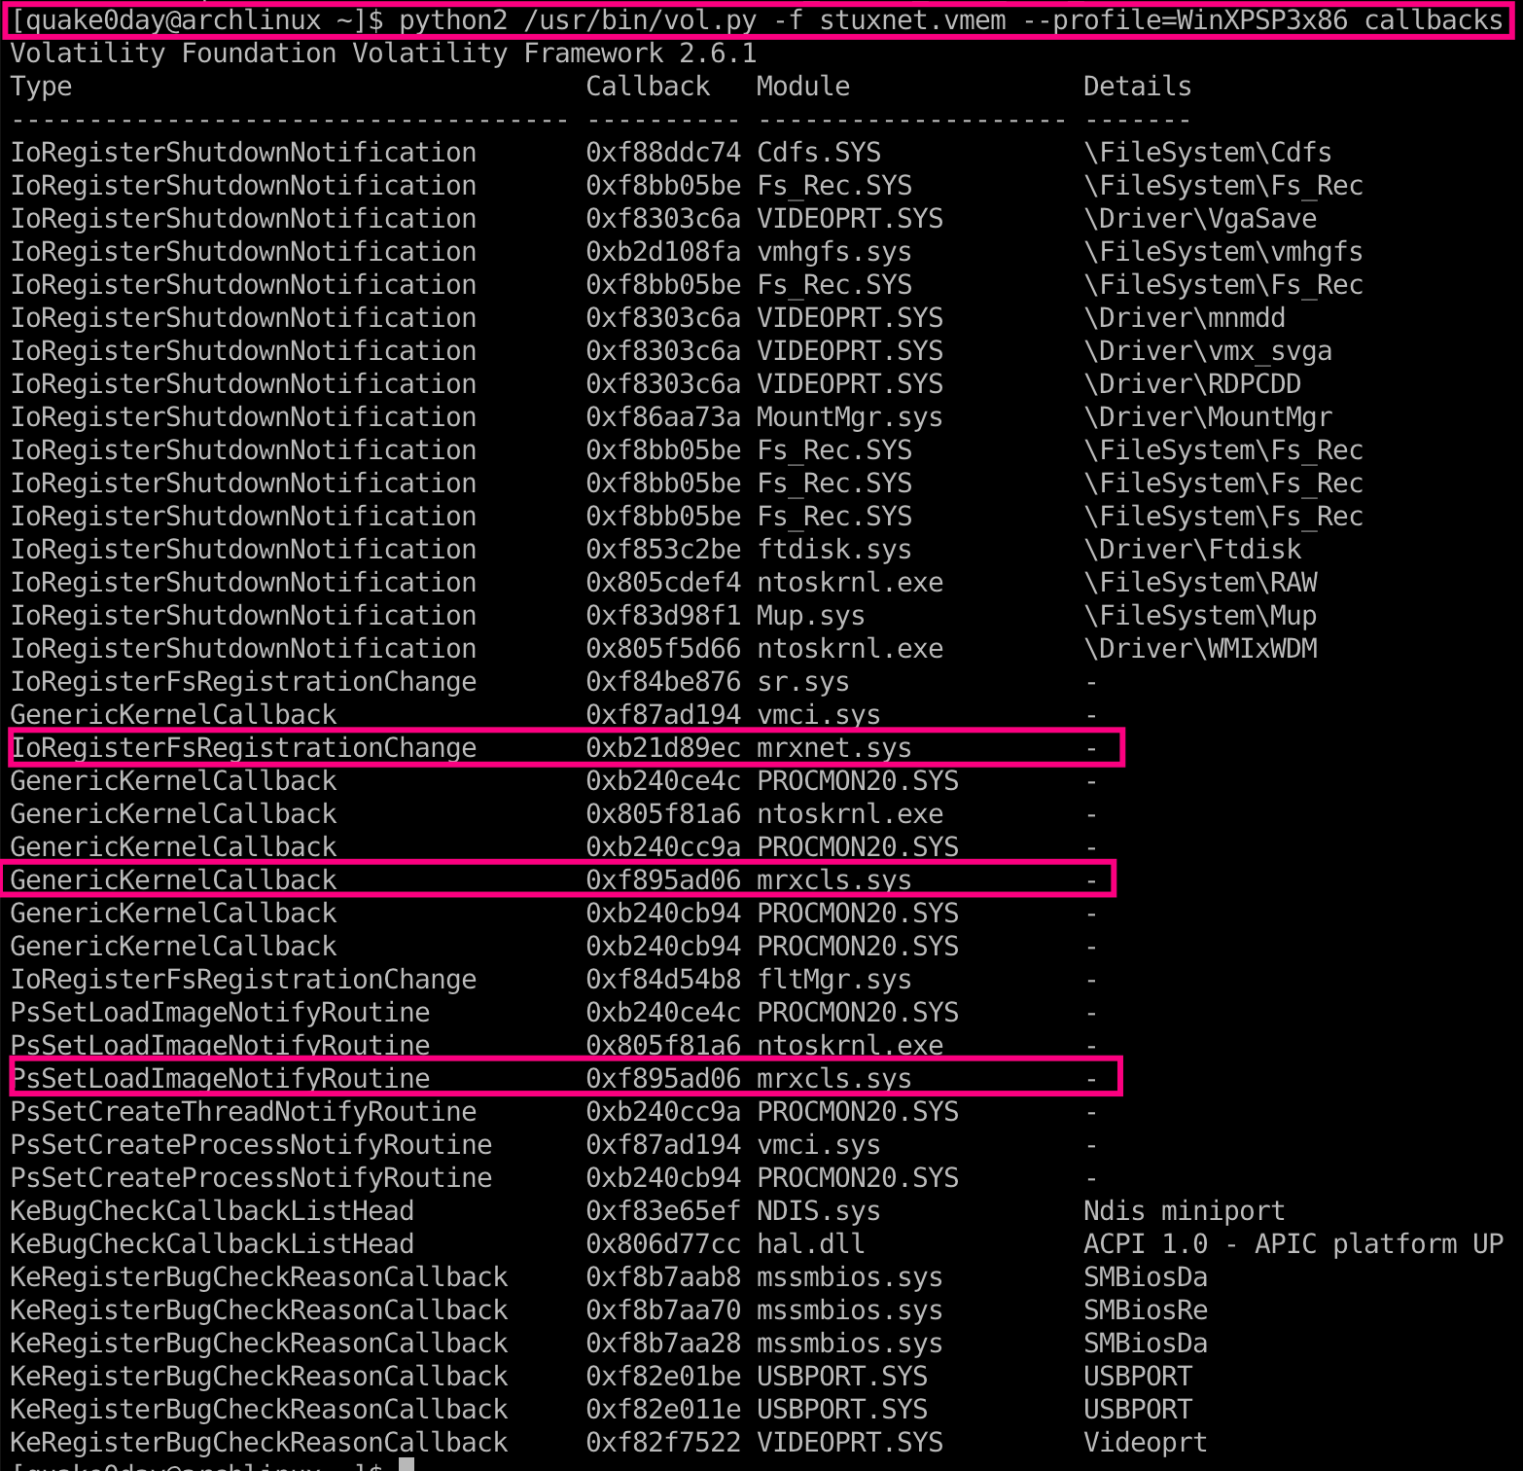
Analysis STUXnet Memory Dump Image
Now Stuxnet can receive notification when new file system become available – So it can immediately spread or hide files
And is able to inject code into process when they try to load other DLLs.

Slide 79
7. DKOM
8. Virtualization
9. Hardware

Slide 80

Q & A

