Slide 1

Class09
CSC 497/583 Advanced Topics in Computer Security
Modern Malware Analysis
IAT, IAT Hook,
Anti-virus Software, Dynamic Heuristic Analysis
Si Chen (schen@wcupa.edu)

Slide 2
IAT (Import Address Table)

Slide 3
IAT (Import Address Table)
Let’s review the concept of DLL (Dynamic Link Library) again…

Slide 4
Dynamic Linking

Slide 5
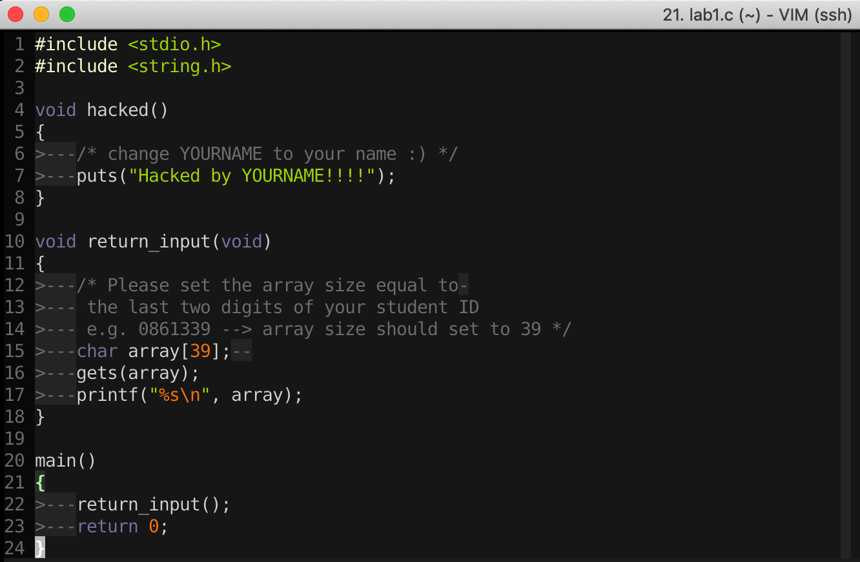
16-Bit DOS System
import Library → Put binary code of stdio library into the executable file

Slide 6
Static Linking
Memory
Waste space
Hard to maintain
Program2
Program2.obj
Lib.obj
Program1
Program1.obj
Lib.obj
Program2
Program2.obj
Lib.obj
Program1
Program1.obj
Lib.obj

Slide 7
Dynamic Linking
Memory
Dynamic linking has the following advantages:
Saves memory
Saves disk space.
Upgrades to the DLL are easier.
Provides after-market support.
Supports multi language programs.
Eases the creation of international versions
Lib.dll
Lib.obj
Program2
Program2.obj
Program1
Program1.obj
Program2
Program2.obj
Lib.dll
Lib.obj
Program1
Program1.obj

Slide 8
Two ways to Load DLL

Slide 9
Two ways to Load DLL
An executable file links to (or loads) a DLL in one of two ways:
Explicit Linking (run-time dynamic linking)
  the executable using the DLL must make function calls to explicitly load and unload the DLL, and to access the DLL's exported functions.
Implicit Linking (load-time dynamic linking)
  The operating system loads the DLL when the executable using it is loaded.

Slide 10
Two ways to Load DLL
Explicit Linking (run-time dynamic linking)
Implicit Linking (load-time dynamic linking)

Slide 11
Two ways to Load DLL
An executable file links to (or loads) a DLL in one of two ways:
DLL Injection
Explicit Linking (run-time dynamic linking)
  the executable using the DLL must make function calls to explicitly load and unload the DLL, and to access the DLL's exported functions.
Implicit Linking (load-time dynamic linking)
  The operating system loads the DLL when the executable using it is loaded.
IAT Table

Slide 12
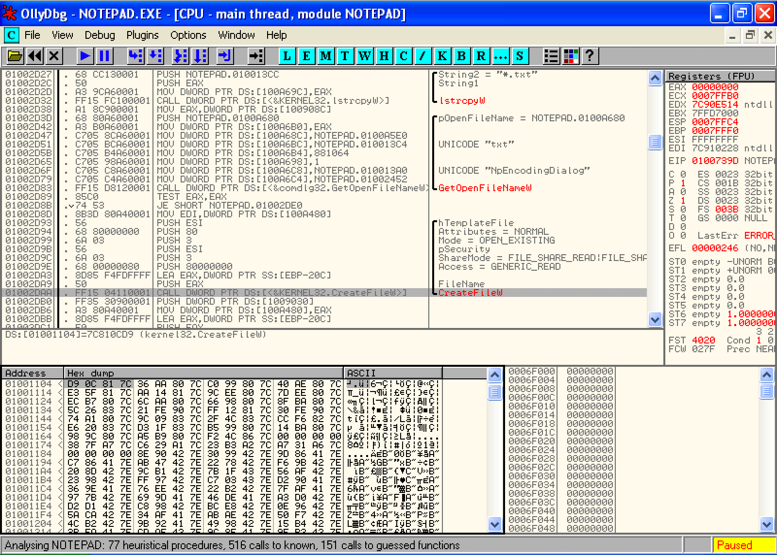
Implicit Linking and IAT (Import Address Table)
Notepad.exe Call CreateFileW() → Call 0x01001104 → Call 0x7C810CD9

Slide 13
Implicit Linking and IAT (Import Address Table)
Notepad.exe Call CreateFileW() → Call 0x01001104 → Call 0x7C810CD9
Call 0x01001104
Look up
IAT Table
Function Name | IAT Address | Real Address
…
CreateFileW() | 0x01001104 | 0x7C810CD9
…
When the application was first compiled, it was designed so that all API calls will NOT use direct hardcoded addresses but rather work through a function pointer.
This was accomplished through the use of an import address table. This is a table of function pointers filled in by the windows loader as the dlls are loaded.

Slide 14
IAT (Import Address Table)
Why IAT?

Slide 15
IAT (Import Address Table)
Support different Windows Version (9X, 2K, XP, Vista, 7, 8, 10)
Call CreateFileW() --> Call 0x01001104
Look up
XP
IAT Table
Function Name | IAT Address | Real Address
…
CreateFileW() | 0x01001104 | 0x7C810CD9
…
Windows 7
Function Name | IAT Address | Real Address
…
CreateFileW() | 0x01001104 | 0x7C81FFFF
…

Slide 16
IAT (Import Address Table)
Support DLL Relocation

Slide 17
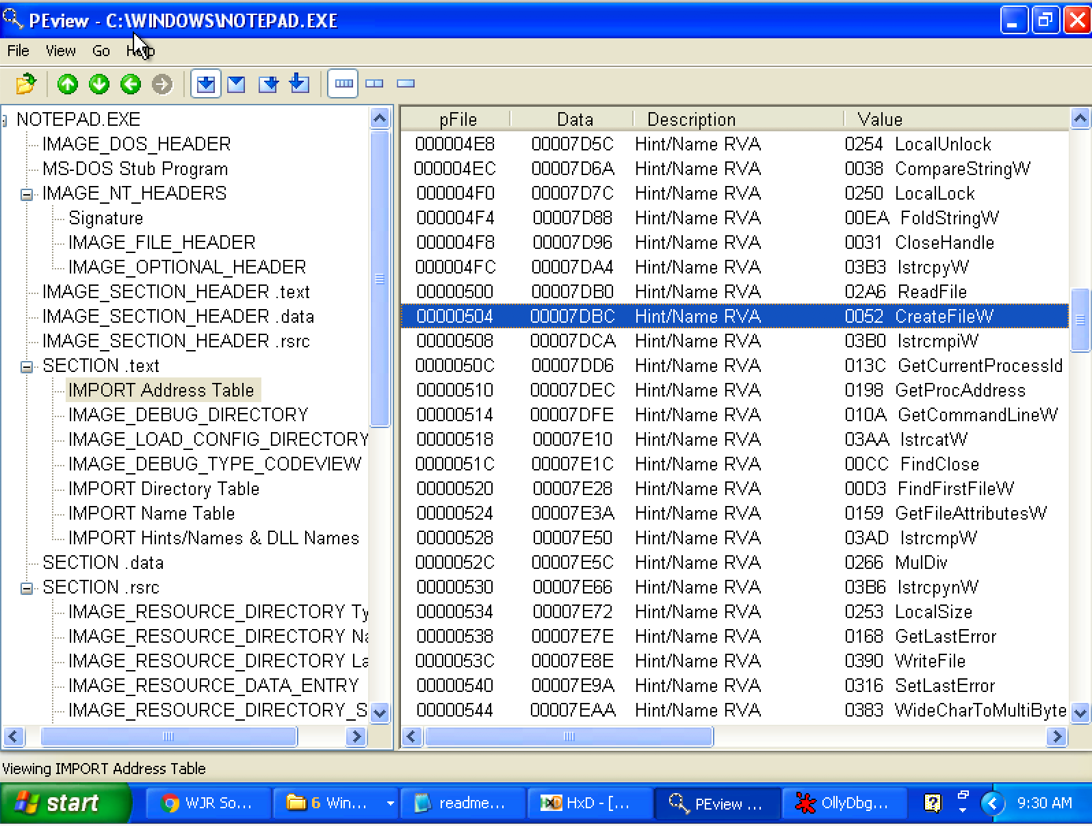
Look up IAT Table with PEview

Slide 18
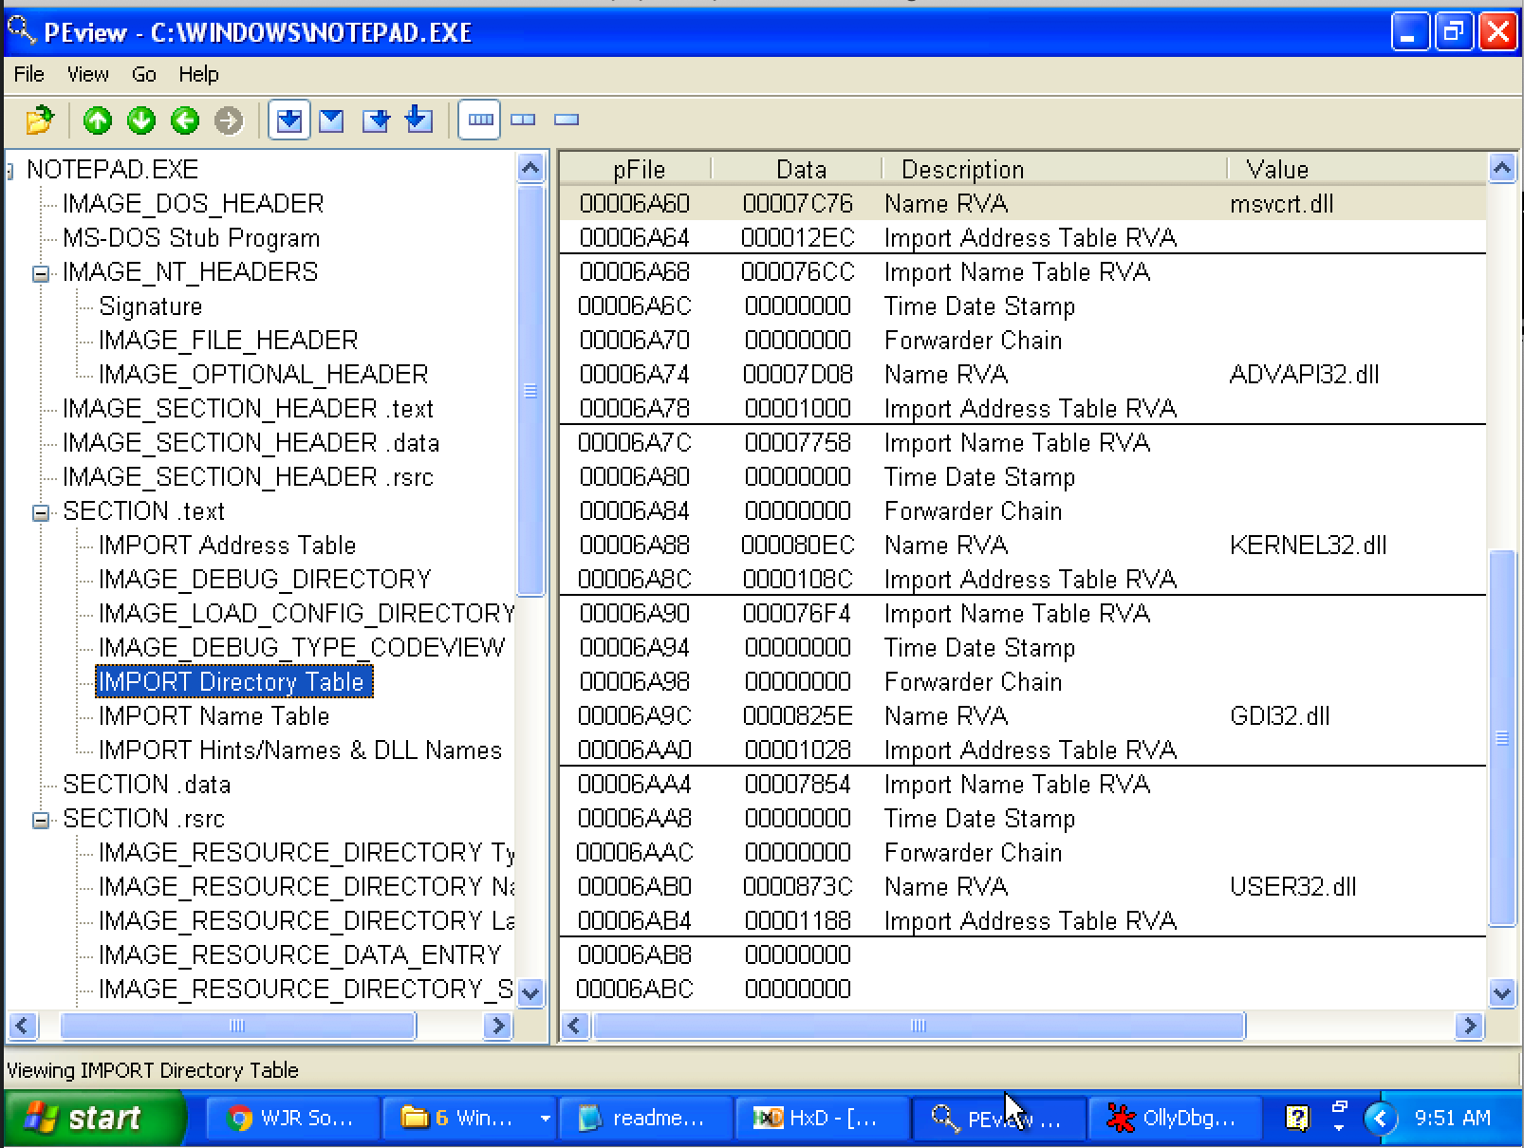
Import Directory Table
The Import Directory Table contains entries for every DLL which is loaded by the executable. Each entry contains, among other, Import Lookup Table (ILT) and Import Address Table (IAT)

Slide 19
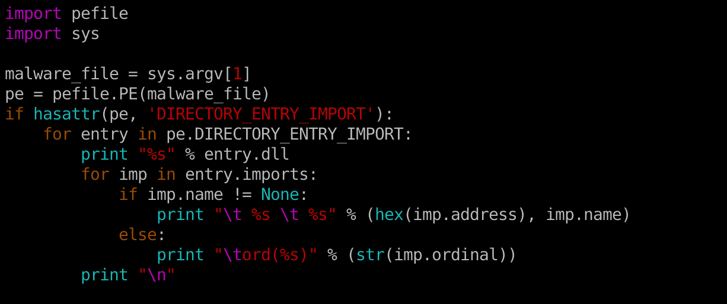
Inspecting file imports with pefile library

Slide 20
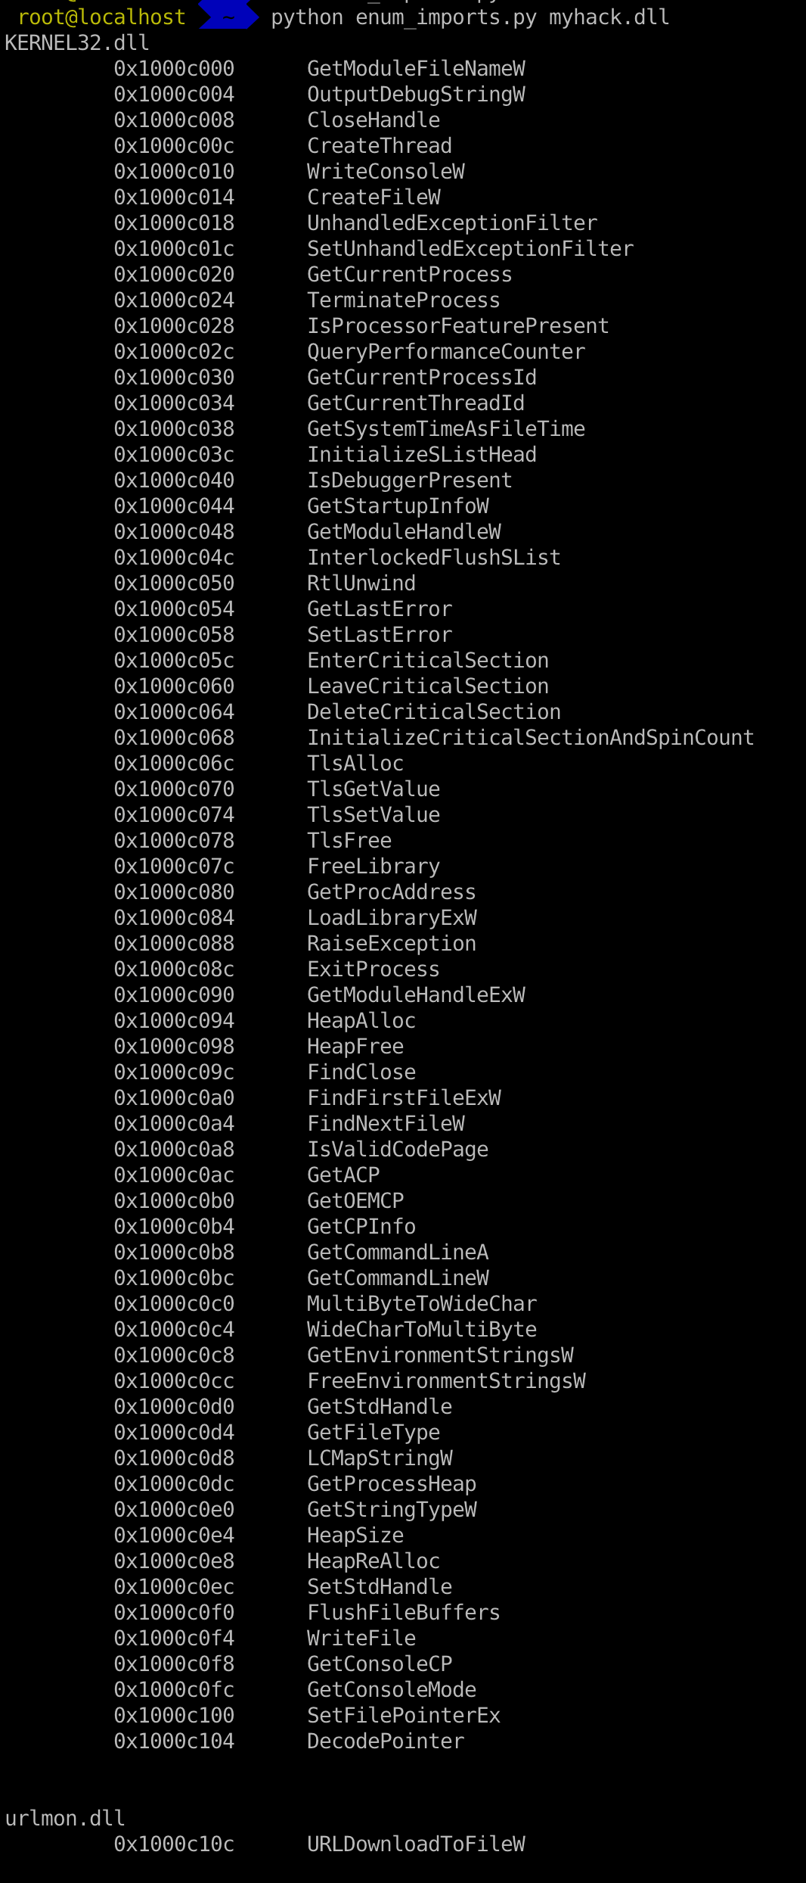

Slide 21
EAT (Export Address Table)
Similar to IAT, EAT data is stored in IMAGE_EXPORT_DIRECTORY
EAT contains an RVA that points to an array of pointers to (RVAs of) the functions in the module.

Slide 22
IAT Hook

Slide 23
IAT Hook Example
Download IATHookMsgBox.zip
Unzip and run it

Slide 24
Analysis IAT Hook Example
Use Ollydbg

Slide 25
What we’ve learned so far...
Basic Analysis
  Quickly glean information from the sample(s)
  Help guide and focus Advanced Analysis

Slide 26
What we’ve learned so far...
Advanced Analysis - Static
  Used to see what is going on
  Confirm suspicions aroused during basic analysis
  Identify functionality
Advanced Analysis - Dynamic
  Control the program
    Take new code paths
    Change data

Slide 27
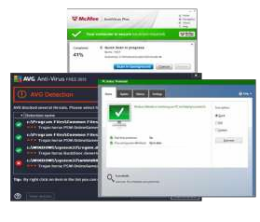

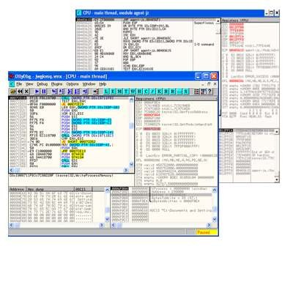
What we’ve learned so far...
Windows API and systems
  How does malware interact with Windows?
  How does Windows make malware author’s lives easier?
  How does it make their lives harder?

Slide 28
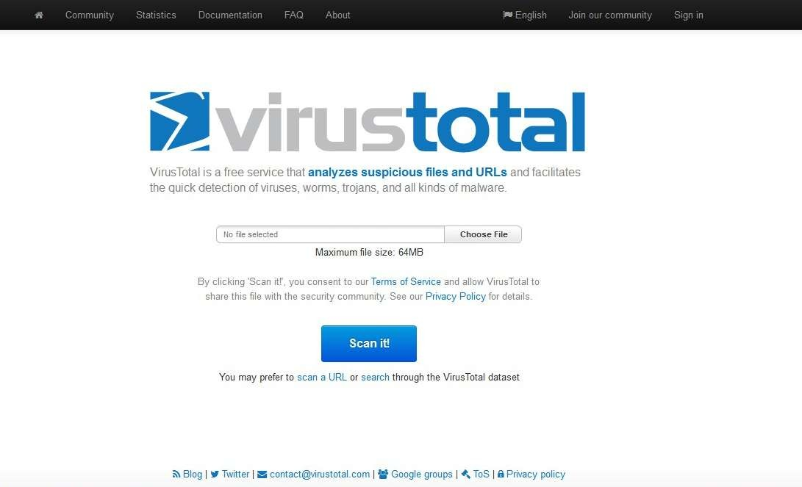
Anti-virus: How they actually work
Nowadays AV scans our system on real-time basis.
Information is analyzed based on the origin of the information
  i.e. source of information.
Operates differently depending upon source of information.

Slide 29
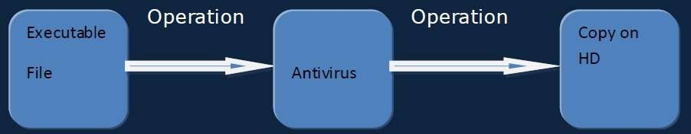
Anti-virus working from top level view.
If the file is found malicious then the information will not be copied onto the destination location.
(Here destination in our case is HD)

Slide 30
One of the two possibilities takes place
When the data is found to be legitimate, the scanner forwards that data to the destination location.
When virus is detected then a warning is sent to UI for user`s action. Interface may vary.

Slide 31
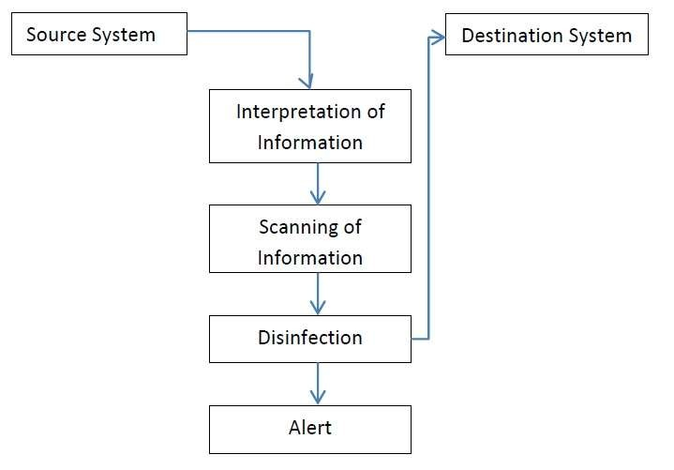
Process flow of working of AV.
AV scanner, scanning information on real time.

Slide 32
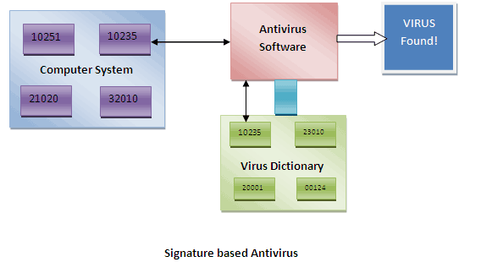
AV detection techniques(Scan - Engines)
Signature Based detection (also sometimes called as “string based” detection)
AV maintains a dictionary of the signatures of known Viruses, malwares, spywares etc.
This dictionary is stored at client side and is usually in binary.
Next-generation signature based detection
Disadvantage?

Slide 33
AV detection techniques(Scan - Engines)
Example:
https://www.cs.wcupa.edu/schen/malware/VirusShare_00001.md5

Slide 34
Heuristic based Detection
Used to detect new, unknown viruses in your system that has not yet been identified.
Based on the piece-by-piece examination of a virus.
Looks for the sequence of instruction that differentiate the virus from ‘normal programs’
Disadvantage?
Example:
  Lab1

Slide 35
AV bypassing techniques
This are those techniques that the hackers and crackers already knew.
Binders and packers Using splitter Code conversion from EXE to These are: client side script Code obfuscation Using metasploit framework Code or DLL Injection

Slide 36
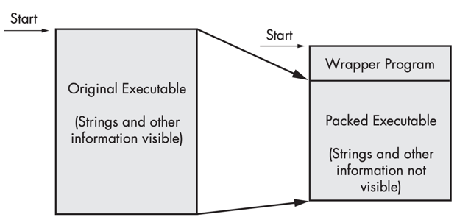
Packed and Obfuscated Malware
Malware writers often use packing or obfuscation to make their files more difficult to detect or analyze.
Obfuscated programs are ones whose execution the malware author has attempted to hide.
Packed programs are a subset of obfuscated programs in which the malicious program is compressed and cannot be analyzed.
Both techniques will severely limit your attempts to statically analyze the malware.

Slide 37
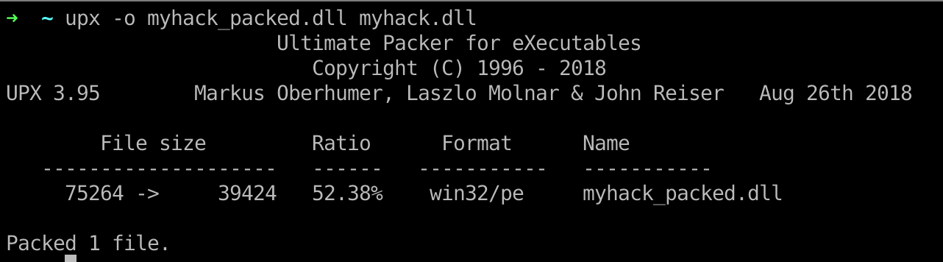
Packers and Cryptos

Slide 38
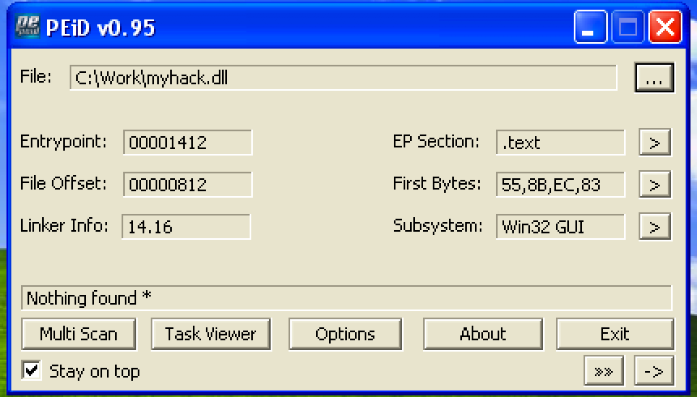
Packed and Obfuscated Malware

Slide 39
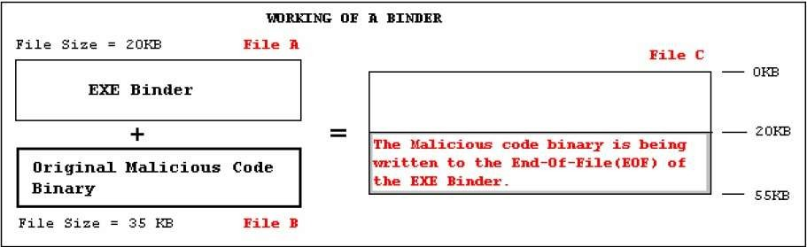
Binders and Packers
Binders

Slide 40
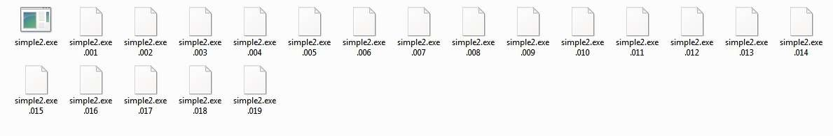
Splitting the File and Code Obfuscation
These are those programs that split a single files into no. of small sized files.
One may change some code into some small chunked file to evade AV detection and again join it and scan it to check whether AV flags it malicious or not. A trial and Error method..

Slide 41
Behavioral based detection
Just observes how the program executes, rather than merely emulating its execution.
Identify malware by looking for suspicious behavior.
Disadvantage?

Slide 42
Sandboxing Based detection
What is “sandbox” ?
Isolate the files which are to be scanned and monitors their activity.

Slide 43
Heuristic Engines
Heuristic engines are basically statistical and rule based analyze mechanisms.
Their main purpose is detecting new generation(previously unknown) viruses by categorizing and giving threat/risk grades to code fragments according to predefined criteria.
Heuristic engines are the most advanced part of AV products they use significant amount of rules and criteria.
Since no anti virus company releases blueprints or documentation about their heuristic engines all known selective criteria's about their threat/risk grading policy are found with trial and error.

Slide 44
Dynamic Heuristic Analysis
PE file
contains C:\, D:\, E:\
And windows, System32 Folder and system file
monitoring the behavior of the unknow sample, logging the function call, parameters, etc…
malware expert use the log file to find the key features and add it to the malware database

Slide 45
Some of the known rules about threat grading
– Decryption loop detected
– Reads active computer name
– Reads the cryptographic machine GUID
– Contacts random domain names
– Reads the windows installation date
– Drops executable files
– Found potential IP address in binary memory
– Modifies proxy settings
– Installs hooks/patches the running process
– Injects into explorer
– Injects into remote process
– Queries process information
– Sets the process error mode to suppress error box
– Unusual entrophy
– Possibly checks for the presence of antivirus engine
– Monitors specific registry key for changes

Slide 46
Some of the known rules about threat grading
– Contains ability to elevate privileges
– Modifies software policy settings
– Reads the system/video BIOS version
– Endpoint in PE header is within an uncommon section
– Creates guarded memory regions
– Spawns a lot of processes
– Tries to sleep for a long time
– Unusual sections
– Reads windows product id
– Contains decryption loop
– Contains ability to start/interact device drivers
– Contains ability to block user input

Slide 47
 | Pros | Cons
Static Heuristic Analysis | Fast, easy | Cannot handle shell, code obfuscation
Dynamic Heuristic Analysis | It can “reveal” the malware | May attacked by the anti-VM technology

Slide 48
Experiment
In today’s experiment, we want to monitoring the behavior of a ransomware, generate a log file. And analysis it.

Slide 49
Ransomware
Ransomware is a type of malicious software, or malware, designed to deny access to a computer system or data until a ransom is paid.

Slide 50
Experiment
Malware behavior(s):
  Find all docx file in the current folder
  change their filename to it’s CRC32 (hash) value, and change the filename to crc32
  Use the first 16 bytes to do XOR with 0x01 → to simulate file encryption
  generate a txt file to ask for money (or bitcoin ☺)
  delete itself → the best way to protect itself

Slide 51

Q & A

