Slide 1

Class08
CSC 497/583 Advanced Topics in Computer Security
Modern Malware Analysis
Hooks, IAT, IAT Hooks,
Dynamic Heuristic Analysis
Si Chen (schen@wcupa.edu)

Slide 2
Overview
Hooks
  Definition
  Message Hook
    Message Hook Chain
    Message Hook Example 1 – Keyboard Event Hook
  IAT Hook
    IAT Hook Basics
    IAT Hook Example – A ”Big” MessageBox

Slide 3
Hooks
A hook is a point in the system message-handling mechanism where an application can install a subroutine to monitor the message traffic in the system and process certain types of messages before they reach the target window procedure.

Slide 4
Message Hook

Slide 5
Message Hook
The system supports many different types of hooks; each type provides access to a different aspect of its message-handling mechanism.

Slide 6
Message Hook Chain
A hook chain is a list of pointers to special, application-defined callback functions called hook procedures.
When a message occurs that is associated with a particular type of hook, the system passes the message to each hook procedure referenced in the hook chain, one after the other.

Slide 7
Message Hook Example
Download Hook.zip from our course website, unzip it (password: infected)
Try HookMain.exe

Slide 8
Message Hook

Slide 9
Analysis Source Code
In this example, we use two files:
  HookMain.exe → Launch the attack
  KeyHook.dll → Provide “Hook” function

Slide 10
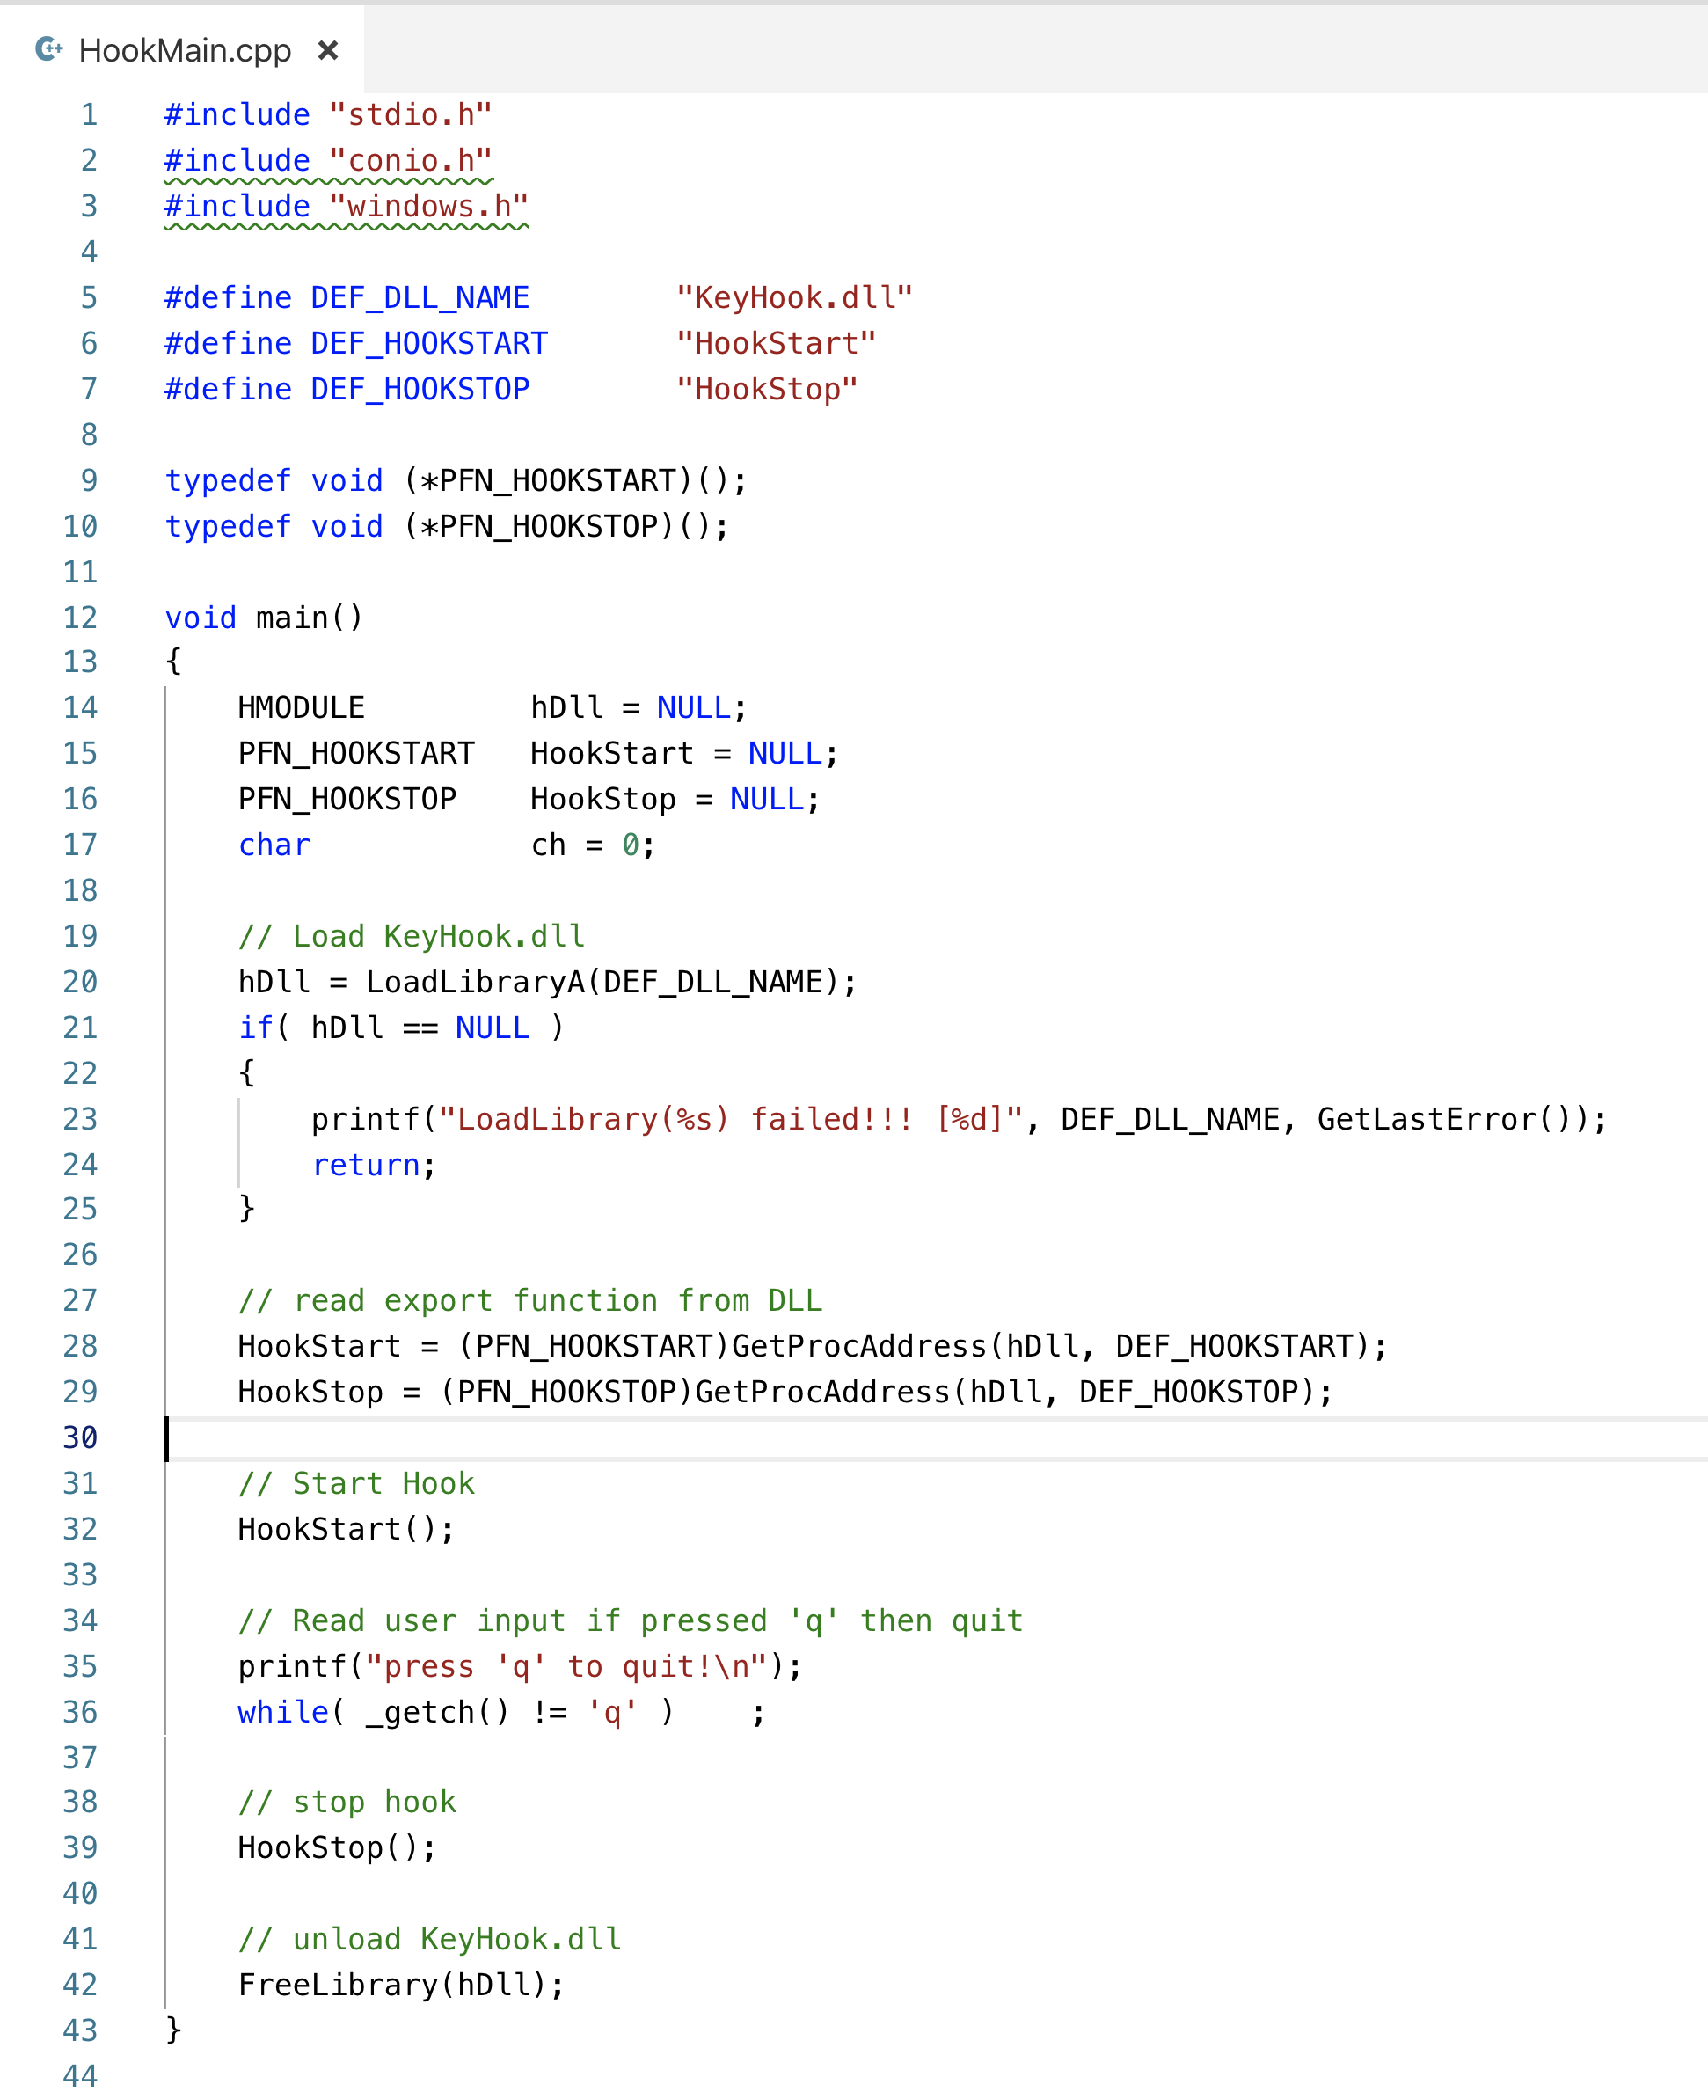
LoadDLL()
HookStart()
HookStop()
UnloadDLL()

Slide 11
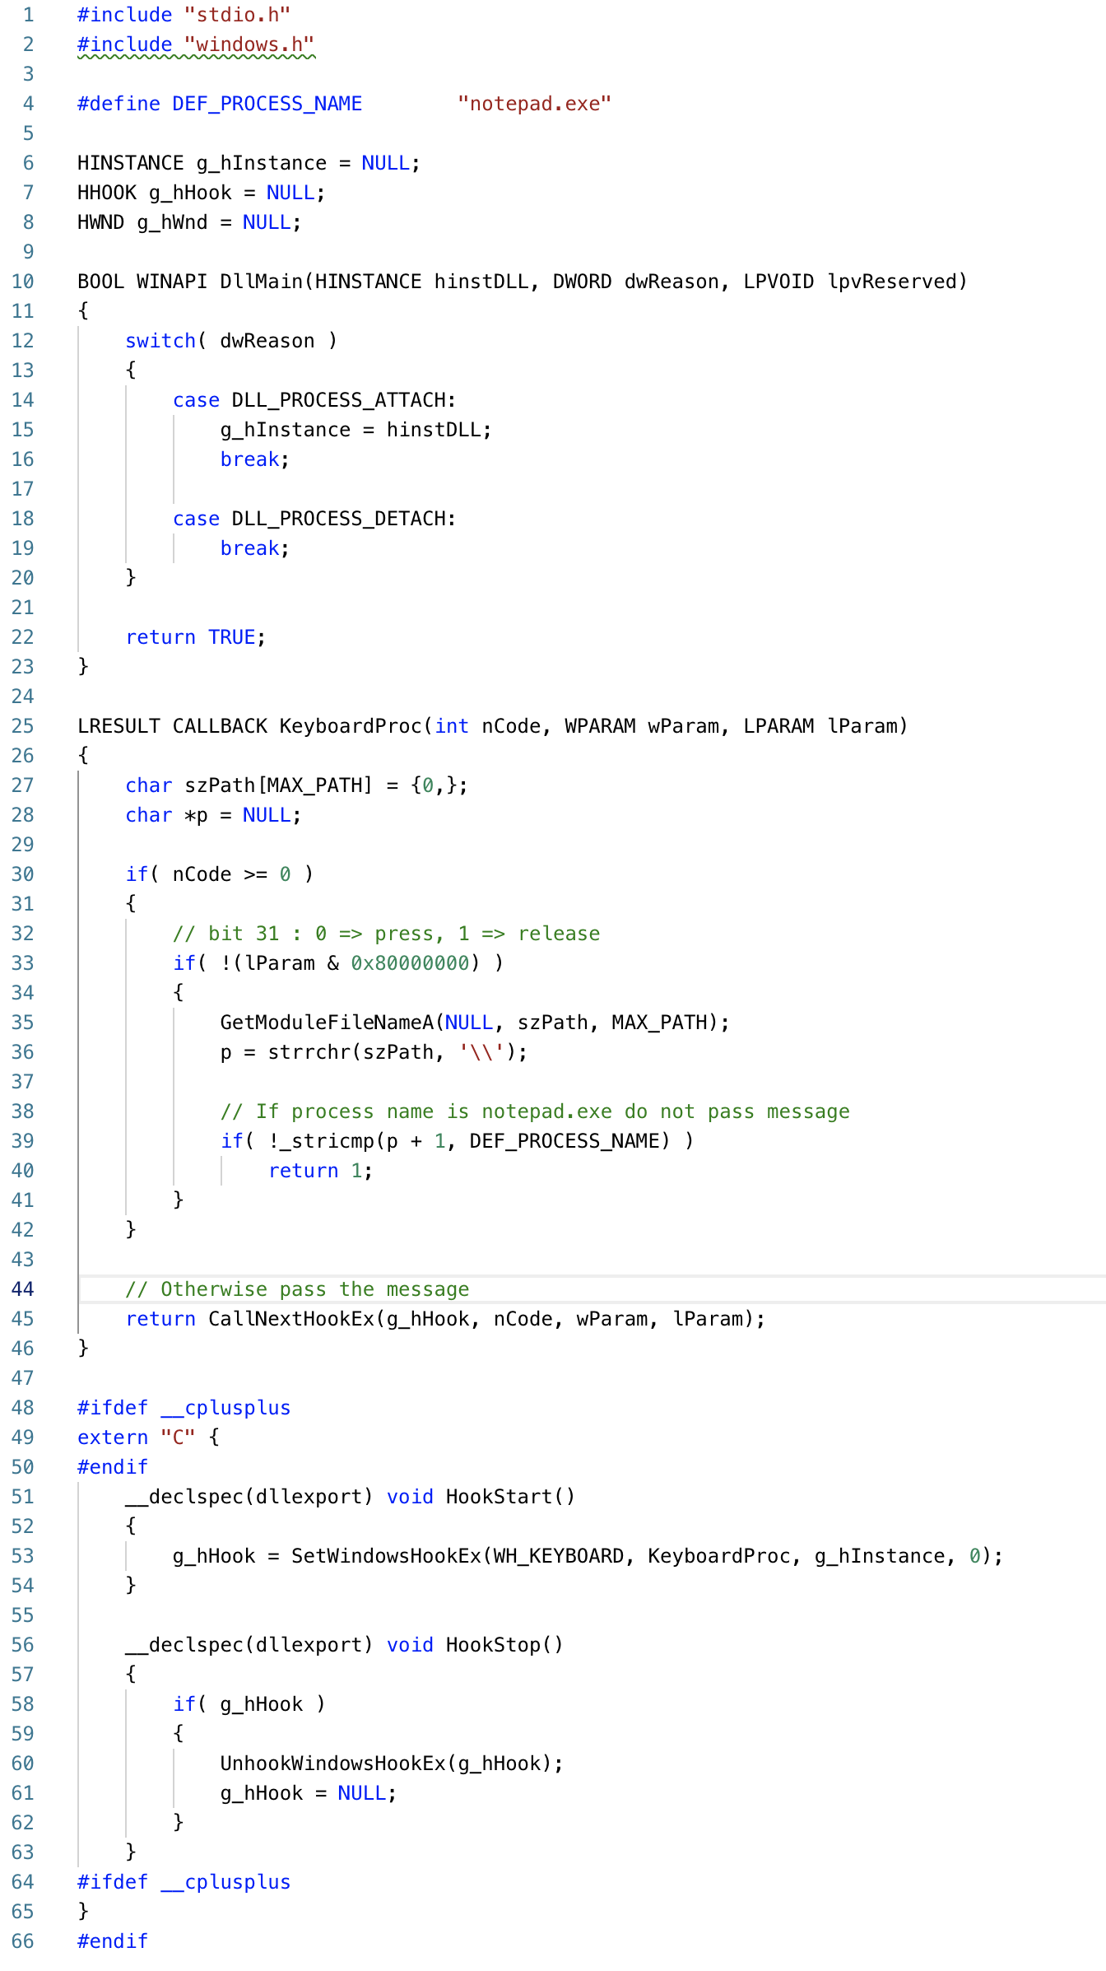

Slide 12
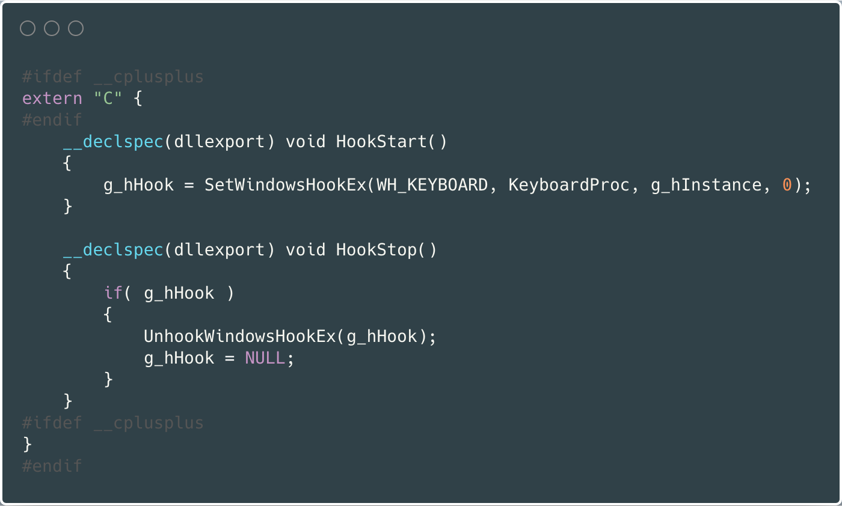
Analysis Source Code
g_hHook = SetWindowsHookEx(WH_KEYBOARD, KeyboardProc, g_hInstance, 0);

Slide 13
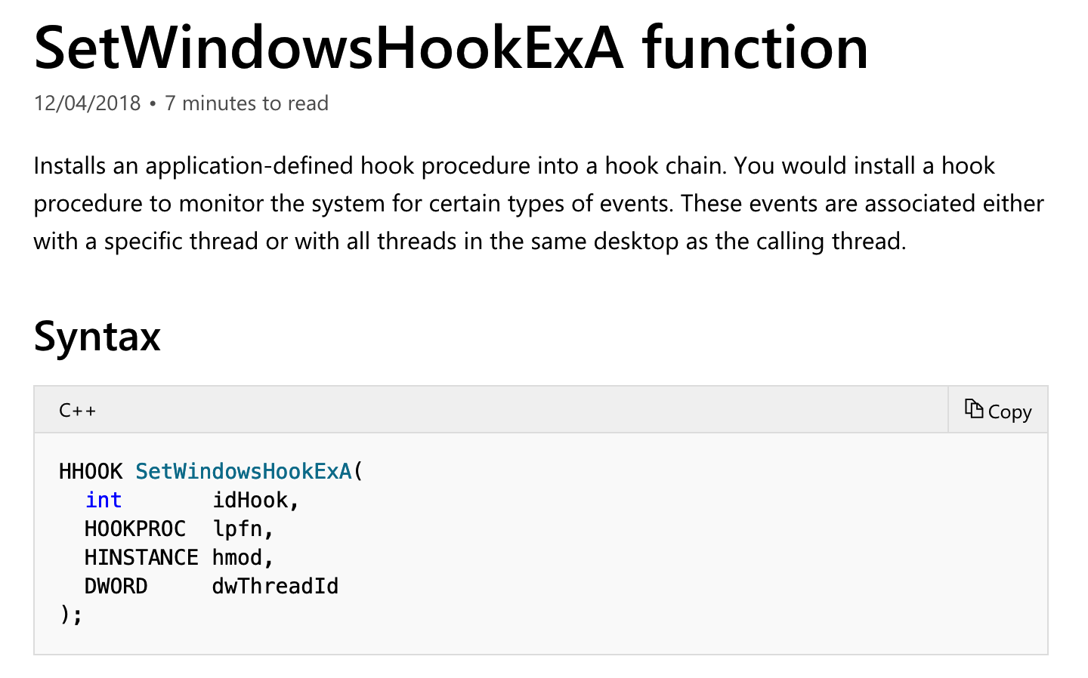
Analysis Source Code
https://docs.microsoft.com/en-us/windows/desktop/api/winuser/nf-winuser-setwindowshookexa

Slide 14
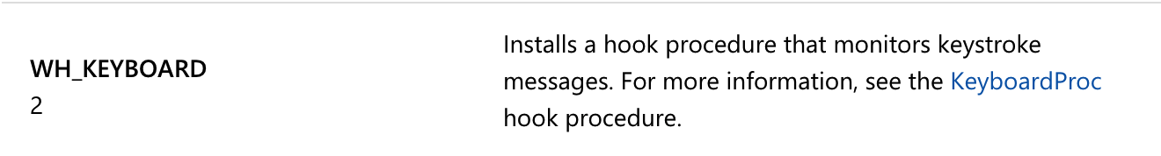
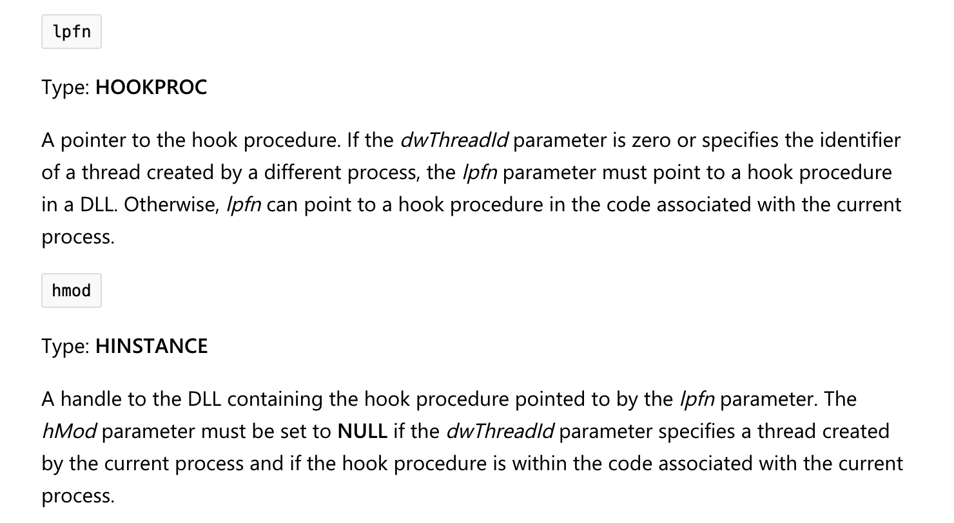
Analysis Source Code
g_hHook = SetWindowsHookEx(WH_KEYBOARD, KeyboardProc, g_hInstance, 0);

Slide 15
Message Hook

Slide 16
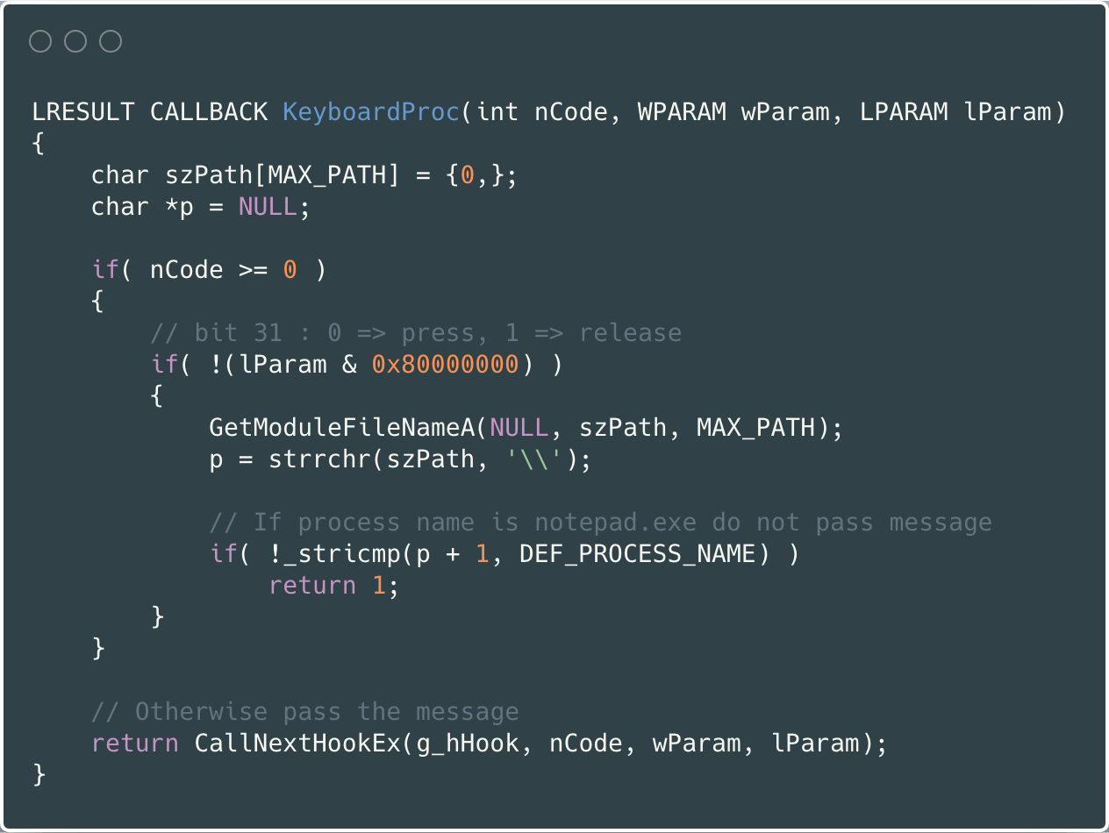
Analysis Source Code

Slide 17
IAT (Import Address Table)

Slide 18
IAT (Import Address Table)
Let’s review the concept of DLL (Dynamic Link Library) again…

Slide 19
Dynamic Linking

Slide 20
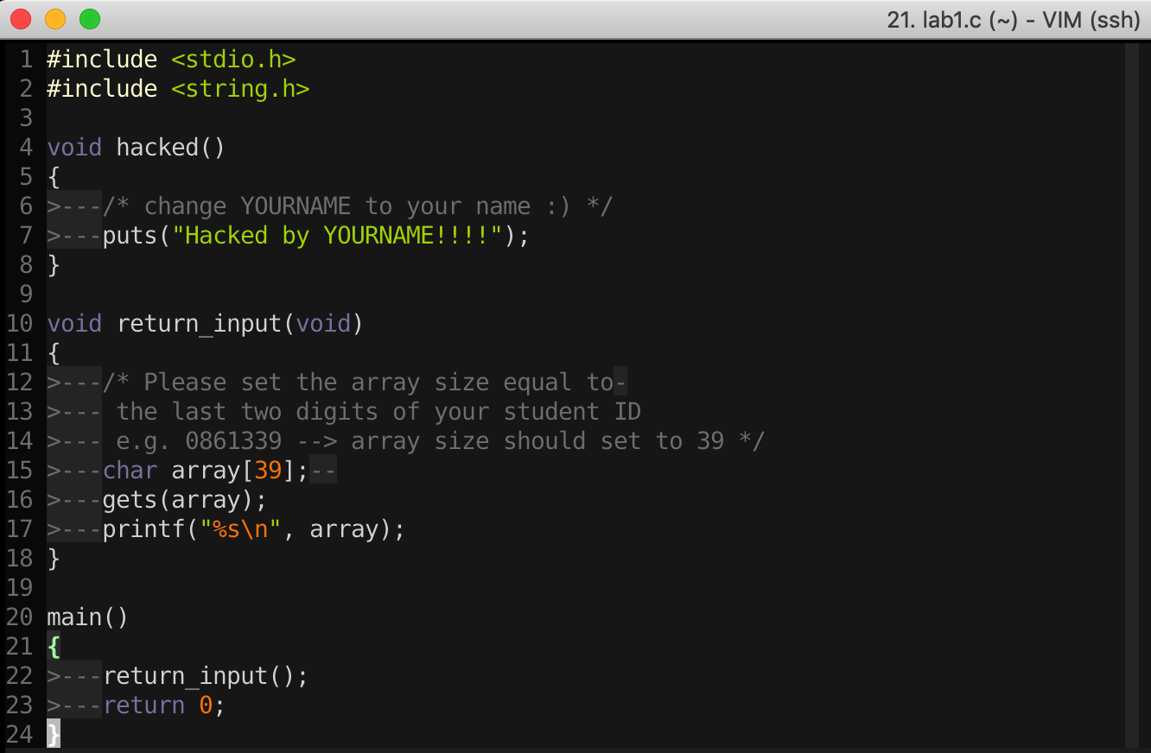
16-Bit DOS System
import Library → Put binary code of stdio library into the executable file

Slide 21
Static Linking
Memory
Waste space
Hard to maintain
Program2
Program2.obj
Lib.obj
Program1
Program1.obj
Lib.obj
Program2
Program2.obj
Lib.obj
Program1
Program1.obj
Lib.obj

Slide 22
Dynamic Linking
Memory
Dynamic linking has the following advantages:
Saves memory
Saves disk space.
Upgrades to the DLL are easier.
Provides after-market support.
Supports multi language programs.
Eases the creation of international versions
Lib.dll
Lib.obj
Program2
Program2.obj
Program1
Program1.obj
Program2
Program2.obj
Lib.dll
Lib.obj
Program1
Program1.obj

Slide 23
Two ways to Load DLL

Slide 24
Two ways to Load DLL
An executable file links to (or loads) a DLL in one of two ways:
Explicit Linking (run-time dynamic linking)
  the executable using the DLL must make function calls to explicitly load and unload the DLL, and to access the DLL's exported functions.
Implicit Linking (load-time dynamic linking)
  The operating system loads the DLL when the executable using it is loaded.

Slide 25
Two ways to Load DLL
Explicit Linking (run-time dynamic linking)
Implicit Linking (load-time dynamic linking)

Slide 26
Two ways to Load DLL
An executable file links to (or loads) a DLL in one of two ways:
DLL Injection
Explicit Linking (run-time dynamic linking)
  the executable using the DLL must make function calls to explicitly load and unload the DLL, and to access the DLL's exported functions.
Implicit Linking (load-time dynamic linking)
  The operating system loads the DLL when the executable using it is loaded.
IAT Table

Slide 27
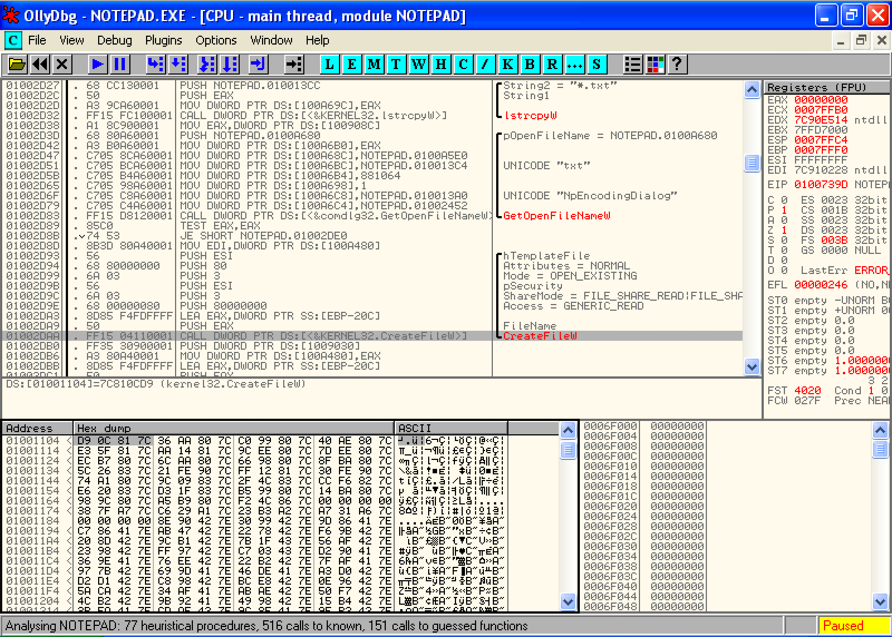
Implicit Linking and IAT (Import Address Table)
Notepad.exe Call CreateFileW() → Call 0x01001104 → Call 0x7C810CD9

Slide 28
Implicit Linking and IAT (Import Address Table)
Notepad.exe Call CreateFileW() → Call 0x01001104 → Call 0x7C810CD9
Call 0x01001104
Look up
IAT Table
Function Name | IAT Address | Real Address
…
CreateFileW() | 0x01001104 | 0x7C810CD9
…
When the application was first compiled, it was designed so that all API calls will NOT use direct hardcoded addresses but rather work through a function pointer.
This was accomplished through the use of an import address table. This is a table of function pointers filled in by the windows loader as the dlls are loaded.

Slide 29
IAT (Import Address Table)
Why IAT?

Slide 30
IAT (Import Address Table)
Support different Windows Version (9X, 2K, XP, Vista, 7, 8, 10)
Call CreateFileW() --> Call 0x01001104
Look up
XP
IAT Table
Function Name | IAT Address | Real Address
…
CreateFileW() | 0x01001104 | 0x7C810CD9
…
Windows 7
Function Name | IAT Address | Real Address
…
CreateFileW() | 0x01001104 | 0x7C81FFFF
…

Slide 31
IAT (Import Address Table)
Support DLL Relocation

Slide 32
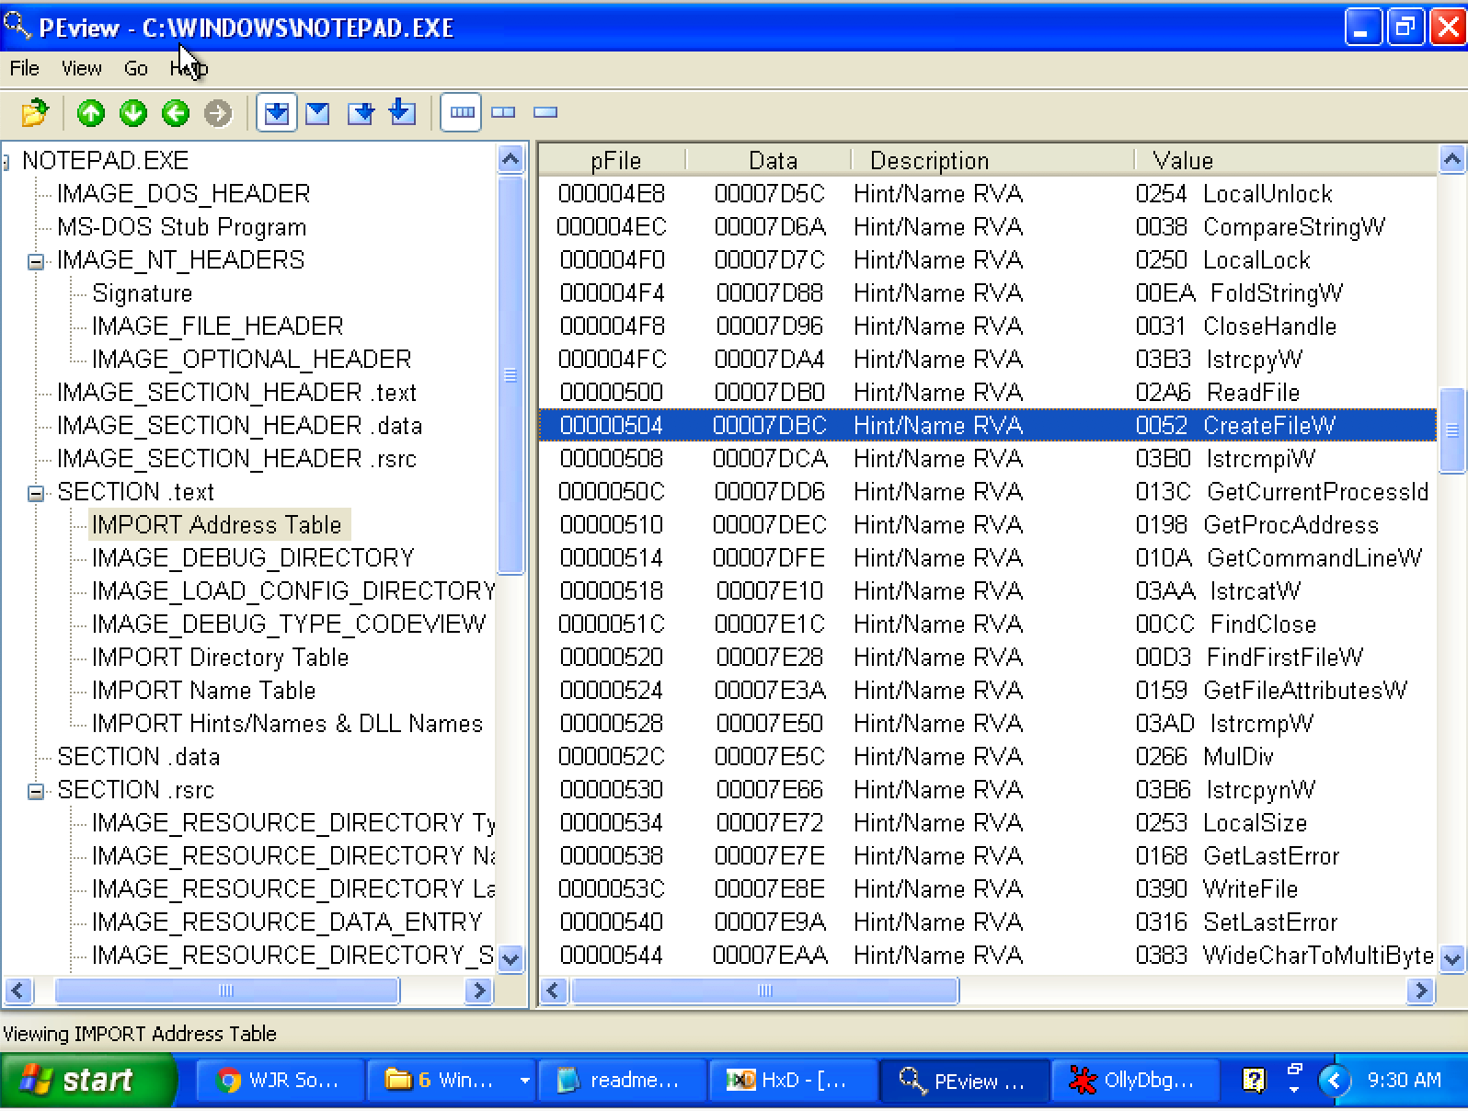
Look up IAT Table with PEview

Slide 33
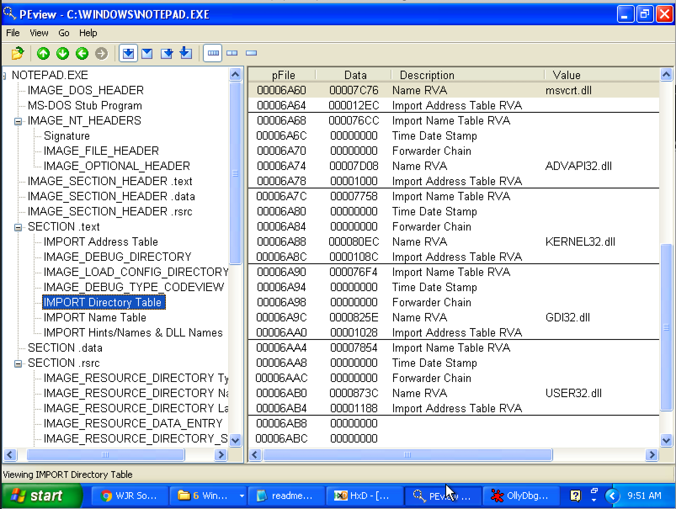
Import Directory Table
The Import Directory Table contains entries for every DLL which is loaded by the executable. Each entry contains, among other, Import Lookup Table (ILT) and Import Address Table (IAT)

Slide 34
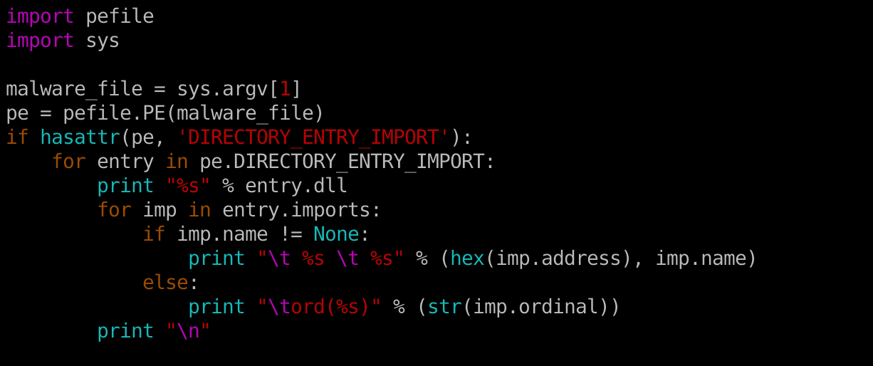
Inspecting file imports with pefile library

Slide 35
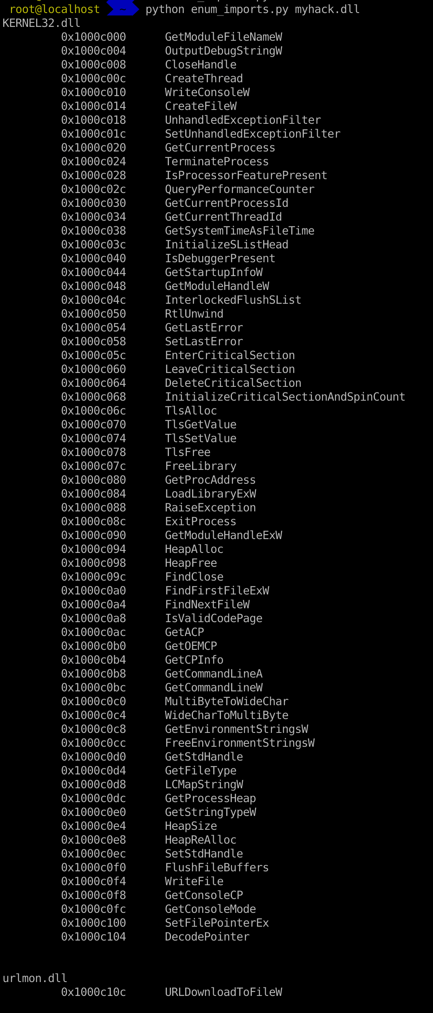

Slide 36
EAT (Export Address Table)
Similar to IAT, EAT data is stored in IMAGE_EXPORT_DIRECTORY
EAT contains an RVA that points to an array of pointers to (RVAs of) the functions in the module.

Slide 37
IAT Hook

Slide 38
Check class 5
IAT (Import Address Table)
Quick Review

Slide 39
Load PE file (Notepad.exe) into Memory

Slide 40
Look up IAT Table with PEview

Slide 41
Implicit Linking and IAT (Import Address Table)
Notepad.exe Call CreateFileW() → Call 0x01001104 → Call 0x7C810CD9
Call 0x01001104
Look up
IAT Table
Function Name | IAT Address | Real Address
…
CreateFileW() | 0x01001104 | 0x7C810CD9
…
When the application was first compiled, it was designed so that all API calls will NOT use direct hardcoded addresses but rather work through a function pointer.
This was accomplished through the use of an import address table. This is a table of function pointers filled in by the windows loader as the dlls are loaded.

Slide 42
IAT (Import Address Table)
Why IAT?

Slide 43
IAT (Import Address Table)
Support different Windows Version (9X, 2K, XP, Vista, 7, 8, 10)
Call CreateFileW() --> Call 0x01001104
Look up
XP
IAT Table
Function Name | IAT Address | Real Address
…
CreateFileW() | 0x01001104 | 0x7C810CD9
…
Windows 7
Function Name | IAT Address | Real Address
…
CreateFileW() | 0x01001104 | 0x7C81FFFF
…

Slide 44
IAT (Import Address Table)
Support DLL Relocation

Slide 45
IAT Hook Example
Download IATHookMsgBox.zip
Unzip and run it

Slide 46
Analysis IAT Hook Example
Use Ollydbg

Slide 47

Q & A

