Slide 1
Class07
CSC 497/583 Advanced Topics in Computer Security
Modern Malware Analysis
Calling Convention
Si Chen (schen@wcupa.edu)

Slide 2
Stack Frame

Slide 3
https://www.slideshare.net/saumilshah/how-functions-work-7776073

Slide 4
https://www.slideshare.net/saumilshah/how-functions-work-7776073

Slide 5
https://www.slideshare.net/saumilshah/how-functions-work-7776073

Slide 6
https://www.slideshare.net/saumilshah/how-functions-work-7776073

Slide 7
https://www.slideshare.net/saumilshah/how-functions-work-7776073

Slide 8
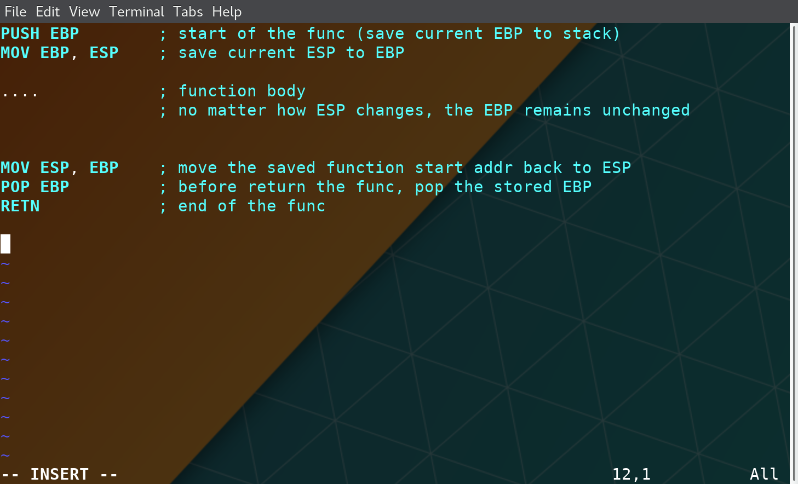
Stack Frame

Slide 9
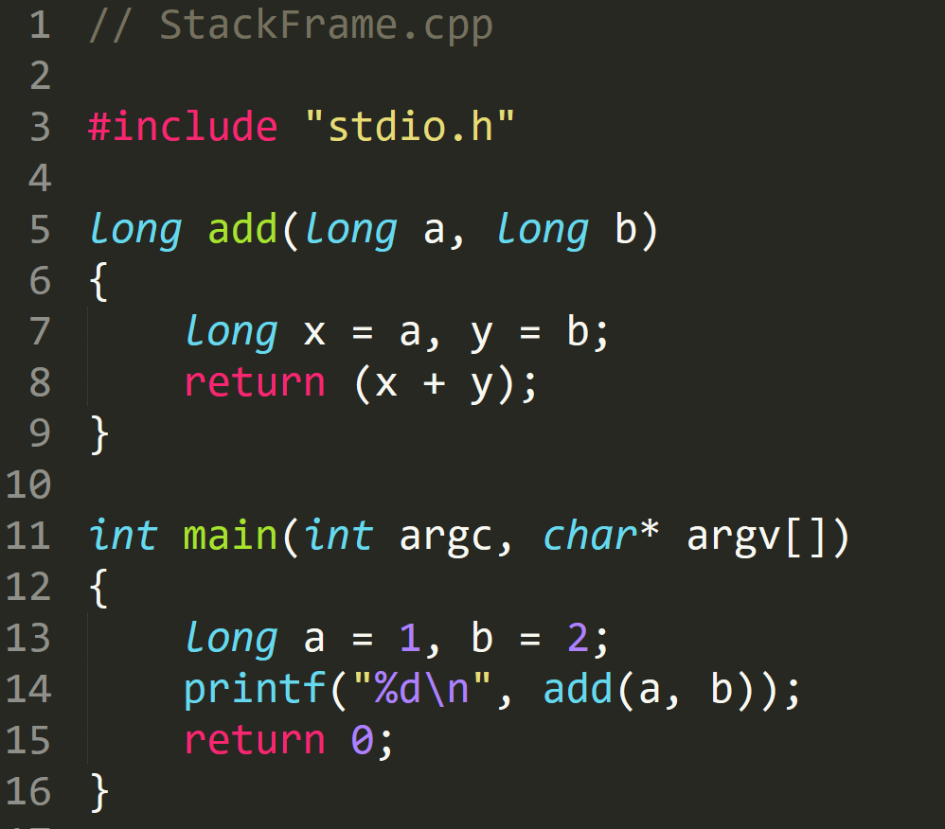
StackFrame.exe

Slide 10
StackFrame.exe

Slide 11
StackFrame.exe

Slide 12
StackFrame.exe
Notes:
EBP 12FFC0
ESP 12FF7C

Slide 13
StackFrame.exe
Notes:
EBP
ESP 12FF78

Slide 14
StackFrame.exe

Slide 15
StackFrame.exe
Create space for ‘a’ and ‘b’ → long → 4 byte
Notes:
EBP
ESP 12FF78

Slide 16
StackFrame.exe
Create space for ‘a’ and ‘b’ → long → 4 byte
Notes:
EBP
ESP 12FF78

Slide 17
StackFrame.exe
Assembly | C | Type Conversion
DWORD PTR SS:[EBP-4] | *(DWORD*)(EBP-4) | DWORD (4 byte)
WORD PTR SS:[EBP-4] | *(WORD*)(EBP-4) | WORD (2 byte)
BYTE PTR SS:[EBP-4] | *(BYTE*)(EBP-4) | 1 byte
4 Byte memory space at address [EBP-4]

Slide 18
StackFrame.exe

Slide 19
StackFrame.exe

Slide 20
StackFrame.exe

Slide 21
StackFrame.exe

Slide 22
StackFrame.exe

Slide 23
StackFrame.exe
Clean Stack

Slide 24
StackFrame.exe
Clean Stack

Slide 25
StackFrame.exe

Slide 26
StackFrame.exe
Set EAX –> 0
Faster than
MOV EAX,0

Slide 27
Stack
Pass arguments
Save the return address
Save local variable

Slide 28
Local Variable
Limited Register(s) → Store Local Variable in stack
Use esp and ebp to define a stack frame for current function
Use relative position of esp or ebp for retrieving and storing data
e.g. mov eax, [esp+124]
Very easy to do recursive call

Slide 29
Calling Convention

Slide 30
Two Questions
Q: When a function finished, how to handle the parameter left in the stack.
Q: When a function finished, how change the ESP value?
A: We don’t care…
A: ESP should be restored to the previous value

Slide 31
Standard C Calling Conventions
Calling conventions are a standardized method for functions to be implemented and called by the machine.
A calling convention specifies the method that a compiler sets up to access a subroutine.
There are three major calling conventions that are used with the C language on 32-bit x86 processors:
CDECL
STDCALL,
FASTCALL.

Slide 32
CDECL
The C language, by default, uses the CDECL calling convention
In the CDECL calling convention the following holds:
Arguments are passed on the stack in Right-to-Left order, and return values are passed in eax.
The calling function cleans the stack. This allows CDECL functions to have variable-length argument lists.

Slide 33
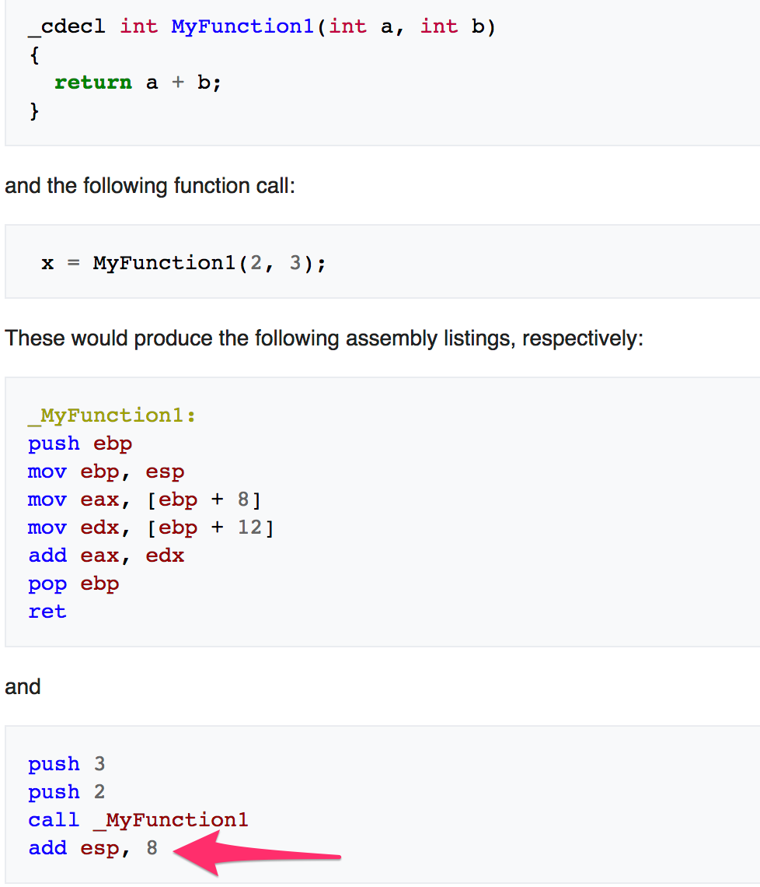
STDCALL
The C language, by default, uses the CDECL calling convention
In the CDECL calling convention the following holds:
Arguments are passed on the stack in Right-to-Left order, and return values are passed in eax.
The calling function cleans the stack. This allows CDECL functions to have variable-length argument lists.

Slide 34
STDCALL
STDCALL, also known as "WINAPI" (and a few other names, depending on where you are reading it) is used almost exclusively by Microsoft as the standard calling convention for the Win32 API.
STDCALL passes arguments right-to-left, and returns the value in eax.
The called function cleans the stack, unlike CDECL. This means that STDCALL doesn't allow variable-length argument lists.

Slide 35
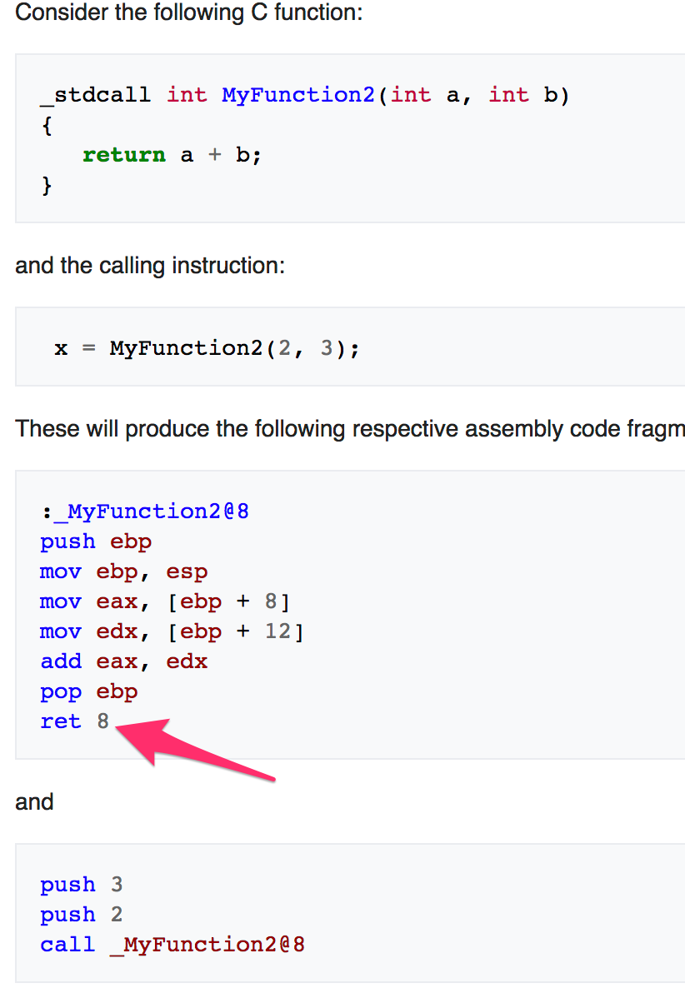
STDCALL
STDCALL, also known as "WINAPI" (and a few other names, depending on where you are reading it) is used almost exclusively by Microsoft as the standard calling convention for the Win32 API.
STDCALL passes arguments right-to-left, and returns the value in eax.
The called function cleans the stack, unlike CDECL. This means that STDCALL doesn't allow variable-length argument lists.
RET 8 ➔ RET + POP 8 Byte

Slide 36
FASTCALL
The FASTCALL calling convention is not completely standard across all compilers, so it should be used with caution.
The calling function most frequently is responsible for cleaning the stack, if needed.

Slide 37
Q & A

