Slide 1

Class5
CSC 497/583 Advanced Topics in Computer Security
Modern Malware Analysis
Assembly, Disassembly Primer
PE Format: IAT, EAT
Si Chen (schen@wcupa.edu)

Slide 2
Lab1
Create your own anti-malware system based on heuristic analysis.
Check course website

Slide 3
Review: PE Format

Slide 4

Portable Executable (PE) file
PE formatted files include:
  .exe, .scr (executable)
  .dll, .ocx, .cpl, drv (library)
  .sys, .vxd (driver files)
  .obj (objective file)
All PE formatted files can be executed, except obj file.
  .exe, .scr can be directly executed inside Shell (explorer.exe)
  others can be executed by other program/service
PE refers to 32 bit executable file, or PE32. 64 bit executable file is named as PE+ or PE32+. (Note that it is not PE64).

Slide 5
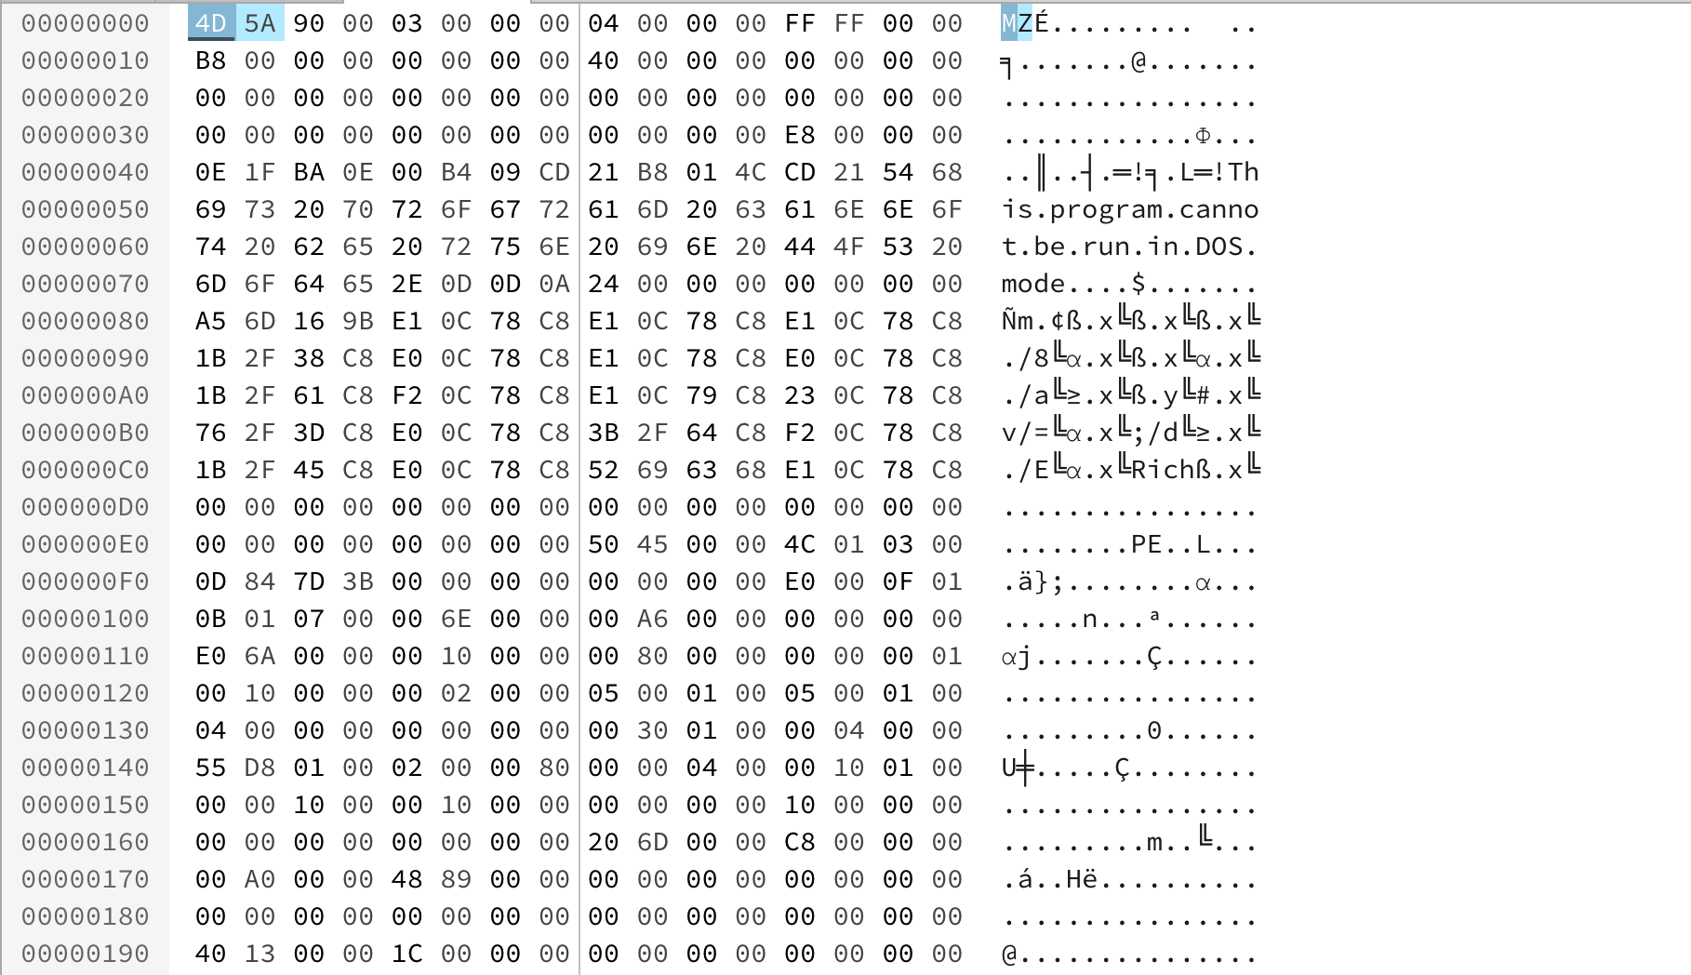
PE Example – Notepad.exe

Slide 6
Load PE file (Notepad.exe) into Memory

Slide 7
PE Structure

Slide 8
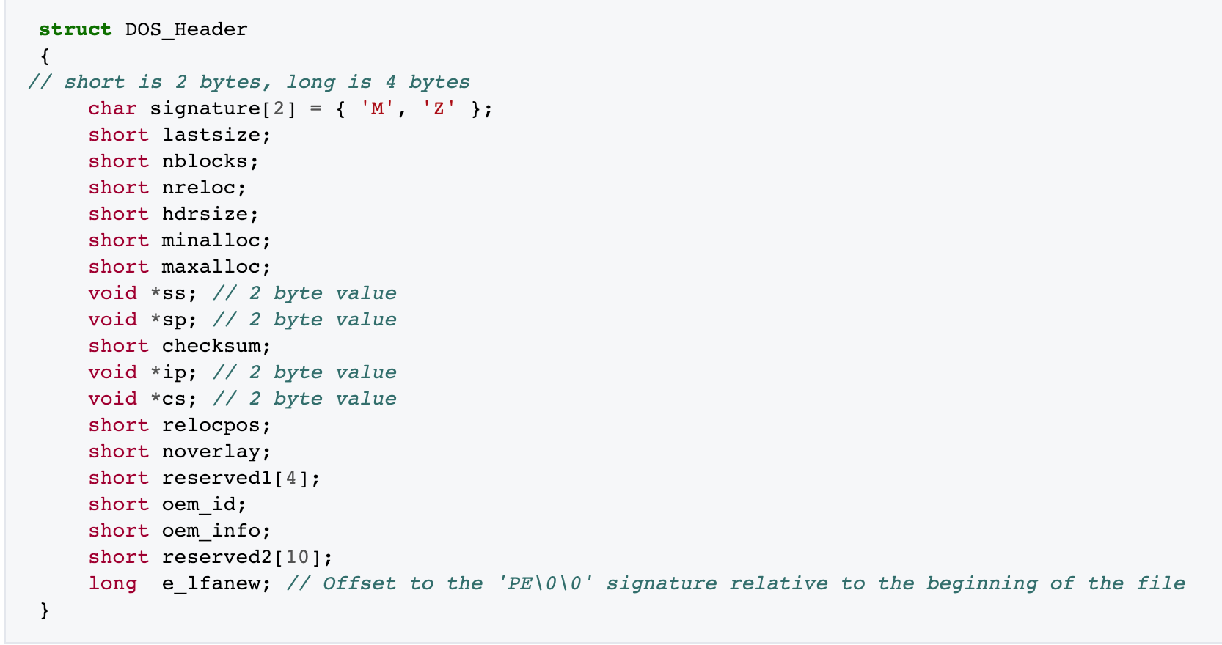
DOS Header
The first 2 letters are always the letters "MZ", the initials of Mark Zbikowski, who created the first linker for DOS. To some people, the first few bytes in a file that determine the type of file are called the "magic number,"

Slide 9
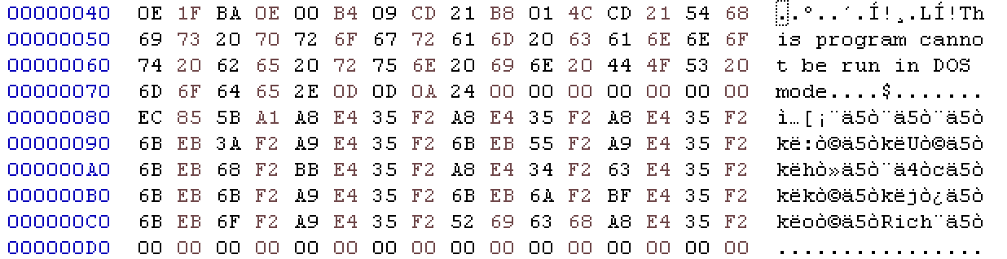
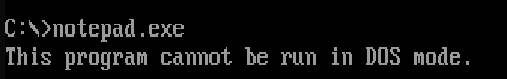
DOS stub
https://virtualconsoles.com/online-emulators/dos/

Slide 10
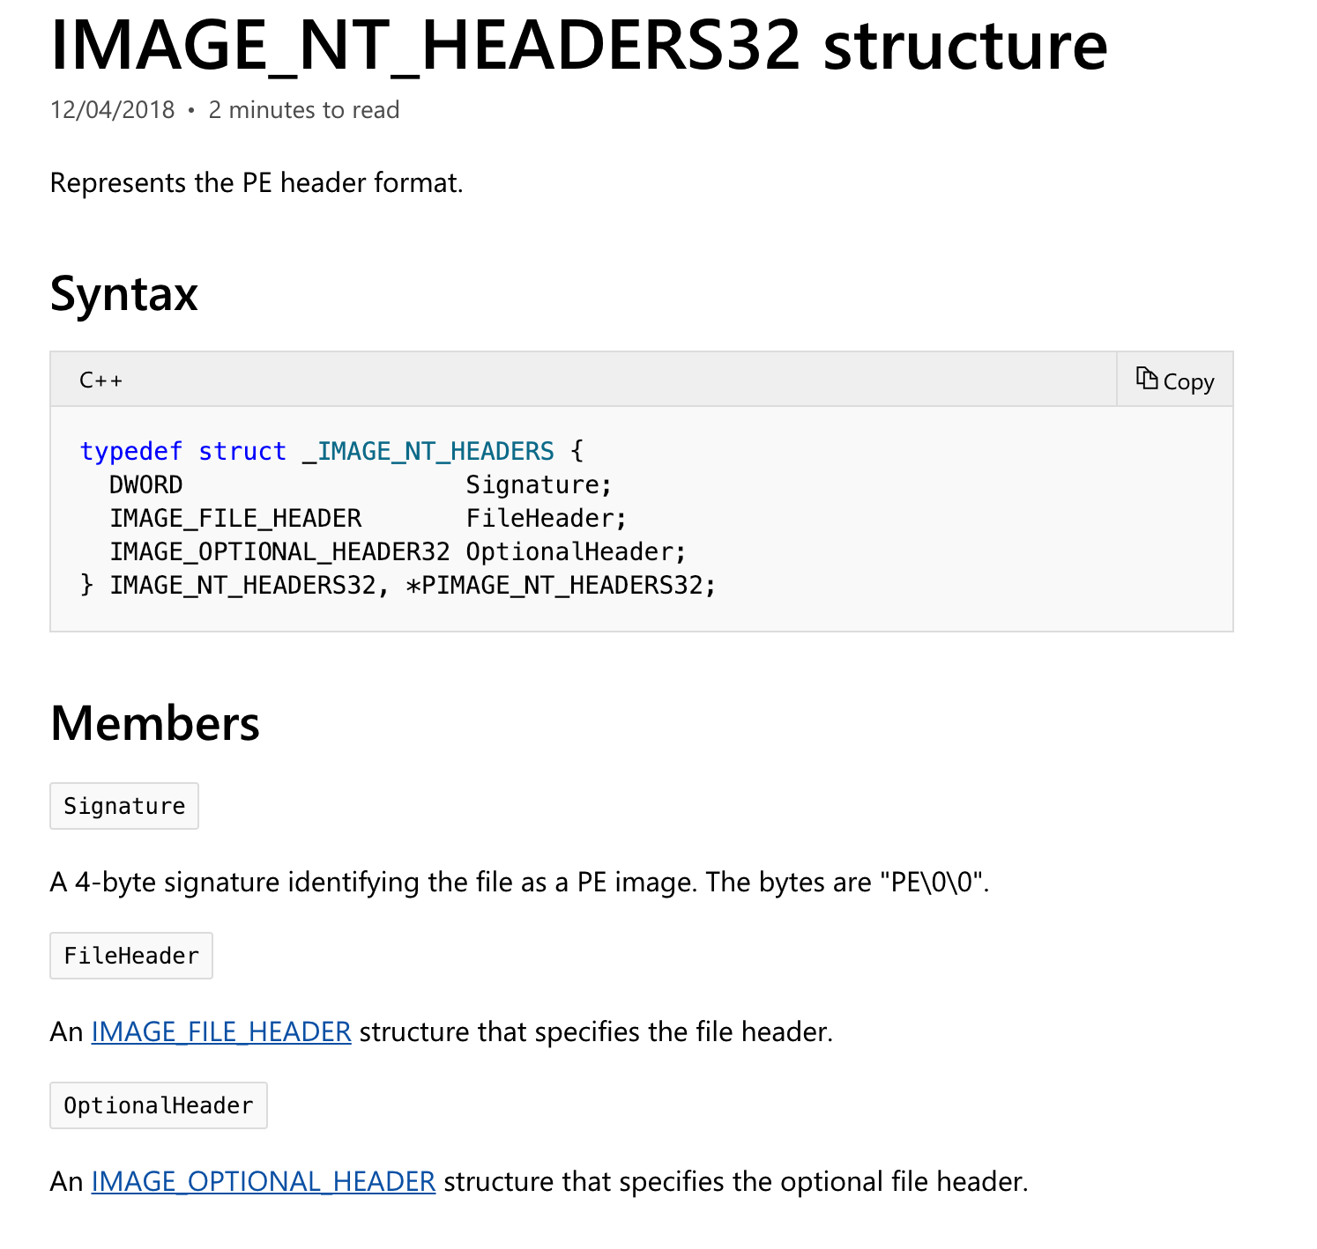
NT Header
https://docs.microsoft.com/en-us/windows/desktop/api/winnt/

Slide 11
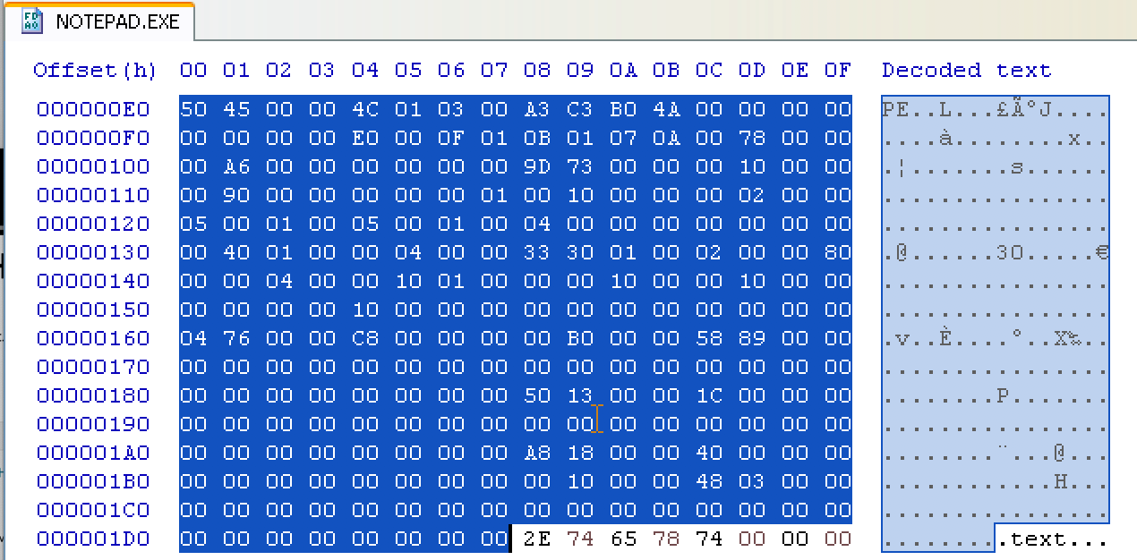
NT Header

Slide 12
Section Header
Name | Privilege
.code | Executable, read
.data | Non-Executable, read/write
.resource | Non-Executable, read

Slide 13
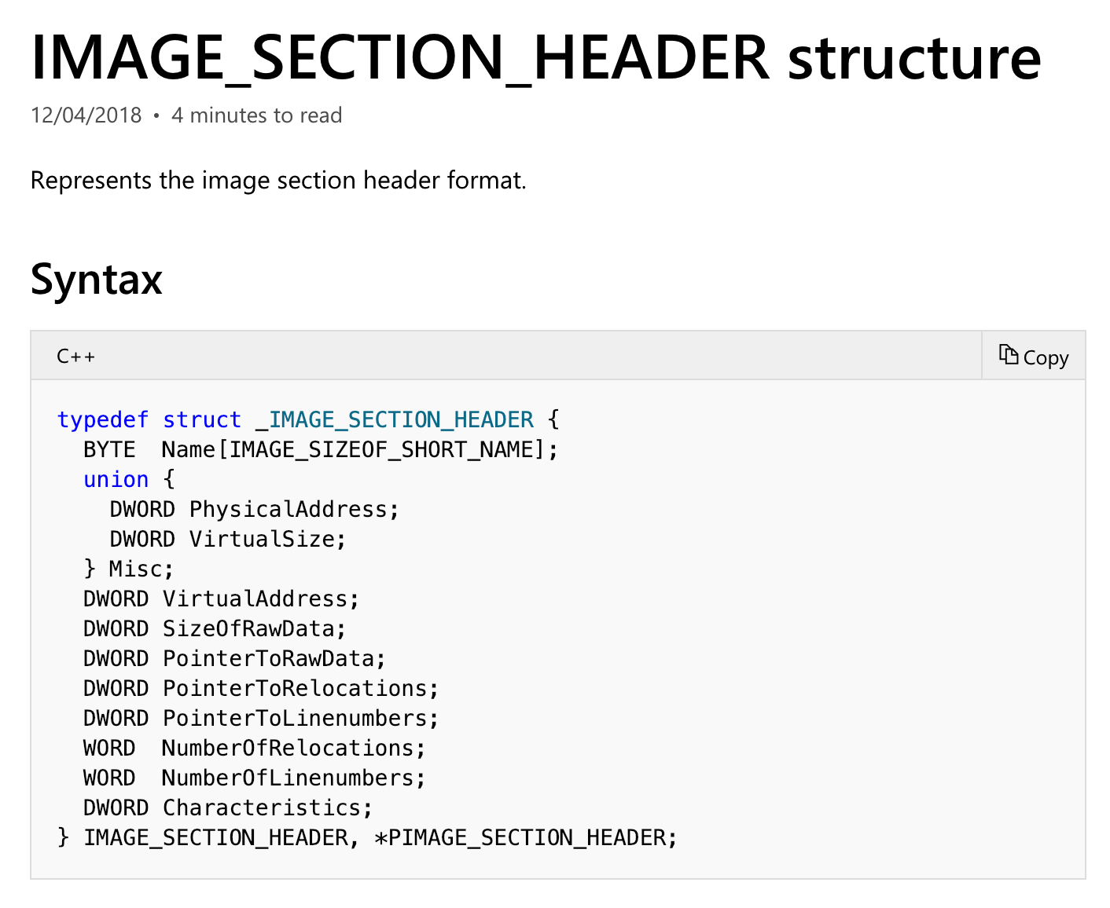
Section Header

Slide 14
Section Header
Members | Meaning
VirtualSize | The total size of the section when loaded into memory, in bytes.
VirtualAddress | The address of the first byte of the section when loaded into memory (RVA)
SizeOfRaw Data | The size of the section data on disk, in bytes.
PointerToRawData | The address of the first byte of the section on disk.
Characteristics | The characteristics of the image.
https://docs.microsoft.com/en-us/windows/desktop/api/winnt/ns-winnt-_image_section_header

Slide 15
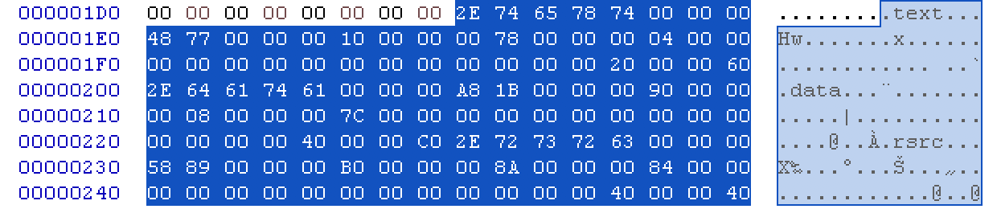
Section Header

Slide 16
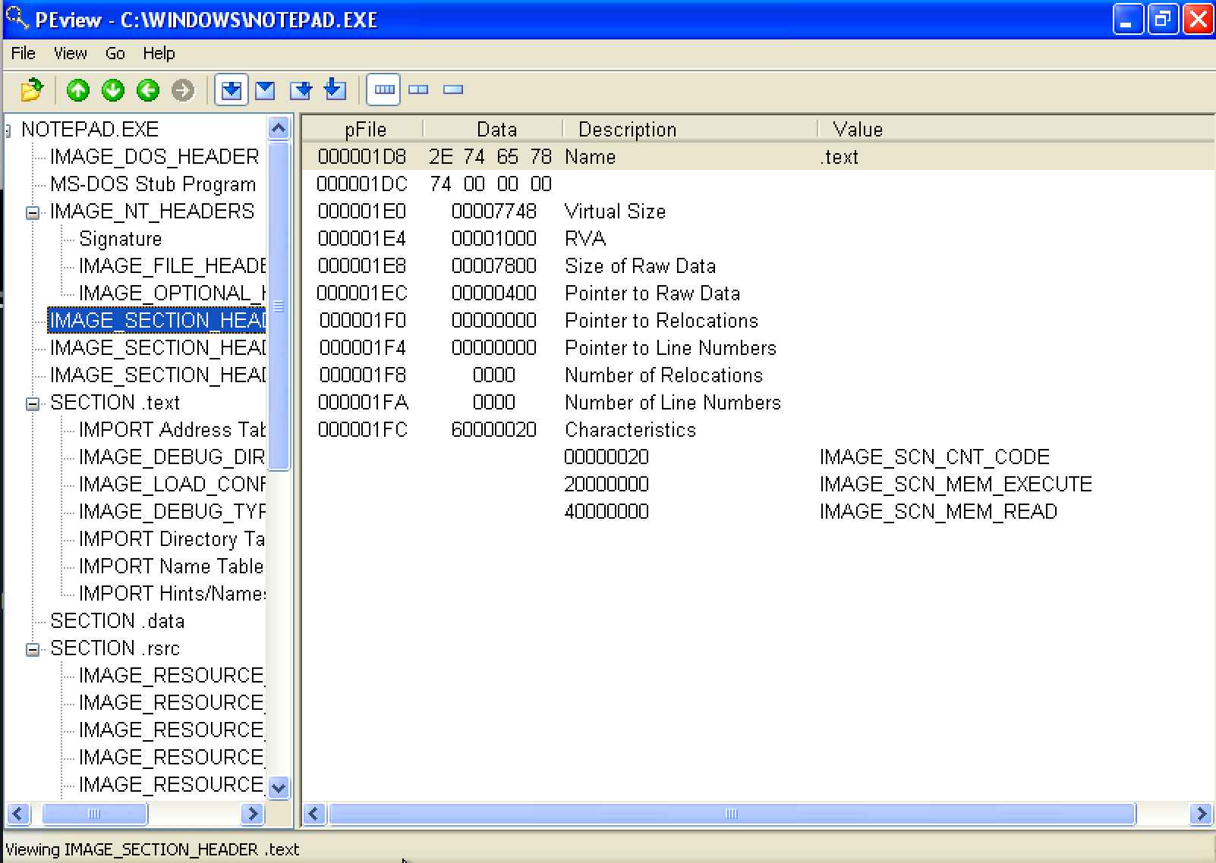
Inspecting PE Header Information

Slide 17
Disassembly Primer

Slide 18
Introduction
Static analysis and dynamic analysis are great techniques to understand the basic functionality of malware, but these techniques do not provide all the required information regarding the malware’s functionality.
Malware authors write their malicious code in a high level language, such as C or C++, which is compile to an executable using a compiler.
You only have the malicious executable, without its source code during your investigation.
To gain deeper understanding of a malware’s inner workings and to understand the critical aspects of a malicious binary, assembly code analysis needs to be performed.

Slide 19
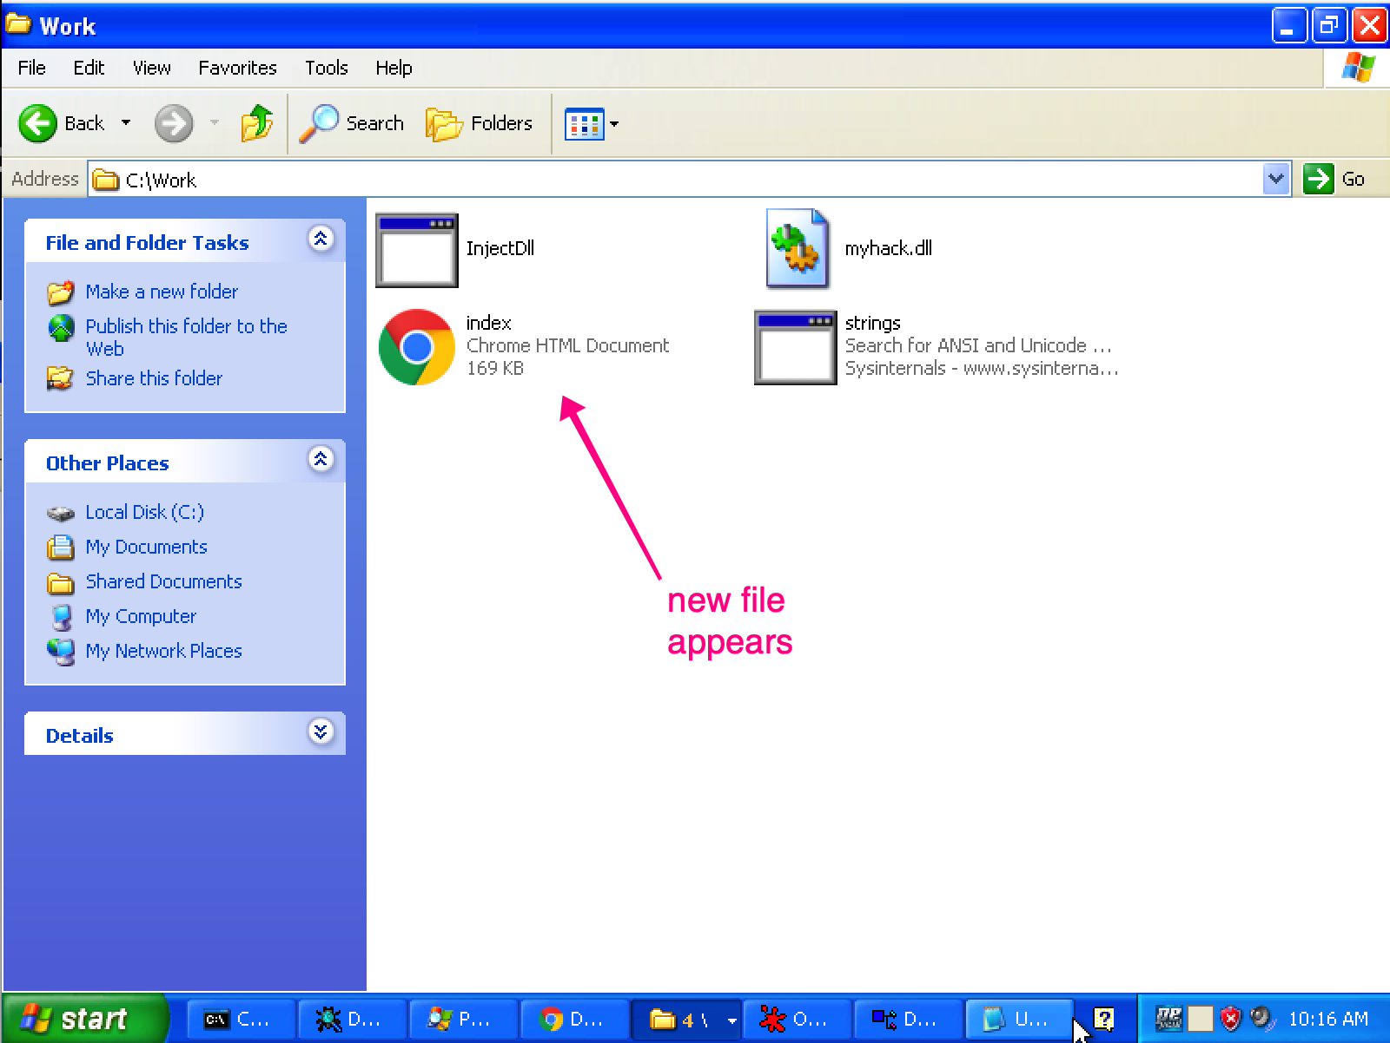
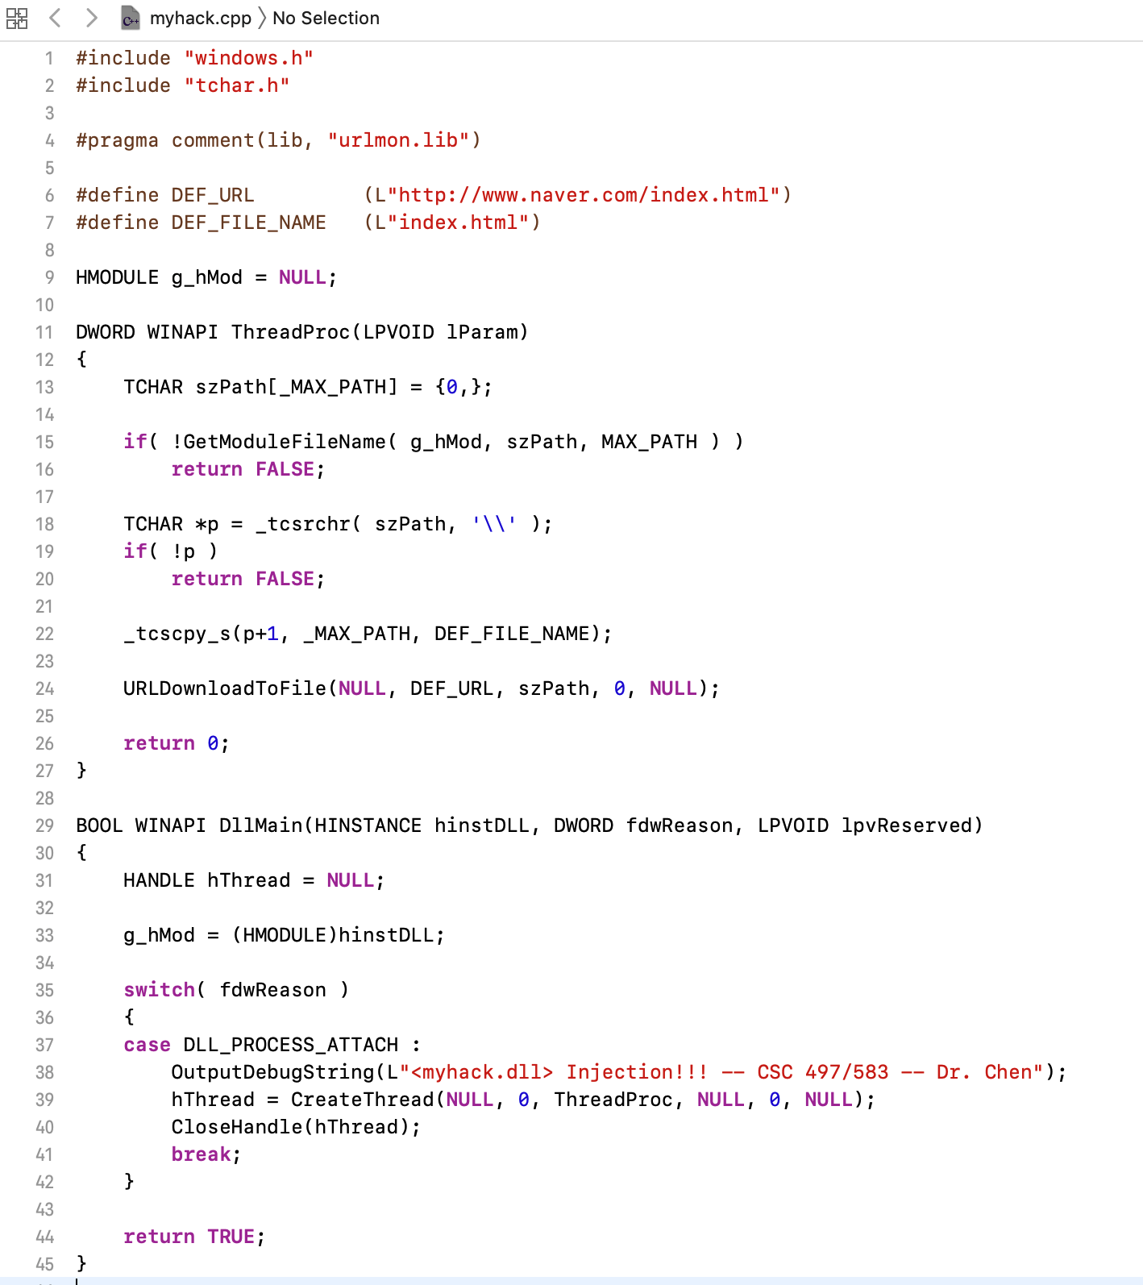
Introduction
executables
source code

Slide 20
Introduction
Is it possible to reconstruct high level code from executable directly?
It’s possible!
Not always working

Slide 21
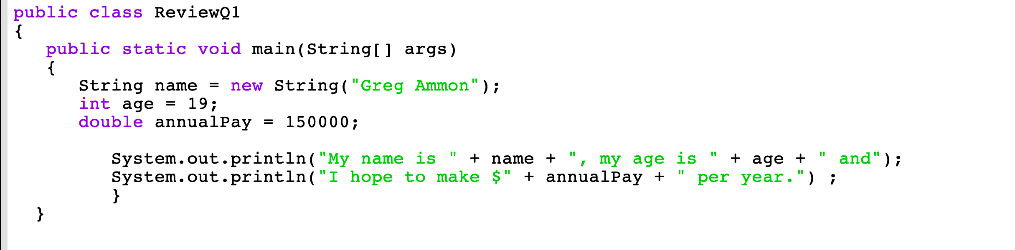
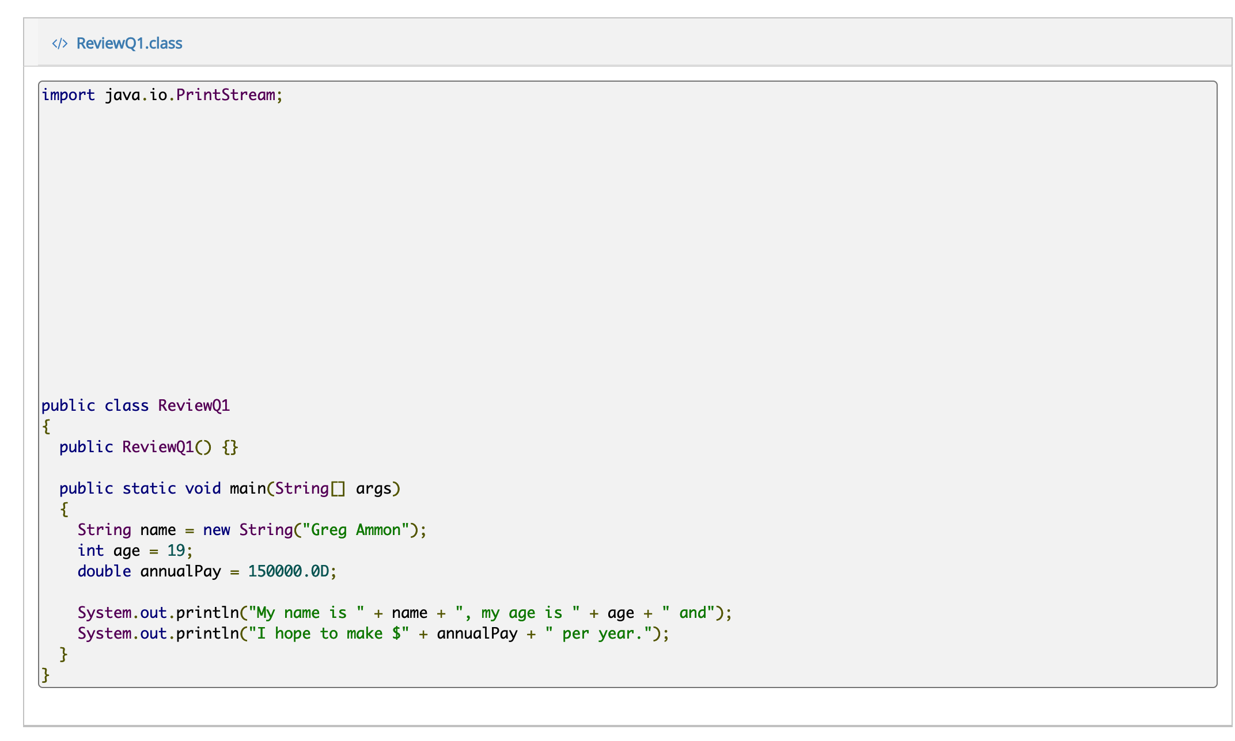
source code
decompile result

Slide 22
Introduction
decompile result

Slide 23
Overview
Computer basics, memory and the CPU
Data transfer, arithmetic, and bitwise operations
Functions and stack

Slide 24
Computer Basics
A group of 8 bits makes a byte
A single byte is represented as two hexadecimal digits
5D
0 | 1 | 0 | 1 | 1 | 1 | 0 | 1
5
D

Slide 25
PE Example – Notepad.exe

Slide 26
RAM
The main memory (RAM) stores the code (machine code) and data for the computer.
A computer’s main memory is an array of bytes.
Each byte labeled with a unique number, known as address.
Address
0x10F1009
0x10F1008
0x10F1007
0x10F1006
0x10F1005
0x10F1004
0x10F1003
Data in Memory
45
FC
00
30
0F
01
51

Slide 27
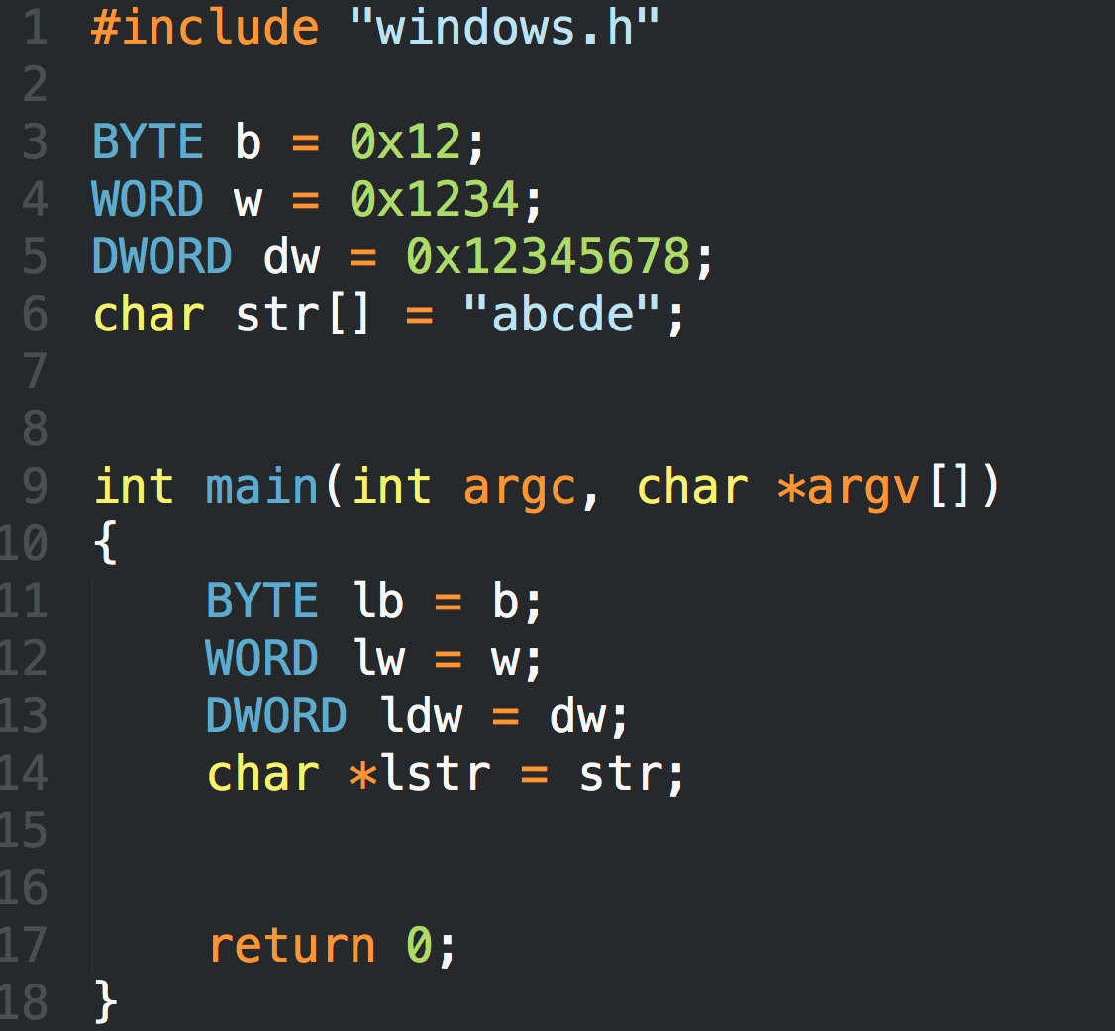
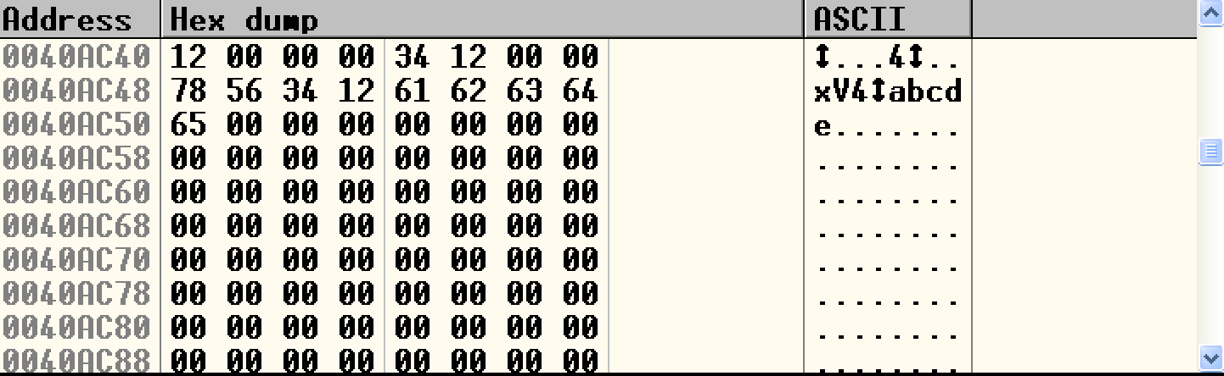
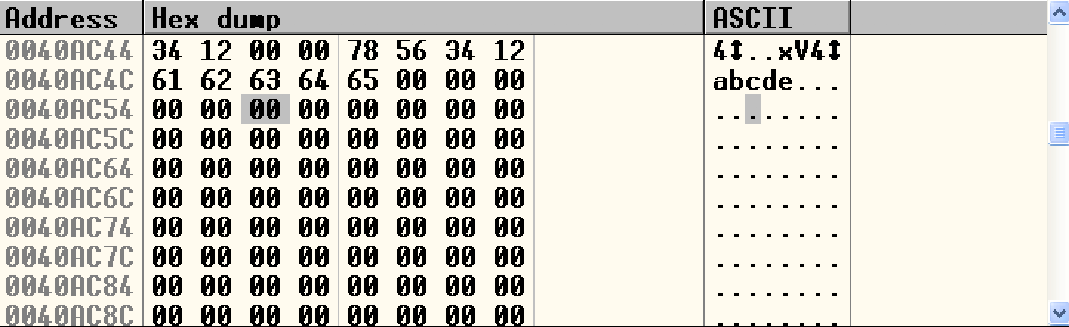
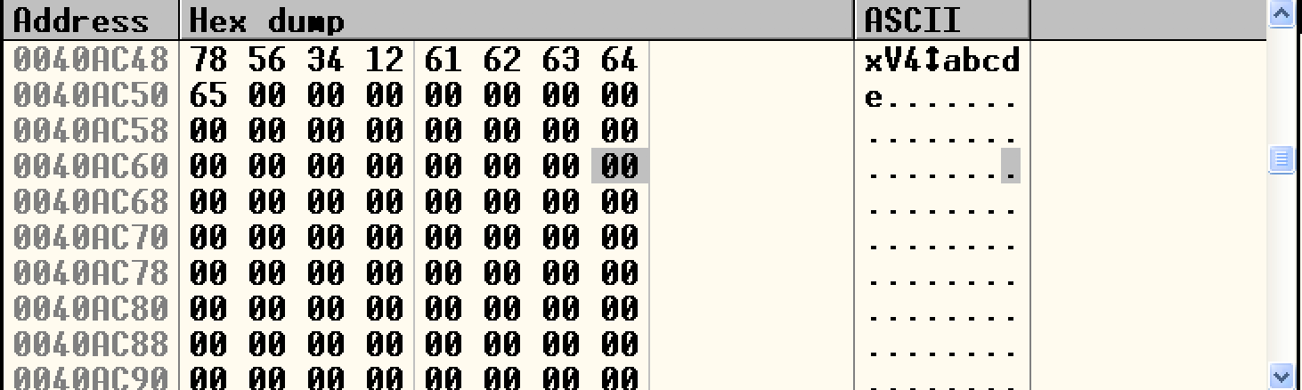
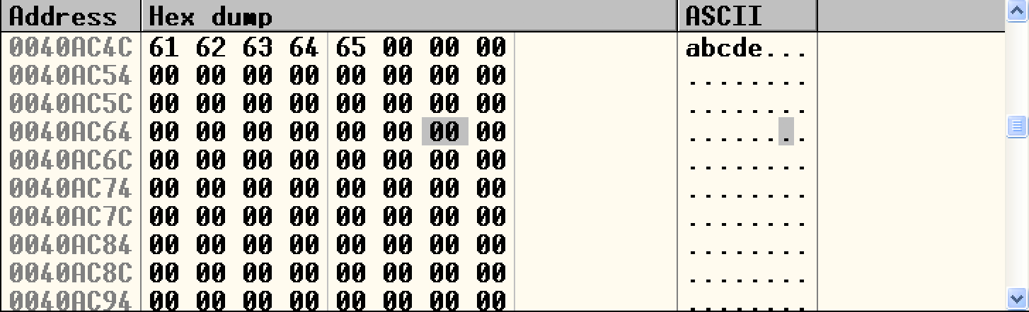
LittleEndian.exe

Slide 28
Program Basics
Program on disk

Slide 29
Program Basics
Program on disk

Slide 30
Program Basics
Memory
low memory
addr
Program in memory
high memory
addr

Slide 31
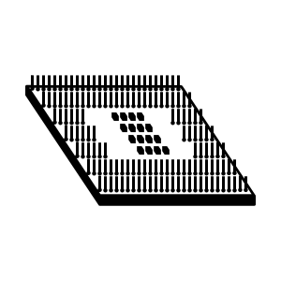
Program Basics
Memory
CPU
low memory
addr
high memory
addr
The CPU fetches the machine instruction, decodes it, and executes it
The CPU fetches the required data from memory, the data can also be written to the memory

Slide 32
IA-32 Register

Slide 33
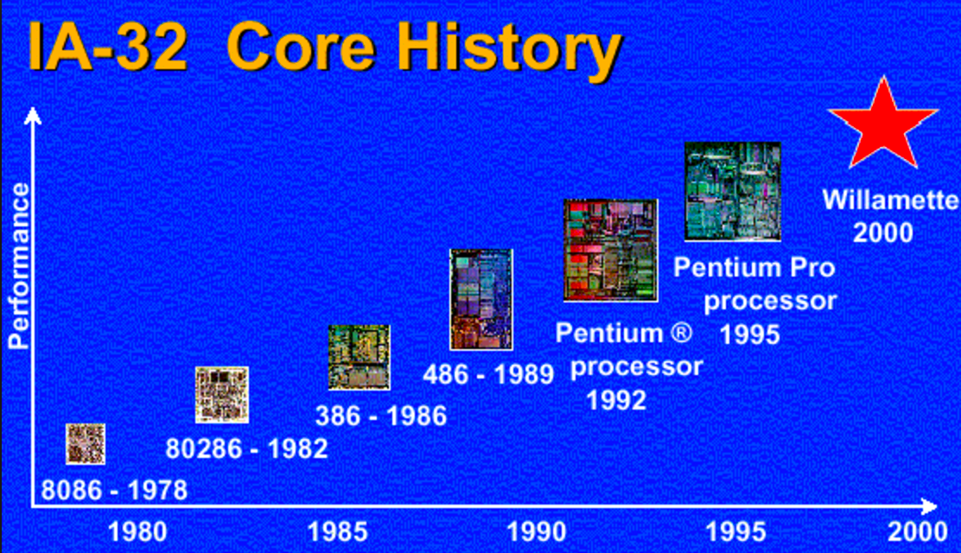
Intel IA-32 Processor
Intel uses IA-32 to refer to Pentium processor family, in order to distinguish them from their 64-bit architectures.

Slide 34
CPU Registers
The CPU contains special storage called registers.
The CPU can access data in registers much faster than data in memory

Slide 35
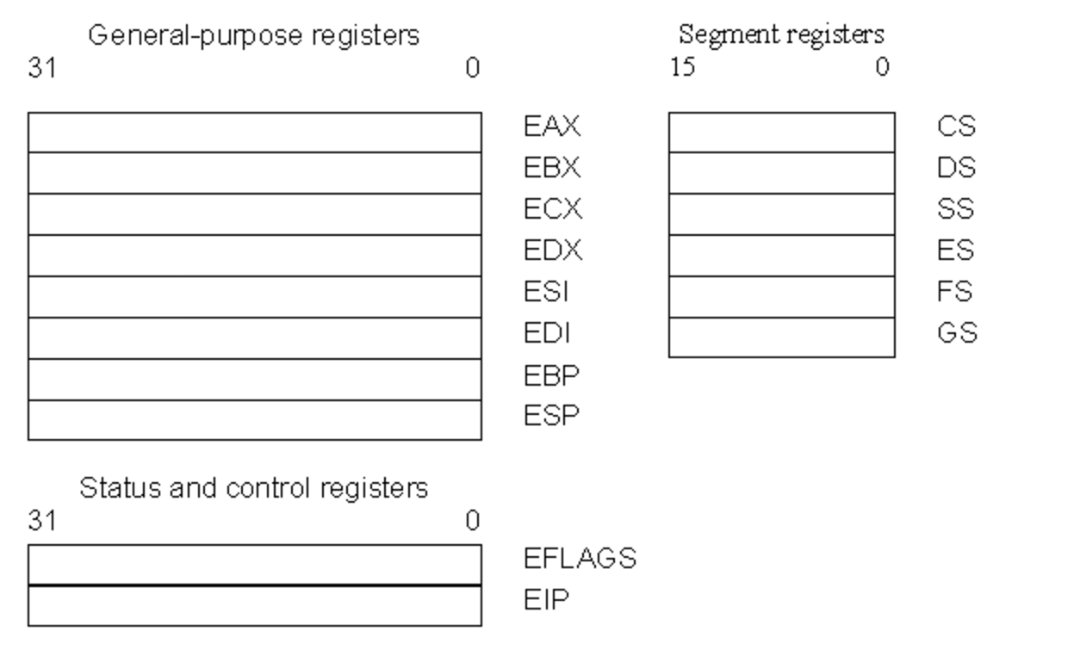
Register Set
There are three types of registers:
  general-purpose data registers,
  segment registers,
  status and control registers.

Slide 36
General-purpose Registers
The eight 32-bit general-purpose data registers are used to hold operands for logical and arithmetic operations, operands for address calculations and memory pointers
4 Bytes
Notes:
The following figure shows the lower 16 bits of the general-purpose registers can be used with the names AX, BX, CX, DX, BP, SP, SI, and DI (the names for the corresponding 32-bit ones have a prefix "E" for "extended"). Each of the lower two bytes of the EAX, EBX, ECX, and EDX registers can be referenced by the names AH, BH, CH, and DH (high bytes) and AL, BL, CL, and DL (low bytes).

Slide 37
Other uses…
  EAX—Accumulator for operands and results data.
  EBX—Pointer to data in the DS segment.
  ECX—Counter for string and loop operations.
  EDX—I/O pointer.
We use these four registers when we perform arithmetic operations (ADD, SUB, XOR, OR) -- store constant or variable’s value.
Some assembly operations (MUL, DIV, LODS) directly operate these register and altered the value when finished.
ECX is used for loop count → decrease 1 after each loop
EAX is used for storing the return value of a function (Win32 API)

Slide 38
Other uses…
ESI—Pointer to data in the segment pointed to by the DS register; source pointer for string operations.
EDI—Pointer to data (or destination) in the segment pointed to by the ES register; destination pointer for string operations.
EBP—Pointer to data on the stack.
ESP—Stack pointer.
PUSH, POP, CALL, RET

Slide 39
Segment Registers

Slide 40
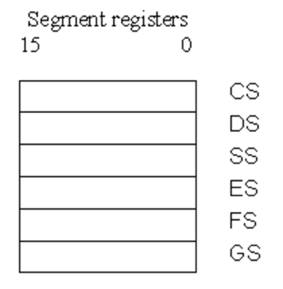
Segment Registers
What is “Segment”??
  Segments are specific areas defined in a program for containing data, code and stack. There are three main segments −
    Code Segment − It contains all the instructions to be executed. A 16-bit Code Segment register or CS register stores the starting address of the code segment.
    Data Segment − It contains data, constants and work areas. A 16-bit Data Segment register or DS register stores the starting address of the data segment.
    Stack Segment − It contains data and return addresses of procedures or subroutines. It is implemented as a 'stack' data structure. The Stack Segment register or SS register stores the starting address of the stack.
there are other extra segment registers - ES (extra segment), FS and GS, which provide additional segments for storing data.

Slide 41

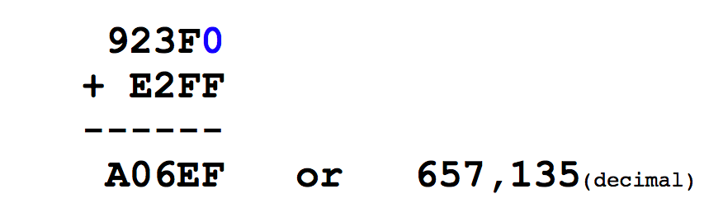
Segment Registers
    Physical Address = [Segment Register] * 16 + Offset

Slide 42
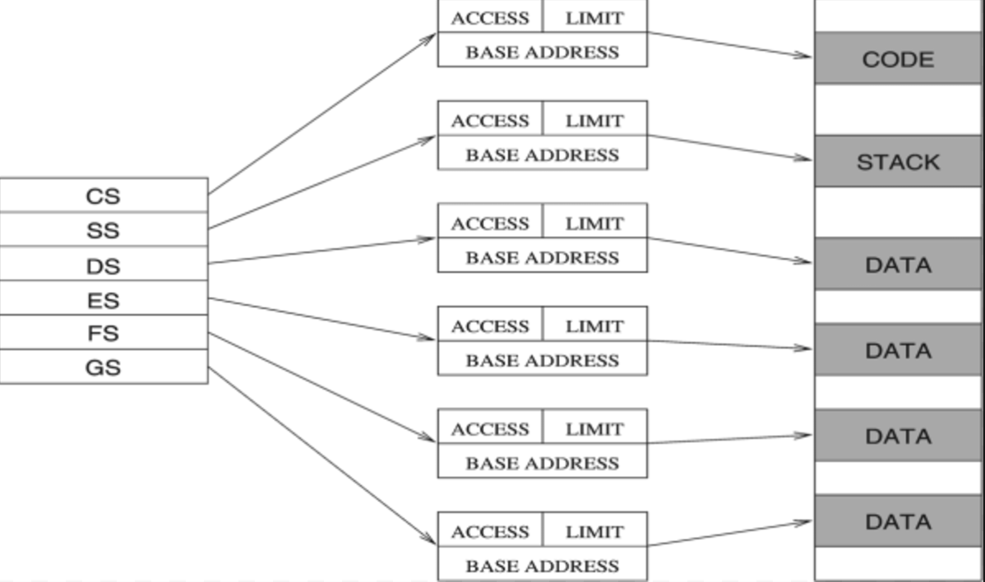
Segment Registers
There are six segment registers that hold 16-bit segment selectors. A segment selector is a special pointer that identifies a segment in memory.
  CS: code segment register
  SS: stack segment register
  DS, ES, FS, GS: data segment registers

Slide 43
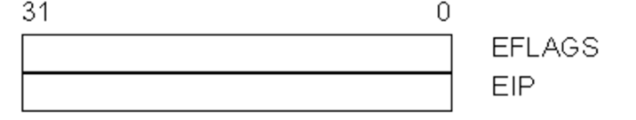
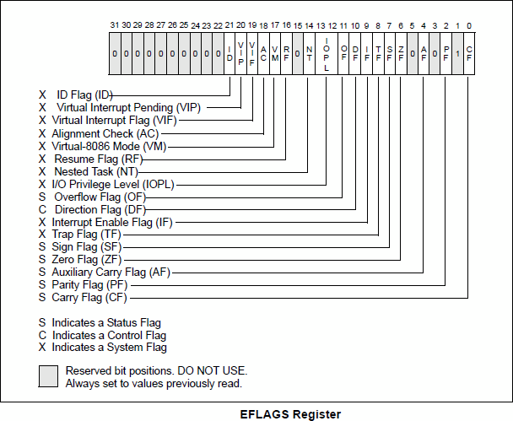
  Status and Control Registers
The 32-bit EFLAGS register contains a group of status flags, a control flag, and a group of system flags.
JCC

Slide 44
Status and Control Registers
Change to ‘1’ if:
Signed integer overflow
Change in MSB (Most Significant Bit)
Change to ‘1’ if:
Calculation result is 0
Change to ‘1’ if:
unsigned integer overflow

Slide 45
  Status and Control Registers
EIP Register (Instruction Pointer)
The EIP register (or instruction pointer) can also be called "program counter."
It contains the offset in the current code segment for the next instruction to be executed.
It is advanced from one instruction boundary to the next in straight-line code or it is moved ahead or backwards by a number of instructions when executing JMP, Jcc, CALL, RET, and IRET instructions.

Slide 46
X86 ASM

Slide 47
MOV
Move reg/mem value to reg/mem
  mov A, B is "Move B to A" (A=B)
  Same data size
  mov eax, 0x1337
  mov bx, ax
  mov [esp+4], bl

Slide 48
More About Memory Access
mov ebx, [esp + eax * 4] Intel
mov (%esp, %eax, 4), %ebx AT&T
mov BYTE [eax], 0x0f
You must indicate the data size: BYTE/WORD/DWORD

Slide 49
ADD / SUB
ADD / SUB
Normallly "reg += reg" or "reg += imm"
Data size should be equal
  add eax, ebx
  sub eax, 123
  sub eax, BL ; Illegal

Slide 50
INC / DEC
inc, dec — Increment, Decrement
The inc instruction increments the contents of its operand by one. The dec instruction decrements the contents of its operand by one.
Syntax
inc <reg>
inc <mem>
dec <reg>
dec <mem>
Examples
dec eax — subtract one from the contents of EAX.
inc DWORD PTR [var] — add one to the 32-bit integer stored at location var

Slide 51
Jump
Unconditional jump: jmp
Conditional jump: je/jne
and ja/jae/jb/jbe/jg/jge/jl/jle ...
Sometime with ”cmp A, B” -- compare these two values and set eflags
Conditional jump is decided by some of the eflags bits.

Slide 52
Jump
ja/jae/jb/jbe are unsigned comparison
jg/jge/jl/jle are signed comparison

Slide 53
CMP
cmp — Compare
Compare the values of the two specified operands, setting the condition codes in the machine status word appropriately. This instruction is equivalent to the sub instruction, except the result of the subtraction is discarded instead of replacing the first operand. Syntax
cmp <reg>,<reg>
cmp <reg>,<mem>
cmp <mem>,<reg>
cmp <reg>,<con>
Example
cmp DWORD PTR [var], 10
jeq loop
If the 4 bytes stored at location var are equal to the 4-byte integer constant 10, jump to the location labeled loop.

Slide 54
CALL/RET(RETN)
CALL: The call instruction calls near procedures using a full pointer. call causes the procedure named in the operand to be executed. When the called procedure completes, execution flow resumes at the instruction following the call instruction
RET: The ret instruction transfers control to the return address located on the stack. Issue the ret instruction within the called procedure to resume execution flow at the instruction following the call.

Slide 55
IAT (Import Address Table)

Slide 56
IAT (Import Address Table)
Let’s review the concept of DLL (Dynamic Link Library) again…
IAT table

Slide 57
Dynamic Linking

Slide 58
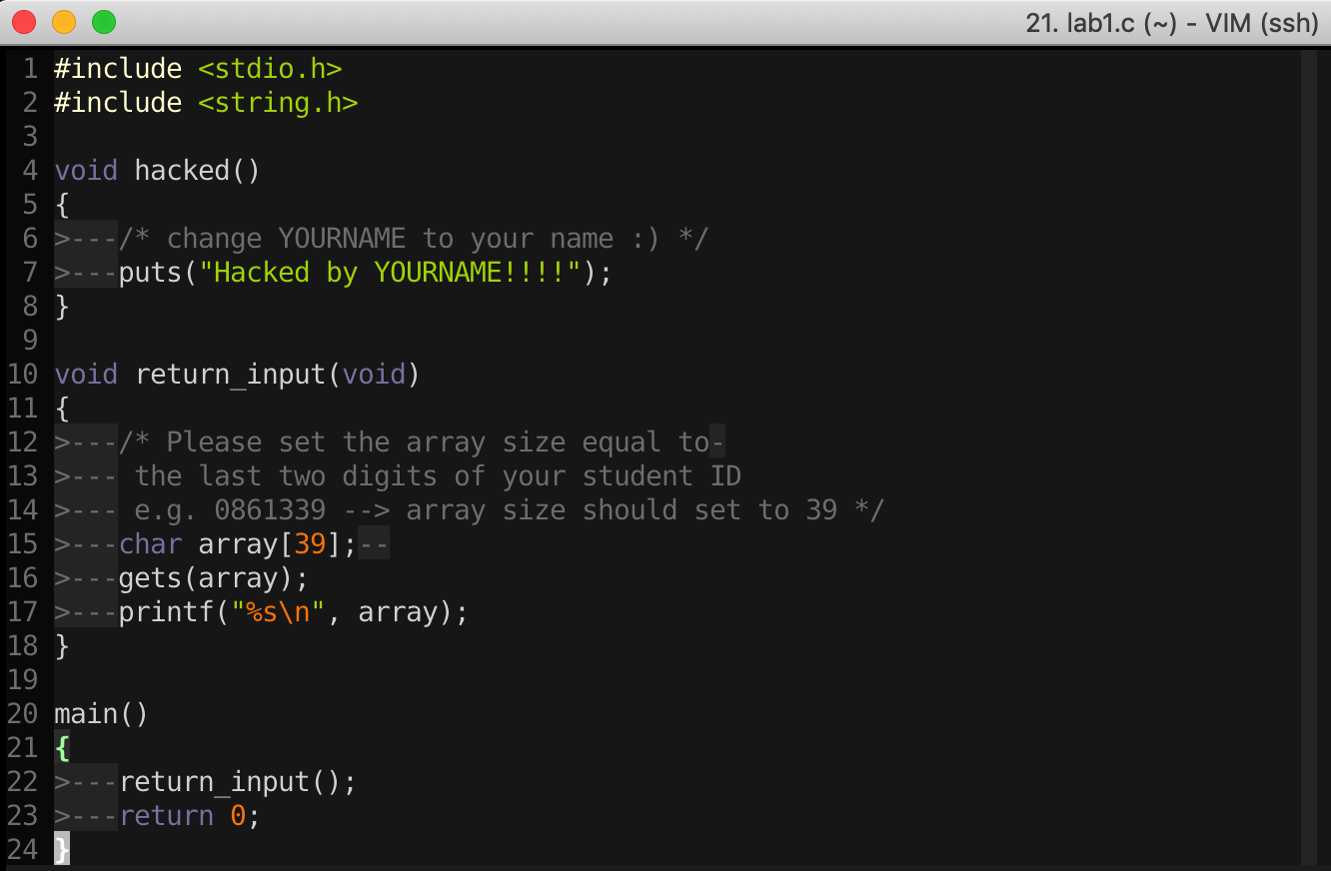
16-Bit DOS System
import Library → Put binary code of stdio library into the executable file

Slide 59
Static Linking
Memory
Waste space
Hard to maintain
Program2
Program2.obj
Lib.obj
Program1
Program1.obj
Lib.obj
Program2
Program2.obj
Lib.obj
Program1
Program1.obj
Lib.obj

Slide 60
Dynamic Linking
Memory
Dynamic linking has the following advantages:
Saves memory
Saves disk space.
Upgrades to the DLL are easier.
Provides after-market support.
Supports multi language programs.
Eases the creation of international versions
Lib.dll
Lib.obj
Program2
Program2.obj
Program1
Program1.obj
Program2
Program2.obj
Lib.dll
Lib.obj
Program1
Program1.obj

Slide 61
Two ways to Load DLL

Slide 62
Two ways to Load DLL
An executable file links to (or loads) a DLL in one of two ways:
Explicit Linking (run-time dynamic linking)
  the executable using the DLL must make function calls to explicitly load and unload the DLL, and to access the DLL's exported functions.
Implicit Linking (load-time dynamic linking)
  The operating system loads the DLL when the executable using it is loaded.

Slide 63
Two ways to Load DLL
Explicit Linking (run-time dynamic linking)
Implicit Linking (load-time dynamic linking)

Slide 64
Two ways to Load DLL
An executable file links to (or loads) a DLL in one of two ways:
DLL Injection
Explicit Linking (run-time dynamic linking)
  the executable using the DLL must make function calls to explicitly load and unload the DLL, and to access the DLL's exported functions.
Implicit Linking (load-time dynamic linking)
  The operating system loads the DLL when the executable using it is loaded.
IAT Table

Slide 65
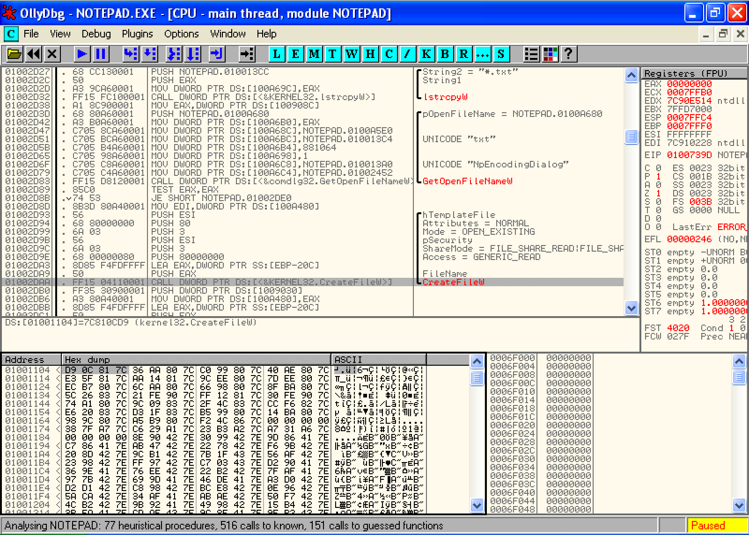
Implicit Linking and IAT (Import Address Table)
Notepad.exe Call CreateFileW() → Call 0x01001104 → Call 0x7C810CD9

Slide 66
Implicit Linking and IAT (Import Address Table)
Notepad.exe Call CreateFileW() → Call 0x01001104 → Call 0x7C810CD9
Call 0x01001104
Look up
IAT Table
Function Name | IAT Address | Real Address
…
CreateFileW() | 0x01001104 | 0x7C810CD9
…
When the application was first compiled, it was designed so that all API calls will NOT use direct hardcoded addresses but rather work through a function pointer.
This was accomplished through the use of an import address table. This is a table of function pointers filled in by the windows loader as the dlls are loaded.

Slide 67
IAT (Import Address Table)
Why IAT?

Slide 68
IAT (Import Address Table)
Support different Windows Version (9X, 2K, XP, Vista, 7, 8, 10)
Call CreateFileW() --> Call 0x01001104
Look up
XP
IAT Table
Function Name | IAT Address | Real Address
…
CreateFileW() | 0x01001104 | 0x7C810CD9
…
Windows 7
Function Name | IAT Address | Real Address
…
CreateFileW() | 0x01001104 | 0x7C81FFFF
…

Slide 69
IAT (Import Address Table)
Support DLL Relocation

Slide 70
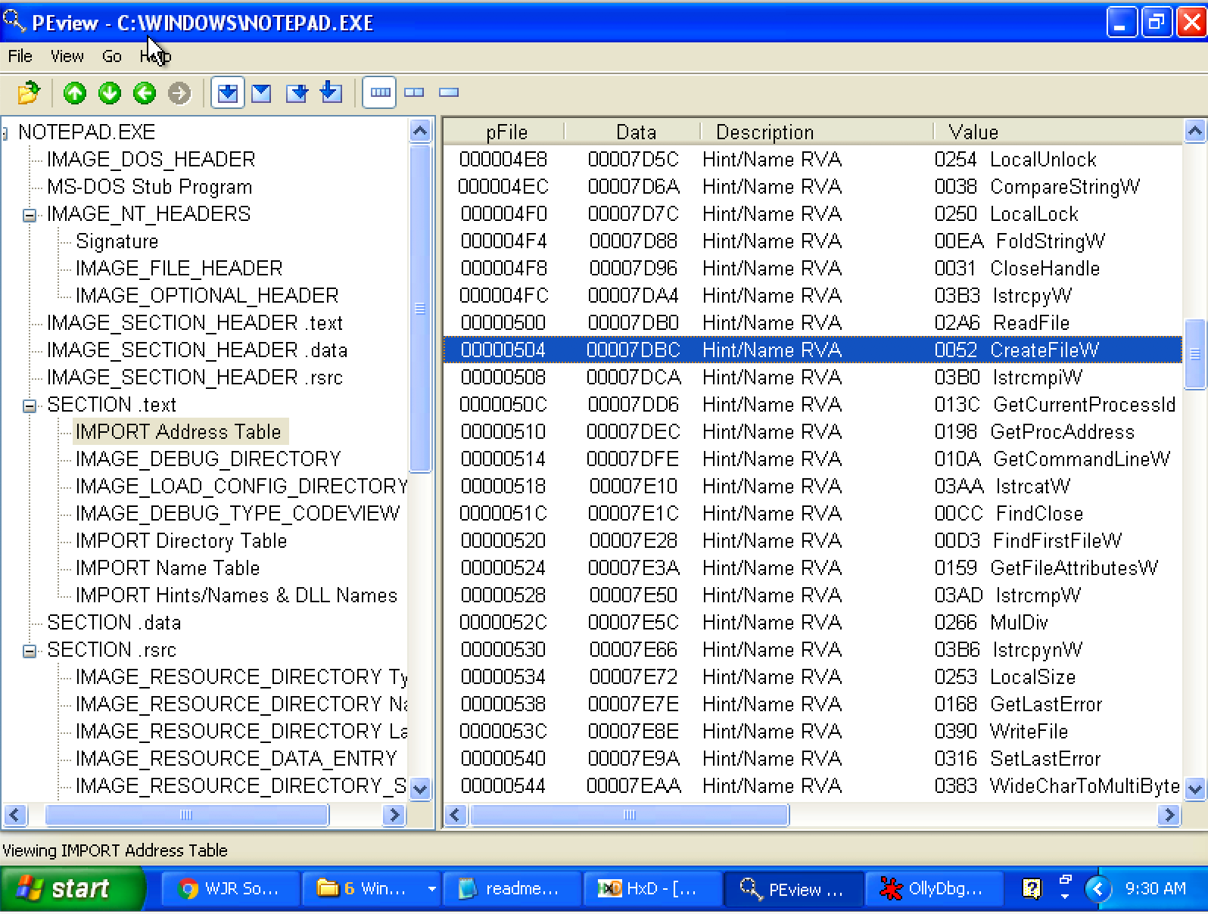
Look up IAT Table with PEview

Slide 71
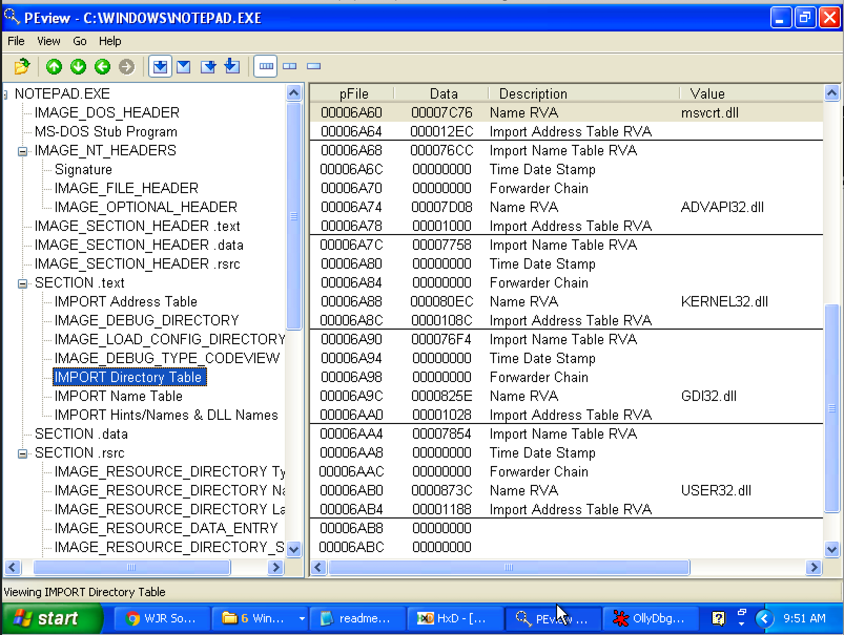
Import Directory Table
The Import Directory Table contains entries for every DLL which is loaded by the executable. Each entry contains, among other, Import Lookup Table (ILT) and Import Address Table (IAT)

Slide 72
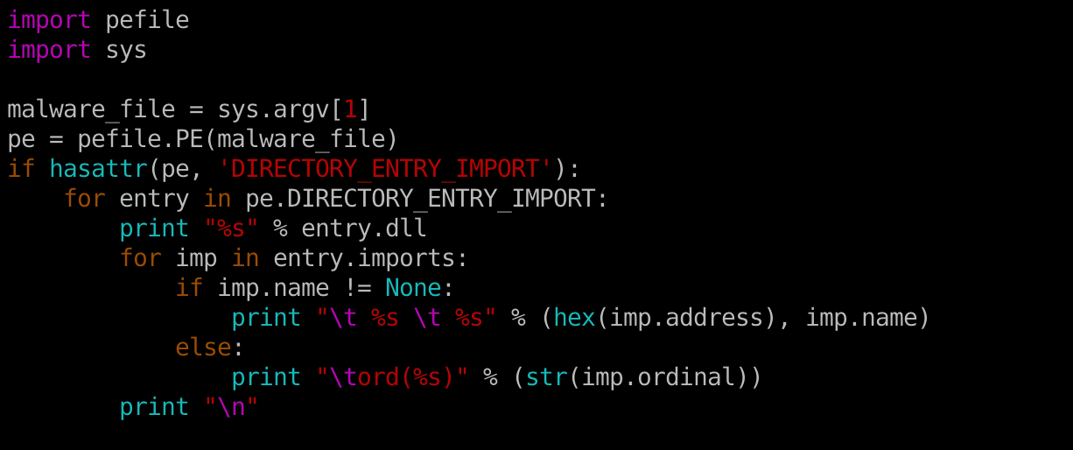
Inspecting file imports with pefile library

Slide 73
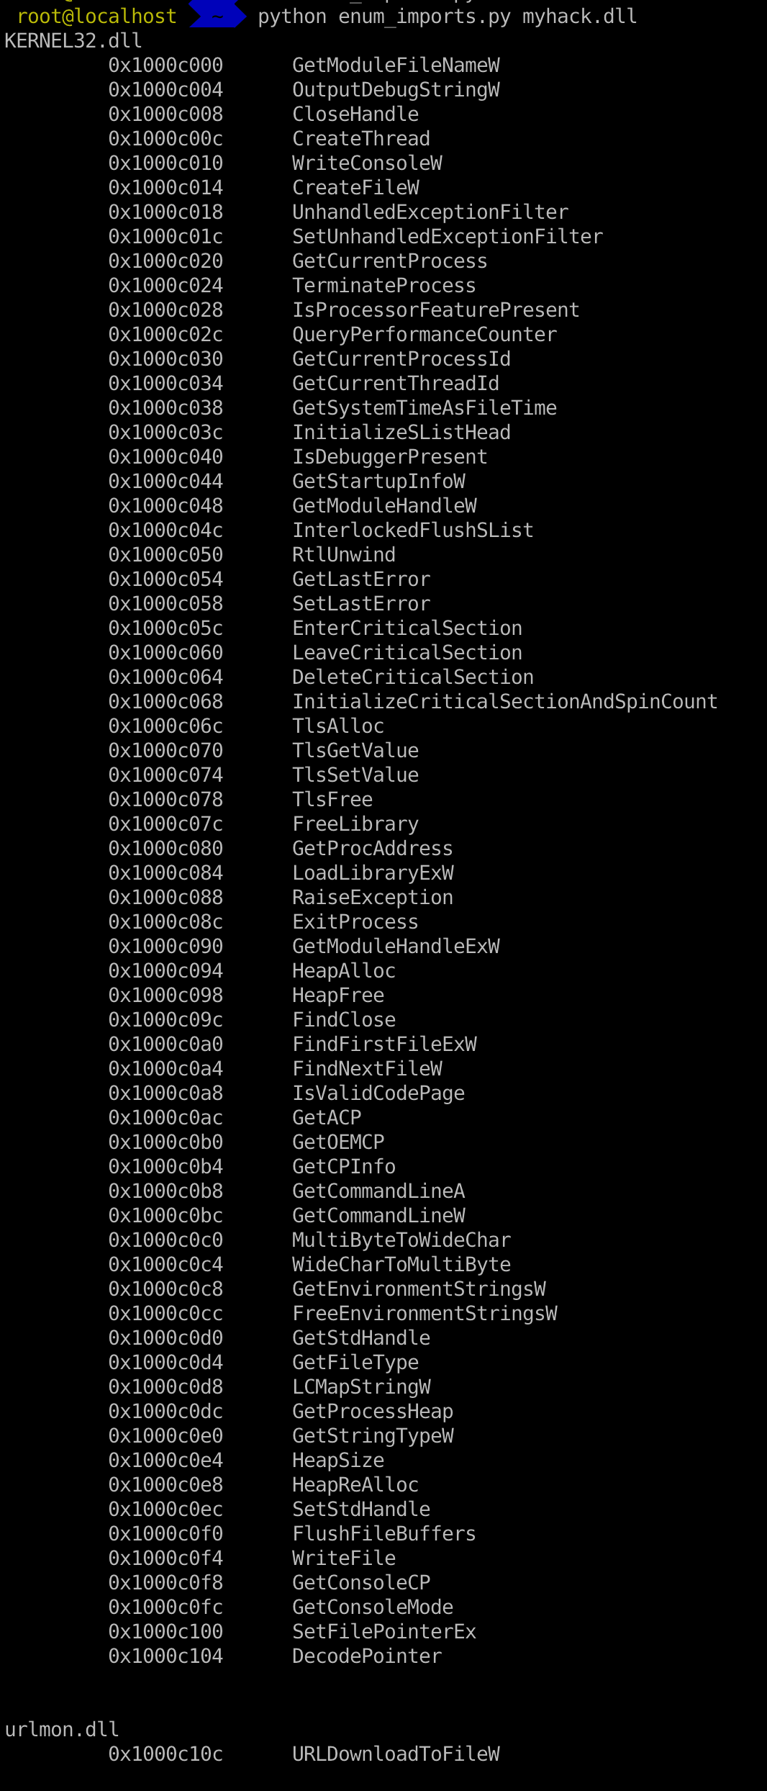

Slide 74
EAT (Export Address Table)
Similar to IAT, EAT data is stored in IMAGE_EXPORT_DIRECTORY
EAT contains an RVA that points to an array of pointers to (RVAs of) the functions in the module.

Slide 75
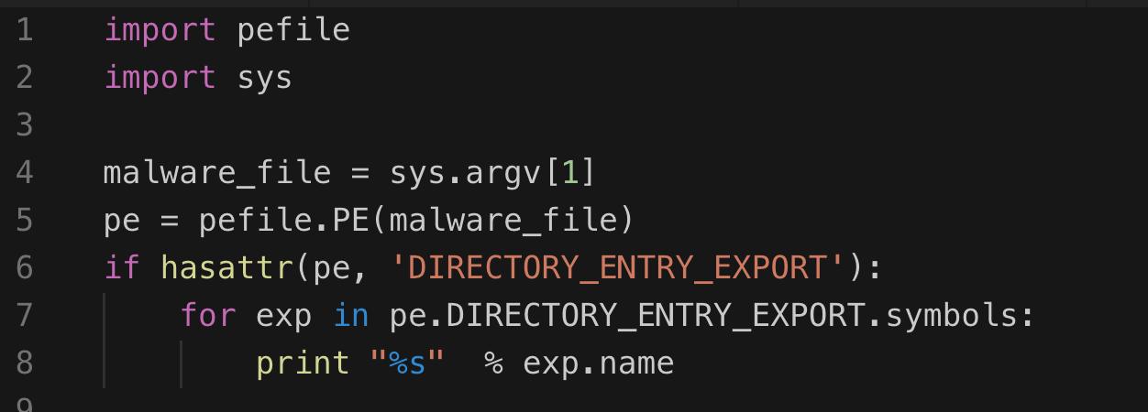
Inspecting file export with pefile library

Slide 76
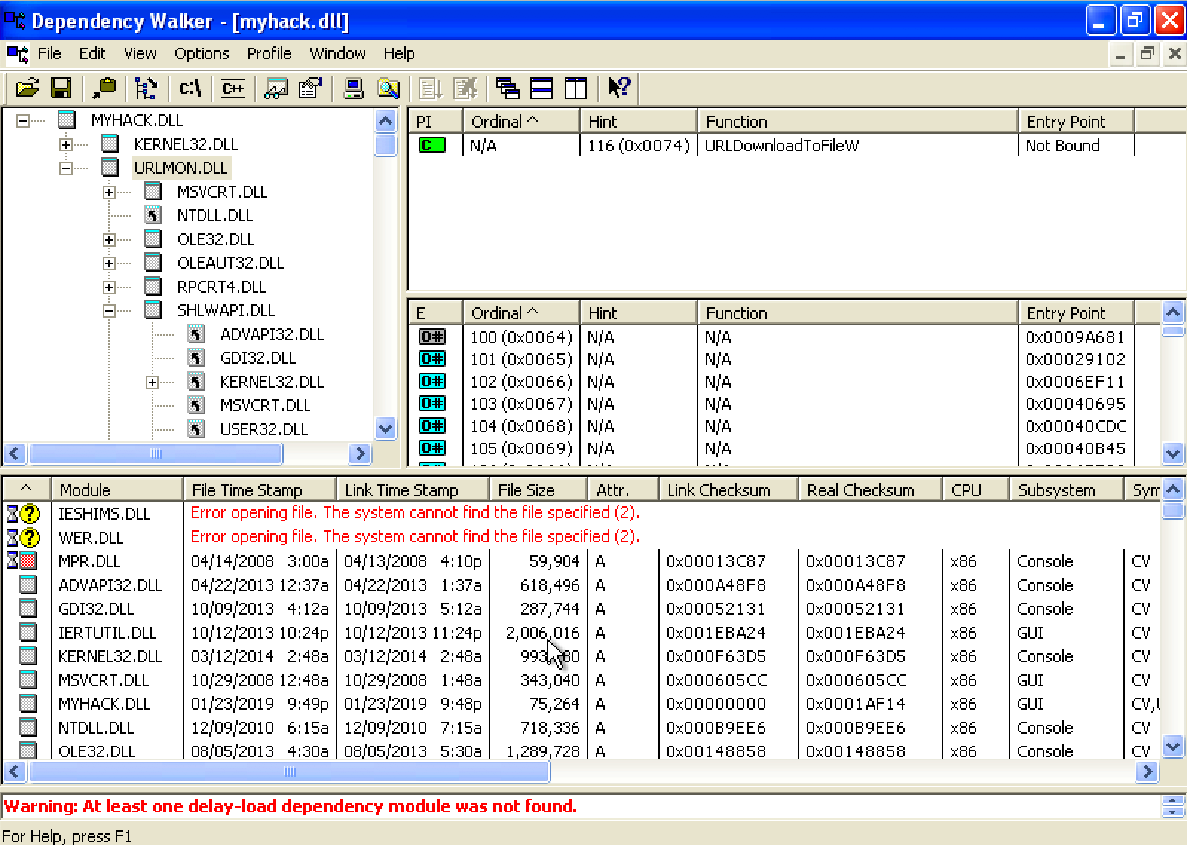
Exploring Dynamically Linked Functions with Dependency Walker

Slide 77
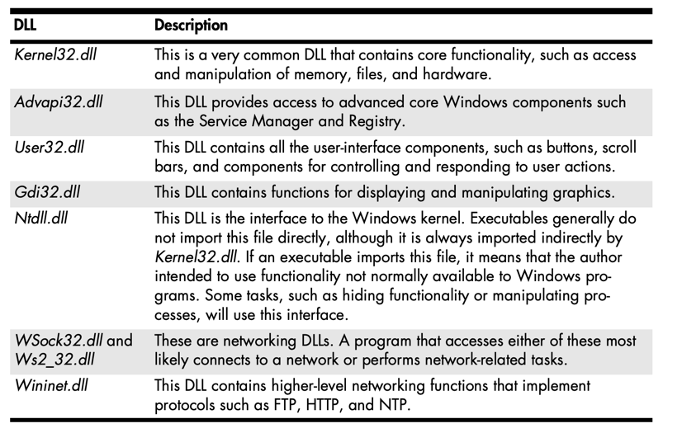
Common DLLs

Slide 78

Q & A

