Slide 1

Class4
CSC 497/583 Advanced Topics in Computer Security
Modern Malware Analysis
PE Format
Si Chen (schen@wcupa.edu)

Slide 2

Portable Executable (PE) file
A Portable Executable (PE) file is the standard binary file format for an Executable (.exe) or DLL under Windows NT, Windows 95, and Win32.
Derived from COFF (Common Object File Format) in UNIX platform, and it is not really “portable”.
Now here is the kicker. Even though this specification is spelled out by Microsoft, compilers/linkers chose to ignore some parts of it.
To make things even worse, the Microsoft loader doesn't enforce a good portion of this specification and instead makes assumptions if things start getting weird.
So even though the spec outlined here says a particular field is supposed to hold a certain value, the compiler/linker or even a malicious actor could put whatever they want in there and the program will likely still run...

Slide 3

Portable Executable (PE) file
PE formatted files include:
  .exe, .scr (executable)
  .dll, .ocx, .cpl, drv (library)
  .sys, .vxd (driver files)
  .obj (objective file)
All PE formatted files can be executed, except obj file.
  .exe, .scr can be directly executed inside Shell (explorer.exe)
  others can be executed by other program/service
PE refers to 32 bit executable file, or PE32. 64 bit executable file is named as PE+ or PE32+. (Note that it is not PE64).

Slide 4
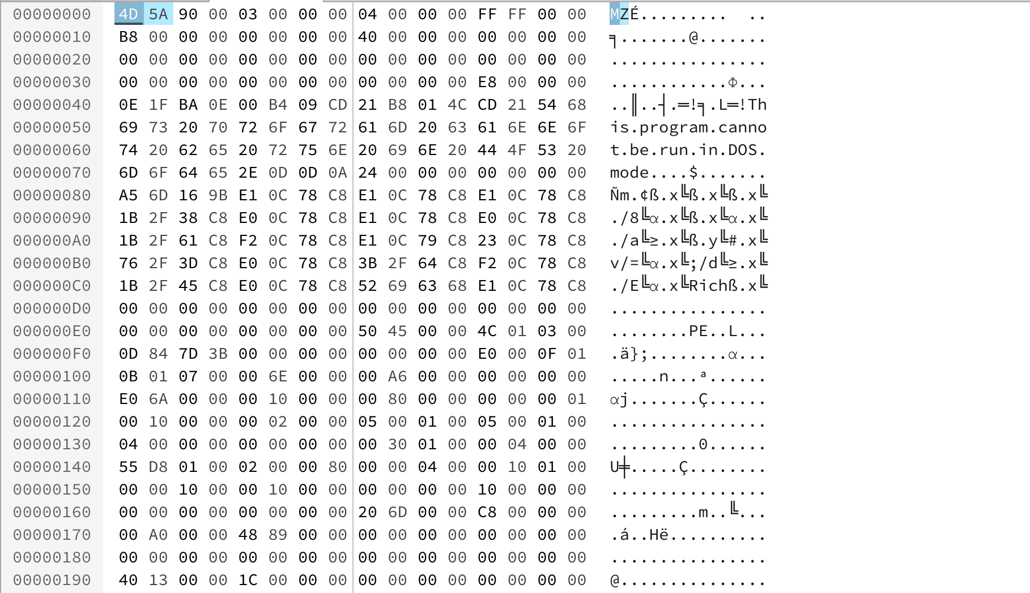
PE Example – Notepad.exe

Slide 5
Load PE file (Notepad.exe) into Memory

Slide 6
VA & RVA
VA (Virtual Address): The address is called a “VA” because Windows creates a distinct VA space for each process, independent of physical memory. For almost all purposes, a VA should be considered just an address. A VA is not as predictable as an RVA because the loader might not load the image at its preferred location.
RVA (Relative Virtual Address): The address of an item after it is loaded into memory, with the base address of the image file subtracted from it. The RVA of an item almost always differs from its position within the file on disk (file pointer).
RVA + ImageBase = VA
In 32bit Windows OS, each process has 4GB virtual memory
which means the range of VA is: 00000000 - FFFFFFFF

Slide 7
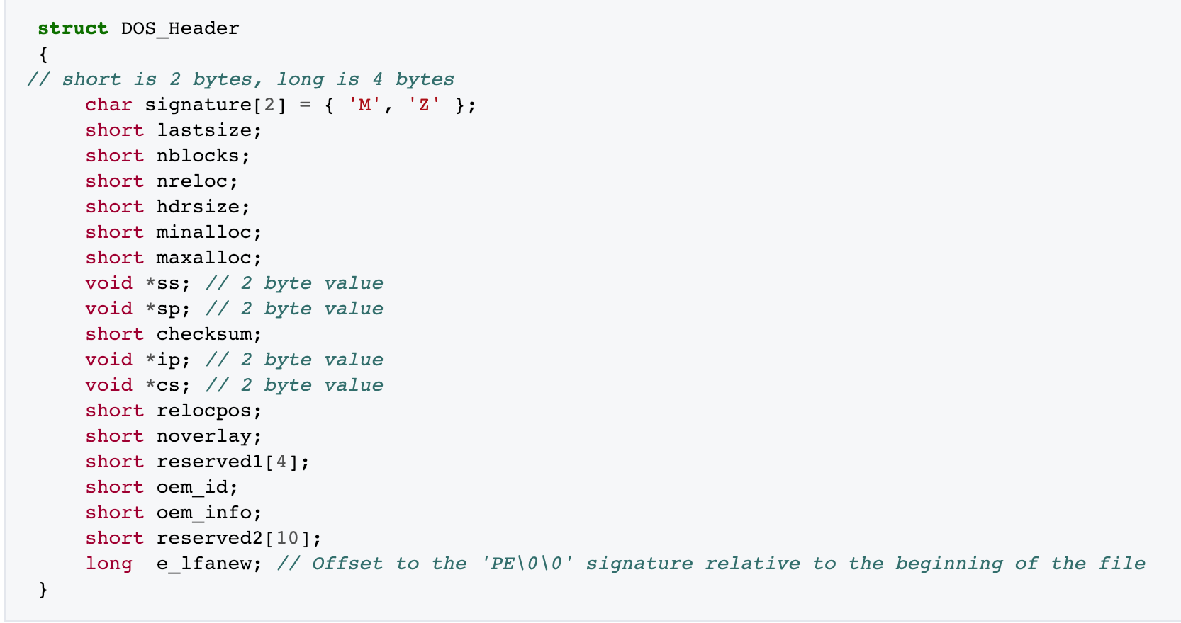
DOS Header
The first 2 letters are always the letters "MZ", the initials of Mark Zbikowski, who created the first linker for DOS. To some people, the first few bytes in a file that determine the type of file are called the "magic number,"

Slide 8
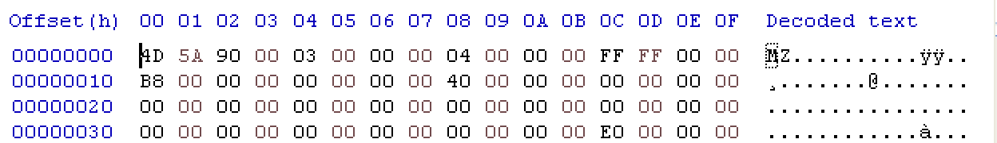
DOS Header
long → 32 bit → ? Byte
E0 00 00 00
value for e_lfanew → ?

Slide 9
Byte Order

Slide 10
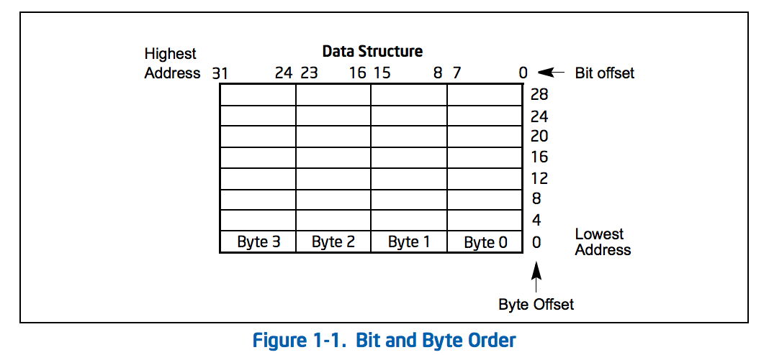
Little endian
IA-32 processors use "little endian" as their byte order. This means that the bytes of a word are numbered starting from the least significant byte and that the least significant bit starts of a word starts in the least significant byte.

Slide 11
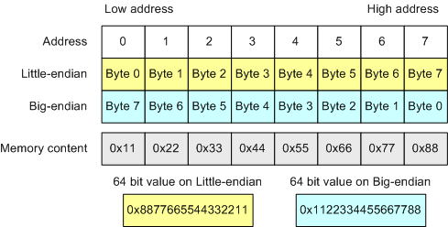
Byte Order

Slide 12
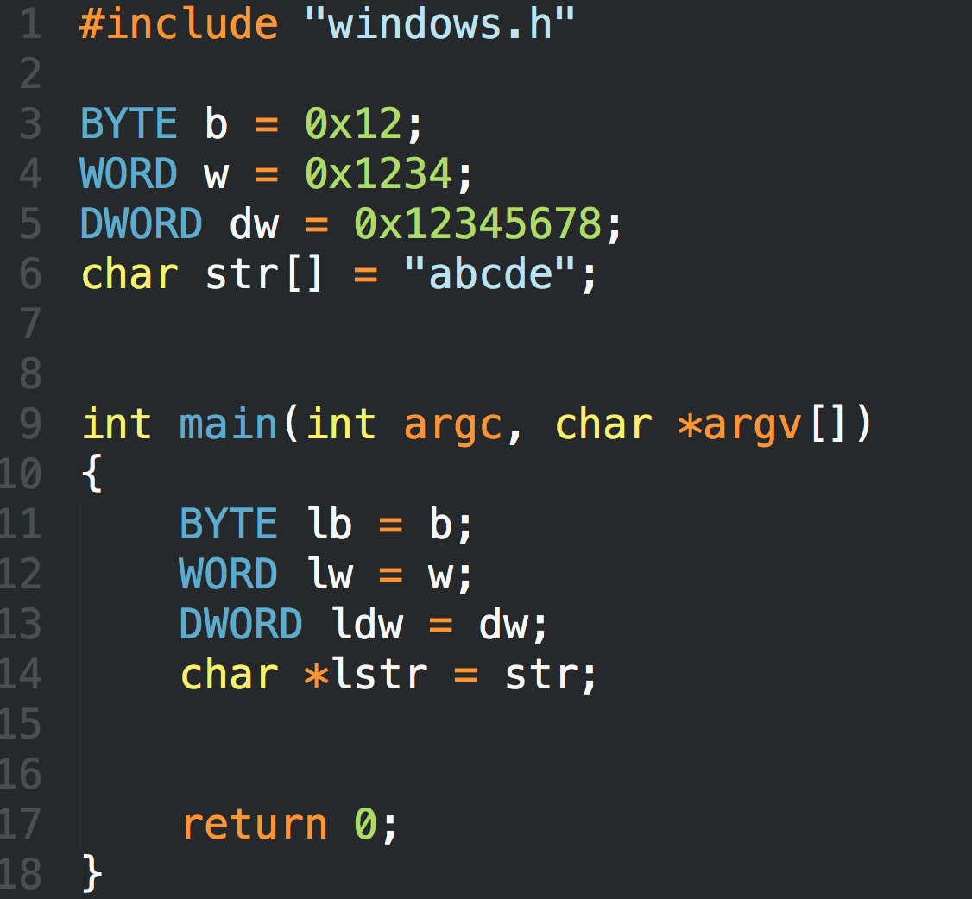
LittleEndian.exe

Slide 13
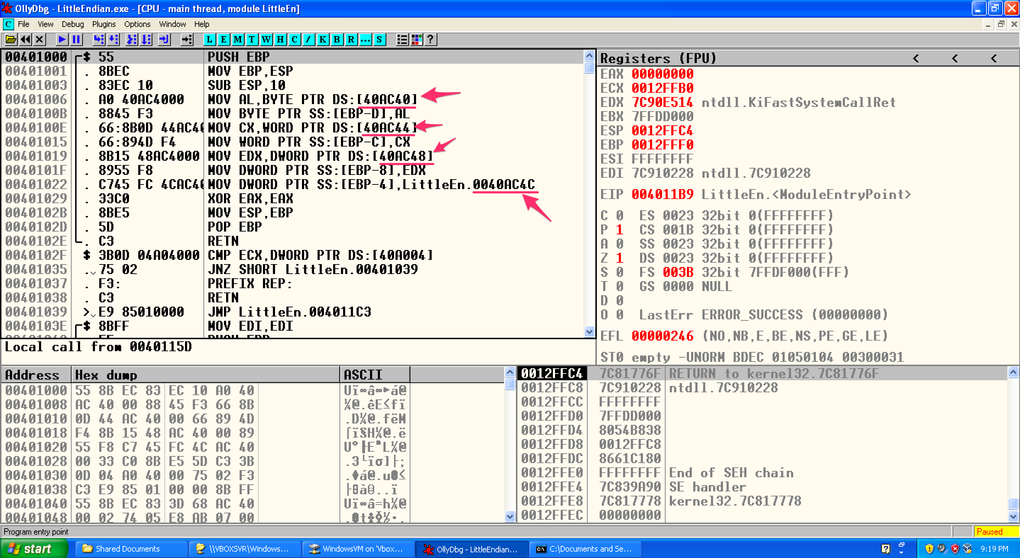
LittleEndian.exe

Slide 14
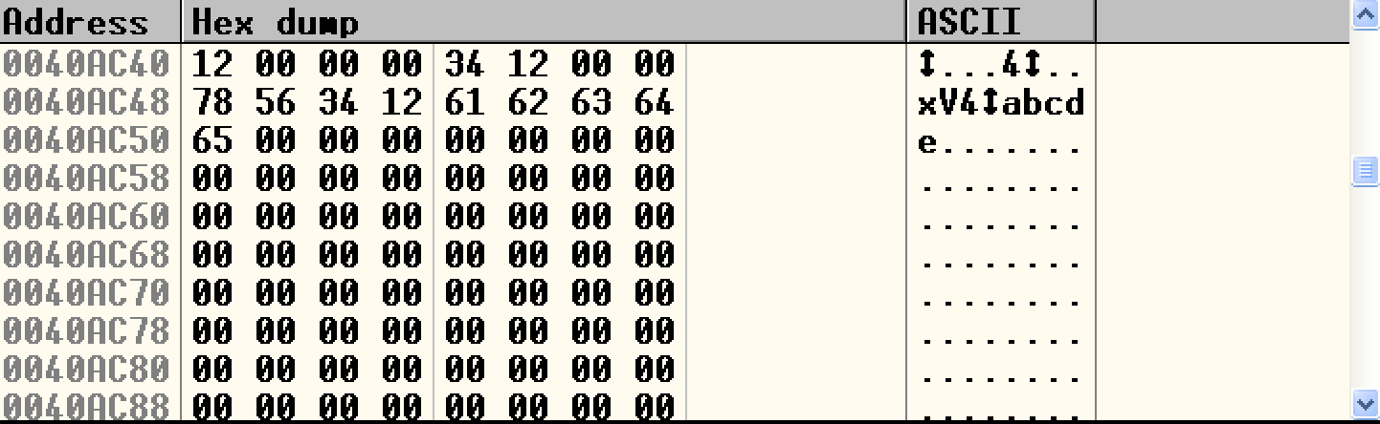
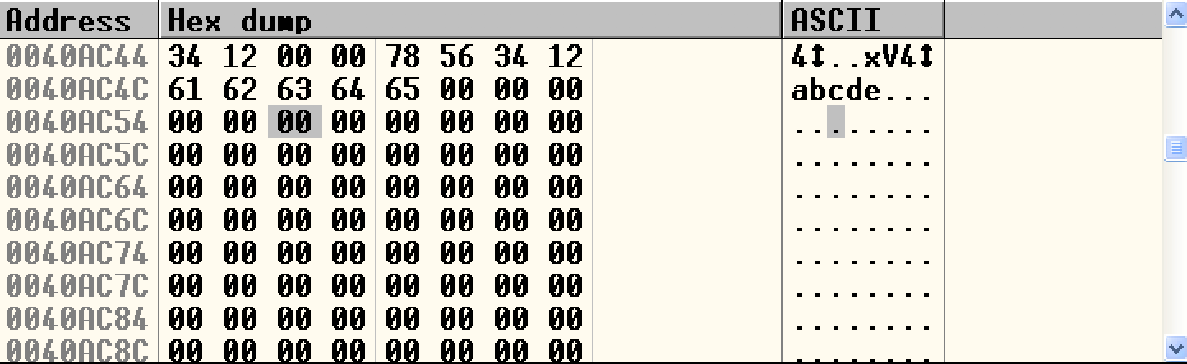
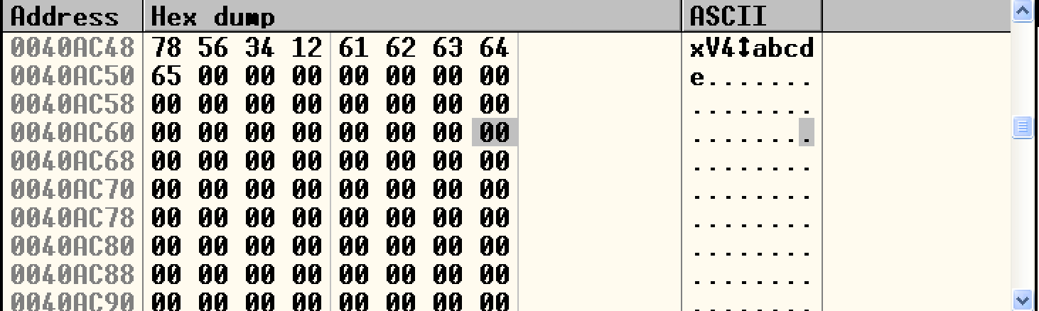
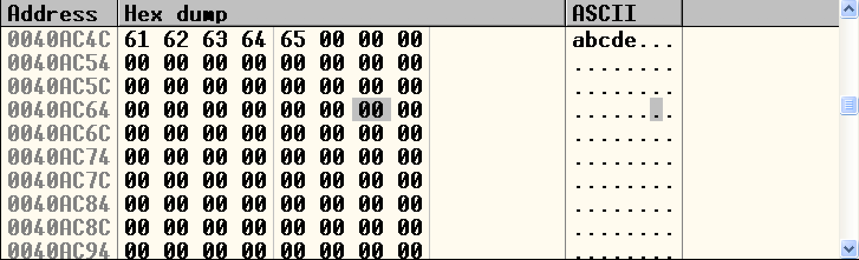
LittleEndian.exe

Slide 15
DOS Header
e_lfanew → 000000E0

Slide 16
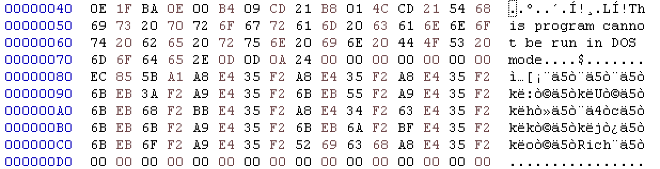
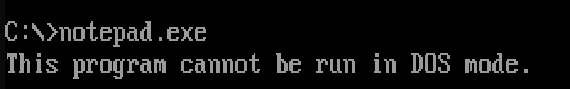
DOS stub
https://virtualconsoles.com/online-emulators/dos/

Slide 17
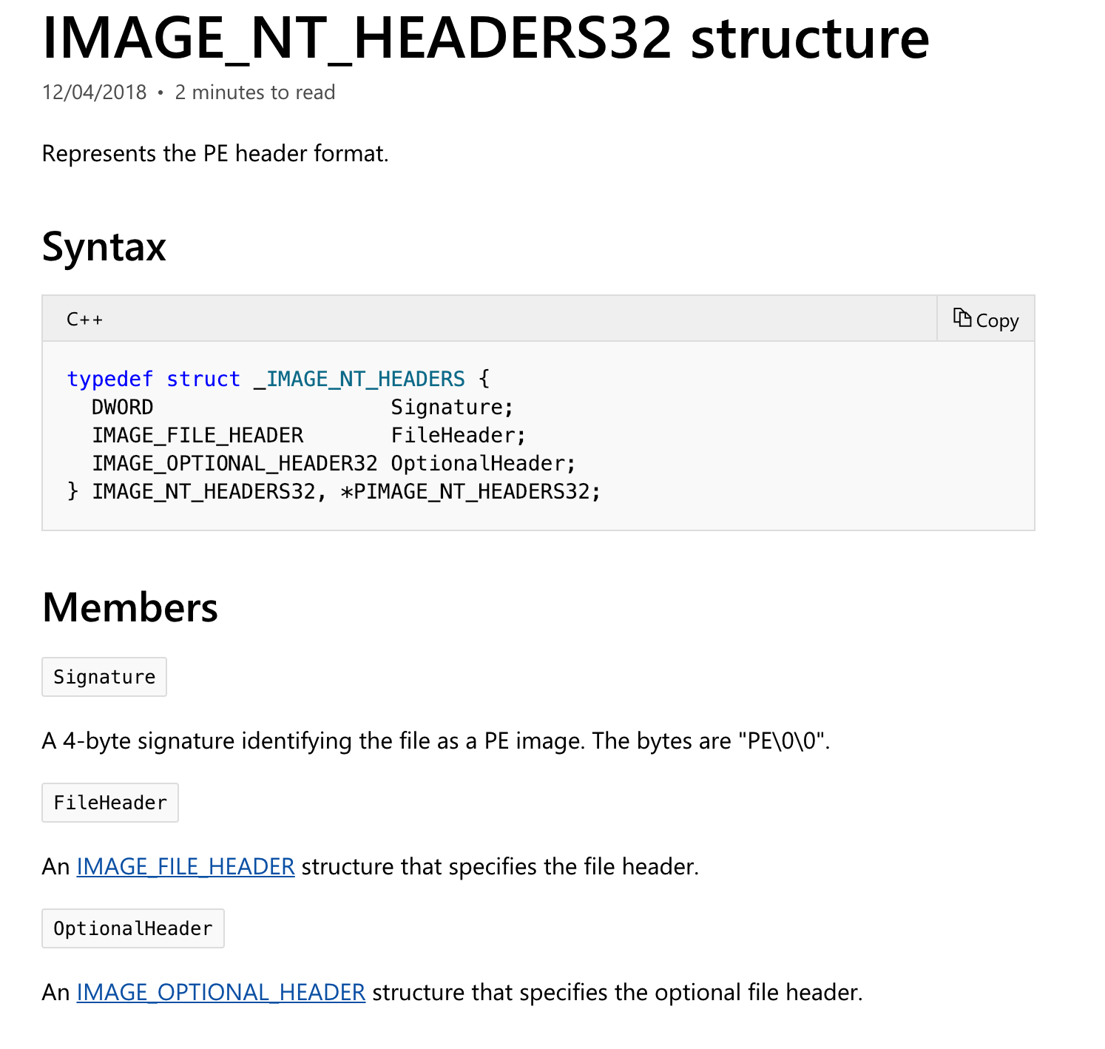
NT Header
https://docs.microsoft.com/en-us/windows/desktop/api/winnt/

Slide 18
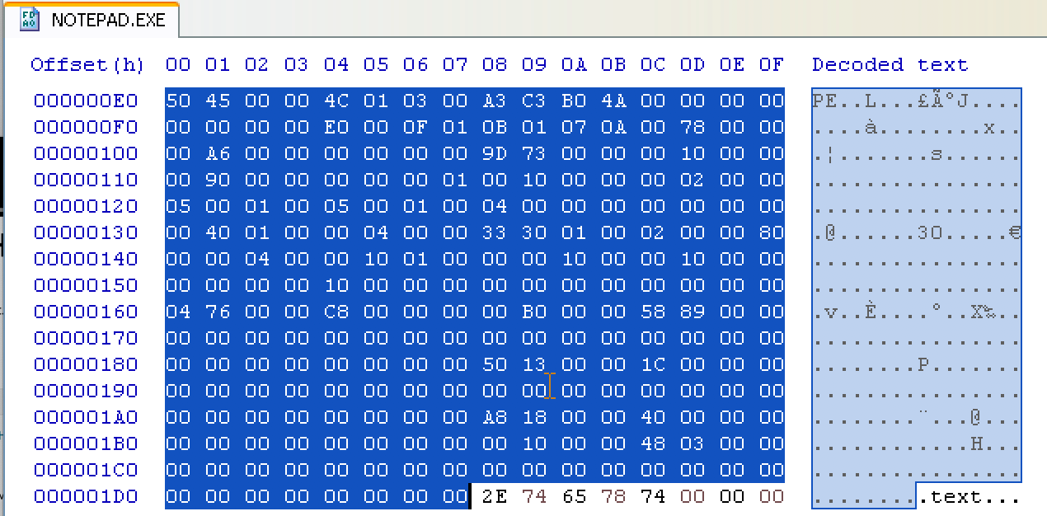
NT Header

Slide 19
Section Header
Name | Privilege
.code | Executable, read
.data | Non-Executable, read/write
.resource | Non-Executable, read

Slide 20
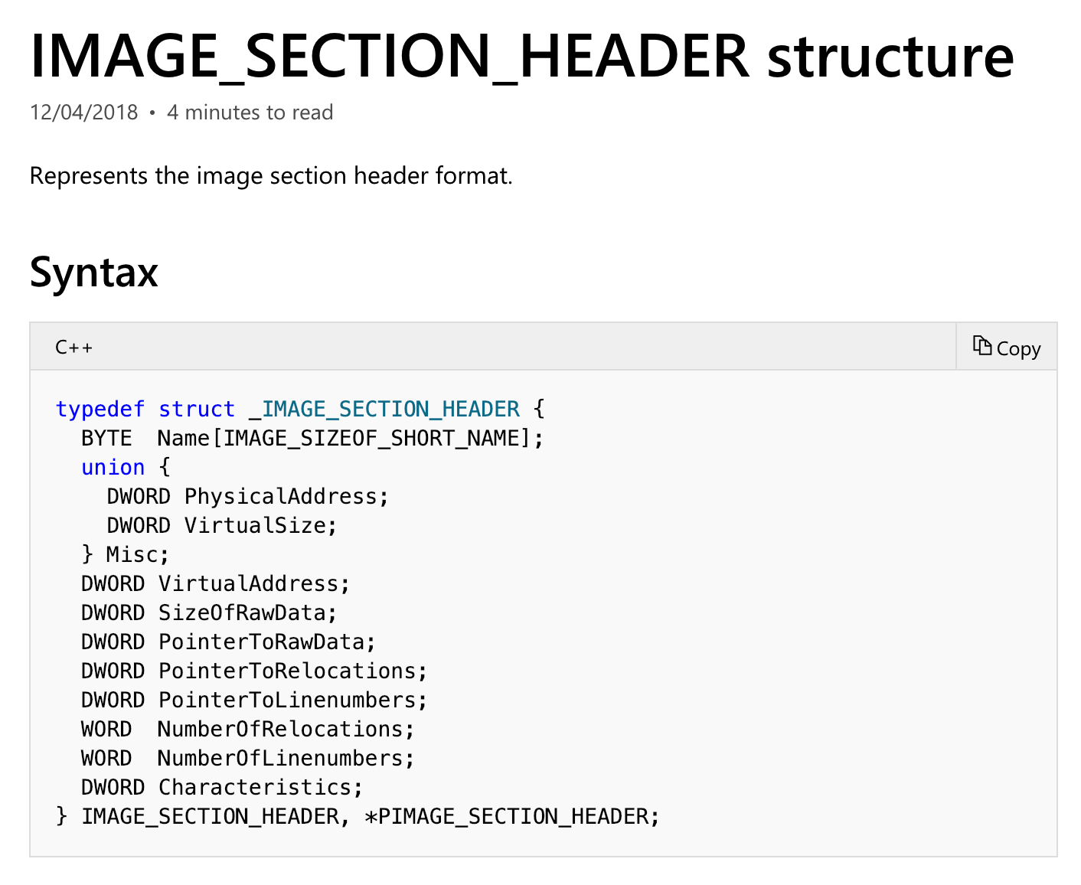
Section Header

Slide 21
Section Header
Members | Meaning
VirtualSize | The total size of the section when loaded into memory, in bytes.
VirtualAddress | The address of the first byte of the section when loaded into memory (RVA)
SizeOfRaw Data | The size of the section data on disk, in bytes.
PointerToRawData | The address of the first byte of the section on disk.
Characteristics | The characteristics of the image.
https://docs.microsoft.com/en-us/windows/desktop/api/winnt/ns-winnt-_image_section_header

Slide 22
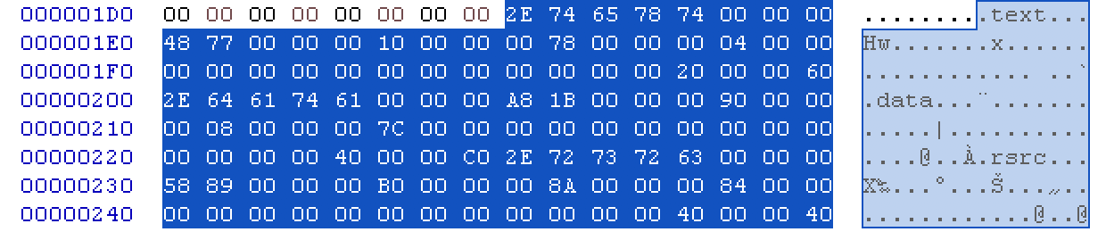
Section Header

Slide 23
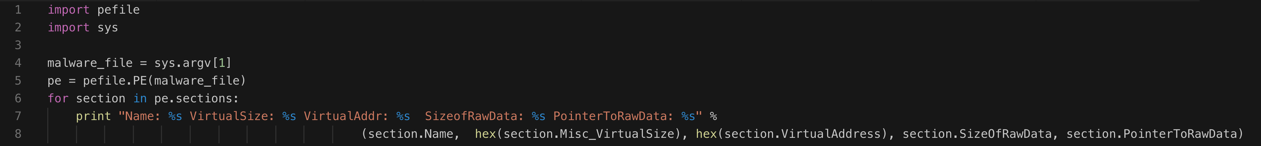
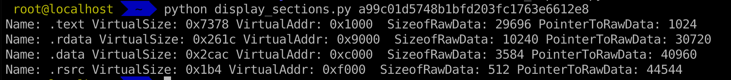
Inspecting PE Header Information in Linux

Slide 24
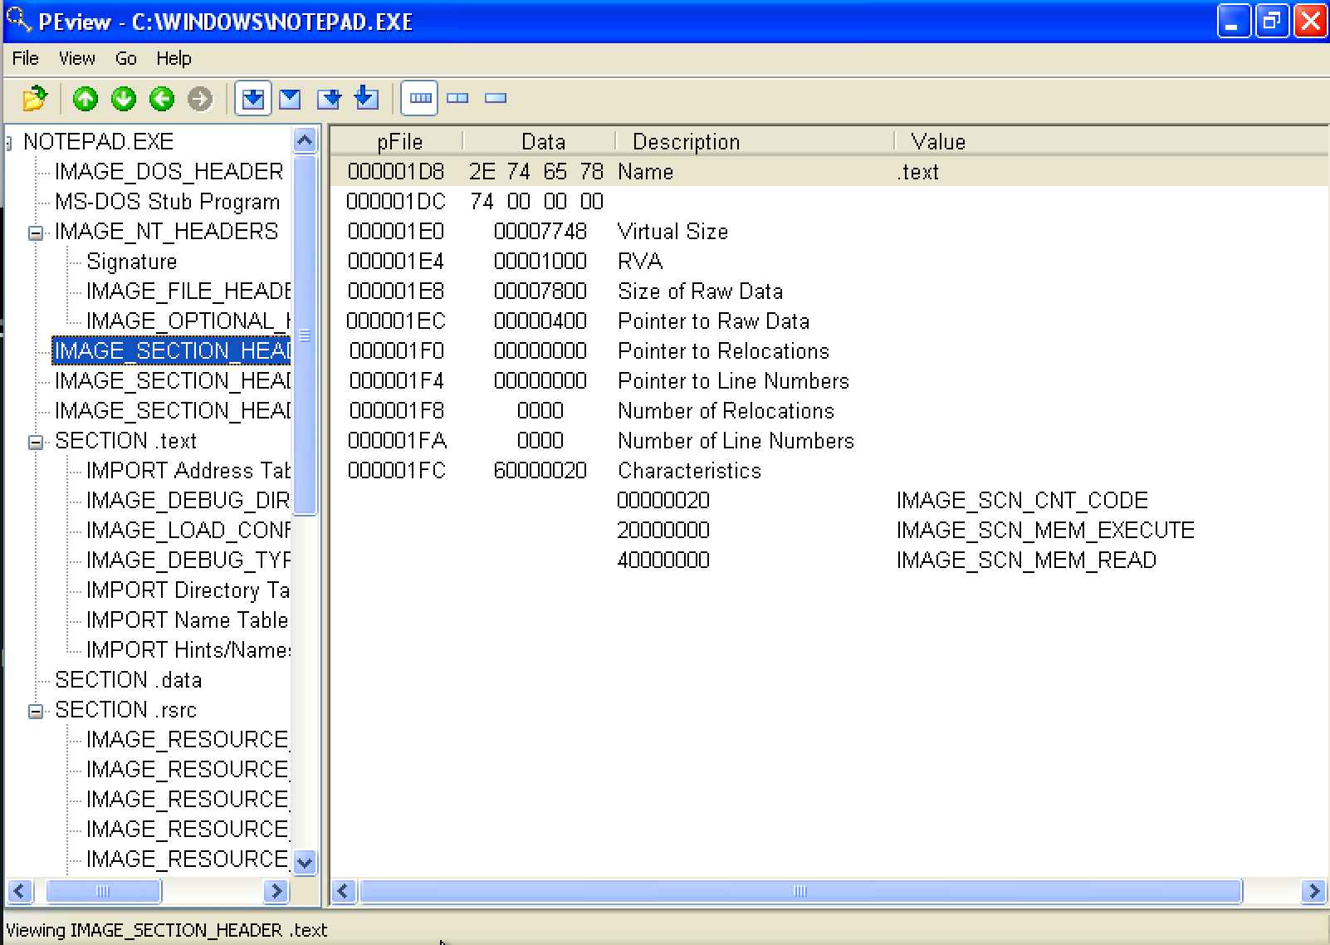
Inspecting PE Header Information

Slide 25
Examining PE Section Table and Sections
https://hub.docker.com/r/remnux/pescanner/

Slide 26
IAT (Import Address Table)

Slide 27
IAT (Import Address Table)
Let’s review the concept of DLL (Dynamic Link Library) again…

Slide 28
Dynamic Linking

Slide 29
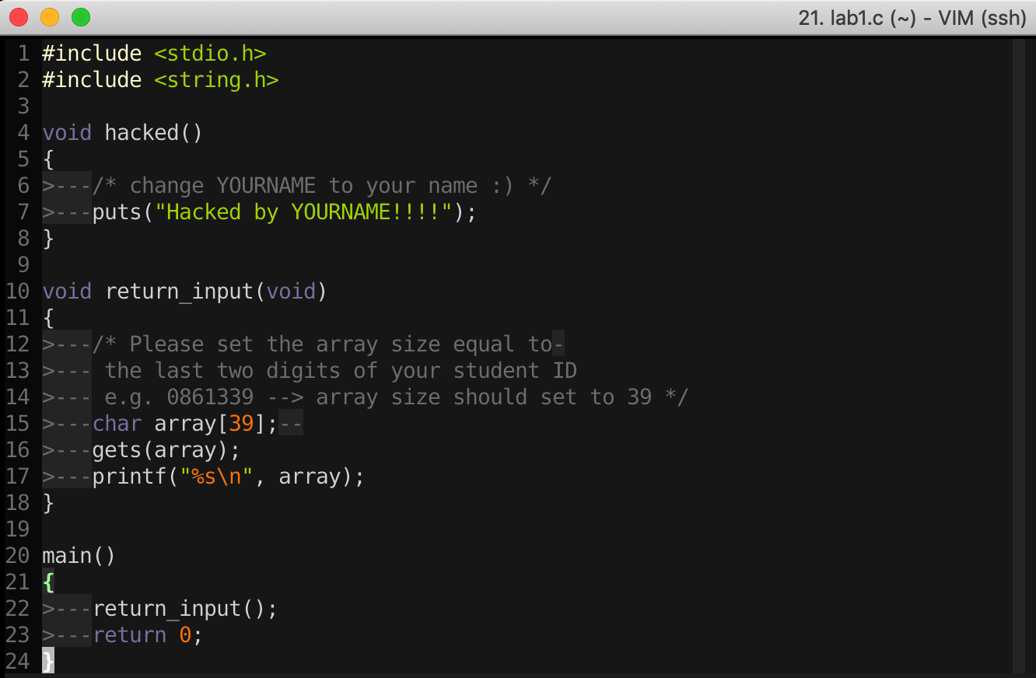
16-Bit DOS System
import Library → Put binary code of stdio library into the executable file

Slide 30
Static Linking
Memory
Waste space
Hard to maintain
Program2
Program2.obj
Lib.obj
Program1
Program1.obj
Lib.obj
Program2
Program2.obj
Lib.obj
Program1
Program1.obj
Lib.obj

Slide 31
Dynamic Linking
Memory
Dynamic linking has the following advantages:
Saves memory
Saves disk space.
Upgrades to the DLL are easier.
Provides after-market support.
Supports multi language programs.
Eases the creation of international versions
Lib.dll
Lib.obj
Program2
Program2.obj
Program1
Program1.obj
Program2
Program2.obj
Lib.dll
Lib.obj
Program1
Program1.obj

Slide 32
Two ways to Load DLL

Slide 33
Two ways to Load DLL
An executable file links to (or loads) a DLL in one of two ways:
Explicit Linking (run-time dynamic linking)
  the executable using the DLL must make function calls to explicitly load and unload the DLL, and to access the DLL's exported functions.
Implicit Linking (load-time dynamic linking)
  The operating system loads the DLL when the executable using it is loaded.

Slide 34
Two ways to Load DLL
Explicit Linking (run-time dynamic linking)
Implicit Linking (load-time dynamic linking)

Slide 35
Two ways to Load DLL
An executable file links to (or loads) a DLL in one of two ways:
DLL Injection
Explicit Linking (run-time dynamic linking)
  the executable using the DLL must make function calls to explicitly load and unload the DLL, and to access the DLL's exported functions.
Implicit Linking (load-time dynamic linking)
  The operating system loads the DLL when the executable using it is loaded.
IAT Table

Slide 36
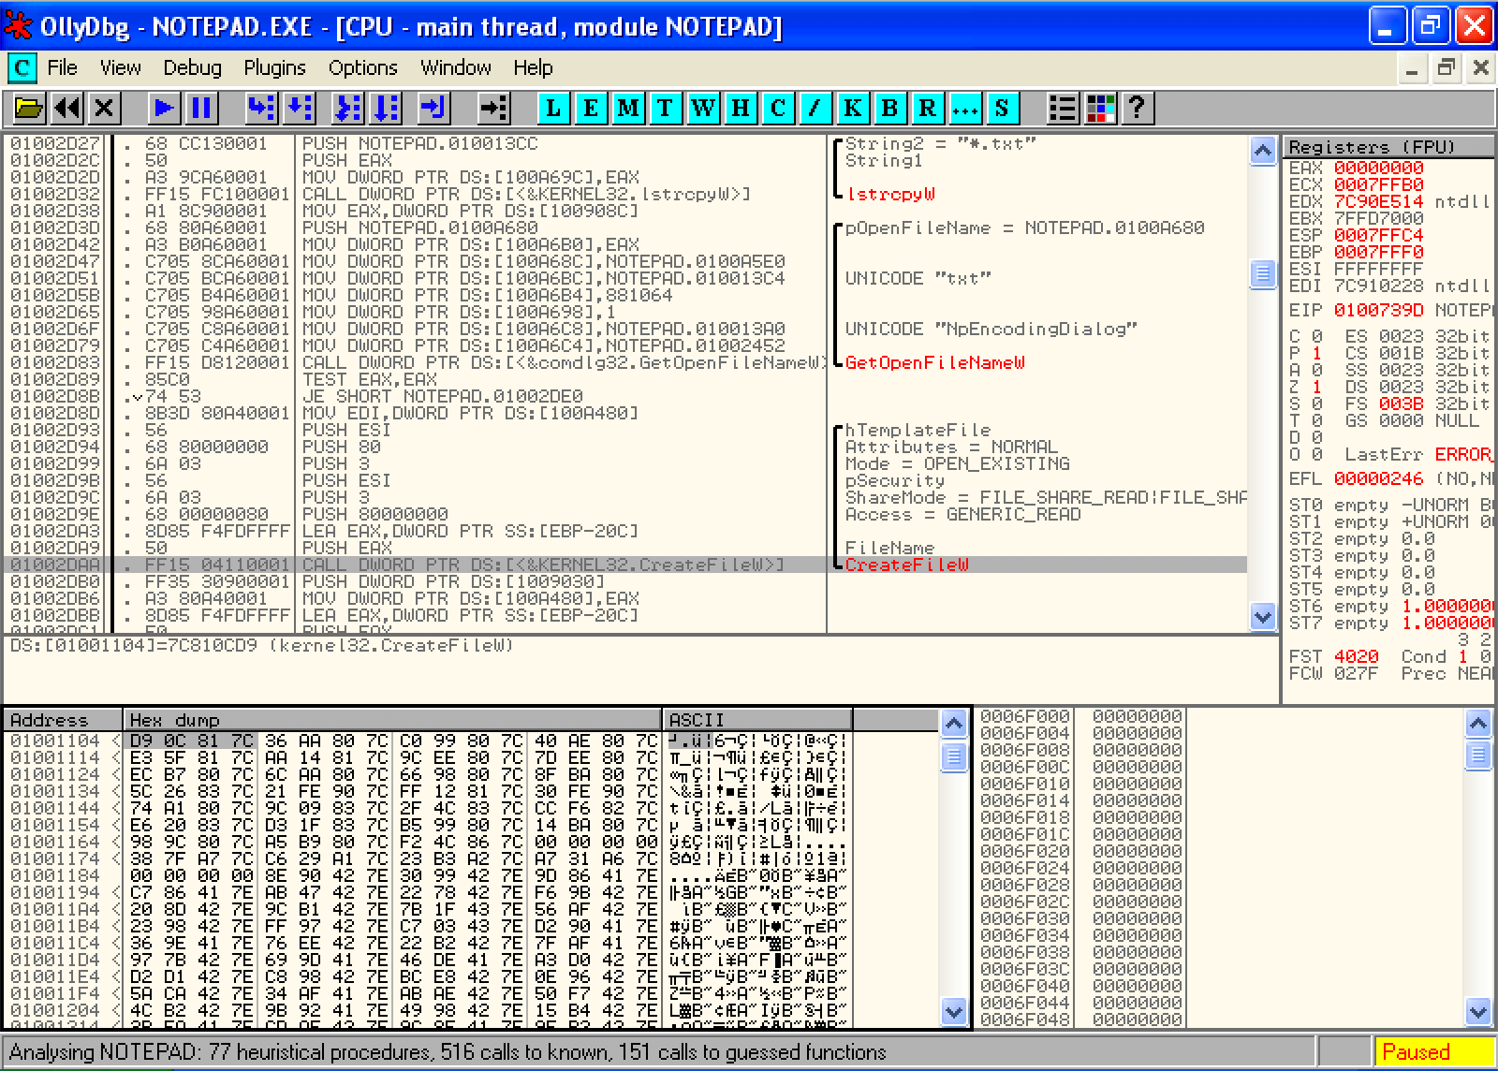
Implicit Linking and IAT (Import Address Table)
Notepad.exe Call CreateFileW() → Call 0x01001104 → Call 0x7C810CD9

Slide 37
Implicit Linking and IAT (Import Address Table)
Notepad.exe Call CreateFileW() → Call 0x01001104 → Call 0x7C810CD9
Call 0x01001104
Look up
IAT Table
Function Name | IAT Address | Real Address
…
CreateFileW() | 0x01001104 | 0x7C810CD9
…
When the application was first compiled, it was designed so that all API calls will NOT use direct hardcoded addresses but rather work through a function pointer.
This was accomplished through the use of an import address table. This is a table of function pointers filled in by the windows loader as the dlls are loaded.

Slide 38
IAT (Import Address Table)
Why IAT?

Slide 39
IAT (Import Address Table)
Support different Windows Version (9X, 2K, XP, Vista, 7, 8, 10)
Call CreateFileW() --> Call 0x01001104
Look up
XP
IAT Table
Function Name | IAT Address | Real Address
…
CreateFileW() | 0x01001104 | 0x7C810CD9
…
Windows 7
Function Name | IAT Address | Real Address
…
CreateFileW() | 0x01001104 | 0x7C81FFFF
…

Slide 40
IAT (Import Address Table)
Support DLL Relocation

Slide 41
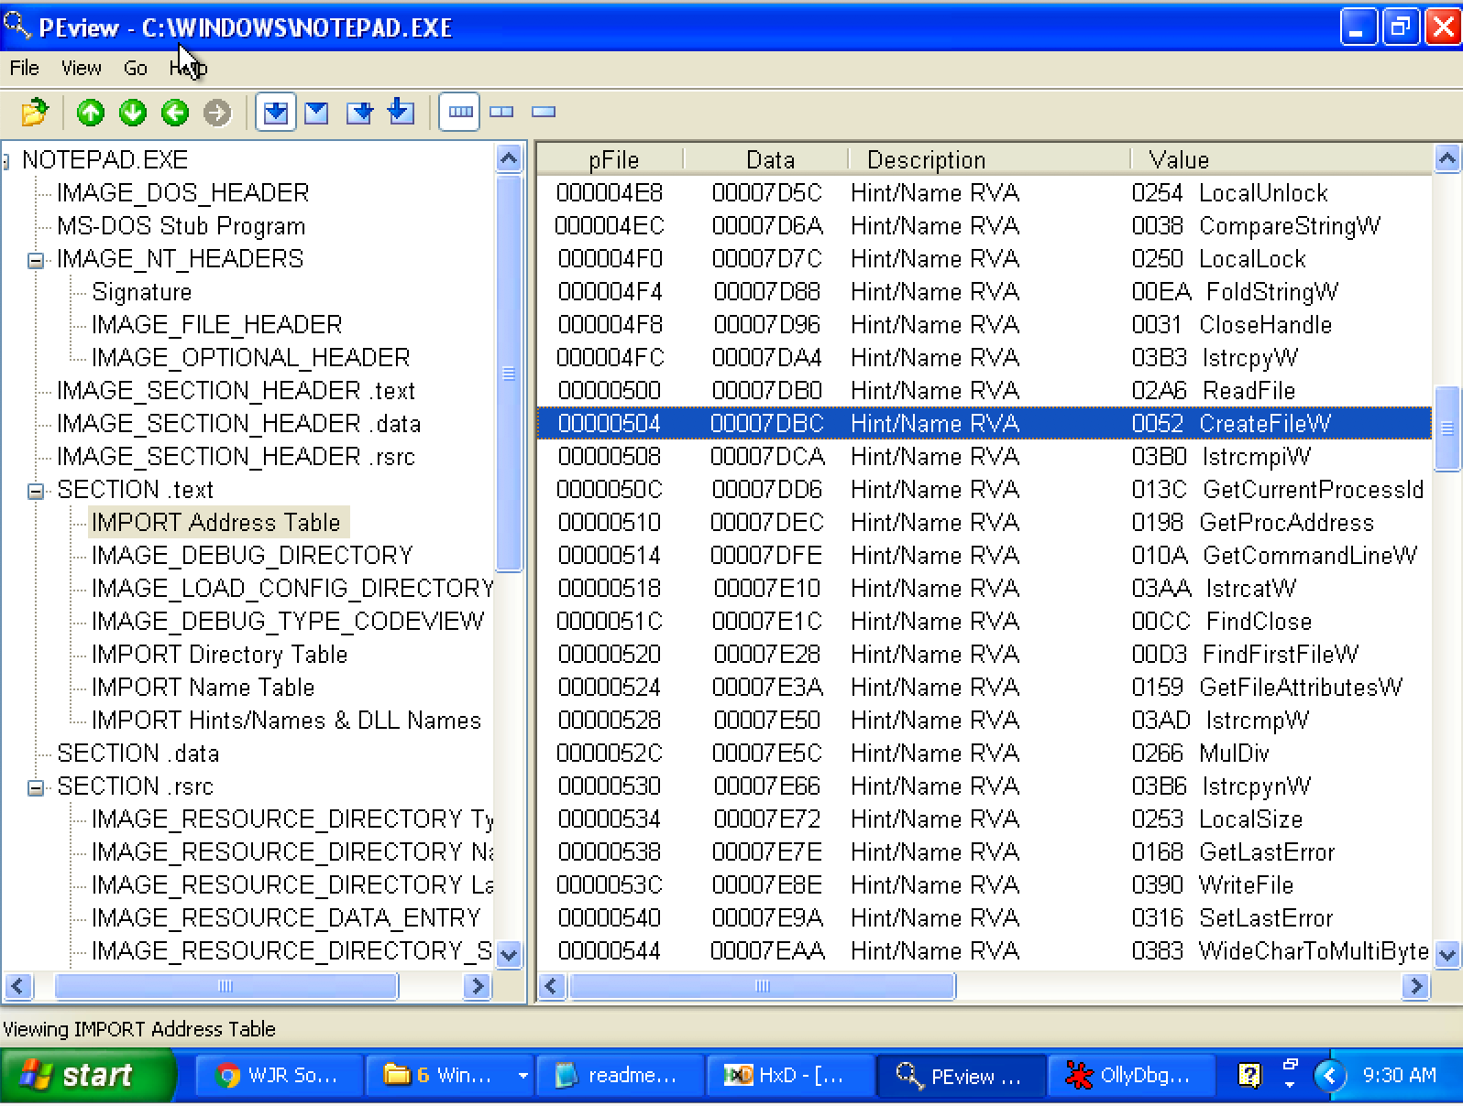
Look up IAT Table with PEview

Slide 42
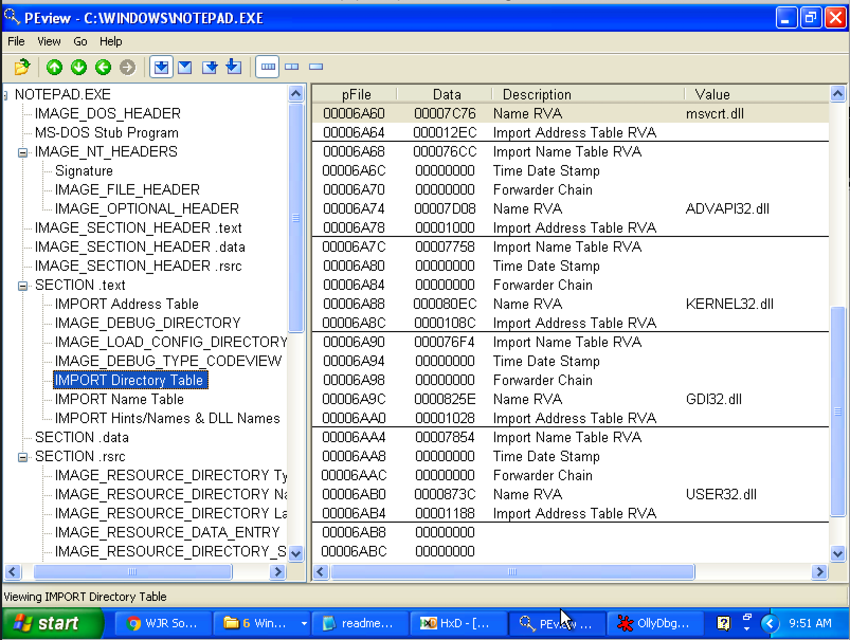
Import Directory Table
The Import Directory Table contains entries for every DLL which is loaded by the executable. Each entry contains, among other, Import Lookup Table (ILT) and Import Address Table (IAT)

Slide 43
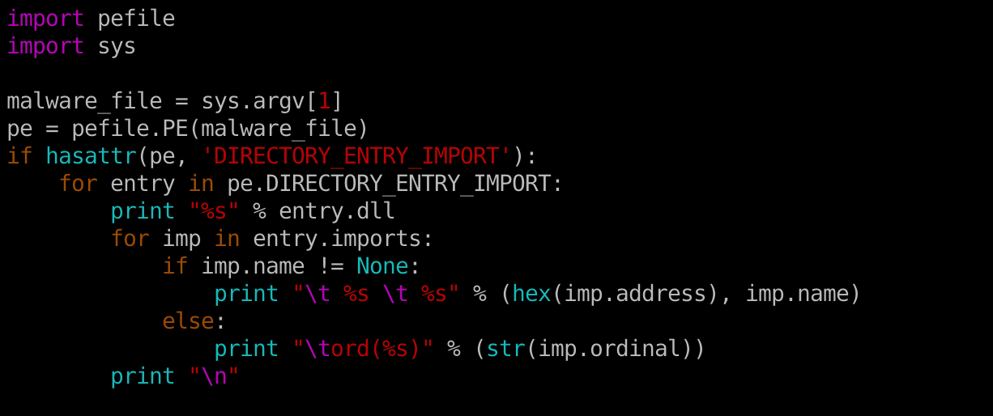
Inspecting file imports with pefile library

Slide 44
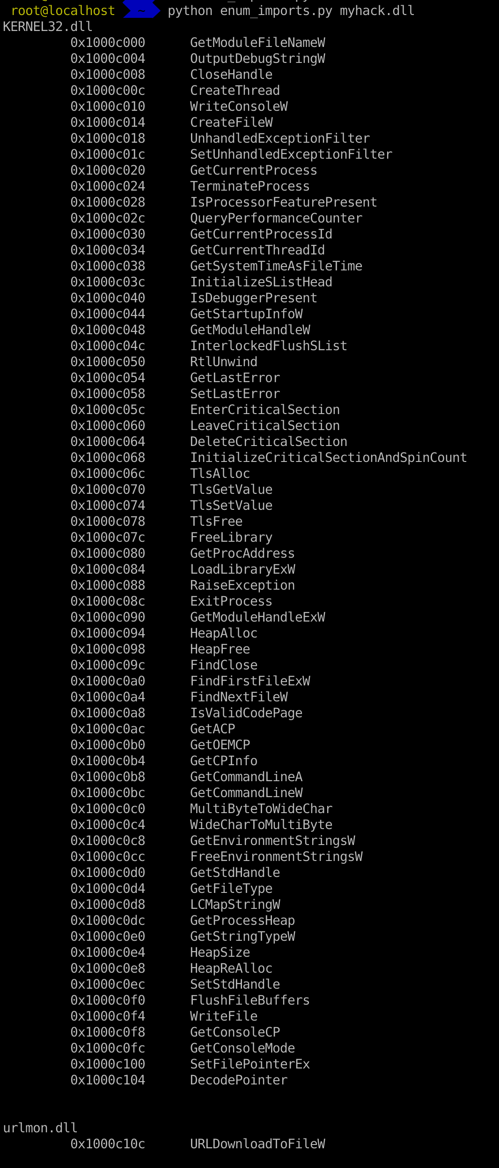

Slide 45
Real-world Case Study

Slide 46
16d6b0e2c77da2776a88dd88c7cfc672
(Trojan.Win32.Dllhijack.a)

Slide 47
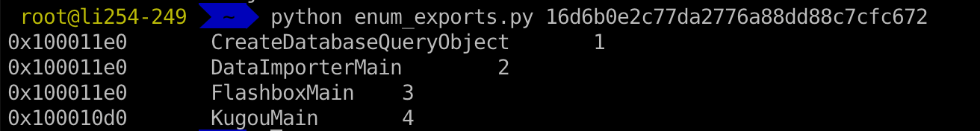
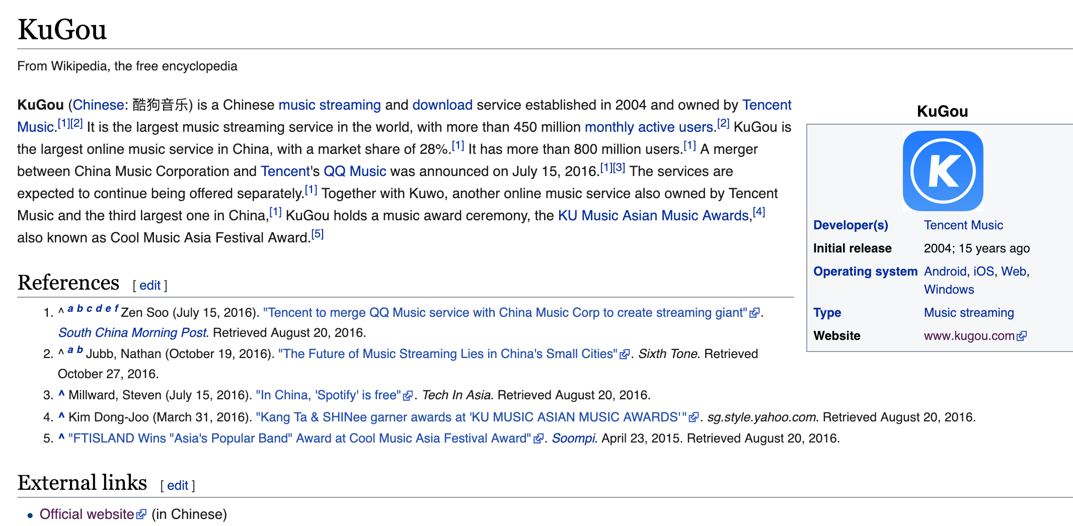
16d6b0e2c77da2776a88dd88c7cfc672

Slide 48
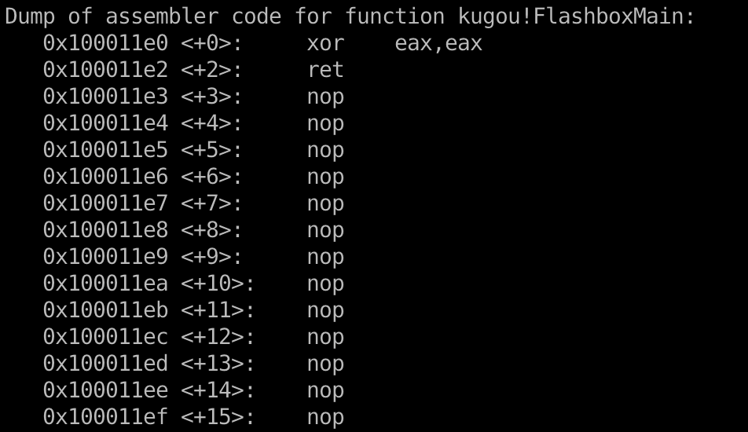
16d6b0e2c77da2776a88dd88c7cfc672

Slide 49
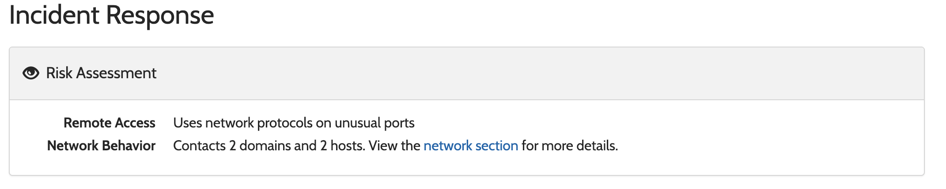
16d6b0e2c77da2776a88dd88c7cfc672
https://www.hybrid-analysis.com/sample/037203d274cb66bad34559c0f426e9e1bf91a048155240581f4aa554be17925c?environmentId=100

Slide 50
0fd6e3fb1cd5ec397ff3cdbaac39d80c

Slide 51
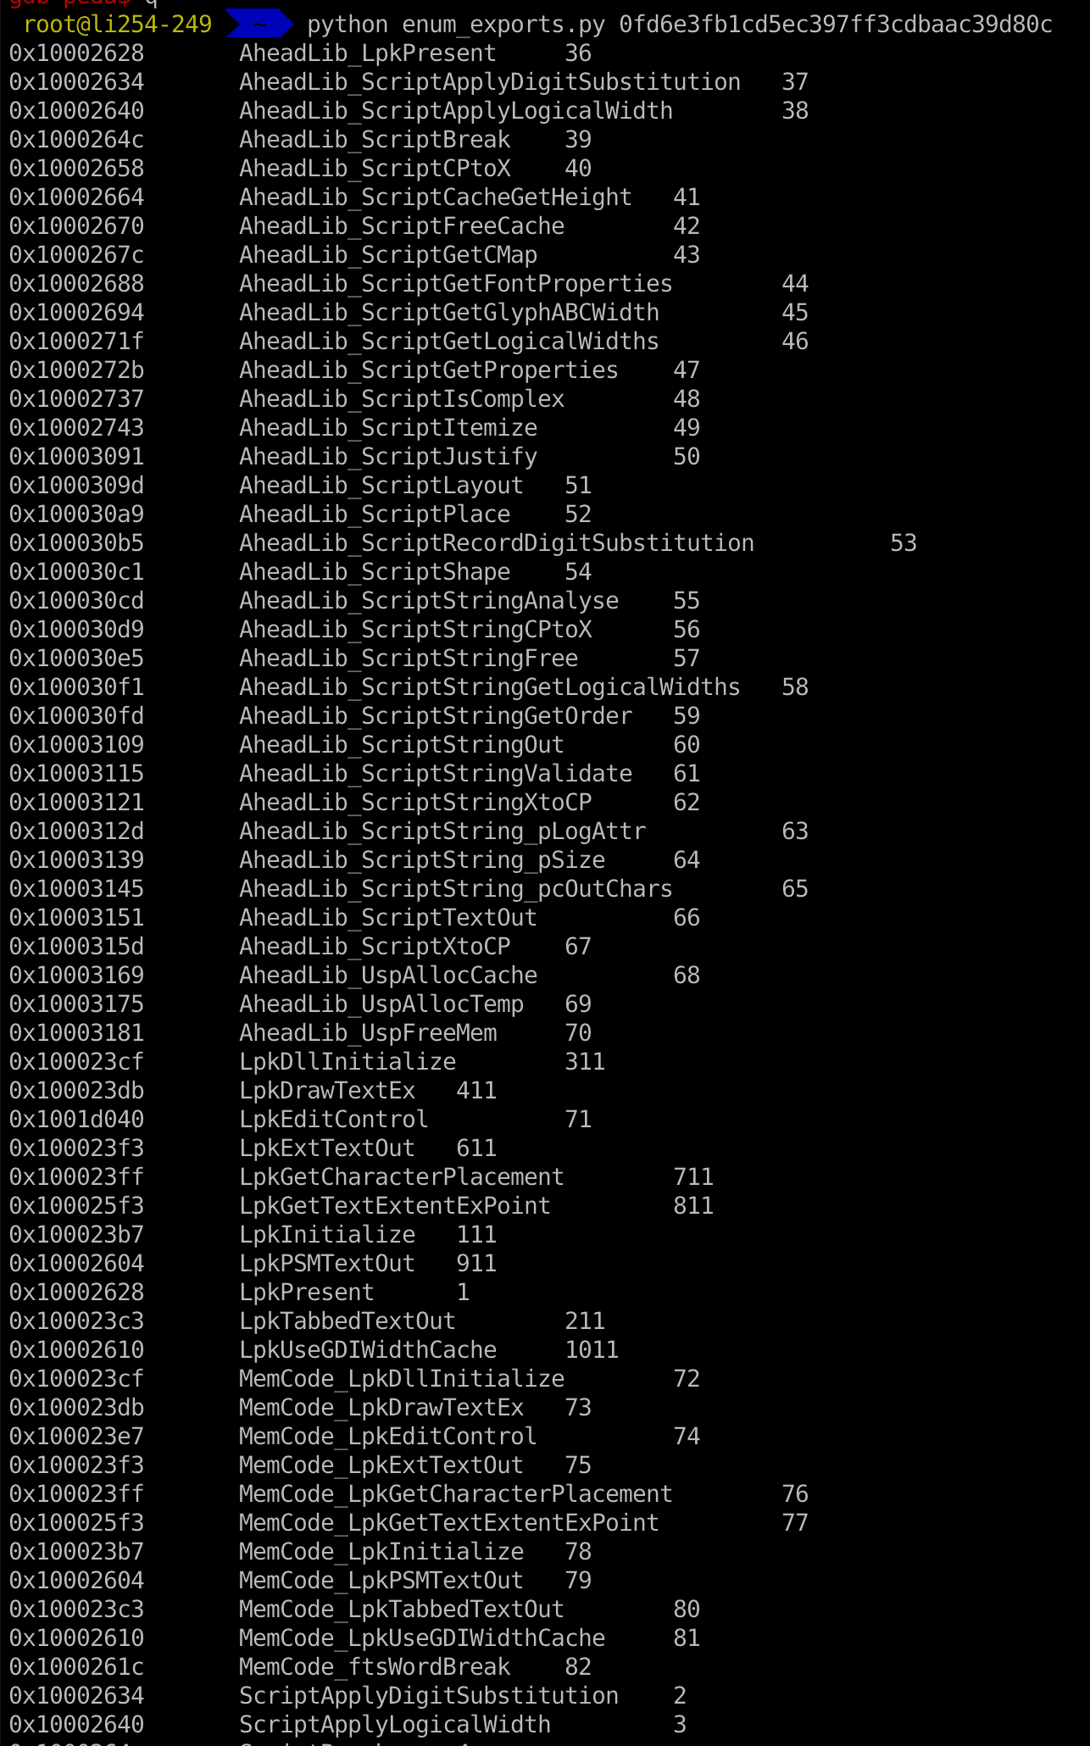
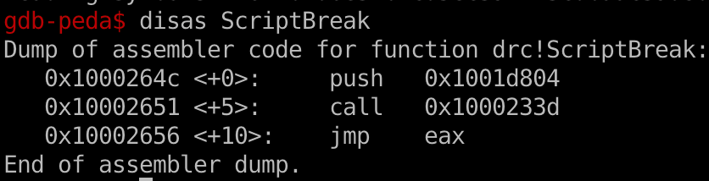
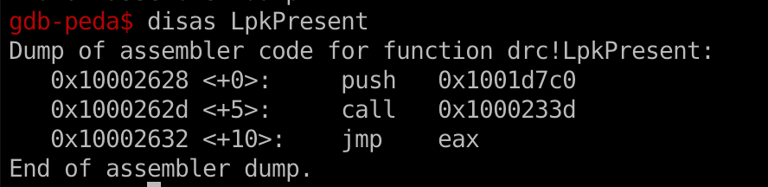

Slide 52
6a764e4e6db461781d080034aab85aff
&
cc3c6c77e118a83ca0513c25c208832c

Slide 53

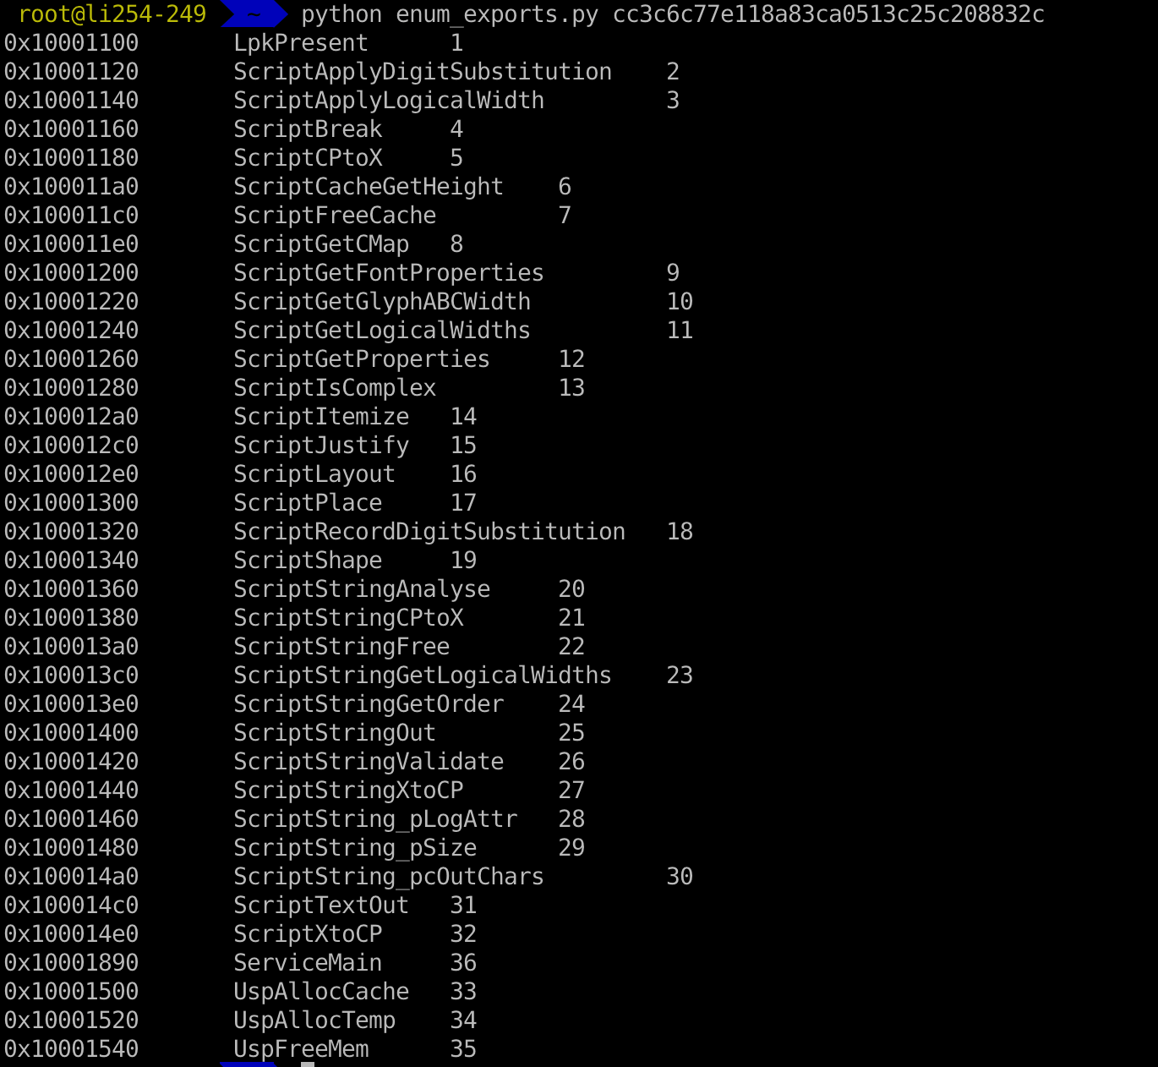

Slide 54
e0bed0b33e7b6183f654f0944b607618

Slide 55
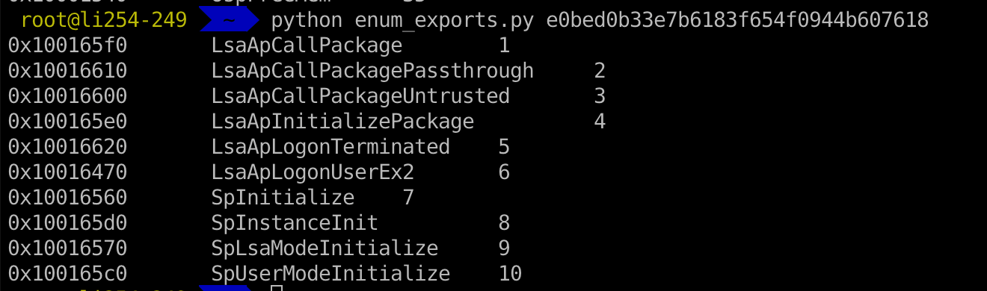
e0bed0b33e7b6183f654f0944b607618

Slide 56
db8199eeb2d75e789df72cd8852a9fbb
(Rootkit.Win32.blackken.b)

Slide 57
db8199eeb2d75e789df72cd8852a9fbb
Is this claim correct?
If two export functions share the same address, it’s a malware.

Slide 58
1c1131112db91382b9d8b46115045097

Slide 59
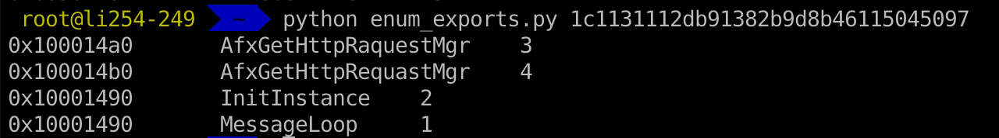
1c1131112db91382b9d8b46115045097

Slide 60
Lab1
Create your own anti-malware system based on heuristic analysis.
Check course website

Slide 61
EAT (Export Address Table)
Similar to IAT, EAT data is stored in IMAGE_EXPORT_DIRECTORY
EAT contains an RVA that points to an array of pointers to (RVAs of) the functions in the module.

Slide 62
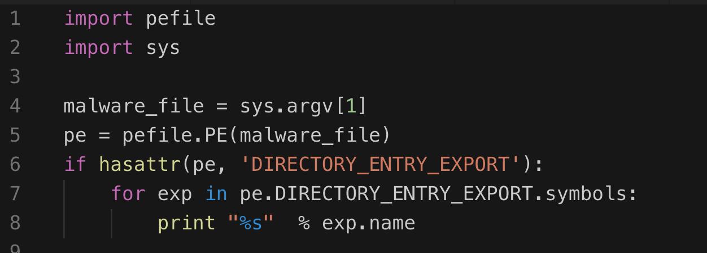
Inspecting file export with pefile library

Slide 63
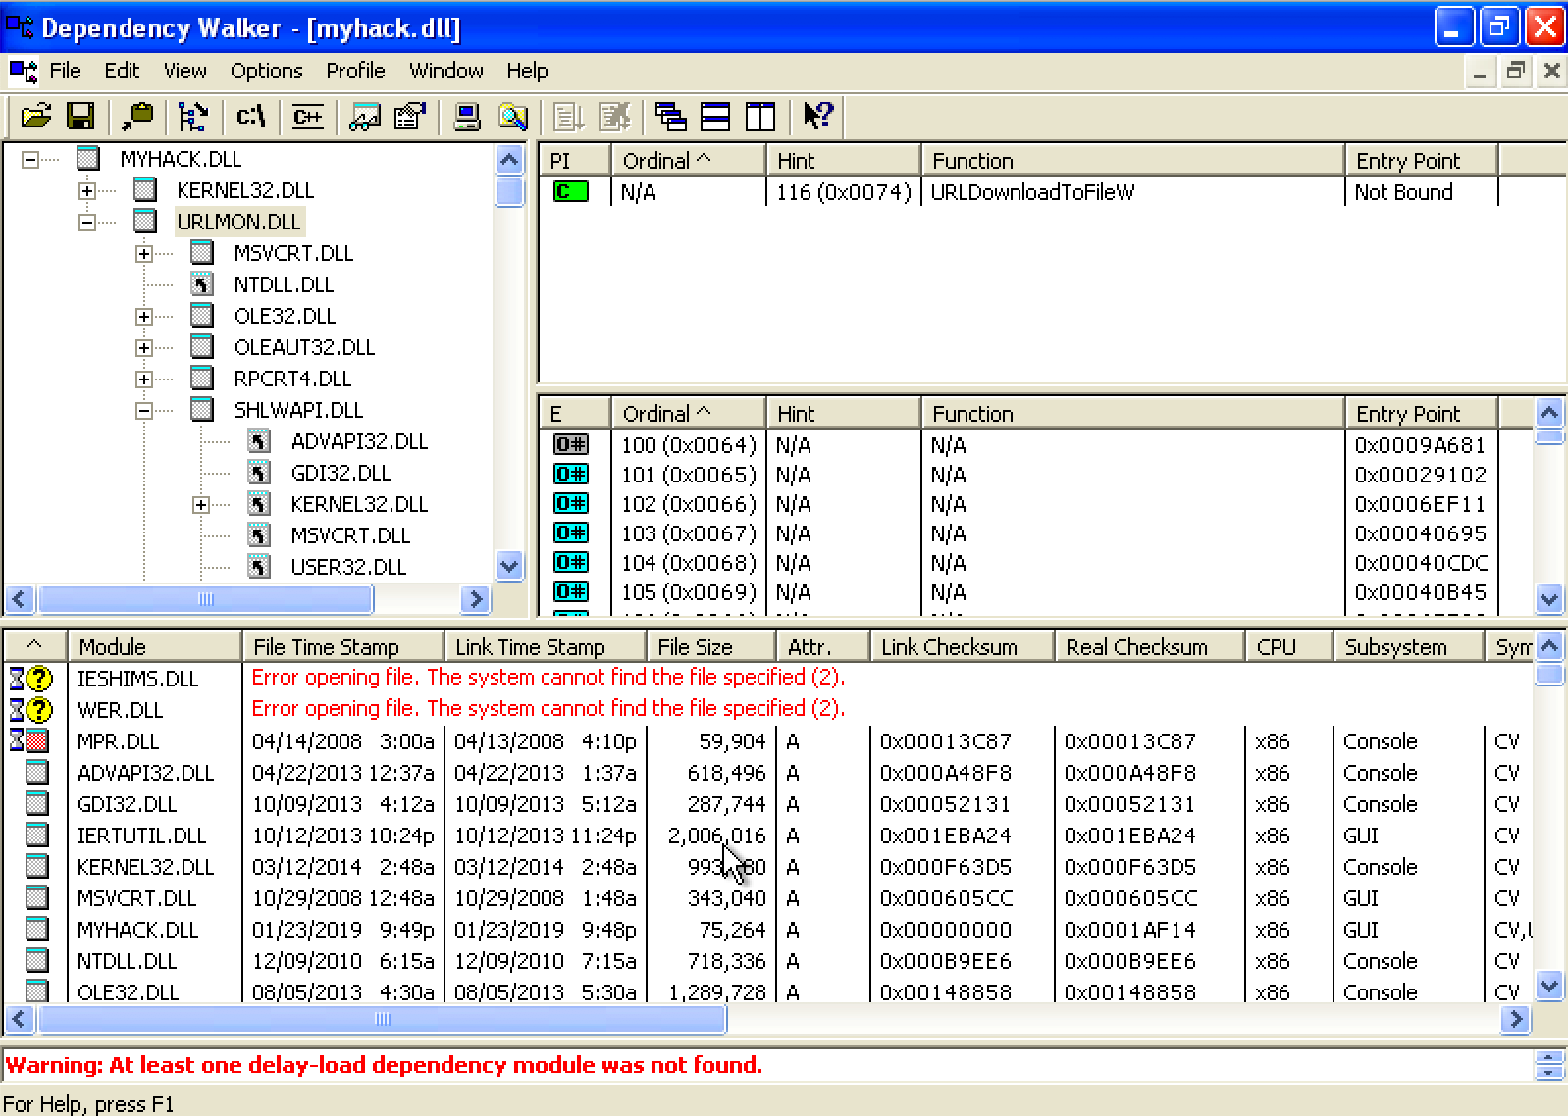
Exploring Dynamically Linked Functions with Dependency Walker

Slide 64
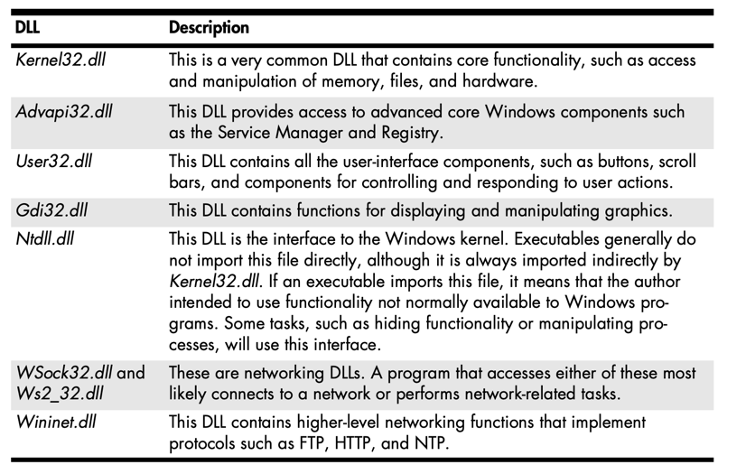
Common DLLs

Slide 65
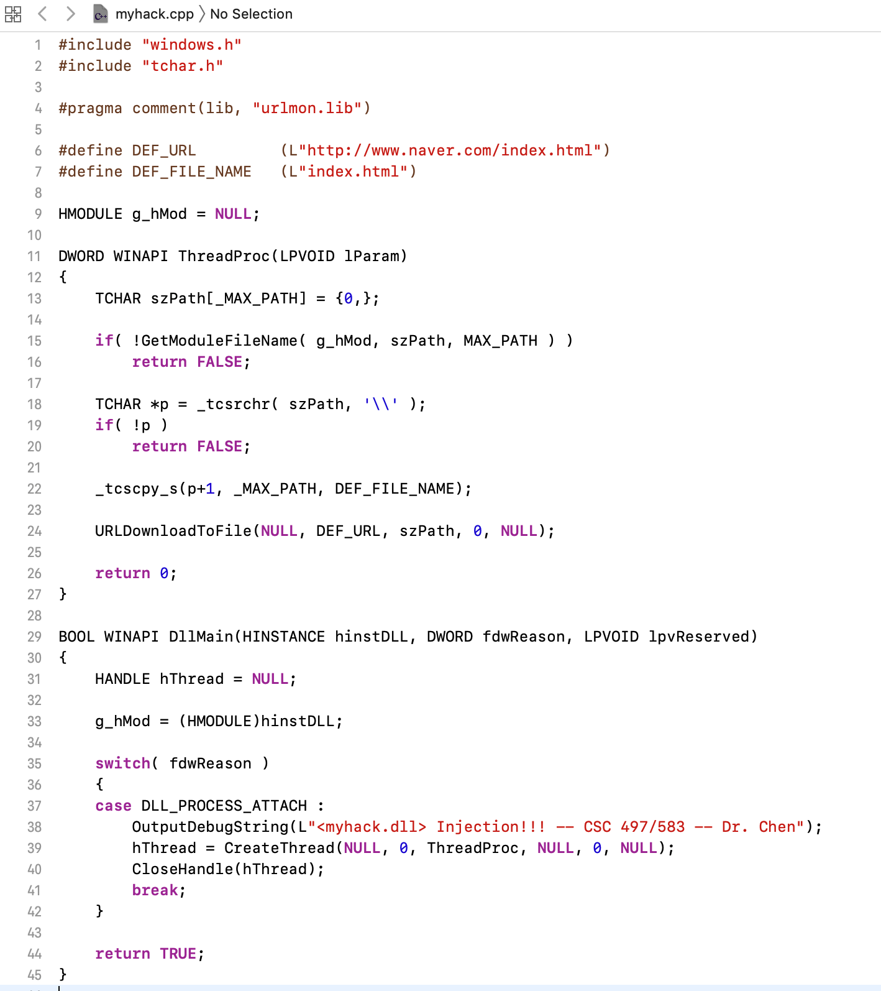
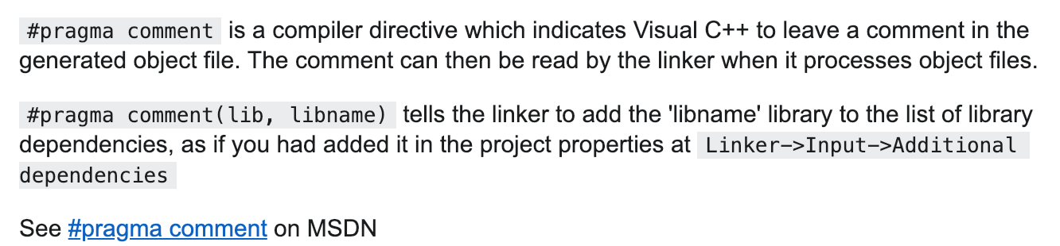
Exploring Dynamically Linked Functions with Dependency Walker

Slide 66

Q & A

