Slide 1
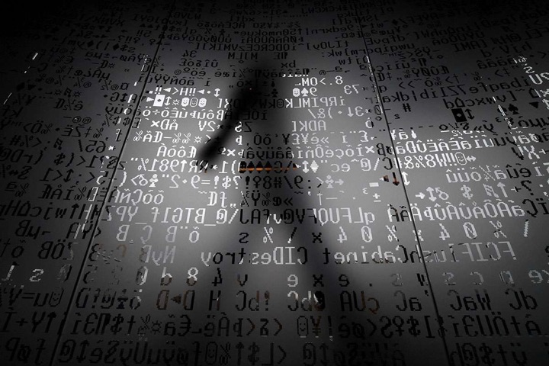
Class3
CSC 497/583 Advanced Topics in Computer Security
Modern Malware Analysis
DLL Injection, Static Analysis, PE Format
Si Chen (schen@wcupa.edu)

Slide 2
Course Outline (1)
DLL Injection
  Dynamic-link library
  DLL Injection example
  Source code of myhack.dll
Static Analysis
  Cryptographic Hash
  Anti-Virus Scanning
  Strings
  PE file
  Packer and Cryptor
PE Format

Slide 3
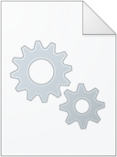

Dynamic-link library (DLL)
Dynamic-link library (or DLL) is Microsoft's implementation of the shared library concept in the Microsoft Windows
A DLL is a module that contains functions (called exported functions or exports) that can be used by another program.

Slide 4
Dynamic Linking
Memory
Lib.dll
Lib.obj
Program2
Program2.obj
Program1
Program1.obj
Program2
Program2.obj
Lib.dll
Lib.obj
Program1
Program1.obj

Slide 5
Dynamic Linking in Linux and Windows
Linux | Windows
ELF file | .exe (PE)
.so (Shared object file) | .dll (Dynamic Linking Library)
.a | .lib (static linking library)
.o (intermediate file between complication and linking, object file) | .obj

Slide 6
DLL Injection
DLL injection is method of injecting code to some other processe’s address space and executing that piece of code on behalf of that process.
DLL injection provides a platform for manipulating the execution of a running process.
  It's very commonly used for logging information while reverse engineering.
  It has gained bad name for itself since it’s mostly used by malware for stealth purposes:
    Hiding malicious code into system process
      Winlogon.exe, services.exe, svchost.exe explorer.exe
    Open backdoor port
    Connect remote server
    Keylogging…
  It’s also frequently used within the game hacking world to code bots

Slide 7
DLL Injection

Slide 8
DLL Injection

Slide 9
DLL Injection

Slide 10
Let’s try our first “Malware”
Download and run XP VM image
Open command line terminal and go to C:\Work
Open a Notepad
Open DebugView
Open Process Explorer and find the PID of Notepad
In command line, type
  InjectDll.exe <PID OF NOTEPAD> myhack.dll

Slide 11

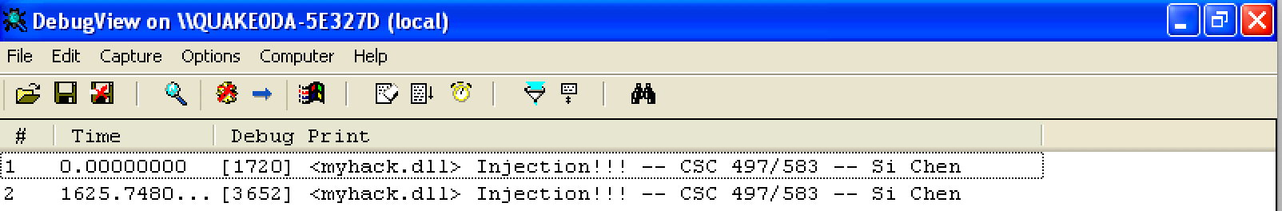
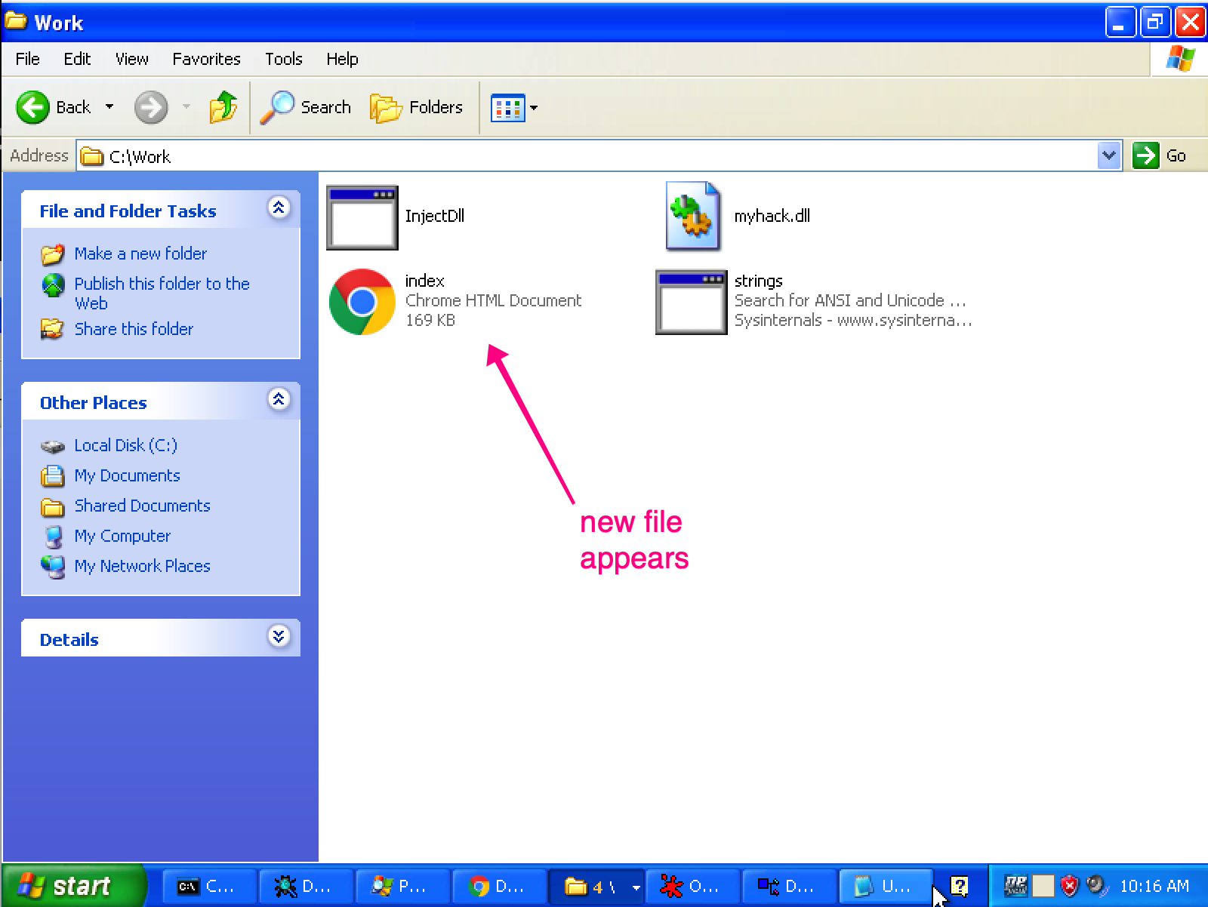
Screenshots

Slide 12
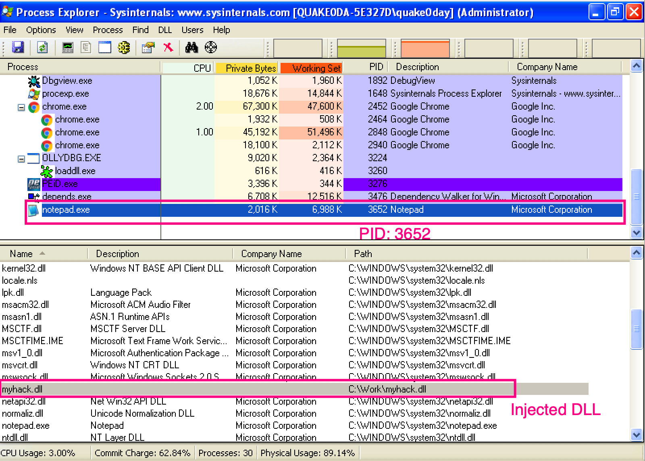
Screenshots

Slide 13
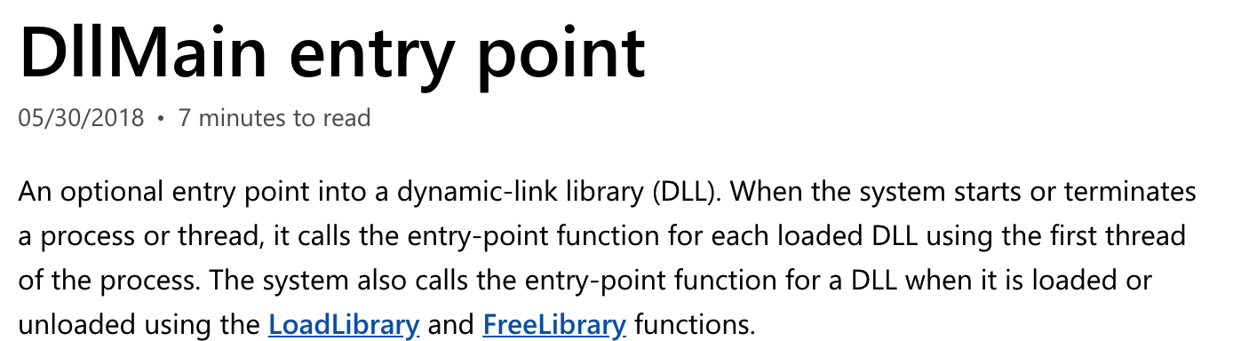
DllMain()

Slide 14
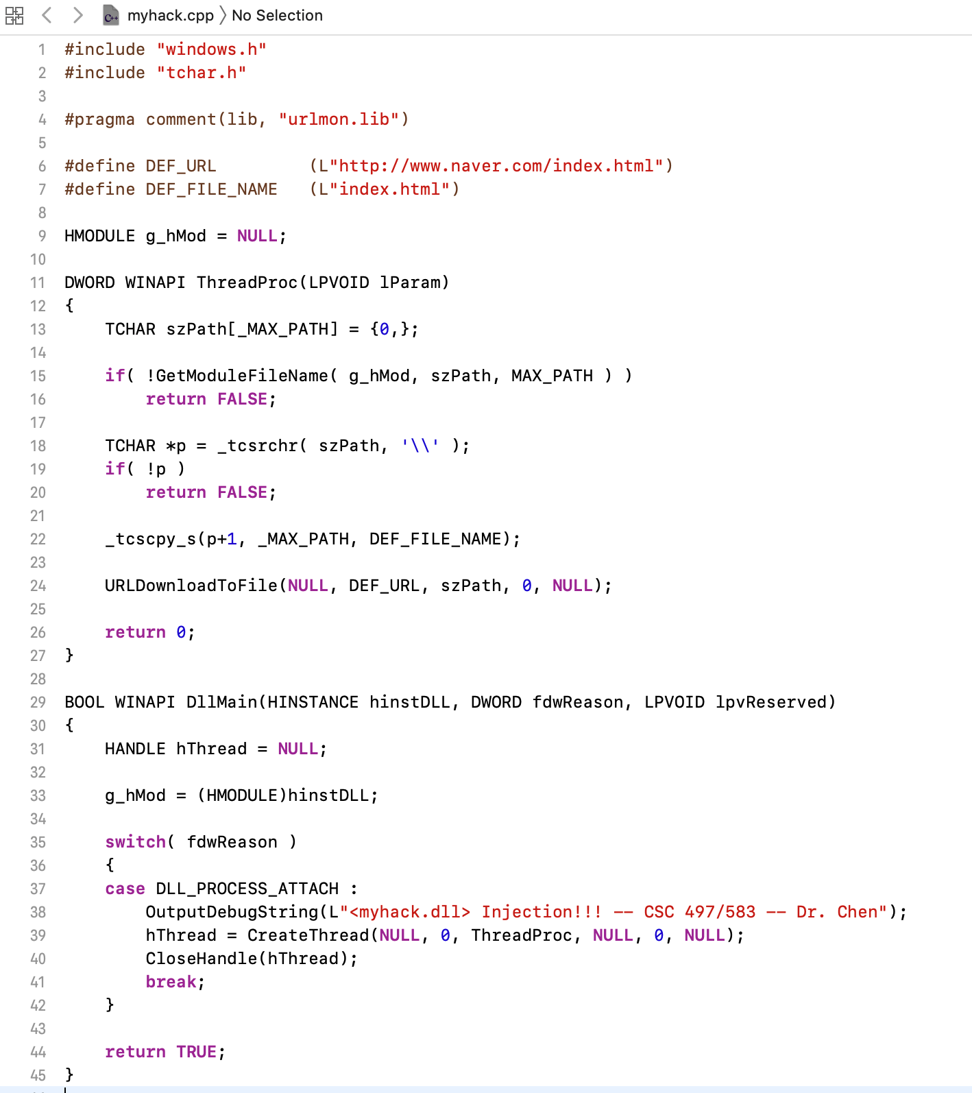
Source Code of myhack.dll

Slide 15
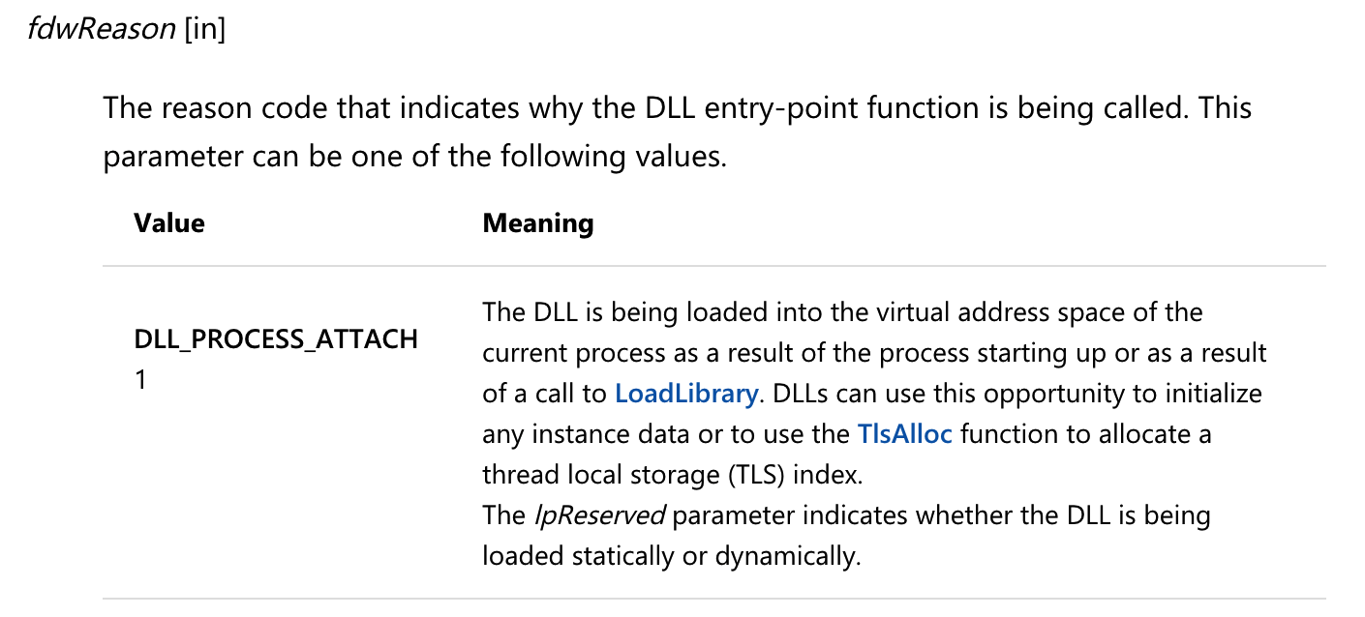
Source Code of myhack.dll

Slide 16
Source Code of myhack.dll

Slide 17
Static Analysis

Slide 18
Fingerprinting the Malware -- Cryptographic Hash

Slide 19
Fingerprinting the Malware
Fingerprinting involves generating the cryptographic hash values for the suspect binary based on its file content.
Same cryptographic hashing algorithms:
  MD5
  SHA1
  SHA256
Why not just use the file name?
  Ineffective, same malware sample can use different filenames, cryptographic hash is calculated based on the file content.
File hash is frequently used as an indicator to share with other security researchers to help them identify the sample.

Slide 20
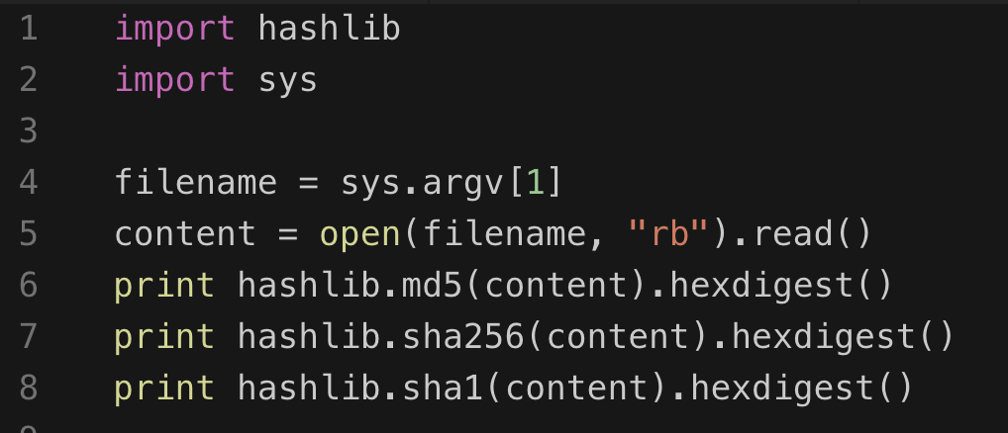
Tools and Python code
md5sum
sha256sum
sha1sum

Slide 21
Strings
Finding Strings ^{[1]}
  A string in a program is a sequence of characters such as “the.”
  A program contains strings if it prints a message, connects to a URL, or copies a file to a specific location.
  Searching through the strings can be a simple way to get hints about the functionality of a program.
    For example, if the program accesses a URL, then you will see the URL accessed stored as a string in the program.
  You can use the Strings program to search an executable for strings, which are typically stored in either ASCII or Unicode format.
[1]. Practical Malware Analysis, page 11

Slide 22

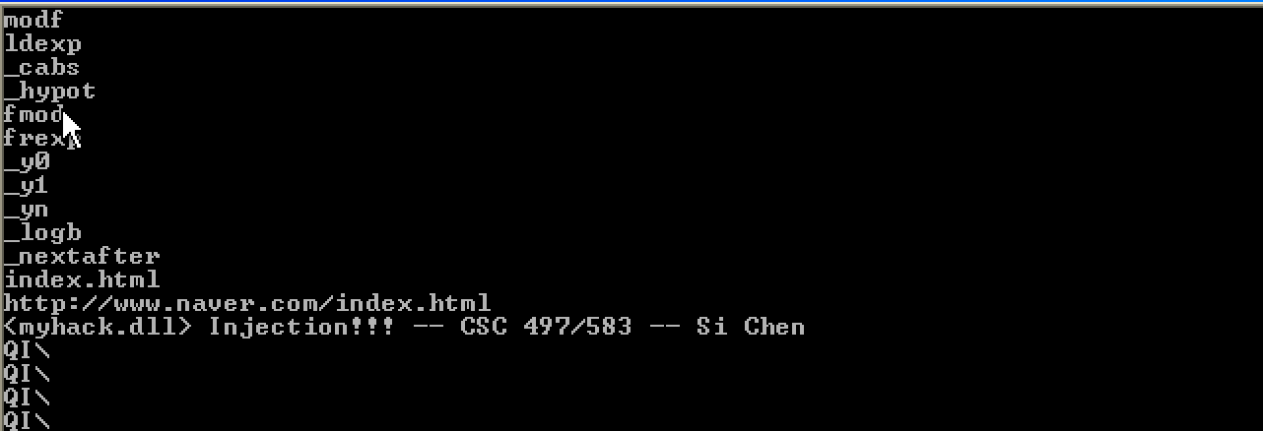
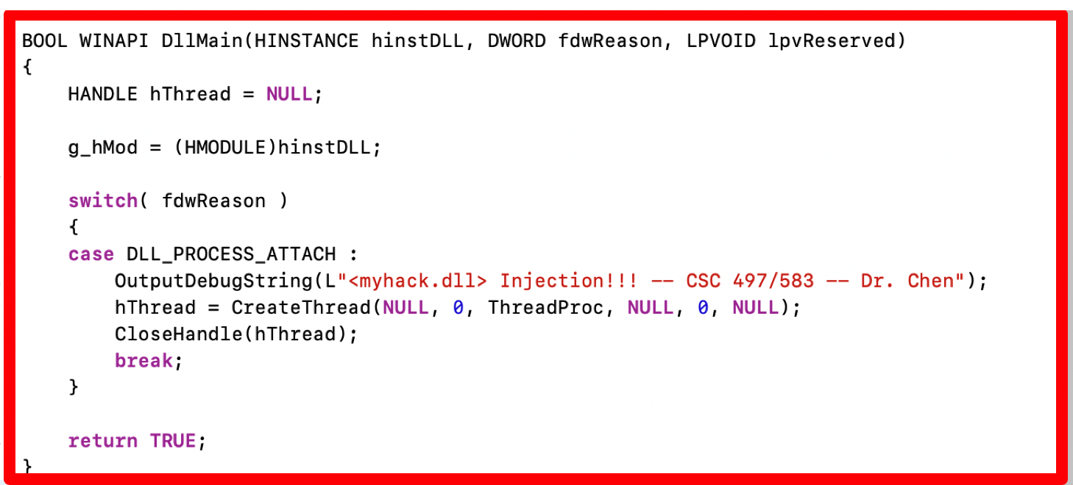
Static analysis (myhack.dll)

Slide 23
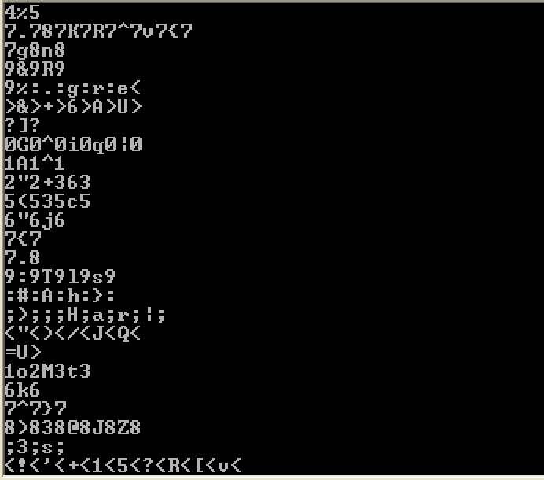
Static analysis (myhack.dll)
Sometimes the strings detected by the Strings program are not actual strings.

Slide 24
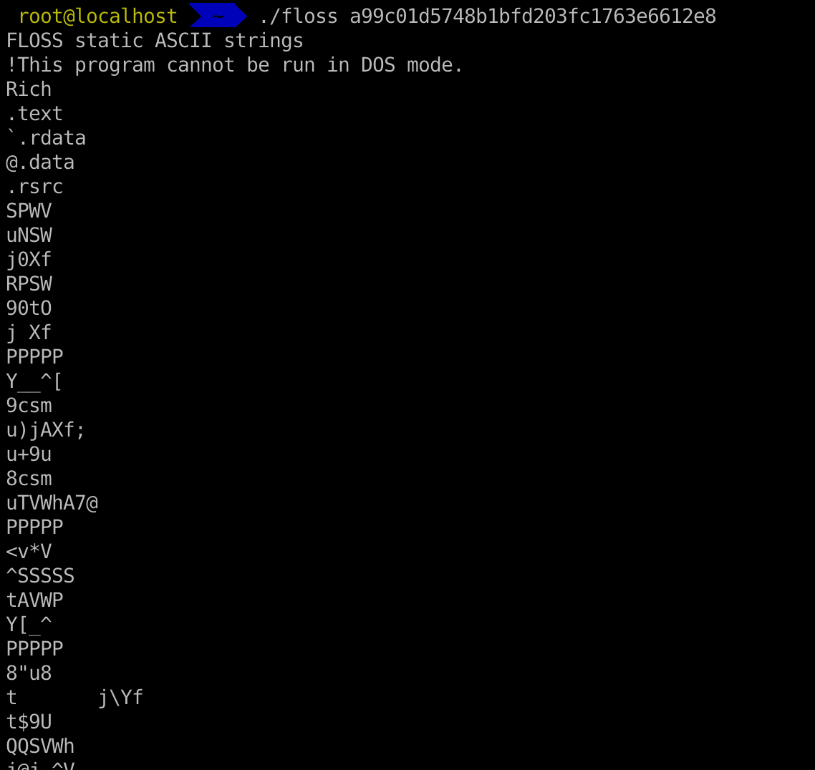
strings in Linux and flare-floss
FireEye Labs Obfuscated String Solver
  Many malware authors evade heuristic detections by obfuscating only key portions of an executable
    These portions are strings and resources used to configure domains, files, and other artifacts of an infection
  The FireEye Labs Obfuscated String Solver (FLOSS) uses advanced static analysis techniques to automatically deobfuscate strings from malware binaries.

Slide 25
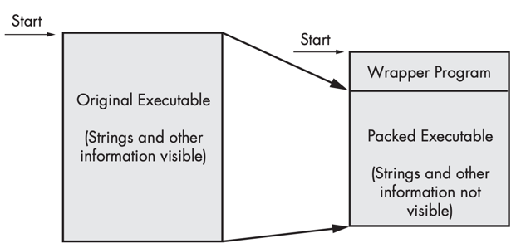
Packed and Obfuscated Malware
Malware writers often use packing or obfuscation to make their files more difficult to detect or analyze.
Obfuscated programs are ones whose execution the malware author has attempted to hide.
Packed programs are a subset of obfuscated programs in which the malicious program is compressed and cannot be analyzed.
Both techniques will severely limit your attempts to statically analyze the malware.

Slide 26
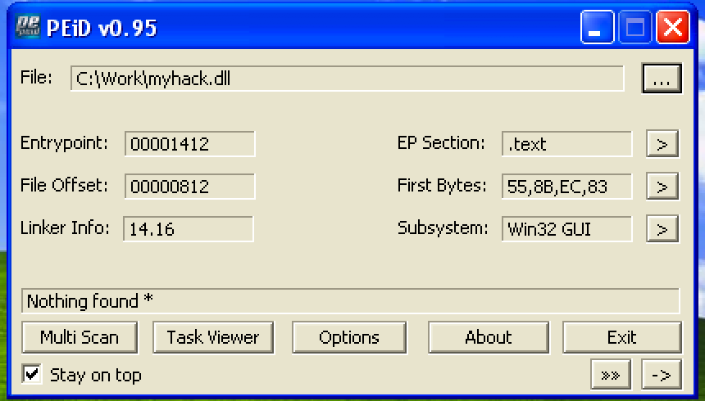
Packed and Obfuscated Malware

Slide 27
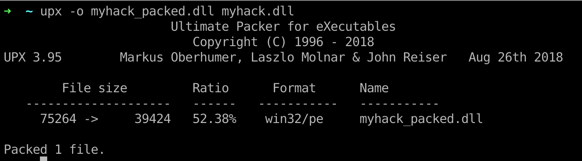
Packers and Cryptos

Slide 28
Portable Executable (PE) file
A Portable Executable (PE) file is the standard binary file format for an Executable (.exe) or DLL under Windows NT, Windows 95, and Win32.

Slide 29
Portable Executable (PE) file
PE formatted files include:
  .exe, .scr (executable)
  .dll, .ocx, .cpl, drv (library)
  .sys, .vxd (driver files)
  .obj (objective file)
All PE formatted files can be executed, except obj file.
  .exe, .scr can be directly executed inside Shell (explorer.exe)
  others can be executed by other program/service
PE refers to 32 bit executable file, or PE32. 64 bit executable file is named as PE+ or PE32+. (Note that it is not PE64).

Slide 30
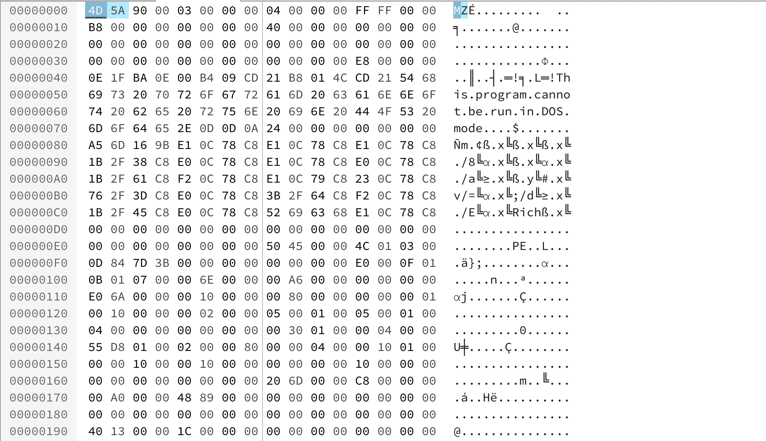
PE Example – Notepad.exe

Slide 31
Load PE file (Notepad.exe) into Memory

Slide 32
VA & RVA
VA (Virtual Address): The address is called a “VA” because Windows creates a distinct VA space for each process, independent of physical memory. For almost all purposes, a VA should be considered just an address. A VA is not as predictable as an RVA because the loader might not load the image at its preferred location.
RVA (Relative Virtual Address): The address of an item after it is loaded into memory, with the base address of the image file subtracted from it. The RVA of an item almost always differs from its position within the file on disk (file pointer).
RVA + ImageBase = VA
In 32bit Windows OS, each process has 4GB virtual memory
which means the range of VA is: 00000000 - FFFFFFFF

Slide 33
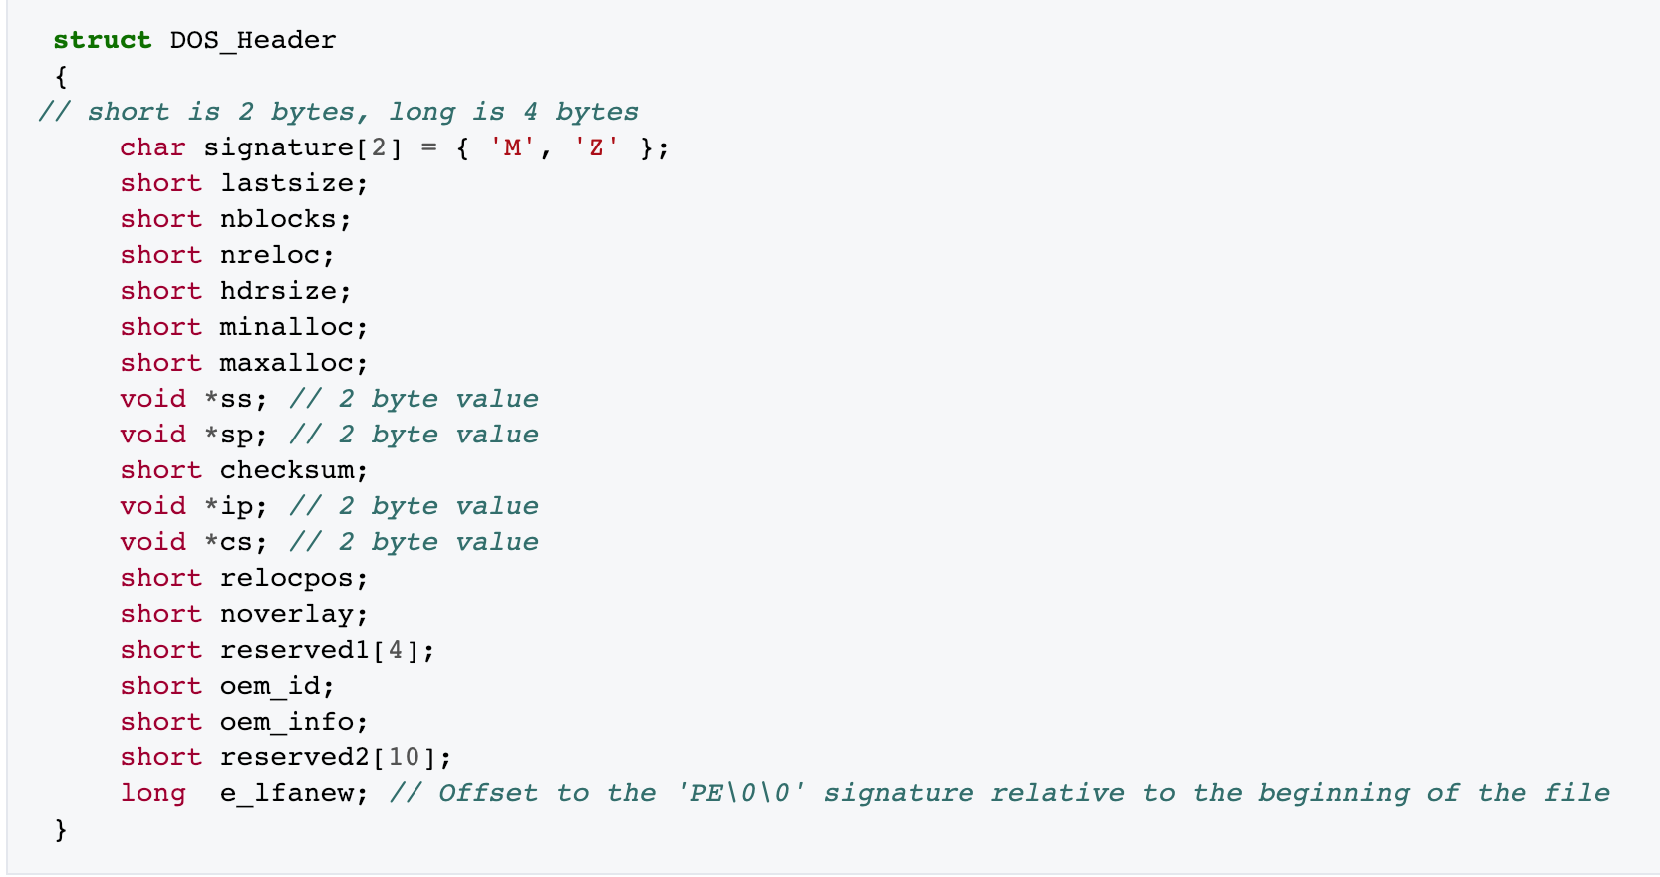
DOS Header
The first 2 letters are always the letters "MZ", the initials of Mark Zbikowski, who created the first linker for DOS. To some people, the first few bytes in a file that determine the type of file are called the "magic number,"

Slide 34
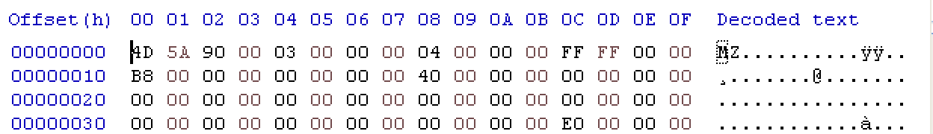
DOS Header
long → 32 bit → ? Byte
E0 00 00 00
value for e_lfanew → ?

Slide 35
Byte Order

Slide 36
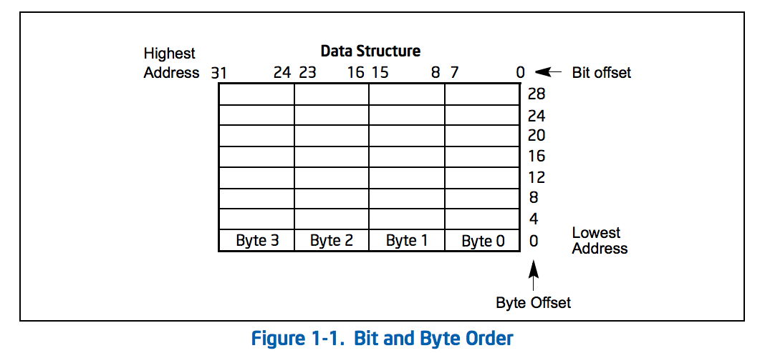
Little endian
IA-32 processors use "little endian" as their byte order. This means that the bytes of a word are numbered starting from the least significant byte and that the least significant bit starts of a word starts in the least significant byte.

Slide 37
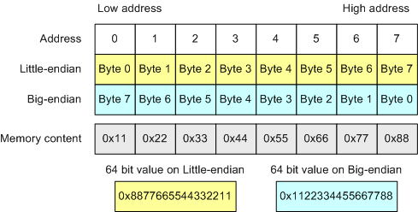
Byte Order

Slide 38
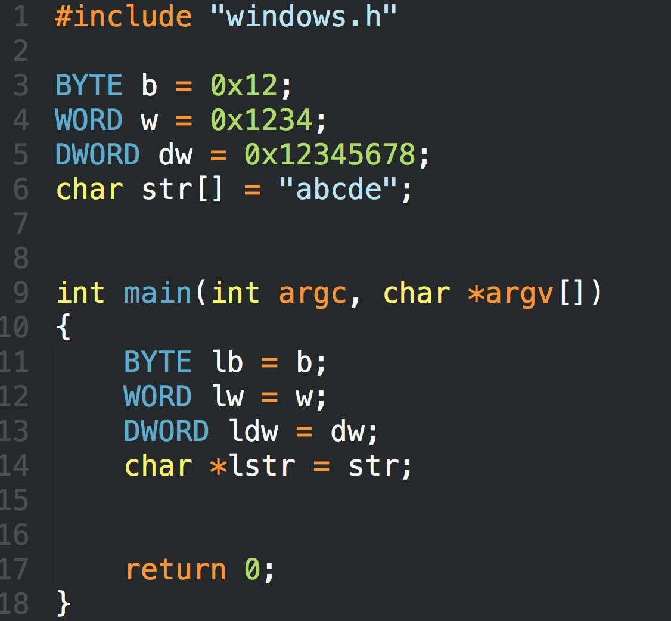
LittleEndian.exe

Slide 39
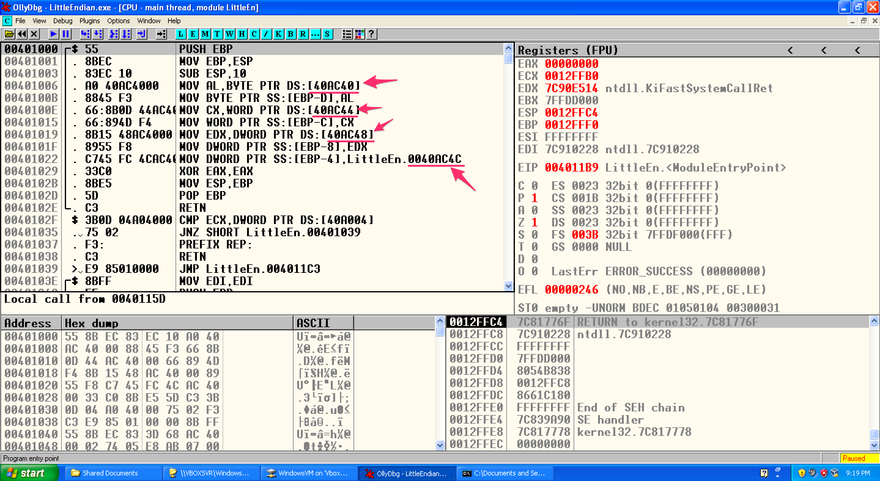
LittleEndian.exe

Slide 40
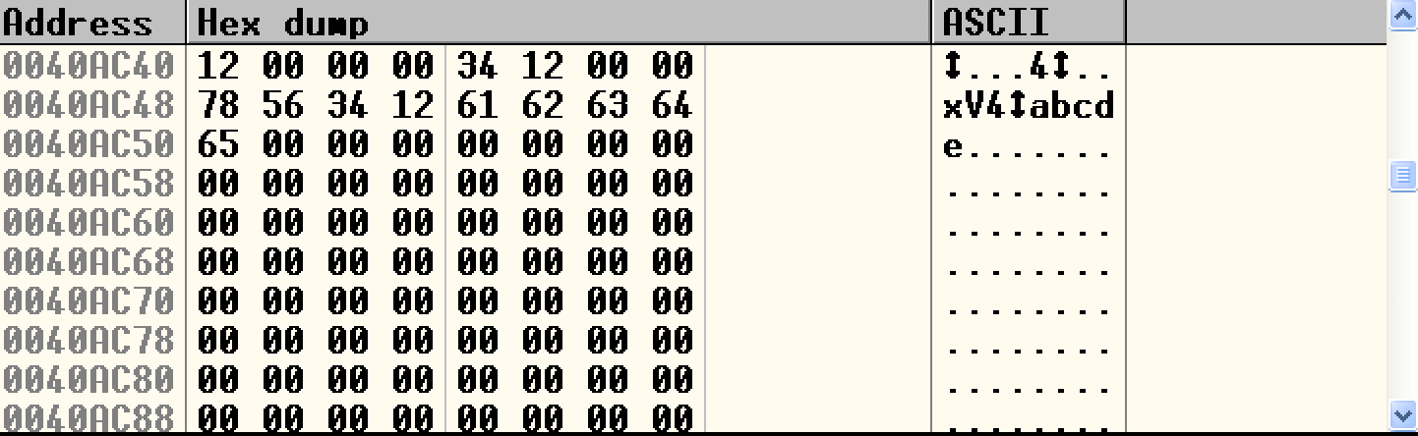
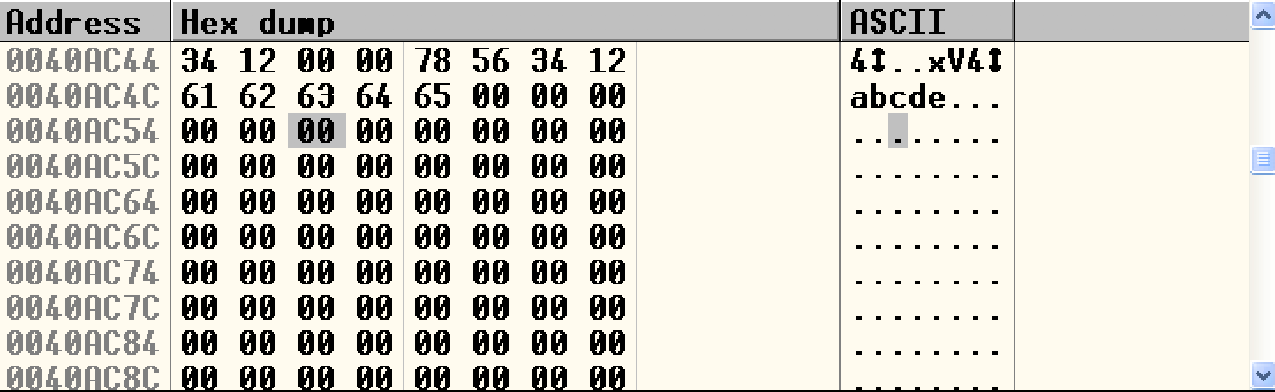
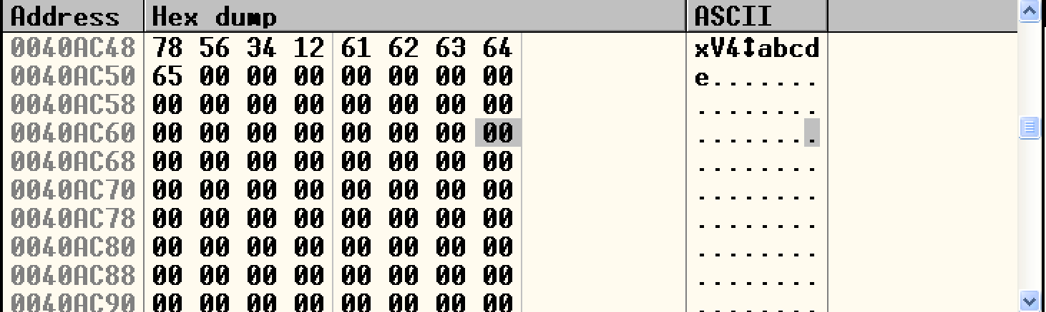
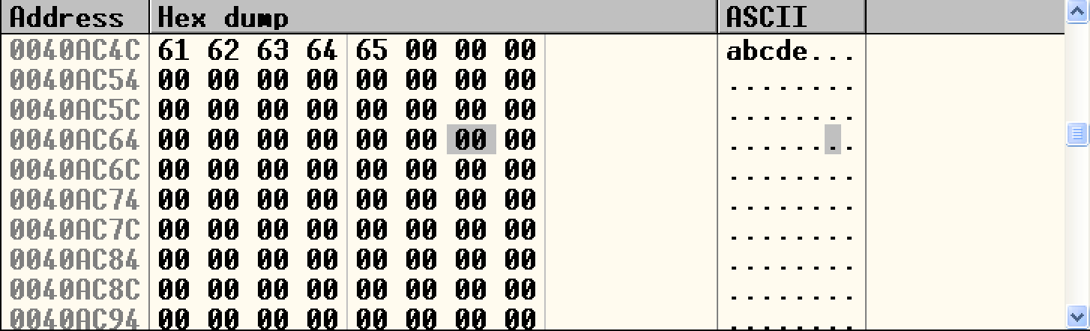
LittleEndian.exe

Slide 41
DOS Header
e_lfanew → 000000E0

Slide 42
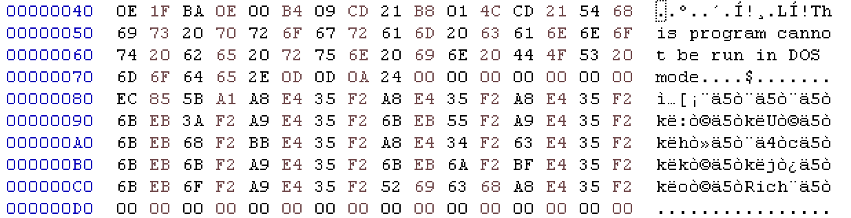
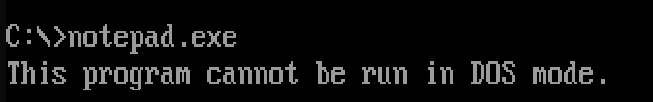
DOS stub
https://virtualconsoles.com/online-emulators/dos/

Slide 43
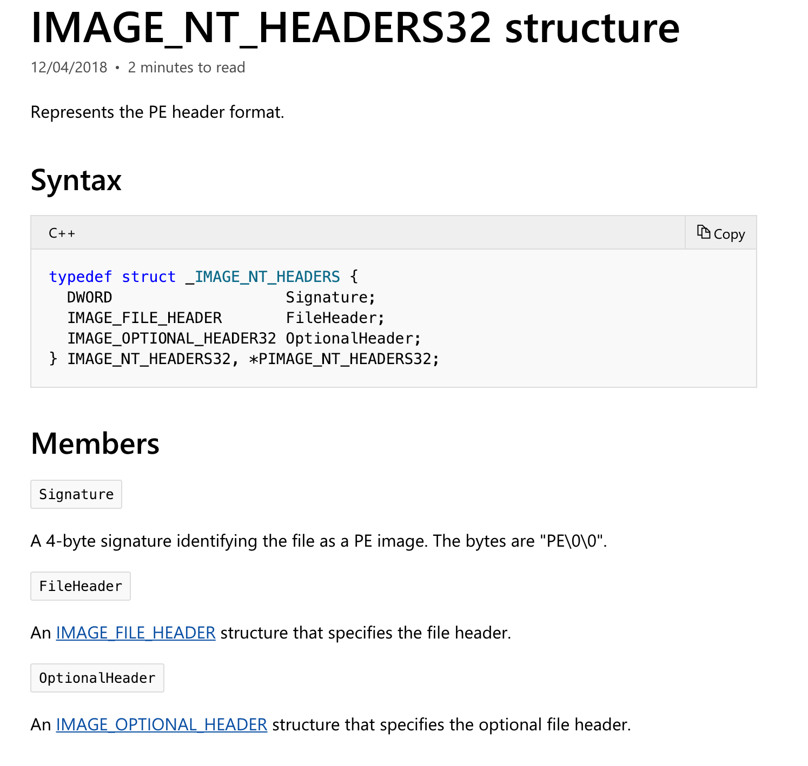
NT Header
https://docs.microsoft.com/en-us/windows/desktop/api/winnt/

Slide 44
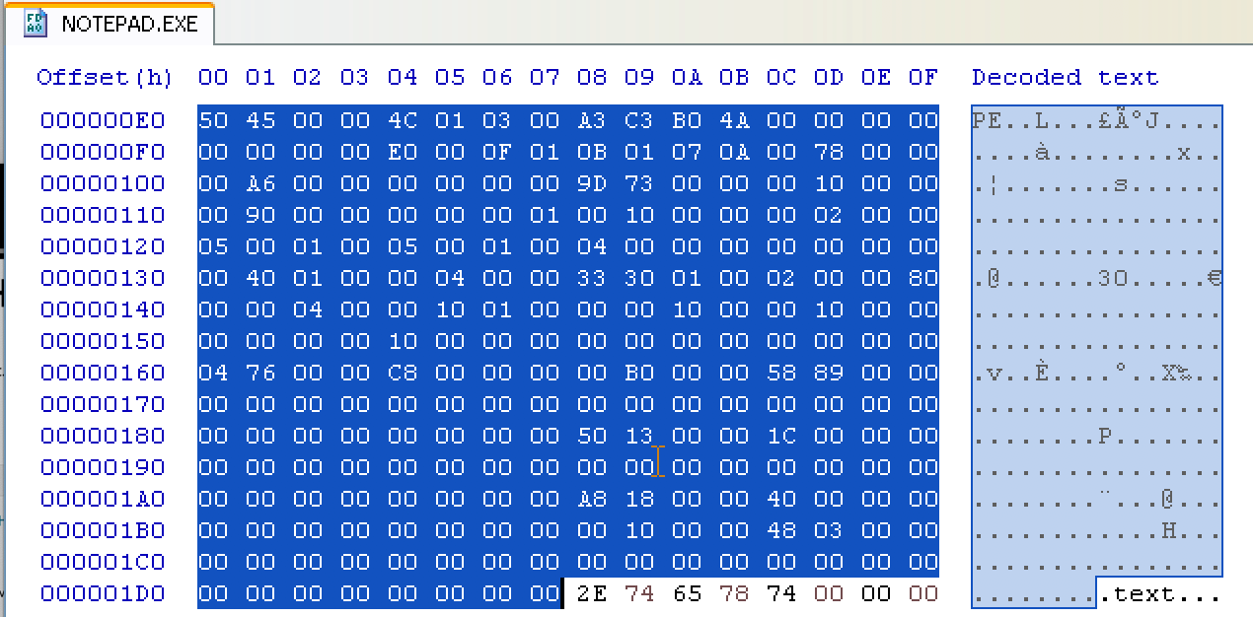
NT Header

Slide 45
Section Header
Name | Privilege
.code | Executable, read
.data | Non-Executable, read/write
.resource | Non-Executable, read

Slide 46
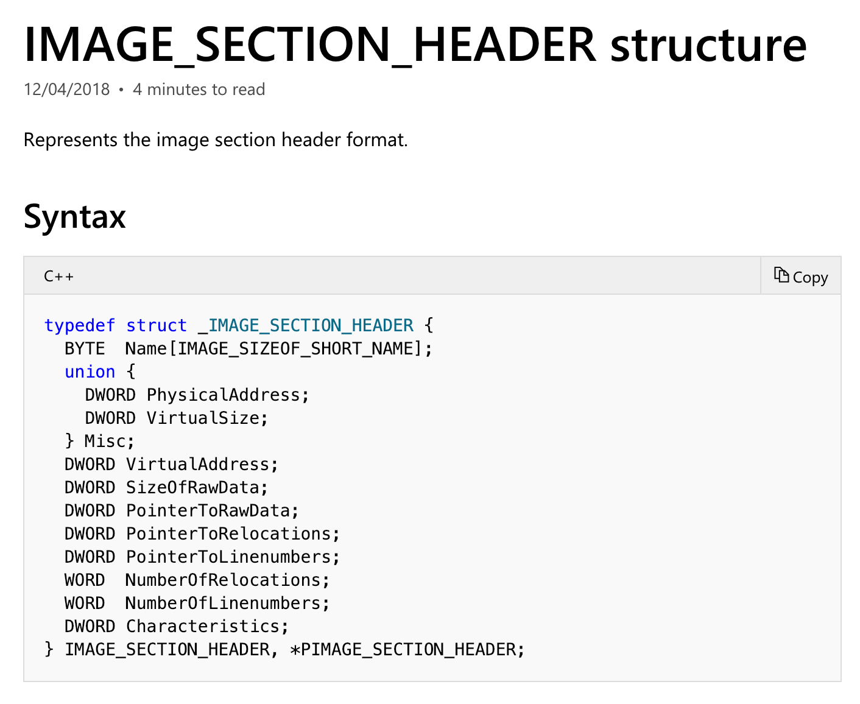
Section Header

Slide 47
Section Header
Members | Meaning
VirtualSize | The total size of the section when loaded into memory, in bytes.
VirtualAddress | The address of the first byte of the section when loaded into memory (RVA)
SizeOfRaw Data | The size of the section data on disk, in bytes.
PointerToRawData | The address of the first byte of the section on disk.
Characteristics | The characteristics of the image.
https://docs.microsoft.com/en-us/windows/desktop/api/winnt/ns-winnt-_image_section_header

Slide 48
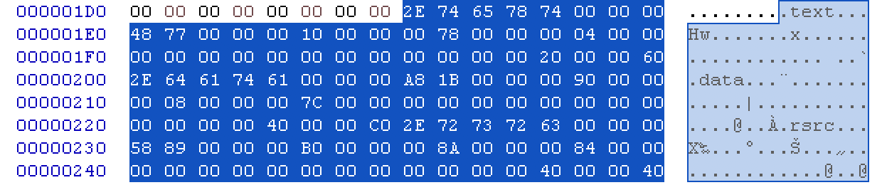
Section Header

Slide 49
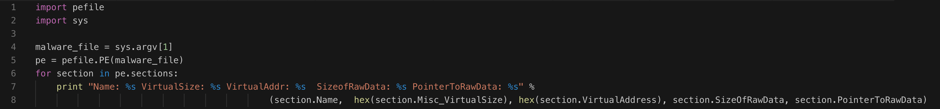
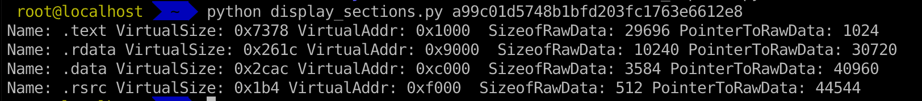
Inspecting PE Header Information in Linux

Slide 50
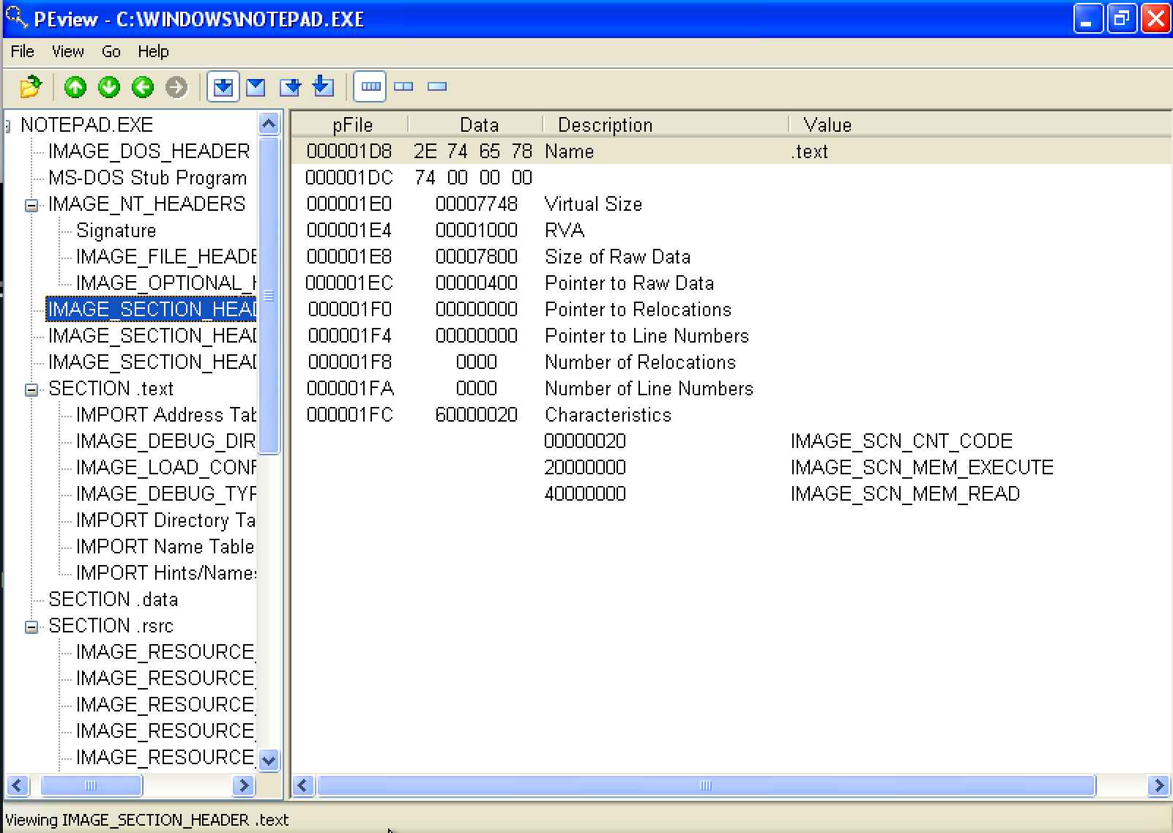
Inspecting PE Header Information

Slide 51
Examining PE Section Table and Sections
https://hub.docker.com/r/remnux/pescanner/

Slide 52

Q & A

