Slide 1

Class2
CSC 497/583 Advanced Topics in Computer Security
Modern Malware Analysis
Basic Analysis, DLL Injection
Si Chen (schen@wcupa.edu)

Slide 2
Course Outline
Introduction
  Virtual Machine
  Static Analysis
A “Hello World” Malware Example: DLL Injection (hack_dll.zip)
  Behavior
  Analysis
  Source code
DLL Injection

Slide 3

Virtual Machines
What is a virtual machine?
  Simply, a computer in your computer
  Really, a segregated virtual environment that emulates real hardware
    There are different types/methods
VirtualBox
VMware
Parallels

Slide 4
Virtual Machines
Why are we using a virtual machine? (for this course)
  Safety, reliability, consistency, it’s easy
  Keep the malware in a contained environment
  Snapshots
    Completely 100% revert the VM to an earlier state
    If things go bad, no one cares

Slide 5
Static Analysis
Analyzing a sample without executing any code
Safe
  Infer functionality
Provides a lot of useful information to guide dynamic and advanced analysis
Lots of tools involved
Can be an easy way to find signatures
  URLs, filenames, registry keys

Slide 6
Let’s try our first “Malware”
Download and run XP VM image
Open command line terminal and go to C:\Work
Open a Notepad
Open DebugView
Open Process Explorer and find the PID of Notepad
In command line, type
  InjectDll.exe <PID OF NOTEPAD> myhack.dll

Slide 7

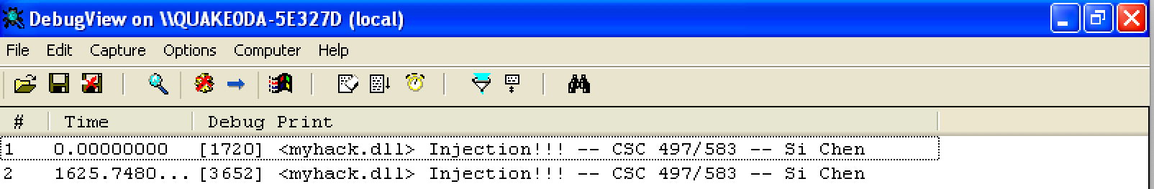
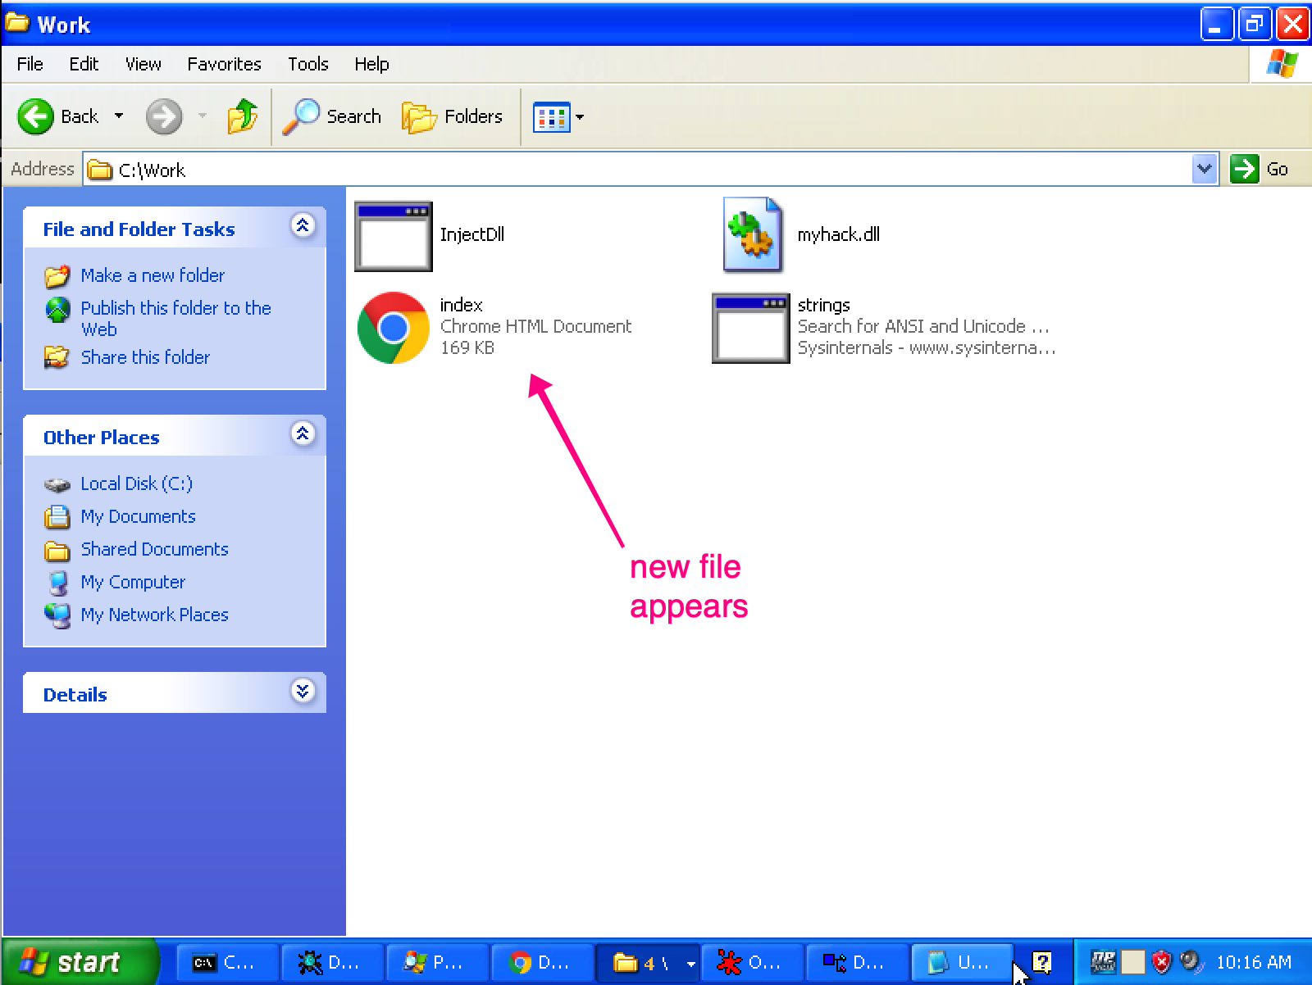
Screenshots

Slide 8
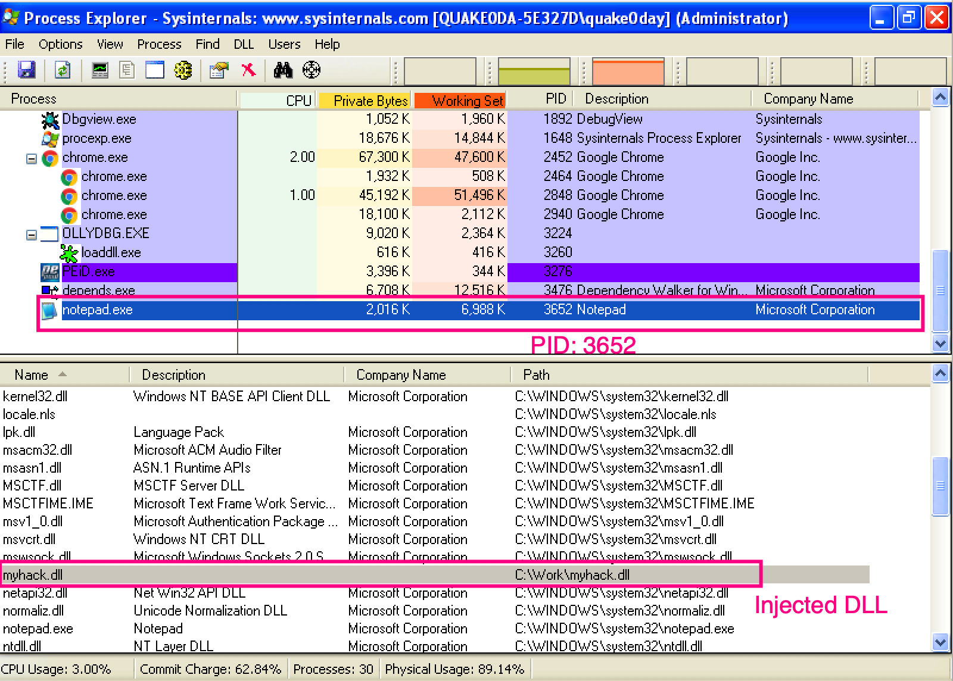
Screenshots

Slide 9


Dynamic-link library (DLL)
Dynamic-link library (or DLL) is Microsoft's implementation of the shared library concept in the Microsoft Windows

Slide 10
Dynamic Linking

Slide 11
Drawbacks of Static Linking
Memory
Waste space
Hard to maintain
Program2
Program2.obj
Lib.obj
Program1
Program1.obj
Lib.obj
Program2
Program2.obj
Lib.obj
Program1
Program1.obj
Lib.obj

Slide 12
Dynamic Linking
Memory
Lib.dll
Lib.obj
Program2
Program2.obj
Program1
Program1.obj
Program2
Program2.obj
Lib.dll
Lib.obj
Program1
Program1.obj

Slide 13
Dynamic Linking in Linux and Windows
Linux | Windows
ELF file | .exe (PE)
.so (Shared object file) | .dll (Dynamic Linking Library)
.a | .lib (static linking library)
.o (intermediate file between complication and linking, object file) | .obj

Slide 14
DLL Injection
DLL injection is method of injecting code to some other processe’s address space and executing that piece of code on behalf of that process.
DLL injection provides a platform for manipulating the execution of a running process.
  It's very commonly used for logging information while reverse engineering.
  It has gained bad name for itself since it’s mostly used by malware for stealth purposes:
    Hiding malicious code into system process
      Winlogon.exe, services.exe, svchost.exe explorer.exe
    Open backdoor port
    Connect remote server
    Keylogging…
  It’s also frequently used within the game hacking world to code bots

Slide 15
DLL Injection

Slide 16
DLL Injection

Slide 17
DLL Injection

Slide 18
DLL Injection

Slide 19
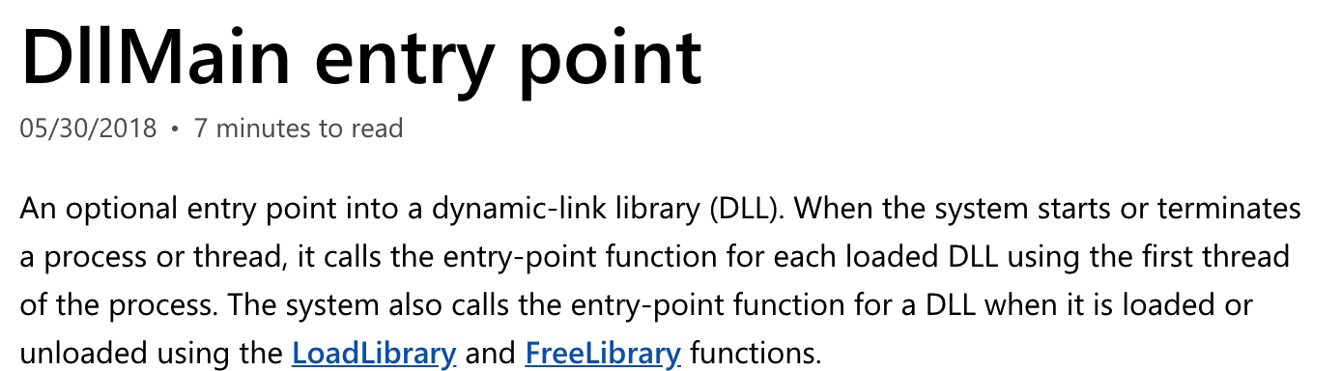
DllMain()

Slide 20
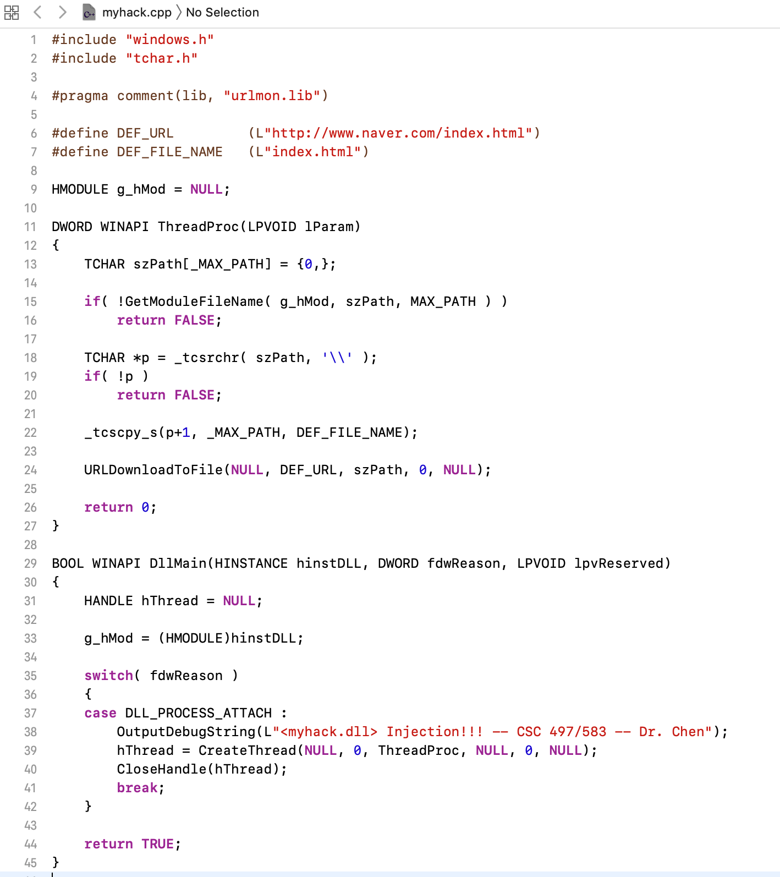
Source Code of myhack.dll

Slide 21
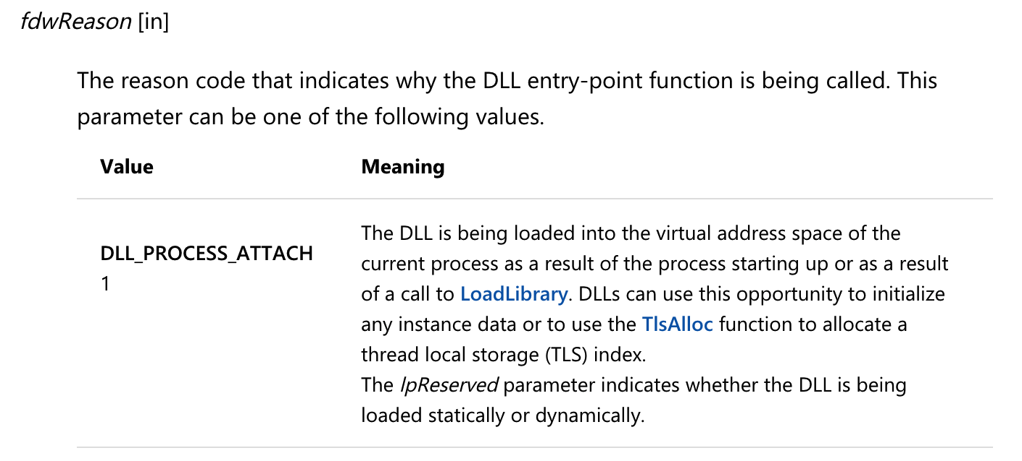
Source Code of myhack.dll

Slide 22
Source Code of myhack.dll

Slide 23
Static analysis (myhack.dll)
Finding Strings ^{[1]}
  A string in a program is a sequence of characters such as “the.”
  A program contains strings if it prints a message, connects to a URL, or copies a file to a specific location.
  Searching through the strings can be a simple way to get hints about the functionality of a program.
    For example, if the program accesses a URL, then you will see the URL accessed stored as a string in the program.
  You can use the Strings program to search an executable for strings, which are typically stored in either ASCII or Unicode format.
[1]. Practical Malware Analysis, page 11

Slide 24

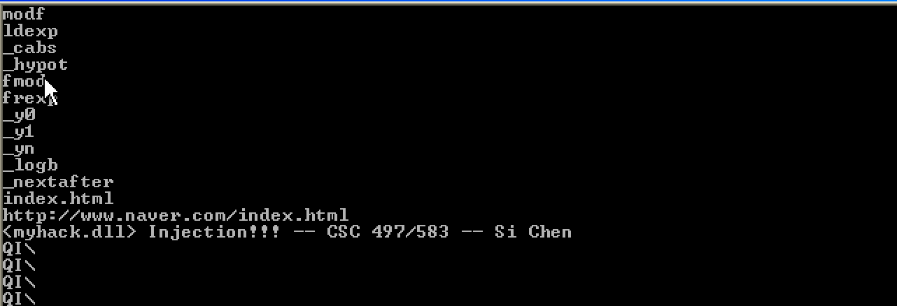
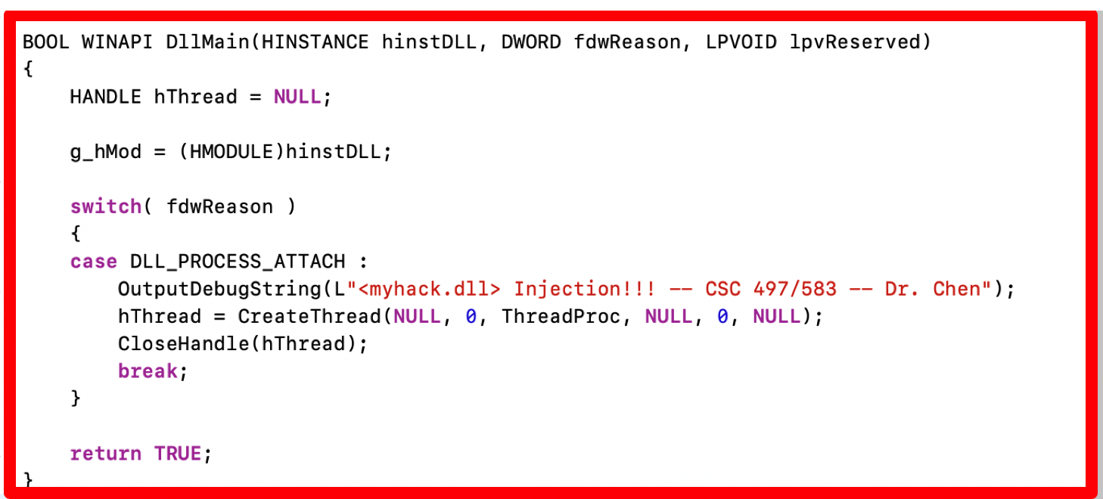
Static analysis (myhack.dll)

Slide 25
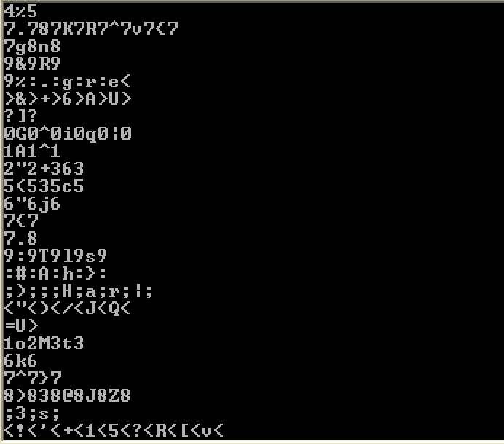
Static analysis (myhack.dll)
Sometimes the strings detected by the Strings program are not actual strings.

Slide 26
Portable Executable (PE) file
A Portable Executable (PE) file is the standard binary file format for an Executable (.exe) or DLL under Windows NT, Windows 95, and Win32.

Slide 27
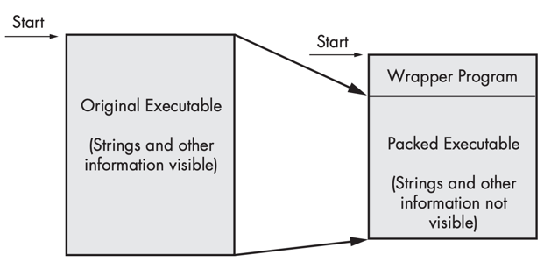
Packed and Obfuscated Malware
Malware writers often use packing or obfuscation to make their files more difficult to detect or analyze.
Obfuscated programs are ones whose execution the malware author has attempted to hide.
Packed programs are a subset of obfuscated programs in which the malicious program is compressed and cannot be analyzed.
Both techniques will severely limit your attempts to statically analyze the malware.

Slide 28
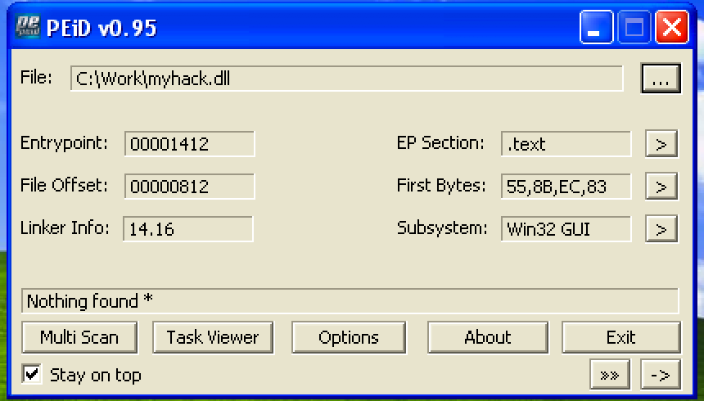
Packed and Obfuscated Malware

Slide 29
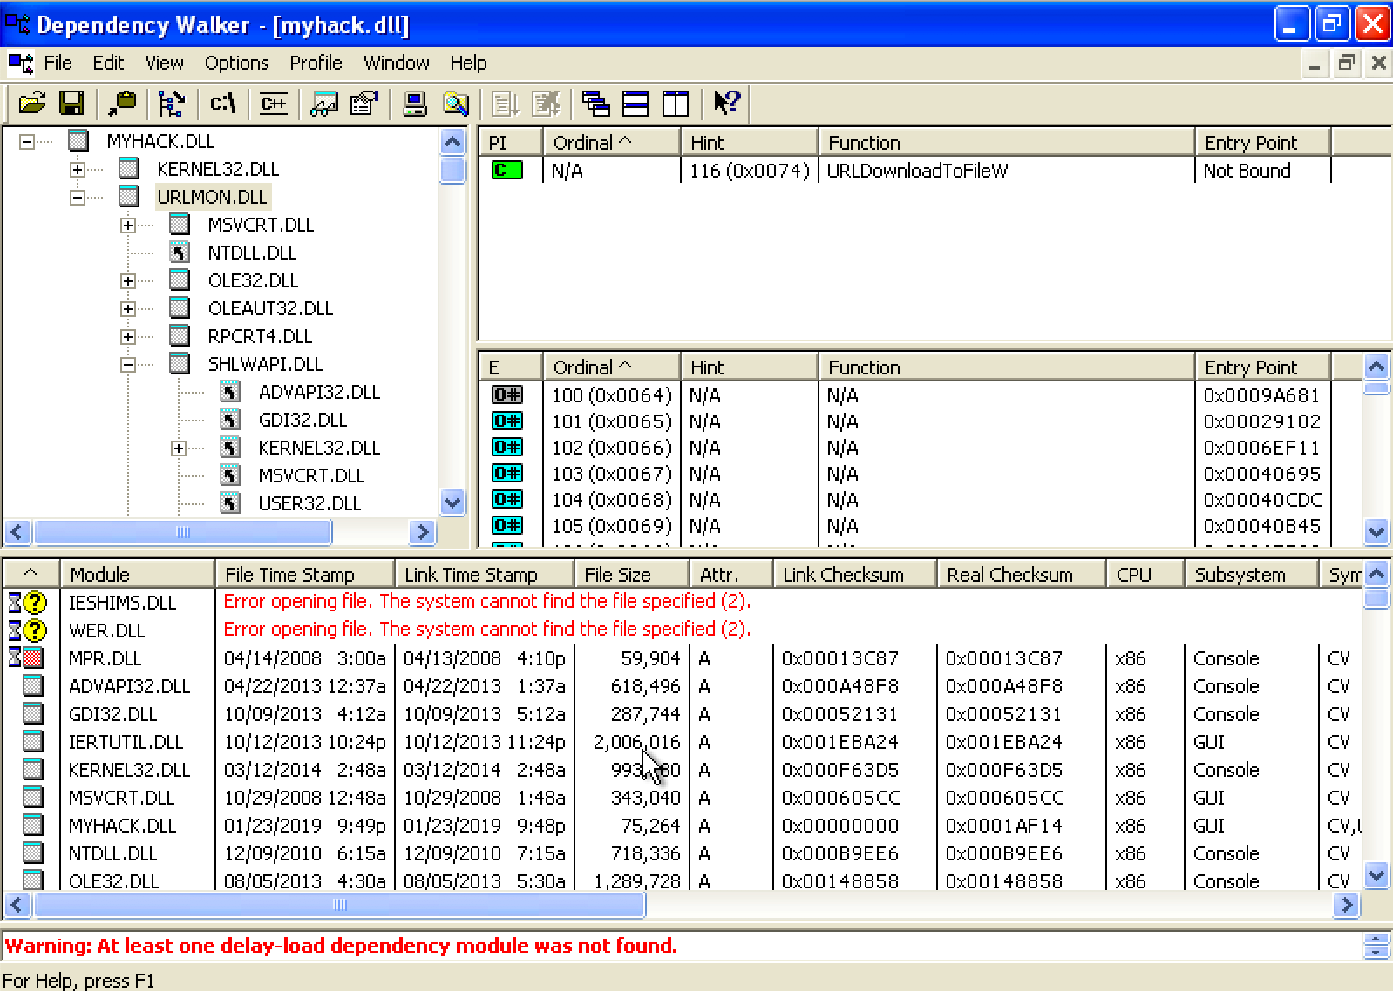
Exploring Dynamically Linked Functions with Dependency Walker

Slide 30
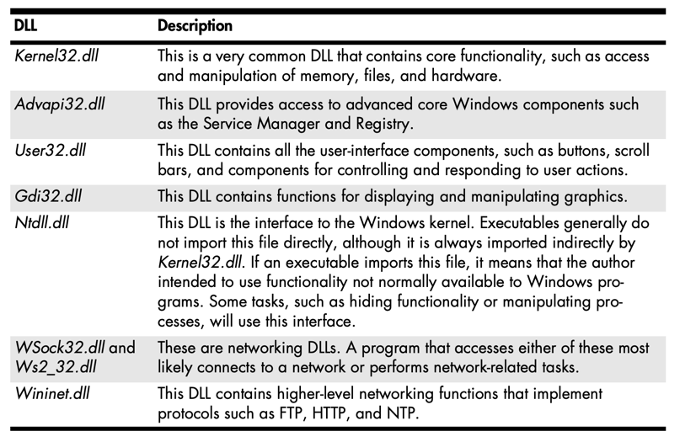
Common DLLs

Slide 31
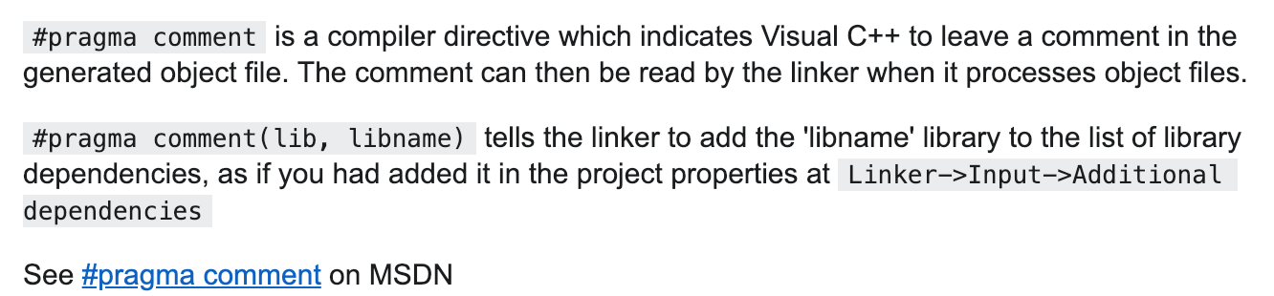
Exploring Dynamically Linked Functions with Dependency Walker

Slide 32

Q & A

