Slide 1

Class1
CSC 497/583 Advanced Topics in Computer Security
Modern Malware Analysis
Si Chen (schen@wcupa.edu)

Slide 2
Course Roadmap
Basic Analysis
  Debugging
  Reverse Engineering
  Malware Behavior
Modern malware threats
  APTs (Advanced Persistent threats)
  Mobile malware
  Web browser malware
  IoT malware
  Blockchain/smart contract malware
  …

Slide 3
Our approach
Breakdown each topic into two parts:
  Part I: Malware Analysis Foundations
    Lecture
    Lab
  Part II: Research Area Case Studies
    Reading paper and answer some questions (Reading Homework)
    Group Presentation and Discussion

Slide 4
What is malware?
Some common names…
  Trojan, virus, worm, RAT, rootkit
  A piece of software that is intended to perform unwanted activities on a machine
Some examples of malicious behavior...
  Serving ads, stealing data, consuming resources
  Others?

Slide 5
Why do people write malware?
Morris Worm
  On accident
  Purpose: “gauge the size of the internet”
  What happened: Fork bomb

Slide 6
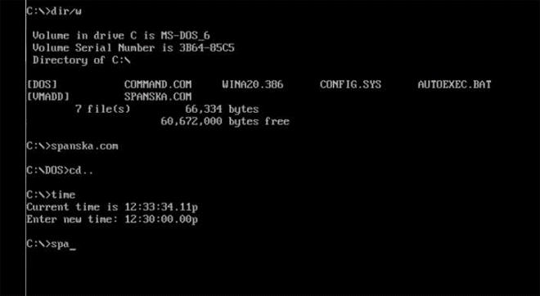
Why do people write malware?
Once upon a time… (25 Years Ago)
  Just for fun
  Spread to other machines & display a message

Slide 7
Why do people write malware?
Today
  $$$
Organizations buy malware
  Steal passwords, credit cards, bank info, ransoms, intellectual property, trade secrets
  They can use this info or sell it

Slide 8
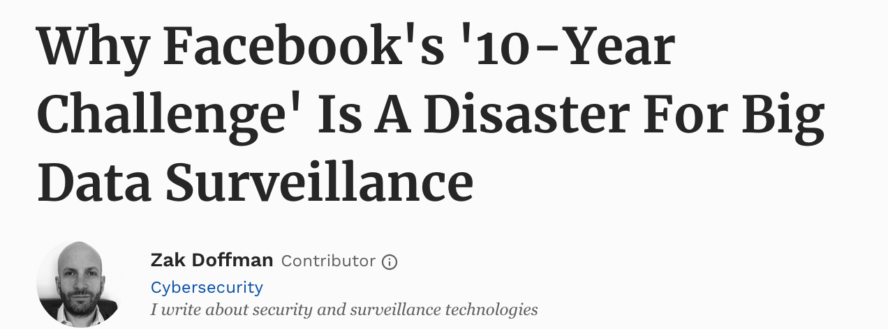
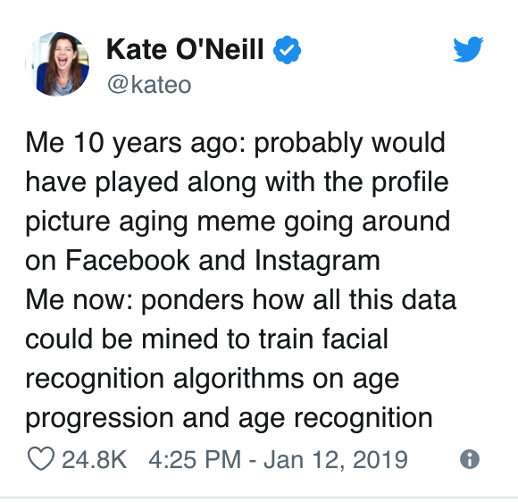
Why do people write malware?
Future…
  Gathering (more) Information

Slide 9
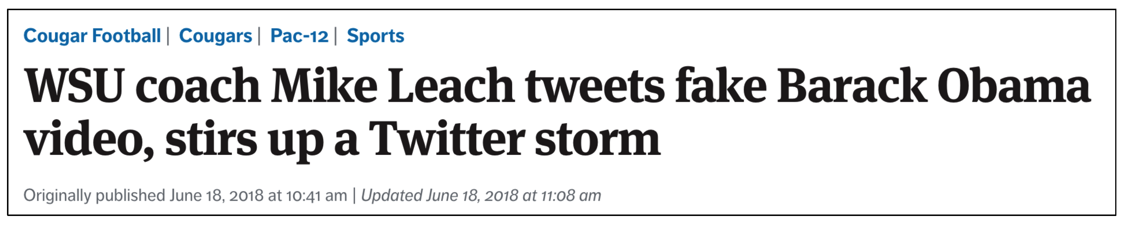
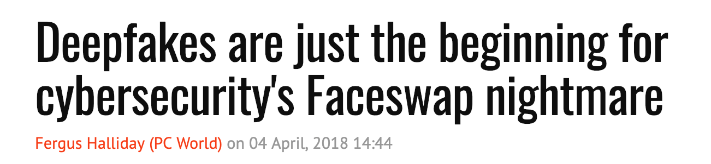
Why do people write malware?
Future…
  Spread False Information
https://www.youtube.com/watch?v=cQ54GDm1eL0

Slide 10
Why do people write malware?
Future…
  Control your Life

Slide 11
Our project – Disinformation in AR
Virtual-world
attack
Real-world
attack

Slide 12
Our project – Disinformation in AR
Virtual-world
attack
Real-world
attack

Slide 13
Why analyze malware?
Detect and respond to intrusions
  Threat analysis
    Host & Network signatures
    What’s the damage?
      Who/What is infected?
  Threat prevention
  Threat removal

Slide 14

General perspectives and attack research

Slide 15
Top computer security conference
--- The Big 4

Slide 16
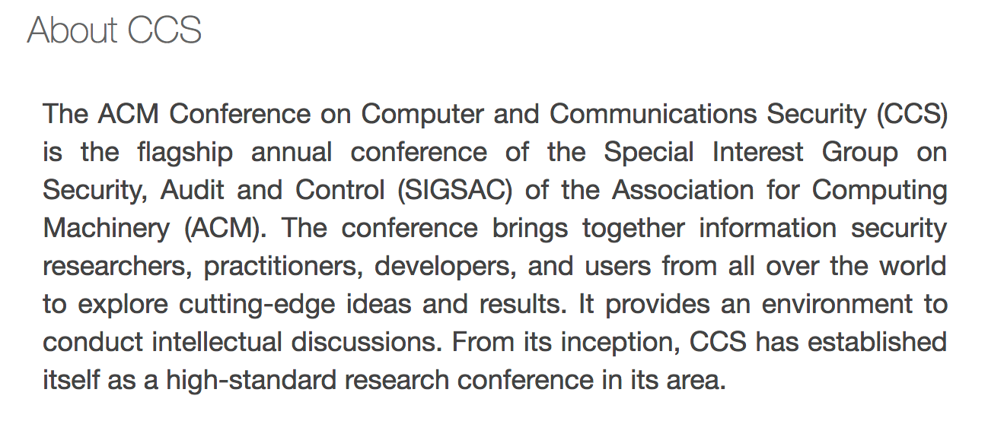
Top computer security conference
ACM Conference on Computer and Communications Security (CCS)

Slide 17
Top computer security conference
IEEE Symposium on Security and Privacy (S&P)
Since 1980, the IEEE Symposium on Security and Privacy (S&P)has been the premier forum for the presentation of developments in computer security and electronic privacy, and for bringing together researchers and practitioners in the field.

Slide 18
Top computer security conference
ISOC Network and Distributed System Security Symposium (NDSS)
The Network and Distributed System Security Symposium (NDSS) fosters information exchange among researchers and practitioners of network and distributed system security. The target audience includes those interested in practical aspects of network and distributed system security, with a focus on actual system design and implementation. A major goal is to encourage and enable the Internet community to apply, deploy, and advance the state of available security technologies.

Slide 19
Top computer security conference
Usenix Security Symposium (USENIX)
The USENIX Security Symposium brings together researchers, practitioners, system administrators, system programmers, and others interested in the latest advances in the security and privacy of computer systems and networks.

Slide 20
Top Security Conference for Hacking
  Black hat USA
  DEFCON

Slide 21
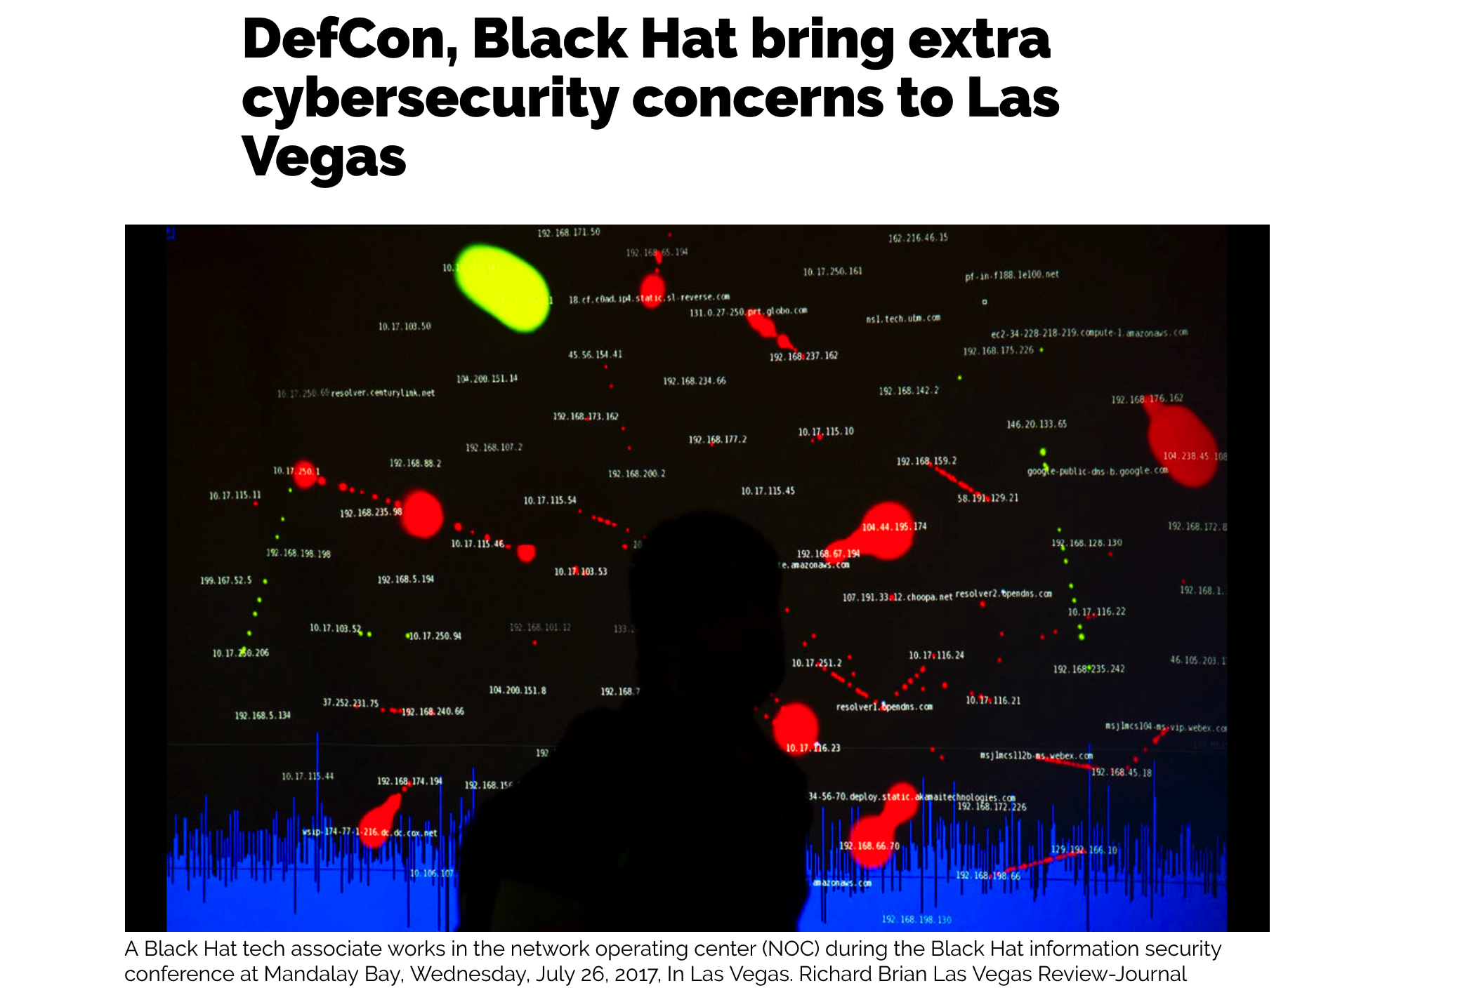

Slide 22


\

Slide 23

Q & A

