Slide 1
Class15
CSC 497/583 Advanced Topics in Computer Security
Modern Malware Analysis
Kernel Mode Rootkit
Si Chen (schen@wcupa.edu)

Slide 3
Review: Stealth Process
Stealth Process

Slide 4
Processes API
  CreateToolhelp32Snapshot()
  EnumProcess()
  ntdll.ZwQuerySystemInformation()
  ntdll.ZwQuerySystemInformation()
NTSTATUS WINAPI ZwQuerySystemInformation(
_In_ SYSTEM_INFORMATION_CLASS SystemInformationClass,
_Inout_ PVOID SystemInformation,
_In_ ULONG SystemInformationLength,
_Out_opt_ PULONG ReturnLength
);
Retrieves the specified system information.

Slide 5
Create Stealth Process
  CreateToolhelp32Snapshot()
  EnumProcess()
  ntdll.ZwQuerySystemInformation()
  ntdll.ZwQuerySystemInformation()
Process1
Process2
Process3
Process4
Process1
Process3
Process4

Slide 6
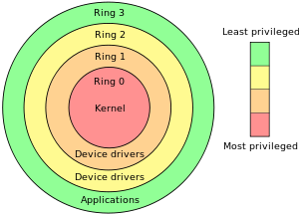
The “Ring”
System Call →
WinAPI (Windows)

Slide 7
CPU Interrupt
User Mode Execution
Interruption occurred
Next instruction
User Mode
Kernel Mode
Interrupt Vector Table
Interrupt Handler

Slide 8
Windows System Call and API
The Win32 API is a layer that runs in user mode (ring 3).
Only API calls that use kernel resources (CreateThread, VirtualAlloc, etc) will call into the "real" operating system (ntdll.dll) and trap into ring 0 with a software interrupt (int 0x2e).

Slide 9
Write a file in Notepad
Application
fwrite()
notepad.exe
Run Time
Library
write()
Libcmt.lib
msvcr90.dll
API (Windows)
NtWriteFile()
Kernel32.dll
NTDLL.dll
Interrupt 0x2e
Kernel
IoWriteFile()
Kernel
NtosKrnl.exe

Slide 10
Rootkit (Kernel Mode)
Application
fwrite()
notepad.exe
Run Time
Library
write()
Libcmt.lib
msvcr90.dll
API (Windows)
NtWriteFile()
Kernel32.dll
NTDLL.dll
Interrupt 0x2e
Kernel
IoWriteFile()
Kernel
NtosKrnl.exe

Slide 11
Rootkit (Kernel Mode)
Kernel Mode Rootkits are installed as either drivers (SYS) or Kernel Modules (DLL)
Most rootkits target 32-bit Windows OS’s
64-bit Windows architectures require drivers to be signed by Microsoft before they can be installed
To subvert this, attackers will:
  Install a valid, signed driver with a known exploit
  Use stolen signing certificates
  Exploit the kernel itself

Slide 12
Rootkit (Kernel Mode)

Slide 14
1. Userland Hooking

Slide 15
Hooking
The most classic of all kernel rootkit techniques
Simple to implement, simple to detect
Still widely used
  Often in conjunction with other techniques

Slide 16
2. IDT Hooking

Slide 17
Interrupt Descriptor Table Hooking (IDT Hooking)
Base address of the IDT is stored in the IDTR
In order to hook a specific Interrupt, a rootkit just changes the pointer in the IDT to their own malicious function
SIDT and LIDT instructions
  Used to read/write to/from the IDTR register
  Each processor has it’s own IDTR and IDT
    This means that a rootkit will have to hook each IDT

Slide 18
IDT Hooking Problems
This technique is old
  As of 2009, INT 0x2E was made obsolete
SYSENTER is now used to perform syscalls
  Interrupt hooking is easy to detect
No way to filter results of an interrupt
  The rootkit’s hook function is just pass-through code that is executed before the interrupt handler

Slide 19
3. MSR Hooking

Slide 20
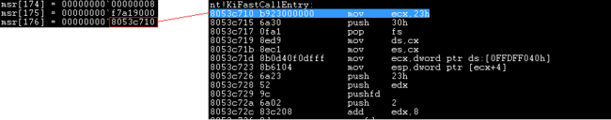
Machine Specific Register Hooking (MSR Hooking)
This is how we hook SYSENTER
  SYSENTER switches to kernel-mode using three MSR’s
    IA32_SYSENTER_CS → 0x174, 16-bit selector of ring 0 code segment
    IA32_SYSENTER_EIP → 0x176, 32-bit offset into ring 0 code segment
    IA32_SYSENTER_ESP → 0x175, 32-bit stack pointer for ring 0 stack
Just like the IDTR, there are instructions for accessing the MSR’s
  RDMSR and WRMSR - read/write MSR
  MSR’s are processor specific just like IDT’s
174h is the CS Register.
175h is the ESP Register.
176h is the EIP Register.

Slide 21
MSR Hooking Problems
More modern than IDT hooking
Still easy to detect, and only provides passthrough functions

Slide 22
4. SSDT Hooking

Slide 23
System Descriptor Table Hooking (SDT, SSDT)
SSDT resides in read-only memory
  Rootkits have to disable and then re-enable the Write Protection (WP) bit in the CR0 register
    Rootkit authors could also map a Memory Descriptor List (MDL) over the SSDT
Disable Write Protection (WP)
Enable Write Protection (WP)

Slide 24
Registers available in the x86-64 instruction set

Slide 25
System Descriptor Table Hooking (SDT, SSDT)
With WP off, the attacker swaps a new address into the target address
  Declare the original syscall prototype (e.g., ZwSetValueKey())
  Declare a corresponding function ptr (e.g., ZwSetValueKeyPtr)
  Define a function ptr (e.g., oldZwSetValueKey)
  Implement a hook routine (e.g., newZwSetValueKey())
  InterlockedExchange() to swap in a ptr to new function
    The new function can execute the old syscall, and filter the results
      Hook ZwQueryDirectoryFile() to hide directories
      Hook ZwQuerySystemInformation() to hide processes

Slide 26
System Descriptor Table Hooking (SDT, SSDT)
KeServiceDescriptorTable
KiServiceTable
Base
Count
Limit
Number
[0] | Function 0
[ i ] | Function i
Before Hook:
Kernel
Code
KeServiceDescriptorTable
KiServiceTable
Base
Count
Limit
Number
[0] Function 0
After Hook:
Kernel
[ i ] Function i
Hook
Code

Slide 27
SSDT Hooking Problems
Relatively straightforward to implement
Provides the ability to filter system calls!
On it’s own, still trivial to detect

Slide 28
6. Filter Driver
5. Code Patching

Slide 29
Windows Driver 101
This make drivers pretty complex and cumbersome to implement.
Notes:
Is this same driver going to do all the business of detecting the device attached to it, handle all its main functions, even auxiliary function like let's say encrypting and decrypting the flow of data to and from the device.

Slide 30
Windows Driver 101
Notes:
Thus, not all the drivers communicate directly with device. For a given I/O request, there are several drivers, layered as stack, that participate in the request.

Slide 31
Windows Driver 101
Driver Stack
Notes:
Bus Driver
A Bus driver drives an individual I/O bus device and provides per-slot functionality that is device independent.
Microsoft provides bus drivers for mist buses, such as PCI, SCSI, USB, etc. Other bus drivers can be provided by IHVs and OEMs. Bus drivers are required drivers => there is one bus driver for each type of bus on a machine.
The primary responsibility of a bus driver are to:
Enumerate the device on its bus.
Respond to Plug and Play and Power management IRPs.
Multiplex access to the bus.
Generically administer the devices on the bus.

Slide 32
Device Object and Driver Stack

Slide 33
Filter Driver Rootkit

Slide 34
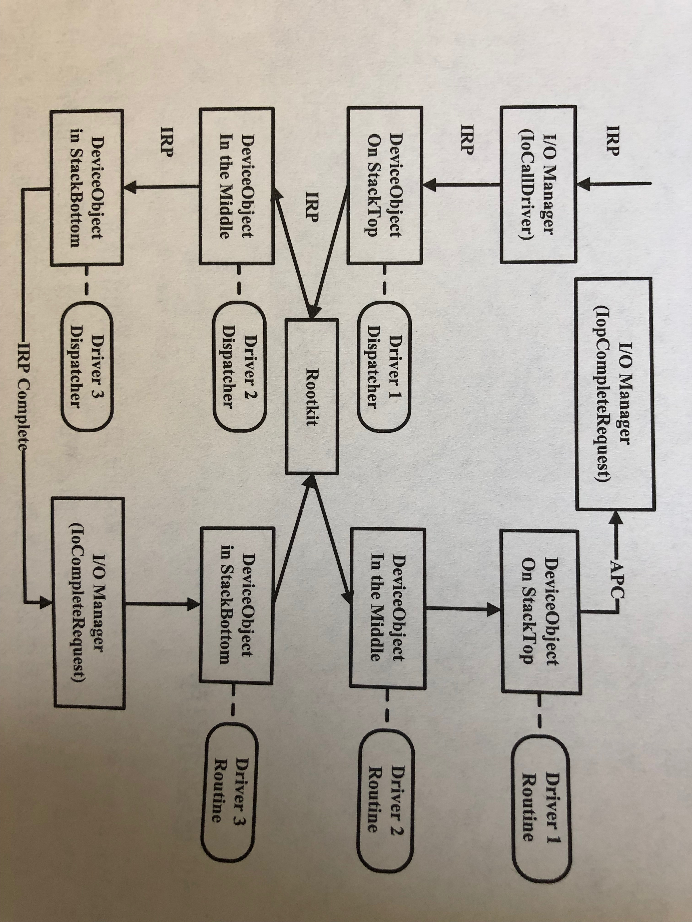
Filter Driver Rootkit

Slide 35
STUXnet

Slide 36
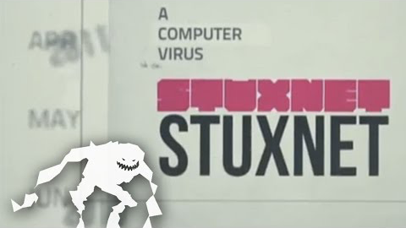
STUXnet

Slide 37
STUXnet

Slide 38
Analysis STUXnet Memory Dump Image
Malware
https://github.com/volatilityfoundation/volatility

Slide 39
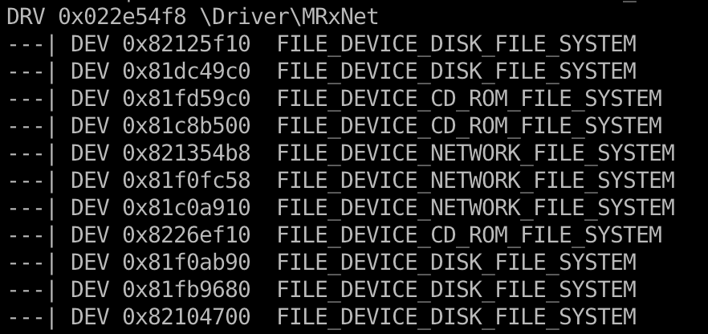
Analysis STUXnet Memory Dump Image

Slide 40
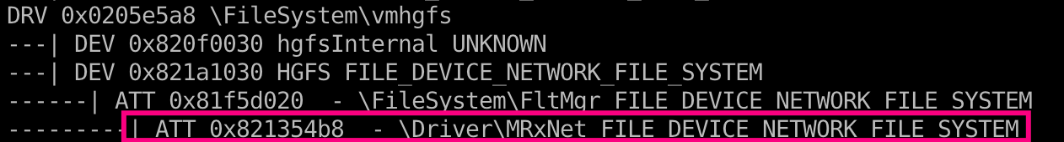
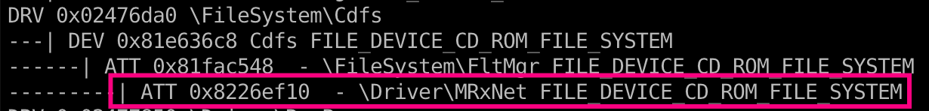
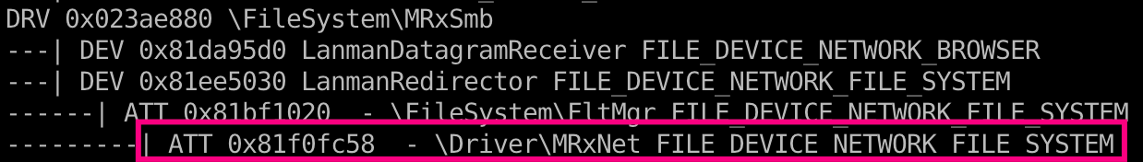
Analysis STUXnet Memory Dump Image
Now Stuxnet can filter or hide specifically named files and directories on those file systems!

Slide 41
Kernel Callback
A callback function is one which is passed as an argument to another function and is invoked after the completion of the parent function.
  In other words callback is a piece of executable code that is passed as an argument to other code, which is expected to call back (execute) the argument at some convenient time.
Kernel Callback
  Supported on 64 bit systems
  Safe for multicore machines
  Lists of events:
    Process creation
    Thread creation
    System shutdown
    File system registration
    PnP(Plug and Play)
    etc…

Slide 42
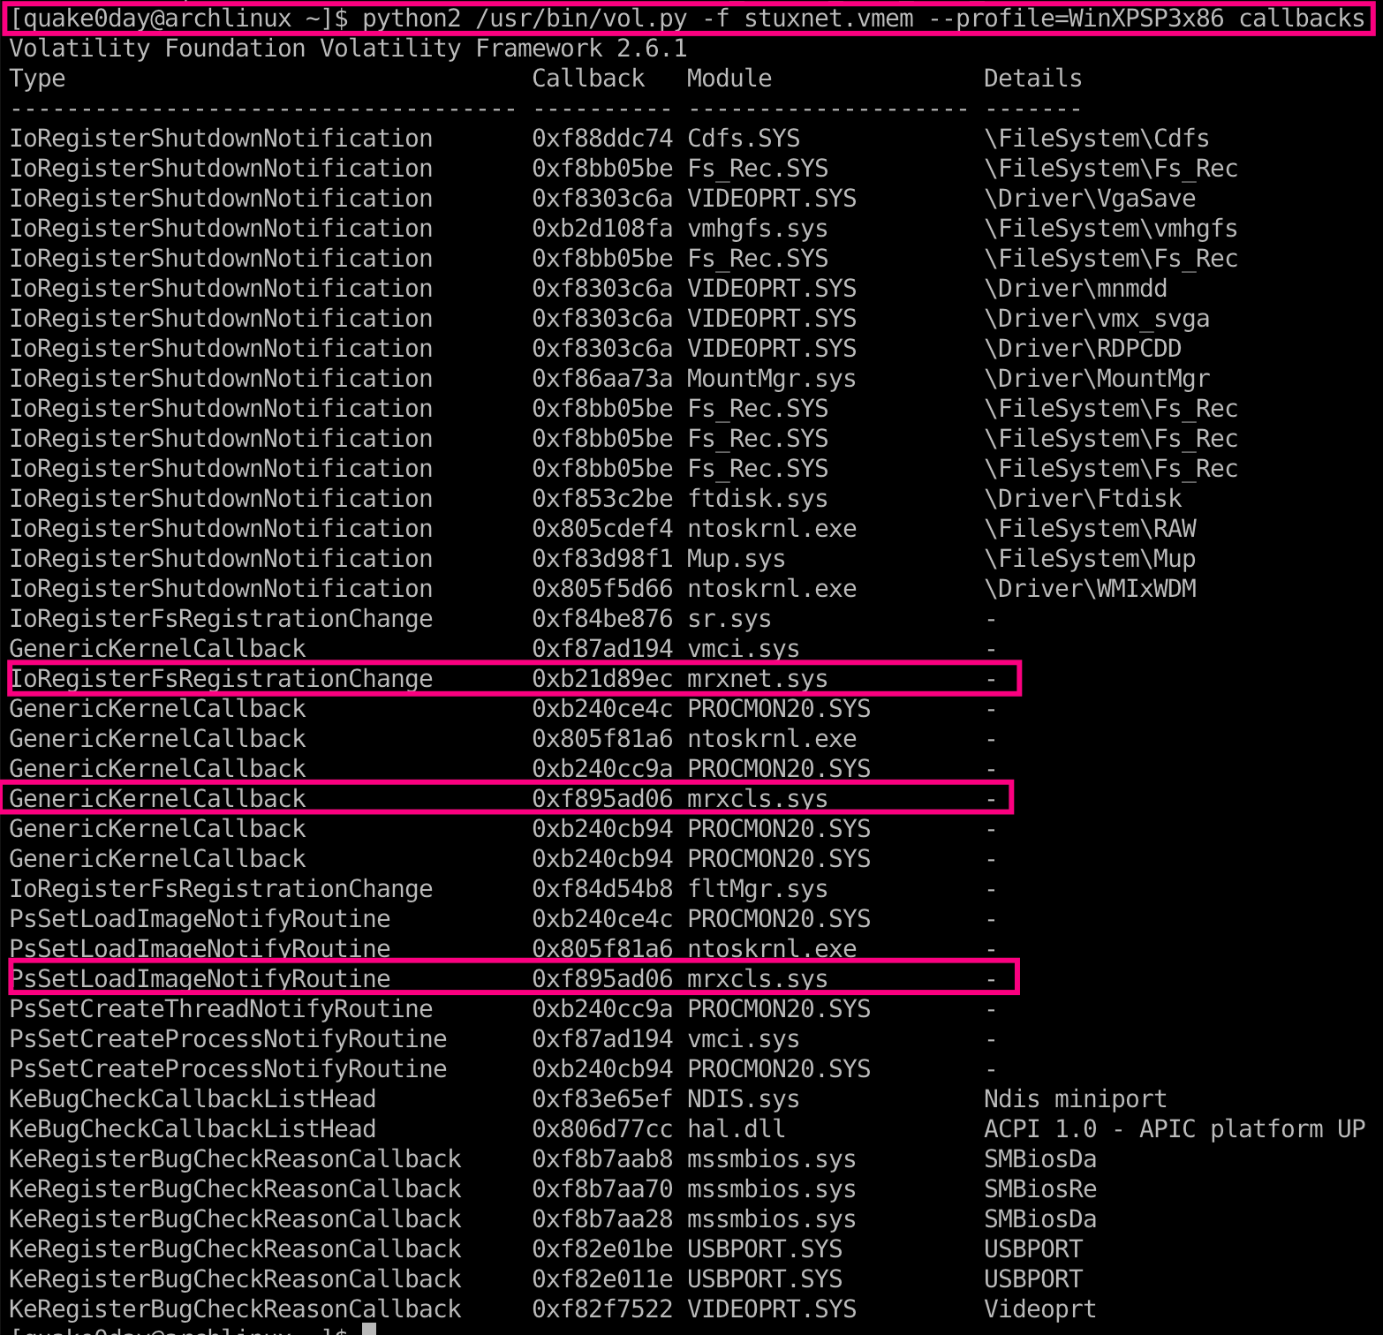
Analysis STUXnet Memory Dump Image
Now Stuxnet can receive notification when new file system become available – So it can immediately spread or hide files
And is able to inject code into process when they try to load other DLLs.

Slide 43
7. DKOM
8. Virtualization
9. Hardware

Slide 44

Q & A

