Slide 1

Class14
CSC 497/583 Advanced Topics in Computer Security
Modern Malware Analysis
API Hook, Stealth process (Rootkit)
Si Chen (schen@wcupa.edu)

Slide 2
Review – Hook
A hook is a point in the system message-handling mechanism where an application can install a subroutine to monitor the message traffic in the system and process certain types of messages before they reach the target window procedure.

Slide 3
River System ???

Slide 4
Review – Message Hook

Slide 5
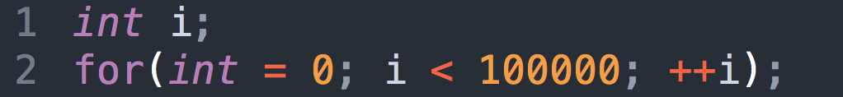
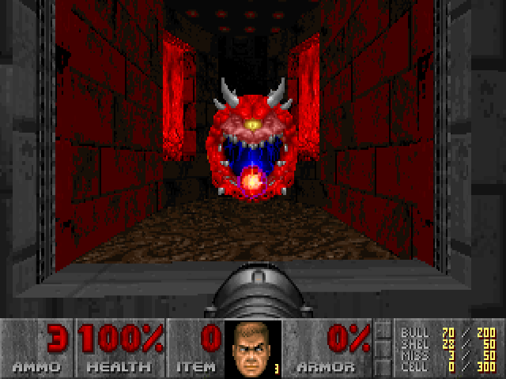
Introduction to WinAPI
System resources (file, network, IO, device) may be accessed by multiple applications at the same time, can cause confliction.
Modern OS protect these resources.
E.g. How to let a program to wait for a while?
100Mhz CPU -> 1s
1000Mhz CPU -> 0.1s
Use WinAPI → Timer

Slide 6
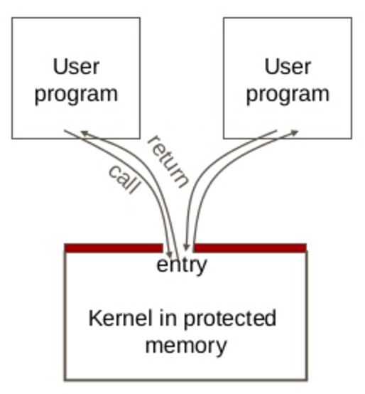
System Call & WinAPI
User code can be arbitrary
User code cannot modify kernel memory
The call mechanism switches code to kernel mode
System Call →
WinAPI (Windows)

Slide 7
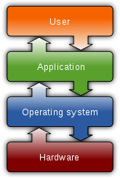
What is System Call?
Let an application to access system resources.
OS provide an interface (System call) for the application
It usually use the technique called “interrupt vector”
  Linux use 0x80
  Windows use 0x2E
In system programming, an interrupt is a signal to the processor emitted by hardware or software indicating an event that needs immediate attention.

Slide 8
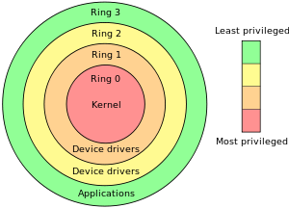
The “Ring”
System Call →
WinAPI (Windows)

Slide 9
CPU Interrupt
User Mode Execution
Interruption occurred
Next instruction
User Mode
Kernel Mode
Interrupt Vector Table
Interrupt Handler

Slide 10
Windows System Call and API
The Win32 API is a layer that runs in user mode (ring 3).
Only API calls that use kernel resources (CreateThread, VirtualAlloc, etc) will call into the "real" operating system (ntdll.dll) and trap into ring 0 with a software interrupt (int 0x2e).

Slide 11
User Mode and Kernel

Slide 12
Write a file in Notepad
Application
fwrite()
notepad.exe
Run Time
Library
write()
Libcmt.lib
msvcr90.dll
API (Windows)
NtWriteFile()
Kernel32.dll
NTDLL.dll
Interrupt 0x2e
Kernel
IoWriteFile()
Kernel
NtosKrnl.exe

Slide 13
API Hook
Application
fwrite()
notepad.exe
Run Time
Library
write()
Libcmt.lib
msvcr90.dll
API (Windows)
NtWriteFile()
Kernel32.dll
NTDLL.dll
Interrupt 0x2e
Kernel
IoWriteFile()
Kernel
NtosKrnl.exe

Slide 14
API Call (Normally)

Slide 15
API Hook
Detour Function

Slide 16
API Hook Tech Map
Method | Target | Location | Tech |  | API
Dynamic | Process/Memory 00000000 - 7FFFFFFF | IAT Code EAT | Interactive Debug |  | DebugActiveProcess GetThreadContext SetThreadContext
 |  |  | Standalone Injection | Independent Code | CreateRemoteThread
 |  |  |  | Dll File | Resistry (AppInit_DLLs) BHO (IE only)
 |  |  |  |  | SetWindowsHookEx CreateRemoteThread

Slide 17
API Hook Tech Map
Method | Target | Location | Tech |  | API
Dynamic | Process/Memory 00000000 - 7FFFFFFF | IAT Code EAT | Interactive Debug |  | DebugActiveProcess GetThreadContext SetThreadContext
 |  |  | Standalone Injection | Independent Code | CreateRemoteThread
 |  |  |  | Dll File | Resistry (AppInit_DLLs) BHO (IE only)
 |  |  |  |  | SetWindowsHookEx CreateRemoteThread

Slide 18
API Hook Tech Map
Method | Target | Location | Tech |  | API
Dynamic | Process/Memory 00000000 - 7FFFFFFF | IAT Code EAT | Interactive Debug |  | DebugActiveProcess GetThreadContext SetThreadContext
 |  |  | Standalone Injection | Independent Code | CreateRemoteThread
 |  |  |  | Dll File | Resistry (AppInit_DLLs) BHO (IE only)
 |  |  |  |  | SetWindowsHookEx CreateRemoteThread
IAT Hook Example

Slide 19
Stealth process (Rootkit)

Slide 20
Processes in Windows

Slide 21
Stealth Process
Northrop Grumman B-2 Spirit

Slide 22
Stealth Process
Stealth Process

Slide 23
API Hook Tech Map
Method | Target | Location | Tech |  | API
Dynamic | Process/Memory 00000000 - 7FFFFFFF | IAT Code EAT | Interactive Debug |  | DebugActiveProcess GetThreadContext SetThreadContext
 |  |  | Standalone Injection | Independent Code | CreateRemoteThread
 |  |  |  | Dll File | Resistry (AppInit_DLLs) BHO (IE only)
 |  |  |  |  | SetWindowsHookEx CreateRemoteThread

Slide 24
Processes in Windows
Detect Processes in User Mode (WinAPI):
  CreateToolhelp32Snapshot()
  EnumProcess()
HANDLE CreateToolhelp32Snapshot(
DWORD dwFlags,
DWORD th32ProcessID
);
Takes a snapshot of the specified processes, as well as the heaps, modules, and threads used by these processes.
BOOL EnumProcesses(
DWORD *lpidProcess,
DWORD cb,
LPDWORD lpcbNeeded
);
Retrieves the process identifier for each process object in the system.

Slide 25
Processes API
  CreateToolhelp32Snapshot()
  EnumProcess()
  ntdll.ZwQuerySystemInformation()
  ntdll.ZwQuerySystemInformation()
NTSTATUS WINAPI ZwQuerySystemInformation(
_In_ SYSTEM_INFORMATION_CLASS SystemInformationClass,
_Inout_ PVOID SystemInformation,
_In_ ULONG SystemInformationLength,
_Out_opt_ PULONG ReturnLength
);
Retrieves the specified system information.

Slide 26
Create Stealth Process
  CreateToolhelp32Snapshot()
  EnumProcess()
  ntdll.ZwQuerySystemInformation()
  ntdll.ZwQuerySystemInformation()
Process1
Process2
Process3
Process4
Process1
Process3
Process4

Slide 27
Processes in Windows
taskmgr.exe
ProcExp.exe
  ntdll.ZwQuerySystemInformation()
  ntdll.ZwQuerySystemInformation()
Notes:
Isseus:
How many process to hook?
New Process? Should we hook?

Slide 28
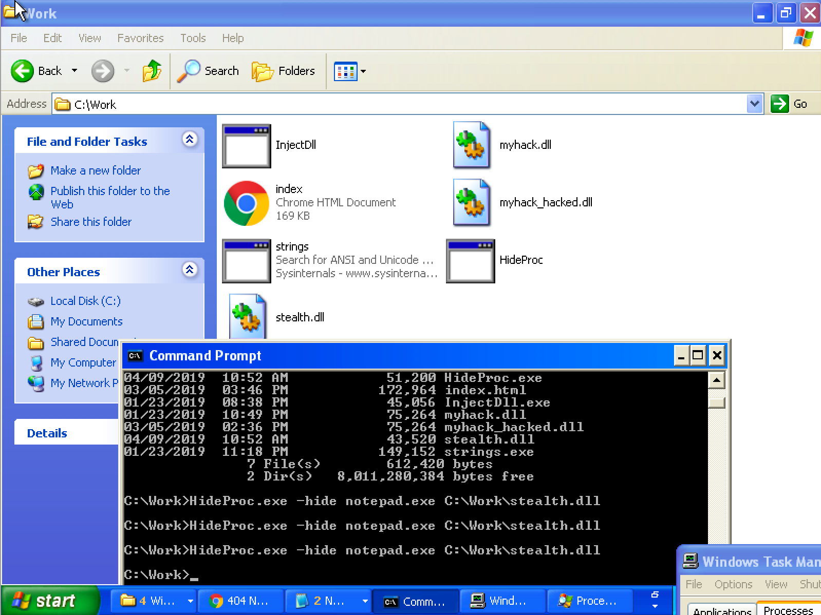
Example 1: Stealth Process
Download and try StealthProcess1.zip
HideProc.exe –hide notepad.exe C:\Work\stealth.dll

Slide 29
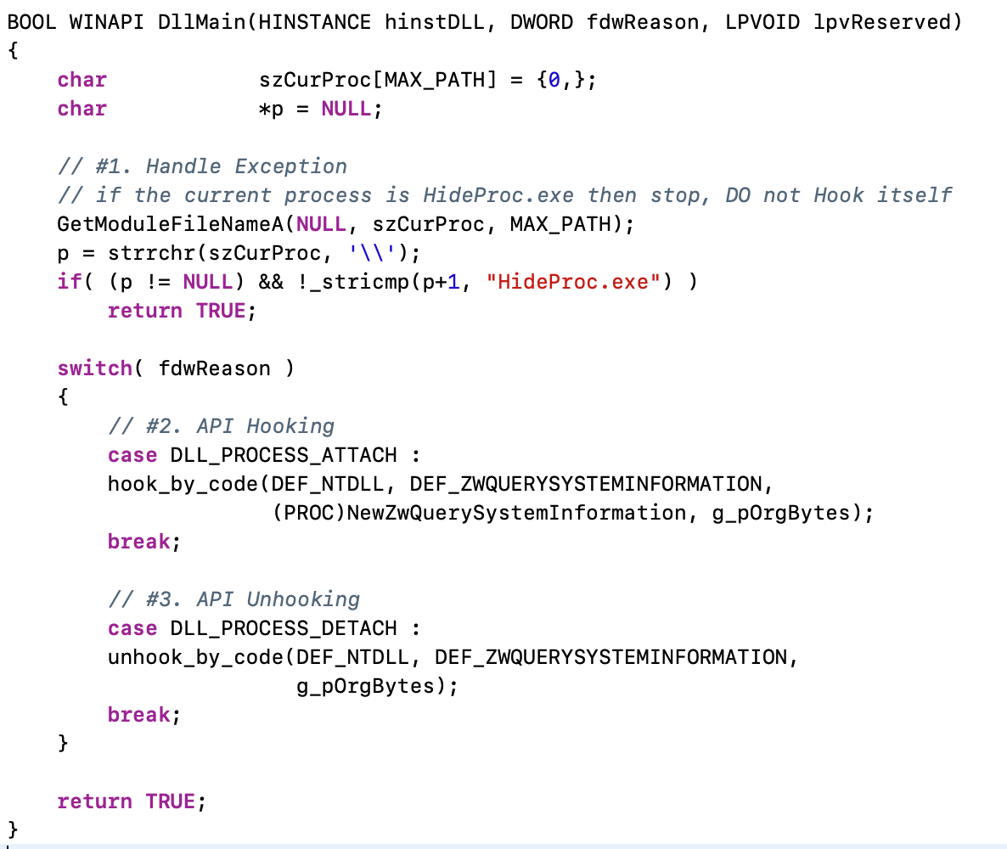
stealth.cpp → DllMain()

Slide 30
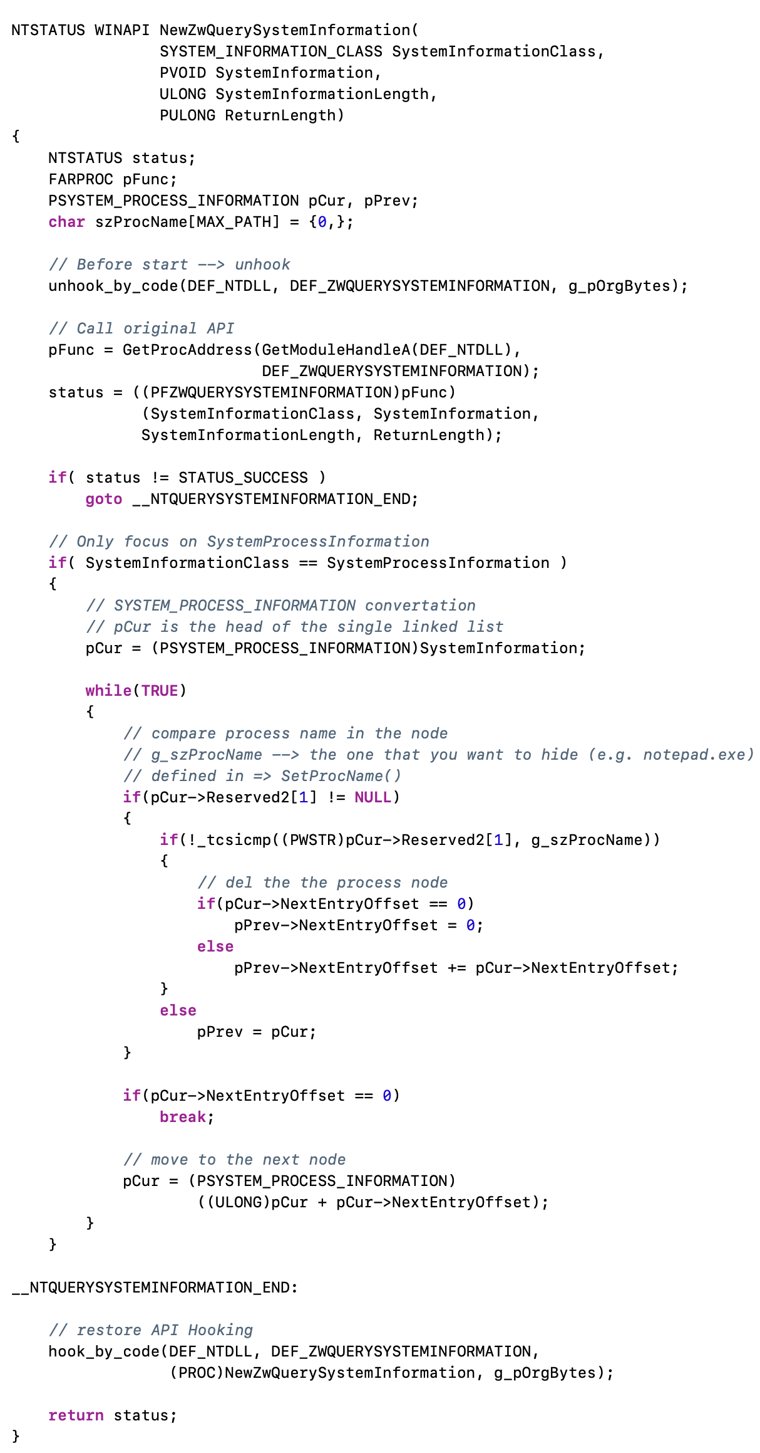
stealth.cpp → DllMain()

Slide 31
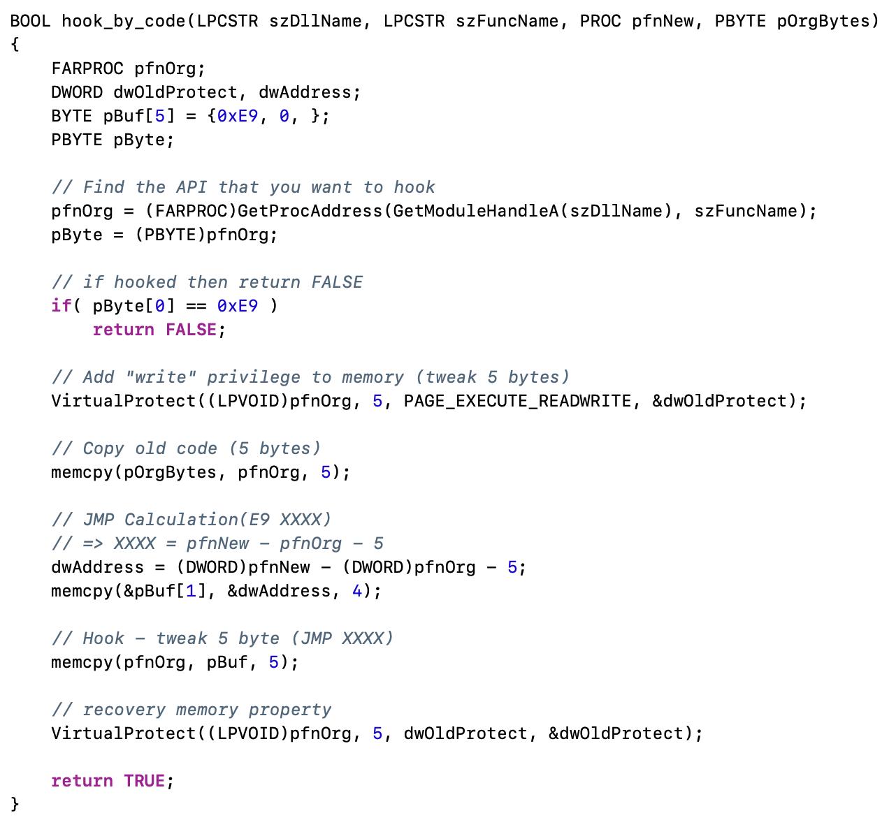
stealth.cpp → DllMain()

Slide 33
Create Stealth Process
  ntdll.ZwQuerySystemInformation()
  ntdll.ZwQuerySystemInformation()
Issues: How many process(es) should we hook?

Slide 34
Create Stealth Process
  ntdll.ZwQuerySystemInformation()
Issues: Newly created process(es)

Slide 35
Create Stealth Process
Solution: Hook all of them! → Global Hook

Slide 36
Example 2: Global Hook
Download and try StealthProcess2.zip
copy stealth2.dll to %SystemRoot%\system32 folder
HideProc2.exe –hide stealth2.dll

Slide 37

Q & A

