Slide 1

Class12
CSC 497/583 Advanced Topics in Computer Security
Modern Malware Analysis
Hooks
Si Chen (schen@wcupa.edu)

Slide 2
Overview
Hooks
  Definition
  Message Hook
    Message Hook Chain
    Message Hook Example 1 – Keyboard Event Hook
  IAT Hook
    IAT Hook Basics
    IAT Hook Example – A ”Big” MessageBox

Slide 3
Hooks
A hook is a point in the system message-handling mechanism where an application can install a subroutine to monitor the message traffic in the system and process certain types of messages before they reach the target window procedure.

Slide 4
Message Hook

Slide 5
Message Hook
The system supports many different types of hooks; each type provides access to a different aspect of its message-handling mechanism.

Slide 6
Message Hook Chain
A hook chain is a list of pointers to special, application-defined callback functions called hook procedures.
When a message occurs that is associated with a particular type of hook, the system passes the message to each hook procedure referenced in the hook chain, one after the other.

Slide 7
Message Hook Example
Download Hook.zip from our course website, unzip it (password: infected)
Try HookMain.exe

Slide 8
Message Hook

Slide 9
Analysis Source Code
In this example, we use two files:
  HookMain.exe → Launch the attack
  KeyHook.dll → Provide “Hook” function

Slide 10
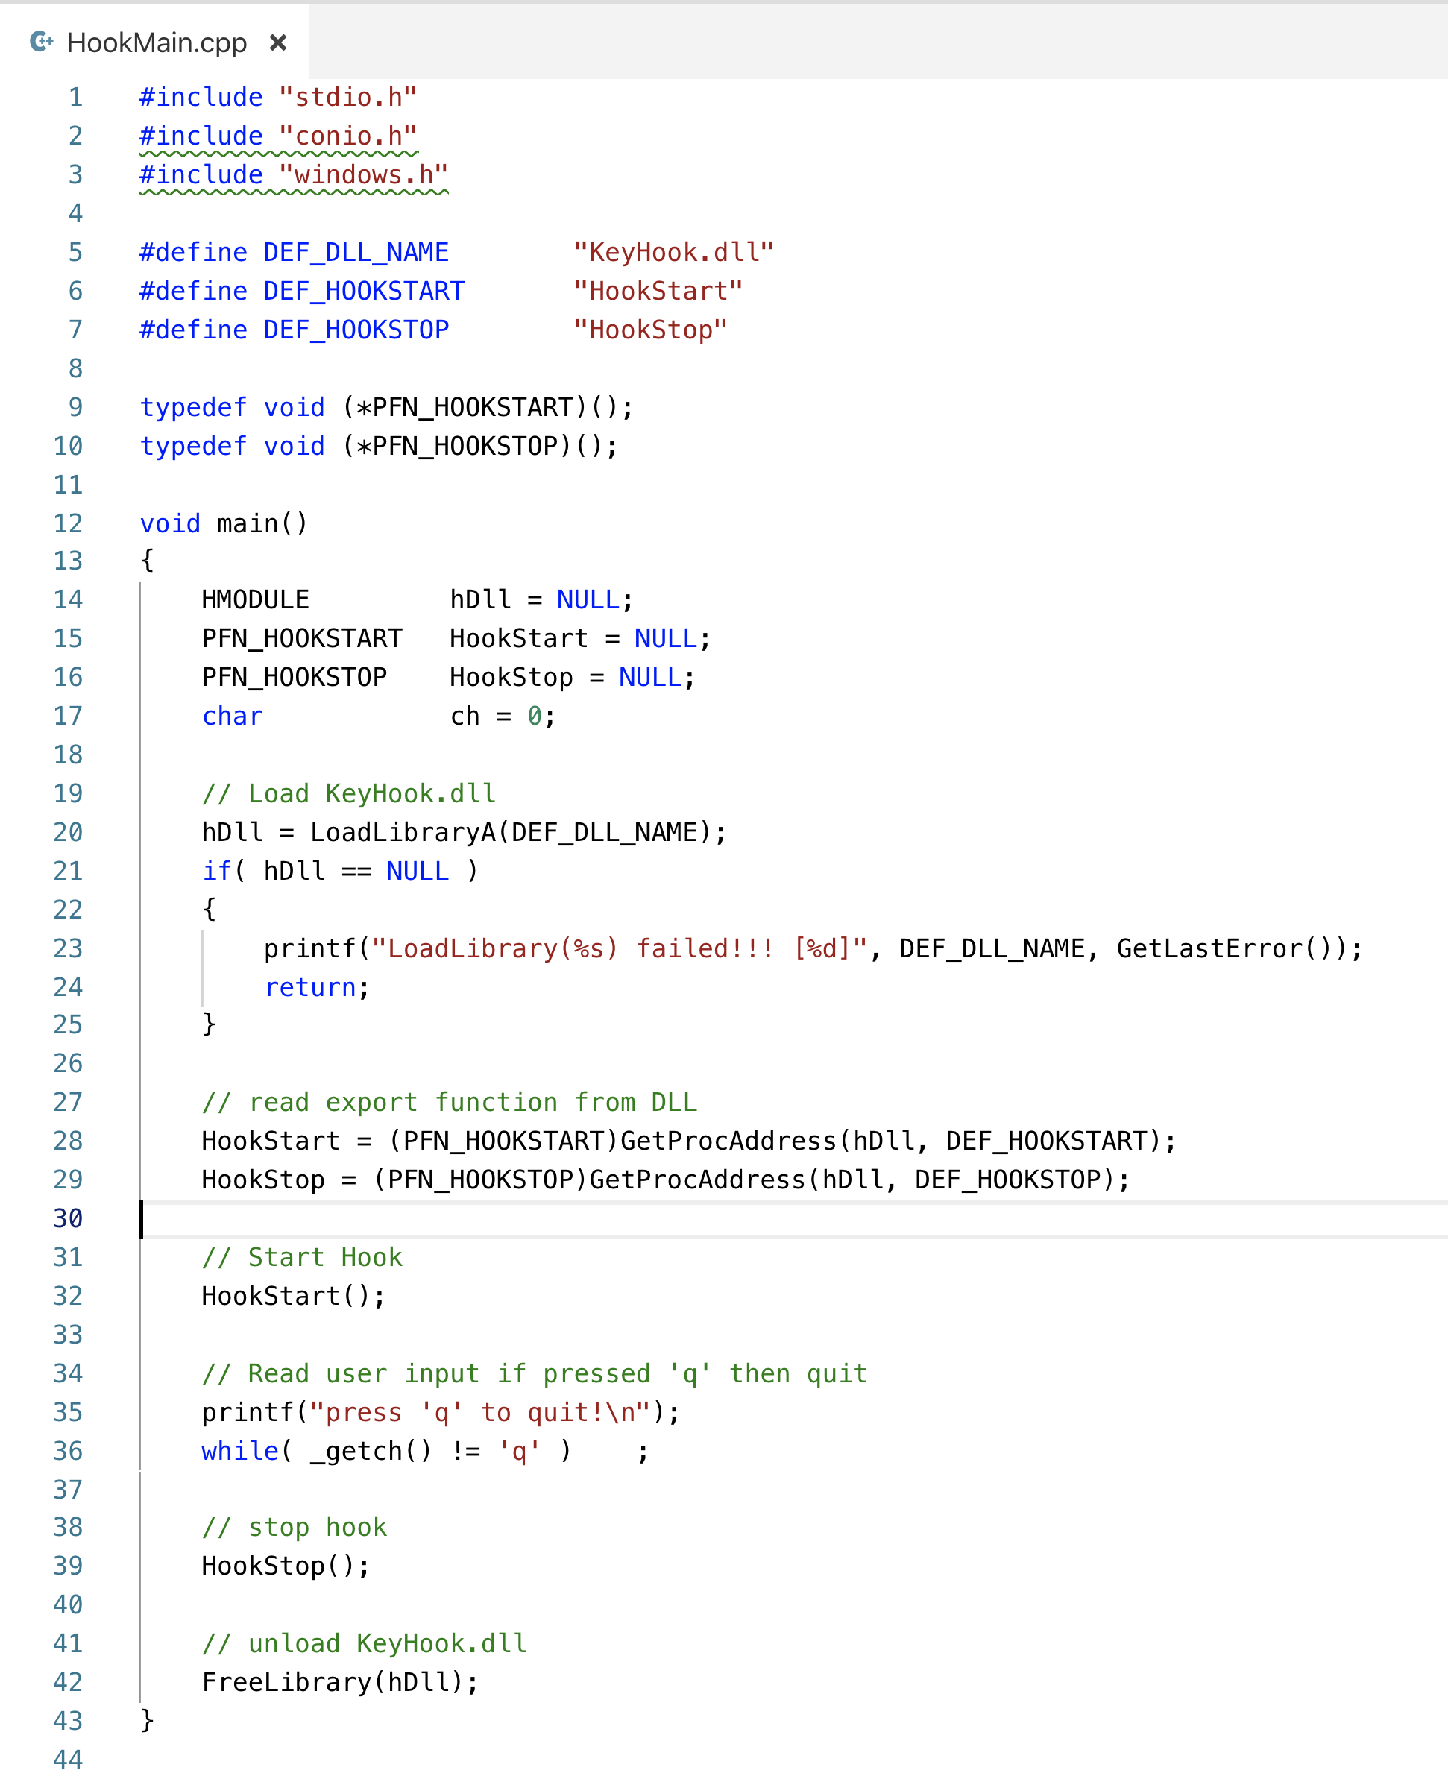
LoadDLL()
HookStart()
HookStop()
UnloadDLL()

Slide 11
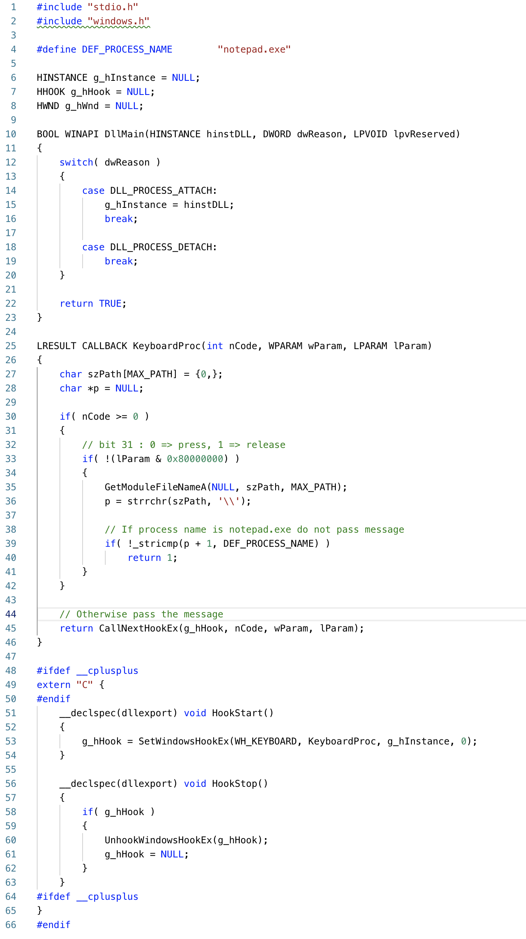

Slide 12
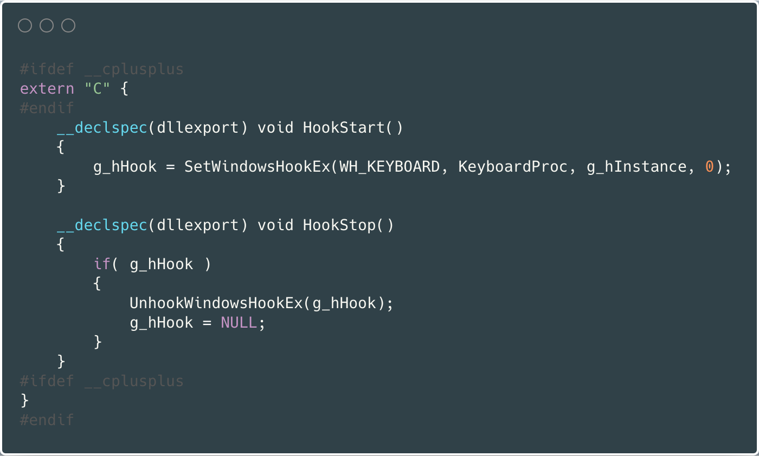
Analysis Source Code
g_hHook = SetWindowsHookEx(WH_KEYBOARD, KeyboardProc, g_hInstance, 0);

Slide 13
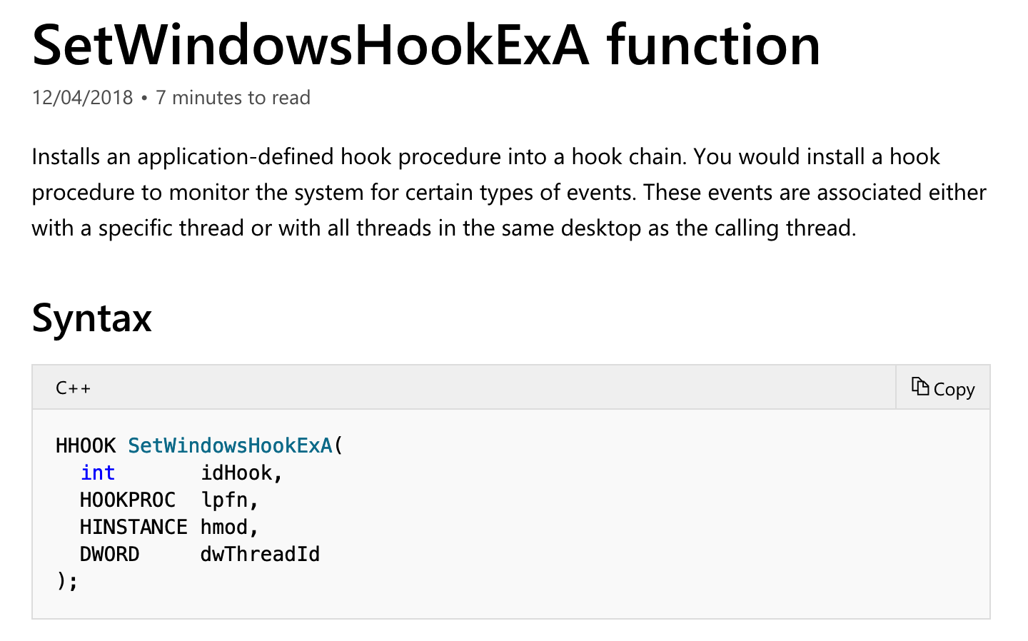
Analysis Source Code
https://docs.microsoft.com/en-us/windows/desktop/api/winuser/nf-winuser-setwindowshookexa

Slide 14
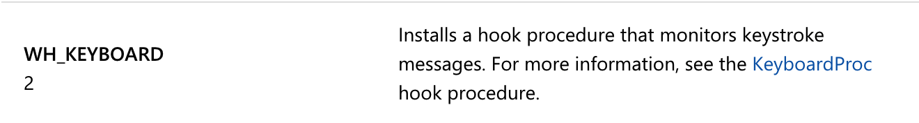
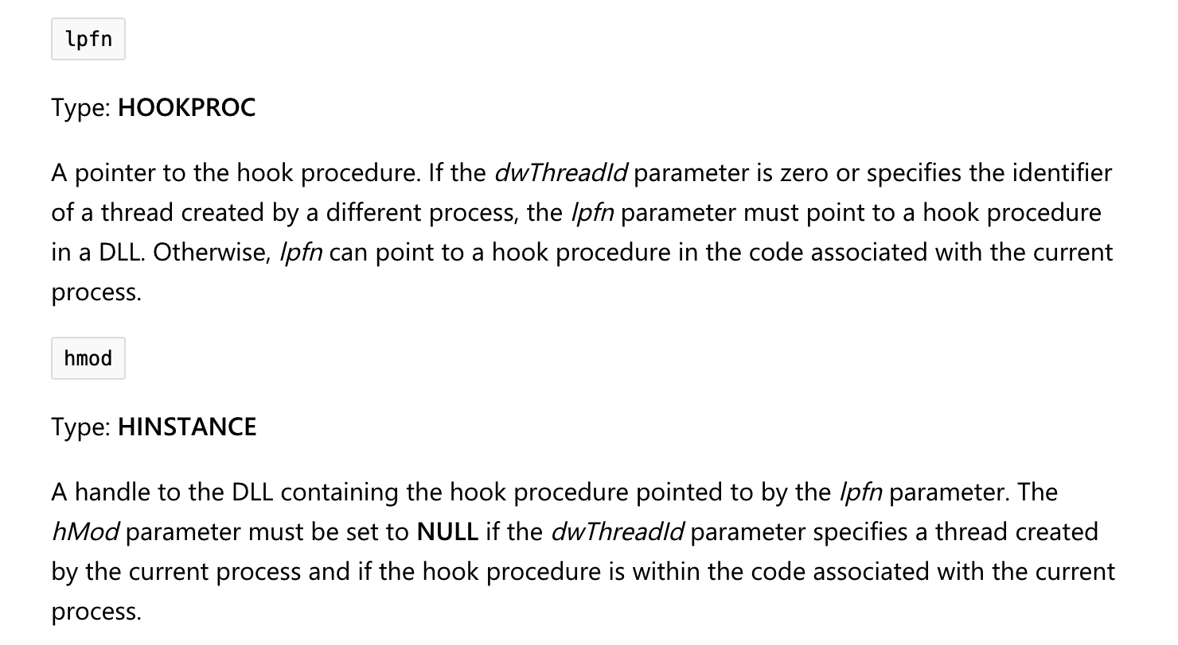
Analysis Source Code
g_hHook = SetWindowsHookEx(WH_KEYBOARD, KeyboardProc, g_hInstance, 0);

Slide 15
Message Hook

Slide 16
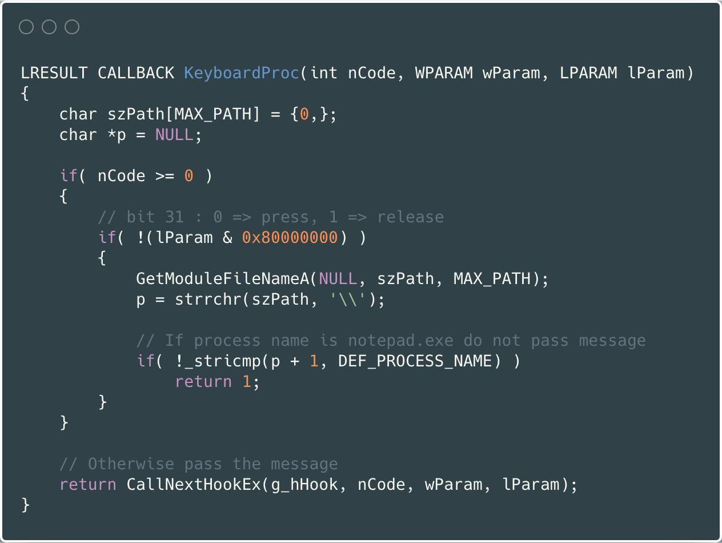
Analysis Source Code

Slide 17
IAT Hook

Slide 18
Check class 5
IAT (Import Address Table)
Quick Review

Slide 19
Load PE file (Notepad.exe) into Memory

Slide 20
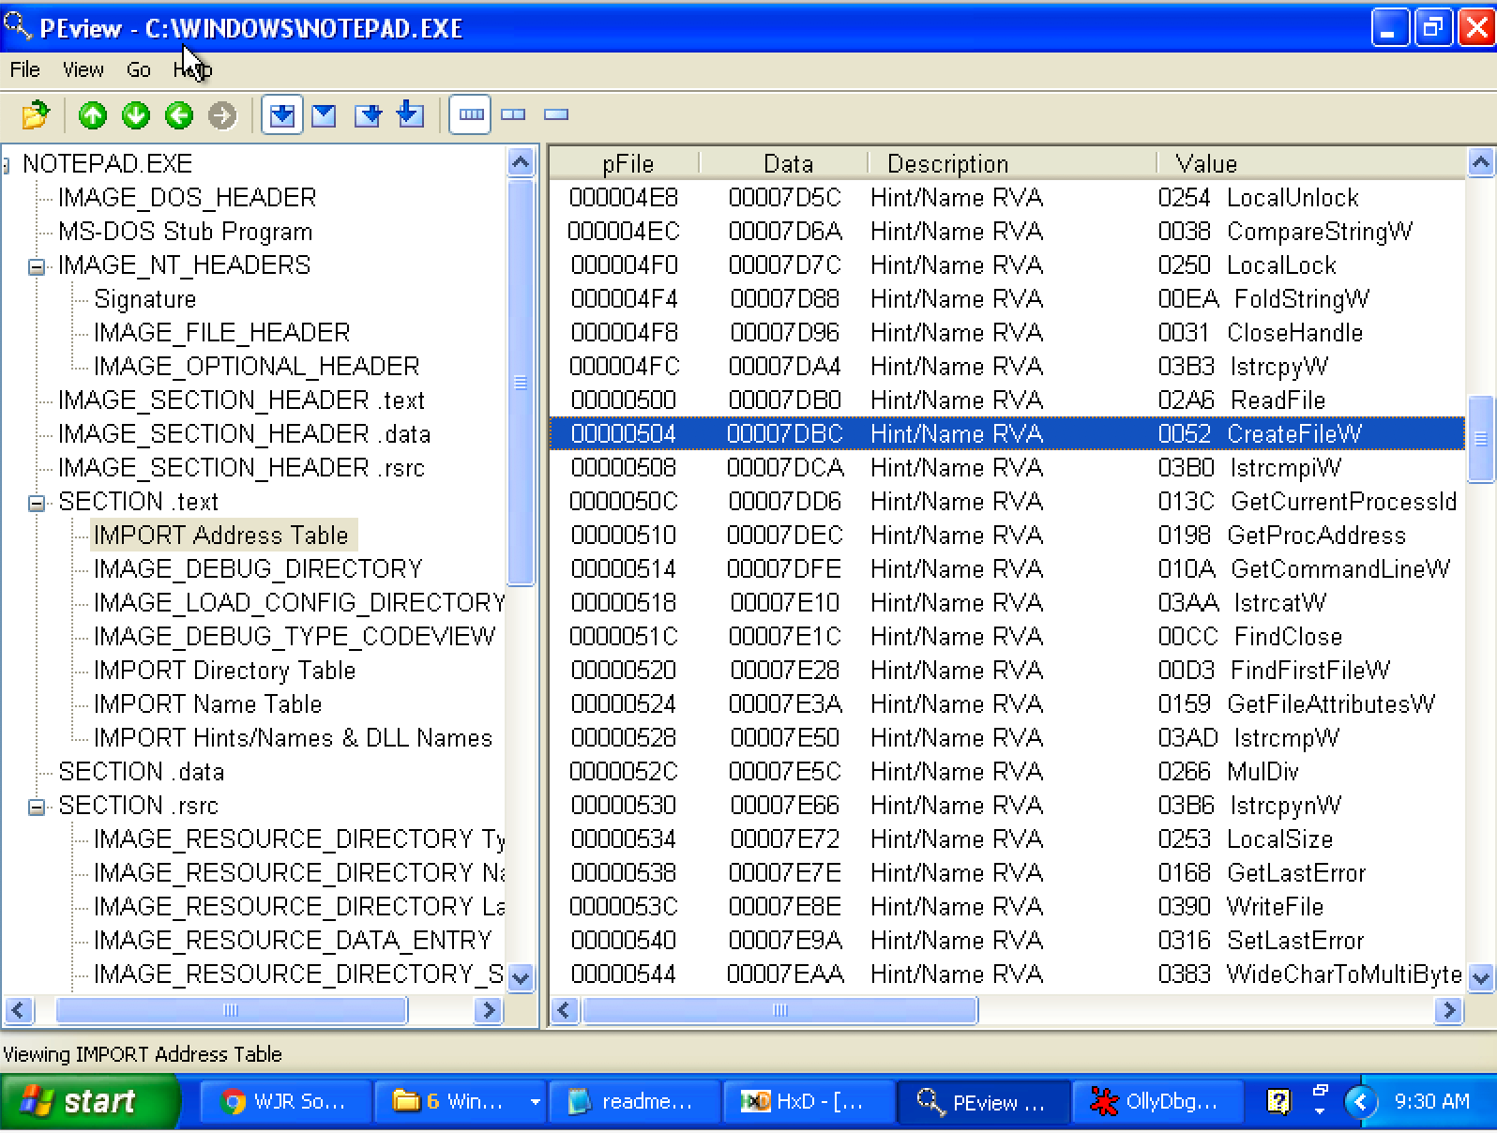
Look up IAT Table with PEview

Slide 21
Implicit Linking and IAT (Import Address Table)
Notepad.exe Call CreateFileW() → Call 0x01001104 → Call 0x7C810CD9
Call 0x01001104
Look up
IAT Table
Function Name | IAT Address | Real Address
…
CreateFileW() | 0x01001104 | 0x7C810CD9
…
When the application was first compiled, it was designed so that all API calls will NOT use direct hardcoded addresses but rather work through a function pointer.
This was accomplished through the use of an import address table. This is a table of function pointers filled in by the windows loader as the dlls are loaded.

Slide 22
IAT (Import Address Table)
Why IAT?

Slide 23
IAT (Import Address Table)
Support different Windows Version (9X, 2K, XP, Vista, 7, 8, 10)
Call CreateFileW() --> Call 0x01001104
Look up
XP
IAT Table
Function Name | IAT Address | Real Address
…
CreateFileW() | 0x01001104 | 0x7C810CD9
…
Windows 7
Function Name | IAT Address | Real Address
…
CreateFileW() | 0x01001104 | 0x7C81FFFF
…

Slide 24
IAT (Import Address Table)
Support DLL Relocation

Slide 25
IAT Hook Example
Download IATHookMsgBox.zip
Unzip and run it

Slide 26
Analysis IAT Hook Example
Use Ollydbg

Slide 27

Q & A

