Slide 1

Class11
CSC 497/583 Advanced Topics in Computer Security
Modern Malware Analysis
Dynamic Analysis, Message Hook
Si Chen (schen@wcupa.edu)

Slide 2
Dynamic Analysis
Dynamic analysis is the process of executing malware in a monitored environment to observe its behaviors.
In today’s lecture:
  Dynamic Analysis
    Tweak myhack.dll → Redo Lab0
    Dynamic analysis myhack.dll with OllyDbg
    Use wireshark to monitor network traffic
  Hook

Slide 3
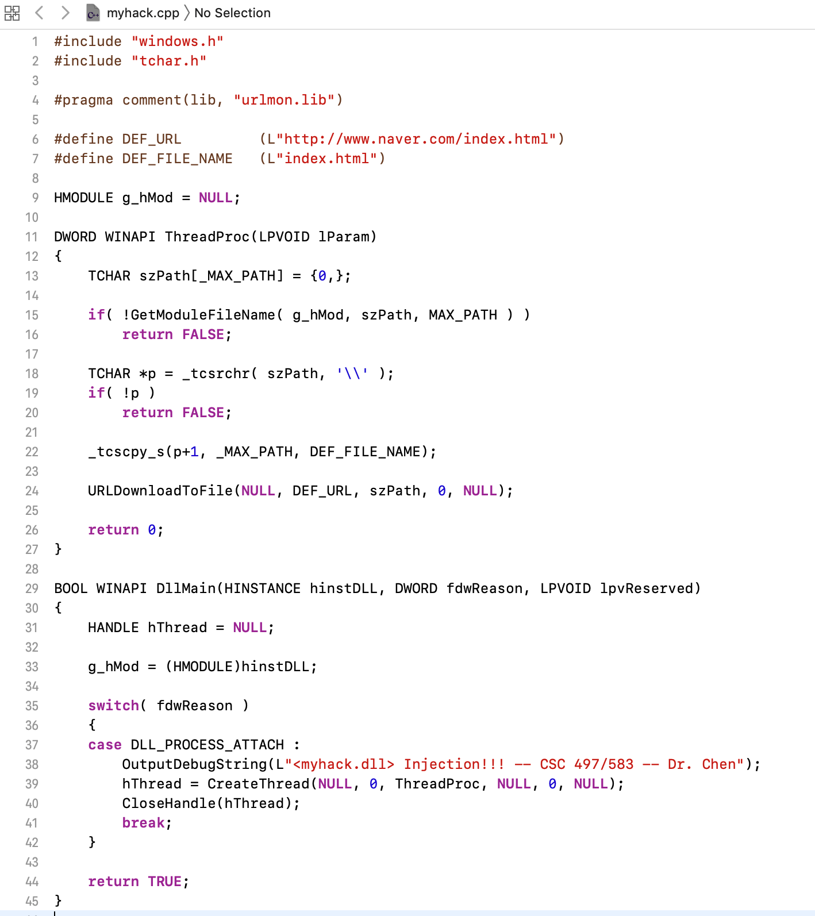
Source Code of myhack.dll

Slide 4
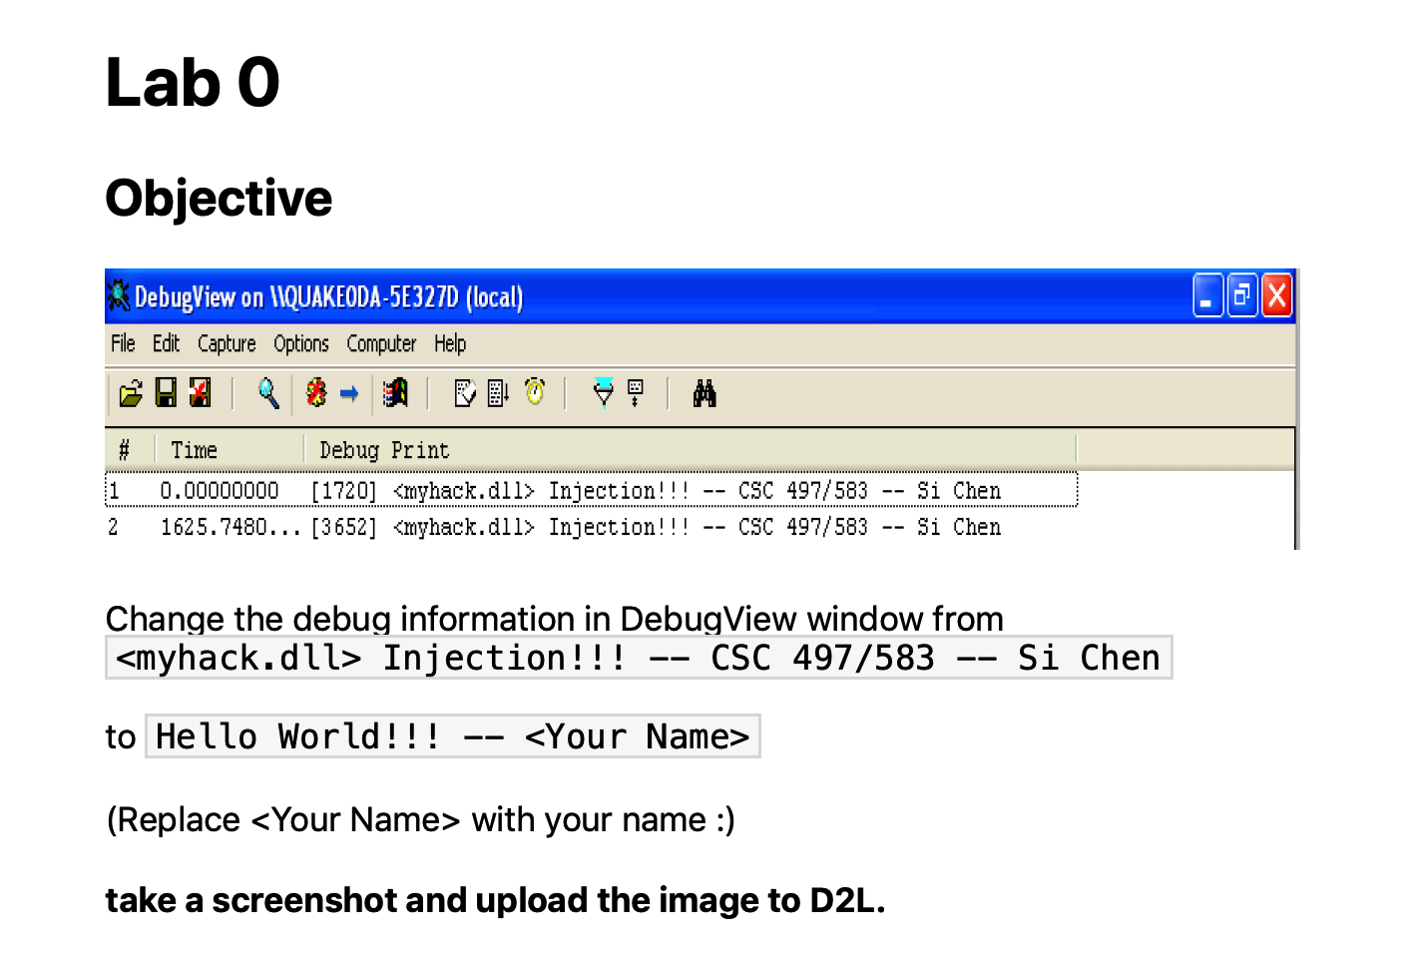
Revisit Lab0

Slide 5
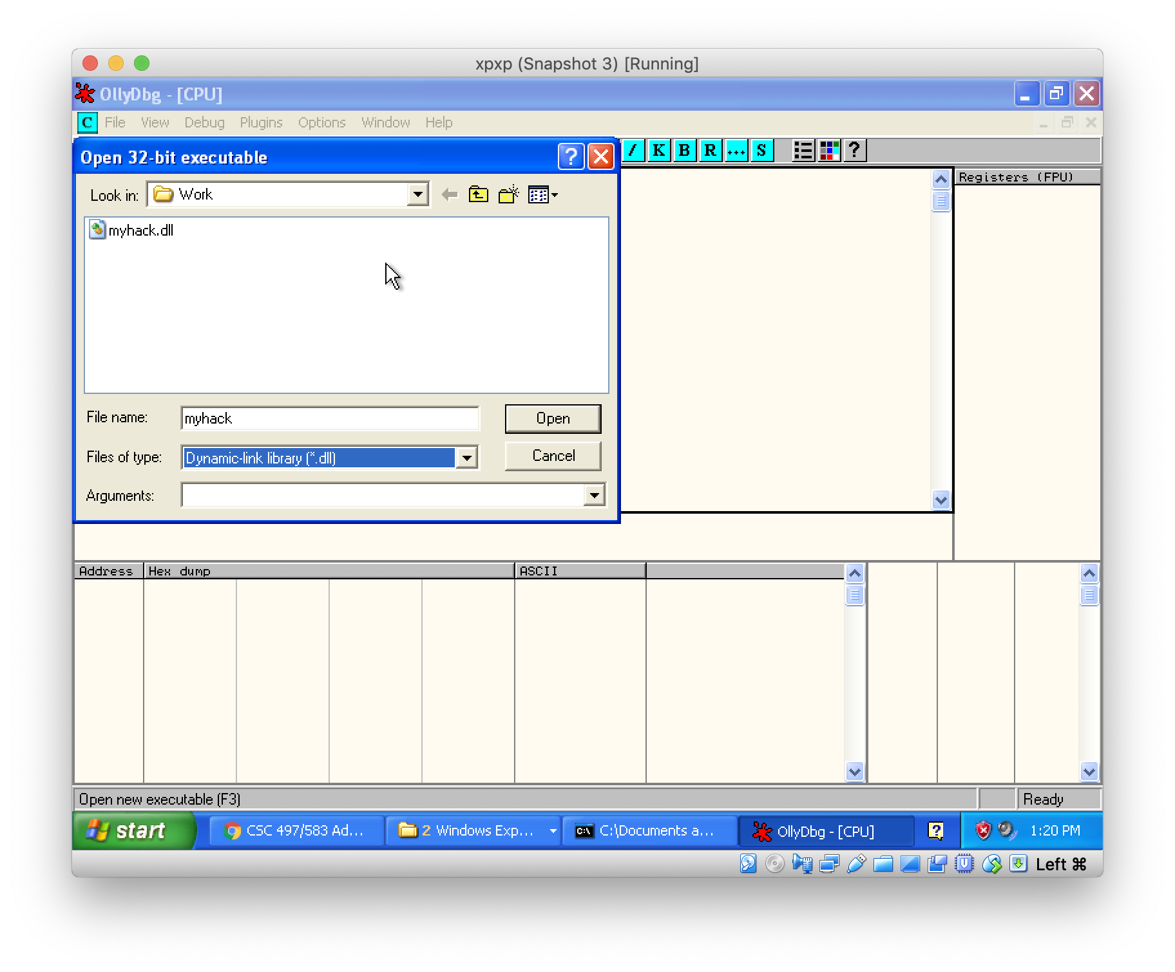
Use Ollydbg to reverse myhack.dll

Slide 6
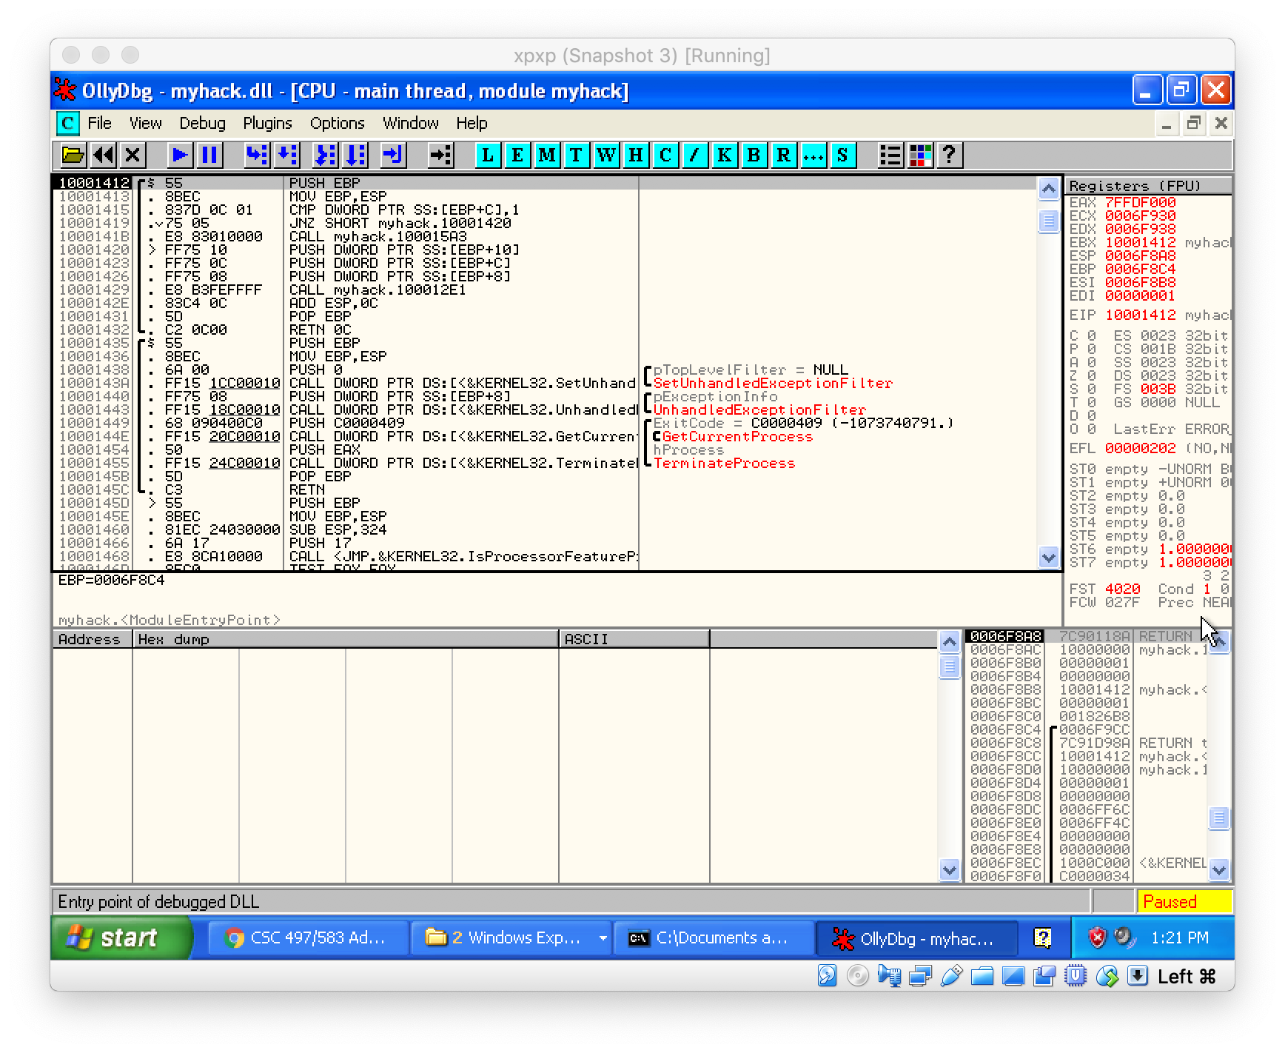
Use Ollydbg to reverse myhack.dll

Slide 7
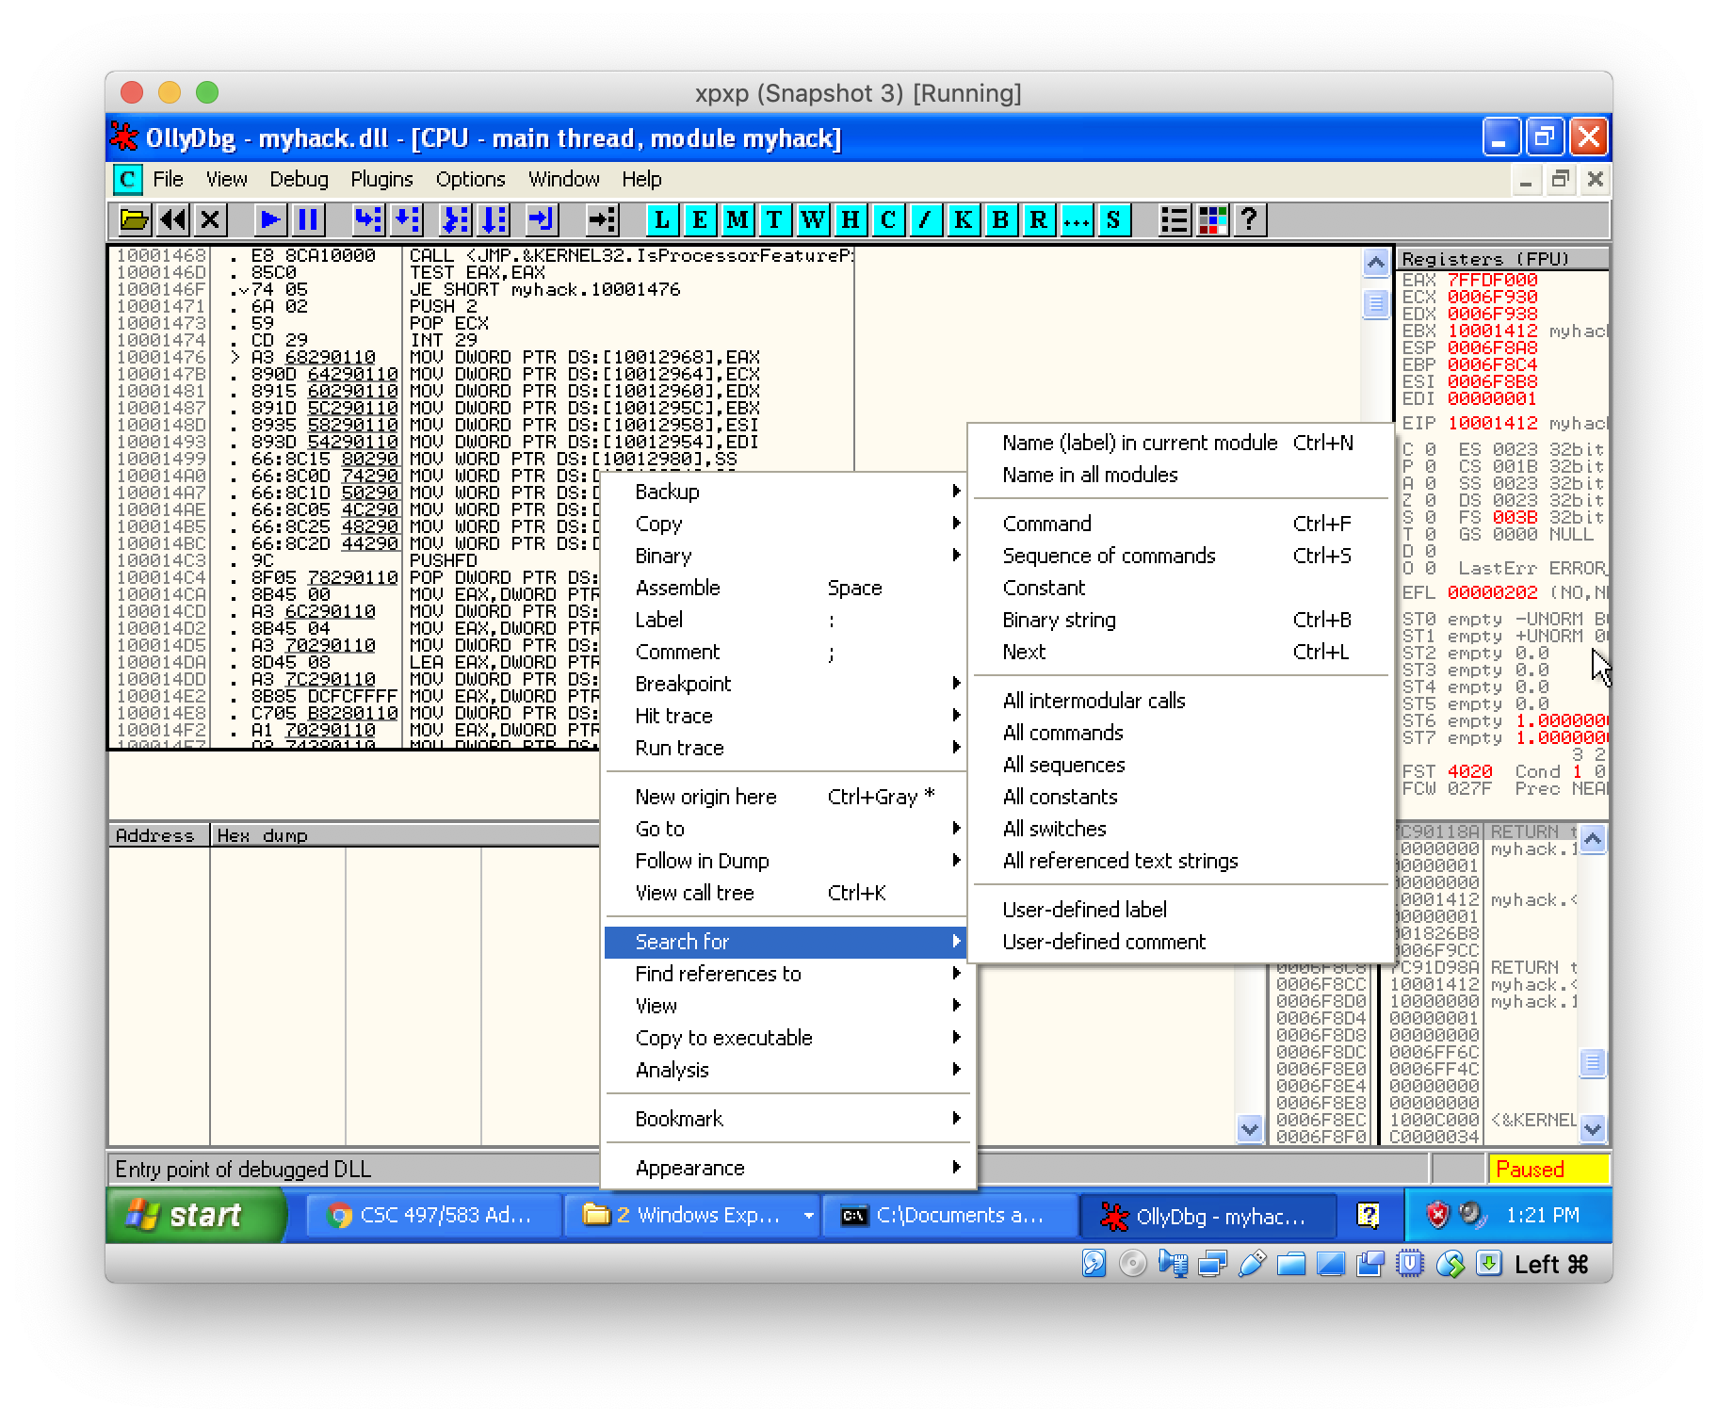
Search Text Strings

Slide 8
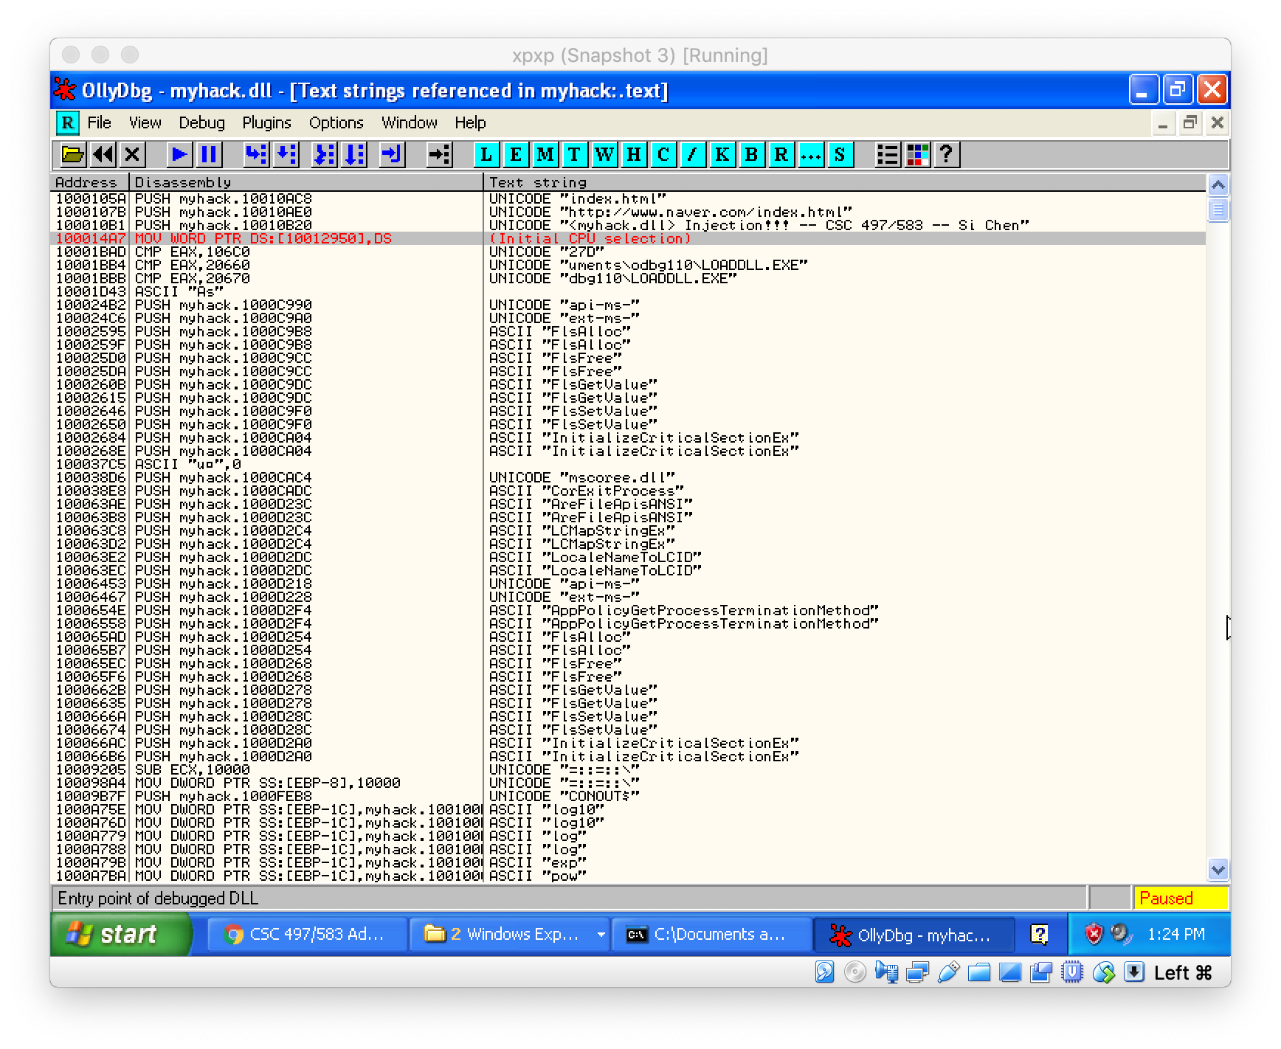
Search Text Strings

Slide 9
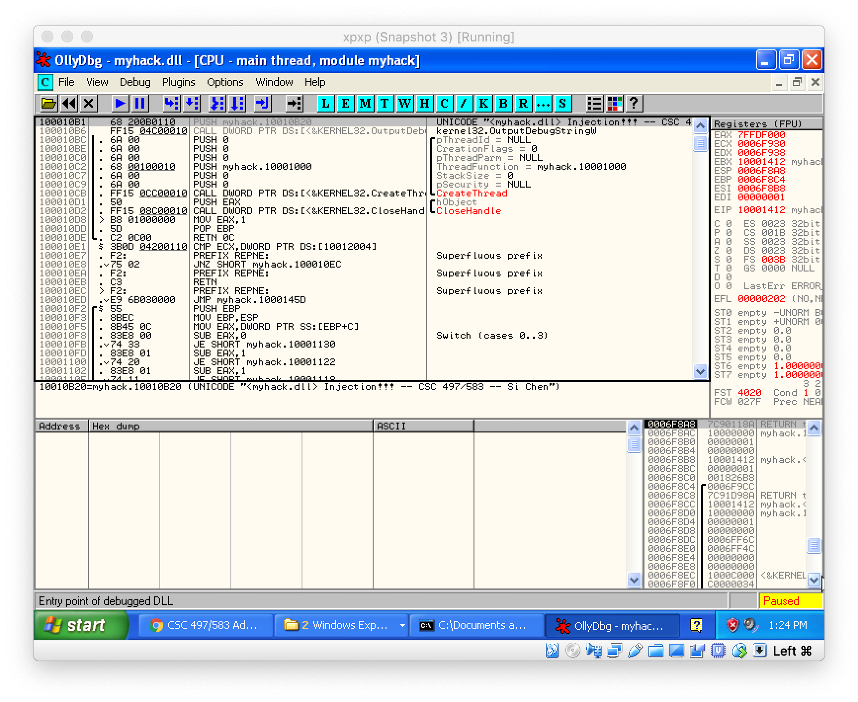
Search Text Strings
Target address: 10010B20

Slide 10
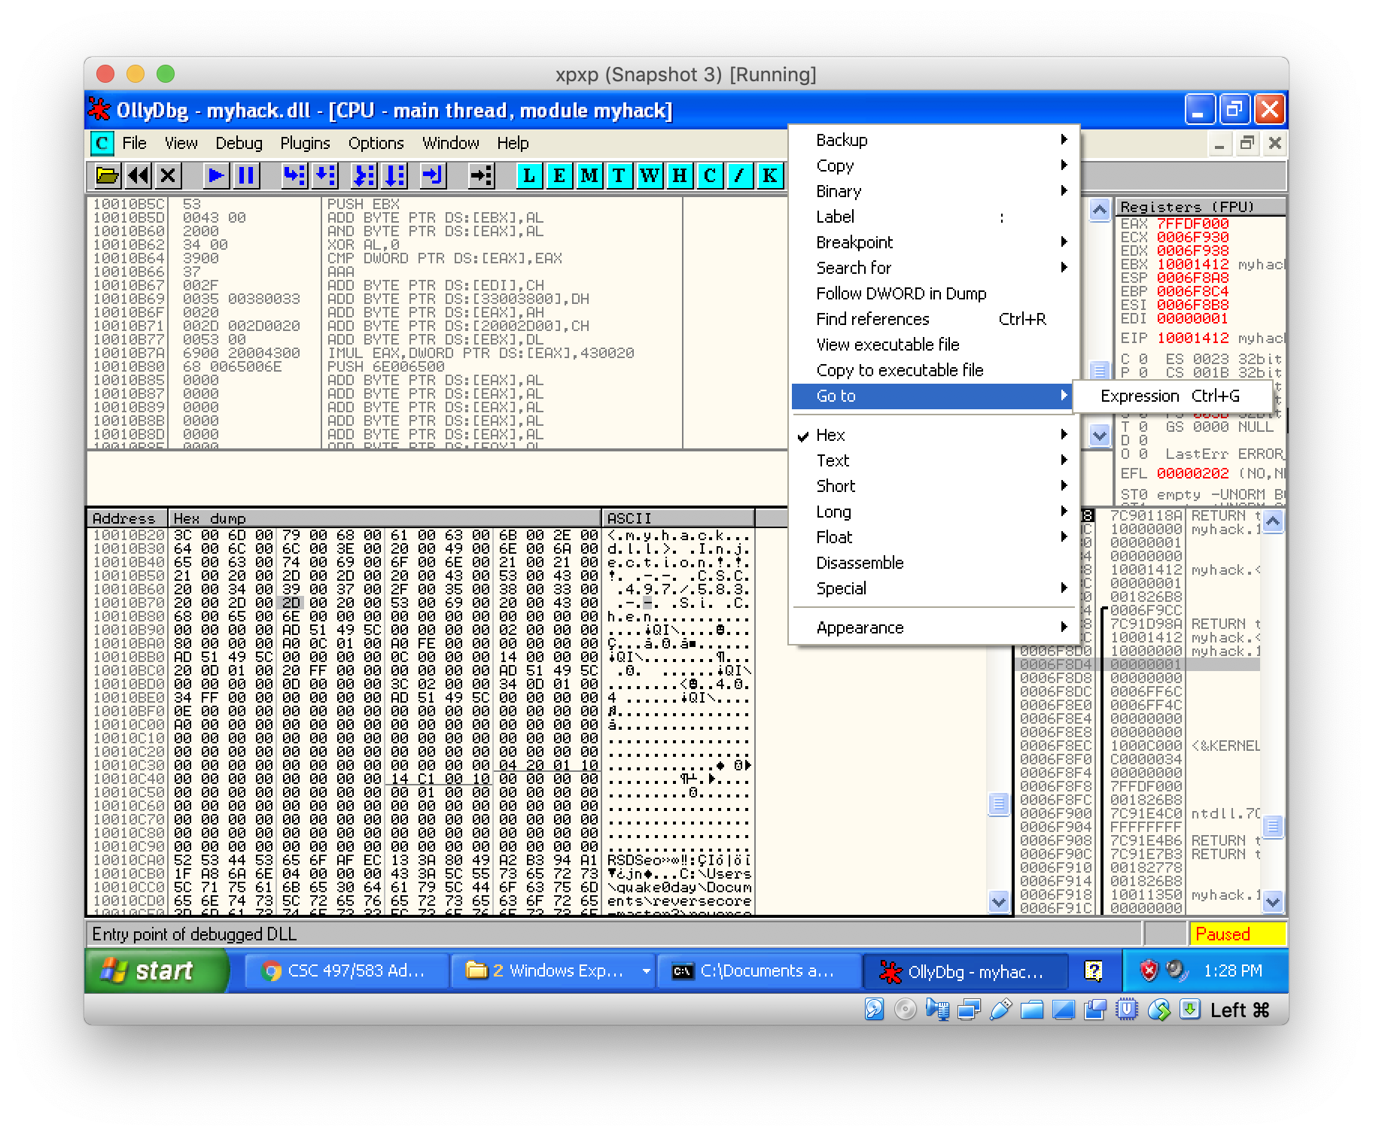
Check memory address
right click here

Slide 11
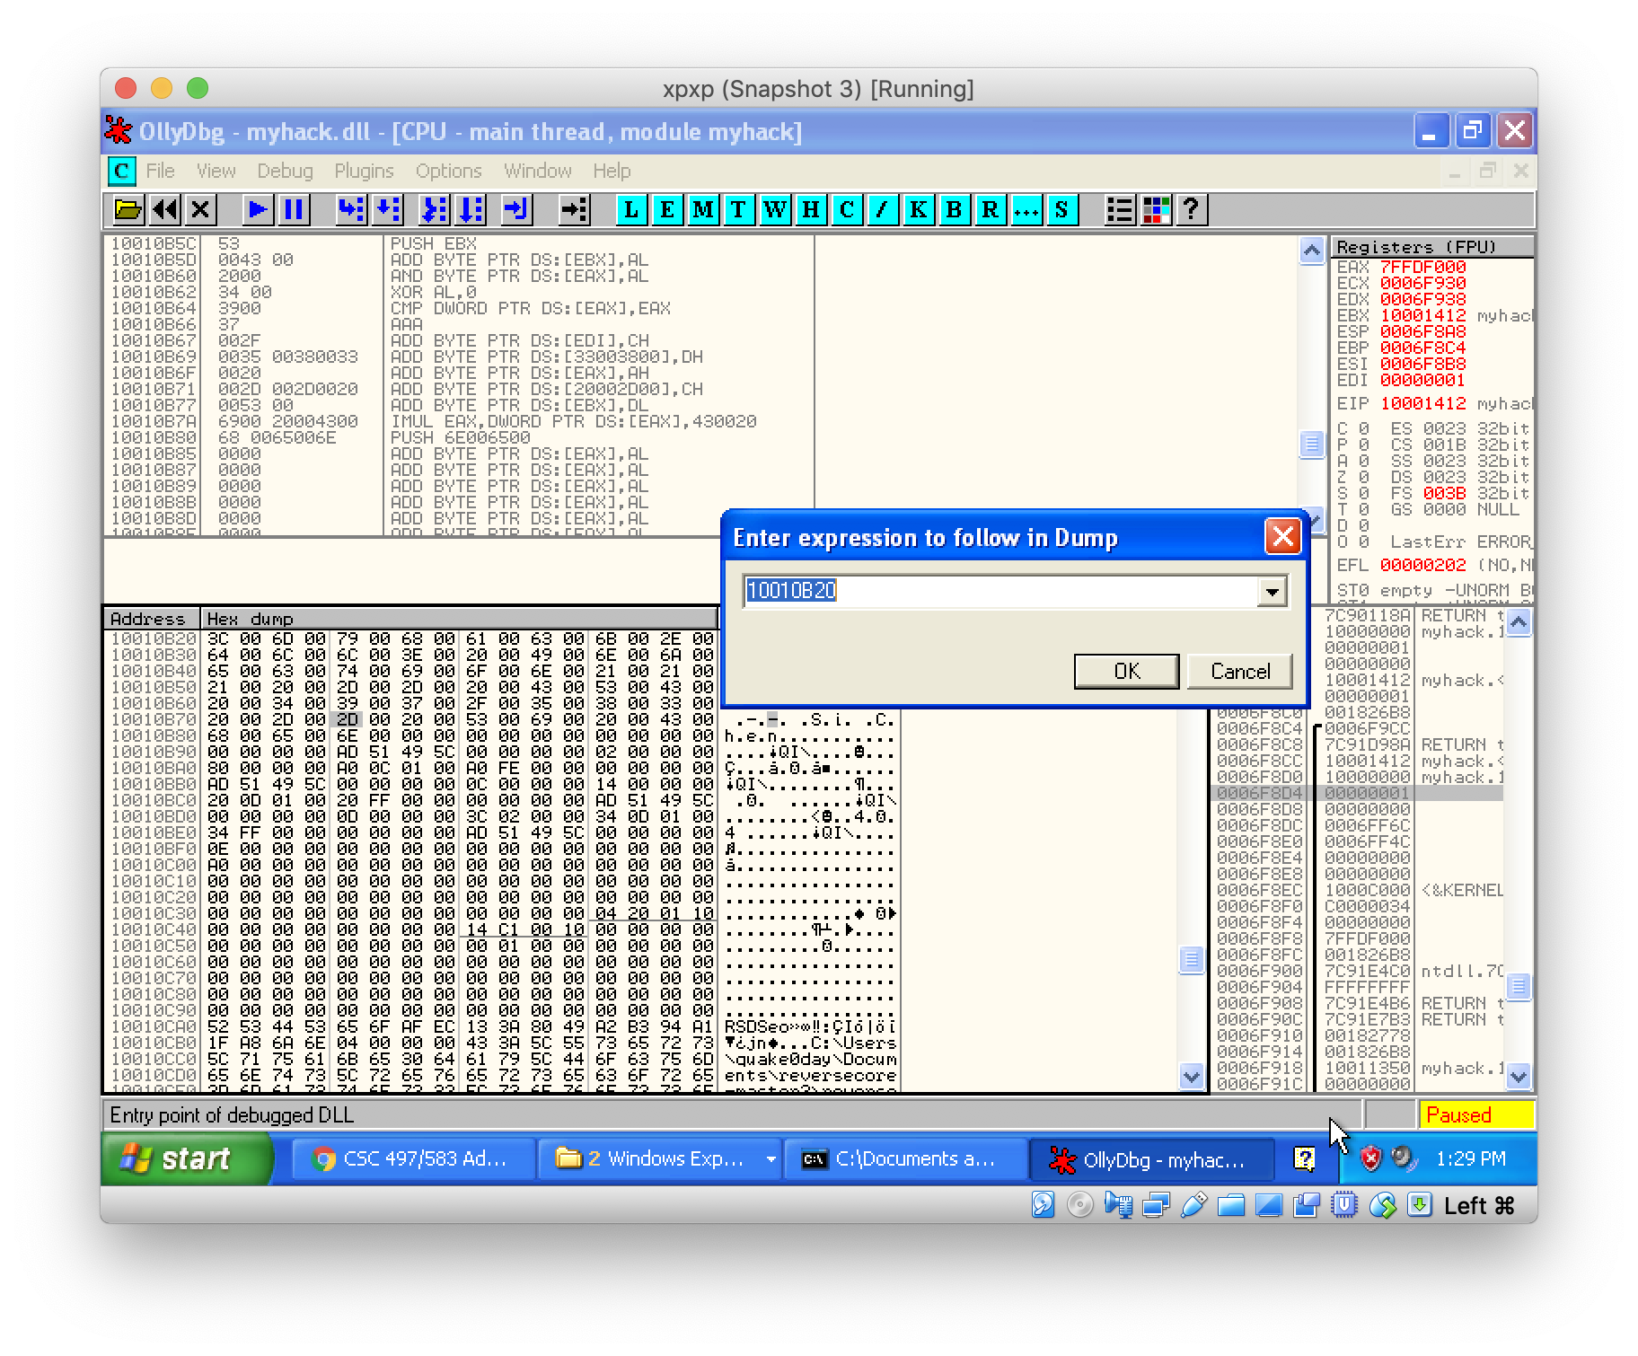
Check memory address
Type address: 10010B20

Slide 12
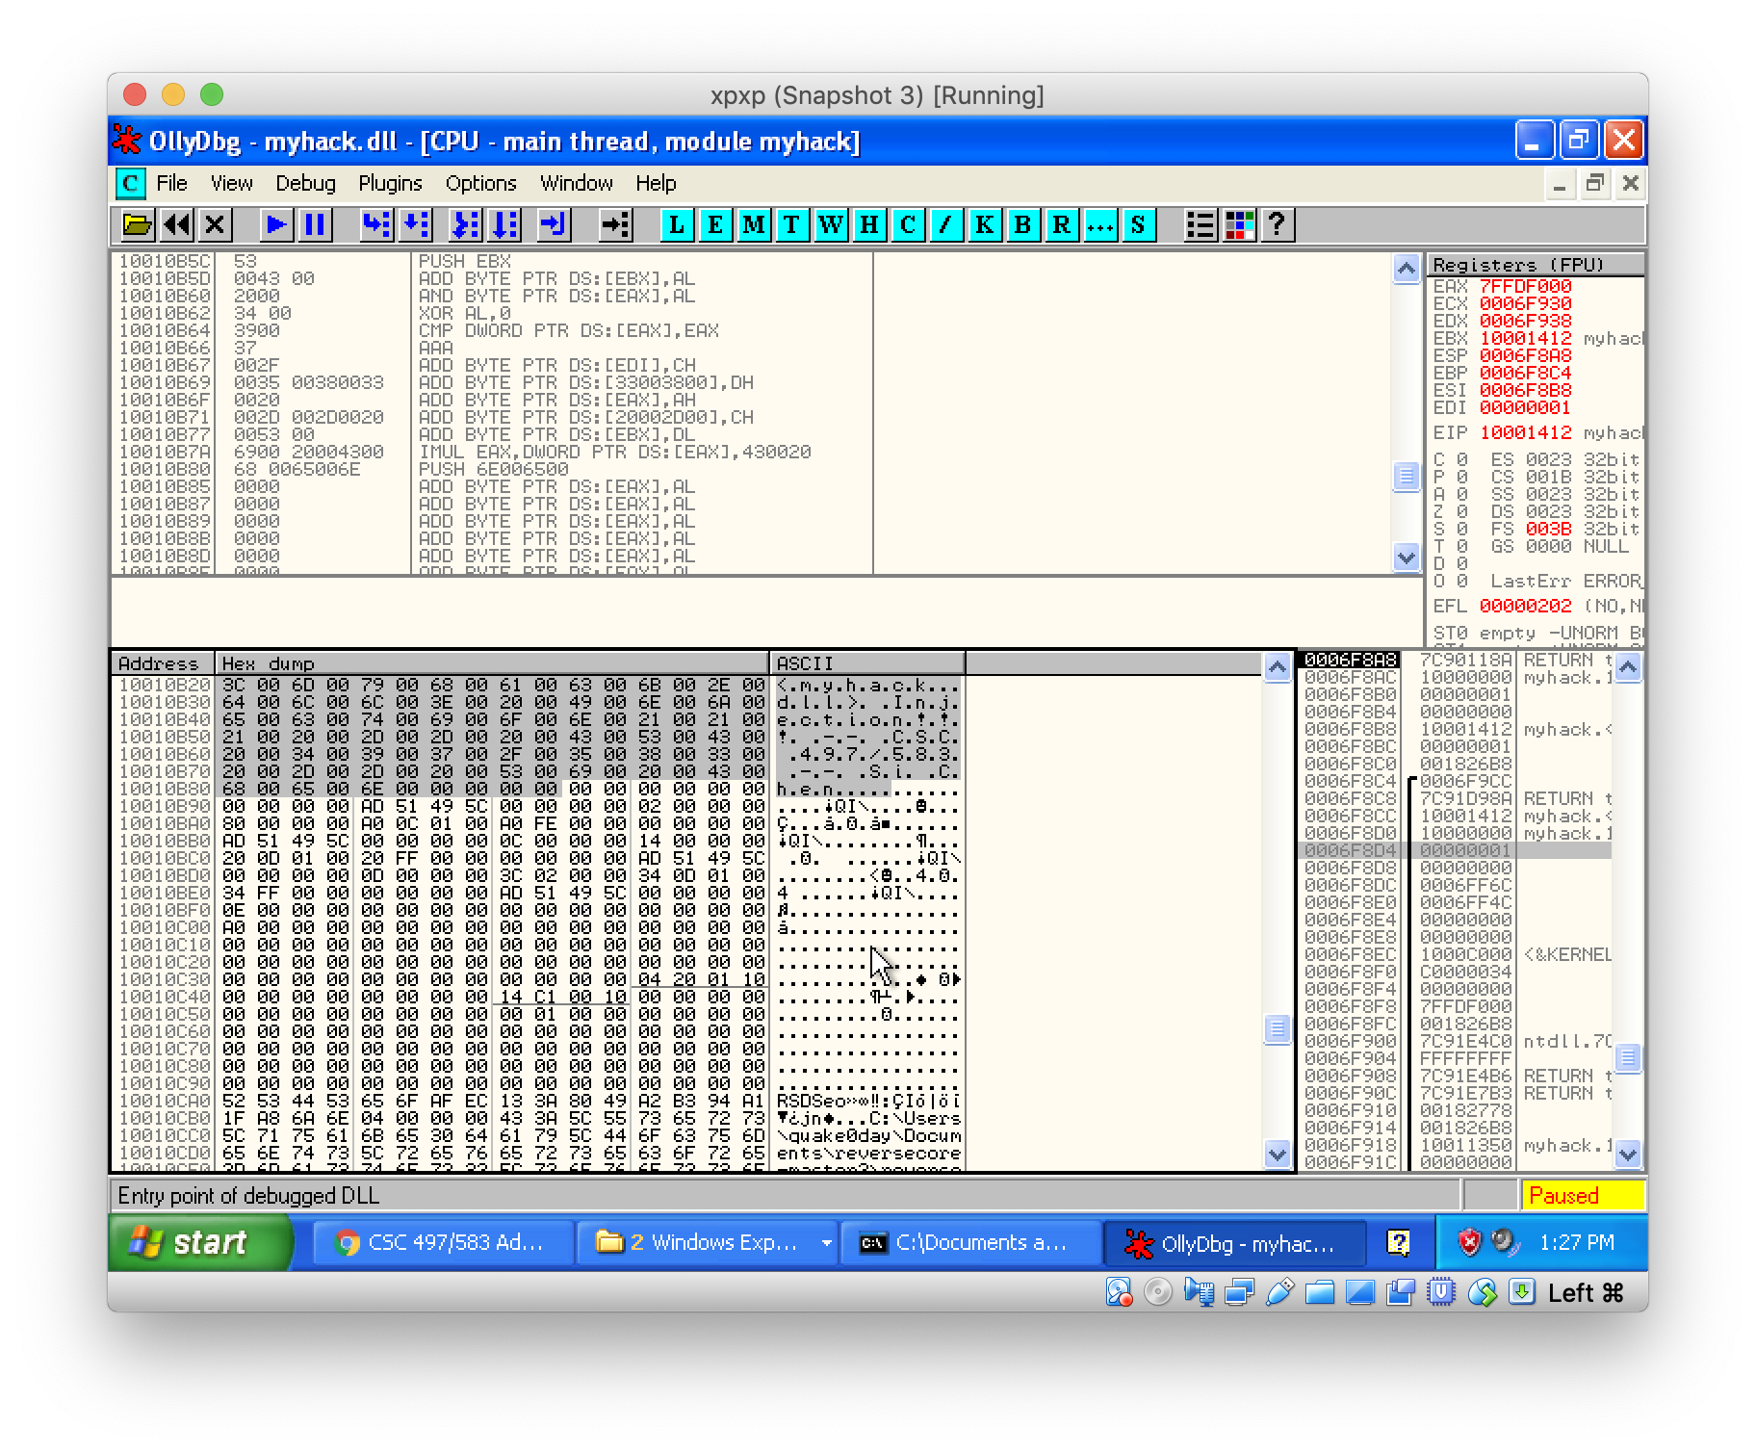
Check memory address

Slide 13
Edit the binary data
highlight the region and right click and select → Binary → Edit

Slide 14
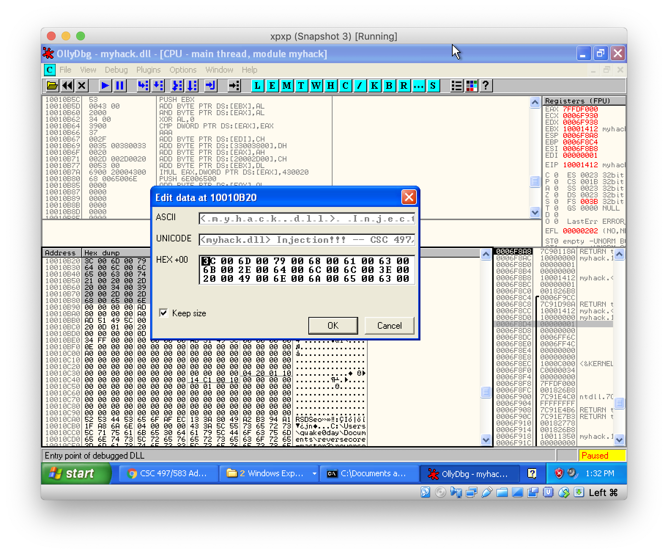
Change the value

Slide 15
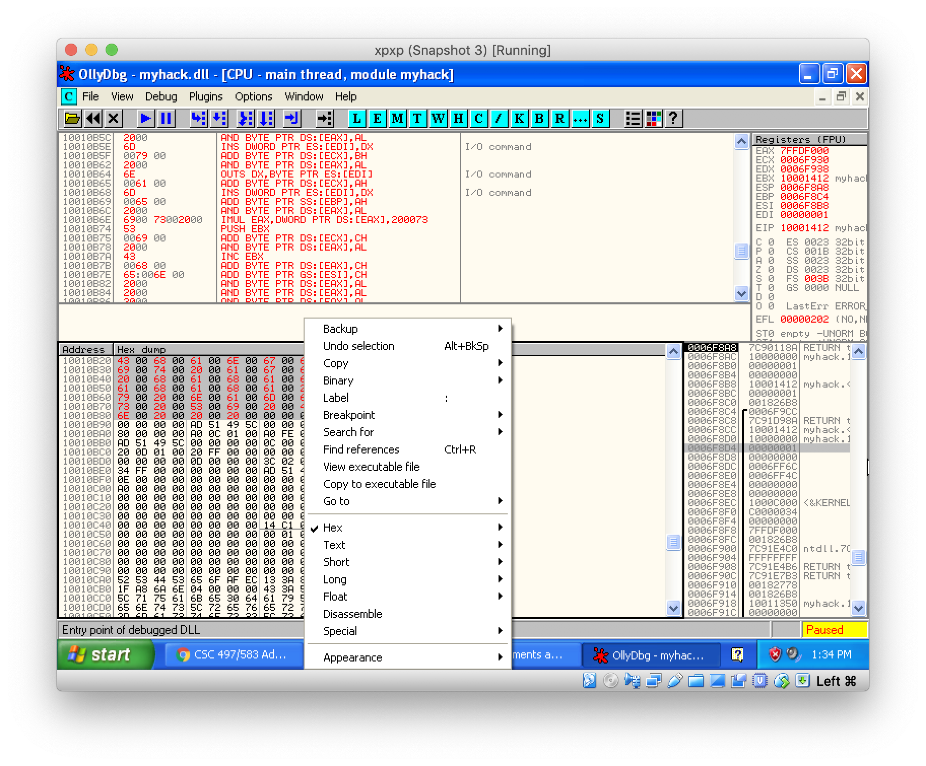
Save the file
Right click and
Select “Copy to executable file”

Slide 16
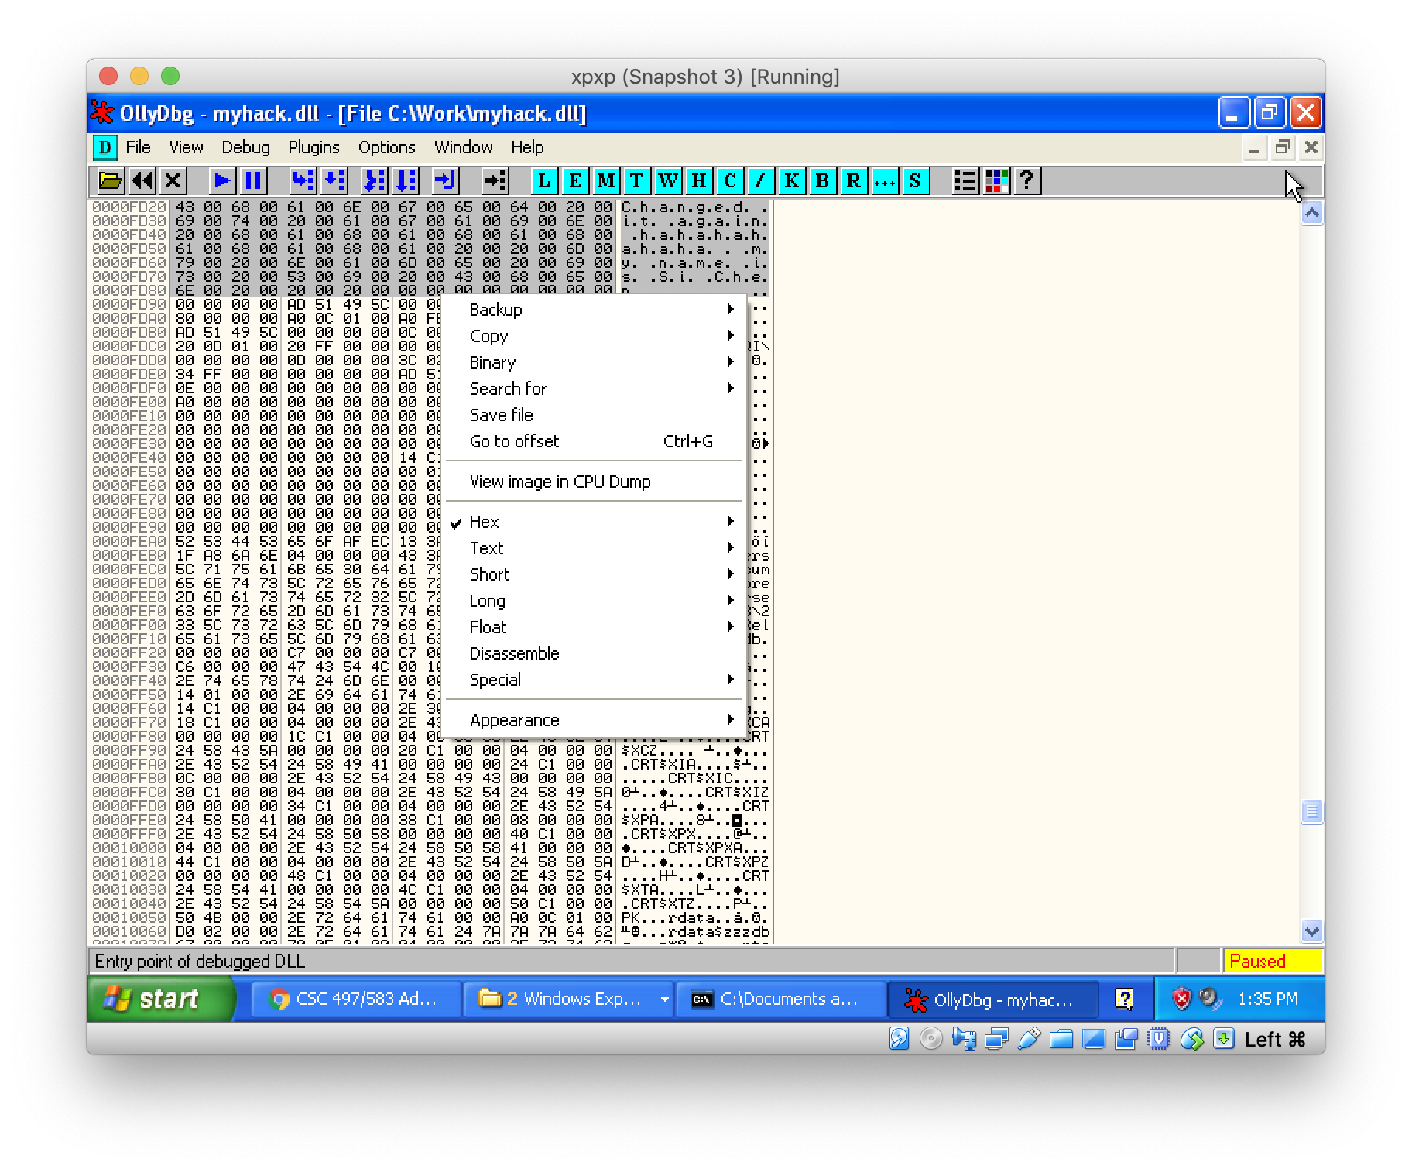
Save the file
Right click and
Select “save file”

Slide 17
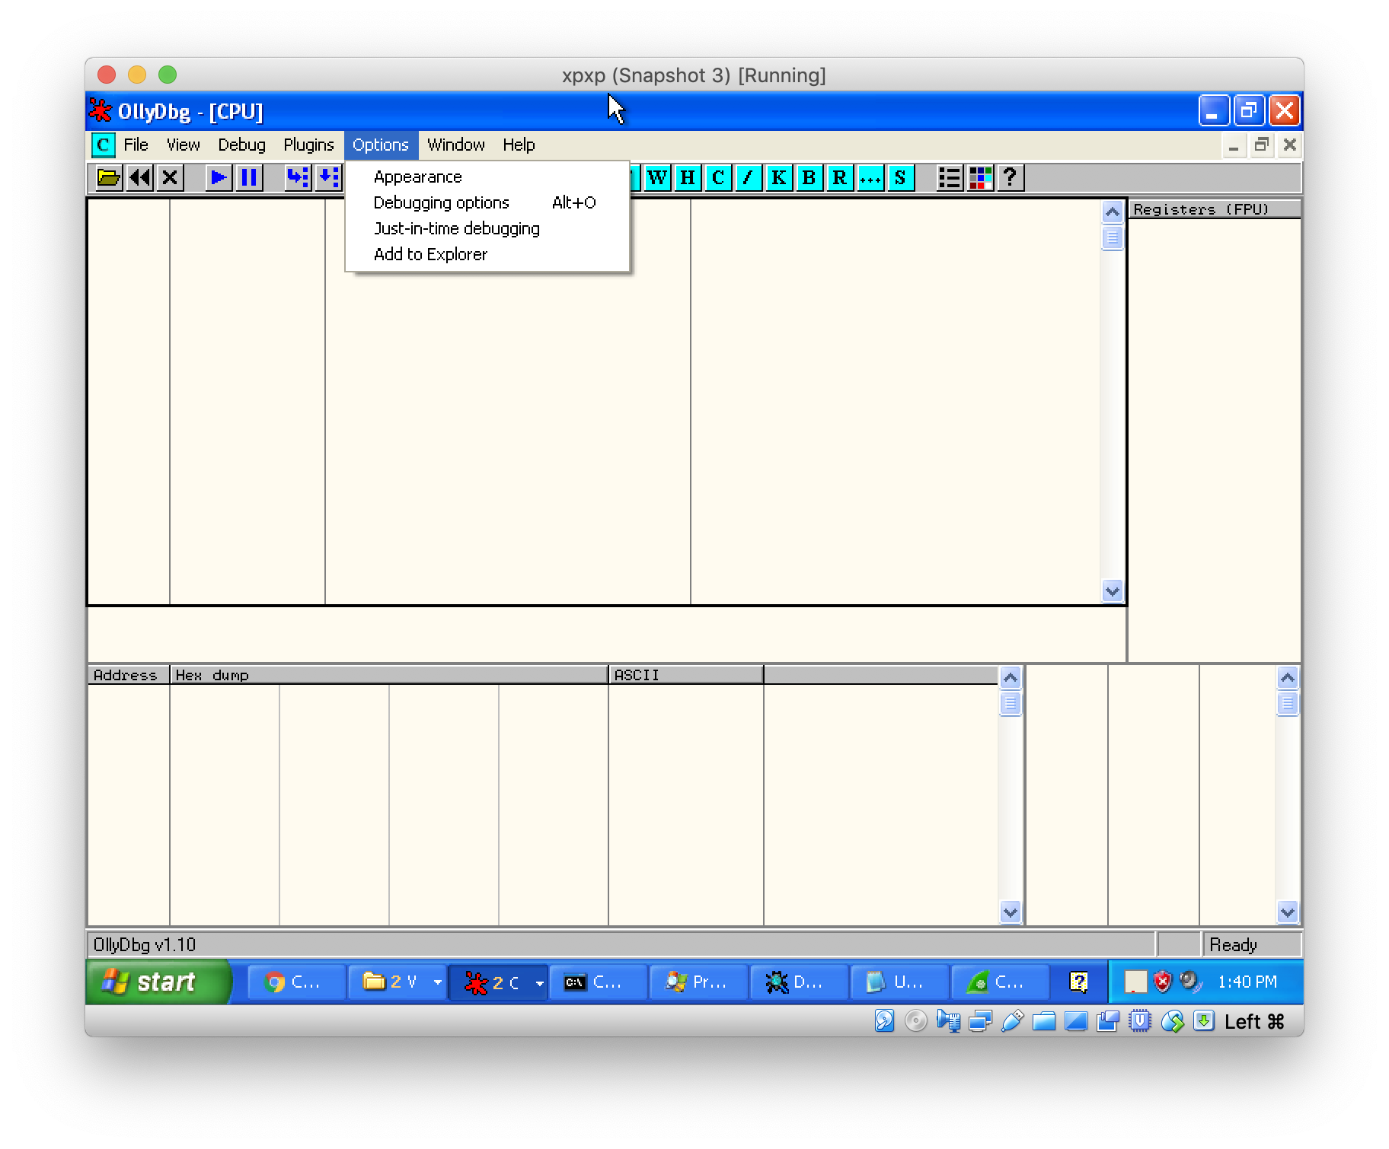
Dynamic analysis myhack.dll with Ollydbg

Slide 18
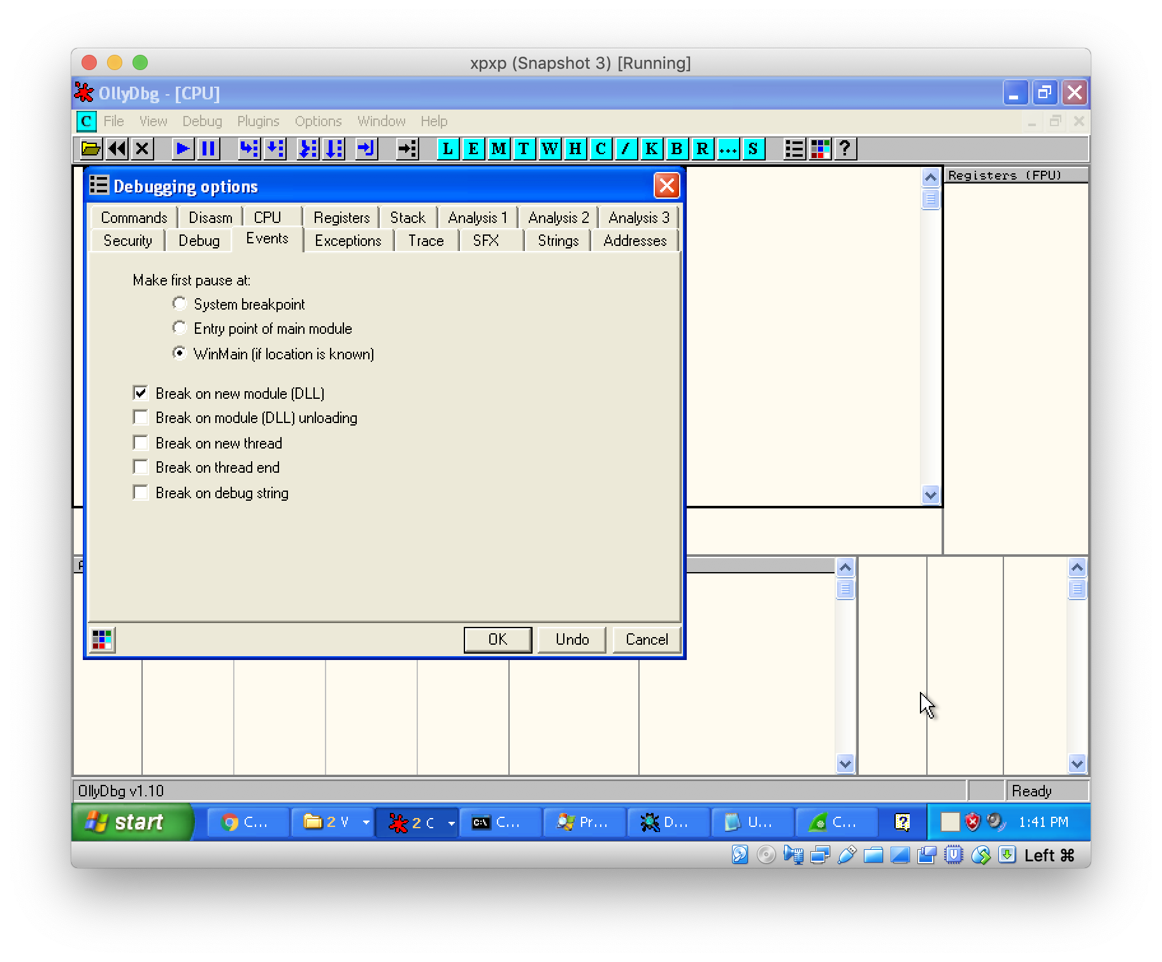
Go to ”Events” → select “Break on new module (DLL)”

Slide 19
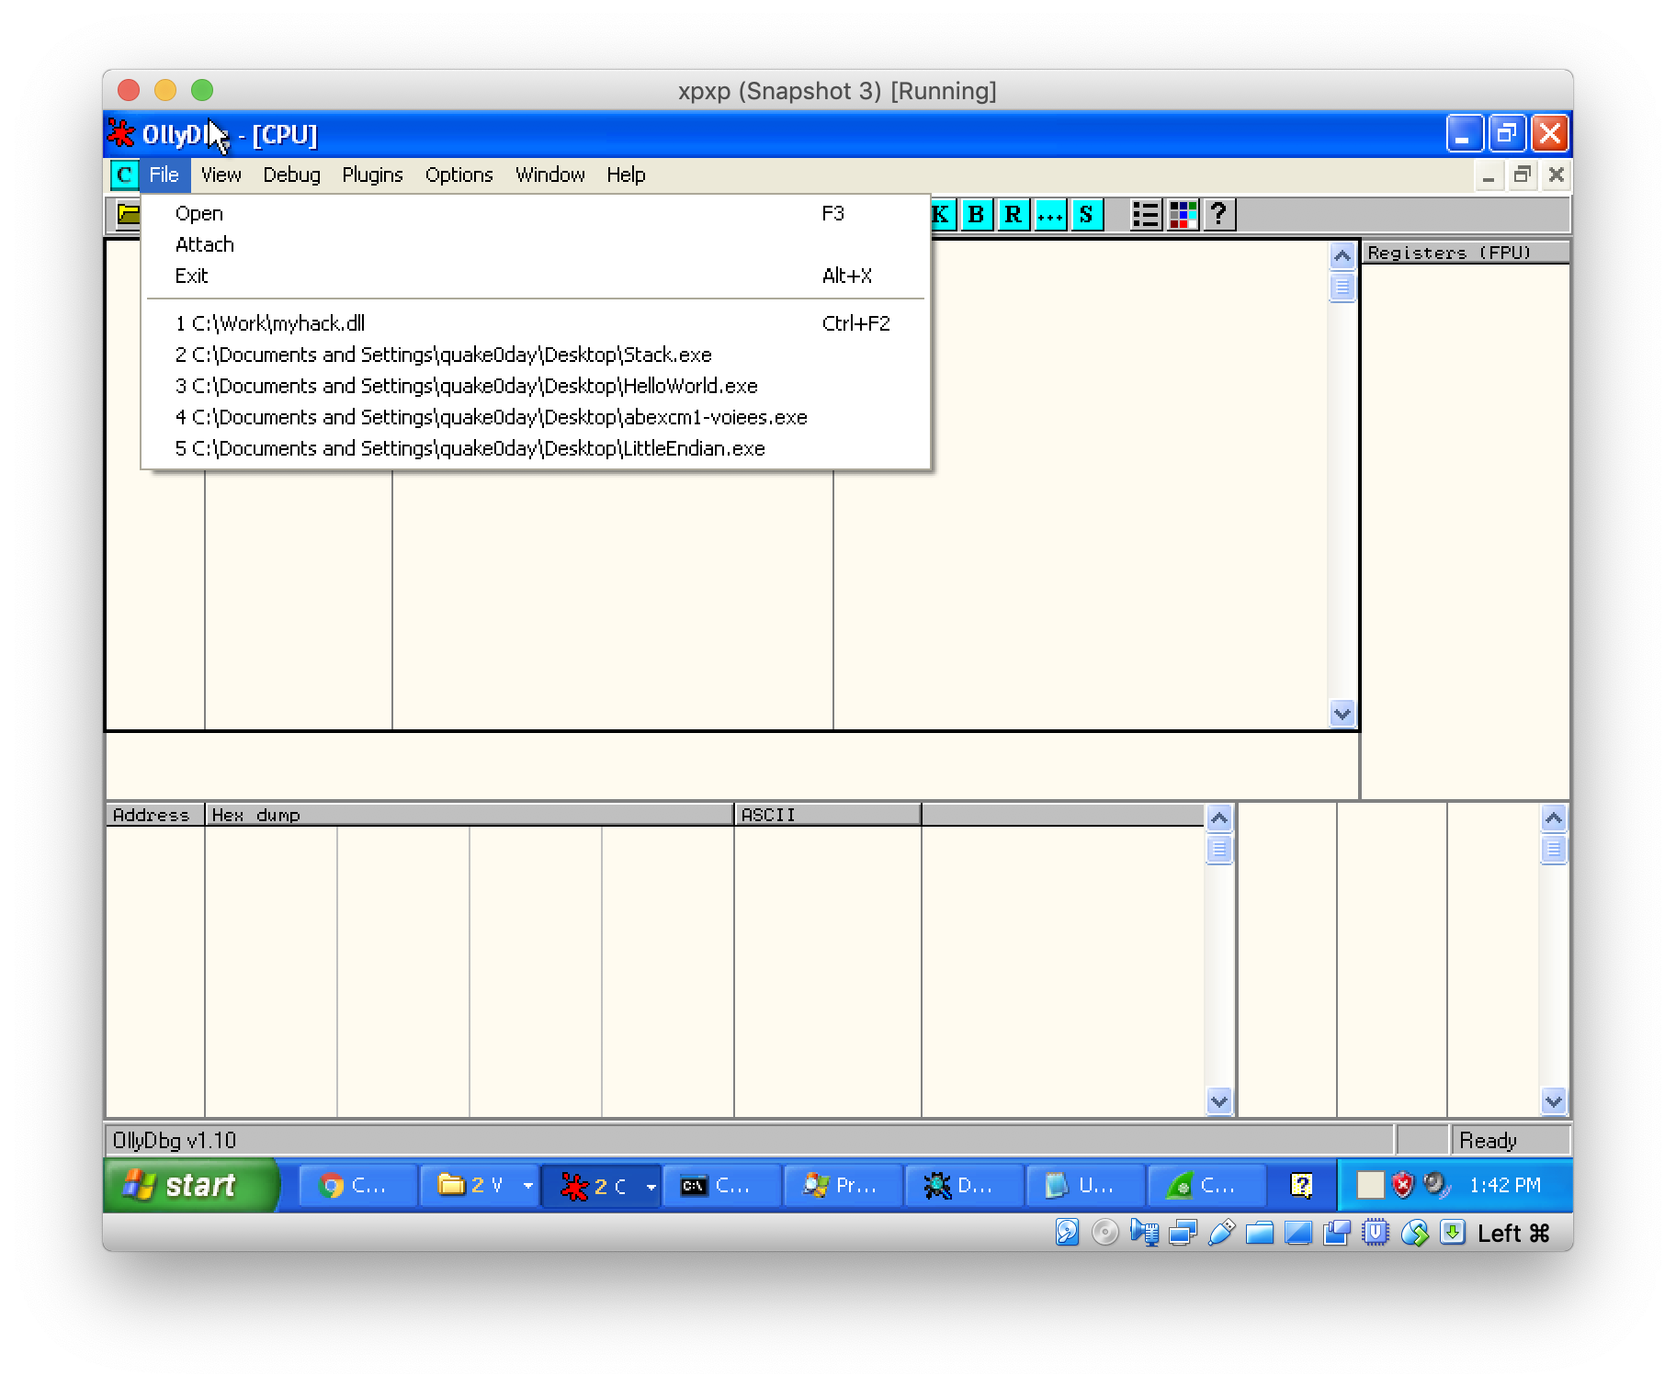
Attach to a process

Slide 20
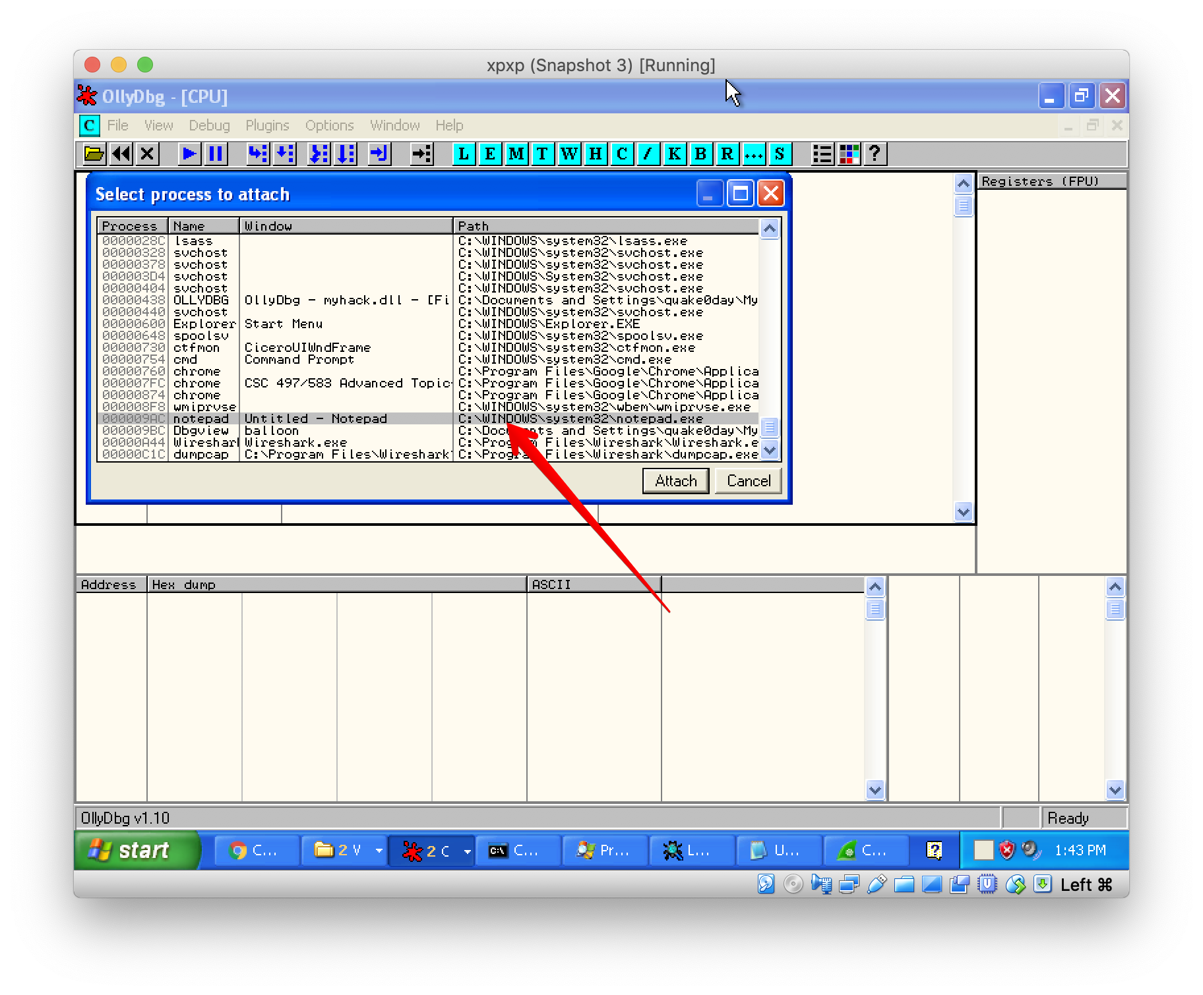
Attach to a process (Notepad.exe)

Slide 21
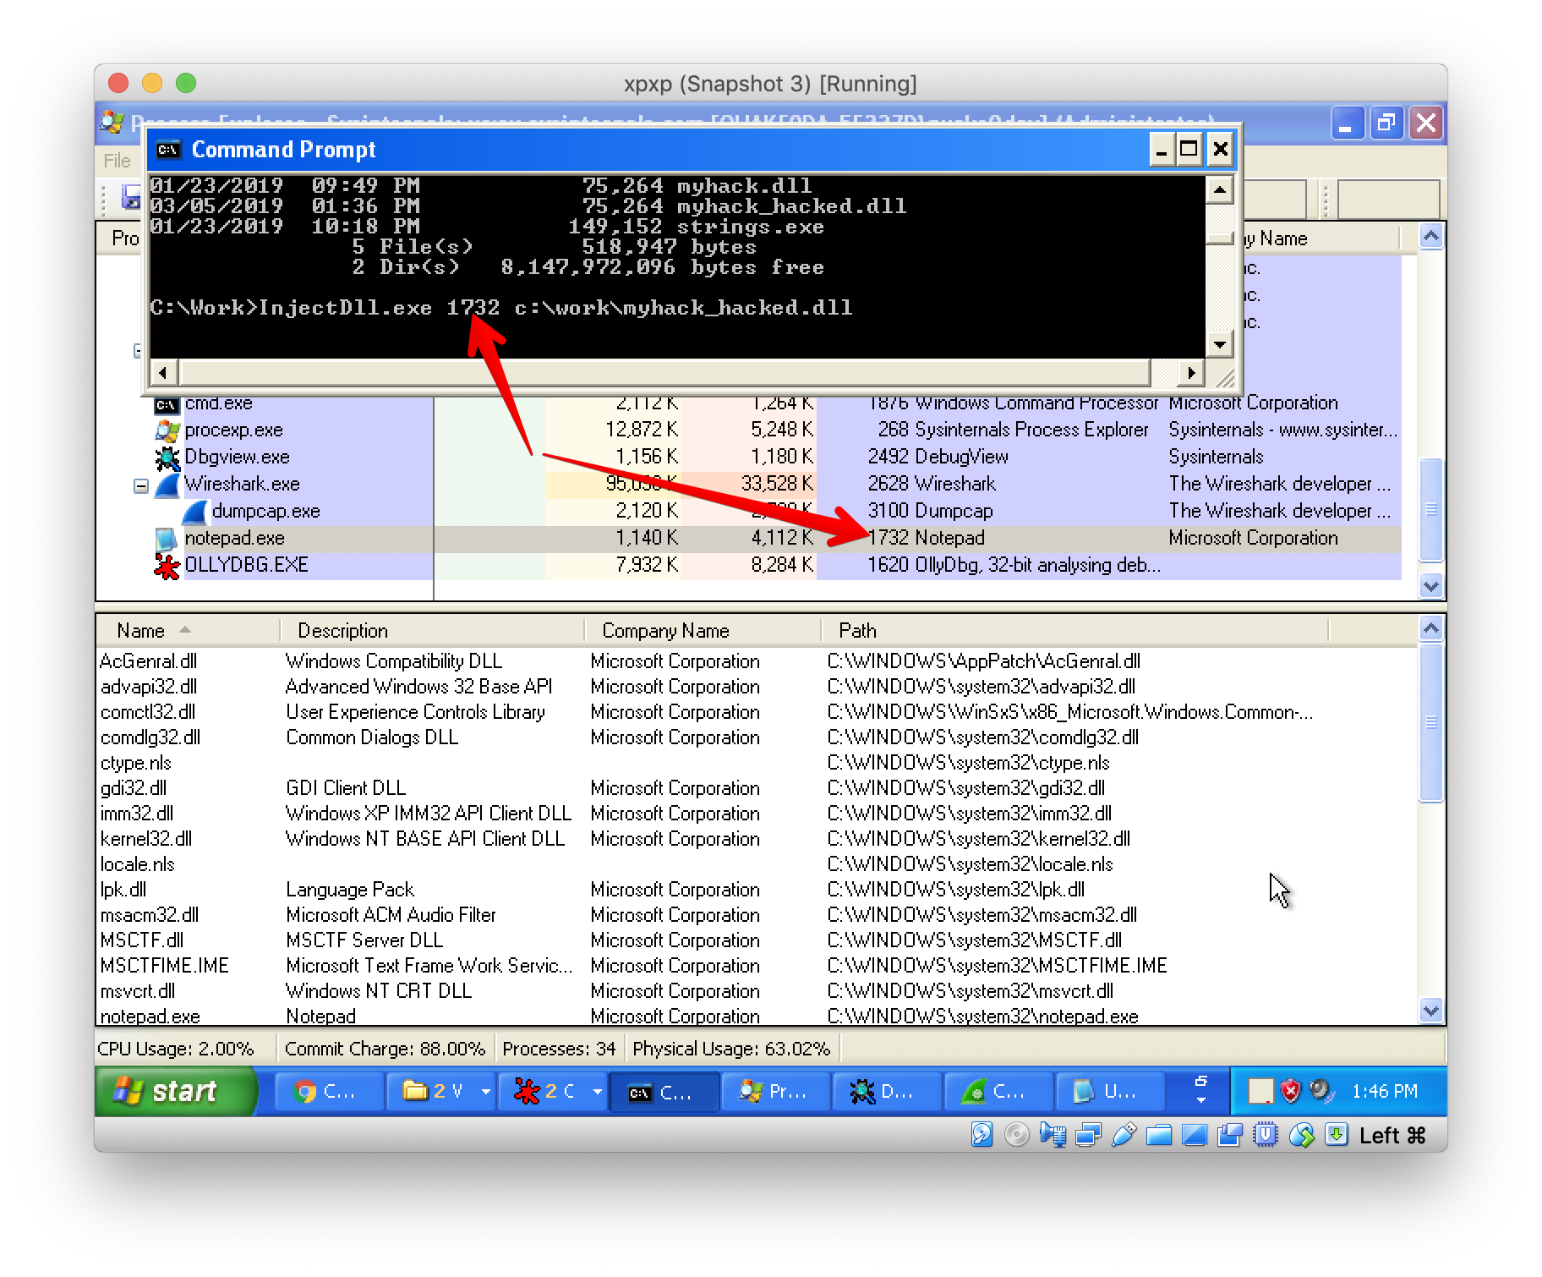
Inject Dll

Slide 22
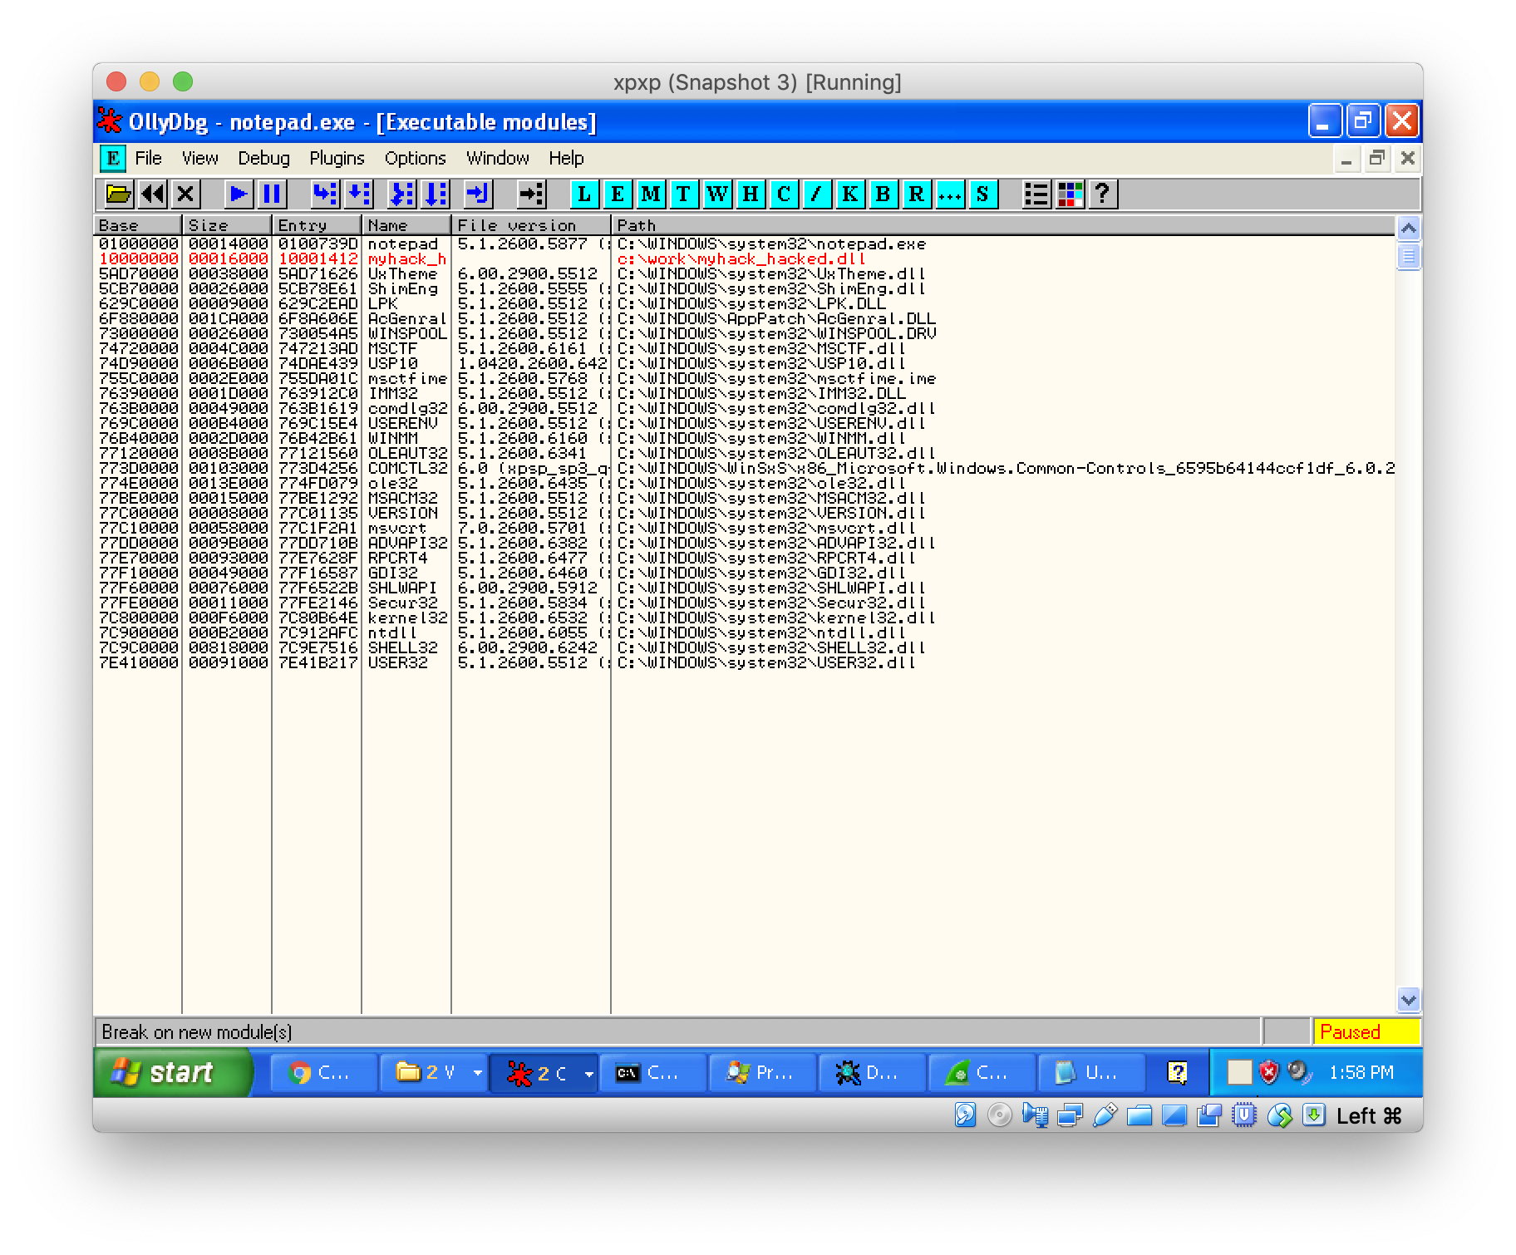

Slide 23
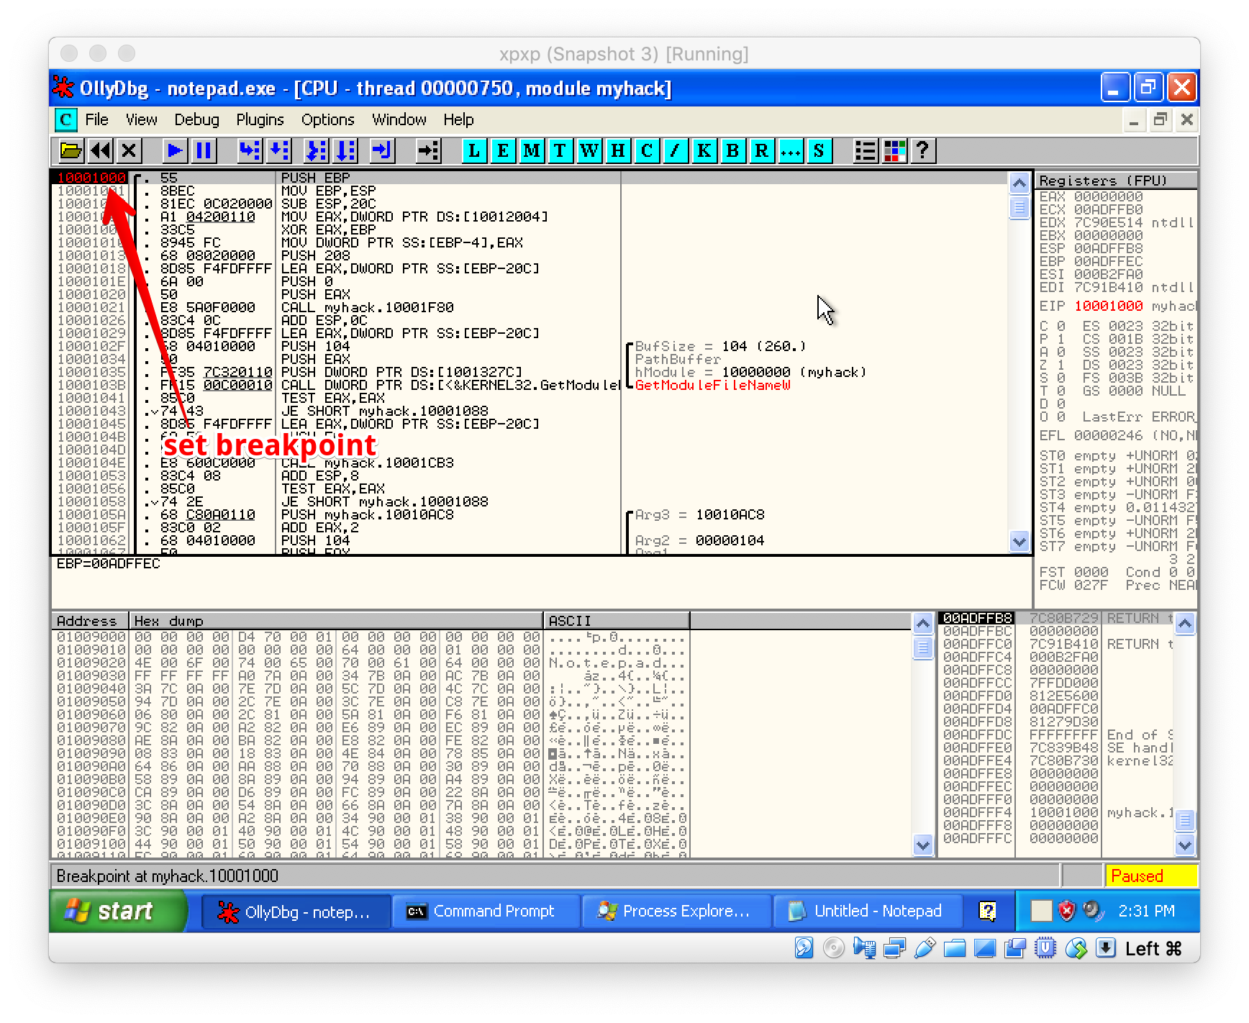

Slide 24
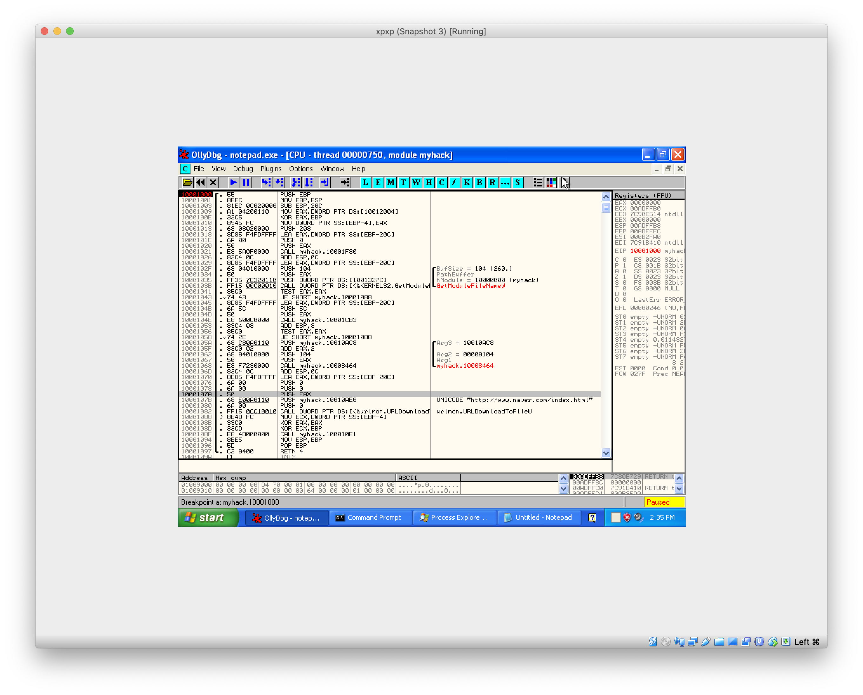

Slide 25
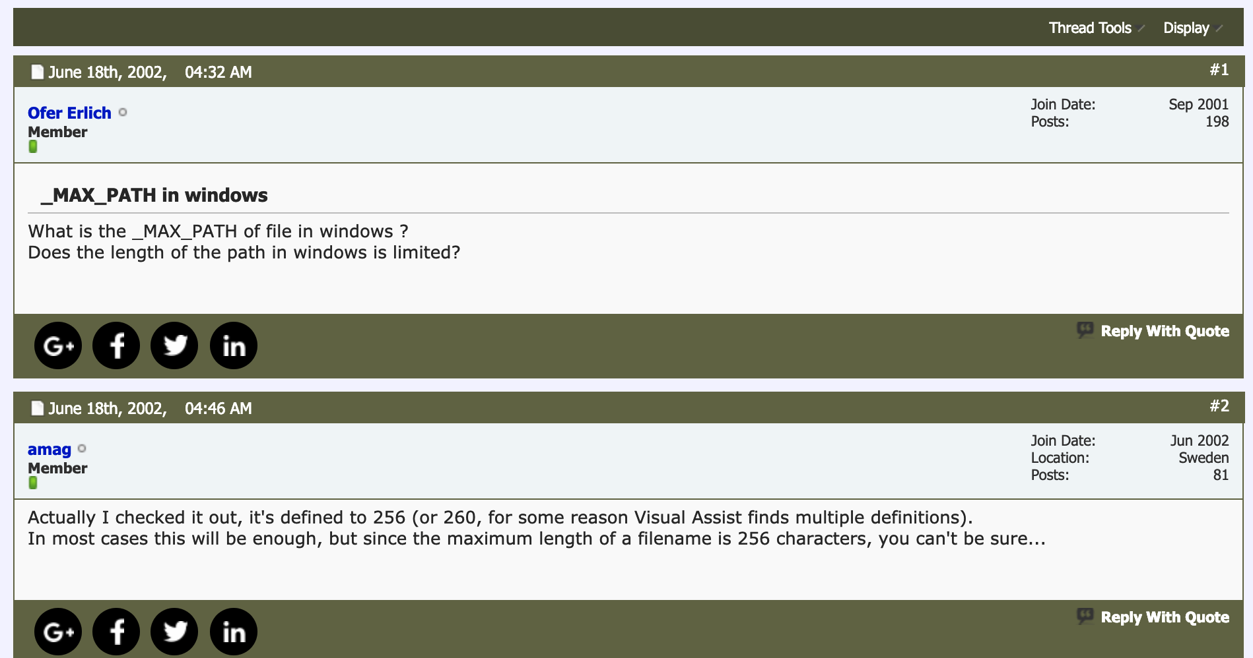

Slide 26
Use Wireshark to monitor network traffic
Use Wireshark to monitor network traffic

Slide 27
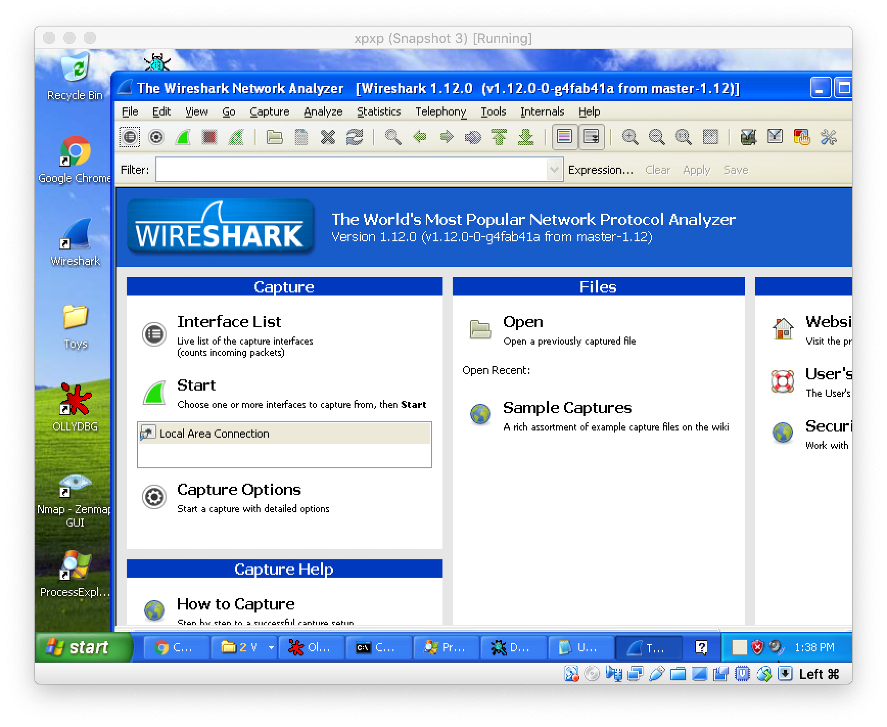
Wireshark

Slide 28
Message Hook

Slide 29
Message Hook

Slide 30
Message Hook Example
Try HookMain.exe
Download Hook.zip from our course website, unzip it (password: infected)

Slide 31
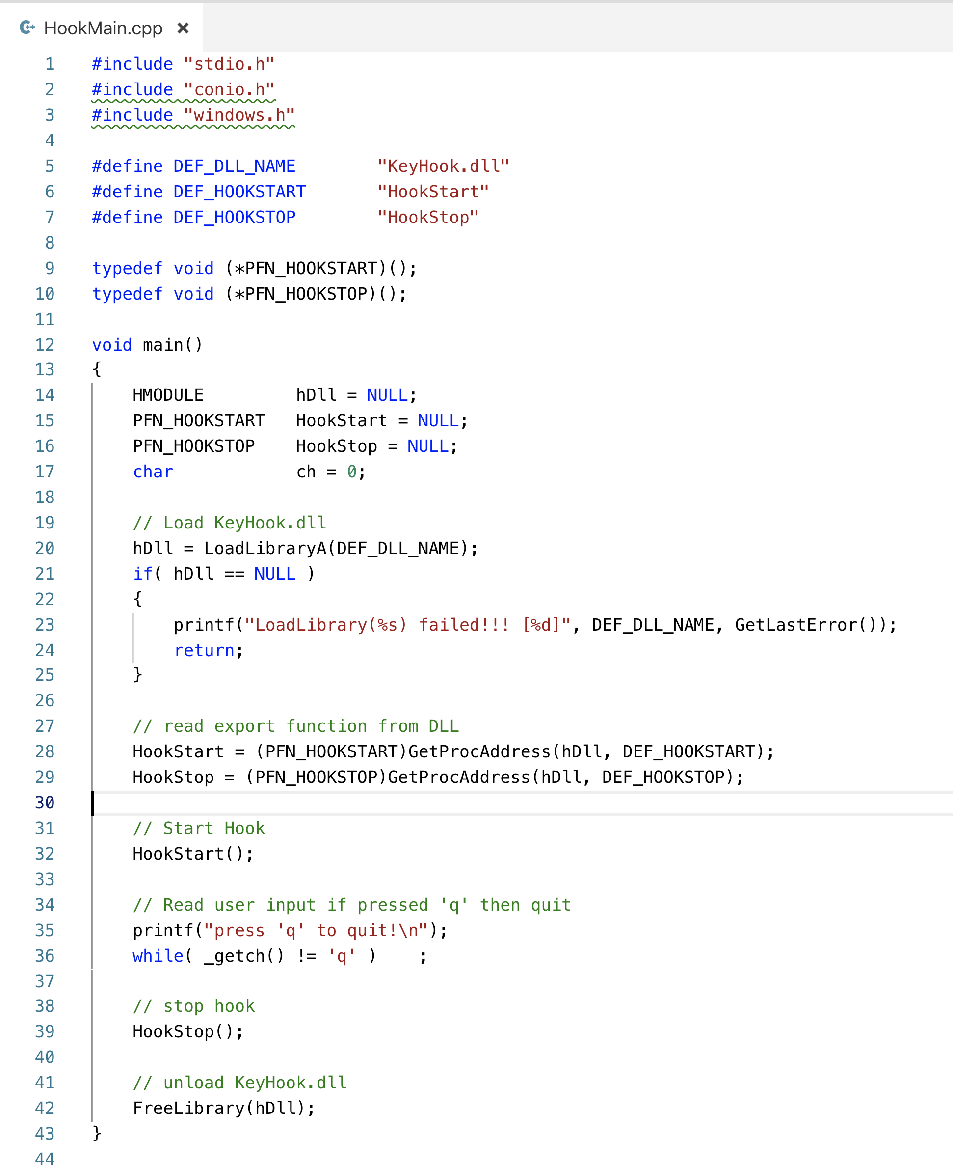

Slide 32
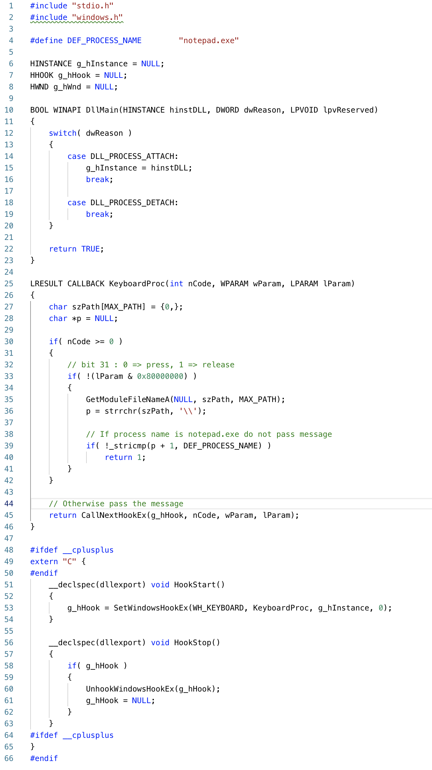

Slide 33

Q & A

