Slide 1

Class9
CSC 497/583 Advanced Topics in Computer Security
Modern Malware Analysis
Stack Frame, Calling Convention
Si Chen (schen@wcupa.edu)

Slide 2
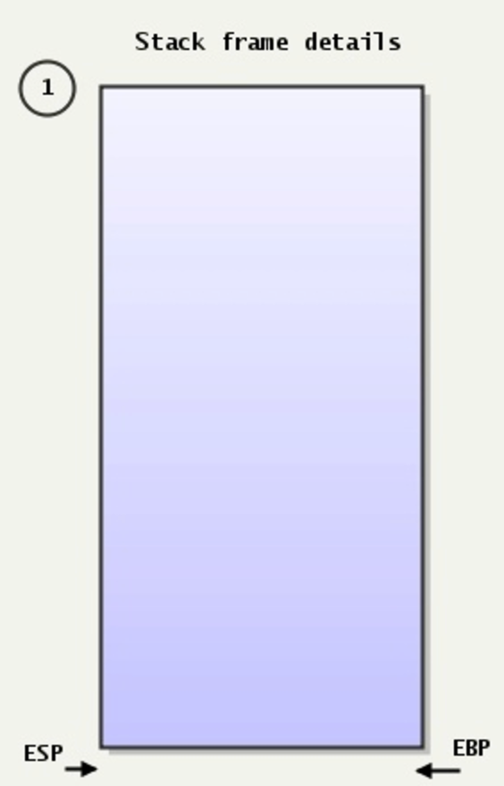
The Stack
Stack:
A special region of your computer's memory that stores temporary variables created by each functions
The stack is a "LIFO" (last in, first out) data structure
Once a stack variable is freed, that region of memory becomes available for other stack variables.
Top
12E00
Properties:
the stack grows and shrinks as functions push and pop local variables
there is no need to manage the memory yourself, variables are allocated and freed automatically
the stack has size limits
stack variables only exist while the function that created them, is running
PUSH
POP
EBP—Pointer to data on the stack ESP—Stack pointer
13000
Bottom

Slide 3
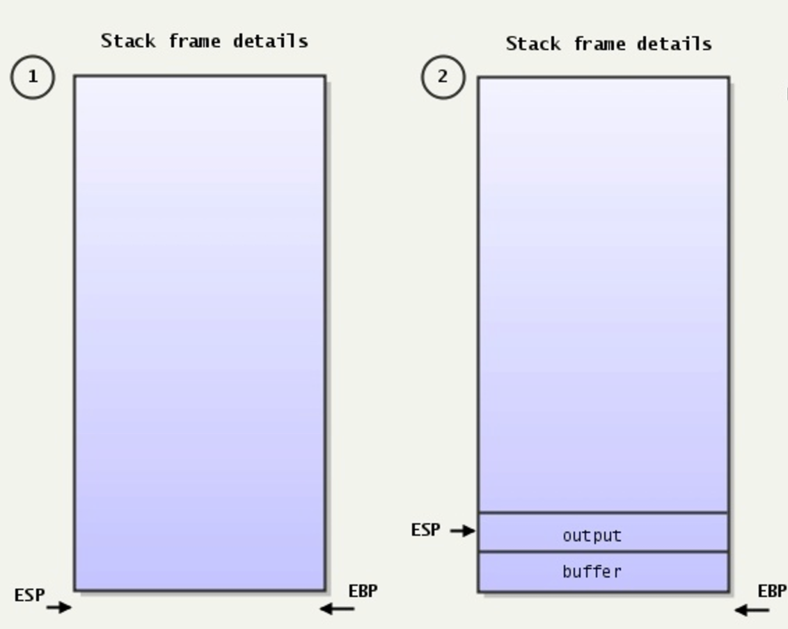
The Stack
Stack:
A special region of your computer's memory that stores temporary variables created by each functions
The stack is a "LIFO" (last in, first out) data structure
Once a stack variable is freed, that region of memory becomes available for other stack variables.

Slide 4
Stack Frame

Slide 5
Stack Frame
A stack frame is a frame of data that gets pushed onto the stack.
In the case of a call stack, a stack frame would represent a function call and its argument data.

Slide 6
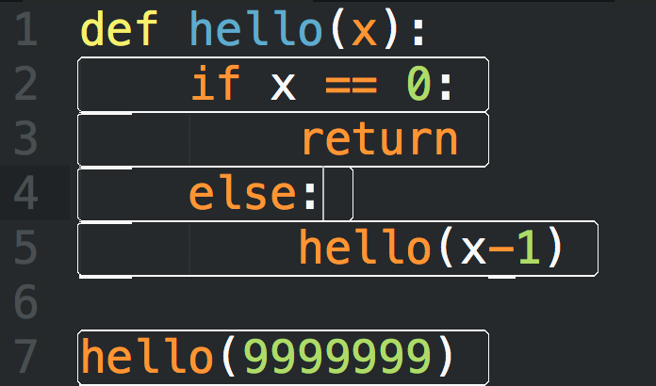
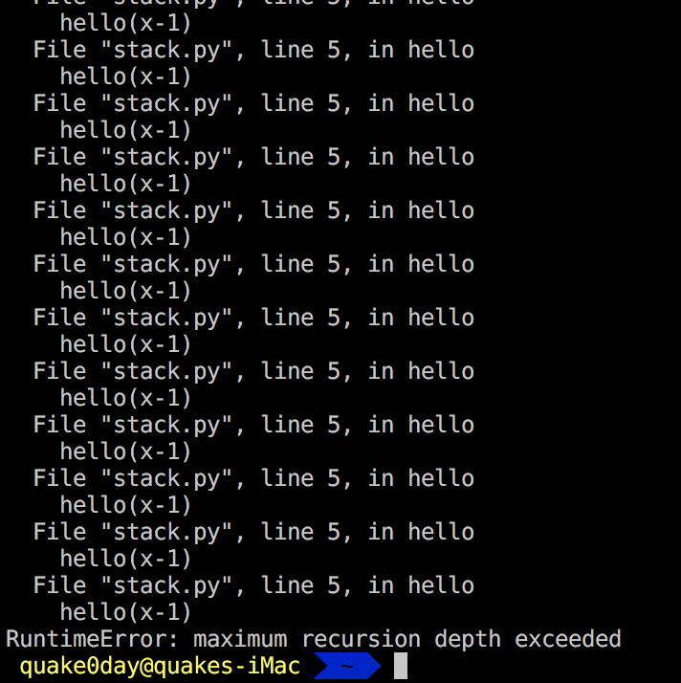
Stack Frame

Slide 7
Stack
Pass arguments
Save the return address
Save local variable

Slide 8
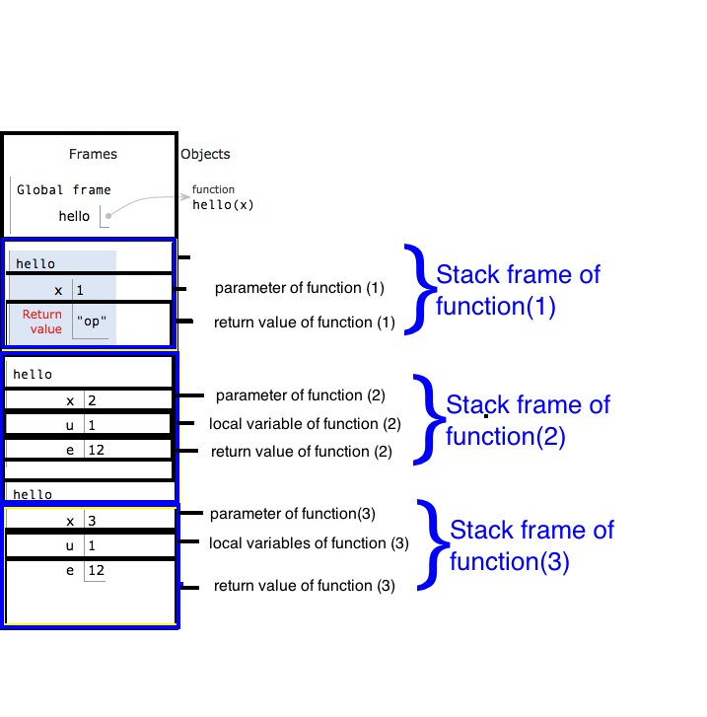
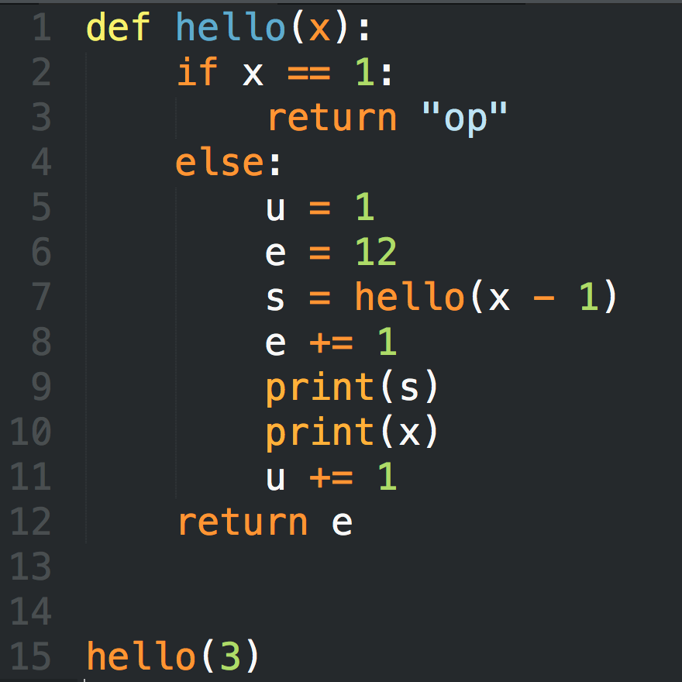
Stack Frame

Slide 9
Stack Frame

Slide 10
Local Variable
Limited Register(s) → Store Local Variable in stack
  Use esp and ebp to define a stack frame for current function
  Use relative position of esp or ebp for retrieving and storing data
    e.g. mov eax, [esp+124]
Very easy to do recursive call

Slide 11
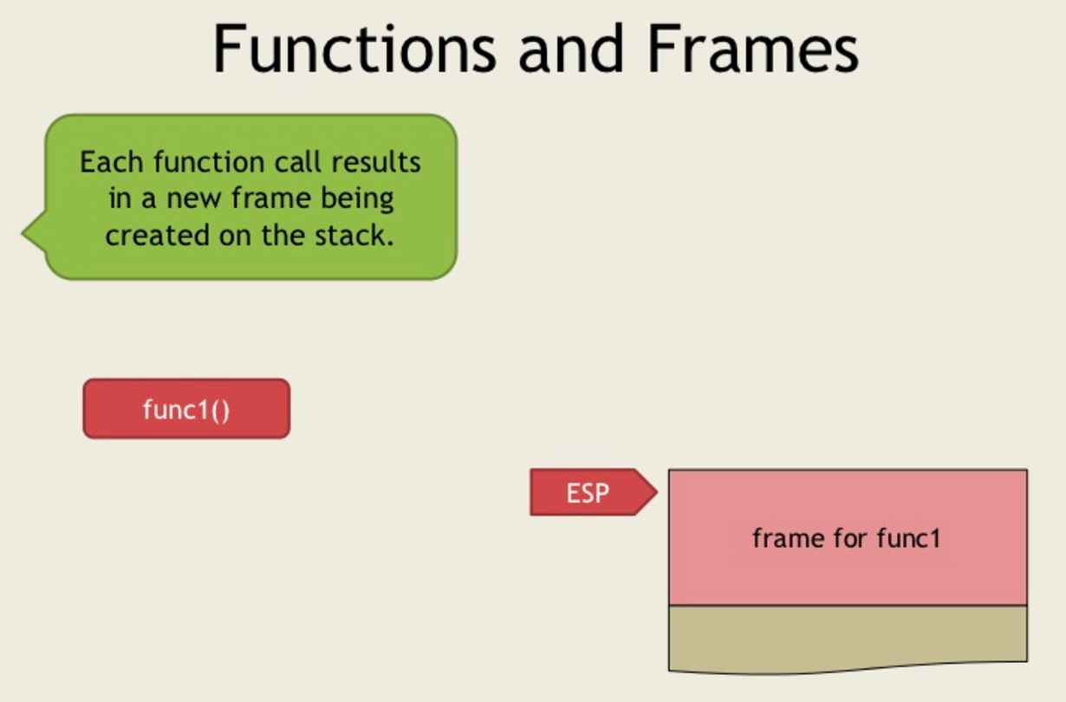
https://www.slideshare.net/saumilshah/how-functions-work-7776073

Slide 12
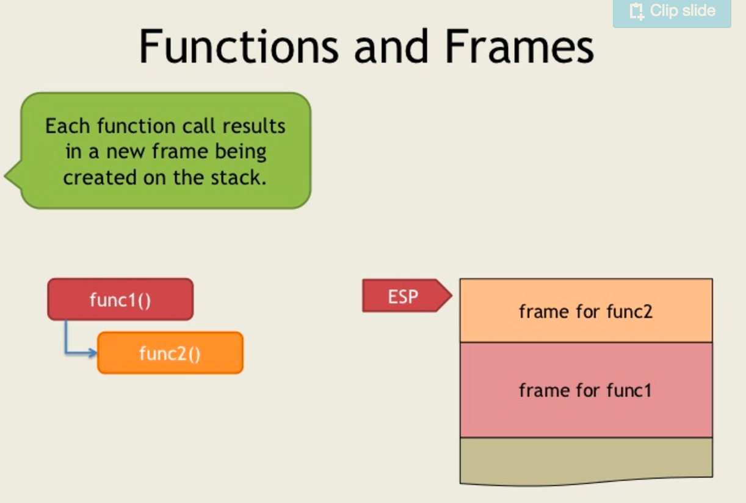
https://www.slideshare.net/saumilshah/how-functions-work-7776073

Slide 13
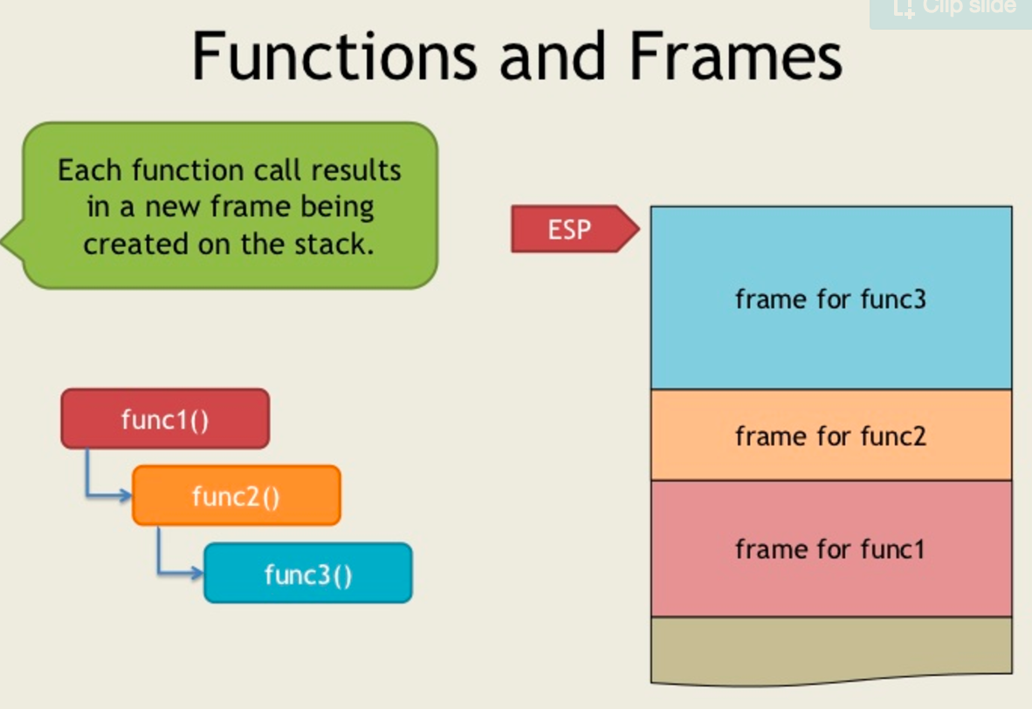
https://www.slideshare.net/saumilshah/how-functions-work-7776073

Slide 14
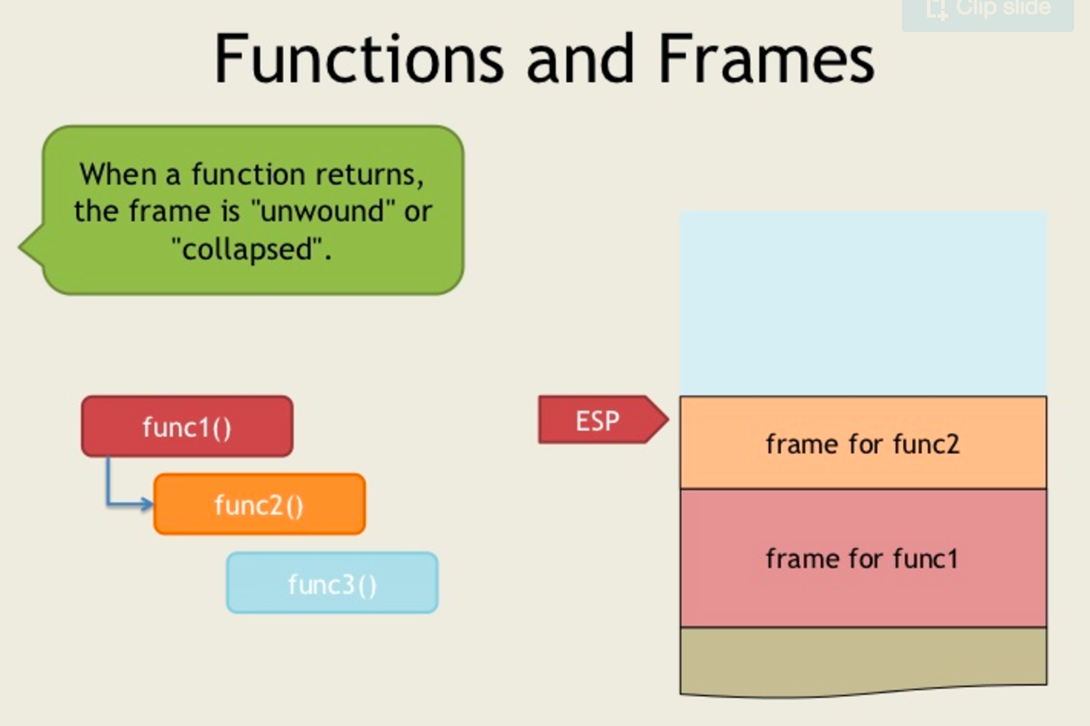
https://www.slideshare.net/saumilshah/how-functions-work-7776073

Slide 15
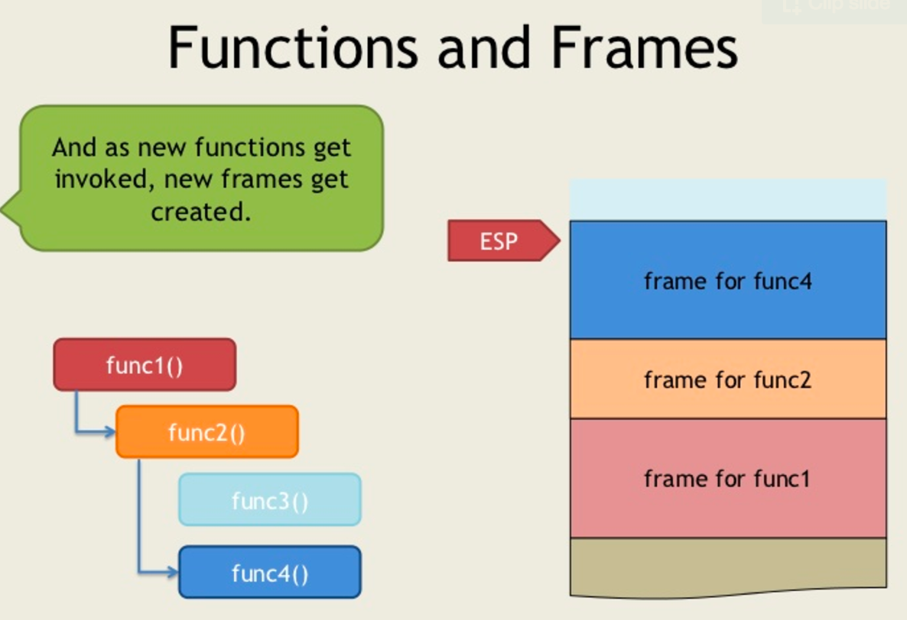
https://www.slideshare.net/saumilshah/how-functions-work-7776073

Slide 16
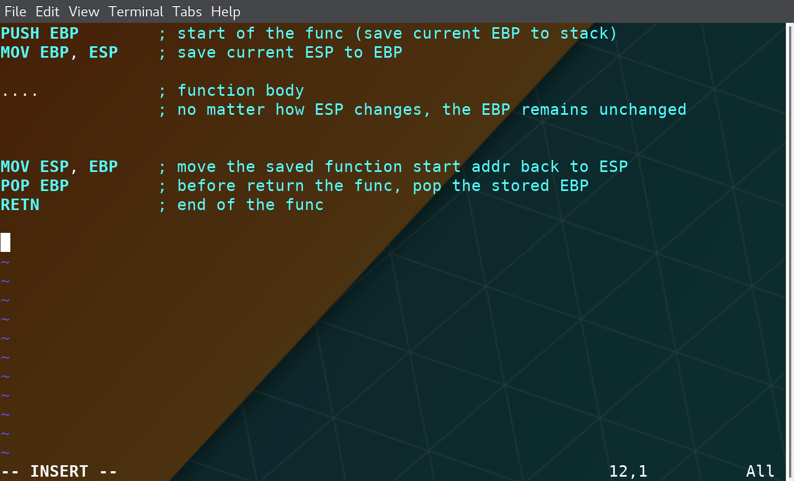
Stack Frame

Slide 17
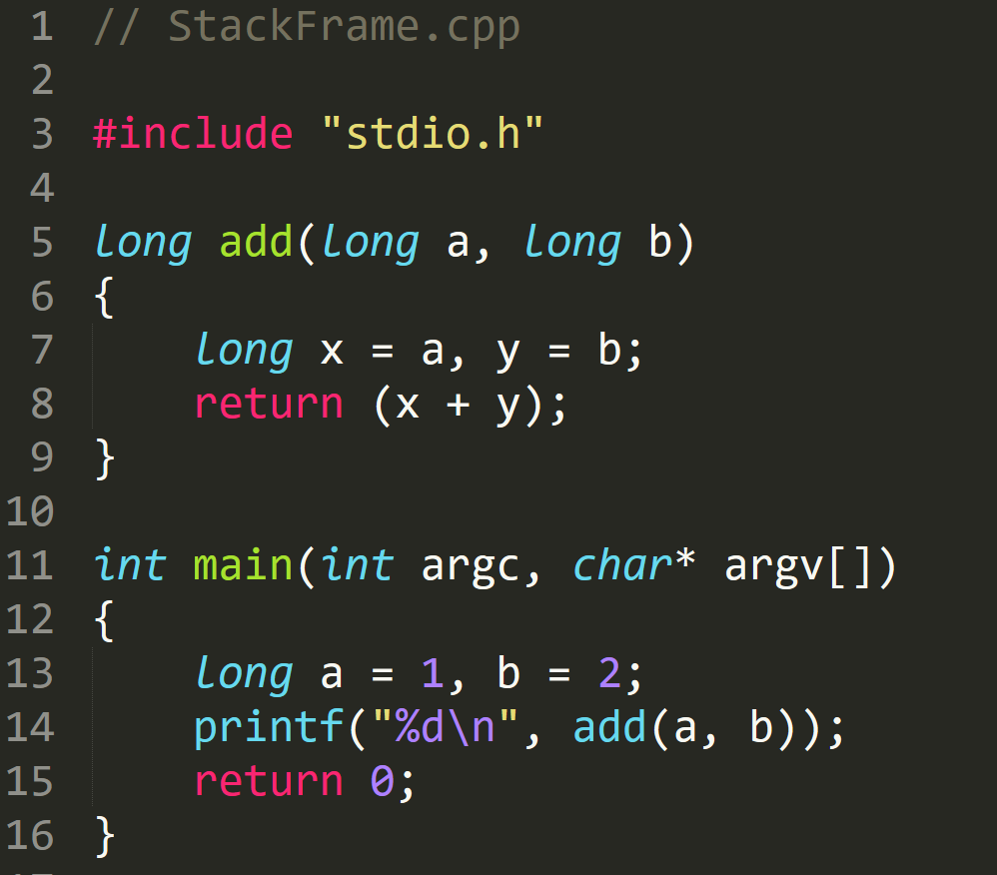
StackFrame.exe

Slide 18
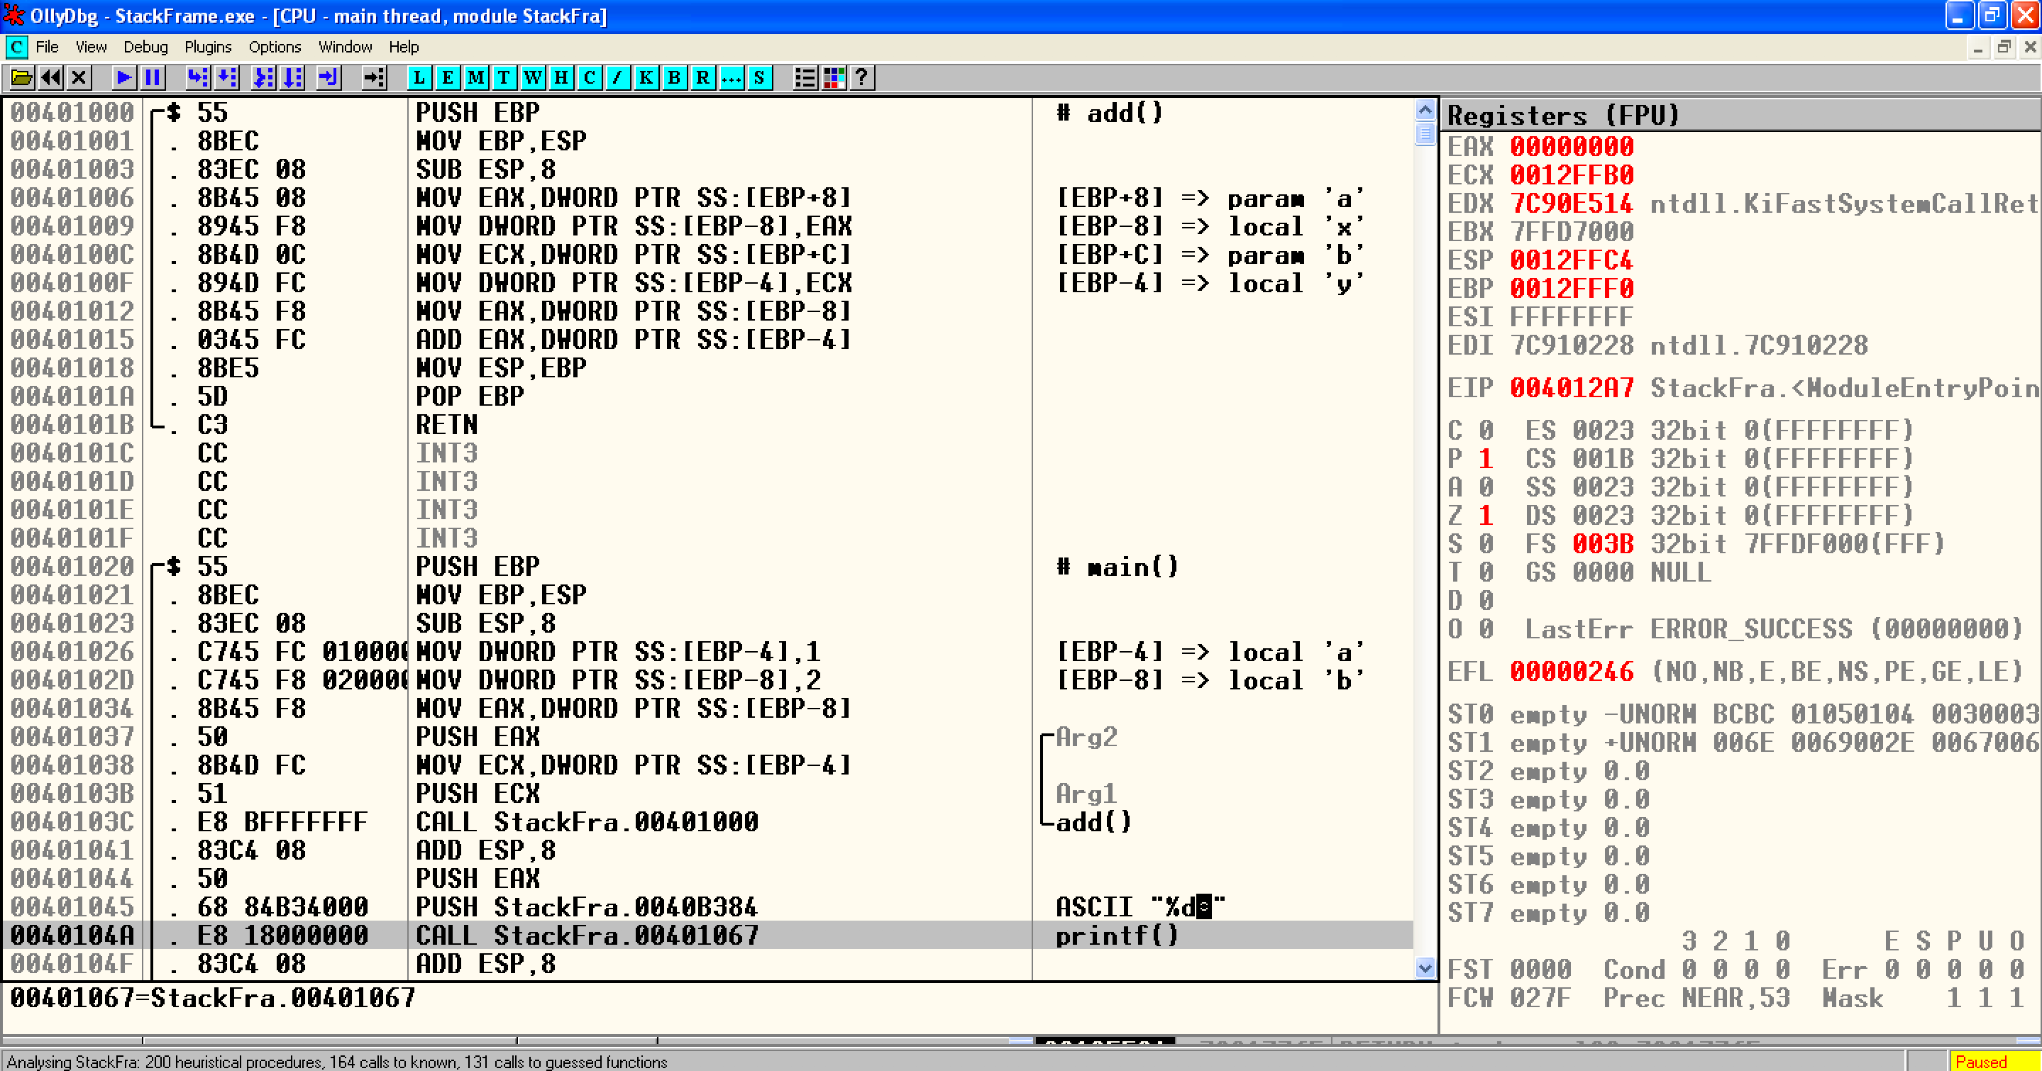
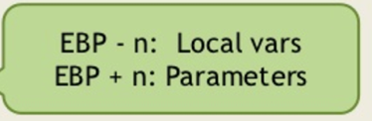
StackFrame.exe

Slide 19
StackFrame.exe

Slide 20
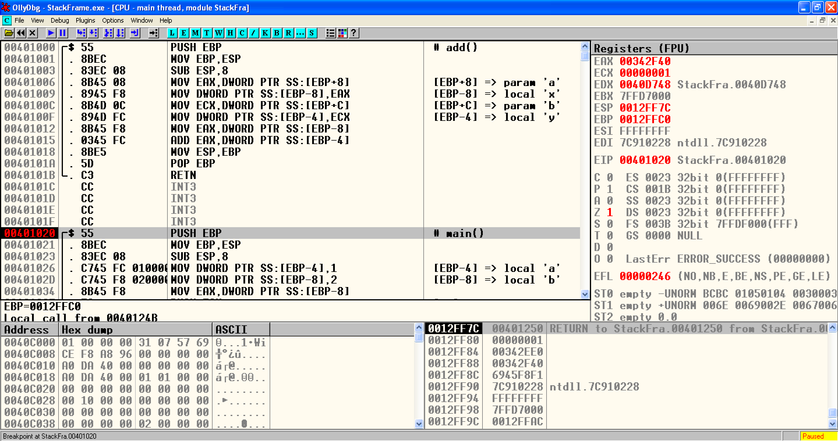
StackFrame.exe
Notes:
EBP 12FFC0
ESP 12FF7C

Slide 21
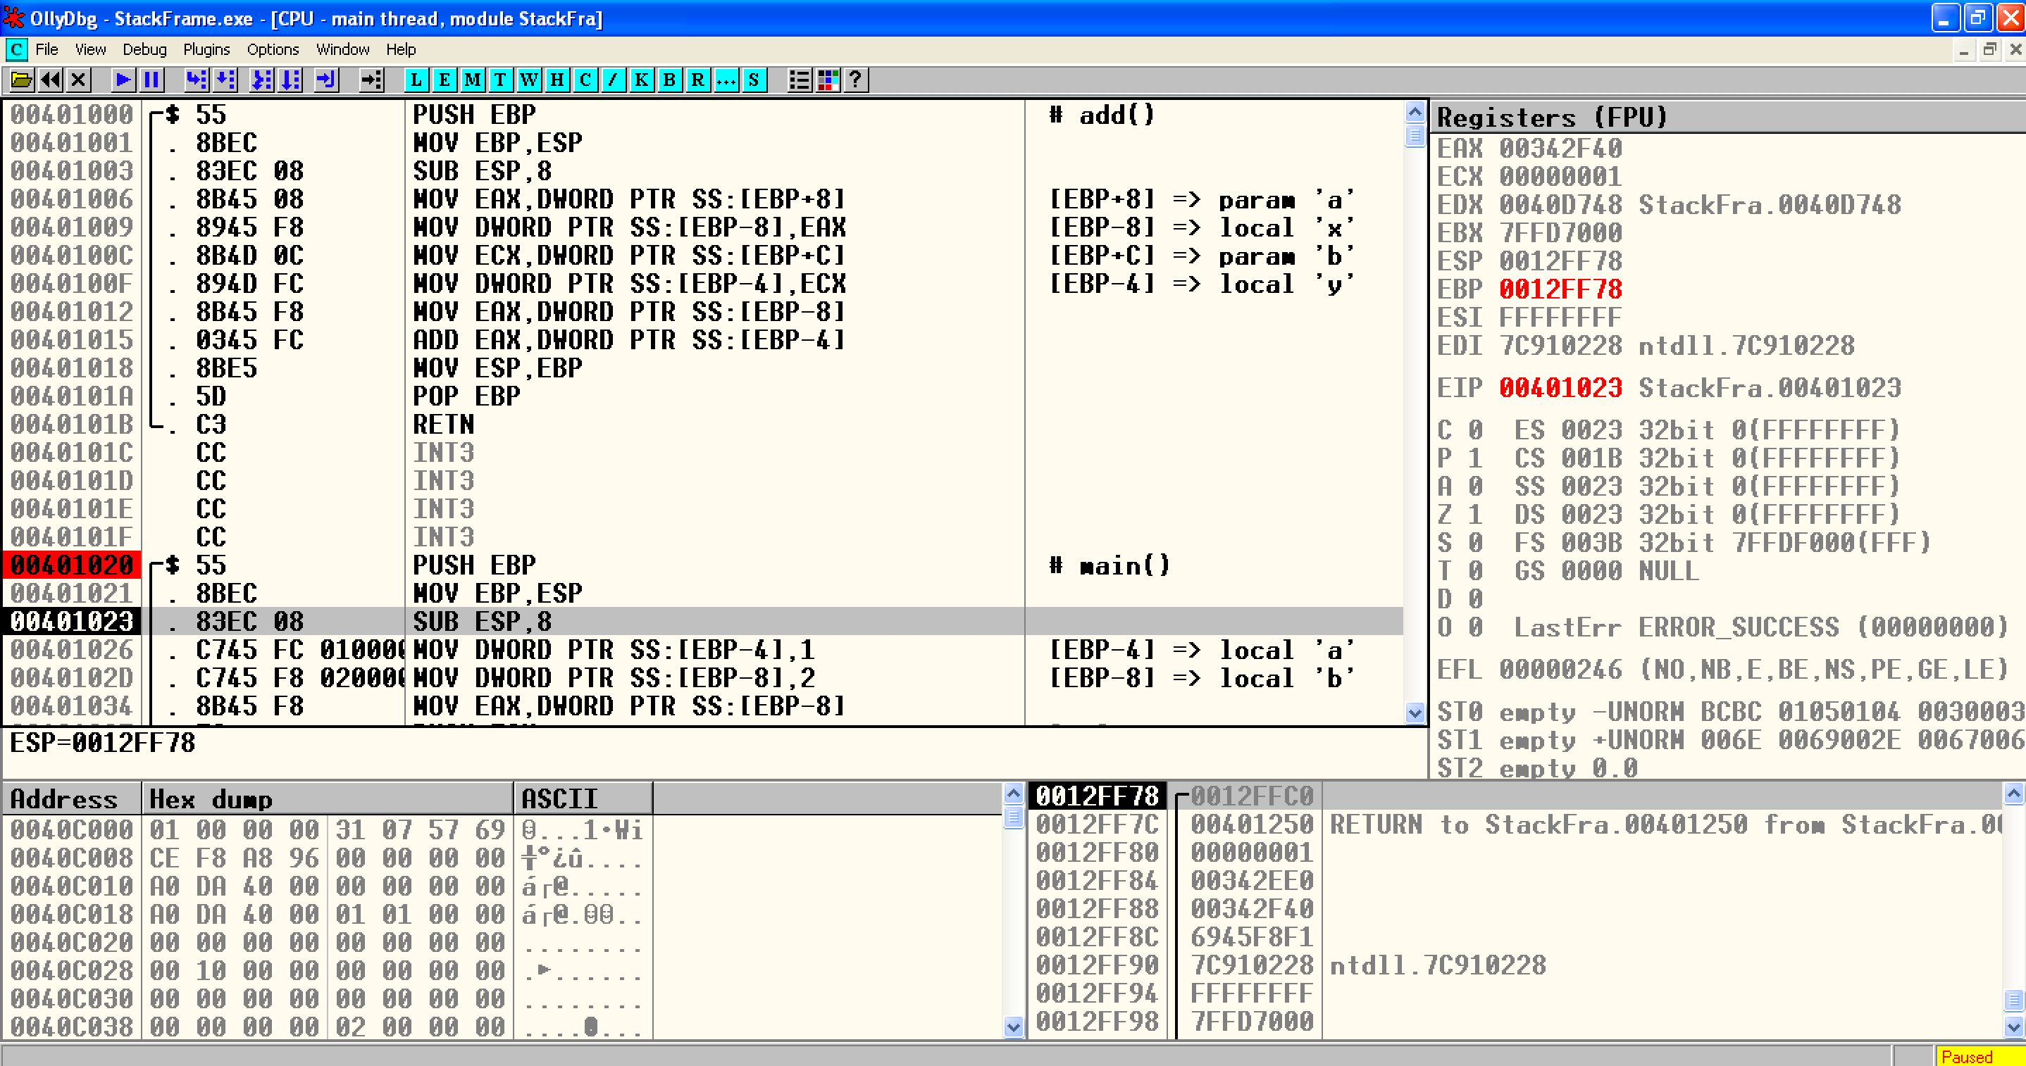
StackFrame.exe
Notes:
EBP
ESP 12FF78

Slide 22
StackFrame.exe

Slide 23
StackFrame.exe
Create space for ‘a’ and ‘b’ → long → 4 byte
Notes:
EBP
ESP 12FF78

Slide 24
StackFrame.exe
Create space for ‘a’ and ‘b’ → long → 4 byte
Notes:
EBP
ESP 12FF78

Slide 25
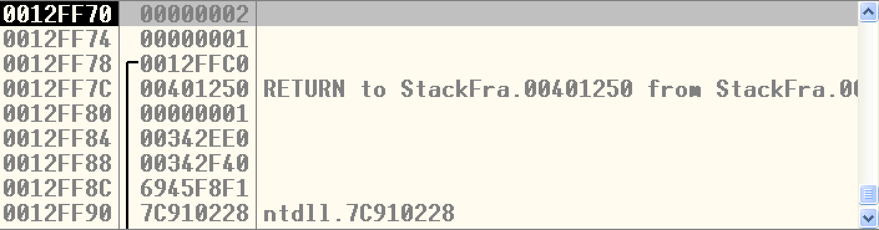
StackFrame.exe
Assembly | C | Type Conversion
DWORD PTR SS:[EBP-4] | *(DWORD*)(EBP-4) | DWORD (4 byte)
WORD PTR SS:[EBP-4] | *(WORD*)(EBP-4) | WORD (2 byte)
BYTE PTR SS:[EBP-4] | *(BYTE*)(EBP-4) | 1 byte
4 Byte memory space at address [EBP-4]

Slide 26
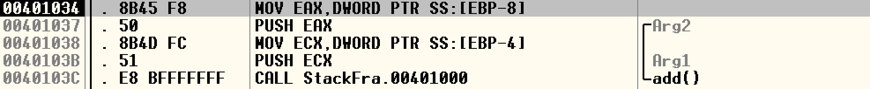
StackFrame.exe

Slide 27
StackFrame.exe

Slide 28
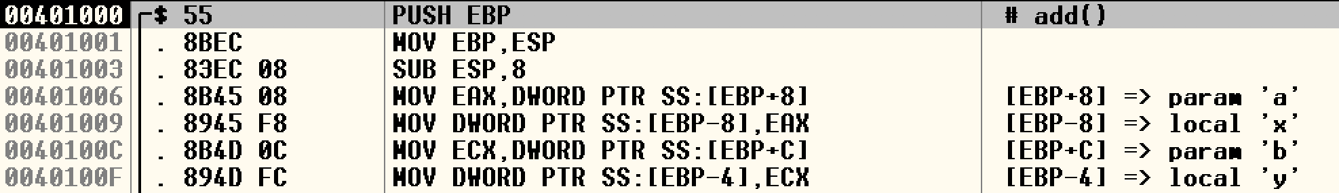
StackFrame.exe

Slide 29
StackFrame.exe

Slide 30
StackFrame.exe

Slide 31
StackFrame.exe
Clean Stack

Slide 32
StackFrame.exe
Clean Stack

Slide 33
StackFrame.exe

Slide 34
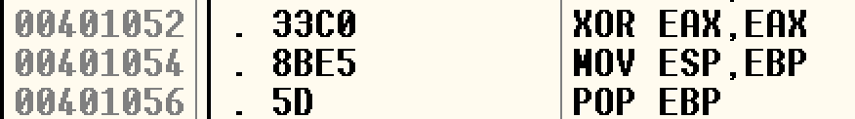
StackFrame.exe
Set EAX –> 0
Faster than
MOV EAX,0

Slide 35
Calling Convention

Slide 36
Two Questions
Q: When a function finished, how to handle the parameter left in the stack.
Q: When a function finished, how change the ESP value?
A: We don’t care…
A: ESP should be restored to the previous value

Slide 37
Standard C Calling Conventions
Calling conventions are a standardized method for functions to be implemented and called by the machine.
A calling convention specifies the method that a compiler sets up to access a subroutine.
There are three major calling conventions that are used with the C language on 32-bit x86 processors:
  CDECL
  STDCALL,
  FASTCALL.

Slide 38
  CDECL
The C language, by default, uses the CDECL calling convention
In the CDECL calling convention the following holds:
  Arguments are passed on the stack in Right-to-Left order, and return values are passed in eax.
  The calling function cleans the stack. This allows CDECL functions to have variable-length argument lists.

Slide 39
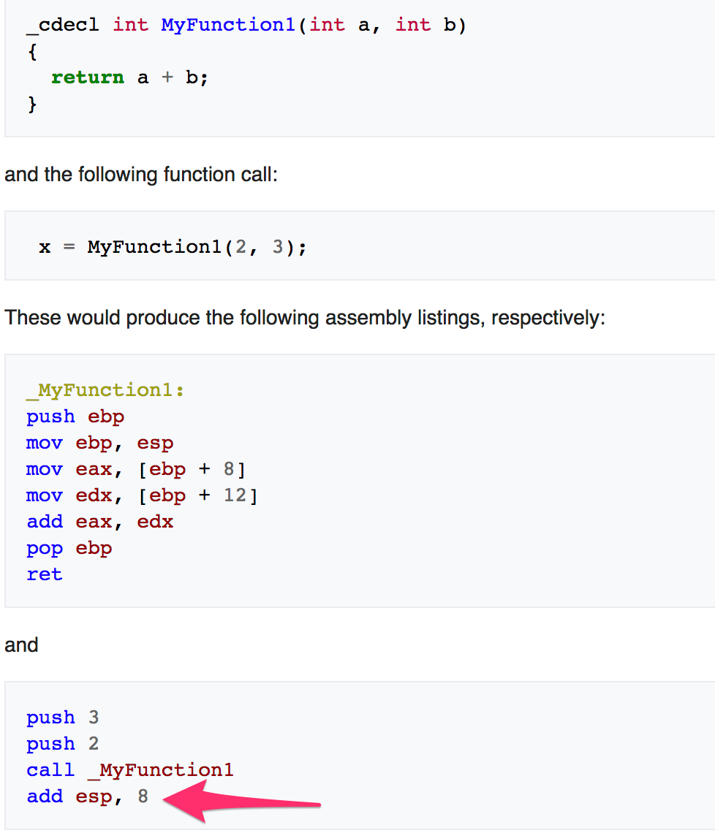
  STDCALL
The C language, by default, uses the CDECL calling convention
In the CDECL calling convention the following holds:
  Arguments are passed on the stack in Right-to-Left order, and return values are passed in eax.
  The calling function cleans the stack. This allows CDECL functions to have variable-length argument lists.

Slide 40
STDCALL
STDCALL, also known as "WINAPI" (and a few other names, depending on where you are reading it) is used almost exclusively by Microsoft as the standard calling convention for the Win32 API.
  STDCALL passes arguments right-to-left, and returns the value in eax.
  The called function cleans the stack, unlike CDECL. This means that STDCALL doesn't allow variable-length argument lists.

Slide 41
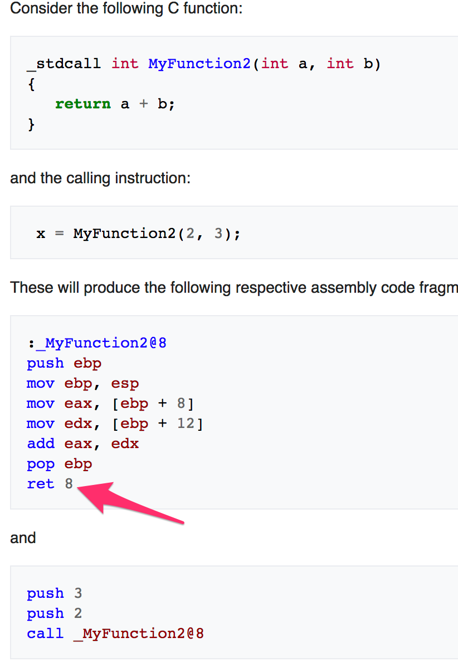
STDCALL
STDCALL, also known as "WINAPI" (and a few other names, depending on where you are reading it) is used almost exclusively by Microsoft as the standard calling convention for the Win32 API.
  STDCALL passes arguments right-to-left, and returns the value in eax.
  The called function cleans the stack, unlike CDECL. This means that STDCALL doesn't allow variable-length argument lists.
RET 8 ➔ RET + POP 8 Byte

Slide 42
FASTCALL
The FASTCALL calling convention is not completely standard across all compilers, so it should be used with caution.
The calling function most frequently is responsible for cleaning the stack, if needed.

Slide 43

Q & A

