Slide 1

Class8
CSC 497/583 Advanced Topics in Computer Security
Modern Malware Analysis
X86 ASM, Stack, Stack Frame
Si Chen (schen@wcupa.edu)

Slide 2
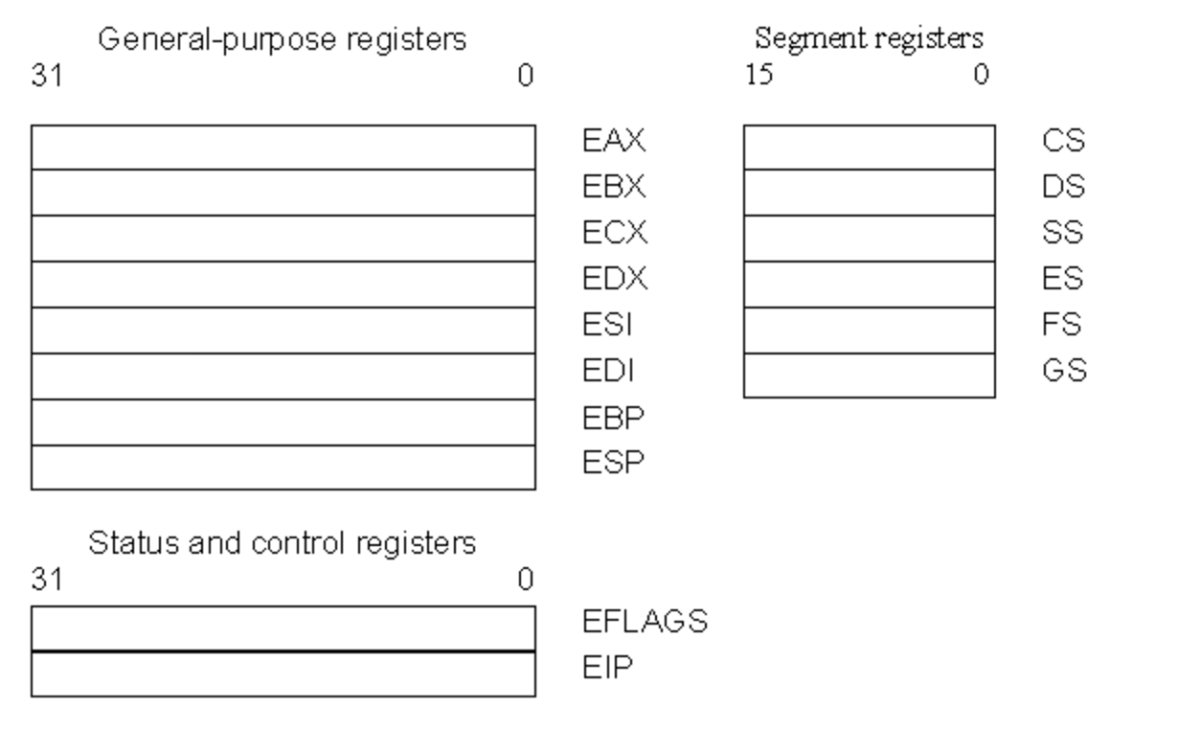
Register Set
There are three types of registers:
  general-purpose data registers,
  segment registers,
  status and control registers.

Slide 3
General-purpose data registers
The eight 32-bit general-purpose data registers are used to hold operands for logical and arithmetic operations, operands for address calculations and memory pointers
4 Bytes
Notes:
The following figure shows the lower 16 bits of the general-purpose registers can be used with the names AX, BX, CX, DX, BP, SP, SI, and DI (the names for the corresponding 32-bit ones have a prefix "E" for "extended"). Each of the lower two bytes of the EAX, EBX, ECX, and EDX registers can be referenced by the names AH, BH, CH, and DH (high bytes) and AL, BL, CL, and DL (low bytes).

Slide 4
## Register
+ `esp` `ebp` `esi` `edi` - DWORD 8 Byte (32-bit)
+ `sp` `bp` `si` `di` - WORD (16-bit) - rarely used
+ \[esp, ebp\] - mark the range of stack frame
## Other Register
+ `eip` - Program counter, pointing to the current line
+ `eflags` - cannot change the value directly, store the instruction result
+ `cs` `ss` `ds` `es` `fs` `gs` - segment register

Slide 5
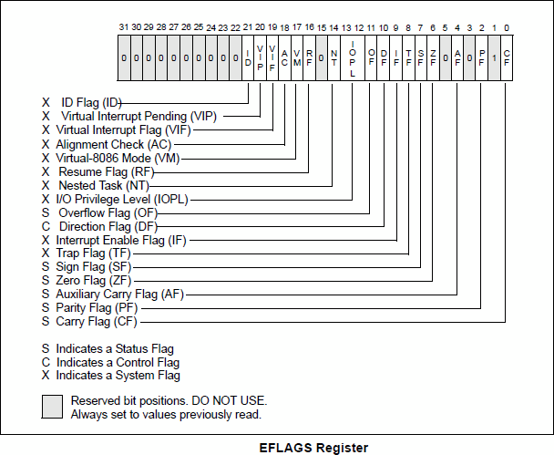
Status and Control Registers
Change to ‘1’ if:
Signed integer overflow
Change in MSB (Most Significant Bit)
Change to ‘1’ if:
Calculation result is 0
Change to ‘1’ if:
unsigned integer overflow

Slide 6
X86 ASM

Slide 7
MOV
Move reg/mem value to reg/mem
  mov A, B is "Move B to A" (A=B)
  mov eax, 0x42
  mov eax, ebx
  mov eax, [0x4038C4]
  mov eax, [ebx+esi*4]

Slide 8
ADD / SUB
ADD / SUB
Normally "reg += reg" or "reg += imm"
Data size should be equal
  add eax, ebx
  sub eax, 123
  sub eax, BL ; Illegal

Slide 9
INC / DEC
inc, dec — Increment, Decrement
The inc instruction increments the contents of its operand by one. The dec instruction decrements the contents of its operand by one.
Syntax
inc <reg>
inc <mem>
dec <reg>
dec <mem>
Examples
dec eax — subtract one from the contents of EAX.
inc DWORD PTR [var] — add one to the 32-bit integer stored at location var

Slide 10
CMP
cmp — Compare
Compare the values of the two specified operands, setting the condition codes in the machine status word appropriately.
Syntax
cmp <reg>,<reg>
cmp <reg>,<mem>
cmp <mem>,<reg>
cmp dst, src | ZF | CF
dst = src | 1 | 0
dst < src | 0 | 1
dst > src | 0 | 0

Slide 11
Jump
Unconditional jump: jmp
This is performed by the JMP instruction.
  Transfer of control may be forward, to execute a new set of instructions
  or backward, to re-execute the same steps.

Slide 12
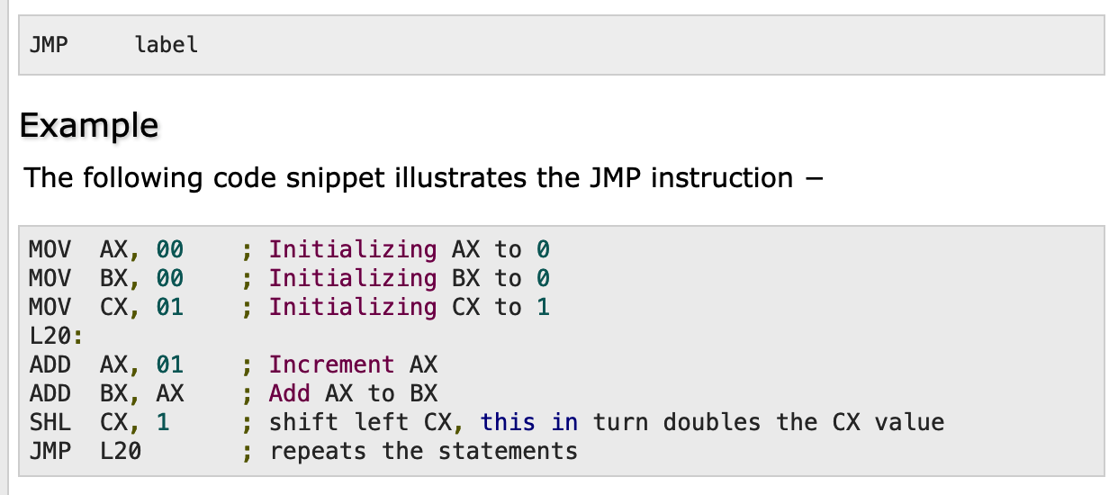
Jump

Slide 13
Jump
Conditional jump: je/jne
and ja/jae/jb/jbe/jg/jge/jl/jle ...
Sometime with ”cmp A, B” -- compare these two values and set eflags
Conditional jump is decided by some of the eflags bits.

Slide 14
Jump
ja/jae/jb/jbe are unsigned comparison
jg/jge/jl/jle are signed comparison

Slide 15
Assembly 101 Example: abexcm1-voiees.exe
Assembly 101 Example: abexcm1-voiees.exe
Open Assembly 101 Example: abexcm1-voiees.exe in your windows XP VM.
Use Ollydbg to open the file (Desktop/toys/abexcm1-voiees.exe)
  Dynamic Analysis

Slide 16
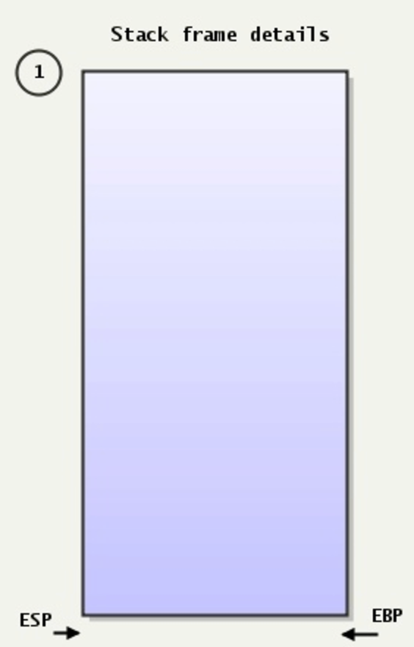
The Stack
Stack:
A special region of your computer's memory that stores temporary variables created by each functions
The stack is a "LIFO" (last in, first out) data structure
Once a stack variable is freed, that region of memory becomes available for other stack variables.
Top
12E00
Properties:
the stack grows and shrinks as functions push and pop local variables
there is no need to manage the memory yourself, variables are allocated and freed automatically
the stack has size limits
stack variables only exist while the function that created them, is running
PUSH
POP
EBP—Pointer to data on the stack ESP—Stack pointer
13000
Bottom

Slide 17
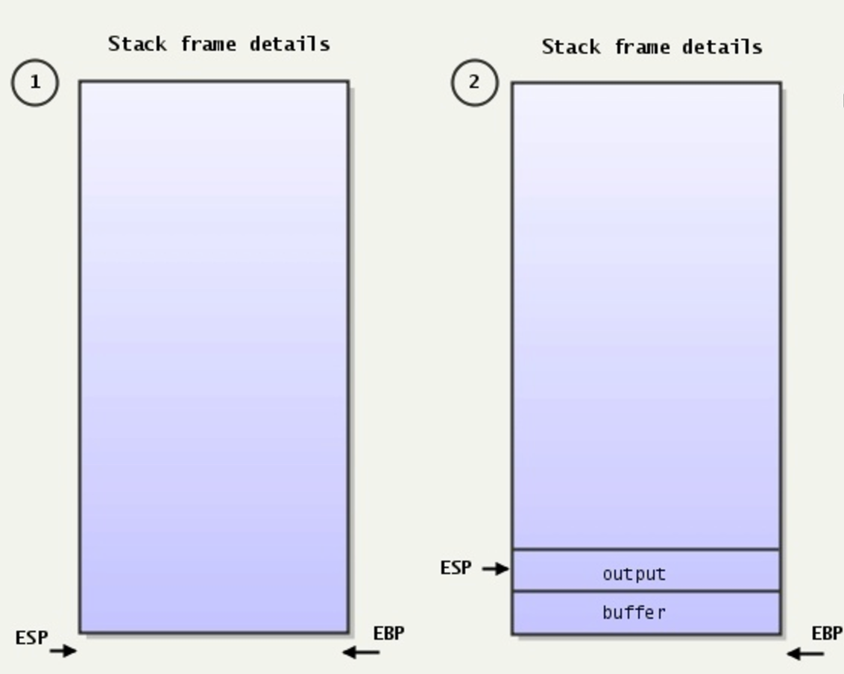
The Stack
Stack:
A special region of your computer's memory that stores temporary variables created by each functions
The stack is a "LIFO" (last in, first out) data structure
Once a stack variable is freed, that region of memory becomes available for other stack variables.

Slide 18
Stack Frame

Slide 19
Stack Frame
A stack frame is a frame of data that gets pushed onto the stack.
In the case of a call stack, a stack frame would represent a function call and its argument data.

Slide 20
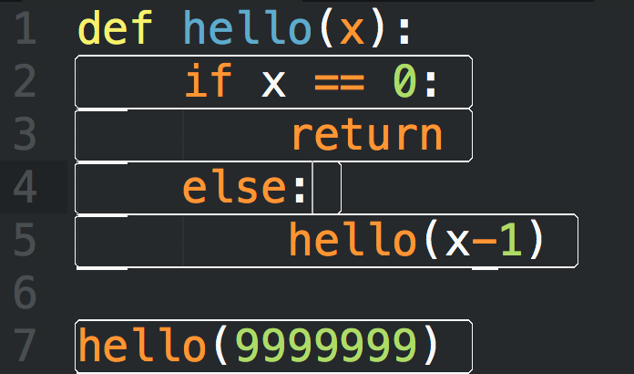
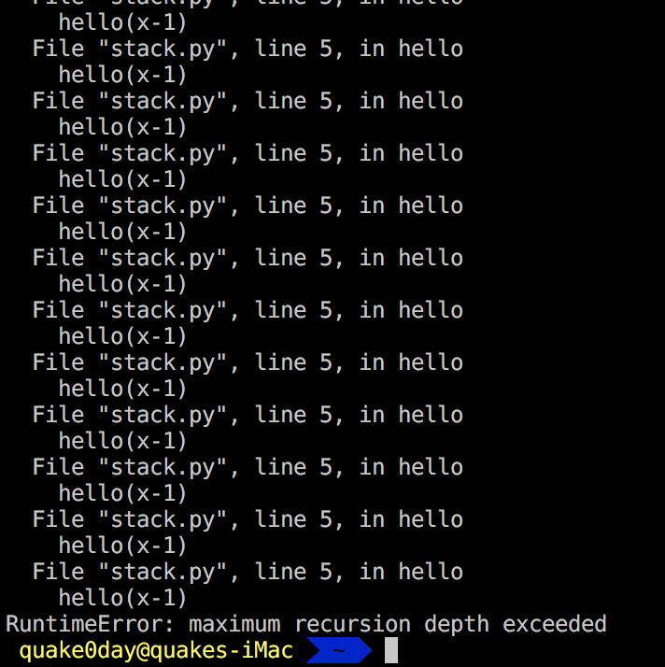
Stack Frame

Slide 21
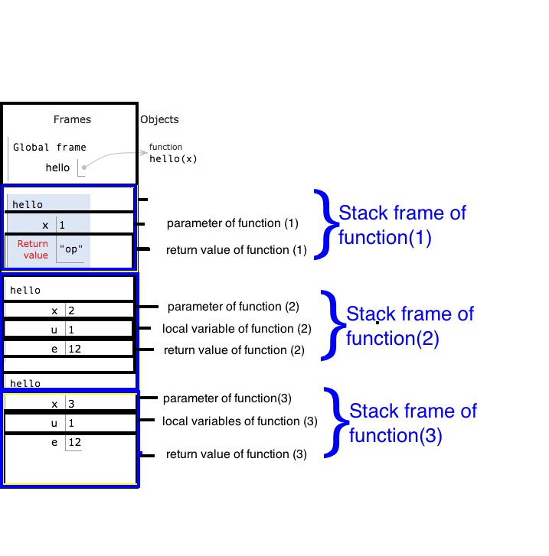
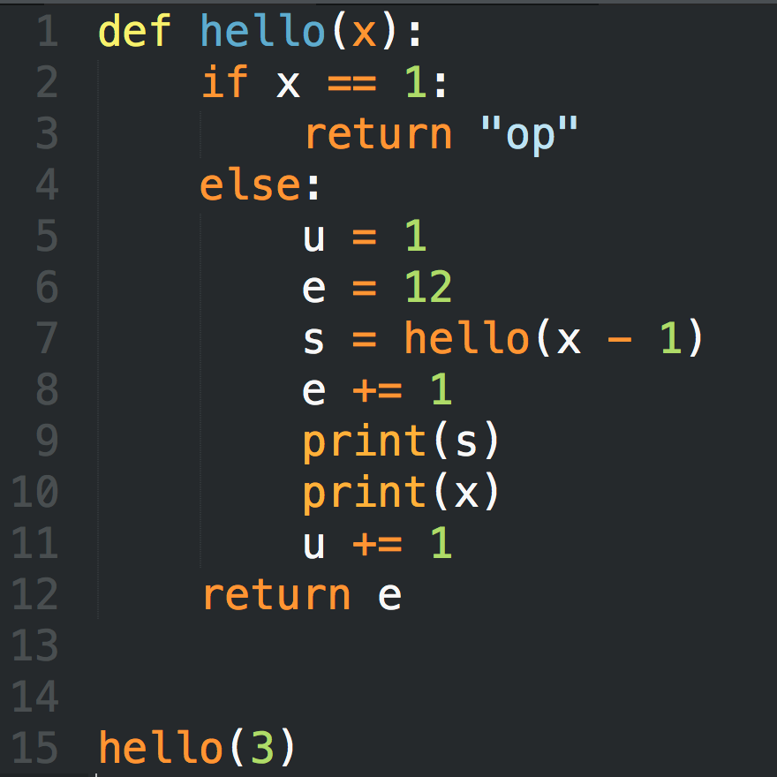
Stack Frame

Slide 22
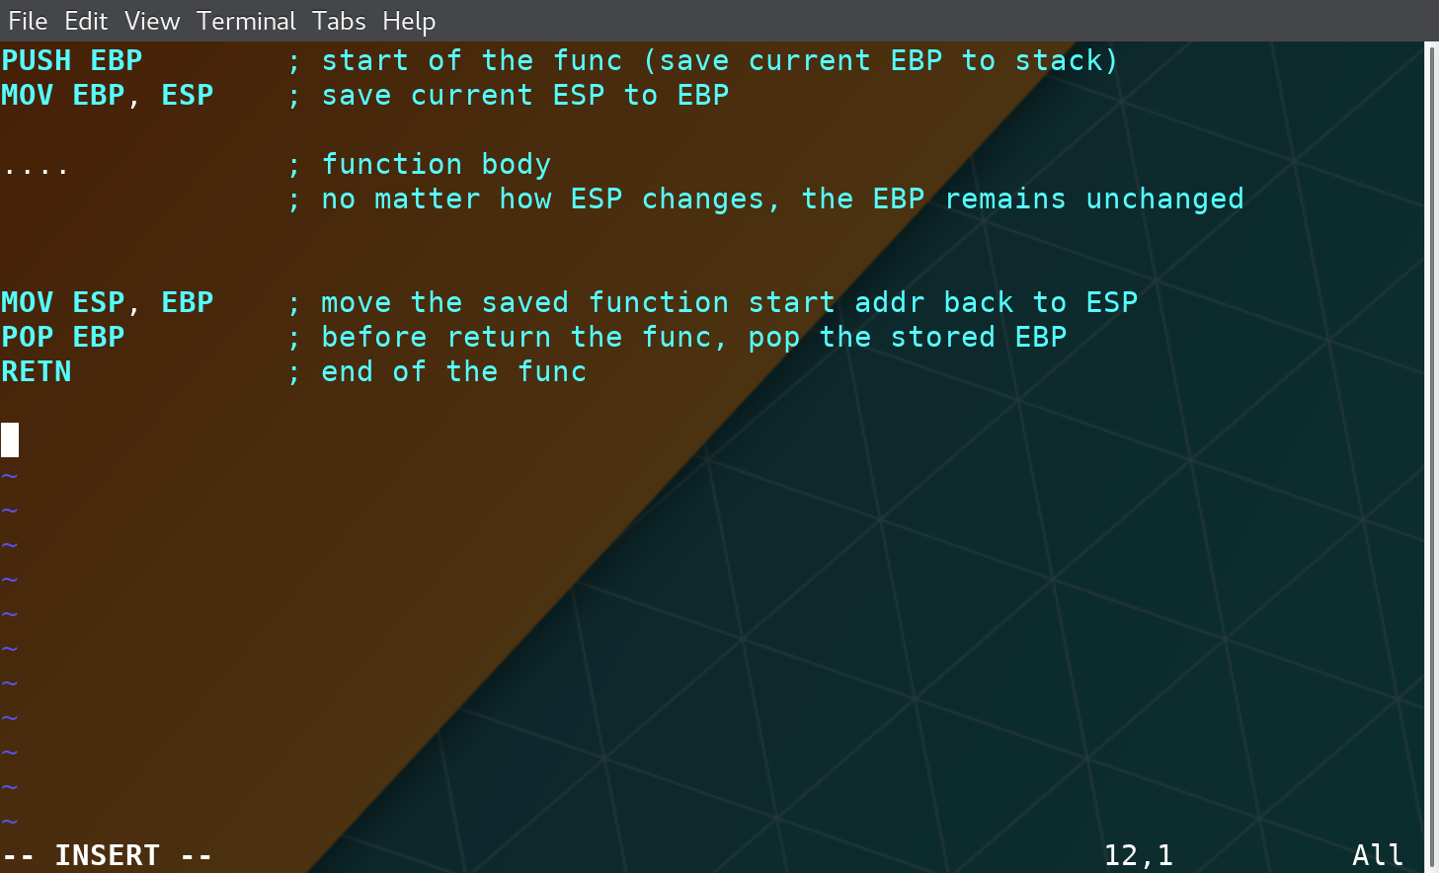
Stack Frame

Slide 23
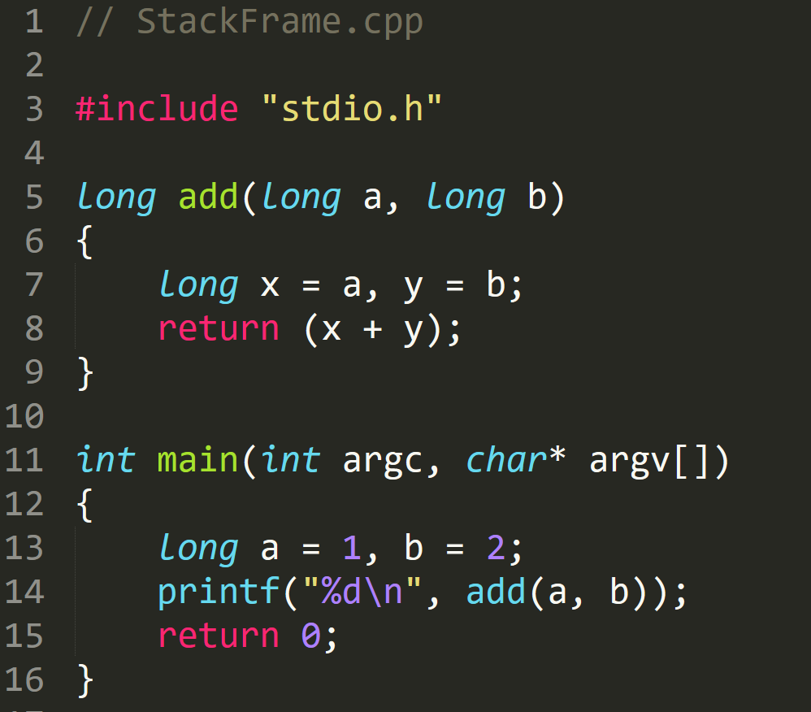
StackFrame.exe

Slide 24
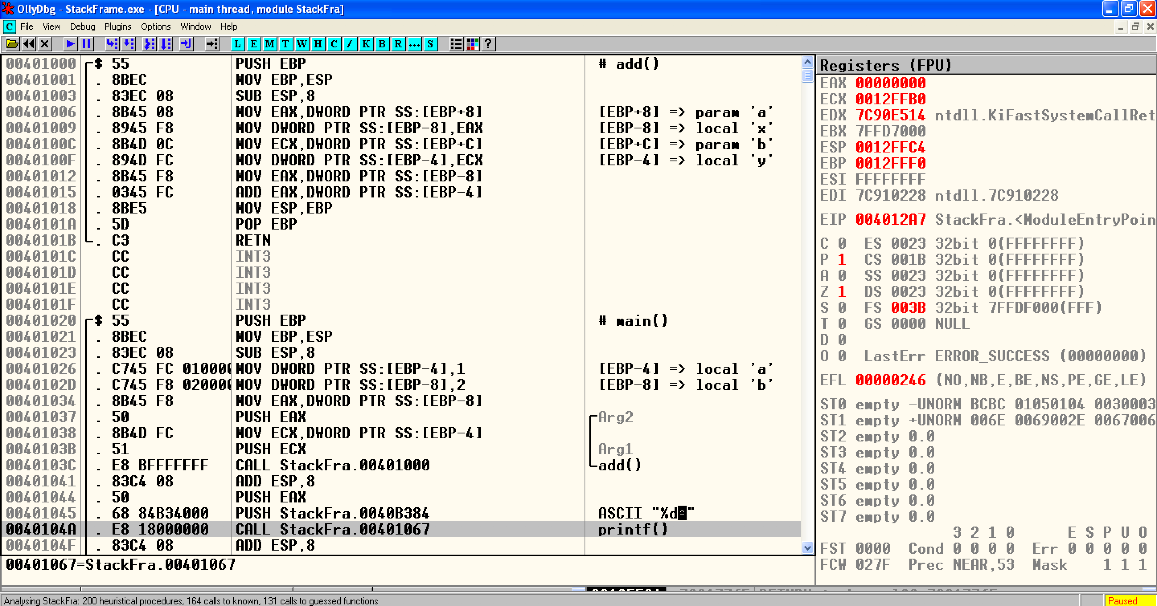
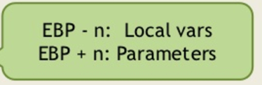
StackFrame.exe

Slide 25
StackFrame.exe

Slide 26
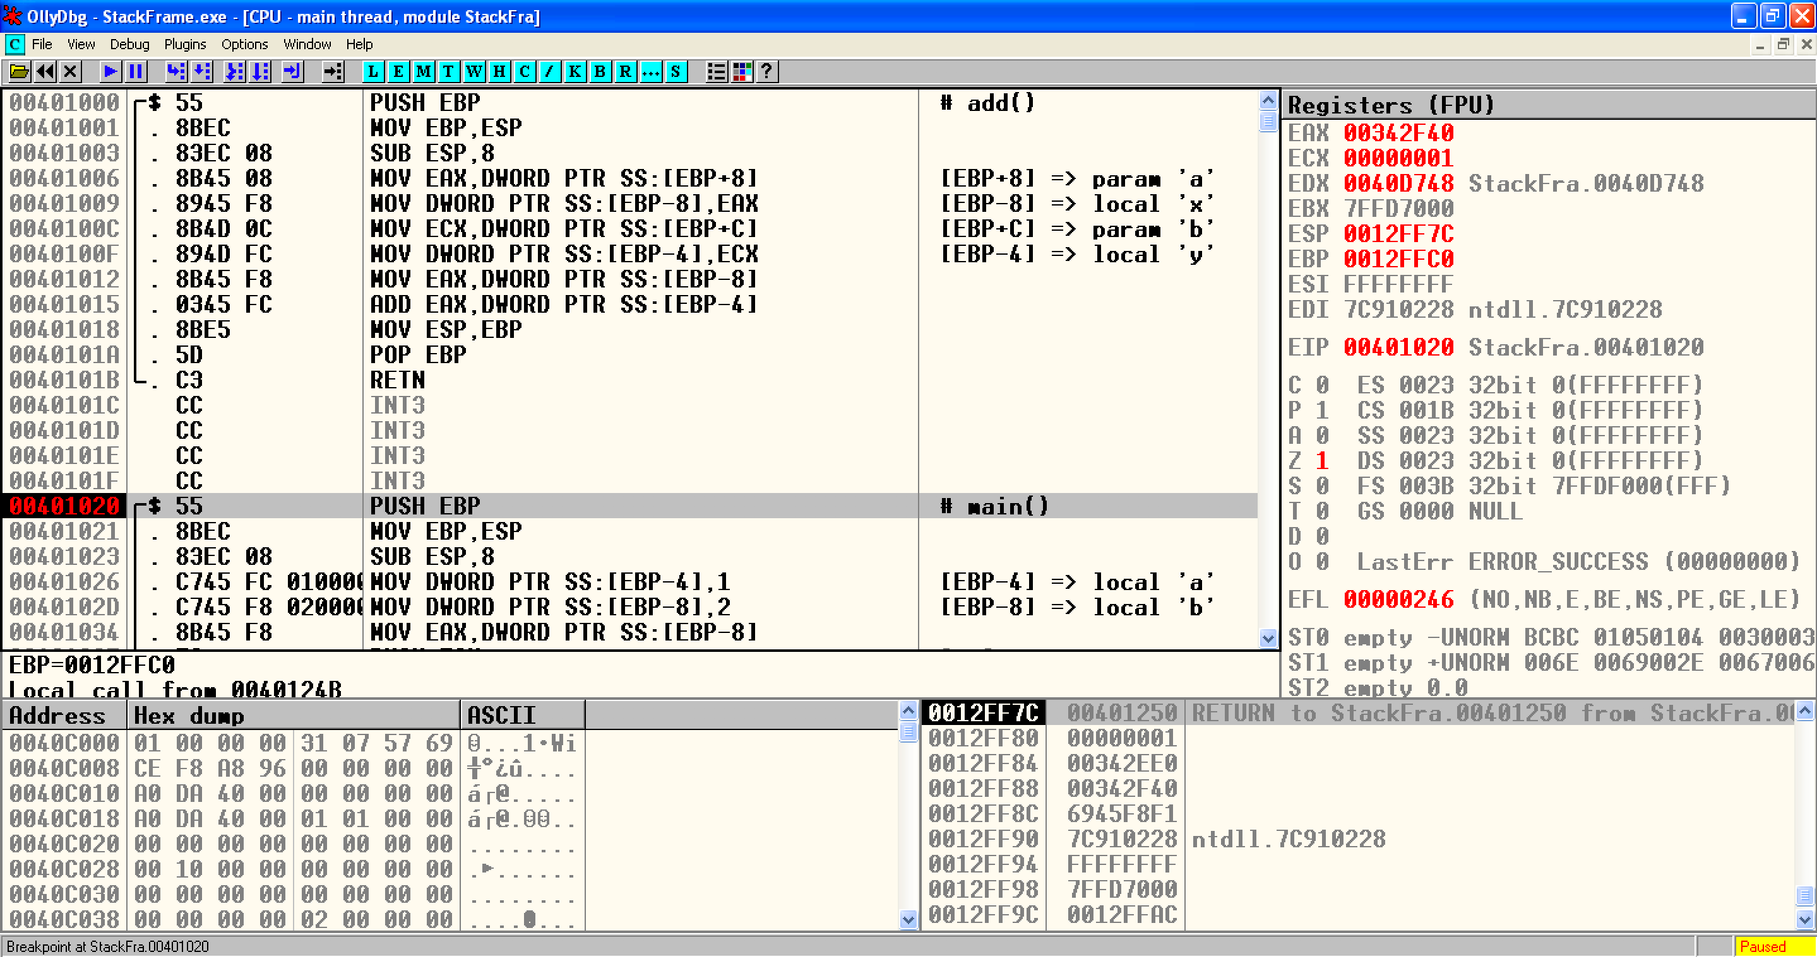
StackFrame.exe
Notes:
EBP 12FFC0
ESP 12FF7C

Slide 27
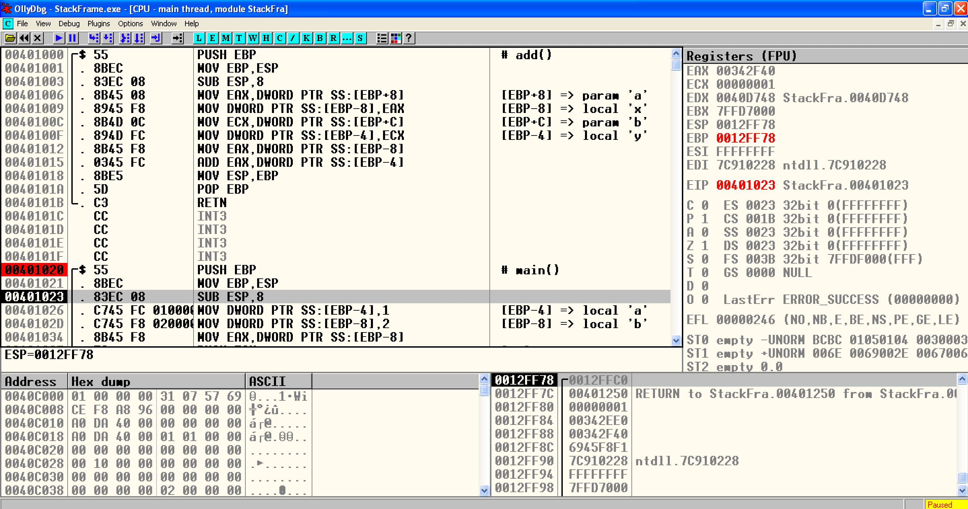
StackFrame.exe
Notes:
EBP
ESP 12FF78

Slide 28
StackFrame.exe

Slide 29
StackFrame.exe
Create space for ‘a’ and ‘b’ → long → 4 byte
Notes:
EBP
ESP 12FF78

Slide 30
StackFrame.exe
Create space for ‘a’ and ‘b’ → long → 4 byte
Notes:
EBP
ESP 12FF78

Slide 31
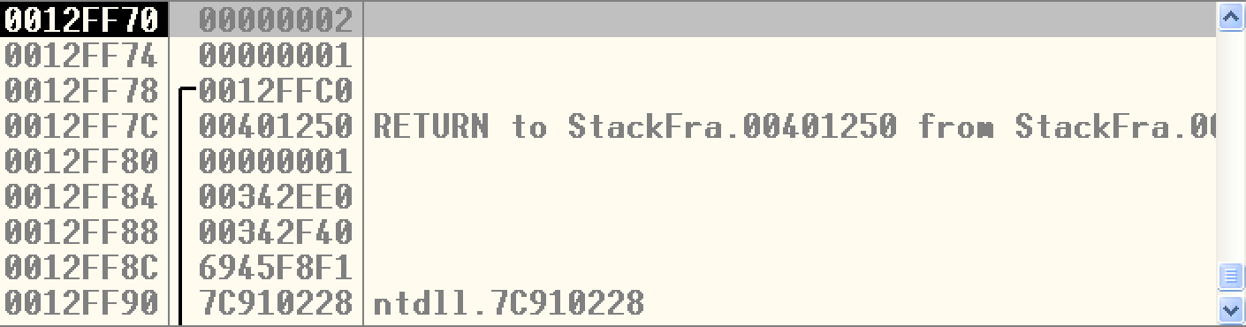
StackFrame.exe
Assembly | C | Type Conversion
DWORD PTR SS:[EBP-4] | *(DWORD*)(EBP-4) | DWORD (4 byte)
WORD PTR SS:[EBP-4] | *(WORD*)(EBP-4) | WORD (2 byte)
BYTE PTR SS:[EBP-4] | *(BYTE*)(EBP-4) | 1 byte
4 Byte memory space at address [EBP-4]

Slide 32
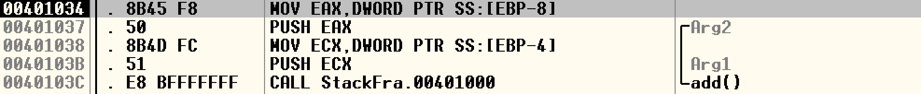
StackFrame.exe

Slide 33
StackFrame.exe

Slide 34
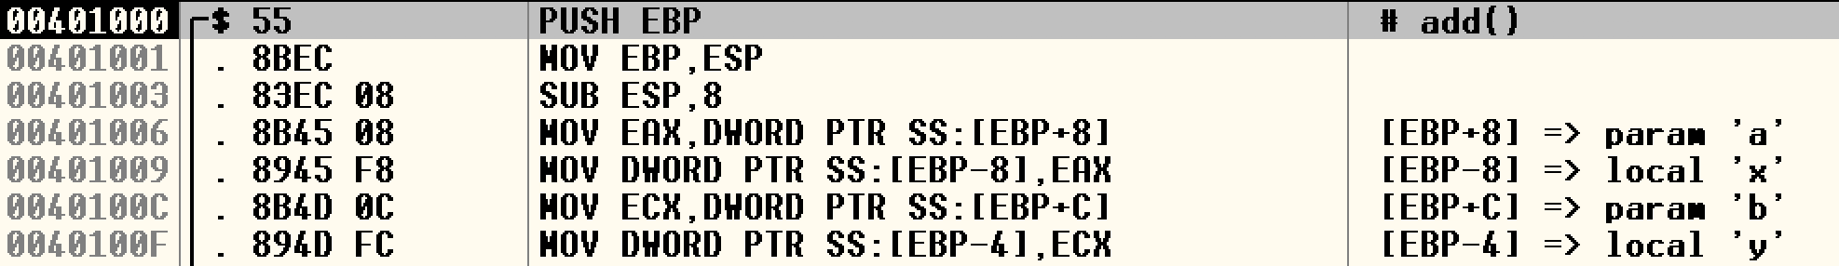
StackFrame.exe

Slide 35
StackFrame.exe

Slide 36
StackFrame.exe

Slide 37
StackFrame.exe
Clean Stack

Slide 38
StackFrame.exe
Clean Stack

Slide 39
StackFrame.exe

Slide 40
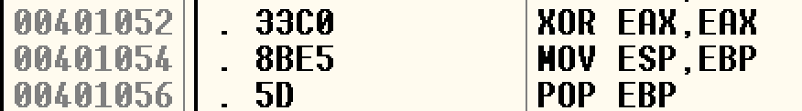
StackFrame.exe
Set EAX –> 0
Faster than
MOV EAX,0

Slide 41

Q & A

