Slide 1

Class7
CSC 497/583 Advanced Topics in Computer Security
Modern Malware Analysis
Assembly Language and Disassembly Primer
Si Chen (schen@wcupa.edu)

Slide 2
Introduction
Static analysis and dynamic analysis are great techniques to understand the basic functionality of malware, but these techniques do not provide all the required information regarding the malware’s functionality.
Malware authors write their malicious code in a high level language, such as C or C++, which is compile to an executable using a compiler.
You only have the malicious executable, without its source code during your investigation.
To gain deeper understanding of a malware’s inner workings and to understand the critical aspects of a malicious binary, assembly code analysis needs to be performed.

Slide 3
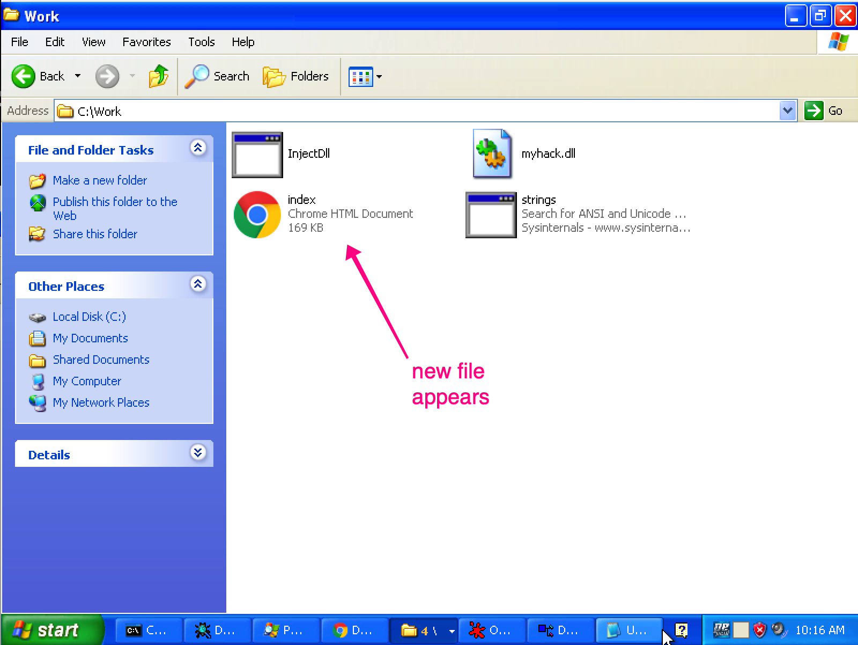
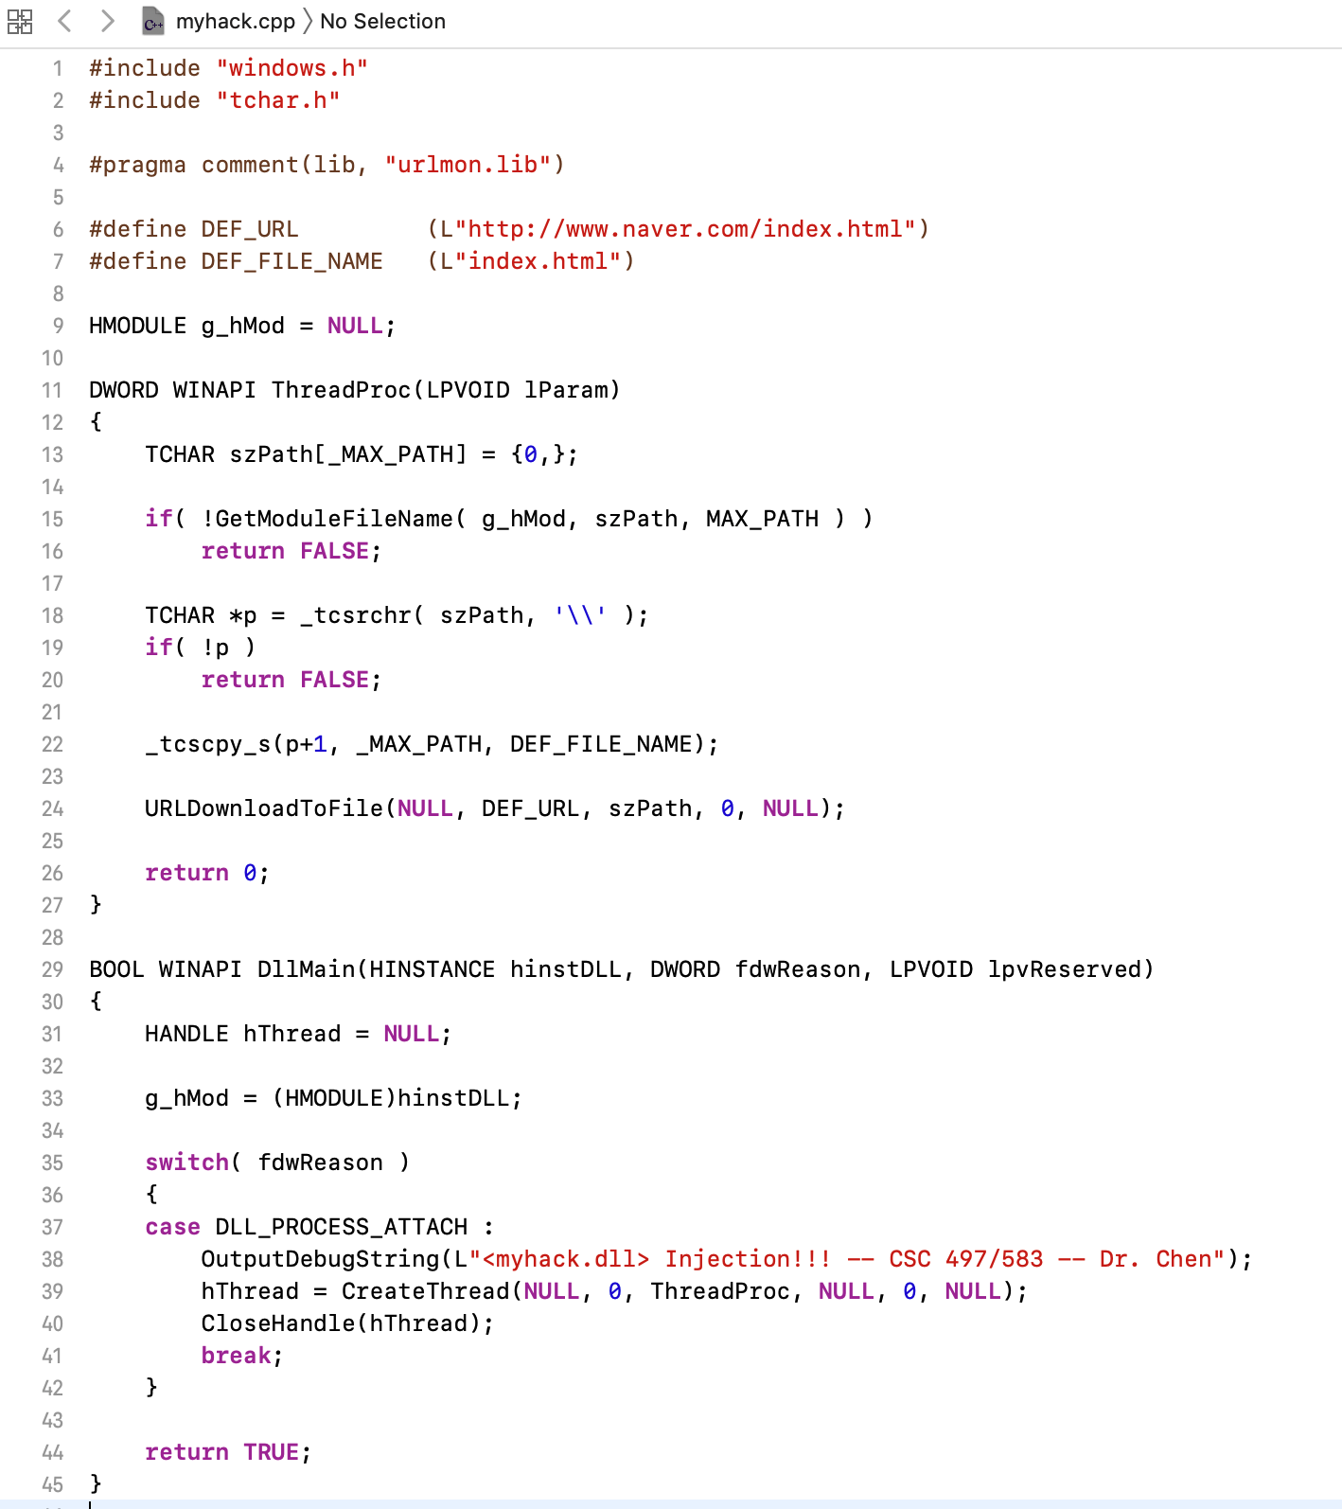
Introduction
executables
source code

Slide 4
Introduction
Is it possible to reconstruct high level code from executable directly?
It’s possible!
Not always working

Slide 5
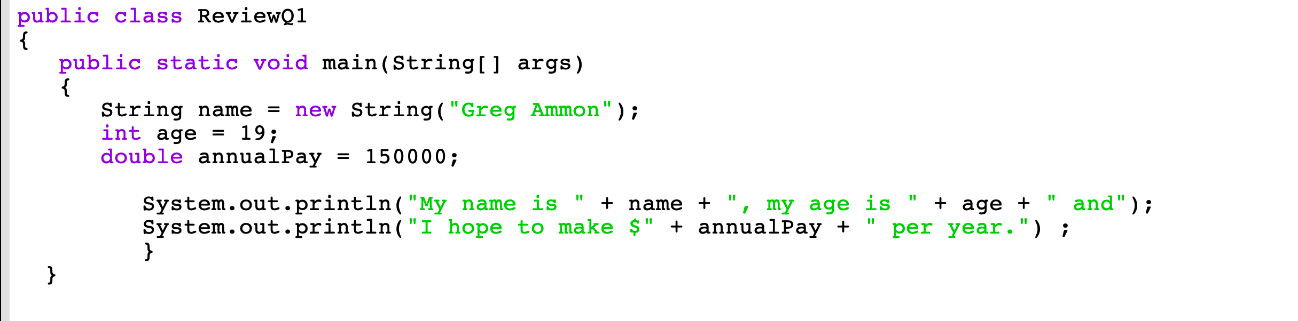
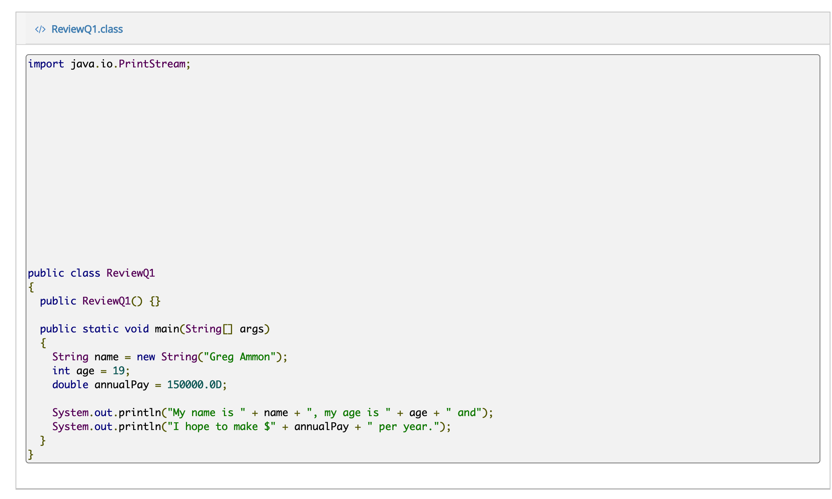
source code
decompile result

Slide 6
Introduction
decompile result

Slide 7
Overview
Computer basics, memory and the CPU
Data transfer, arithmetic, and bitwise operations
Functions and stack

Slide 8
Computer Basics
A group of 8 bits makes a byte
A single byte is represented as two hexadecimal digits
5D
0 | 1 | 0 | 1 | 1 | 1 | 0 | 1
5
D

Slide 9
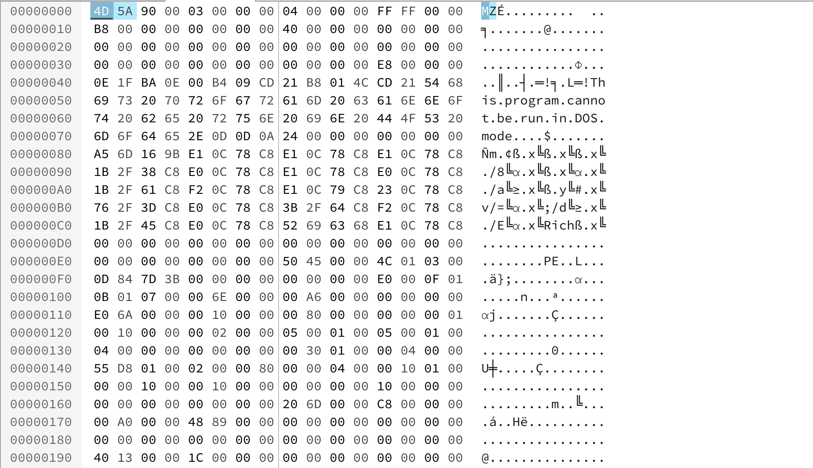
PE Example – Notepad.exe

Slide 10
RAM
The main memory (RAM) stores the code (machine code) and data for the computer.
A computer’s main memory is an array of bytes.
Each byte labeled with a unique number, known as address.
Address
0x10F1009
0x10F1008
0x10F1007
0x10F1006
0x10F1005
0x10F1004
0x10F1003
Data in Memory
45
FC
00
30
0F
01
51

Slide 11
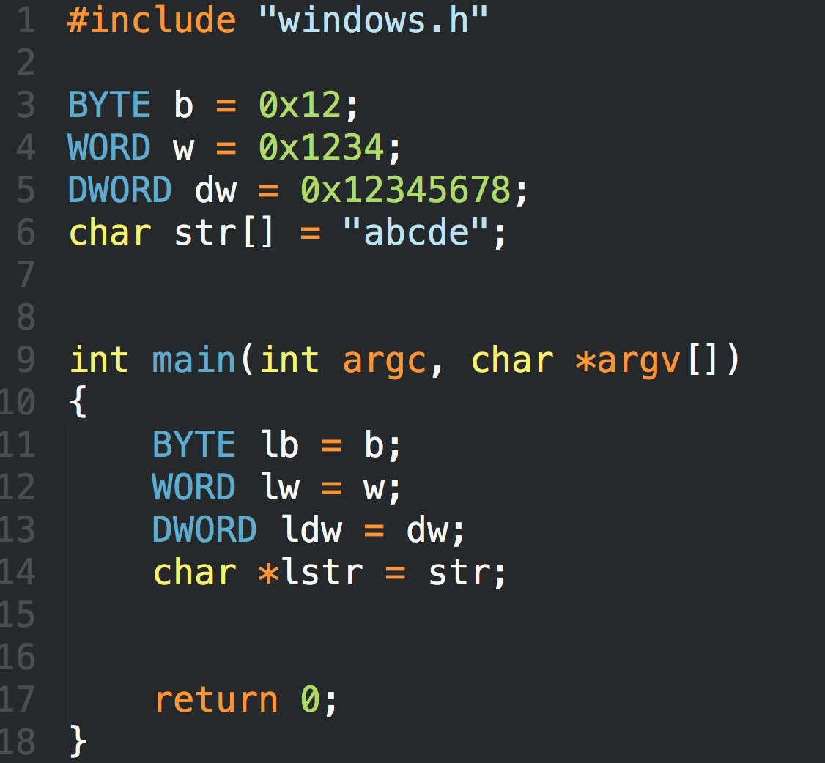
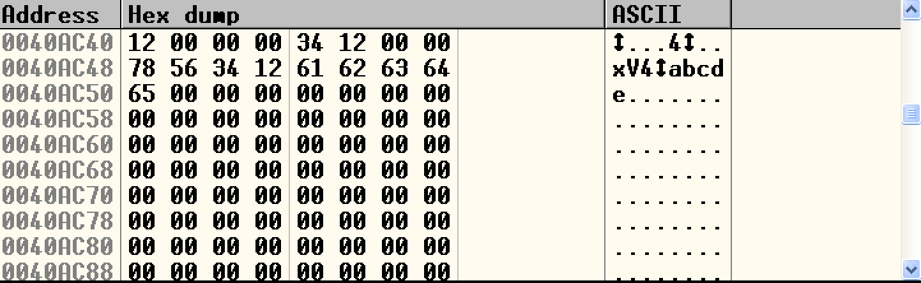
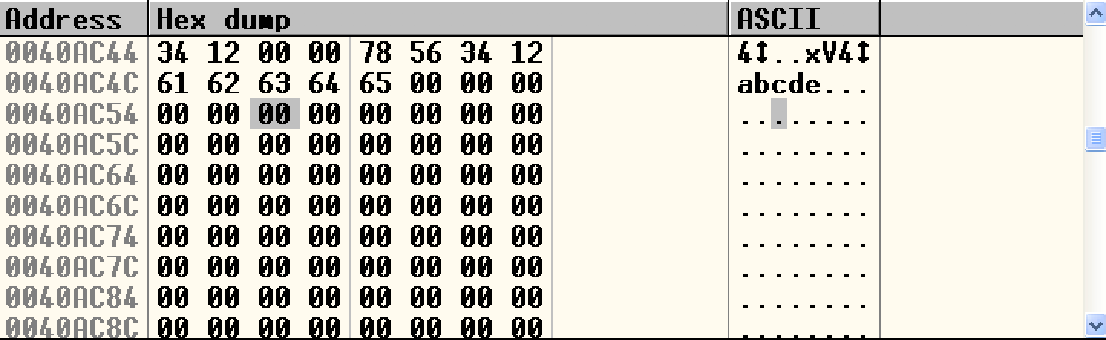
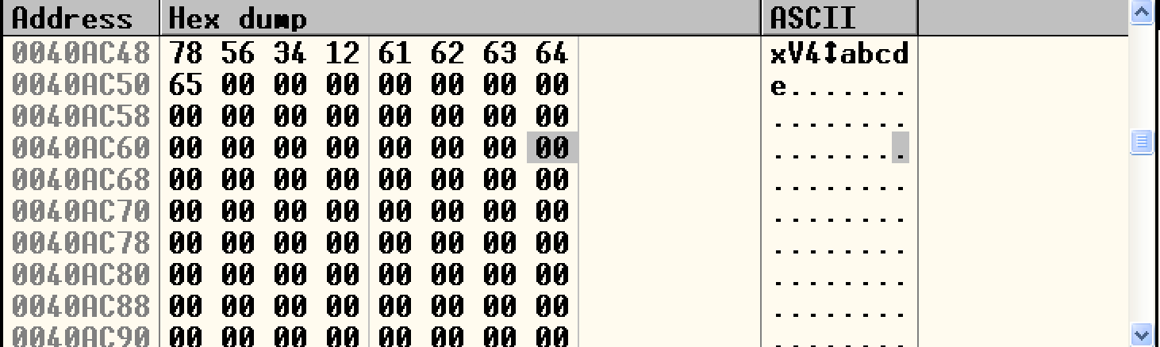
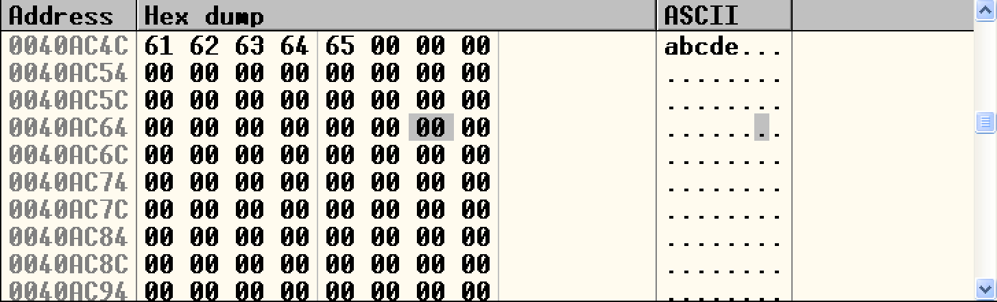
LittleEndian.exe

Slide 12
Program Basics
Program on disk

Slide 13
Program Basics
Program on disk

Slide 14
Program Basics
Memory
low memory
addr
Program in memory
high memory
addr

Slide 15
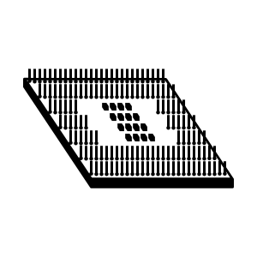
Program Basics
Memory
CPU
low memory
addr
high memory
addr
The CPU fetches the machine instruction, decodes it, and executes it
The CPU fetches the required data from memory, the data can also be written to the memory

Slide 16
IA-32 Register

Slide 17
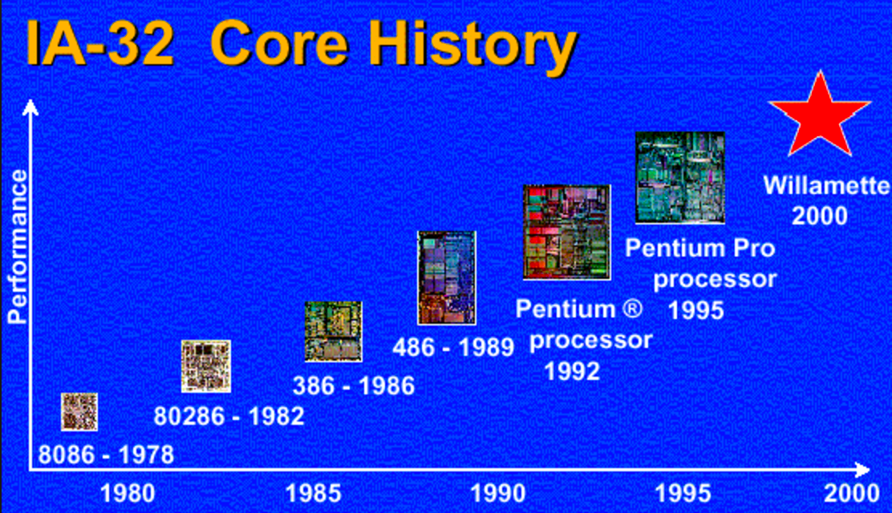
Intel IA-32 Processor
Intel uses IA-32 to refer to Pentium processor family, in order to distinguish them from their 64-bit architectures.

Slide 18
CPU Registers
The CPU contains special storage called registers.
The CPU can access data in registers much faster than data in memory

Slide 19
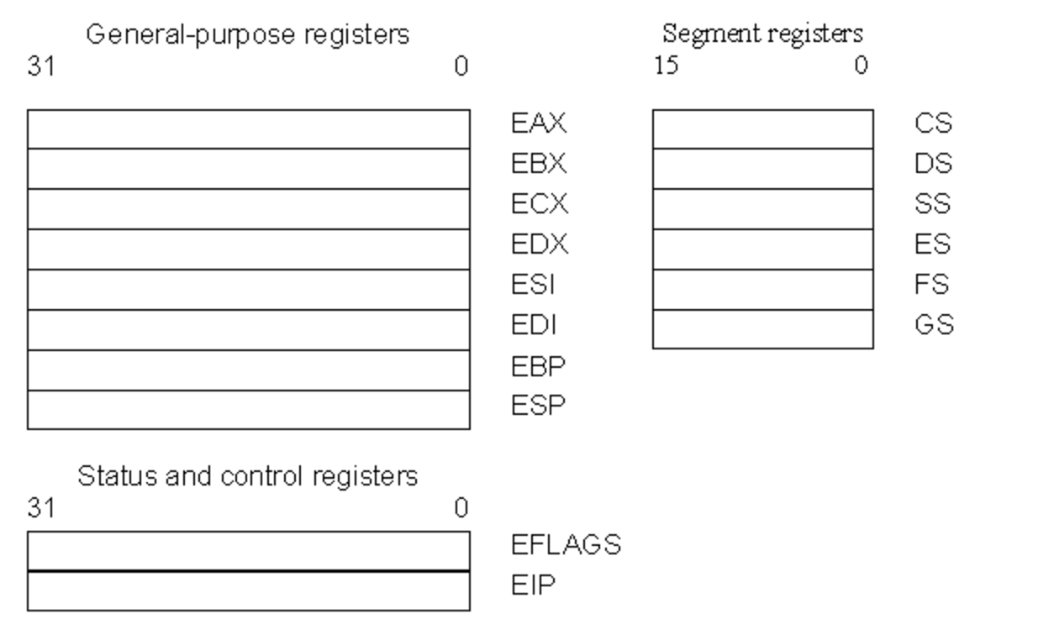
Register Set
There are three types of registers:
  general-purpose data registers,
  segment registers,
  status and control registers.

Slide 20
General-purpose Registers
The eight 32-bit general-purpose data registers are used to hold operands for logical and arithmetic operations, operands for address calculations and memory pointers
4 Bytes
Notes:
The following figure shows the lower 16 bits of the general-purpose registers can be used with the names AX, BX, CX, DX, BP, SP, SI, and DI (the names for the corresponding 32-bit ones have a prefix "E" for "extended"). Each of the lower two bytes of the EAX, EBX, ECX, and EDX registers can be referenced by the names AH, BH, CH, and DH (high bytes) and AL, BL, CL, and DL (low bytes).

Slide 21
Other uses…
  EAX—Accumulator for operands and results data.
  EBX—Pointer to data in the DS segment.
  ECX—Counter for string and loop operations.
  EDX—I/O pointer.
We use these four registers when we perform arithmetic operations (ADD, SUB, XOR, OR) -- store constant or variable’s value.
Some assembly operations (MUL, DIV, LODS) directly operate these register and altered the value when finished.
ECX is used for loop count → decrease 1 after each loop
EAX is used for storing the return value of a function (Win32 API)

Slide 22
Other uses…
ESI—Pointer to data in the segment pointed to by the DS register; source pointer for string operations.
EDI—Pointer to data (or destination) in the segment pointed to by the ES register; destination pointer for string operations.
EBP—Pointer to data on the stack.
ESP—Stack pointer.
PUSH, POP, CALL, RET

Slide 23
Segment Registers

Slide 24
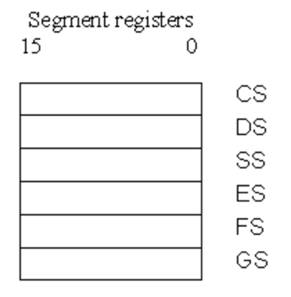
Segment Registers
What is “Segment”??
  Segments are specific areas defined in a program for containing data, code and stack. There are three main segments −
    Code Segment − It contains all the instructions to be executed. A 16-bit Code Segment register or CS register stores the starting address of the code segment.
    Data Segment − It contains data, constants and work areas. A 16-bit Data Segment register or DS register stores the starting address of the data segment.
    Stack Segment − It contains data and return addresses of procedures or subroutines. It is implemented as a 'stack' data structure. The Stack Segment register or SS register stores the starting address of the stack.
there are other extra segment registers - ES (extra segment), FS and GS, which provide additional segments for storing data.

Slide 25

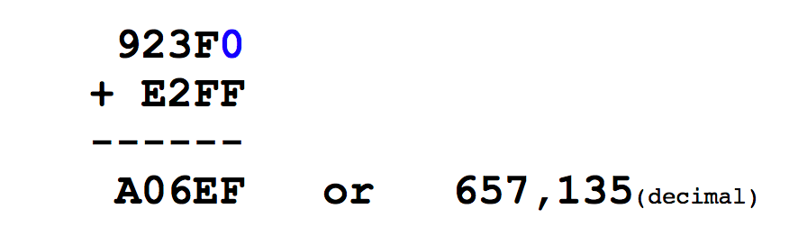
Segment Registers
    Physical Address = [Segment Register] * 16 + Offset

Slide 26
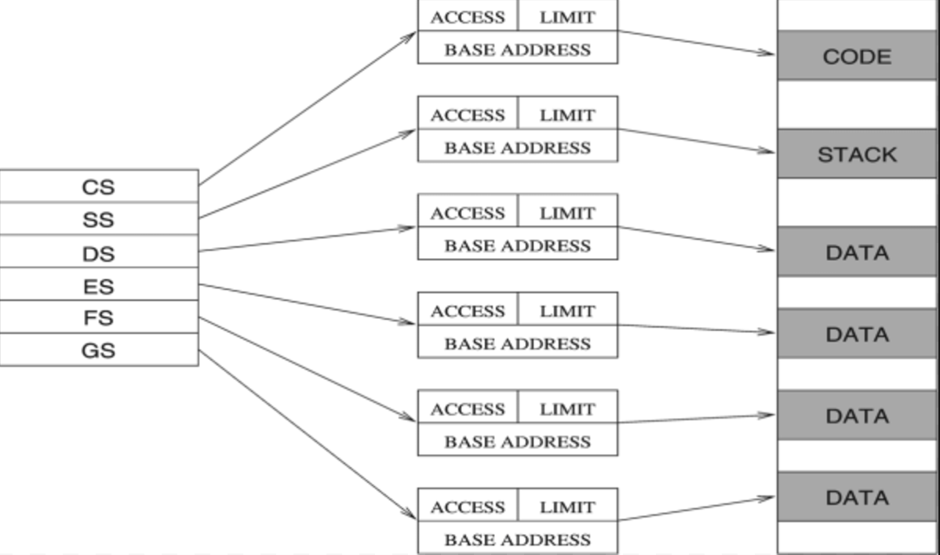
Segment Registers
There are six segment registers that hold 16-bit segment selectors. A segment selector is a special pointer that identifies a segment in memory.
  CS: code segment register
  SS: stack segment register
  DS, ES, FS, GS: data segment registers

Slide 27
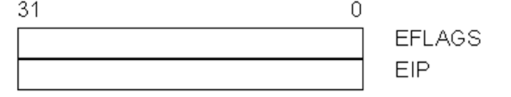
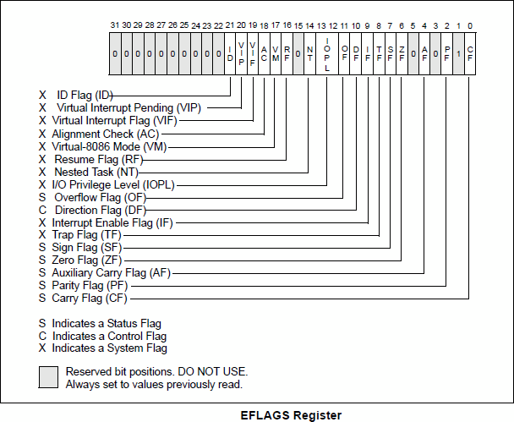
  Status and Control Registers
The 32-bit EFLAGS register contains a group of status flags, a control flag, and a group of system flags.
JCC

Slide 28
Status and Control Registers
Change to ‘1’ if:
Signed integer overflow
Change in MSB (Most Significant Bit)
Change to ‘1’ if:
Calculation result is 0
Change to ‘1’ if:
unsigned integer overflow

Slide 29
  Status and Control Registers
EIP Register (Instruction Pointer)
The EIP register (or instruction pointer) can also be called "program counter."
It contains the offset in the current code segment for the next instruction to be executed.
It is advanced from one instruction boundary to the next in straight-line code or it is moved ahead or backwards by a number of instructions when executing JMP, Jcc, CALL, RET, and IRET instructions.

Slide 30
X86 ASM

Slide 31
MOV
Move reg/mem value to reg/mem
  mov A, B is "Move B to A" (A=B)
  Same data size
  mov eax, 0x1337
  mov bx, ax
  mov [esp+4], bl

Slide 32
More About Memory Access
mov ebx, [esp + eax * 4] Intel
mov (%esp, %eax, 4), %ebx AT&T
mov BYTE [eax], 0x0f
You must indicate the data size: BYTE/WORD/DWORD

Slide 33
ADD / SUB
ADD / SUB
Normallly "reg += reg" or "reg += imm"
Data size should be equal
  add eax, ebx
  sub eax, 123
  sub eax, BL ; Illegal

Slide 34
INC / DEC
inc, dec — Increment, Decrement
The inc instruction increments the contents of its operand by one. The dec instruction decrements the contents of its operand by one.
Syntax
inc <reg>
inc <mem>
dec <reg>
dec <mem>
Examples
dec eax — subtract one from the contents of EAX.
inc DWORD PTR [var] — add one to the 32-bit integer stored at location var

Slide 35
Jump
Unconditional jump: jmp
Conditional jump: je/jne
and ja/jae/jb/jbe/jg/jge/jl/jle ...
Sometime with ”cmp A, B” -- compare these two values and set eflags
Conditional jump is decided by some of the eflags bits.

Slide 36
Jump
ja/jae/jb/jbe are unsigned comparison
jg/jge/jl/jle are signed comparison

Slide 37
CMP
cmp — Compare
Compare the values of the two specified operands, setting the condition codes in the machine status word appropriately. This instruction is equivalent to the sub instruction, except the result of the subtraction is discarded instead of replacing the first operand. Syntax
cmp <reg>,<reg>
cmp <reg>,<mem>
cmp <mem>,<reg>
cmp <reg>,<con>
Example
cmp DWORD PTR [var], 10
jeq loop
If the 4 bytes stored at location var are equal to the 4-byte integer constant 10, jump to the location labeled loop.

Slide 38
The Stack

Slide 39
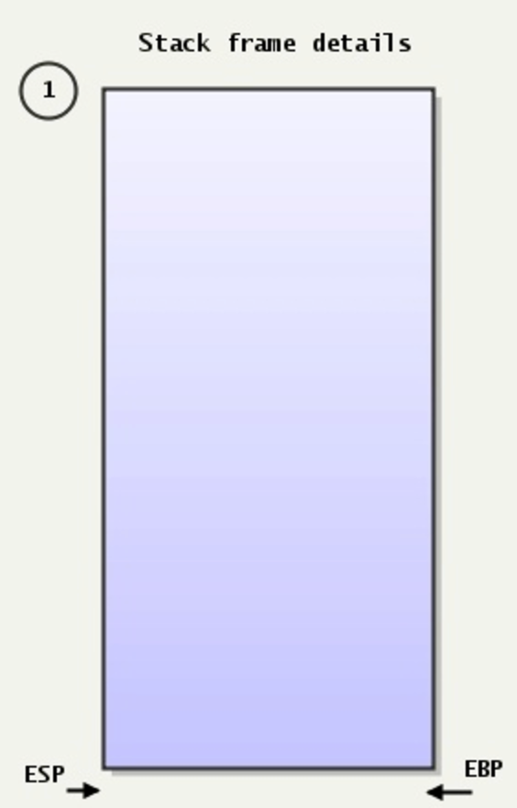
The Stack
Stack:
A special region of your computer's memory that stores temporary variables created by each functions
The stack is a "LIFO" (last in, first out) data structure
Once a stack variable is freed, that region of memory becomes available for other stack variables.
Top
12E000
Properties:
the stack grows and shrinks as functions push and pop local variables
there is no need to manage the memory yourself, variables are allocated and freed automatically
the stack has size limits
stack variables only exist while the function that created them, is running
PUSH
POP
EBP—Pointer to data on the stack ESP—Stack pointer
13000
Bottom

Slide 40
PUSH
push — Push stack (Opcodes: FF, 89, 8A, 8B, 8C, 8E, ...)
The push instruction places its operand onto the top of the hardware supported stack in memory. Specifically, push first decrements ESP by 4, then places its operand into the contents of the 32-bit location at address [ESP]. ESP (the stack pointer) is decremented by push since the x86 stack grows down - i.e. the stack grows from high addresses to lower addresses.
Syntax
push <reg32>
push <mem>
push <con32>Examples
push eax — push eax on the stack
push [var] — push the 4 bytes at address var onto the stack

Slide 41
POP
pop — Pop stack
The pop instruction removes the 4-byte data element from the top of the hardware-supported stack into the specified operand (i.e. register or memory location). It first moves the 4 bytes located at memory location [SP] into the specified register or memory location, and then increments SP by 4.Syntax
pop <reg32>
pop <mem>
Examples
pop edi — pop the top element of the stack into EDI.
pop [ebx] — pop the top element of the stack into memory at the four bytes starting at location EBX.

Slide 42
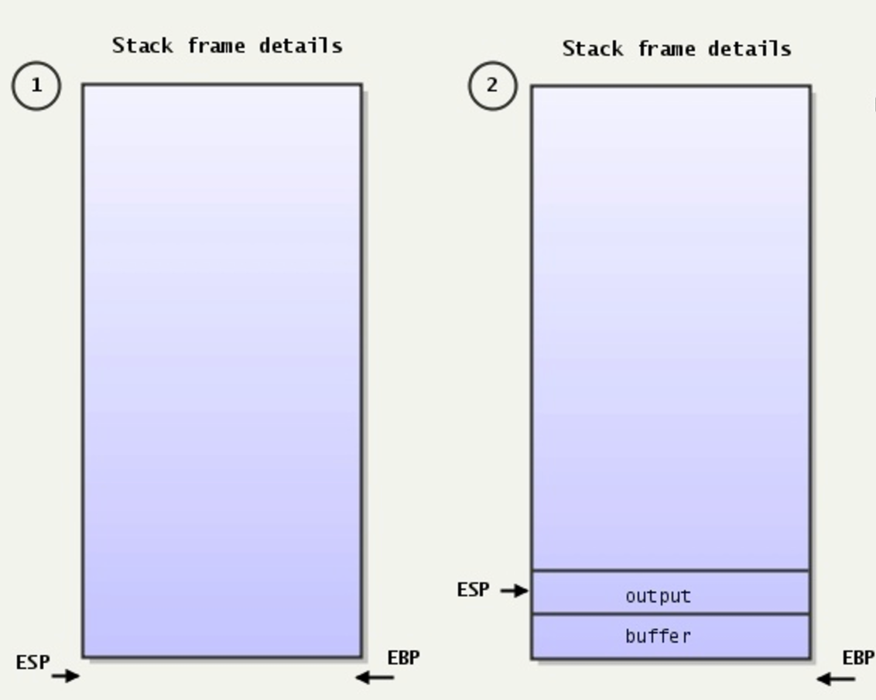
The Stack
Stack:
A special region of your computer's memory that stores temporary variables created by each functions
The stack is a "LIFO" (last in, first out) data structure
Once a stack variable is freed, that region of memory becomes available for other stack variables.

Slide 43
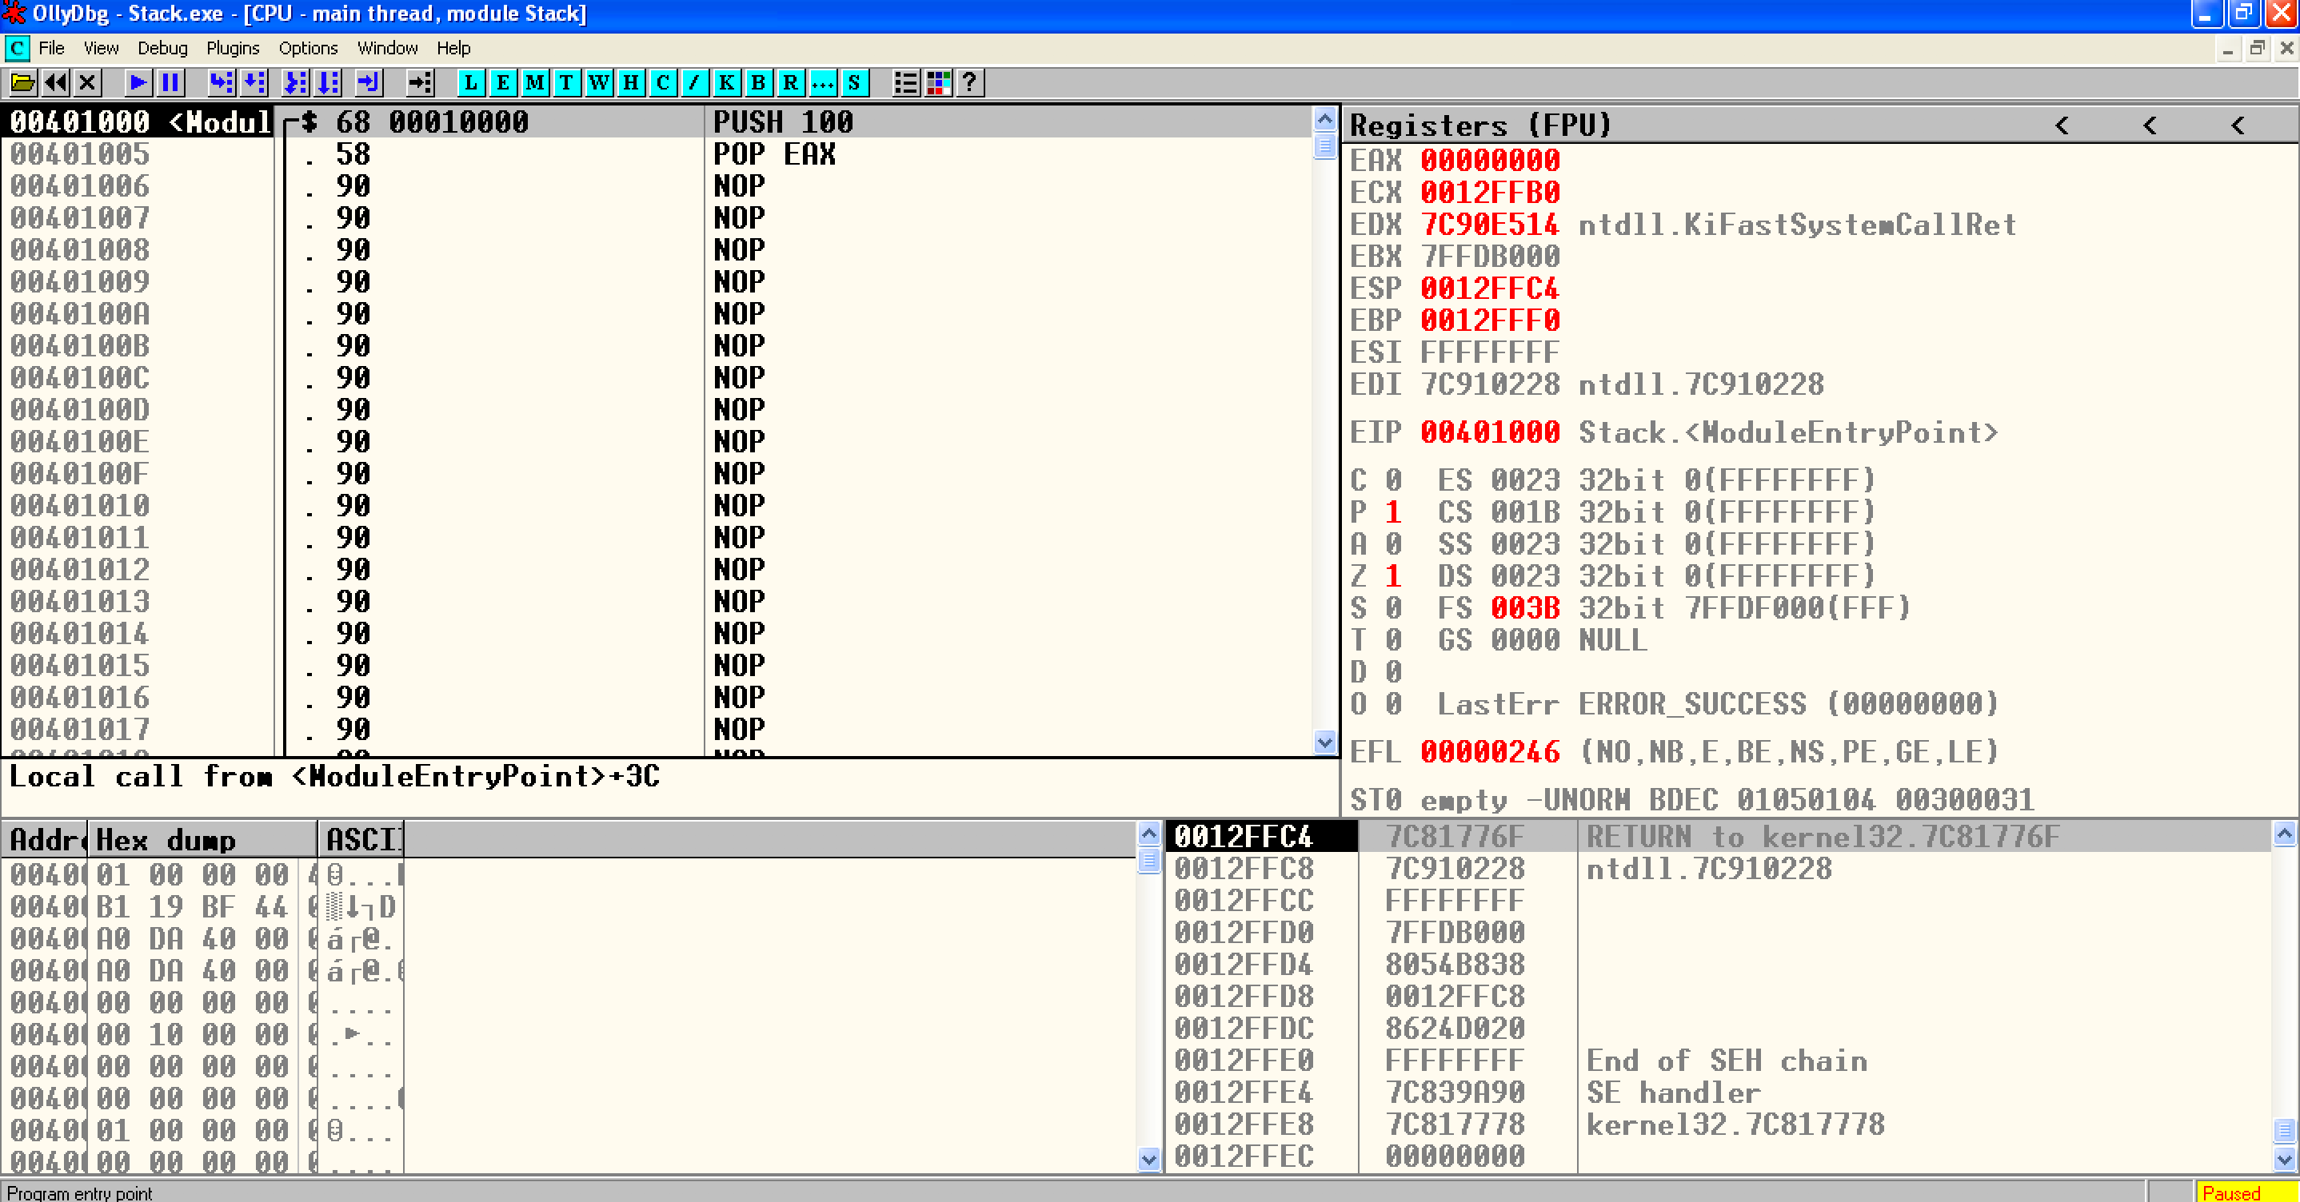
Stack.exe

Slide 44
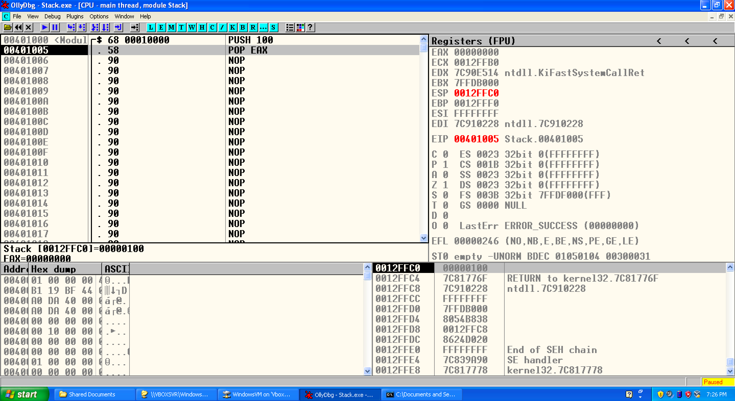
Stack.exe

Slide 45
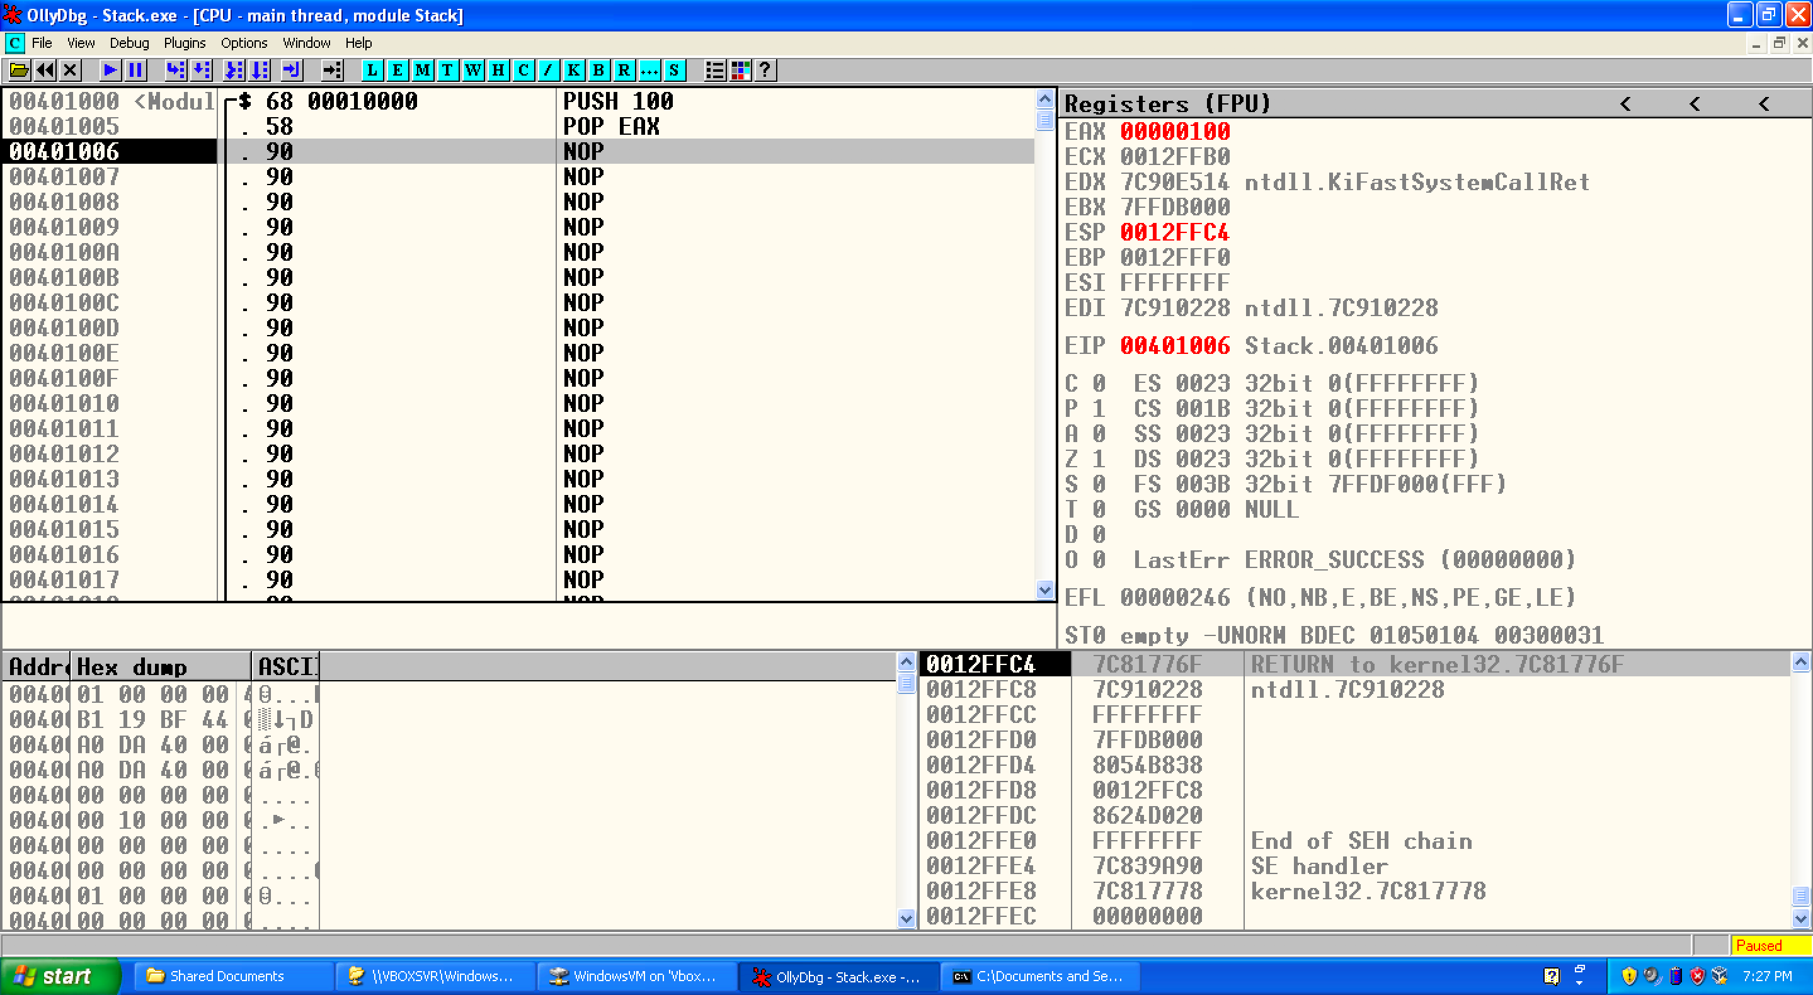
Stack.exe

Slide 46

Q & A

