Slide 1

Class6
CSC 497/583 Advanced Topics in Computer Security
Modern Malware Analysis
Static Analysis: Real-world Case Study
Si Chen (schen@wcupa.edu)

Slide 2
Load PE file (Notepad.exe) into Memory

Slide 3
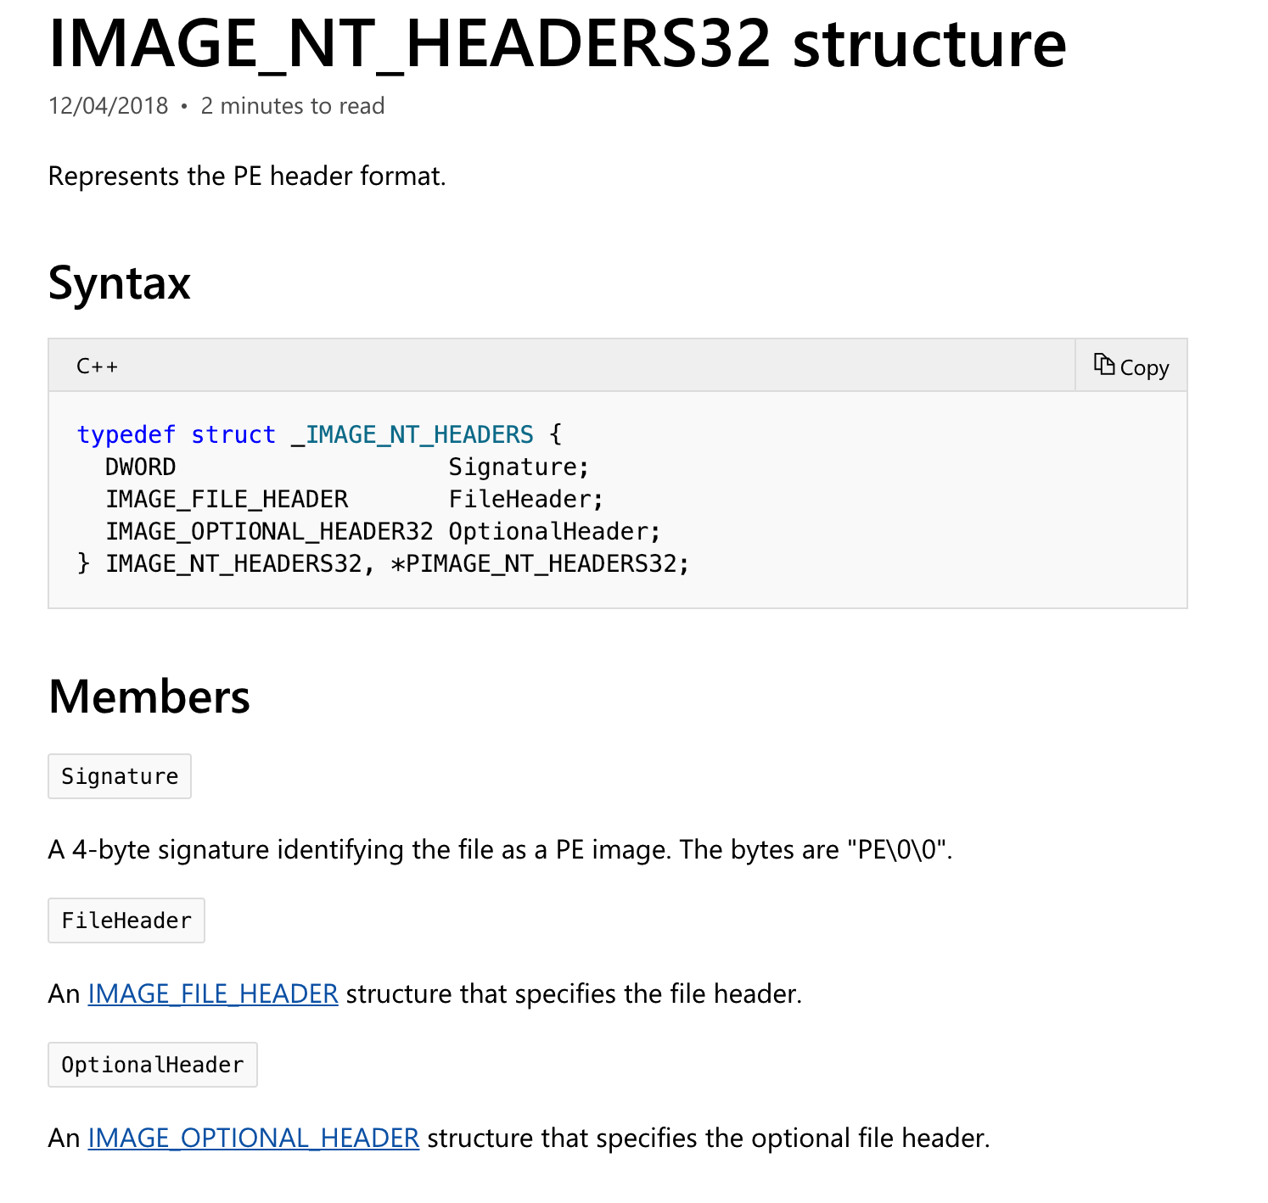
NT Header
https://docs.microsoft.com/en-us/windows/desktop/api/winnt/

Slide 4
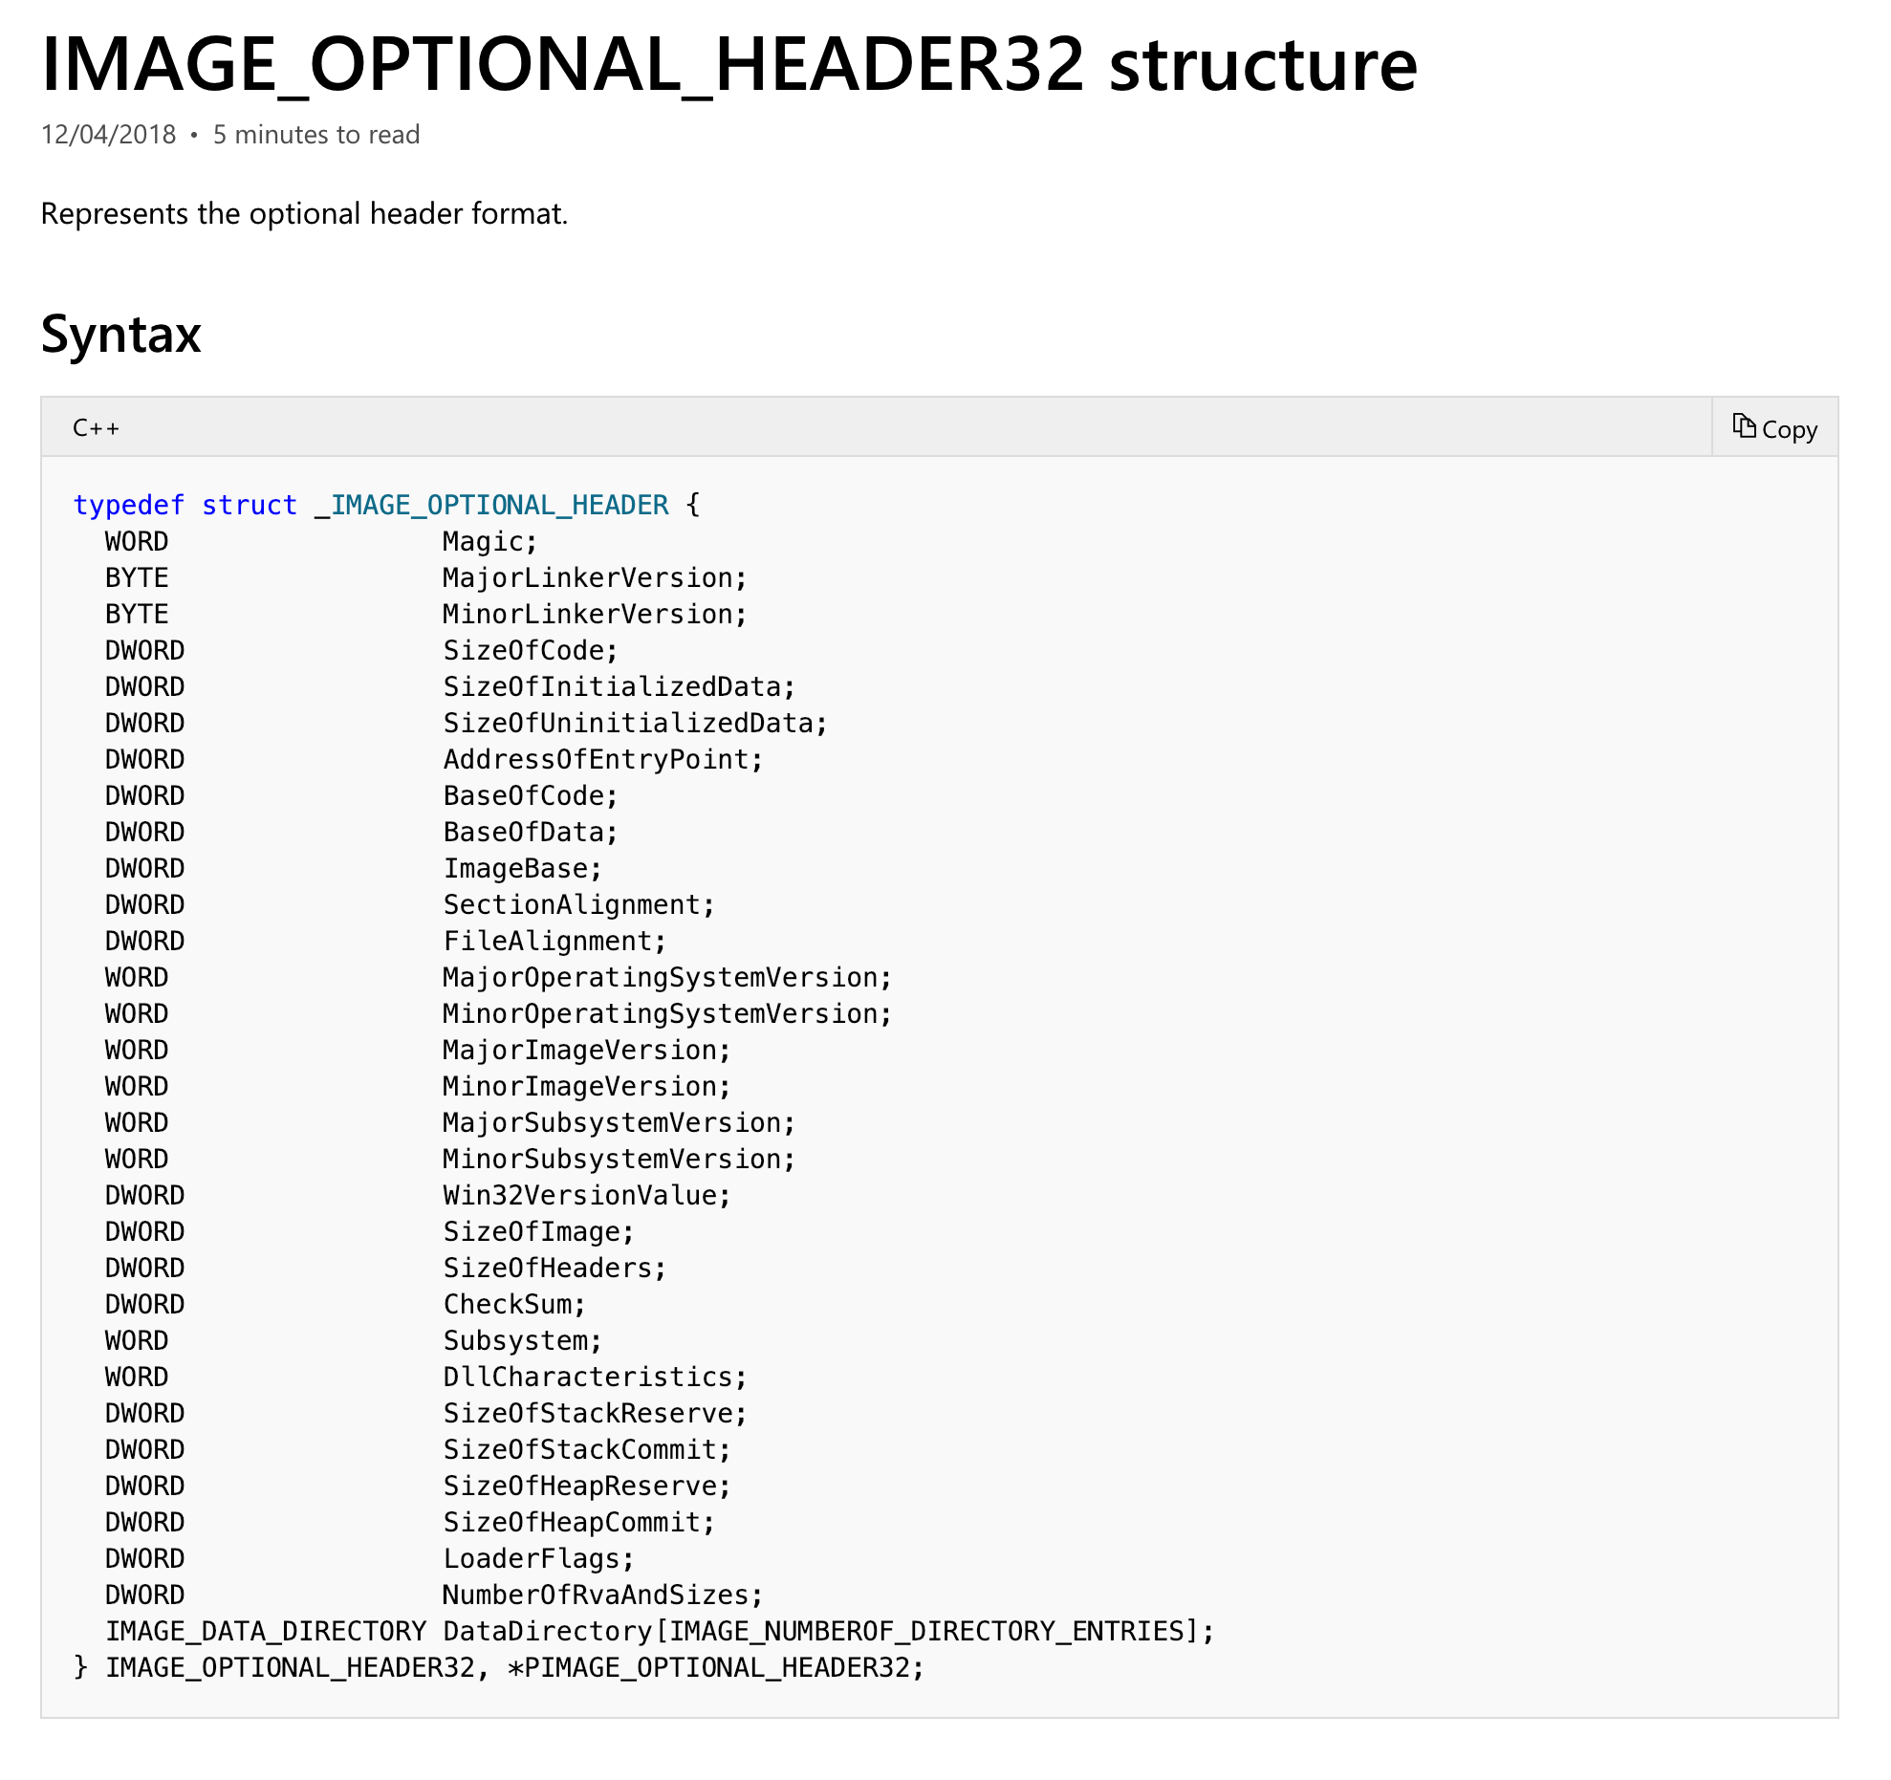

Slide 5
PE Header Structure

Slide 6
IAT (Import Address Table)

Slide 7
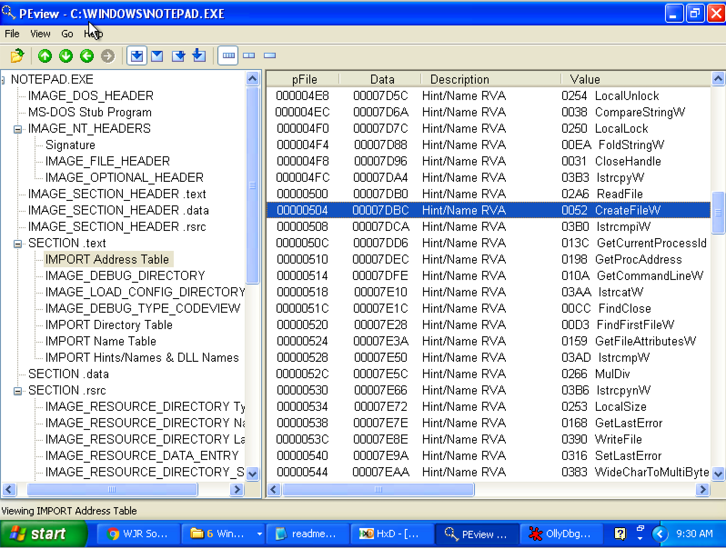
Look up IAT Table with PEview

Slide 8
Two ways to Load DLL
An executable file links to (or loads) a DLL in one of two ways:
Implicit Linking (load-time dynamic linking)
  The operating system loads the DLL when the executable using it is loaded.
IAT Table

Slide 9
Implicit Linking and IAT (Import Address Table)
Notepad.exe Call CreateFileW() → Call 0x01001104 → Call 0x7C810CD9
Call 0x01001104
Look up
IAT Table
Function Name | IAT Address | Real Address
…
CreateFileW() | 0x01001104 | 0x7C810CD9
…
When the application was first compiled, it was designed so that all API calls will NOT use direct hardcoded addresses but rather work through a function pointer.
This was accomplished through the use of an import address table. This is a table of function pointers filled in by the windows loader as the dlls are loaded.

Slide 10
IAT (Import Address Table)
Why IAT?

Slide 11
IAT (Import Address Table)
Support different Windows Version (9X, 2K, XP, Vista, 7, 8, 10)
Call CreateFileW() --> Call 0x01001104
Look up
XP
IAT Table
Function Name | IAT Address | Real Address
…
CreateFileW() | 0x01001104 | 0x7C810CD9
…
Windows 7
Function Name | IAT Address | Real Address
…
CreateFileW() | 0x01001104 | 0x7C81FFFF
…

Slide 12
IAT (Import Address Table)
Support DLL Relocation

Slide 13
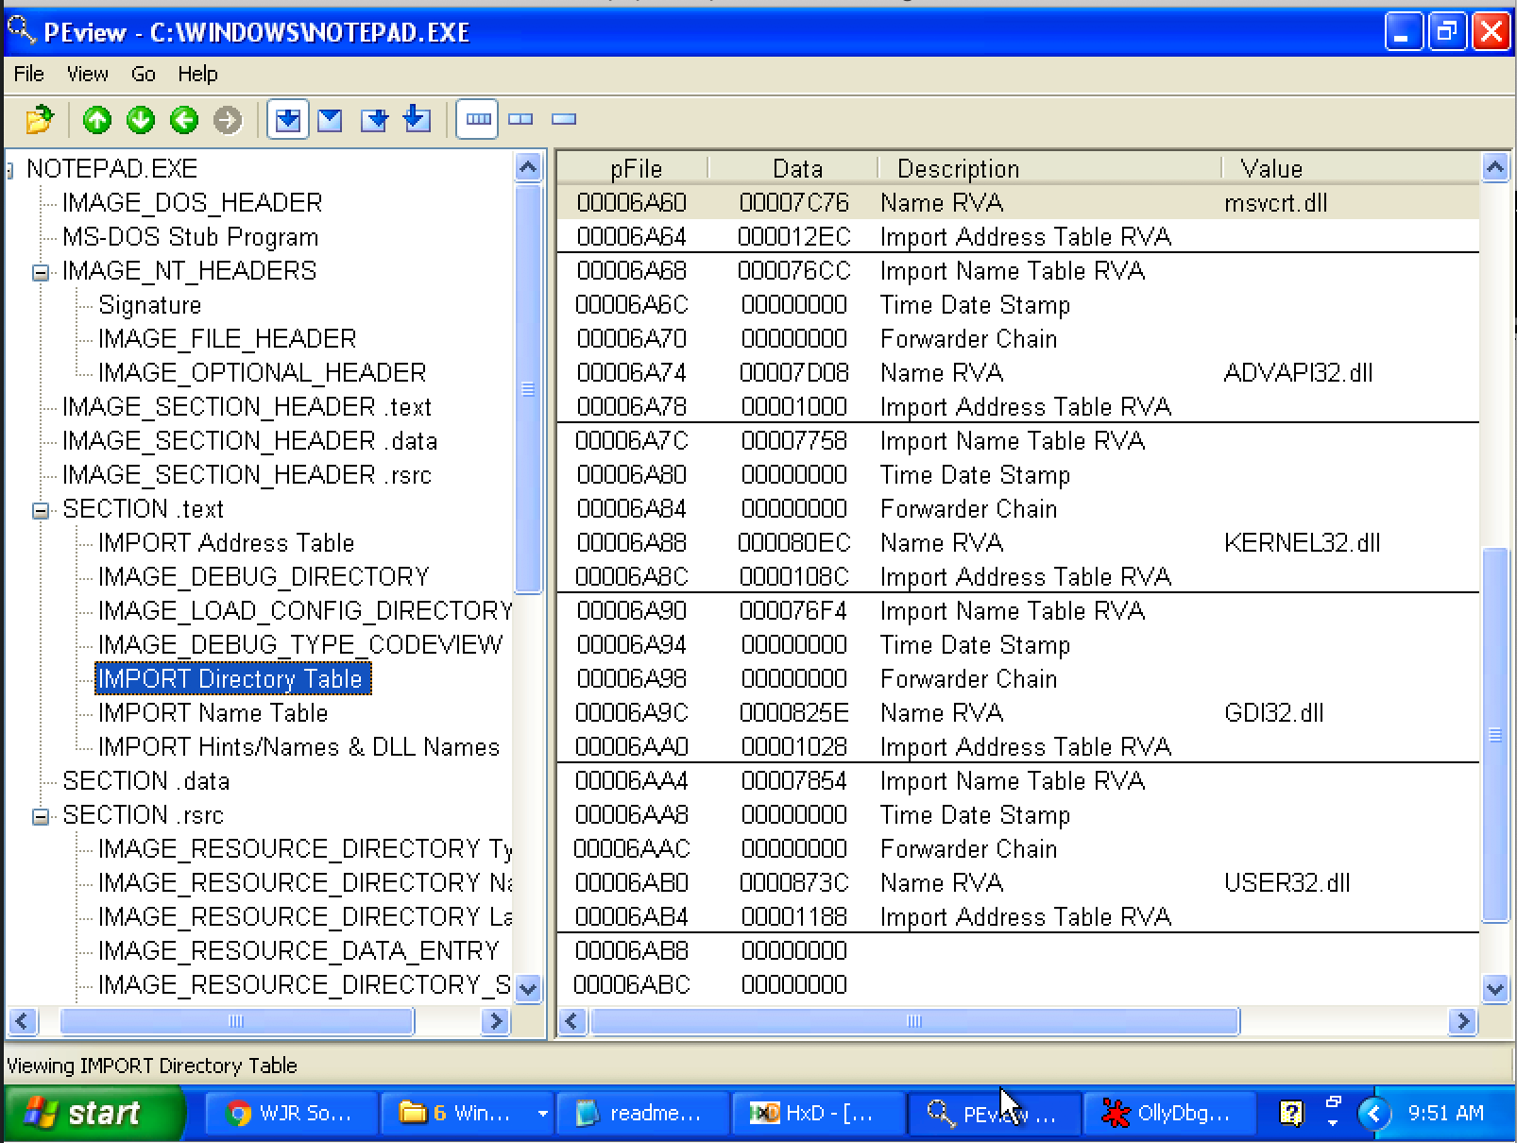
Import Directory Table
The Import Directory Table contains entries for every DLL which is loaded by the executable. Each entry contains, among other, Import Lookup Table (ILT) and Import Address Table (IAT)

Slide 14
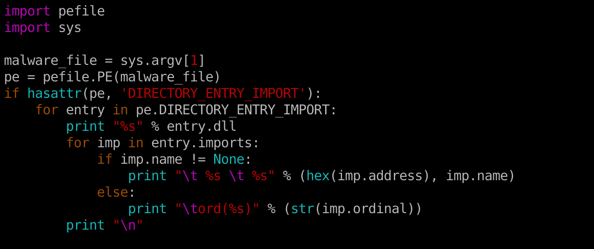
Inspecting file imports with pefile library

Slide 15
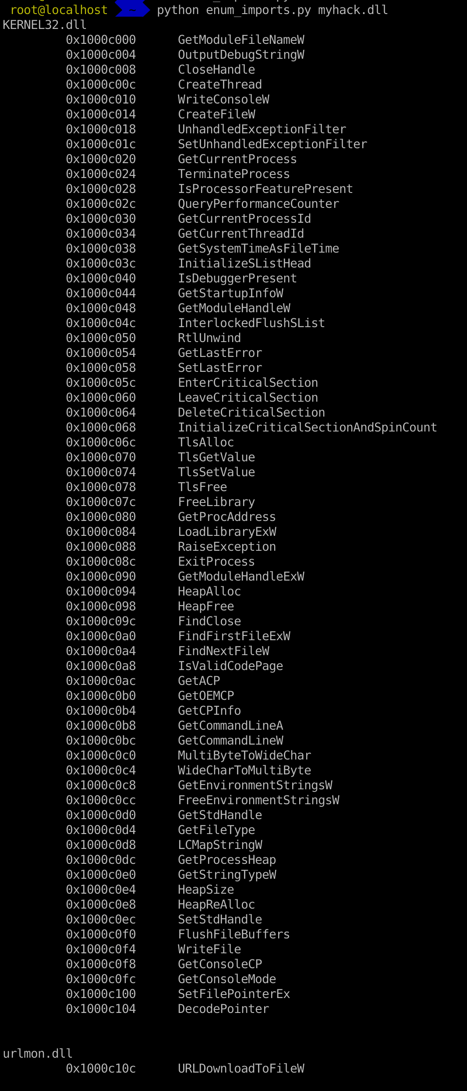

Slide 16
EAT (Export Address Table)
Similar to IAT, EAT data is stored in IMAGE_EXPORT_DIRECTORY
EAT contains an RVA that points to an array of pointers to (RVAs of) the functions in the module.

Slide 17
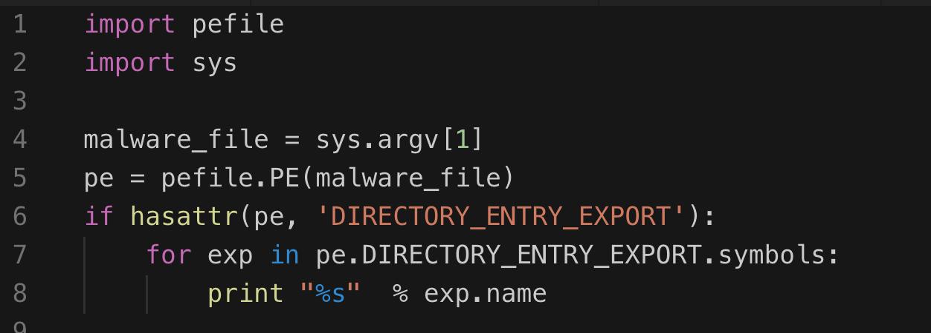
Inspecting file export with pefile library

Slide 18
Real-world Case Study

Slide 19
16d6b0e2c77da2776a88dd88c7cfc672
(Trojan.Win32.Dllhijack.a)

Slide 20
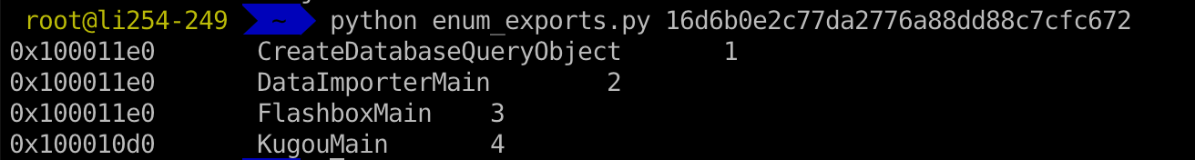
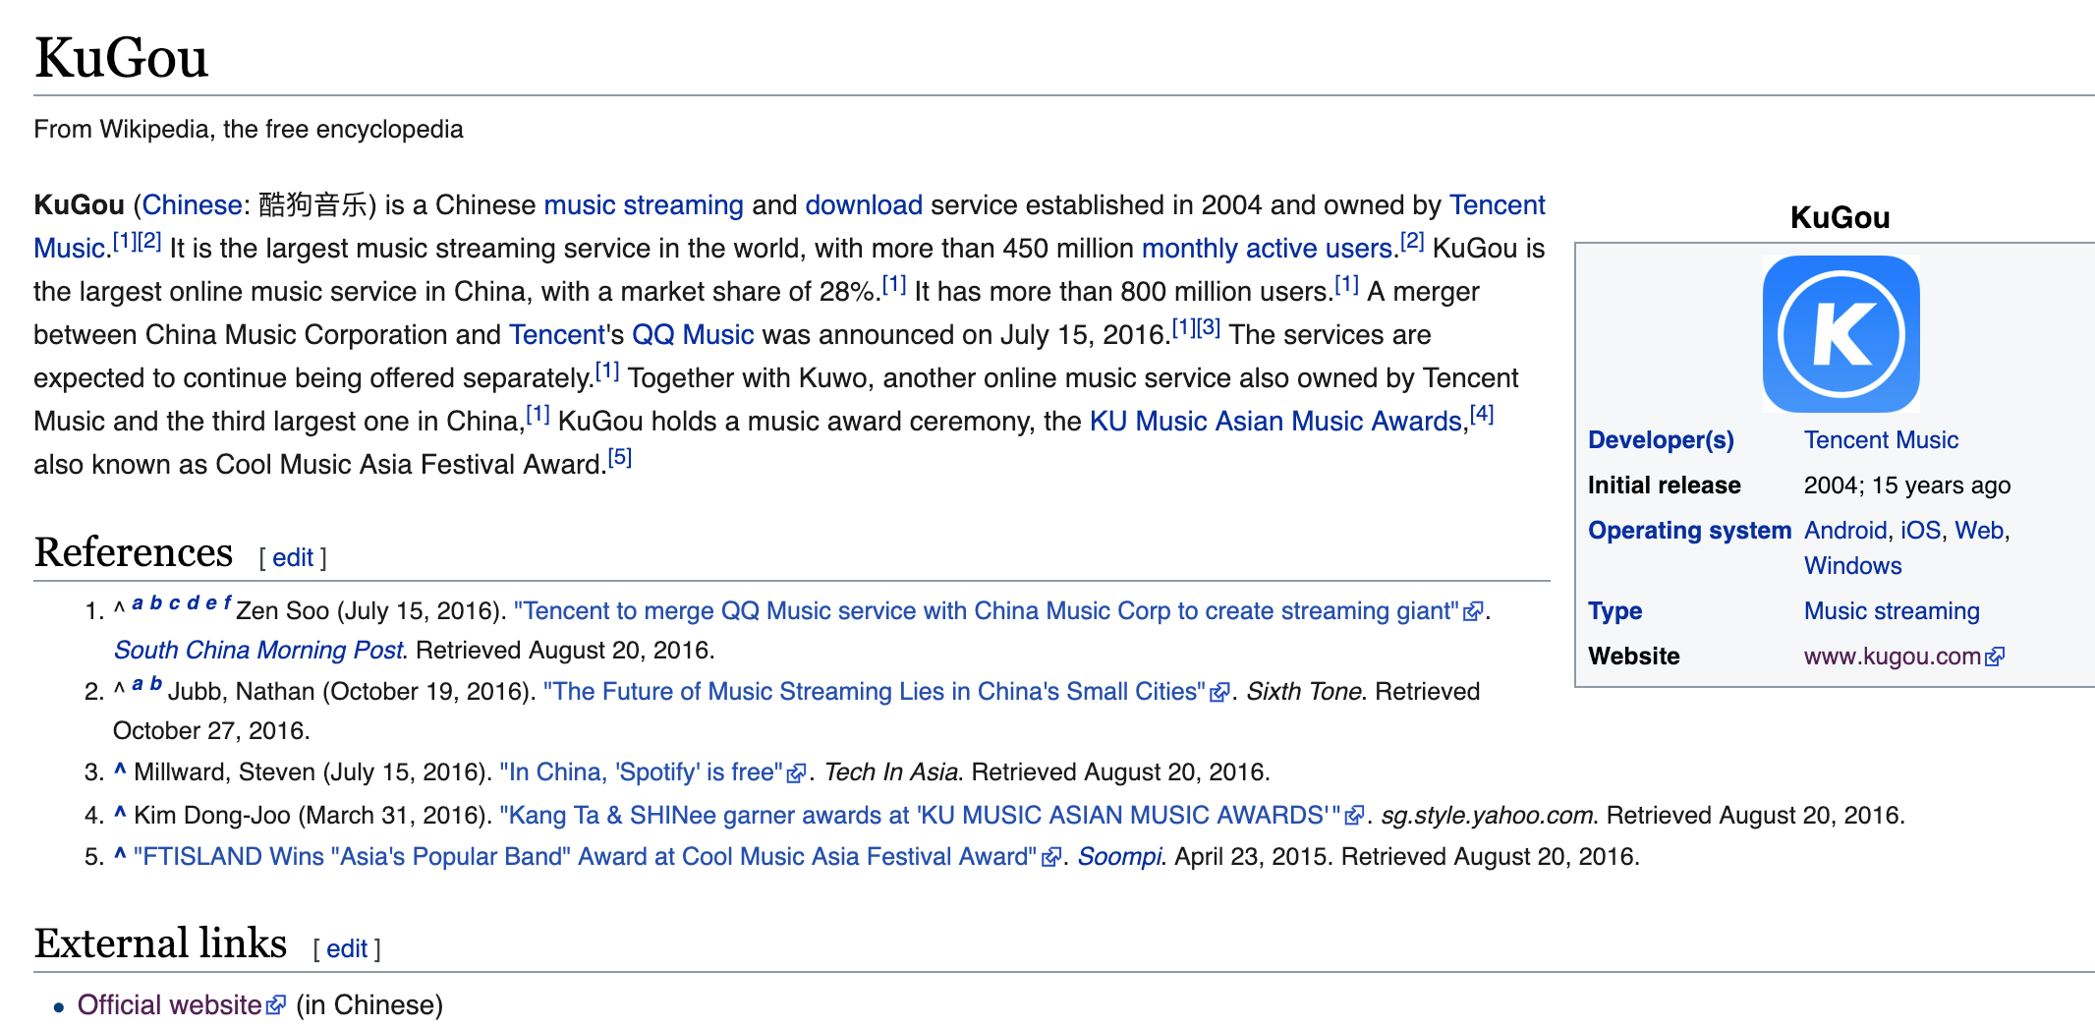
16d6b0e2c77da2776a88dd88c7cfc672

Slide 21
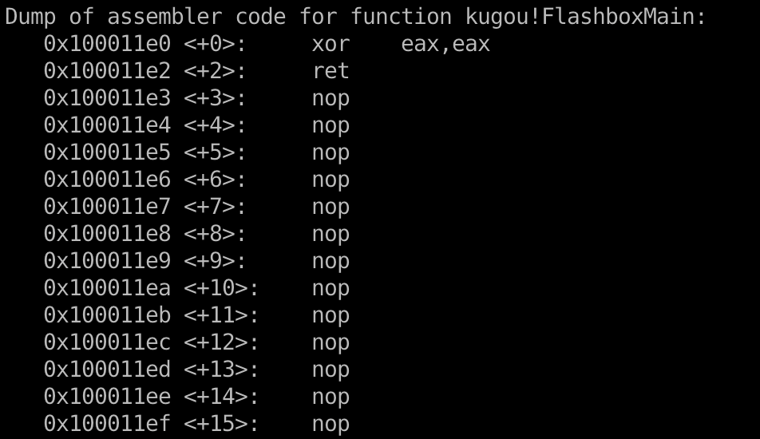
16d6b0e2c77da2776a88dd88c7cfc672

Slide 22
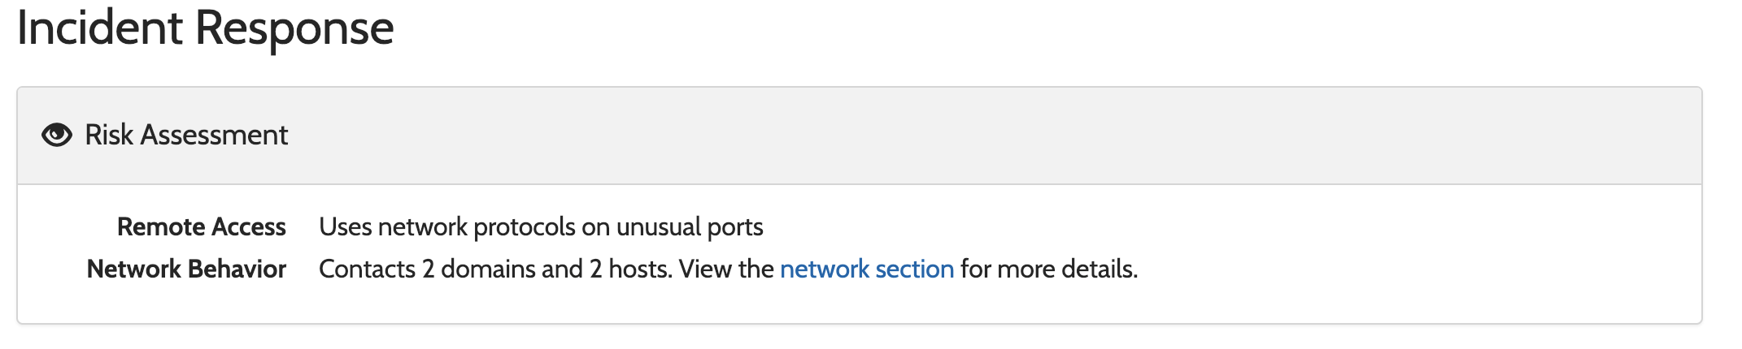
16d6b0e2c77da2776a88dd88c7cfc672
https://www.hybrid-analysis.com/sample/037203d274cb66bad34559c0f426e9e1bf91a048155240581f4aa554be17925c?environmentId=100

Slide 23
0fd6e3fb1cd5ec397ff3cdbaac39d80c

Slide 24
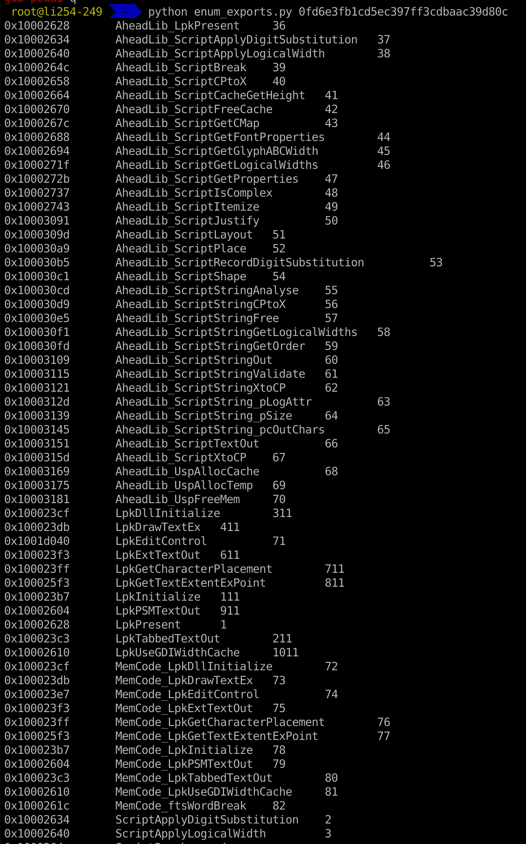
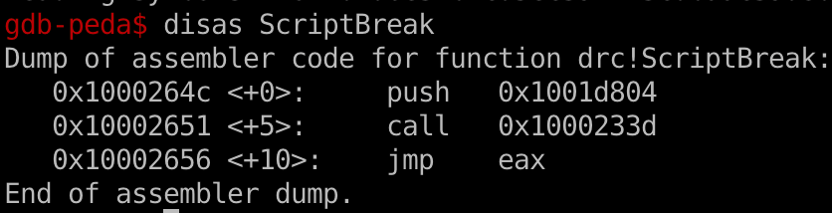
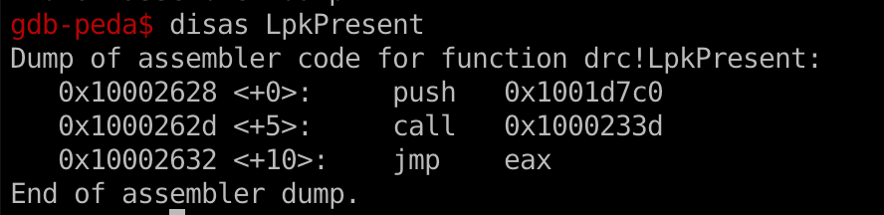

Slide 25
6a764e4e6db461781d080034aab85aff
&
cc3c6c77e118a83ca0513c25c208832c

Slide 26

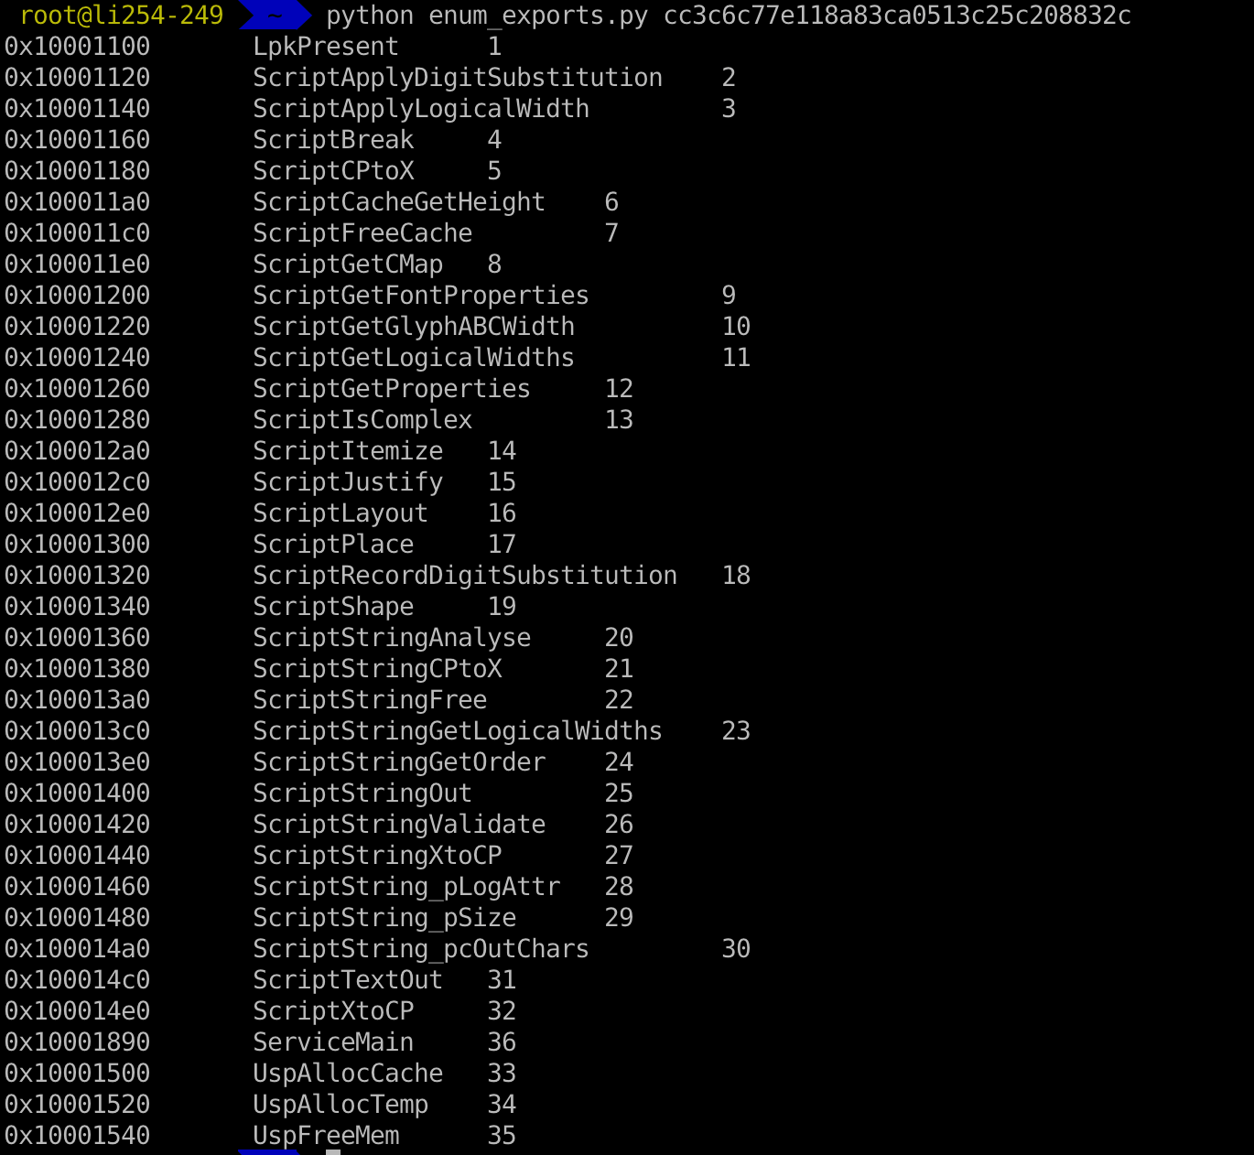

Slide 27
e0bed0b33e7b6183f654f0944b607618

Slide 28
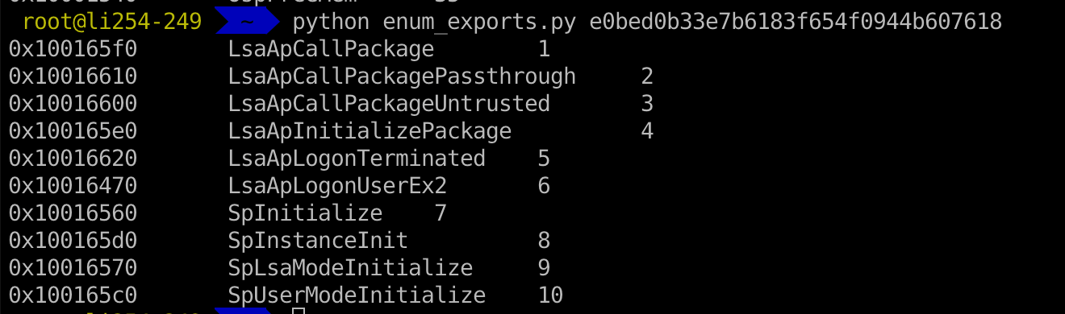
e0bed0b33e7b6183f654f0944b607618

Slide 29
db8199eeb2d75e789df72cd8852a9fbb
(Rootkit.Win32.blackken.b)

Slide 30
db8199eeb2d75e789df72cd8852a9fbb
Is this claim correct?
If two export functions share the same address, it’s a malware.

Slide 31
1c1131112db91382b9d8b46115045097

Slide 32
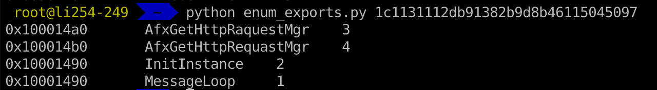
1c1131112db91382b9d8b46115045097

Slide 33
Lab1
Create your own anti-malware system based on heuristic analysis.
Check course website

Slide 34

Q & A

