Slide 1

Class5
CSC 497/583 Advanced Topics in Computer Security
Modern Malware Analysis
PE Format (2): NT Header, IAT, EAT
Si Chen (schen@wcupa.edu)

Slide 2

Portable Executable (PE) file
A Portable Executable (PE) file is the standard binary file format for an Executable (.exe) or DLL under Windows NT, Windows 95, and Win32.
Derived from COFF (Common Object File Format) in UNIX platform, and it is not really “portable”.
Now here is the kicker. Even though this specification is spelled out by Microsoft, compilers/linkers chose to ignore some parts of it.
To make things even worse, the Microsoft loader doesn't enforce a good portion of this specification and instead makes assumptions if things start getting weird.
So even though the spec outlined here says a particular field is supposed to hold a certain value, the compiler/linker or even a malicious actor could put whatever they want in there and the program will likely still run...

Slide 3

Portable Executable (PE) file
PE formatted files include:
  .exe, .scr (executable)
  .dll, .ocx, .cpl, drv (library)
  .sys, .vxd (driver files)
  .obj (objective file)
All PE formatted files can be executed, except obj file.
  .exe, .scr can be directly executed inside Shell (explorer.exe)
  others can be executed by other program/service
PE refers to 32 bit executable file, or PE32. 64 bit executable file is named as PE+ or PE32+. (Note that it is not PE64).

Slide 4
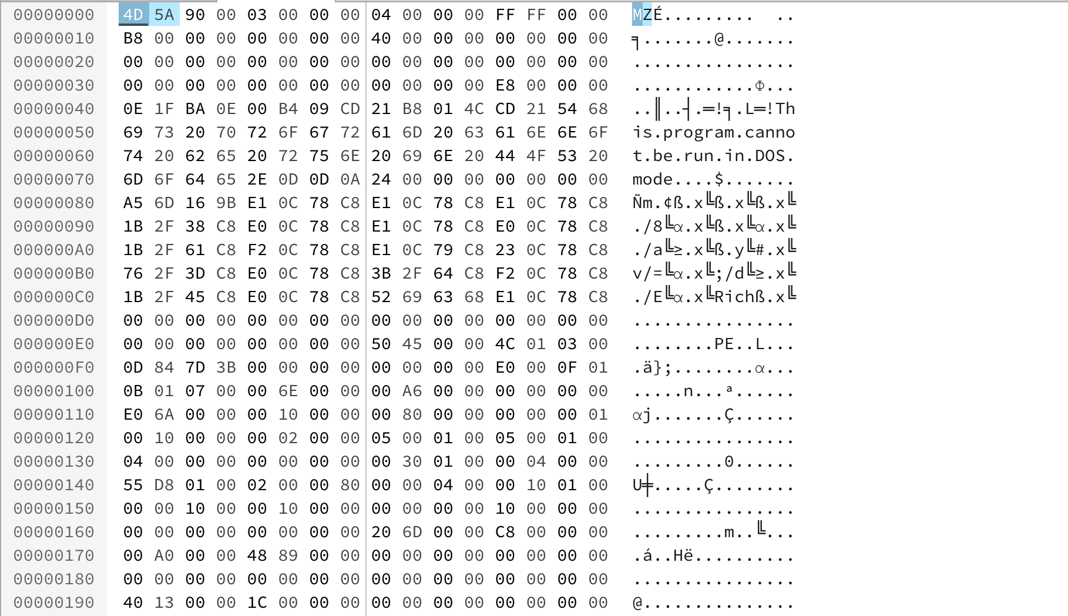
PE Example – Notepad.exe

Slide 5
Load PE file (Notepad.exe) into Memory

Slide 6
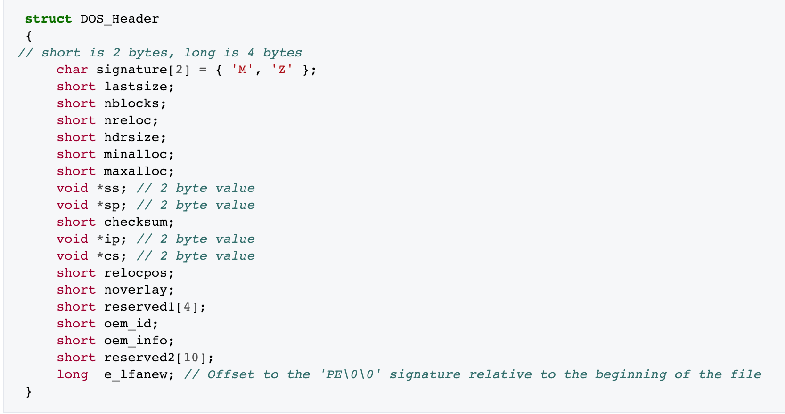
DOS Header
The first 2 letters are always the letters "MZ", the initials of Mark Zbikowski, who created the first linker for DOS. To some people, the first few bytes in a file that determine the type of file are called the "magic number,"

Slide 7
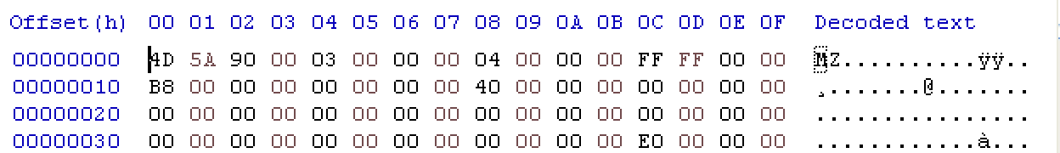
DOS Header
e_lfanew → 000000E0

Slide 8
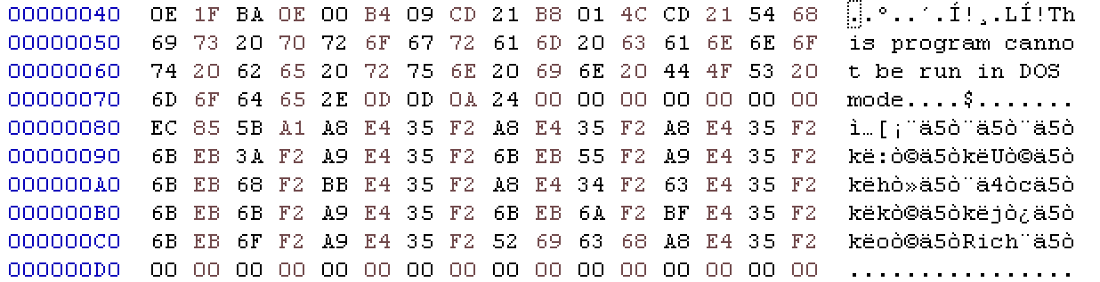
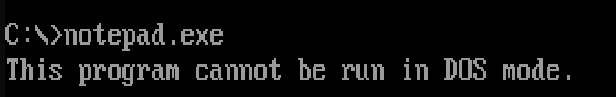
DOS stub
https://virtualconsoles.com/online-emulators/dos/

Slide 9
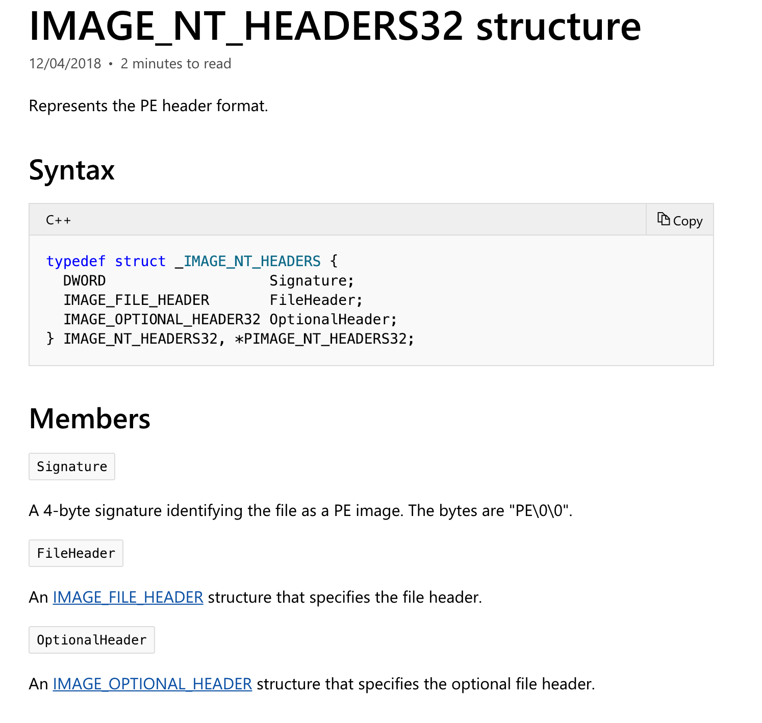
NT Header
https://docs.microsoft.com/en-us/windows/desktop/api/winnt/

Slide 10
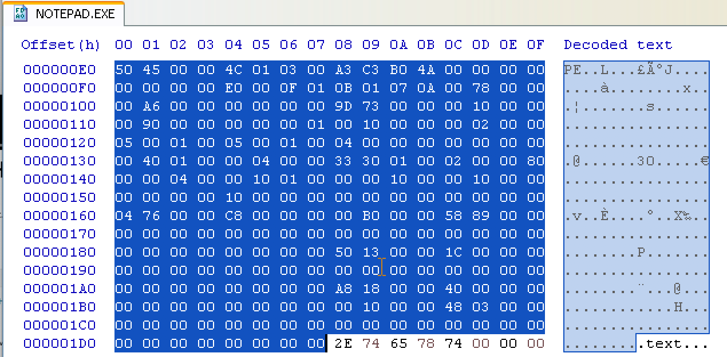
NT Header

Slide 11
Section Header
Name | Privilege
.text/.code | Executable, read
.data | Non-Executable, read/write
.resource/.rsrc | Non-Executable, read

Slide 12
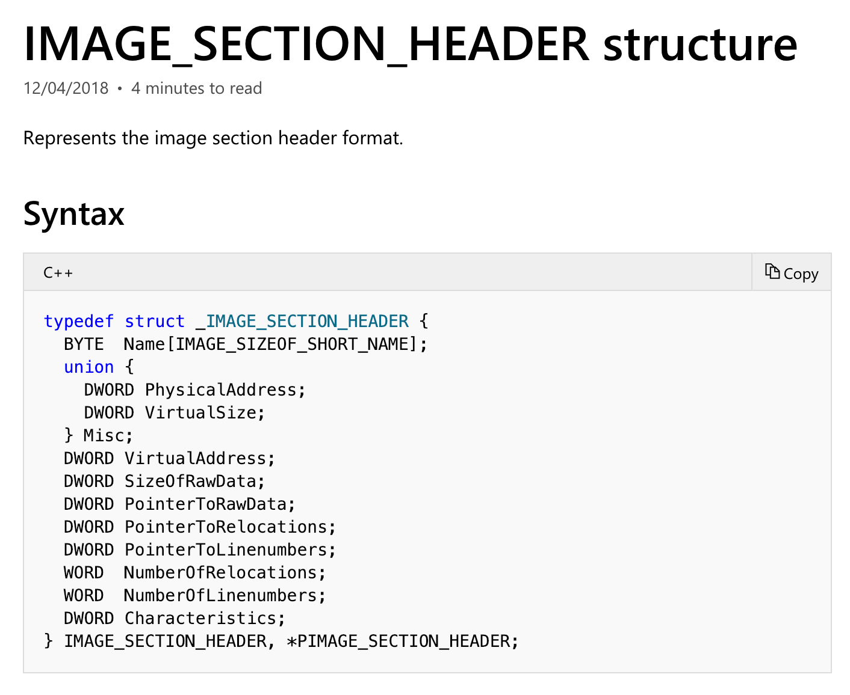
Section Header

Slide 13
Section Header
Members | Meaning
VirtualSize | The total size of the section when loaded into memory, in bytes.
VirtualAddress | The address of the first byte of the section when loaded into memory (RVA)
SizeOfRaw Data | The size of the section data on disk, in bytes.
PointerToRawData | The address of the first byte of the section on disk.
Characteristics | The characteristics of the image.
https://docs.microsoft.com/en-us/windows/desktop/api/winnt/ns-winnt-_image_section_header

Slide 14
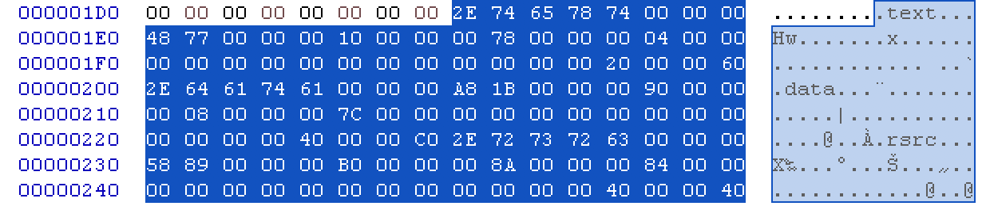
Section Header

Slide 15
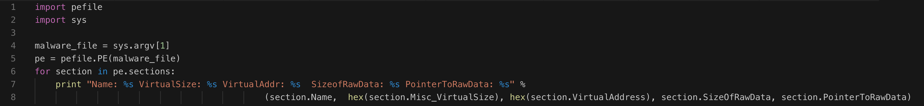
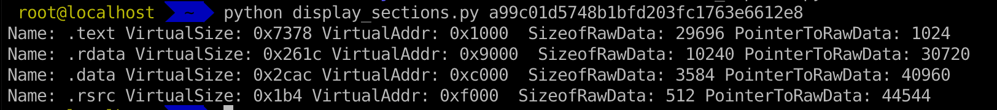
Inspecting PE Header Information in Linux

Slide 16
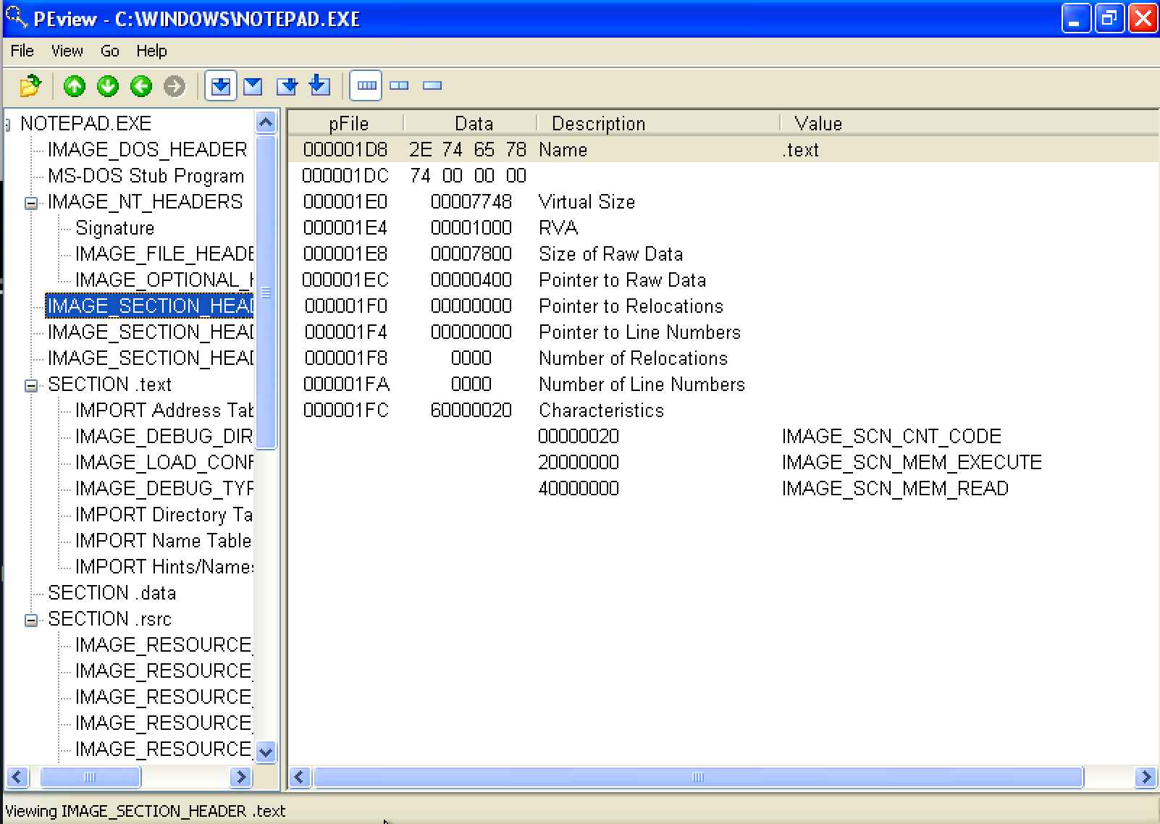
Inspecting PE Header Information

Slide 17
Examining PE Section Table and Sections
https://hub.docker.com/r/remnux/pescanner/

Slide 18
IAT (Import Address Table)

Slide 19
IAT (Import Address Table)
Let’s review the concept of DLL (Dynamic Link Library) again…

Slide 20
Dynamic Linking

Slide 21
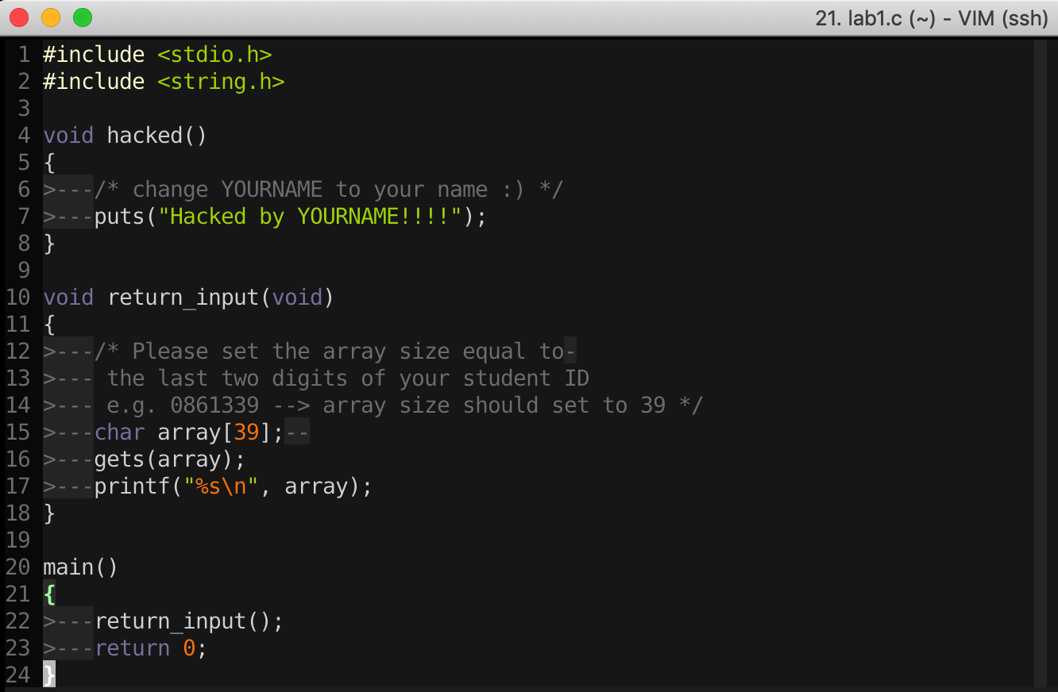
16-Bit DOS System
import Library → Put binary code of stdio library into the executable file

Slide 22
Static Linking
Memory
Waste space
Hard to maintain
Program2
Program2.obj
Lib.obj
Program1
Program1.obj
Lib.obj
Program2
Program2.obj
Lib.obj
Program1
Program1.obj
Lib.obj

Slide 23
Dynamic Linking
Memory
Dynamic linking has the following advantages:
Saves memory
Saves disk space.
Upgrades to the DLL are easier.
Provides after-market support.
Supports multi language programs.
Eases the creation of international versions
Lib.dll
Lib.obj
Program2
Program2.obj
Program1
Program1.obj
Program2
Program2.obj
Lib.dll
Lib.obj
Program1
Program1.obj

Slide 24
Two ways to Load DLL

Slide 25
Two ways to Load DLL
An executable file links to (or loads) a DLL in one of two ways:
Explicit Linking (run-time dynamic linking)
  the executable using the DLL must make function calls to explicitly load and unload the DLL, and to access the DLL's exported functions.
Implicit Linking (load-time dynamic linking)
  The operating system loads the DLL when the executable using it is loaded.

Slide 26
Two ways to Load DLL
Explicit Linking (run-time dynamic linking)
Implicit Linking (load-time dynamic linking)

Slide 27
Two ways to Load DLL
An executable file links to (or loads) a DLL in one of two ways:
DLL Injection
Explicit Linking (run-time dynamic linking)
  the executable using the DLL must make function calls to explicitly load and unload the DLL, and to access the DLL's exported functions.
Implicit Linking (load-time dynamic linking)
  The operating system loads the DLL when the executable using it is loaded.
IAT Table

Slide 28
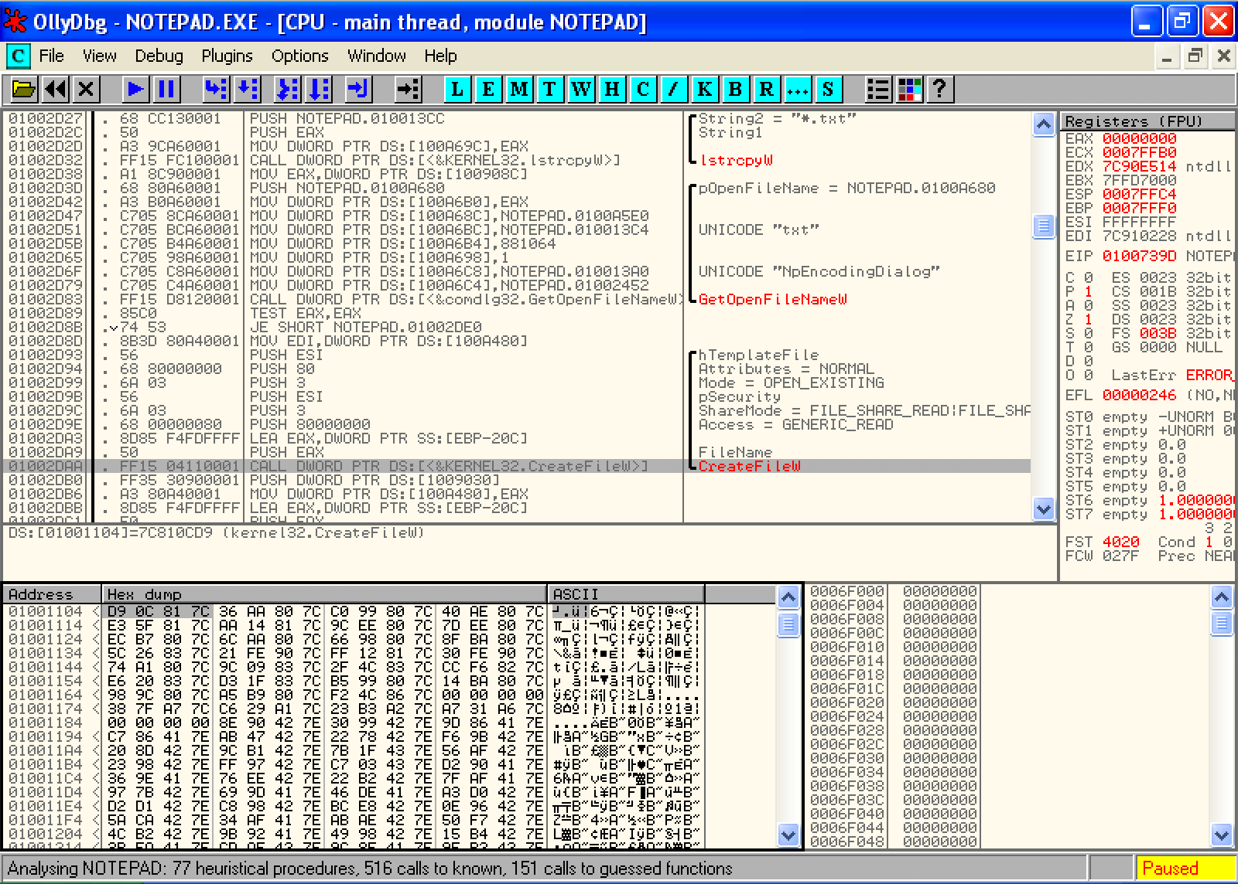
Implicit Linking and IAT (Import Address Table)
Notepad.exe Call CreateFileW() → Call 0x01001104 → Call 0x7C810CD9

Slide 29
Implicit Linking and IAT (Import Address Table)
Notepad.exe Call CreateFileW() → Call 0x01001104 → Call 0x7C810CD9
Call 0x01001104
Look up
IAT Table
Function Name | IAT Address | Real Address
…
CreateFileW() | 0x01001104 | 0x7C810CD9
…
When the application was first compiled, it was designed so that all API calls will NOT use direct hardcoded addresses but rather work through a function pointer.
This was accomplished through the use of an import address table. This is a table of function pointers filled in by the windows loader as the dlls are loaded.

Slide 30
IAT (Import Address Table)
Why IAT?

Slide 31
IAT (Import Address Table)
Support different Windows Version (9X, 2K, XP, Vista, 7, 8, 10)
Call CreateFileW() --> Call 0x01001104
Look up
XP
IAT Table
Function Name | IAT Address | Real Address
…
CreateFileW() | 0x01001104 | 0x7C810CD9
…
Windows 7
Function Name | IAT Address | Real Address
…
CreateFileW() | 0x01001104 | 0x7C81FFFF
…

Slide 32
IAT (Import Address Table)
Support DLL Relocation

Slide 33
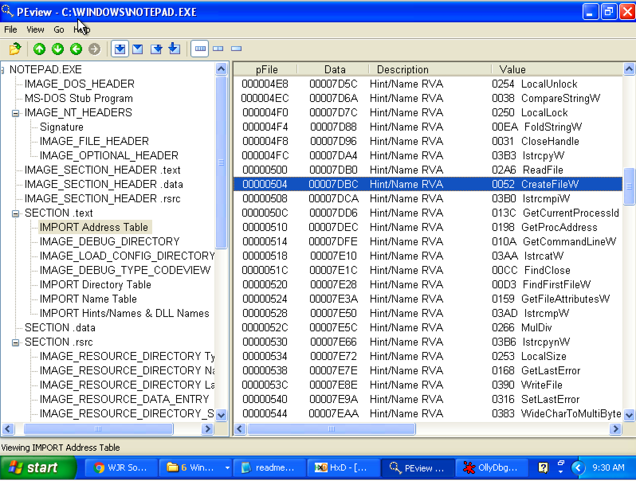
Look up IAT Table with PEview

Slide 34
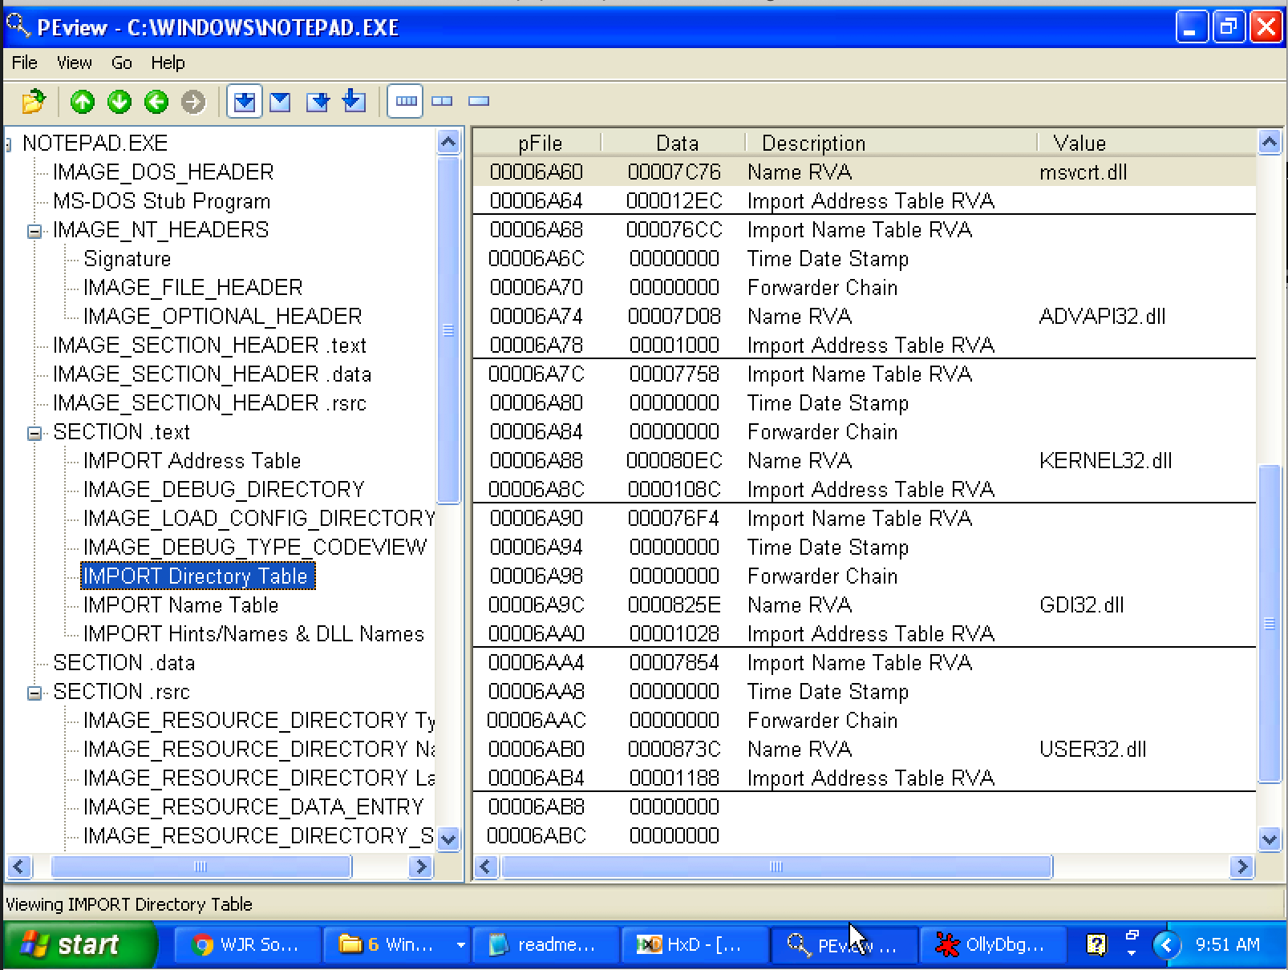
Import Directory Table
The Import Directory Table contains entries for every DLL which is loaded by the executable. Each entry contains, among other, Import Lookup Table (ILT) and Import Address Table (IAT)

Slide 35
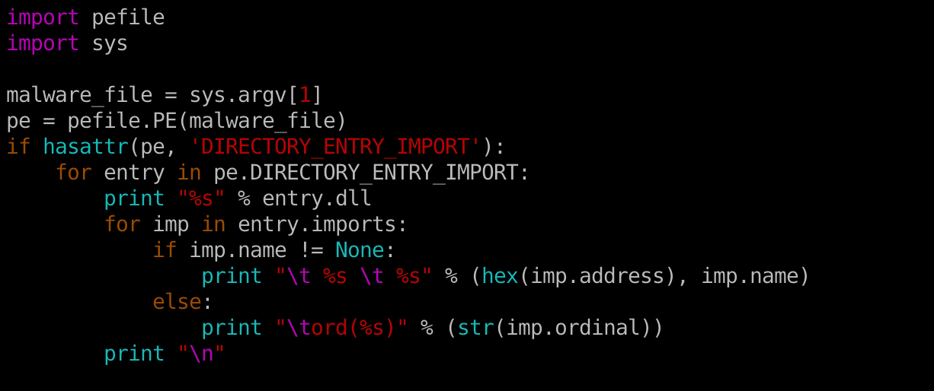
Inspecting file imports with pefile library

Slide 36
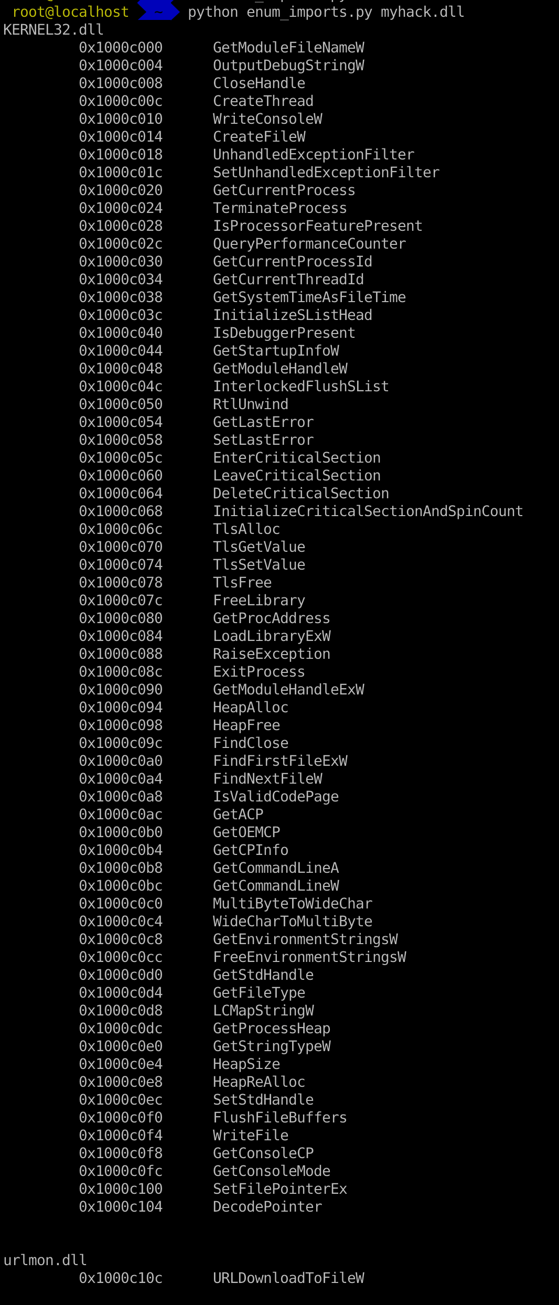

Slide 37
EAT (Export Address Table)
Similar to IAT, EAT data is stored in IMAGE_EXPORT_DIRECTORY
EAT contains an RVA that points to an array of pointers to (RVAs of) the functions in the module.

Slide 38
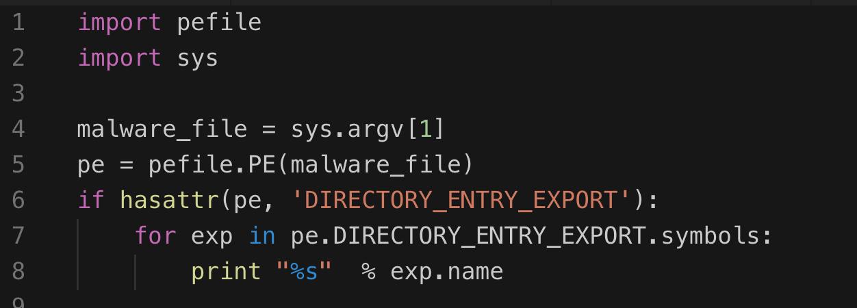
Inspecting file export with pefile library

Slide 39
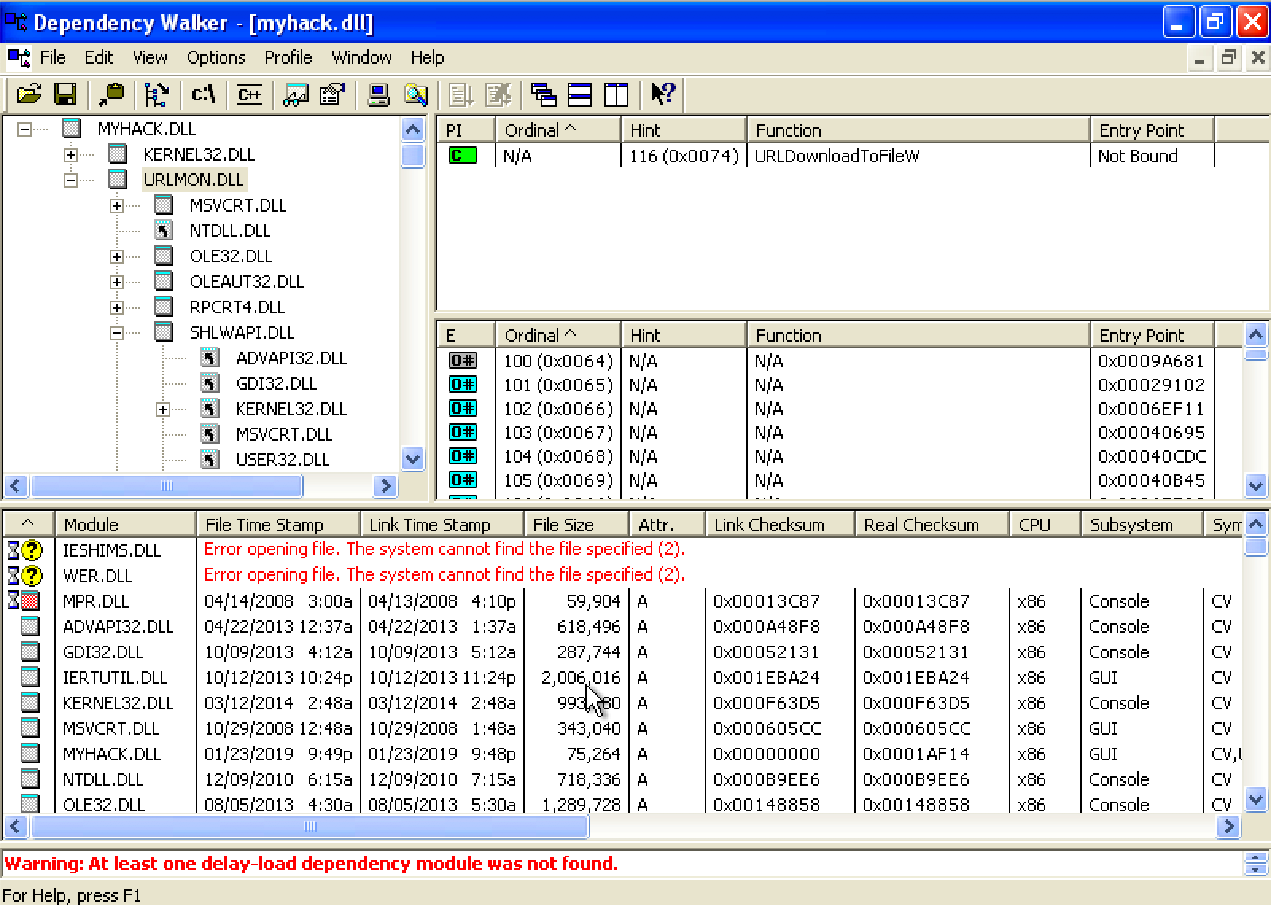
Exploring Dynamically Linked Functions with Dependency Walker

Slide 40
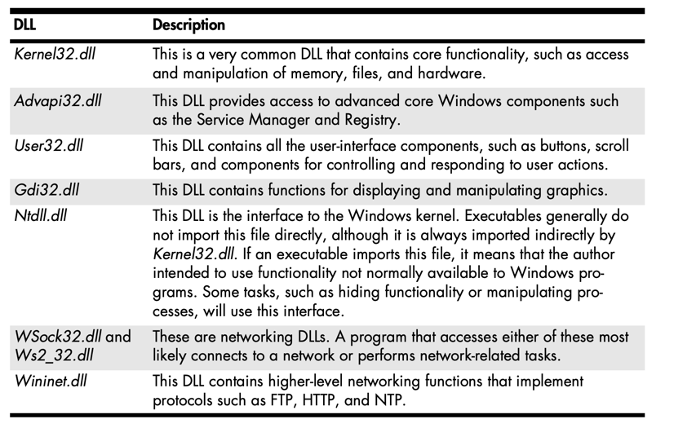
Common DLLs

Slide 41
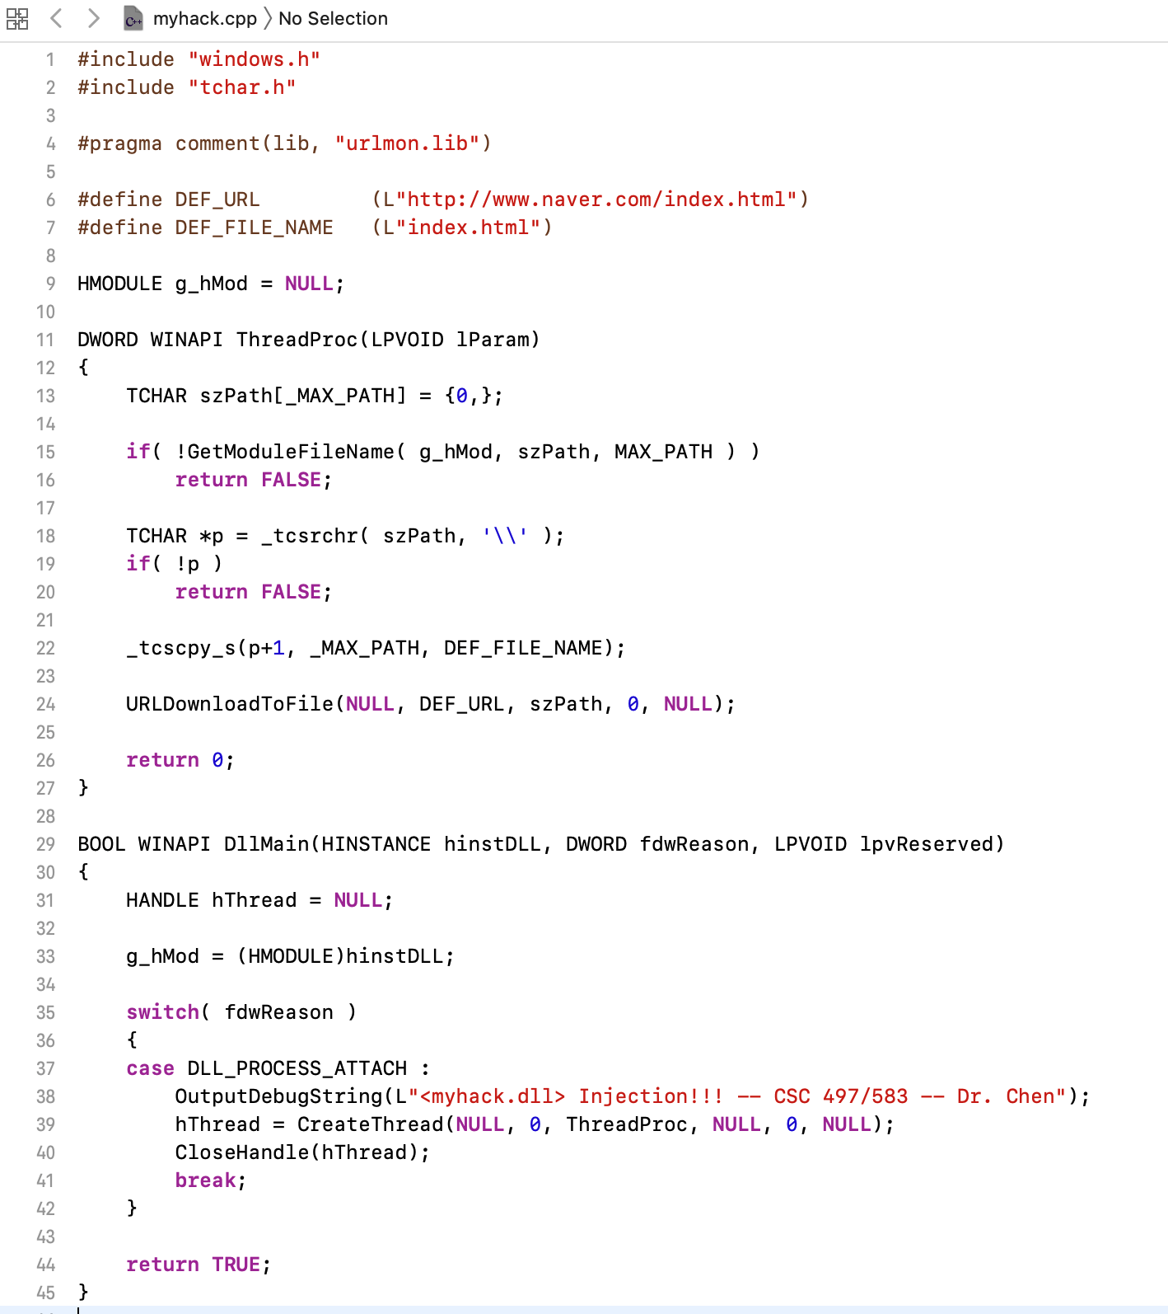
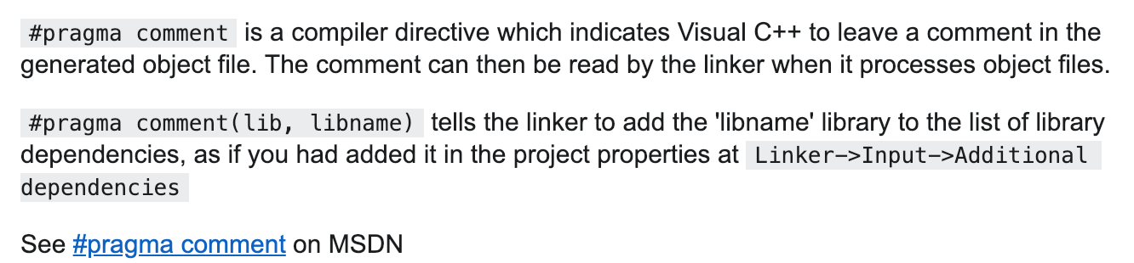
Exploring Dynamically Linked Functions with Dependency Walker

Slide 42
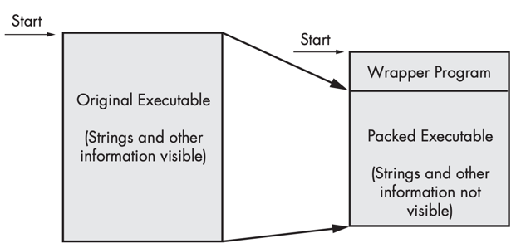
Packed and Obfuscated Malware
Malware writers often use packing or obfuscation to make their files more difficult to detect or analyze.
Obfuscated programs are ones whose execution the malware author has attempted to hide.
Packed programs are a subset of obfuscated programs in which the malicious program is compressed and cannot be analyzed.
Both techniques will severely limit your attempts to statically analyze the malware.

Slide 43
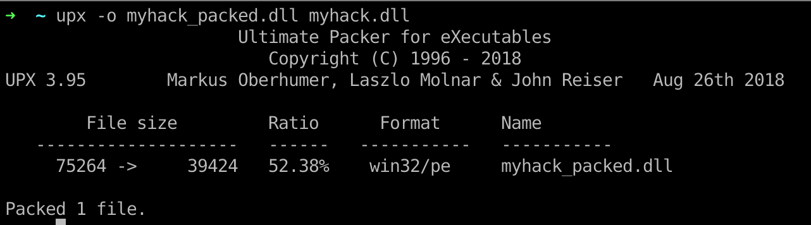
Packers and Cryptos

Slide 44
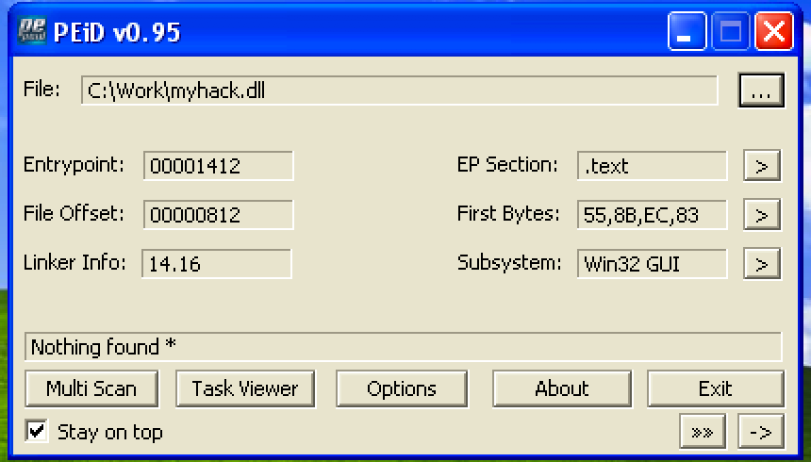
Packed and Obfuscated Malware

Slide 45
DLL Injection

Slide 46

Q & A

