Slide 1

Class4
CSC 497/583 Advanced Topics in Computer Security
Modern Malware Analysis
Static Analysis (2), PE Format
Si Chen (schen@wcupa.edu)

Slide 2
Course Outline
Static Analysis
  Cryptographic Hash
  Anti-Virus Scanning
  Strings
  PE file
  Packer and Cryptor

Slide 3
Fingerprinting the Malware
Fingerprinting involves generating the cryptographic hash values for the suspect binary based on its file content.
Same cryptographic hashing algorithms:
  MD5
  SHA1
  SHA256
Why not just use the file name?
  Ineffective, same malware sample can use different filenames, cryptographic hash is calculated based on the file content.
File hash is frequently used as an indicator to share with other security researchers to help them identify the sample.

Slide 4
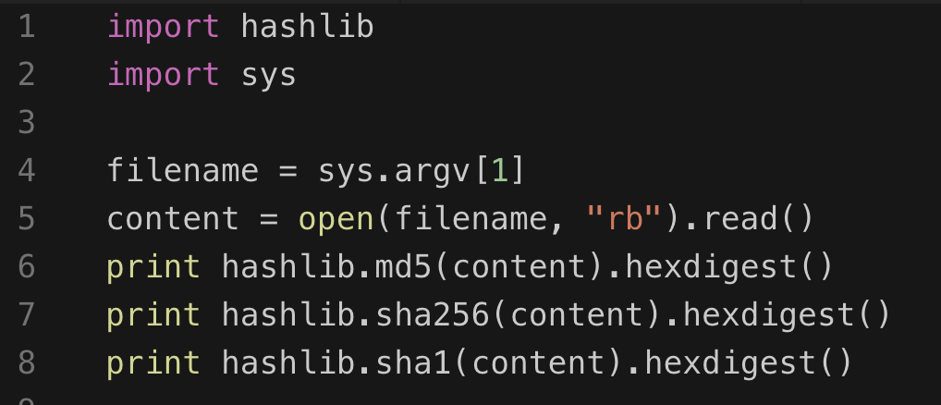
Tools and Python code
md5sum
sha256sum
sha1sum

Slide 5
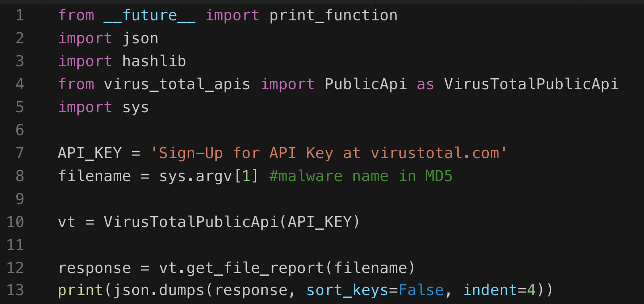
Querying Hash Values Using VirusTotal Public API
VirusTotal Public API
  https://www.virustotal.com/en/documentation/public-api/
VirusTotal Commandline Tool

Slide 6
Strings
Finding Strings ^{[1]}
  A string in a program is a sequence of characters such as “the.”
  A program contains strings if it prints a message, connects to a URL, or copies a file to a specific location.
  Searching through the strings can be a simple way to get hints about the functionality of a program.
    For example, if the program accesses a URL, then you will see the URL accessed stored as a string in the program.
  You can use the Strings program to search an executable for strings, which are typically stored in either ASCII or Unicode format.
[1]. Practical Malware Analysis, page 11

Slide 7

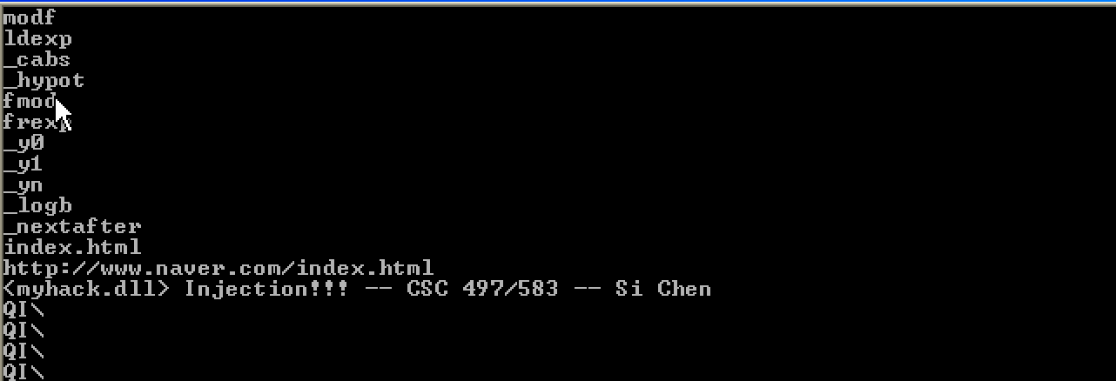
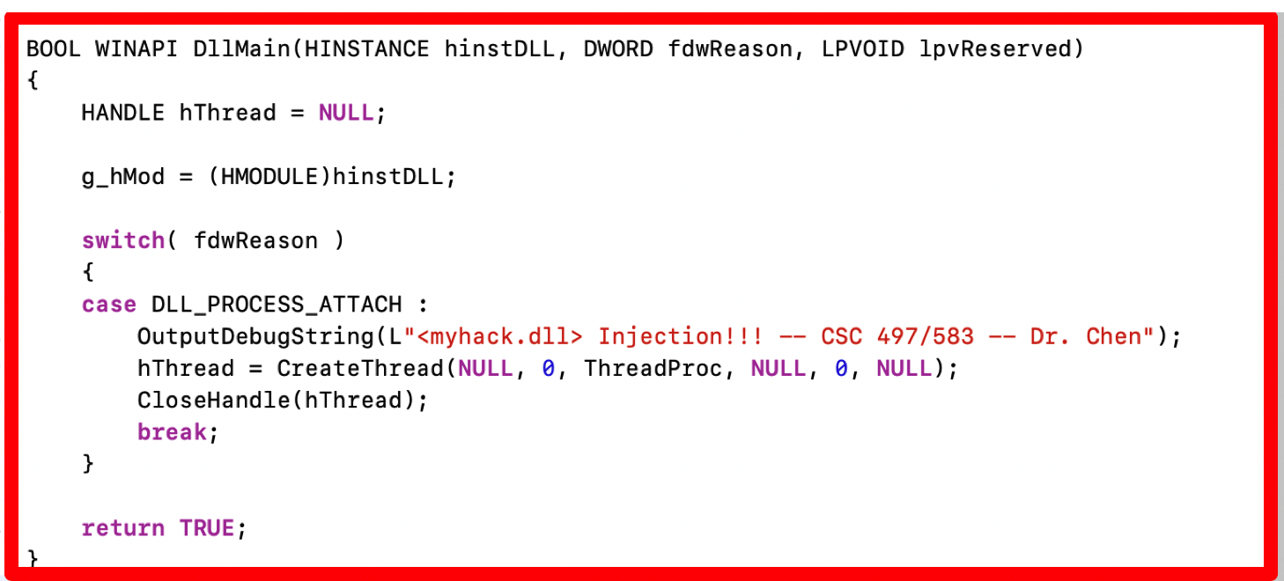
Static analysis (myhack.dll)

Slide 8
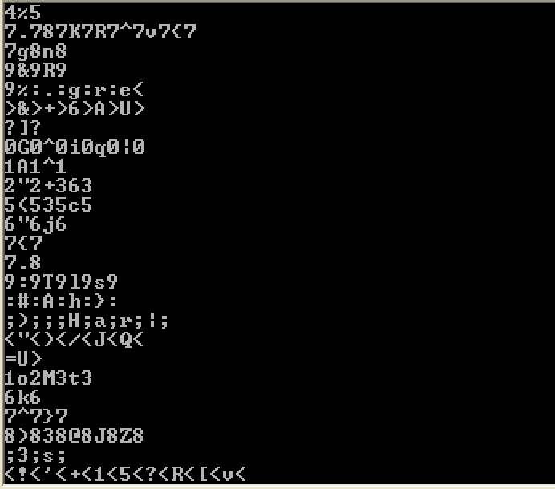
Static analysis (myhack.dll)
Sometimes the strings detected by the Strings program are not actual strings.

Slide 9
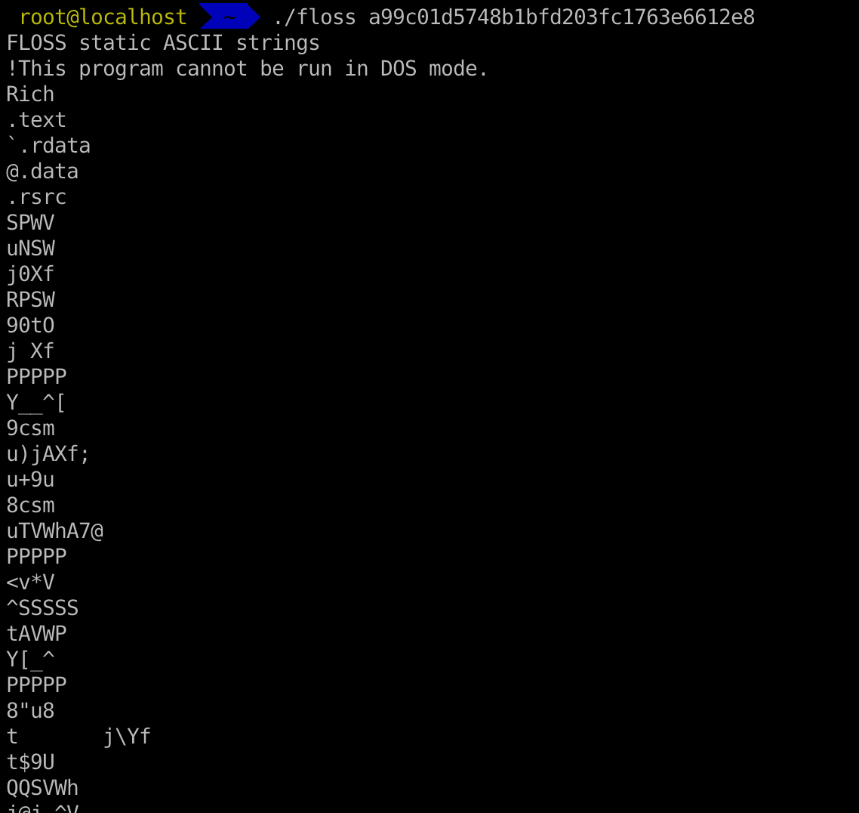
strings in Linux and flare-floss
FireEye Labs Obfuscated String Solver
  Many malware authors evade heuristic detections by obfuscating only key portions of an executable
    These portions are strings and resources used to configure domains, files, and other artifacts of an infection
  The FireEye Labs Obfuscated String Solver (FLOSS) uses advanced static analysis techniques to automatically deobfuscate strings from malware binaries.

Slide 10

Portable Executable (PE) file
A Portable Executable (PE) file is the standard binary file format for an Executable (.exe) or DLL under Windows NT, Windows 95, and Win32.
Derived from COFF (Common Object File Format) in UNIX platform, and it is not really “portable”.
Now here is the kicker. Even though this specification is spelled out by Microsoft, compilers/linkers chose to ignore some parts of it.
To make things even worse, the Microsoft loader doesn't enforce a good portion of this specification and instead makes assumptions if things start getting weird.
So even though the spec outlined here says a particular field is supposed to hold a certain value, the compiler/linker or even a malicious actor could put whatever they want in there and the program will likely still run...

Slide 11

Portable Executable (PE) file
PE formatted files include:
  .exe, .scr (executable)
  .dll, .ocx, .cpl, drv (library)
  .sys, .vxd (driver files)
  .obj (objective file)
All PE formatted files can be executed, except obj file.
  .exe, .scr can be directly executed inside Shell (explorer.exe)
  others can be executed by other program/service
PE refers to 32 bit executable file, or PE32. 64 bit executable file is named as PE+ or PE32+. (Note that it is not PE64).

Slide 12
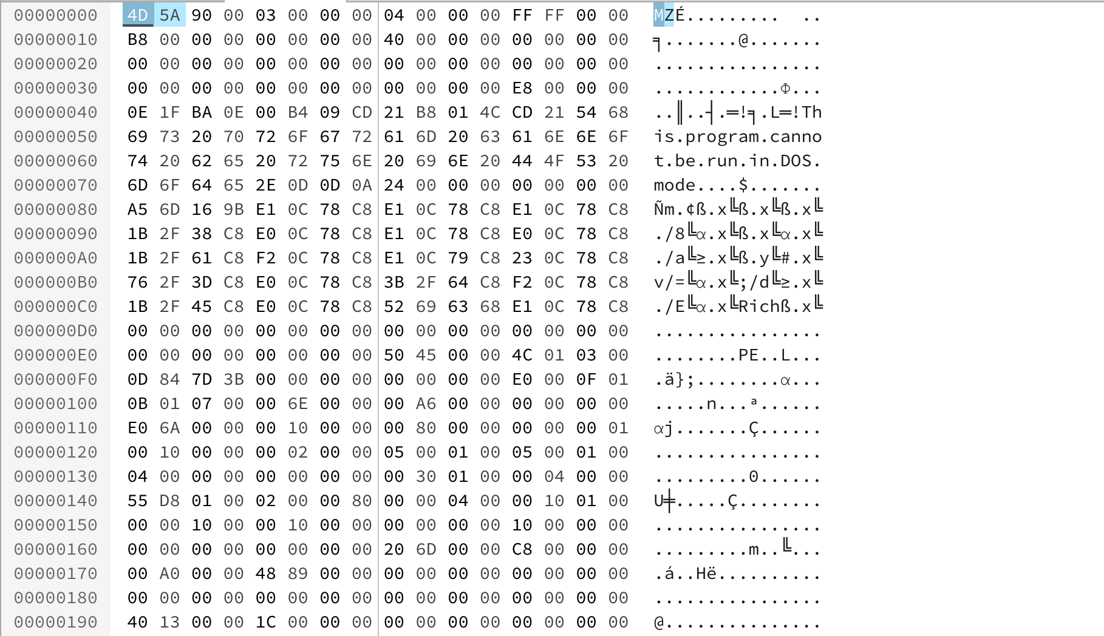
PE Example – Notepad.exe

Slide 13
Load PE file (Notepad.exe) into Memory

Slide 14
VA & RVA
VA (Virtual Address): The address is called a “VA” because Windows creates a distinct VA space for each process, independent of physical memory. For almost all purposes, a VA should be considered just an address. A VA is not as predictable as an RVA because the loader might not load the image at its preferred location.
RVA (Relative Virtual Address): The address of an item after it is loaded into memory, with the base address of the image file subtracted from it. The RVA of an item almost always differs from its position within the file on disk (file pointer).
RVA + ImageBase = VA
In 32bit Windows OS, each process has 4GB virtual memory
which means the range of VA is: 00000000 - FFFFFFFF

Slide 15
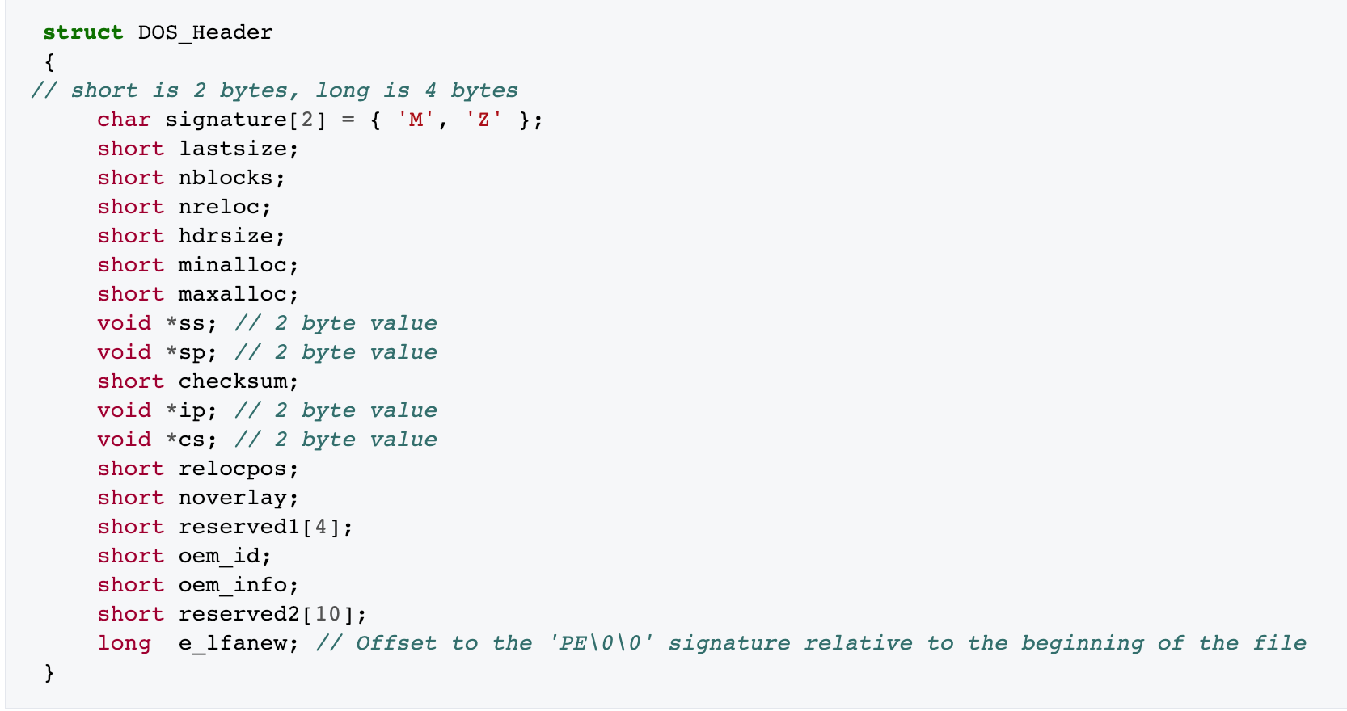
DOS Header
The first 2 letters are always the letters "MZ", the initials of Mark Zbikowski, who created the first linker for DOS. To some people, the first few bytes in a file that determine the type of file are called the "magic number,"

Slide 16
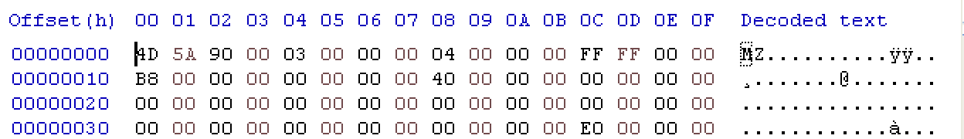
DOS Header
long → 32 bit → ? Byte
E0 00 00 00
value for e_lfanew → ?

Slide 17
Byte Order

Slide 18
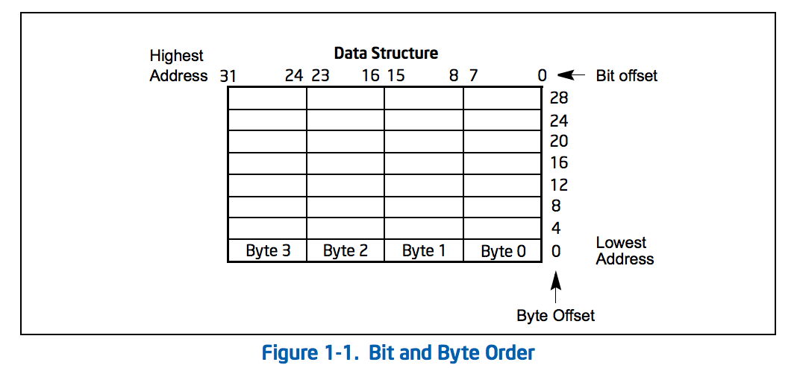
Little endian
IA-32 processors use "little endian" as their byte order. This means that the bytes of a word are numbered starting from the least significant byte and that the least significant bit starts of a word starts in the least significant byte.

Slide 19
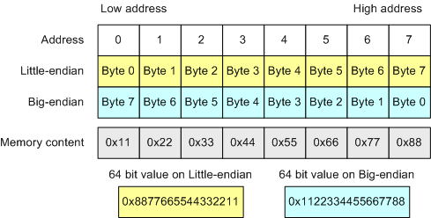
Byte Order

Slide 20
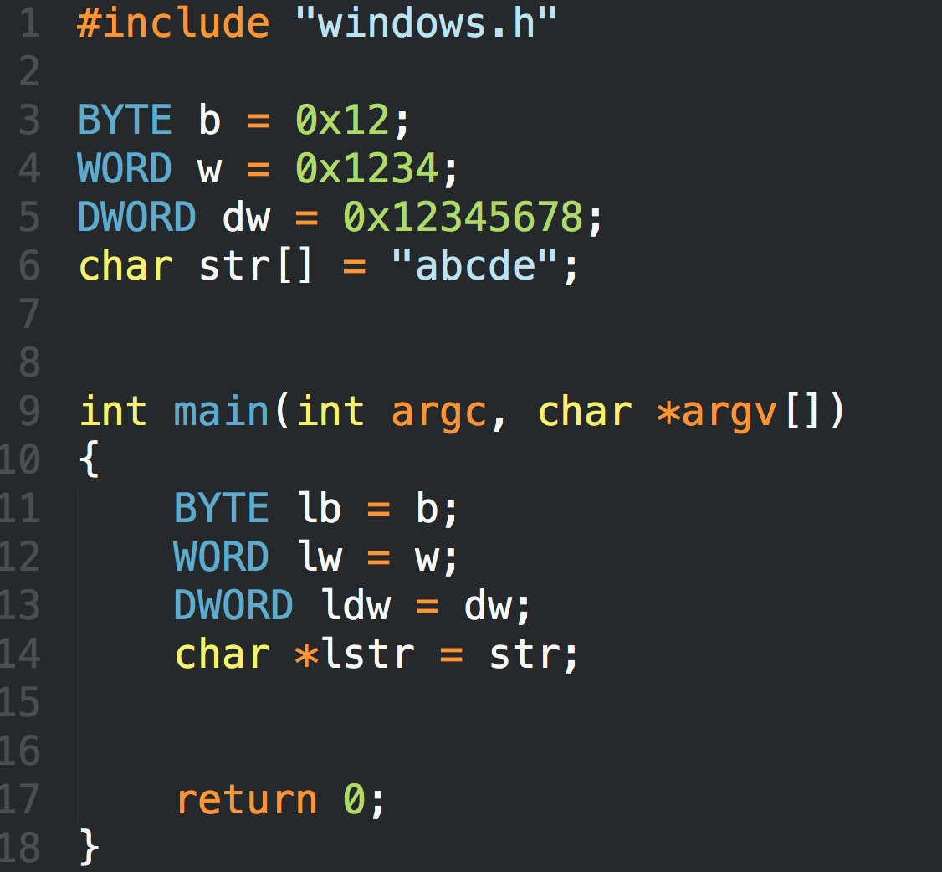
LittleEndian.exe

Slide 21
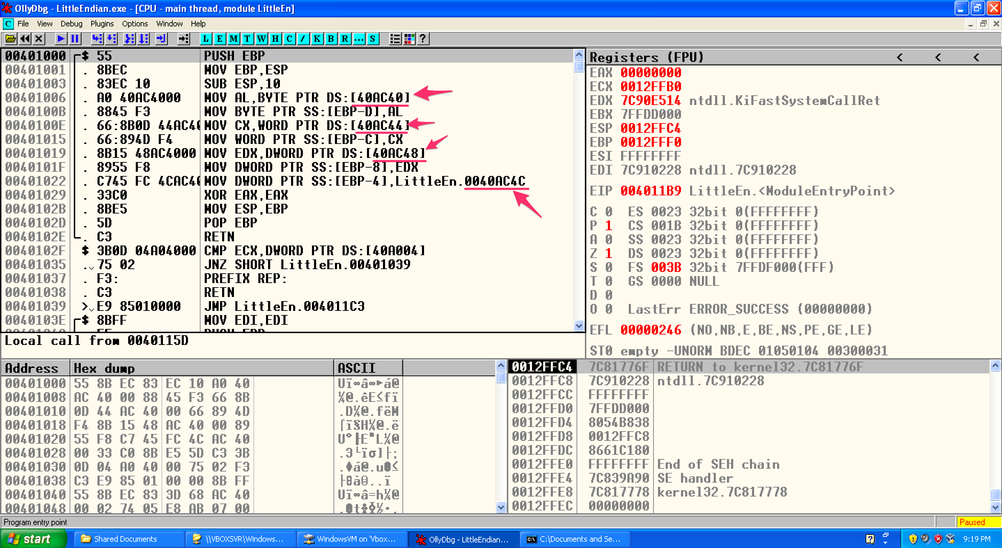
LittleEndian.exe

Slide 22
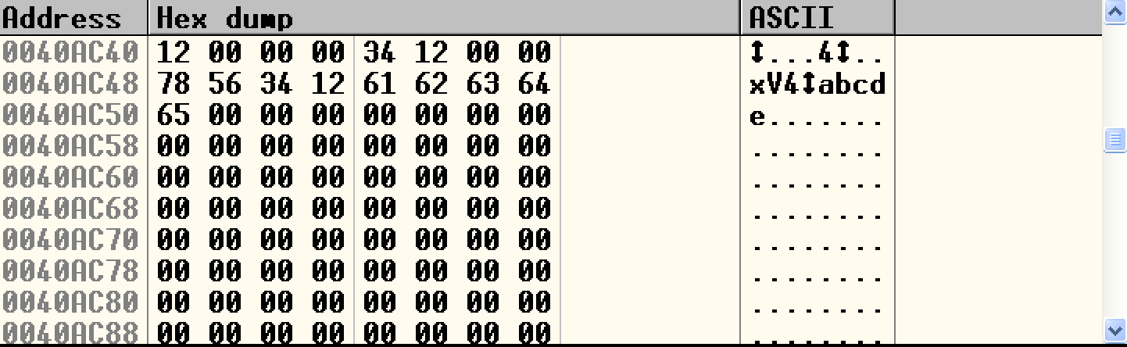
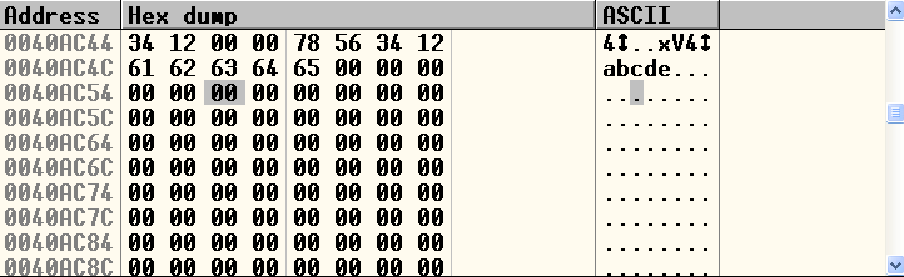
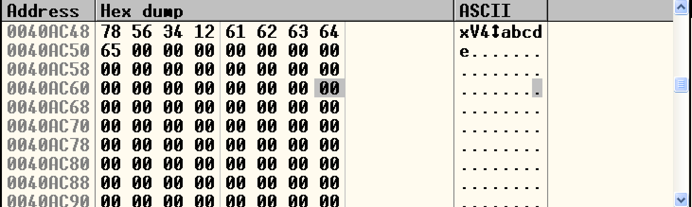
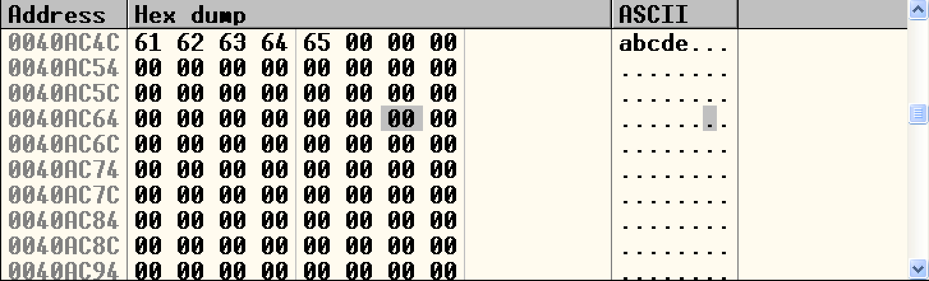
LittleEndian.exe

Slide 23
DOS Header
e_lfanew → 000000E0

Slide 24
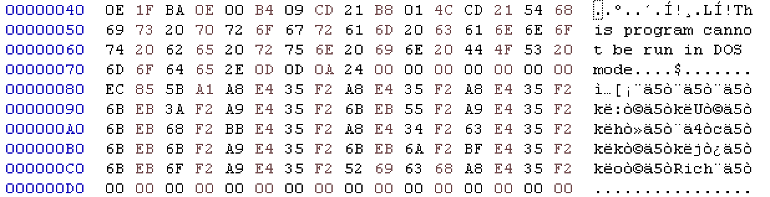
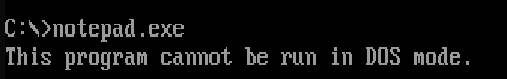
DOS stub
https://virtualconsoles.com/online-emulators/dos/

Slide 25
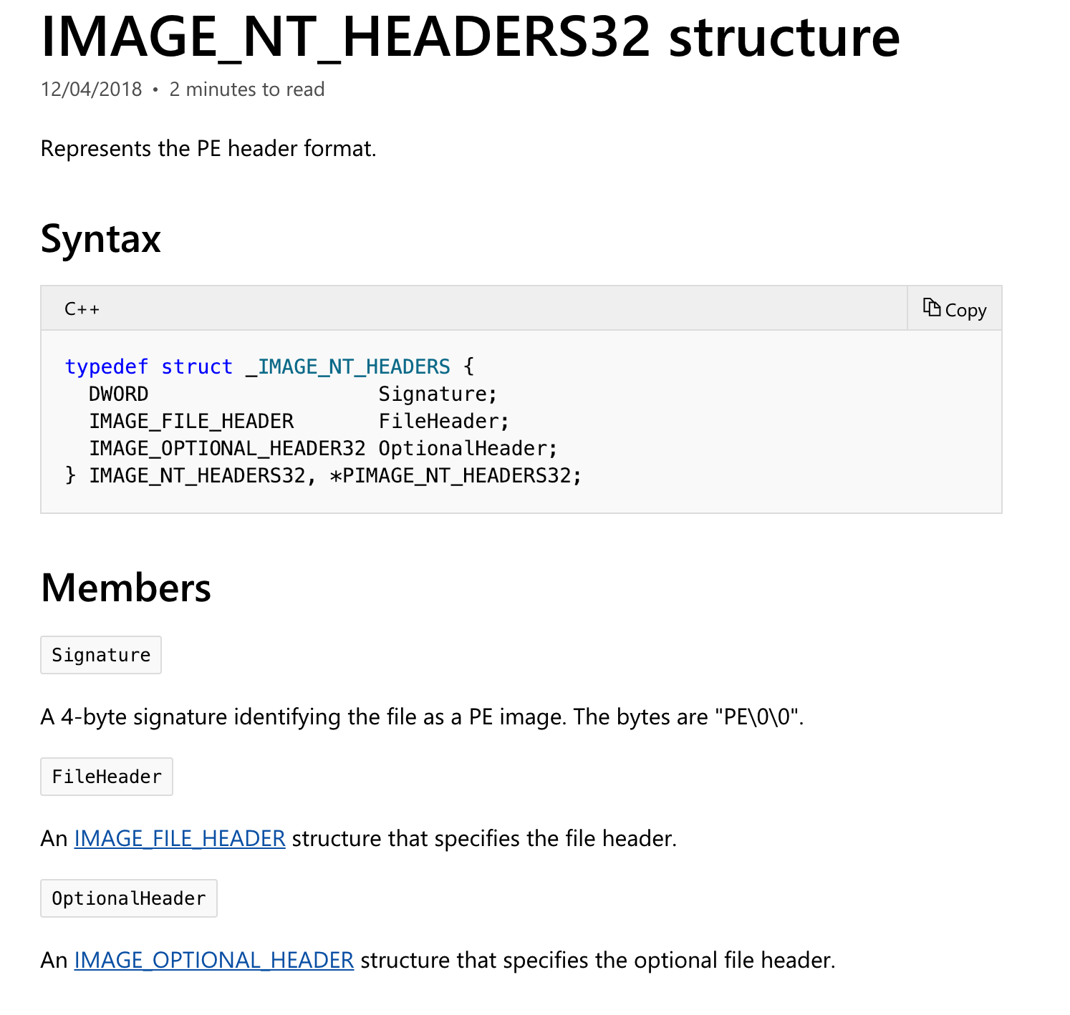
NT Header
https://docs.microsoft.com/en-us/windows/desktop/api/winnt/

Slide 26
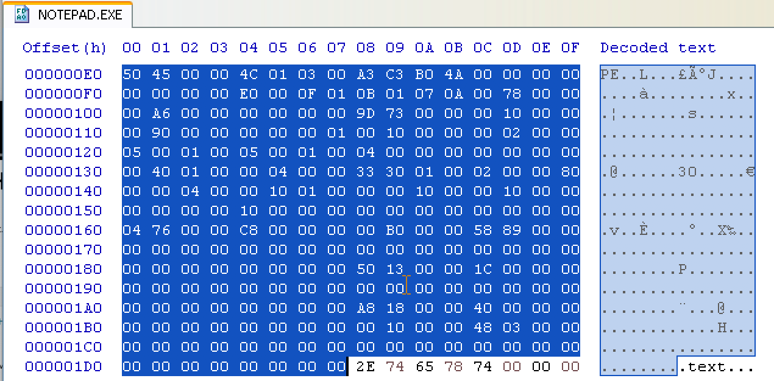
NT Header

Slide 27
Section Header
Name | Privilege
.code | Executable, read
.data | Non-Executable, read/write
.resource | Non-Executable, read

Slide 28
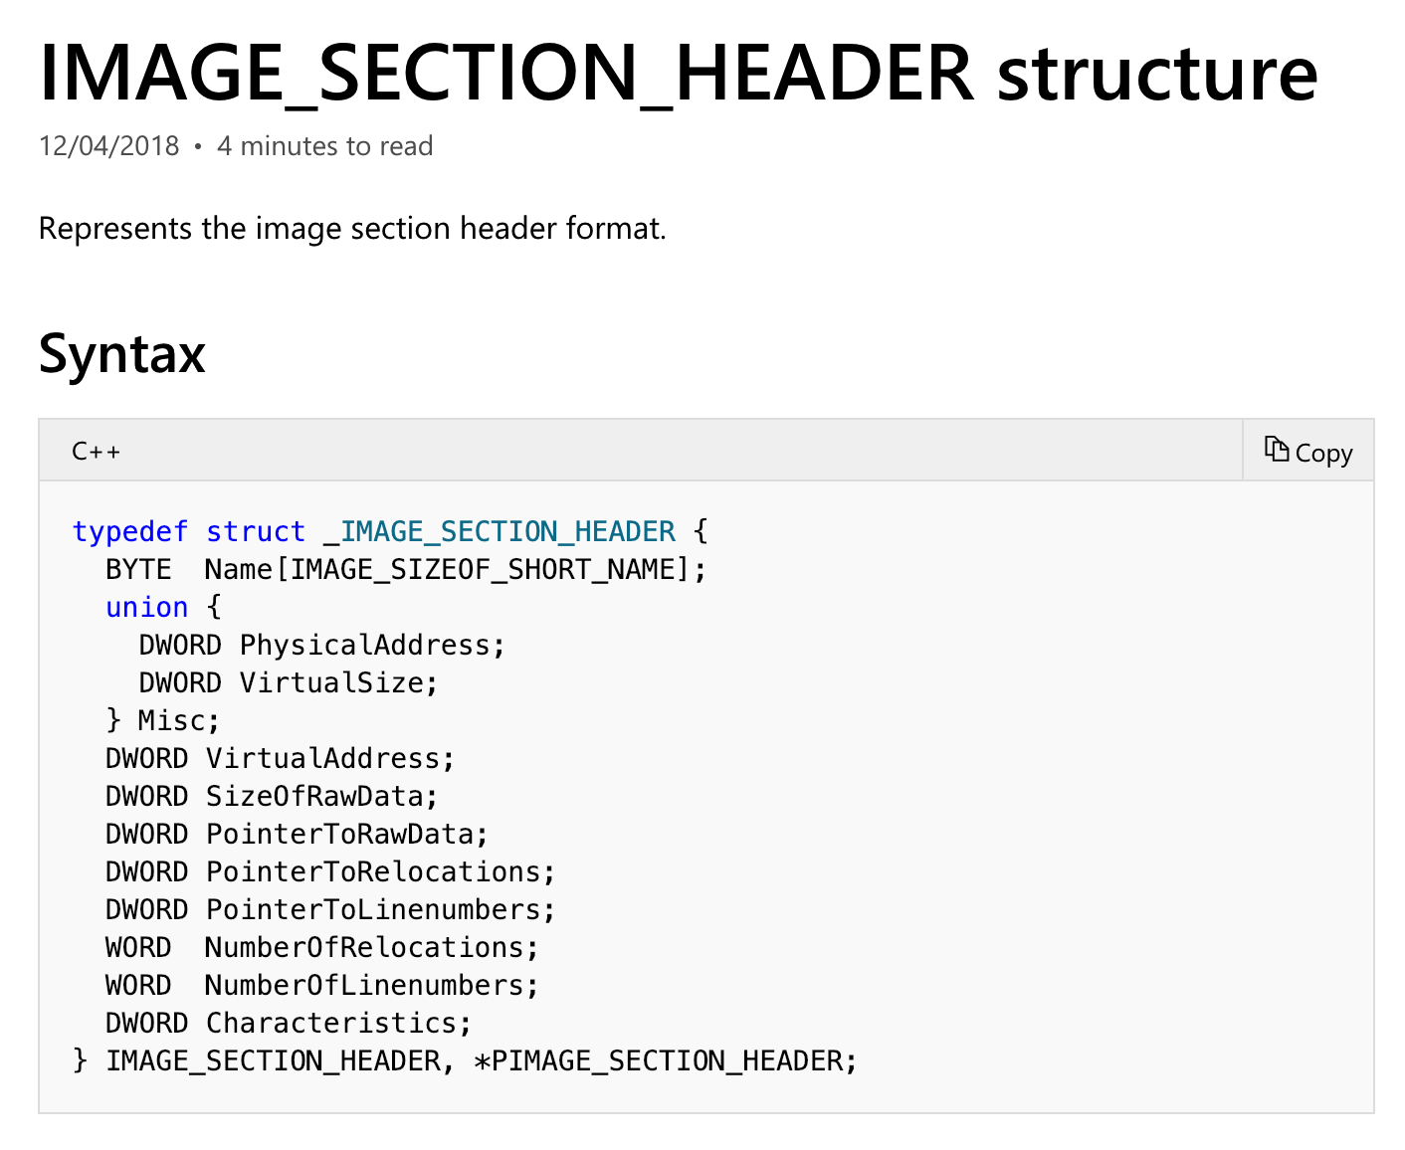
Section Header

Slide 29
Section Header
Members | Meaning
VirtualSize | The total size of the section when loaded into memory, in bytes.
VirtualAddress | The address of the first byte of the section when loaded into memory (RVA)
SizeOfRaw Data | The size of the section data on disk, in bytes.
PointerToRawData | The address of the first byte of the section on disk.
Characteristics | The characteristics of the image.
https://docs.microsoft.com/en-us/windows/desktop/api/winnt/ns-winnt-_image_section_header

Slide 30
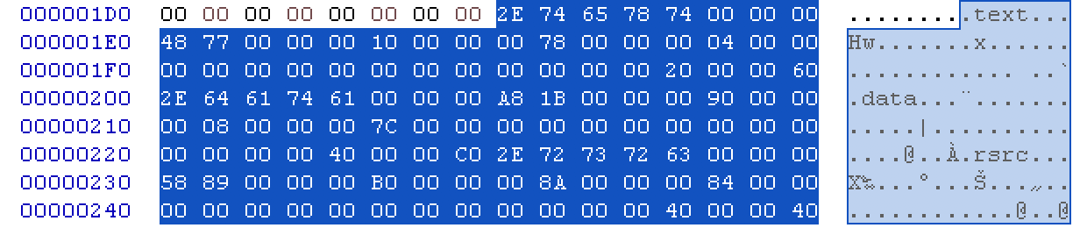
Section Header

Slide 31
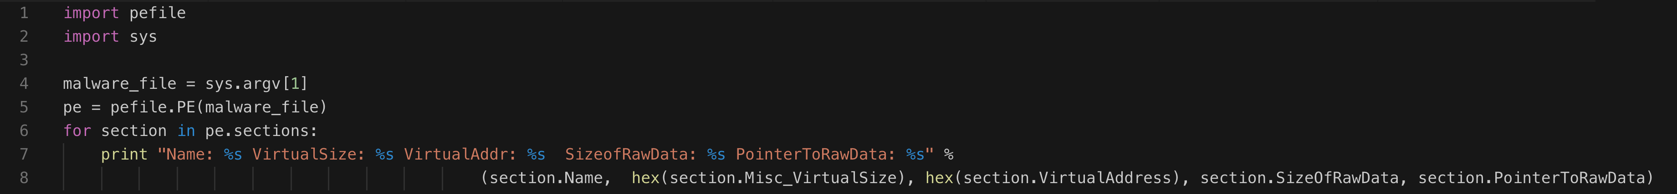
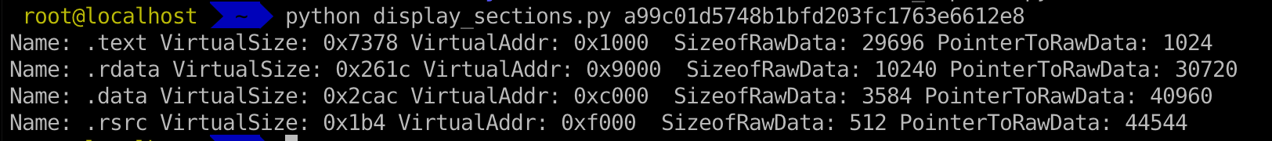
Inspecting PE Header Information in Linux

Slide 32
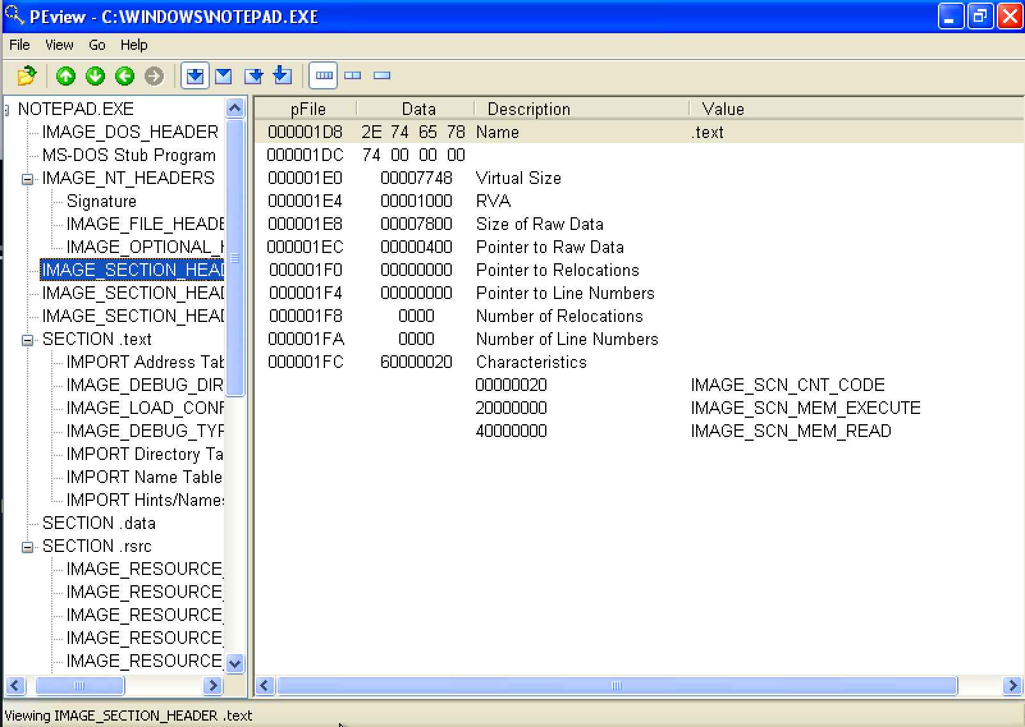
Inspecting PE Header Information

Slide 33
Examining PE Section Table and Sections
https://hub.docker.com/r/remnux/pescanner/

Slide 34
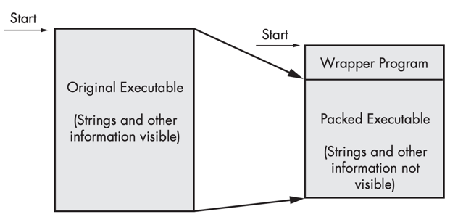
Packed and Obfuscated Malware
Malware writers often use packing or obfuscation to make their files more difficult to detect or analyze.
Obfuscated programs are ones whose execution the malware author has attempted to hide.
Packed programs are a subset of obfuscated programs in which the malicious program is compressed and cannot be analyzed.
Both techniques will severely limit your attempts to statically analyze the malware.

Slide 35
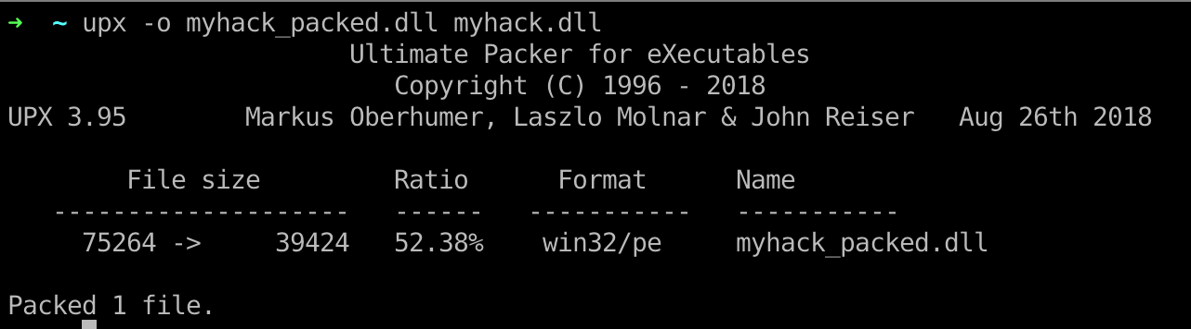
Packers and Cryptos

Slide 36
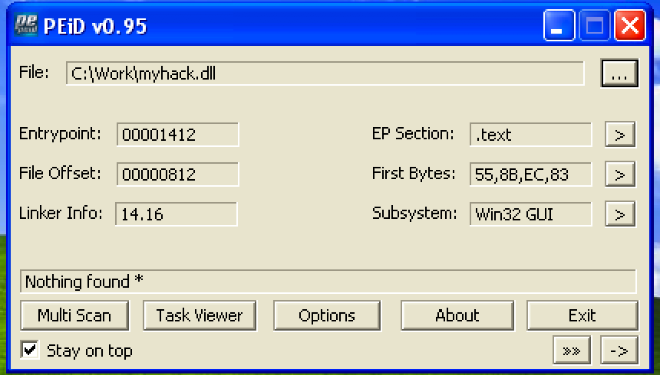
Packed and Obfuscated Malware

Slide 37
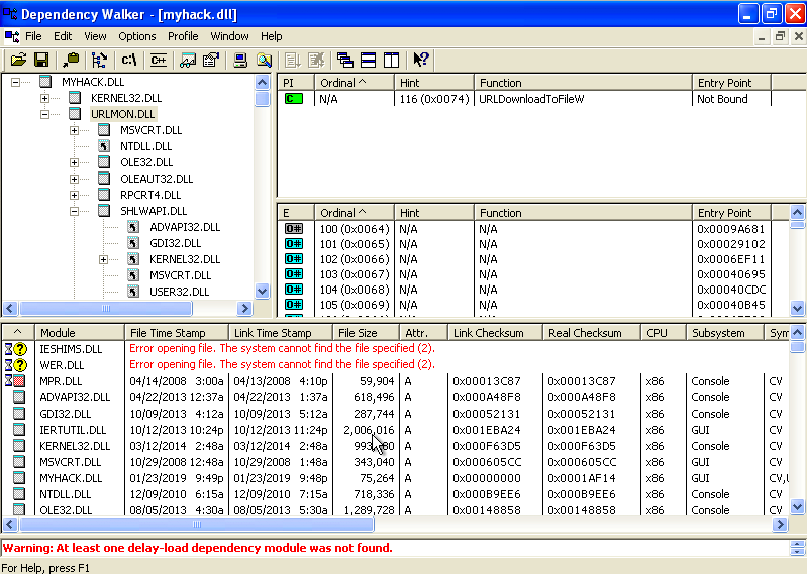
Exploring Dynamically Linked Functions with Dependency Walker

Slide 38
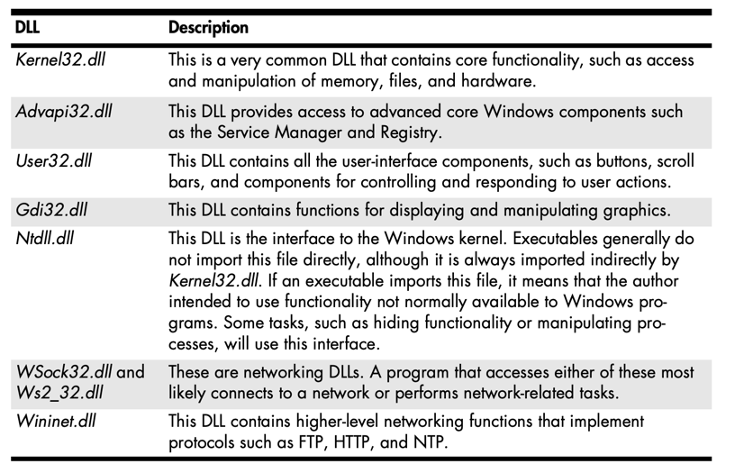
Common DLLs

Slide 39
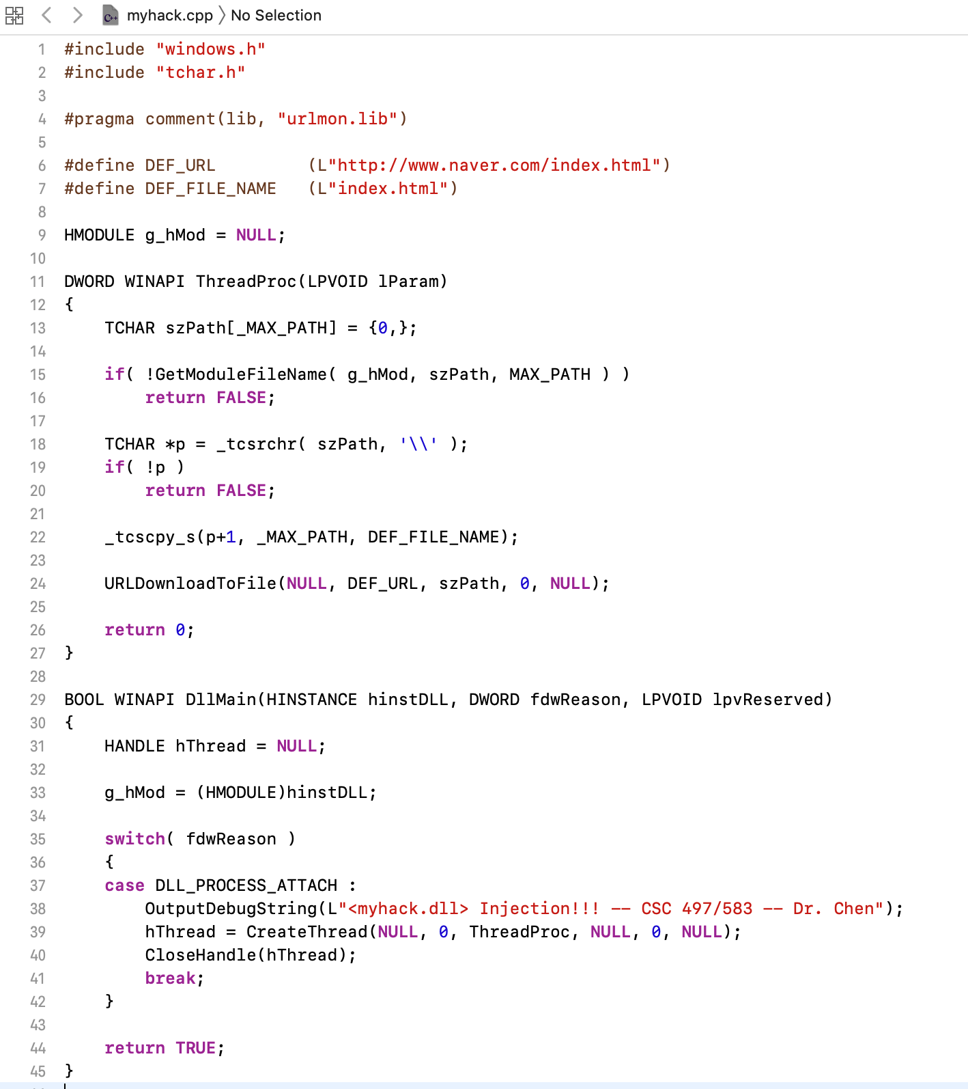
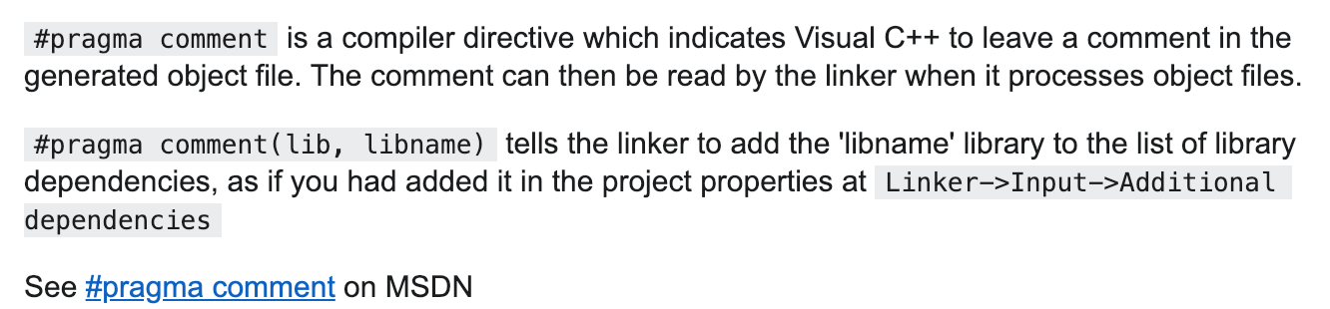
Exploring Dynamically Linked Functions with Dependency Walker

Slide 40
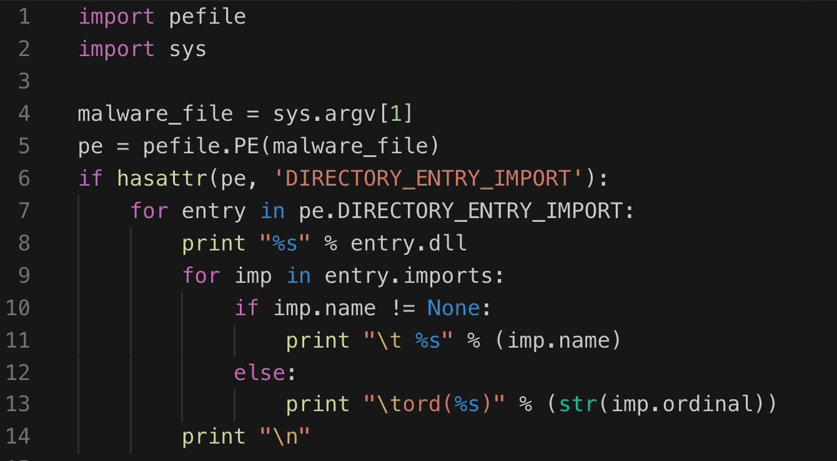
Inspecting file imports with pefile library

Slide 41
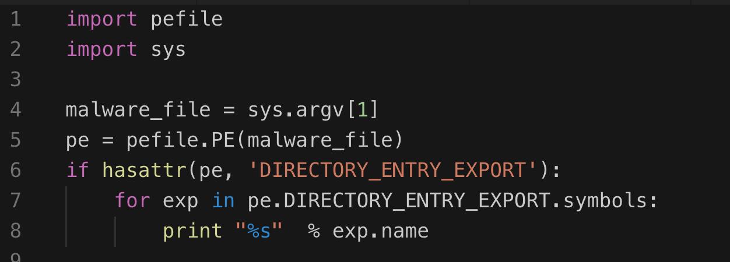
Inspecting file export with pefile library

Slide 42
DLL Injection

Slide 43

Q & A

