Slide 1

Class3
CSC 497/583 Advanced Topics in Computer Security
Modern Malware Analysis
Basic Analysis, DLL Injection
Si Chen (schen@wcupa.edu)

Slide 2
Course Outline
DLL Injection
  Dynamic-link library
  DLL Injection example
  Source code of myhack.dll
Static Analysis
  Cryptographic Hash
  Anti-Virus Scanning
  Strings
  PE file
  Packer and Cryptor

Slide 3


Dynamic-link library (DLL)
Dynamic-link library (or DLL) is Microsoft's implementation of the shared library concept in the Microsoft Windows
A DLL is a module that contains functions (called exported functions or exports) that can be used by another program.

Slide 4
Dynamic Linking
Memory
Lib.dll
Lib.obj
Program2
Program2.obj
Program1
Program1.obj
Program2
Program2.obj
Lib.dll
Lib.obj
Program1
Program1.obj

Slide 5
Dynamic Linking in Linux and Windows
Linux | Windows
ELF file | .exe (PE)
.so (Shared object file) | .dll (Dynamic Linking Library)
.a | .lib (static linking library)
.o (intermediate file between complication and linking, object file) | .obj

Slide 6
DLL Injection
DLL injection is method of injecting code to some other processe’s address space and executing that piece of code on behalf of that process.
DLL injection provides a platform for manipulating the execution of a running process.
  It's very commonly used for logging information while reverse engineering.
  It has gained bad name for itself since it’s mostly used by malware for stealth purposes:
    Hiding malicious code into system process
      Winlogon.exe, services.exe, svchost.exe explorer.exe
    Open backdoor port
    Connect remote server
    Keylogging…
  It’s also frequently used within the game hacking world to code bots

Slide 7
DLL Injection

Slide 8
DLL Injection

Slide 9
DLL Injection

Slide 10
Let’s try our first “Malware”
Download and run XP VM image
Open command line terminal and go to C:\Work
Open a Notepad
Open DebugView
Open Process Explorer and find the PID of Notepad
In command line, type
  InjectDll.exe <PID OF NOTEPAD> myhack.dll

Slide 11

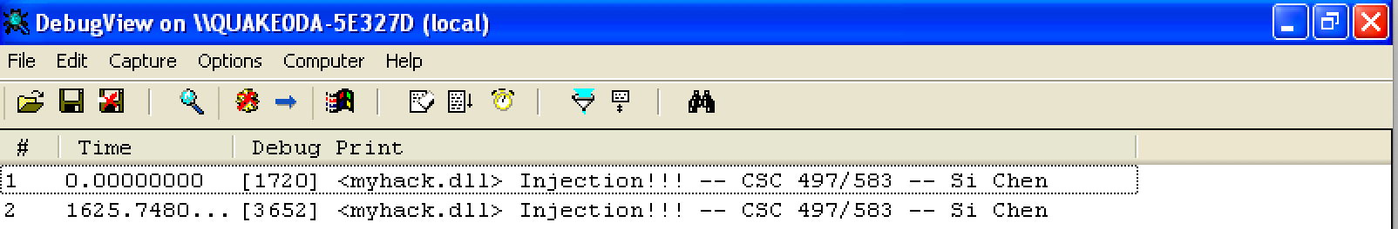
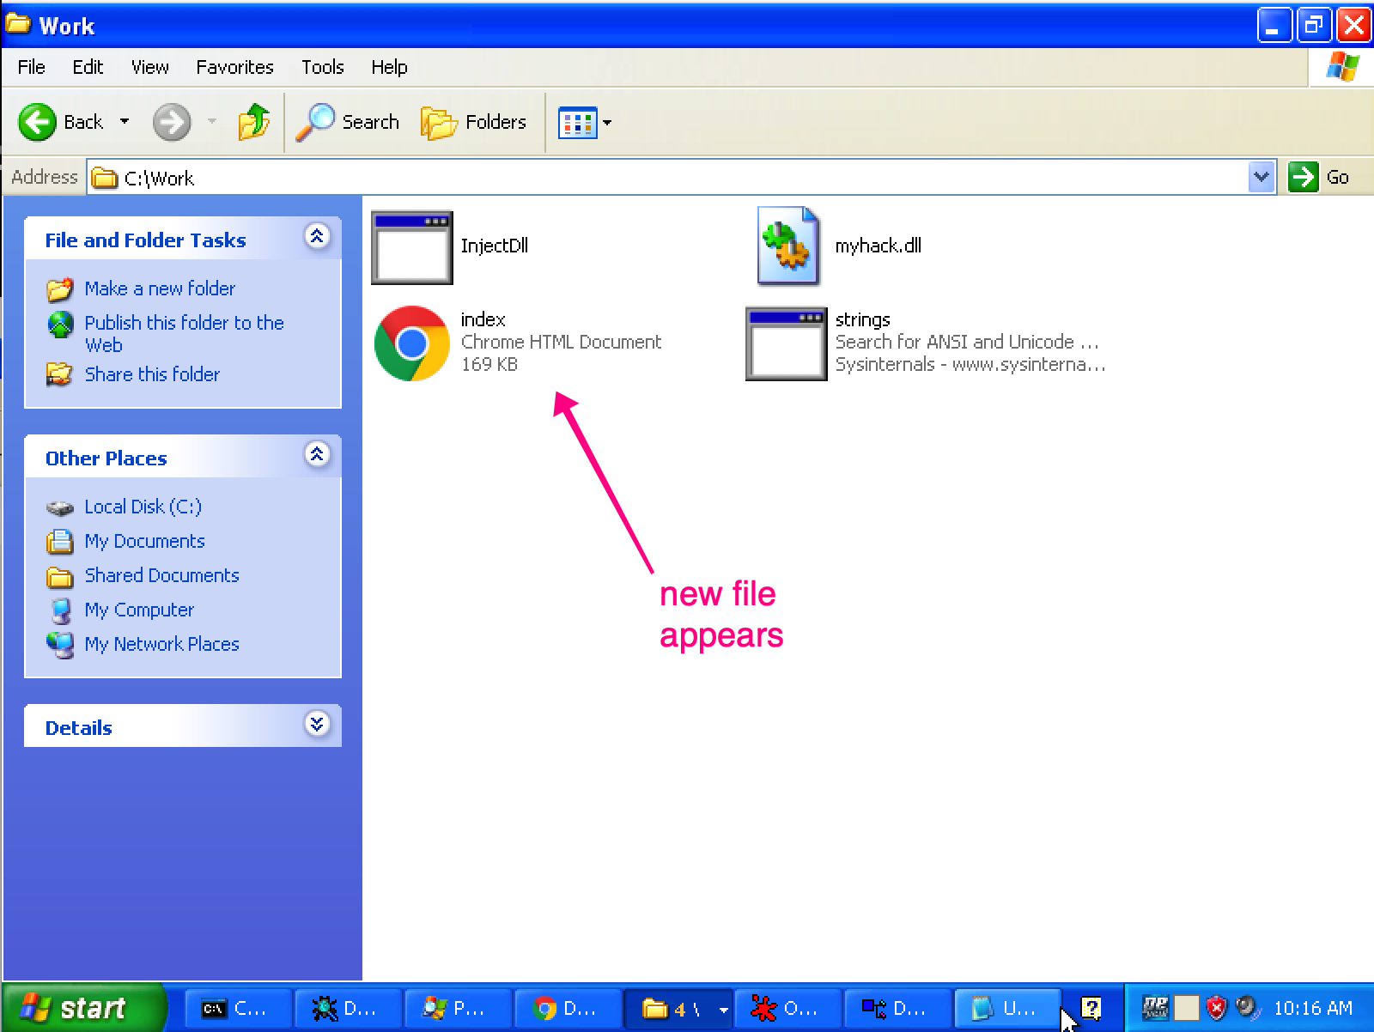
Screenshots

Slide 12
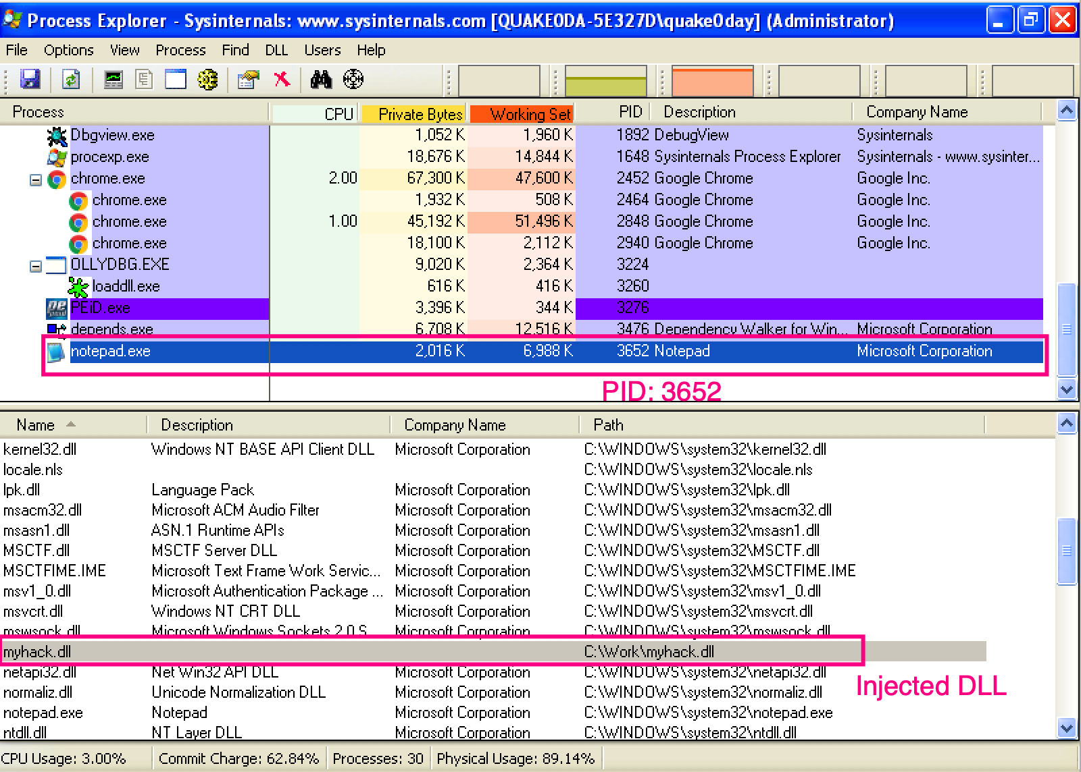
Screenshots

Slide 13
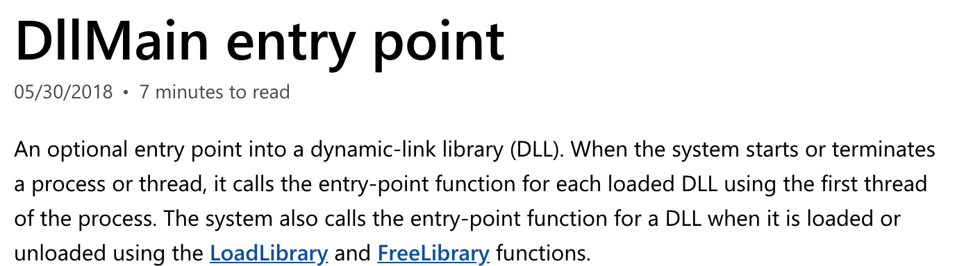
DllMain()

Slide 14
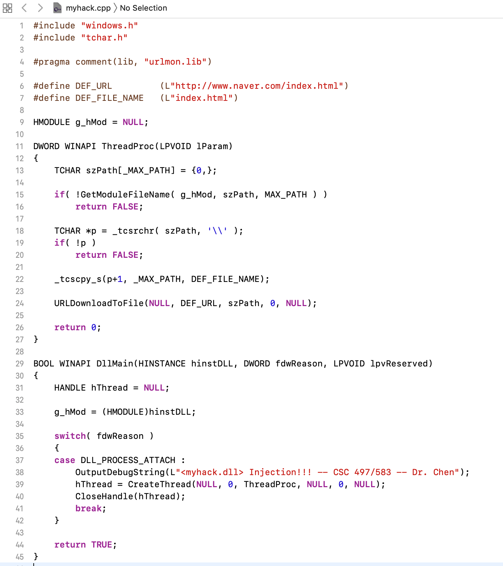
Source Code of myhack.dll

Slide 15
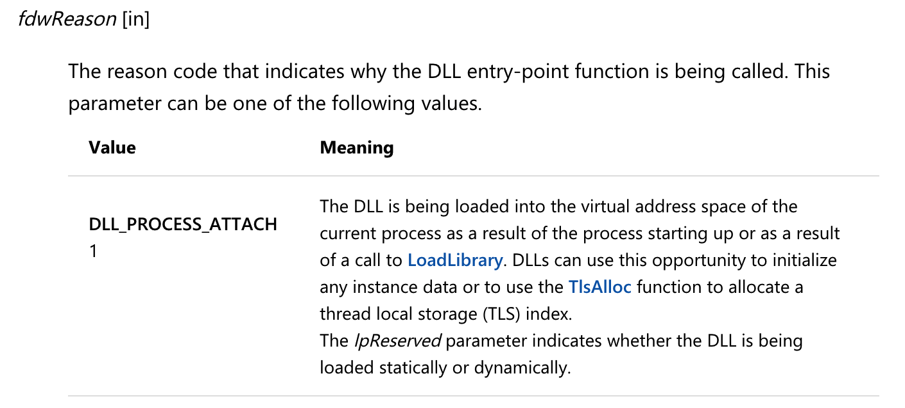
Source Code of myhack.dll

Slide 16
Source Code of myhack.dll

Slide 17
Static Analysis

Slide 18
Fingerprinting the Malware -- Cryptographic Hash

Slide 19
Fingerprinting the Malware
Fingerprinting involves generating the cryptographic hash values for the suspect binary based on its file content.
Same cryptographic hashing algorithms:
  MD5
  SHA1
  SHA256
Why not just use the file name?
  Ineffective, same malware sample can use different filenames, cryptographic hash is calculated based on the file content.
File hash is frequently used as an indicator to share with other security researchers to help them identify the sample.

Slide 20
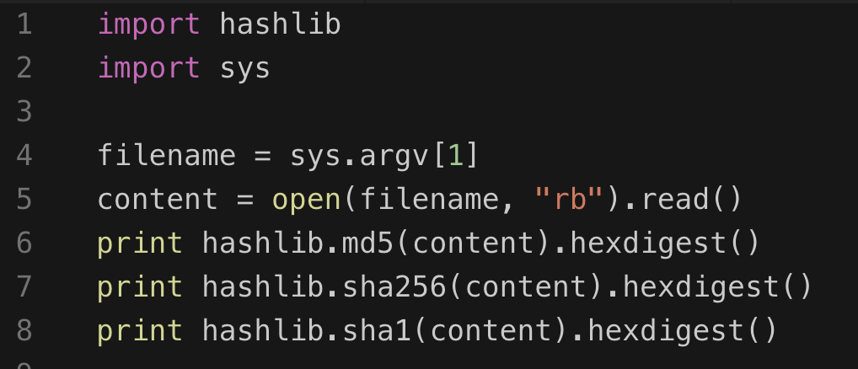
Tools and Python code
md5sum
sha256sum
sha1sum

Slide 21
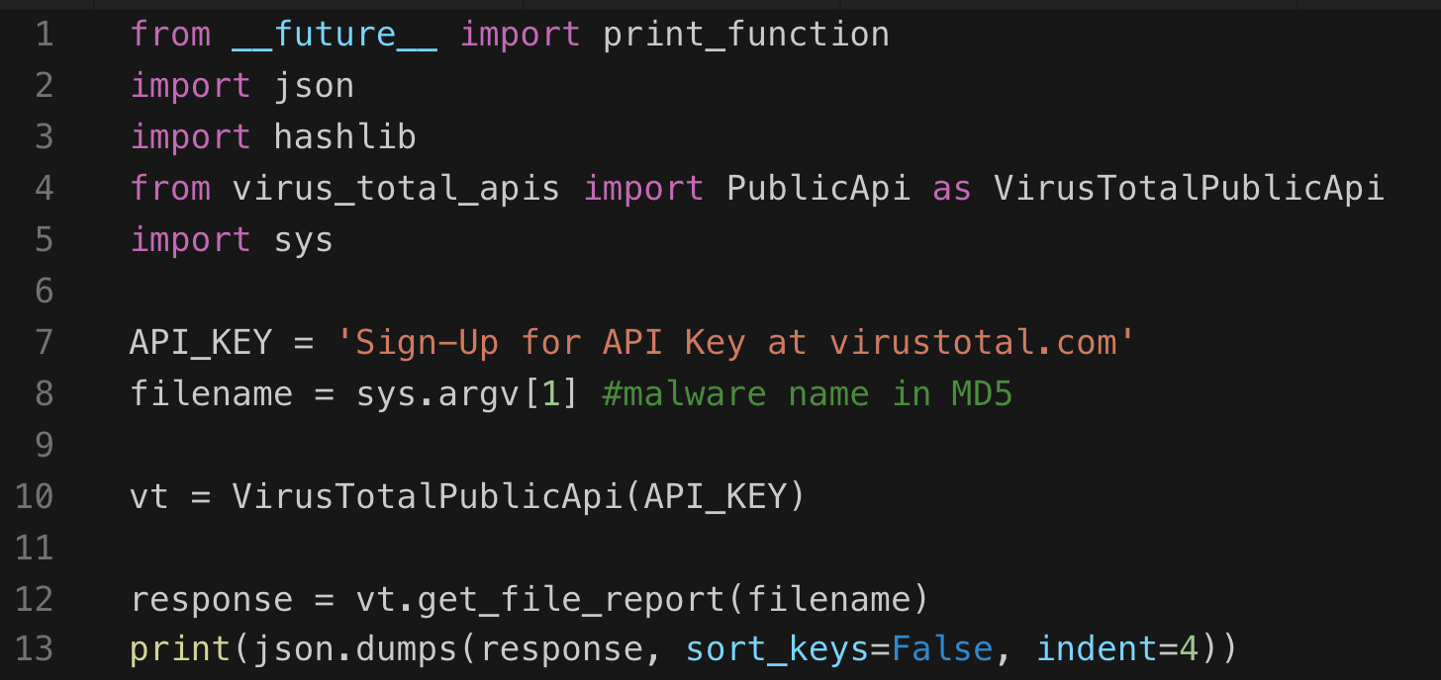
Querying Hash Values Using VirusTotal Public API
VirusTotal Public API
  https://www.virustotal.com/en/documentation/public-api/
VirusTotal Commandline Tool

Slide 22
Strings
Finding Strings ^{[1]}
  A string in a program is a sequence of characters such as “the.”
  A program contains strings if it prints a message, connects to a URL, or copies a file to a specific location.
  Searching through the strings can be a simple way to get hints about the functionality of a program.
    For example, if the program accesses a URL, then you will see the URL accessed stored as a string in the program.
  You can use the Strings program to search an executable for strings, which are typically stored in either ASCII or Unicode format.
[1]. Practical Malware Analysis, page 11

Slide 23

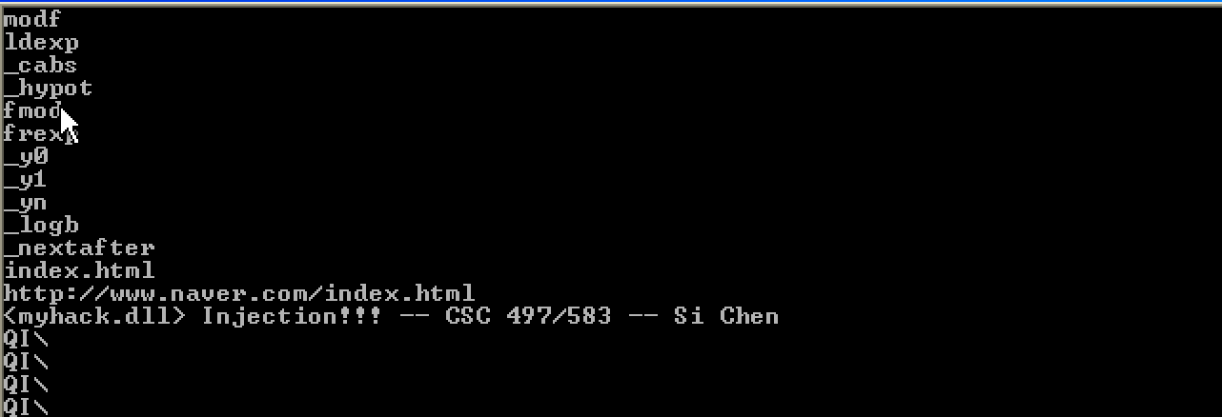
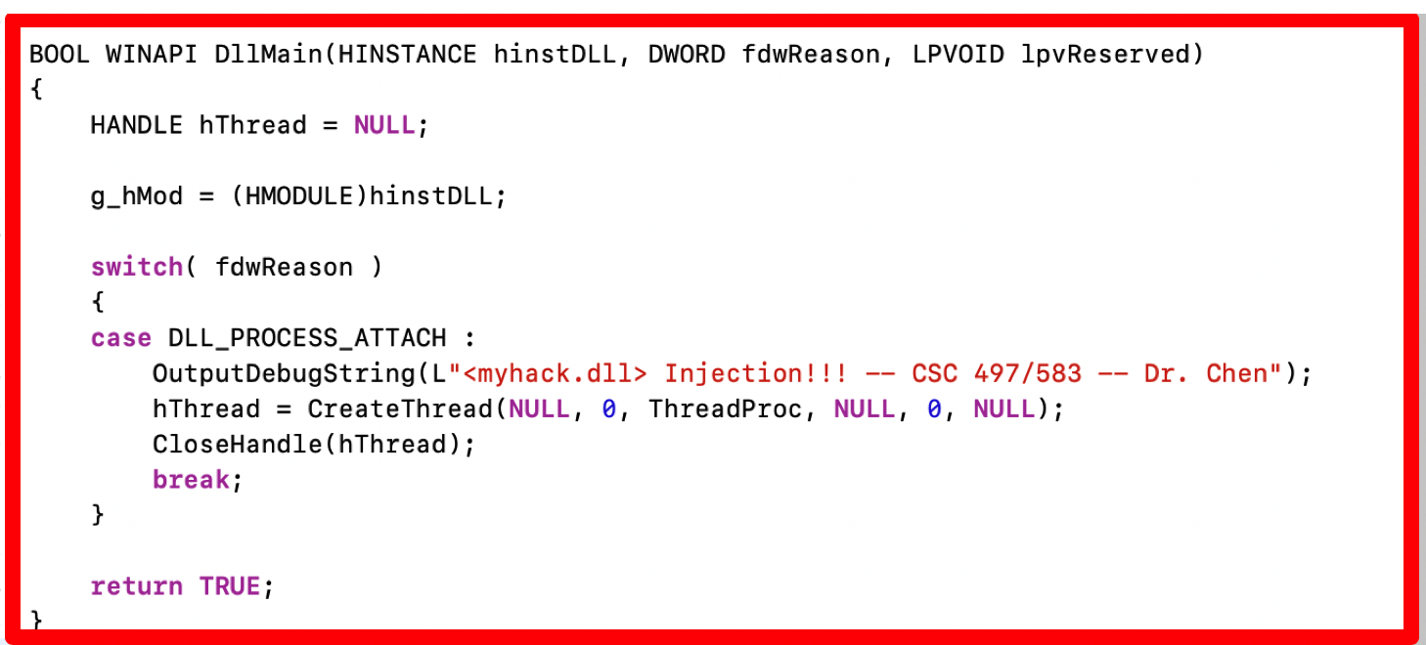
Static analysis (myhack.dll)

Slide 24
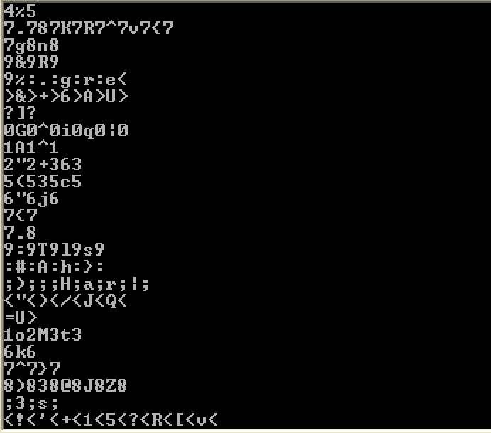
Static analysis (myhack.dll)
Sometimes the strings detected by the Strings program are not actual strings.

Slide 25
Portable Executable (PE) file
A Portable Executable (PE) file is the standard binary file format for an Executable (.exe) or DLL under Windows NT, Windows 95, and Win32.

Slide 26
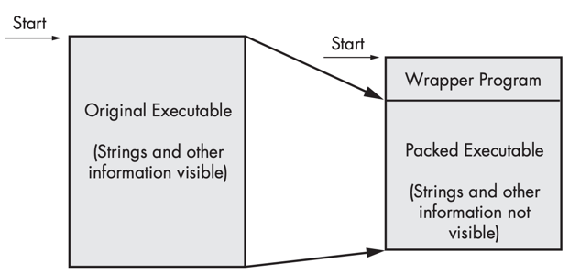
Packed and Obfuscated Malware
Malware writers often use packing or obfuscation to make their files more difficult to detect or analyze.
Obfuscated programs are ones whose execution the malware author has attempted to hide.
Packed programs are a subset of obfuscated programs in which the malicious program is compressed and cannot be analyzed.
Both techniques will severely limit your attempts to statically analyze the malware.

Slide 27
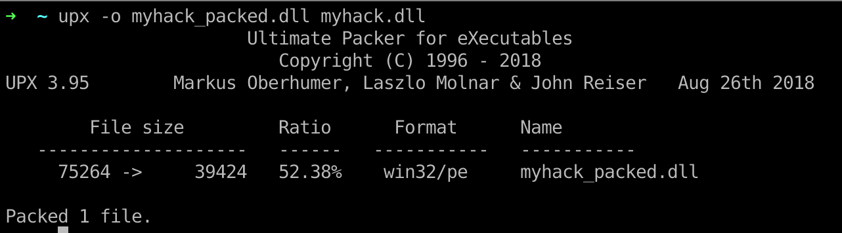
Packers and Cryptos

Slide 28
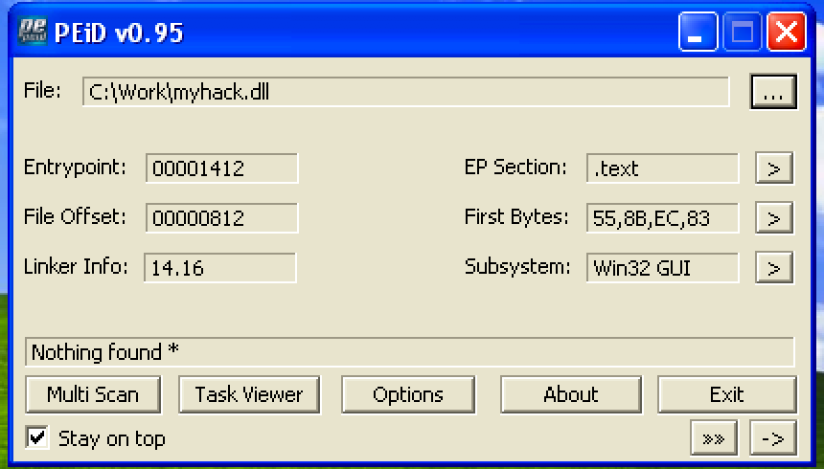
Packed and Obfuscated Malware

Slide 29
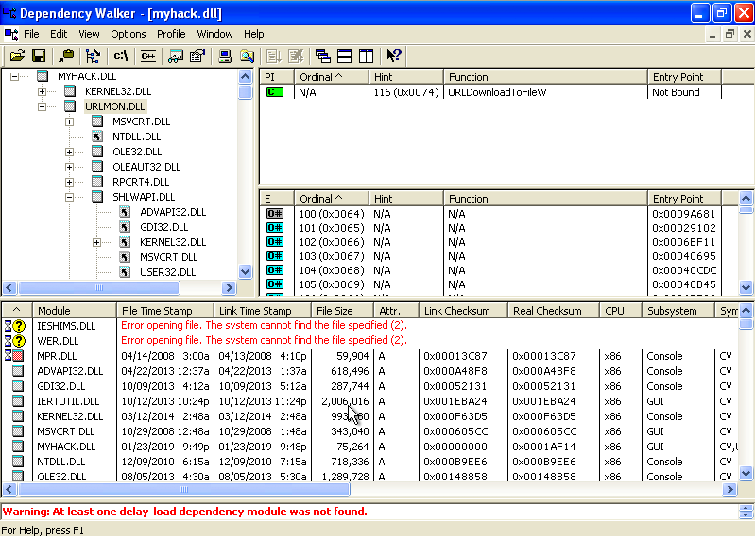
Exploring Dynamically Linked Functions with Dependency Walker

Slide 30
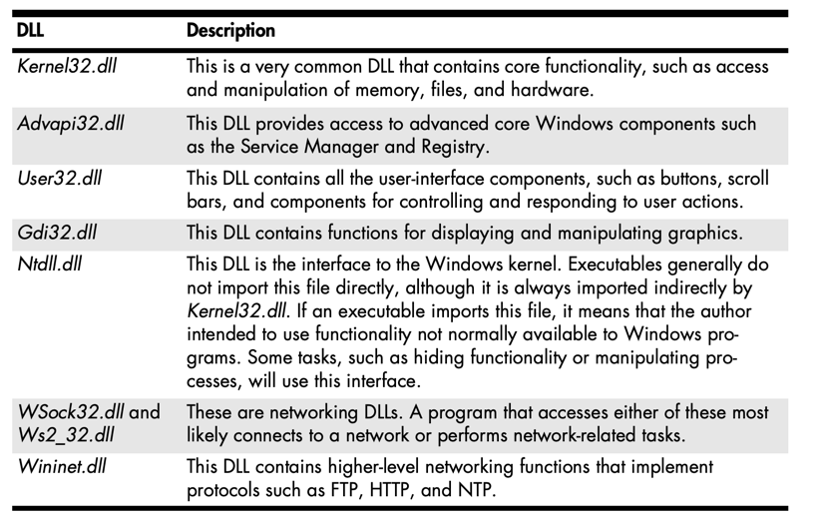
Common DLLs

Slide 31
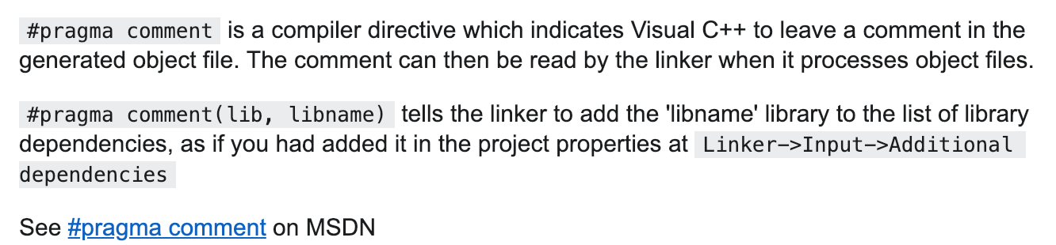
Exploring Dynamically Linked Functions with Dependency Walker

Slide 32
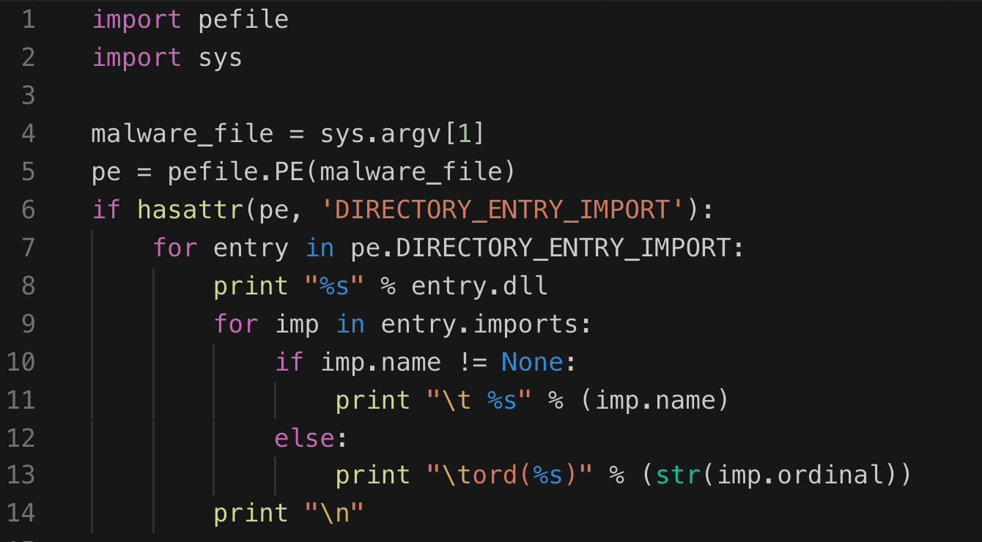
Inspecting file imports with pefile library

Slide 33
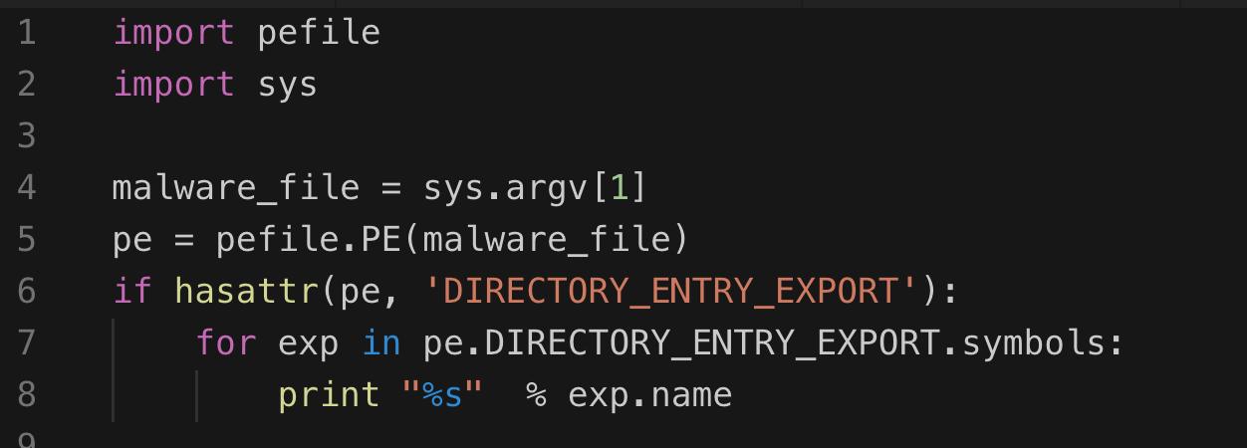
Inspecting file export with pefile library

Slide 34
DLL Injection

Slide 35

Q & A

